Slide 1
Finite amplitude method for fast QRPA calculations
M. Frosini
DES/IRESNE/DER/SPRC/LEPh

Slide 2
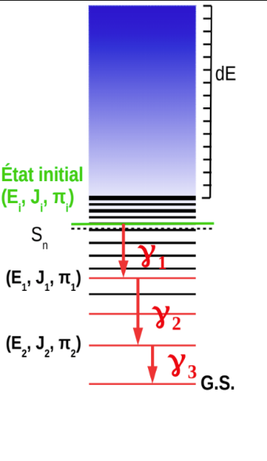
When structure meets evaluated data
Capture, emission, diffusion…
Structure properties of nuclei play an important role in the description of these phenomena
Example :
Capture cross section with Hauser Feshbach statistical model
How to compute these properties?
Macroscopic models of nuclei
Cheap & simple to use
Good description of measurements
Focused on few observables
No predictive power
Today’s presentation
Introduce microscopic QRPA-FAM formalism for fast microscopic calculation of gamma SF
Display some first calculations on light open-shell nuclei with ab initio interactions
Collect some input about needs and challenges at play in reactor physics
Systems, Observables, Multipolarities
Level scheme of compound nucleus
(NLD)
Electromagnetic transfer coefficient
Extracted from gamma-SF
Neutron transfer coefficient
Extracted from optical potential
Microscopic models
Build nucleus from interacting nucleons
Questions regarding the choice of interaction
Energy Density Functional vs. Ab Initio
Unified model of all nuclei & observables
Less descriptive, but more predictive
Possibility to assess theoretical uncertainties
$$\left(−\frac{p^{2}}{2m}+H+U\right)Ψ=0$$
Diffusion of nucleon on nucleus

Slide 3
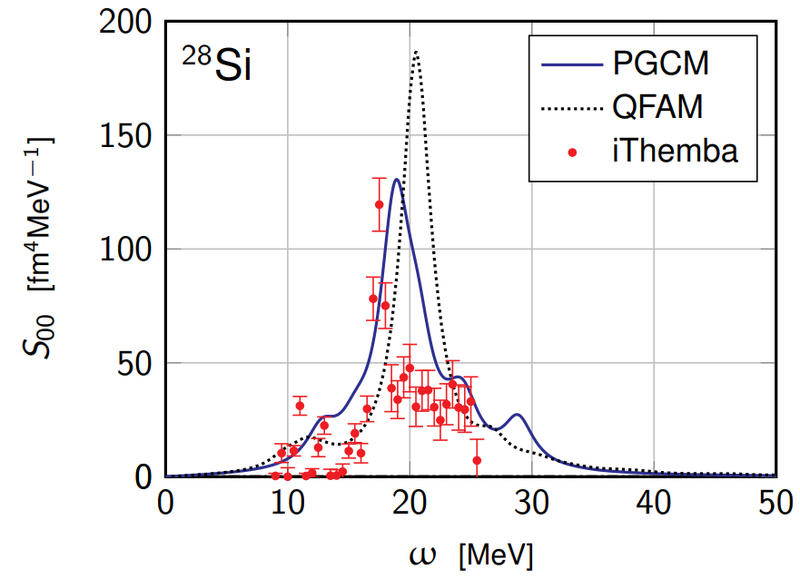
PAN@CEA
DAM-DES-DRF shared project aiming at providing a common utility to solve the nuclear many-body problem
With different interactions Gogny, Skyrme, Ab Initio, etc.
With different microscopic many-body approximations HFB < QRPA, PGCM, PT, SCGF
For a large variety of observables / applications Ground state, spectroscopy, reactions
Interaction & formalism are not uncorrelated
Why? Fair comparison of as many existing theories as possible
Better understanding of complex phenomena
Systematic predictions for theory and evaluated data
Identification of uncertainty sources in theoretical predictions
Example with today’s topic
Strength functions (GMR in deformed Si)
QRPA-FAM (Harmonic approximation, no projection)
PGCM (Shape mixing + projection)
New formalisms (PQRPA, PGCM-PT, GSCGF)
A. Porro et al., in preparation
PGCM shown to improve QRPA SF in nuclei
with shallow energy surface
with shape coexistence / mixing
Revisit some physical interpretations

Slide 4
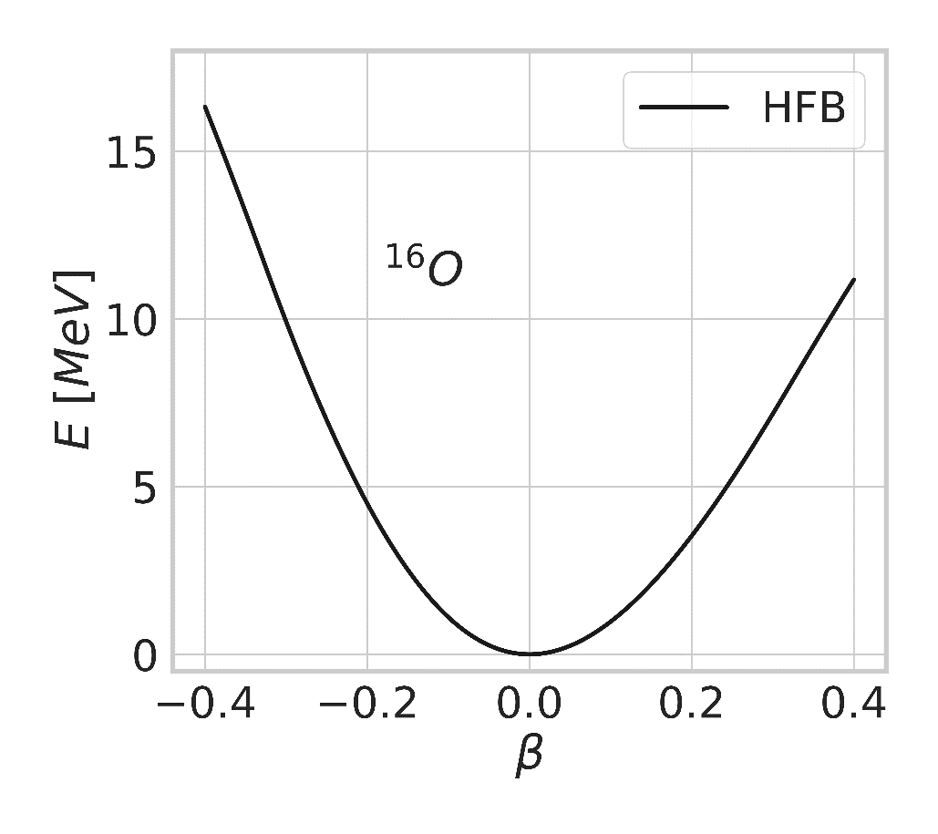
From HFB to QRPA matrix
Schrödinger equation in nuclear structure
Ab initio nucleon-nucleon potential
1, 2, 3 body
Derived from QCD (Chiral EFT)
Fitted on light (A<5) systems
Correlated eigenstates
A! parameters
(Not an observable)
$$H |Ψ^{A,J,π,i}〉=E^{A,J,π,i}|Ψ^{A,J,π,i}〉$$
Ground state: Mean-field approximation (HFB)
Minimize energy over set of (simple) product states
Definition of energy functional
Choice of symmetries / set of product states / dofs
Compromise physics / runtime
Choice of starting point
Minimization of functional
Self-consistent loop
Gradient method
$$E[Φ]$$
$$|Φ〉↔ℛ$$
$$0=\left[ℋ,ℛ\right], ℋ=\frac{δE}{δℛ}$$
$$|Φ+δΦ〉≡exp\left(Z\right)|Φ〉$$
$$E\left[Φ+δΦ\right]≡E\left[Φ\right]+H^{20}⋅Z+⋯$$
⬅ Follow steepest descent

Slide 5
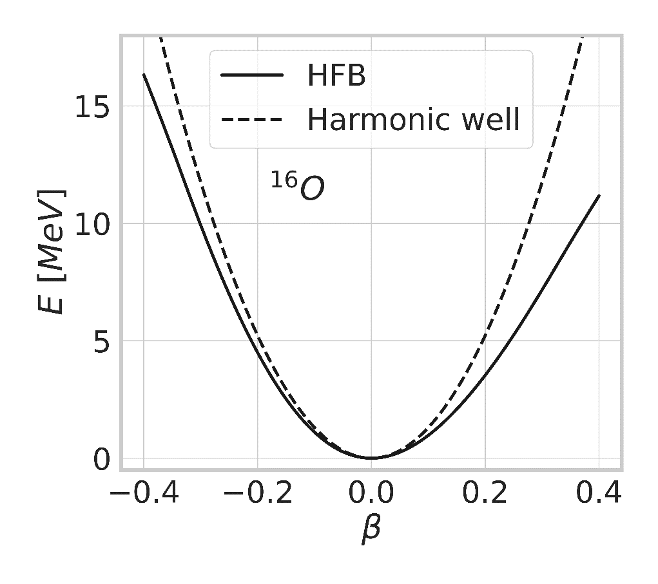
From HFB to QRPA matrix
Schrödinger equation in nuclear structure
Ab initio nucleon-nucleon potential
1, 2, 3 body
Derived from QCD (Chiral EFT)
Fitted on light (A<5) systems
Correlated eigenstates
A! parameters
(Not an observable)
$$H |Ψ^{A,J,π,i}〉=E^{A,J,π,i}|Ψ^{A,J,π,i}〉$$
Excitations and QRPA matrix
Next order tells us how the system vibrates in its well
$$E\left[Φ_{0}+δΦ\right]≡E_{HFB}+\frac{1}{2}\left(\begin{matrix}Z^{∗} & Z\end{matrix}\right)\left(\begin{matrix}\frac{∂^{2}E}{∂Z^{∗}∂Z} & \frac{∂^{2}E}{∂Z^{∗}∂Z^{∗}} \\ \frac{∂^{2}E}{∂Z∂Z} & \frac{∂^{2}E}{∂Z∂Z^{∗}}\end{matrix}\right)\left(\begin{matrix}Z \\ Z^{∗}\end{matrix}\right)+⋯$$
Information about vibrational spectrum hidden in Hessian
QRPA matrix
Only harmonic approximation
To be corrected by higher order terms

Slide 6
Comparison of matricial QRPA and Finite Amplitude Method
$$M=\left(\begin{matrix}\frac{∂^{2}E}{∂Z^{∗}∂Z} & \frac{∂^{2}E}{∂Z^{∗}∂Z^{∗}} \\ \frac{∂^{2}E}{∂Z∂Z} & \frac{∂^{2}E}{∂Z∂Z^{∗}}\end{matrix}\right)$$
Exact diagonalization
$O(N^{6})$ operations
Discrete spectrum BY CONSTRUCTION
Smearing of the strength
Convolution with Lorentzian
MATRICIAL QRPA
$$S\left(ω\right)=\sum_{i}{\frac{B(i→0)}{{\left(ω−ω_{i}\right)}^{2}+γ^{2}}}$$
$$ω_{i}, B\left(LM,i→0\right), X_{i}$$
Spectrum
Transitions
Transition matrices
Expressed in 2qp space
$O(N^{4})$ matrix elements
Constructed in $O(N^{5})$ operations
Truncation in qp configurations
Continuum effects BY HAND
QRPA-FAM
(L,M)
$$ω$$
Self-consistent equation
HFB-like loop
Truncation-free
$O\left(N^{4}\right)$ operations
$$ω_{i}, B\left(LM,i→0\right), X_{i}$$
…
But you need to be right on top resonance, and response is infinite…
HFB
Excite vacuum with a probe

Slide 7
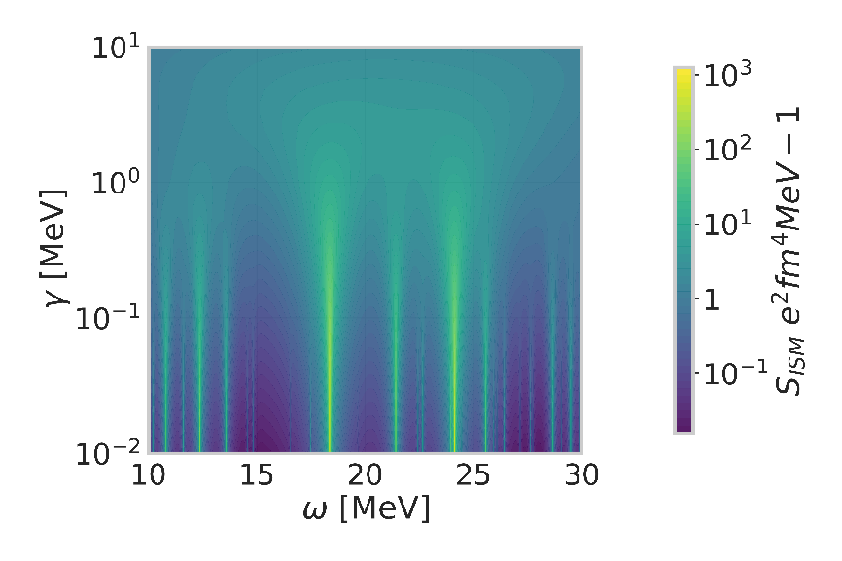
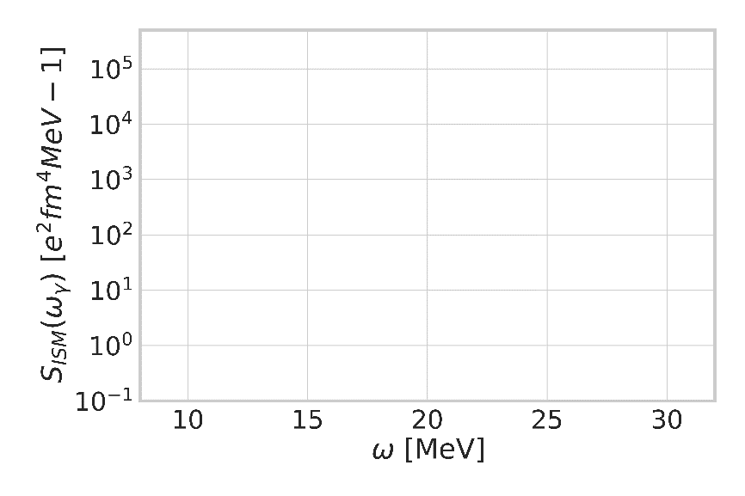
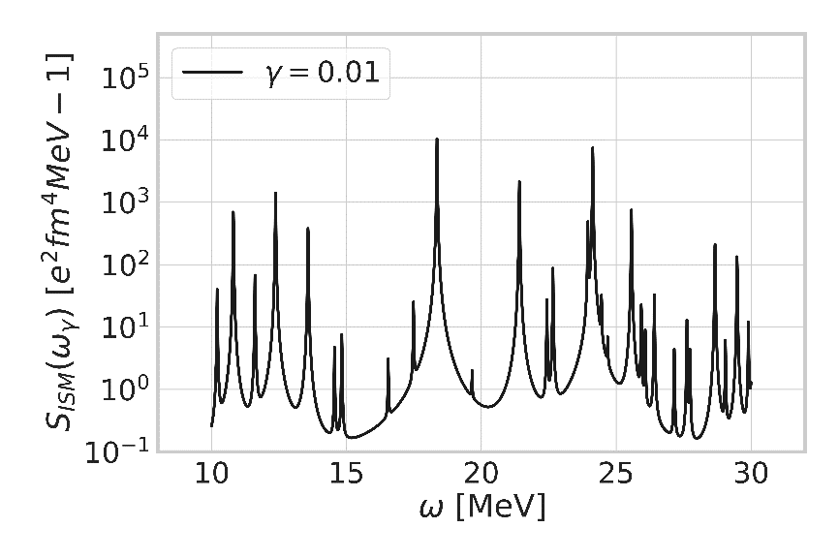
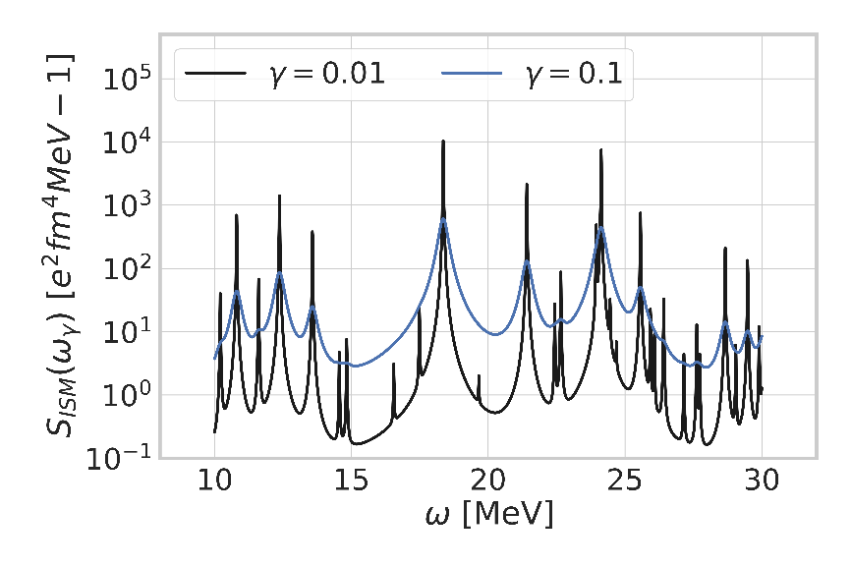
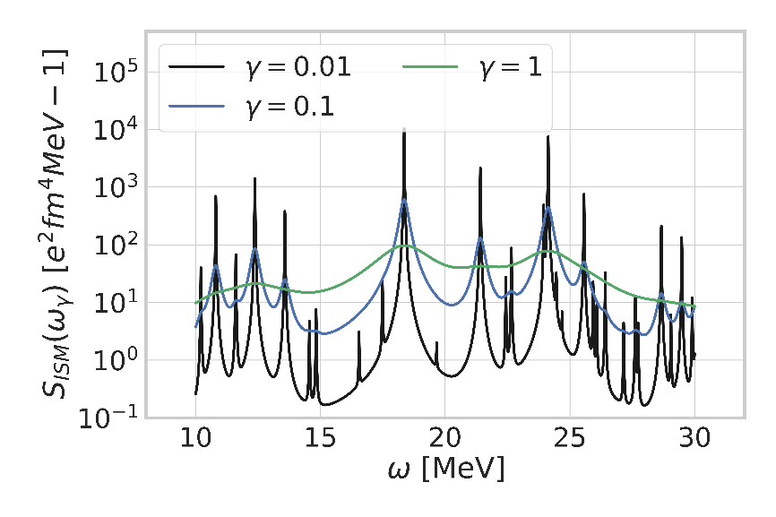
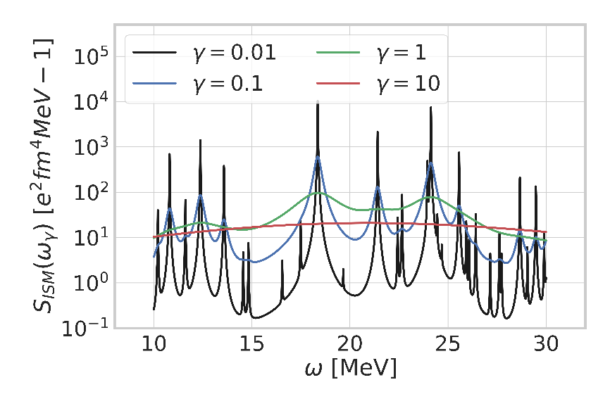
Comparison of matricial QRPA and Finite Amplitude Method
$$M=\left(\begin{matrix}\frac{∂^{2}E}{∂Z^{∗}∂Z} & \frac{∂^{2}E}{∂Z^{∗}∂Z^{∗}} \\ \frac{∂^{2}E}{∂Z∂Z} & \frac{∂^{2}E}{∂Z∂Z^{∗}}\end{matrix}\right)$$
Exact diagonalization
$O(N^{6})$ operations
Discrete spectum BY CONSTRUCTION
Smearing of the strength
Convolution with Lorentzian
MATRICIAL QRPA
$$S\left(ω\right)=\sum_{i}{\frac{B(i→0)}{{\left(ω−ω_{i}\right)}^{2}+γ^{2}}}$$
$$ω_{i}, B\left(LM,i→0\right), X_{i}$$
Spectrum
Transitions
Transition matrices
Expressed in 2qp space
$O(N^{4})$ matrix elements
Constructed in $O(N^{5})$ operations
Truncation in qp configurations
Continuum effects BY HAND
QRPA-FAM
(L,M)
$$ω+iγ$$
Self-consistent equation
HFB-like loop
Truncation-free
Imaginary part simulates the effects of continuum : free parameter
$O\left(N^{4}\right)$ operations
HFB
Excite vacuum with a probe
Introduce complex frequency
$ω→ω+iγ$ ⬄ Lorentzian smearing

Slide 8
Comparison of matricial QRPA and Finite Amplitude Method
$$M=\left(\begin{matrix}\frac{∂^{2}E}{∂Z^{∗}∂Z} & \frac{∂^{2}E}{∂Z^{∗}∂Z^{∗}} \\ \frac{∂^{2}E}{∂Z∂Z} & \frac{∂^{2}E}{∂Z∂Z^{∗}}\end{matrix}\right)$$
Exact diagonalization
$O(N^{6})$ operations
Discrete spectum BY CONSTRUCTION
Smearing of the strength
Convolution with Lorentzian
MATRICIAL QRPA
More on QRPA-FAM memory gain and speed-up estimation
Realistic calculation: $N∼10^{3}−10^{4}$ single-particle states
Storage Runtime
Matricial $O\left(N^{4}\right)∼100Go−10To$ (axial) $O\left(N^{6}\right)$
FAM $O\left(N^{2}\right)∼1Go$ (triaxial) $100×10×40× O\left(N^{4}\right)$
Gain $×100 −1000000$ (w/o symmetries) $×100−1000$
FAM implementation
Extremely faster
Extremely lighter
Embarrassingly parallel
$$S\left(ω\right)=\sum_{i}{\frac{B(i→0)}{{\left(ω−ω_{i}\right)}^{2}+γ^{2}}}$$
$$ω_{i}, B\left(LM,i→0\right), X_{i}$$
Spectrum
Transitions
Transition matrices
Expressed in 2qp space
$O(N^{4})$ matrix elements
Constructed in $O(N^{5})$ operations
Truncation in qp configurations
Continuum effects BY HAND
QRPA-FAM
(L,M)
$$ω+iγ$$
Self-consistent equation
HFB-like loop
Truncation-free
Recovering discrete spectrum / moments
Complex contour integration
$O\left(N^{4}\right)$ operations
WITHOUT APPROXIMATION
HFB
Conclusion M-QRPA / QRPA-FAM
Same results, different strategies
Simpler to implement
Faster to execute
Requires less memories
FAM gives back QRPA its « rightful » scaling
Excite vacuum with a probe
Introduce complex frequency
$ω→ω+iγ$ ⬄ Lorentzian smearing

Slide 9
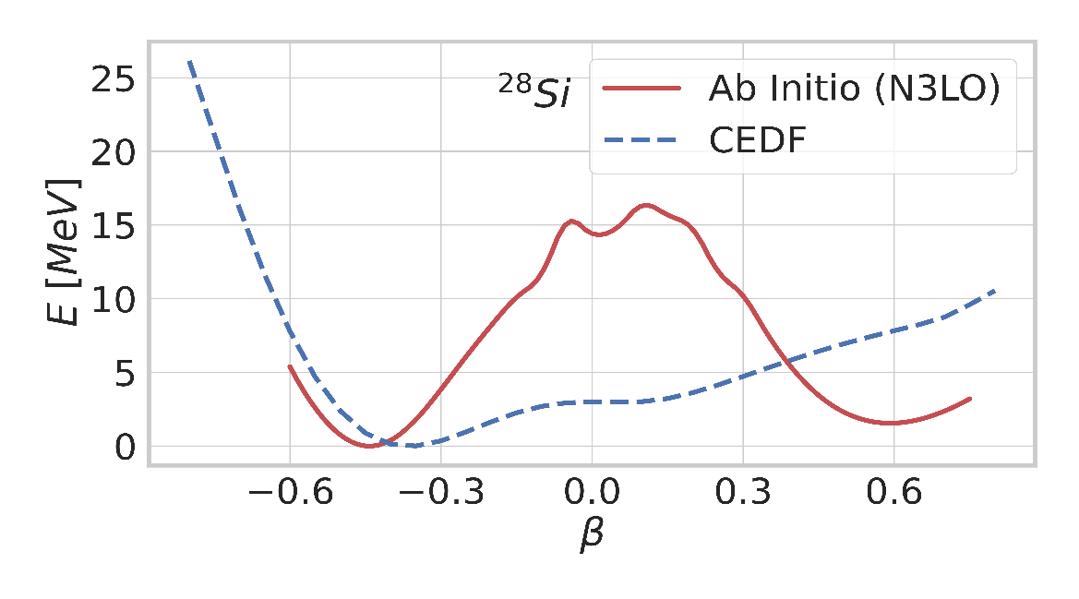
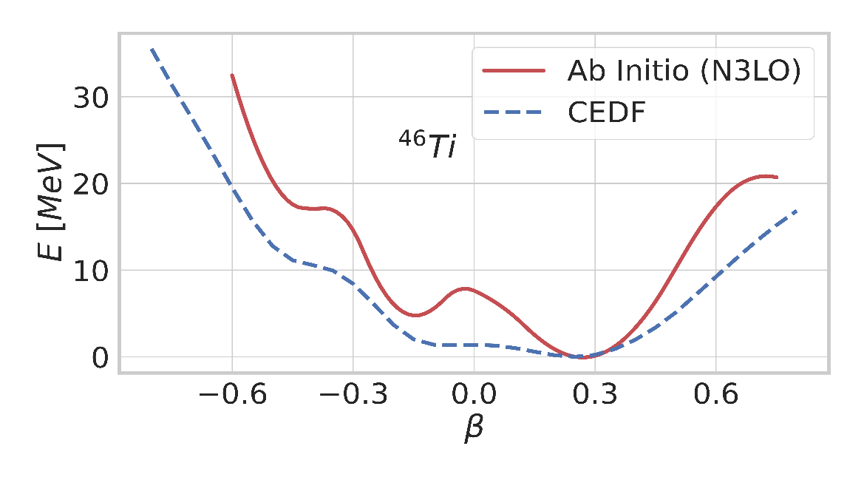
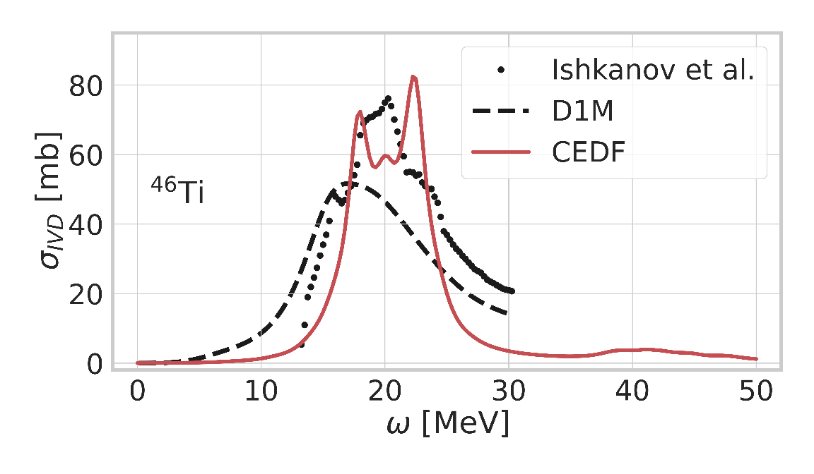
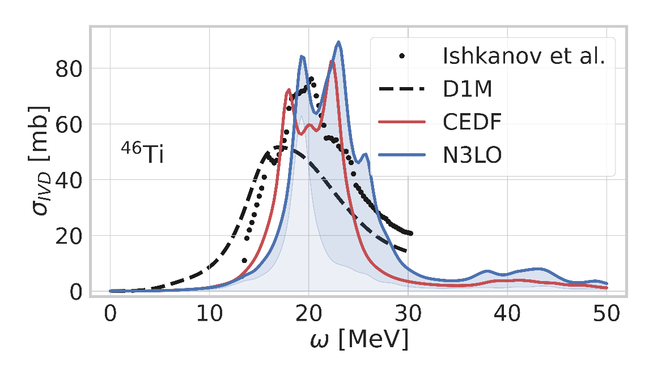
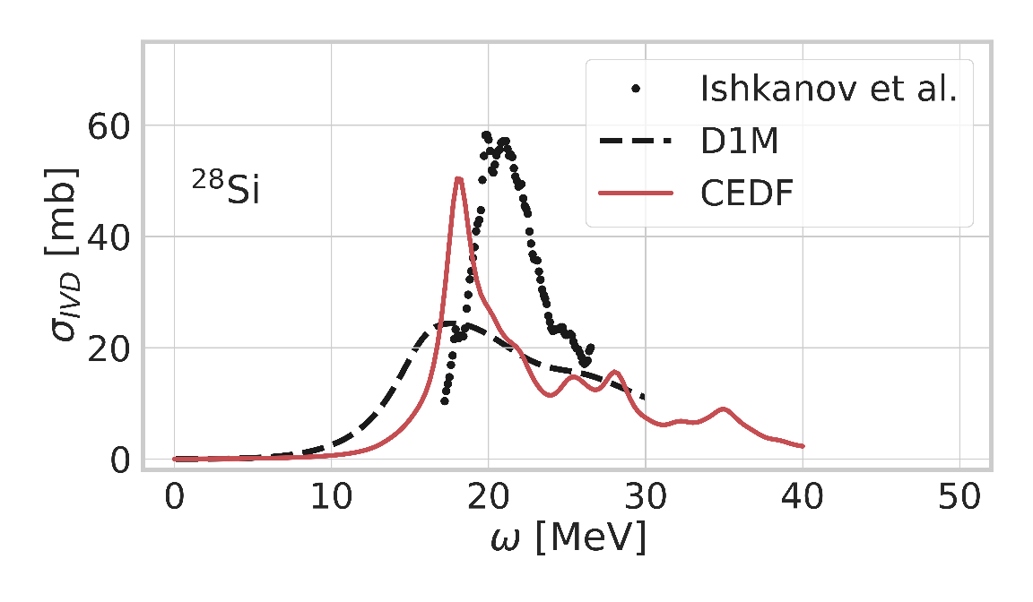
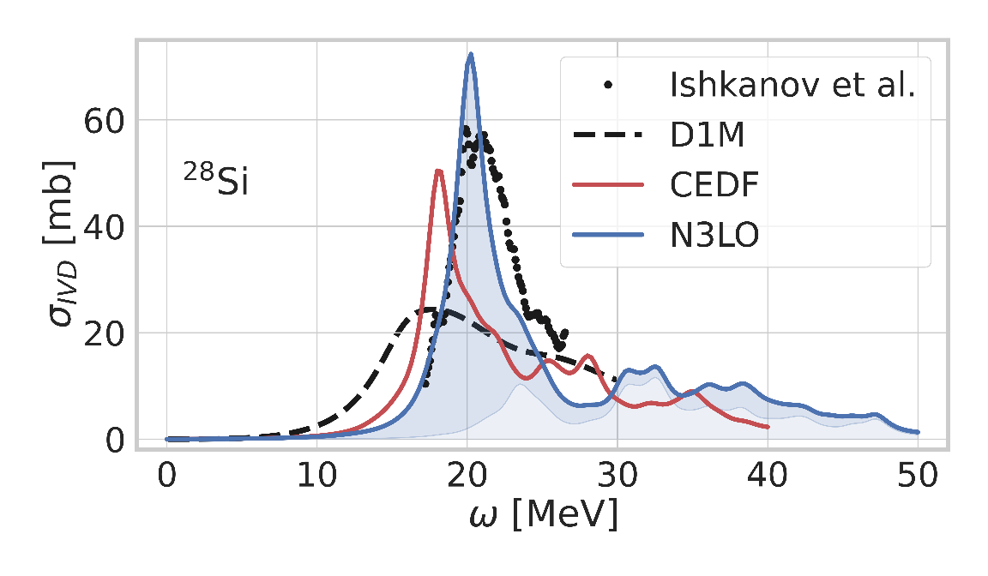
Application of axial QRPA-FAM to E1 response in light systems
First application to superfluid + deformed nuclei with ab initio interactions
Interaction consistently derived from first principles at N3LO [R. Roth]
Mean-field solved in harmonic oscillator basis
Mean-field breaks rotational symmetry
Prolate Ti46 with small anharmonicities
Energy surface comparable with Covariant Energy Density Functional
« Harder » ab initio surface : less correlations
Good reproduction of GDR
Qualitatively very similar to
D1M [S. Goriely, S. Hilaire, S. Péru] ➔ reference in evaluated date
CEDF [J. P. Ebran]
Structure effects play dominant role
Oblate Si28 with double well
QRPA-FAM explores only oblate well
Coupling between wells introduced in other theories (A. Porro)
Good position of the main peak (slightly shifted in PGCM)
Good agreement of structures with CEDF

Slide 10
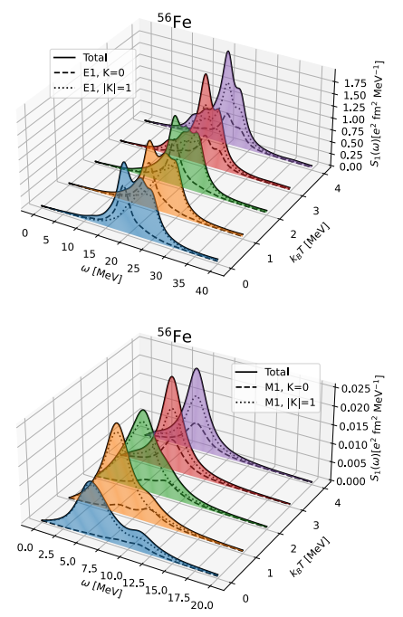
QRPA and finite temperature
Beaujeault-Taudière et al. (2022)
Finite temperature
QRPA-FAM naturally builds on top of statistical reference state
Finite temperature with Boltzmann weights
Equal filling approximation for odd nuclei
Access to desexcitation strength functions
Significantly affects GDR
But low-energy upbend is not obtained from our calculations
Need for another model (work in progress)

Slide 11
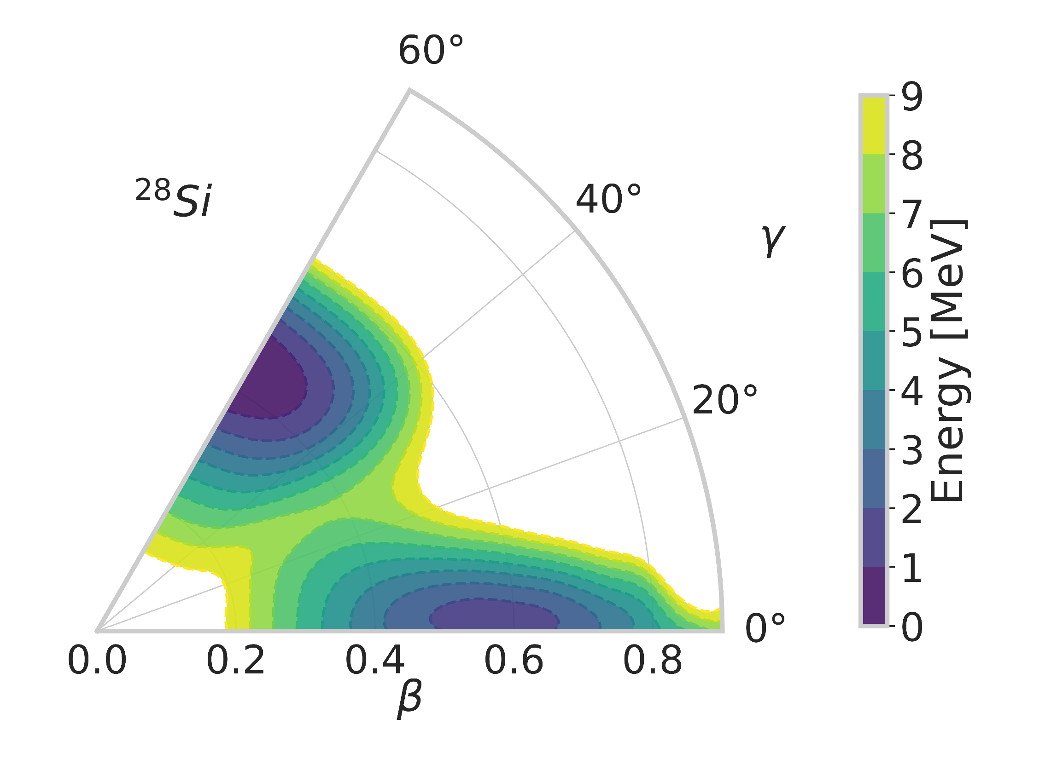
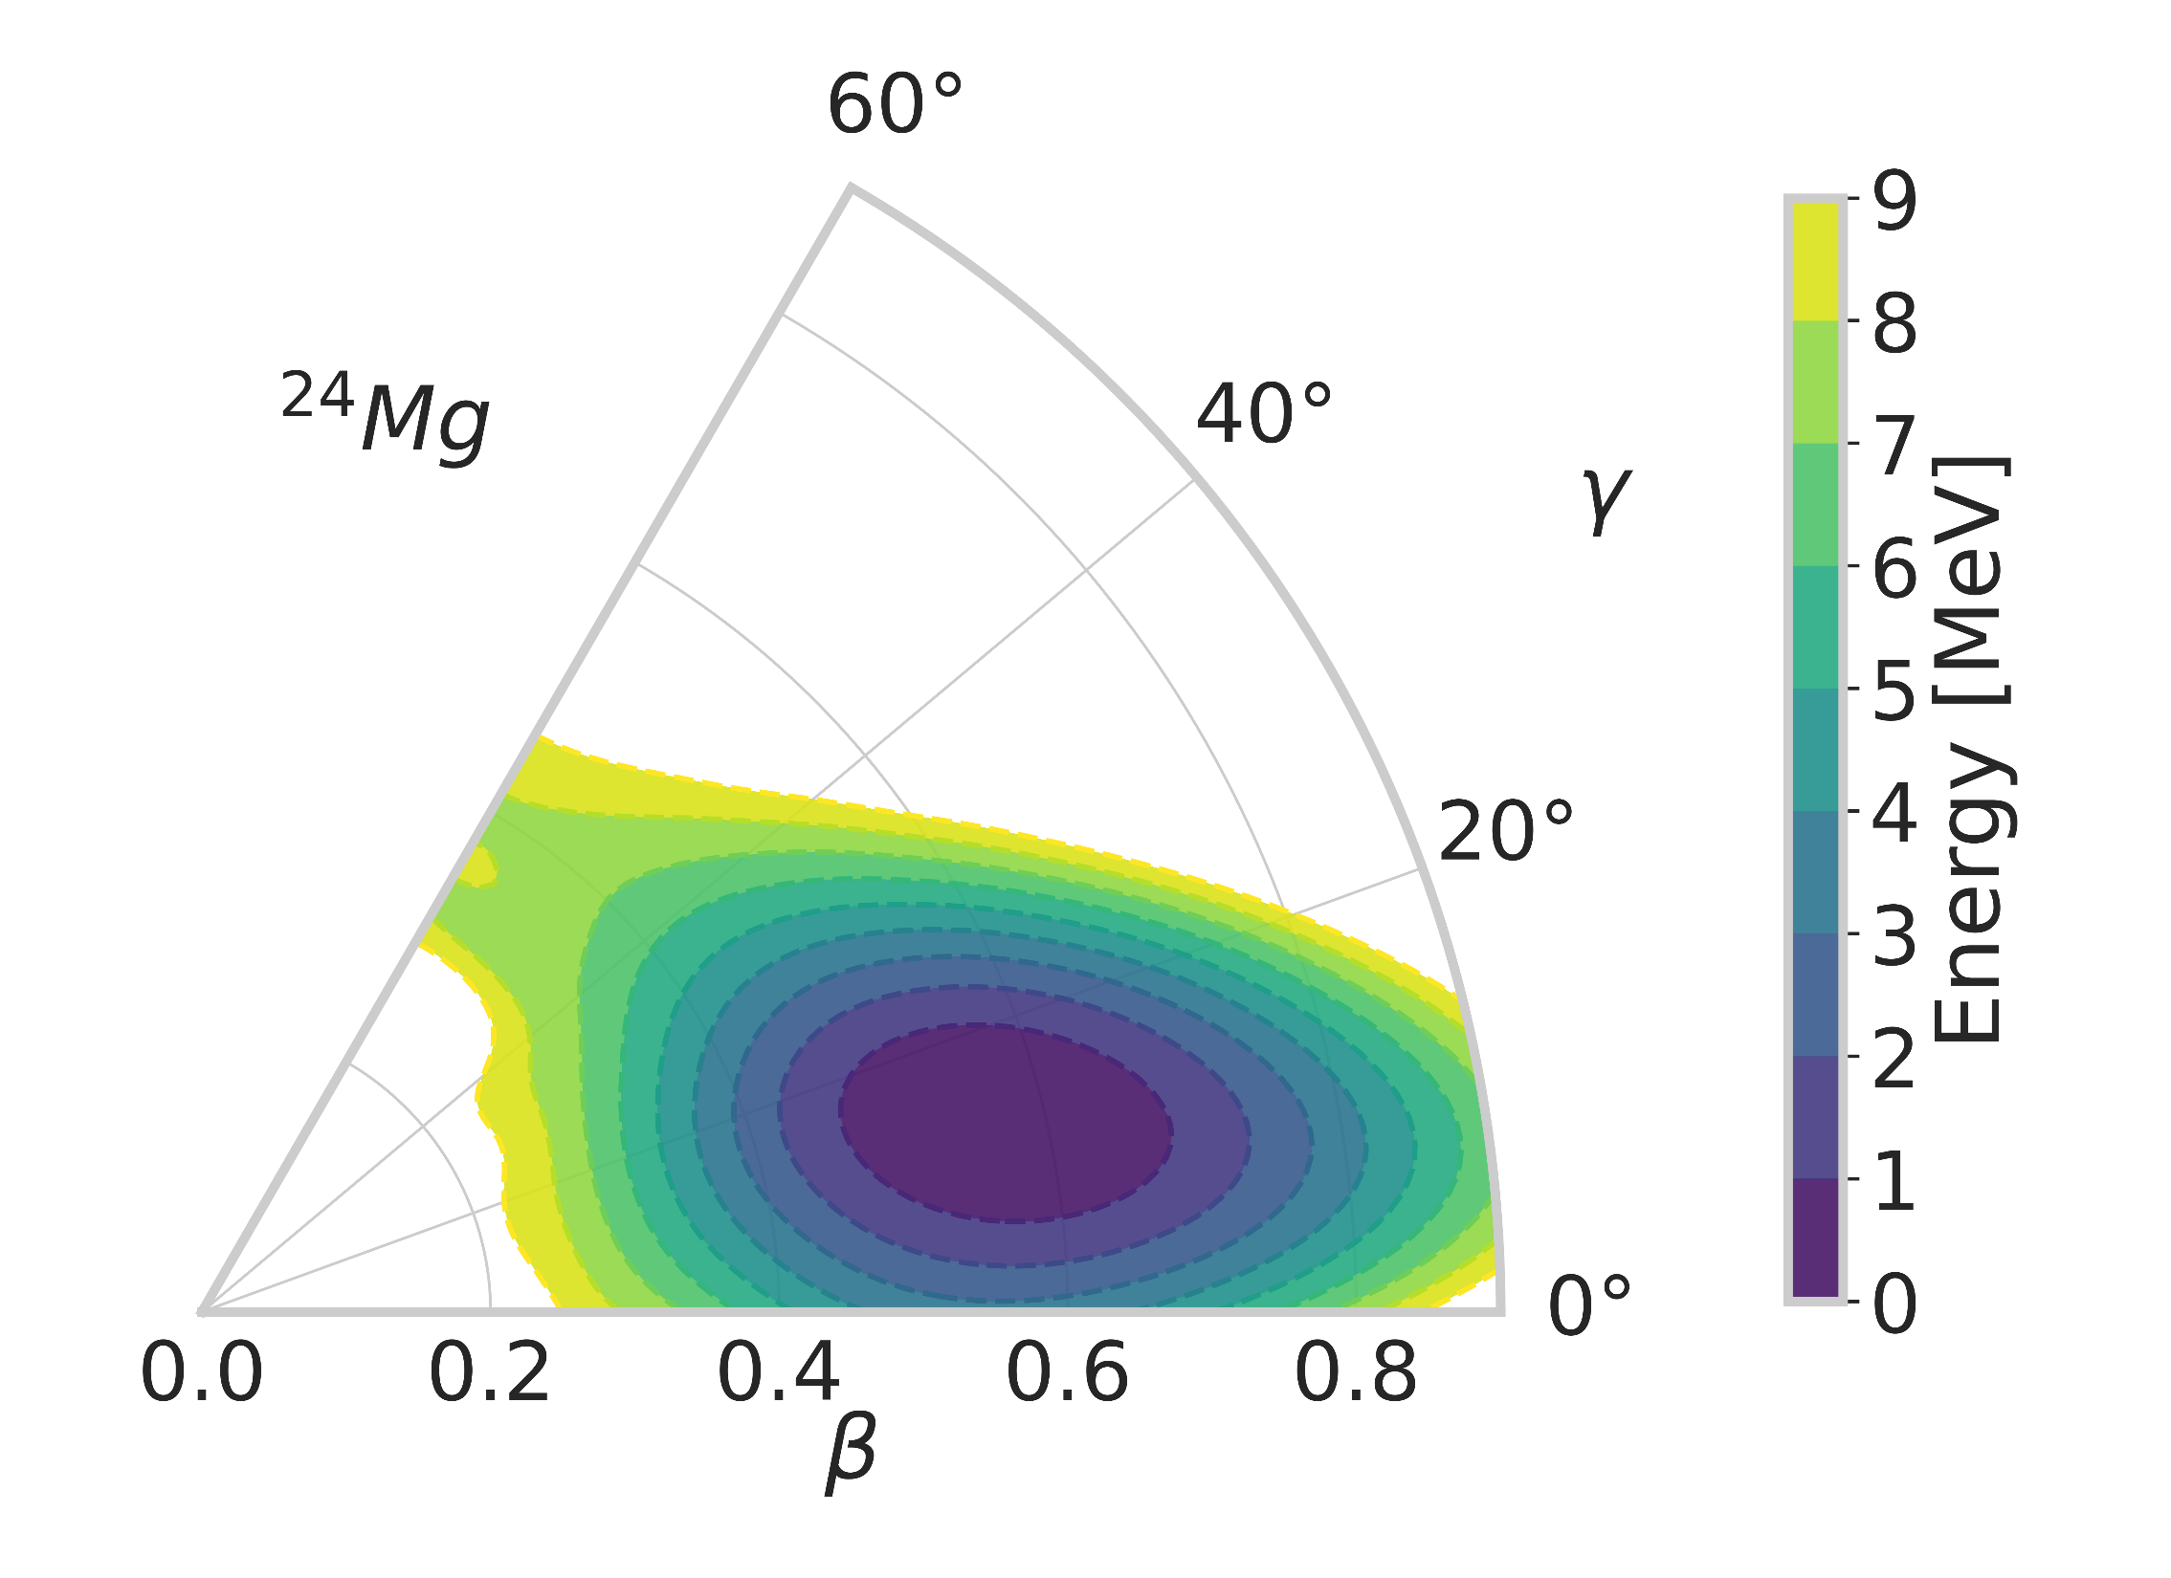
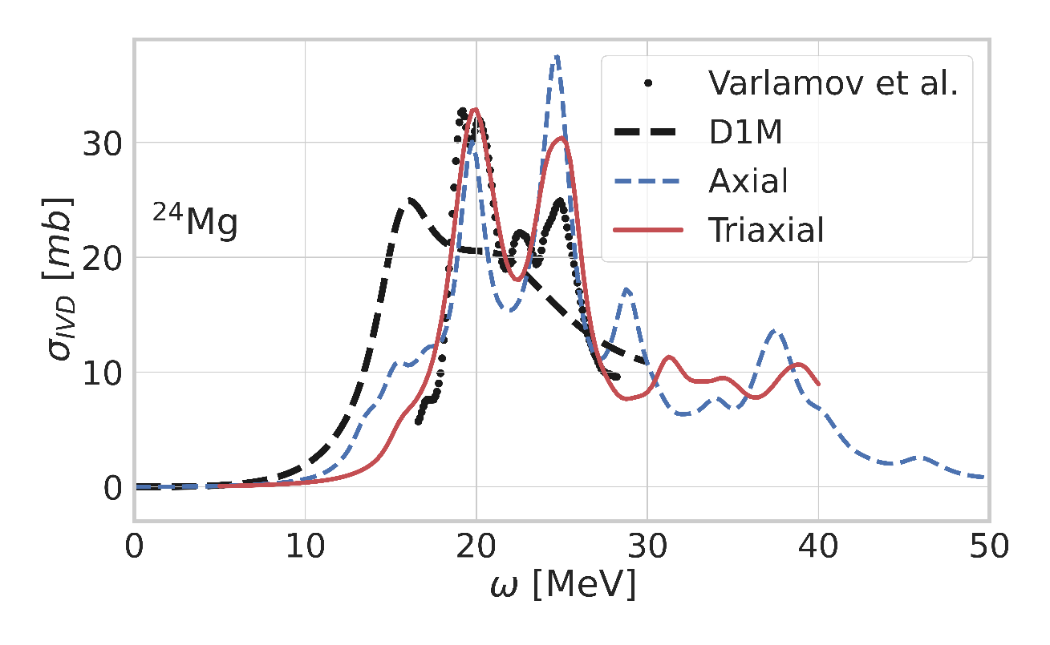
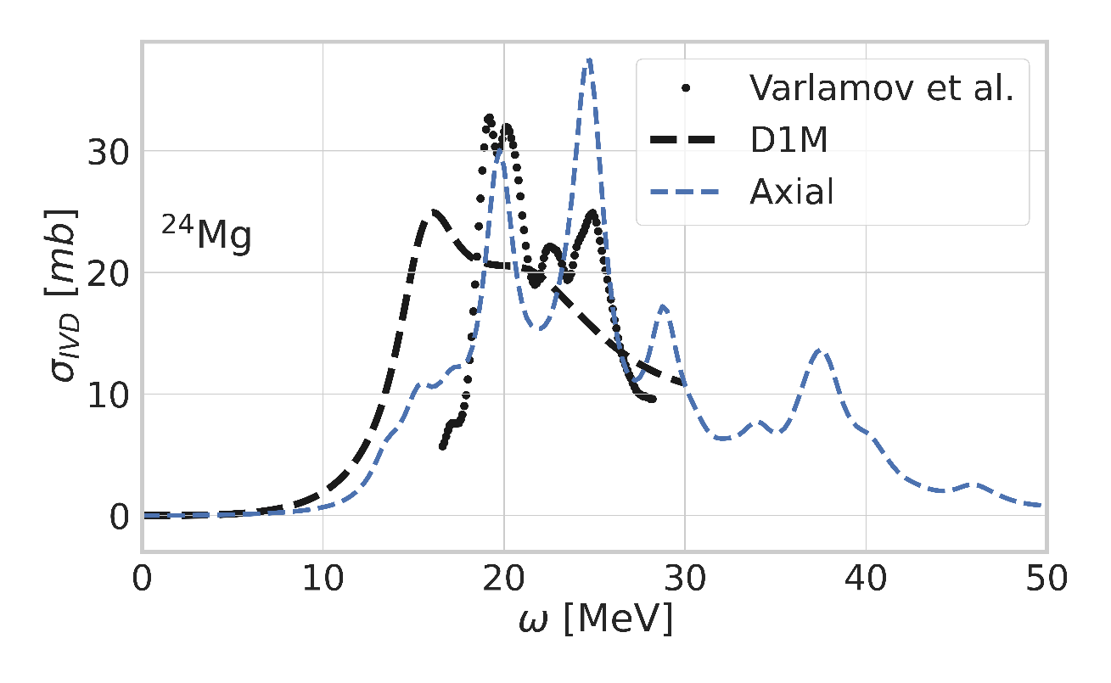
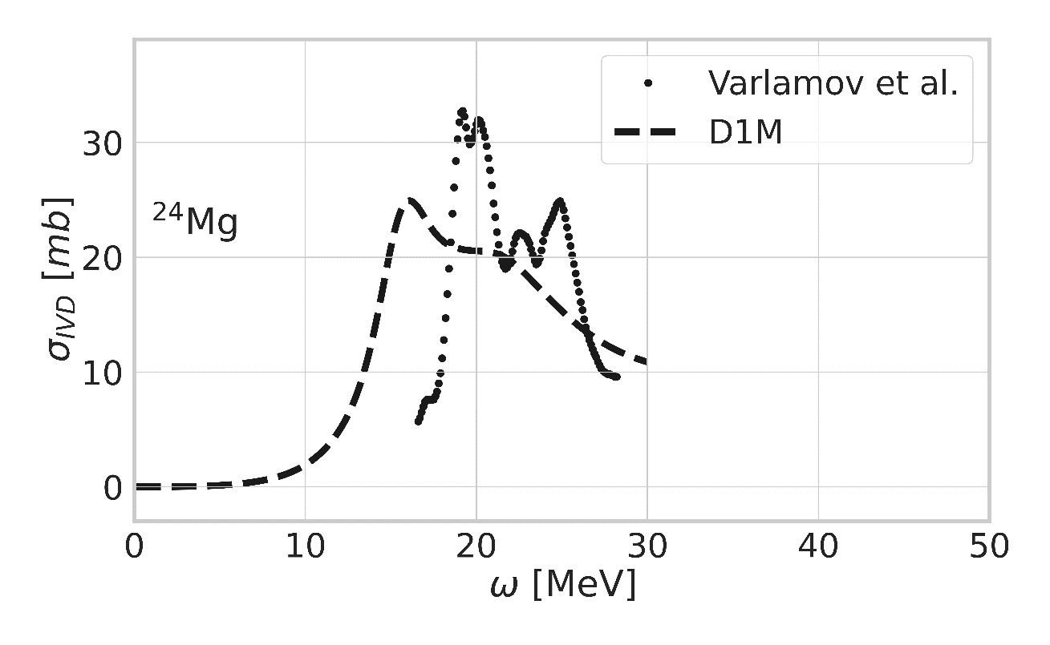
Generalizing to triaxial systems : preliminary results
Light systems and triaxiality
Axial shape approximation is accurate in most of large systems
But not so much in lighter systems
Cluster configurations in ground and excited states
Island of deformation around magnesium
Model space can be reduced and complexity increased!
Influence on the QRPA-FAM strength functions
Good qualitative description of axial D1M
Axial calculation with chiral interaction
Good localization of the two main peaks
Missing hierarchy between two peaks
Triaxiality corrects for this effect (subleading correction)
Very encouraging results to be confirmed in other systems!

Slide 12
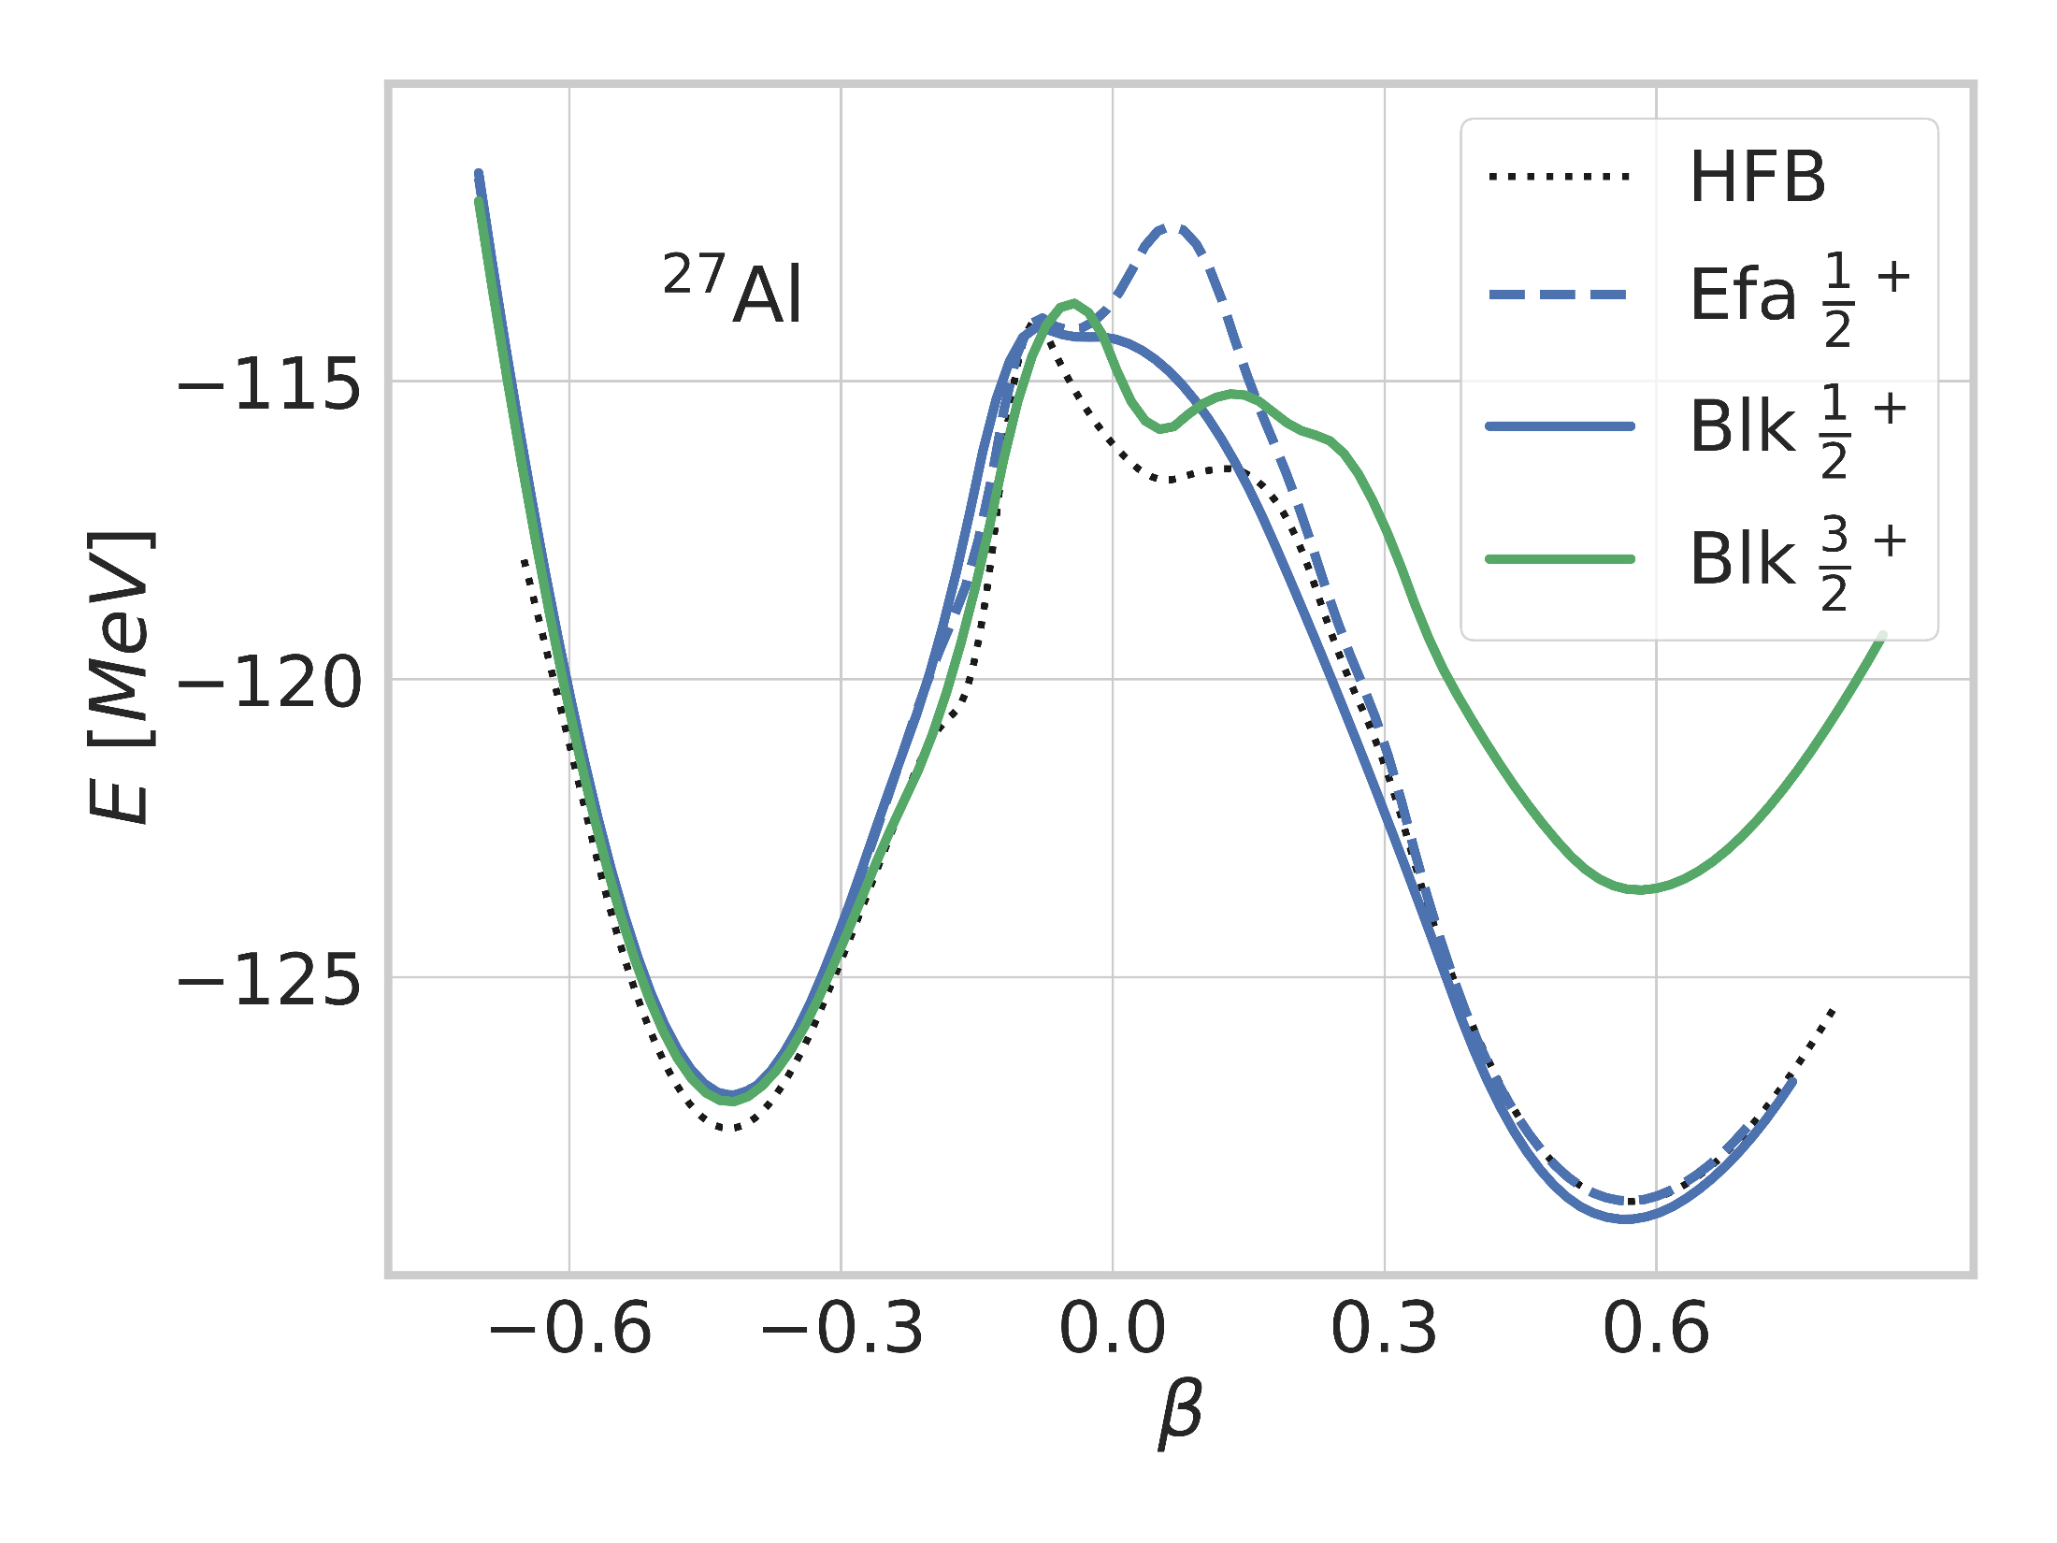
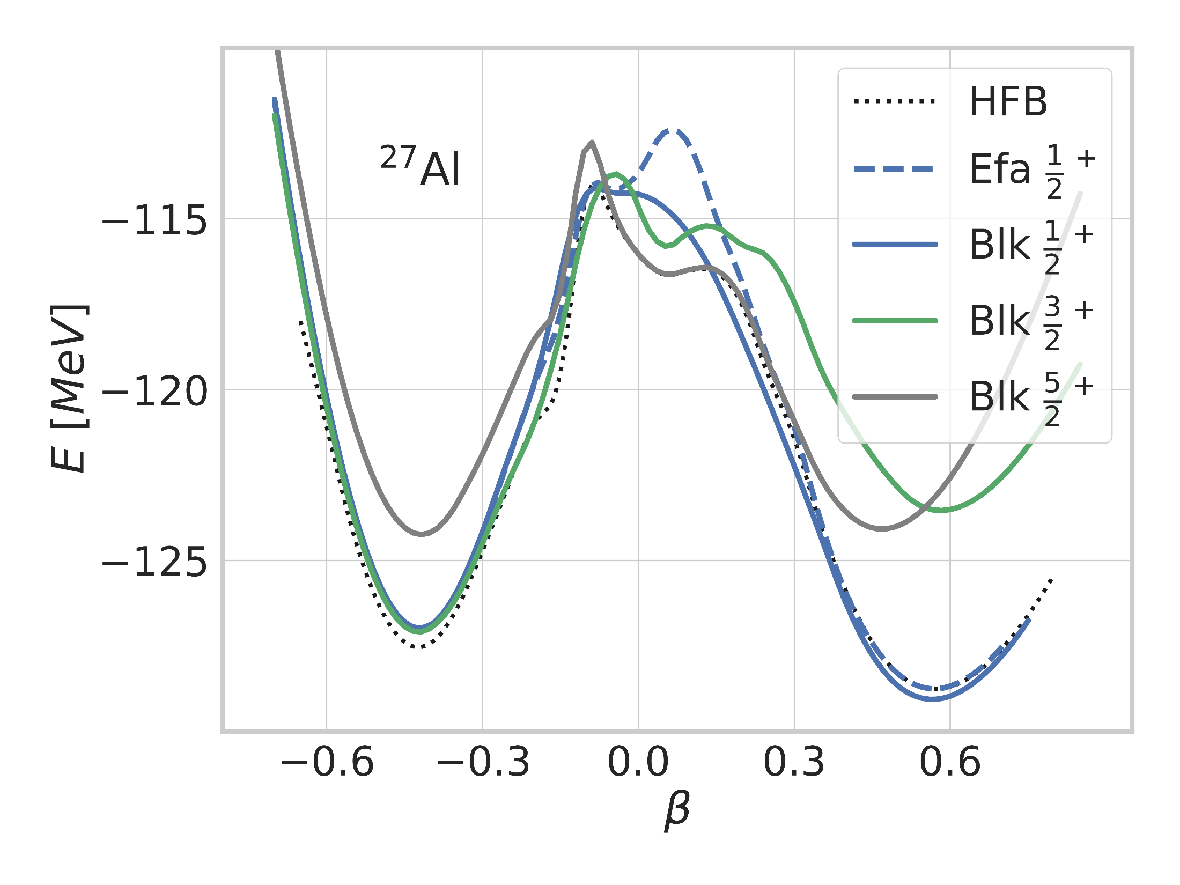
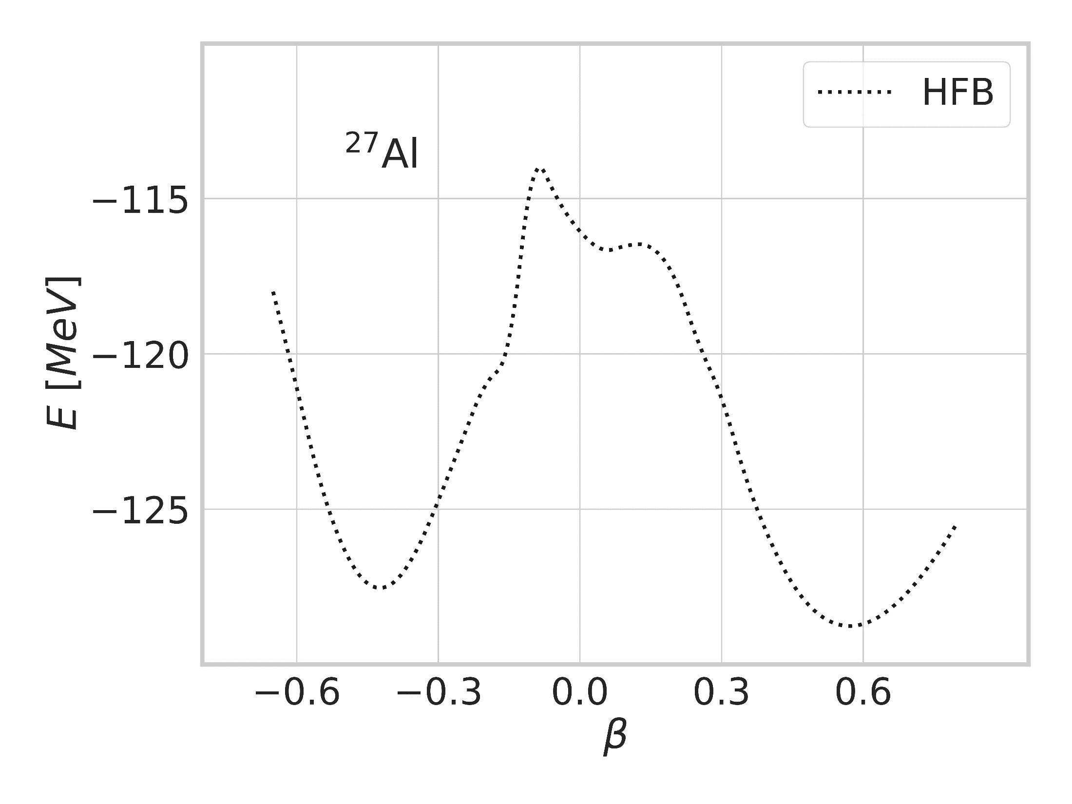
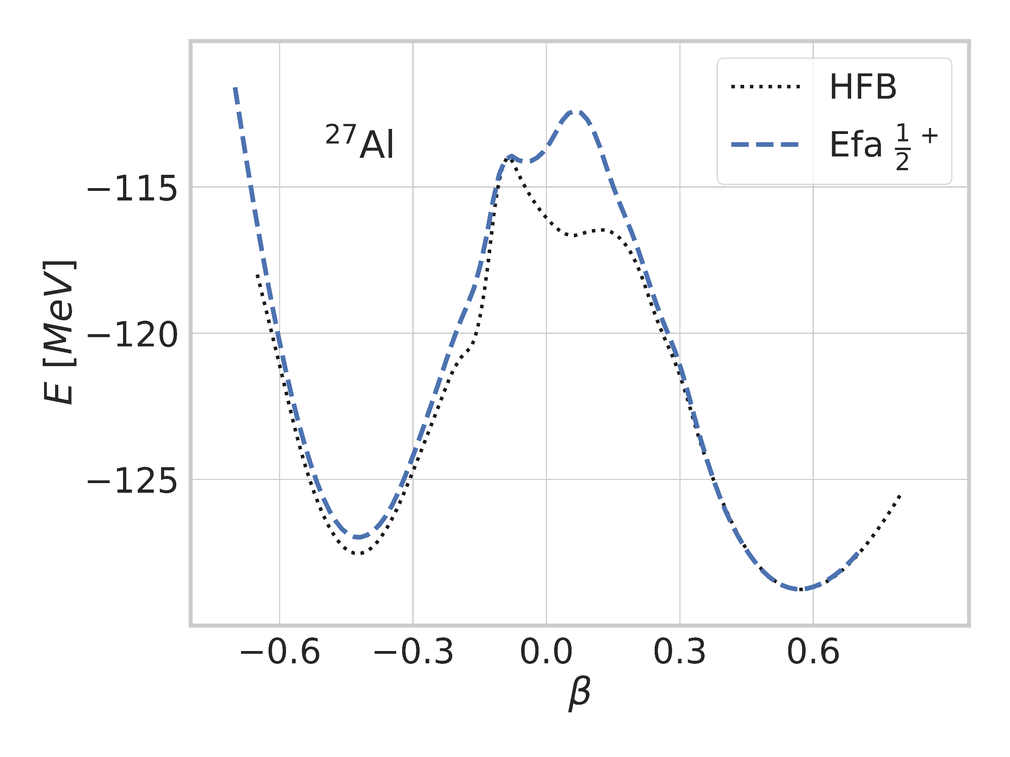
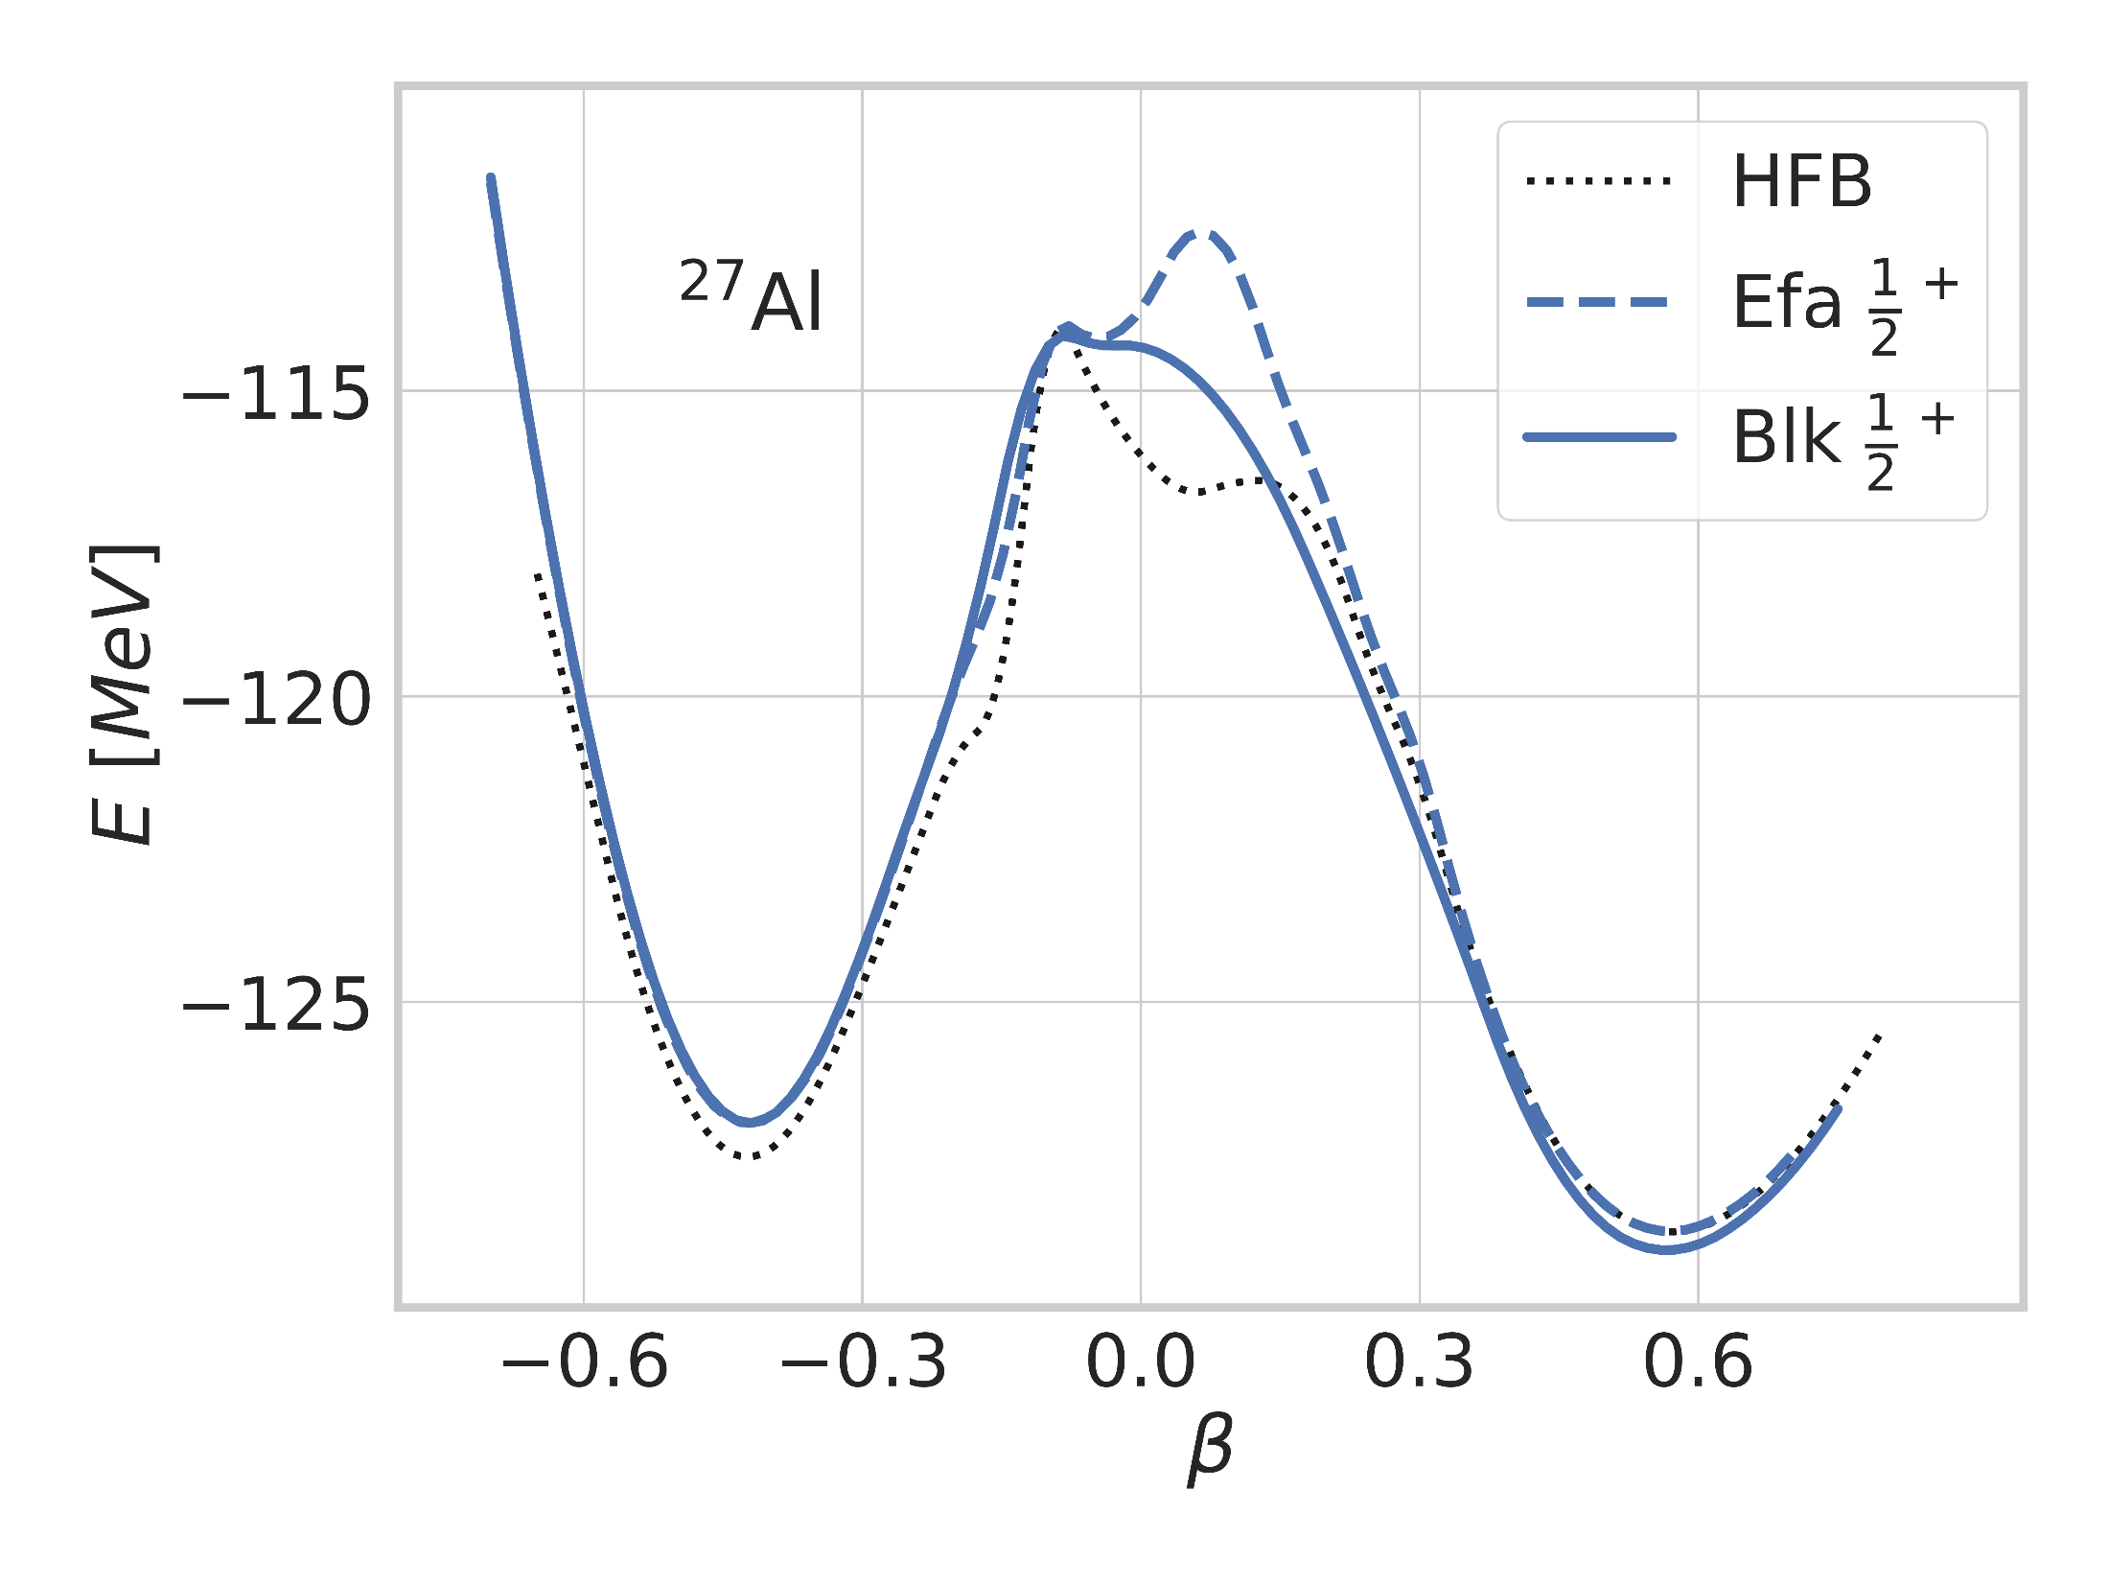
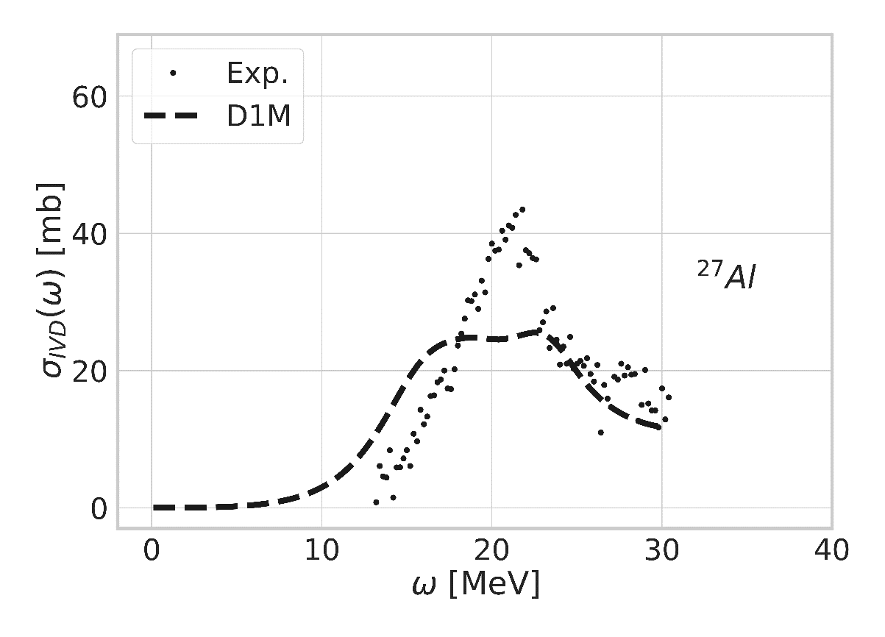
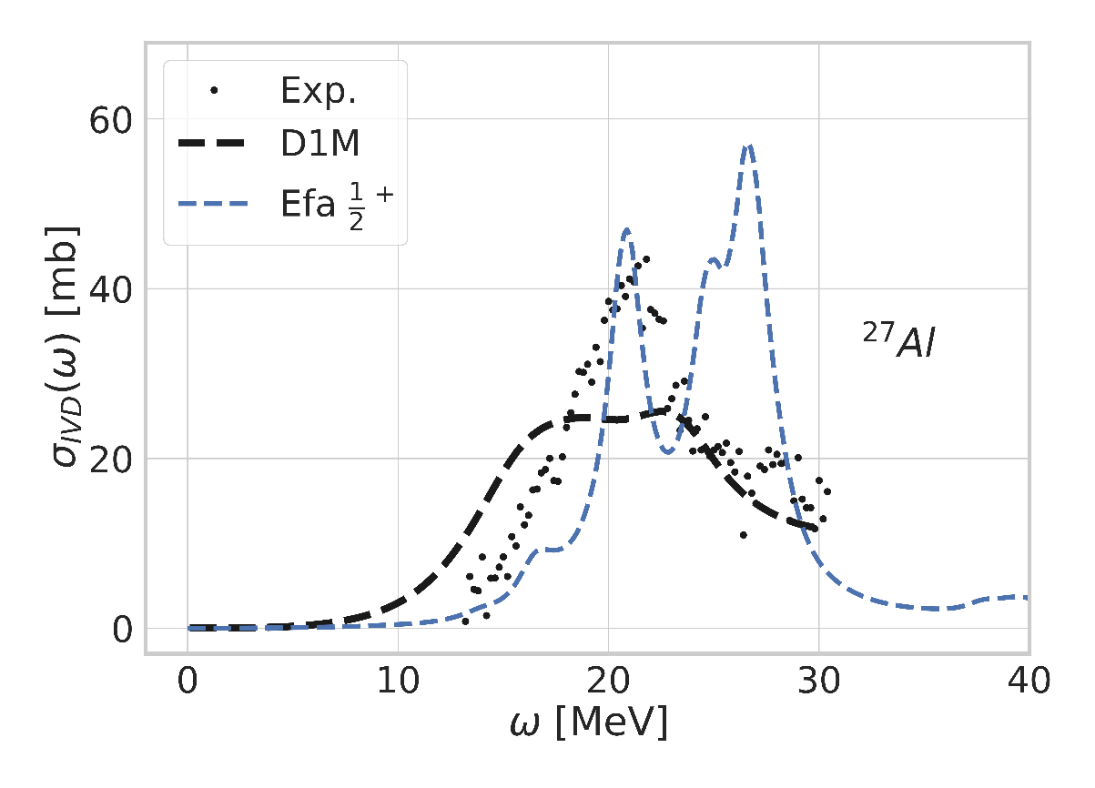
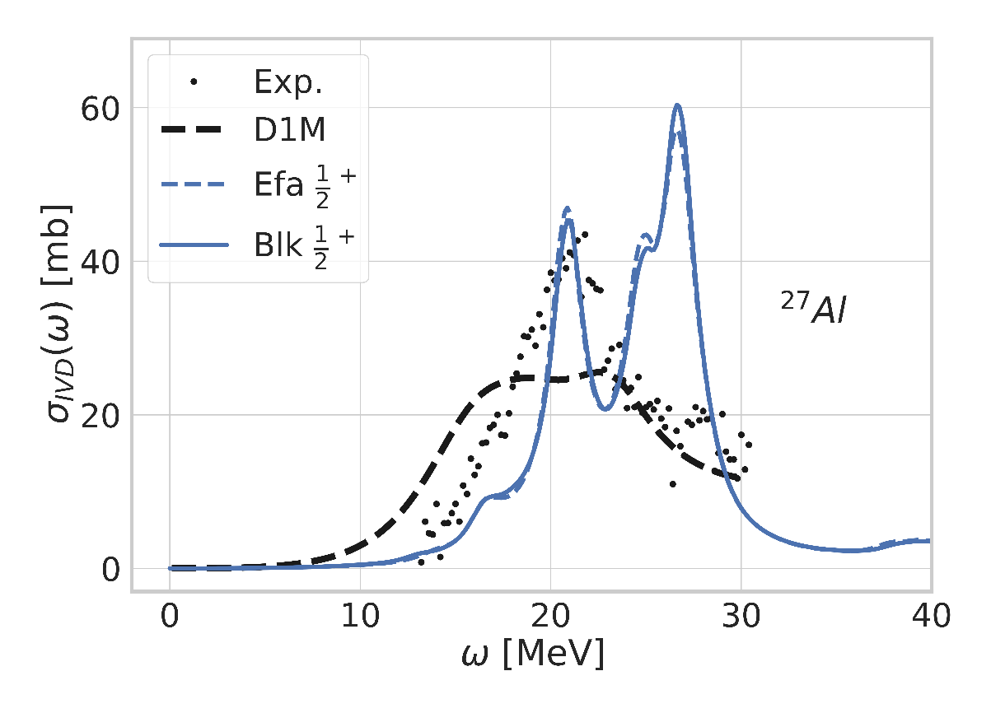
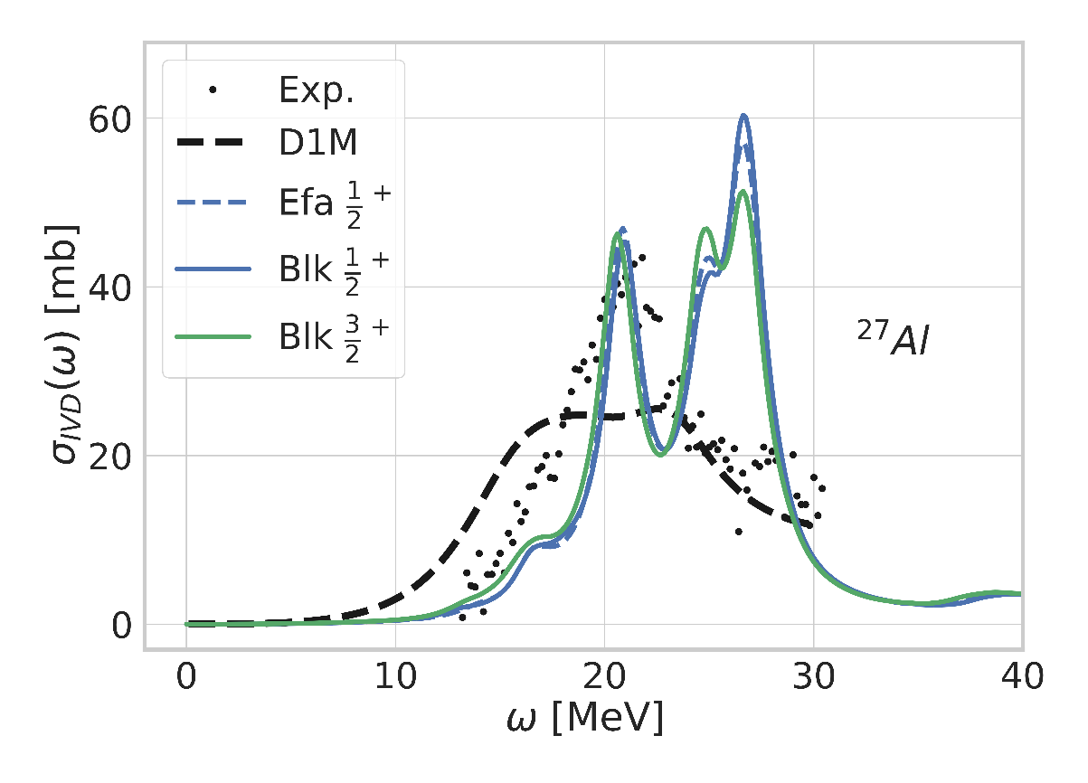
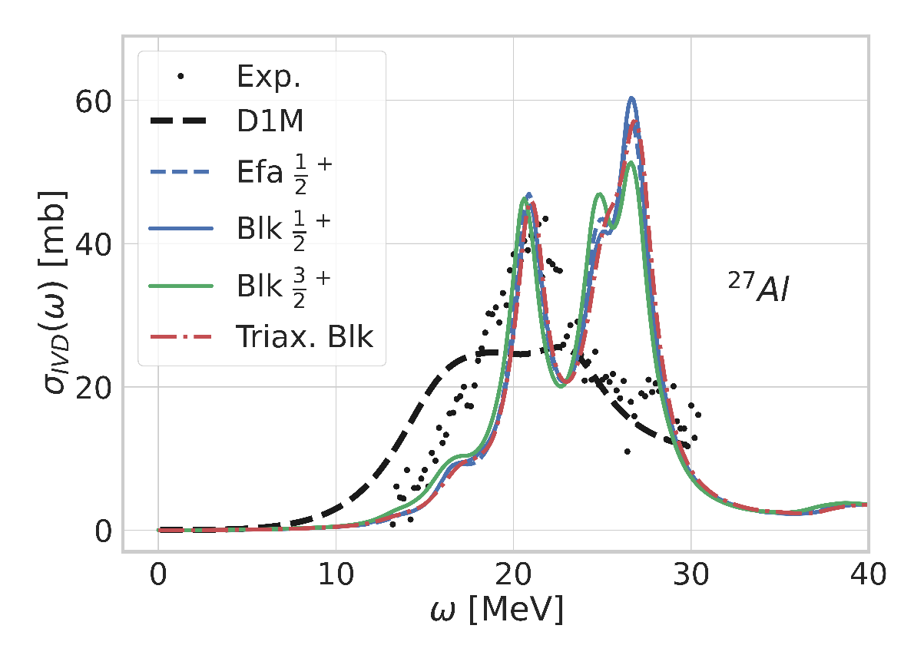
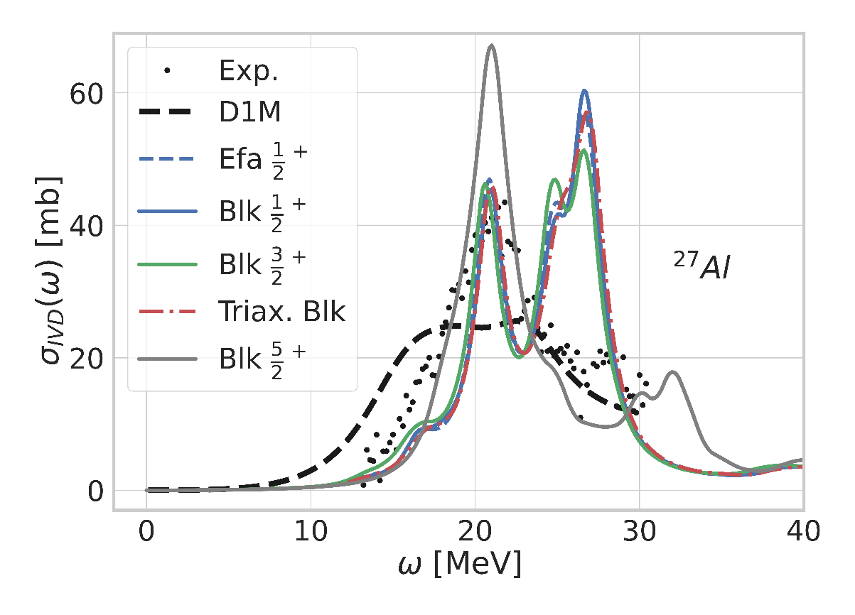
QRPA-FAM in odd systems : very preliminary results
Odd nuclei more challenging
Time-odd fields
Blocking on several quasi-particles
Polarization effects favoring triaxial shape
QRPA-FAM ideal tool to keep the problem « simple »
Three level of approximation: EFA, Blocking, Triaxial blocking
First glance at odd nuclei
Unique tool to study extensively odd systems with QRPA in various approximations
Made possible by the simplicity of FAM formalism
Need for know-how, feed-back, reference data
All approximations of prolate odd nuclei give similar results
… but show wrong strength profile
Triaxiality does not help (only midly triaxial at HFB level)
Oblate vacuum much closer to experiment
Luck ? Misled by interaction? False interpretation?
Need for better understanding + beyond QRPA to decide
Systematic calculations should give a clearer picture

Slide 13
Conclusions
Summary
QRPA-FAM as a tool of choice for low-lying spectroscopy
FAM : fast calculation of QRPA strength functions
Systematics, inclusion of spectroscopic information into the fit?
Newest generation of ab initio interactions
Fair reproduction of experimental data
Confirms results obtained with PGCM in previous works
Opening toward triaxial and odd systems
Made possible by the rapidity of FAM over QRPA
Towards systematic calculations of all light / medium mass systems?
Envisioned work in the near future
Gogny / Skyrme QRPA-FAM
Gogny interaction only available at HFB (N. Dubray), generic triaxial implementation on-going (A. Roux)
PAN@CEA Beyond QRPA calculations to investigate theoretical limitations of the model
Dynamical PGCM (A. Porro)
Projected QRPA (A. Porro)
TDHFB
Deformed self-consistent Green’s function (A. Scalesi)

Slide 14
Thank you for your attention
Thomas Duguet
Vittorio Somà
Benjamin Bally
Andrea Porro
Alberto Scalesi
Gianluca Stelini
Jean-Paul Ebran
Yann Beaujeault-Taudière
Noël Dubray
Antoine Roux
Rémi Bernard
Gilles Noguerre
Alessandro Pastore
Pierre Tamagno
Robert Roth

Slide 15
Finite Amplitude Method for QRPA
Ref: Beaujeault-Taudière, PhD thesis
Definition of QRPA matrix
$$|Φ_{0}+δΦ〉= exp\left(Z\right)|Φ_{0}〉$$
QRPA-FAM in a nutshell
Find the HFB minimum of the functional
Excite the minimum with
Various probes (E0, E1, E2, M1)
Various frequency
Collect the system response to the probe
Individual? Collective?
$$E[Φ_{0}+δΦ]≡E_{HFB}+\frac{1}{2}\left(\begin{matrix}Z^{∗} & Z\end{matrix}\right)\left(\begin{matrix}\frac{∂^{2}E}{∂Z^{∗}∂Z} & \frac{∂^{2}E}{∂Z^{∗}∂Z^{∗}} \\ \frac{∂^{2}E}{∂Z∂Z} & \frac{∂^{2}E}{∂Z∂Z^{∗}}\end{matrix}\right)\left(\begin{matrix}Z \\ Z^{∗}\end{matrix}\right)$$
Keeping HFB
dimensionality
Large dimensions
Difficult to diagonalize
QRPA-FAM : explore the QRPA spectrum iteratively
Deriving QFAM from TD-HFB
$$i\dot{ℛ}=\left[ℋ+ℱ\left(t\right),ℛ\right]$$
Transform $δℛ(ω)$
(sp)
Transform 𝛿ℛ(𝜔)
(sp)
Compute $δℛ[δℋ,ω]$
(qp)
Compute 𝛿ℛ[𝛿ℋ,𝜔]
(qp)
Compute $δℋ\{δℛ\left(ω\right)\}$
(sp)
Compute 𝛿ℋ{𝛿ℛ(𝜔)}
(sp)
Transform $δℋ\left(ω\right)$
(qp)
Transform 𝛿ℋ(𝜔)
(qp)
Linearisation + Fourier Transform
$$ℱ\left(t\right)=ℱ\left(ω\right)e^{−iωt}+h.c.$$
➔
$$ℛ\left(t\right)=ℛ_{0}+δℛ\left(ω\right)e^{−iωt}+h.c.$$
$$ℛ_{0}=\left(\begin{matrix}f & 0 \\ 0 & 1−f\end{matrix}\right)$$
Statistical reference state
Finite temperature, EFA, true odd?
Ongoing project with A. Pastore
$$δ𝓡\left(ω\right)=\left[𝓗_{0},δ𝓡\left(ω\right)\right]+\left[𝓕\left(ω\right)+δ𝓗\left\{δ𝓡\left(ω\right)\right\}, 𝓡_{0}\right]$$
Note: complex frequency
Convolution with Lorentzian
⬄ Smearing of the strength
$$S\left(F,ω\right)=Tr(ℱ^{+}δℛ(ω))$$
Solved self-consistently

