Slide 1
EOSC Architecture WG
Jean-François ABRAMATIC
EOSC Executive Board member
H2020-ESCAPE Progress Meeting
Brussels, 27 February 2020

Slide 2
Agenda
EOSC Working Groups
EOSC Architecture WG
AAI Task Force
PID Task Force
PID Policy
Draft Document from FAIR & Architecture WGs
Minimal Viable EOSC vs Maximum Valuable EOSC

Slide 3
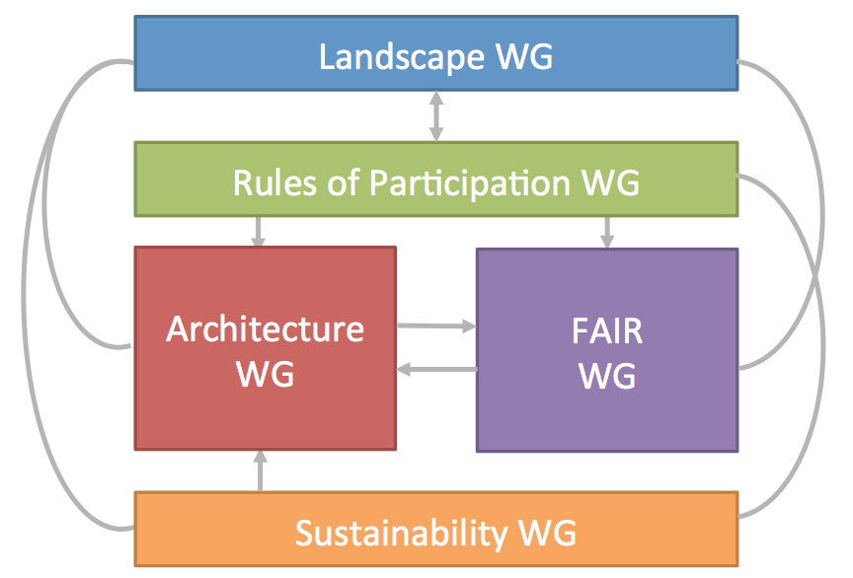
EOSC Working Groups
EOSC Executive Board created Five Working Groups for 2019-2020

Slide 4
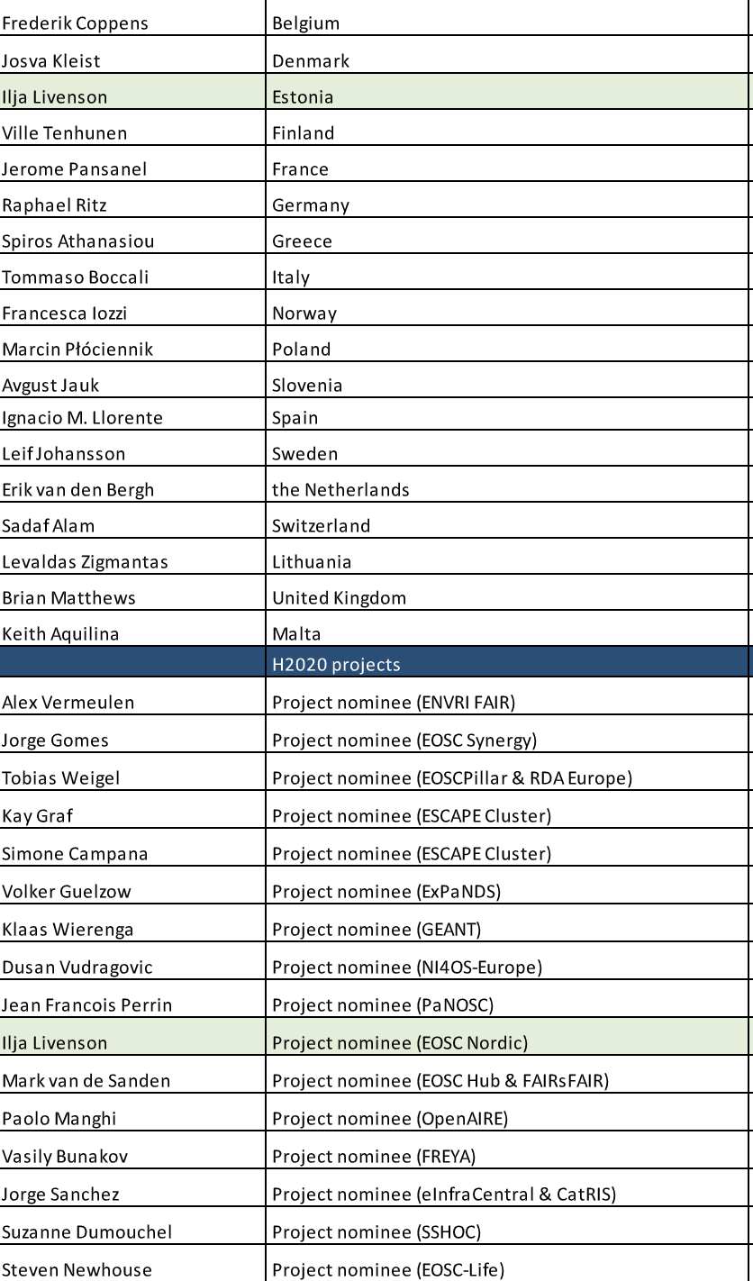
EOSC Architecture WG
First meeting: July 3, 2019
Membership
18 countries, 16 H2020 projects
EOSC Symposium: November 26, 2019
Town Hall meeting
Task Forces
AAI, PID

Slide 5
AAI Task Force
Co-Chairs: Klaas Wierenga (GEANT), Leif Johansson (Sweden)
Architecture for Authentication, Authorization and Access Control
Deliverables:
First Principles (draft)
Requirements (draft)
Baseline Architecture (draft)
Catalogue of good examples (collecting inputs)
Rules of Participation

Slide 6
PID Task Force
Co-Chairs: Tobias Weigel (EOSC Pillar), Brian Matthews (UK)
Status: installed base, spectrum of use cases, global
Gaps: metadata profiles, missing PID types
PID Policy (with the FAIR WG)
Initial document published
PID Technical Architecture

Slide 7
PID Policy Document (developed by FAIR & Architecture WGs)
Status: Published for public consultation
https://zenodo.org/record/3574203#.XlUGpJNKi-w
Next release : March 2020, Final release: October 2020
Contents
Rationale and principles
Definition of a PID
Roles and Responsibilities to create a trusted and sustainable PID Ecosystem
How PIDs should be applied
Types of things PIDs can be applied to
Necessary features of PID Services and their Service Providers
Governance and Sustainability required to build trust.

Slide 8
Minimal Viable EOSC (MVE)
From Sustainability WG (”Tinman report”)
A mechanism for naming and locating data and services
A mechanism for discovery of and access to data and services
A framework for managing user identity and access

Slide 9
Minimal Viable EOSC (MVE) vs “Maximum Valuable EOSC”
• Open science policy framework provides a data compliance framework for open & FAIR data
• PID services allow to generate, resolve and validate Persistent IDentifiers
• Metadata framework ensures openness and interoperability, privacy and security, copyright status, disclosure limitations, patents pending, … on datasets or workflows
• Portal provides a generic way of accessing and using EOSC Resources
• Data access framework offers data as a service (discovery & reuse)
• Services access framework provides a consistent definition of services:
what they offer, what is their operational capacity, how they are accessed, who pays for them.
• Authentication and Authorization Infrastructure (AAI) delivers trust and identity service
• Helpdesk offers a framework for linking national/thematic/institutional service desks
• Open metrics framework sets the rules for the assessment of EOSC components and facilitates incentives and rewards mechanisms

Slide 10
THANK YOU
Feel free to contact me:
jean-francois.abramatic@inria.fr

