Slide 1
Enhancing researchers involvement in EOSC and ESCAPE Position Statement
Giovanni LAMANNA
ESCAPE progress meeting. Brussels, 26-27 February 2020

Slide 2
Outline
Background
The ESCAPE Position Statement Document
Open Science and ESCAPE Test Science Projects
Towards some pillar actions… (round-table debate)
2

Slide 3
Some current issues and considerations
Currently main actions are devoted to find the right implementation of the EOSC concept.
The EOSC agenda is not always aligned with Science Clusters agendas
Main support is devoted to pan-European e-infrastructures, that reinvent/reaffirm their own roles for consolidation in the EOSC scenario. This is understandable.
The five Science Clusters (encompassing 45 out of 55 ESFRI RIs) represent the “federated” thematic research communities committing in open science
SCs interacting with EC, EOSC secretariat and ESFRI board have underlined the need to connect EOSC more and better with researchers.
A central role of Science Clusters for enhancing researchers commitment in the EOSC take off is required today. EOSC should be science driven first!
3

Slide 4
PSD
During this first year various exchanges took place with the EOSC secretariat, governance and working groups.
EC chaired EOSC stakeholders’ concertation events to gather the scientific views on the implementation of EOSC.
One Position Statement Document (PSD) per each Science Cluster was proposed. The PSD summarizes the current views and expectations of astronomy and particle physics partners in ESCAPE about EOSC, addressing mainly three questions:
1. What is the research community expecting from EOSC?
2. What added value will EOSC bring to the research?
3. Which main issues/key messages should be considered by both the EOSC executive and governing boards?
https://www.projectescape.eu/sites/default/files/Escape_position_statement_web.pdf
4

Slide 5
WHAT IS THE RESEARCH COMMUNITY
EXPECTING FROM EOSC?
1. EOSC will federate resources across national data centres, e-infrastructures, and research infrastructures.
2. ESCAPE partners contribute to the provision of data services for the benefit of ESFRI and EOSC, while EOSC provides a sustainable environment in which data and data infrastructures are made interoperable and re-usable.
3. The research-community-based foundation approach to build a global virtual research environment within EOSC (accessing a combination of data produced from the facilities and other data generated and shared by the concerned community).
4. EOSC establishes a federated digital repository for the sustainability of scientific data preservation independently of the lifetime of each individual research infrastructure.
5. EOSC defines and/or supports credit systems, acknowledgement, standard licences, and certification for the results of all researchers engaged in open science.

Slide 6
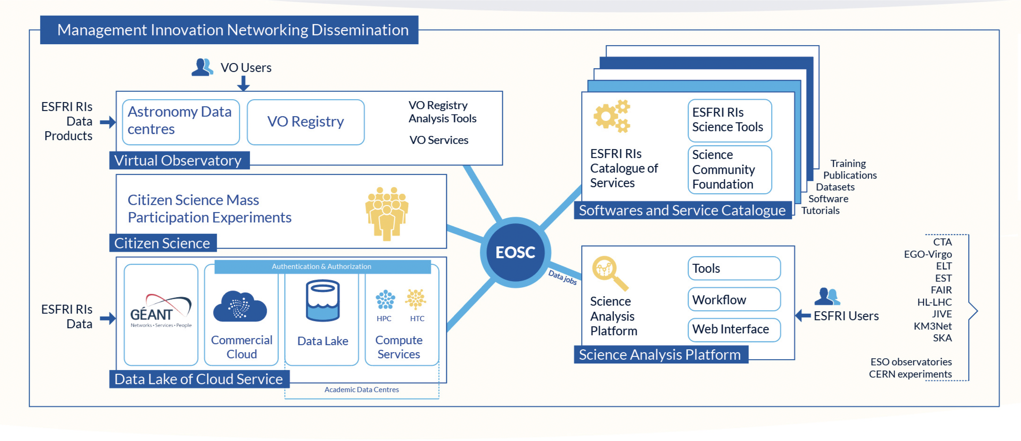
What ESCAPE will deliver to EOSC ?
ESCAPE is expected to deliver components of “a thematic cell” of the global EOSC.
Such a “cell” in Astronomy and Particle/Nuclear Physics will enable EOSC to adopt transversally some services and e-infrastructures that will be useful also in support of other “thematic cells”.
The added value of EOSC for our community is a “virtual research environment” upon the “cell” .
There, researchers can upload their analyses in a notebook-like, reproducible and shareable style; co-develop software; add mining to data and knowledge by running and improving workflows.
(-> this is the way most of ESCAPE ESFRI RI are considering…. )

Slide 7
WHICH MAIN ISSUES OR KEY MESSAGES SHOULD BE CONSIDERED BY BOTH THE EOSC EXECUTIVE & GOVERNING BOARDS?
The EOSC executive and governing boards aim at exploring and establishing the most pertinent and effective format for the EOSC implementation.
The bottom-up approach where the researchers are central in the implementation choices for the effectiveness of open-data-research through EOSC.
A cross-disciplinary approach is critical to guaranteeing that EOSC will be inclusive. The organization, orchestration and accessibility of underpinning heterogeneous e-infrastructures for data archive, access and analysis are important structural EOSC issues.
EOSC is more than e-infrastructures and not limited to a marketplace provision, but be a continuous evolving working space where researchers should routinely find out their daily dashboard for trusted data research and continuous networking opportunities.
The Science Cluster as a sustainable ecosystem as well as a successful approach for effectiveness and inclusiveness.
The EU is invited to facilitate Member States to guarantee core and sustained funding for the cluster role in EOSC.

Slide 8
Open Science vision
Open science has become a pillar of the current national and international views and political programmes of governments, research funding bodies, and forums.
There are three main ambitions for that:
Change the way citizens could perceive research and public investments for research.
Enable opportunities offered by the digital revolution to allow everybody to participate in the scientific process by accessing research data.
Accelerate the discoveries and increase scientific value by sharing data and by transferring knowledge within scientific communities.

Slide 9
ESCAPE Test Science Projects (TSP)
Yesterday discussions have demonstrated the need to adopt use cases to add cohesion among WPs.
A major Clusters’ mission: supporting initiatives to enhance the participation of researchers in EOSC.
To address these objectives, ESCAPE could leverage some Test Science Projects (TSP) federating more than a single ESFRI RI.
TSPs were originally conceived as validation bench of our prototypes. As per the original ESCAPE proposal (section 1.3, “Engage the community in EOSC”):
“… WP1 among other management, dissemination and networking activities, will bring all partners together to work on some ESCAPE Test Science Projects (E-TSP). They are scientific analysis projects that will produce original scientific results and publications. Such E-TSPs will correspond to some multi-messenger key-science objectives of the concerned ESFRI facilities. The partners will address them by fully exploiting the “ESCAPE-EOSC cell” services demonstrating the innovative impact of the open-science data analysis in the EOSC framework and promoting the application of FAIR principles for data stewardship.
Some of the potential E-TSPs currently proposed are:
- Multi-probe combined Dark Matter search with precursors’ archived data and simulated data of ESFRI facilities.
- Fast Radio Burst monitoring and analysis through multi facilities.
- Multi-wavelength and multi-domain follow-ups of future Gravitation Wave events…”
9

Slide 10
ESCAPE Test Science Projects (TSP)
Today it is relevant to leverage the TSP approach in order to federate collaborative actions among researchers, possibly transversal (e.g. experimentalist and theorists; astrophysicists, particle and nuclear physicists).
Aiming at increasing the involvement of the ESCAPE scientific community in the EOSC concept implementation.
This was the message shared at the recent JENAS workshop (https://indico.lal.in2p3.fr/event/5418/contributions/17542/) that has triggered discussions and supported initiatives to formulate proposal to the JENAS Expression of Interest call (such as the one on Dark Matter - https://indico.cern.ch/event/869195/).
This implies an anticipation of a Virtual Research Environment (prototype) implementation (and not such as an ultimate deliverable for the end of the ESCAPE).
Not to forget the “inclusiveness” of ESCAPE. It is a thematic Science Cluster and not only limited to the beneficiaries. ESCAPE opens up to other RI and to all researchers willing to participate (either in the WPs or in the TSPs).
10

Slide 11
Next in agenda…
What is next in today agenda?
Some examples in the next section.
Two more talks about “EOSC Architecture” and “FAIR data & policies”
Some more ideas and a round table discussion
11

Slide 12
Thank you !

