Slide 1
Work Package Six: «ECO» Engagement and Communication
Stephen Serjeant, Open University WP6 Lead
Rita Meneses, Trust-IT Services
Mathilde Hubert CNRs-LAPP
ESCAPE All-Hands Meeting, 27° February 2020

Slide 2
Vision
Task 6.1
ESCAPE science community
Mass Participation Experiments
Society at large
Task 6.2

Slide 3



WP6 - Engagement and Communication
“Task 6.1 Public Engagement and Communication”
T6.1 Leader
Timing: M1-M48
Lead: Trust-IT Services (28PM)
Partners Involved: CNRS-LAPP (12PM) & OU (2PM)
Deliverables:
  D6.1 – ESCAPE website live (June19)
  D6.2 – Dissemination & Exploitation Plan (Janry20)
  D6.3 – Brochure publication (June20)
Contributions requested for next 6 months:
  Blogposts from EOSC WG members that support objectives of ESCAPE
  Every 2 months, a WP updated about latest activities
  Pieces of news / Webinars of ESCAPE Services & Science projects
Supported by
Synchronyse our efforts of communication by liaising well with all WPs to ensure that a consistent message is carried out throughout the whole project timeframe

Slide 4







WP6 - Engagement and Communication
T6.1
Task 6.1 Public Engagement and Communication” goals
  Develop ESCAPE website & portal tailored to different stakeholders & the gateway for the catalogue of services
  Share with us relevant updates from your WP
Generate ESCAPE Communication Toolbox (PR, flyers, posters, videos, stands).
  To use at events at exhibitions when engaging with stakeholders
Support attendance at external high-level events and meetings.
  Get our support on online visibility through social media channels | Fill in the “excel” to track events’ presence.
Disseminate internally ESCAPE results, within the community and beyond.
  We are all ESCAPE’s ambassadors
Co-ordinate translation and adaption of resources for different national communities & compile master Classes and MPE online resources (EN, DE, ES, FR & IT)
Establish a dissemination and exploitation plan: KPI definition & monitoring: D6.2 – Dissemination & Exploitation Plan
Support ESCAPE final Event to showcase the final results of the ESCAPE project
Communication & Community User Engagement are continuous tasks, to engage directly with stakeholders with content rich insights

Slide 5
Timeline of activities done in M1-M12
Feb 2019 – Jan 2020
WP6
RDA Plenary - FI
ECFA-NuPECC
-ApPEC - FR
EOSC Symposium - HU
KoM Annecy
1st Press Release
EWAAS -FR
Building EOSC - BE
ADASS - NL
ESA/ESO SCIOPS - ES
Social Media networks
WP5 workshop on Science Platform design and requirements - NL
EOSC Jam Session -IT
Astronomical Data Archives Meeting - AU
New Section: organisation
Workshop: Data Infrastructure and Analysis Platform: defining architecture and implementation plan - NL
CHEP2019 - AU
IBERGRID - ES
Website live
Services branding
1st CS project
1 position statement
Branding, rollup & templates
Website revamp
Open Talks at Open University- UK
REINFORCE KoM - IT
Interviews
Flyer
2 posters
1 poster
M1
M3
M5
M6
M7
M8
M9
M10
M12
D6.1 – ESCAPE project website live
D6.2 - Dissemination and
exploitation plan
Communication & engagement activities in Y1, to support successful exploitation

Slide 6
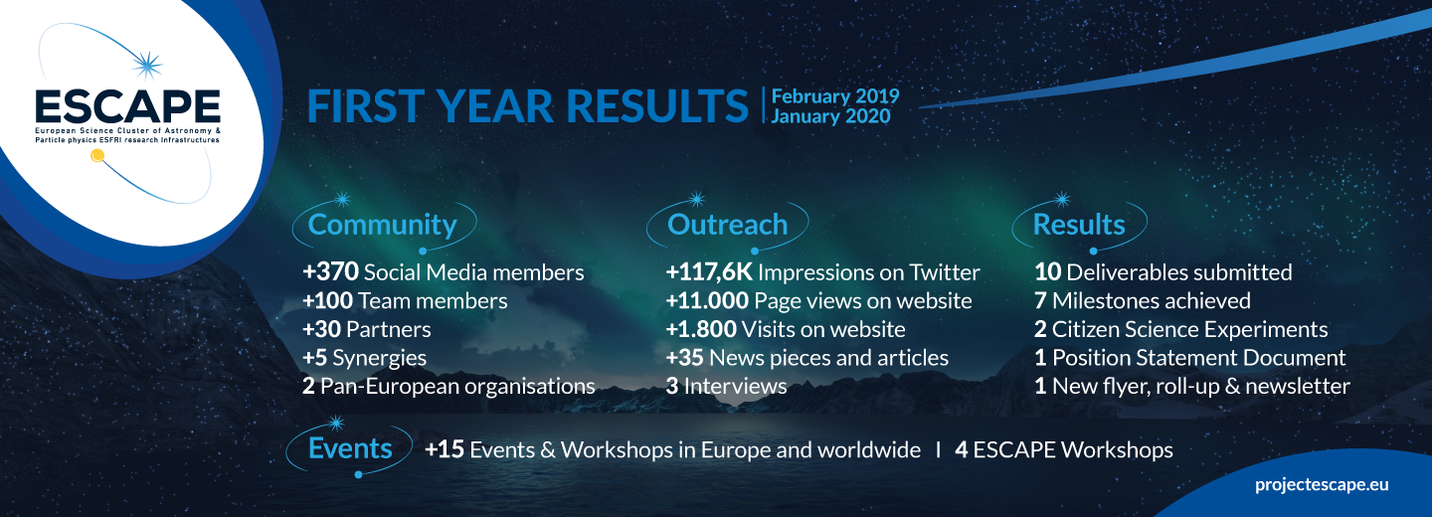
Activities & results (M1-M12) Synthesis
WP6
Initial community of +350, through regular communication & dissemination actions on social media, presence at third-party events and establishment of synergies

Slide 7




Communication Strategy in ESCAPE
WP6
YEAR 1
CREATE AWARENESS ABOUT ESCAPE
YEAR 2
SERVICE FEEDBACK & TESTING
YEAR 3
SERVICE PROMOTION & DEPLOYMENT IN EOSC
Services
Science Projects
W
H
A
T
Network stakeholders from different backgrounds
Outreach to distinct audiences & future end-users about ESCAPE future developments
Highlight real use-case scenarios between ESCAPE and Science Projects
W
H
Y
Promote interdisciplinary synergies to unlock potential for discovery, to support the implementation of EOSC thanks to open data management
Collect feedback & perform tests with future service users (science projects), to ensure service adoption & sustainability for the long-term. Contribute to EOSC discussions
Deliver the “Astronomy and Particle/Nuclear Physics EOSC cell”, following FAIR principles
HOW
Identify stakeholders & engage with them using adequate communication tools & channels. Create communication pieces to spread the word & raise awareness
Focus on the end-users & obtain testimonials from them
Workshops & schools, perform assessments, develop initial pilots and test science projects, publish stories from science projects to demonstrate service value propositions & engage directly with stakeholders.
Promote the ESCAPE EOSC cell across sectors, organise workshops for service final training, consolidate synergies with EOSC & leverage with international initiatives/player
Increase stakeholders’ engagement to stimulate adoption of ESCAPE results

Slide 8





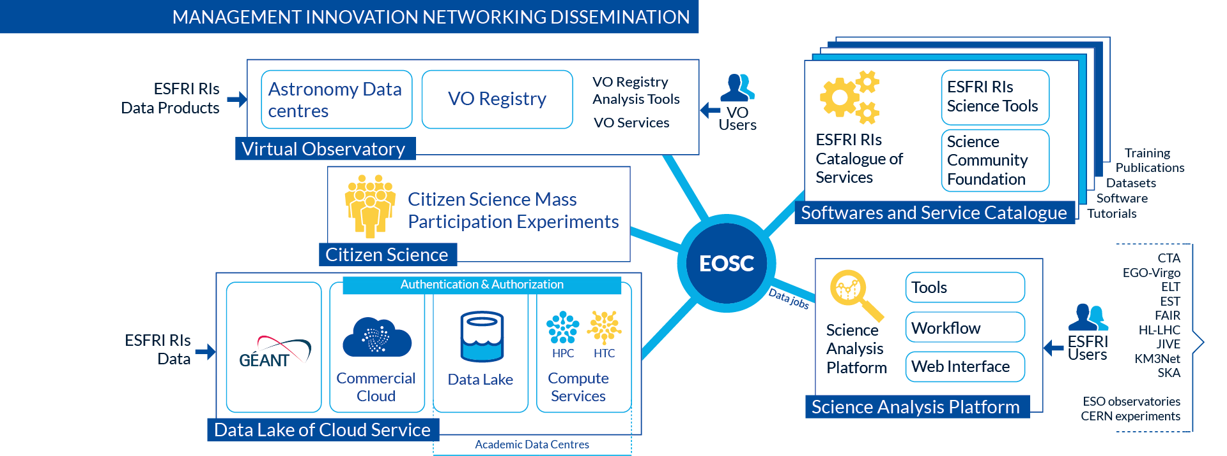

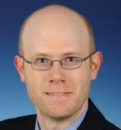
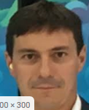
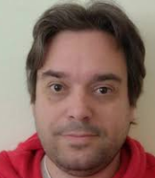
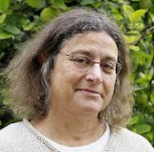



EOSC & ESCAPE Communication Strategy
T6.1
Source: ESCAPE Position Statement – “Integration in EOSC”
Leverages collaboration and integration of work from previous & ongoing frameworks, builds on and integrate existing work from a variety of areas, as well as uses the current state of the art solutions in the appropriate areas
Turn the software and service developed by the ESFRIs available to the scientific community via an the OSSR. A competence group for innovations will be formed to steer these developments
Map the VO framework to the EOSC so that the VO enabled archive services from ESFRI will be interoperable. Lead the connection to the EOSC with the ESFRI facilities to set the path for a new era of cross-disciplinary interoperability.
Make efficient use of the full performance potential of the HPC centres, by building upon existing EOSC-hub activities such as Federated High Throughput Computing, Scientific Workflow Management and Orchestration, and EOSC-hub AAI
A harmonised suite of Citizen Science experiments and online video material. The ESCAPE EOSC “cell” prototype will allow researchers to stage existing data collections for analysis including citizen science
ESCAPE in EOSC Working Groups
How ESCAPE is delivering the EOSC Cell
Cross-Cluster Real Science Projects (WiP)
Mark
Allan
Simone Campana
Tommaso Boccali
Francoise Genova
Build a Test Science Case where research & software developers can practice their requirements “to create an EOSC powered system” to test, validate their needs in an open access, open data and a virtual access environment for Federating in Science (crucial for EOSC environment).
Potential collaborations
Possibility to expand the collaboration with other clusters
Architecture WG
FAIR WG
FOLLOW-UP COMMUNICATION ACTIONS
Promote specific sections from Position Statement on social media
Short video animation describing ESCAPE Services or Science Projects in EOSC
News article about ESCAPE role in EOSC
Announce Mark Allen as champion part of FAIRsFAIR EGFC
ESCAPE indivuals part of EOSC WG members to provice blogpost on latest discussions and ESCAPE today / future contributions on the topic
UPCOMING DELIVERABLES
D4.2 Intermediate analysis report on use for IVOA standards for FAIR ESFRI and community data – M14
D4.4 Intermediate analysis report on integration of VO data and services into the EOSC – M18
Demonstrate “in Practice” how ESCAPE is supporting Open Science & EOSC implementation. Crucial to provide examples of «provide exemplars of cross-domain working and solutions that are applicable across domains.

Slide 9







Engagement with ESCAPE Stakeholders
T6.1
ESFRI projects
H2020 projects
EOSC Governance & Policy Bodies
Pan-European
Research Organisations
News articles presenting each ESCAPE service
1 Citizen Science programme (Clump Scout)
Social media messages & newsletter
Joint-stakeholder forum at ESOF 2020 with other initiatives
Member of FAIRsFAIR European Group of FAIR Champions
Social media messages & newsletter
- Delivery of Position Statement
Participation at EOSC events
ESCAPE members part of EOSC Working Groups & FAIRsFAIR European Group of FAIR Champions
Social media messages & newsletter
- Participation at events organised by CERN (Particple Physics community) and ESO (Astronomy) to present ESCAPE DIOS & ESCAPE VO services
- Joined the Dark Matter initiative
Proposal creation a cross-cluster real science project
Social Media Messages & newsletter
Scientists
Joint international workshops and cooperative projects such as JENAS 2019.
Social media messages & newsletter
NEXT ENGAGEMENT PRIORITIES
Increase engagement with e-Infrastructures & Industry
Synergise with more European research organisations
More active & continuous engagement with ESFRI clusters
Engagement with scientific, research, industrial & policy communities, to produce active end-users of ESCAPE results

Slide 10

Editorial Plan – What’s next?
T6.1
User-stories: ESCAPE services vs each Test Science Project (TSP)
  Interviews and/or news articles with testimonials
  Webinars to showcase first collaboration results from ESCAPE vs research infrastructures
  Max 30-second videos for each TSP
ESCAPE WPs updates: bi-monthly WPs updates on the website
  Each month to have 1 dedicated news piece from 3 ESCAPE WPs
ESCAPE Services: publish dedicated news of each ESCAPE service
  ESCAPE OSSR news article is online
ESCAPE & EOSC: ESCAPE contribution to EOSC
  Video
  Blogposts from members part of the EOSC WGs.
  News articles about ESCAPE in FAIRsFAIR EGFC
Deliverables: concise news piece about the
purpose, results, end-user benefits and conclusion
Others: presence at 3rd party events & ESCAPE workshops
Testimonials from end-users from the science projects
Ensure both ESCAPE’s website & social media channels require continuous & timely dissemination of each WP developments, to effective engagement with each stakeholder group

Slide 11







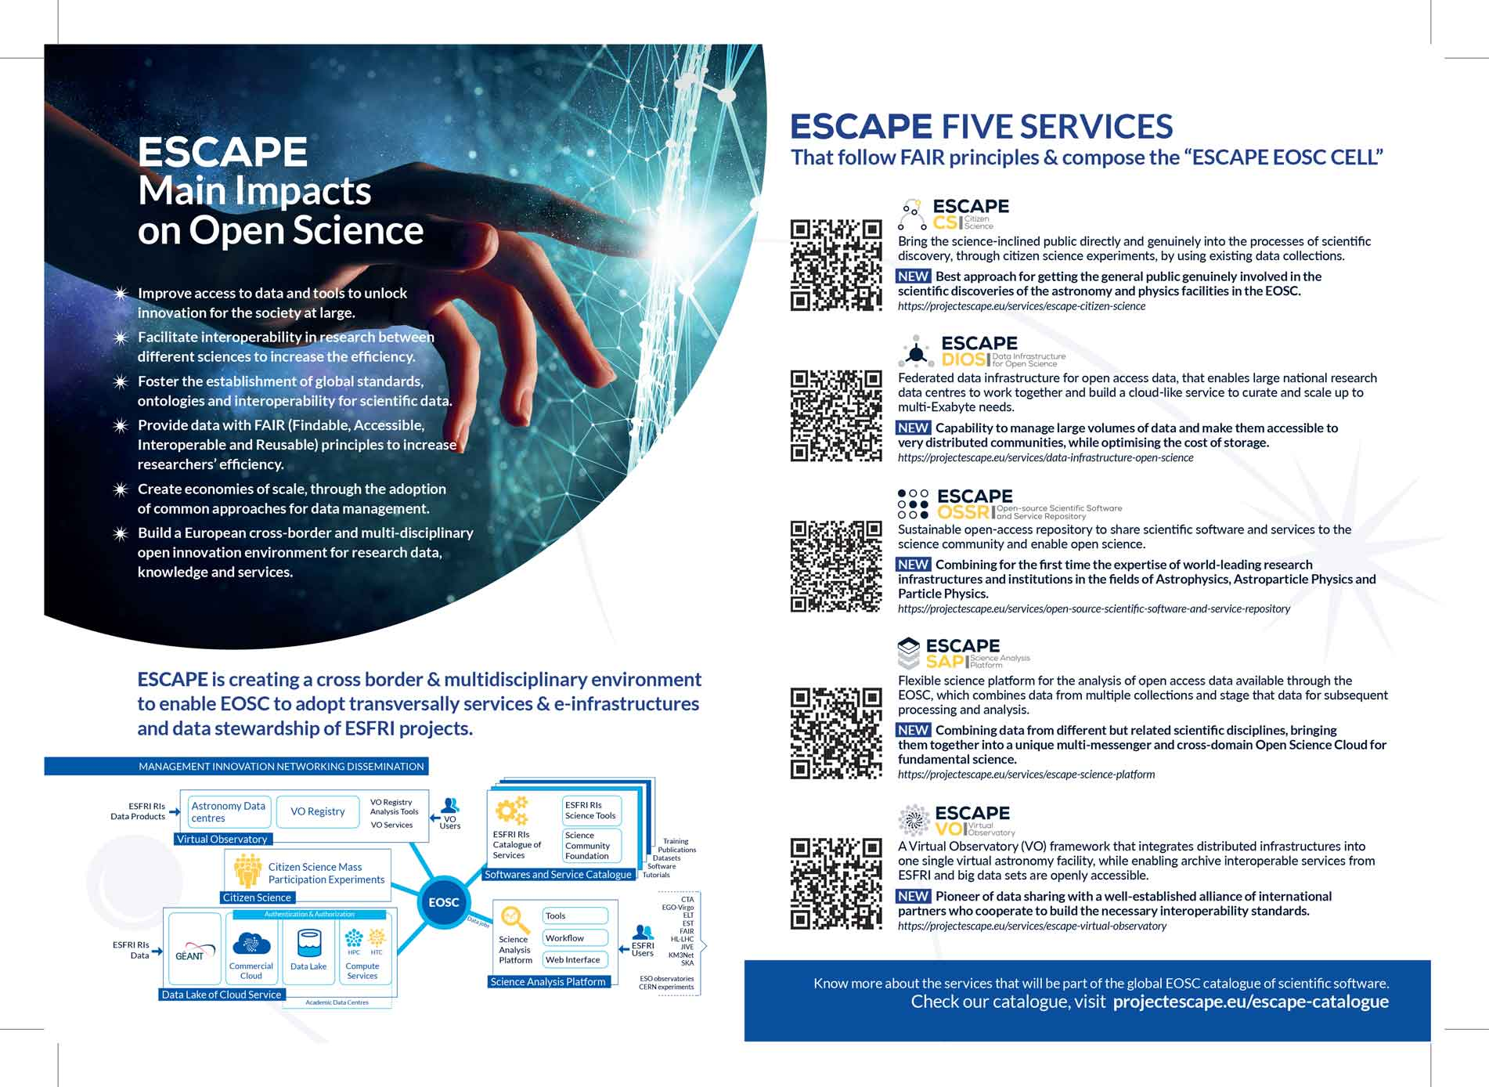
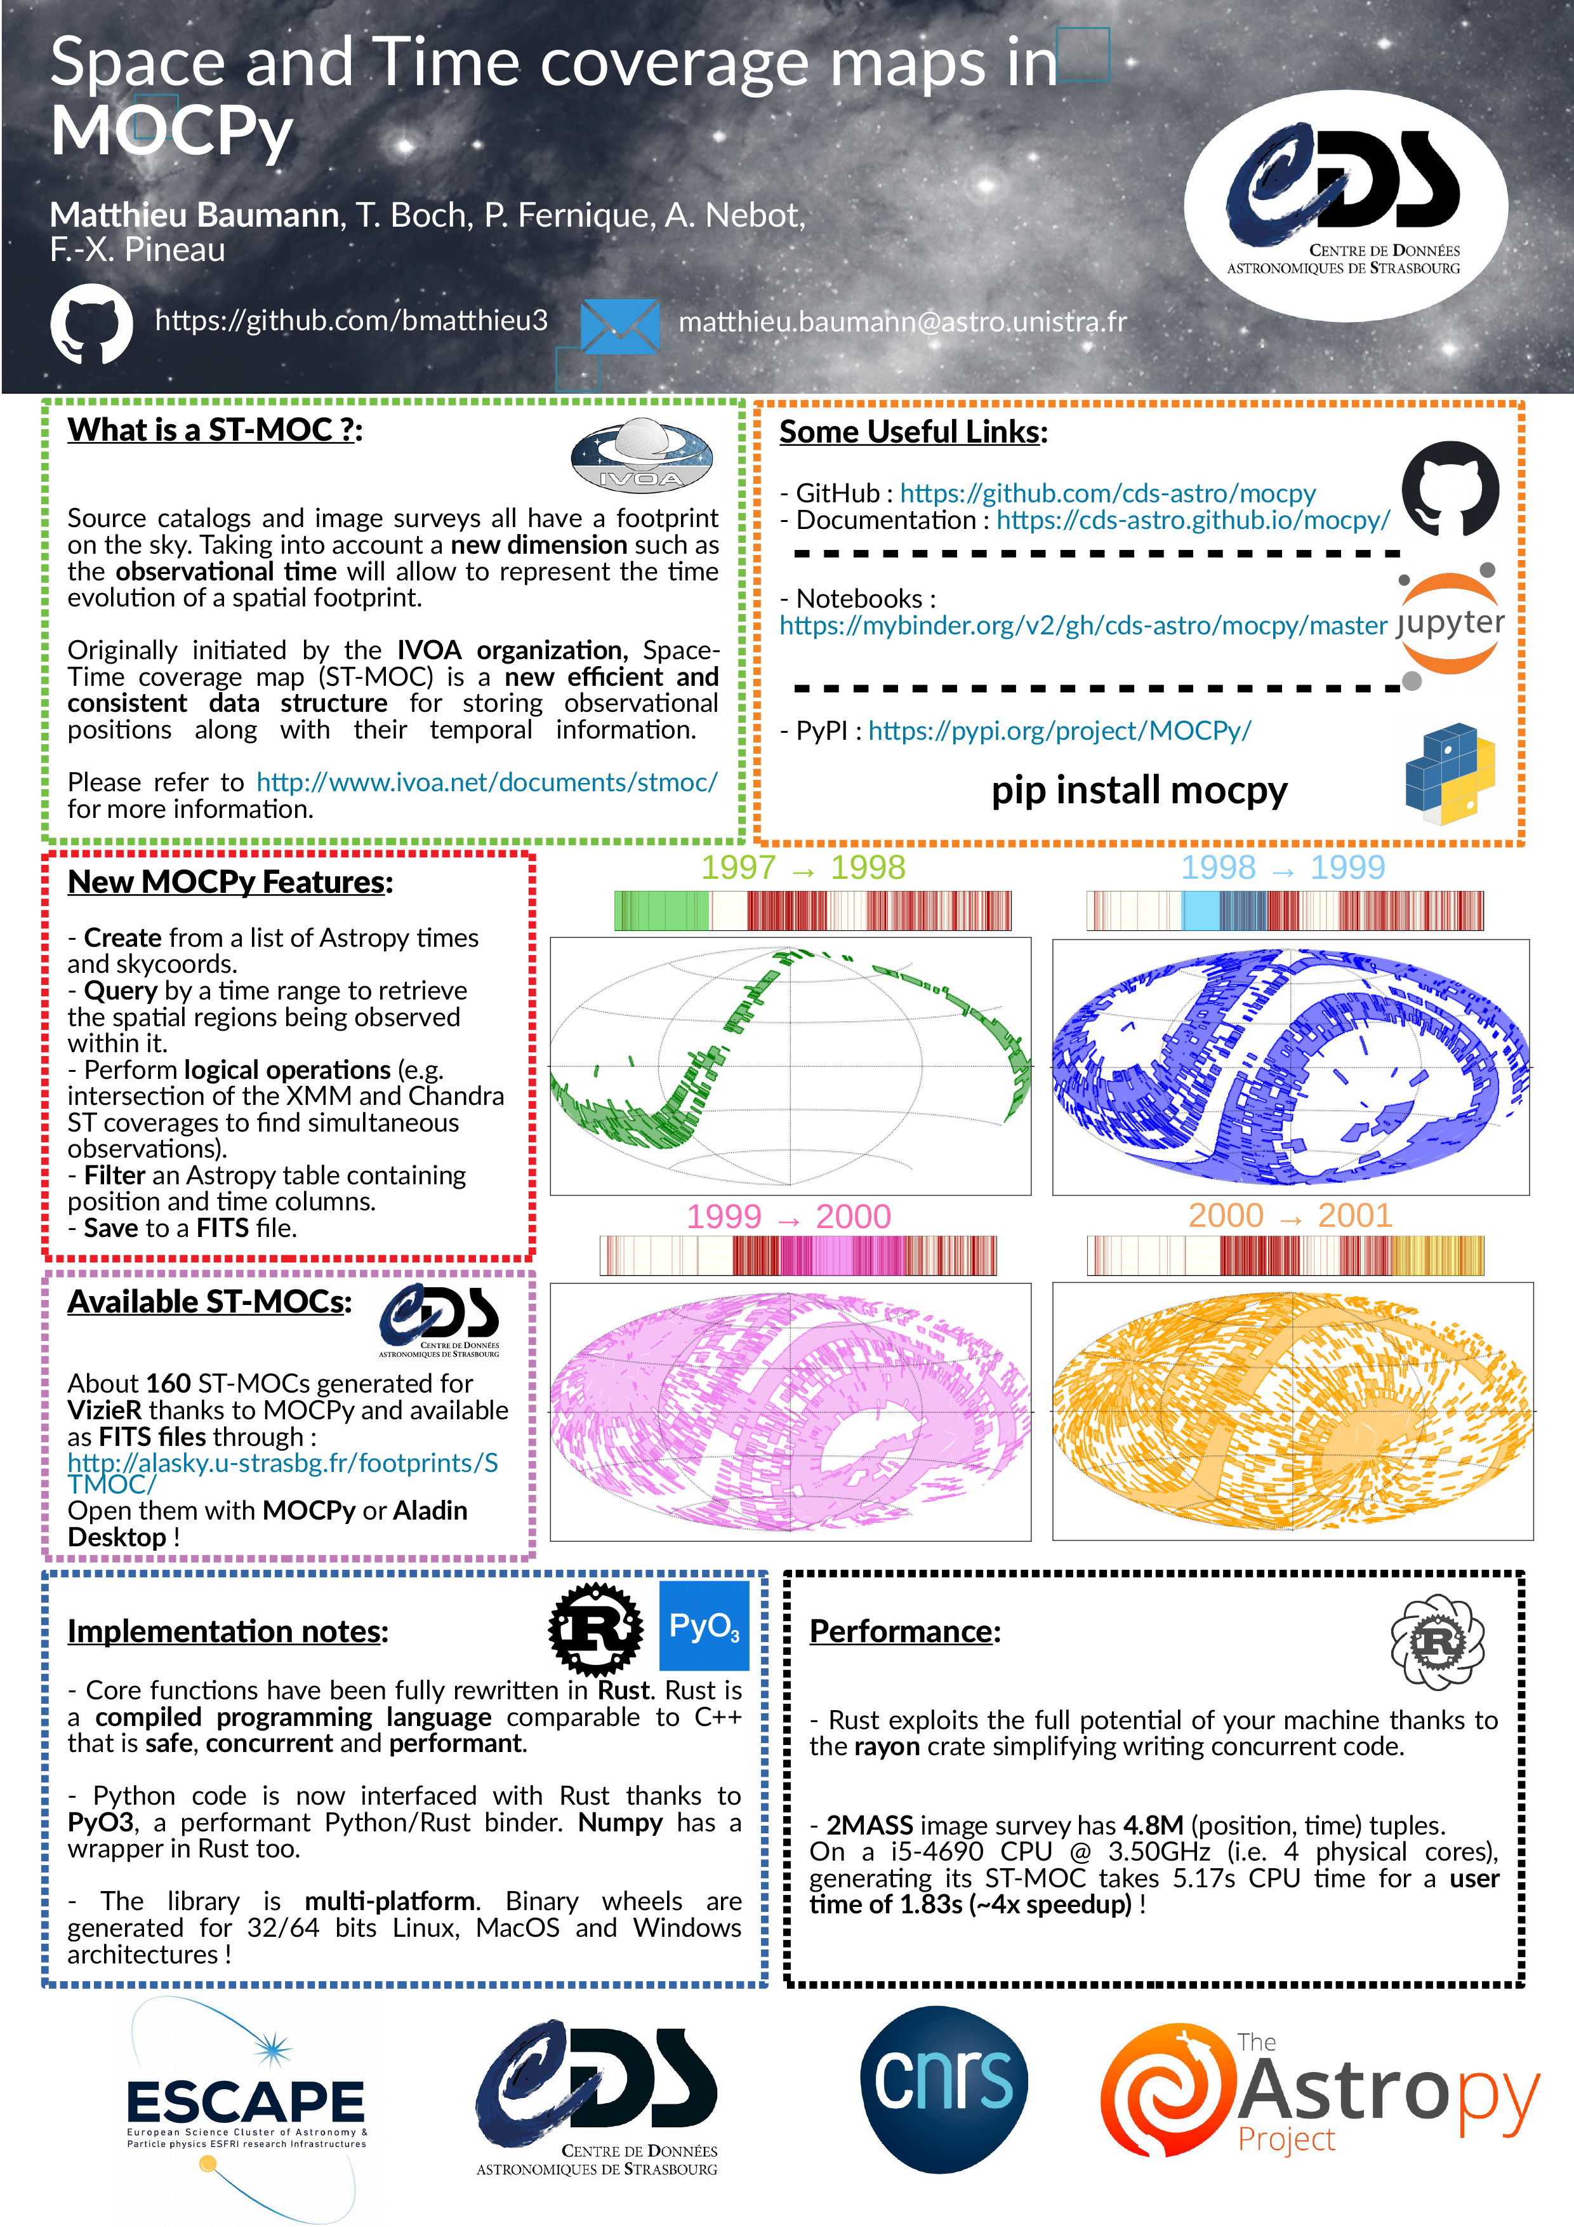


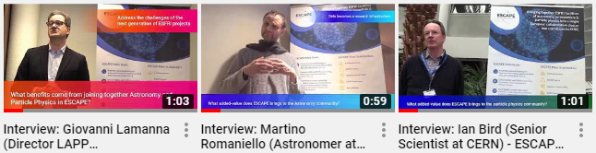
Branding & Comm material
T6.1
PRINTED MATERIALS
Available in the Comm-kit area of the website
DIGITAL MATERIALS
FLYERS
PRESS RELEASE
PROJECT LOGO & PPT / WORD TEMPLATES
Flyers
5 SERVICE LOGOS (+ 2 REBRANDED)
Flyer 1
D6.3 completed in M5
Flyer 2 – M13
Press Release – M1
Rebranded logos by M13
INFOGRAPHICS & SOCIAL MEDIA IMAGES
POSTERS
ROLLUP BANNERS
By M12 & M13
VIDEOS
Poster 1, Poster 2 – ADASS Conference, M9
Poster 3 –EOSC Symposium M10
Rollup Banners:
M1 & M13
3 Videos – Month 4, Other Videos to be produced
Communication Channels & Materials to set the basis for stakeholders’ engagement

Slide 12


Website Evolution
T6.1
Website 1° Version – M5
New URL: projectescape.eu
New sections:
  Services, Science Projects, News, Events, Deliverables and Presentations, About us,
  Access Internal Tools for Partners;
Website 2° Version – M8
UPDATES SINCE WEBSITE LAUNCH
Included Newsletter subscription form
New website search box
Revamped sections: Comm-Kit, Citizen Science Page and Organisation Section
  Waiting for WP1 & WP4 info for the website
Submission of “D6.1 – ESCAPE Website live” by M8
RESULTS BY JANUARY 2020
Nº Visitors → 2.351
Page Views → 13.910 (Jan 2020)
The exploitation plan after ESCAPE conclusion?
Online catalogue of ESCAPE services
What else?
Website continuous improvements to better disseminate ESCAPE’s results

Slide 13
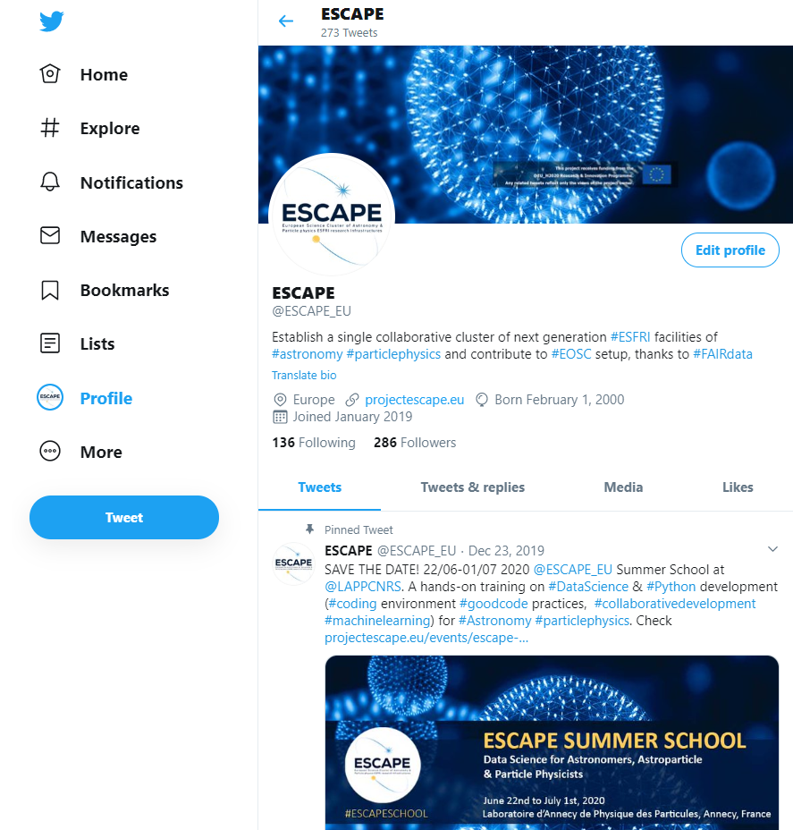

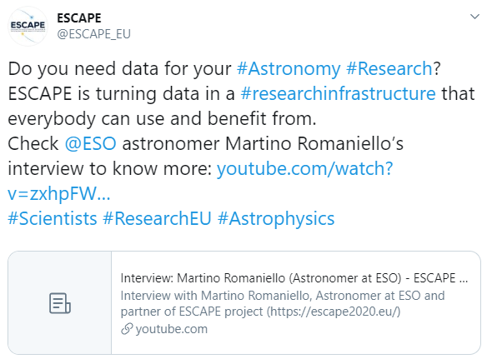
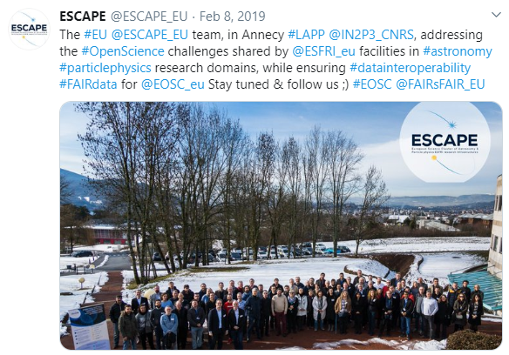

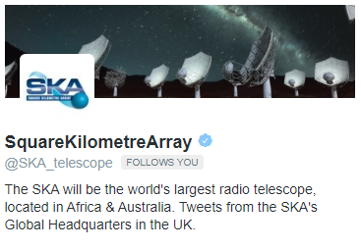


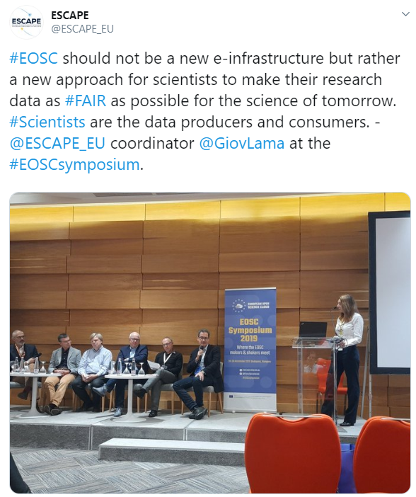
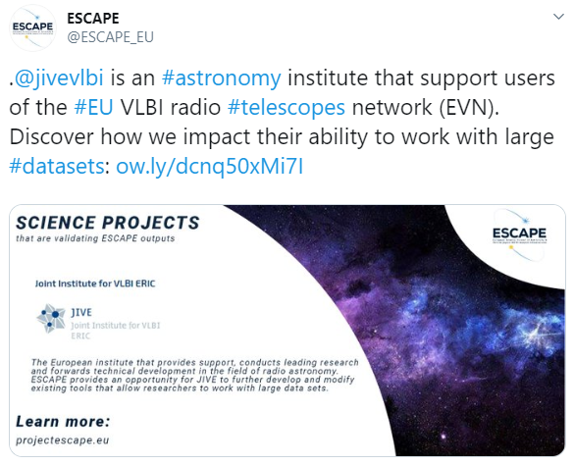
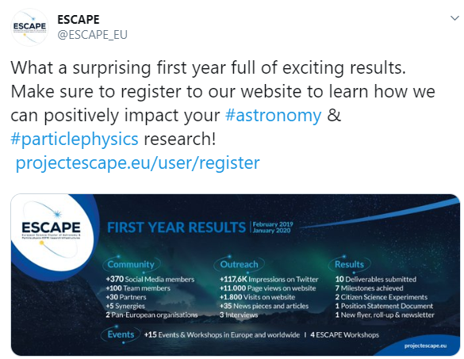


Twitter Community
KPI: 700 tweets by the End of the Project
Content rich Tweets attractive messaging
Twitter
ESCAPE Outputs
ESCAPE Live Tweeting
ESCAPE Events
+270 Tweets
+285 Followers
+125.000 Impressions
8.803 Impressions
7.477 Impressions
2.796 Impressions
KPI: 420 followers by the End of the Project
Multipliers/influencers that count
10.500 followers
ESCAPE Third
part Events
Science Projects
ESCAPE Infographic made in-house
21.200 followers
10.300 followers
2.231 Impressions
868 Impressions
245
Impressions
7.293 followers
2.161 followers
Engaging the right communities as multiplier for dissemination. For next months, the social media channels will benefit from project updates available online
Live-tweeting events

Slide 14

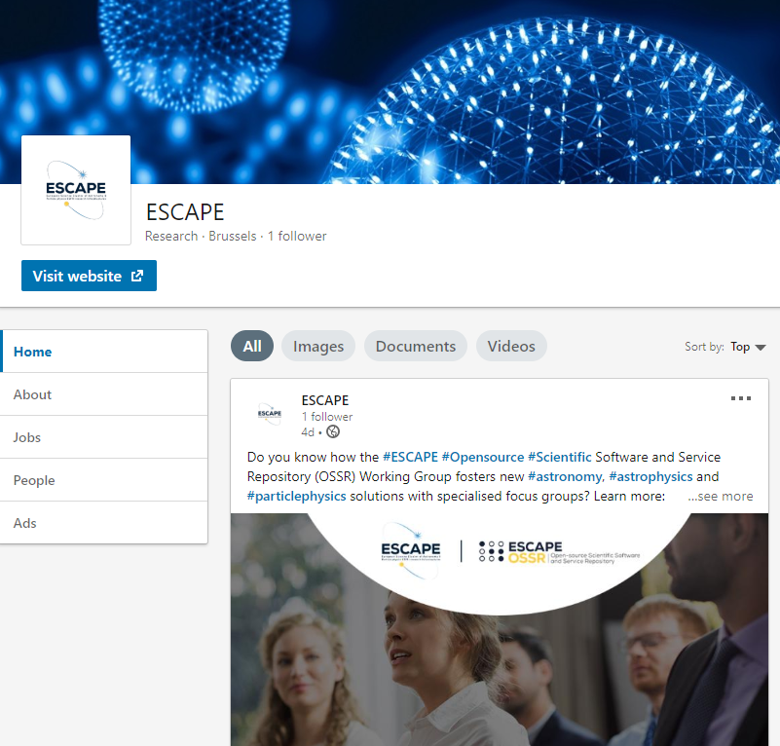
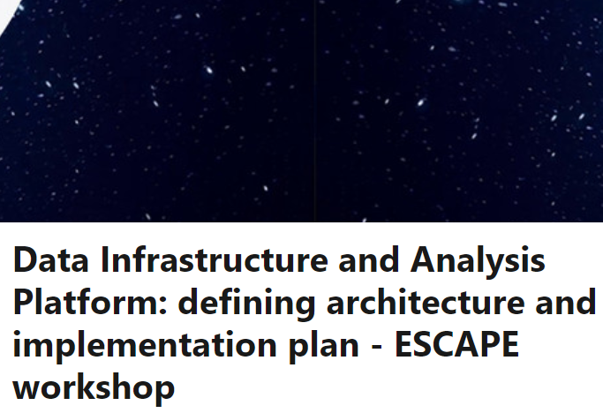

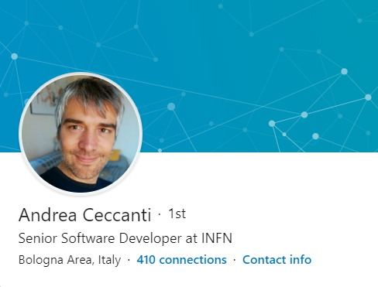
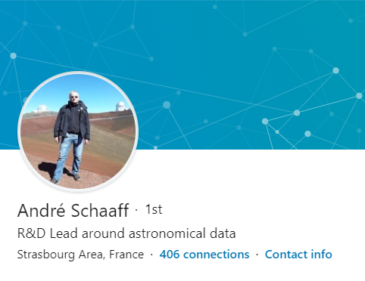
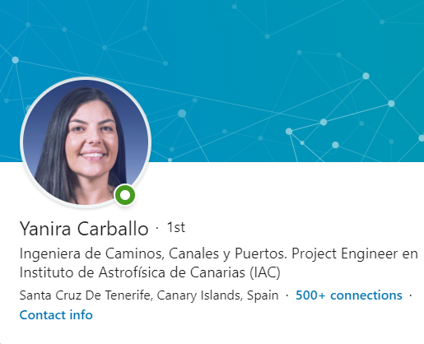


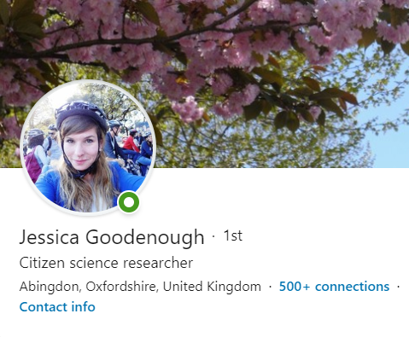
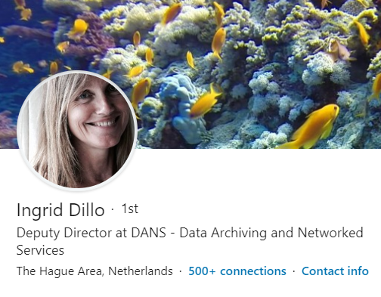
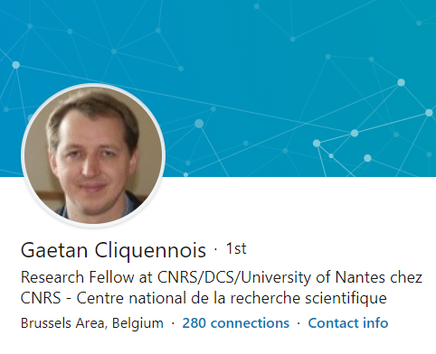

LinkedIn Community
Content rich Posts & Articles
LinkedIn
ESCAPE Events
ESCAPE Services
88 members
7 LinkedIn posts
130 Posts Views
KPI: 85 LinkedIn followers End of Project
Connections with exponential outreach audience
ESCAPE at 3rd party events
ESCAPE Jobs
Software Dev
Astronomy
Astrophysics
+400 connections
+400 connections
+500 connections
Citizen Science
Data
Research
ESCAPE Activities
+500 connections
+500 connections
+270 connections
Follow the New Linkedin Page: https://www.linkedin.com/company/projectescape
Getting attention from an engaged community thanks to a more interactive page
Live-tweeting events

Slide 15




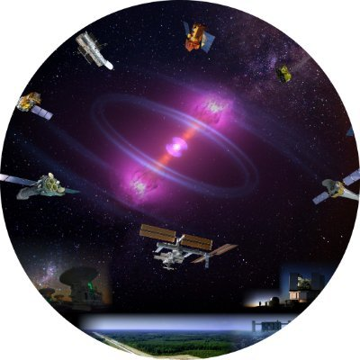




Visibility at events
T6.1
Astronomy, astroparticle, particle & nuclear physics events
Joint ECFA-NuPECC-ApPEC Data Archives
24th Conference
on Computing
in High-Energy
& Nuclear Physics
ESA/ESO SCIOPS workshop
Astronomical Data Archives
IBERGRID
2nd IVOA - ADASS
June 2019
Lyon, France
August 2019
Sydney, Autralia
September 2019
Compostela, Spain
October 2019
Groningen, The Netherlands
October 2019
Orsay, France
November 2019
Adelaide, Australia
November
Madrid, Spain
Astrophysicists
Astronomers & Data Managers
Software developers, data managers & computing professionals
Astronomers Data Analysis & Software Systems
Data science and astroparticle physics professionals
Computing professionals from High Energy and Nuclear Physics.
ESA and ESO communities concerned with “cross-facility coordination in the multi-messenger era”
EOSC related events
Other events
ESFRI RIs
& EOSC Workshop
Building EOSC through the H2020 projects
EOSC Services, Collaborations
& the RDA
EOSC Symposium
Open talks at Open University
Reinforce kick-off meeting
November 2018
Austria
January 2019
London,UK
June 2019
Turin, Italie
September 2019
Brussels, Belgium
October 2019
Helsinki, Finland
November 2019
September 2019
Online event
December 2019
Pisa, Italy
Research Communities
& Policy Makers
ESFRI & EOSC stakeholders
EOSC & Clusters projects
EOSC related projects
EOSC & Research Data Communities
EOSC Communities, Research, Industries, Policy Makers
Students
& general public
Academia
& citizen science professionals
Total of 15 events, reaching different stakeholders

Slide 16

ESCAPE events organised during Y1
16-17 April 2019, Groningen (The Netherlands)
WP5 WORKSHOP
ON SCIENCE PLATFORM DESIGN & REQUIREMENTS
Goal: ESFRI Use Case Requirements workshop
Topic: ESFRI Science platform design
Audience: ESFRI Partners, UEDIN, DESY and JIVE
Result: D5.1 Preliminary report on requirements for ESFRI
science analysis use cases
1-3 July 2019, Amsterdam (The Netherlands)
DATA INFRASTRUCTURE
& ANALYSIS PLATFORM: ARCHITECTURE
& IMPLEMENTATION PLAN
Goal: incorporate feedback from the scientific projects
Topics: a Data Infrastructure for Open Science & a Scientific Analysis Platform for the participating ESFRI projects
Audience: ESCAPE consortium, GEANT & EGI representatives
Result: define the ESCAPE Data Lake Cloud Service
Collecting feedback from end-users about services, that will support the service adoption after end of the project

Slide 17












Synergies with relevant initiatives
T6.1
EOSC Clusters Projects
Other H2020 projects
Meeting every 3 months, to join forces
For 2020, discussing Joint Stakeholder Forum at ESOF 2020
Chair of Advisory Board
Dissemination of CS iniatives
Develop collaborative storage service to researcher communities.
EOSC Governance & FAIR Data
Astronomy, Astro Particle & Particle Physics
Presence at events
Delivery of Position Statement
Participation at events
Member of European Group of FAIR Champions
Discussing the organisation of joint events & seminars
Cooperation on Dark Matter initiative with a prototype science analysis platform from ESCAPE
Joint webinar?
Research Infrastructures
What other organisations are relevant to synergise with?
Validation ESCAPE services in real usage scenarios
Establishment of Strategic partnerships and synergies, with reputable initiatives,
that can help further increase uptake, user adoption & long-term exploitation

Slide 18
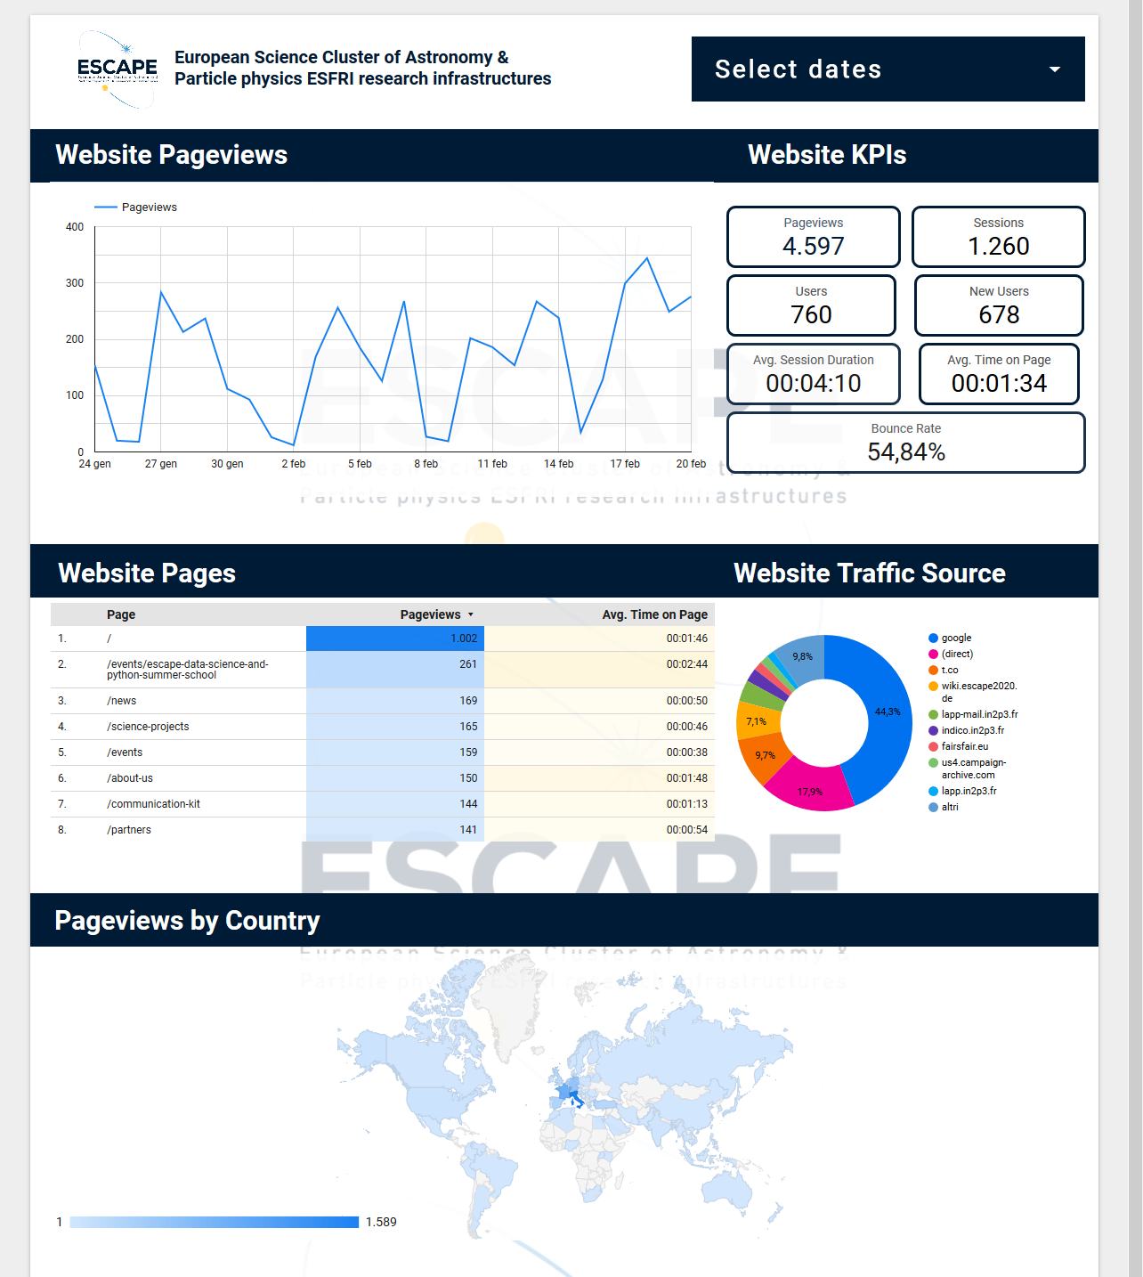
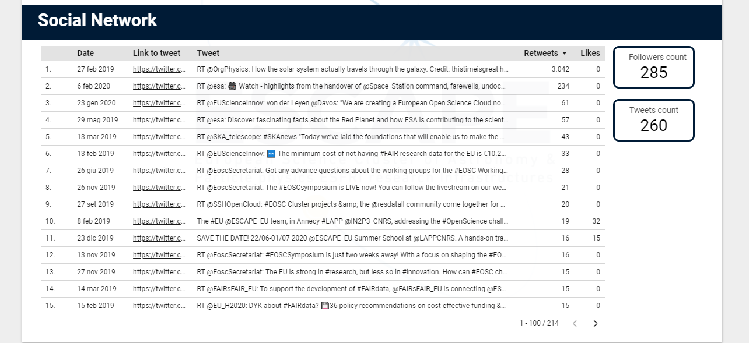
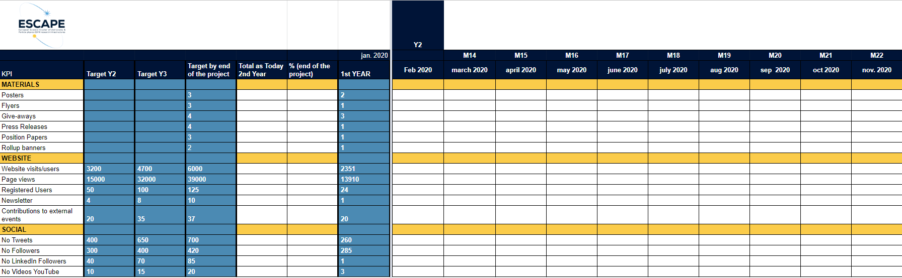
Impact Monitoring
Website & Social Media Dashboard
T6.1
KPIs
Regular pursuit of objectives will lead to the achievement of expected results on all KPIs

Slide 19


Deliverables, Milestones & KPIs
WP6
Milestones
KPIs
Milestone Number | Milestone Title | Due Date (in months)
MS36 | First Citizen Science Workshop | 18
MS37 | Second Citizen Science Workshop | 20
Type of material | Created by | KPIs M42 (End of project)
Posters | 3 | 3
Flyers | 2 | 3
Give-aways | 3 | 4
Press Releases | 1 | 4
Position Papers | 1 | 3
Rollup Banner | 2 | 2
Videos | 3 | 20
Subject | Created by | KPIs M42 (End of project)
Website visitors | 2.351 | 6.000
Page Views | 13.910 | 39.000
Registered Users | 24 | 125
Tweets Number | 260 | 700
Twitter Followers | 285 | 425
LinkedIn Community | 88 | 85
YouTube Videos | 3 | 20
Newsletter | 1 | 10
Contributions to external events/year | 20 | 37
Deliverables
Deliverable | WP | Month
D6.1 | WP6 | 5
D6.2 | WP6 | 12
Having a join effort from all partners will ensure the achievement of KPIs

Slide 20
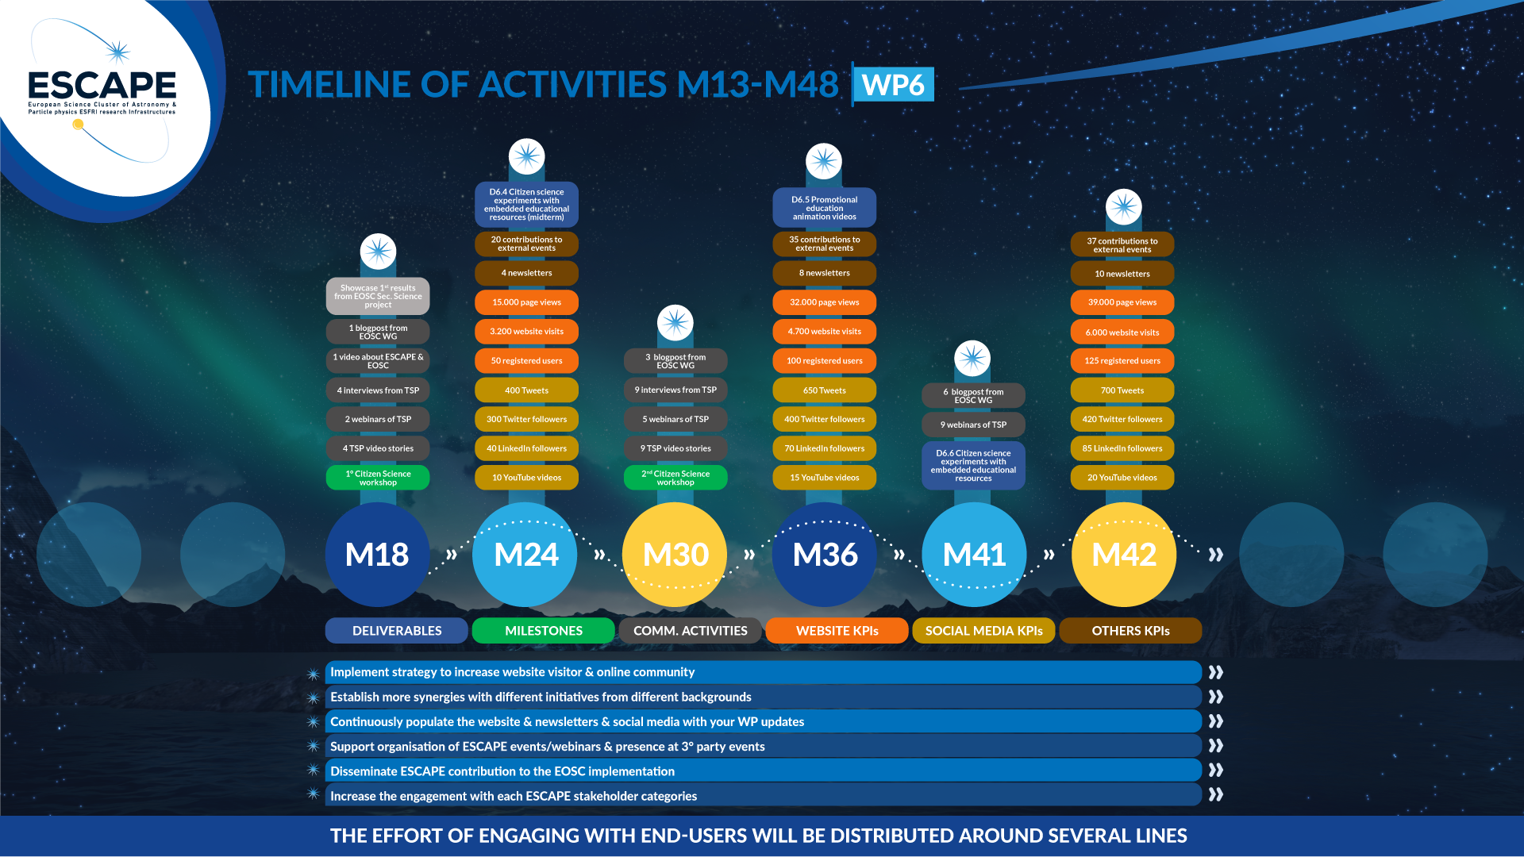

Slide 21
Communication Strategy in ESCAPE
T6.1
Year one:
  Website
  Newsletter
  Branded materials
  Chat Server: https://chat.escape2020.de/home
  Document Repository: https://cloud.escape2020.de/
  Project Management: https://project.escape2020.de/
  Event Organiser Tool: https://indico.in2p3.fr/
Approach for next years:
  Coordinated social media (pre-)promotion for events attended by ESCAPE
  Press releases & translation activities

Slide 22
Communication Strategy in ESCAPE
T6.1
Monthly interviews on the results for each WP - showcase their results as aprt of the WP6 actiivty & spotlight them
Video animations on what ESCAPE intends to do

Slide 23

Communication Strategy in ESCAPE
T6.1
Monthly interviews on the results for each WP - showcase their results as aprt of the WP6 actiivty & spotlight them
Video animations on what ESCAPE intends to do

Slide 24
Activities & results (M1-M12) Synthesis
T6.1
Create an infographic that sums up what’s been done in the past year

Slide 25
Branding & Communications material
T6.1
2 posters:
  Poster 1 https://projectescape.eu/sites/default/files/ESCAPE_Poster_Feb_2020.pdf
  Poster 2 https://projectescape.eu/sites/default/files/POSTER%20P2-1_Molinaro.pdf
1 flyer: https://projectescape.eu/sites/default/files/ESCAPE_Flyer_21x21_Feb_2020.pdf
1 rollup banner:
https://projectescape.eu/sites/default/files/Rollup_January2019_2_v2.3_0.pdf
3 video interviews:
  Video 1: https://www.youtube.com/watch?v=tEpVIjVY-T0
  Video 2: https://www.youtube.com/watch?v=zxhpFWnW1JU
  VIdeo 3: https://www.youtube.com/watch?v=2b3jjg8ArZU
1 position paper:
https://www.projectescape.eu/sites/default/files/Escape_position_statement_web.pdf
1 press release: https://www.projectescape.eu/communication-kit/eu-particle-physics-astronomy-commit-research-data-revolution-making-european-open
3 giveaways: pens, notepads and bags with ESCAPE branding
2 banners and programs:
  https://indico.in2p3.fr/event/20306/
  https://indico.in2p3.fr/event/20203/

Slide 26

Website Evolution
T6.1

Slide 27
Website Evolution
T6.1
Compilation of services, products and assets completed: https://docs.google.com/spreadsheets/d/1gRjH7Ca_QVNdHv1HQHP2_WSZUXA2oNTh_B2tGBVdX8w/edit#gid=0
Located a new image that is less exclusively astrophysics
Amended the white ESCAPE logo on a black background
Chnged "Signals", "Events" and "Images" (i.e. data-based approach) to Astrophysics and Particle Physics (i.e. application-based approach)
Replaced 'About' menu item with Partners
Removed Helpdesk menu item
Generalised the "Training events" to simply Events
New domain bought: www.projectescape.eu, superseding the shortly-out-of-date escape2020.eu
"User friendly navigation experience" check

Slide 28

Website Evolution
T6.1
.

Slide 29
Events
T6.1
Date, Location | Event | Target Audience | Type of participation
21-22 Nov 2018 Vienna (Austria) | EOSCpilot Stakeholder Forum | Research Organisations, Academic Institutions and Research, Libraries, E-infrastructures, H2020 projects, Enterprise, General Public, Government Agencies, Research Funding Bodies, Research Infrastructures, Research, Communities, Scientific Associations, Service Providers, European policy and decision makers | Presentation at Plenary Session 2: A community- empowered EOSC
30 Jan 2019 London (UK) | ESFRI RIs and EOSC Workshop | ESFRI, ESFRI RIs and EOSC stakeholders | Presentation at plenary session
6-7 Jun 2019 Turin (Italy) | EOSC Jam Session | EOSC projects and EOSC ESFRI Cluster projects. | Attended as an observer & contributed to discussions
24-28 Jun 2019 Lyon (France) | EWAAS - European Week of Astronomy and Space Science | Astrophysicists from all over Europe and beyond | Presentation about ESCAPE
5-8 August 2019 Sydney (Australia) | Astronomical Data Archives Meeting 2019 | Astronomers & data managers | Presentation about ESCAPE
12 Sep 2019 Online event (UK) | Open Talks at Open University | University students & general public | Presentation about ESCAPE
24 Sep 2019 Compostela (Spain) | IBERGRID 2019 | Software developers, data managers & computing professionals | Presentation about ESCAPE
6-10 Oct 2019 Groningen (The Netherlands) | 2nd IVOA - ADASS Astronomical Data Analysis Software and Systems | Astronomical Data Analysis and Software Systems | ESCAPE posters (Abstract 1 | Abstract 2 | Poster 1)
9-10 Sep 2019 Brussels (The Netherlands) | Building EOSC through the H2020 projects current status and future directions | EOSC-related projects | Showcase project roll-up banner and flyer were distributed
14-16 Oct 2019 Orsay (France) | Joint ECFA-NuPECC-ApPEC Seminar | Data science and astroparticle physics professionals
21 Oct 2019 Helsinki (Finland) | EOSC Services, Collaborations, and the RDA | EOSC and Research Data Communities | ESCAPE presentation
4-8 Nov 2019 Adelaide (Australia) | 24th International Conference on Computing in High-Energy and Nuclear Physics | Computing professionals from High Energy and Nuclear Physics. | ESCAPE presentation
19-22 Nov 2019 Madrid (Spain) | ESA/ESO SCIOPS workshop 2019 | ESA and ESO communities concerned with “cross-facility coordination in the multi-messenger era”. | 2 ESCAPE presentations
26-28 Nov 2019 Budapest (Hungary) | EOSC Symposium | EOSC community, Research & Academic institution, Research Communities, Business organisations, EU eInfrastructures, Research Infrastructures, policy makers, funding agencies, industry, HPC centers, SDOs, citizen scientists, publishers, Data service providers. | Poster presentation
8-9 Dec 2019 Pisa (Italy) | REINFORCE kick-off meeting | Academia and citizen science professionals | ESCAPE Citizen Science Presentation

Slide 30
International Synergies
T6.1
With whom? | To which purpose? | How?
EOSC Secretariat | To develop an EOSC as a large infrastructure to support and develop open science and open innovation in Europe and beyond, ESCAPE engages with the EOSC Secretariat | Release of an ESCAPE Position Statement
APPEC, NuPPEC, ECFA, ASTRONET & ESA | With a view on exploring synergies in research and organisation | Organizing seminars or events
2020 REINFORCE project | To create citizen science experiments, and some of these experiments also happen to have links to ESFRIs (KM3NeT, CERN, EGO/VIRGO) | ESCAPE funded role in REINFORCE is to chair the Advisory Board, to seek added value from collaborations and avoid duplications
Other clusters, (ENVRI-FAIR, PaNOSC, SSHOC, EOSC-Life) & FAIRsFAIR | Adopt common solutions for an even larger economy of scale as well as the roles of a federation of clusters in support of the EOSC effective governance. | Meetings on 3-month basis, to share best practices in communication and dissemination, create synergies, join forces. This process was begun during the Research Data Alliance Plenary Meeting in Helsinki (21 October 2019). At that meeting, SSHOC invited representatives from ESFRI cluster projects, the EOSC, as well as the RDA Working and Interest Groups, to discussions on collaborations & commonalities. The aspiration is to engage more widely at ESOF 2020, and to form a Joint Stakeholder Forum
FAIRsFAIR | Explore synergies on cross-cluster work on FAIR data principles and practices via the dissemination and stakeholder engagement | ESCAPE successfully nominated Dr Mark Allen as a representative for the FAIRsFAIR EGFC call
CS3MESH | The CS3MESH project aims to provide a collaborative storage service to researchers, research institutions and universities and to deliver the initial and coherent implementation of the long-term CS3 collaborative infrastructure. | ESCAPE and CS3MESH will work together to these objectives.

Slide 31
Social media Channels
T6.1
3 channels were created to build ESCAPE community and draw attention to the project and its outcomes, achievements and updates:
  Twitter: https://twitter.com/ESCAPE_EU | 281 followers & 256 twees
  LinkedIn: https://www.linkedin.com/company/projectescape | 88 followers
  Youtube: https://www.youtube.com/channel/UC05braEQdP2rCSUamHm9I_Q/featured | 104 views | 2 subscribers
In order to keep followers informed, to reinforce their commitment or to draw attention to an event in real time, live tweets were organized on several occasions:
  Building Open Science in Europe: The road ahead for the EOSC community, Tallinn - June 2019
  RDA Plenary Meeting, Helsinki - October 2019,
  EOSC Symposium, Budapest - November 2020,
  WP4 Technology Forum, Strasbourg

Slide 32
Events
T6.1
Describe here the ESCAPE ones & the external ones (third party, trtainig ) -
How do we maximise our exposure here ?
Do I manage to indicate the return by attending the events?

Slide 33
ESCAPE Community Profile Database
T6.1
.

Slide 34
Impact Monitoring – KPIs
T6.1
Dashboard
Kpi excel tracker

Slide 35
Deliverables, Milestones, KPIs M1-M12
WP6
(trust-it to fill in those from T6.1)

Slide 36
Timeline of activities M13-M24
WP6
Include list of priorities below the timeline

Slide 37
Task 6.2: Citizen Science
D6.6: Citizen Science experiments & education
Branding & Identity
KoM Annecy
Recruit ML/CS PDRA
D6.4: Citizen Science experiments & education
D6.5: Promotional videos
Final Event
M0
M1
M5
M24
M36
M41
M48
Two hands-on workshops to generate projects for D6.4 and D6.6
e-eco@escape2020.eu

Slide 38
Task 6.2: Citizen Science
Enormously ahead of M24 deliverable schedule
Once crowdsourcing experiment already launched: Galaxy Zoo: Clump Scout
  Backend for accelerating volunteer classifications
  Future applications to ESCAPE ESFRI LSST / VRO
Second crowdsourcing experiment currently in beta-phase, being tested by experienced volunteers: Radio Galaxy Zoo: LOFAR
  Future applications to ESCAPE ESFRI SKA
1st ESCAPE citizen science workshop in Jun/Jul 2020
STOP PRESS:
LAUNCHED TUE 25 FEB

Slide 39
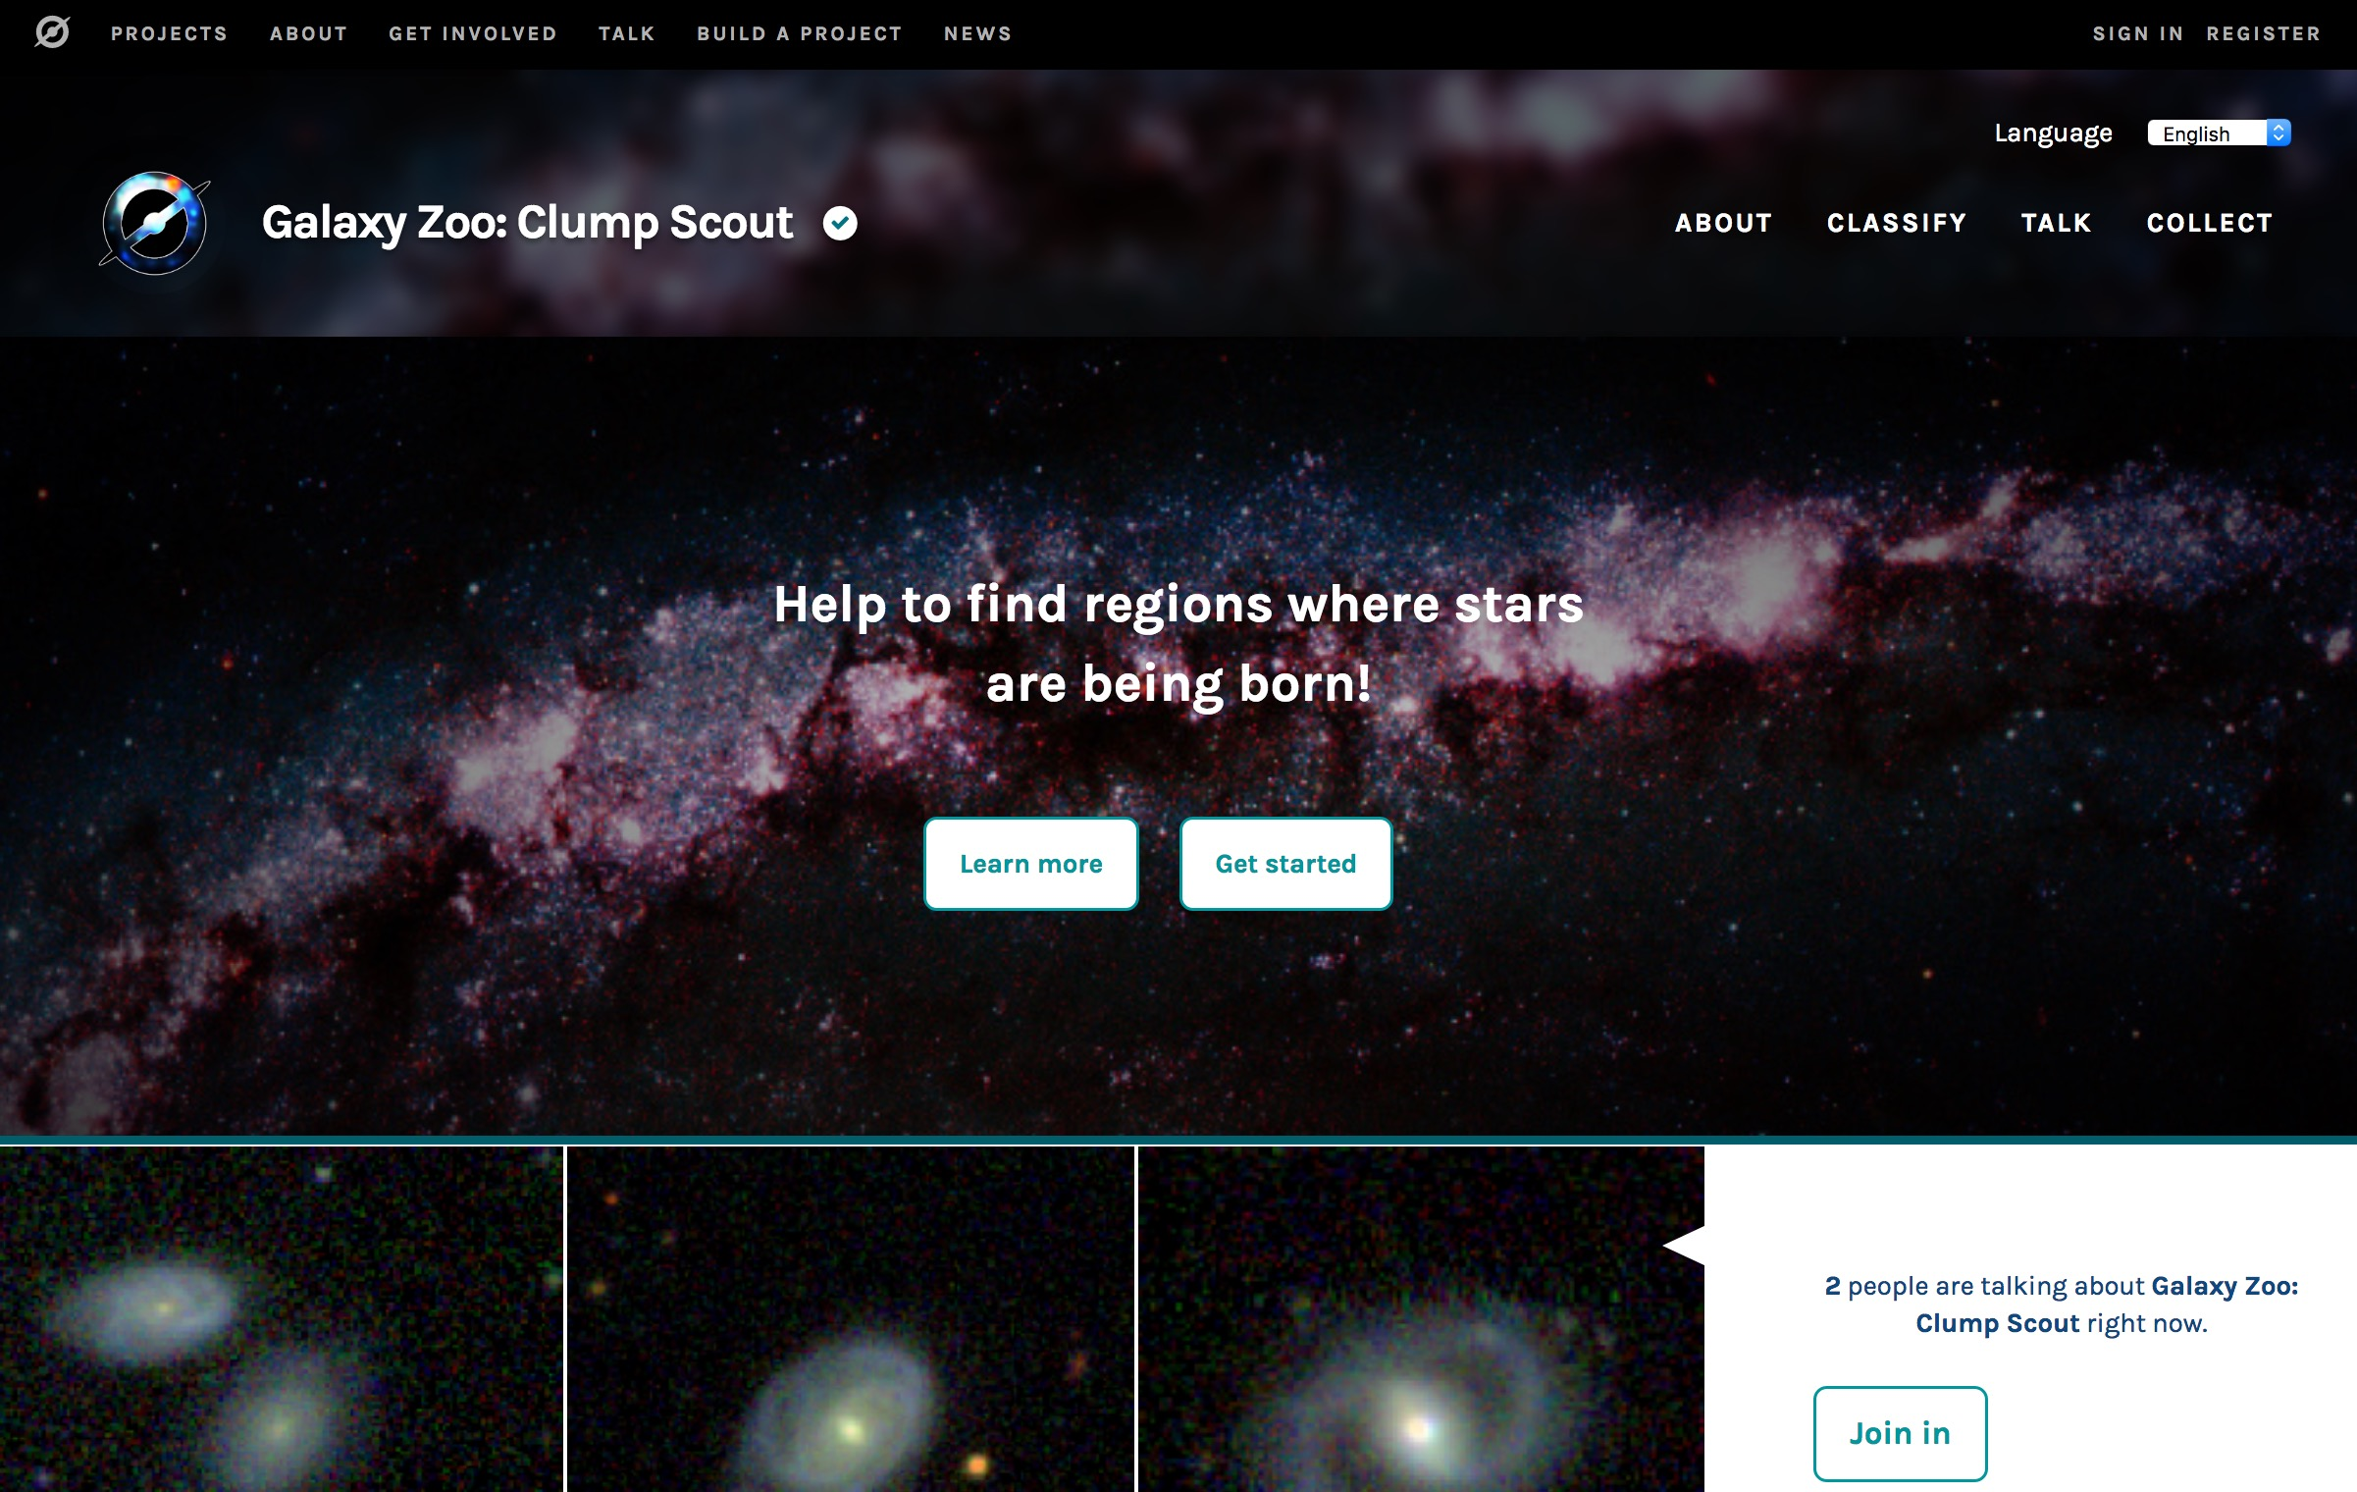

Slide 40
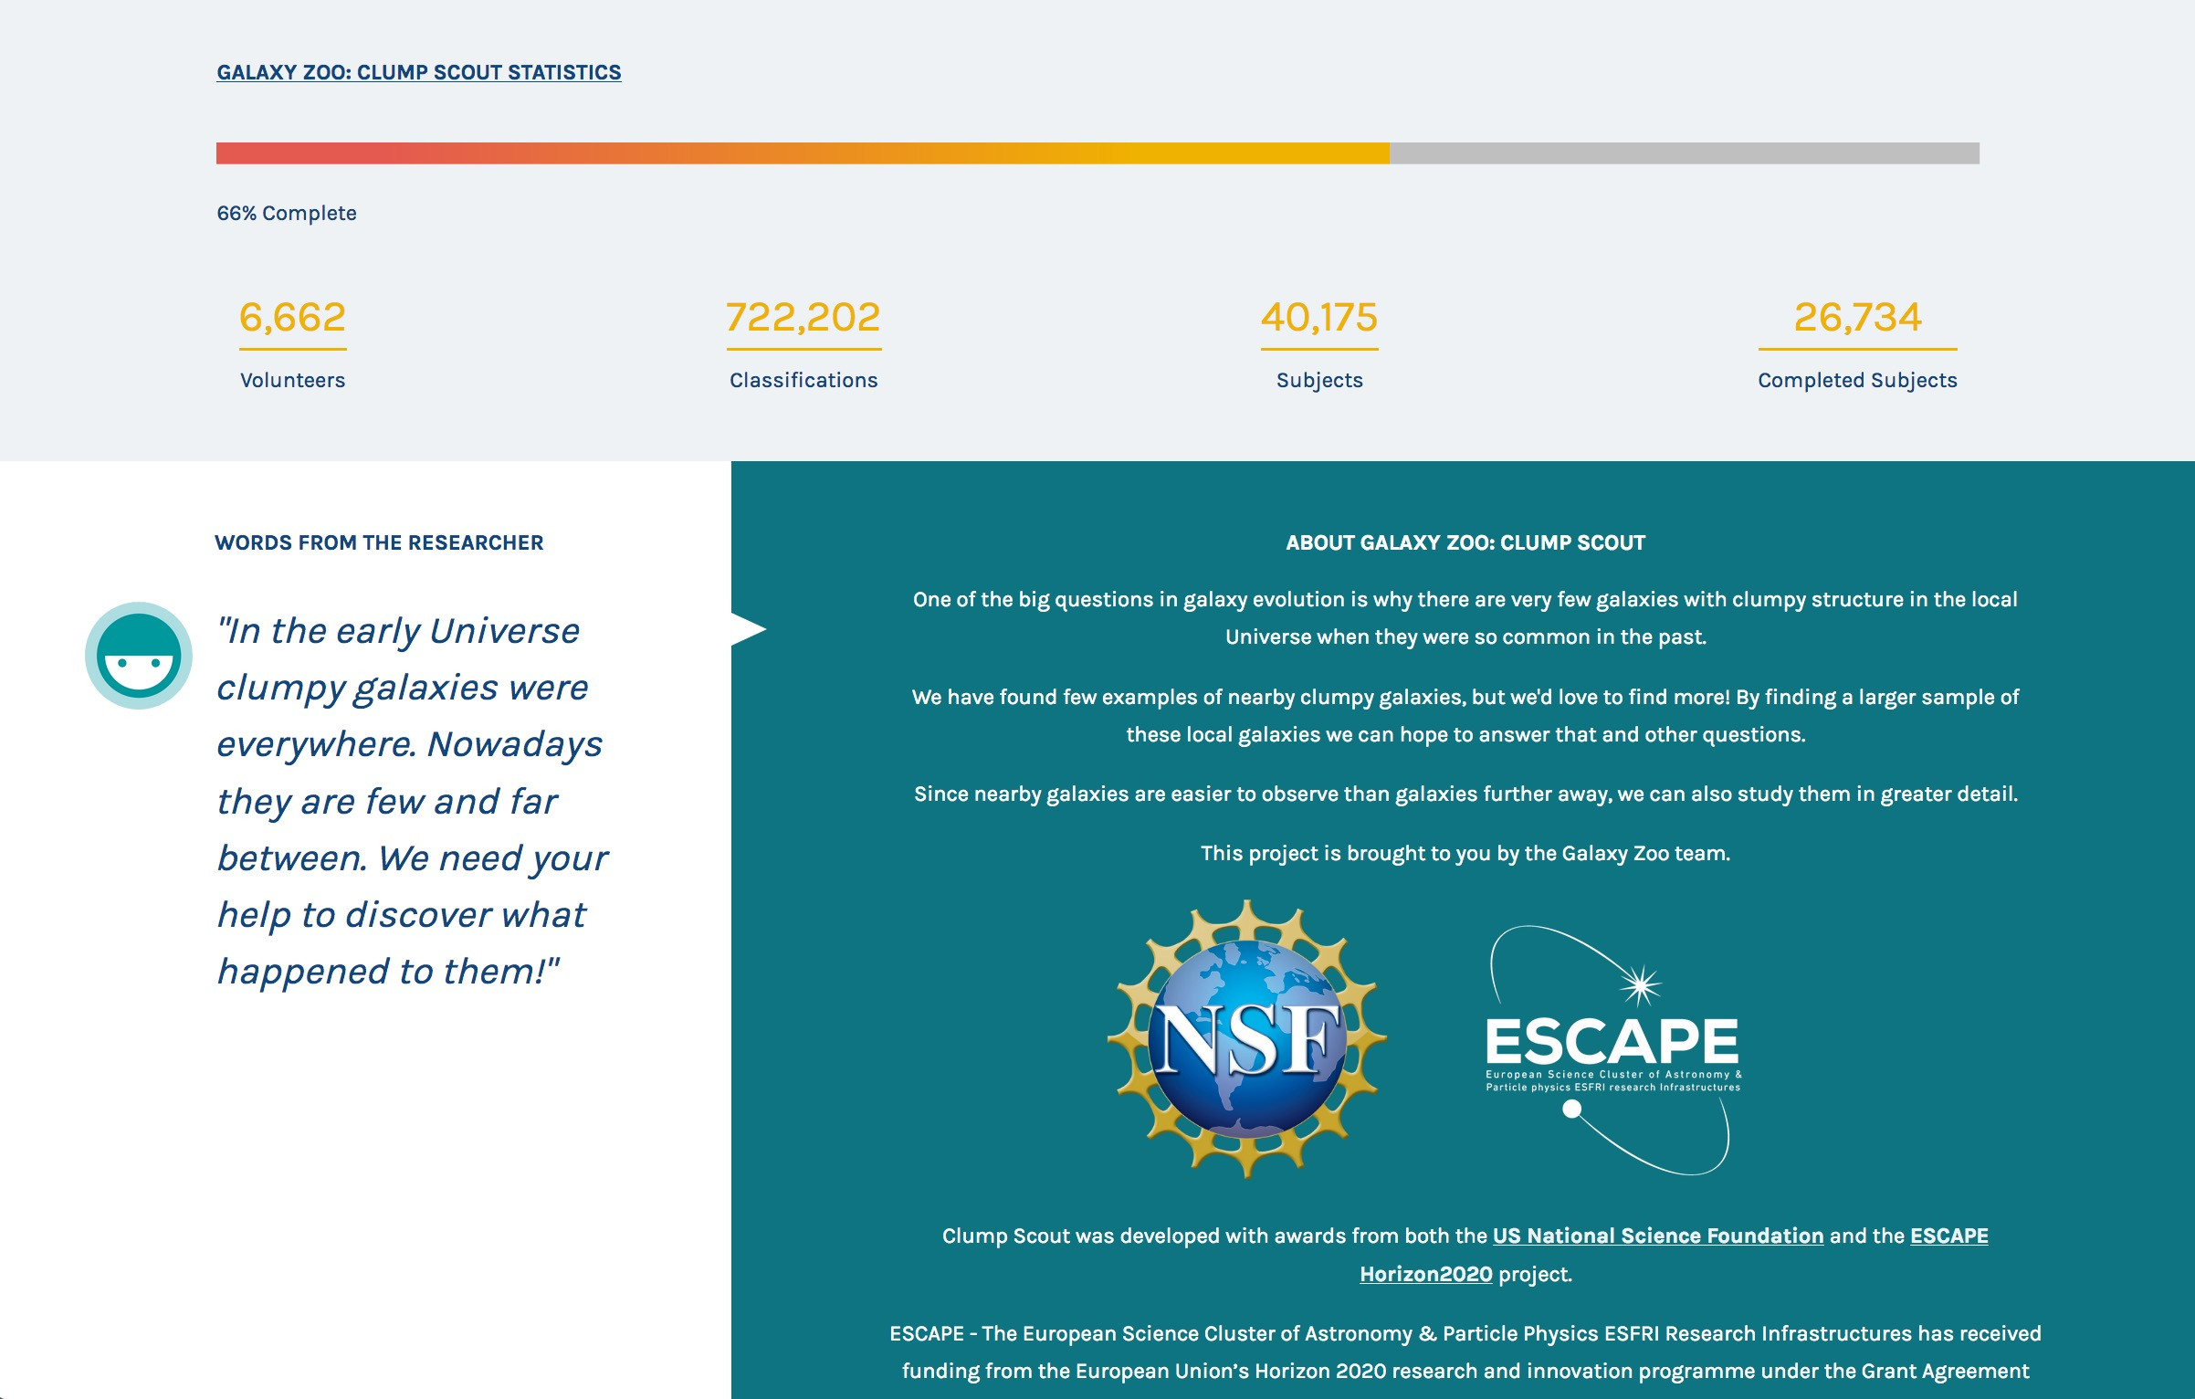

Slide 41
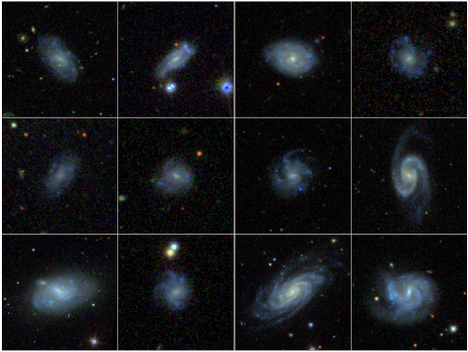

Slide 42
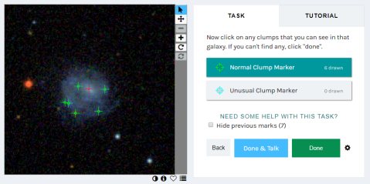

Slide 43
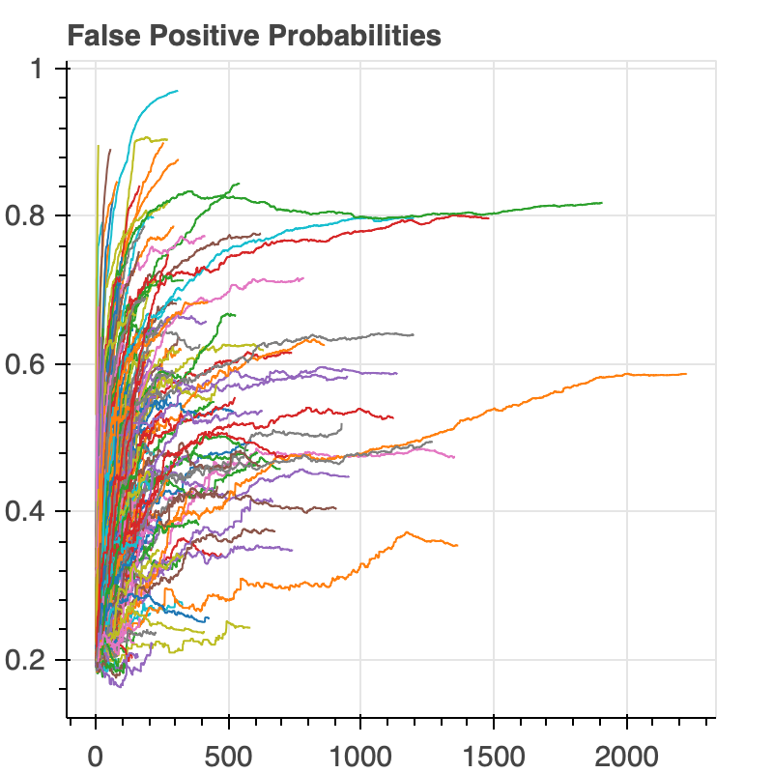
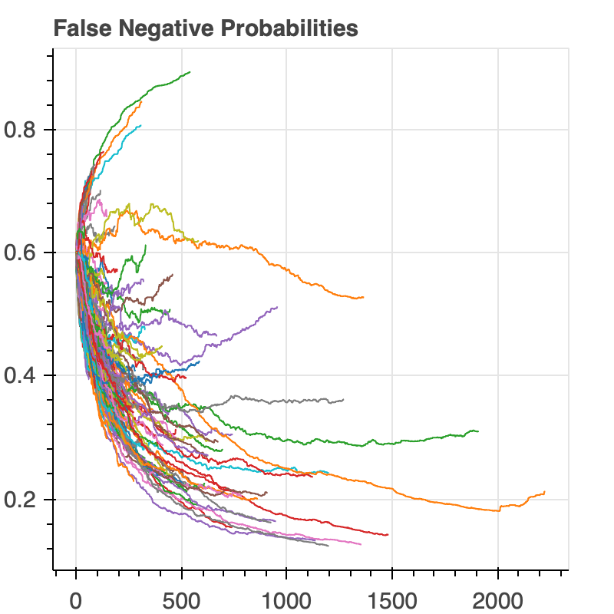
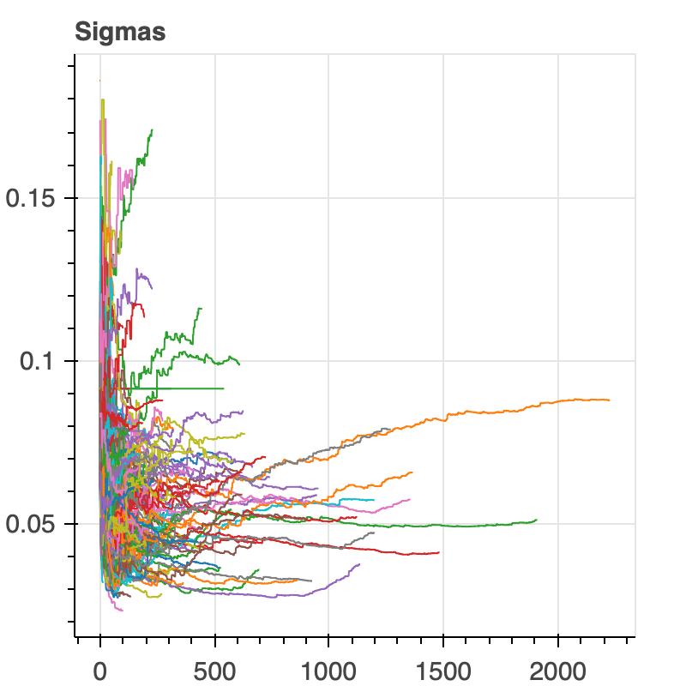
CLUMP SCOUT
zooniverse.org/projects/hughdickinson/galaxy-zoo-clump-scout
Dynamic statistical model for classification process.
Quantitative reliability metric.
Accelerated aggregation and improved efficiency.
More accurate consensus.

Slide 44
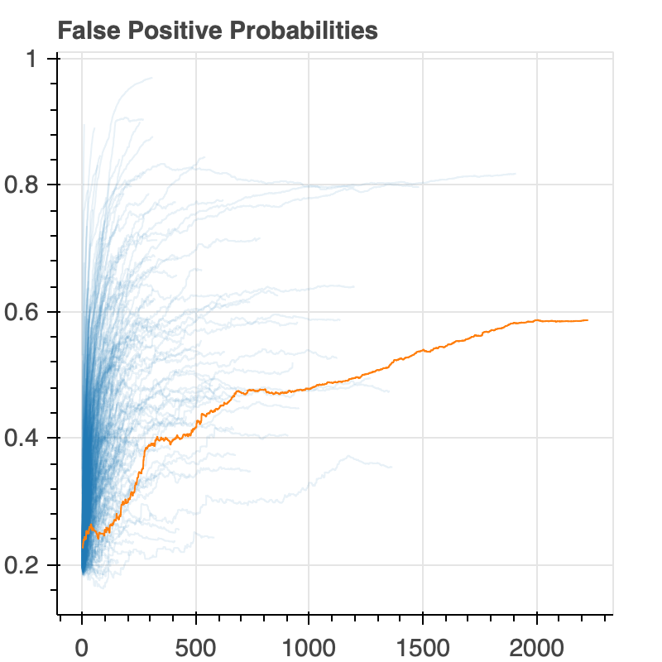
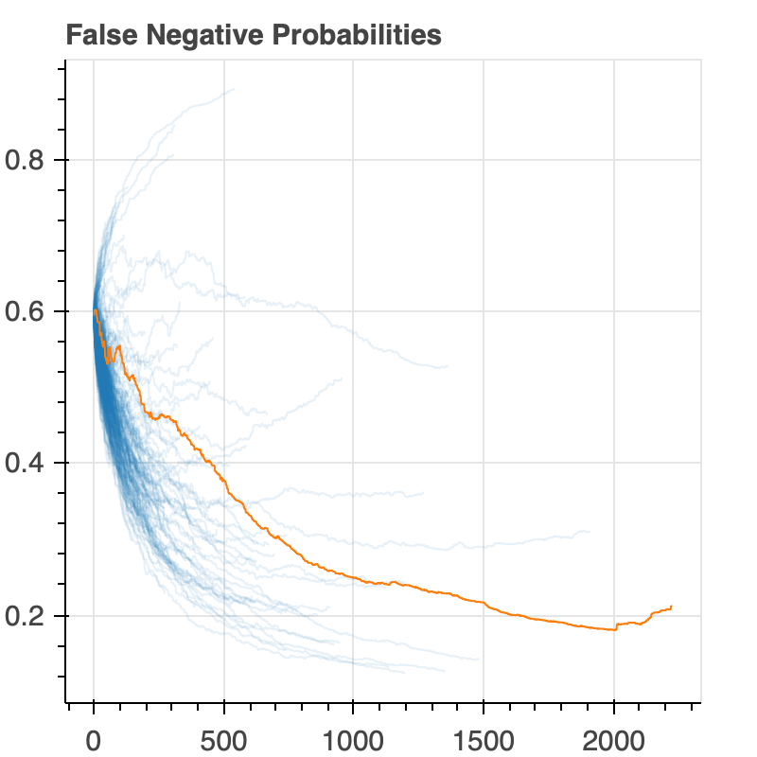
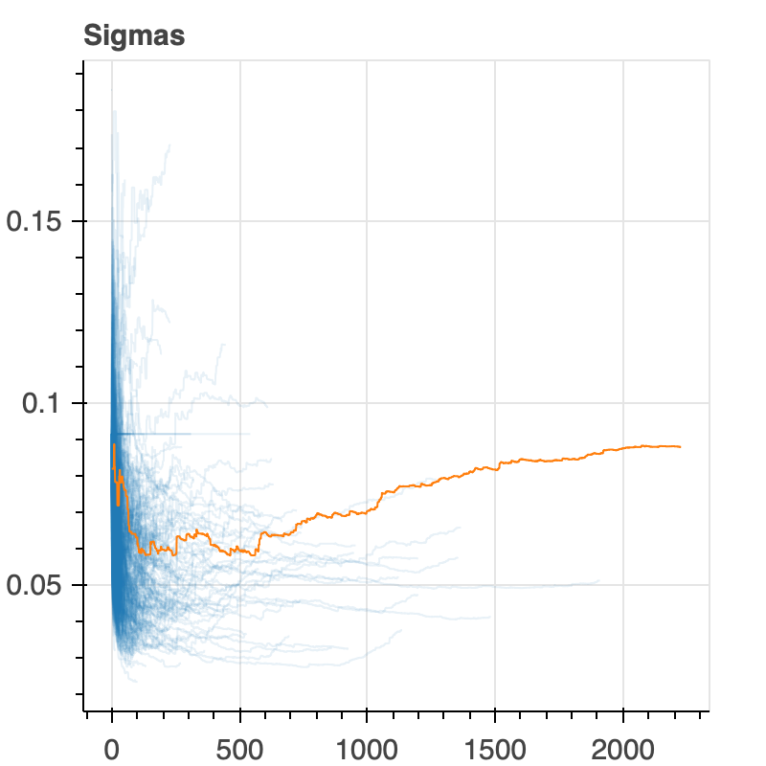
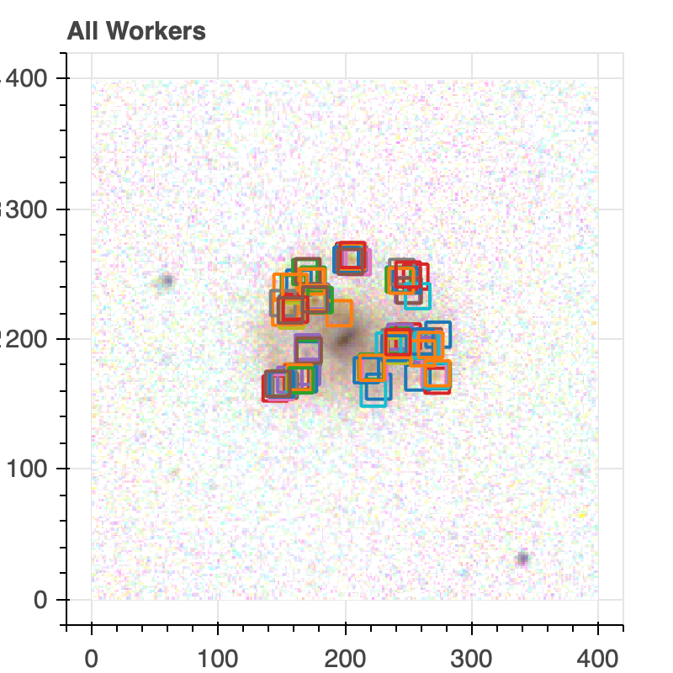
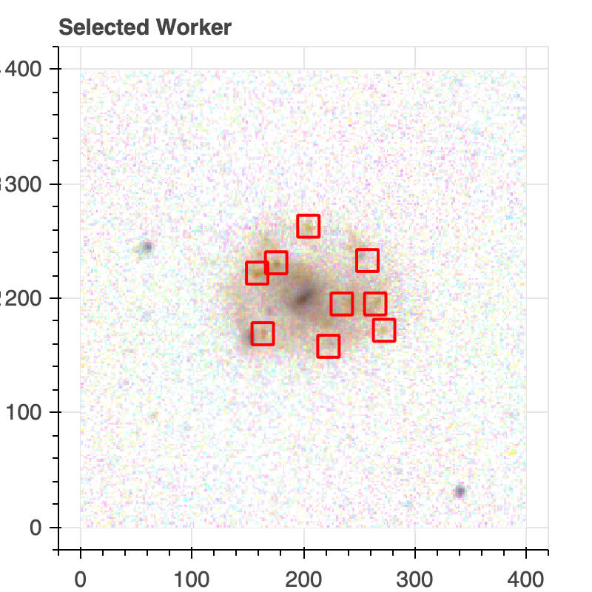
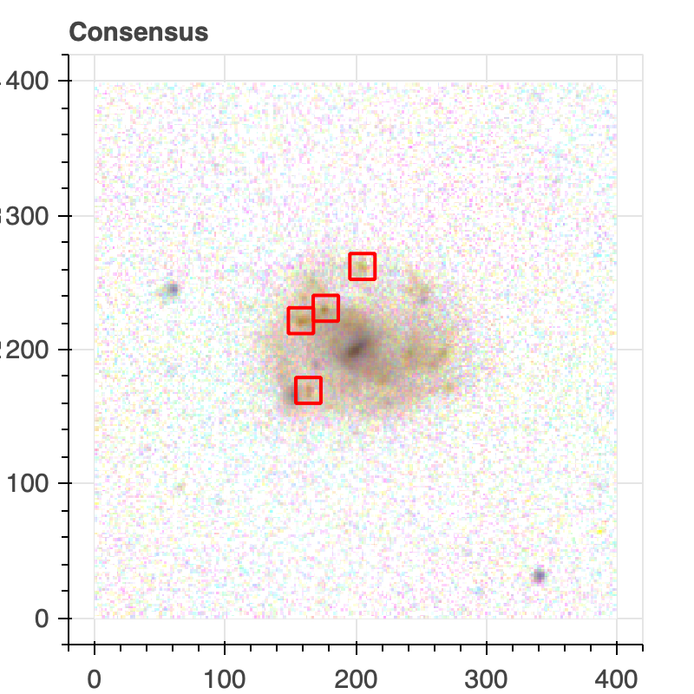
CLUMP SCOUT
zooniverse.org/projects/hughdickinson/galaxy-zoo-clump-scout

Slide 45
Notes:
Optimal aggregator uses a continually updating Bayesian model for subject difficulty and volunteer skill
Object training will use the Tensorflow object detection API
Active learning still under development – uses deep learning model uncertainty to request annotations for the most poorly classified subjects

Slide 46
From Description of Work
Open the science related ESFRI facilities (and their pathfinders/precursors) and the data-research impact of the EOSC to the general public by creating, managing and operating a harmonised suite of mass participation experiments for these facilities, and develop/adapt machine-learning tools for deciding when subjects are well characterised and for volunteer classification reliability; provide a web-based interface to present this ensemble of ESCAPE mass participation experiments.

Slide 47
From Description of Work
Open the science related ESFRI facilities (and their pathfinders/precursors) and the data-research impact of the EOSC to the general public by creating, managing and operating a harmonised suite of mass participation experiments for these facilities, and develop/adapt machine-learning tools for deciding when subjects are well characterised and for volunteer classification reliability; provide a web-based interface to present this ensemble of ESCAPE mass participation experiments.

Slide 48
Summary
Communication and dissemination work on schedule
Citizen science and education ahead of schedule
Work ongoing in ML – human interface

Slide 49



Thank you very much!
Stephen Serjeant: stephen.serjeant@open.ac.uk
Rita Meneses: r.meneses@trust-itservices.com
Mathilde Hubert: hubert@lapp.in2p3.fr
Follow ESCAPE on
@ESCAPE_EU
linkedin.com/company/projectescape/
youtube.com/channel/UC05braEQdP2rCSUamHm9I_Q

