Slide 1
First Year of ESCAPE WP2 - DIOS
Simone Campana (CERN)
For the WP2 work package
ESCAPE Progress Meeting – Brussels February 2020

Slide 2
WP2 important milestones
Today
Jul 2019
Jan 2020
Jul 2020
Jan 2021
Jul 2021
Jan 2022
Jul 2022
6
12
18
24
30
36
42
Implementation plan and the design of the of the pilot
Initial datalake with at least 3 centers
Analysis and assessment of the first version of the pilot datalake
Extended Prototype with more centres and tools
Final analysis and assessment of full prototype

Slide 3
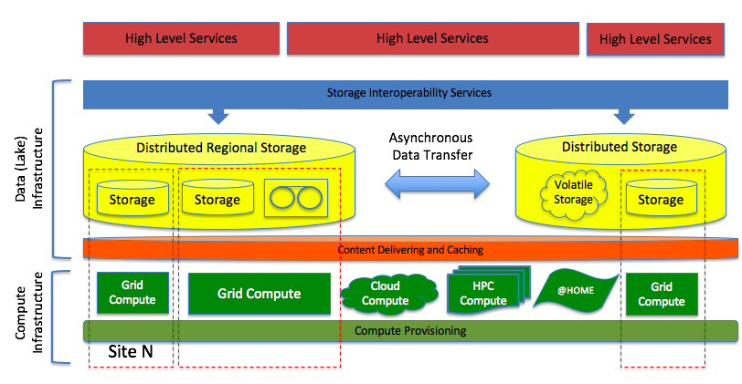
WP2 – Data Infrastructure for Open Science
AAI & Network
Data Lake building blocks
Define, integrate and commission an ecosystem of tools and services to build a data lake
Leaves to the science projects the flexibility to choose the services and layout most
suitable to their needs. Provides a reference implementation
Contributes to deliver Open Access and FAIR data services: relies on trustable data repositories; enables data management policies; hides the complexities of the underlying infrastructure providing a transparent data access layer

Slide 4
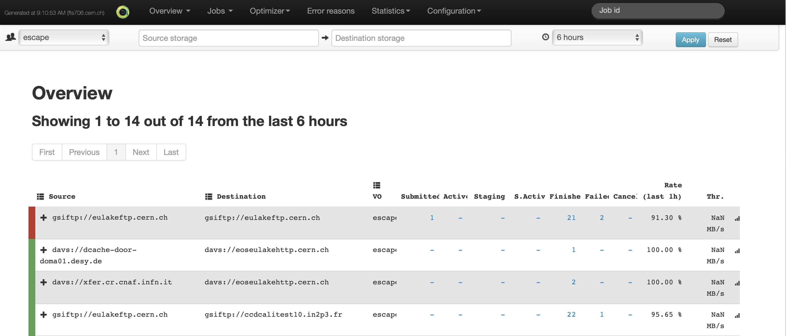
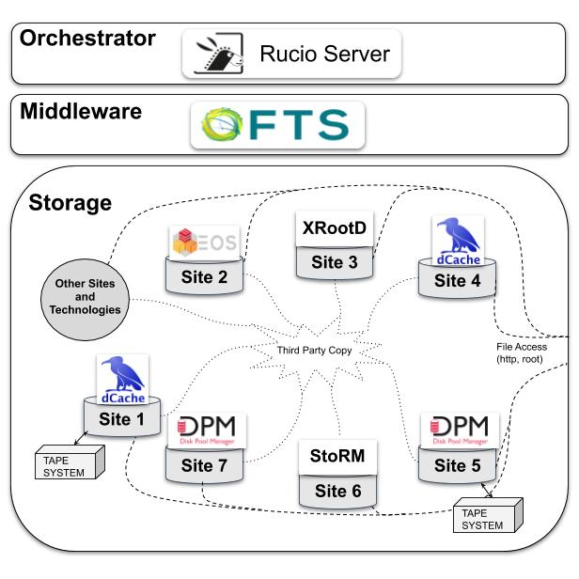
Datalake Reference Implementation stack
Rucio as the Orchestration service in the reference implementation
File/dataset catalog, rule based engine
FTS is the workhorse for asynchronous point-to-point data transfer in the reference implementation
HTTP and xrootd as transfer protocols

Slide 5
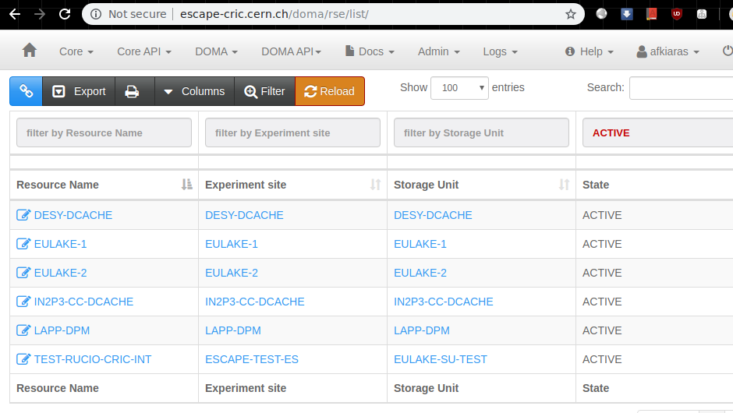
Configuration
CRIC as the DataLake configuration service
In use in WLCG, integrated with Rucio

Slide 6
Today’s datalake deployment
Currently deployed (green) and foreseen (grey) storage services in ESCAPE datalake, orchestrated by an ESCAPE Rucio Instance
Some centers joining even if not funded by ESCAPE!
An heterogeneous set of storage technologies, deployment models and Quality-Of-Service

Slide 7
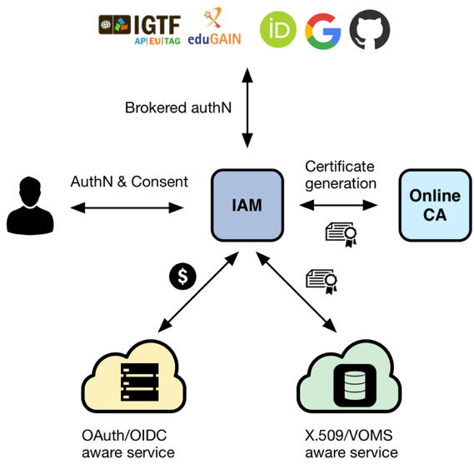
Authentication, Authorization, Identity
AAI has a much broader scope than WP2
IAM was chosen as reference implementation service for AAI
Token-based authentication rather than X509 as baseline. IAM enables translation X509-to-Token for coexistence period
X509-free DataLake is not realistic in the timescale of ESCAPE (IMHO)
Some fully token based use cases however are in range
We have a IAM service for ESCAPE deployed by INFN and VOMS compatibility

Slide 8
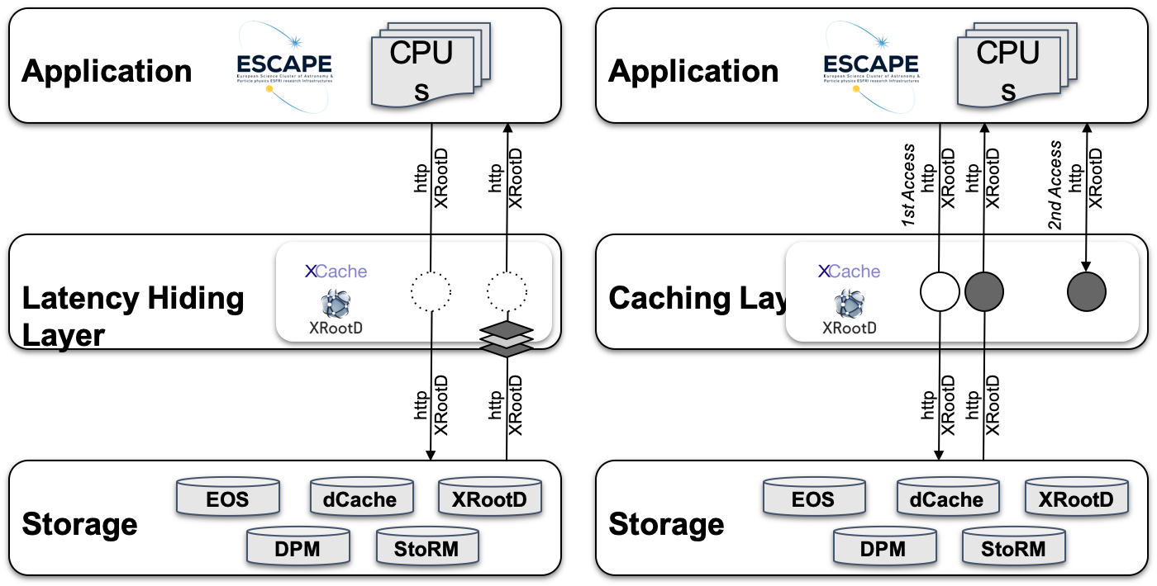
Caching and Latency hiding
xCache technology as reference implementation.
Support HTTP and xrootd protocols

Slide 9
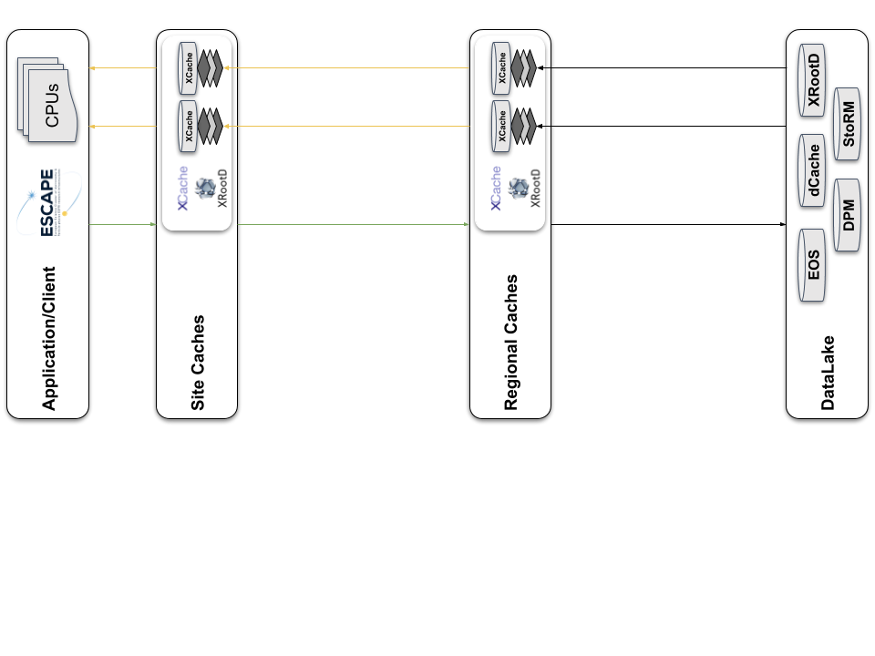
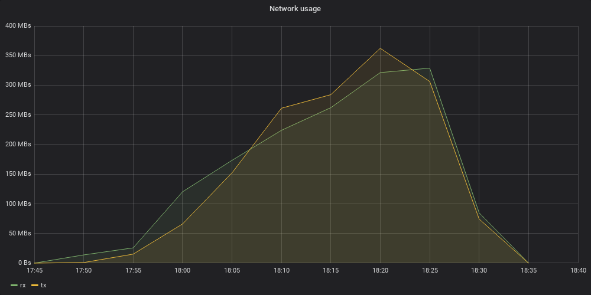
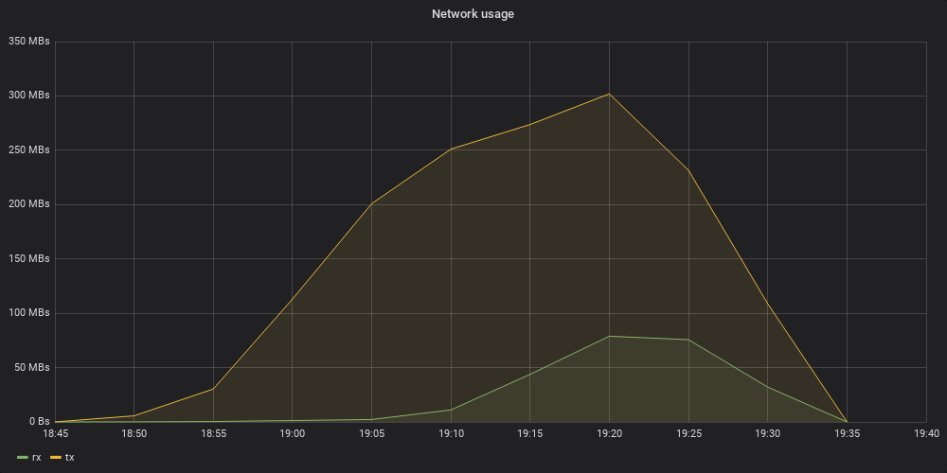
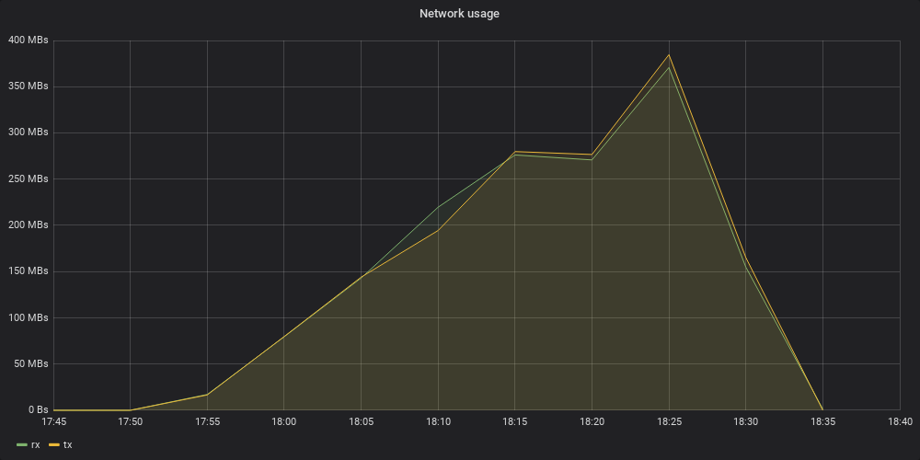
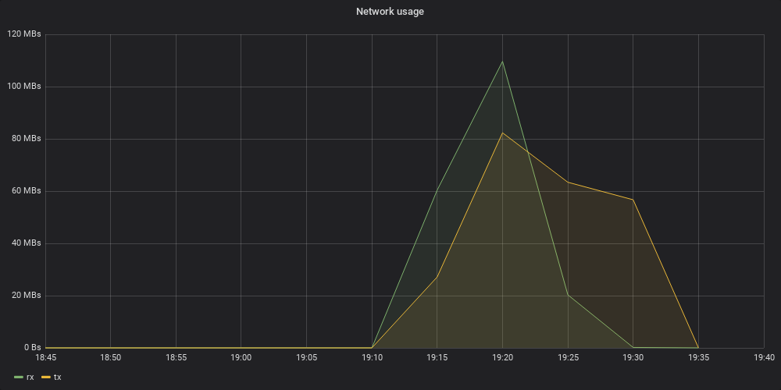
Green (rx): requests to caches Yellow (tx): transmits from caches
Prototyping a layered
content delivery services
1st Access
2nd Access
Site Caches
400 MBs
350 MBs
Regional Caches
400 MBs
350 MBs
55 min
55 min

Slide 10
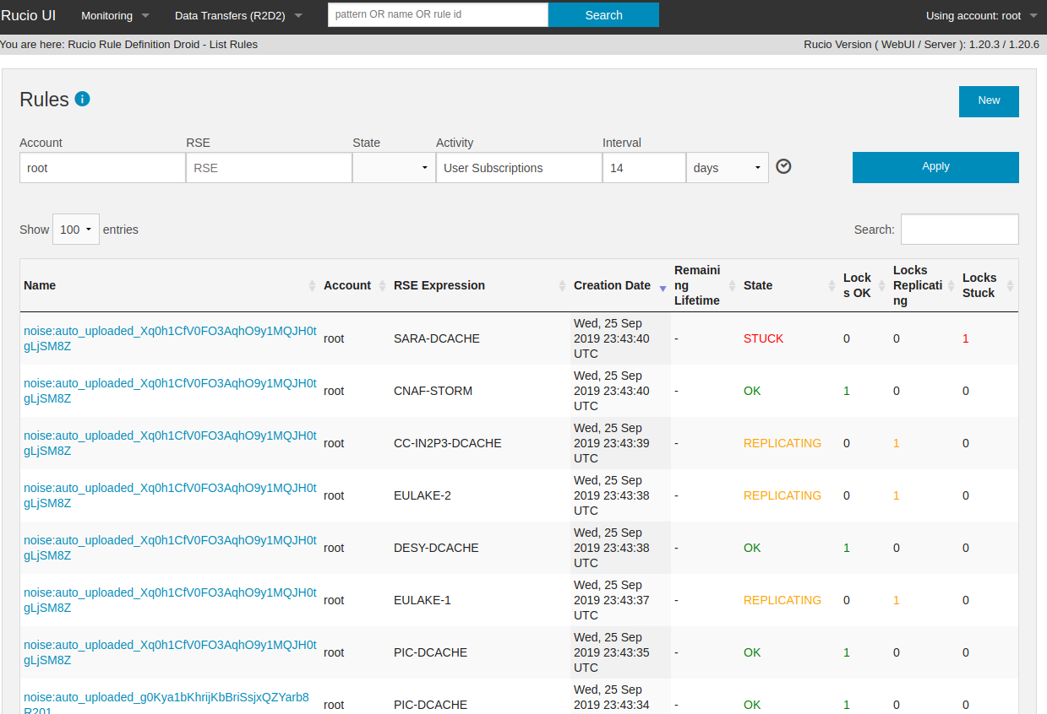
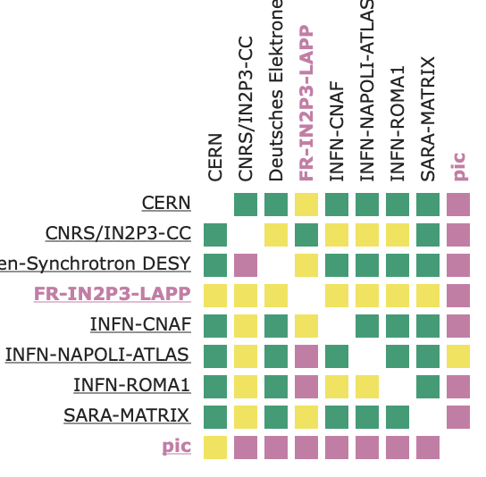
Monitoring
Rucio WebUI as interface for ESCAPE users
ESCAPE DataLake dashboard
low level network monitoring
FTS dashboard

Slide 11
Next Steps
Jul 2020
Jan 2021
18
24
Today
Initial DataLake with at least 3 centers
Analysis and assessment of the first version of the pilot DataLake
Extended Prototype with more centres and tools
Organize the ESCAPE science projects in the AAI management system
Harden the data lake infrastructure to pre-production level (monitoring, operations, testing, procedures, ..)
Get science project data into the data lake (focus on open data) and implement project specific policies. Some LOFAR and LHC data already in the data lake
Collect representative applications from science projects and use them to access and process the data from the lake through the content delivery layer

Slide 12
Documentation
https://wiki.escape2020.de/index.php/WP2_-_DIOS
Operations: Status of the Datalake and links to monitoring
Service Managers: Instructions for installing/configuring/testing the services
Users: Instructions for science project users
Misc: Minutes of meetings, links to conferences, presentations, workshops, webinars

Slide 13
I am confident the GA will support this proposal
In fact the “professional reasons” is I was appointed WLCG Project Leader - WLCG organizes LHC computing. So I will remain heavily involved in / attentive to ESCAPE

Slide 14
For the attention of the General Assembly …
Year 2 will require even more involvement of the science projects
Y1 focused on identifying the architecture and building blocks. Y2 will focus on getting science project active in interacting with the datalake
Many science projects involved in WP2 through one+ partner. Simpler for those, with caveats
Some science project have no partner in WP2. Still need involvement of those
The role of ESCAPE WP2 is to prototype a datalake service. At the conclusion of ESCAPE the science projects need to be able to independently operate it or find a sustainability model. This means:
Strong focus on documentation
Deep involvement of the science project
Stronger contacts with other WPs
We are not yet ready for embargoed data in the shared ESCAPE datalake
So focus on open data for the moment, but we need to quickly progress on that

Slide 15
For the attention of the General Assembly …
It is getting harder (timewise) to follow all activities in different WPs and this is important to do as there are many interfaces
I think one of the conclusions this week is we are at the stage where an overarching integration activity across the WPs is needed
It is getting harder (timewise/moneywise) to participate physically to hackathon-stile events particularly for partners with low PMs in the WP. So we try to limit those events and do an effort to facilitate remote participation
The SWAN demo for example went fine I think
It is getting harder (timewise) to provide input to the many important initiatives we are involved into and asked to provide feedback to
Some times I have the impression I am asked the same information over again
So, firstly, apologies if WP2 is behind for some of those
And, secondly, an encouragement to rationalize some of this as the quality of the input we provide might degrade if we run out of bandwidth

Slide 16
Conclusions
Year 1: we have a Data Lake pilot, well ahead of the milestone deadline
Architecture driven by the ESCAPE sciences
Technology in synergy and leveraging existing projects and solutions
Year 2: demonstrate its usability for the ESCAPE sciences
Organize and manage experiment data
Process such data integrating compute platforms
Year 2 and beyond: scale up the deployment. Introduce advanced features.

Slide 17
Backup

Slide 18
Commissioning
Hammercloud for testing and commissioning
Can run applications in distributed environments, through different plugins
Comes with monitoring and analytics

