Slide 1
ASTRONOMY & PARTICLE PHYSICS CLUSTER
Giovanni LAMANNA
ESCAPE progress meeting. Brussels, 26-27 February 2020

Slide 2
Outline
ESCAPE origin (a reminder)
ESCAPE goals within EOSC
The annual progress meeting
WPs brief reports
2

Slide 3
European Open Science Cloud (EOSC)
An European Commission action in response of the union member states shared policy about Open Science:
EOSC is a cloud for research data in Europe that allows universal access to data through a single online platform.
EOSC will federate existing resources across national data centres, e-infrastructures, and research infrastructures, allowing researchers and citizens to access and re-use data produced by other scientists.
Respective capacities and domain-based heterogeneous needs of scientific stakeholders make the EOSC implementation a real challenge.

Slide 4
EC cluster-projects initiative
H2020-INFRAEOSC-04-2018 call
Clusters to ensure the connection of the ESFRI RIs with EOSC (and the construction of EOSC)
Expected impact:
Improve access to data and tools leading to new insights and innovation
Facilitate access of researchers to data and resources for data driven science.
Create a cross-border open innovation environment.
Rise the efficiency and productivity of researchers through open data services and infrastructures for discovering, accessing, and reusing data.
Foster the establishment of global standards.
Develop synergies and complementarity between involved research infrastructures.
Adopt common approaches to the data management for economies of scale.
Making data FAIR …
4

Slide 5
Astronomy and Particle Physics
The astronomy-related ESFRI projects and the accelerator-based particle physics ESFRI facilities will open together new paths towards the understanding of the Universe through a multi-probe approach.
Enhance the coordination leveraging two major complementary excellences in data stewardship:
i) the astronomy Virtual Observatory infrastructure;
ii) long-standing expertise of the particle physics community in large-scale
distributed computing and big-data management.

Slide 6
ESCAPE ESFRI facilities aligned expectations
The “Data-FAIRness” challenge for our research infrastructures implies:
Large volumes of data generators (up to multi-Exabyte scale level) -> Not only early adapters of the latest ICT and data-management developments but also constantly pushing the envelope of the current state-of-the-art.
“Observatory” and “Facility” type of operation requires global open access and long-term sustainability of FAIR research data and services.
Training and extension of FAIRness standards and tools for data access and data preservation.
Operating a common/transversal virtual research environment, sharing competence, adopting the Open-Science principles and boarding EOSC.

Slide 8
ESCAPE in a nuthshell
31 partners (including 2 SMEs)
7 ESFRI projects & landmarks: CTA, ELT, EST, FAIR, HL-LHC, KM3NeT, SKA
2 pan-European International Organizations: CERN, ESO (with their world-class established infrastructures, experiments and observatories).
3 supporting European research consortia: APPEC, ASTRONET and NuPECC.
1 involved initiative/infrastructure: EURO-VO
2 European research infrastructures: EGO and JIV-ERIC
Budget: 15.98 M€
Started: 1/2/2019
Duration: 42 months (end date 31/7/2022)
Grant number: 824064
Coordinator: CNRS-LAPP

Slide 9
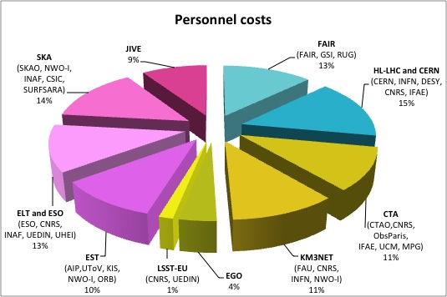
ESCAPE in a nuthshell
As per H2020 INFRAEOSC-04-2018 call - CLUSTER MEMBERSHIP and PARTNERSHIP:
The EC funding contributions in line with the number of pan-European research infrastructures (EUR 1.5 - 2 million for each ESFRI project/landmark) the cluster connects to the EOSC.
In ESCAPE
Each RI commits, teaming
up with a sub-set of
associated national
stakeholders.
Distribution of personnel costs among partners grouped by RI
9

Slide 10
ESCAPE goals towards a VRE
Implementing Science Analysis Platforms for EOSC researchers to stage data collections, analyse them, access ESFRIs’ software tools, bring their own custom workflows.
Contributing to the EOSC global resources federation through a Data-Lake concept implementation to manage extremely large data volumes at the multi-Exabyte level.
Supporting “scientific software” as a major component of ESFRI data to be preserved and accessed in EOSC through dedicated catalogues.
Implementing a community foundation approach for continuous software shared development and training new generation researchers.
Extending the Virtual Observatory standards and methods according to FAIR principles to a larger scientific context; demonstrating EOSC capacity to include existing frameworks.
Further involving society in knowledge discovery.

Slide 11
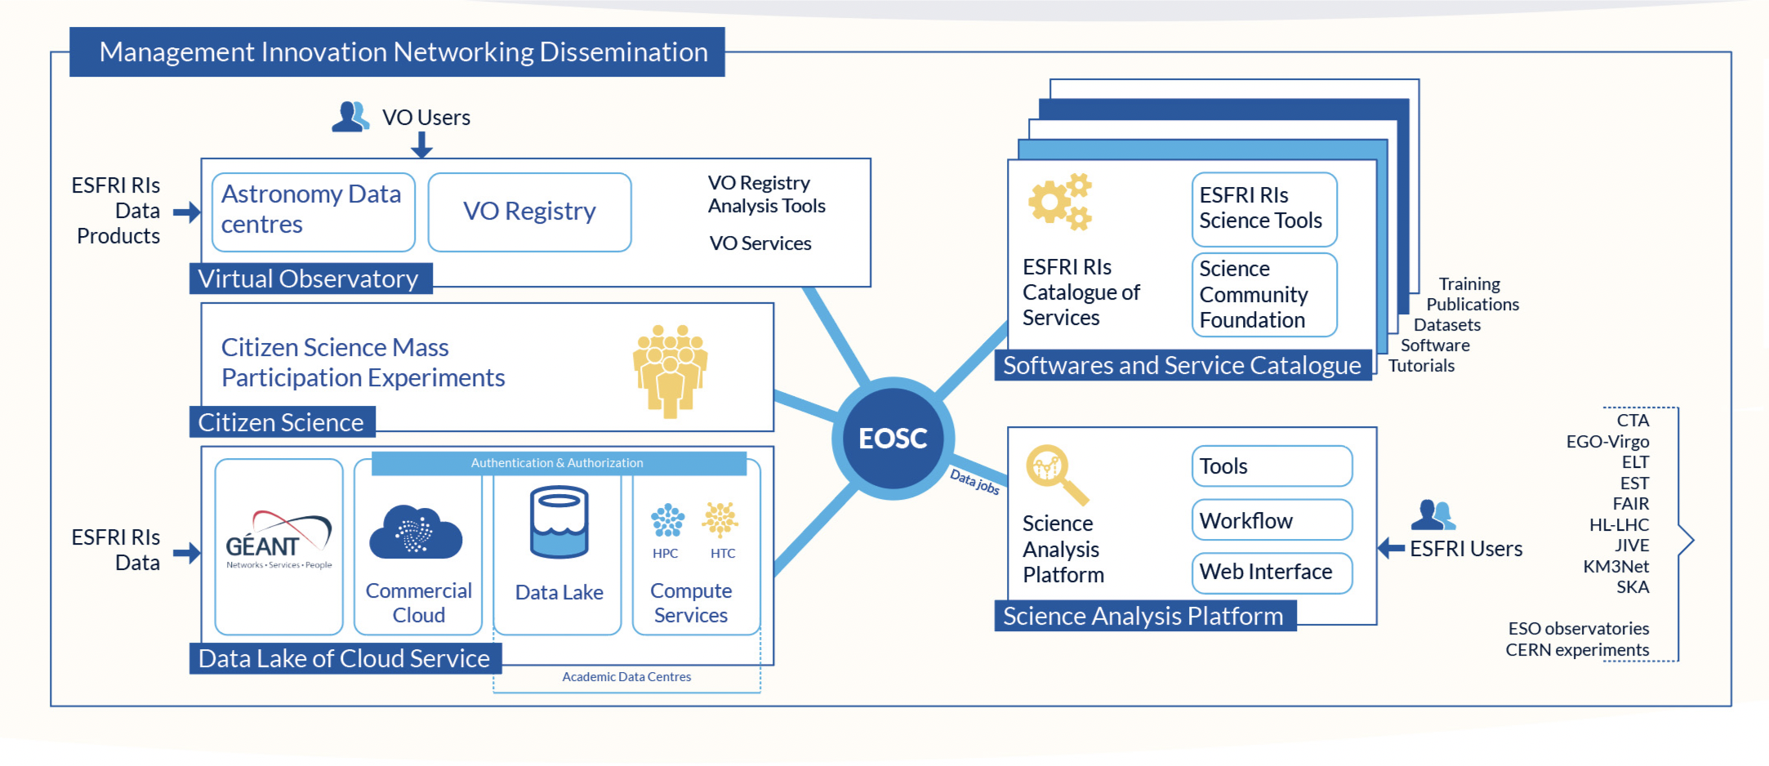
ESCAPE goals: building a domain-based EOSC cell

Slide 12
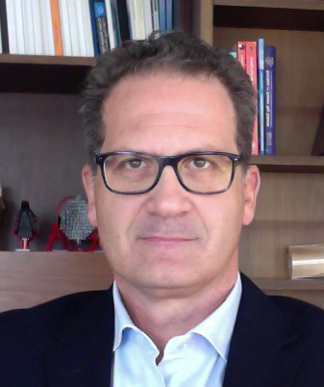
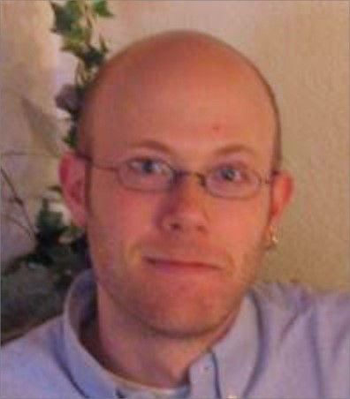
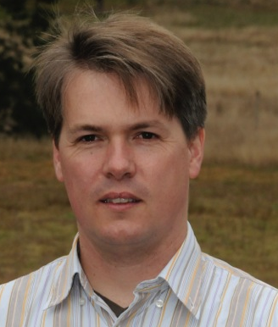
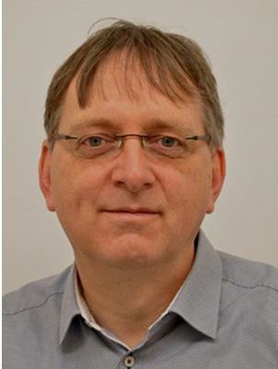
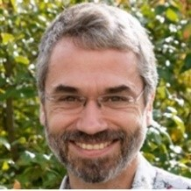
ESCAPE work programme
WP1 MIND. Leader: Giovanni Lamanna, LAPP-CNRS
Management and policy.
WP2 DIOS. Leader: Simone Campana, CERN
Contribute to the federation of global EOSC resources through an implementation of the Data-Lake concept (evolution of WLCG and other ESFRI RIs computing models) to manage extremely large volumes of data up to the multi-exabyte scale
WP3 OSSR. Leader: Kay Graf, FAU
Support for "scientific software" as a major component of the ESFR-RI “data” to be stored and displayed in EOSC via dedicated community-based catalogues. Implementation of a community-based approach for the continuous development of shared software and for training of researchers and data scientists.
WP4 CEVO. Leader: Mark Allen, CDS-CNRS
Extend FAIR standards, methods, tools of the Virtual Observatory to a broader scientific context; demonstrate EOSC's ability to include existing platforms.
WP5 ESAP. Leader: Michiel van Haarlem, ASTRON-NWO
Implementation of scientific analysis platforms enabling EOSC researchers to organize data collections, analyse them, access ESFRI's software tools, and provide their own customized workflows.
WP6 ECO. Leader: Stephen Serjeant, Oxford Open University
Citizen Science, Open Science et Communication
12

Slide 13
Annual progress meeting
Main objective: General Assembly for annual steering and audit of the project (tomorrow afternoon)
Extended agenda for:
Topical interface or co-development exchanges among Work Packages (today)
Science and policy issues discussions concerning EOSC implications for our research domains and next year strategy (tomorrow morning)
13

Slide 14
Brief Work-Packages reports

Slide 15
Brief Work-Packages reports - WP1
WP1 Management, Innovation, Networking and Dissemination (MIND) supports the networking with various EOSC stakeholders (EOSC governance, e-infrastructures, other H2020 projects, policy bodies, industries); implement the connection between EOSC and the ESCAPE RIs management boards.
First year actions:
ESCAPE management support team (E-MST) has been setup.
The members of the ESFRI RIs’ management boards were consulted to define ESCAPE view on European Open Science Cloud (EOSC) concept implementation for the ESCAPE concerned domains.
The chairs of the ASTRONET, APPEC, NuPECC and ECFA consortia together with representative from ESA have been formally appointed as the ESCAPE External Expert Advisory Board members.
E-MST has also been very actively exchanging with other EOSC cluster projects EOSC-Life, SSHOC, ENVRI-FAIR and PANOSC.
E-MST has also been representing the consortium at the various international events addressing the implementation of EOSC, both under the initiative of EC and ESFRI boards.
E-MST has so far organized six ESCAPE executive board meetings. These meetings have been instrumental to track the project progress in terms of technical objectives, recruitments as well as steering the interfaces with other EOSC stakeholders.
Three of the ESCAPE executive board members are also contributing to the EOSC architecture and FAIR working group.
The ESCAPE coordinator has represented the ESCAPE consortium and the vision of the ESCAPE scientific community in dedicated high-level consultation meetings with the EC officers, the ESFRI EOSC-Task Force, EOSC secretariat and has taken role in the EOSC-hub scientific strategy board.
15

Slide 16
Brief Work-Packages reports - WP1
Welcoming our external advisory board (EEAB) members:
APPEC
Teresa Montaruli - Chair
ASTRONET
Colin Vincent - Chair
NuPPEC
Marek Lewitowicz - Chair
ECFA
Jorgen D'Hondt - Chair
ESA
Christophe Arviset
16

Slide 17
Brief Work-Packages reports – WP2 to WP5
17

Slide 18
Thank you !

