Slide 1
First Year of ESCAPE
WP2 - DIOS
Simone Campana (CERN)
For the WP2 work package
ESCAPE Progress Meeting – Brussels February 2020

Slide 2
WP2 important milestones
Today
Jul 2019
Jan 2020
Jul 2020
Jan 2021
Jul 2021
Jan 2022
Jul 2022
6
12
18
24
30
36
42
Implementation plan and the design of the of the pilot
Initial datalake with at least 3 centers
Analysis and assessment of the first version of the pilot datalake
Extended Prototype with more centres and tools
Final analysis and assessment of full prototype

Slide 3
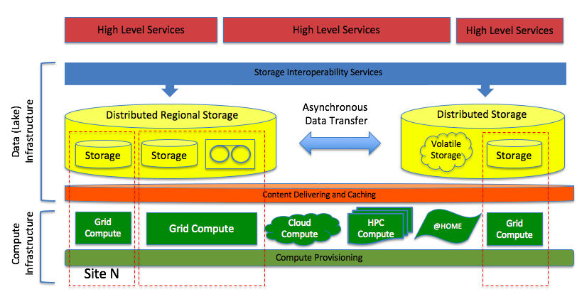
WP2 – Data Infrastructure for Open Science
AAI & Network
Data Lake building blocks
Define, integrate and commission an ecosystem of tools and services to build a data lake
Leaves to the science projects the flexibility to choose the services and layout most
suitable to their needs. Provides a reference implementation
Contributes to deliver Open Access and FAIR data services: relies on trustable data repositories; enables data management policies; hides the complexities of the underlying infrastructure providing a transparent data access layer

Slide 4
Today’s datalake deployment
Currently deployed (green) and foreseen (grey) storage services in ESCAPE datalake, orchestrated by an ESCAPE Rucio Instance
Some centers joining even if not funded by ESCAPE!
An heterogeneous set of storage technologies, deployment models and Quality-Of-Service

Slide 5
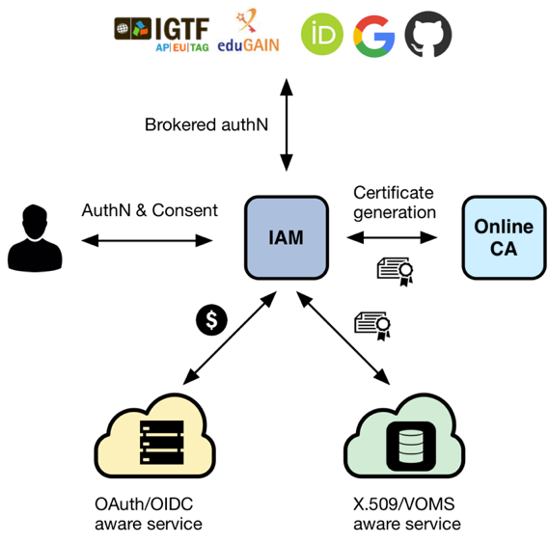
Authentication, Authorization, Identity
AAI has a much broader scope than WP2
IAM was chosen as reference implementation service for AAI
Token-based authentication rather than X509 as baseline. IAM enables translation X509-to-Token for coexistence period
X509-free DataLake is not realistic in the timescale of ESCAPE (IMHO)
Some fully token based use cases however are in range
We have a IAM service for ESCAPE deployed by INFN and VOMS compatibility

Slide 6
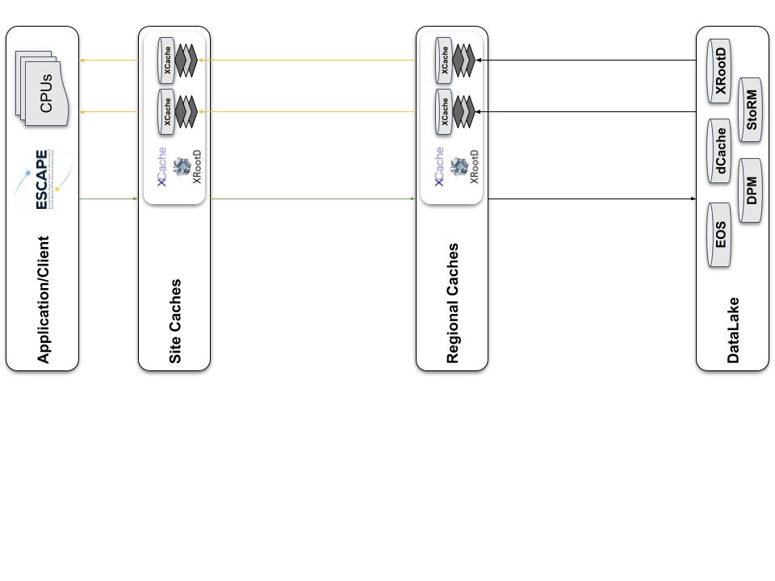
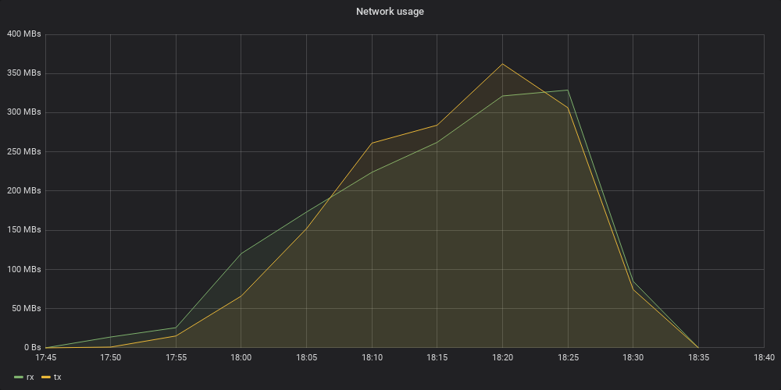
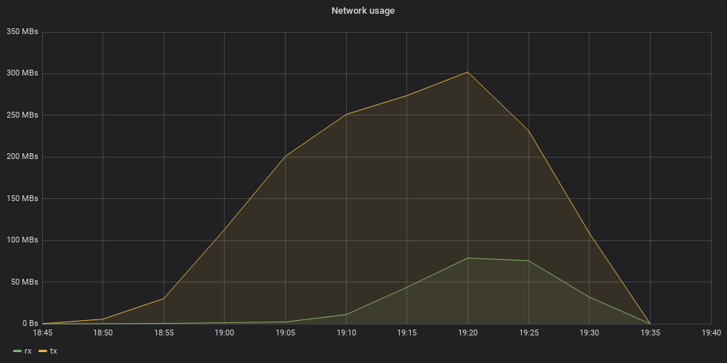
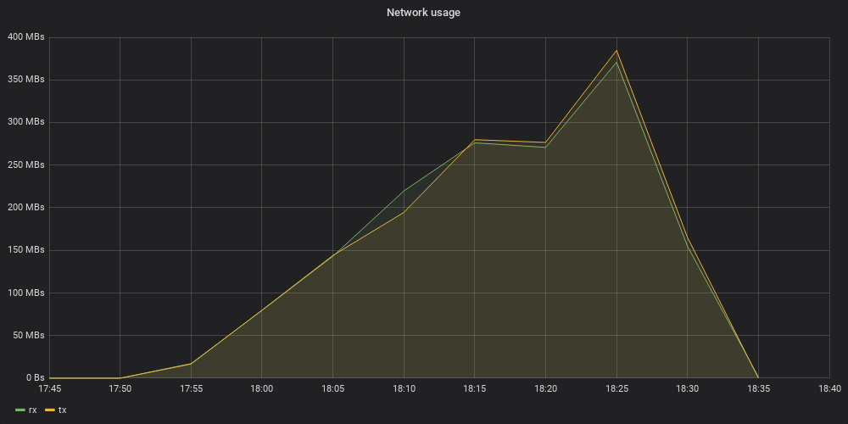
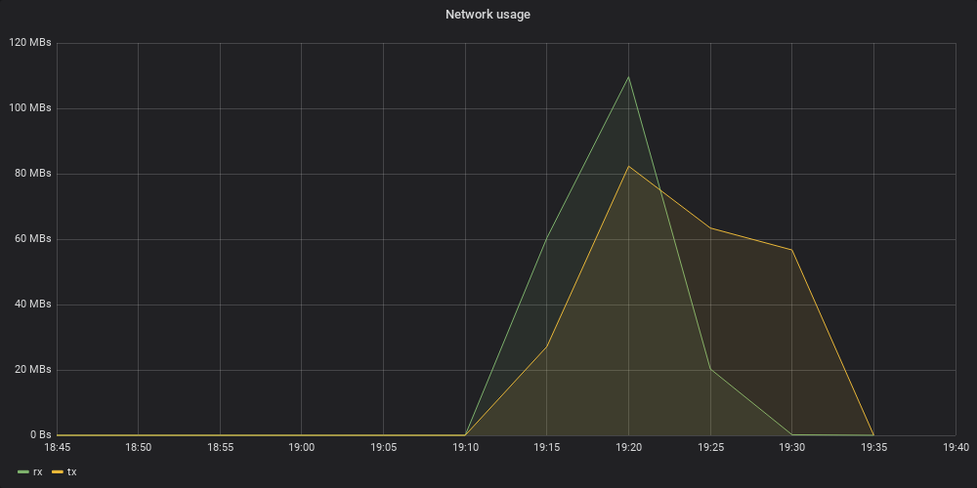
Green (rx): requests to caches
Yellow (tx): transmits from caches
Prototyping a layered
content delivery services
1st Access
2nd Access
Site Caches
400 MBs
350 MBs
Regional Caches
400 MBs
350 MBs
55 min
55 min

Slide 7
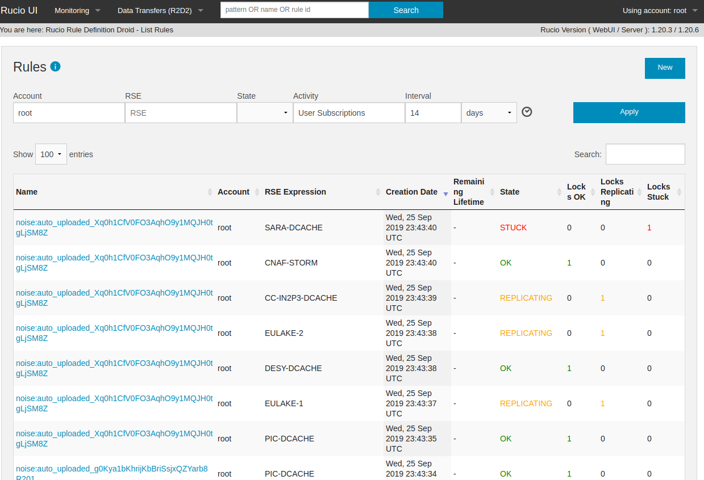
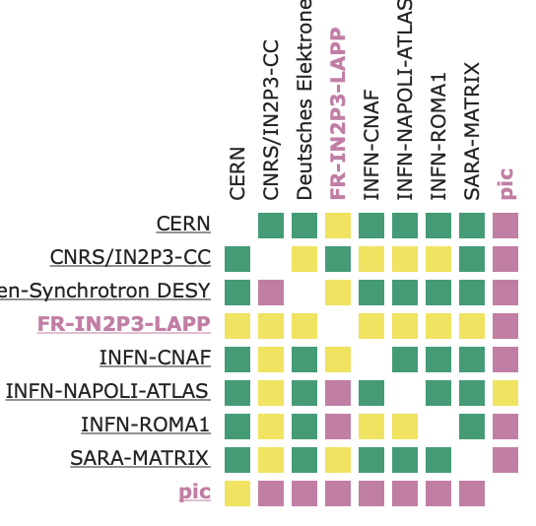
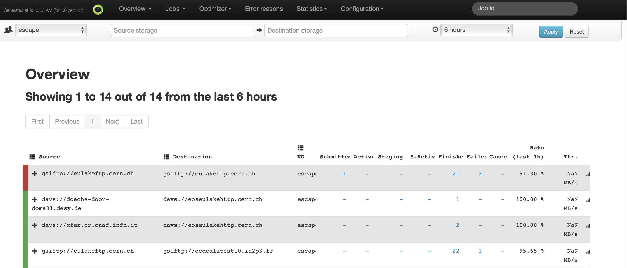

Monitoring
Rucio WebUI as interface for ESCAPE users
ESCAPE DataLake dashboard
low level network monitoring
FTS dashboard

Slide 8
Next Steps
Jul 2020
Jan 2021
18
24
Today
Initial DataLake with at least 3 centers
Analysis and assessment of the first version of the pilot DataLake
Extended Prototype with more centres and tools
Organize the ESCAPE science projects in the AAI management system
Harden the data lake infrastructure to pre-production level (monitoring, operations, testing, procedures, ..)
Get science project data into the data lake (focus on open data) and implement project specific policies. Some LOFAR and LHC data already in the data lake
Collect representative applications from science projects and use them to access and process the data from the lake through the content delivery layer

Slide 9
Documentation
https://wiki.escape2020.de/index.php/WP2_-_DIOS
Operations: Status of the Datalake and links to monitoring
Service Managers: Instructions for installing/configuring/testing the services
Users: Instructions for science project users
Misc: Minutes of meetings, links to conferences, presentations, workshops, webinars

Slide 10

Conclusions
Year 1: we have a Data Lake pilot, well ahead of the milestone deadline
Architecture driven by the ESCAPE sciences
Technology in synergy and leveraging existing projects and solutions
Year 2: demonstrate its usability for the ESCAPE sciences
Organize and manage experiment data
Process such data integrating compute platforms
Year 2 and beyond: scale up the deployment. Introduce advanced features.

Slide 11
Backup

Slide 12

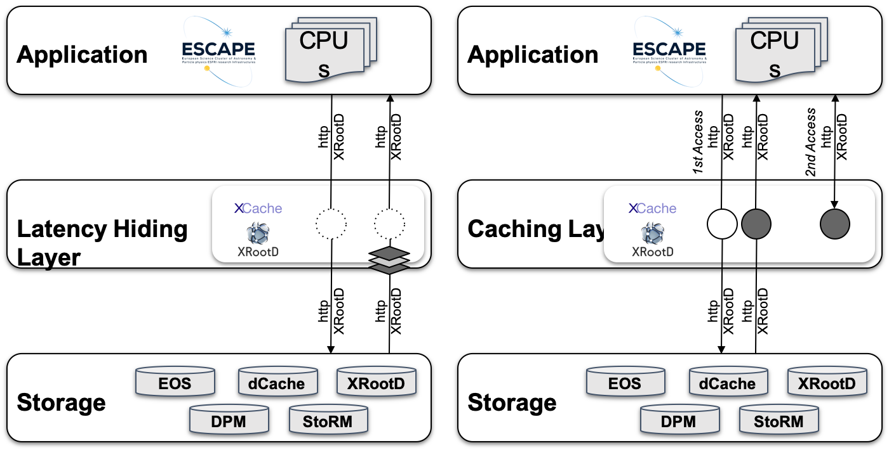
Caching and Latency hiding
xCache technology as reference implementation.
Support HTTP and xrootd protocols

Slide 13
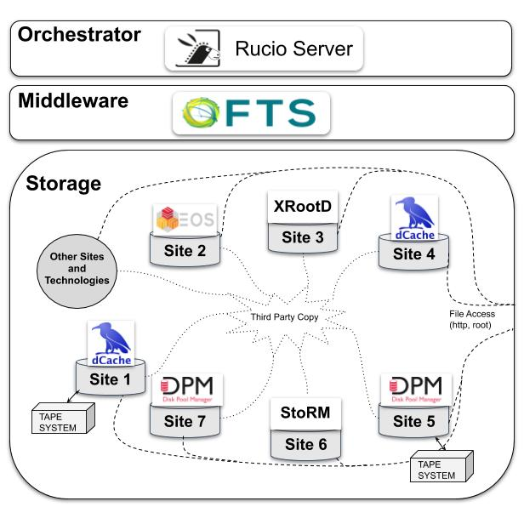
Datalake Reference Implementation stack
Rucio as the Orchestration service in the reference implementation
File/dataset catalog, rule based engine
FTS is the workhorse for asynchronous point-to-point data transfer in the reference implementation
HTTP and xrootd as transfer protocols

Slide 14
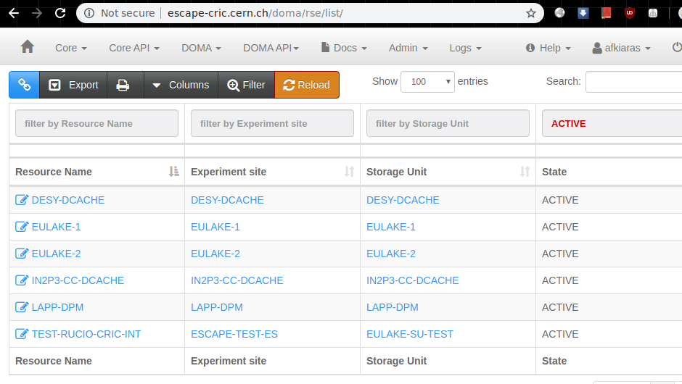

Configuration
CRIC as the DataLake configuration service
In use in WLCG, integrated with Rucio

Slide 15
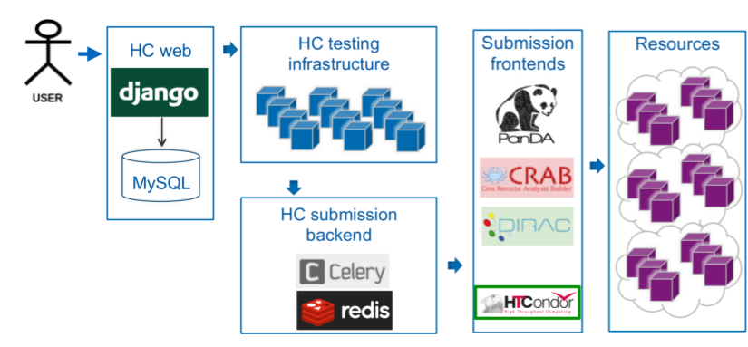
Commissioning
Hammercloud for testing and commissioning
Can run applications in distributed environments, through different plugins
Comes with monitoring and analytics

