Slide 1
WP4 ‘CEVO’ activities
Mark ALLEN, Marco MOLINARO, Françoise GENOVA, Martino ROMANIELLO

Slide 2
Work Package 4 – WP4 “CEVO”
Connecting ESFRI projects to EOSC through the VO framework
EOSC – European Open Science Cloud
VO – Virtual Observatory
Virtual Observatory standards and methods for FAIR principles to a larger scientific context; demonstrating EOSC capacity to include existing frameworks.

Slide 3
WP4 Partners
Partners from ESFRIs and astronomy Research Infrastructures
Partners bringing experience from European Virtual Observatory

Slide 4
WP4 - in full operation
WP4 - First Milestone – Paris IVOA meeting report ✓
WP4 – First Deliverable – WP4 Project Plan ✓
WP4 - Second Milestone – Groningen IVOA meeting report ✓
WP4 Technology Forum 1 ✓
WP4 calendar – in Project Plan document
Progress on all tasks, 4.1, 4.2, 4.3 - see annual report
Challenges / opportunities – diverse partners, evolving EOSC

Slide 5
WP4 specific events in year 1
Transition event – ASTERICS Tech Forum (Feb 2019)
Radio Astronomy and VO meeting / EST and VO meeting (Feb 2019)
VO partner visits to ESFRI/RIs: EST: ROB & KIS, ASTRON, KM3NeT
EOSC-Hub Week (April 2019)
KM3NeT and VO meeting – September 2019
Task 4.3 Meetings (September, December 2019)
Provenance – CTA, KM3NeT (Nov 2019)
SCIOPS – presentation of ESCAPE (Nov 2019)
EOSC Symposium (Nov 2019)
WP4 Technology Forum 1 (Feb 2020)
Paris, Interoperability meeting
May, 2019
Groningen, Interoperability meeting
October, 2019

Slide 6
Evolving landscape of Data Sharing
Convergence of principles and language:
FAIR
Findable, Accessible, Interoperable, Reusable
Open Science
Data sharing with open and seamless services to analyse and reuse research data to improve science
Stewardship
Human skills for curation, quality content, data management, services

Slide 7
What is the Virtual Observatory?
Operational framework for interoperable access to astronomical data and services across all areas of astronomy
Provides unique scientific capabilities, opening up new ways of using rich data in astronomy archives and services
A pioneer of FAIR data sharing - an existing global framework – populated by major data providers (space and ground based) that is heavily used by the community (e.g. Gaia data access is fully VO)

Slide 8
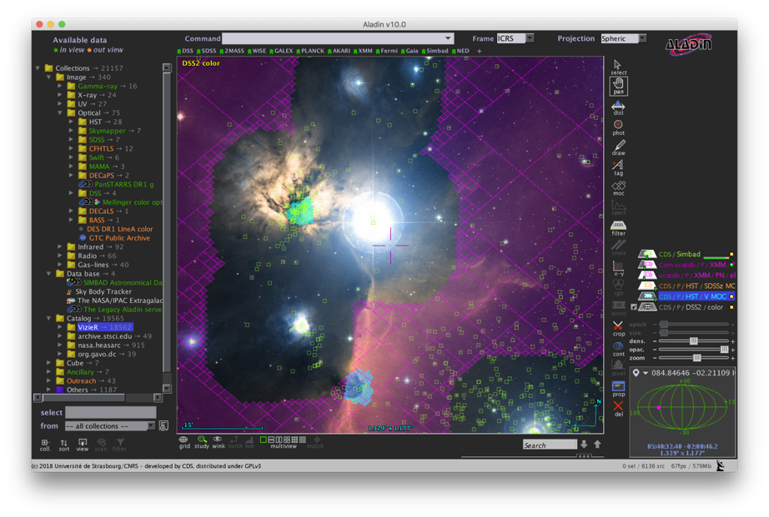
One view of the VO from an application:
Largest catalogues: PanSTARRS, Gaia etc.
1000s All-Sky data sets
Built from VO Registry
Complex ADQL queries
Multi-resolution techniques for Big Data
Data from many observatories and missions
Interoperability of data
Interoperability between applications

Slide 9
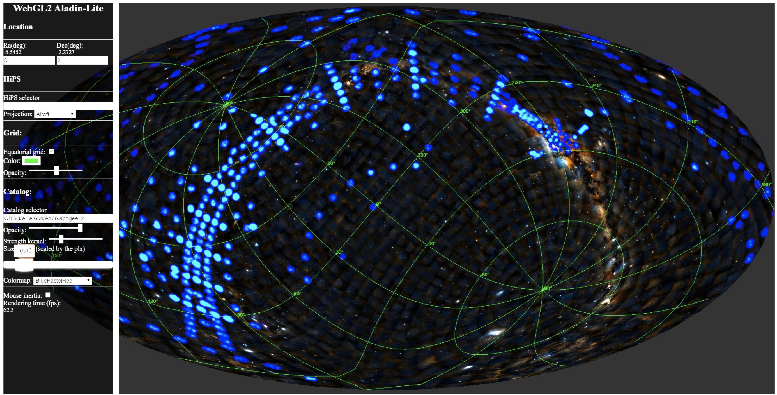
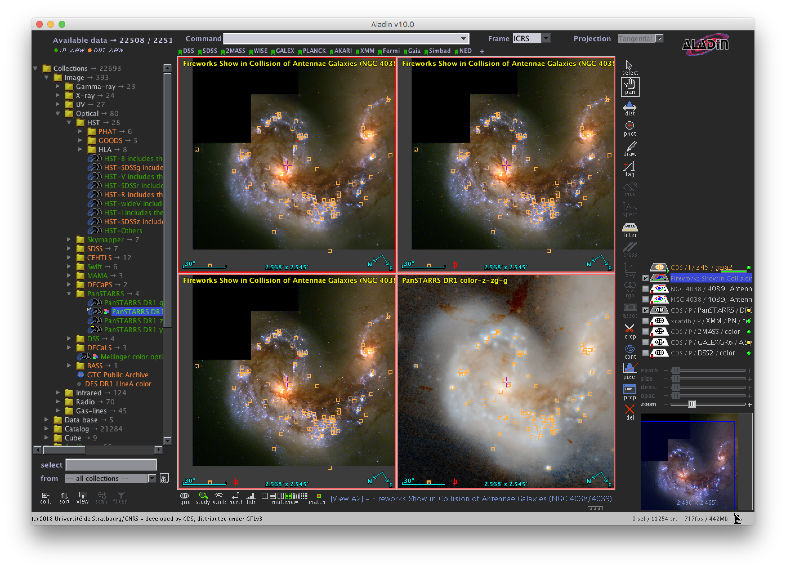
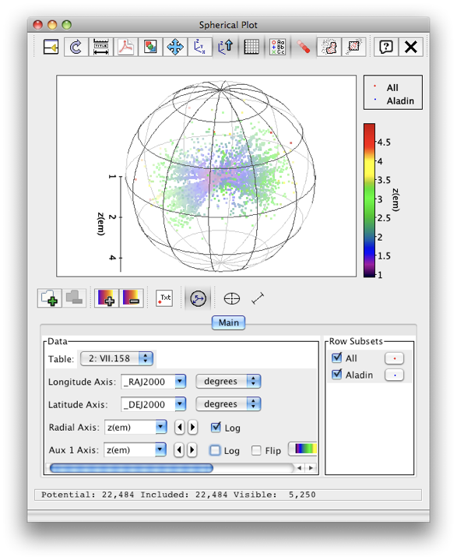
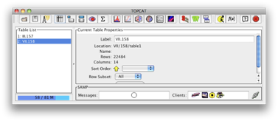
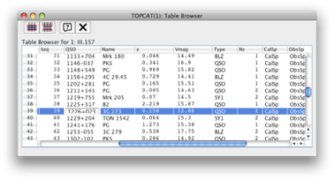
CEVO: VO interoperability in context of ESCAPE / EOSC
New improved WebGL Aladin Lite
Notebooks & Platforms
TOPCAT

Slide 10
WP4 Objectives
Assess and implement the connection of ESFRI and other astronomy research infrastructures to the EOSC by the Virtual Observatory
Refine and pursue implementation of FAIR principles for astronomy data via common interoperability standards - extending the VO to new communities
Establish data stewardship practices for adding value to scientific content of ESFRI data archives

Slide 11
WP4 Tasks
Task 4.1 Integration of astronomy VO data and services into the EOSC
Lead: Marco Molinaro (INAF)
Task 4.2 Implementation of FAIR principles for ESFRI data through the Virtual Observatory
Lead: Françoise Genova (CNRS-ObAS)
Task 4.3 Adding value to trusted content in astronomy archives
Co-leads: Mark Allen (CNRS-ObAS) & Martino Romaniello (ESO)

Slide 12
Progress in year 1 – all tasks active
First 6 months: ramp-up period setting up the work package…
Interaction with all partners ➔ WP4 Detailed Project Plan (D4.1)
Task 4.1 Integration of astronomy VO data and services into the EOSC
Interaction with EOSC bodies, VO registry in B2FIND, tests of service publishing
Task 4.2 Implementation of FAIR principles for ESFRI data through the Virtual Observatory
Milestones – representation of ESCAPE priorities at IVOA level
ESFRI/RI partners requirements defined, results on tools and VO publishing
Task 4.3 Adding value to trusted content in astronomy archives
- First results of machine learning applied to archive data sets

Slide 13
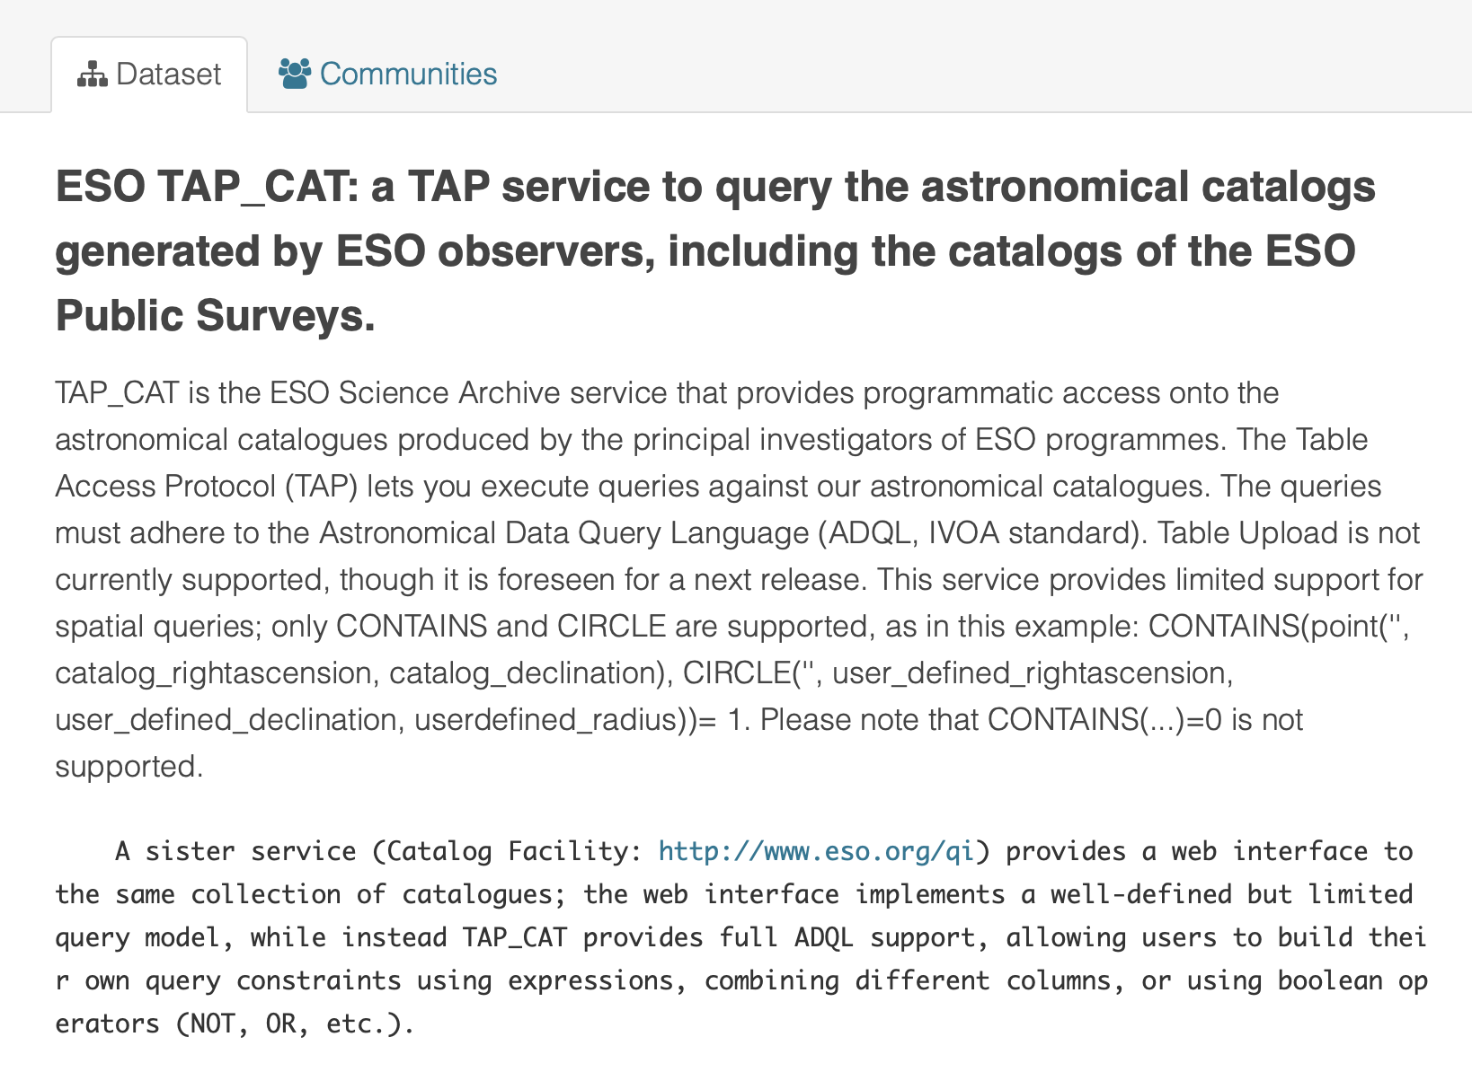
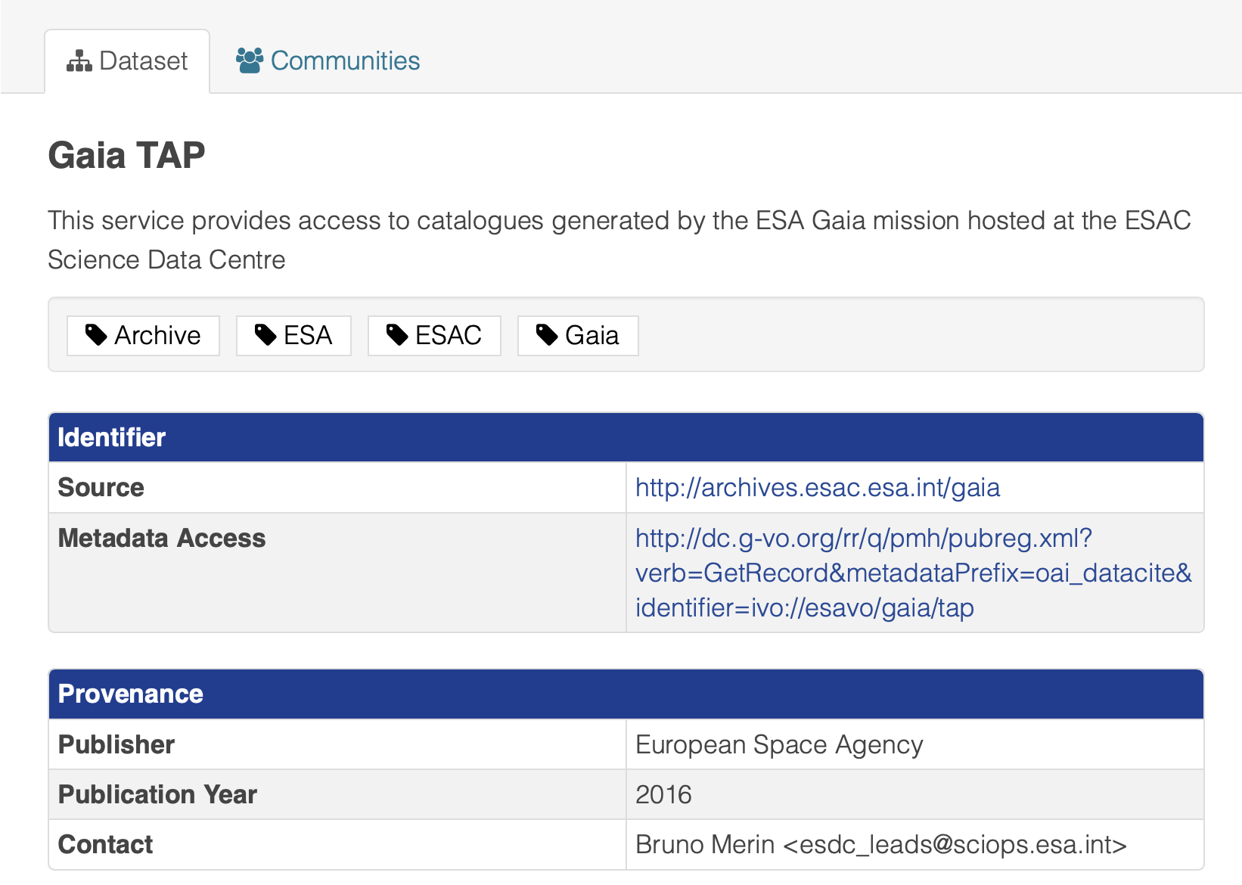
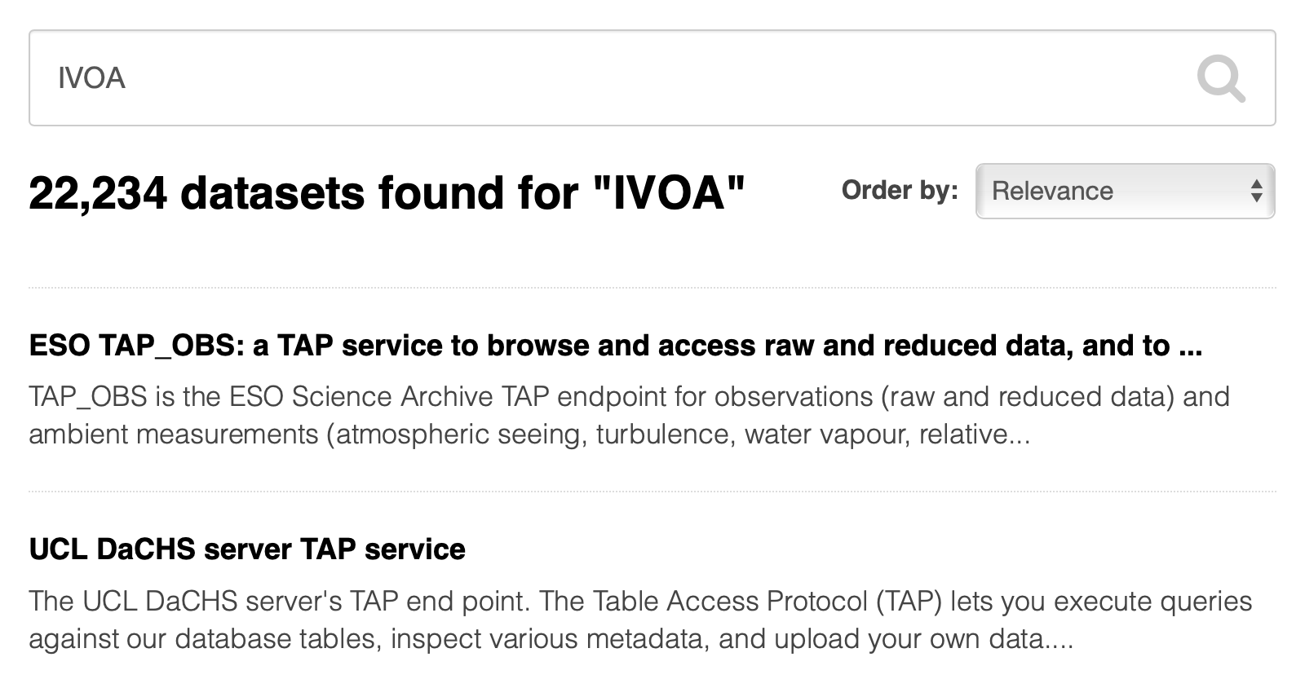
Task 4.1 B2FIND
Demonstrates 1st level of metadata compatibility
Links to the actual service
… but is not intended as a user-interface

Slide 14
Task 4.2 – IVOA Milestones
Common domain-specific standards for FAIR data
First Milestone – Paris IVOA meeting (May 2019)
Introduction of solar physics requirements at IVOA, EST partners
EUDAT participation – registry integration
30 contributions from ESCAPE partners, ESCAPE highlighted at IVOA level
Second Milestone – Groningen IVOA meeting (November 2019)
Focus on Radio/mm astronomy – SKAO, LOFAR, JIVE,ALMA + international radio projects -- leading to IVOA Interest Group on Radio Astronomy
Space-time indexing of astronomy data
22 contributions from ESCAPE partners

Slide 15
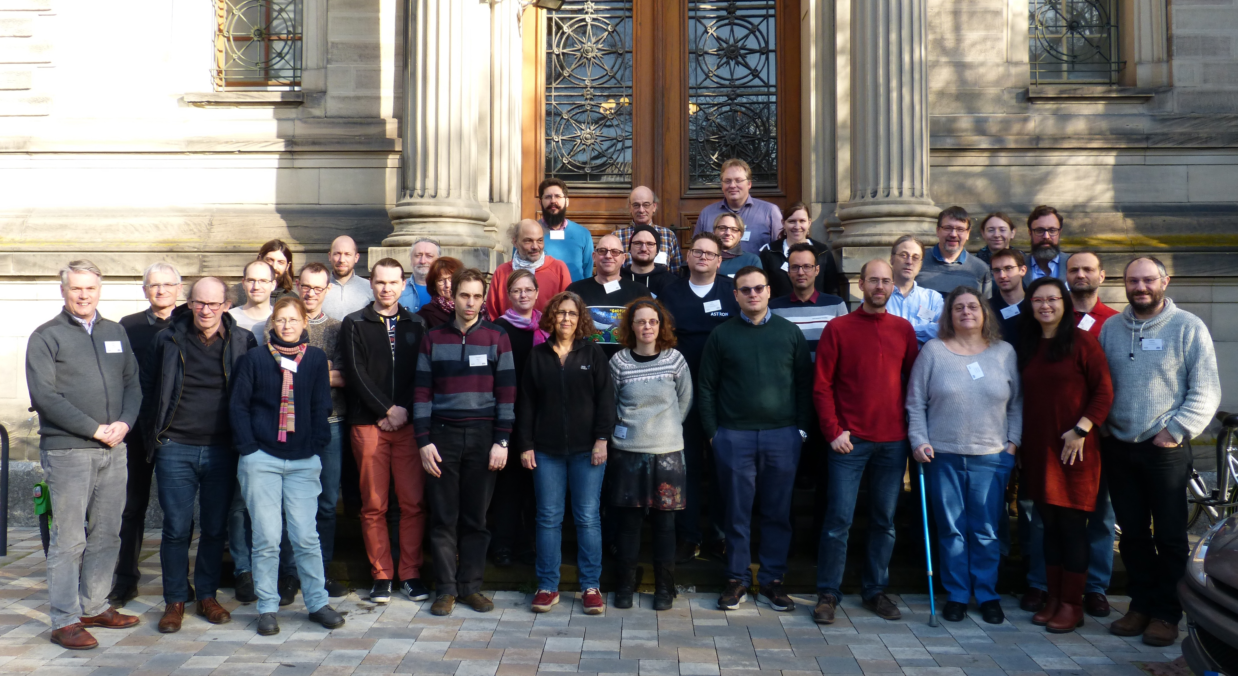
WP4 Technology Forum 1
Major Work Package meeting (+ WP3, WP5 interaction)
Invited experts and collaborators
EUROPLANET, TOPCAT-developer, ObsParis – Radio & Solar expertise, ESA (Videocon)
Progress presentations + Hack-a-thon working meeting sessions
Report of test of the RDA FAIR Data Maturity Model WG
See presentation by F. Genova (tomorrow)
Mapping VO expertise – ESFRI needs
Live demos and coding
Tracking progress

Slide 16
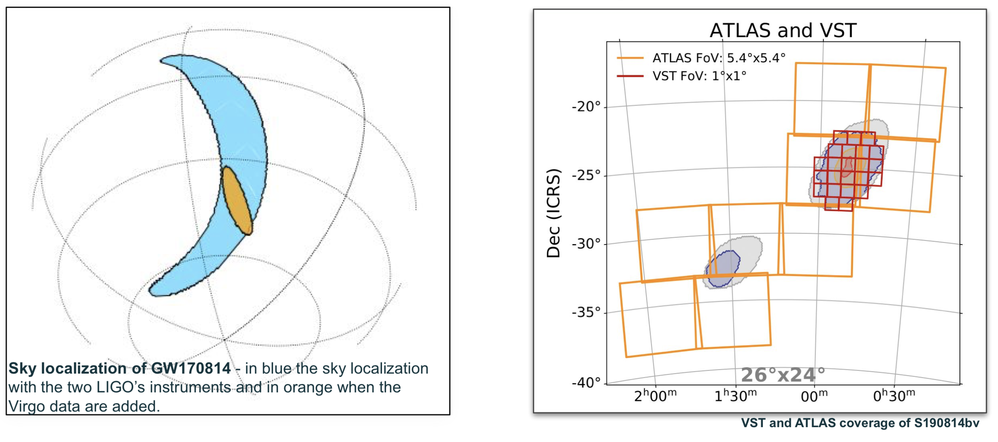
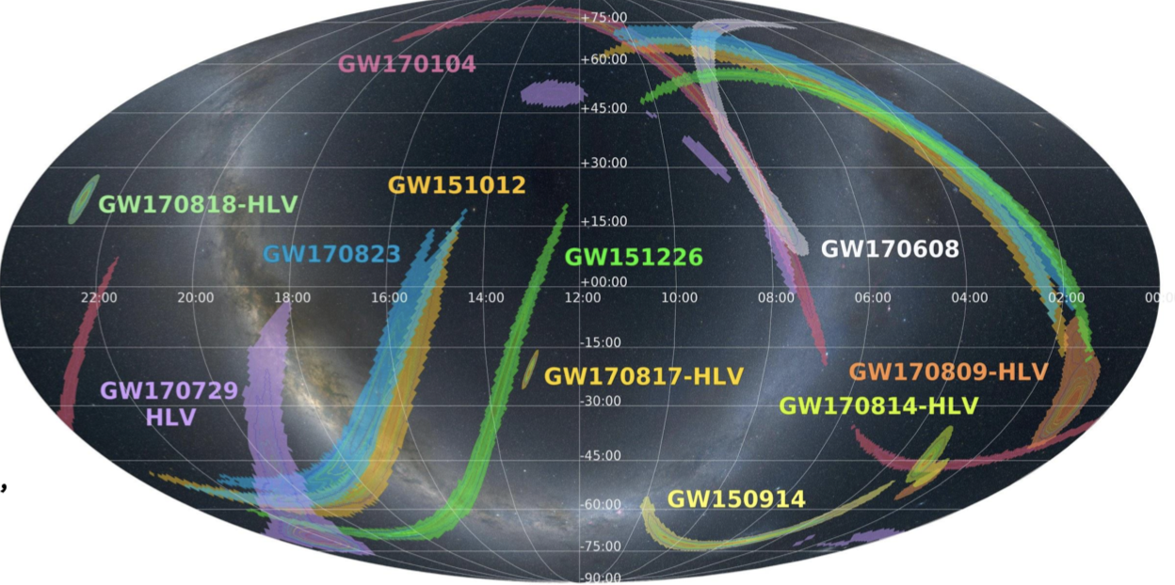
e.g. progress on data access and visualisation
IVOA MOC standard adapted for GW sky localization
Prototype WebGL-enabled visualization component (Aladin Lite) for portals / platforms

Slide 17
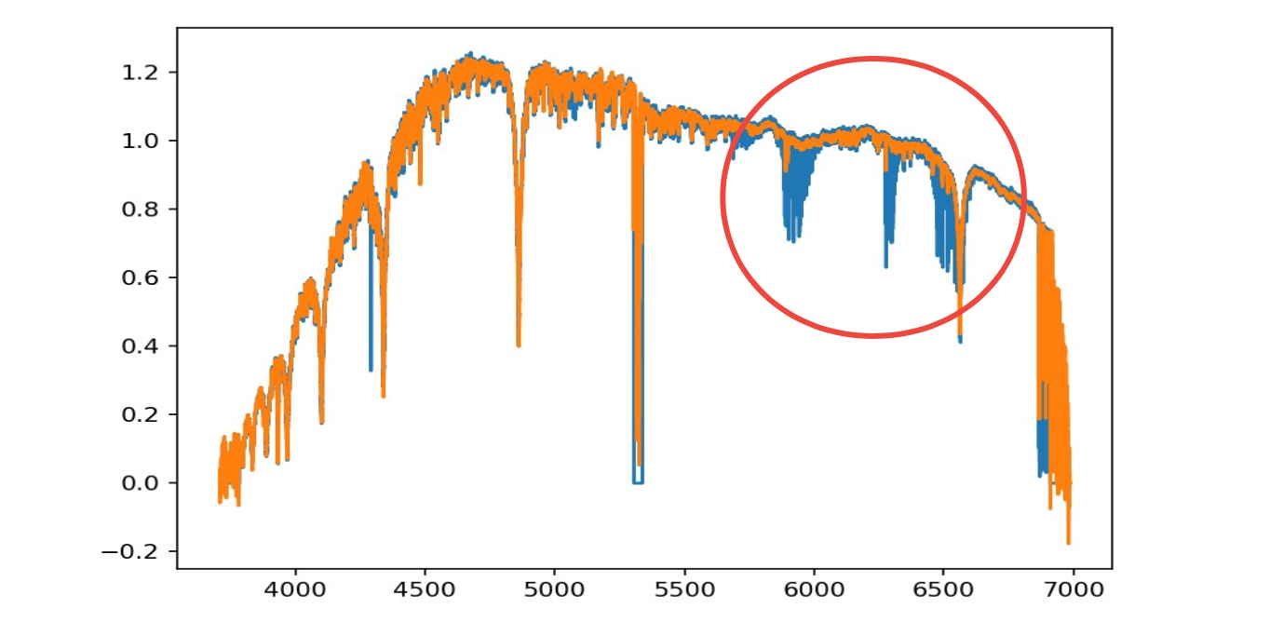
Task 4.3 – Deep Learning and Data Archives
Scope: provide archive users with novel ways to identify data
Beyond query parameters approach – Let the data speak!
Extension of recent move from instrument to data keywords (e.g. exposure time to signal-to-noise
Deep Learning analysis of entire ESO HARPS archive (~270k spectra)
Search for ‘similar spectra’
Different approaches
HITS: fully-connected autoencoder 2 latent dimensions
Agile architecture for speed and interactivity
ESO: combination of convolutional and fully-connected layers with between 4 to 8192 latent dimensions, full spectral resolution
Find minimal representation which preserves all the relevant information

Slide 18
WP4 Opportunities and Challenges
Opportunities take for dissemination / visibility in the community
Research community : European Astronomical Society (EAS/EWASS) (~1200 people)
Astro Archives/Software/Data Services community: ADASS conference (~350 people)
ESA/ESO operations: SCIOPS conference
EOSC and RDA events – EOSC-Hub week, EOSC Symposia, RDA Plenaries
Challenges
Diverse set of ESFRI/RI needs and different levels of development of ESFRI/RI
Required an approach of specific meetings
Explaining EOSC to the research community – while EOSC is being formed

Slide 19
WP4 Next Steps
Technology Forum results – update of the work plan
Compile first results into Deliverable reports:
D4.2 : Intermediate report on the use of IVOA standards – March 2020
D4.4 : Intermediate analysis report of VO data and service integration into EOSC July 2020
IVOA Interoperability meeting – 4-8 May, Sydney – Milestone
1st Science with Interoperable Data School – May 26-28, 2020, Madrid (D4.3)
Continue to increase interaction with other WPs

