Slide 1
Work Package Six: «ECO» Engagement and Communication
Stephen Serjeant, Open University WP6 Lead
Rita Meneses, Trust-IT Services
Mathilde Hubert CNRs-LAPP
ESCAPE All-Hands Meeting, 26° February 2020

Slide 2
Vision
Task 6.1
ESCAPE science community
Mass Participation Experiments
Society at large
Task 6.2

Slide 3
WP6 - Engagement and Communication
“Task 6.1 Public Engagement and Communication”
T6.1 Leader
Timing: M1-M48;
Lead: Trust-IT Services (28PM)
Partners Involved: CNRS-LAPP (12PM) & OU (2PM)
Deliverables:
D6.1 – ESCAPE website live (June19)
D6.2 – Dissemination & Exploitation Plan (Janry20)
D6.3 – Brochure publication (June20)
Contributions requested within the next 6 months:
Blogposts from EOSC WG members
Each 2 months, a WP updated about latest activities
Pieces of news / Webinars of ESCAPE Services & Science projects
Synchronyse our efforts of communication by liaising well with all WPs to ensure that a consistent message is carried out throughout the whole project timeframe

Slide 4
Timeline of activities done in M1-M12 Feb 2019 – Jan 2020
WP6
RDA Plenary - FI
ECFA-NuPECC
-ApPEC - FR
EOSC Symposium - HU
KoM Annecy
1st Press Release
EWAAS -FR
Building EOSC - BE
ADASS - NL
ESA/ESO SCIOPS - ES
Social Media networks
WP5 workshop on Science Platform design and requirements - NL
EOSC Jam Session -IT
Astronomical Data Archives Meeting - AU
New Section: organisation
Workshop: Data Infrastructure and Analysis Platform: defining architecture and implementation plan - NL
CHEP2019 - AU
IBERGRID - ES
Website live
Services branding
1st CS project
1 position statement
Branding, rollup & templates
Website revamp
Open Talks at Open University- UK
REINFORCE KoM - IT
Interviews
Flyer
2 posters
1 poster
M1
M3
M5
M6
M7
M8
M9
M10
M12
D6.1 – ESCAPE project website live
D6.2 - Dissemination and
exploitation plan
Communication & engagement activities in Y1, to support a successful exploitation

Slide 6
WP6 - Engagement and Communication
T6.1
Task 6.1 Public Engagement and Communication” goals
Develop ESCAPE website & portal tailored to different stakeholders & the gateway for the catalogue of services
Share with us relevant updates from your WP
Generate ESCAPE Communication Toolbox (PR, flyers, posters, videos, stands).
To use at events at exhibitions when engaging with stakeholders
Support attendance at external high-level events and meetings.
Get our support on online visibility through social media channels | Fill in the “excel” to track events’ presence.
Disseminate internally ESCAPE results, within the community and beyond.
We are all ESCAPE’s ambassadors
Co-ordinate translation and adaption of resources for different national communities & compile master Classes and MPE online resources (EN, DE, ES, FR & IT)
Establish a dissemination and exploitation plan: KPI definition & monitoring: D6.2 – Dissemination & Exploitation Plan
Support ESCAPE final Event to showcase the final results of the ESCAPE project
Communication & Community User Engagement are continuous tasks, to engage directly with stakeholders with content rich insights

Slide 7
Communication Strategy in ESCAPE
WP6
YEAR 1
CREATE AWARENESS ABOUT ESCAPE
YEAR 2
SERVICE FEEDBACK & TESTING
YEAR 3
SERVICE PROMOTION & DEPLOYMENT IN EOSC
Services
Science Projects
W
H
A
T
Network stakeholders from different backgrounds
Outreach to distinct audiences & future end-users about ESCAPE future developments
Highlight real use-case scenarios between ESCAPE and Science Projects
W
H
Y
Promote interdisciplinary synergies to unlock potential for discovery, to support the implementation of EOSC thanks to open data management
Collect feedback & perform tests with future service users (science projects), to ensure service adoption & sustainability for the long-term. Contribute to EOSC discussions
Deliver the “Astronomy and Particle/Nuclear Physics EOSC cell”, following FAIR principles
HOW
Identify stakeholders & engage with them using adequate communication tools & channels. Create communication pieces to spread the word & raise awareness
Focus on the end-users & obtain testimonials from them
Workshops & schools, perform assessments, develop initial pilots and test science projects, publish stories from science projects to demonstrate service value propositions & engage directly with stakeholders.
Promote the ESCAPE EOSC cell across sectors, organise workshops for service final training, consolidate synergies with EOSC & leverage with international initiatives/player
Increase stakeholders’ engagement to stimulate adoption of ESCAPE results

Slide 8
Editorial Plan – What is next?
T6.1
User-stories: ESCAPE services vs each Test Science Project (TSP)
Interviews and/or news articles with testimonials
Webinars to showcase first collaboration results from ESCAPE vs research infrastructures
Max 30-second videos for each TSP
ESCAPE WPs updates: bi-monthly WPs updates on the website
Each month to have 1 dedicated news piece from 3 ESCAPE WPs
ESCAPE Services: publish dedicated news of each ESCAPE service
ESCAPE OSSR news article is online
ESCAPE & EOSC: ESCAPE contribution to EOSC
Video
Blogposts from members part of the EOSC WGs.
News articles about ESCAPE in FAIRsFAIR EGFC
Deliverables: concise news piece about the
purpose, results, end-user benefits and conclusion
Others: presence at 3rd party events & ESCAPE workshops
Testimonials from end-users
Ensure both ESCAPE’s website & social media channels require continuous & timely dissemination of each WP developments, to effective engagement with each stakeholder group

Slide 9
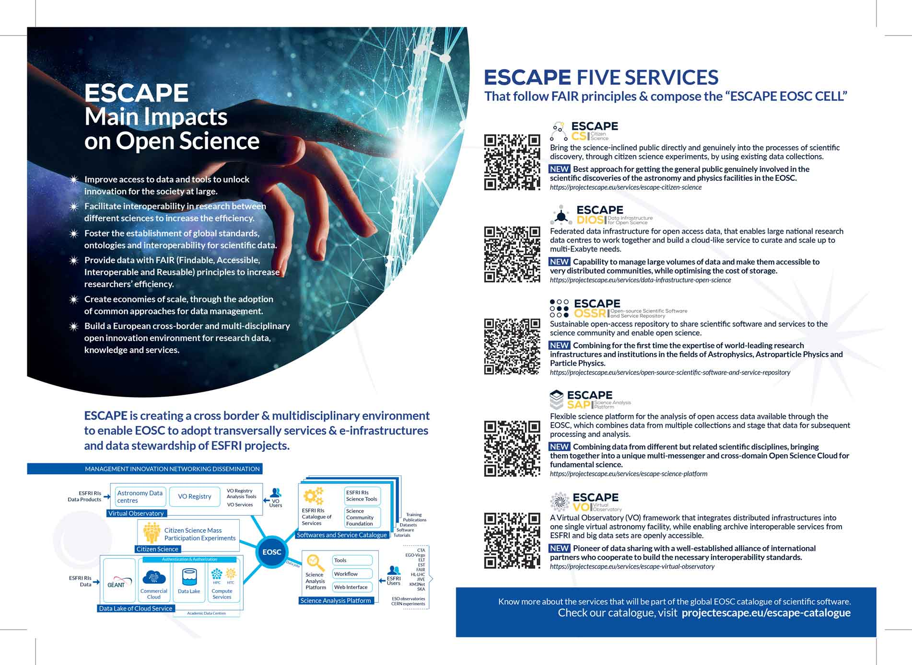
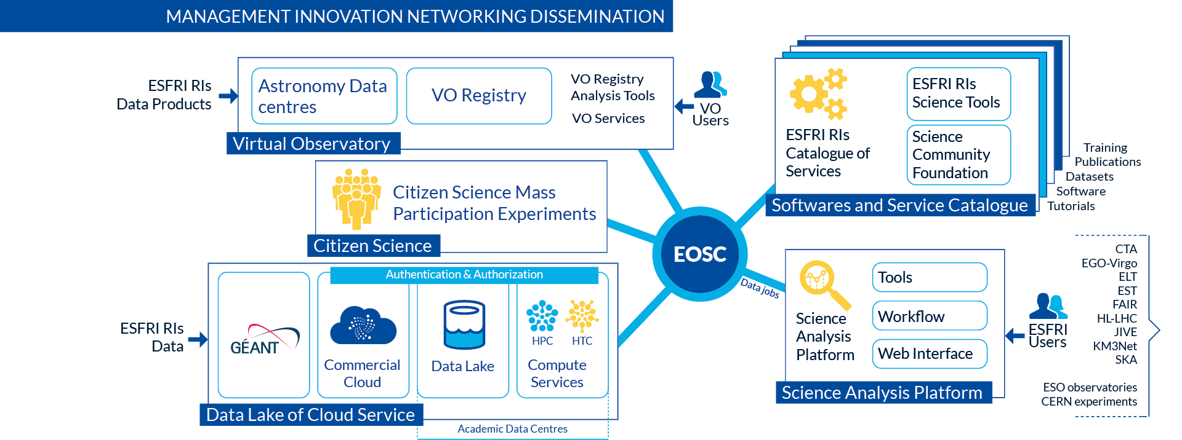
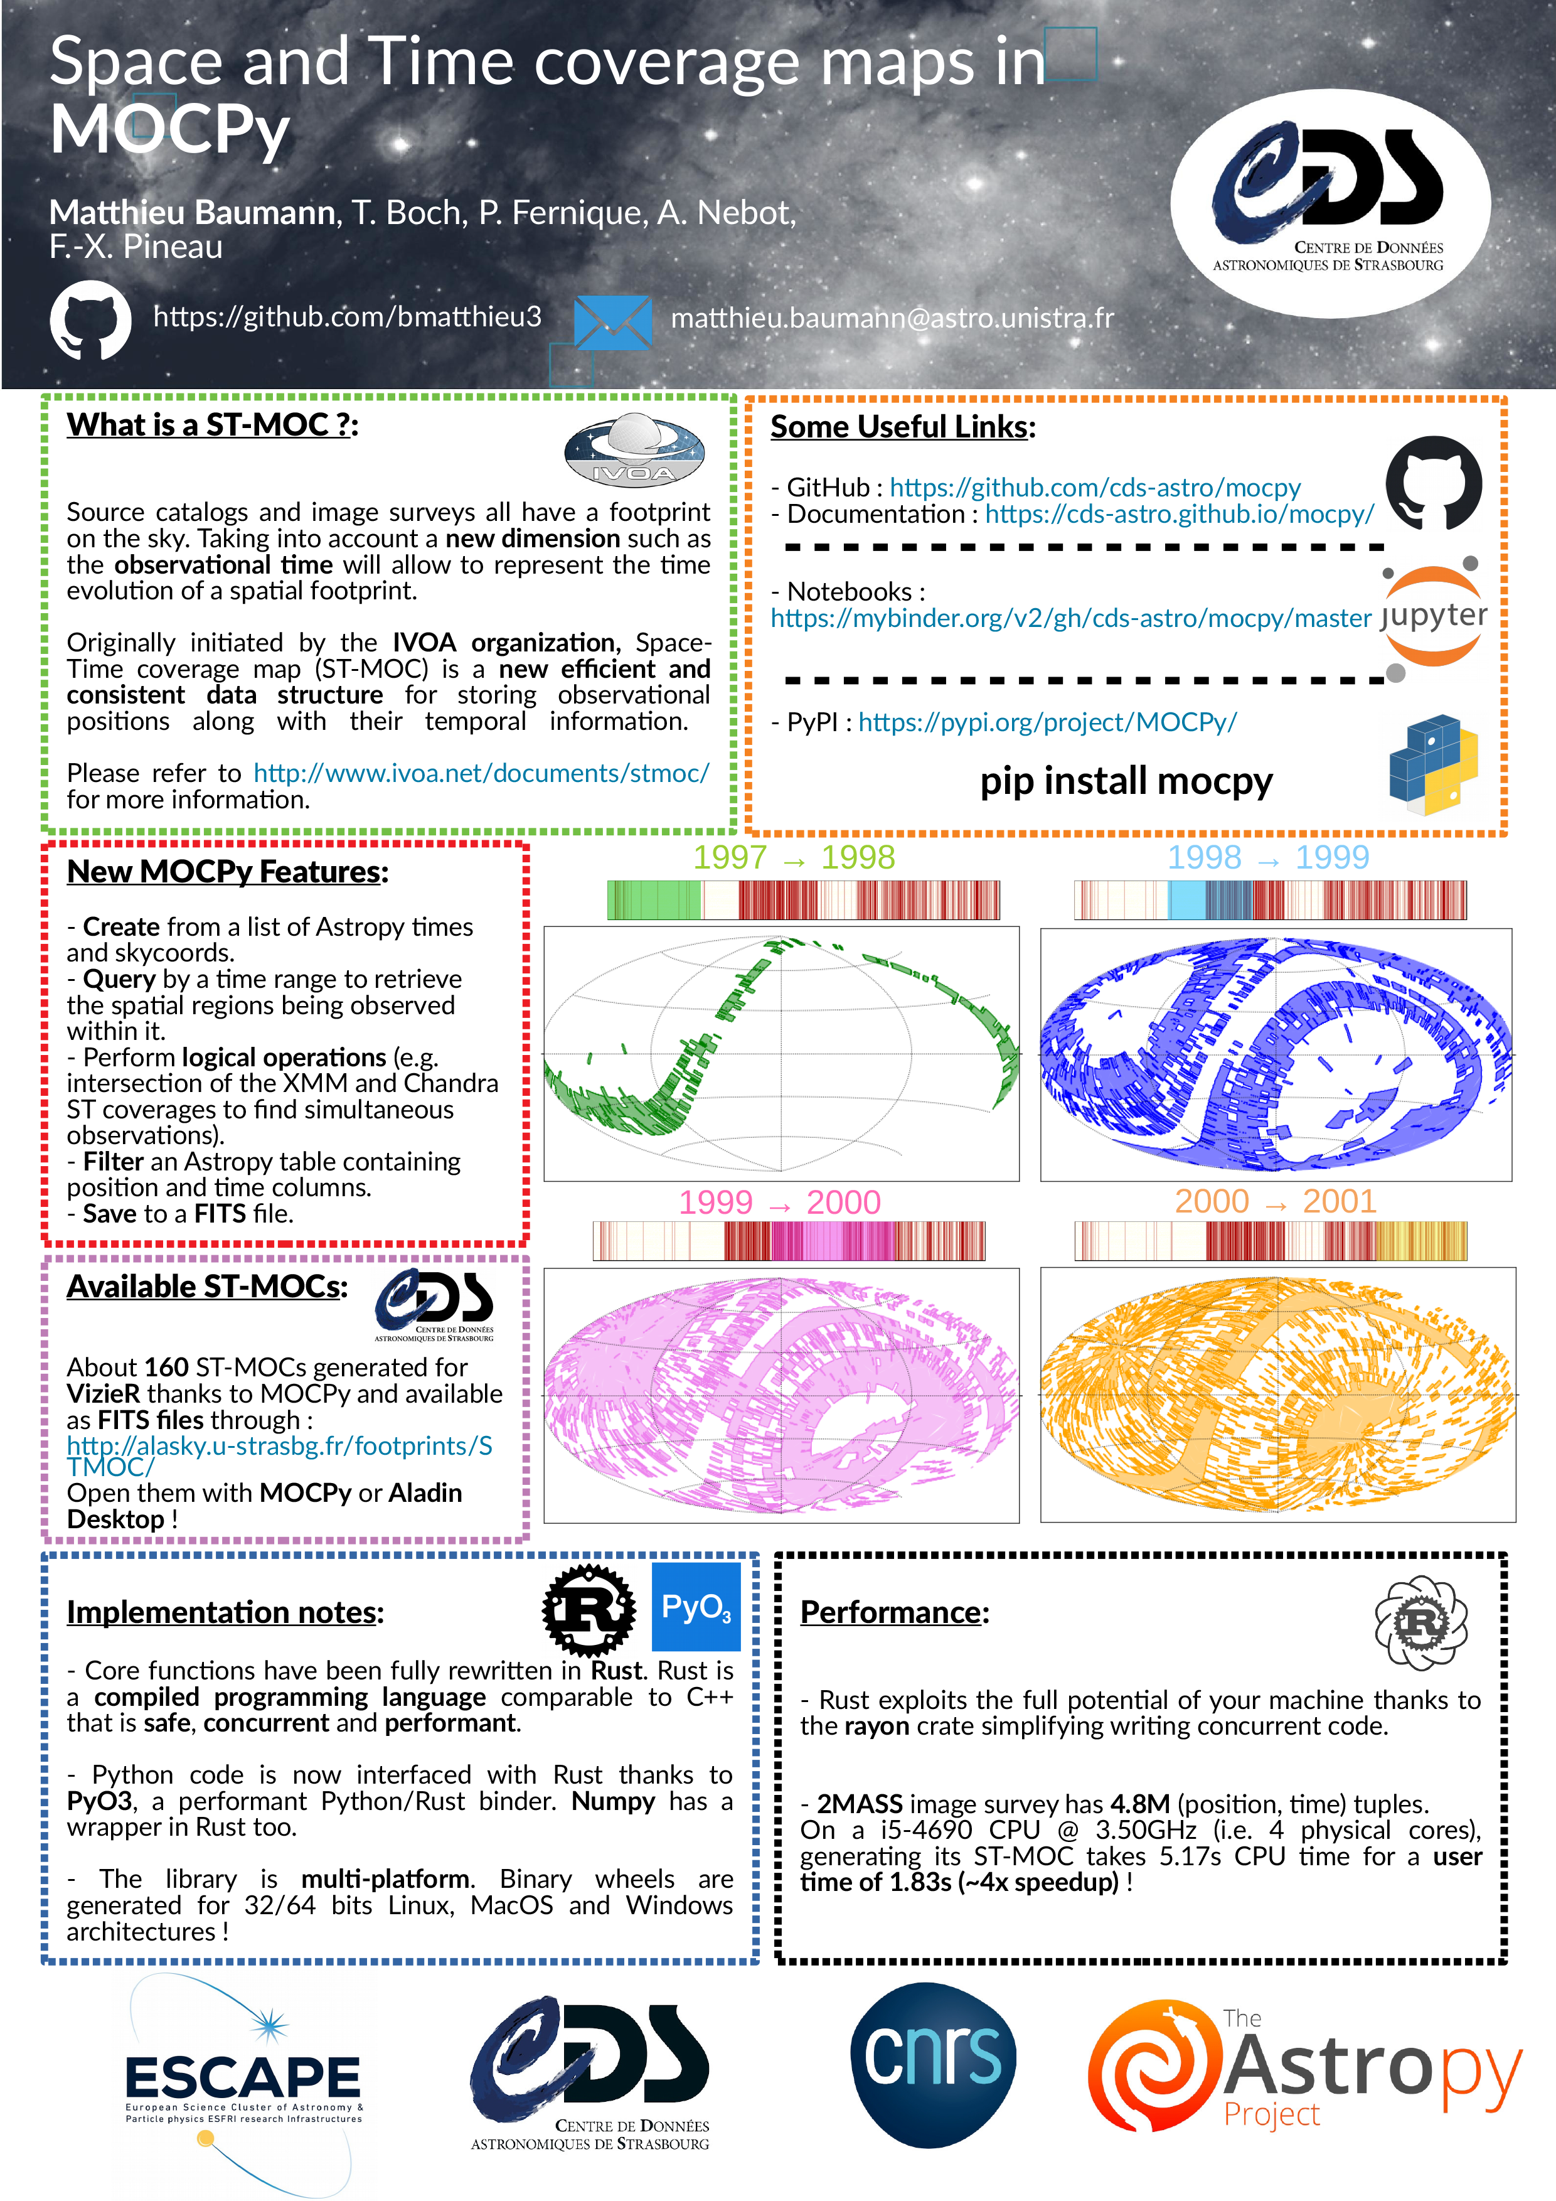
Branding & Comm material
T6.1
PRINTED MATERIALS
Available in the Comm-kit area of the website
DIGITAL MATERIALS
FLYERS
PRESS RELEASE
PROJECT LOGO & PPT / WORD TEMPLATES
Flyers
5 SERVICE LOGOS (+ 2 REBRANDED)
Flyer 1
D6.3 completed in M5
Flyer 2 – M13
Press Release – M1
Rebranded logos by M13
INFOGRAPHICS & SOCIAL MEDIA IMAGES
POSTERS
ROLLUP BANNERS
By M12 & M13
VIDEOS
Poster 1, Poster 2 – ADASS Conference, M9
Poster 3 –EOSC Symposium M10
Rollup Banners:
M1 & M13
3 Videos – Month 4, Other Videos to be produced
Communication Channels & Materials to set the basis for stakeholders’ engagement

Slide 10
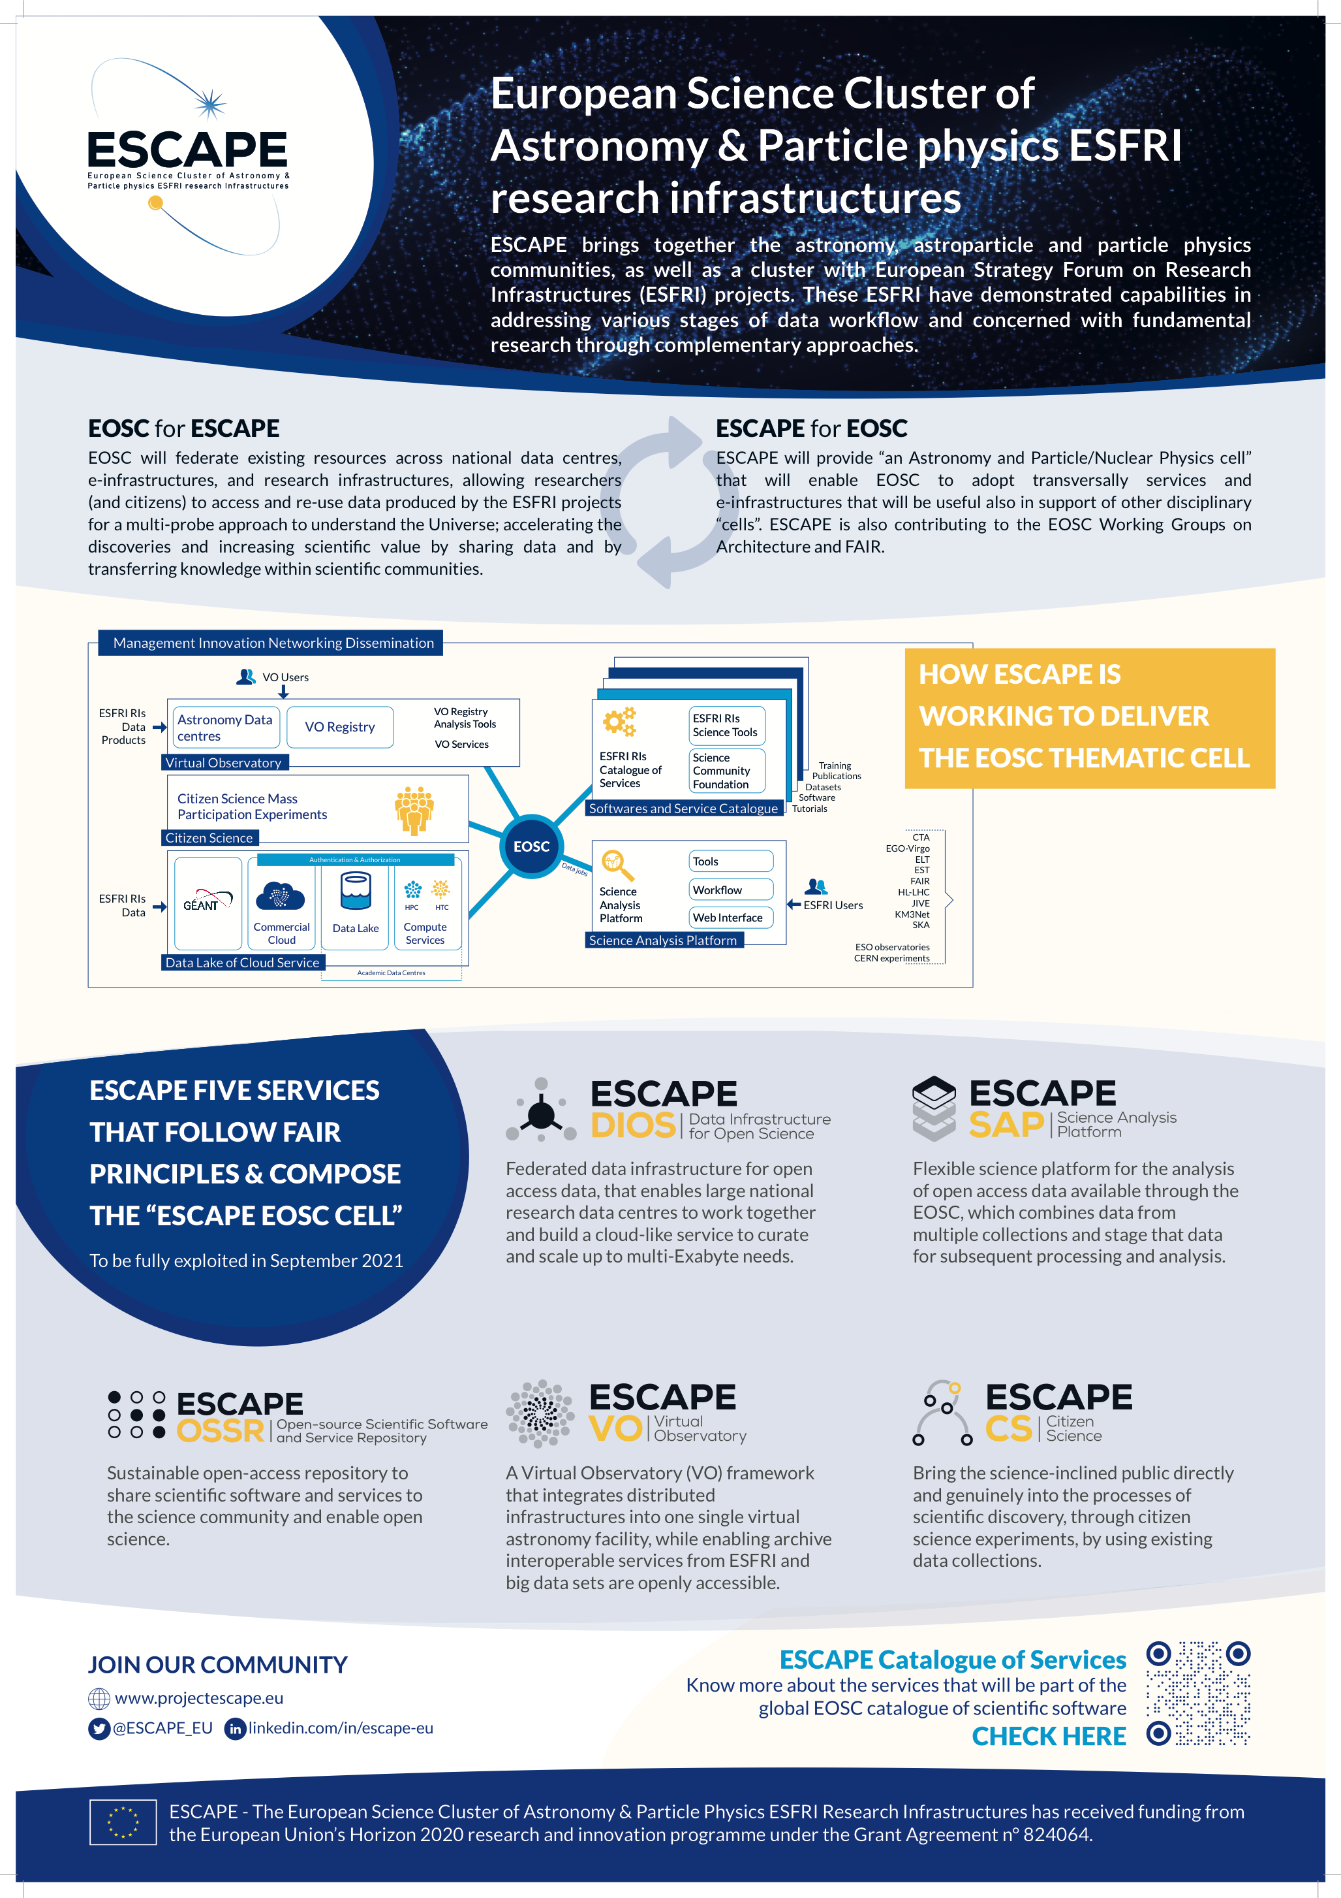
Branding & Communications material
T6.1

Slide 11
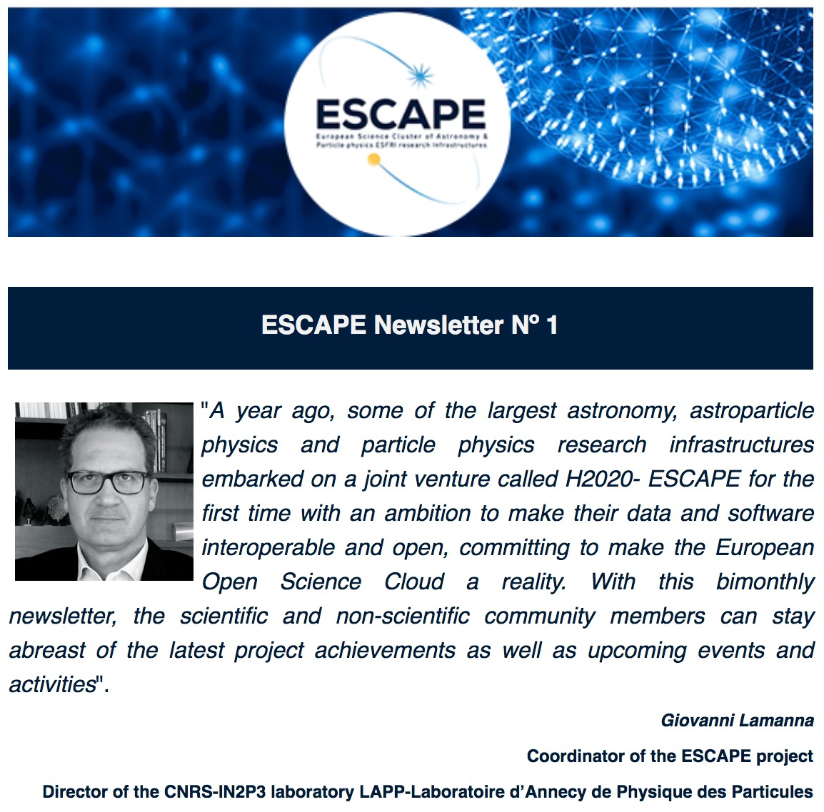
Branding & Communications material
T6.1

Slide 12
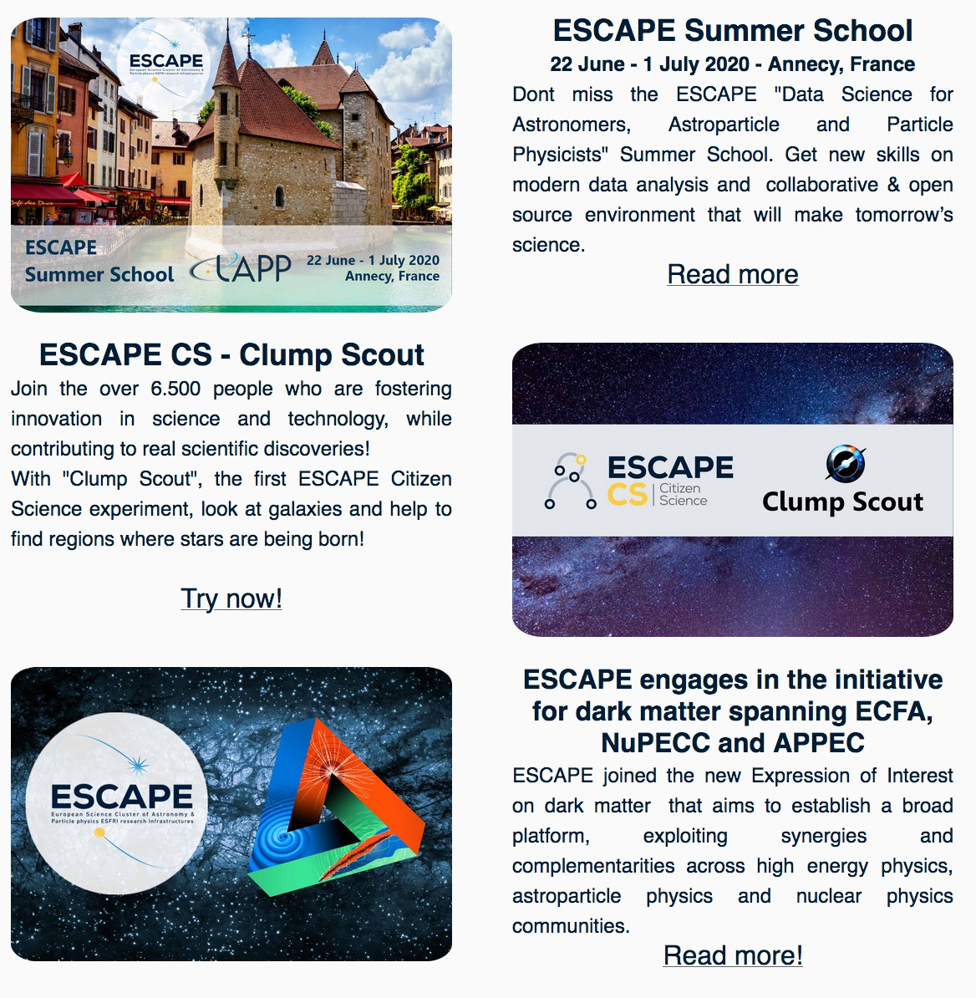
Branding & Communications material
T6.1

Slide 13
Website Evolution
T6.1
Website 1° Version – M5
New URL: projectescape.eu
New sections:
Services, Science Projects, News, Events, Deliverables and Presentations, About us,
Access Internal Tools for Partners;
Website 2° Version – M8
UPDATES SINCE WEBSITE LAUNCH
Included Newsletter subscription form
New website search box
Revamped sections: Comm-Kit, Citizen Science Page and Organisation Section
Waiting for WP1 & WP4 info for the website
Submission of “D6.1 – ESCAPE Website live” by M8
RESULTS BY JANUARY 2020
Nº Visitors → 2.351
Page Views → 13.910 (Jan 2020)
The exploitation plan after ESCAPE conclusion?
Online catalogue of ESCAPE services
What else?
Website continuous improvements to better disseminate ESCAPE’s results

Slide 14
Website Evolution
T6.1

Slide 15
Website Evolution
T6.1
.

Slide 16
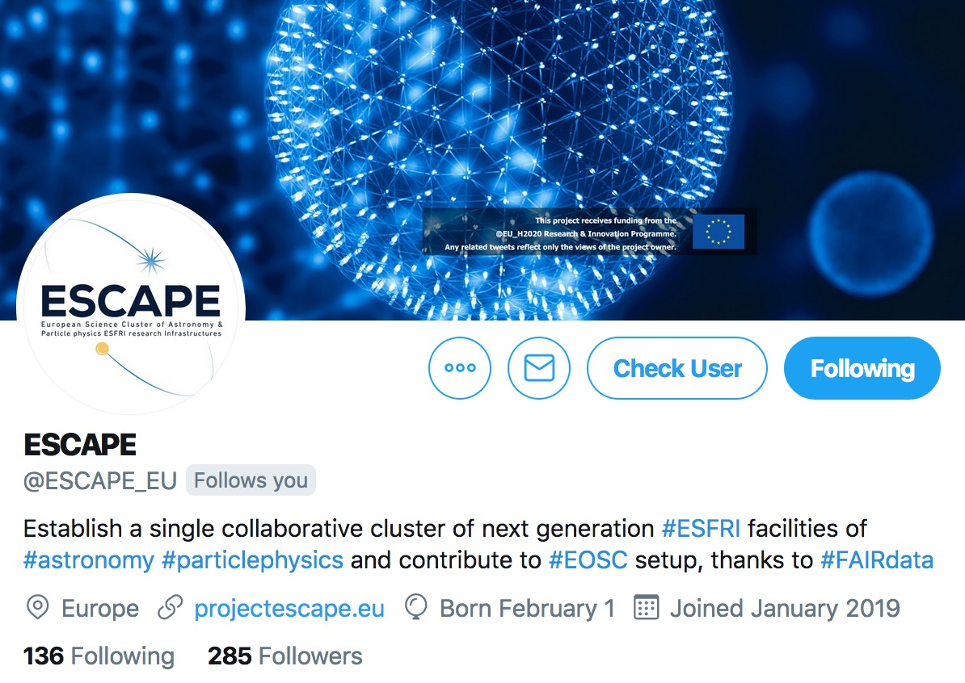
Social media Channels
T6.1

Slide 17
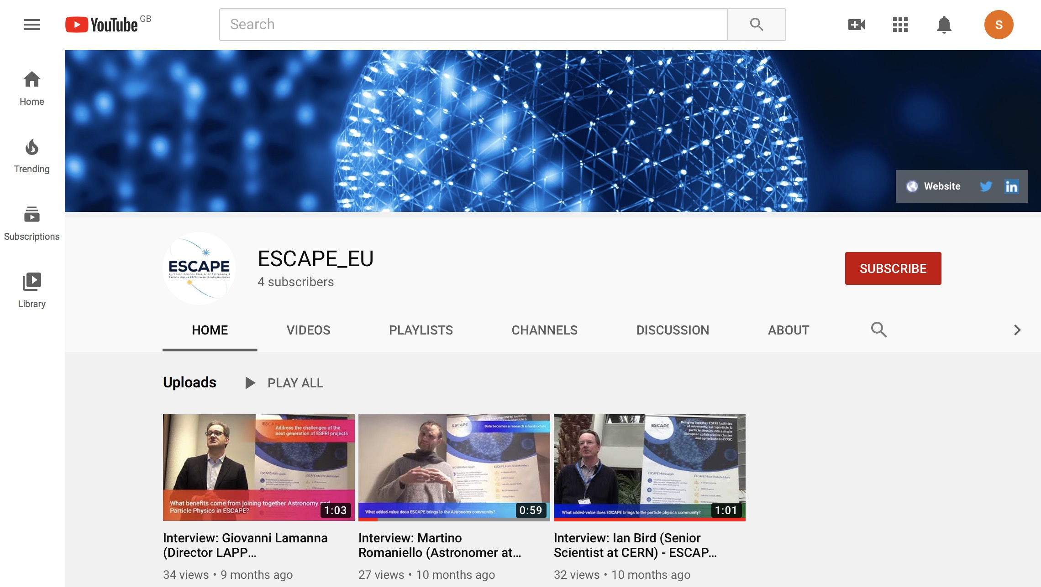
Social media Channels
T6.1

Slide 18
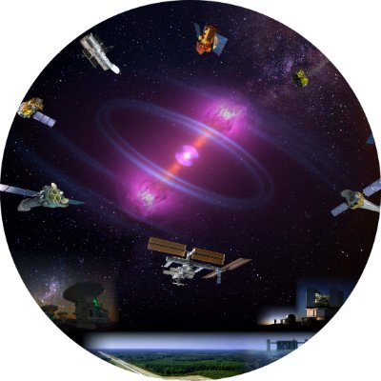
Visibility at events
T6.1
Astronomy, astroparticle, particle & nuclear physics events
Joint ECFA-NuPECC-ApPEC Data Archives
24th Conference
on Computing
in High-Energy
& Nuclear Physics
ESA/ESO SCIOPS workshop
Astronomical Data Archives
IBERGRID
2nd IVOA - ADASS
June 2019
Lyon, France
August 2019
Sydney, Autralia
September 2019
Compostela, Spain
October 2019
Groningen, The Netherlands
October 2019
Orsay, France
November 2019
Adelaide, Australia
November
Madrid, Spain
Astrophysicists
Astronomers & Data Managers
Software developers, data managers & computing professionals
Astronomers Data Analysis & Software Systems
Data science and astroparticle physics professionals
Computing professionals from High Energy and Nuclear Physics.
ESA and ESO communities concerned with “cross-facility coordination in the multi-messenger era”
EOSC related events
Other events
ESFRI RIs
& EOSC Workshop
Building EOSC through the H2020 projects
EOSC Services, Collaborations
& the RDA
EOSC Symposium
Open talks at Open University
Reinforce kick-off meeting
November 2018
Austria
January 2019
London,UK
June 2019
Turin, Italie
September 2019
Brussels, Belgium
October 2019
Helsinki, Finland
November 2019
September 2019
Online event
December 2019
Pisa, Italy
Research Communities
& Policy Makers
ESFRI & EOSC stakeholders
EOSC & Clusters projects
EOSC related projects
EOSC & Research Data Communities
EOSC Communities, Research, Industries, Policy Makers
Students
& general public
Academia
& citizen science professionals
Total of 15 events, reaching different stakeholders

Slide 19
Vision
Task 6.1
ESCAPE science community
Mass Participation Experiments
Society at large
Task 6.2

Slide 20
T6.2 Timeline of Actions & Outlook for M1-M48
D6.6: Citizen Science experiments & education
Branding & Identity
KoM Annecy
Recruit ML/CS PDRA
D6.4: Citizen Science experiments & education
D6.5: Promotional videos
Final Event
M0
M1
M5
M24
M36
M41
M48
Two hands-on workshops to generate projects for D6.4 and D6.6
e-eco@escape2020.eu

Slide 21
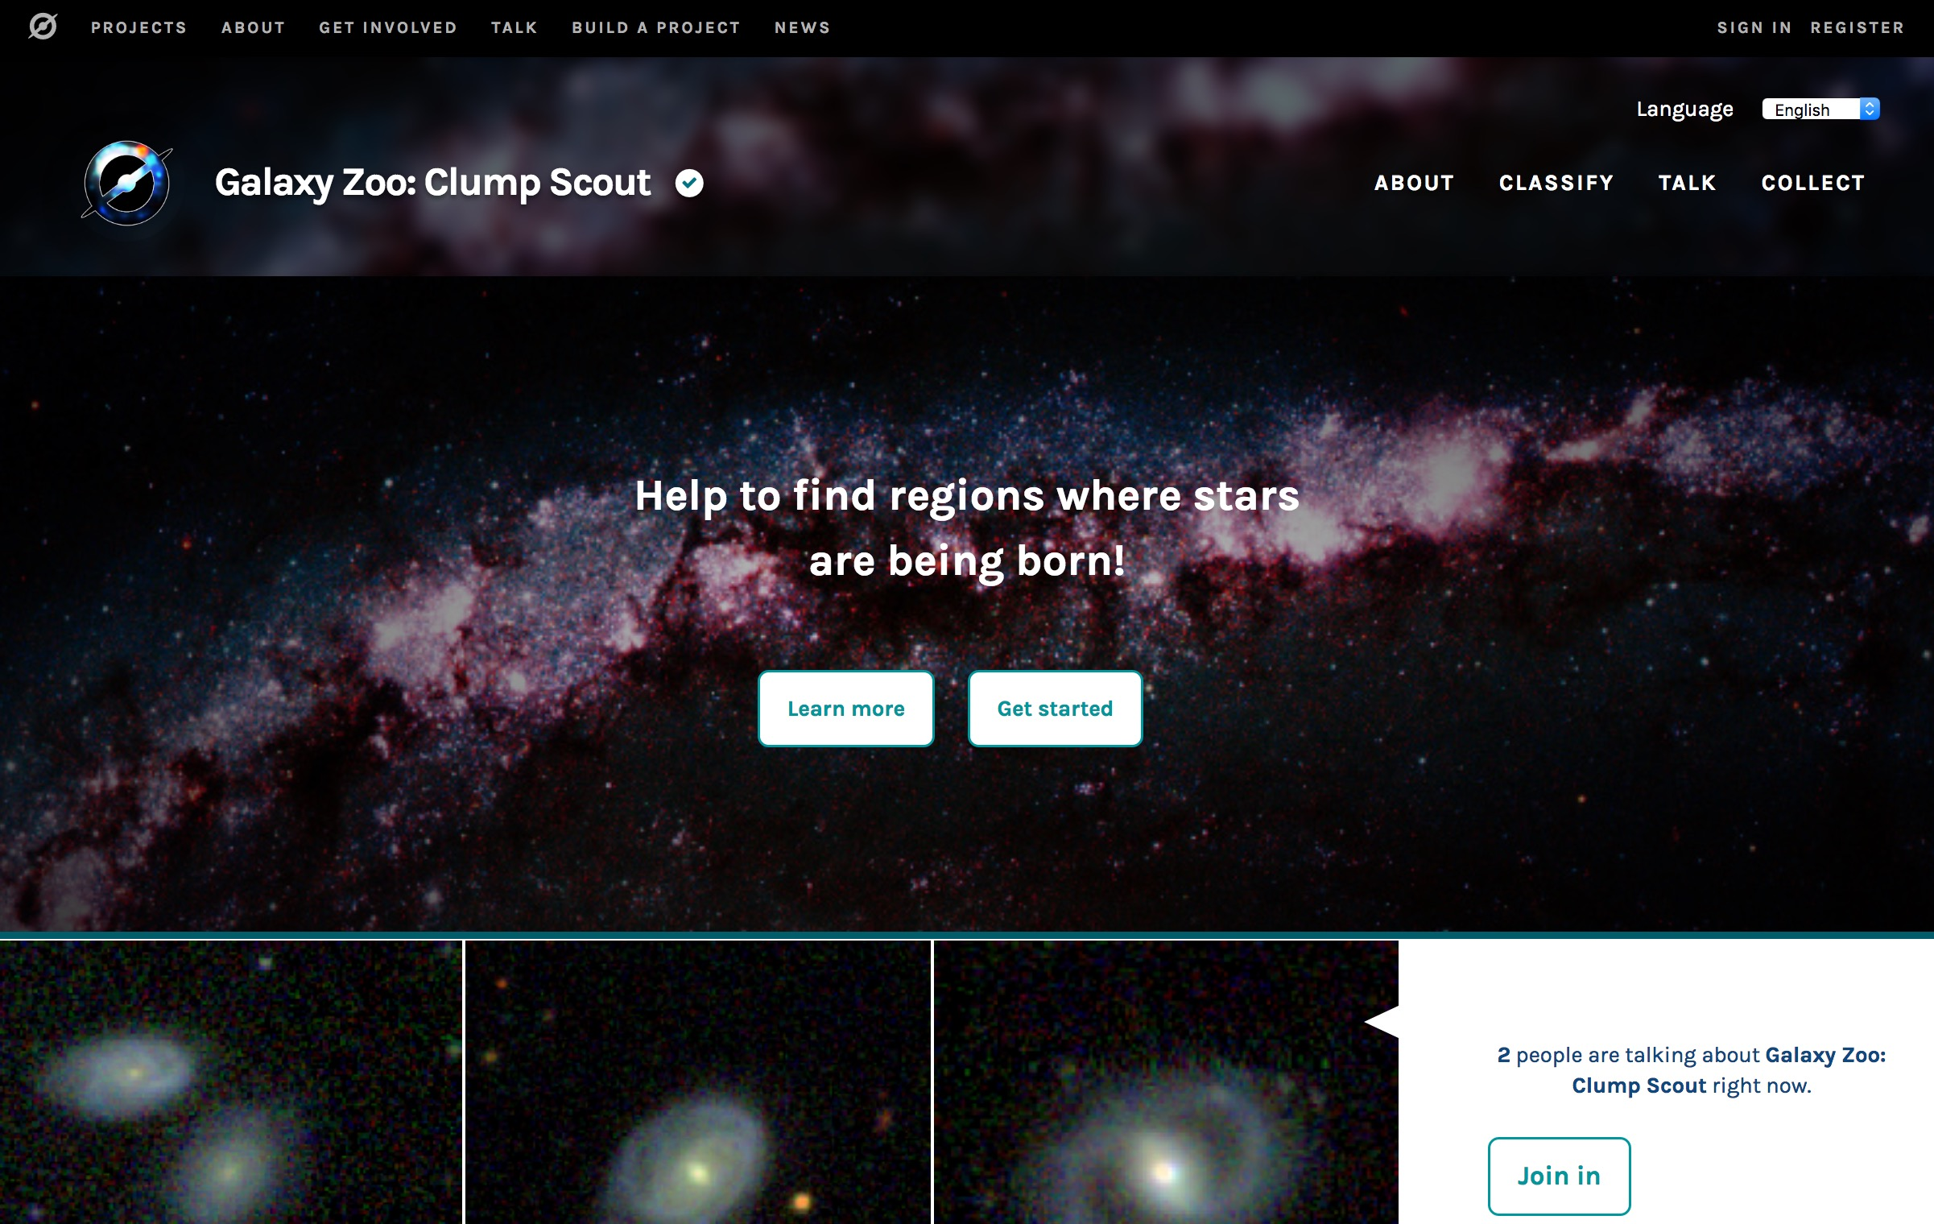

Slide 22
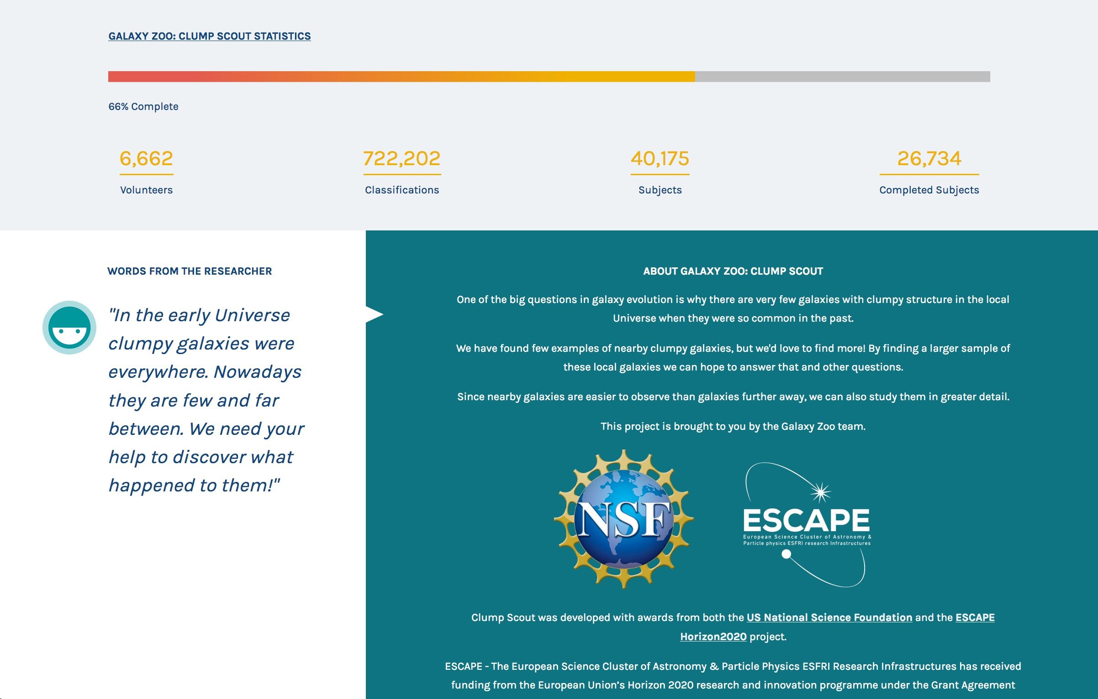

Slide 23
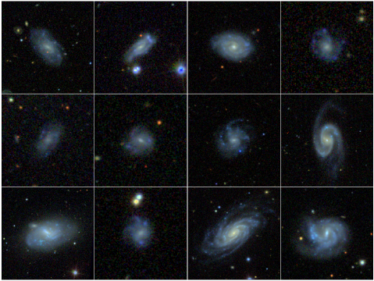

Slide 24
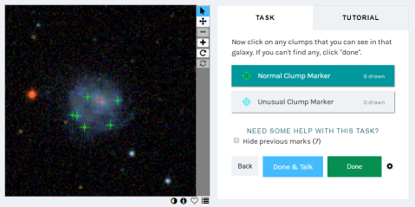

Slide 25
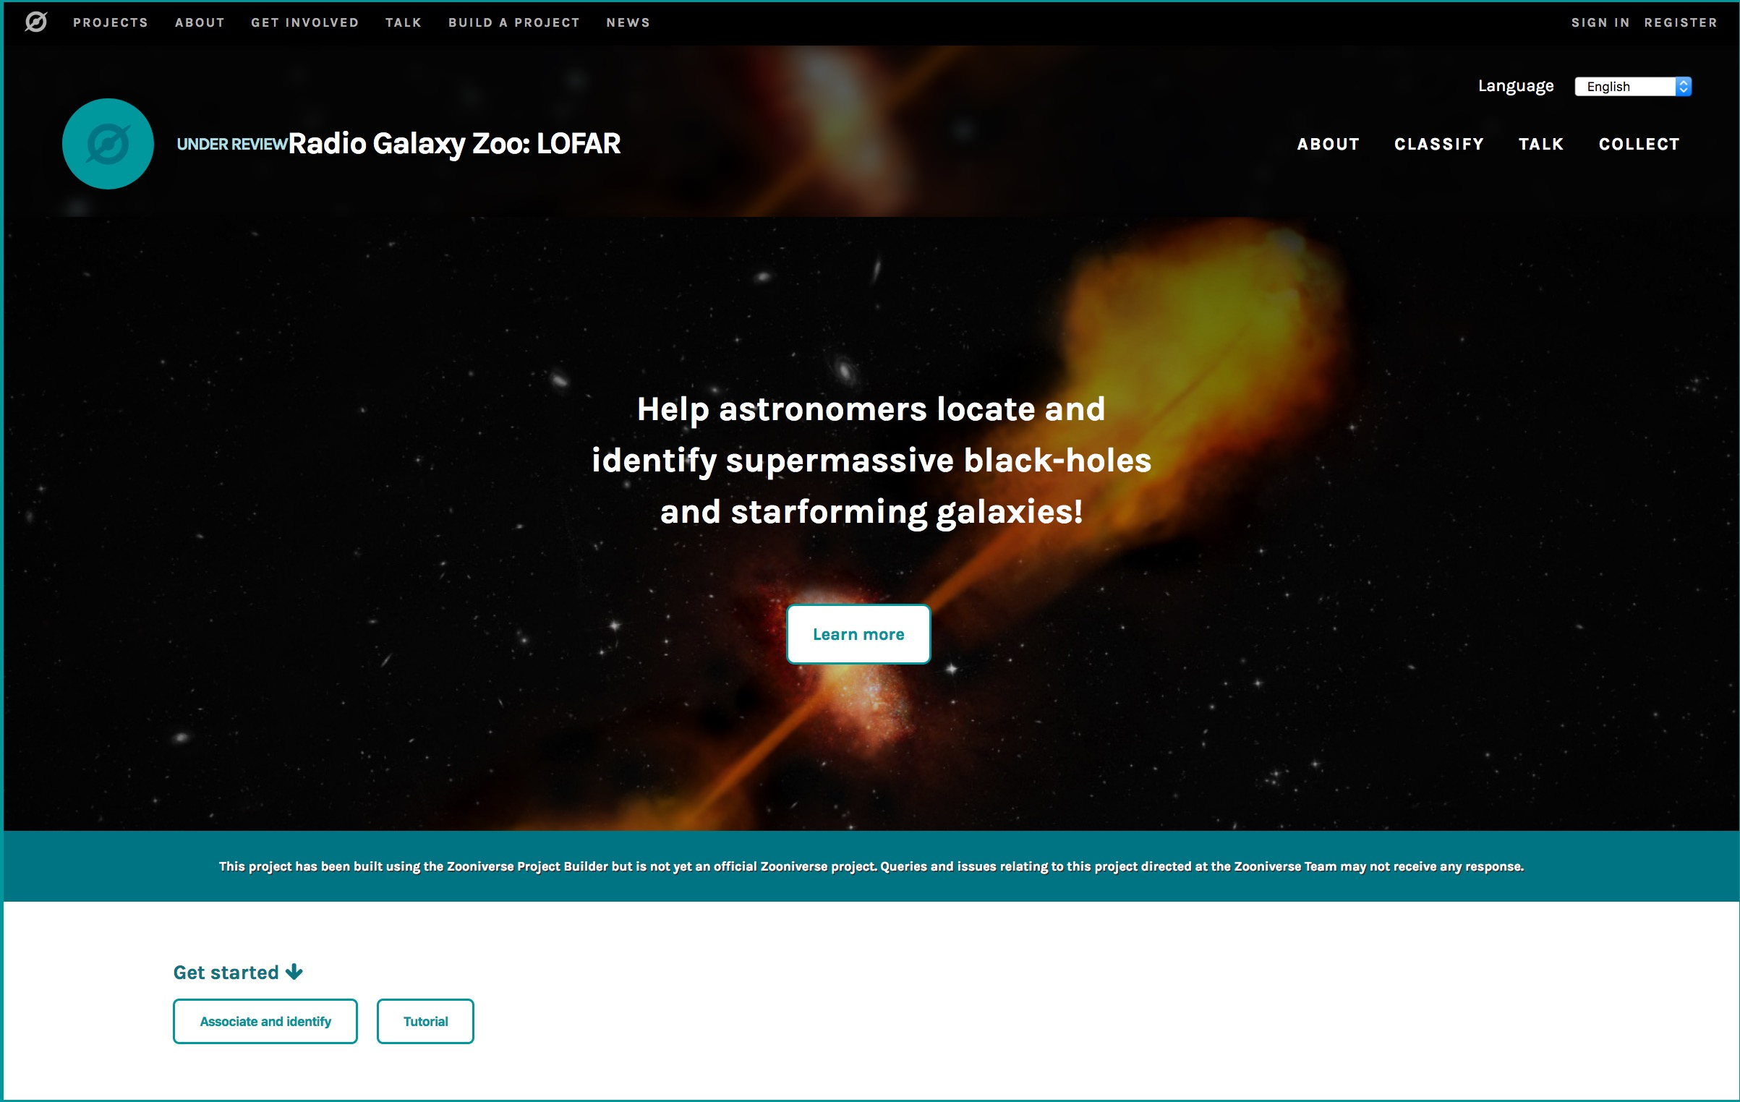
STOP PRESS:
LAUNCHED TUE 25 FEB

Slide 26
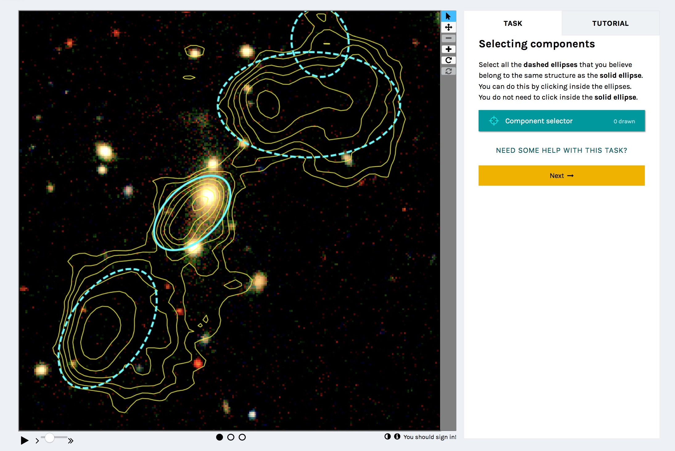
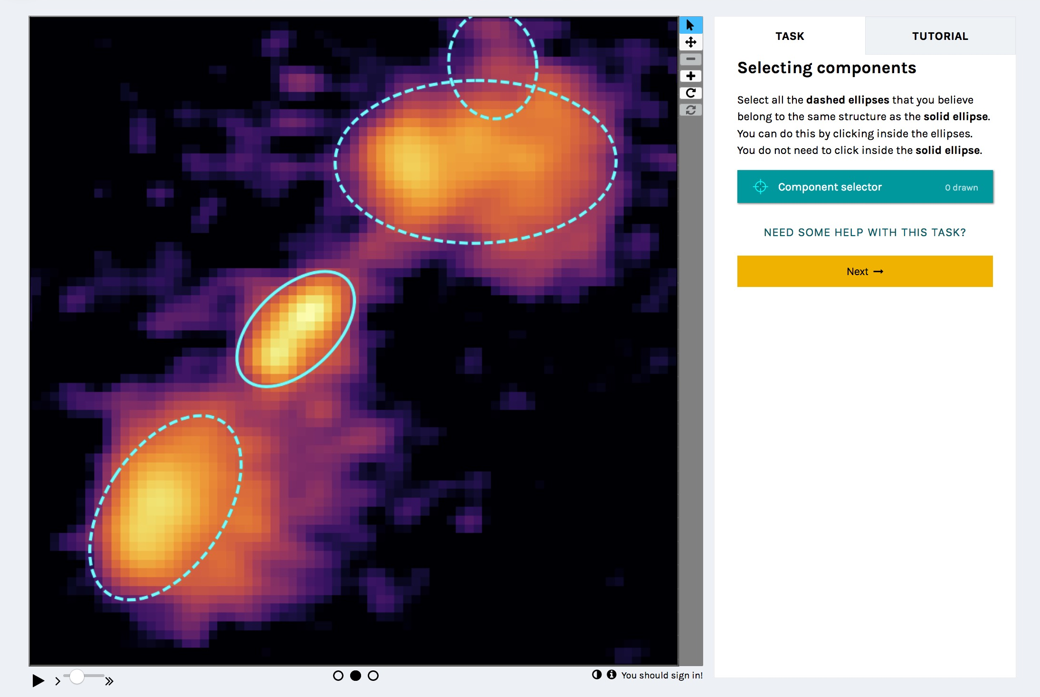
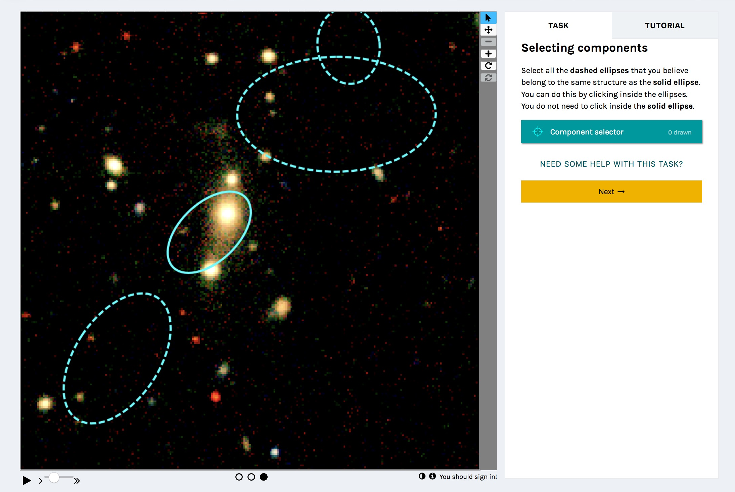

Slide 27
T6.2 Timeline of Actions & Outlook for M1-M48
D6.6: Citizen Science experiments & education
Branding & Identity
KoM Annecy
Recruit ML/CS PDRA
D6.4: Citizen Science experiments & education
D6.5: Promotional videos
Final Event
M0
M1
M5
M24
M36
M41
M48
Two hands-on workshops to generate projects for D6.4 and D6.6
e-eco@escape2020.eu

Slide 28
T6.2 Timeline of Actions & Outlook for M1-M48
D6.6: Citizen Science experiments & education
Branding & Identity
KoM Annecy
Recruit ML/CS PDRA
D6.4: Citizen Science experiments & education
D6.5: Promotional videos
Final Event
M0
M1
M5
M24
M36
M41
M48
HANDS-ON ZOONIVERSE WORKSHOP IN JULY 2020 – DETAILS SOON AND TASTER TODAY!
e-eco@escape2020.eu

Slide 29
Thank you very much!
Stephen Serjeant: stephen.serjeant@open.ac.uk
Rita Meneses: r.meneses@trust-itservices.com
Mathilde Hubert: hubert@lapp.in2p3.fr
Follow ESCAPE on
@ESCAPE_EU
linkedin.com/company/projectescape/
youtube.com/channel/UC05braEQdP2rCSUamHm9I_Q

