Slide 1
GATE status and future perspectives
David Sarrut
University of Lyon
CREATIS, CNRS UMR5220, Inserm U1044, INSA-Lyon, Université Lyon 1, France

Slide 2
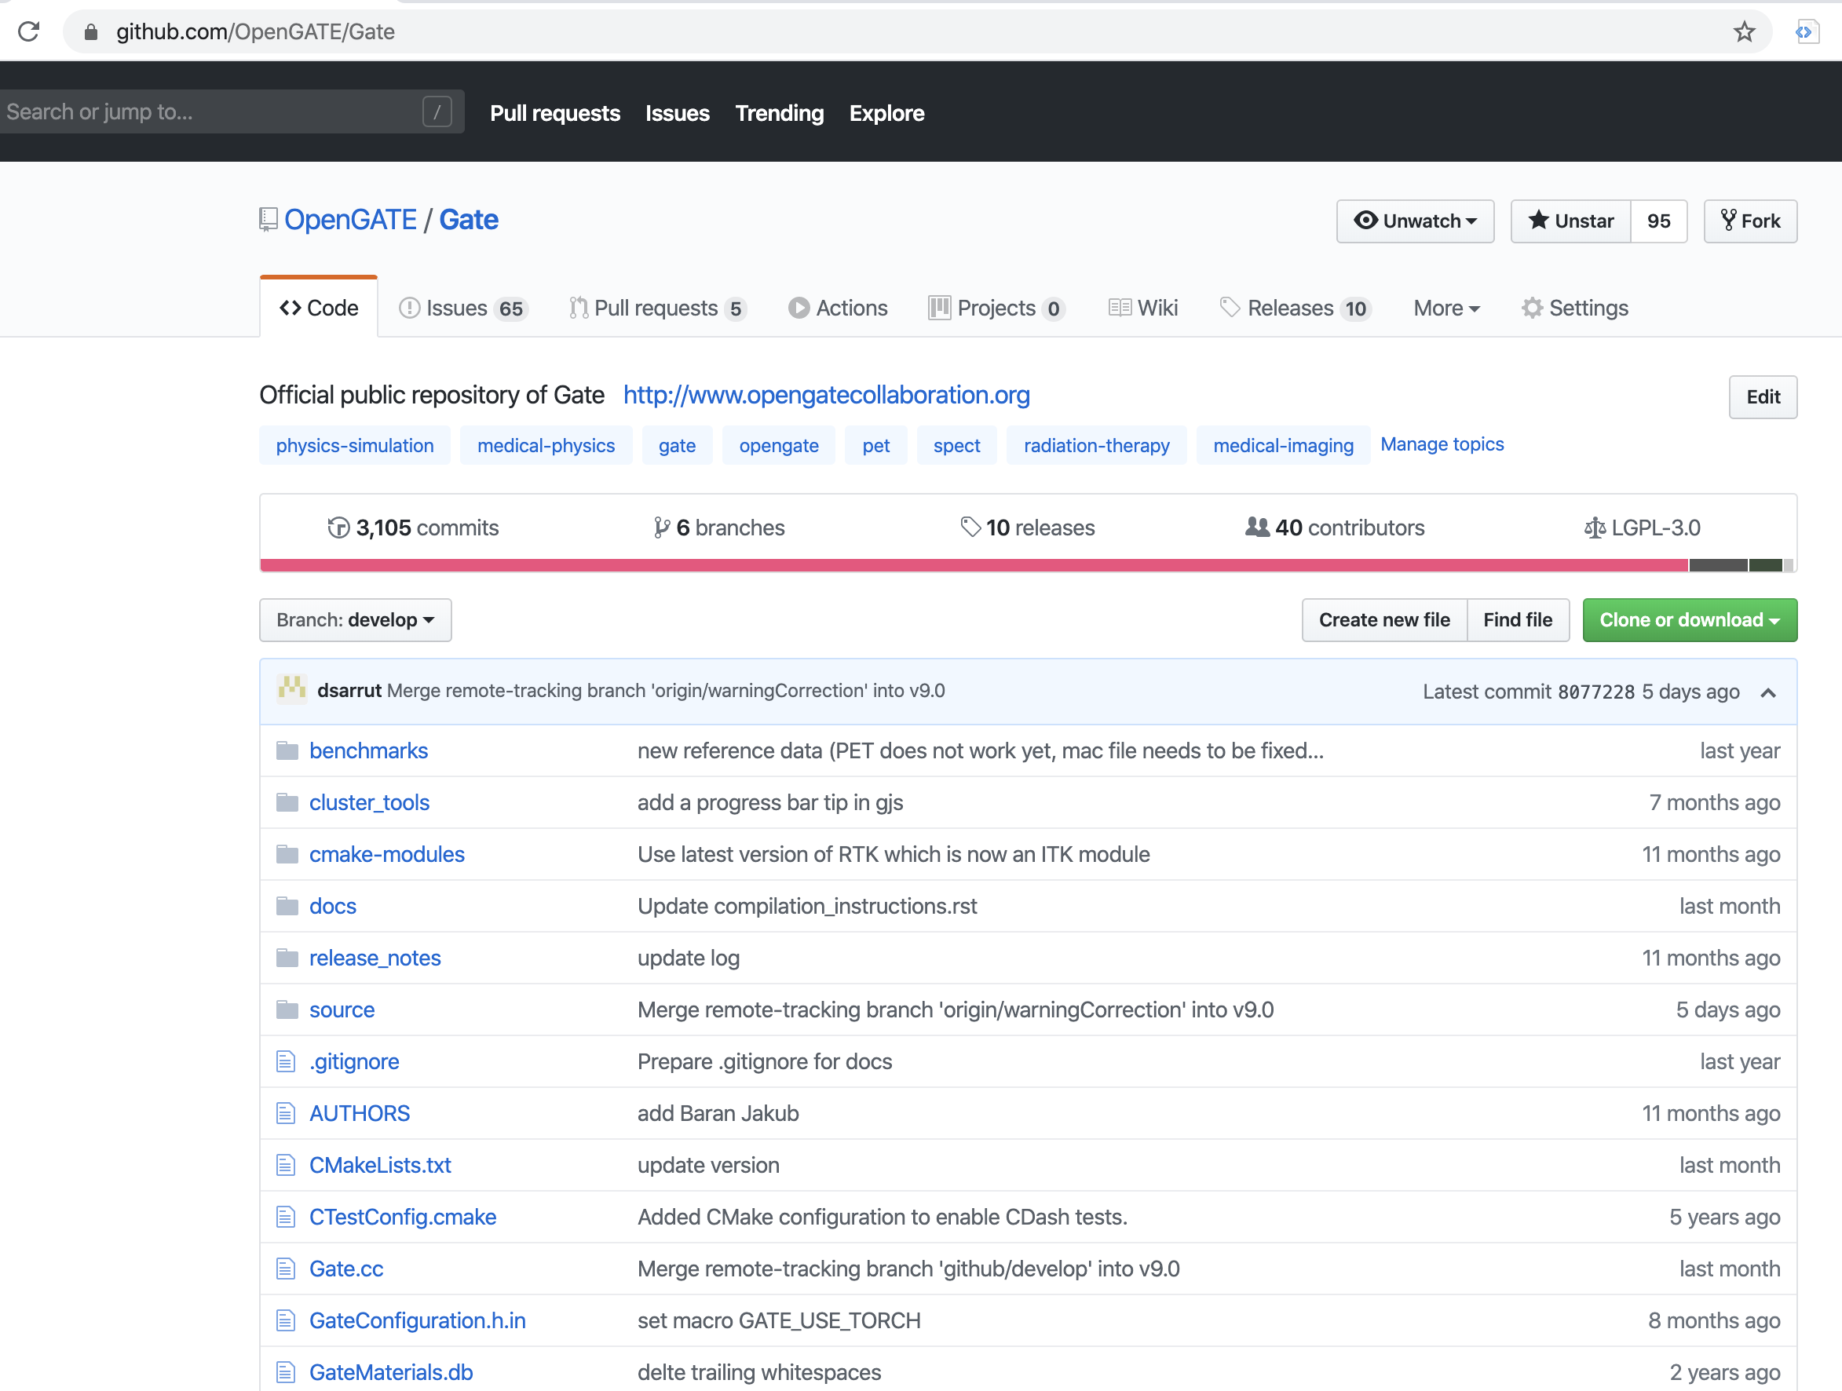
Gate current release: v8.2
https://github.com/OpenGATE/Gate
Version 8.2, February 2019
Work with Geant4 10.4 and 10.5
Git branch « master », tag v8.2
Git branch « develop »
Is not continuously validated
May not compile from time to time
https://github.com/OpenGATE/GateContrib
https://github.com/OpenGATE/GateTools

Slide 3
Gate community contribution
Propose bug correction via Pull Request system
Propose new feature via Pull Request system
Add one example of use in GateContrib
Add documentation on readthedocs

Slide 4
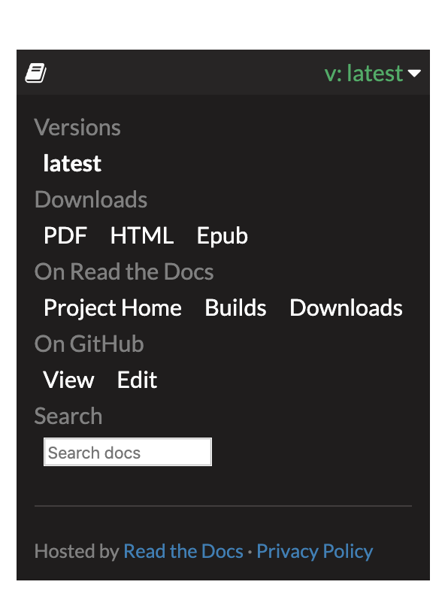
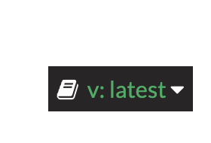
New documentation system
https://opengate.readthedocs.io

Slide 5
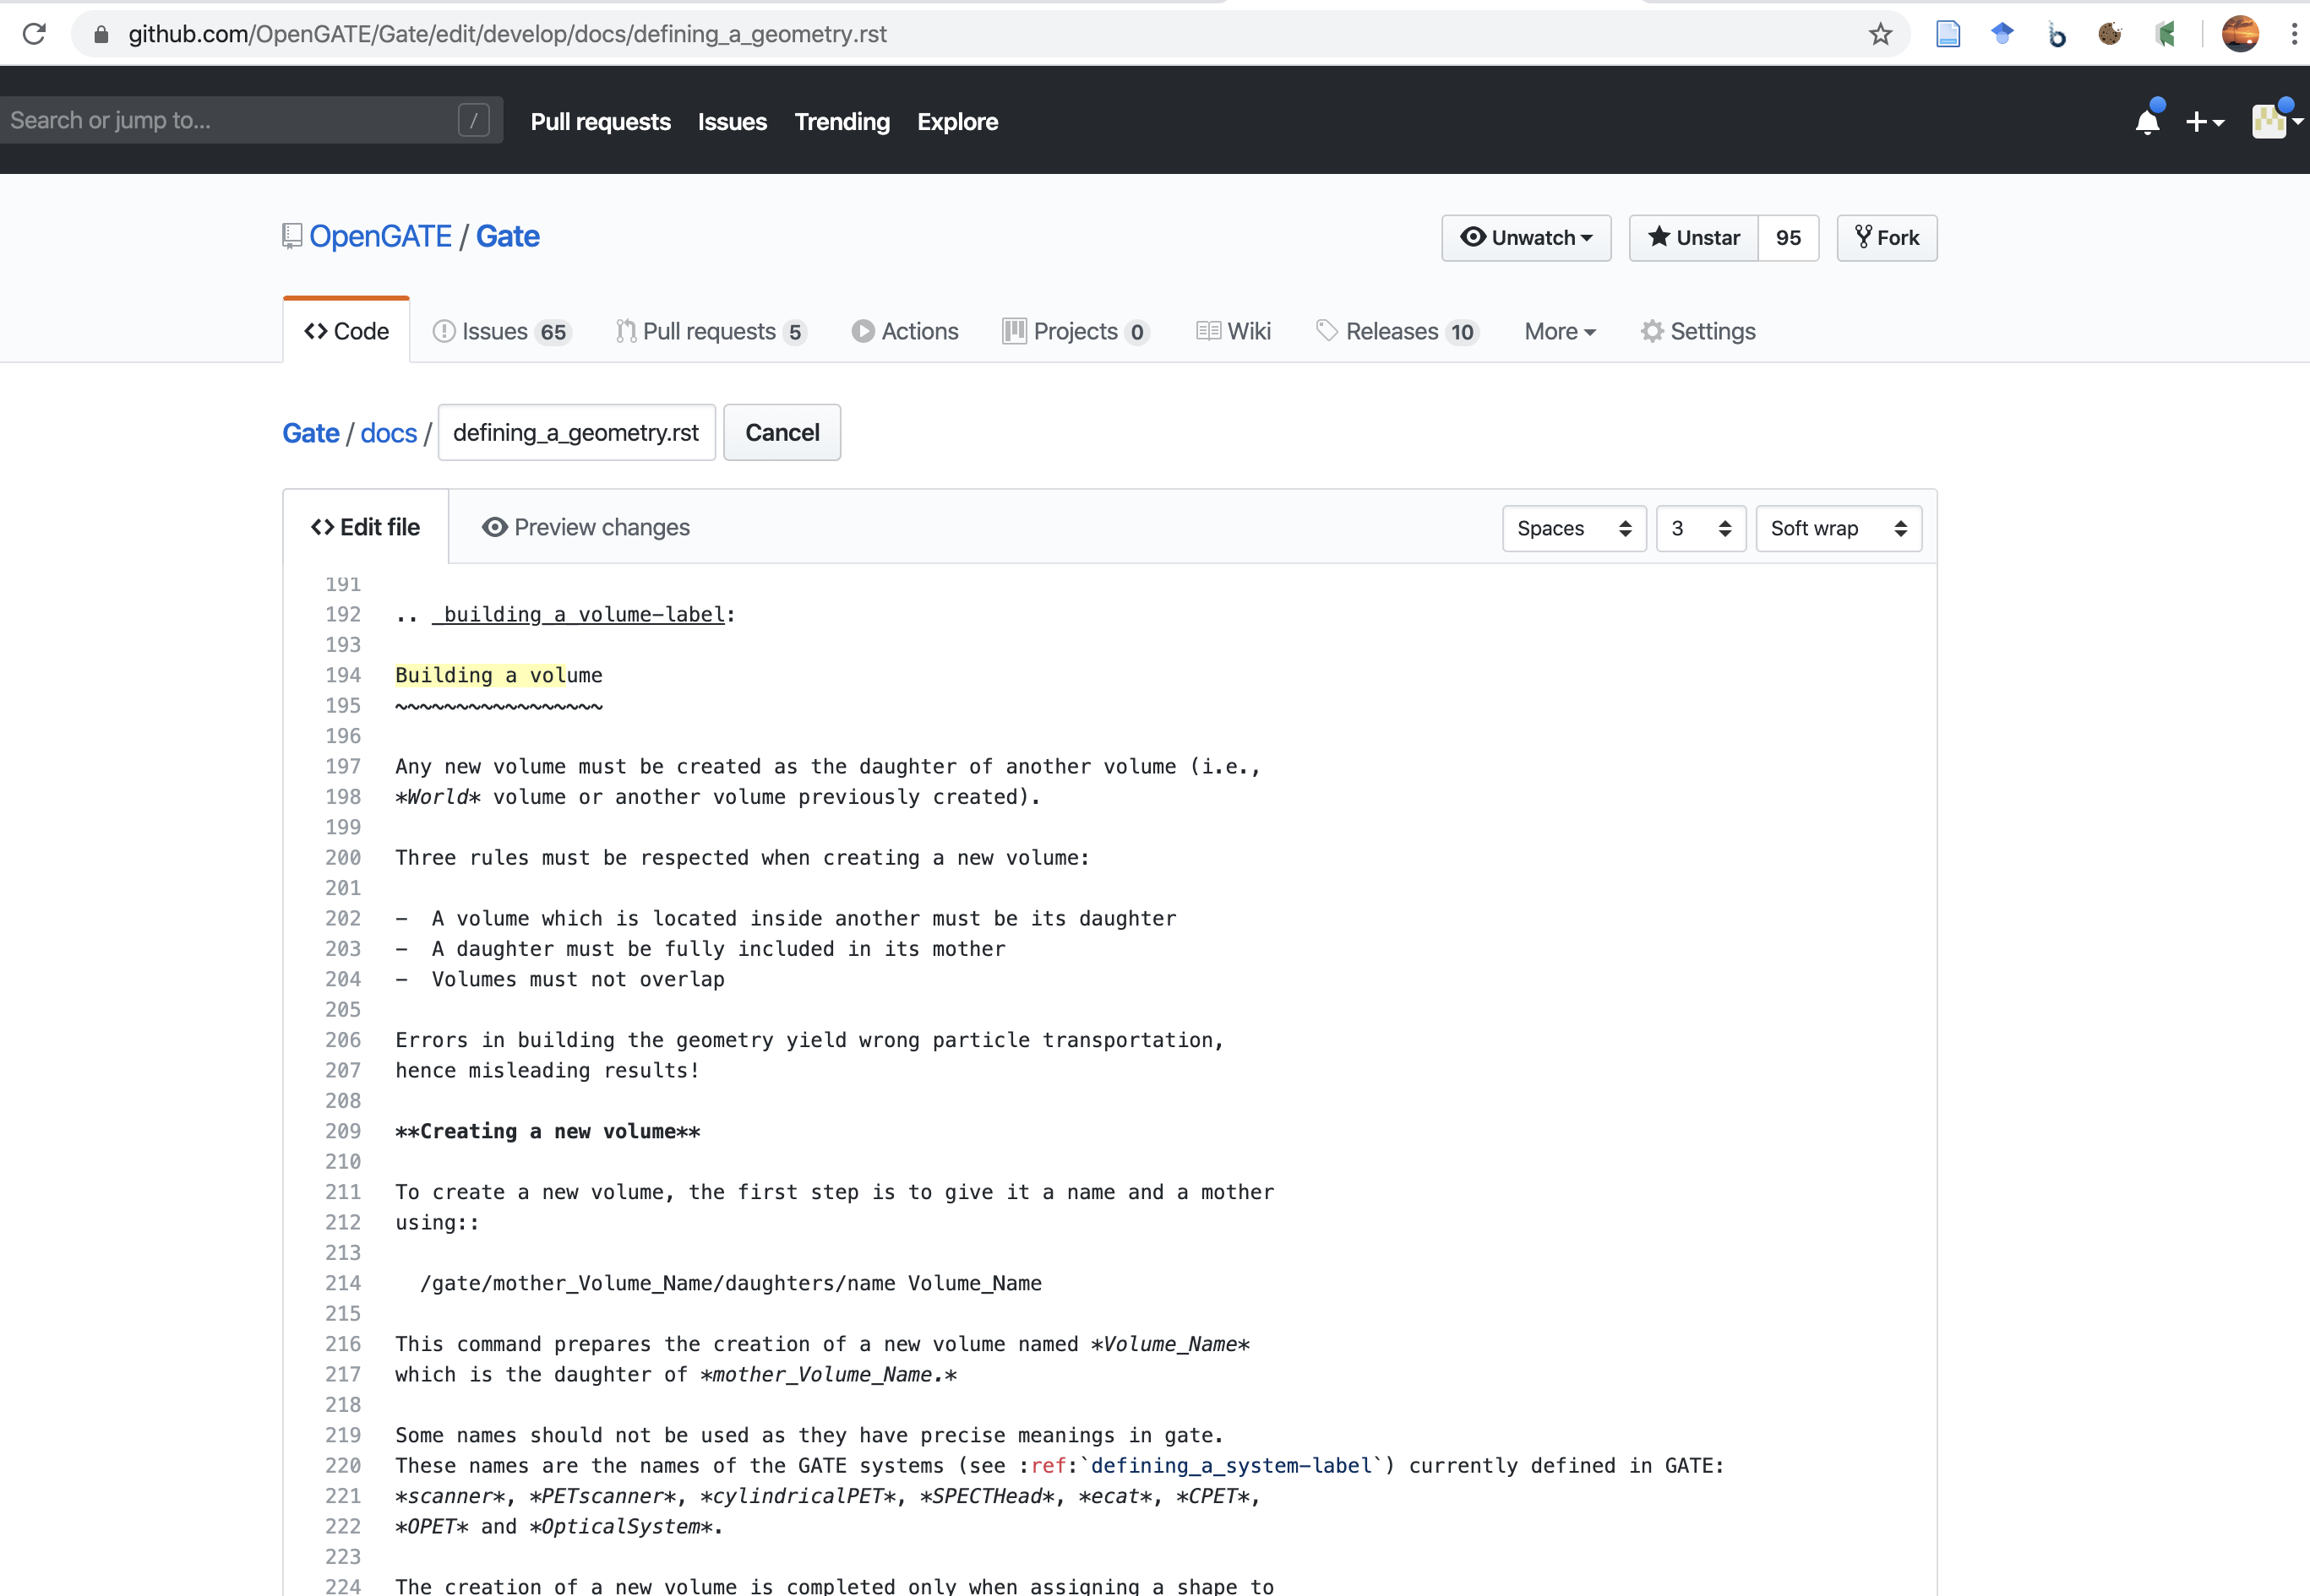

Slide 6
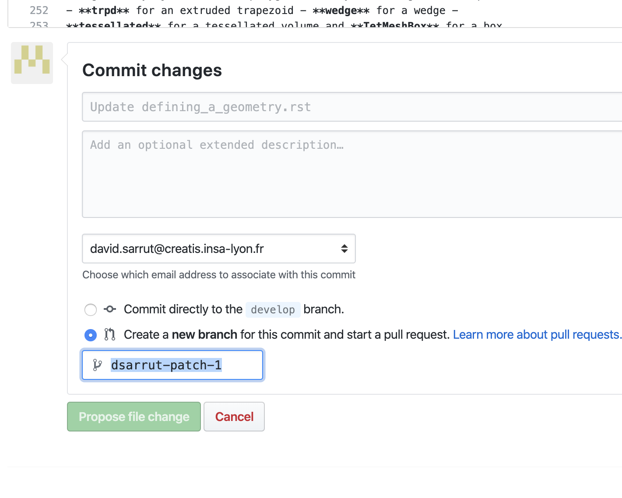
Create a new Pull Request
We will accept and integrate the changes

Slide 7
New documentation system
Edit on github in RST format (ReStructured Text)
Simple, like markdown or wiki
Allows better versioning (git)
Allows better export pdf
Do not hesitate to contribute !

Slide 8
New GateTools project
https://github.com/OpenGATE/GateTools
Python helpers functions (API) and command line tools
Examples
Command line
gt_image_convert -i input.dcm -o output.mhd
gt_image_convert -i input.mhd -o output_float.mhd -p float
gt_image_arithm -i *.mhd -o output.mhd -O sum
gt_gamma_index dose.mhd gate-DoseToWater.mhd -o gamma.mhd --dd 2 --dta 2.5 -u "%" -T 0.2
pip install gatetools
Python script
import gatetools as gt
gt.image_convert(inputImage, pixeltype)

Slide 9
GateTools example
gt_gamma_index –help
Usage: gt_gamma_index [OPTIONS] REFERENCE TARGET
Compute the gamma index [Daniel Low, 1998] between a reference image and a target image.
For every voxel i in the target image, determine the gamma value of the reference image voxels j near to it
[…]
Options:
-d, --dd FLOAT "Dose distance"; you can choose the unit
with the --dd-unit/-u option (default is
"percent").
-u, --ddunit [percent|%|absolute|abs]
With "percent" (default), the "Dose
distance" value is interpreted as a
percentage. With "absolute", the "dose
distance" value is taken as an absolute
value in the same units as the reference and
target images.
-r, --dta FLOAT "Distance To Agreement" [same unit as used
for the voxel spacing]
-T, --threshold FLOAT Threshold dose value (exclusive) [same unit
as ref/target input files].
-D, --defvalue FLOAT Default value for voxels that are outside of
the overlap region with the reference image,
or that have dose less than the th.
-o, --output PATH Output filename [required]
-v, --verbose / -q, --quiet Be verbose (-v) or keep quiet (-q, default)
--logfile TEXT Path of debugging log file. Default: empty
(no log file is written). If you specify
"auto" then an informative logfile name will
be generated automatically.
-h, --help Show this message and exit.
All tools have –h or --help

Slide 10
GateTools
Open-source
https://github.com/OpenGATE/GateTools
Please install, test it and feedback !
Not a sandbox (there is GateContrib for that)
Any contribution welcome
Generic tools, useful for Gate analsysis + doc + unit test
Please contact us before as several groups may propose similar tools

Slide 11
Towards next Gate release v9.0
With Geant4 10.6 (dec 2019)
Several bug fixes
PET debug noise and deadtime
GateEnergySpectrumActor
…
Main new features
New extended source from JPET
New Compton Camera module
New npy format for PhaseSpace (Actor and Source)
Link with pytorch for GARF and GAGA (optional)
Towards less Root dependencies: PET/SPECT npy output
…
Hopefully in February

Slide 12
Benchmarks
Several benchmarks exist, but …
… still mostly visual comparison for the validation of a new release
… painful, long, error prone
Towards statistical automated test in the future ?
Lack for human resource to do that.
At least: Continuous Integration (via Travis or Azure) will be setup (by Thomas Baudier)

Slide 13
Thanks for your attention !

