Slide 1
GATE activities Medical University of Vienna
Hermann Fuchs
Department of Radiation Oncology

Slide 2
What you see is what you treat
Making MR guided particle therapy a reality

Slide 3
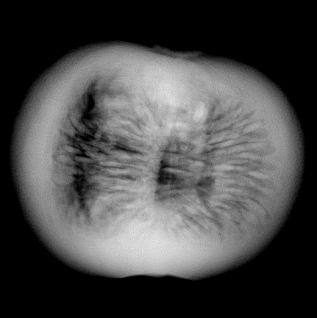
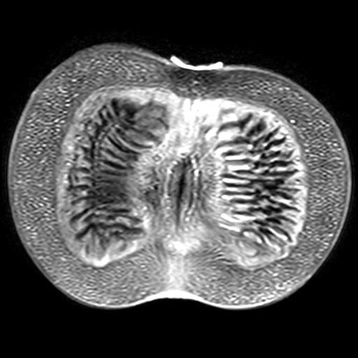
Motivation and Vision
At the treatment table only X-Ray/CBCT available
On line MR images
Advance adaptive treatment strategies

Slide 4
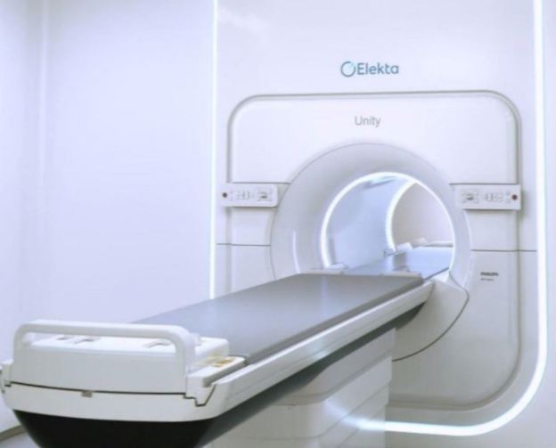
Motivation and Vision
Integrated systems for photon-MR clinically available
For particles much research still to be done
Making on-line MR-guidance for particle therapy a reality

Slide 5
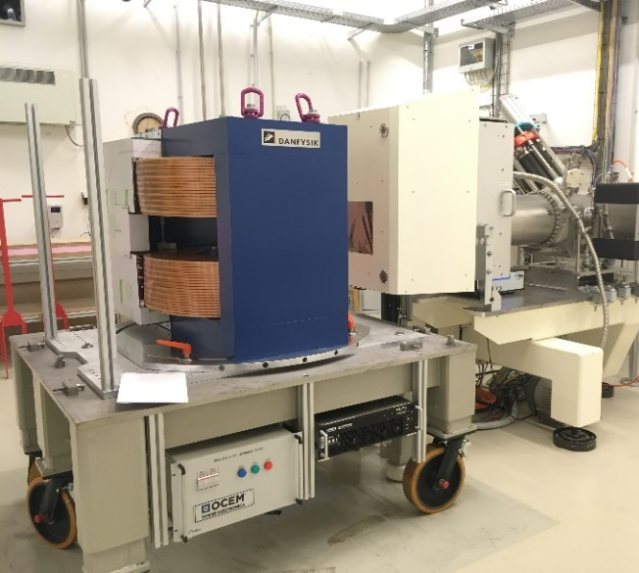
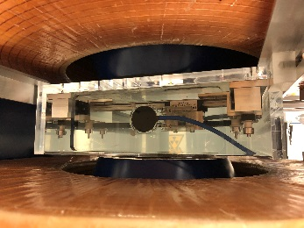
Dosimetry
Measurements with dosimetry detectors in magnetic fields (0 - 1 T)
Characterization of detector response
MC modelling of an ionization detector

Slide 6
Proton beams in magnetic fields
Magnet
Nozzle
MC beam model
Clinical beamline IR1@MedAustron
Custom magnetic field maps
From G4 Purging Magnet
Steppers and chord reconstruction
parameters from Geant4 available in GATE
Experimental benchmarking

Slide 7
Beam model validation
Padilla-Cabal et al., Med. Phys. 2019.
In-depth & lateral dose profiles
EBT3 Films:
Averaged dose LET correction
Single energy fields and SOBP
B fields 0 and 1T

Slide 8
Future steps
Extend to custom electric + magnetic field implementation.
Homogeneous
3D maps
Submit to GitHub
Modelling dosimetric detectors - response function

Slide 9
Film corrections
EBT3 films
Multiple positions in SOBP
No magnetic field effects detected
Correction on film quenching using GATE actor
original
corrected
Padilla-Cabal et al., Med. Phys 46, 2019
Resch et al., submitted to Med. Phys

Slide 10
Beam modelling
Fast generation of beam models

Slide 11
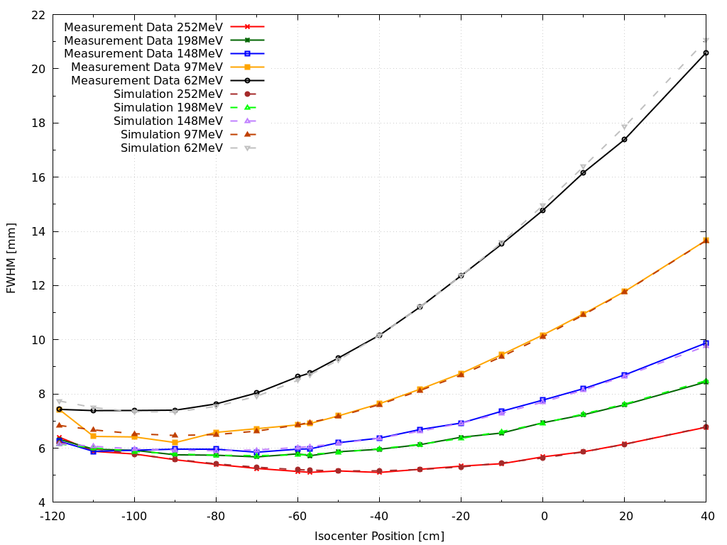
Beam modelling - Status
Publication in preparation
Beam modelling scripts working well
Proton and carbon ions
>10 Beam modells created
Will become part of GATE tools

Slide 12
Expanding capabilities
Non-dedicated eyline at MedAustron

Slide 13
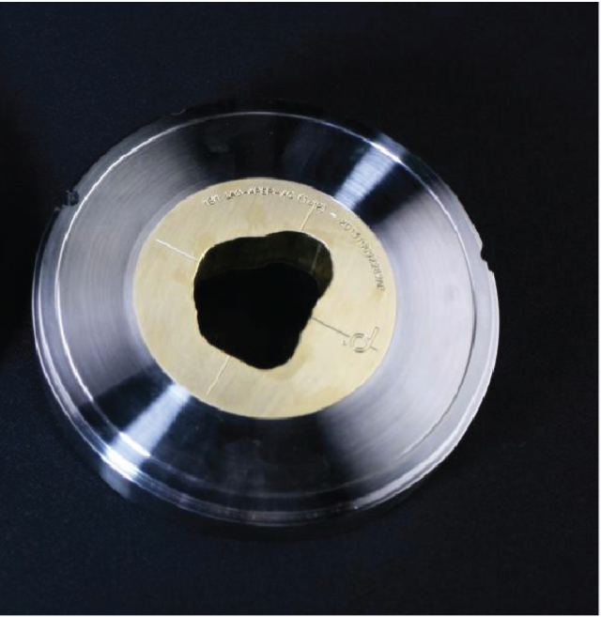
Feasibility study of uveal melanoma treatment Non-dedicated eye beamline at MedAustron
Collimator
Material
Geometry
Particles
Proton & 12C
Range in water: 3 cm
Arrangement of passive elements
→ Simulation study using GATE
Hao Chen et al 2014 Phys. Med. Biol. 59 5043

Slide 14
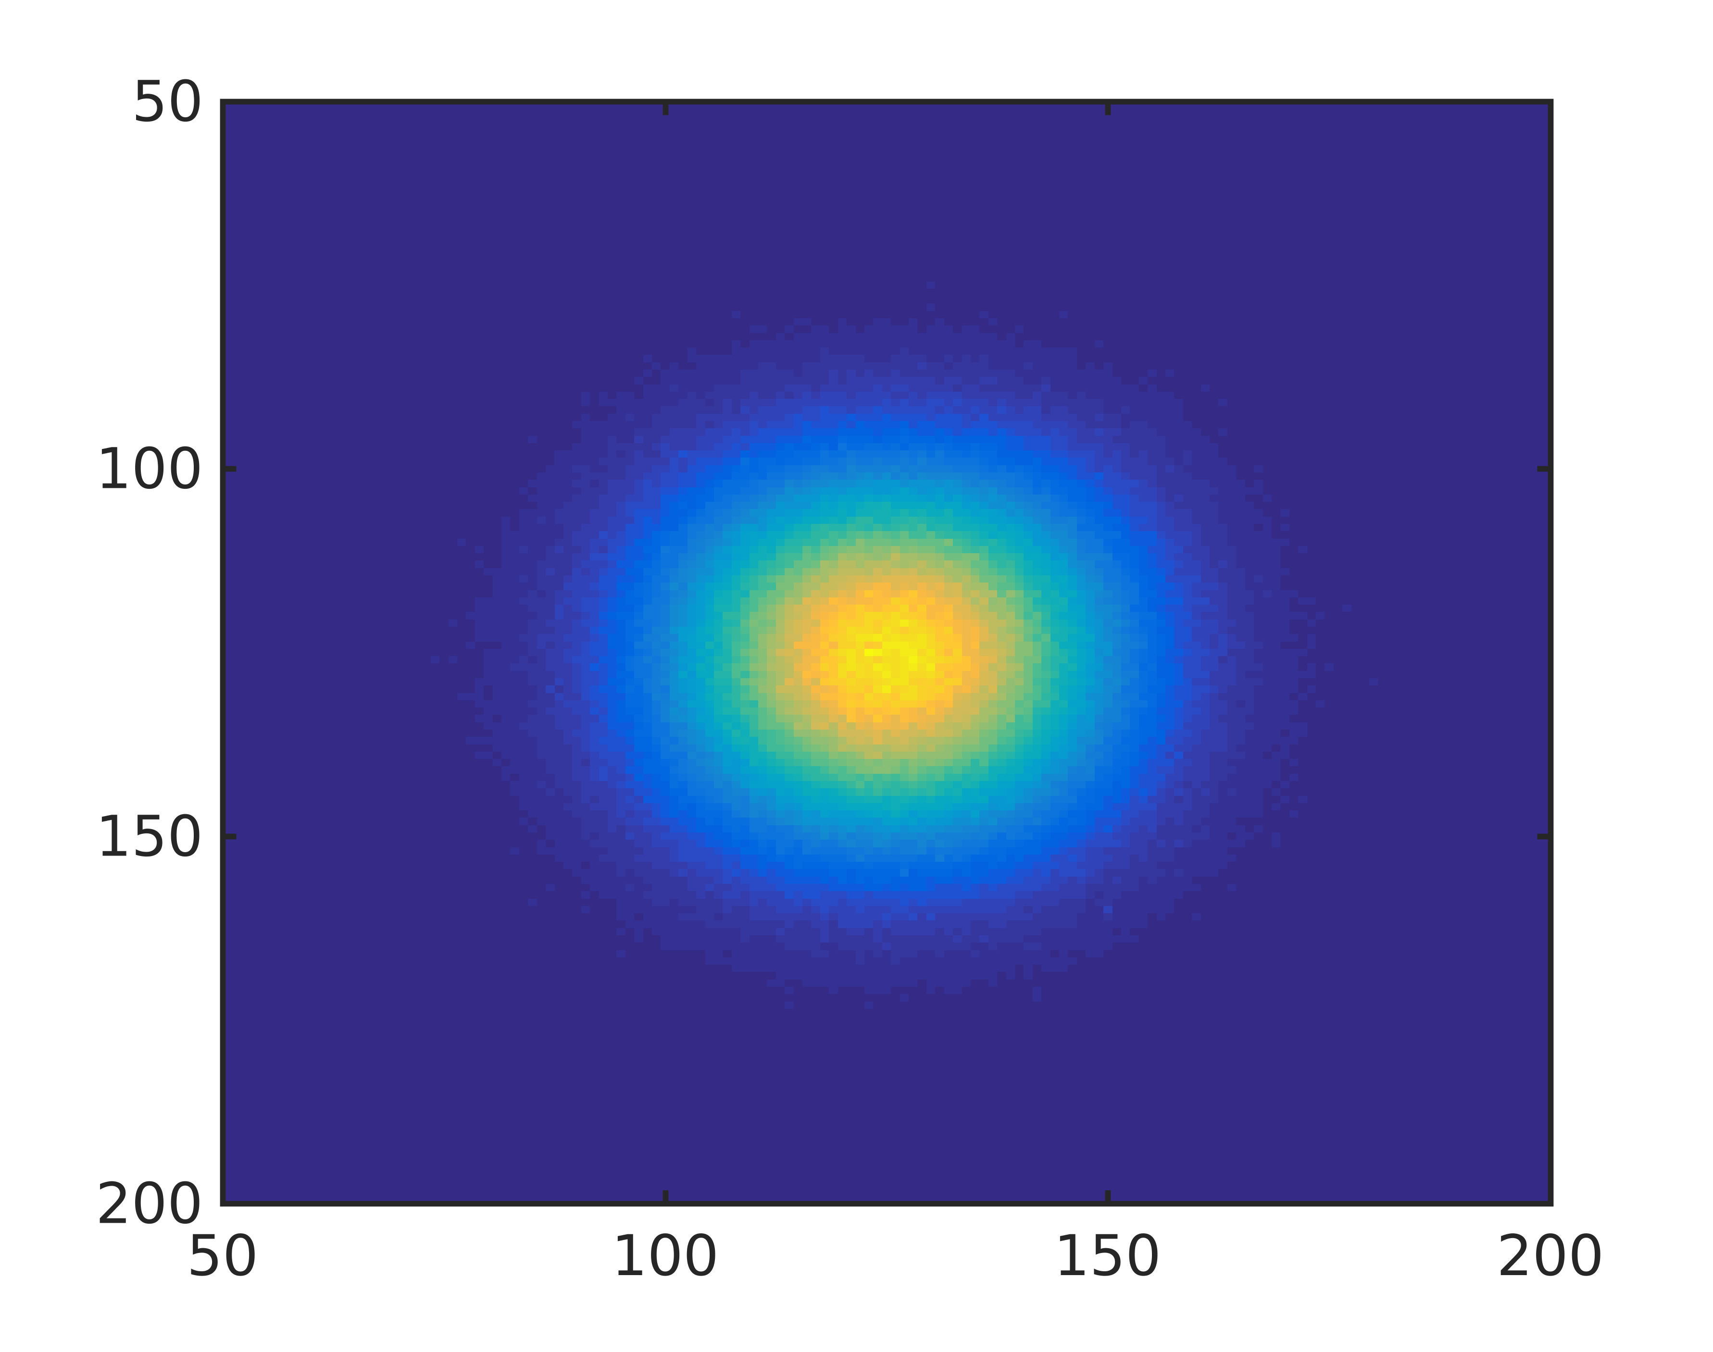
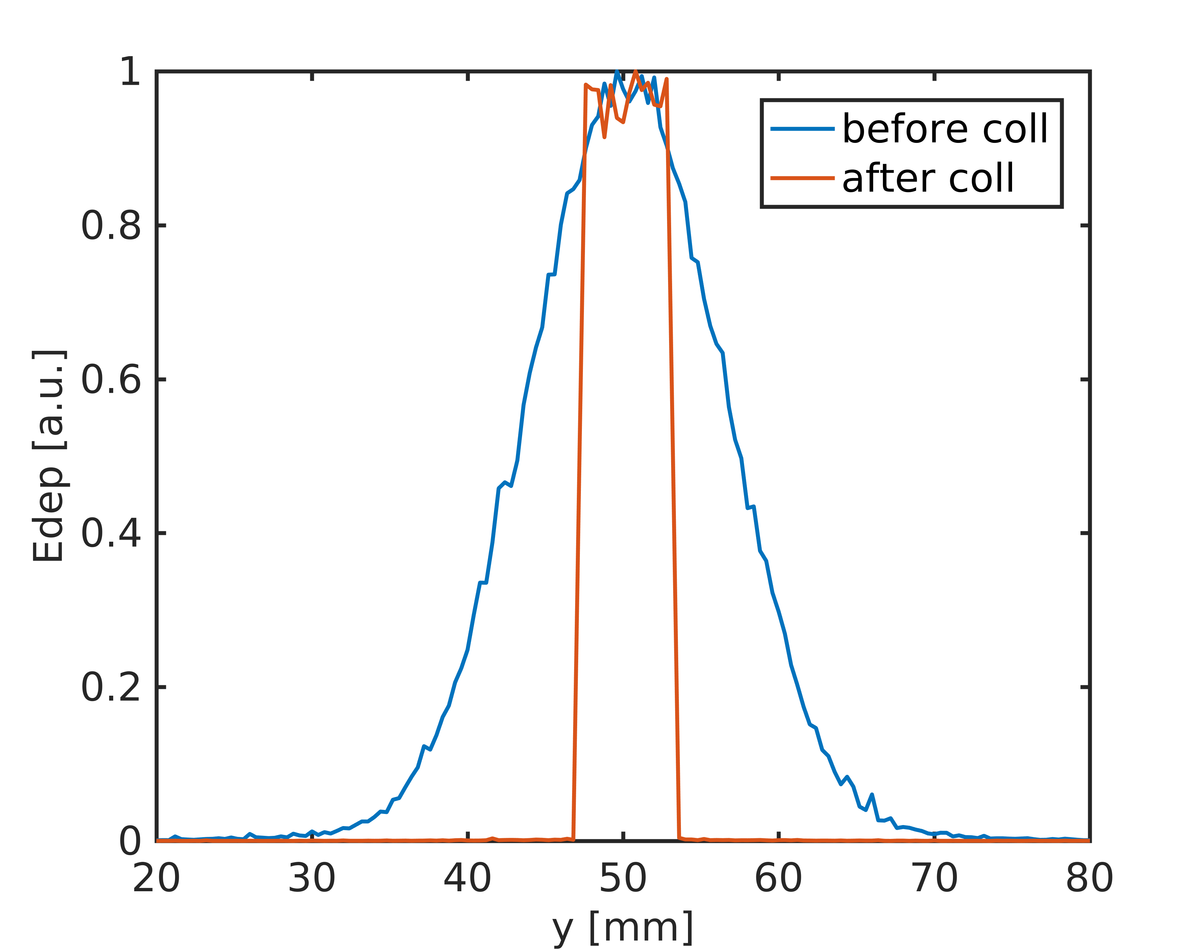
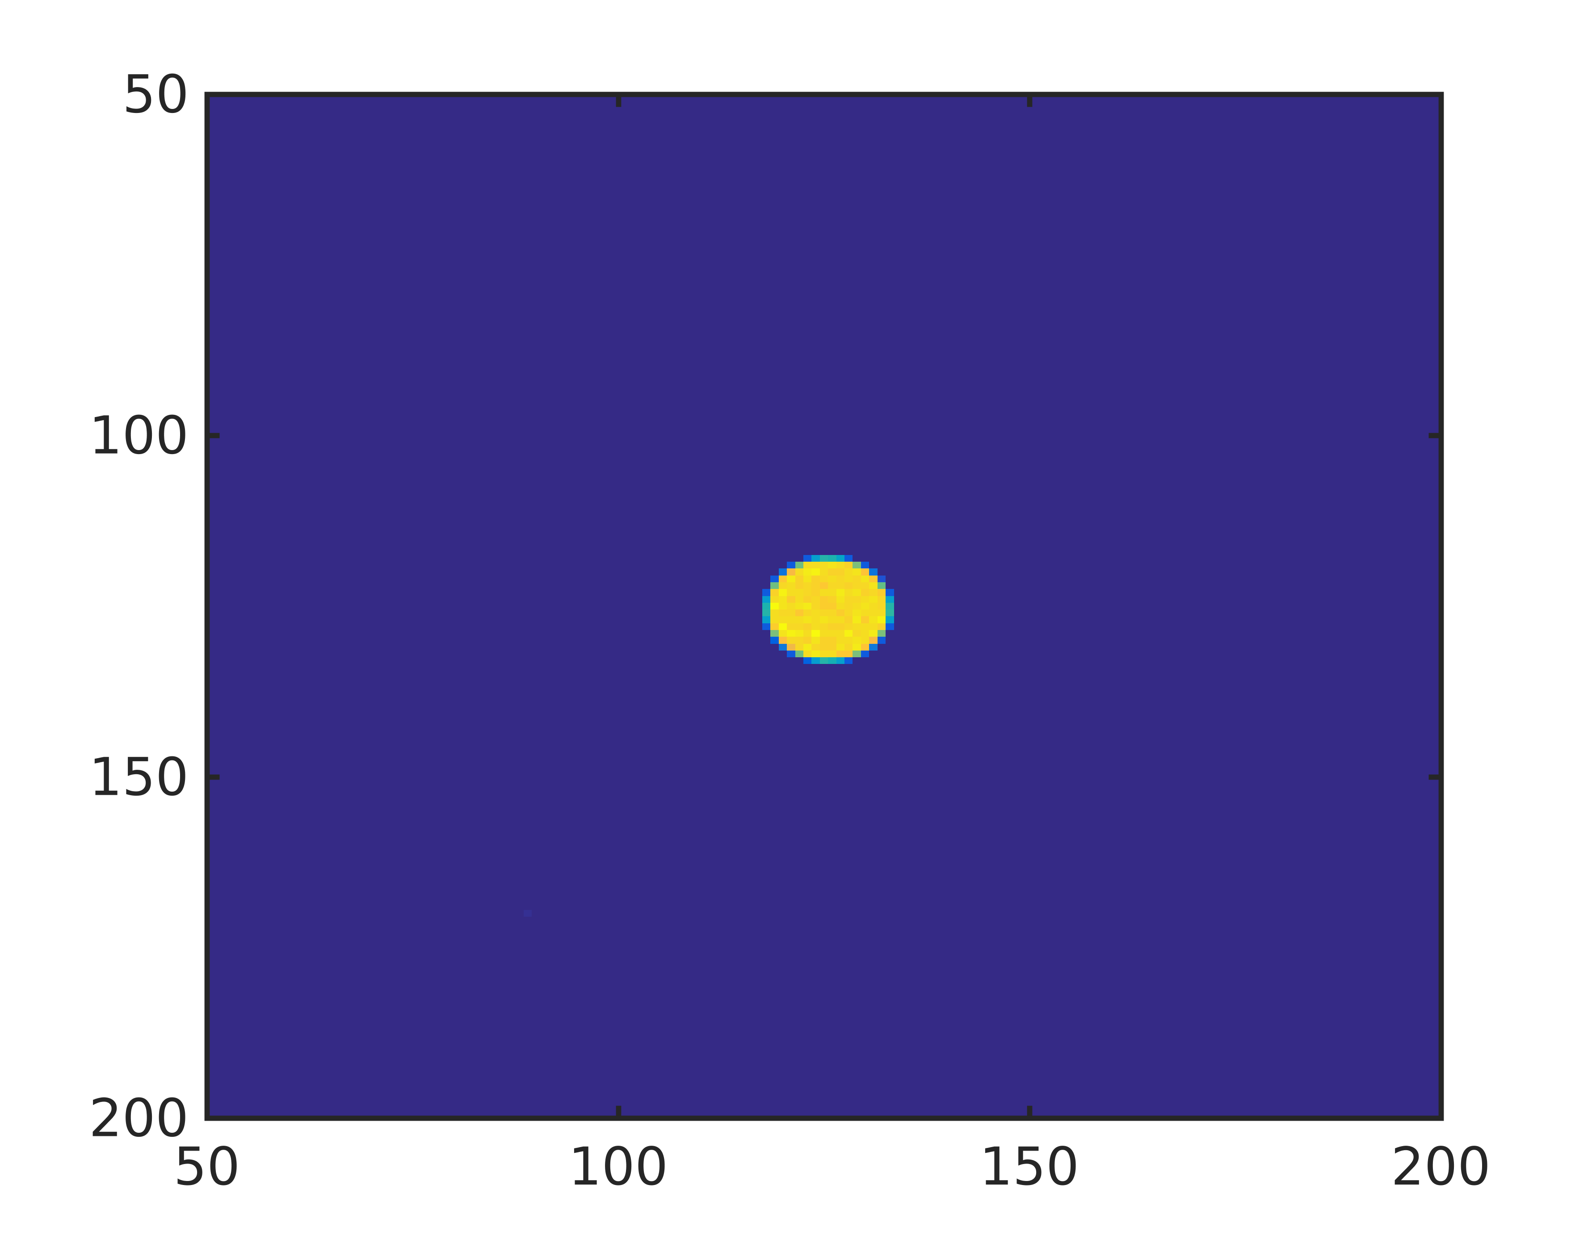
Lateral dose profile before and after collimator in air

Slide 15
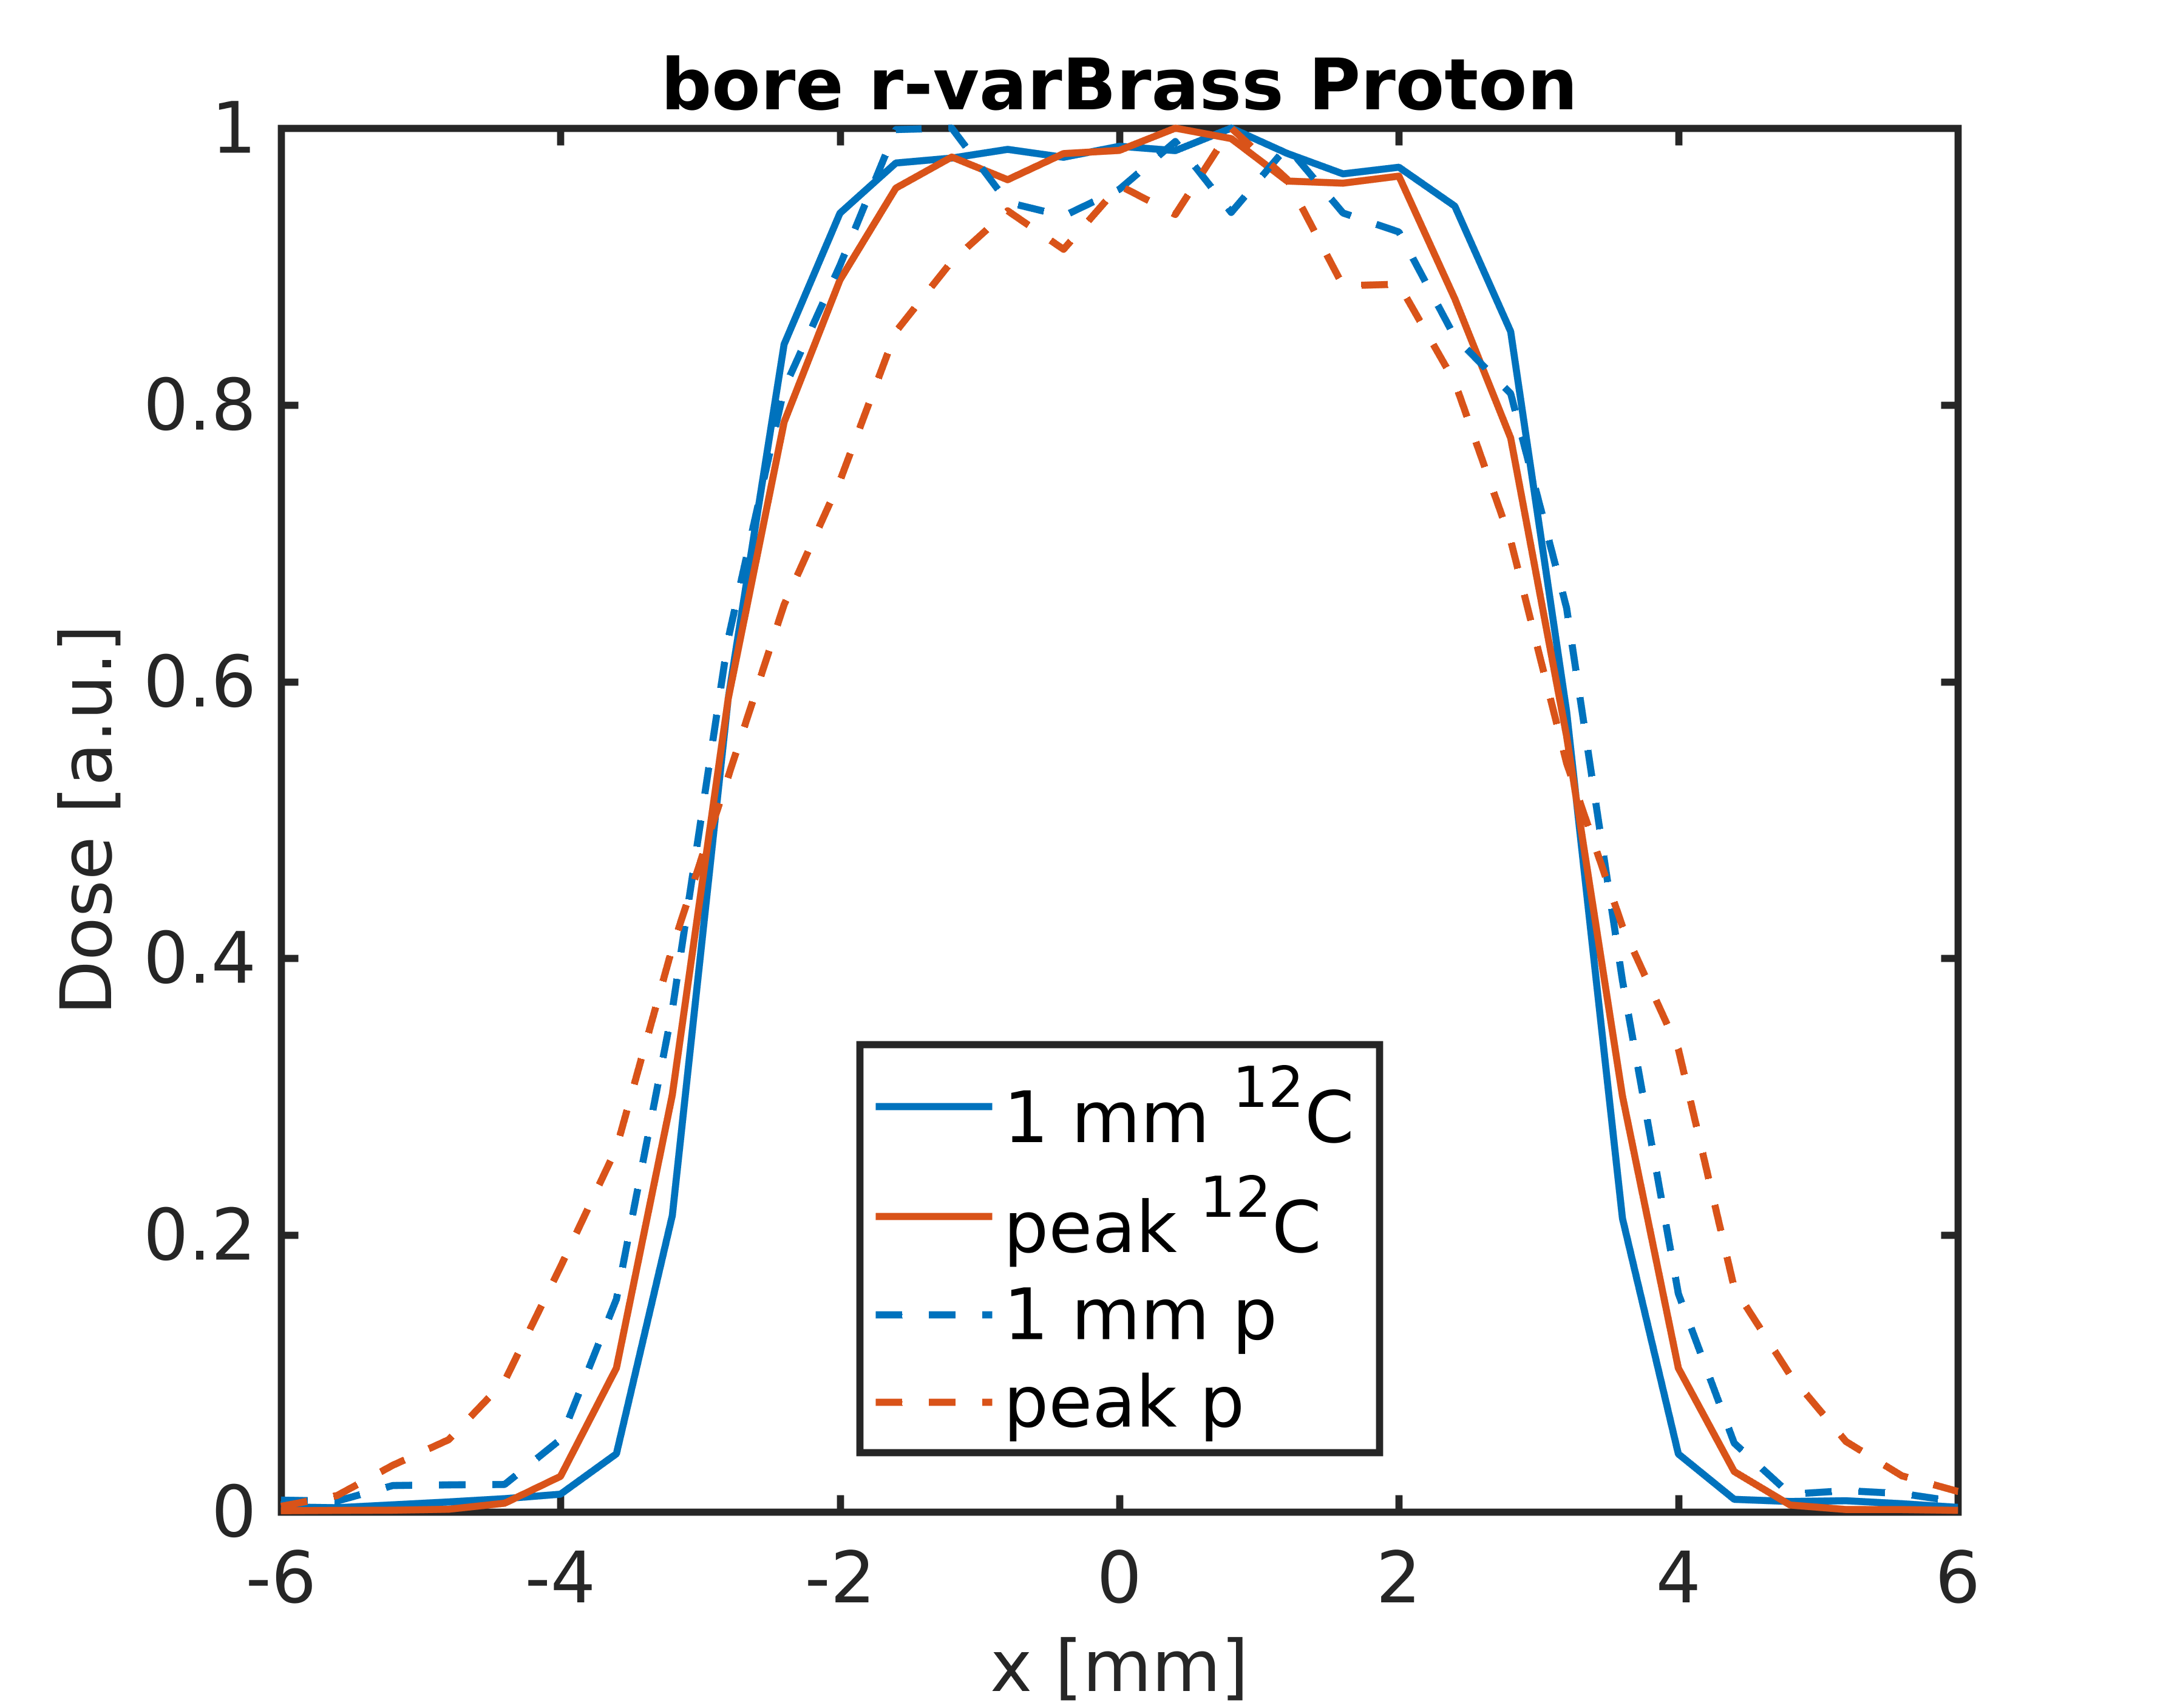
Preliminary results: Lateral dose profile in water
Dose fall off sharper for 12C
Parameter to quantify: p8020
- Distance from 80% to 20% dose

Slide 16
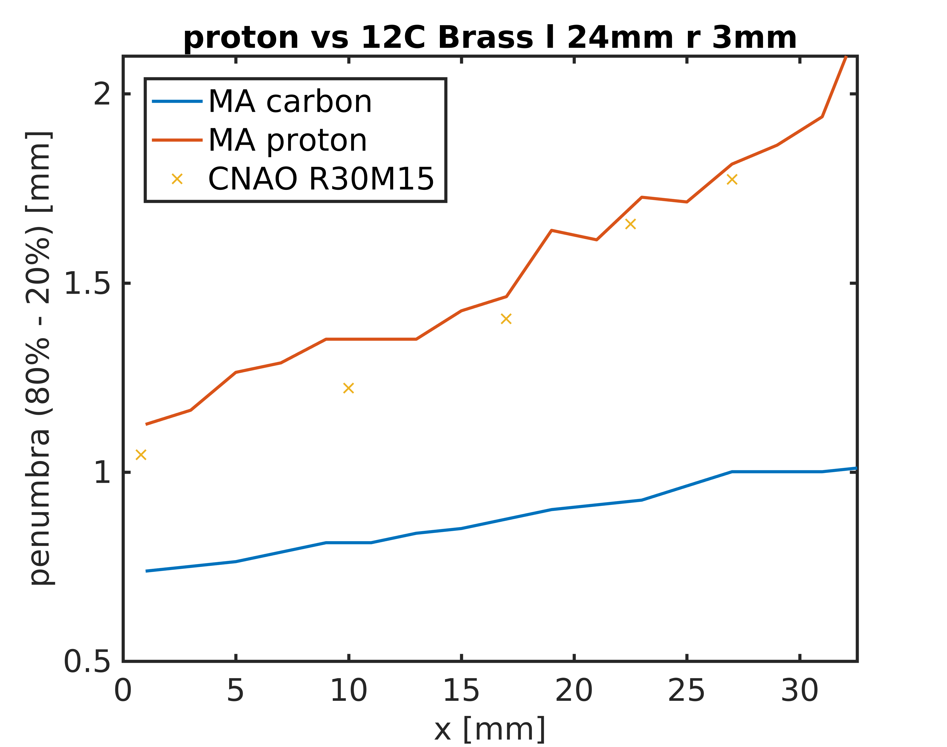
Penumbra 80-20% over depth in water
Protons
Lateral dose characteristics similar to other proton eye beam lines
Further optimization
Carbon ions
Considerably sharper
Relative biological effectiveness ?

Slide 17
Summary
GATE extended to magnetic and electric field maps
Validated
Pull request on-going
Tool set for fast beam model generation
Publication in preparation
Will become part of GATE tools
Use of GATE for design process of eye-line at MedAustron

