Slide 1
GATE for the development of fast CT scanner
Nicolò Tuccori

Slide 2
Agenda
Introduction to the project
Using GATE
First outcomes
Next steps

Slide 3
Introduction to the project

Slide 4
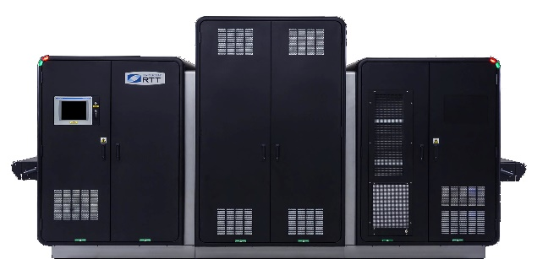
RADnet collaboration
Experimental particle physics group
MAIN OBJECTIVE: Development of the detection system of the CT scanner;
FIRST STEP: Detailed simulation to evaluate possible rooms for improvements;

Slide 5
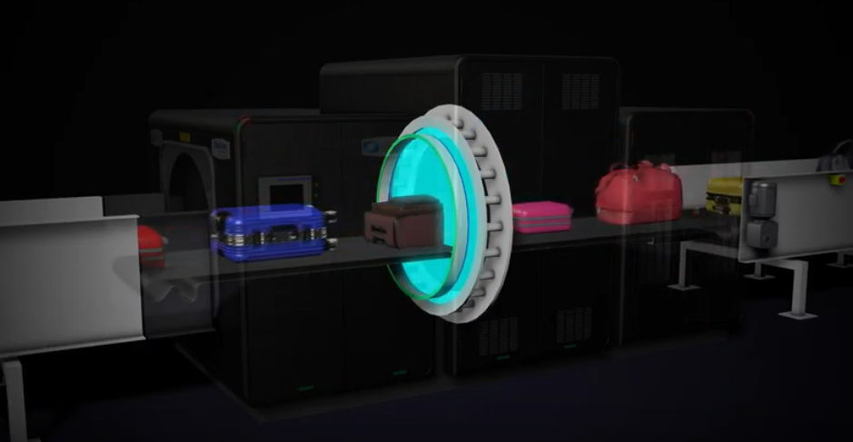
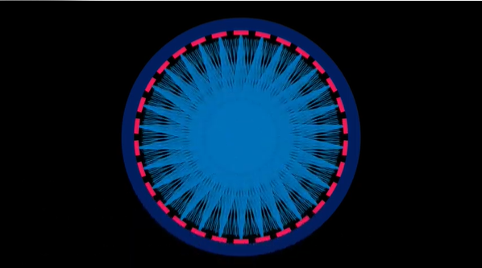
CT scanner
STATIONARY GANTRY
Several detectors and emitters associated
BELT IN CONSTANT MOVEMENT
Fast scans with high-intensity radiation

Slide 6
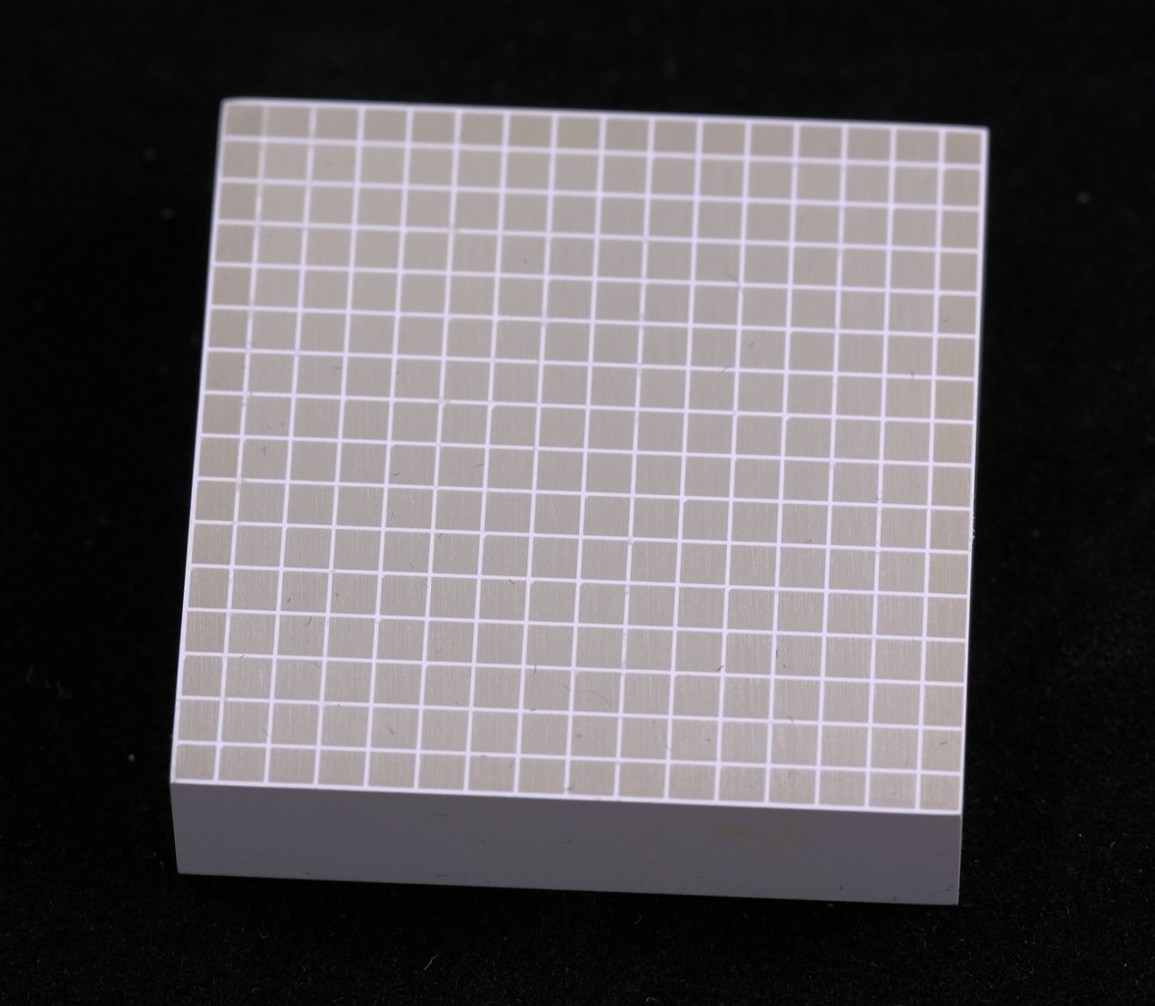
Detection system single unit
PECULIARITIES:
Array of fast scintillator crystals;
Unfocused x-rays < 200 keV;
Photodiodes coupled to crystals;
High-intensity radiation each scan;

Slide 7
Detection system single unit
COMPLICATIONS TO BE STUDIED:
Array of scintillator crystals;
Unfocused x-rays < 200 keV;
Cross-talk;
Light-output optimization;
Photodiodes coupled to crystals;
Coupling influence;
High intensity radiation each scan;
Performance vs accumulate dose;

Slide 8
Using GATE

Slide 9
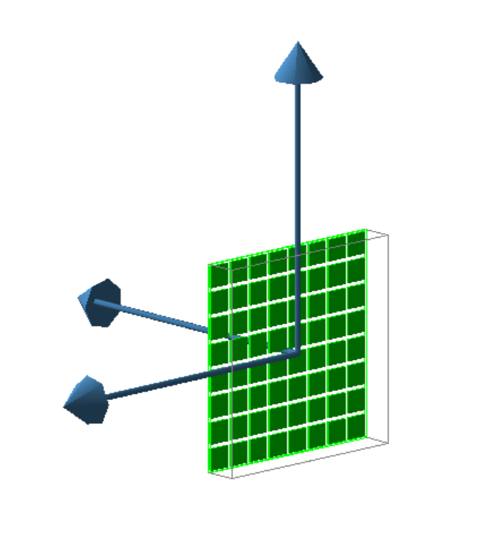
Single unit model
PHOTODIODES (ACTIVE PART)
Phase Space actor -> store infos of scintillation photons that reach this volume;

Slide 10
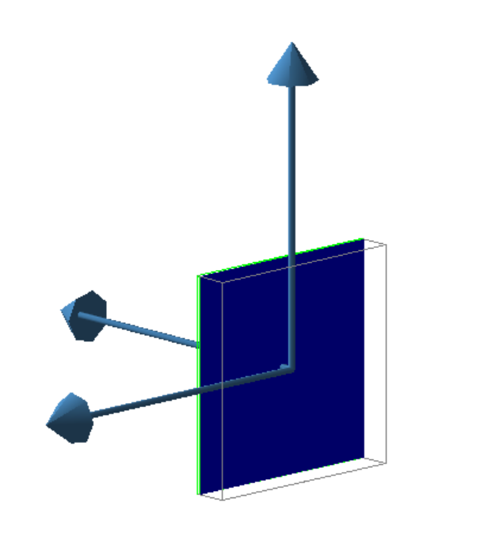
Single unit model
PHOTODIODES (ACTIVE PART)
Phase Space actor -> store infos of scintillation photons that reach this volume;
ELECTRONICS BOARD
Phase Space actor -> store all steps of x-rays interacting in this volume;

Slide 11
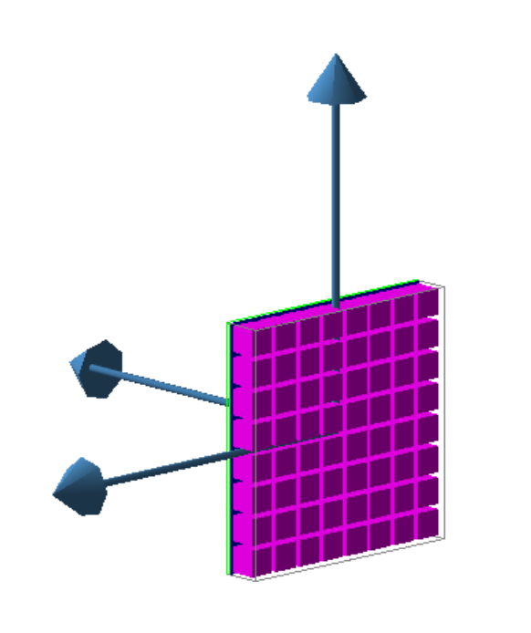
Single unit model
PHOTODIODES (ACTIVE PART)
Phase Space actor -> store infos of scintillation photons that reach this volume;
CRYSTALS ARRAY
Phase Space actor -> modified to store:
Edep;
First step of scintillation photons;
All steps of X-rays and secondary e-;
ELECTRONICS BOARD
Phase Space actor -> store all steps of x-rays interacting in this volume;

Slide 12
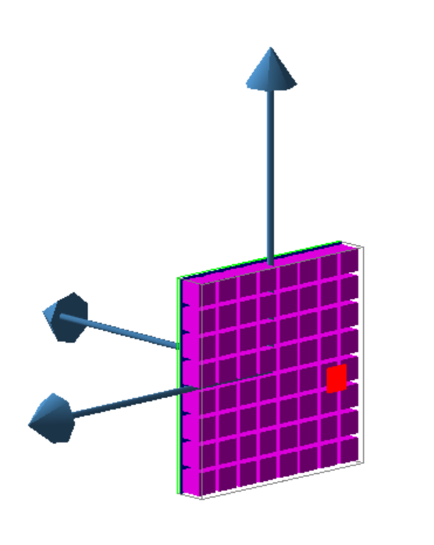
Single unit model
PHOTODIODES (ACTIVE PART)
Phase Space actor -> store infos of scintillation photons that reach this volume;
CRYSTALS ARRAY
Phase Space actor -> modified to store:
Edep;
First step of scintillation photons;
All steps of X-rays and secondary e-;
ELECTRONICS BOARD
Phase Space actor -> store all steps of x-rays interacting in this volume;
SOURCE
Rectangular, facing one crystal of the array and emitting X-rays toward it;

Slide 13
First outcomes

Slide 14
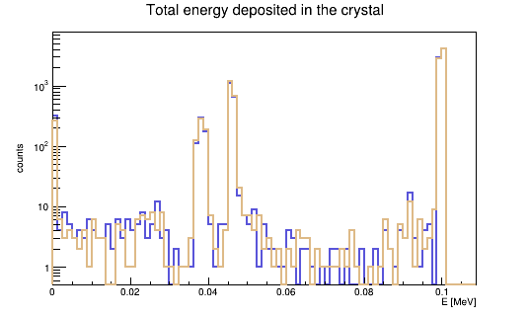
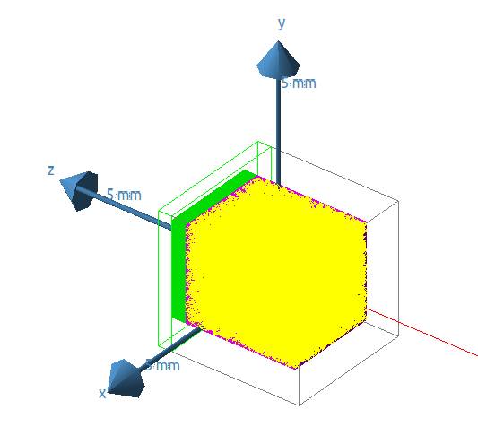
Example
Using LYSO crystals and a monoenergetic source of 100 keV,
“New” detector
“Used” detector
reflector with half reflectivity;
coupling surface more rough;

Slide 15
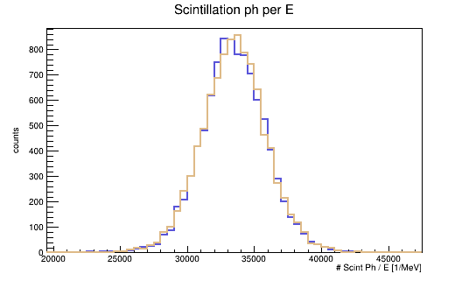
Example
Using LYSO crystals and a monoenergetic source of 100 keV,
“New” detector
“Used” detector
reflector with half reflectivity;
coupling surface more rough;

Slide 16
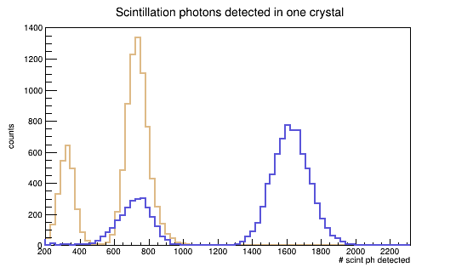
Example
Using LYSO crystals and a monoenergetic source of 100 keV,
“New” detector
“Used” detector
reflector with half reflectivity;
coupling surface more rough;

Slide 17
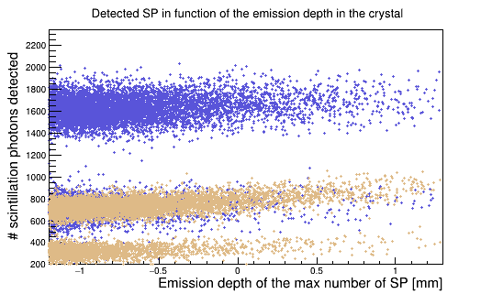
Example
Using LYSO crystals and a monoenergetic source of 100 keV,
“New” detector
“Used” detector
reflector with half reflectivity;
coupling surface more rough;

Slide 18
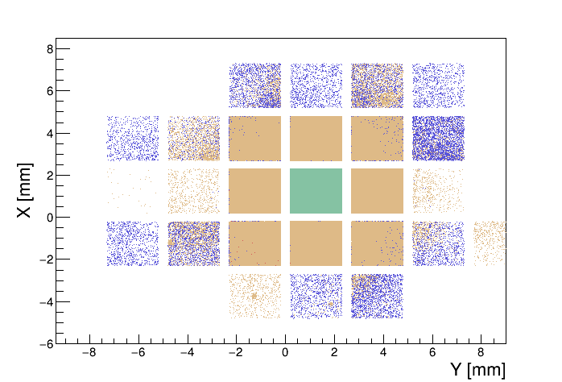
Example
Using LYSO crystals and a monoenergetic source of 100 keV,
“New” detector
“Used” detector
reflector with half reflectivity;
coupling surface more rough;
Cross-talk of optical photons

Slide 19
Next steps

Slide 20
Next steps
NEAR FUTURE
Optimization of the simulation output;
Estimation of missing parameters;
Validation of the simulation results;
.. OTHER POSSIBLE AREA OF INTEREST
The effect of slow signal components on ghosting;
Compare different fast scintillators performances;

Slide 21
Thank you N.Tuccori@sussex.ac.uk

