Slide 1
WP4 ‘CEVO’ status
Mark ALLEN
CDS, Observatoire de Strasbourg

Slide 2
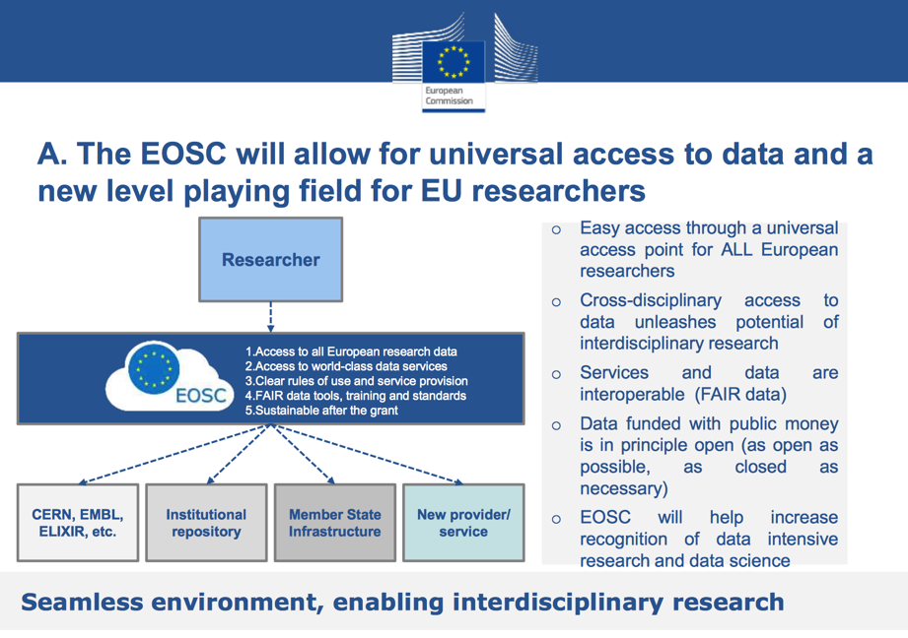
In Europe… there is a new big initiative for data:
European Open Science Cloud (EOSC)

Slide 3
What is the Virtual Observatory?
Operational framework for interoperable access to astronomical data and services across all areas of astronomy
Provides unique scientific capabilities, opening up new ways of using rich data in astronomy archives and services
A pioneer of FAIR data sharing - an existing global framework – populated by major data providers (space and ground based) that is heavily used by the community (e.g. Gaia data access is fully VO)
Re-used and customized by planetary science (EuroPLANET), atomic and molecular physics (VAMDC) and materials sciences (via RDA Working Group)

Slide 4
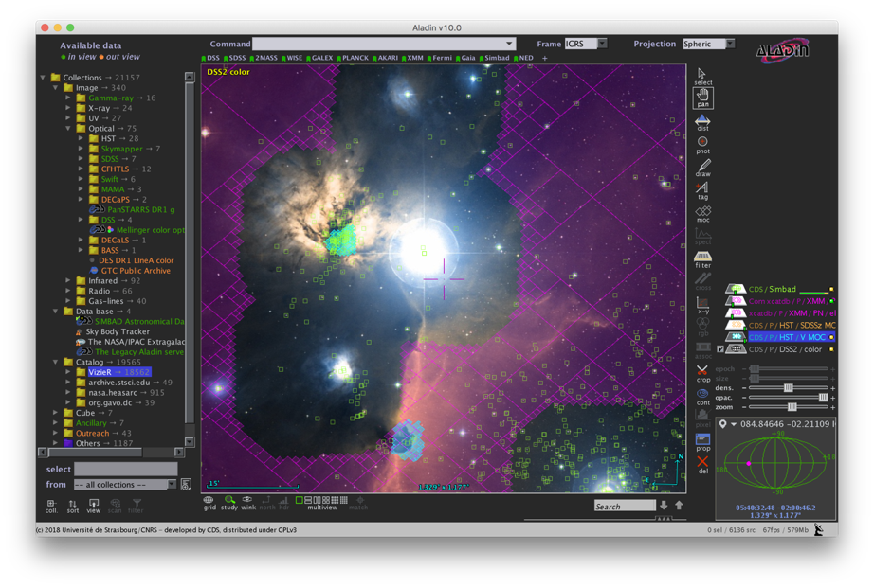
One view of the VO from an application:
Largest catalogues: PanSTARRS, Gaia etc.
1000s All-Sky data sets
Built from VO Registry
Complex ADQL queries
Multi-resolution techniques for Big Data
Data from many observatories and missions
Interoperability of data
Interoperability between applications

Slide 5
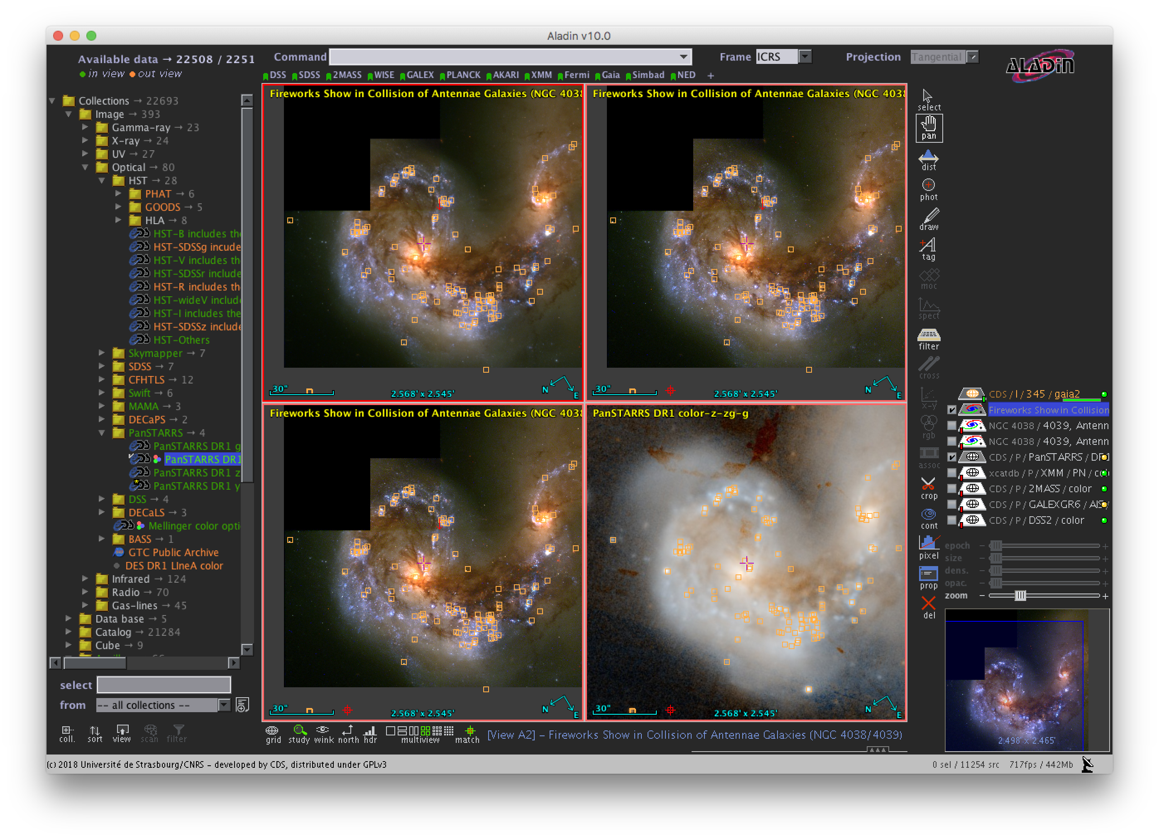
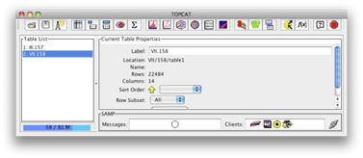
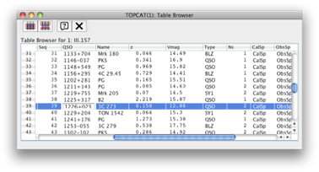
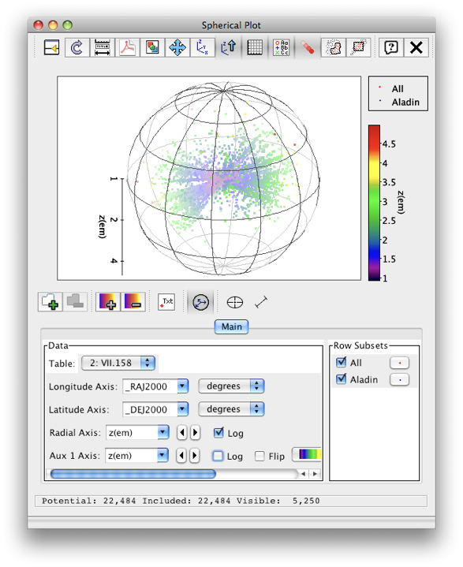


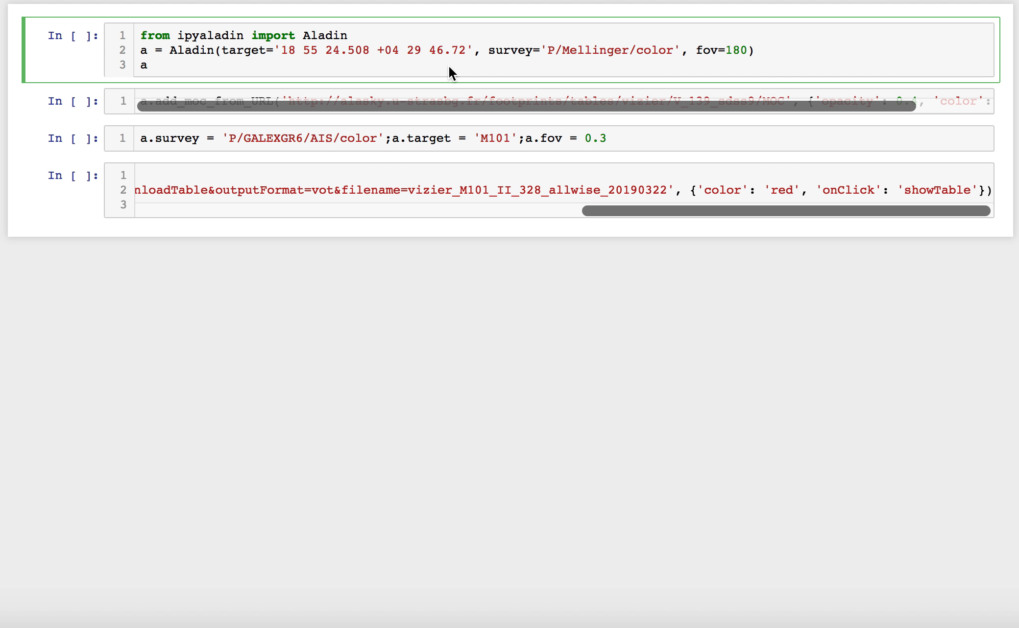
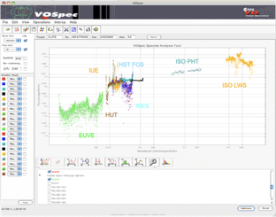

Interoperable applications and services
Data exploration and integration tools
Your apps
& programs
TOPCAT
Notebooks
Spectral tools

Slide 6
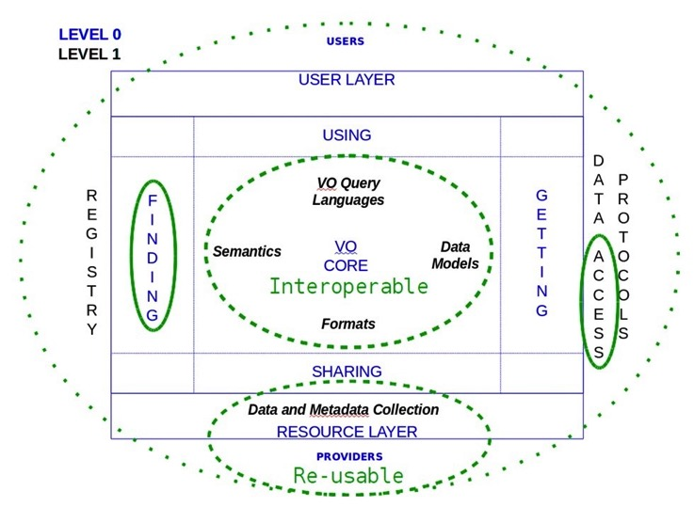
VO is FAIR

Slide 7
ESCAPE in a nutshell
ESCAPE convenes a large scientific community
31 partners : 7 ESFRI & landmarks: CTA, ELT, EST, FAIR, HL-LHC, KM3NeT, SKA
2 pan-European International Organizations: CERN, ESO (with their world-class established infrastructures, experiments and observatories).
4 supporting ERA-NET initiatives: HEP (CERN), NuPECC, ASTRONET, APPEC
1 involved initiative/infrastructure: EURO-VO (Virtual Observatory)
2 European research infrastructures: EGO and JIVE-ERIC
Budget: 16 M€, Started: Feb 2019, Duration: 42 months
Coordinator: CNRS (Centre National de la Recherche Scientifique)
Home page: https://projectescape.eu

Slide 8
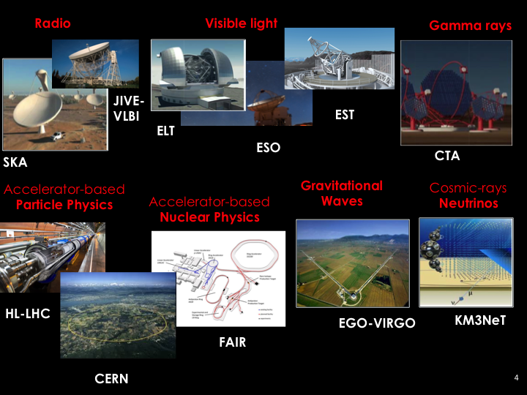

Slide 9
ESCAPE goals
Implementing Science Analysis Platforms for EOSC researchers to stage data collections, analyse them, access ESFRIs’ software tools, bring their own custom workflows.
Contributing to the EOSC global resources federation through a Data-Lake concept implementation to manage extremely large data volumes at the multi-Exabyte level.
Supporting “scientific software” as a major component of ESFRI data to be preserved and exposed in EOSC through dedicated catalogues.
Implementing a community foundation approach for continuous software shared development and training new generation researchers.
Virtual Observatory standards and methods for FAIR principles to a larger scientific context; demonstrating EOSC capacity to include existing frameworks.
Further involving SMEs and society in knowledge discovery.

Slide 10

http://projectescape.eu

Slide 11
ESCAPE Executive Board : E-EB – having regular meetings
Other WPs – having regular telecons, and setting up meetings
Communication – active, looking for things to highlight
WP4 - First Milestone – Paris IVOA meeting report - done
WP4 – First Deliverable – WP4 Project Plan - done
WP4 – Second Milestone – Groningen IVOA meeting - done
WP4 – Technology Forum announced: Strasbourg, Feb 4-6, 2020
ESCAPE “Progress Meeting” Brussels, Feb 26-27, 2020
Project tools: Indico / mailing lists / file sharing repository

Slide 12
WP4 Objectives
  Assess and implement the connection of ESFRI and other astronomy research infrastructures to the EOSC by the Virtual Observatory
  Refine and pursue implementation of FAIR principles for astronomy data via common interoperability standards - extending the VO to new communities
  Establish data stewardship practices for adding value to scientific content of ESFRI data archives

Slide 13
WP4 Tasks
Task 4.1 Integration of astronomy VO data and services into the EOSC
Lead: Marco Molinaro (INAF)
Task 4.2 Implementation of FAIR principles for ESFRI data through the Virtual Observatory
Lead: Françoise Genova (CNRS-ObAS)
Task 4.3 Adding value to trusted content in astronomy archives
Co-leads: Mark Allen (CNRS-ObAS) & Martino Romaniello (ESO)

Slide 14















WP4 Partners
Partners from ESFRIs and astronomy Research Infrastructures
Partners bringing experience from European Virtual Observatory projects

Slide 15
Task 4.1 Integration of astronomy VO data and services into the EOSC
Map the VO framework to EOSC
  Aim to include the VO enabled archive services from ESFRI into EOSC
VO Registry in EOSC
Portfolio of astronomy VO services
Contribution to EOSC hybrid cloud
Containerised domain-specific services

Slide 16
Task 4.1 - overview
“Integration of astronomy VO data and services into the EOSC”
Interfacing the VO framework with EOSC
  VO registry federated as EOSC catalogue/s
  Astronomy vocabularies as EOSC services
Portfolio of astronomy VO services
EOSC Hybrid Cloud contribution
Domain-specific services containerisation
WP5 (ESAP) coordination on computing “close” to data
WP2 (DIOS) coordination to test the above on the “data lake” solution
(of course) collaboration with the other WP4 Tasks to work on latest VO standards and data resource integration in the EOSC.

Slide 17
Has participated in many EOSC events
  EOSC hub week, RDA plenary (included RDA-EOSC meeting), EOSC Symposium
  VO registry re-integrated into EUDAT, collaboration with C. Maartens
  Summary of progress at the Tech forum
D4.4 Intermediate analysis report on integration of VO data and services into EOSC (Report). | Month 18 July 2020
D4.7 Final analysis report on integration of VO data and services into the EOSC (Report). | Month 38 March 2022

Slide 18
Task 4.2 Implementation of FAIR principles for ESFRI data through the Virtual Observatory
Definition and adoption of common open IVOA standards for interoperability based on ESFRI requirements
Connection to EOSC through Task 4.1

Slide 19
Task 4.2 Activities: Requirements and VO update
Gathering requirements from ESFRIs/RIs on their use of the VO framework and its connection to EOSC
  Initial priorities interferometric data (SKA and JIVE), event based data (CTA, EGO/VIRGO, SKA), scalability for extremely large data sets and their use in the science platform (WP5)
  EST – new participant in VO interoperability
Update definition of standards and representation of ESFRI/RI interests in IVOA

Slide 20

Task 4.2 Activities: problem solving platform and support to science community
Establish a practical problem-solving platform
  Expertise and documentation for common solutions to support implementation by ESFRI/RIs
  One Hands-on Training (M24)
Support of the science community
  Vizualisation tools multi-wavelength/multi-messenger
  Two Hands-On Schools providing reusable materials
    Use cases a essential feature of the schools
Engagement with RDA

Slide 21
D4.2 Intermediate analysis report on use of IVOA standards for FAIR ESFRI and community data (Report) | Month 14, March 2020
D4.3 First science with interoperable data school (Event and report) | Month 16, May 2020
D4.6 Second science with interoperable data school (Event and report) | Month 35, December 2021
D4.8 Final analysis report on use of IVOA standards for FAIR ESFRI and community data and best stewardship practices for value-added data (R) | Month 40, May 2022
M4.1 Progress and priorities at IVOA (1) M4.2 Progress and priorities at IVOA (2) M4.3 Progress and priorities at IVOA (3) M4.4 Progress and priorities at IVOA (4) M4.5 Hands-on Workshop for Data Providers M4.6 Progress and priorities at IVOA (5) M4.7 Progress and priorities at IVOA (6) | Month 5, June 2019 Month 10, November 2019 Month 17, June 2020 Month 22, November 2020 Month 28, May 2021 Month 29, June 2021 Month 34, November 2021

Slide 22
Task 4.2 - Partner expected contribution
All ESFRIs/RI to contribute requirements, feedback and implementation, incl. test. Specific effort on
  ORB & KIS (EST): Solar VO – a new domain for the VO
  JIVE, SKA: interferometric data
  ASTERICS demonstrated the power of direct involvement of ESFRIs/RIs in the IVOA
All VO teams contribute their expertise, in particular
  INAF: expertise in VO standards, scalability, and liaison with Task 4.1 and WP5
  INTA: scientific schools
  UEDIN: time-domain, scalability, a link to WP5
  UHEI: support to implementation

Slide 23
Task 4.3 Adding value to trusted content in astronomy archives
Next generation functionalities for creation and publication of high-level, value-added data products from ESFRIs
Assessment and application of new techniques – machine learning analytics. (connection to WP3)
  Specific example applied to ESO archives data products
Identification of stewardship best practices
  Curation and publication of next-generation data products via ESFRI archives
  Technical and human aspects

Slide 24
D4.5 Release of prototype machine learning enabled archive services providing value-added content to archives (Demonstration) | Month 30 July 2021
D4.8 Final analysis report on use of IVOA standards for FAIR ESFRI and community data and best stewardship practices for value-added data (Report) (includes report of feedback on prototype services developed for D4.5) | Month 40 May 2022

Slide 25
Month 1 | February 2019
Month 2 | March
Month 3 | April
Month 4 | May
Month 5 | June | M4.1 Progress and priorities at IVOA
Month 6 | July | D4.1 Detailed project plan for WP4 (This document)
Month 7 | August
Month 8 | September
Month 9 | October
Month 10 | November | M4.2 Progress and priorities at IVOA
Month 11 | December
Month 12 | January 2020
Month 13 | February
Month 14 | March | D4.2 Intermediate report on use of IVOA standards
Month 15 | April
Month 16 | May | D4.3 1st Science with interoperable data school
Month 17 | June | M4.3 Progress and priorities at IVOA
Month 18 | July | D4.4 Intermediate analysis report of VO data and service integration into EOSC
Month 19 | August
Month 20 | September
Month 21 | October
Month 22 | November | M4.4 Progress and priorities at IVOA
Month 23 | December
Month 24 | January 2021
Month 25 | February
Month 26 | March
Month 27 | April
Month 28 | May | M4.5 Hands-on workshop for data providers
Month 29 | June | M4.6 Progress and priorities at IVOA
Month 30 | July | D4.5 Prototype demonstrator for value-added archive services
Month 31 | August
Month 32 | September
Month 33 | October
Month 34 | November | M4.7 Progress and priorities at IVOA
Month 35 | December | D4.6 2nd Science with interoperable data school
Month 36 | January 2022
Month 37 | February
Month 38 | March | D4.7 Final analysis report on integration of VO data and services into EOSC
Month 39 | April
Month 40 | May | D4.8 Final analysis report on IVOA standards and stewardship best practices
Month 41 | June
Month 42 | July

Slide 26
Technology Forum – an important WP4 event!
  Aimed at the whole WP, please bring the technical people!
  Presentations, Hackathon, special focus: Radio and Solar
  Will have WP5 cross-WP activity integrated into the forum
  Question – Can we please have a Task 4.3 presentation at the forum?
ESCAPE – Progress Meeting
  First day: WP meetings and cross-WP discussions
  Aimed at cross-WP coordination (aim to have 1 person per WP4 partner)
  Second day:
    Interaction with EOSC, being defined now
    General Assembly (Partner reps only)
    External Advisory Board

Slide 27
1st Science with interoperable data school
  Late May 2020, ESAC near Madrid
  Announcement TBD, but hopefully Jan 2020
  Aimed at PhD students, postdoc, early career
  Question – any Task 4.3 possibilities for the school tutorials ?

Slide 28
Next steps:
Tech Forum
- Presentation on Task 4.3 on progress and ideas.
Hackathon meeting – demo in Jupyter notebook? (2 hrs)
Cross-WP4/5 question – desired platform capabilities from Task 4.3 experience
Task 4.3 Meeting
End March/ beginning April 2020 – Strasbourg (date TBD)
Make plans for imaging, catalogue, cube explorations.
Input for ESCAPE progress meeting - 3 slides (to be finalized at Strasbourg Tech forum)
( - input for ESO users committee: 2-3 slides for April 2020) – MR to decide
Input for mid-term report. Written description of progress: probably needed by end June 2020
- Meeting HITS before summer 2020 (probably July)
(how do we keep that after finished? - who can re-run it?) (F-X - visit to HITS)
- AD’I Jan-June 2020: Concentrate on UVES data, apply same approach as done from HARPS, but also look for overlaps. (Make the prototype system somehow transferrable)
- Toward the Deliverable Demo - July 2021
- A vision for the demo; February 2021
- Define venue/audience for demo: ESO Users committee 2021, EWASS 2021, IAU 2021?

Slide 29
Spectra:
* finalize HARPS - atmosphere removal (short investigation by HITS before Tech forum). Try the system with simulated stellar spectra - is similar really similar? ESO (John) – goal to show in April 2020 (may involve pre-procesing/norms/...?)
* UVES work
- Self-Organizing-Maps?
- What to do instead of 0-padding?
- Does the dimensionality reduction cluster different "objects" (galaxy, star, QSO, BD) ?
- Getting labels from SIMBAD and ‘re-label' centroids [FS(ESO) – CDS]
- Question: are we good enough with redshifts?
* Gather some initial feedback from astronomers: what is a "similarity" of spectra that *they* would find useful for *their* science -> maybe this will lead to different methods of pre-processing/loss-function
* Precision topic:
  - How many dimensions do we need to capture "most" of the spectral information ?
  - ESO to try to force orthogonality in latent space + order by importance
  - Noise estimation and then decide on the dimensions that are really necessary
  * Other instruments ? Consider which spectrographs addition to HARPS and UVES - can we make one model that can contain spectra from all/more instruments?

Slide 30
Interface:
* Think of concepts for the interfaces

