Slide 1
EW Physics at the CEPC
Zhijun Liang
(On behalf of the CEPC physics and detector group)
Institute of High energy physics, CAS
The 2024 International Workshop on the Circular Electron Positron Collider
Marseille, France, Apr 8–11, 2024

Slide 2
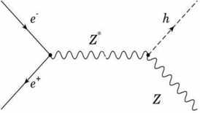
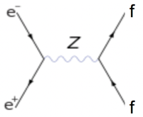
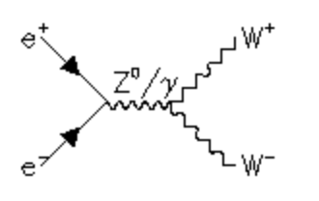
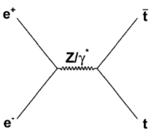
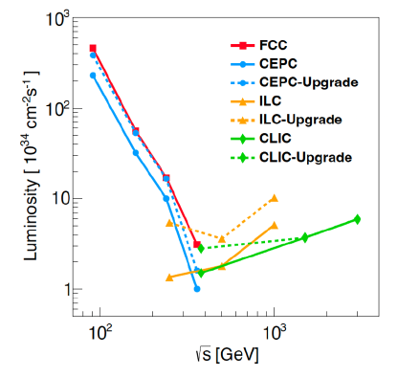
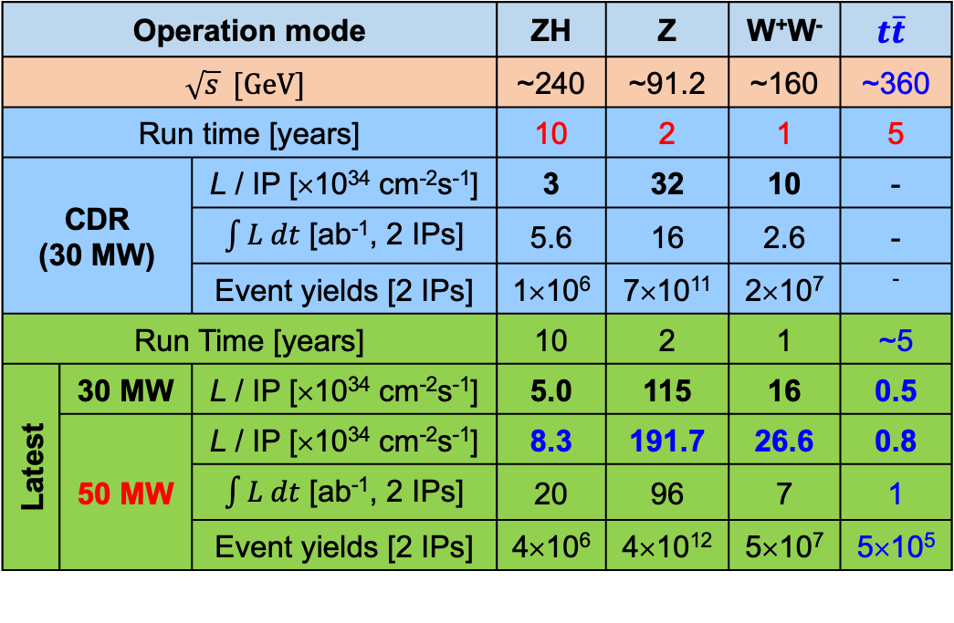
CEPC physics program
An extremely versatile machine with a broad spectrum of physics opportunities
→ Far beyond a Higgs factory
Operation mode |  |  | ZH | Z | W⁺W⁻ | $$t\overline{t}$$
$$\sqrt{s} [GeV]$$ |  |  | ~240 | ~91.2 | ~160 | ~360
Run time [years] |  |  | 10 | 2 | 1 | 5
CDR (30 MW) |  | L / IP [×10³⁴ cm⁻²s⁻¹] | 3 | 32 | 10 | -
 |  | $\int{L dt}$ [ab⁻¹, 2 IPs] | 5.6 | 16 | 2.6 | -
 |  | Event yields [2 IPs] | 1×10⁶ | 7×10¹¹ | 2×10⁷ | ⁻
Run Time [years] |  |  | 10 | 2 | 1 | ~5
Latest | 30 MW | L / IP [×10³⁴ cm⁻²s⁻¹] | 5.0 | 115 | 16 | 0.5
 | 50 MW | L / IP [×10³⁴ cm⁻²s⁻¹] | 8.3 | 191.7 | 26.6 | 0.8
 |  | $\int{L dt}$ [ab⁻¹, 2 IPs] | 20 | 96 | 7 | 1
 |  | Event yields [2 IPs] | 4×10⁶ | 4×10¹² | 5×10⁷ | 5×10⁵
CEPC Accelerator white paper for
Snowmass21, arXiv:2203.09451
Both 50 MW and $t\overline{t}$ modes are currently considered as CEPC upgrades.

Slide 3
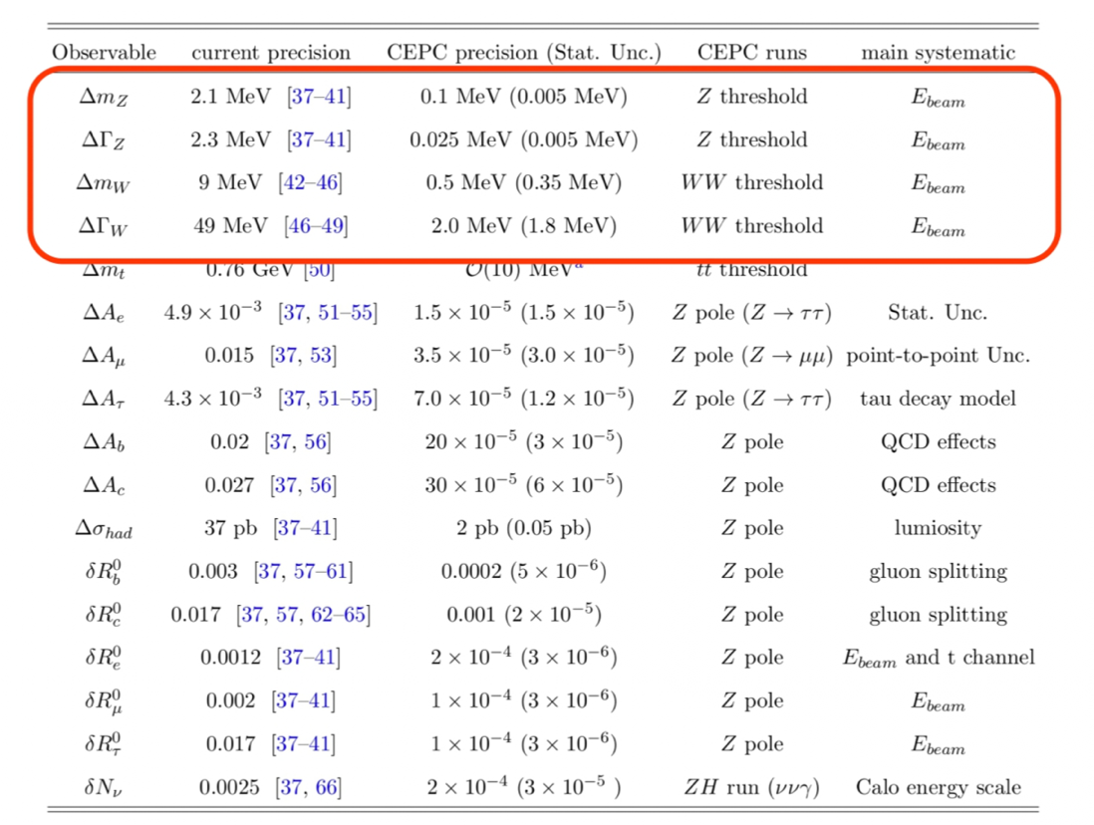
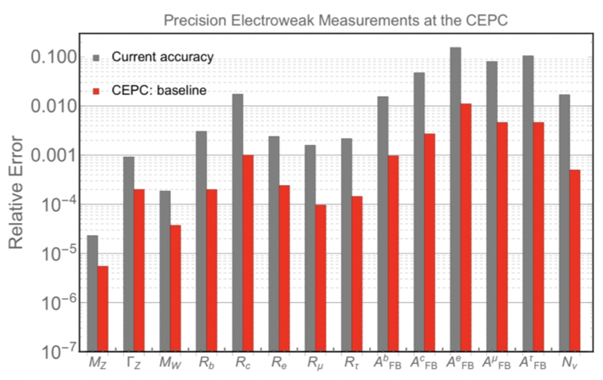
EWK precision measurements (ZH, Z pole, WW runs)
CEPC is expected to improve the current precision by 1-2 orders of magnitude, offering a great opportunity to test the consistency of the SM.

Slide 4
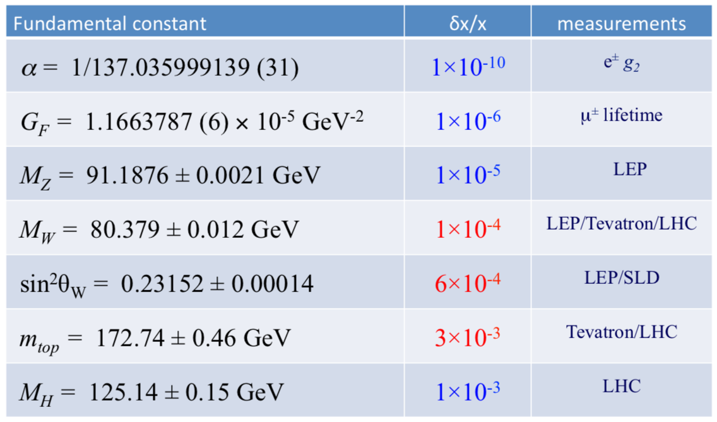
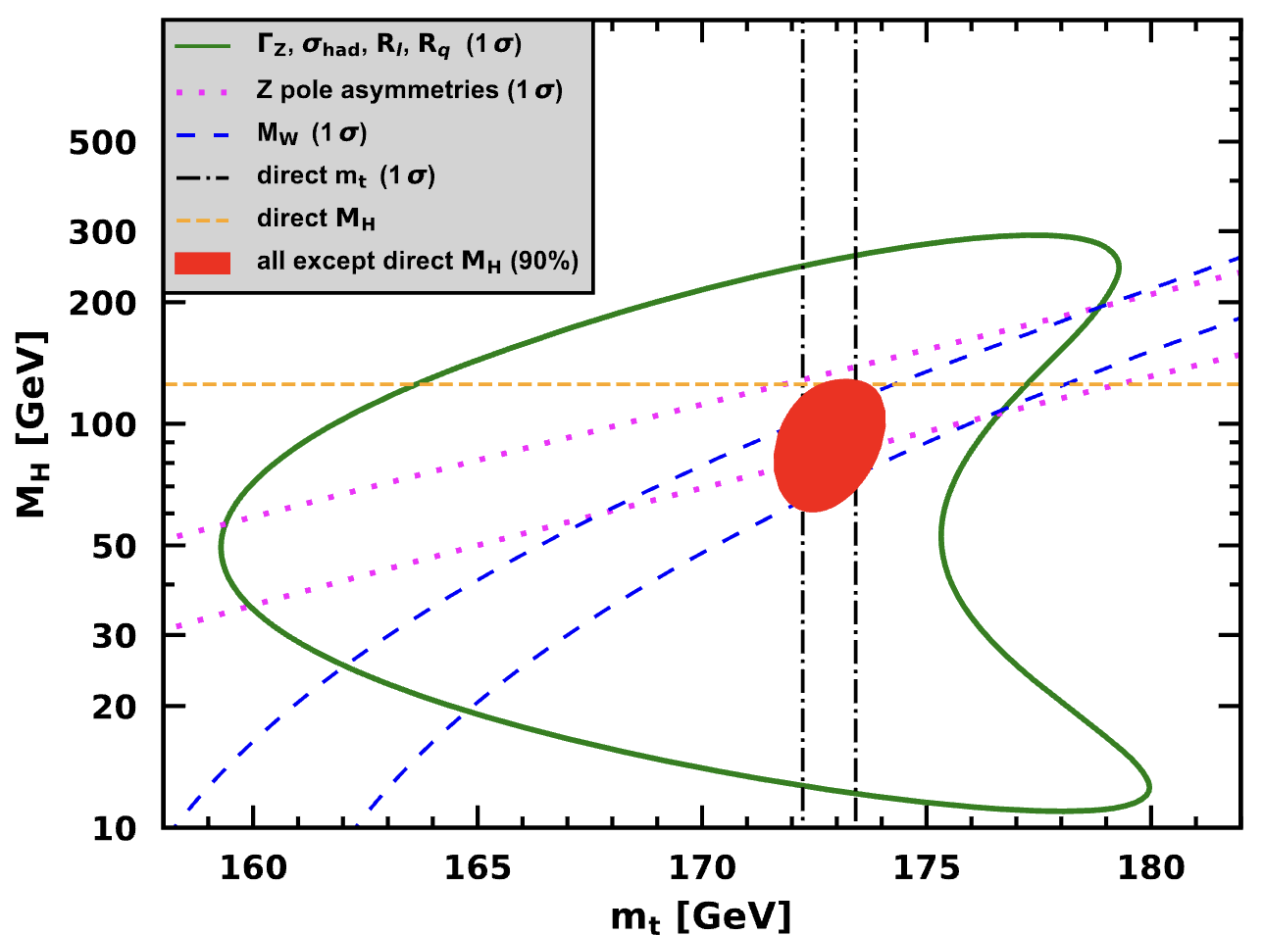
The status of electroweak global fit
7 key observables in electroweak global fit
  Consistency study of the standard model electroweak section
  Need CEPC Z pole and WW runs : Precise measurements on EWK observables.
PDG 2023

Slide 5
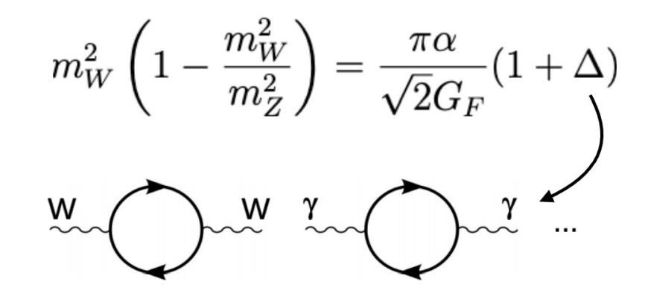
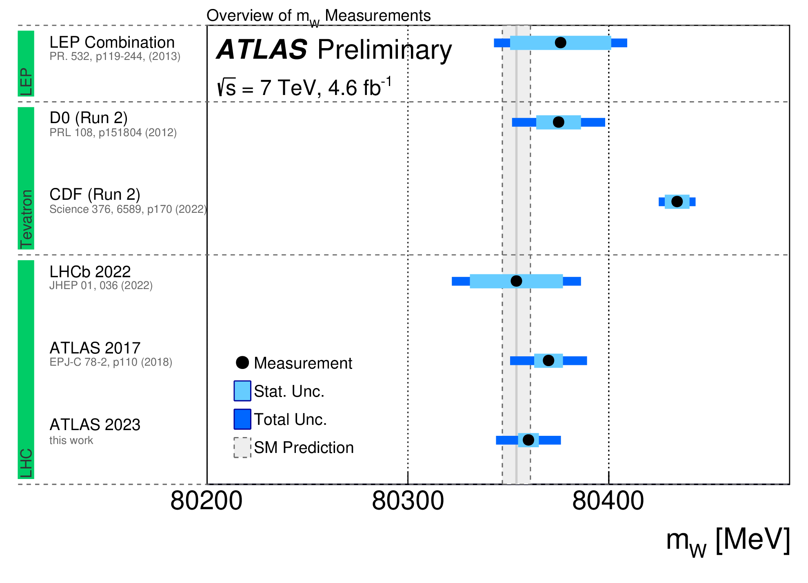
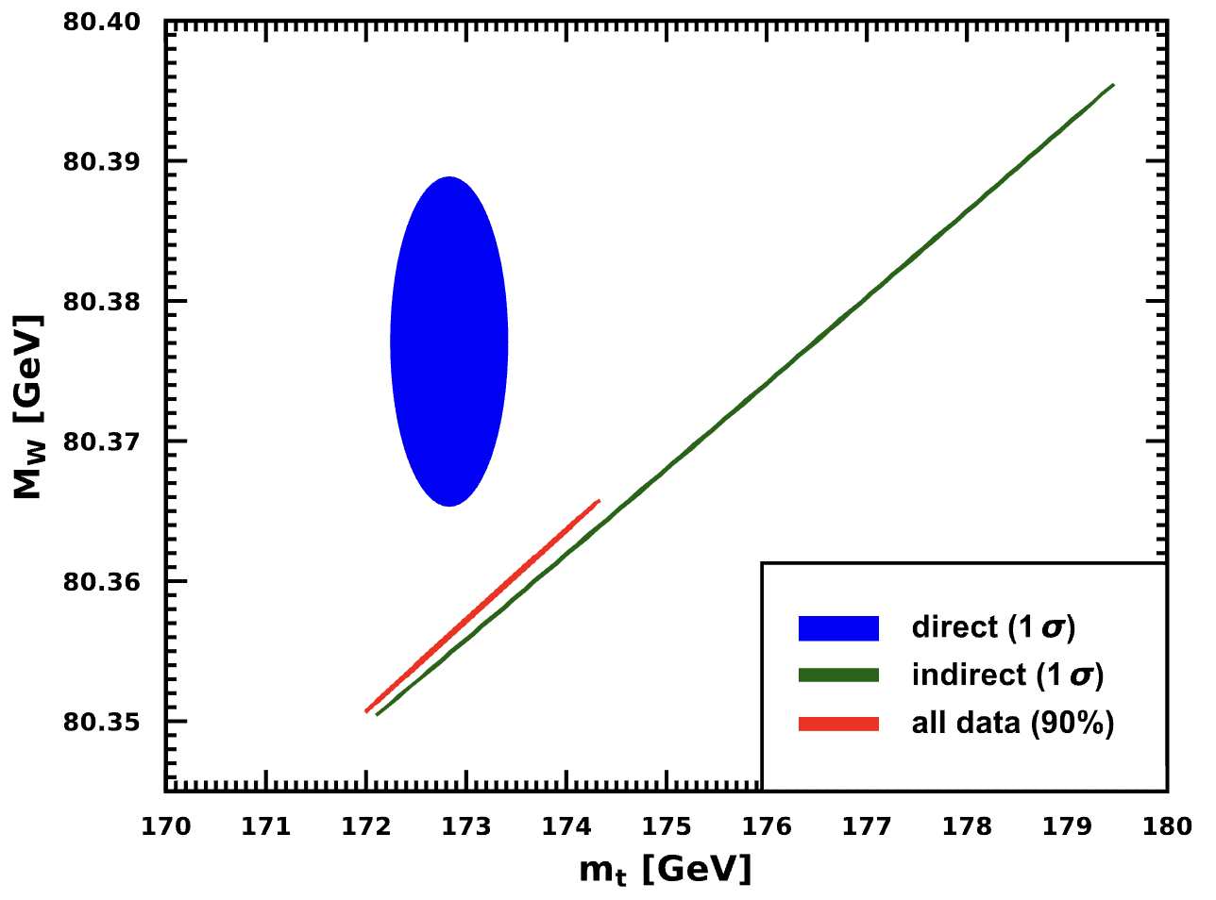
W mass measurement
m_{W} is a key observable to test SM consistency
  CDF Observed 7σ deviation wrt SM predictions
  Difficult to reach to same level of precision at LHC
  m_{W} Measurement at future collider is essential
ATLAS-CONF-2023-004

Slide 6
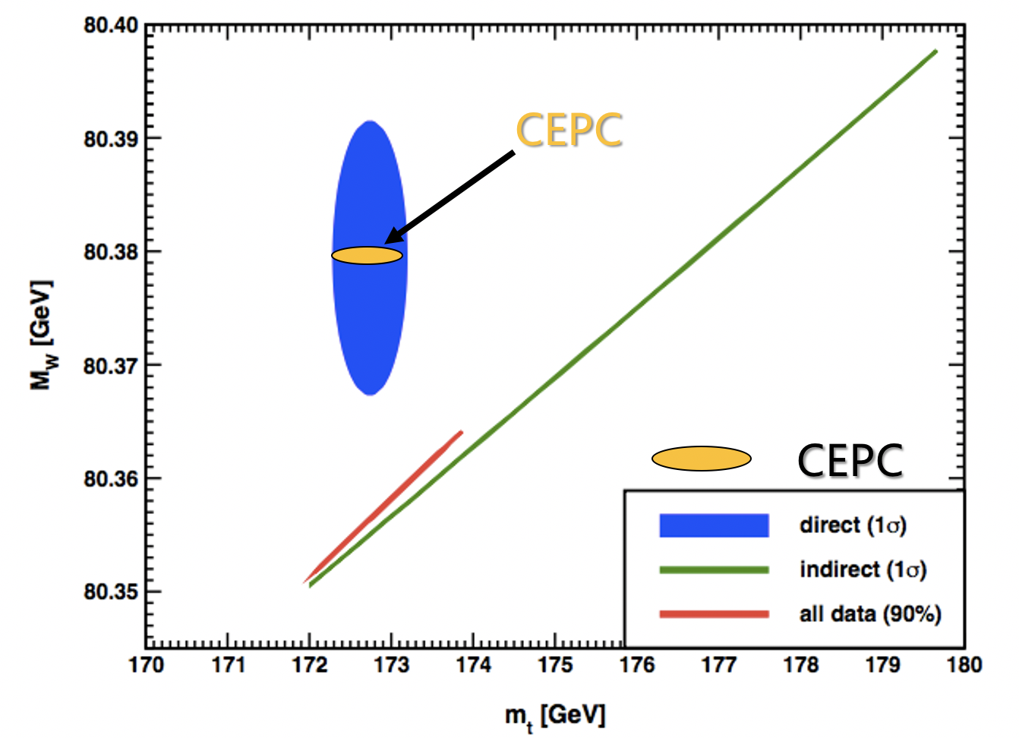
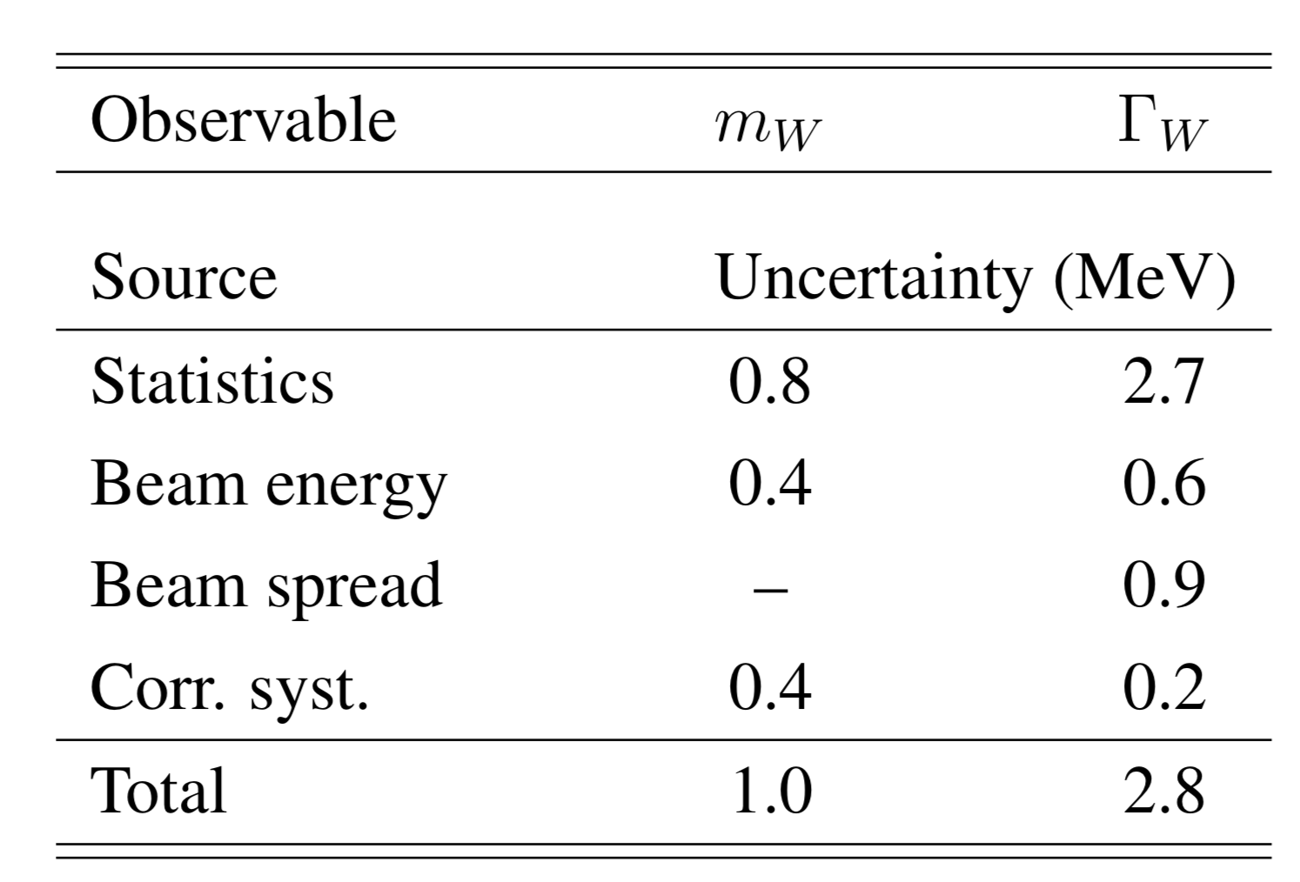
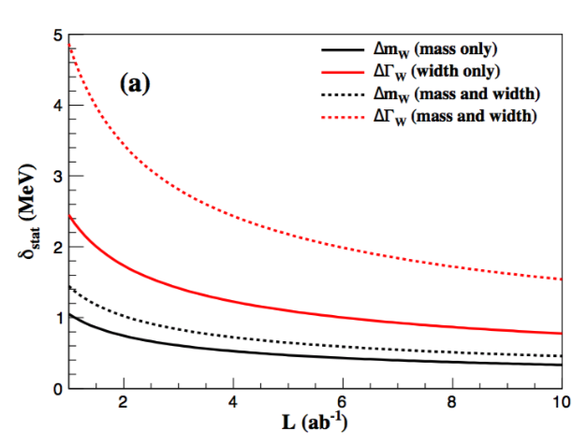
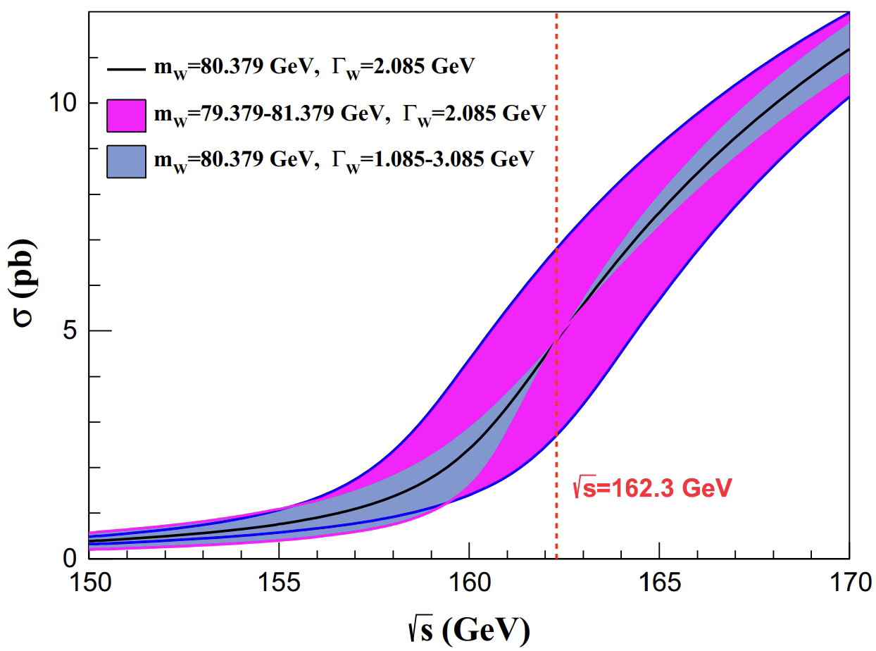
Prospect of W mass measurement at CEPC (WW threshold runs)
Expect to reach below 1MeV precision on W mass
  Four energy scan points:
    157.5, 161.5, 162.5( W mass, W width measurements)
    172.0 GeV (⍺QCD (mW), Br (W->had) , CKM |Vcs|)
P.X.Shen, P.Azzuri , G.Li et,al,
Eur.Phys.J.C 80 (2020) 1, 66
Joint study of CEPC/Fcc-ee

Slide 7
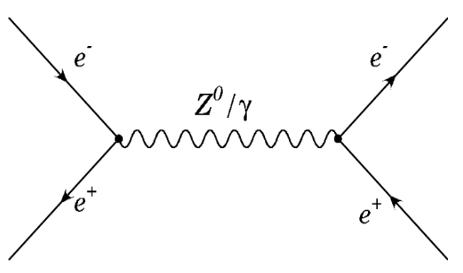
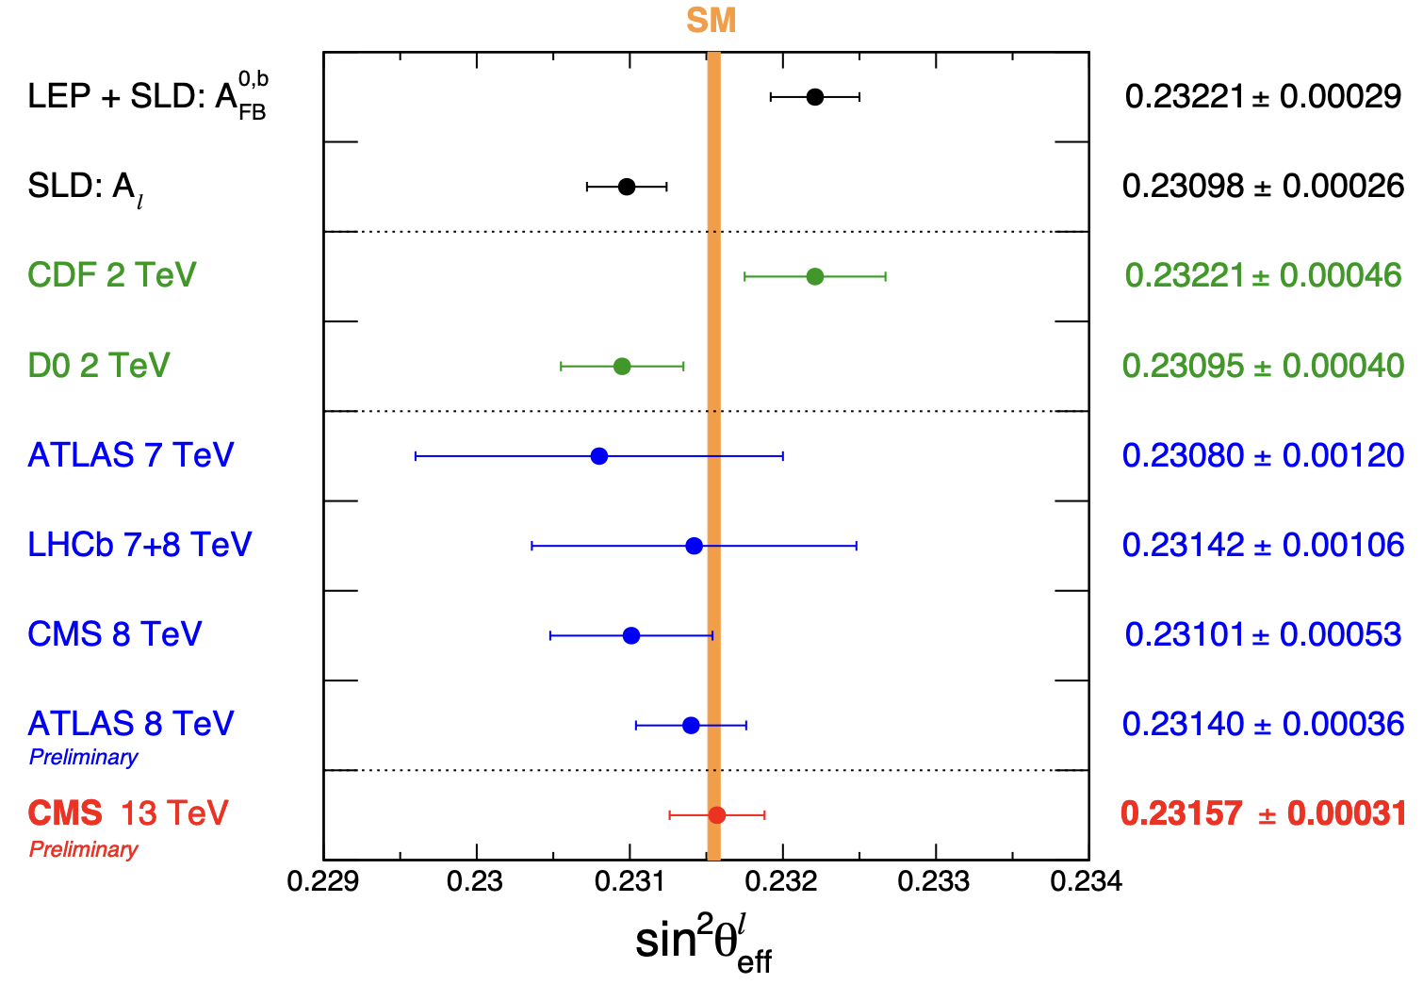
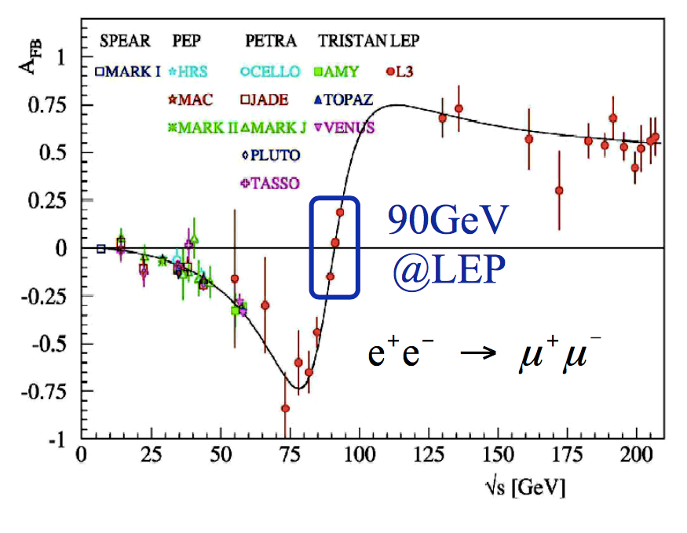
Weak mixing angle measurements (Sin²θ_{W} )
Weak mixing angle measurement is well motivated
  ~3σ tension between LEP and SLC measurements
  LHC results can reach similar precision level now
CMS 2024 update
CMS PAS SMP-22-010

Slide 8
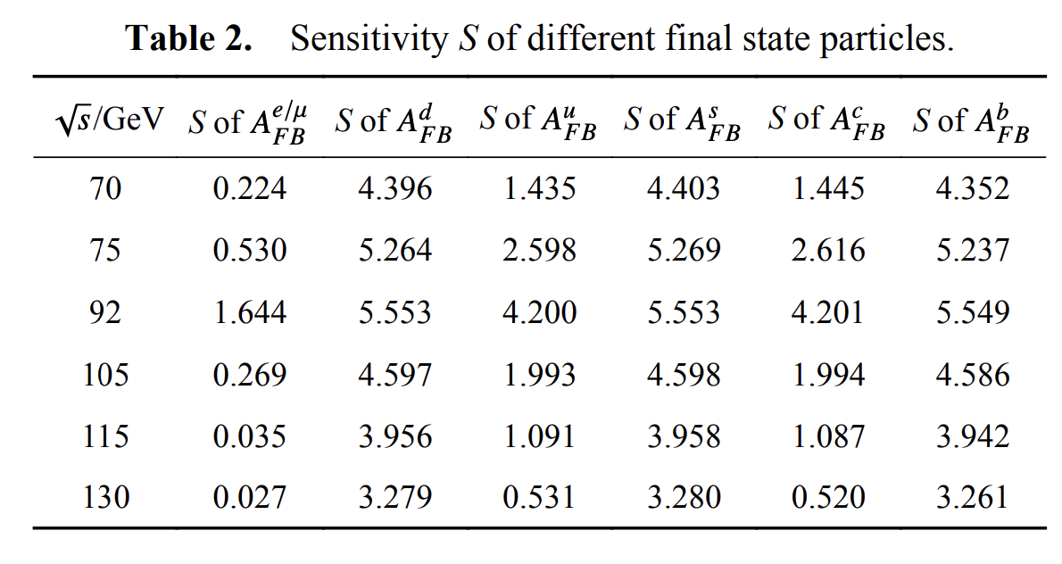
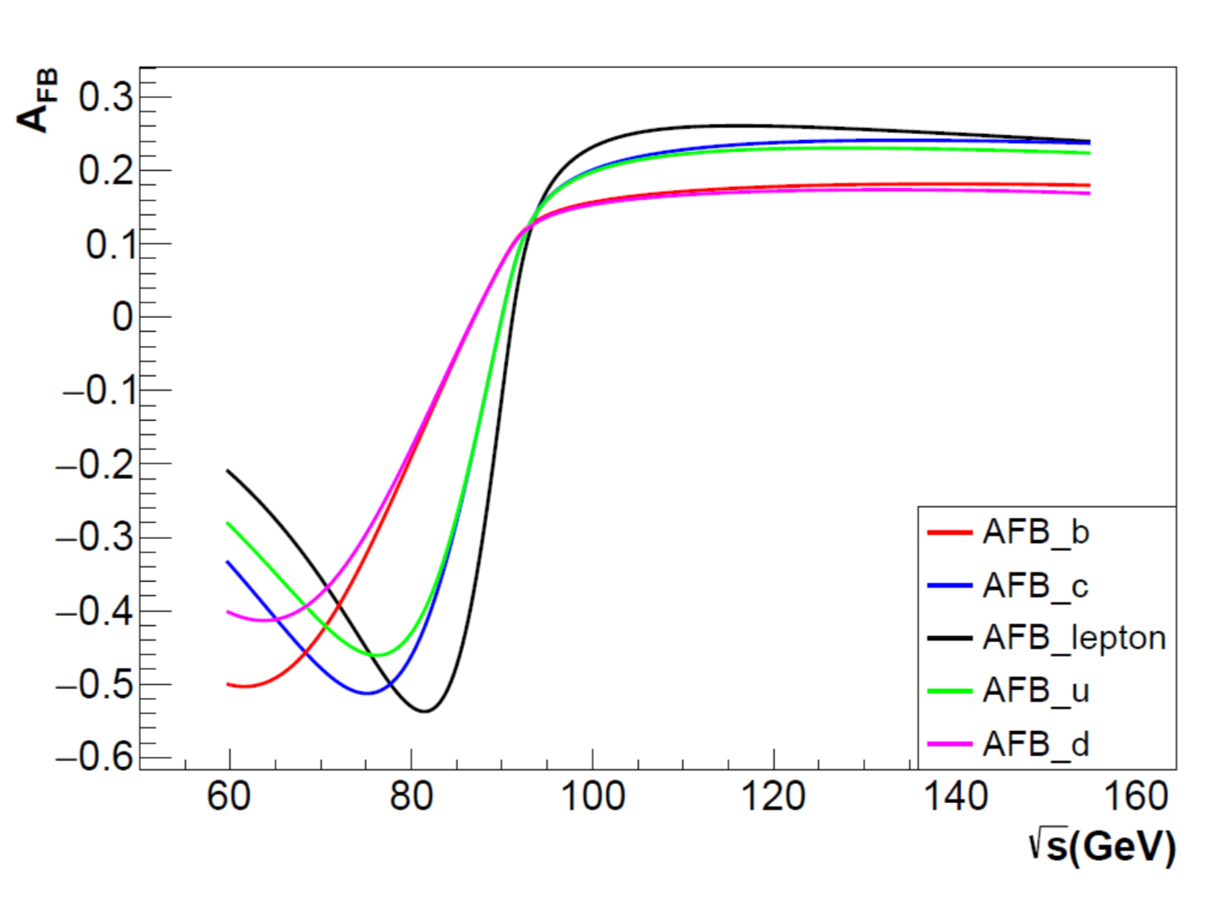
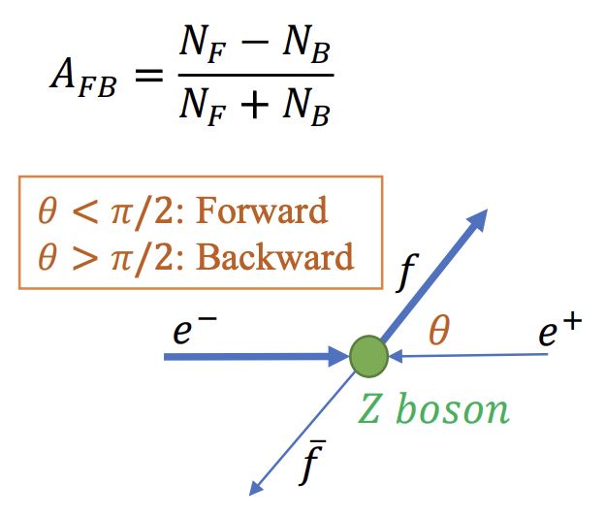
Weak mixing angle measurements at CEPC (A_{FB})
Study of off-peak runs for weak mixing angle measurements.
Chinese Phys. C 47 123002

Slide 9
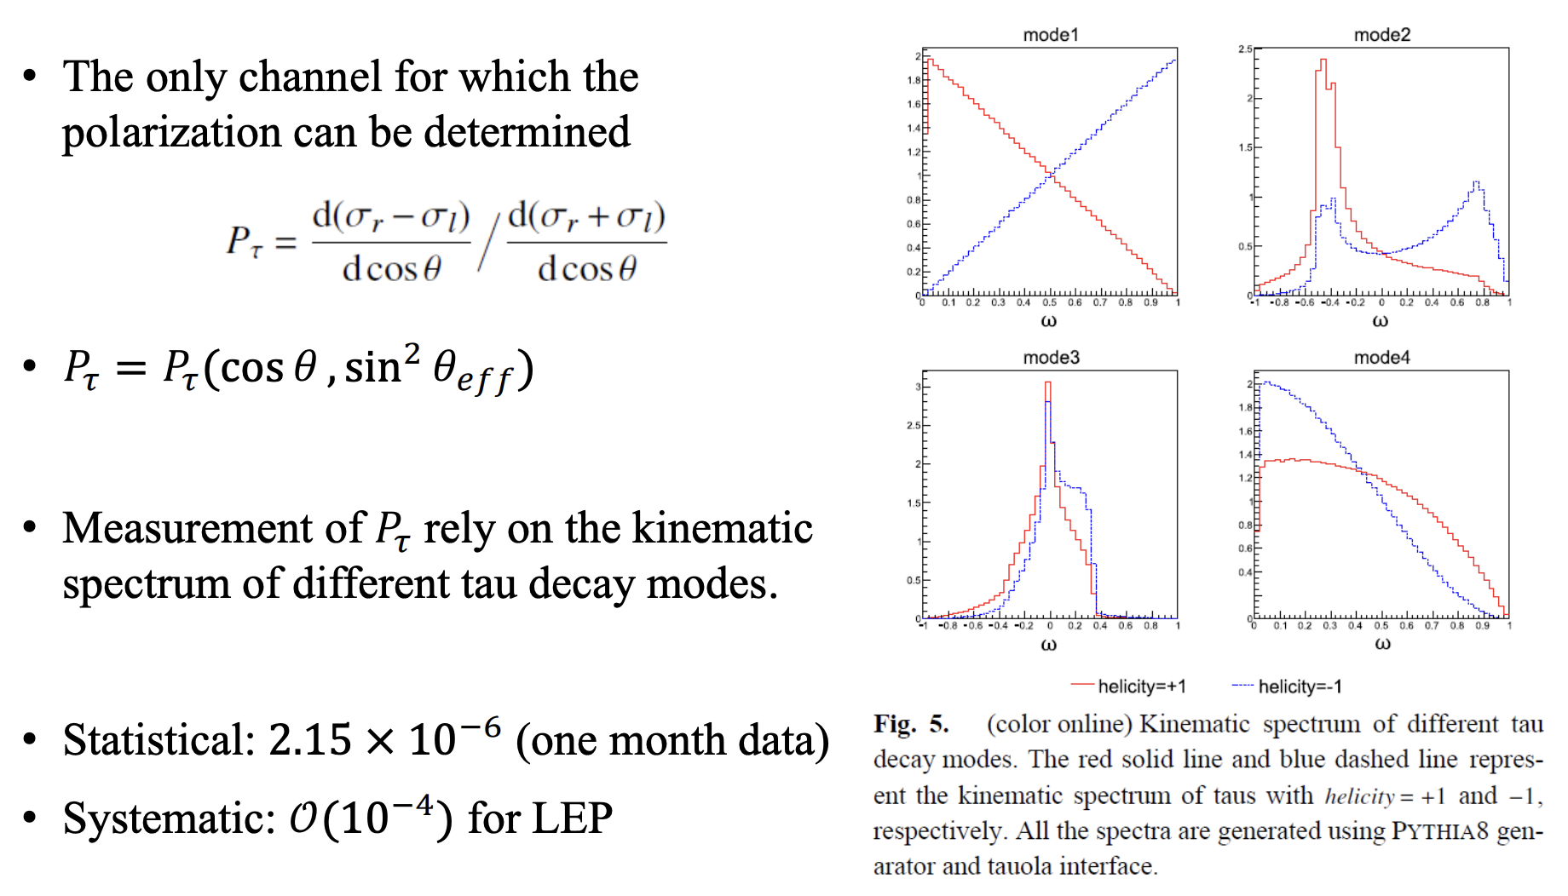
Weak mixing angle at CEPC (from 𝑃𝜏 measurement)
Chinese Phys. C 47 123002

Slide 10
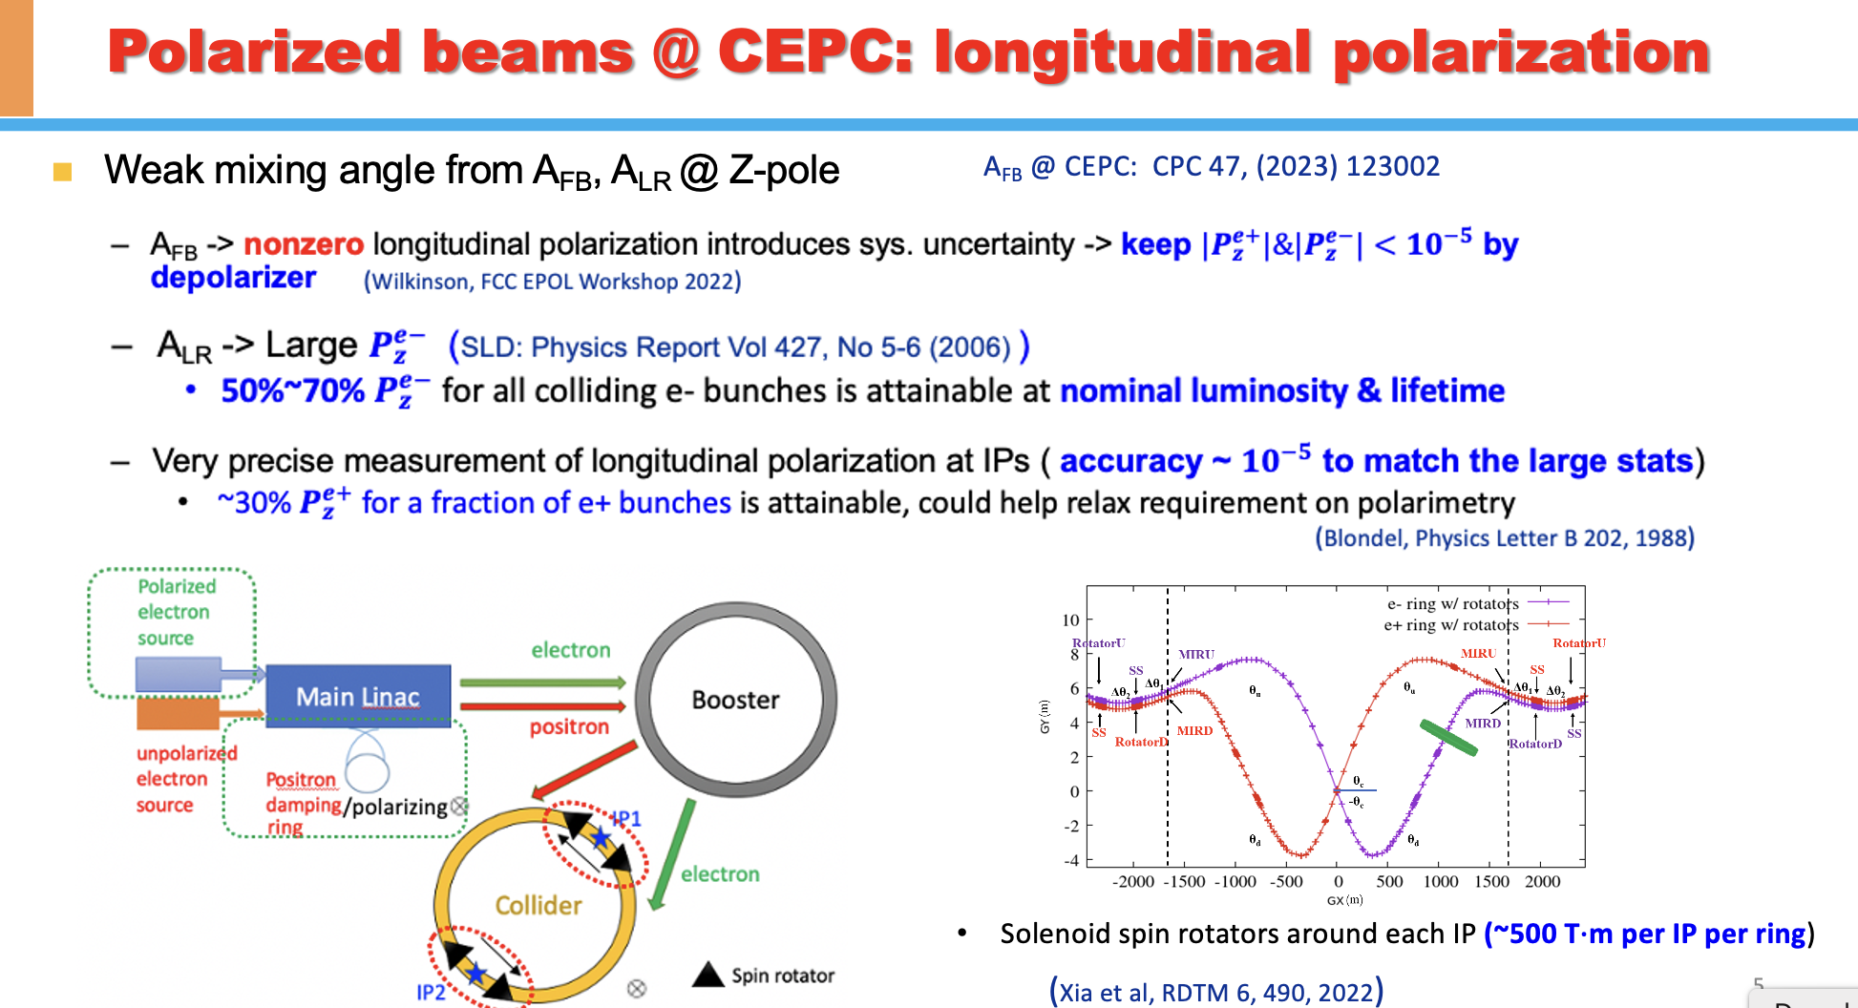
Weak mixing angle at CEPC (from A_{LR} measurement)
Potential to have longitudinal beam polarization in CEPC baseline design

Slide 11
Weak mixing angle measurements (Sin²θ_{W} )
CEPC has potential to improve it by two order of magnitudes
Experiment | Stat. (10⁻⁵) | Syst. (10⁻⁵) | Theory unc. (PDF+QCD) (10⁻⁵) | Total unc. (10⁻⁵) δsin²θ_{W}
LEP | 29 | ~ 1 | ~0 | 29
Tevatron | 27 | 5 | 18 | 33
ATLAS 8TeV (ATL-CONF-2018-037) | 21 | 16 | 24 | 36
CMS 13TeV (SMP-22-01) | 10 | 15 | 9 | 27
CEPC (2205.08553) | ~0.2 | ~0.2 | ~0 | ~0.3
Theory prediction |  |  | ~4 | ~4

Slide 12
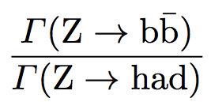
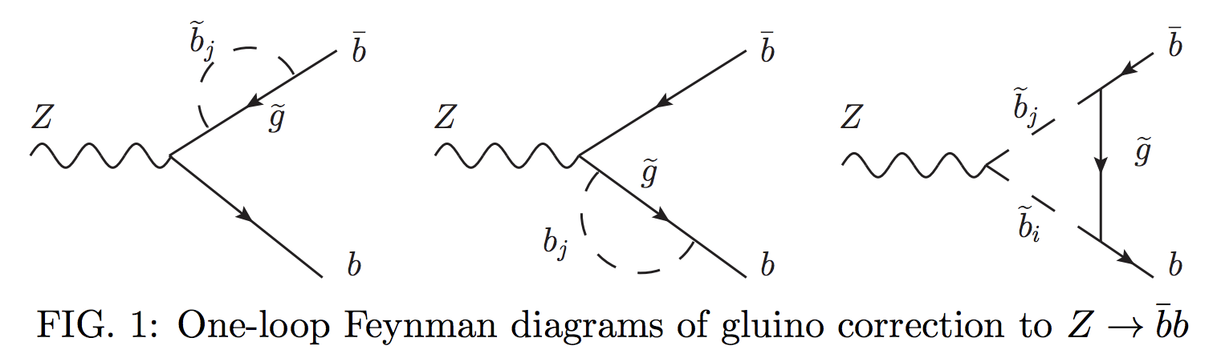
R^{b} measurement
At LEP measurement 0.21594 ±0.00066
CEPC aim to improve the precision by a factor 10~20 (0.02%)
R^{b} measurement is sensitive to New physics models (SUSY)
  SUSY predicts corrections to Z→ bb vertex
  Through gluino and chargino loop …
1601.07758

Slide 13
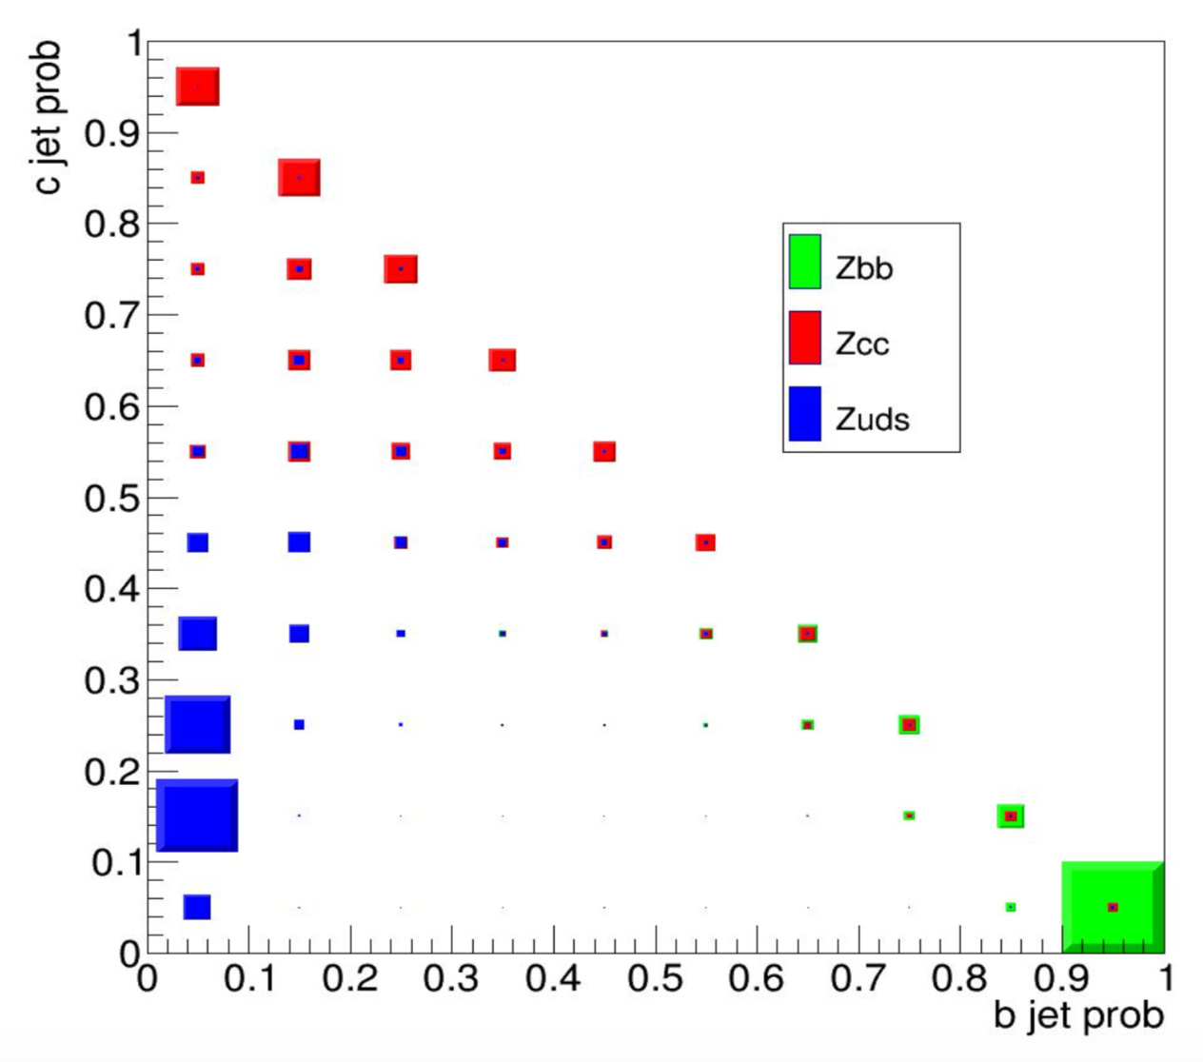
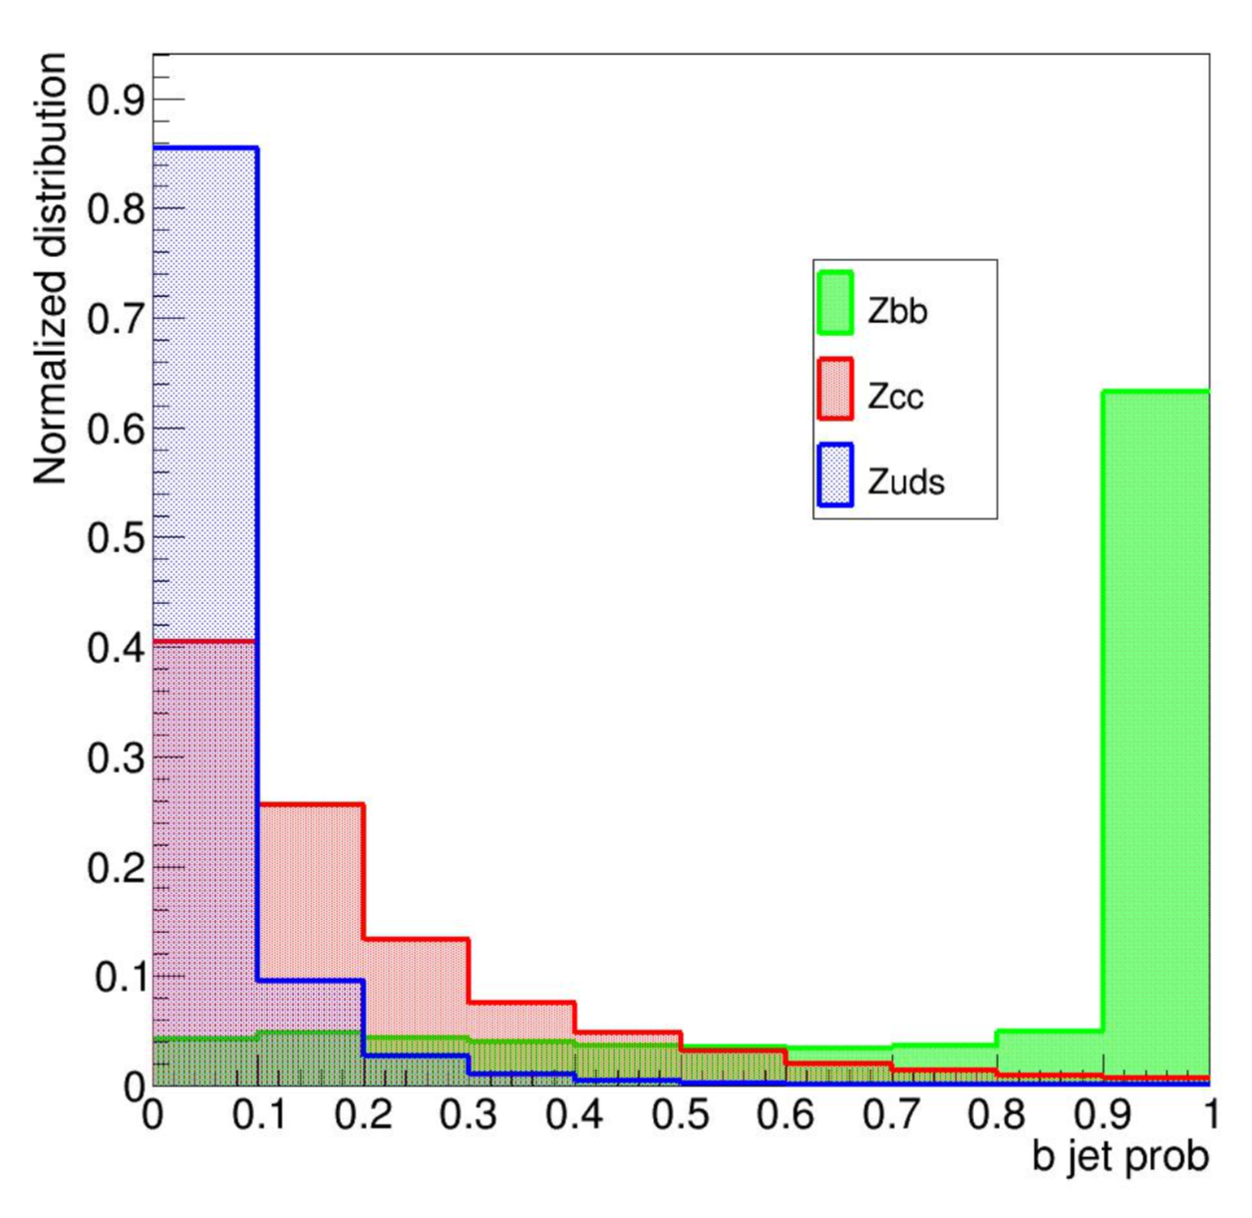
R^{b} measurement (2)
  Expected to be 20~50 times better than LEP measurements
    With 95% purity working points, efficiency > 70% in CEPC ( ~30% for LEP)
    1D and 2D template fit for b tagging probability
  A global analysis method is developed to reduce impact from correlations between jet pairs. Method is under validation
Eur. Phys. J. Plus 136, 1 (2021)
Error source | ΔR^{b} (10⁻⁵)
Statistics | 1
Tracking resolution | 1
Charm modeling | 3
Gluon spliting | 1
Hemisphere correlation | 6
Total | 7
13

Slide 14
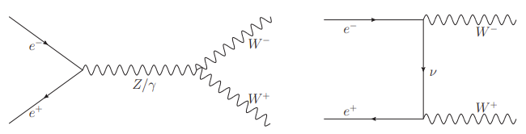
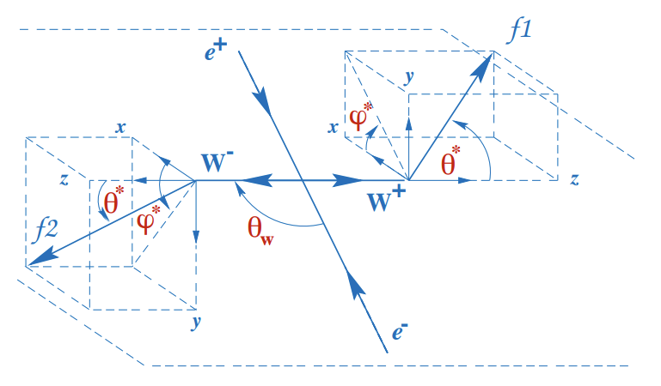
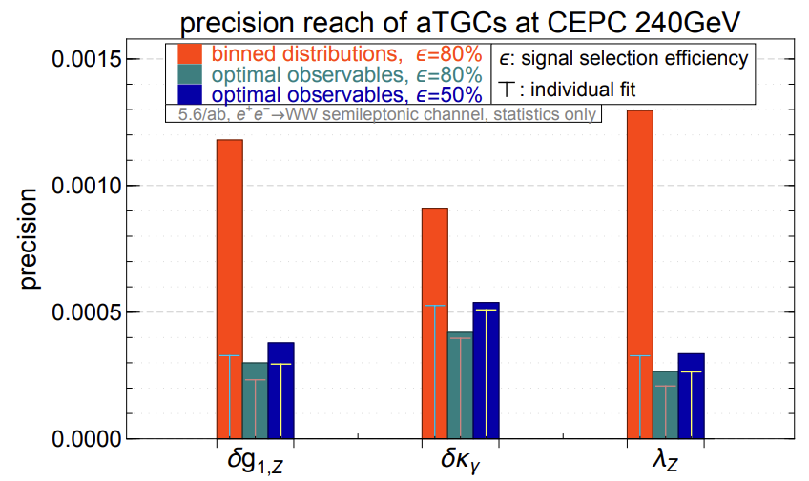
Search for aTGCs with ee→WW
Measurement of ee→WW process provides important constraints on various new physics contributions
7 parameters considered for further EFT studies
aTGC couplings
gauge couplings modifier
The optimal observable method explore for this search
(Z. Phys. C 62 (1994) 397–412)
arXiv:1907.04311

Slide 15
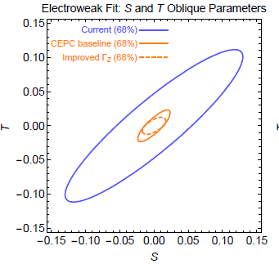
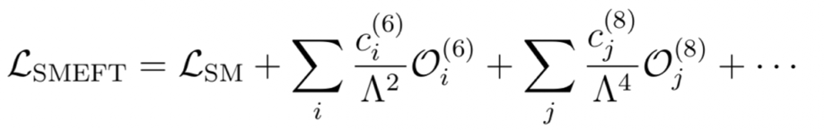
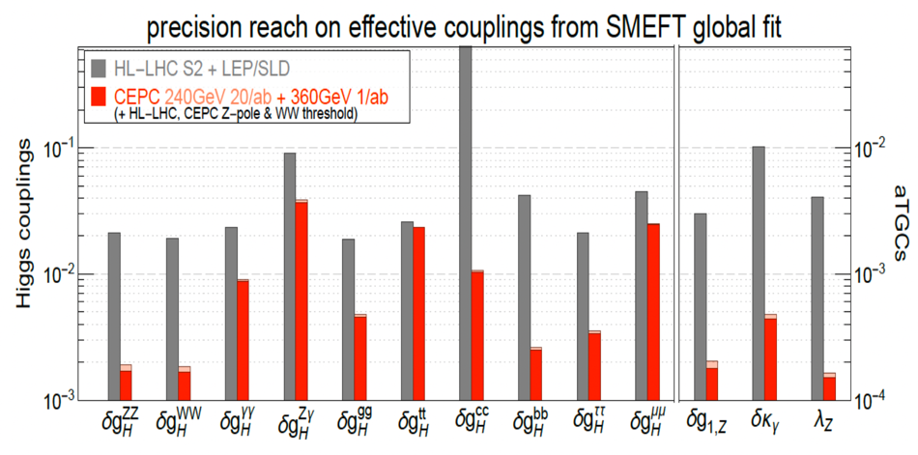
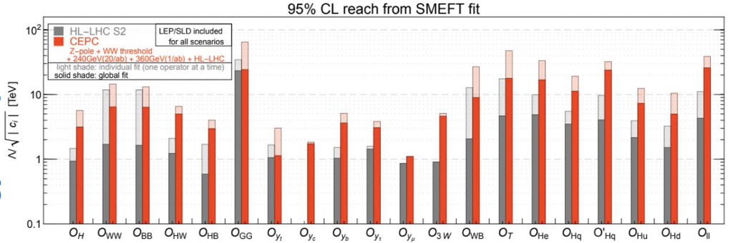
Global fit with SMEFT: new physics constrains
CEPC has potential to reveal new physics @10 TeV by combining Higgs, EWK and top measurements → power of precision

Slide 16
Summary
CEPC is designed to have 100km double ring accelerator
  Multiple collision energy (from Z pole to ttbar threshold) proposed for various physics motivations
Unprecedented luminosity provides chance to test the SM EWK sector in a more precise way
  Expected 1-2 order of magnitude better than current precision
  Would help to solve puzzles in current measurements

