Slide 1
Status of CEPCSW
Tao Lin
(on behalf of CEPC software group)
2024 European Edition of the International Workshop on the Circular Electron-Positron Collider
Marseille, FRANCE
Apr 8 – 11, 2024

Slide 2
Outline
Introduction
Overview of CEPCSW
Detector description
Simulation
Reconstruction
Towards Reference Detector TDR (short-term tasks)
Requirements
Software Releases
Plans (long-term tasks)
Summary

Slide 3
Introduction
The CEPC software development first started with the iLCSoft
Reused most software modules: Marlin, LCIO, MokkaC, Gear
Developed CEPC’s software components for simulation and reconstruction
Massive M.C. data produced for detector and physics potential studies
CDR was released in Nov, 2018, based on results from the iLCSoft
New CEPC software (CEPCSW) prototype was proposed at the Oxford workshop in April 2019
The consensus among CEPC, CLIC, FCC, ILC and other future experiments was reached at the Bologna workshop in June 2019
Develop a Common Turnkey Software Stack (Key4hep) for future collider experiments
Maximize the sharing of software components among different experiments

Slide 4
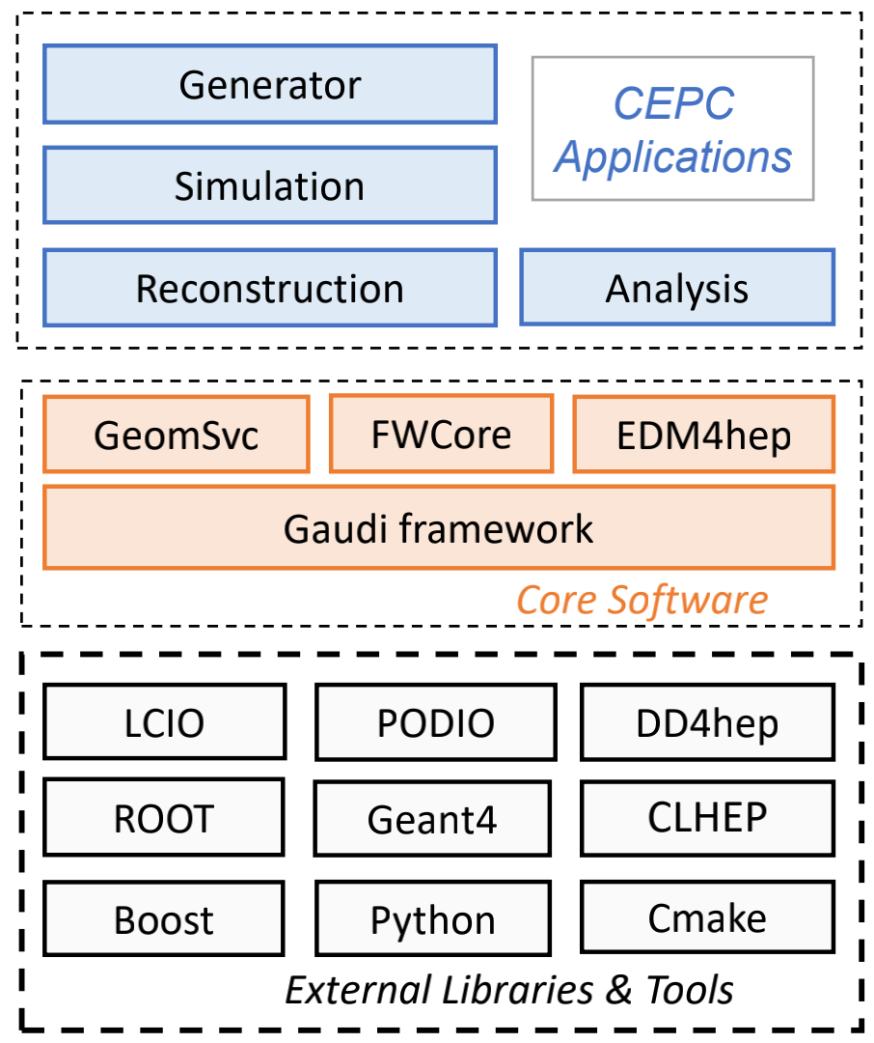
Overview of CEPCSW
Core software: Wenxing Fang, Xingtao Huang, Teng Li, Weidong Li, Tao Lin, Jiaheng Zou etc.
CEPCSW software structure
Core software
Applications: simulation, reconstruction and analysis
External libraries
Core software
Gaudi/Gaudi Hive: defines interfaces to all software components and controls their execution
EDM4hep: generic event data model
K4FWCore: manages the event data
DD4hep: geometry description
CEPC-specific framework software: generator, Geant4 simulation, beam background mixing, fast simulation, machine learning interface, etc.
https://github.com/cepc/CEPCSW
https://code.ihep.ac.cn/cepc/CEPCSW

Slide 5
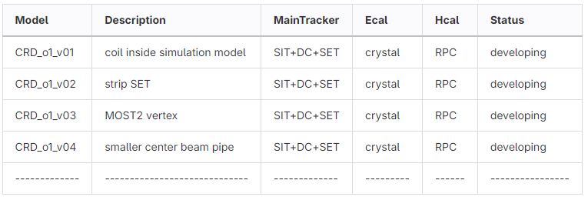
Detector Description
DD4hep is adopted to provide the full detector description with a single source of information.
Different detector options are managed in a git repository.
Easy to track the changes of detectors and compare between different options.
Available options in CEPCSW
CEPCv4: baseline detector in Conceptual Design Report
CRD: CEPC Reference Detector
Geometry: Chengdong Fu

Slide 6
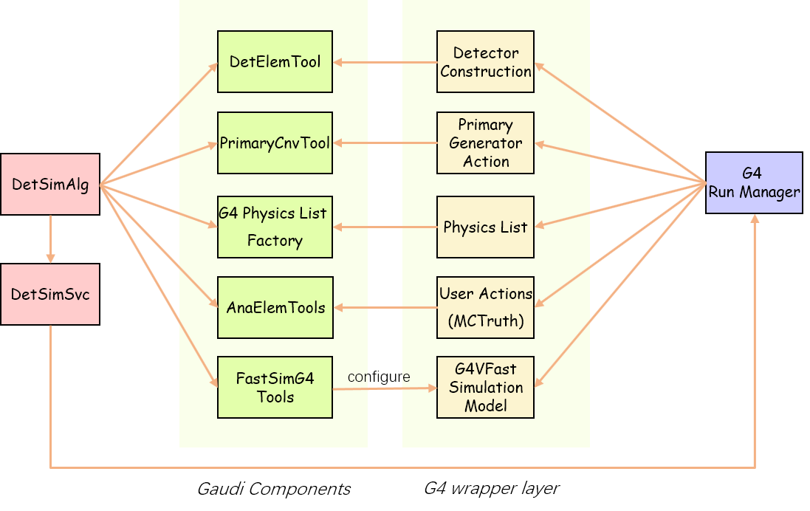
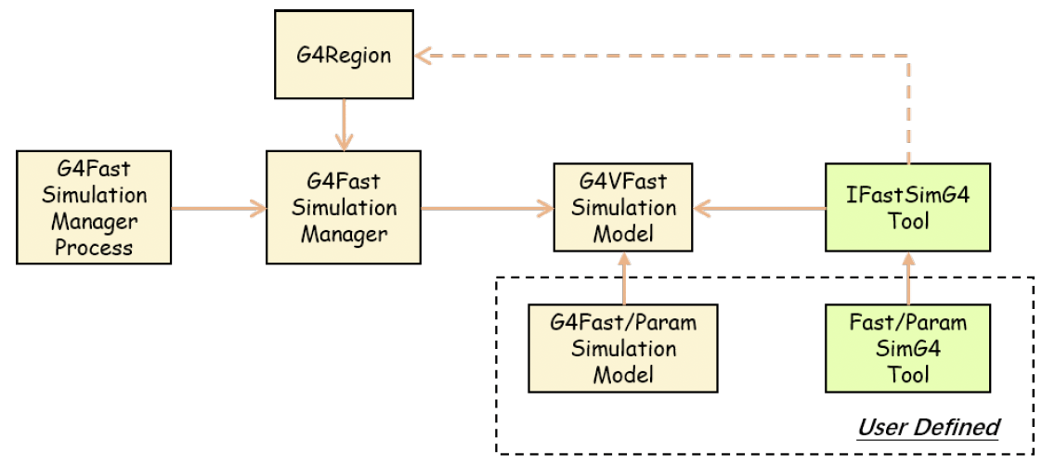
Detector Simulation (1)
Simulation framework: Tao Lin
Full detector simulation has been developed based on Geant4.
A unified simulation framework: integrate Geant4 and Gaudi.
Event data: SimTrackerHit and SimCalorimeterHit
Generator interfaces: HepMC, LCIO, StdHep, Beam background, Particle Gun
Fast simulation interfaces: Geant4 Region based.
Detector responses: trackers, DC, TPC, calorimeter
Monte Carlo truth: association between hits and MC particles
The background mixing algorithm is under development.

Slide 7
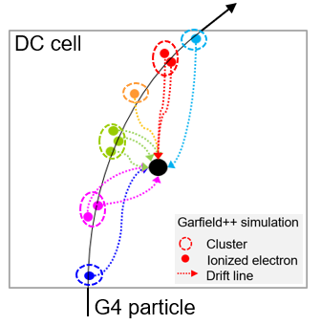
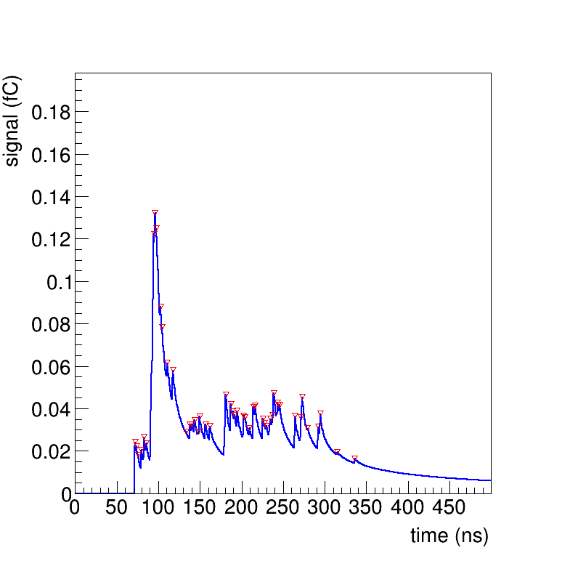
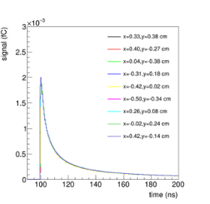
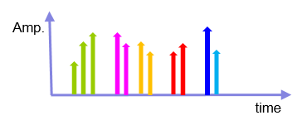
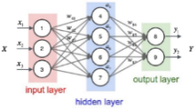
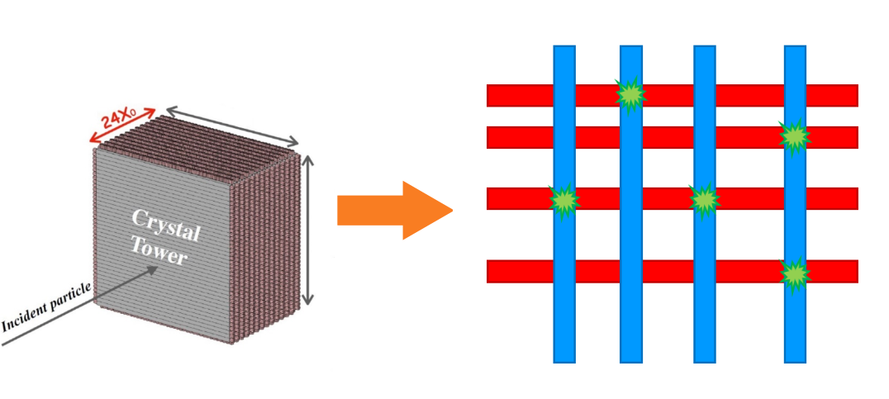
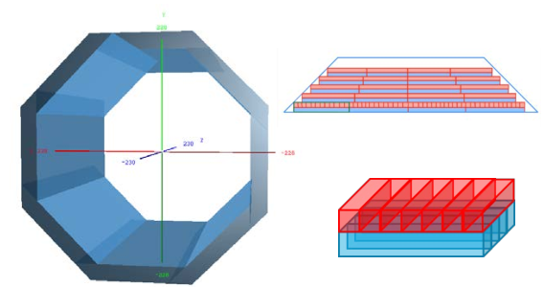
Detector Simulation (2)
The simulation software supports the software development of both DC and ECAL.
DC simulation: Mengyao Liu, Wenxing Fang etc.
Garfield++ waveform simulation, highly time-consuming
waveform
Fast simulation
NN simulates the pulse’s time and amplitude
Pulse shape template
ECAL Simulation: Fangyi Guo, Yang Zhang, Shengsen Sun etc.

Slide 8
Reconstruction (1)
Existing algorithms are migrated from Marlin to CEPCSW.
New reconstruction algorithms are developed as well.
Detector | Package | Status
Silicon | SiliconTracking | Migration Done
 | ForwardTracking | Migration Done
 | TrackSubset | Migration Done
 | FullLDCTracking | Migration Done
TPC | Clupatra | Migration Done
DC | RecGenfitAlg | Under development
ECAL/HCAL | CRDEcalRec | Under development
Muon |  | Under development

Slide 9
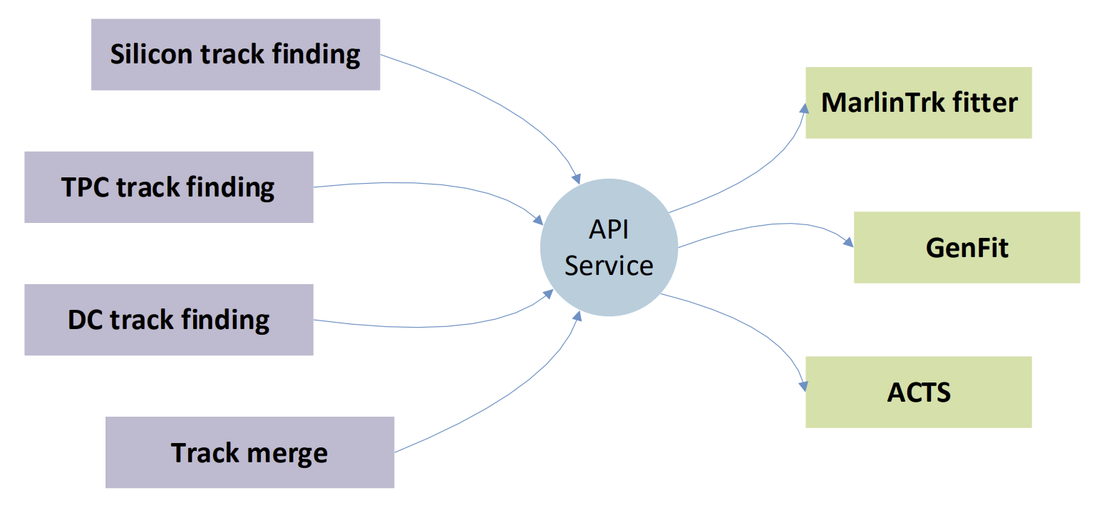
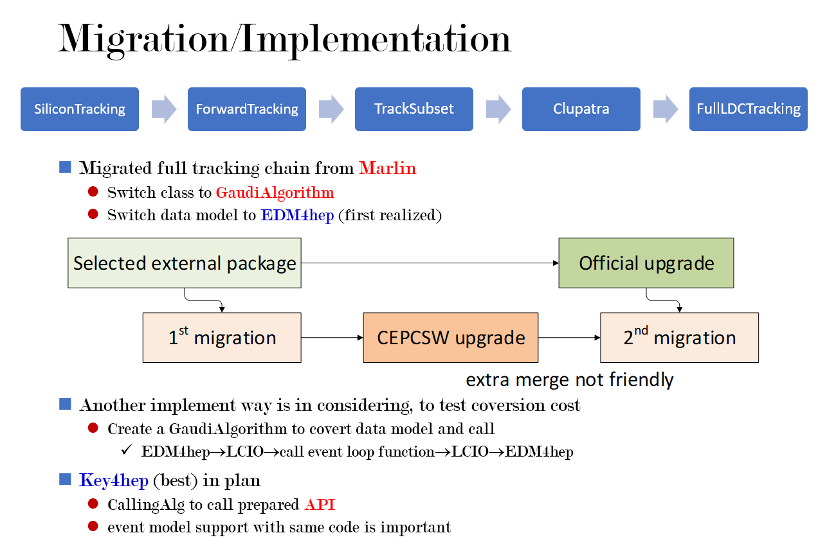
Reconstruction (2)
Chengdong Fu | Tracking for CEPC
ECFA Higgs Factories: 1st Topical Meeting on Reconstruction
Tracking software
A complete tracking chain.
Configure the tracking algorithms for different detectors and perform the merging algorithm.
For silicon tracker: SiliconTracking, ForwardTracking, TrackSubset, ConformalTracking
For TPC: Clupatra, ArborTracking

Slide 10
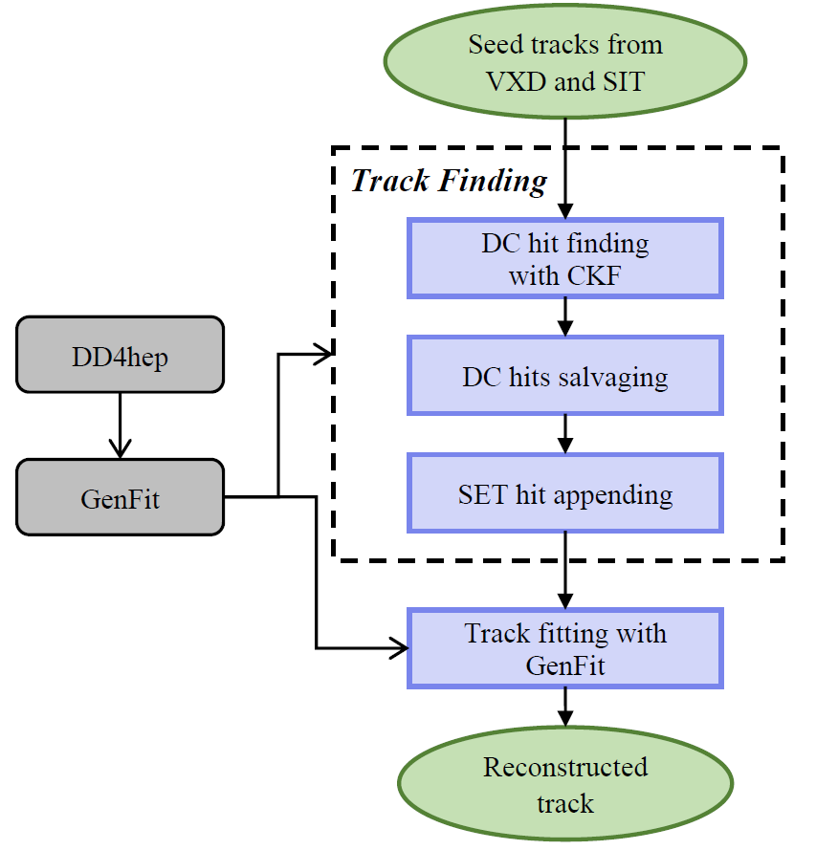
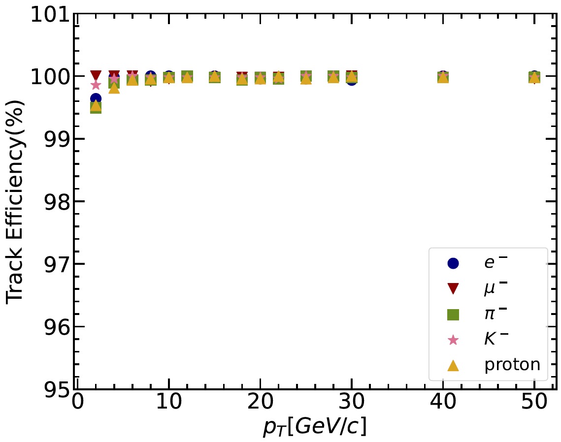
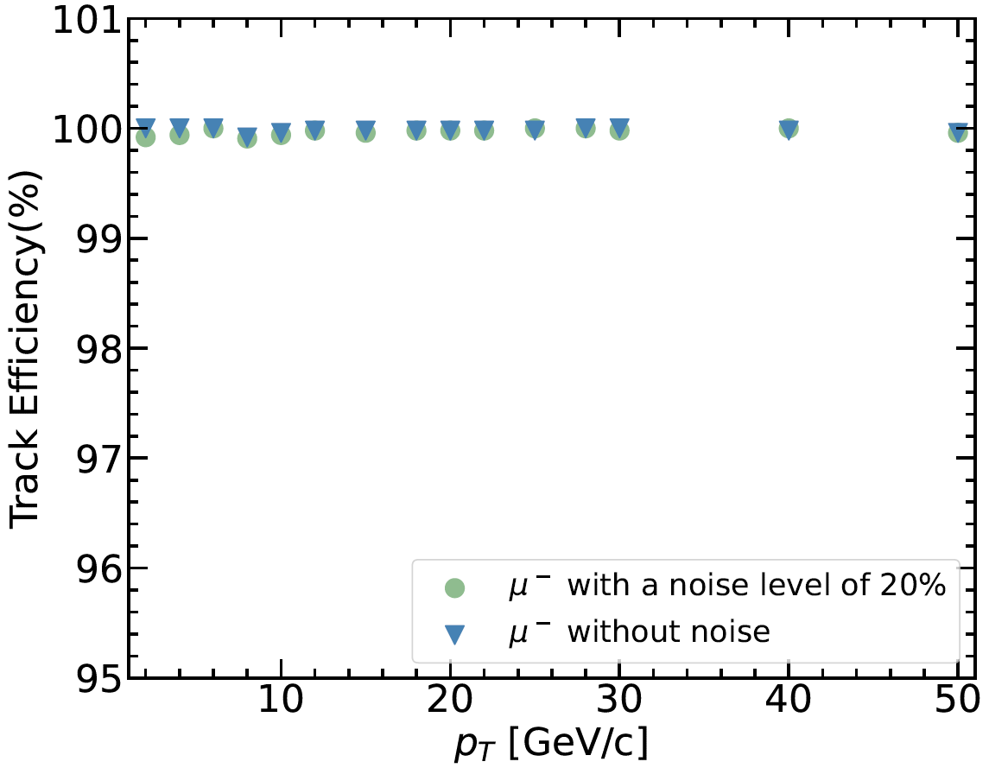
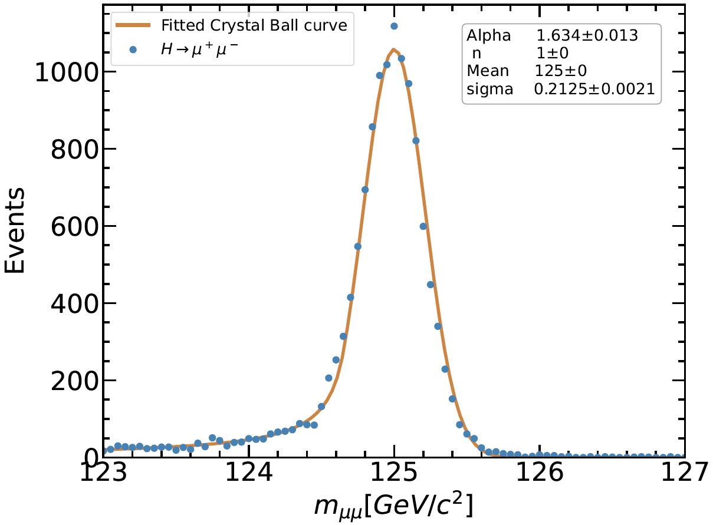
Reconstruction (3)
Mengyao Liu, Weidong Li, Xingtao Huang, Yao Zhang, Ye Yuan etc.
DC Reconstruction
Track Finding with Combinatorial Kalman Filter
Migrate from Belle2
Track Fitting with GenFit
Using DAF Kalman filter
Implementation
Extrapolation based on GenFit
Field, material and geometry from DD4hep
A data format converter from EDM4hep
Performance validation completed
μ = 125GeV/c
$σ$ = 212MeV/c
without background

Slide 11
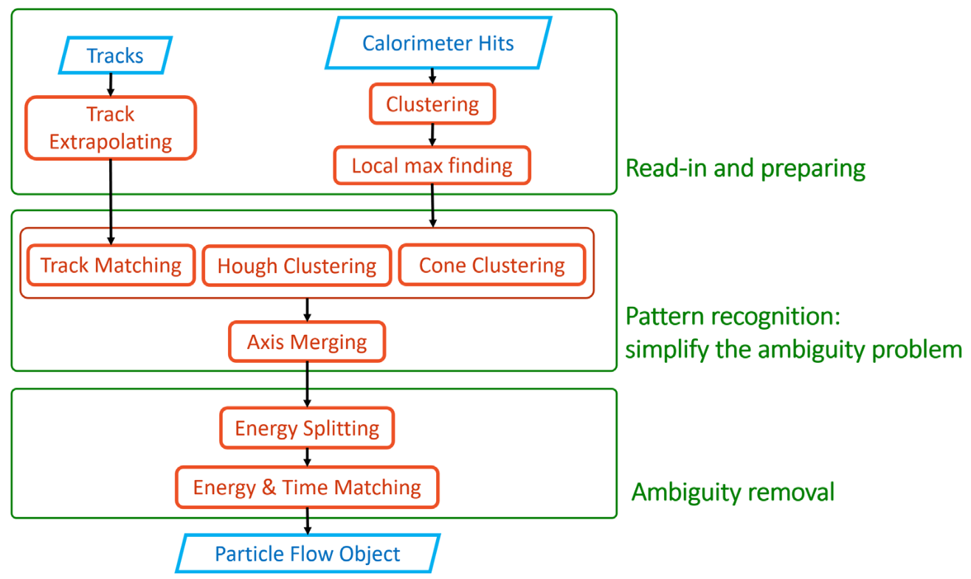
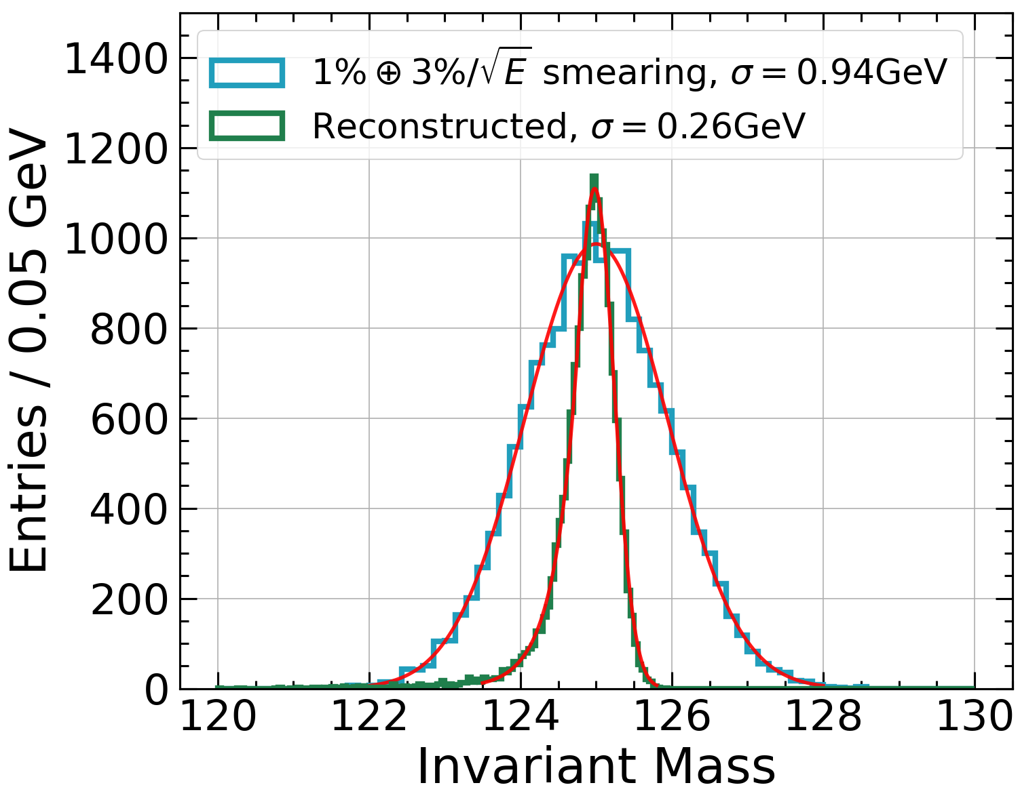
Reconstruction (4)
Fangyi Guo, Weizheng Song, Shengsen Sun, Linghui Wu, Yang Zhang etc.
Long Crystal Bar ECAL
For details, see talk by Fangyi
𝐻 → 𝛾𝛾 in CEPC

Slide 12
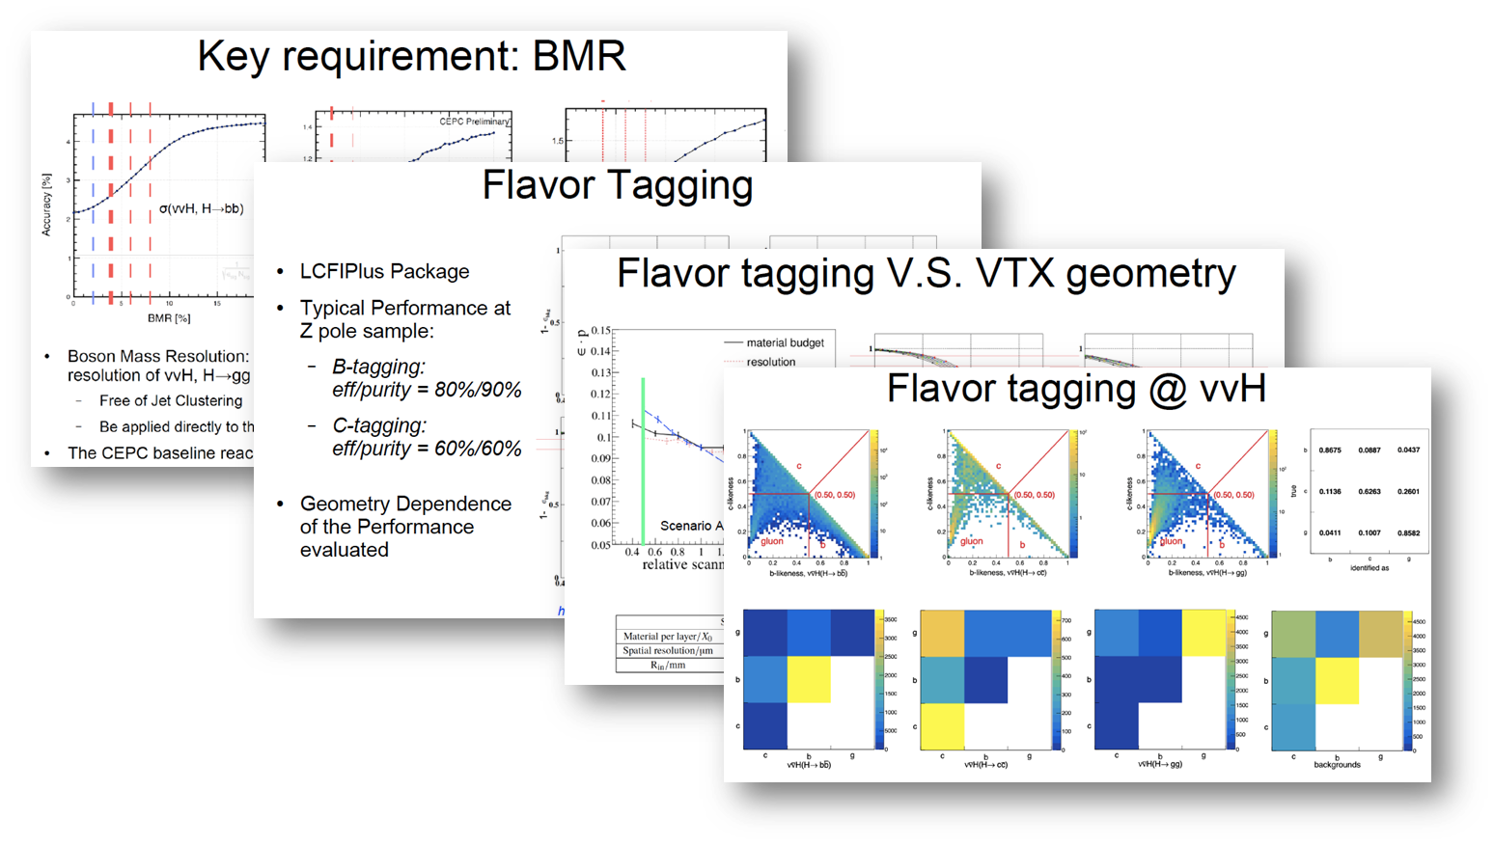
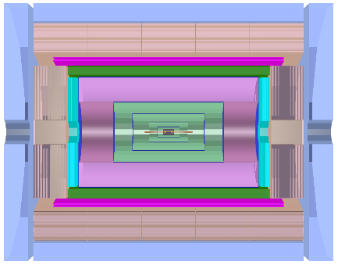
Towards Reference Detector TDR
Motivation
Support the fast iterations of the reference detector design.
Release the latest versions of detectors to support physics and performance studies.
Mechanical
Vertex
Tracker
CEPCSW
Physics &
Performance
studies
Calorimetry
feedbacks
Muon

Slide 13
Software Releases for TDR
The software development
Adopt a new version scheme: tdrYY.MM
Driven by Issues and Merge Requests. Project management via milestones.
The repository is hosted at IHEP GitLab.
Source code is mirrored to GitHub.
Short-term plans before July.
Latest version could be found in CVMFS:
/cvmfs/cepcsw.ihep.ac.cn/prototype/releases/tdr24.3.1/
Baseline performance will be released as well.
Release | Timeline | Features
tdr24.3 √ | March | Core software
tdr24.4 | April | Tracking and Background mixing
tdr24.5 | May | PID and muon
tdr24.6 | June | Calorimeters

Slide 14
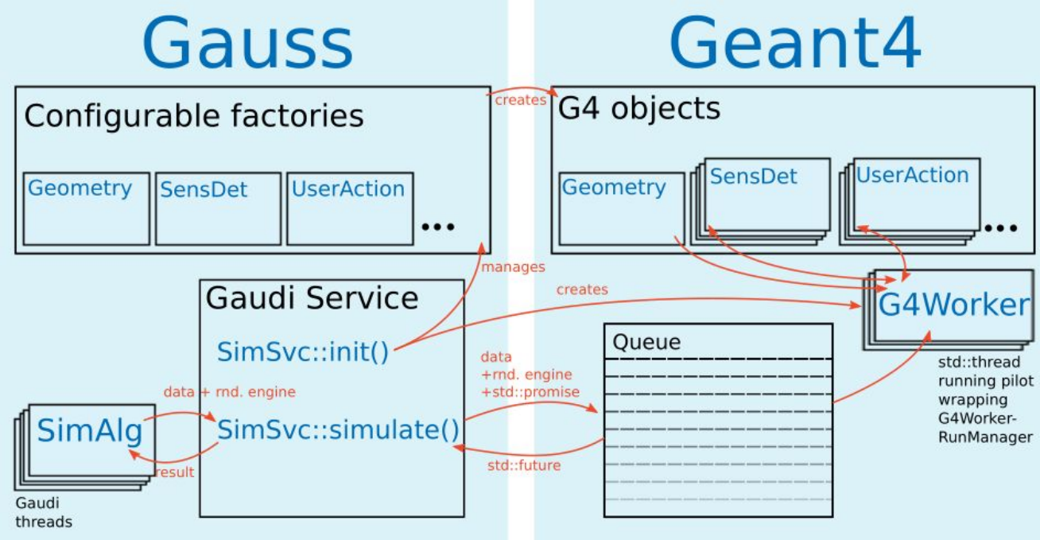
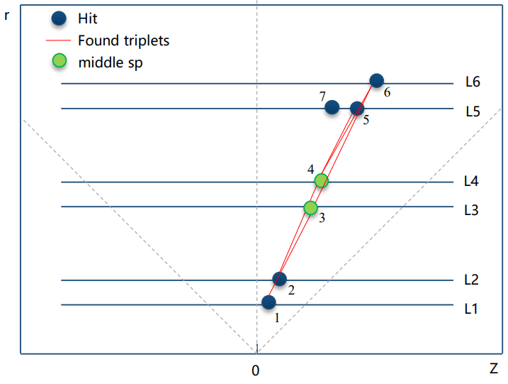
Long-term Plans in CEPCSW (1)
Xingtao Huang, Teng Li, Weidong Li, Tao Lin, Yizhou Zhang, Jiaheng Zou
Parallelization and Heterogeneous
CEPC-on-Gaussino prototype: CEPC is working with Key4hep project members re-implementing the detector simulation software based on Gaussino
Seeding with TRACCC: CEPC silicon detector is used as an example. Develop the 6-layer seed finding in GPU.

Slide 15
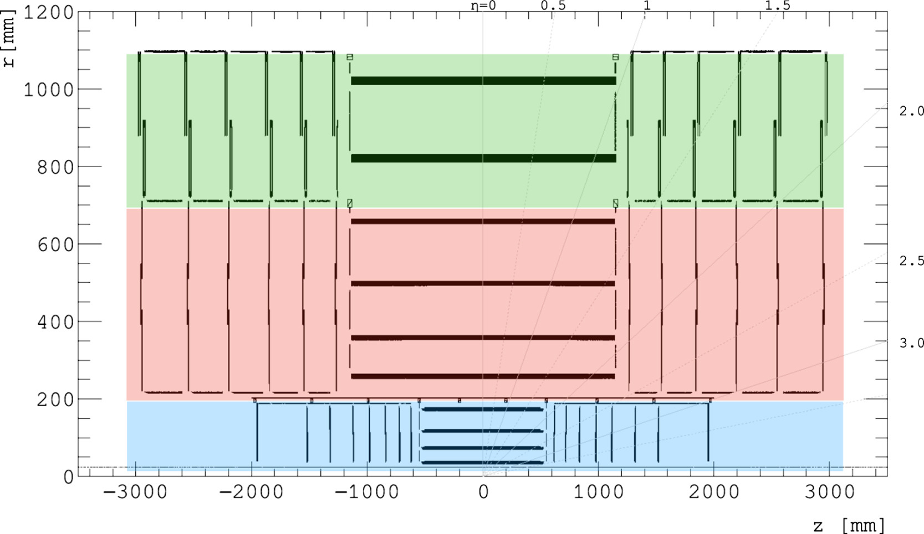
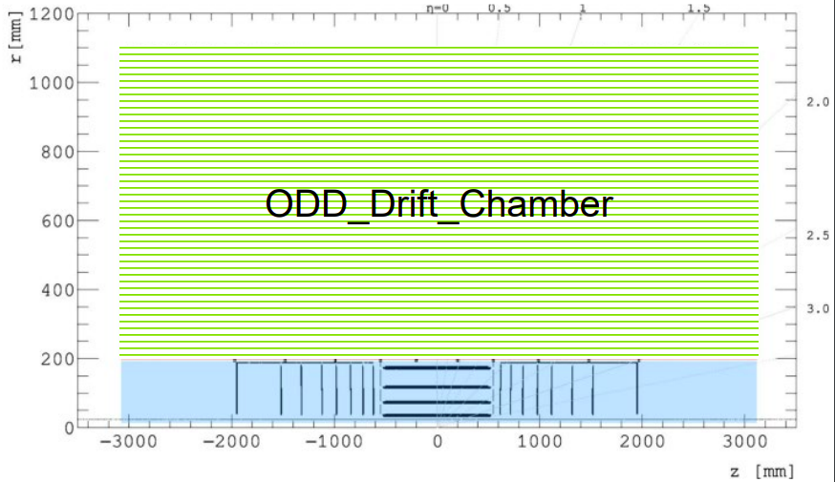
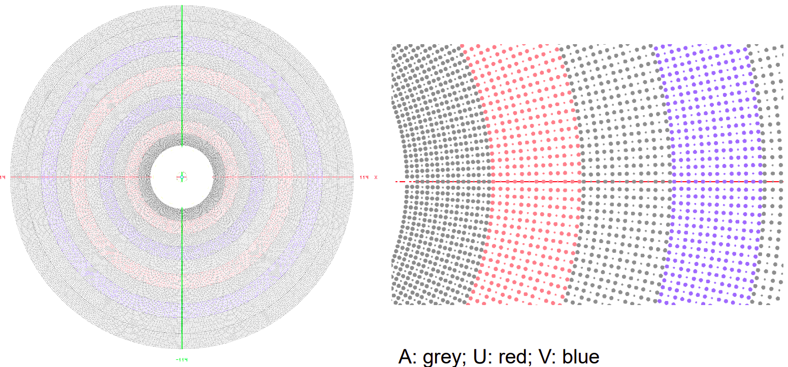
Long-term Plans in CEPCSW (2)
Contribution to common software, such as ACTS
Adding Drift Chamber to Open Data Detector
Xiaocong Ai, Xingtao Huang, Weidong Li, Tao Lin, ACAT 2024
ODD: Pixel + Short Strip + Long Strip
ODD: Pixel + Drift Chamber ?
https://gitlab.cern.ch/acts/OpenDataDetectorMore details here

Slide 16
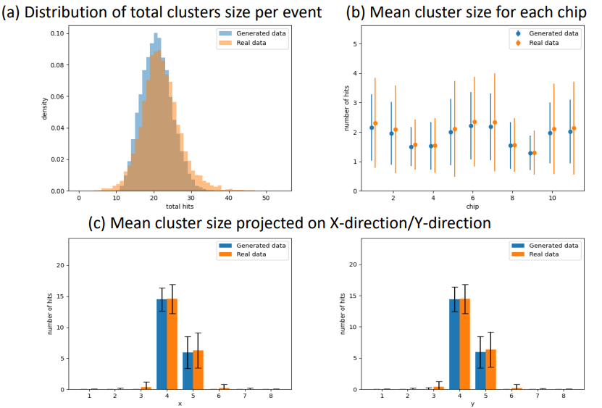
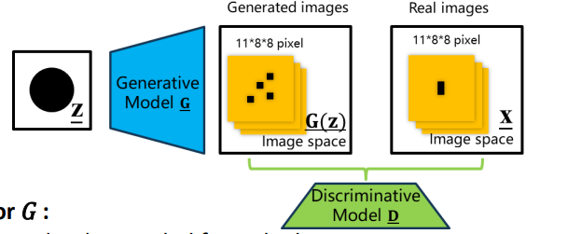
Long-term Plans in CEPCSW (3)
Yizhou Zhang, Xiaozhong Huang, Weidong Li etc. CEPC Workshop 2023
Machine Learning
ML-based digitization for CEPC vertex detector: training based on the test beam data of TaichuPix-3.
Dataset:
Evaluation:
Model:

Slide 17
Summary
Towards the CEPC Reference Detector TDR, there will be four major software releases before June.
The March version is already released.
The next versions will keep optimization to follow the change of detector designs.
Performance plots will be released based on the latest software.
After the choice of reference detector design, the software development will focus on the design.
Long-term development is focus on the new technologies to boost CEPCSW performance.
Source code: | https://github.com/cepc/CEPCSW https://code.ihep.ac.cn/cepc/CEPCSW
Mailing list: | cepc_software@maillist.ihep.ac.cn
Thank you for your attention!

