Slide 1



28 nm electronics developments for future pixel detectors
Marlon Barbero, Roua Boudagga, Denis Fougeron, Eva Joly, Mohsine Menouni
CPPM - Aix-Marseille Univ, France
The 2024 European Edition of the International Workshop on the Circular Electron-Positron Collider (CEPC)
Marseille, France, April 8th-11th

Slide 2
Outline
Introduction: Timing effect
4D tracking in the future experiments
Electronics and sensor requirements for 4D tracking
R&D activities at CPPM
  28 nm chip design
  SEE/SET Testing
  Ring Oscillator Design
  Analog FE pixel array design and simulations
  Preliminary test results
Conclusion and perspectives

Slide 3
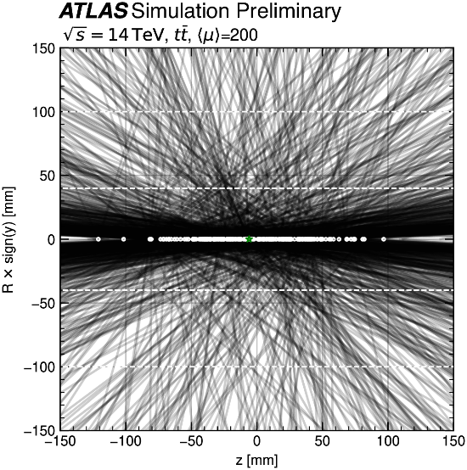
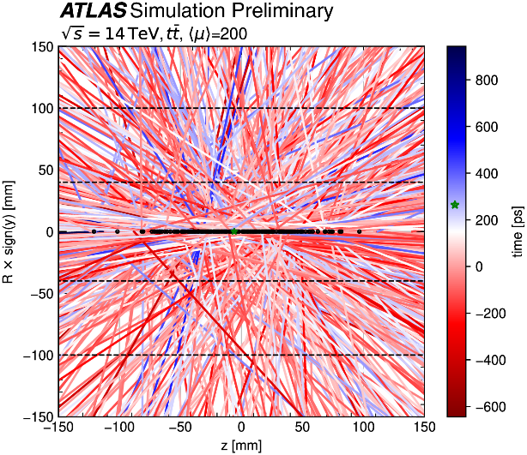
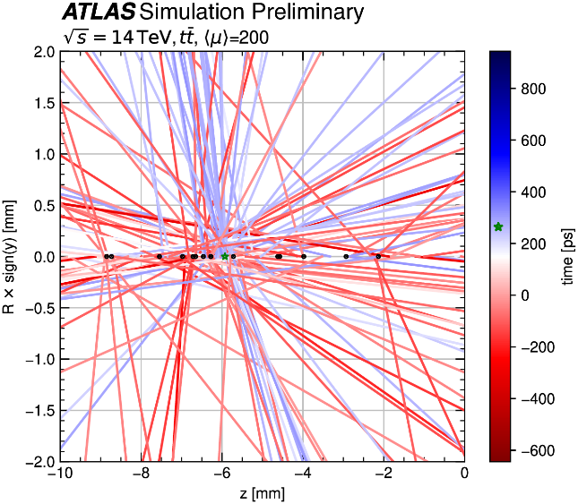
The effects of timing
Pile-Up (PU) level increase for the HL-LHC
  PU average of 200 during HL-LHC (5-10 × LHC)
  PU adds a new level of ambiguity to the reconstruction process
  When timing information is available for the tracks, the association
  of track to vertices becomes less ambiguous
4D tracking
  Using timing at each layer along the tracks
  For the rate of 200 PU events/BC
    Timing resolutions of 30 ps is expected to reduce by a factor of 5 the number of pileup tracks per primary vertex
Without track-timing
With track-timing
Zoom in the spatial coordinate
timing
Investigating the impact of 4D Tracking in ATLAS Beyond Run 4,
Tech. rep., CERN, Geneva (2023), ttps://cds.cern.ch/record/2870326
Timing information will be more important at future high-energy,
high-luminosity hadron colliders with much higher levels of pileup

Slide 4
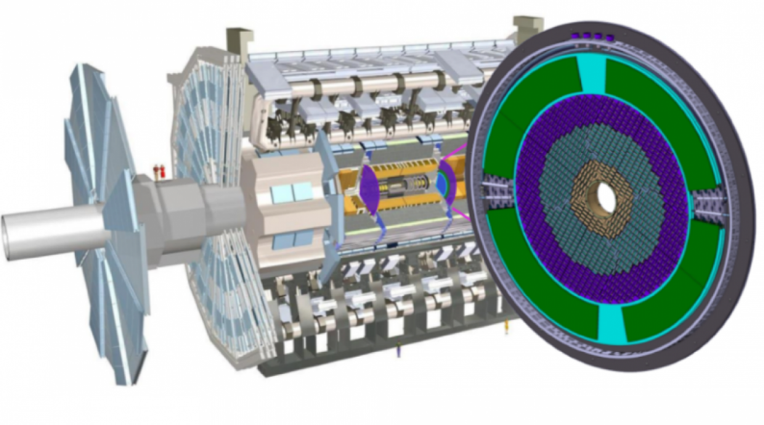
4D tracking in future experiments
Hadron colliders
Timing layers (HL-LHC) Run 4
  CMS and ATLAS are building silicon-based timing detector layers that will timestamp each track with a precision of
  30 ps
  ATLAS High Granularity Timing Detector (HGTD) and the CMS Timing Detector (MTD) placed in the forward regions (2.4<|η|<4.0)
  Based on novel Low Gain Avalanche Detectors (LGADs)
  The readout chip HGTD is an array of 15×15 channels
  of 1.3 × 1.3 mm²
The ATLAS and CMS tracker Run 5
  The two innermost pixel layers will need to be replaced after 5 years (LS4)
  Pixel time resolution of 50 ps is needed to boost the tracking performances
Future Circular Collider tracker (FCC-hh)
  Efficient reconstruction of charged particle tracks in an environment of high pileup density (1000 pileup)
  Position < 10 μm, Time resolution < 10 ps
  Radiation levels: 40 Grad and 6×10¹⁷neq/cm² (40 × HL-LHC)
  A big challenge in sensor and ASIC design
Electron colliders
Linear colliders ( ILC, CLIC) and Circular colliders
(FCPC, FCC-ee)
  High spatial precision is required for physics measurements -> Pixel size < 25 µm x 25 µm
  Time resolution at the ns level is sufficient
  Potential applications of timing at the ps level
Electron Ion Collider (EIC)
  4D detectors based on AC-LGADs are planned to provide timing capability
  Time resolution of 30 ps is required
  Spatial resolutions of 15 μm to 150 μm depending on the location.
Muon Collider
  Initial studies indicate that single hit resolutions of 20-30 ps are sufficient to reduce the Beam-Induced Background (BIB) to a manageable level
ATLAS High Granularity Timing Detector (HGTD)

Slide 5
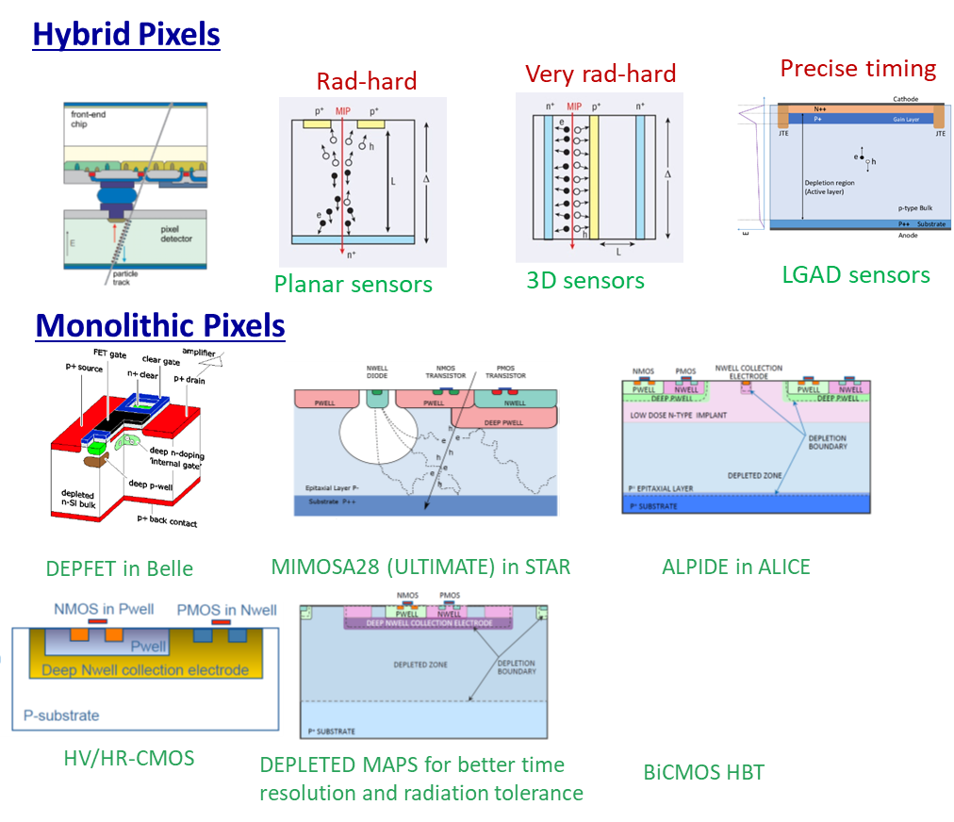
Pixel design for 4D tracking
For the next upgrades or next generation of hadron collider :
  ATLAS, CMS and LHCb trackers upgrades (Run5),
  or for FCC–hh -> Very long-term
  High spatial resolution and high time precision
  Very high radiation tolerance
  Hybrid pixels with a dedicated ASIC bonded to the sensor is
  the best suited to these applications
Sensor candidates currently being considered for 4D tracking
  LGAD sensors with modification of the gain implant profile
    Not yet satisfying a fluence > 2-3 × 10¹⁵ MeV neq/cm²
  3D-trench sensors developed and tested within the TimeSPOT
  project
    No performance loss up to fluences of
    2.5 × 10¹⁶ MeV neq/cm²
Front end electronics
  Need of higher density and higher speed regarding the RD53 chip designed with the 65 nm process
  28nm CMOS technology is considered as the next node for highly integrated chips such as pixel readout chips
ATLAS/CMS inner layers upgrades
Pixel size | 25µm × 25 µm
Sensor capacitance | < 50 fF
Time resolution | < 50 ps RMS
Consumption (pixel) | <5 µA
Threshold | <600 e-
Hit rate | 8 GHz/cm²
Hit rate (pixel) | 5 kHz
TID | > 1 Grad
M. Ferrero et. Al : Nuclear Inst. and Methods
in Physics Research, A 919 (2019) 16–26
Doug Berry:FERMILAB-CONF-22-284-PPD1

Slide 6
  CPPM activities

Slide 7
R&D activities at CPPM
R&D around hybrid pixels for future upgrades and future colliders with the 28nm CMOS technology
  The radiation tolerance of the 28nm process up to 1-2 Grad
  Time measurement with a resolution better than 50ps
  Small pixel size -> 25µm × 25µm
Context
  RD53 collaboration shows a strong interest in these developments for the future upgrades of ATLAS and CMS trackers
  The project is part of the R&D project DEPHY and can be extended to the other IN2P3 labs interested in the 28 nm process
  This work is done with the CERN R&D Program on technologies for Future Experiments
  CPPM is a member of two working groups within the DRD (ECFA) projects
    WG 7.3a (4D and 5D techniques) to develop front ends with high temporal resolution
    WG 7.4b (Advanced and hardened CMOS nodes) to study the effects of radiation on highly advanced processes

Slide 8
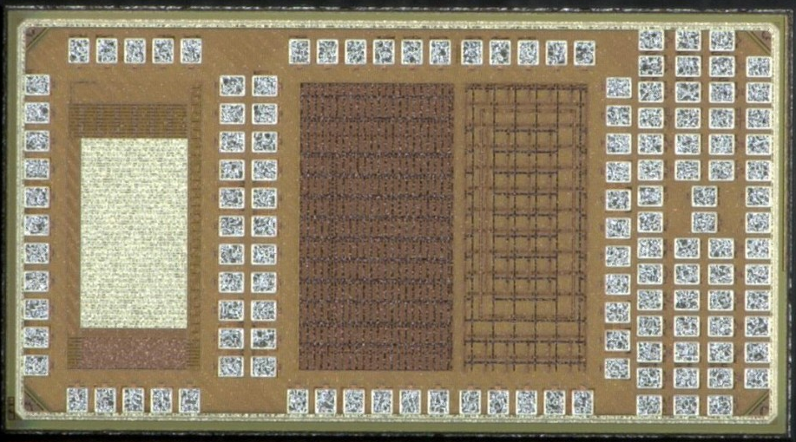
28 nm chip design
R&D on hybrid pixels
  Process qualification in terms of performance for analog, low-power and low-noise circuits
  Architecture studies
  Fast charge amplifier array
Study of Single Event Effects (SEE)
  Measure the SET cross-section
  Measure the SET pulse width with a good
  resolution < 20 ps
  Measure the effect of the std cell size
TID tests and qualification
  Compatibility with typical dose levels for future projects
  28 nm process device qualification
  Gate delay evolution with TID and the effect of the std cell size
  TID Effects modeling → Analog and digital simulations with TID effects
Single
devices
Pixel array
SET
RO - TID
Mini@sics of 2×1 mm2 received June 2023, consisting of 4 main blocks
  Analog pixel array (25×25 µm2) with Fast charge amplifiers for high time resolution
  SET test structures
  Ring Oscillators for TID tests on digital standard cells
  Test structures for TID tolerance studies

Slide 9
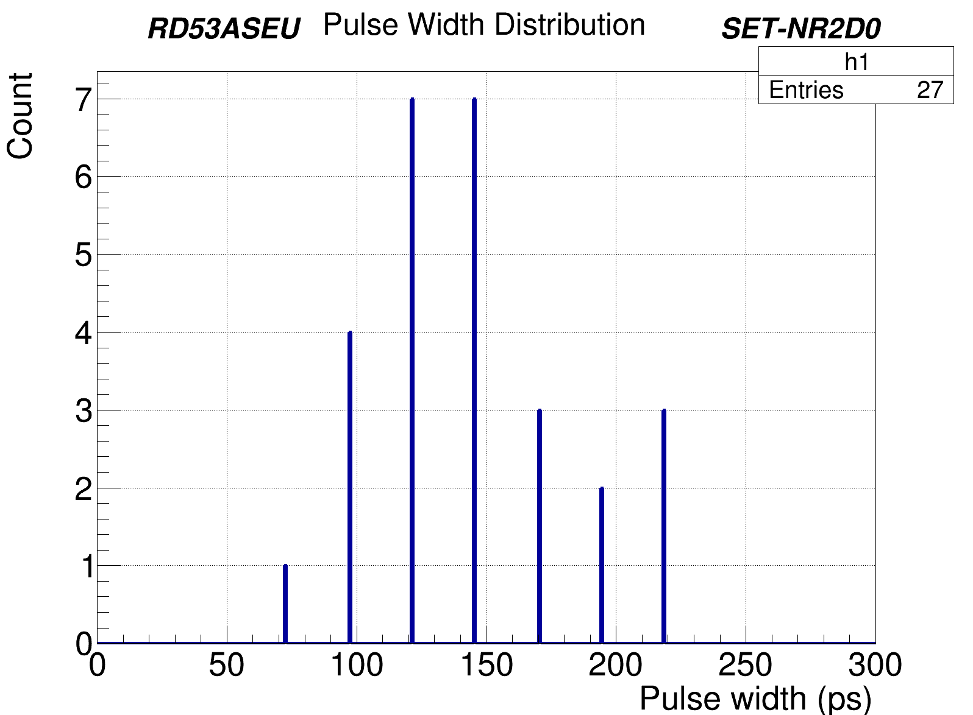
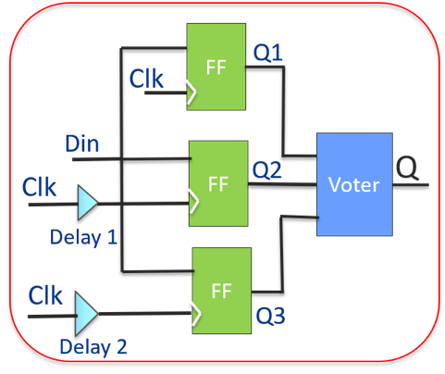
SEE/SET Testing
Single Event Transient (SET) sensitivity increases with process advance
  Propagation through combinatorial logic and generate SEU in memories
  Sensitivity to SET increases with speed
Implementation of test structures to characterize the 28 nm process for SET tolerance
Objectives :
  Measure the SET cross-section
  Measure the SET pulse with a good
  resolution < 20 ps
Allows as an example to define the delay to be used for the triplication with time delay mitigation
SEU tolerant design with
temporal Mitigation

Slide 10
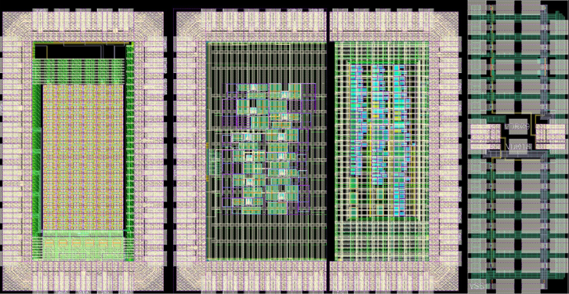
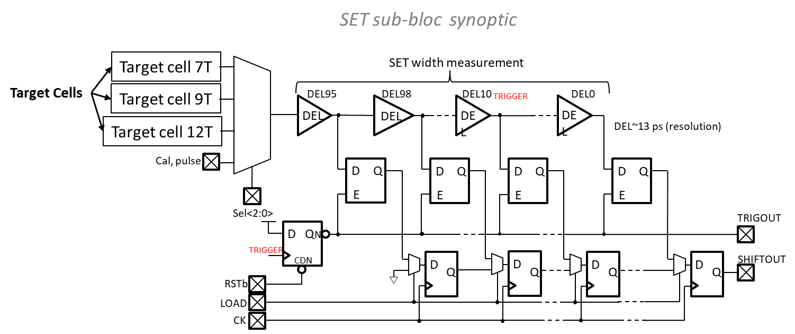
SET chip design
Each sub-bloc contains
  3 target cells made up of thousands of basic cells + 1 calibration input
  Circuit for SET width measurement 96 delay cells (13ps/cell) → from a few ps to 1ns
  Shift register to send the data to the output when a trigger signal occurs
31 SET sub blocs
  24 uses SVT target cells (7T, 9T, 12T) -> Effect of the cell size
  7 uses LVT or HVT target cells -> Effect of the device options
The whole bloc contains 6 inputs / 13 outputs
In addition to SET testing, this constitutes a sub-block of the TDC required in the pixel front end design

Slide 11
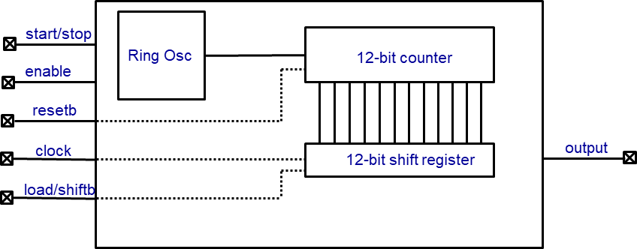
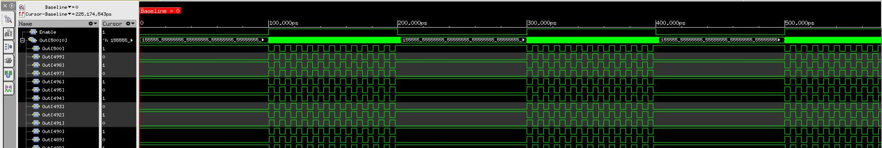
Ring Oscillator chip design
Study of the effect of TID on the performance of digital standard cells
Timing of combinatorial or sequential cells
Leakage currents and static power
Effects of device size on TID tolerance
Design based on the digital flow
96 Rosc sub-bloc
  Cell size (7T, 9T,12T)
  Driving (D0, D2, D4)
  SVT, LVT, HVT
ROsc sub-bloc synoptic
Basic cells | Frequency (MHz)
INVD0 | 154
INVD2 | 222
NAND0 | 118
NAND2 | 143
NOR0 | 111
NOR2 | 139
Simulation

Slide 12
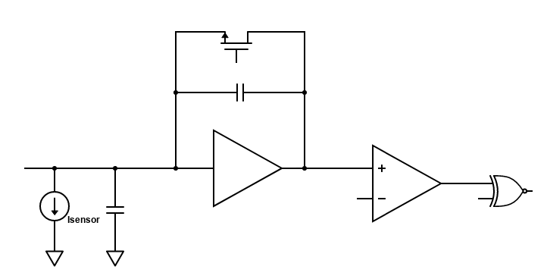
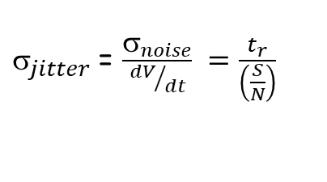
Fast amplifier design
Study the limits to time resolution in the analog front- end designed with the 28 nm CMOS process
  Effects of the Current bias, power supply, Bandwidth, Noise …
Design and test a pixel array of 36 × 12 cells where only the analog part is considered and implemented
The time resolution of the pixel:
Minimizing the front-end jitter corresponds to :
  Low RMS noise of the charge amplifier (CSA)
  High output voltage
  Small rise time → High bandwidth
Cf
HitOr
Cs
CSA
Comp
$_{total}^{2} ={_{jitter}^{2}+ }_{timewalk}^{2}$ $+ _{Landau}^{2}+_{TDC}^{2}$
Analog FE pixel design
$_{jitter}$= $\frac{σ_{noise}}{{dV}/{dt}} =\frac{t_{r}}{\left(\frac{S}{N}\right)}$

Slide 13
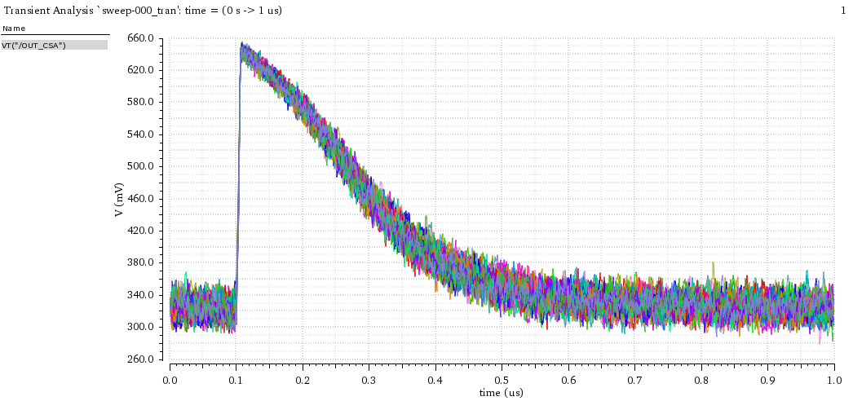
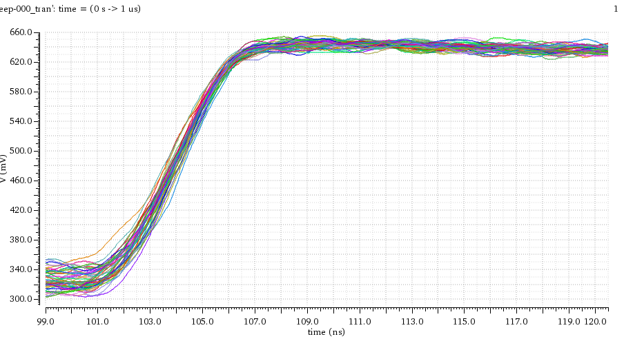
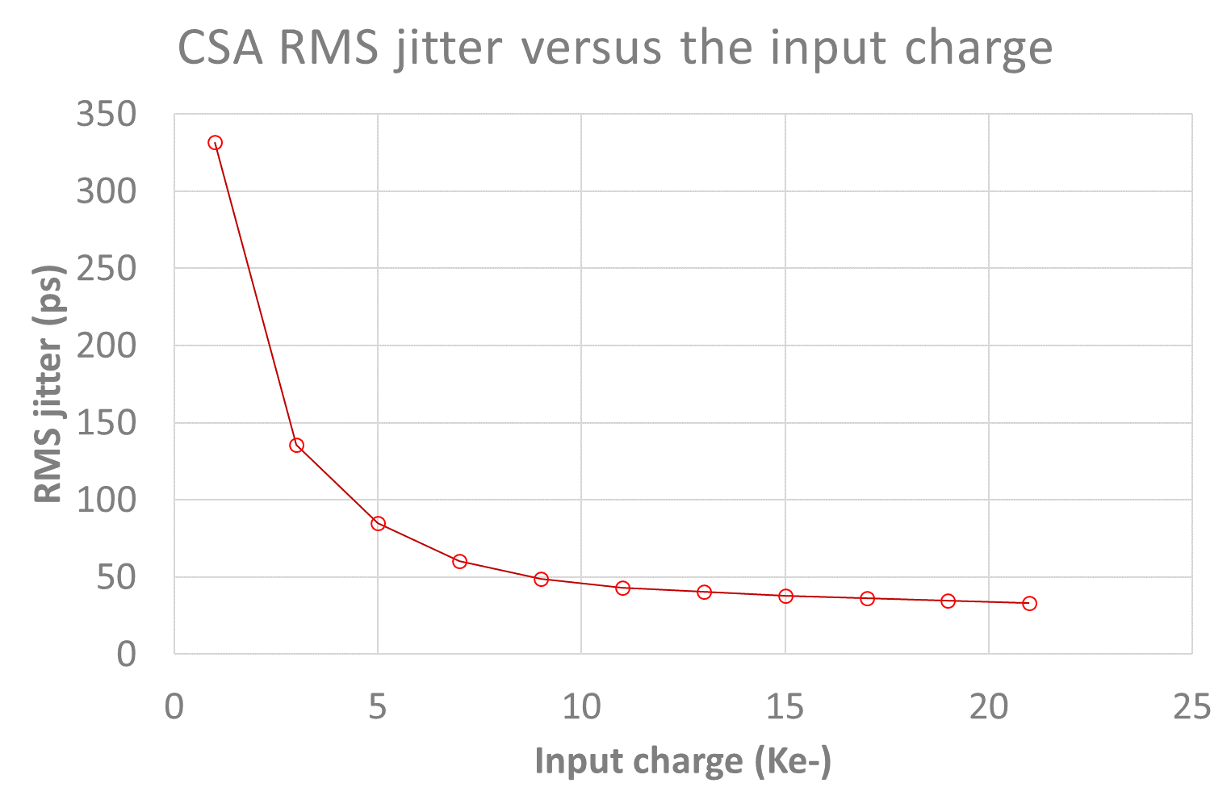
Analog FE pixel prototype
For each pixel :
  The charge amplifier current bias can be set in the range of 2µA-20µA
  MOM capacitance connected to each preamplifier input -> test for different input capacitance values
Large bandwidth buffers (> 1GHz) implemented and connected for a few pixels for direct jitter measurement
Simulations for I_{CSA} = 5 µA
  dV/dt = 100 mV/ns
  RMS noise = 97 e- RMS for Cin = 100fF
  Jitter < 100 ps RMS for input charge > 4 ke-
  Jitter < 40 ps RMS for charge > 10 ke-
Each pixel contains : CSA + Discriminator + 6 bit DAC
  Size : 20 µm × 12 µm
50 superimposed transient noise simulations
Jitter simulations
Pixel array of 36 × 12 pixels

Slide 14
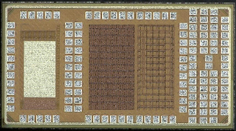
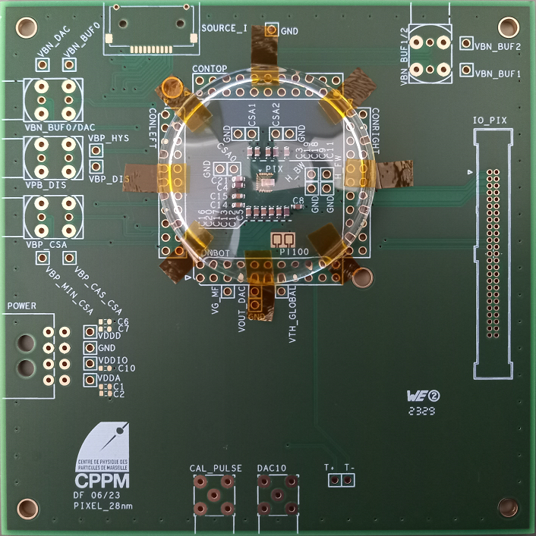
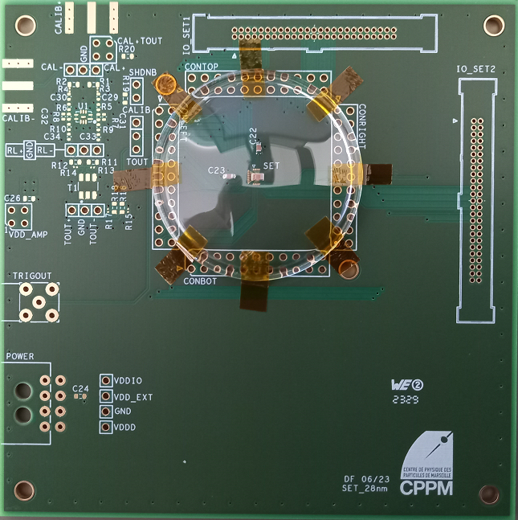
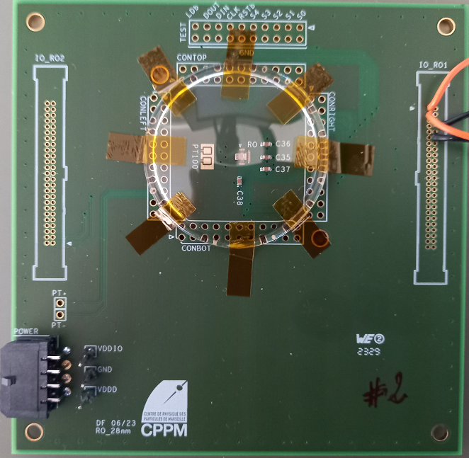
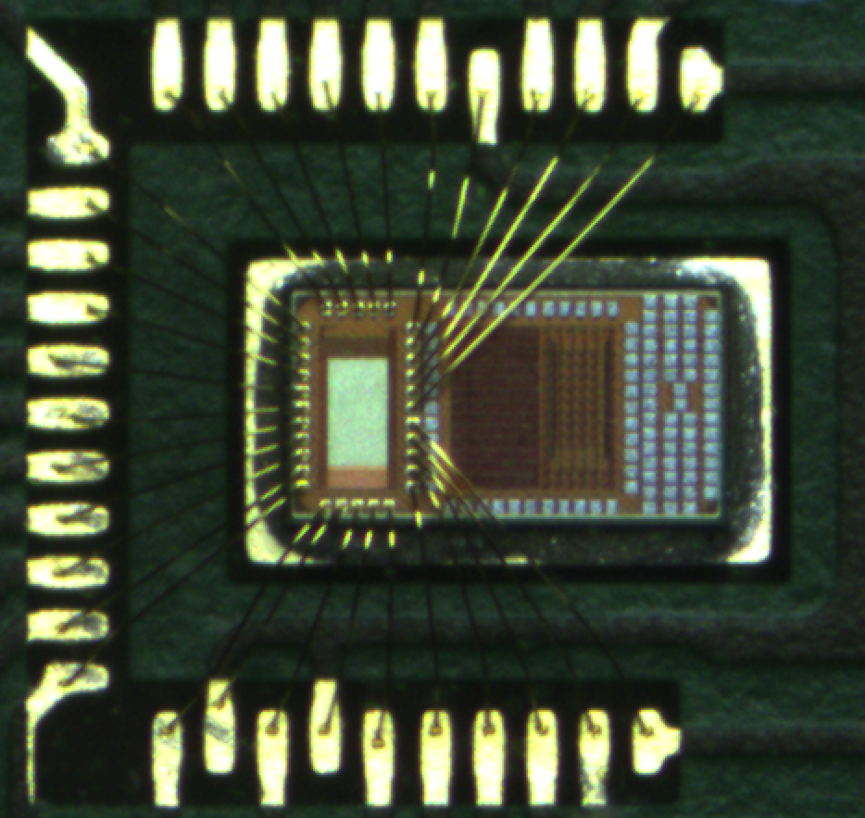
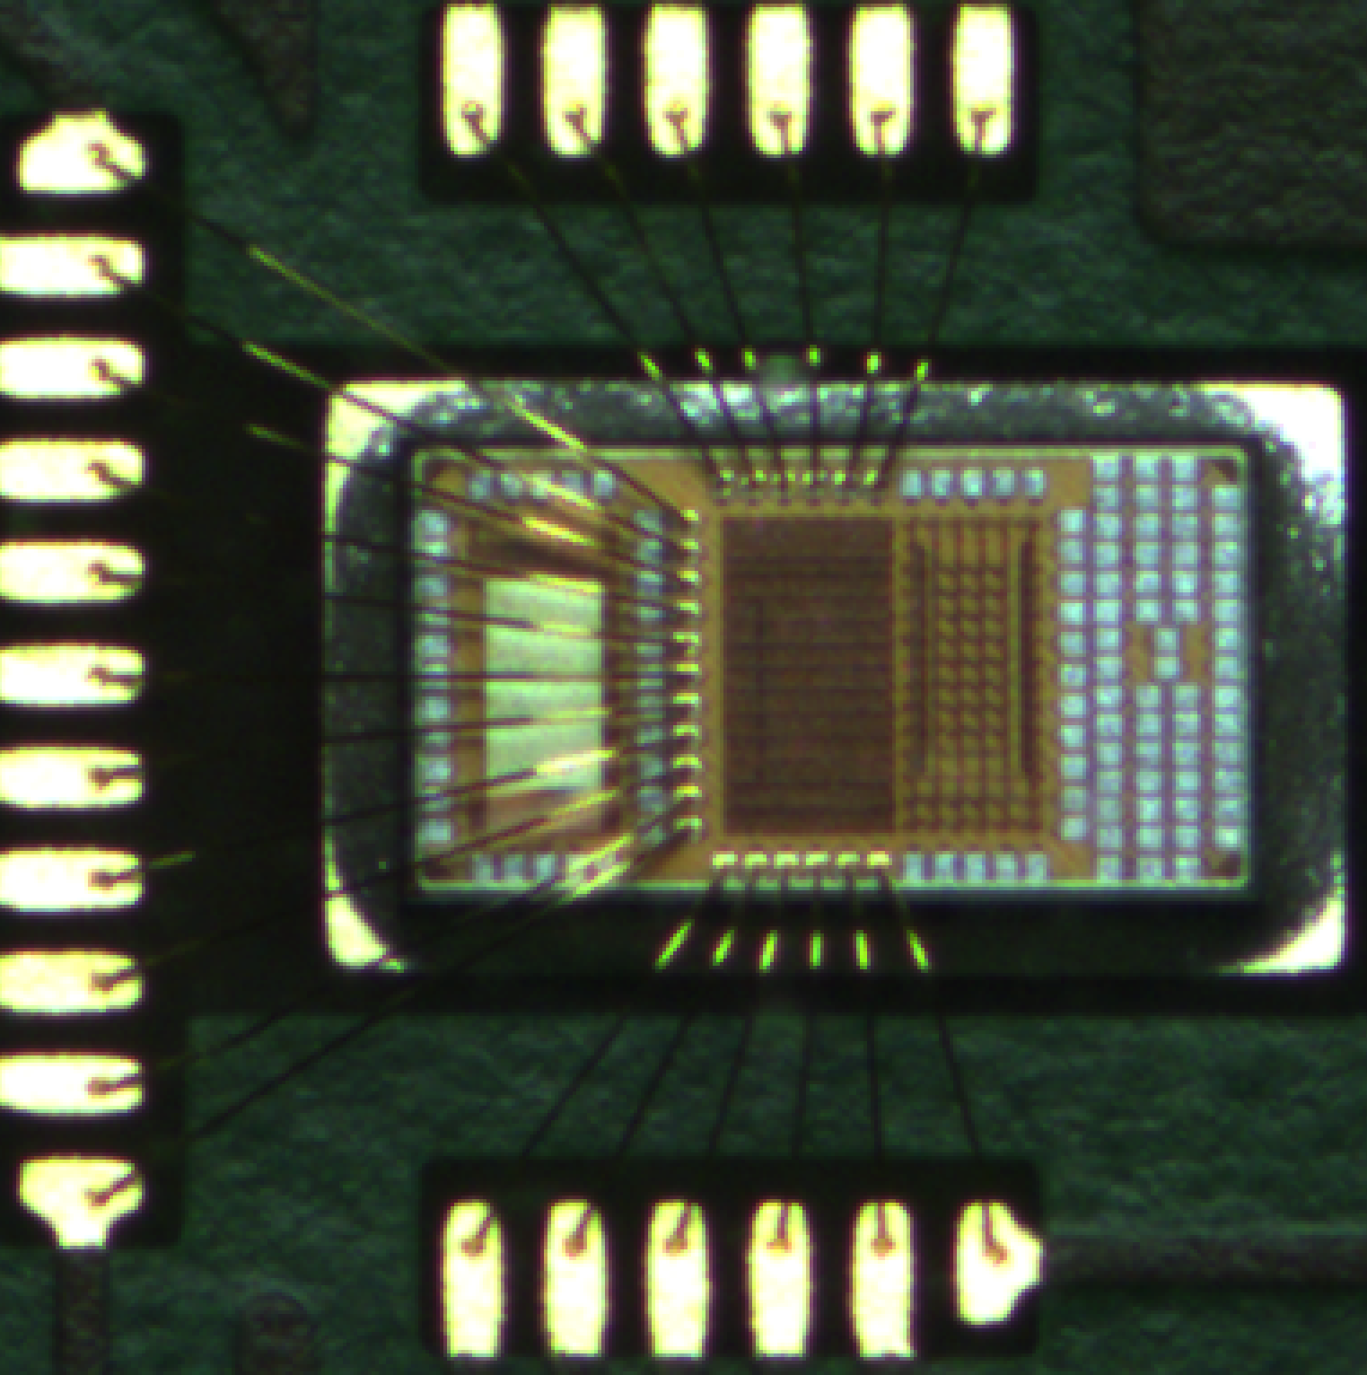
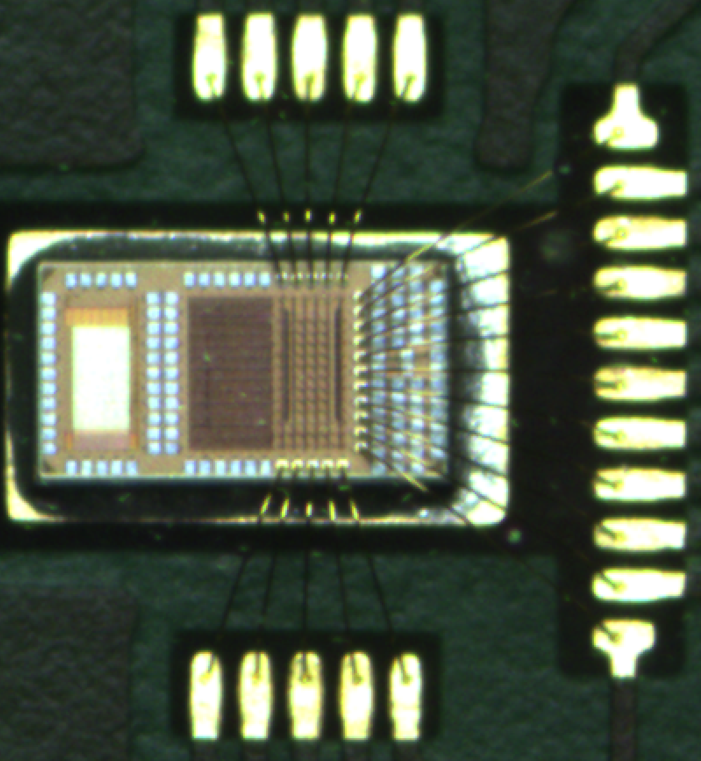
Prototypes 28nm sur PCB
Pixel_28nm
SET_28nm
RO_28nm

Slide 15
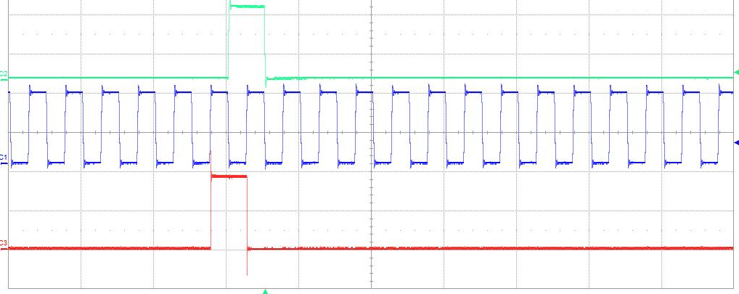
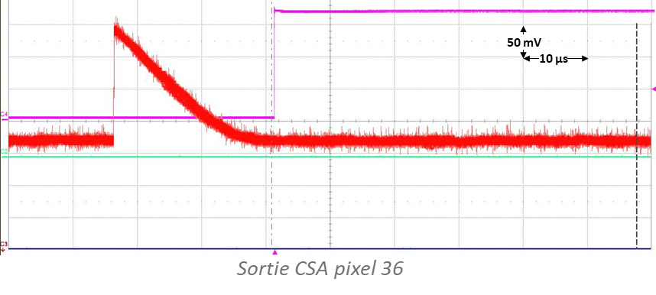
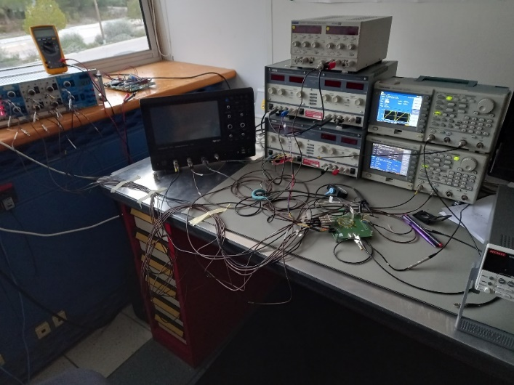
Preliminary results
The pixel array prototype is working properly
  The 3456 registers can be configured correctly
  The output signal of the test pixel is consistent with simulations
  intensive testing under way
Ring oscillators
  Minor configuration issue but should not prevent testing of the various blocks
SET block
  To be tested soon
Devices characterization
  Waiting for the PCB with wire bonded block
DIN
1 V
2 µs
CK
DOUT
Configuration SR chip Pixel_28nm (EN_INJ = ‘1’ pixel 36)

Slide 16
Conclusion and perspectives
28nm prototype test boards received the beginning of 2024
  Testing has started and first results are quite promising
  4 different design to be tested and characterized
  Existing test-setup based on a beagle-bone board to be used
Continuation of the project
  The project is part of the IN2P3 R&D DEPHY project
  Functional tests to be done in Q2 2024
  Irradiation tests (TID and SEE) in Q3-Q4 2024
  A new 28 nm design focused on larger size pixel array
    Implementation of TDC related to ToA and ToT
    The possibility to bump bond the FE array with sensor array
  Use of CERN PDK makes the design more manageable
  Prototype submission scheduled for Q4 2024

Slide 17
Thank you for your attention

Slide 18
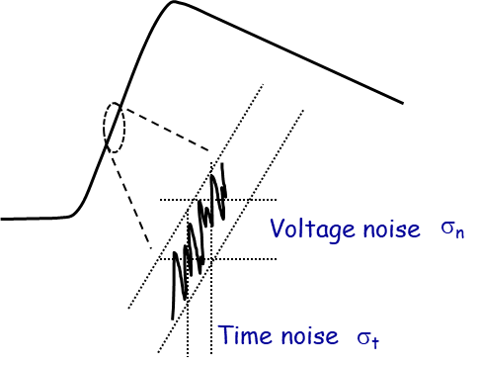
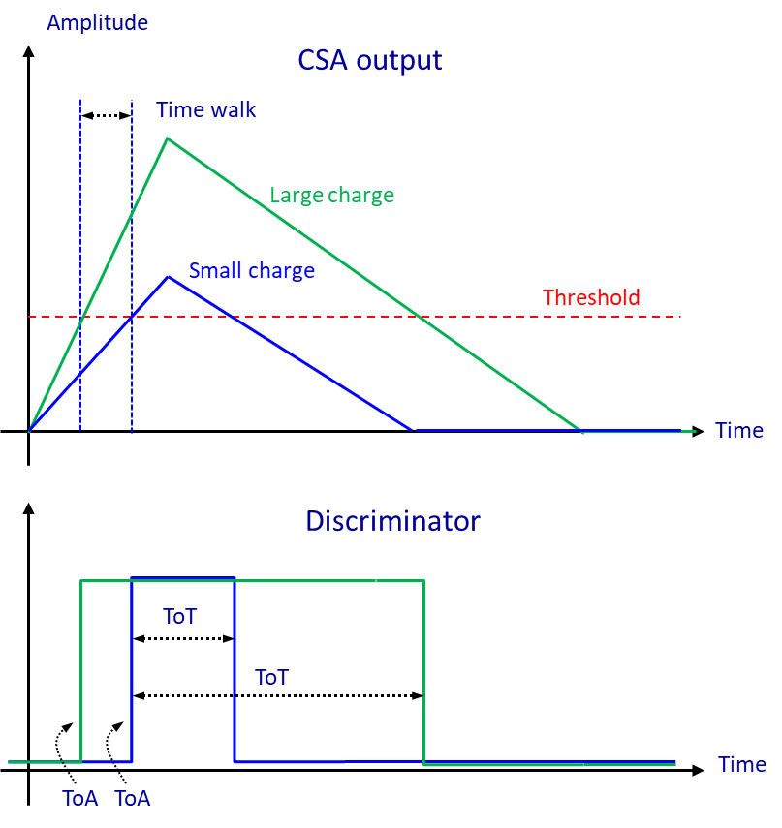




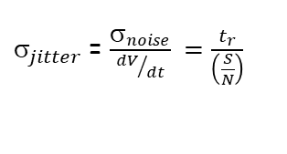

Time resolution
The time resolution of a detector can be expressed as follows:
$_{total}^{2} ={_{jitter}^{2}+ }_{timewalk}^{2}$ $+ _{Landau}^{2}+_{TDC}^{2}$
Due to the noise of the electronic front-end including the sensor
The jitter is proportional to the rise time and inversely proportional to the S/N ratio.
The rise time depends on the FE bandwidth and is proportional to the drift time of charge in the sensor
Related to the variation of the deposited charge event-by-event
Variation of the time of arrival (TOA)
Time walk is corrected by :
  variable threshold → Constant fraction discriminator (CFD)
  constant threshold correction
    Correct the time of arrival (TOA) with a calibration based on the time over the threshold (TOT)
Due to the Landau distribution of the deposited charge
Represents the spatial variation of the deposited charge along the path
  Charges from different depths are collected at different times.
The effect is small for thinner devices or sensors with short drift times
  Absent in 3D detectors
  Not negligible in LGAD sensors
Due to the Time to Digital Converter (TDC) binning
Bin size divided by which is in general small
$$_{jitter}$$
$$_{Landau}$$
$_{jitter}$= $\frac{σ_{noise}}{{dV}/{dt}} =\frac{t_{r}}{\left(\frac{S}{N}\right)}$
$$_{TDC}$$
$$_{timewalk}$$
$$\sqrt{12}$$

Slide 19
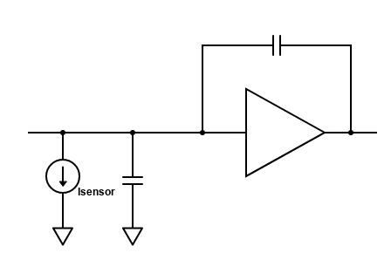
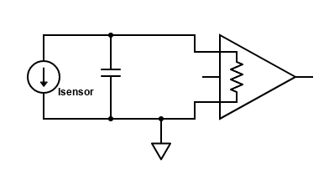
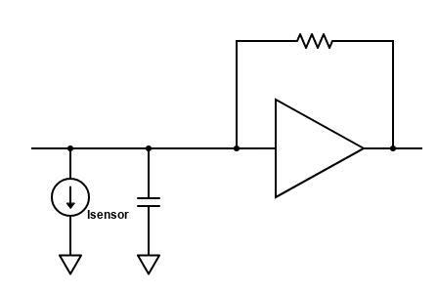
Front-end electronics and ASIC R&D
Charge amplifier (CSA)
Vout = CF×Qsensor
Slow slew rate
Less noise
Current amplifier
Iout = A×Isensor
Fast
slew rate
High noise
Transimpedance amplifier
Low Rin
Vout = RF×Isensor
High bandwidth
High noise
The choice of the fast amplifier depends on the timing specifications and the sensor bandwidth
Front end based on charge amplifier (CSA)
High-resolution TDC
  1 TDC can be shared by several FEs
TOA and TOT measurements
Cf
HitOr
TDC
Cs
CSA
V_{TH}
Comp

Slide 20
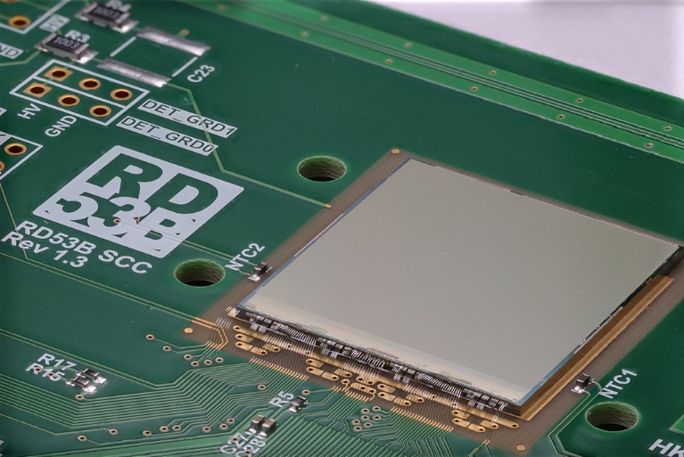
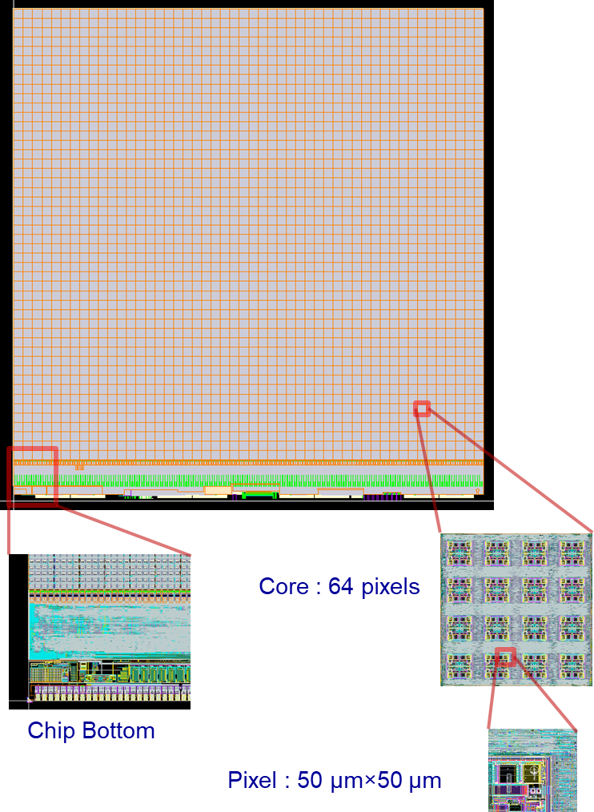
Circuit de lecture du détecteur
ITkPixV2 : puce de lecture de production pour les pixels de ATLAS ITk
  Process CMOS 65nm
  Taille : 20.054 mm × 21.022 mm
  Zone sensible :384 x 400 pixels de
  50 x 50 µm²
  153 600 pixels organisés en 2400 noyaux
Tolérance au rayonnement jusqu'à une dose ionisante totale de 1Grad
Préamplificateurs de charge
  Faible bruit (<100 e)
  Faible consommation (<5 uW) par pixel
Traitement d'un taux de hits de 3 GHz/cm2
Mise en mémoire tampon des données pendant une durée maximale de 12.5 µs
Lecture des données déclenchée à 1MHz
Nécessite des liaisons de données jusqu’à
5 Gbit/s

Slide 21
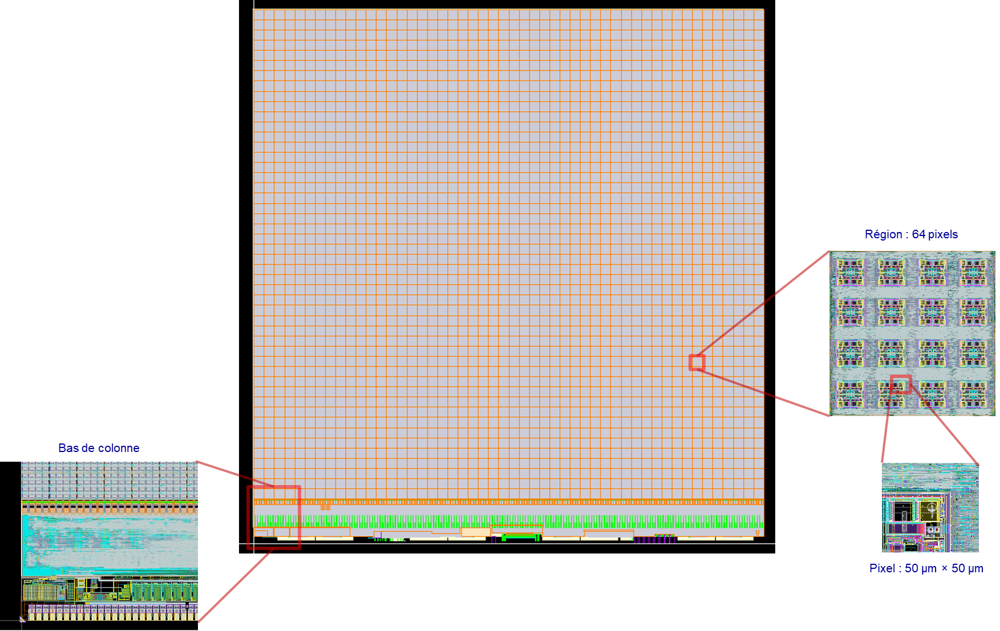
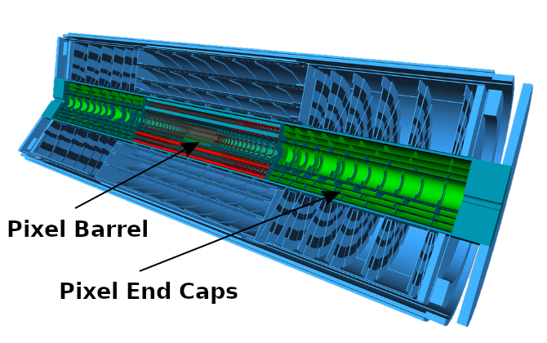
Introduction
Since ~1993: Pixel detectors for tracking and vertexing in the LHC and HL-LHC environments
FE-I3 readout chip: (250nmCMOS process)
  2880 pixels of 50µm × 400µm
FE-I4 chip the IBL (130 nm CMOS process)
  26880 pixels of 50µm × 250µm
RD53 chip for ATLAS/CMS HL-LHC upgrades
(65 nm CMOS process)
  Size: 20 mm × 21 mm
  153 600 pixels of 50µm × 50µm
  Time over Threshold (ToT) measurement implemented in the pixel (resolution of 6.25 ns)
  Precision ToT and ToA (resolution of 1.5 ns) implemented per each core column
  Radiation levels :
  1 Grad and 2 × 10¹⁶ (1 MeV neq) /cm²
RD53 readout chip
ATLAS-ITk

Slide 22

Analog FE pixel prototype
Pixel array of 36 × 12 pixels
  Only the analog pixel is considered and implemented
  Design done for Sensor capacitance of 100 fF (50µm × 50 µm)
The goal of this pixel matrix design is to study the limits to time resolution in analog front designed with the 28 nm CMOS process
  Bandwidth, Noise, Current bias, power supply
The time resolution of the FE is defined by the total jitter of the pixel FE
Minimizing the jitter corresponds to :
  Low RMS noise of the charge amplifier
  High output voltage
  Small rise time → High bandwidth
 | High granularity | Ultra high granularity
Pixel size | 50µm × 50 µm | 25µm × 25 µm
Sensor capacitance | 100 fF | < 50 fF ?
Time resolution | < 50 ps RMS | < 50 ps RMS
Consumption (pixel) | <20 µA | <5 µA
Threshold | < 600 e- | <600 e-
Hit rate | 8 GHz/cm² | 8GHz/cm²
Hit rate (pixel) | 20 kHz | 5 kHz
TID | 2-4 Grad | 2-4Grad
2 options for ATLAS/CMS inner layers upgrades
$_{FE}$= $\frac{t_{r}}{\left(\frac{S}{N}\right)}$
Cf
CSA
HitOr
Cs
VG
Comp
Analog FE pixel design

Slide 23
Semi-conductor pixel detectors
Hybrid devices with a dedicated ASIC bonded to the sensor
  R&D driven by LHC
  Still solution for the HL-LHC pixel detector upgrade (Planar and 3D sensor, LGAD ??)
Monolithic Active Pixel Sensors (MAPS)
  Integrating the sensor and the readout electronics
  Compromise between charge collection and signal read-out speed
Depleted Monolithic Active Pixel Sensors (DeMAPS)
  High radiation hardness and read-out speed

Slide 24
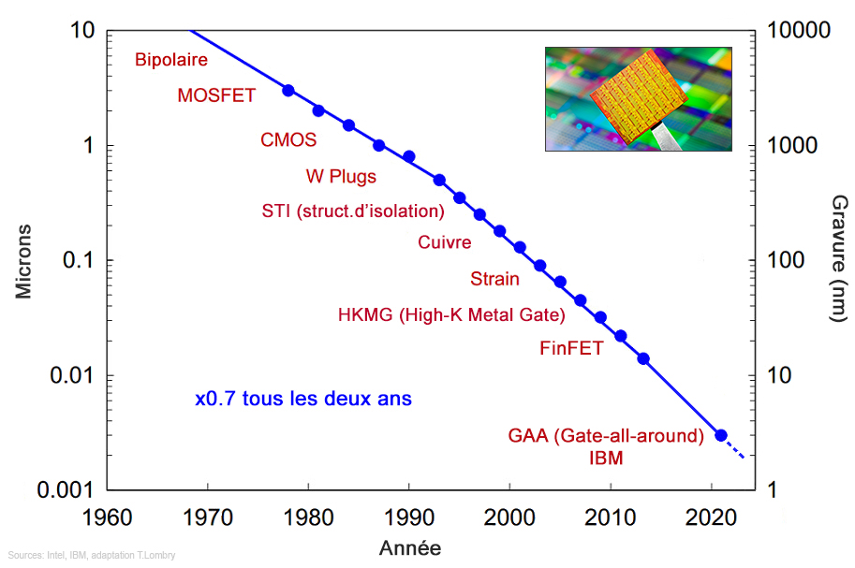
Technology choice and ASICs evolution
Most of the designs for CERN experiments are based on 65 nm and 130nm CMOS
  Qualified by CERN for radiation-hardness
HL-LHC : Over 40 front-end ASICs have been developed in 130 and 65nm CMOS technology for detector readout
  Access to foundry and design tools run centrally from CERN
  Common projects for the specific developments like data links or power conversion
  Collaborative developments across experiments (RD53 or Medipix)
130 and 65nm CMOS technologies are already fifteen to twenty years old
28nm CMOS technology is considered as the next node for highly integrated chips such as pixel readout
A cheaper process should be preserved for less dense/demanding applications
The requirements of lepton and heavy-ion colliders seem to be mostly within reach of technologies from HL-LHC
CMOS Imaging Sensors (CIS) variant should be targeted for monolithic pixels
250 nm
130 nm (FE-I4 – 2007)
65 nm (RD53 -2014)
32 nm (28 nm)
14 nm
3 nm
The CERN community is lagging behind in the use of the new processes
  Cost and accessibility
  Take years to design our complex chips
  Risk of technology aging (factory can abandon the node)

Slide 25
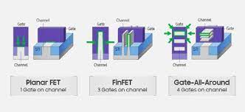
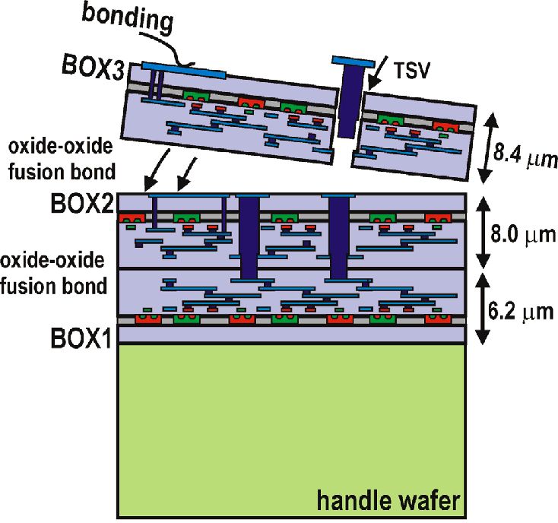
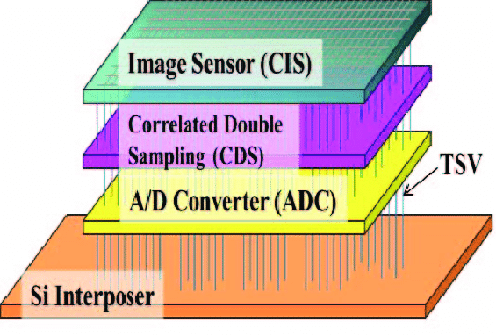
Technology choice and ASICs evolution
FCC-hh or a muon collider
  Electronics can become a facilitator, but also a potentially limiting element
  Access to some of the required technologies and tools
  The R&D strategy will be driven by what is feasible and not just by the requirements of experiments
CMOS nodes below 28nm need to be qualified
  Potential use in future applications requiring extreme miniaturization, High speed and low power
High performance CMOS image sensors are based on stacked active layers to reduce pixel pitch and increase functionality
Commercial CMOS image sensors are a good example, stacking two or three device layers fabricated in different technologies
  Integration of different technologies: sensor/analogue/digital/photonic functions
  R&D in TSVs and bump-less techniques is needed
For ASICs, the microelectronics industry has reached nanoscale CMOS nodes (< 5nm), based on new transistor structures
  FinFETs devices
  GAA devices

