Slide 1
IP Luminosity Feedback and Preliminary Design Considerations for Luminosity Monitoring at CEPC
Meng Li
P. Bambade, J. Gao, D. Wang, H.Y. Shi, S. Bai
2024 European Edition of the International Workshop on the Circular Electron-Positron Collider (CEPC), Marseille, France

Slide 2
CONTENTS
Necessity of the Fast Luminosity feedback for CEPC
Vertical IP orbit feedback—based on BPMs
Horizontal IP orbit feedback—based on luminosity monitor

Slide 3
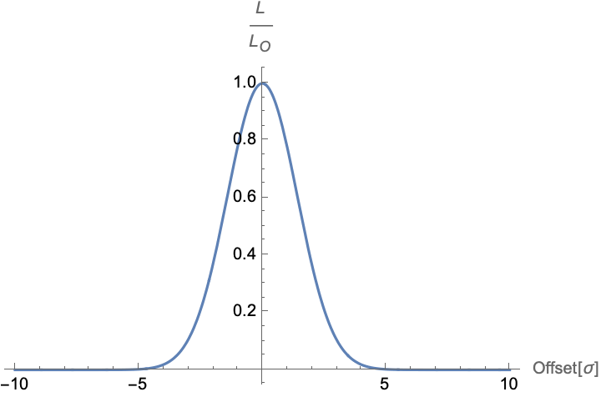
Motivation
CEPC is a proposed double ring collider for Higgs factory (120GeV), designed to operate in 4 modes
Achieve a very high luminosity ➔ IP beam size very small ➔ Luminosity sensitive to beam jitter
( $5×{10}^{34}{cm}^{−2}s^{−1}$ )
( $σ_{y}^{∗}=36nm$ )
( ground motion and other effects )
➔Excellent control two colliding beams to maintain an optimum collision and prevent luminosity loss
➔Require fast IP orbit feedback system
Tuning optical beam parameters at IP to increase luminosity and optimize performance
➔Require luminosity measurement at very low current
Fast luminosity measurements and an orbit feedback system at the IP are essential for CEPC.
Designed machine parameters
$$L/{L_{0}}$$
Position and resolution of the IP BPMs
Ground motion of the construction site

Slide 4
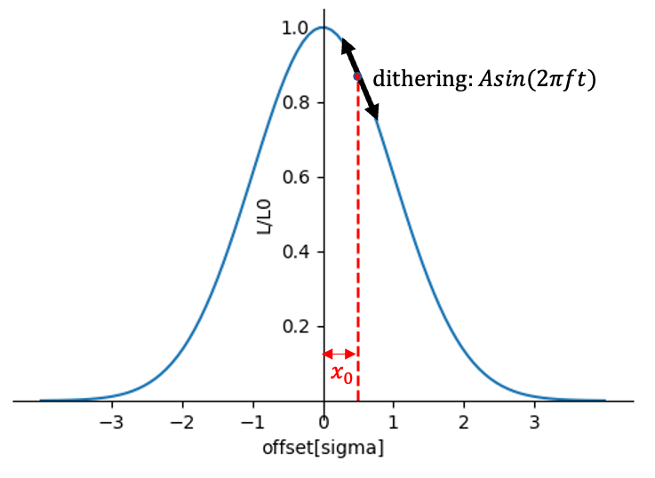
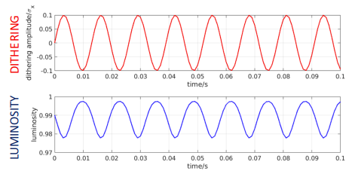
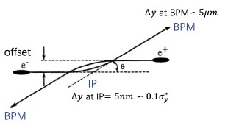
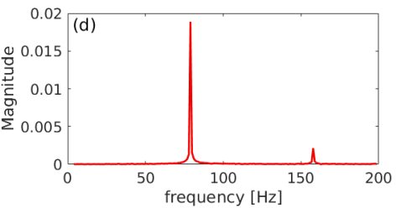
Methods
We considered two possible methods for the IP orbit feedback system at CEPC——similar to SuperKEKB.
Beam-beam deflection driven method
Luminosity driven system
Based on the measurement of the beam orbit around the IP.
The offset at the IP is too small to be accurately measured, but this small offset can be converted into a large offset due to the mutual electromagnetic deflection as the beams propagate forward and collide. By measuring this offset with BPMs upstream and downstream of the IP, we can estimate the offset at the IP and the sign. If accuracy of BPM is precise enough, we may maintain the optimum collision with almost no luminosity loss. We usually prioritize this method for this reason.
Based on measurements of the luminosity. Due to the lumi- nosity being a symmetrical function of offset, we can only know the offset between two beams, but cannot easily know its sign. And some other effects ( beam size and intensity) may also cause luminosity changes at relatively low frequency. To solve this problem, we should introduce a dithering with certain frequency, and then luminosity will change with same frequency, we can extract orbit shifts and correct them.
$${∆y}_{±}^{′}=−\frac{r_{e}N_{∓}}{γ_{±}σ_{y∓}^{∗}\left({\tilde{σ}}_{x∓}^{∗}+σ_{y∓}^{∗}\right)}{∆y}_{IP}$$
$${∆y}_{BPM}=\sqrt{β^{∗}β_{BPM}}∆y^{′}$$

Slide 5
Estimate the performance of the beam-beam at CEPC
Consider the case where the offset at IP is 10% of the beam size caused by ground motion and the luminosity loss is about 1% . The beam-beam angular deflection can be estimated based on the CEPC TDR parameters and the distance from the IP to the IP BPM of about 0.9m.
For the vertical orbit feedback system, this method may work, since the offset is sizable compared to typical expected BPM resolution.
But for horizontal the beam-beam deflection is too weak, makes it difficult to measure such a small beam deflection. The luminosity driven method will be used for the horizontal orbit feedback.

Slide 6
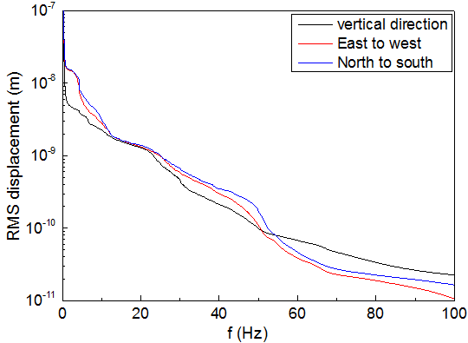
Vertical IP orbit feedback
We prioritize using the beam-beam deflection method for vertical orbit feed- back at the IP.
Higgs mode (2.24μm) is the smallest among the four energy modes.
Good enough to accurately measure orbit changes
However, relying solely on a single pair of BPMs for IP fast orbit feedback is insufficient.
Potential BPM failures
Actual accuracy and resolution lower than design
BPM resolution get worse when operates at lower beam intensity
➔ it is essential to have at least two or more pairs of BPMs
cross-verification
further improve measurement precision

Slide 7
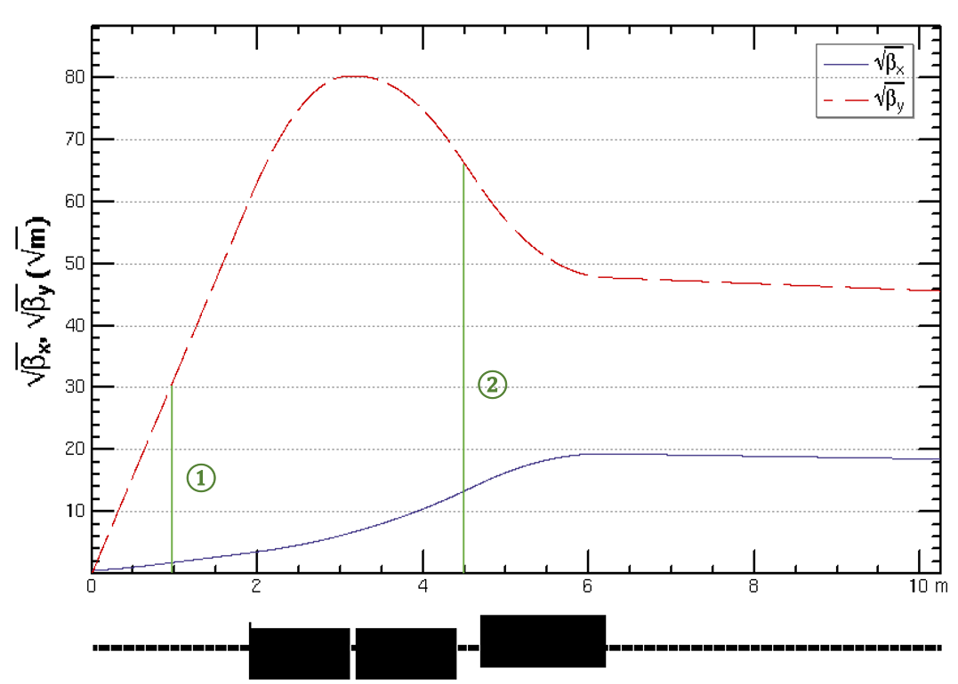
Vertical IP orbit feedback
Utilize two pairs of BPMs for vertical beam orbit feedback, placed at symmetric positions on each side of the IP, located at distances of 0.9m and 4.5m

Slide 8
Horizontal IP orbit feedback
Luminosity-driven method with a dithering system used for orbit feedback and luminosity optimization
➔ considering the weak beam-beam deflection and a lower required feedback speed (1kHz)
The fast luminosity monitor based on radiative Bhabha at zero degree
➔very large cross section (127mbarn)
➔ Bhabha particles produced at the IP is proportional to the luminosity
➔ Sensitive to the change of luminosity in proportion way (relative luminosity measurement)
*
* need further review

Slide 9
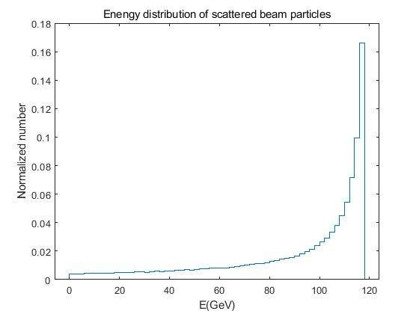
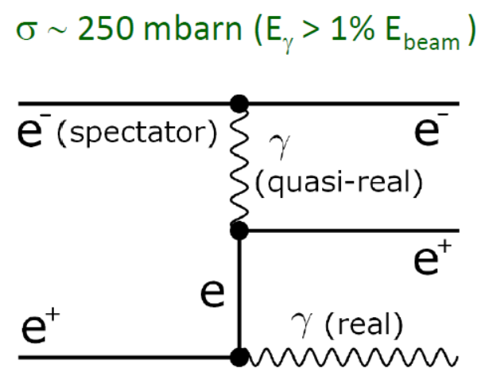
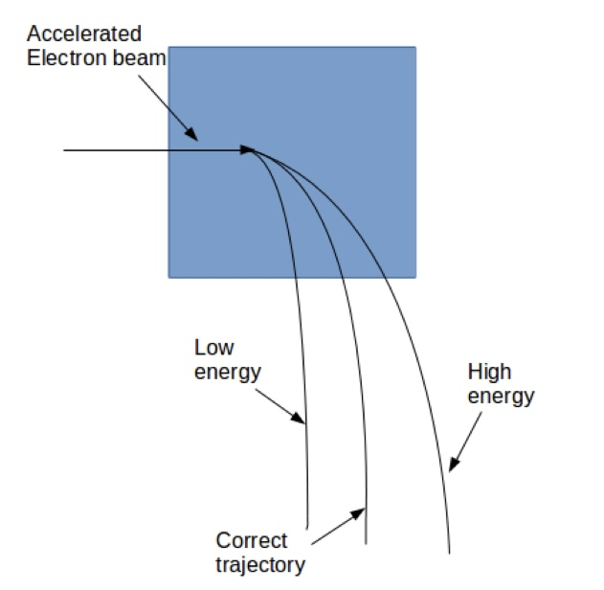
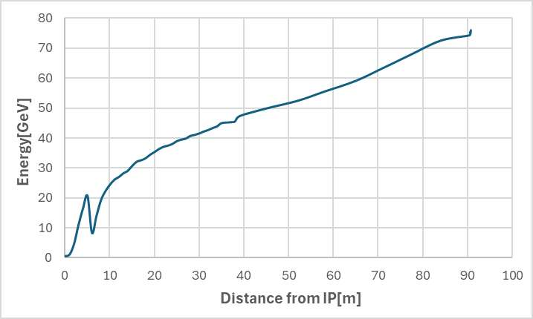
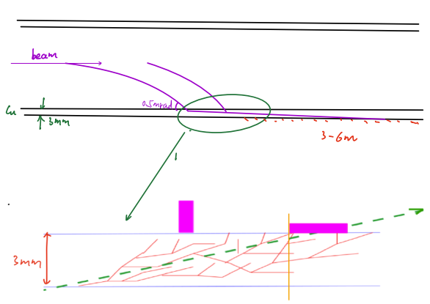
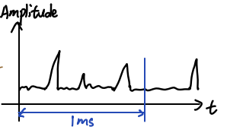
Fast Luminosity Monitor working principle
Radiative Bhabha scattering at zero degree — single Bremsstrahlung of single positron in the field of one electron.
This process is also one of the main sources of particles losses in a very high luminosity e-e+ collider.
Only relative luminosity →. → count the number of signals
$$L∝\frac{dN}{dt}$$
$$E (e^{−})=120GeV$$
$$E (e^{−})=120GeV$$
$$E (e^{+})$$
$$E (e^{+})=120GeV$$
$$E (γ)$$

Slide 10
Fast luminosity monitor design plan
Generating the Bhabha particles through the program( BBBREM or GUINEA-PIG)
Tracking scattered electrons up to 100 meters downstream of the IP using the SAD code and calculate the loss map to identify a suitable position for placing a luminosity detector
fraction of scattered electrons hitting the beam pipe is close to the required value
radiative Bhabha process at zero degree dominates over other particle loss processes
ensure that the Bhabha event rate at this position is minimally affected by beam-beam deflection
Detailed simulation in Geant4 to estimate the signal in the detector and radiation dose simulation
Considering / selecting the detector technology (e.g., Cerenkov, array of pin diodes,etc...)

Slide 11
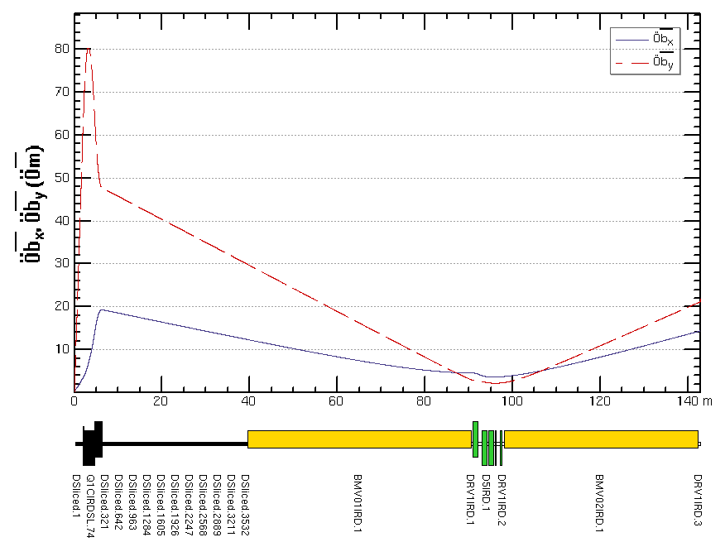
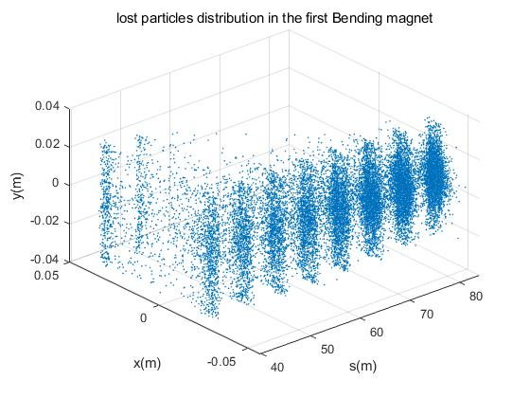
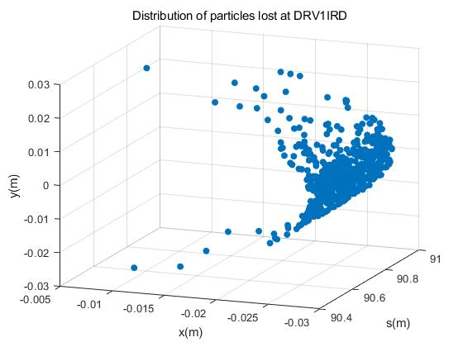
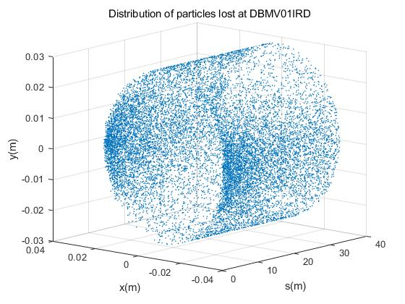
Position of fast luminosity monitor for CEPC
Three potential locations were considered: before, inside, and after the first bending magnet
1
2
3

Slide 12
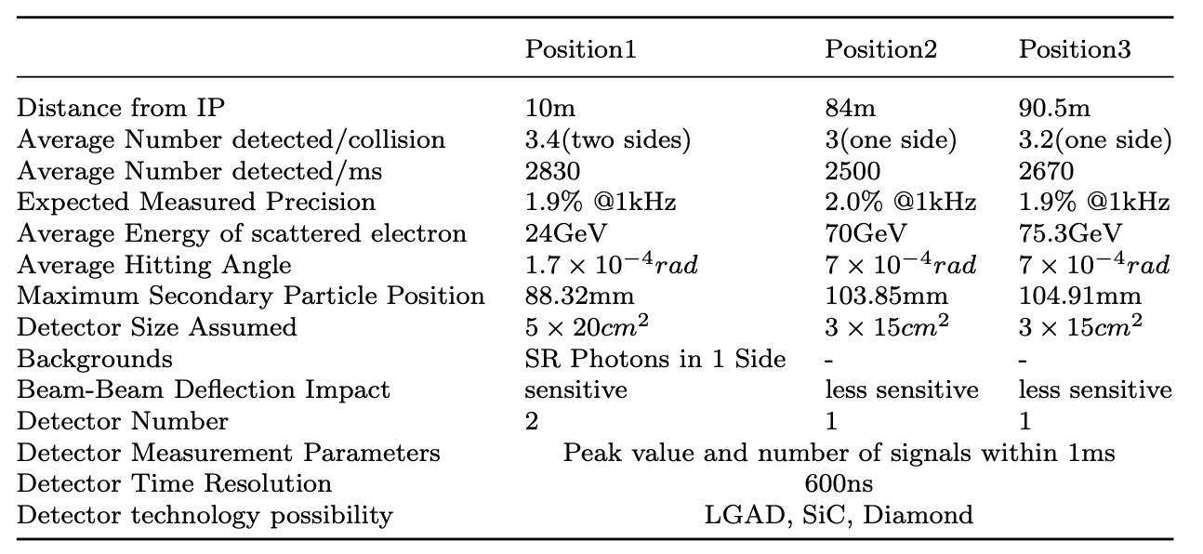
Position of fast luminosity monitor for CEPC
IP
1
2
3

Slide 13
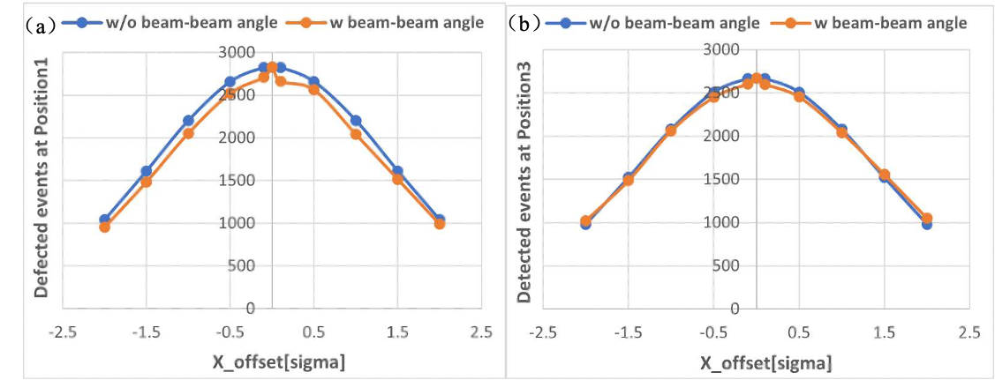
Position of fast luminosity monitor for CEPC
Furthermore, the simulated expected number of Bhabha events that will be detected in different offset cases each millisecond for position 1 and position 3 shows an almost linear relationship with the offset at the IP and varies greatly, making it easy for detectors to measure.

Slide 14
Summary and outlook
Fast Luminosity Tuning System, including fast BPMs and fast luminosity monitor, would be necessary for CEPC to ensure optimal collision and achieve maximum luminosity.
Currently,
The proposed approach involves utilizing the beam-beam deflection driven method based on BPMs for vertical orbit feedback and a luminosity-driven method for horizontal feedback.
Candidate positions for BPMs and luminosity detector have been identified.
The detailed design of the detectors is getting started.
In the future,
Start to end the feedback simulation to specify the precision requirement
Radiation dose simulation (important for detector choice)
Detailed simulation in Geant4 to estimate the real signal in the detector
Design of the BPM and feedback electronics, the design of detectors and data acquisition system

Slide 15
Thanks for your attention

Slide 16
Necessity of the Fast Luminosity Monitor for CEPC
Any Collider must have a luminosity monitor, but not necessarily a fast luminosity monitor. If want to do fast IP luminosity tuning and feedback, maybe should have a fast and precise luminosity monitor.
 | Standard luminosity monitor(LumiCal) | Fast luminosity monitor
Process | Radiative Bhabha at finite angle | Radiative Bhabha at zero angle
$$σ_{Higgs}$$ | $${10}^{−31}{cm}^{−2}$$ | $${1.27×10}^{−25}{cm}^{−2}$$
Design goal | precise physics measurement slow beam tuning (@1Hz) | Fast feedback Tuning accelerator beam parameter at IP
characteristic | Slow but can be precisely calibrated | Faster but not easy to calibrate precisely
Luminosity | $$L=5×{10}^{34}{cm}^{−2}s^{−1}$$
Events | $$N=L×σ×T×f$$
 | Assuming f = 1 $$N=0.5×5×{10}^{34}×{10}^{−31}$$ $$=2.5×{10}^{3}/s→ν=2×{10}^{−2}@1Hz$$ $$=2.5×{10}^{2}/0.1 s→ν=6×{10}^{−2}@10Hz$$ $$=25/0.01s→ν=0.2@100Hz$$ $$=2.5/ms→ν=0.6@1kHz$$ | Assuming f = 0.01 $$N=5×{10}^{34}×0.5×1.27×{10}^{−25}×0.01$$ $$=3.2×{10}^{7}/s→ν=1.8×{10}^{−4}@1Hz$$ = $3.2×{10}^{6}/0.1s→ν=5.6×{10}^{−4}@10Hz$ $$=3.2×{10}^{5}/0.01s→ν=1.7×{10}^{−3}@100Hz$$ $$=3.2×{10}^{4}/ms→ν=5.6×{10}^{−3}@1kHz$$

Slide 17
Fast Luminosity Monitor working principle
Radiative Bhabha scattering at zero degree, also one of the main background sources.
$$E (e^{−})=120GeV$$
$$E (e^{−})=120GeV$$
$$E (e^{+})$$
$$E (e^{+})=120GeV$$
$$E (γ)$$
Amounts to the ”single Bremsstrahlung” of one beam particle in the field of an opposing beam particle. One particle retains its energy and remains in the beam, while the other particle loses part of its energy and emits a photon at almost zero angle, with energy ranging from very low to the beam energy distribution.
The low-energy scattered particles will be deflected downstream of the IP at different locations, as soon as it goes through a magnet, and will then hit the pipe, generating electromagnetic showers. Sensors will be placed just outside the beam pipe to measure the signals from the charged secondary particles.

Slide 18
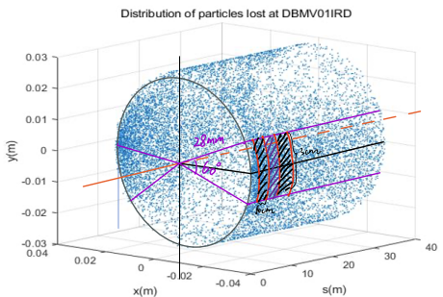
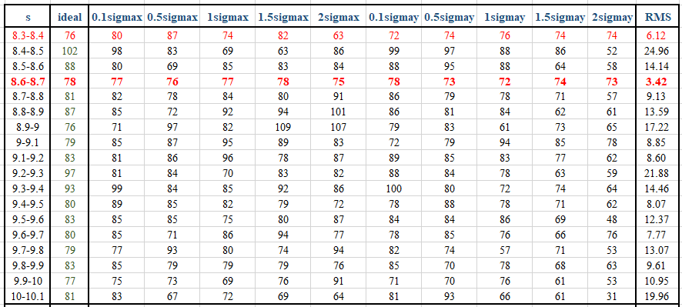
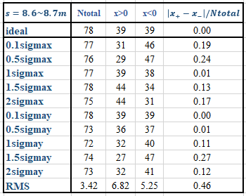
Select a best position to place the detector
$$f=\frac{N_{loss}}{N_{total}}=\frac{78}{2×{10}^{5}}=4×{10}^{−4}$$
$$N=L×σ×T×f$$
$$=5×{10}^{34}×0.5×1.27×{10}^{−25}×4×{10}^{−4}×1s$$
$$=1.27×{10}^{6} per s→ν=8.9×{10}^{−4}@1Hz$$
$$=1.27×{10}^{4} per 10ms→ν=8.9×{10}^{−3}@100Hz$$
$$=1.27×{10}^{3} per ms→υ=2.8×{10}^{−2}@1kHz$$
Assuming the detector is 10cm long and 3cm high and place it in the horizontal symmetrical about Y=0. In this case, the 8.6m downstream of the IP (at the first 2.4m of BDMV01IRD) is the good position for detector.
The total particles number lost on this area is almost unaffected by beam-beam deflection. But the distribution is no longer be symmetrical. So should put a detector on both sides. The fraction of loss particles here is $4×{10}^{−4}$, the precise could reach 3% at 1kHz.
It is not guaranteed that every lost particle can generate a signal in the detector, the fraction is about 60-70%, so it is necessary to consider a slightly larger detector.

Slide 19
Evaluate the level of background
Haoyu Shi, Sha Bai
Background source | lifetime | events | Lost on BDMV01IRD | Nloss/Nevents | Nloss /s | NlossBDM /s
Bhabha at zero | 40 [min] | 200000 | 17053 | $$8.5×{10}^{−2}$$ | $$1.45×{10}^{10}$$ | $$1.2×{10}^{9}$$
Beamstrahlung | 40 [min] | 200000 | 0 | 0 | $$1.45×{10}^{10}$$ | 0
Beam-gas bremsstrahlung | 486 [hour] | 53896132 | 2034 | $$3.8×{10}^{−5}$$ | $$1.99×{10}^{7}$$ | $$7.5×{10}^{2}$$
Beam-gas Coulomb | 28 [hour] | 552608 | 767 | $$1.4×{10}^{−3}$$ | $$3.45×{10}^{8}$$ | $$4.8×{10}^{5}$$
Beam-thermal photon | 50 [hour] | 65804508 | 137 | $$2×{10}^{−6}$$ | $$1.94×{10}^{8}$$ | $$3.9×{10}^{2}$$
Assuming linear loss, i.e., the number of particles lost each turn is the same
$$N_{0}=N_{p}×N_{b}=1.3×{10}^{11}×268=3.5×{10}^{13}$$
$$T=\frac{C}{v}=\frac{100}{3×{10}^{5}}=3.3×{10}^{ −4}s$$
$$N_{loss}=N_{0}\left(1−e^{−t/τ}\right)$$
The number of lost particles due to Bhabha at zero degree in 1s :
$$N_{lossBha}=3.5×{10}^{13}×\left(1−e^{−1/{(40×60)}}\right)=1.45×{10}^{10}$$
The number lost on BDMV01IRD in which：
$$N_{lossBDM}=1.45×{10}^{10}×0.085=1.2×{10}^{9}$$
At BDMV01IRD, the radiative Bhabha at zero angle process dominates over the sum of all the other processes, can be ignored.

Slide 20
Necessity of the Fast Luminosity Monitor for CEPC
Used for IP orbit feedback as a back up
All previous calculations assume that BPM can achieve design precise, and all machine parameters can reach the design values, we can put many BPMs near maximum beta position. But if the BPM in one direction is not so precise and at the beginning of the operation, the nominal parameters will not be achieved, the offset generated at BPM is not big enough to accurately measured with these BPMs.
And the luminosity is at least 10 times lower than the nominal value, and the cross-section of standard luminosity monitor is not large enough, so standard luminosity monitor also doesn’t work for fast feedback, then maybe the luminosity monitor can be alternative.
Used for beam size tuning
Whether you do beam size tuning with beam-beam deflection or luminosity, will introduce beam-beam blow up. We should minimize beam-beam blow-up by reducing strongly beam current, maybe factor of 100, then luminosity drops to ${10}^{30}$. And in that case, standard luminosity monitor doesn’t work, you need to wait ${10}^{4}s$.
 | Standard luminosity monitor (LumiCal) | Fast luminosity monitor
Lower luminosity | $L=5×{10}^{33}{cm}^{−2}s^{−1}$ f=1 $σ_{Higgs}={10}^{−31}{cm}^{−2}$ $$N=L×σ×T×f$$ $=0.5×5×{10}^{34}×{10}^{−31}×1$ $$=2.5×{10}^{2}/s=2.5/10ms$$ If measure at 100Hz, the precise is 0.63 | $$L=5×{10}^{33}{cm}^{−2}s^{−1} f=0.01$$ $σ_{Higgs}={1.27×10}^{−25}{cm}^{−2}$ $$N=L×σ×T×f$$ $=5×{10}^{34}×0.5×1.27×{10}^{−25}×0.01$ $=3.2×{10}^{6}/s=3.2×{10}^{4}/10ms$ If measure at 100Hz, the precise is $5.6×{10}^{−3}$
Lower current | $$L=5×{10}^{30}{cm}^{−2}s^{−1}$$ $$N=L×σ×T×f=0.25/s$$ If measure at 1Hz, the precise is 2 | $$L=5×{10}^{30}{cm}^{−2}s^{−1}$$ $$N=L×σ×T×f=3.2×{10}^{2}/s$$ If measure at 1Hz, the precise is 0.06

