Slide 1



High Field Magnet R&D
for the Next-generation Accelerators
Qingjin XU
for the Superconducting Magnet Group
Accelerator Division, IHEP-CAS
Apr 10 2024

Slide 2


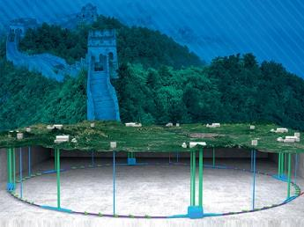
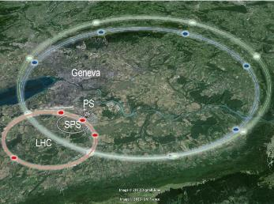
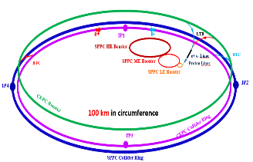
Design Scope for Next-generation Accelerators
High Energy Circular Colliders for next decades | SPPC | FCC
Proposed institution | IHEP-CAS, China | CERN, Europe
Proposed dates | 2012 | 2013
Site of the project | China | Europe
Baseline technology | IBS 20~24 T to reach 125-150 TeV, Nb₃Sn etc as options | Nb₃Sn 16 T to reach 100 TeV
Timeline | Construction at 2040s | Construction at 2050-60s
Cost | * | **

Slide 3
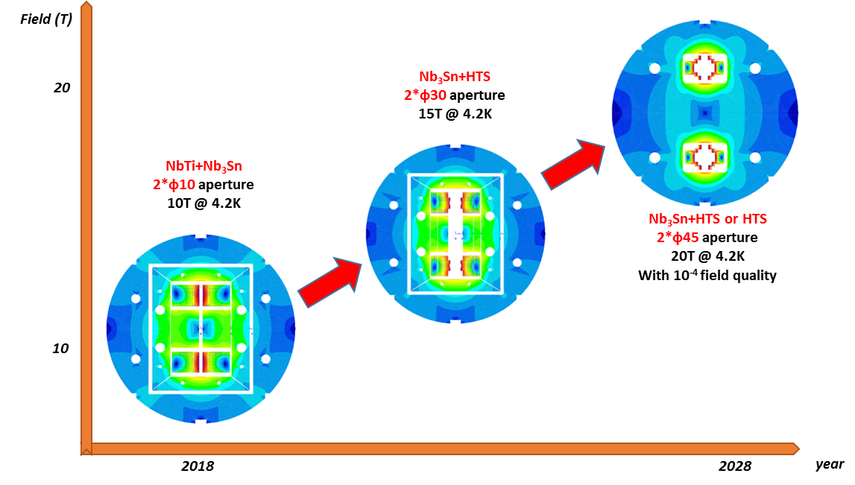
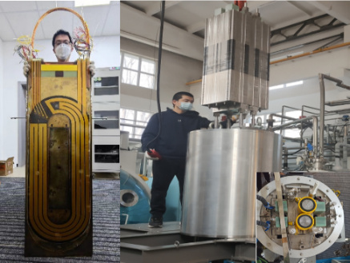
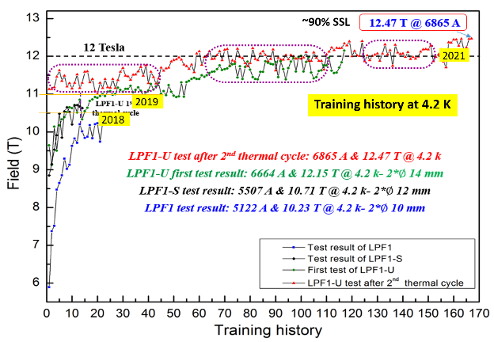
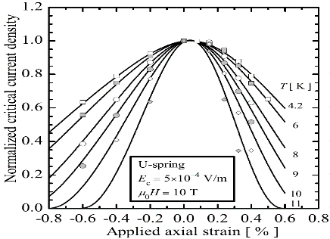
Roadmap of the High Field Magnet R&D at IHEP
2021-2024 16T @ 4.2K
Nb₃Sn + HTS
2018-2021, 12.47T @4.2K
NbTi + Nb₃Sn
Challenges: Stress control, quench protection, field quality control,……

Slide 4
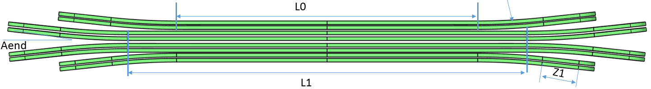
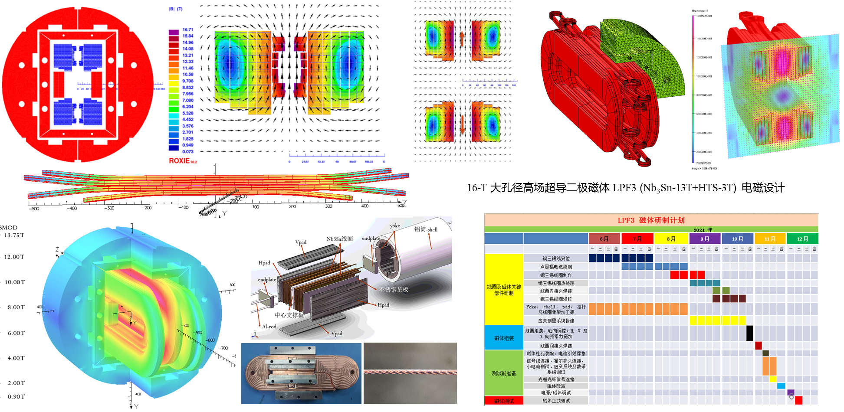
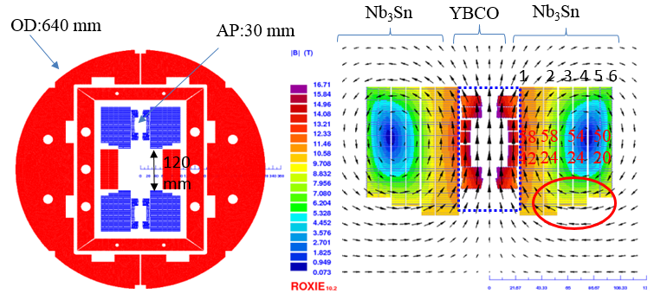
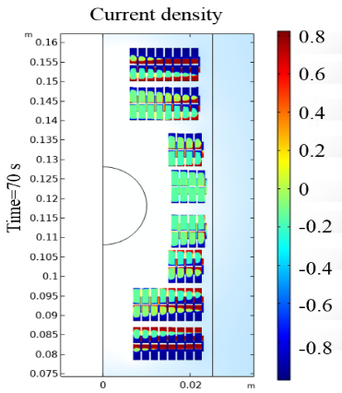
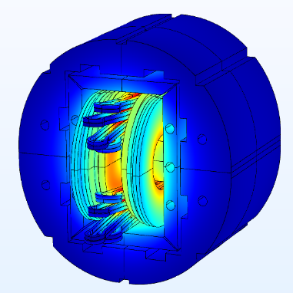
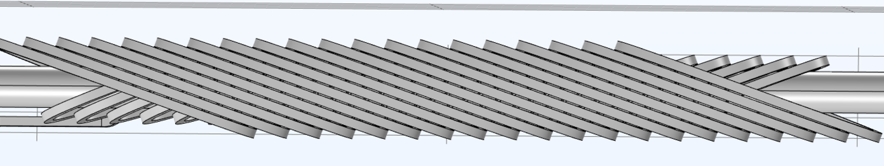
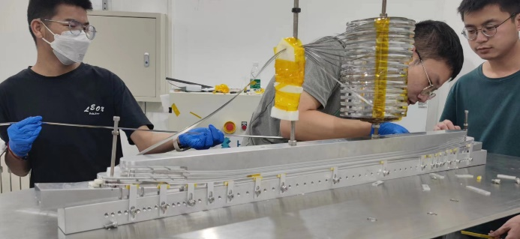
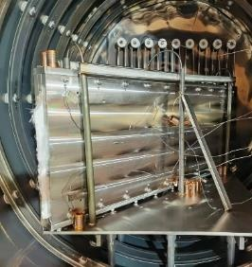
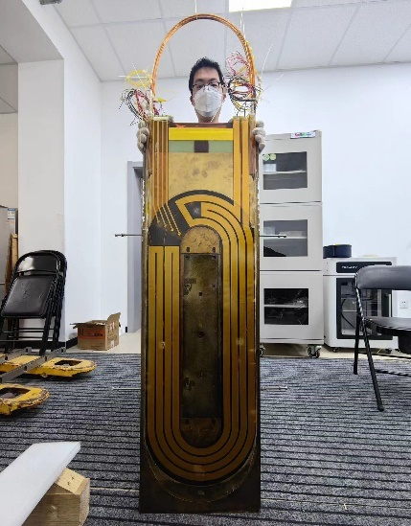
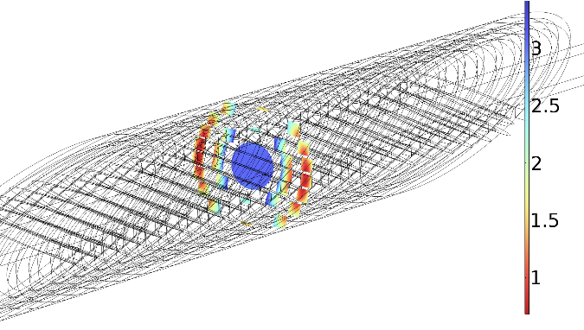
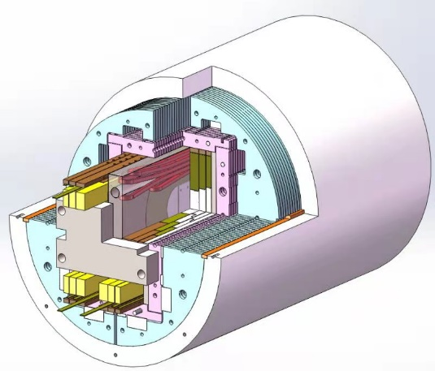
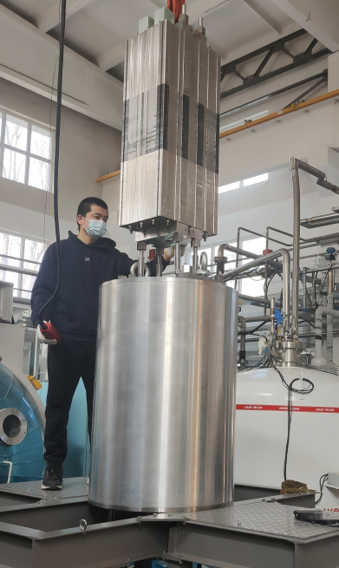
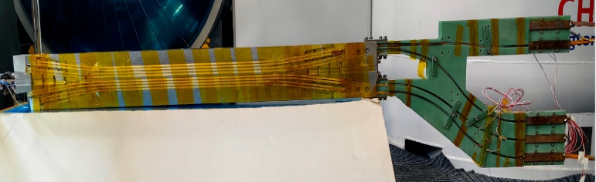
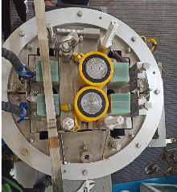
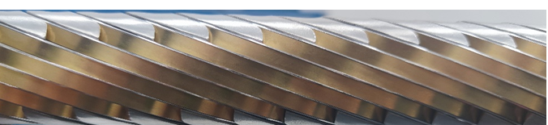
Development of the 16-T Model Dipole LPF3
16 T Model Dipole LPF3: Nb₃Sn 13 T (Common Coil with 55 mm gap) + HTS 3 T inserts (Block & CCT)

Slide 5
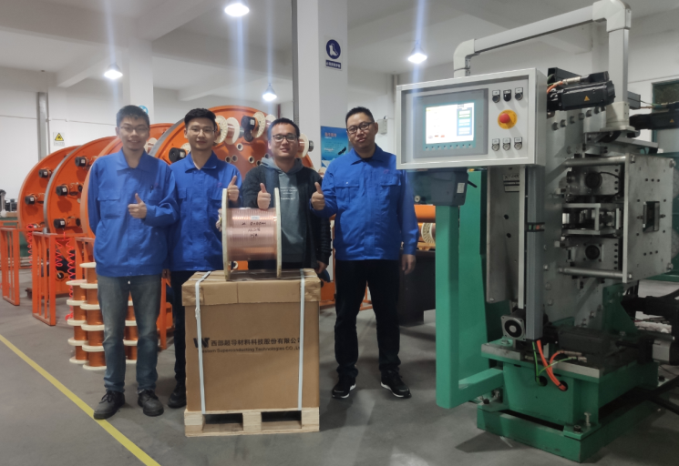

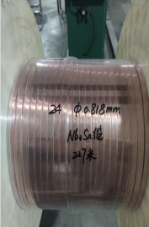
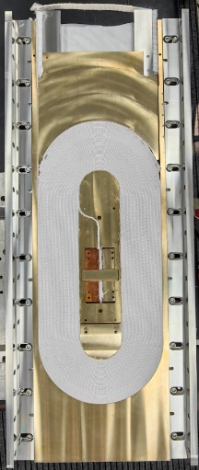
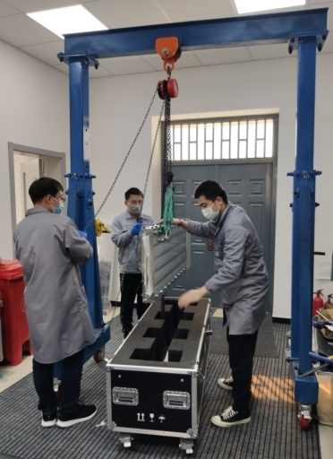
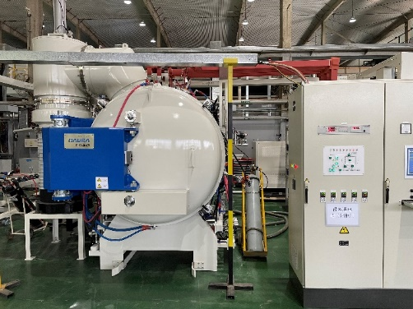
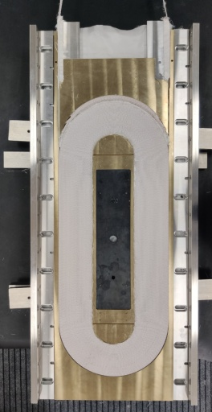
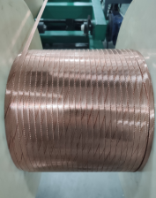
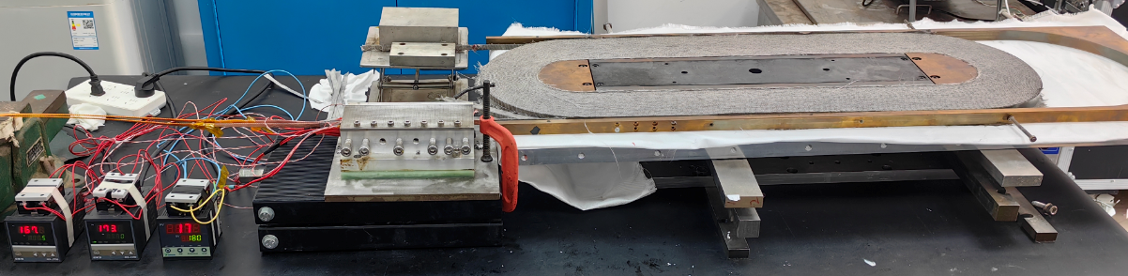
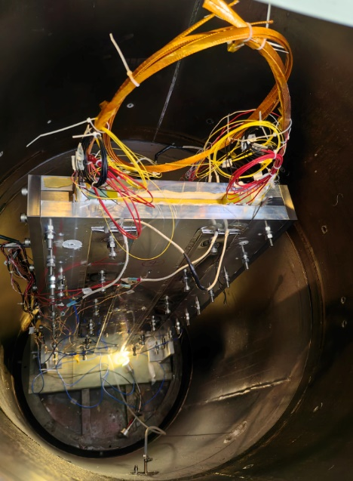
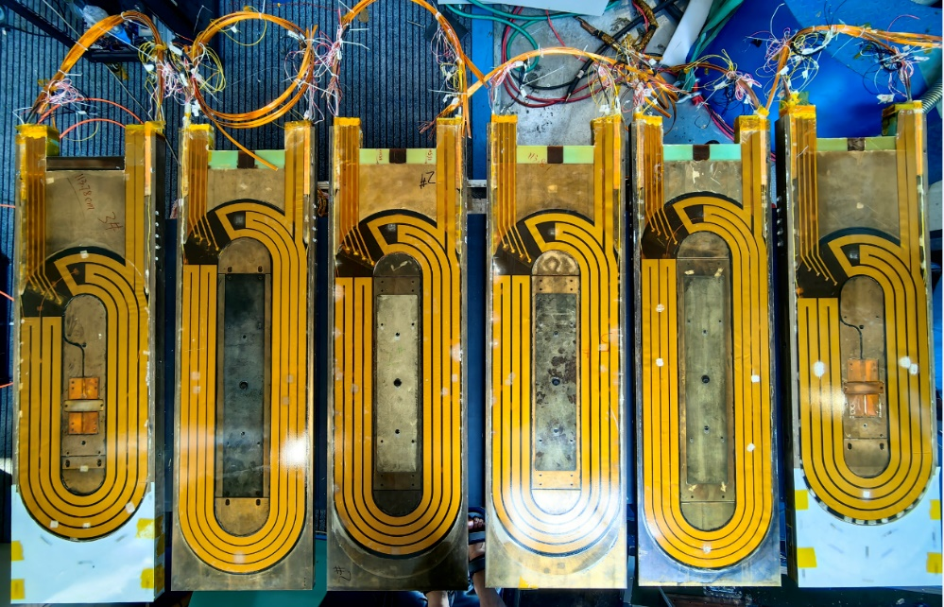
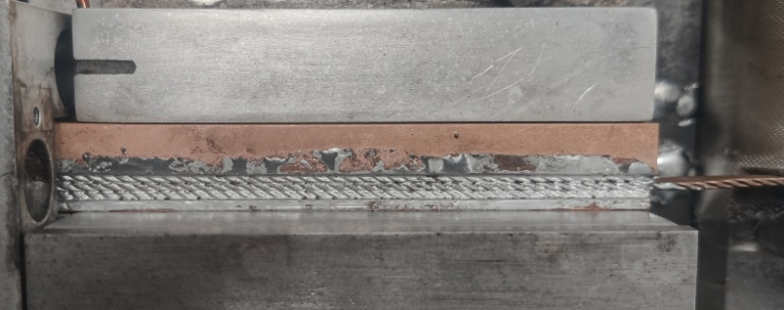
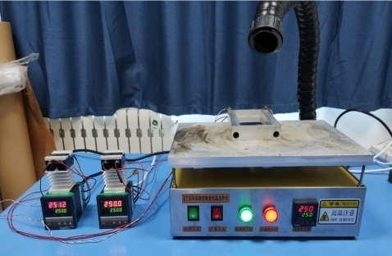
Development of the 16-T Model Dipole LPF3
The Nb₃Sn coils for LPF3
Chengtao Wang et al

Slide 6
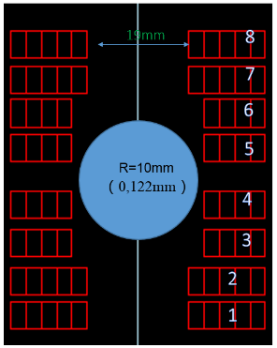
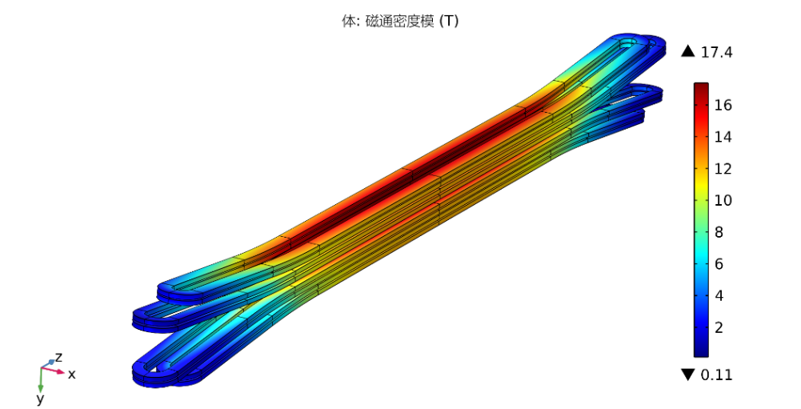
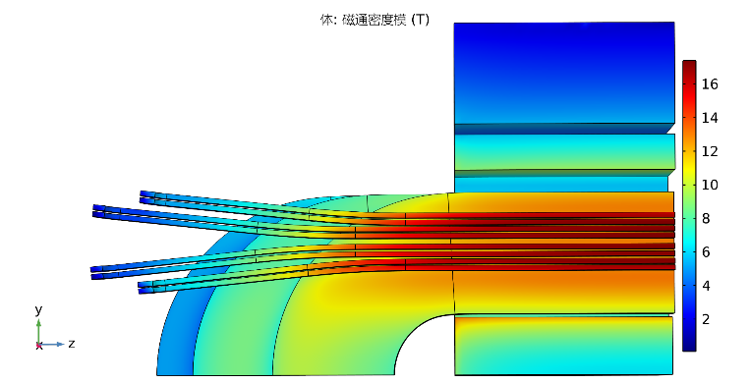

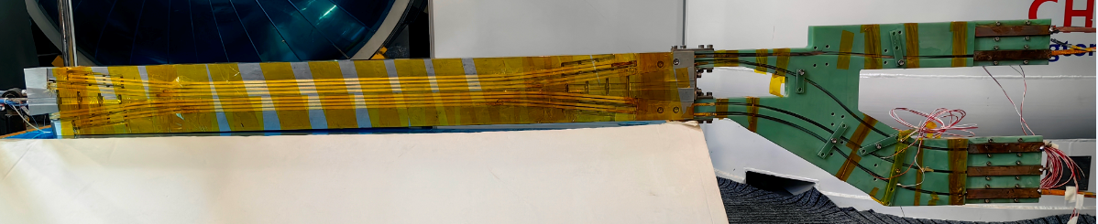
Development of the 16-T Model Dipole LPF3
The ReBCO block insert coils for LPF3
Ze Feng et al
Parameters | Values
L0 | 409.6 mm
L1 | 540.2 mm
Rhard | 800 mm
Aend | 6 °
R1 | 9.5 mm
Z1 | 120 mm

Slide 7

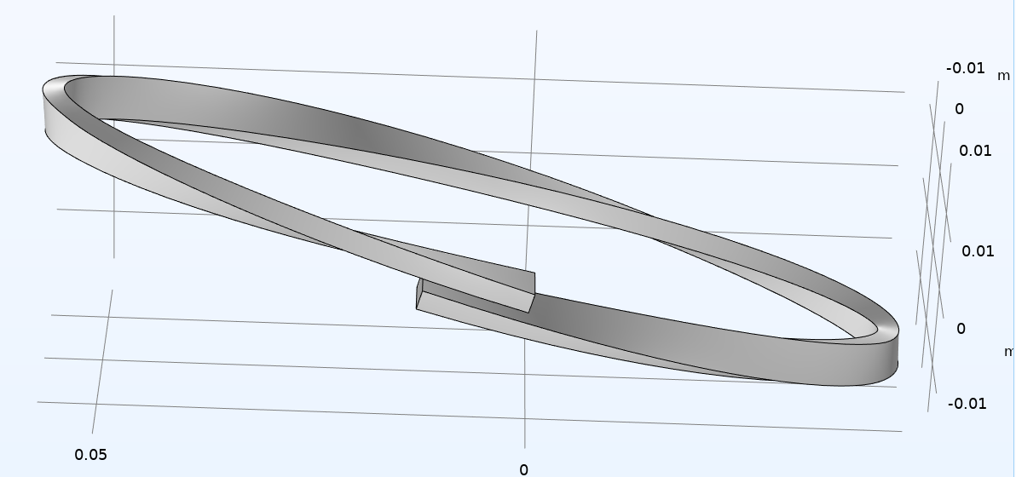
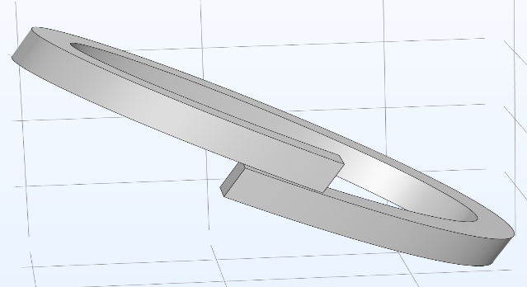
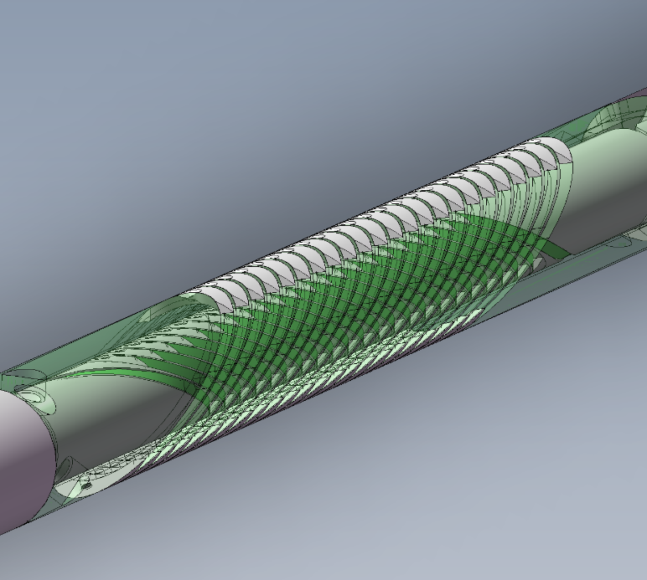
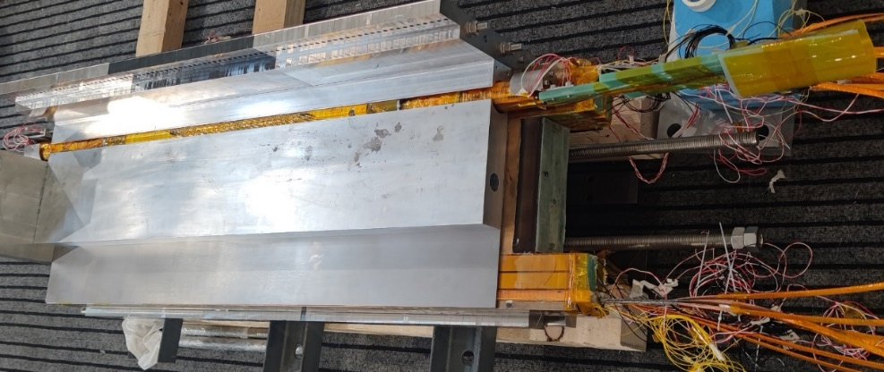
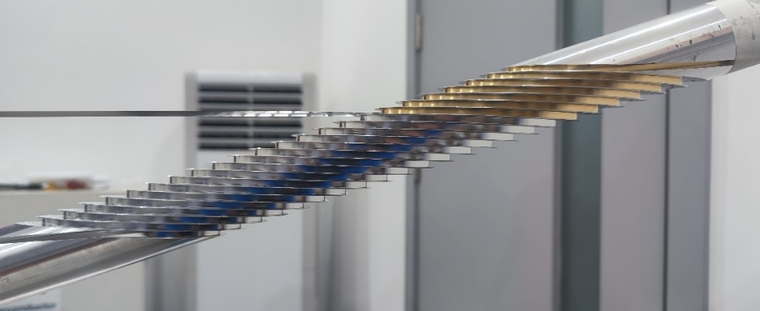
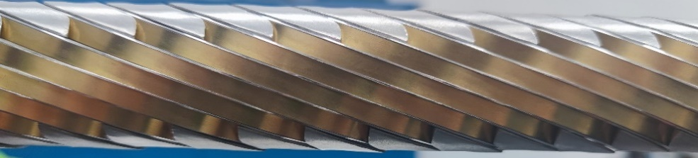
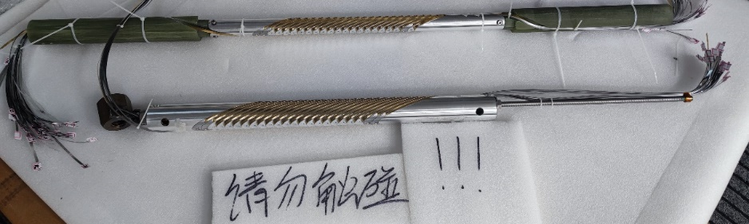
Development of the 16-T Model Dipole LPF3
The ReBCO CCT instert coils for LPF3
Rui Kang et al
典型CCT线圈结构示意
“斜螺线管”型CCT线圈结构示意

Slide 8
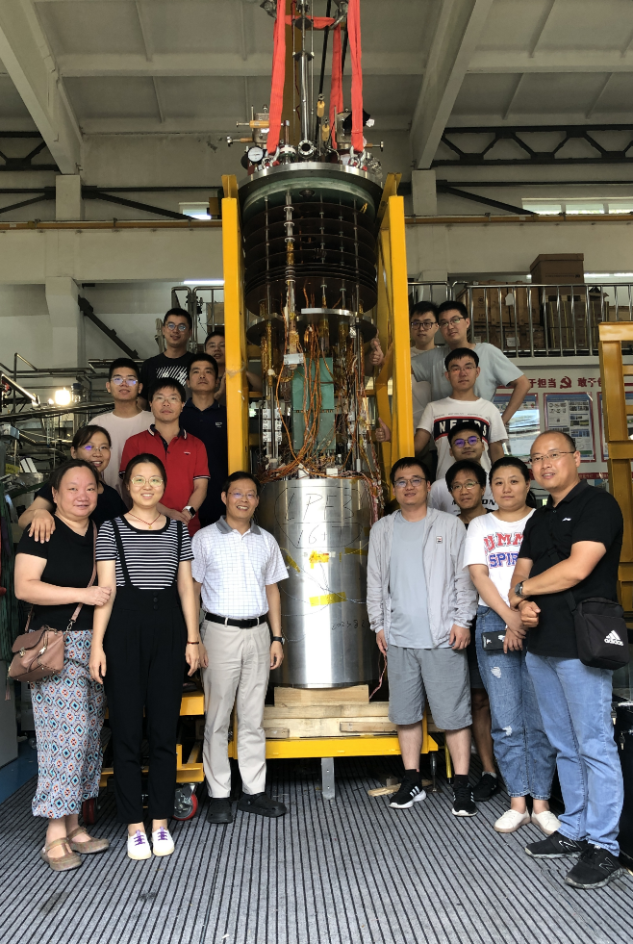
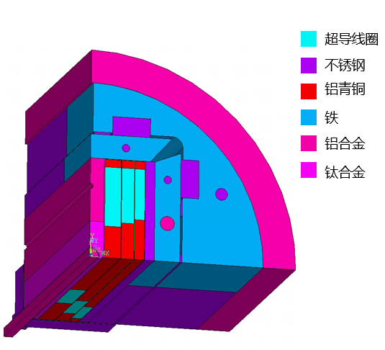
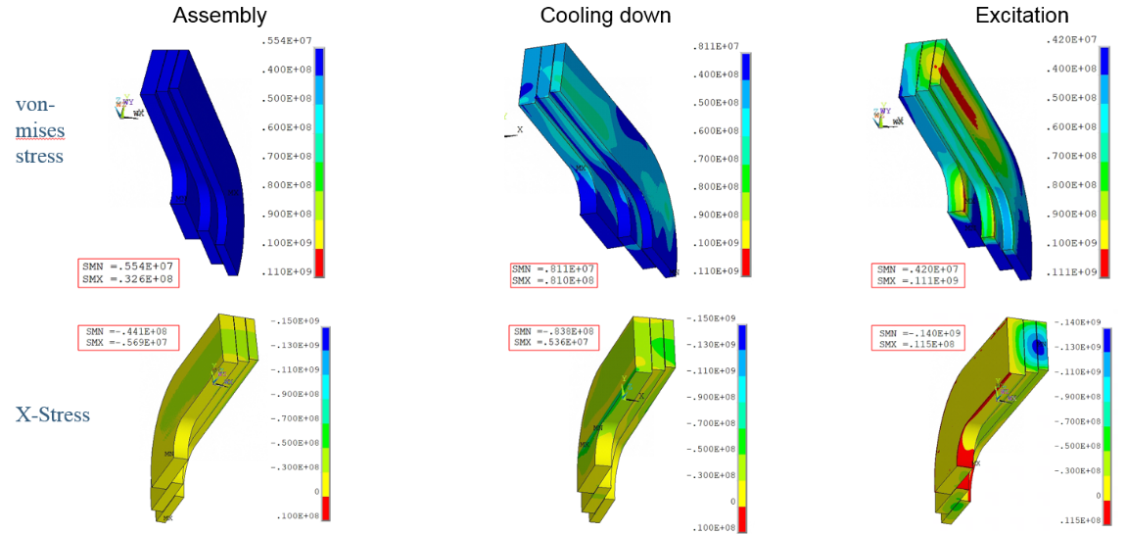
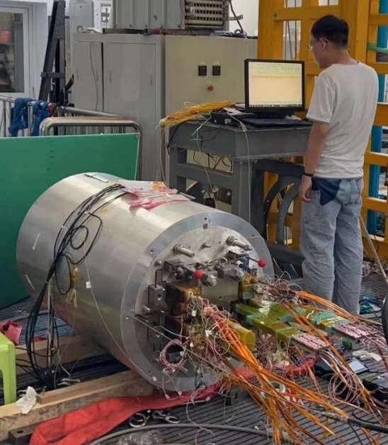
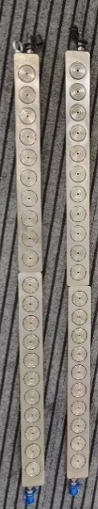


Development of the 16-T Model Dipole LPF3
Pre-stress and assembly of LPF3
Yingzhe Wang et al
Stress monitoring during
assembly with FBG
Pre-stress applied with commercial hydraulic jack
2023.8.29 Assembly completed

Slide 9




Development of the 16-T Model Dipole LPF3
Quench protection of LPF3
Jinrui Shi et al
Varistor plus CLIQ to protect the Nb₃Sn coils. The maximum hot spot is ~ 230 K
NI configuration plus dump resistor to protect the 2 HTS insert coils
Current decay curve at the operating current

Slide 10


Development of the 16-T Model Dipole LPF3
Performance test ongoing from Sep 2023
Wei Li et al
The Nb₃Sn coils were trained firstly, maximum current reached ~85% of I_{op} in Dec 2023, but showed an unstable plateau at 11 T due to one of the outmost Nb₃Sn coil, probably due to insufficient pre-stress during assembly
HTS block coil was ramped independently to 100% of I_{op} with negligible terminal voltage
55 mm 双孔径

Slide 11





Development of the 16-T Model Dipole LPF3
Reassembly of the magnet with enhanced pre-stress
Xin Chen et al
2024 年 1 月
应变片监测磁体组装、降温、励磁过程
光栅光纤监测磁体组装及测试过程

Slide 12



Development of the 16-T Model Dipole LPF3
The 2nd Performance test in Feb 2024
The Nb₃Sn coils showed very unstable performance in the 6300-7000 A region due to one of the inner most coils, but finally passed this region and reached ~87% of I_{op} in the beginning of March 2024
HTS block coil was ramped independently to 120% of I_{op} to test its ultimate performance, but one of the lead was damaged due to the quench.

Slide 13




Development of the 16-T Model Dipole LPF3
Accident in Mar 14 2024
The operator forgot to follow the most important step of the test manual: turn on the quench detection system, and powered the Nb₃Sn coils to high current directly. 2 of 6 Nb₃Sn coils were serious damaged during a quench
Plan for next months: establish a hardware interlock protection system, and re-fabricate 2 new Nb₃Sn coils and 2 HTS coils, to reach 16 T by the end of 2024

Slide 14


IBS Technology: Status and Outlook
90% Stainless-steel & 10% Sliver stabilized IBS tape achieved the highest J_{e} in 2022!
Significantly reduced the cost and raised the
mechanical properties.
IBS 2025
IBS 2022
IBS 2019
IBS 2016

Slide 15


IBS Technology: Status and Outlook
The First IBS Solenoid Coil at 32 T background field
Chunyan Li et al
I_{c} of Φ34mm-17 turns-DPC reached 60 A at 4.2 K and 32 T, world’s highest record up to now
2024 Supercond. Sci. Technol. 37 015001
Successfully fabricated double pancake coils and a series-connected coil consisting of six DP coils

Slide 16




IBS Technology: Status and Outlook
Quench propagation study of the IBS tapes and coils
Chunyan Li et al

Slide 17


IBS Technology: Status and Outlook
Quench propagation study of the IBS tapes and coils
Chunyan Li et al
In 15~17K, when the transmission current of iron-based superconductor is 14-179A, the corresponding NZPV value is 0.4– 7cm/s

Slide 18






IBS Technology: Status and Outlook
IBS solenoid at 32 T
Racetrack at 10 T
1.3 kA transposed cable
J_{e} > 450 A/mm²
@ 10 T, 4.2 K
100-m 7-core IBS tape fabricated
J_{e}= 100 A/mm²
@ 10 T, 4.2 K
Z. Zhao
IBS (T_{c} 55K)
2008.02
2008.04
2008.09
2016
2018
2020
2022
Discovery of IBS
Discovery of
122 phase IBS
IBS solenoid at 24 T
Racetrack at 8 T
J_{e}= 300 A/mm²
@ 10 T, 4.2 K
H. Hosono
IBS (T_{c} 26K)
J_{e} of IBS expected to be similar as ReBCO in 5 years with better mechanical properties and lower cost

Slide 19





Development of CCT Magnets for HL-LHC
Milestone of the HL-LHC CCT Magnet Project
Agreement signed
btw IHEP and CERN
The CCT magnet from China under test at CERN
Installation to tunnel
The qualified prototype delivered to CERN
All the 12 series CCT magnets delivered to CERN
HL-LHC commissioning

Slide 20





Development of CCT Magnets for HL-LHC
Successful design upgrade to solve the “long training problem”, significantly reduced the times of quench during training, ensured the project progress “on track”.

Slide 21







Training of MCBRD02 & MCBRD03
Development of CCT Magnets for HL-LHC
AP1(CB12，25 quenches 526A) reached ±422A after 11 quenches.
AP2(CB09, 33 quenches 530A; after thermal cycle ＞500A) reached ±422A without any quenches.

Slide 22


Training of MCBRD04
Development of CCT Magnets for HL-LHC
Satisfying performance at 4 K for both apertures, tested at IMP-CAS

Slide 23
Development of CCT Magnets for HL-LHC
4 series CCT magnets have been fabricated, successfully reached the design target and delivered to CERN
Components for 2 series magnets being shipped to CERN
Production rate for the rest of series magnets: every 3 month per magnet; to be completed by Oct 2025
 | Coil name | Winding method | Location | Coil stand-alone performance (4.2 K) | Magnet performance at 4.2 K
MCBRD01 | MCBRD_CB01 | Wet wind | CERN | 530 A | Both apertures reached ultimate current 422 A, and passed 4-hour stability test at 4.2 K
 | MCBRD_CB03 | Direct wind |  | 410 A (training stopped due to the availability of the test station)
 | MCBRD_CB02 | Direct wind | CERN | Failed to reach the design current
MCBRD02 | MCBRD_CB04 | Wet wind | CERN | 422 A (training stopped due to the availability of the test station) | Both apertures reached ultimate current 422 A, and passed 4*1 hour stability test at 4.2 K
 | MCBRD_CB06 | Wet wind |  | 530 A
MCBRD03 | MCBRD_CB09 | Direct wind with new channel size | CERN | 530 A | Both apertures reached ultimate current 422 A, and passed stability test at 4.2 K
 | MCBRD_CB12 | Direct wind with new channel size |  | 526 A (25 quenches)
 | MCBRD_CB14 | Direct wind with new channel size | BAMA | 530 A (30+34 quenches), put in quarantine
MCBRD04 | MCBRD_CB13 | Direct wind with new channel size | IMP | 530 A (20+33 quenches) | Both apertures reached ultimate current 422 A, and passed stability test at 4.2 K
 | MCBRD_CB17 | Direct wind with new channel size |  | 524 A (47 quenches)
MCBRD05 | MCBRD_CB18 | Direct wind with new channel size | IHEP | 530 A (43 quenches) | To be assembled
 | MCBRD_CB19 | Direct wind with new channel size | IHEP | 530 A (63 quenches)
 | MCBRD_CB20 | Direct wind with new channel size | IHEP | To be stand-alone tested
MCBRD_CB10, 11, 15, 16 |  | Shipped to CERN for fabrication

Slide 24
Summary
Long-term advanced superconducting magnet R&D for future high-energy accelerators is ongoing at IHEP-CAS
16 T (Nb₃Sn+HTS) model dipole has been fabricated at IHEP-CAS and under performance test at 4.2 K. Re-fabrication of damaged coils to be done in the next months，aiming to reach 16 T in 2024
Strong domestic collaboration for the advanced superconductor R&D (HTS & Nb₃Sn): Stainless-steel-Silver stabilized IBS tape achieved the highest J_{e} in 2022! Significantly reduced the cost and raised the mechanical properties
HL-LHC CCT magnets going well, to be installed in the tunnel in 2026
Thanks for your attention!

