Slide 1
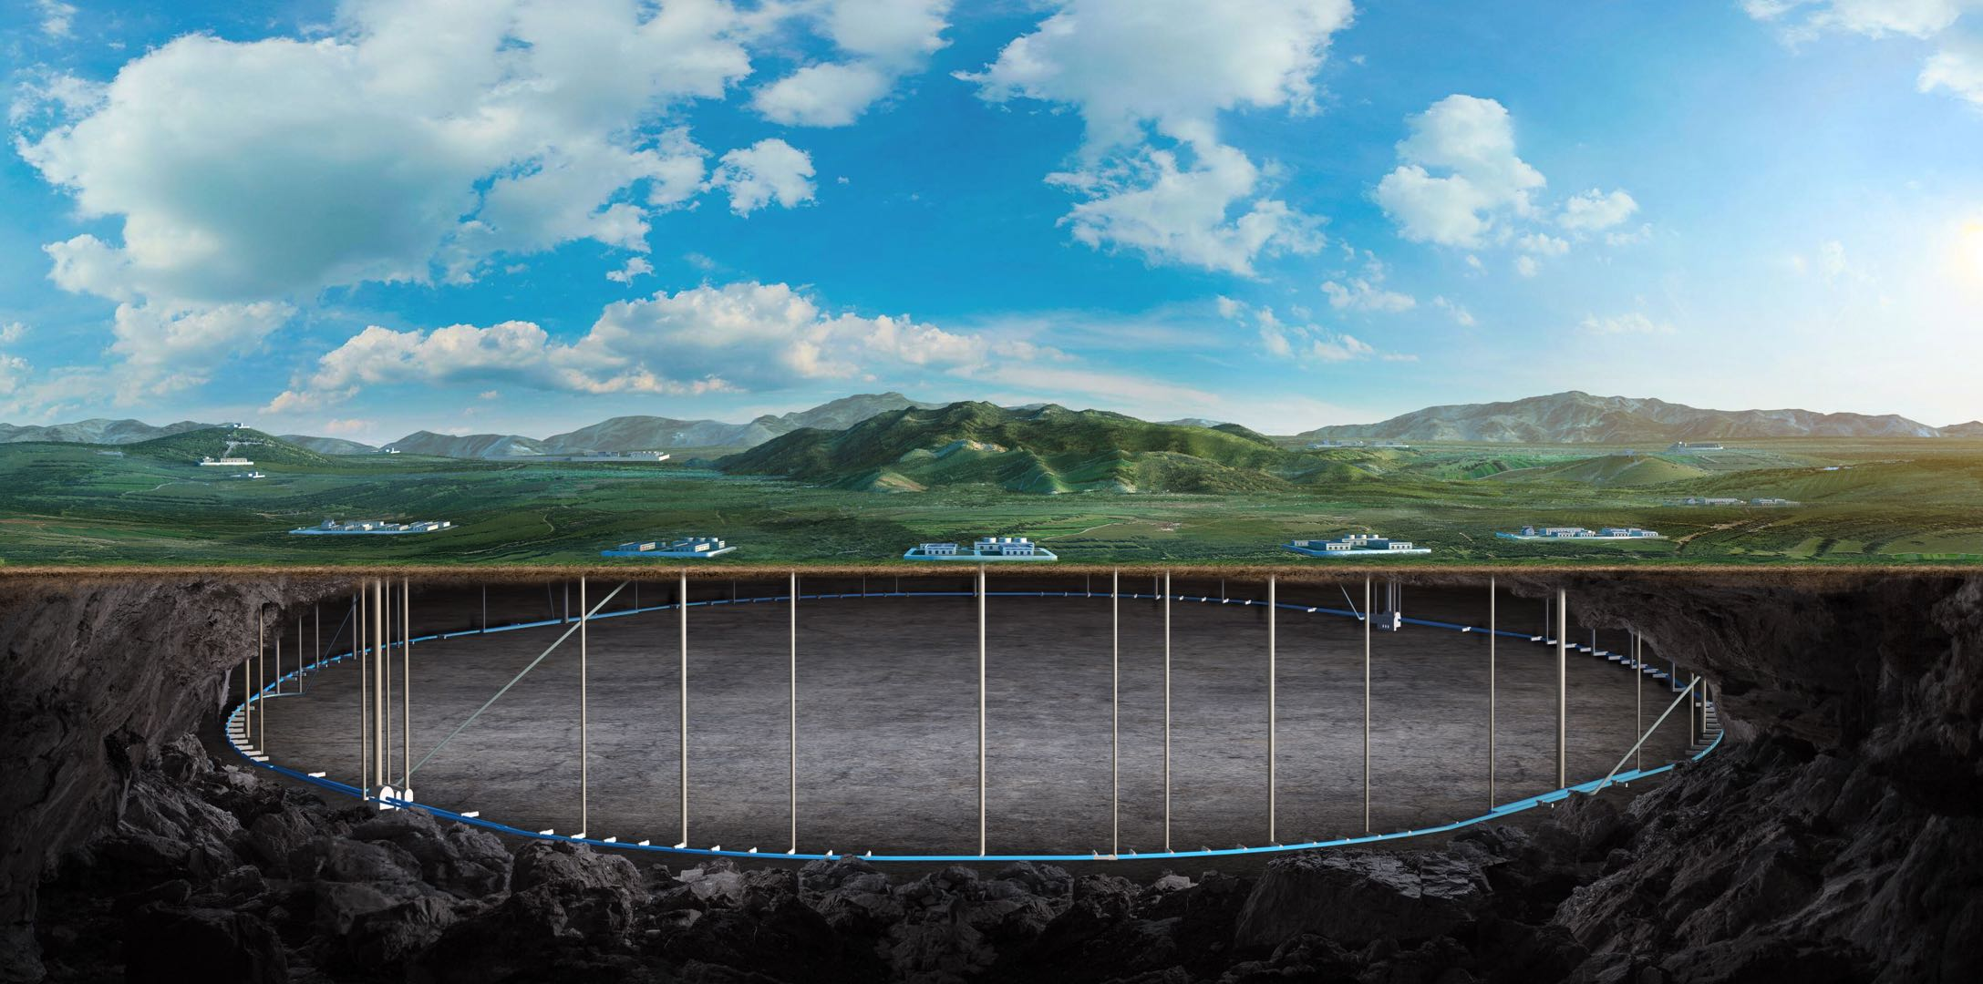
IHEP Beam driven plasma accelerator
and efficiency study
Prof. Wei Lu, Dr. Dazhang Li, et al. On behalf of the IHEP-THU-BNU AARG team
07-11 April 2024, Marseille, International workshop on CEPC (EU Edition)

Slide 2
Content
Plasma-based Linear Collider
CPI studies during TDR
IHEP PBA TF proposals and current status
Summaries and prospects

Slide 3
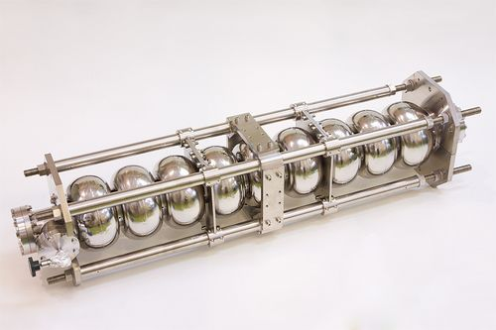
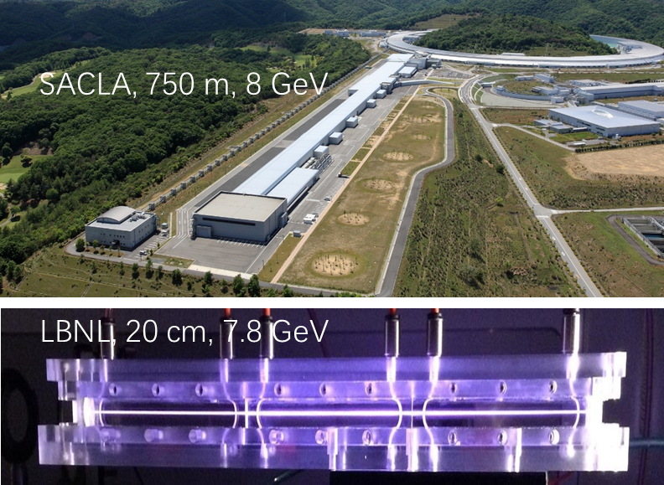
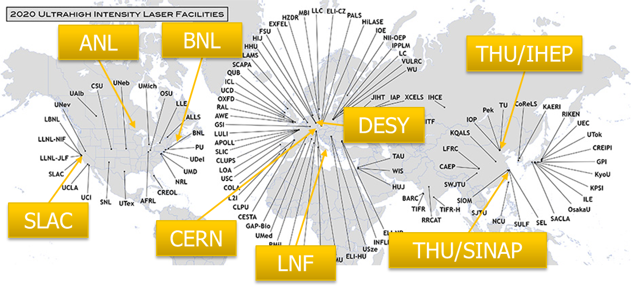
Plasma-based Accelerator
RF Cavity：< 100MeV/m
Driver:
High power laser → LWFA
High energy e- → PWFA
…………
PBA：1-100 GeV/m

Slide 4
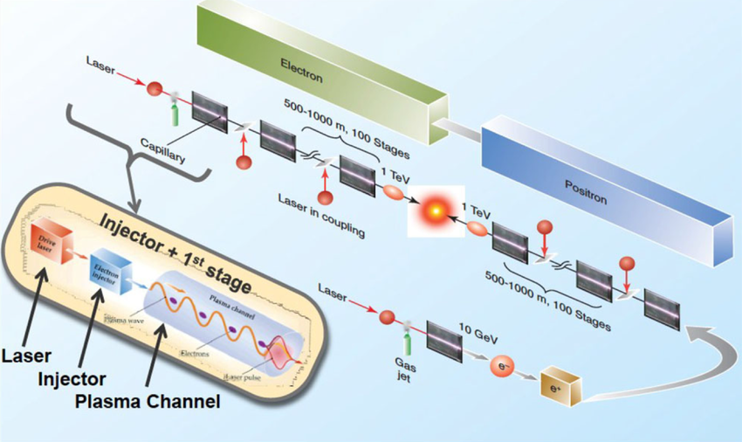
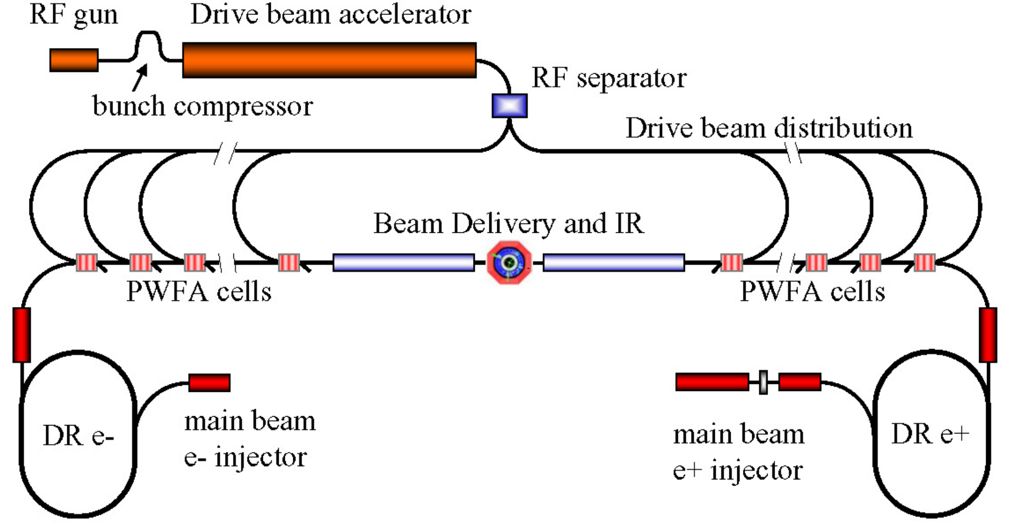
Conceptual design of LWFA/PWFA collider
LWFA collider conceptual design
PWFA collider conceptual design
Ultimate goal for PBA: to build a much cheaper, more compact and green collider
These two conceptual designs were presented ~ 2010, not updated for 15 years
Significant progress has been achieved, while some key issues still need be addressed
Parameters upgrade → Stability improve → application attempts → cost & power optimization

Slide 5
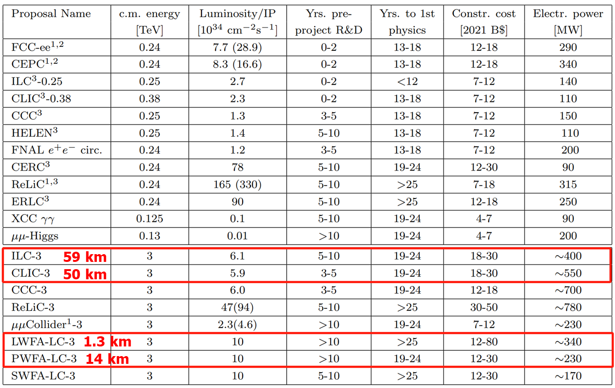
Conceptual design of LWFA/PWFA collider
Size:
LWFA LC << PWFA LC << LC
But NOT 1000 times smaller
Power consumption
In principle, PBA LC < LC, smaller size means smaller vacuum, magnet, SC ……
PWFA LC < LWFA LC, due to higher η_{wall plug→driver} and η_{driver→trailer} efficiency
PBA’s estimation is not accurate compared with conventional LC. How to estimate?
Construction
PBA’s cost is in a big range due to technique uncertainty
May not be ready for colliders in next 20 yrs
A 5~10 year mid-step: an injector for a real machine Vs. a 5-10-100 GeV PBA module

Slide 6
Content
Plasma-based Linear Collider
CPI studies during TDR
IHEP PBA TF proposals and current status
Summaries and prospects

Slide 7
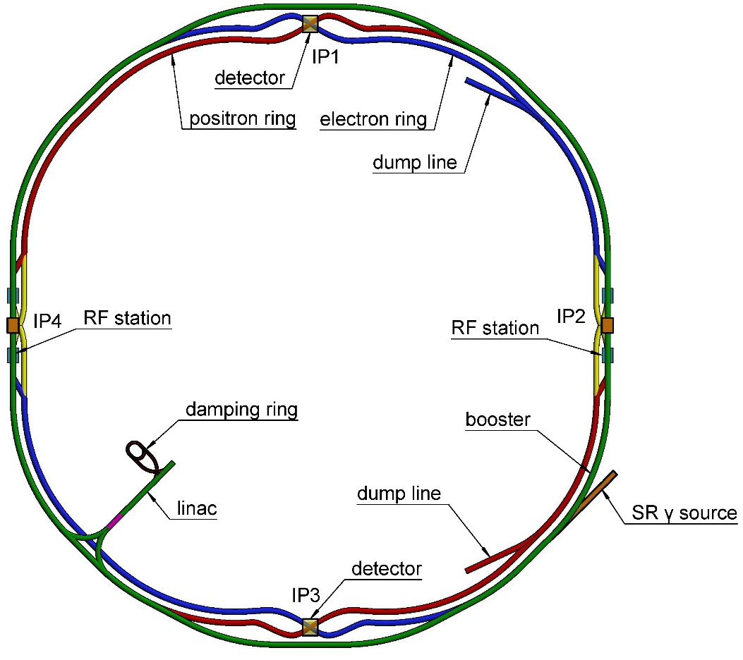
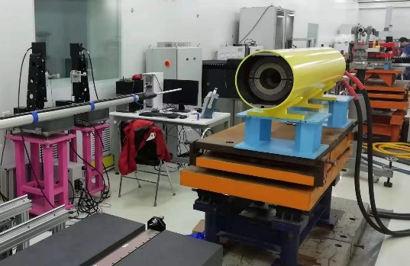
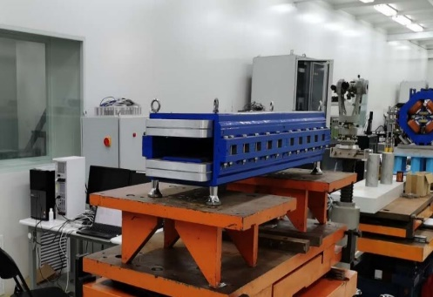
CEPC Plasma Injector (CPI)
10 GeV e-/e+ beam in a 100 km ring
Minimum magnetic field = 28 Gs
Field error < 28 Gs*0.1% = 0.028 Gs
Field reproducibility < 29 Gs*0.05% = 0.014 Gs
The Earth field ~ 0.2-0.5 Gs, the remnant field of silicon steel lamination ~ 4-6 Gs.
Plasma Injector
10 GeV
Linac
100 km
Booster
Collider
Rings
10 GeV linac + CT coil magnet, or 30 GeV linac + iron-core magnet ? Both lead to significant cost rise ~ 1 B RMB

Slide 8
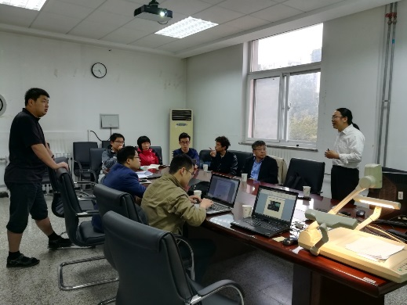
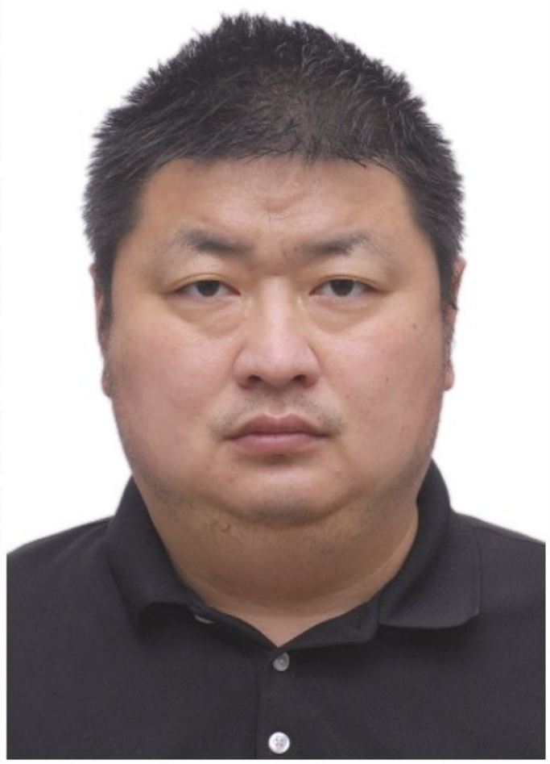
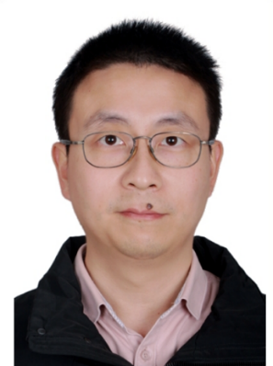
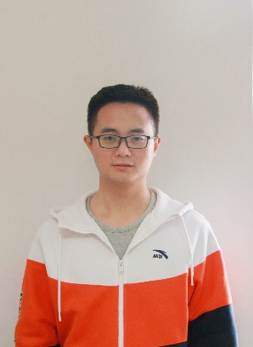
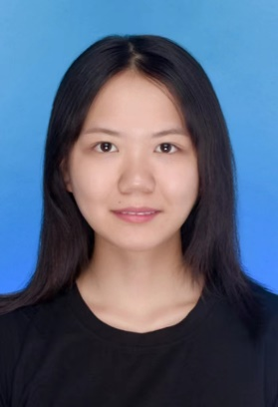
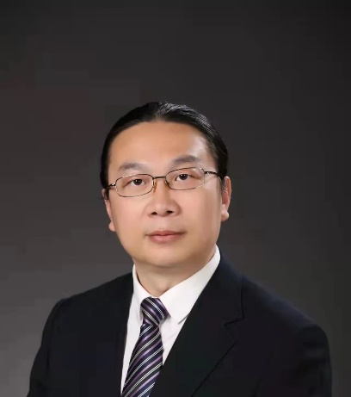
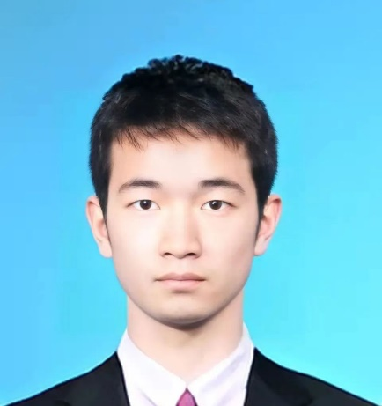
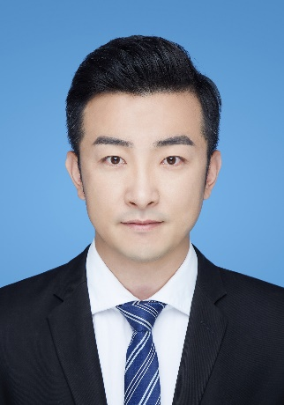
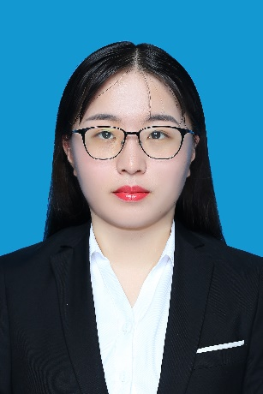
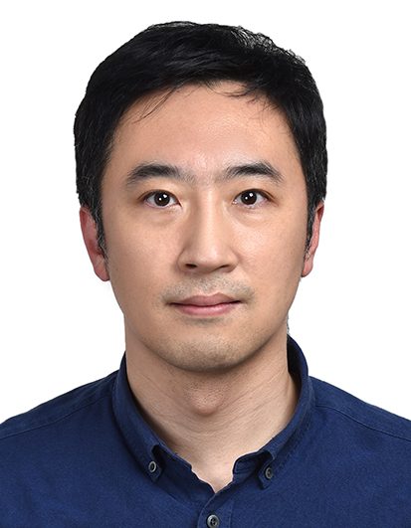
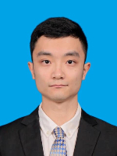
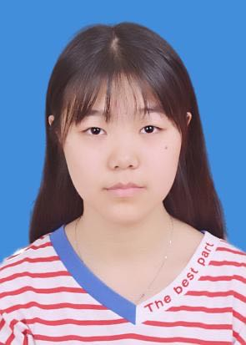
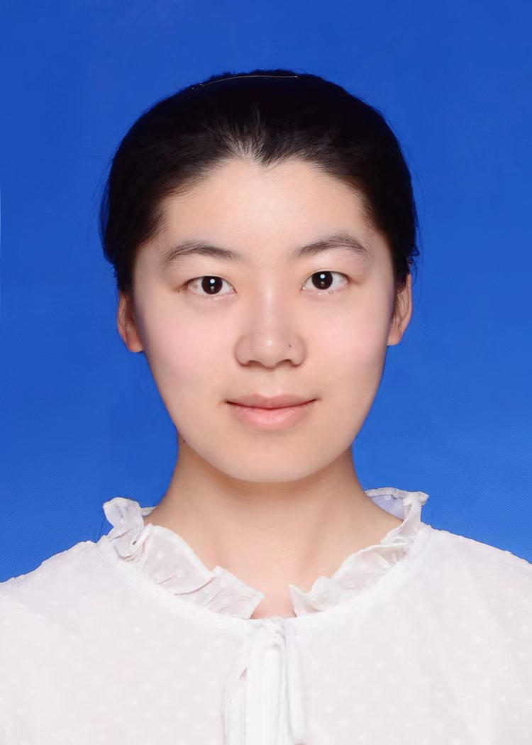
Collaborated team on CPI since 2017
Proposed by Prof. Gao and Prof. Lu on 2017.01
First collaborated group meeting on 2017. 03
Till now, IHEP+THU+BNU, 15+ staffs and 20+ PhDs

Slide 9
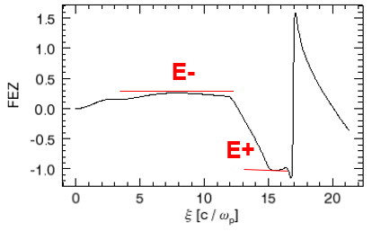
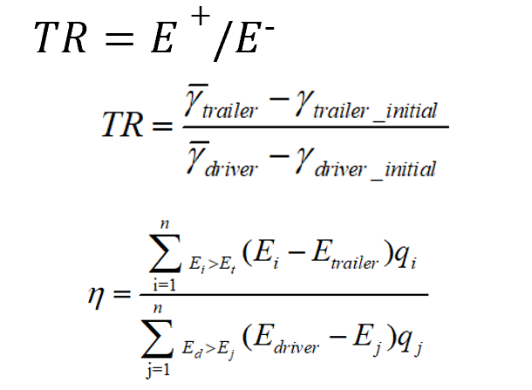
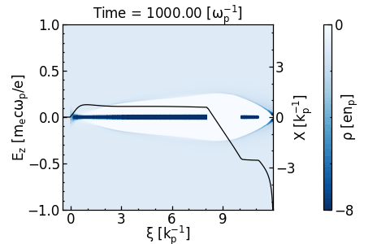
Electron PWFA for TR ≥ 3.5
beam | Driver | Trailer
$${plasma density n}_{p} \left(×1016cm^{−3}\right)$$ | $$0.50334$$
Driver energy $E$ ($GeV$) | 10 | 10
Normalized emittance $ε_{n}(mm mrad)$ | 20 | 100
Length (u$m$) | 600 | 77
(matched) Spot size(u$m$) | 3.89 | 8.65
Charge (nC) | 5.8 | 0.84
Beam distance (u$m$) | 149
Accelerating distance (m) | 10.65
Trailer energy $E$($GeV$) | 45.5
Normalized emittance $ε_{n}(mm mrad)$ | 98.44
Charge(nC) | 0.84
Energy spread $δ_{E}(\%)$ | 0.56
Efficiency (%) (driver → trailer) | 59.1
V2.0 TR≥3.5
The noise is over estimated because the simulation particle number is much smaller than real particle number
ideal case
non-ideal case
For CPI V1.0 and V2.0
TR ≥ (45.5-10)/10=3.55

Slide 10
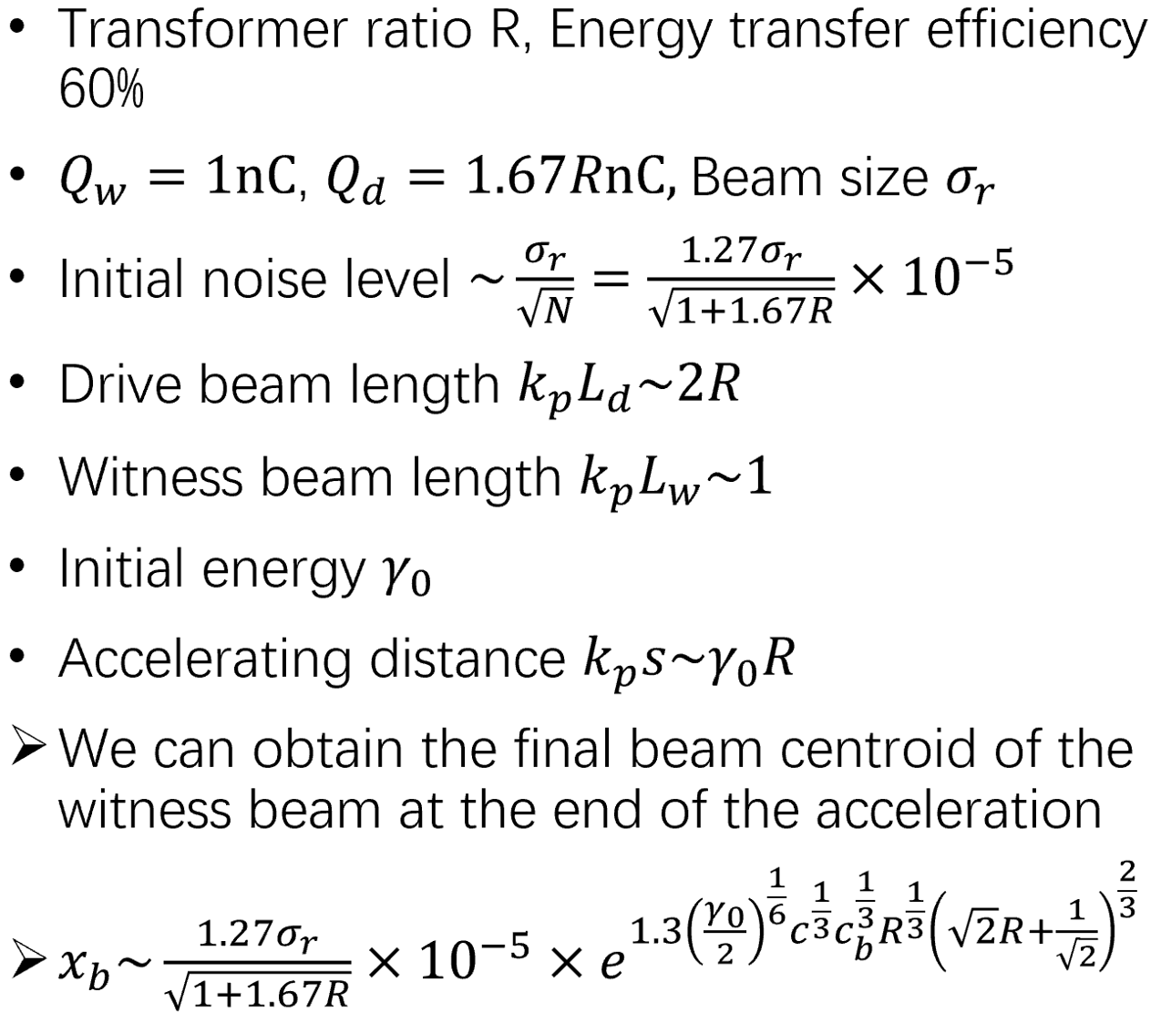
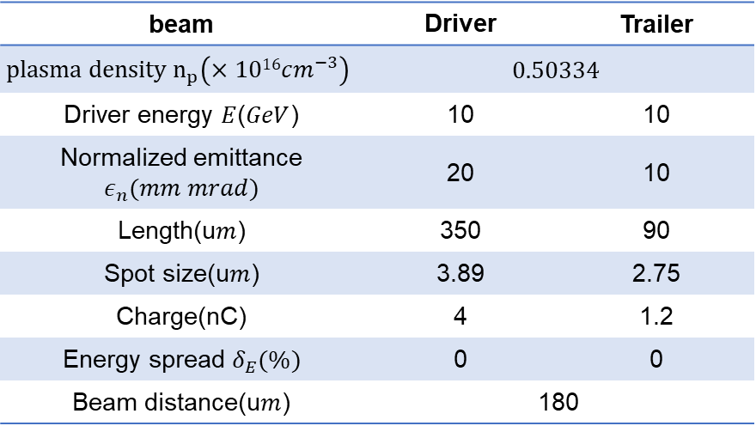
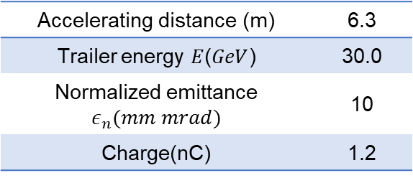
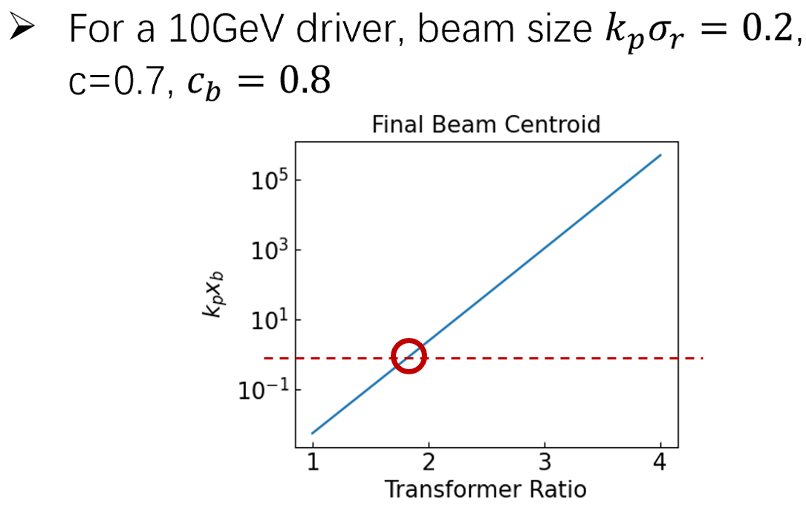
Electron PWFA for TR ~ 2
CEPC injector’s baseline was changed: 10 GeV → 30 GeV → TR ≥ 2
Ion motion can significantly decrease the hosing instability
TR ≤ 1.8 seems acceptable ($x_{b}<1$) if no extra damping mechanism is adopted.

Slide 11
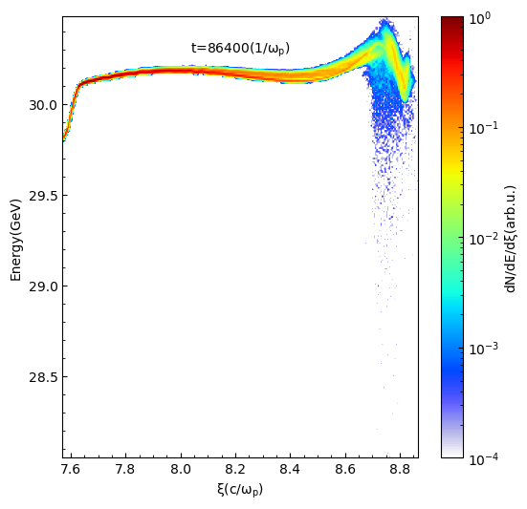
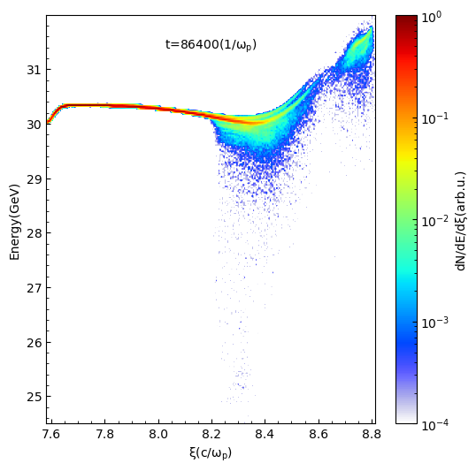
Preliminary error tolerance analysis
trailer
offset_x
driver
Offset (x direction) | 4 μm | 12 μm | 20 μm | 30 μm
Bunch charge [nC] | 1.197 | 1.197 | 1.174 | 1.079
Energy [GeV] | 30.01 | 30.04 | 30.16 | 30.37
RMS energy spread | 0.43 | 0.41 | 0.22 | 0.72
offset_x =20μm
θ
driver
trailer
Tilt angle | 10 μrad | 100 μrad | 1 mrad
Bunch charge [nC] | 1.197 | 1.197 | 0.903
Energy [GeV] | 30.01 | 30.01 | 30.24
RMS energy spread | 0.41 | 0.41 | 0.65
tilt angle =1 mrad

Slide 12
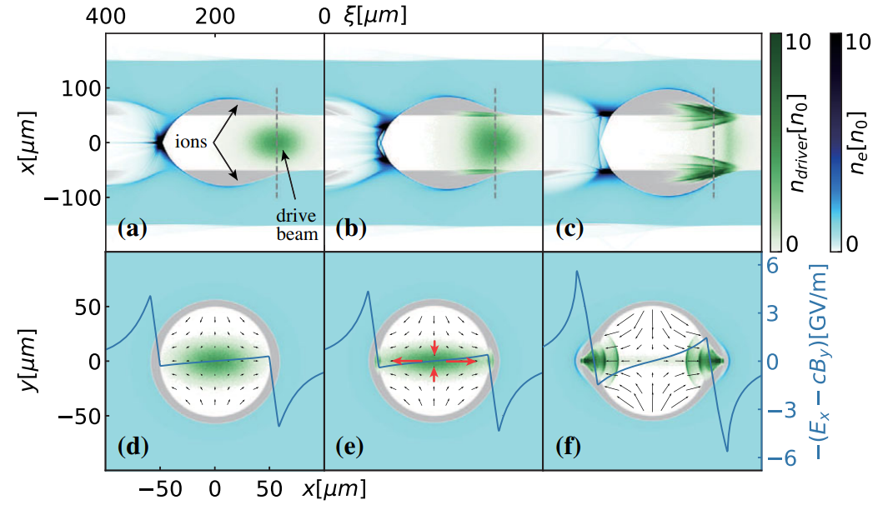
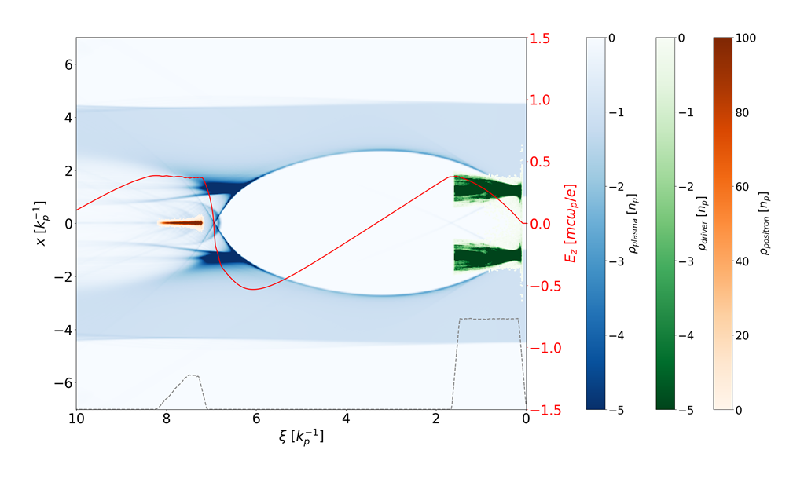
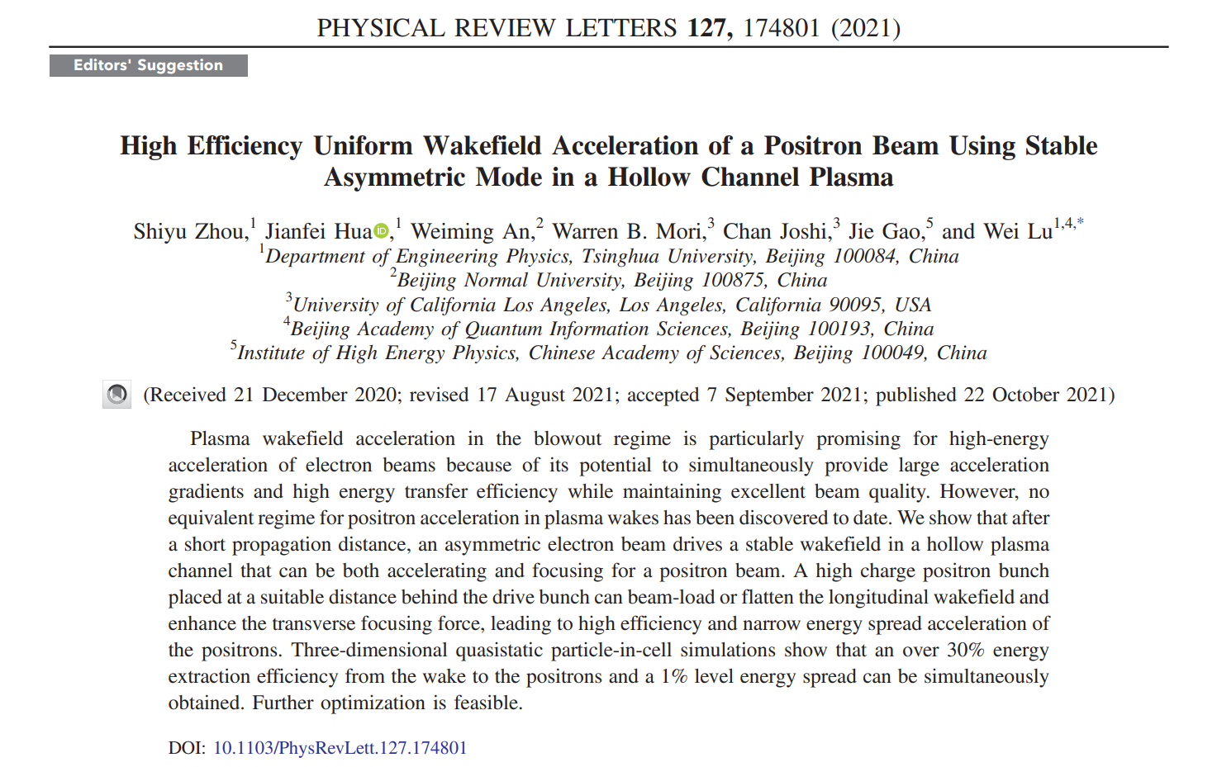
e+ PWFA in TDR: asymmetric electron driver

Slide 13
e+ PWFA in TDR: high quality
Plasma parameters
Density (cm⁻³) | 1.133e15
Inner radius ($μm$) | 158
Outer radius ($μm$) | 711
Beam parameters | Driver | Trailer
Charge ($nC$) | 6.45 | 1.1
Energy (GeV) | 30 | 3
Transverse size (μm) | 32 | 6
Normalized emittance $ε_{n}$(mm⋅mrad) | 32 | 16
Length (μm) | 237 | 153
Energy spread $δ_{E}$(%) | 0 | 0
Beam longitudinal distance (μm) | 885
Positron beam parameters
Charge (nC) | 1.1
Energy (GeV) | 30.1
Normalized emittance $ε_{n}$ (mm⋅mrad) | 41.6 (x)
 | 18.7 (y)
Energy spread $δ_{E}$(%) | 0.68
Acceleration properties
Acceleration length (m) | 20.8
Acceleration gradient (GV/m) | 1.3
Beam loading efficiency (%) | 22.6

Slide 14
e+ PWFA in TDR: Energy compression
Parameter | Symbol | Unit | Value
Beam charge | Q_{e+} | nC | 1.1
Beam energy | E_{e+} | GeV | 30.1
Energy spread | σ_{e} | % | 0.68
Emittance | ε_{n} | mm·mrad | 151(x) / 35.1(y)
Bunch length | σ_{l} | mm | 0.322(rms)
Peak Current | I | kA | 0.647
Parameter | Symbol | Unit | Value
Beam Charge | Q_{e+} | nC | 1.05
Beam energy | E_{e+} | GeV | 30.0
Energy spread | σ_{e} | % | 0.156
Emittance | ε_{n} | mm·mrad | 131 (x) 76.2 (y)

Slide 15
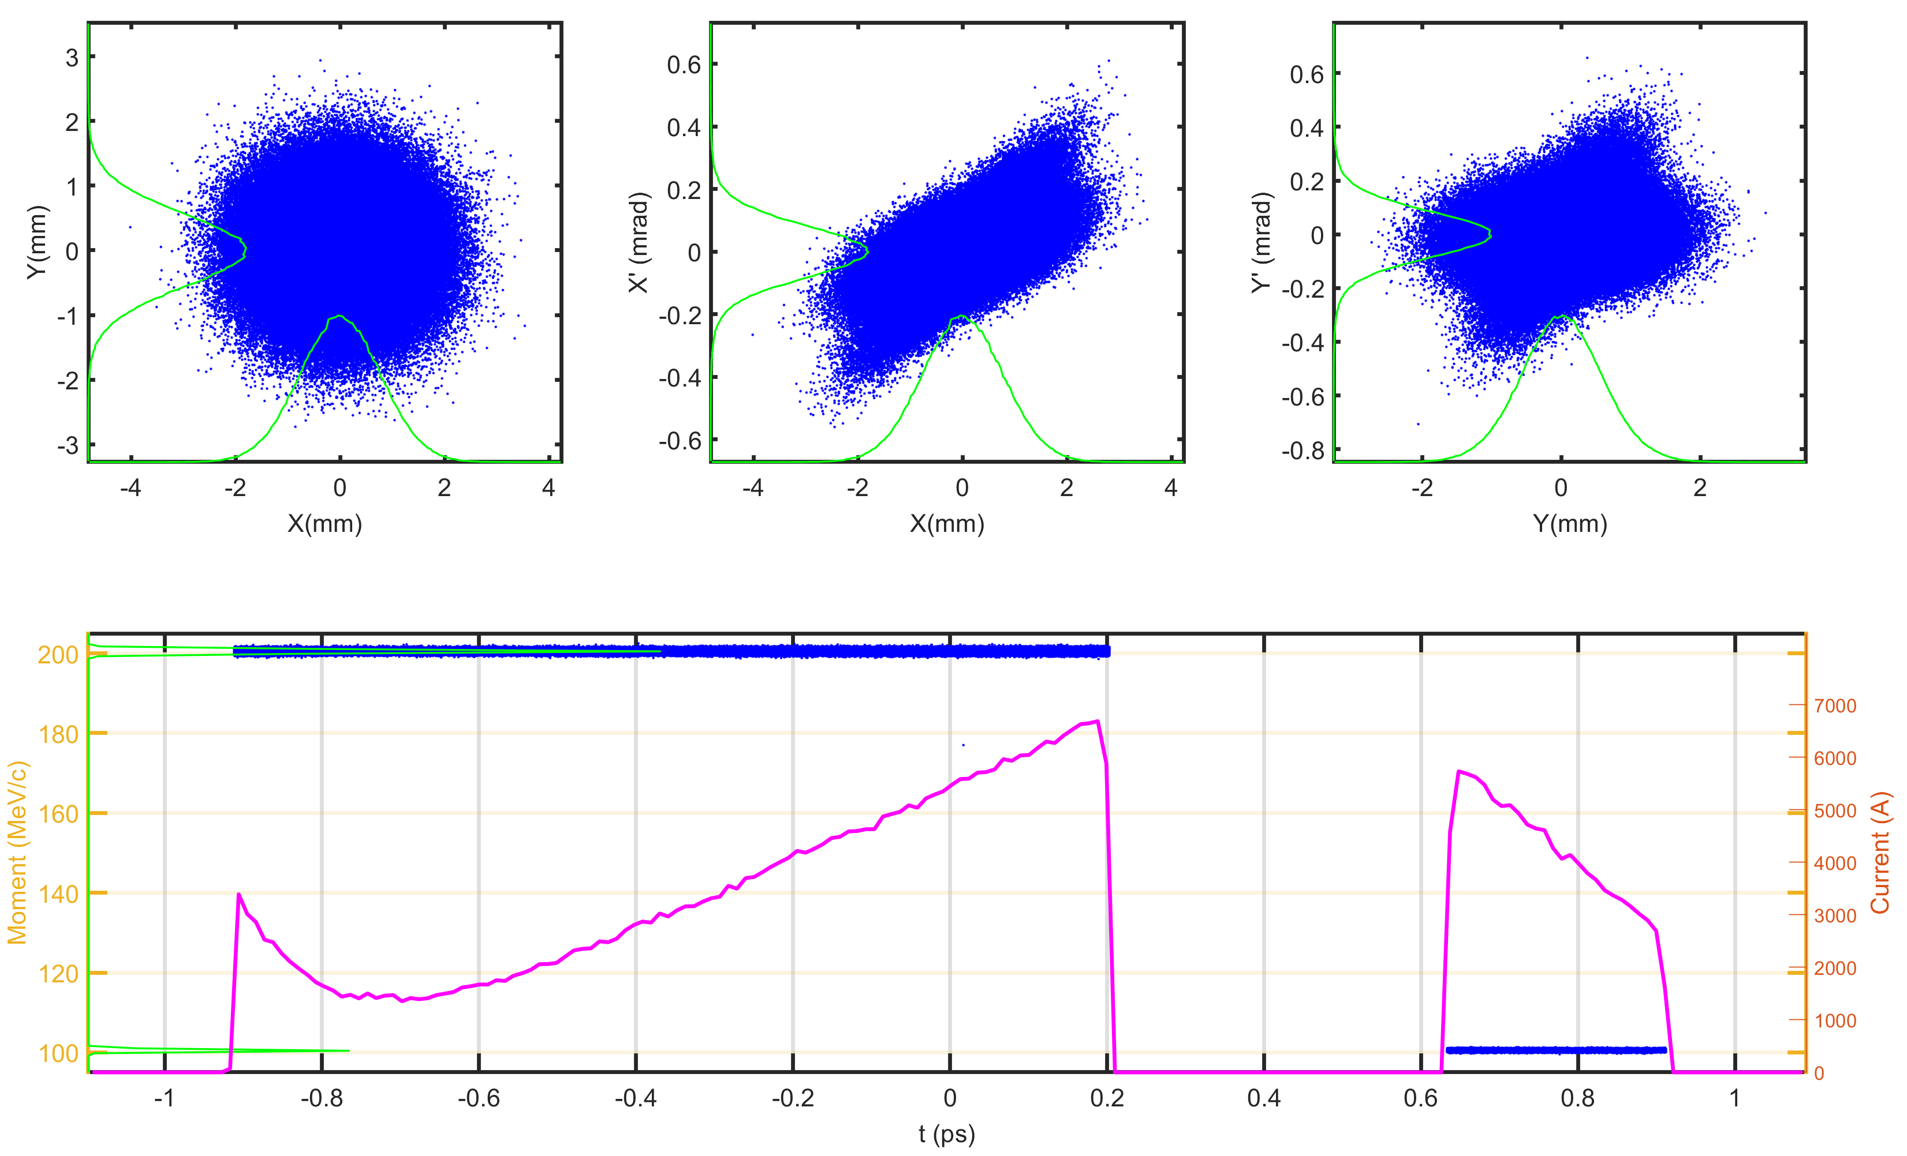
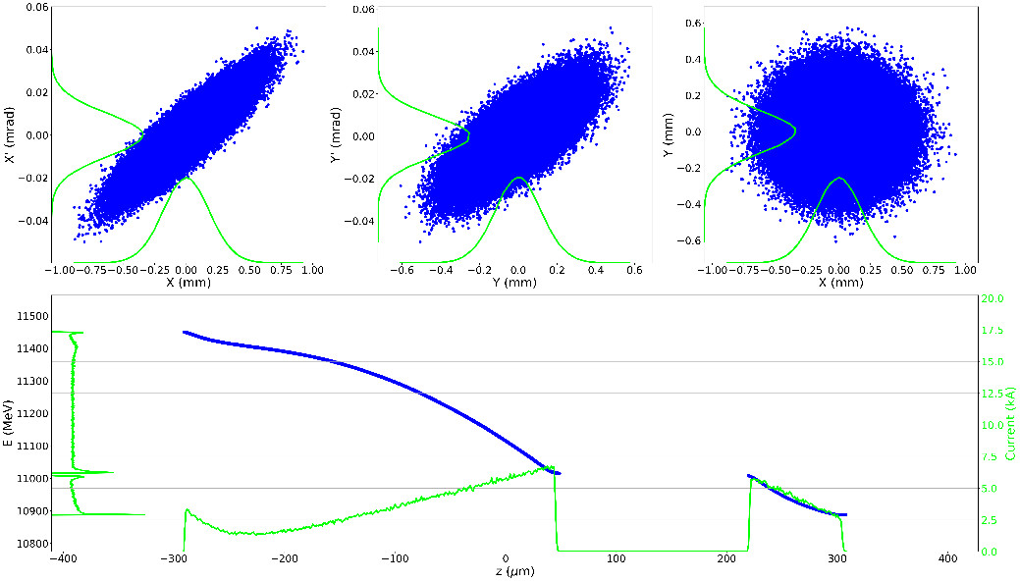
Linac (e- driver) design & optimization for CPI
Parameter | Driver | Trailer | Total
Energy E (GeV) | 11.23 | 10.94 | 11.16
Normalized emittance $ε_{n}$ (mm-mrad) (H/V) | 20.6/20.2 | 10.6/10.2 | 18.8/18.0
Bunch length (μm) | 339.9 | 88.9 | 599.2
Beam size (μm) (H/V) | 192/132 | 178/97 | 189/124
Charge (nC) | 3.87 | 1.19 | 5.06
Energy spread | 1.14% | 0.34% | 1.5%
Beam distance (μm) | 170.4 |  | /

Slide 16
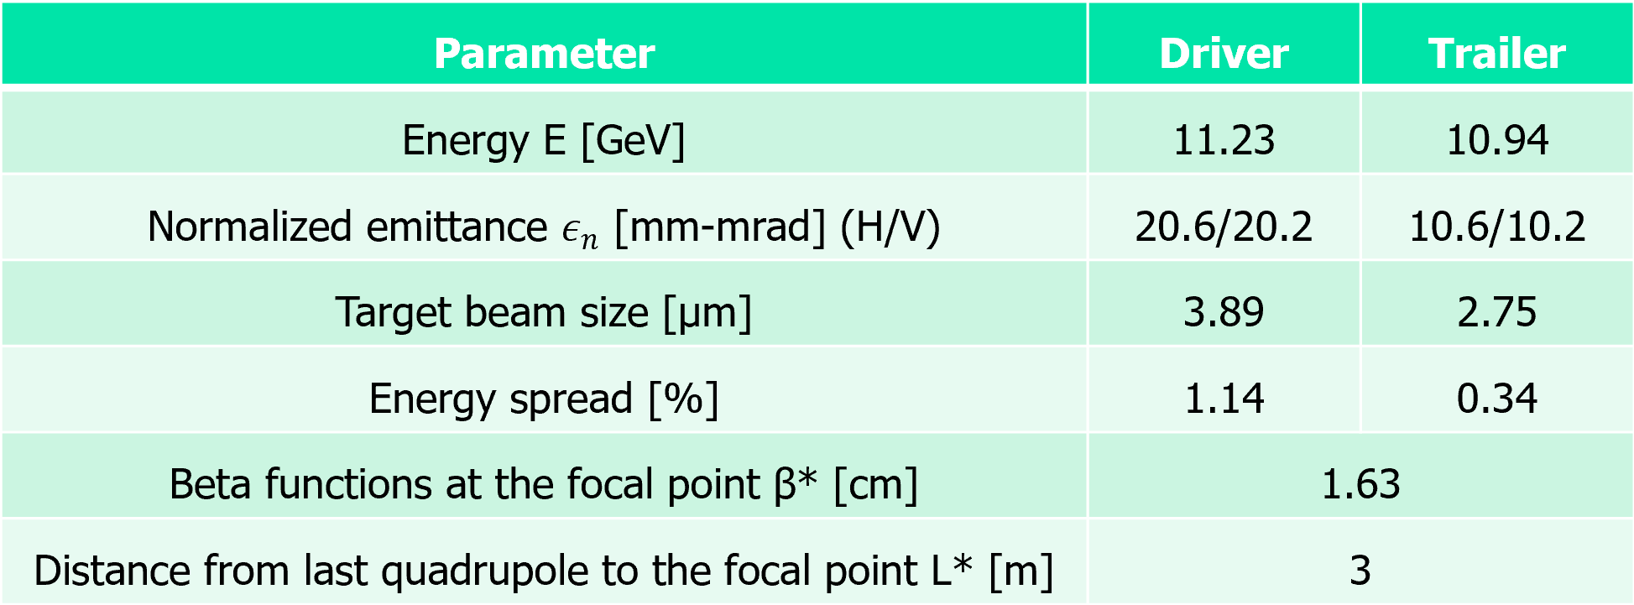
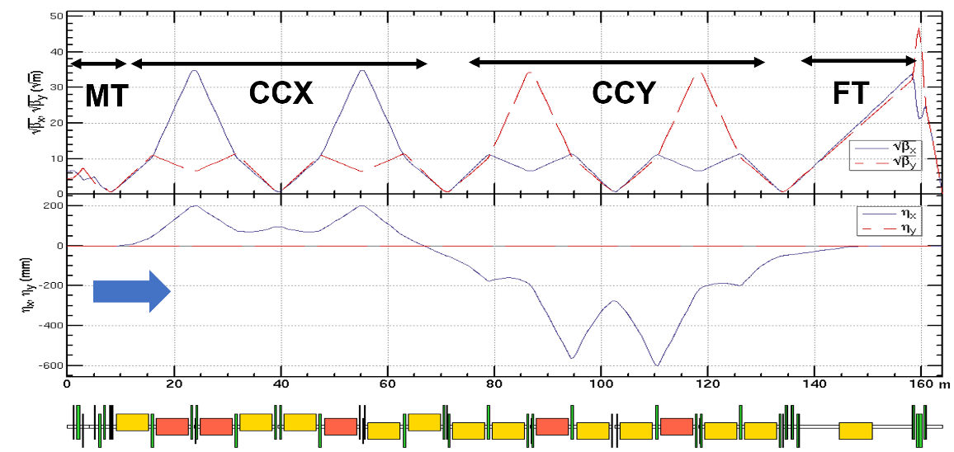
Final Focus design & optimization for CPI
Driver’s transverse emittance need further optimization. Plasma matching section as in e+ PWFA can be helpful

Slide 17
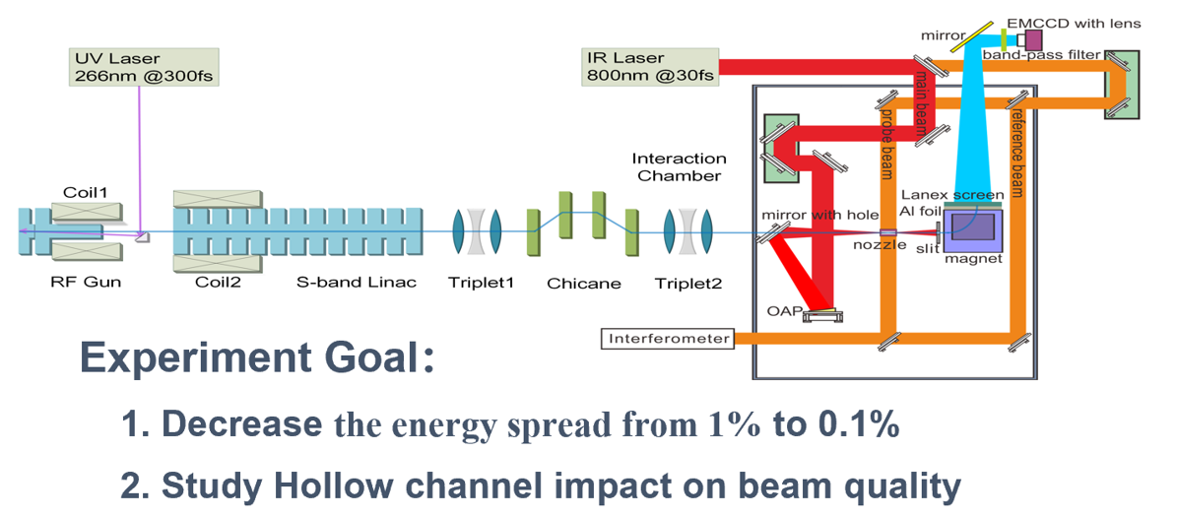
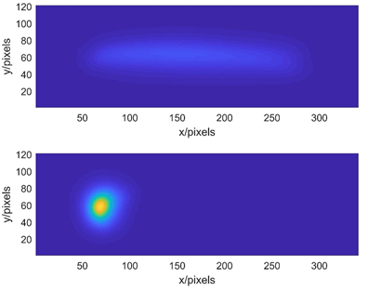
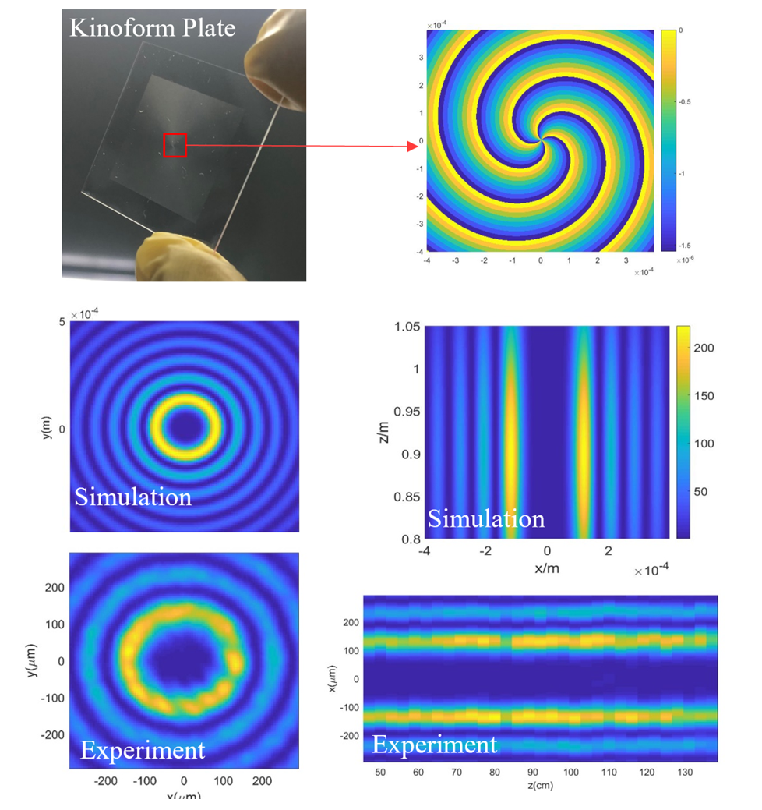
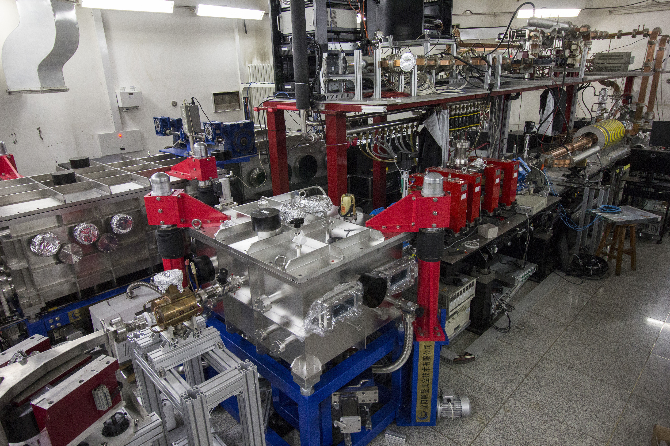
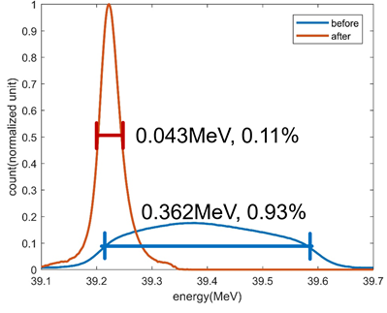
Energy compression with plasma dechirper
RF gun
Chicane
S-band
linac
Compressor
beam
Interaction
chamber
Deflecting
cavity
Dipole
Yipeng, Wu et al., PRL 122 204804 (2019); Dr. Shuang Liu’s PhD Thesis (2020)

Slide 18
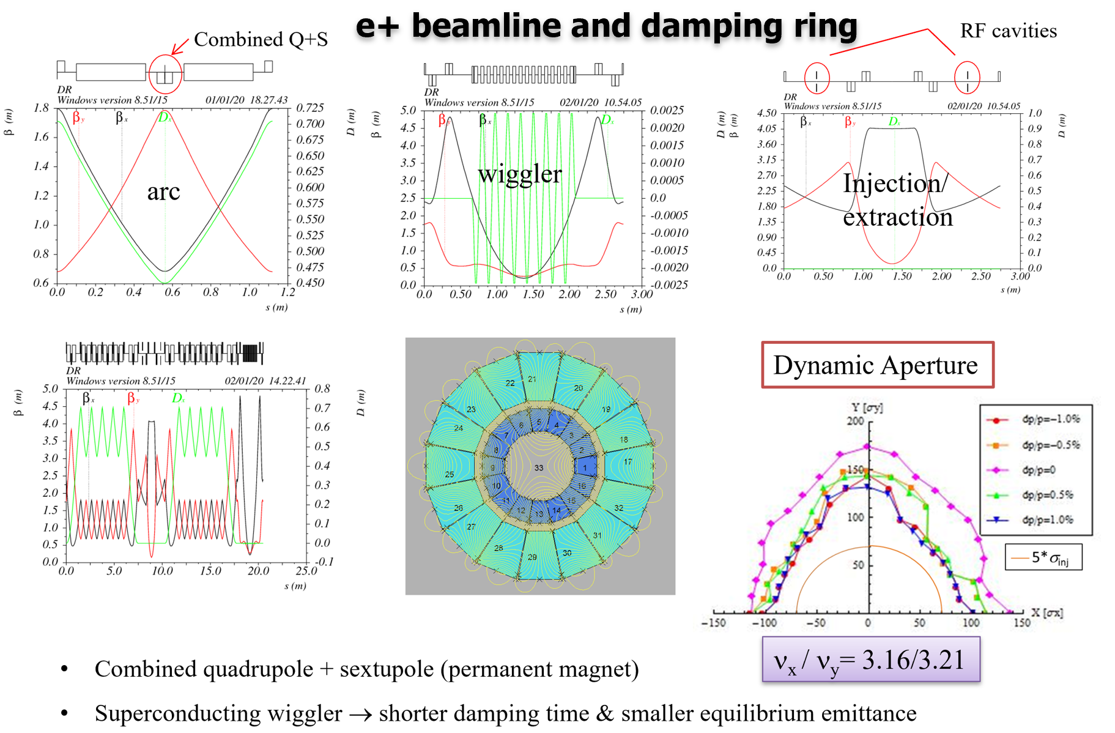
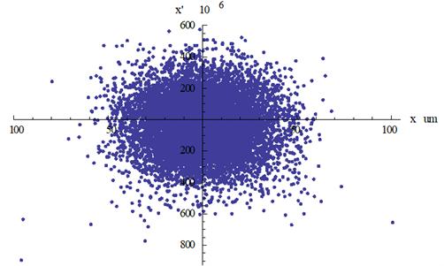
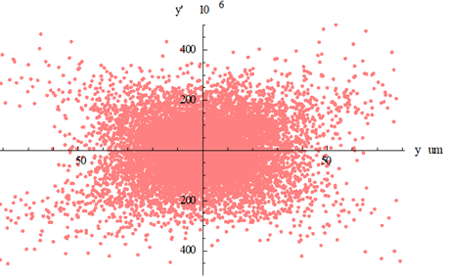
e+ beamline design & optimization for CPI
 | BCI | BCII | BCIII
Initial energy (MeV) | 400 | 400.1 | 405
δinj (%) | 0.054 | 0.367 | 2.17
Initial σz (mm) | 4.4 | 600 | 100
f_{RF} (GHz) | 2.860 | 5.712 | 5.712
Voltage(GV) | 0.0056 | 0.12 | 4.18
Gradient (MV/m) | 20 | 40 | 40
L (m) | 0.28 | 3 | 104
φ_{RF} (degree) | 89 | 88 | 61.5
R₅₆ (mm) | 1200 | 27.6 | 5.5
Final energy(MeV) | 400.1 | 405 | 2400
δext (%) | 0.367 | 2.17 | 1.83
final σz (μm) | 600 | 100 | 20
Beam distribution @ FF (~20μm）

Slide 19
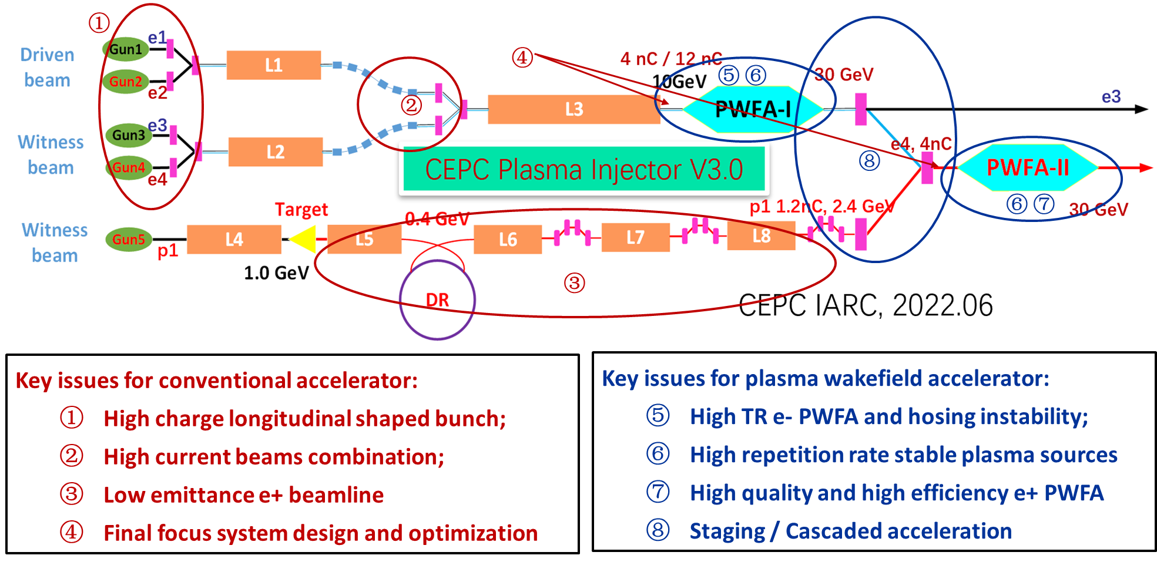
Key issues need to be addressed

Slide 20
Content
Plasma-based Linear Collider
CPI studies during TDR
IHEP PBA TF proposals and current status
Summaries and prospects

Slide 21
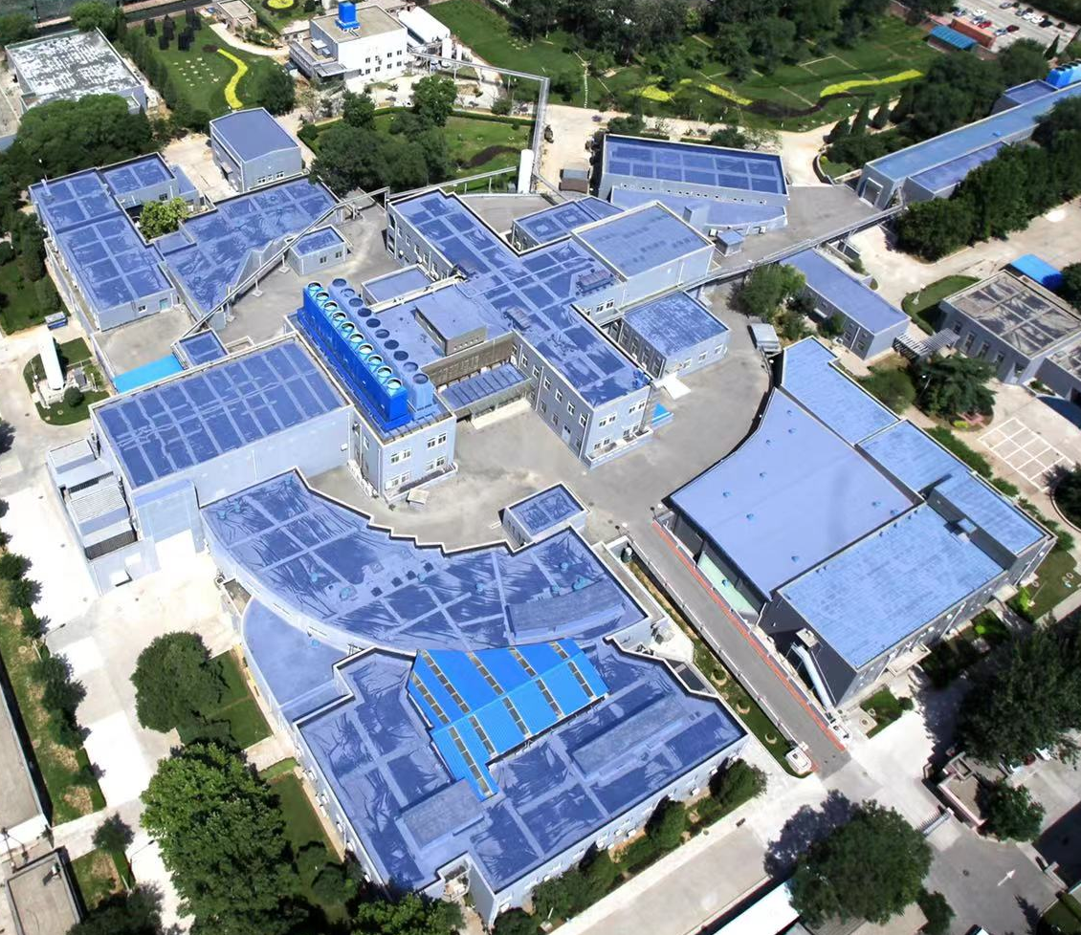
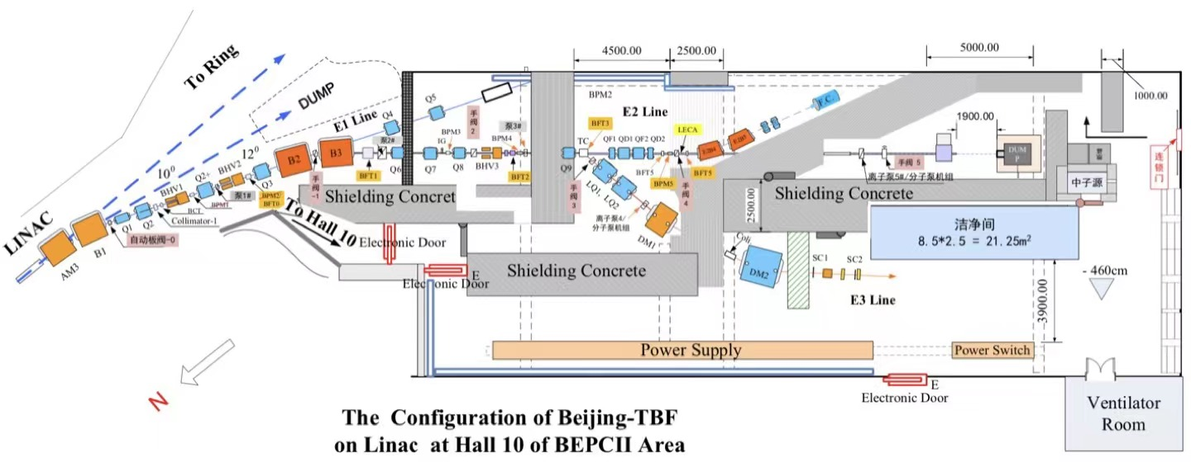
Hall 10 @ IHEP used for detector calibration
2023.12.03

Slide 22
BEPCII-based PWFA TF design V1.0
~ 661 MeV
e- gun
e+ target, ~240 MeV
PWFA lab
束流中心
Diagnostics
2.5 GeV e-/e+ beamline + PW-level high performance laser system

Slide 23
BEPCII-based PWFA TF design V2.0

Slide 24
BEPCII-based PWFA TF design V2.0
2024.03.24

Slide 25
BEPCII-based PWFA TF design V2.0
L-band e- Gun (> 5 nC): ~ CPI requirement
Beams combination: similar to CPI
High quality e+ beam: NO
Final Focus: even harder than CPI
HTR e- acc.: easier than CPI (~CPI @ SXFEL)
High rep. rate plasma source: > CPI
e+ PWFA acc.: 1st exp. result, < CPI
Cascaded/staging: 1st exp. result, < CPI

Slide 26
Budget & timetable of BEPCII-based PWFA TF
2023.10-2024.03: Clear Hall 10
2024.05-2024.10: Construction and re-decoration
2024.07-2024.10: Install BL-I (outside hall 10)
2024.11-2025.06: Install BL-I (inside hall 10)
2025.02-2025.08: Install PW Laser system
2025.07-2025.12: Install BL-II
2026.01-2026.06: Beam and laser commissioning
Since 2026.06: PBA experiments
~ 10 million €

Slide 27
PBA TF based on LPA + Storage Ring @ HN
L-band e- Gun (> 5 nC): NO
Beams combination: → beam manipulation
High quality e+ beam: similar to CPI
Final Focus: NO
HTR e- acc.: NO
Plasma source: ~ CPI
e+ PWFA acc.: ~ CPI
Cascaded/staging: NO

Slide 28
Budget & timetable of PBA TF @ HN
The total budget is 10-15 million € from Henan Province
2024.01-2024.12: Lab construction (2024.4.24, opening ceremony)
2024.01-2024.06: Overall design for both LPA, transport line and SR
2025.01-2025.06: Laser system installation and LPA experiments
2025.07-2025.12: Accelerator installation
2026.01-2026.06: Laser and beam commissioning
2026.07-2027.06: LPA injector experiments and SR light source optimization
2027.07- : Polarization and other novel accelerator physics / techniques studies

Slide 29
Content
Plasma-based Linear Collider
CPI studies during TDR
IHEP PBA TF proposals and current status
Summaries and prospects

Slide 30
Summary and prospect
Conceptual design of CPI has been carried out since 2017
A series of simulation progress has been made during the last 5-6 years
We’ll focus on the TF construction in the next 2-3 years
Linac + PWFA (Beijing) and LPA + Ring (Henan), totally complementary
Not only PBA TF, but also accelerator physics / technique
Test the CPI feasibility on these 2 TFs and push PBA to a real machine
Thank you!

Slide 31
Conceptual design for a dedicated PWFA TF
Lower energy for lower cost
Total Budget: ≥ 300,000,000 RMB
PWFA-based FEL
high charge, longitudinal shaped
High resolution beam/field diagnostics
accumulate, compress and damping e+

