Slide 1
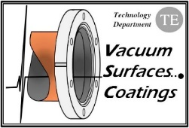
Vacuum Issues in Circular e⁻e⁺ Colliders
R. Kersevan – CERN-TE_VSC
EU Edition Int. Workshop CEPC, Marseille, France, 8-11 April 2024

Slide 2
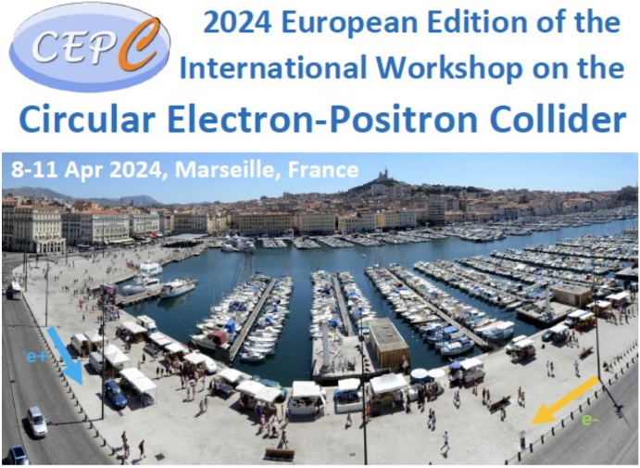
OUTLINE
Circular e-e+ colliders
Synchrotron Radiation
SR-induced desorption
Vacuum chamber geometry, and related issues
Arcs and MDI
Full-energy booster
Dynamic vacuum conditioning
R&D for FCC-ee
Conclusions

Slide 3
low-energy/low current
low-energy/high current
medium-energy/high current
High-energy/low current
High-energy/high current
ep colliders/high current
Circular e-e+Colliders
(partial list, only most recent/modern ones)
VEPPxx Novosibirsk (RU)
BEPC (BEPCII-U) Beijing (CN)
DAFNE Frascati (IT)
CESR Cornell Univ. Ithaca NY (USA)
B-Factory SLAC, Menlo Park CA (USA
KEK-B (SUPERKEKB) Tsukuba (JPN)
LEP CERN, Geneva (CH)
FCC-ee CERN, Geneva (CH)
CEPC China
EIC BNL, Upton NY (USA)
HERA Hamburg (DE)

Slide 4
2. Synchrotron Radiation
A common feature of all the colliders shown above is the presence of intense SR fans
For the vacuum scientist SR is a hindrance, since it is associated to photon-stimulated desorption (PSD), generation of photo-electrons (PE) and ions, and associated beam-loss/beam-degradation effects (e.g. electron-cloud, ion-trapping, HOM trapping, increase of impedance)
In particular, for the high-energy colliders (starting already at the injection energy in the full-energy booster) the critical energy ε_{crit} of the SR can be high, 10s of keV and more
As the beam energy goes above the Z-pole, 45.6 GeV, the associated ε_{crit} from the normal arc dipoles reaches above the Compton edge of common vacuum chamber materials (~100 keV for Al)
In addition to high-energy both the proposed CEPC and FCC-ee will have high-current beams, which adds thermo-mechanical issues to the design of the vacuum system and its cooling
It is becoming clear that the combination of high-energy and high-currents will also entail issues of radiation damage and dose to personnel, if not shielded appropriately
In particular the MDI areas will be the source of extremely high-energy photons generated by at least 5 different physical mechanisms

Slide 5
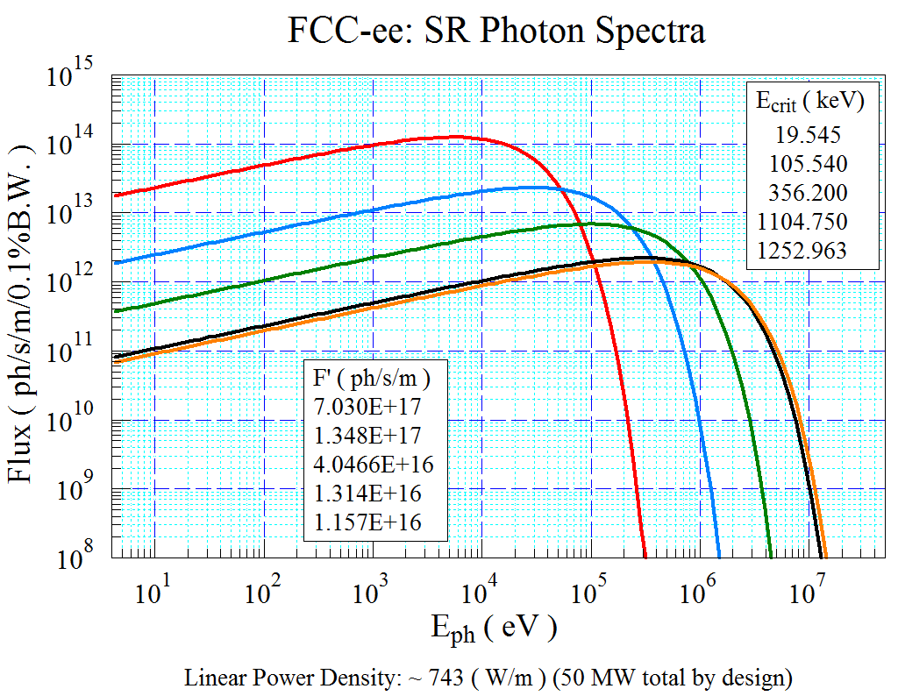
Synchrotron Radiation Spectra
90.7 km machine
Z-Pole: very high photon flux (→ large outgassing load);
Z-pole: compliance with scheduled operation (integrated luminosity first 2 years), requires quick commissioning to I_{NOM}=1.390 A 1270 mA;
T-pole (182.5): extremely large and penetrating radiation, critical energy 1.25 MeV 1.36 MeV;
T-pole (and also W and H): need design which minimizes activation of tunnel and machine components (→ FLUKA);
W, H-pole: intermediate between Z and T; still E_{crit} > Compton edge (~100 keV (Al), ~200 keV (Cu))
Critical energy: ε_{c} = 2218·E³ (GeV) / ρ(m)
97.8 km machine
21.2
114.3
385.7
1196.4
1356.9
https://doi.org/10.1140/epjti/s40485-022-00087-w

Slide 6
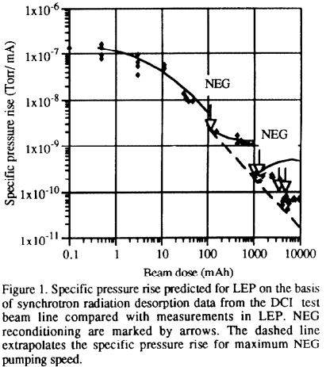
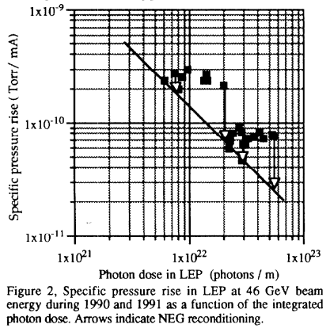
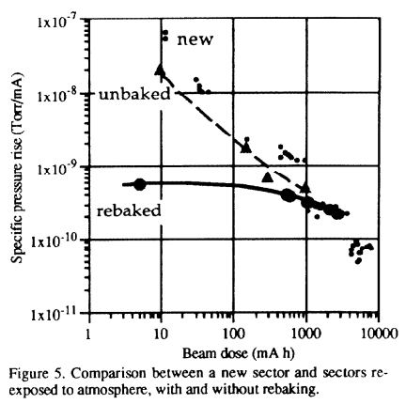
3. Synchrotron Radiation-Induced Desorption
When photons with energy above the work function of the vacuum chamber (VC) material hit the surface they can generate PSD molecular outgassing, mediated by PE emission
The PSD yield η (molecules/photon) is characterized by a conditioning curve which, in a log-log scale vs accumulated photon dose D (photons/m) resembles a power law η=η_{o}·D^{-α} , with 0.3<α<1
“Experience with the Operation of the LEP Vacuum System and its Performance for LEP200”, O. Gröbner et al., EPAC’92

Slide 7
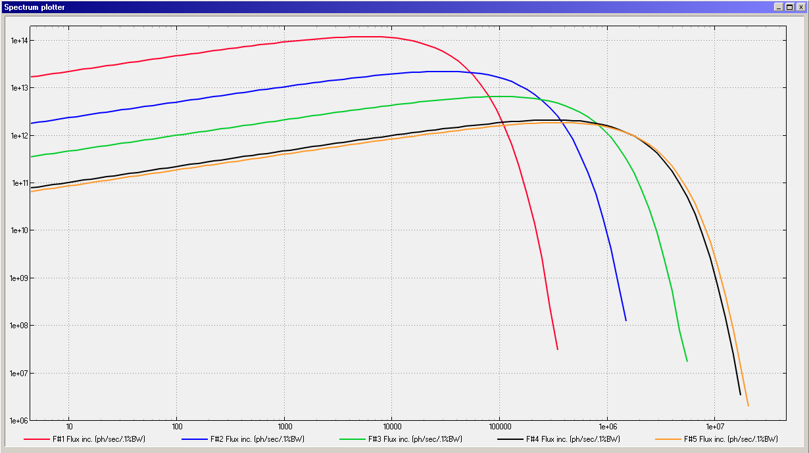
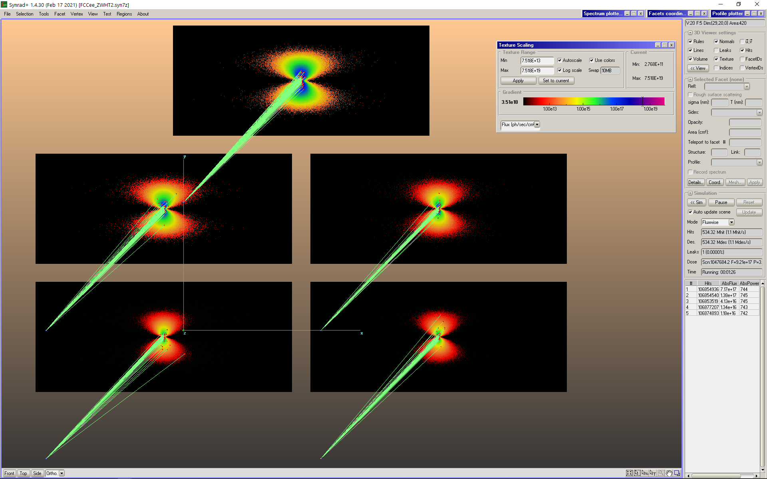
Synchrotron radiation spectrum, flux, power
Typical vertical opening angle SR: 1/γ; γ(ttbar)=357,143; 1/γ=2.8 μrad → @50 m = 0.14 mm
SR Spectra computed with SYNRAD+ (98 km ring)
Radiation projected onto
five 14x6 cm² screens;
1 cm-long dipole arc trajectories;
Flux distribution shown here,
Logarithmic scale for textures,
6 orders of magnitude displayed;
45.6 GeV
80 GeV
120 GeV
175 GeV
182.5 GeV
Beam Energy E(GeV) | Beam Current I(mA) | Critical Energy (keV) | Photon Flux F’(ph/s/m) | PSD Outgassing Load (mbar·l/s/m) @ 1·10⁻⁶(mol/ph)
45.6 | 1390 | 19.5 | 7.17·10¹⁷ | 2.90·10⁻⁸
80 | 147 | 105.5 | 1.38·10¹⁷ | 5.58·10⁻⁹
120 | 29 | 356.2 | 4.13·10¹⁶ | 1.67·10⁻⁹
182.5 | 5.4 | 1253.1 | 1.18·10¹⁶ | 4.78·10⁻¹⁰
45.6
80
120
175
182.5
50 m
Units: Vertical: photons/s/(0.1% bandwidth)/m; Range [10⁶ ; 2·10¹⁴]
Horizontal eV; Range [4 ; - 5·10⁷]

Slide 8
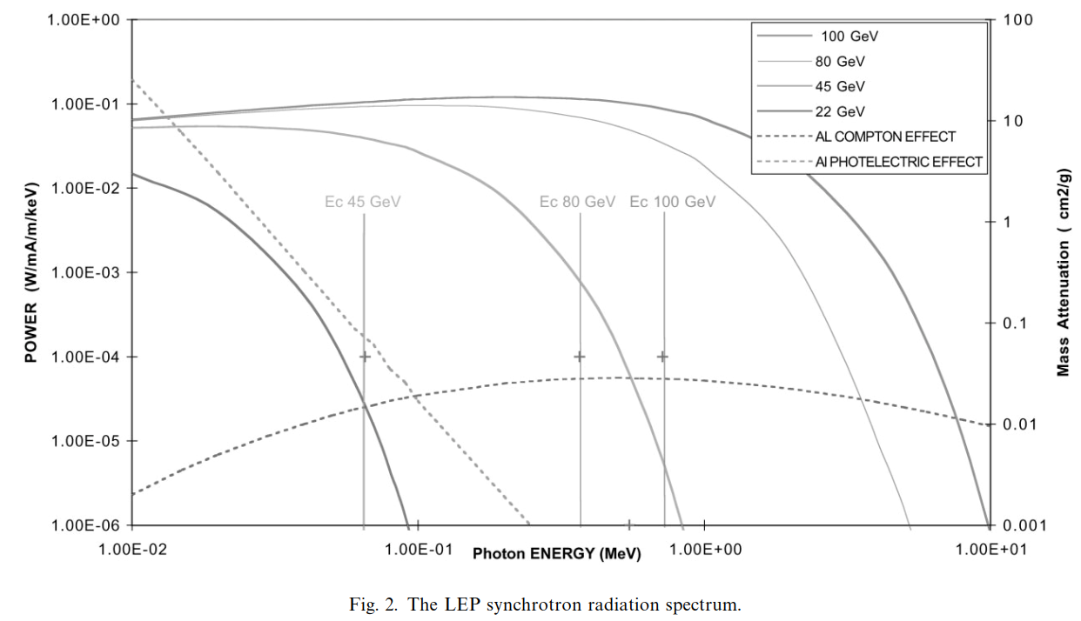
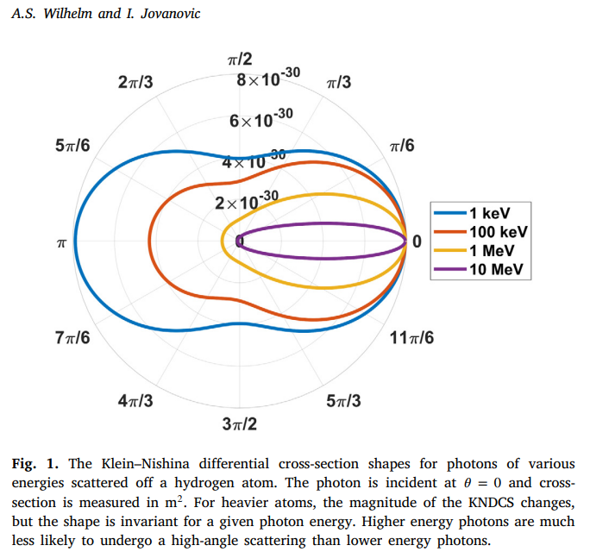
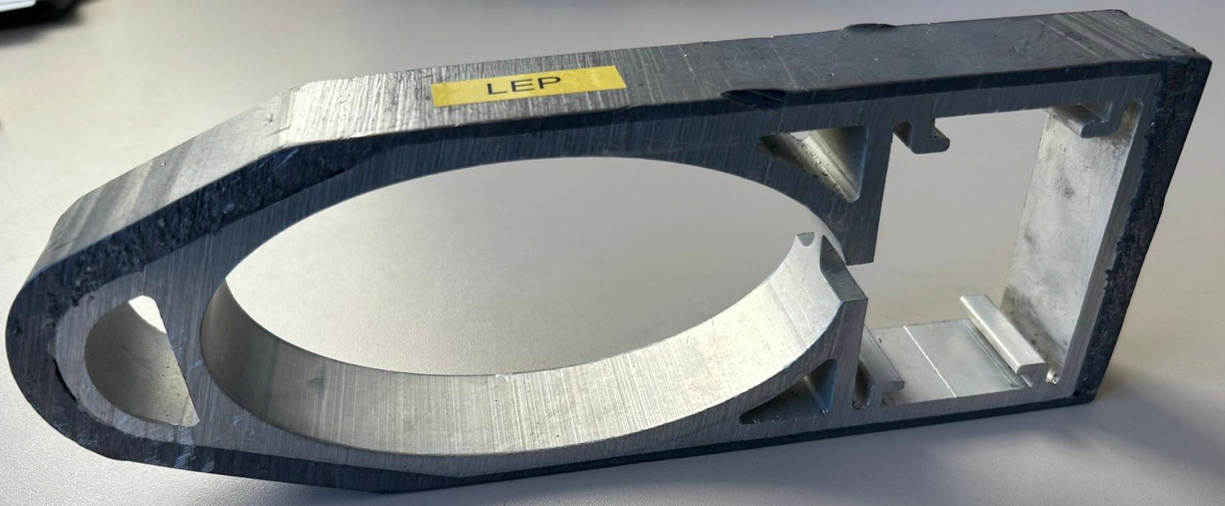
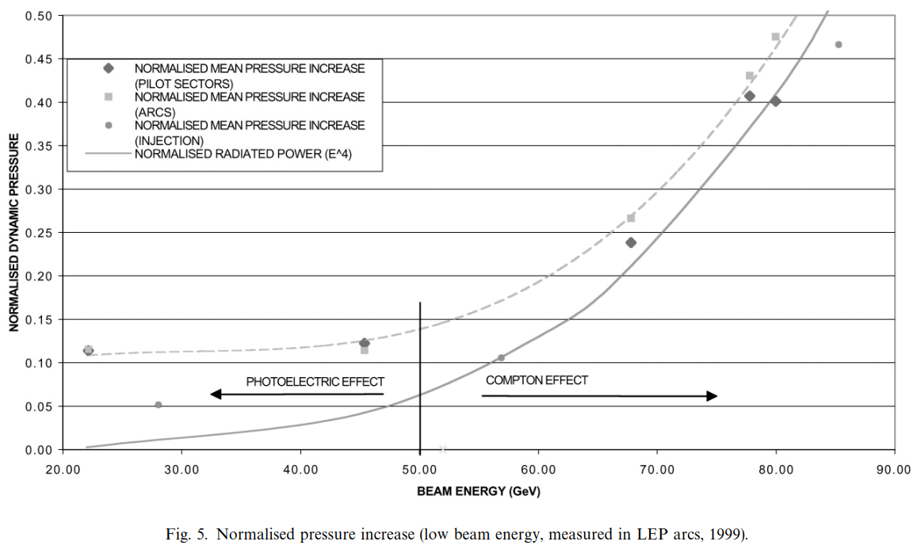
Gas Load for W-, H-, T-poles will have a significant contribution proportional to SR power, due to Compton photons (as per LEP operation, ref. “The pressure and gas composition evolution during the operation of the LEP accelerator at 100 GeV”, M. J. Jimenez et al., Vacuum 60 (2001) p183-189);
F (FCC-ee)>100 keV (%)
Z 0.0639
W 9.220
H 28.852
T(175) 47.810
T(182.5) 49.717
NIM A 1031 2022 166502
If copper alloy is chosen as the material for the vacuum chamber, then a smaller fraction goes into Compton, and shielding improves;
In addition, copper has a lower photon-stimulated desorption yield;
Photon Stimulated Desorption (PSD):
Q(mbar·l/s) = F(ph/s)·η(mol/ph)·k(mbar*l/mol)

Slide 9
3. Synchrotron Radiation-Induced Desorption
At machine start-up η can be as high as several percent: historically SR-dominated accelerators -- most commonly light sources (LS)-- have been considered “vacuum conditioned” when the pressure averaged around the ring reached “few” 10⁻⁹ mbar, which corresponds to η of few 10⁻⁶ mol/ph
Literature data show that most LS have reached the conditioned state after “few” 100 Ah of integrated beam dose
All this tells us that the nominal current for the Ampere-class CEPC or FCC-ee will not be reached immediately (see e.g. KEK-B/SUPERKEKB long conditioning), because the associated SR photon flux and PSD yields would be too large to allow running the machines at the related vacuum pressures
In addition to this, starting the collider at H energy (120 GeV) and therefore rather low current will mean that the vacuum conditioning will be slow in time; Ideally the Z-pole energy 45.6 GeV is the one conditioning faster
At the same time, the experimental users will be eager to get as much luminosity as possible, as quickly as possible: this makes evident that some form of PSD mitigation or advanced pumping method must be implemented

Slide 10
3. Synchrotron Radiation-Induced Desorption
LEP did not have NEG-coating available, only a NEG strip in an antechamber (along dipoles only); in addition, it was made out of aluminum, which has a large PSD yield compared to VC alternatives such as copper and austenitic stainless steel (SS)
As a consequence of aluminum’s large η and limited pumping capacity of the NEG strip of the 80s, LEP’s vacuum sectors needed periodical re-activation of the NEG strip
For rings much bigger than LEP such as CEPC and FCC-ee, re-activating long vacuum sectors for the 2 rings (LEP had only 1 ring!) would be preferably avoided (large impact on operation/maintenance/manpower needs)
Luckily, one technology which at the same time offers PSD mitigation and advanced pumping exists since ~ 2 decades: NEG-coating
NEG-coating has been in use since the late 90s (ESRF) and since then it is used by basically all LSs, the LHC’s long-straight sections, and other accelerators as well (ion-rings, antiproton rings, …); it is therefore a highly tested and validated technology

Slide 11
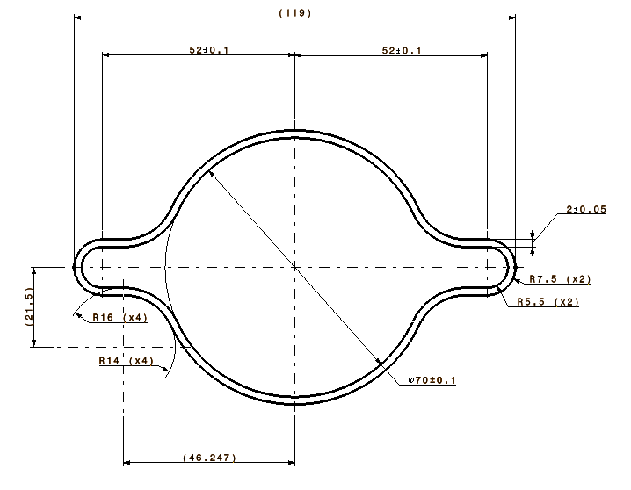
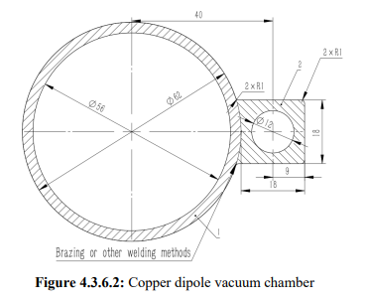
4. Vacuum chamber geometry, and related issues
Extensive modelling is needed in order to make predictions of the vacuum commissioning duration
Modern tools, based on coupled ray-tracing Montecarlo simulations allow to do this (SYNRAD+, Molflow+)
It’s easy to prove that a NEG-coated VC has a clear advantage in terms of average pressure and commissioning time over a lumped-pump configuration with no NEG-coating; also, the final cost is lower for a NEG-coated configuration, since it allow large savings in term of a largely reduced number of cables for the lumped pumps
CEPC copper chamber (from TDR)
FCC-ee Copper Extrusion

Slide 12
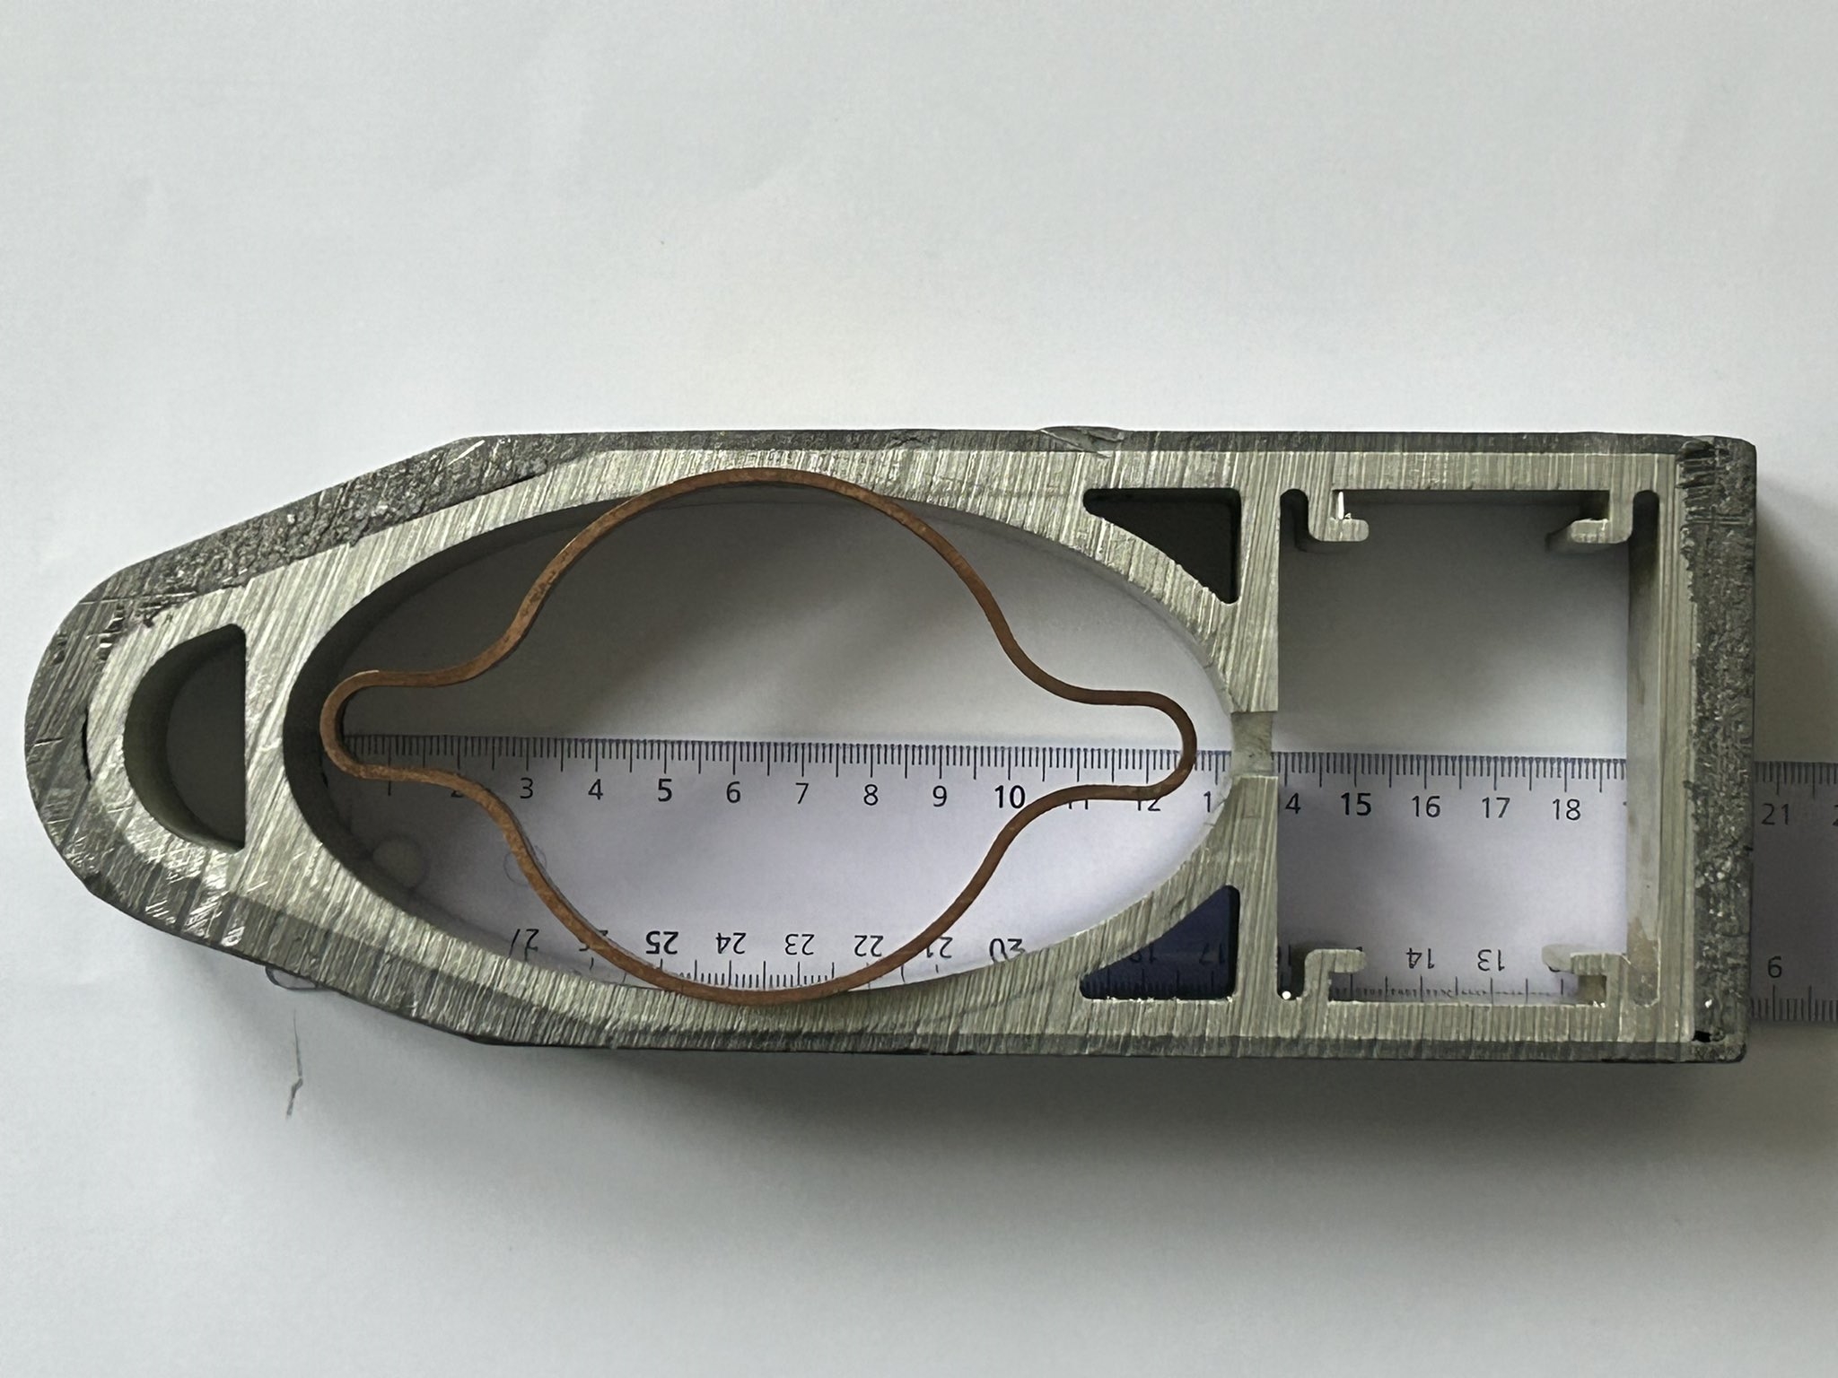
5. Arcs and MDI
The arcs and the MDI share some common design for the vacuum system, but at the same time differ in some key aspects
The arcs’ VCs must present as smooth and continuous as possible cross-section, minimizing the changes of cross-section: LEP already had a continuous elliptical chamber (131x70 mm²), common to dipoles and quadrupoles; CEPC plans to have a circular cross section (impedance), while FCC-ee is looking into a modified SUPERKEKB cross-section, with a round pipe (70 or 60 mm ID) with two “winglets” in the plane of the orbit, to be able to install recessed SR absorbers (SRAs)
Antechamber for NEG strip
Pumping slots
LEP:
ellipse 131x70 mm²
FCC-ee:
115 mm wide, 70 mm ID
Lead shielding
The specific conductance of FCC-ee is ~1/2 that of LEP, ~100:50 l·m/s
The proposed 60 mm ID version for FCC-ee would have a 37% conductance decrease, i.e. only ~1/3 that of LEP

Slide 13
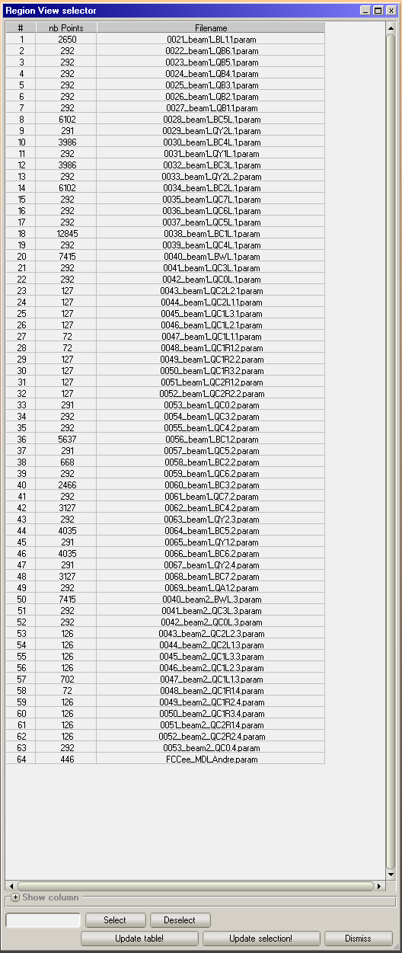
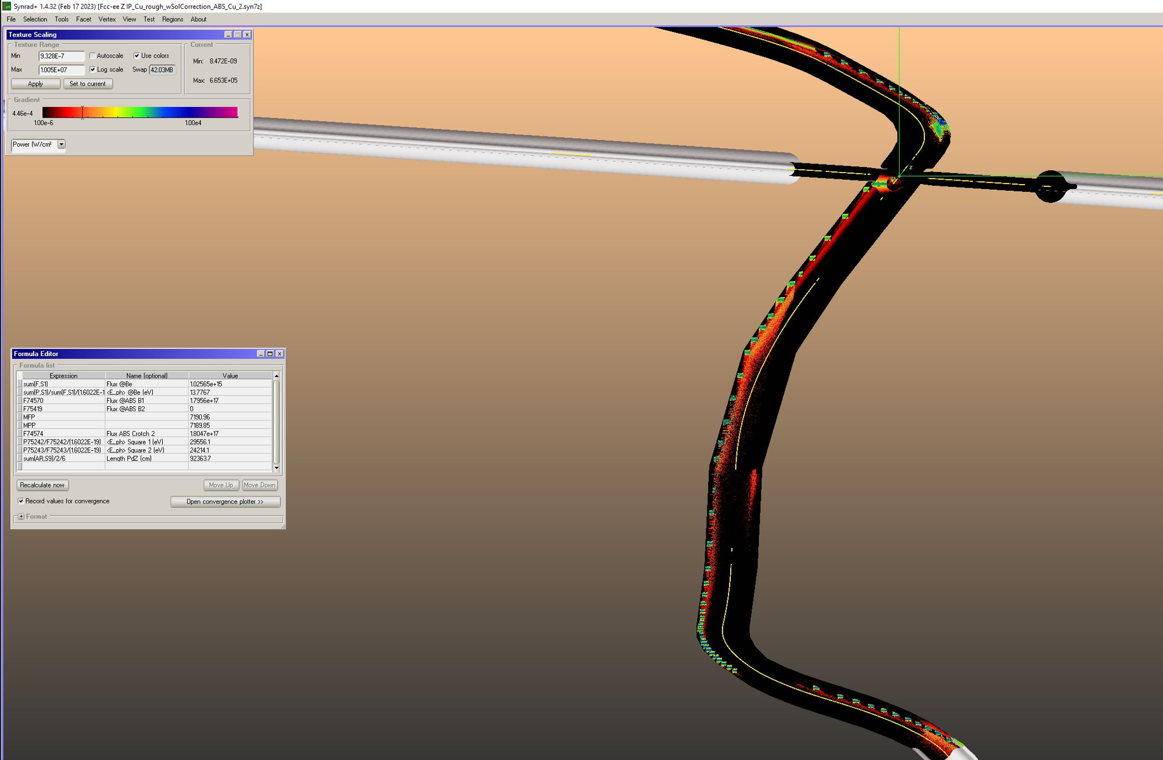
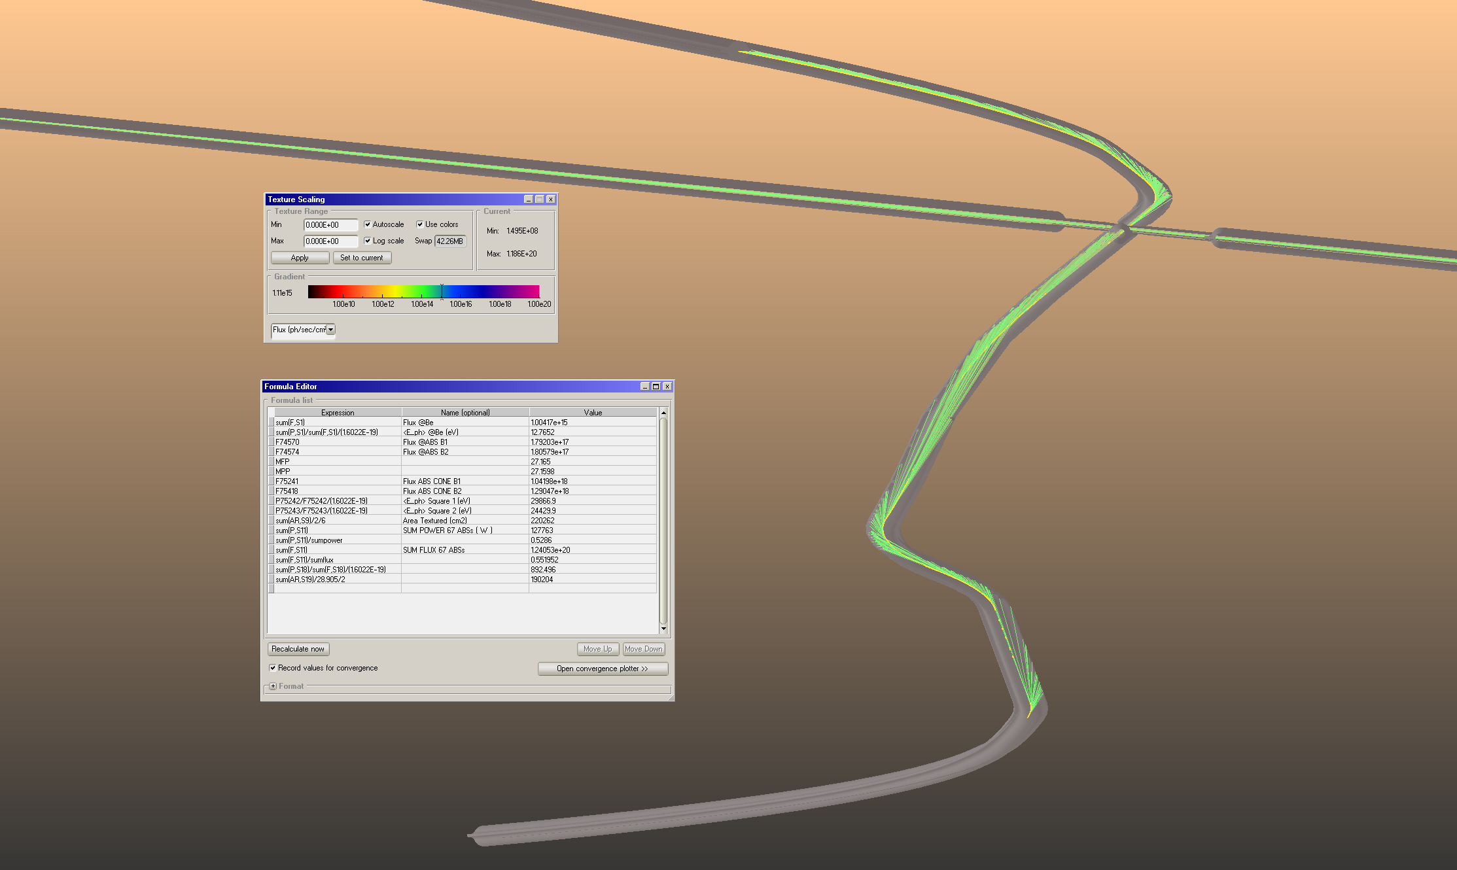
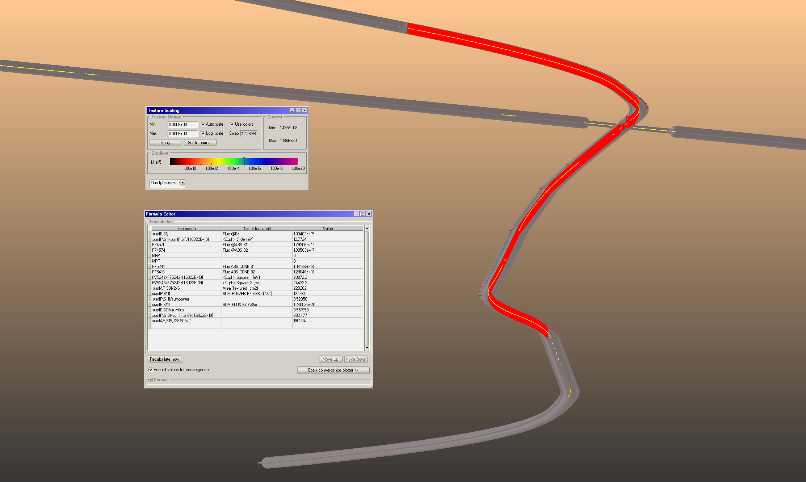
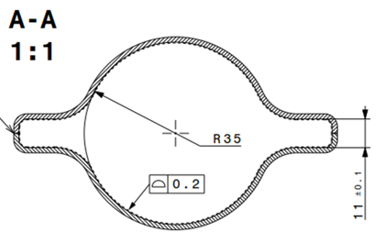
5. Arcs and MDI
The MDI area of FCC-ee at the present stage of design uses the same VC cross-section up to the superconducting focusing doublet, with SRAs placed at strategic locations so as to cast a shadow downstream of them and in particular away from the IP
There are a total of 64 magnetic “regions: 49 for B1, 14 for B2, and 1 for the solenoids
Total power generated by all is 242 kW; total photon flux is 2.25·10²⁰ ph/s (@Z-pole)
This is the ray-tracing for the ideal case of no photon reflection
~385 m distance

Slide 14
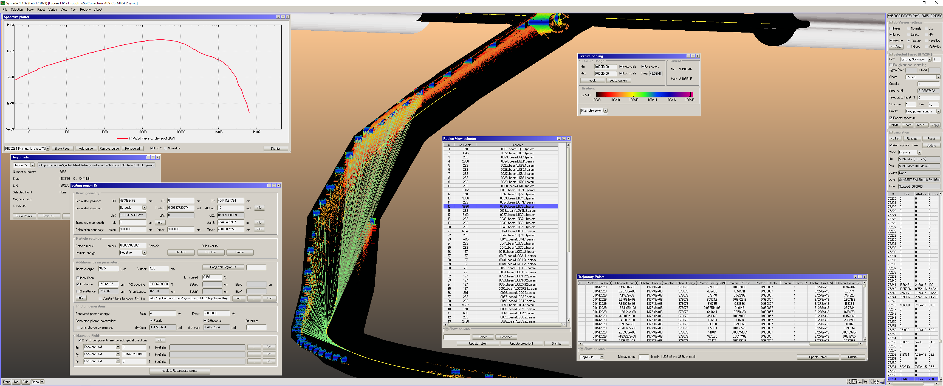
There are a total of 70 magnetic “regions: 49 for B1, 20 for B2, and 1 for the solenoids
Total power generated by all is 196 kW; total photon flux is 3.99·10¹⁸ ph/s (~1/56 of Z-pole case)
This is the ray-tracing for the ideal case of no photon reflection
High critical energy radiation hitting absorber at ~120 m from IP, Compton secondaries?
FCC-ee ttbar:
E_{crit} (BC3L1)=979 keV

Slide 15
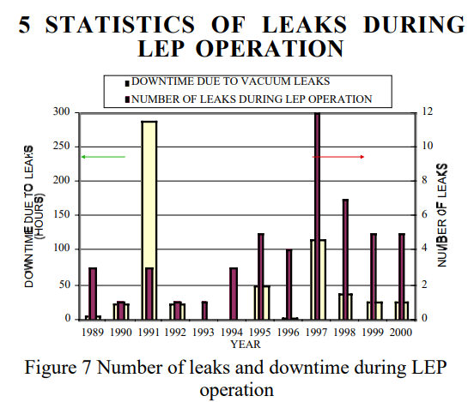
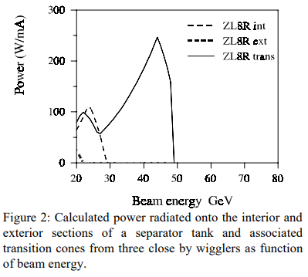
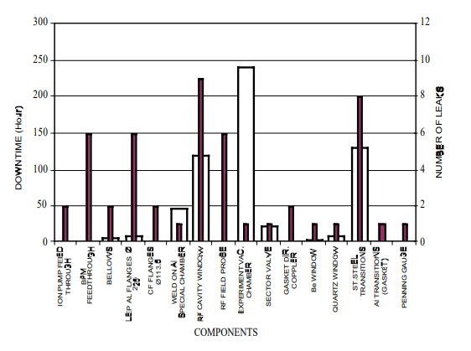
5. Arcs and MDI
LEP operation showed that stray photons and misalignments of both the VCs and the beams could generate large losses in the detectors, and vacuum leaks due to overheating of not sufficiently cooled components (mainly flanges, feedthroughs, RF couplers); The same was noticed for special chambers/devices such as the polarization wigglers with their high power density photon fan.
“The LEP Vacuum System: A Summary of 10 years of Successful Operation”, M. Jimenez et al., EPAC’98
“Synchrotron Radiation Effects at LEP”, R. Bailey et al., EPAC’98

Slide 16
6. Full-energy booster
Contrary to LEP, where the e-e+ beams were stored in the same chamber (pretzeled orbits with electrostatic separators), and the beam energies were raised after the two beams had been fully injected at 16 GeV, the FCC-ee and CEPC foresee a full-energy booster installed in the same tunnel of the collider, and having ~ same length, injecting very frequently in order to balance the beam losses due to the high luminosity and other effects
The booster must accelerate beams in opposite directions, and therefore it needs to take care of both electron cloud and ion trapping effects (depending on the filling pattern)
The booster cannot be pre-conditioned while the installation of the collider rings takes place, like it is done at some LSs which have a separate tunnel for the booster: it therefore needs some quick conditioning, or else the initial operation and commissioning of the collider will be delayed/slowed down
There is a mutual interaction of the radiation field generated by the various beam-loss mechanisms in the booster and the two collider rings: plenty of work to be done by the radioprotection and R2E (Radiation To Electronics) groups, with repercussions on the design of the civil engineering facilities (e.g. alcoves and/or parallel tunnels to install electronics) and their costs
The present design after cost-containment optimization of the FCC-ee booster is a SS VC with no bake-out foreseen, no RF contact fingers in the bellows, no RF grids for the pumps’ connections, and no NEG-coating: → long conditioning and higher pressures!

Slide 17
The tunnel along the arcs has a typical cross-section as shown below (left)
There are TWO counter-rotating beams (e- and e+) guided by dipole, quadrupole, and sextupole magnets (above, right)
Above the two rings of the collider, there is a THIRD ring, the full-energy injection BOOSTER, which injects both e- and e+ (in opposite directions) whenever necessary
There are, therefore, about 3x 91 km ring vacuum system, plus additional (many) km of TRANSFER LINES (TLs) from booster to collider rings, and also other TLs from other accelerators in the chain (pre-booster chain has different options under study)

Slide 18
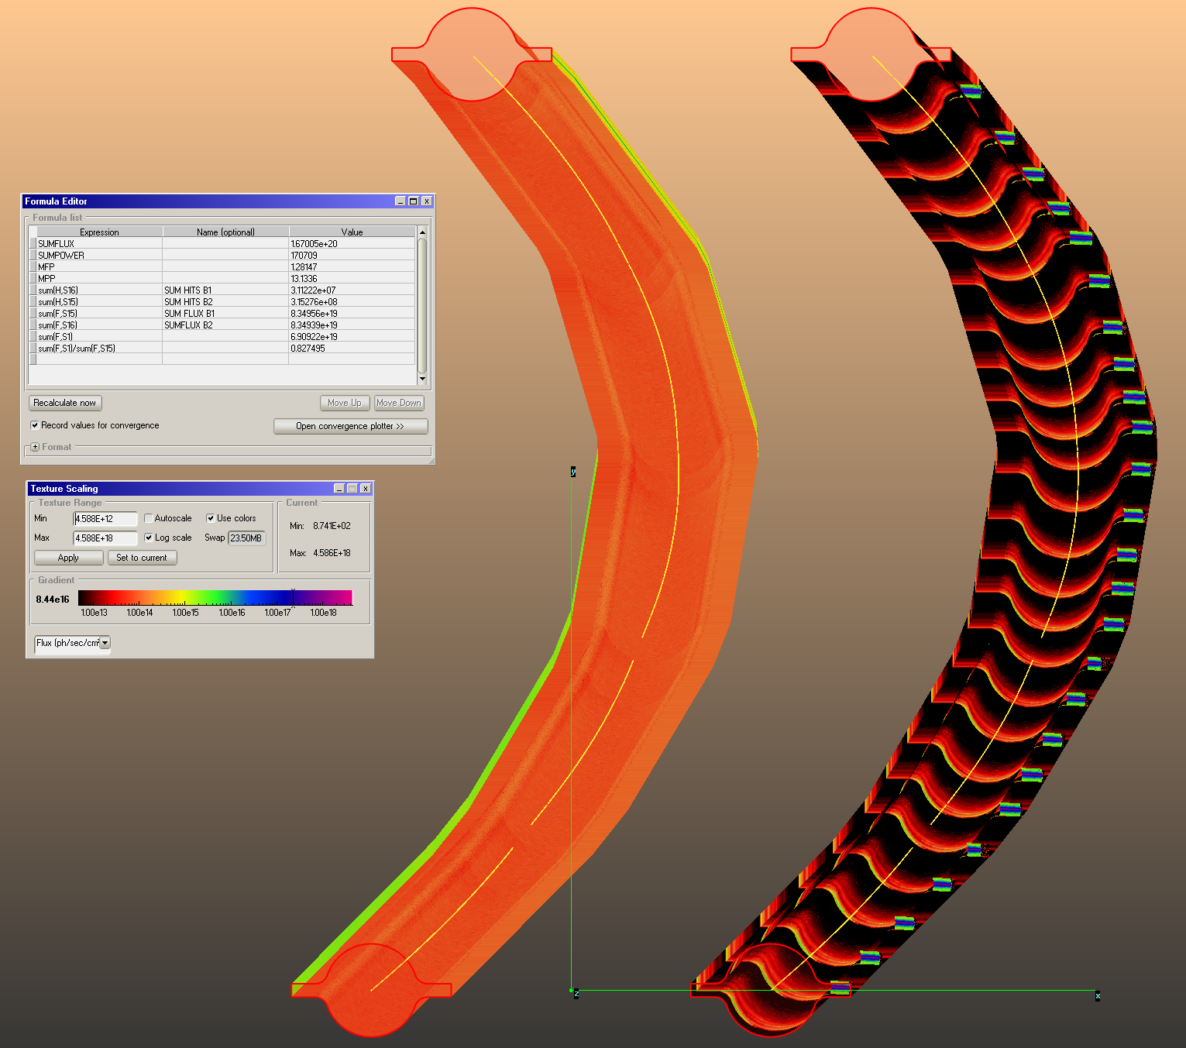
7. Dynamic vacuum conditioning
Extensive modelling is needed in order to make predictions of the vacuum commissioning duration
Modern tools, based on coupled ray-tracing Montecarlo simulations allow to do this (SYNRAD+, Molflow, Comsol, ANSYS,…)
B2
These 2 models represent a section of the arcs (~140 m long)
We have used Molflow+ to calculate the PSD pressure rise at different beam doses, using the photon irradiation maps calculated by SYNRAD+
A sample 140.7 m-long section of an arc has been considered, with the two beams side by side: 5 dipoles and 5 quadrupoles as sources of SR
The orbits along 5 dipoles interleaved with 5 quadrupoles are simulated, importing the lattice files from MADX into SYNRAD+
The 3D model for B1 has 25 absorbers placed at ~ 5.6 m average spacing (avoiding quadrupoles and sextupoles which have tight coils), while B2 has no absorbers, and the SR fan is let impinge onto the bottom of the external winglet (see also B. Humann, FCC Week)
The MDI region adopts the same philosophy: lumped absorbers covering ~100% of the primary SR photon fans
B1

Slide 19
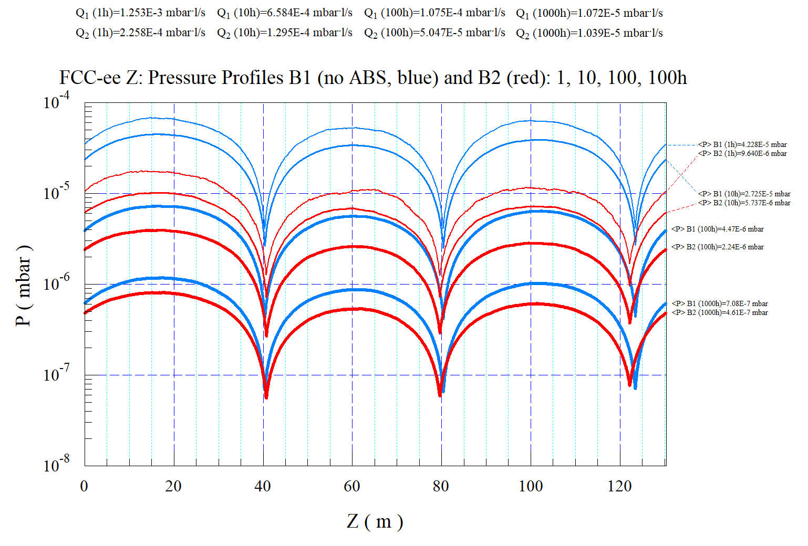
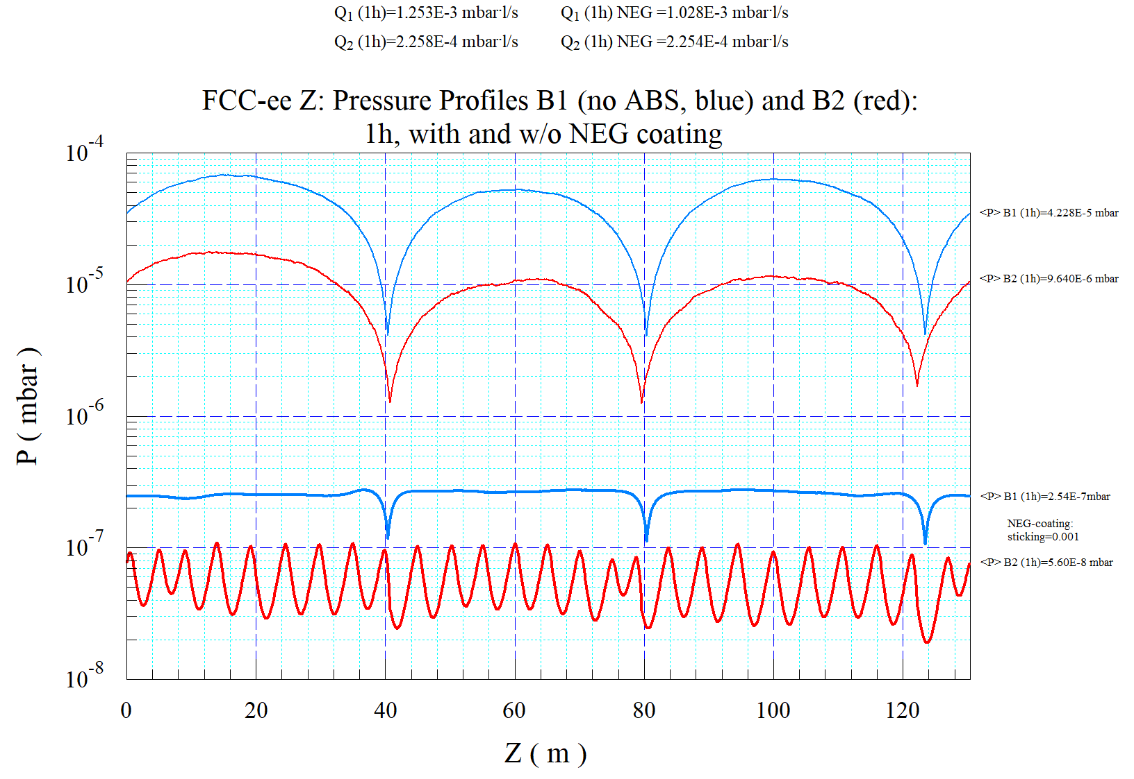
7. Dynamic vacuum conditioning
We can easily prove that a NEG-coated VC has a clear advantage in terms of average pressure and commissioning time over a lumped-pump configuration with no NEG-coating; also, the final cost is lower for a NEG-coated configuration, since it allow large savings in term of a largely reduced number of cables for the lumped pumps
1, 10, 100, 1000 h
4 different beam doses, corresponding to times of 1 h, 10 h, 100 h, 1000 h at nominal current Simulated gas: CO
On the left the case with 3x 100 (l/s) lumped pumps/beam, and no NEG-coating
On the right, the case with NEG-coating with some residual sticking (s=0.001) for 1h case

Slide 20
8. R&D for FCC-ee
A review of some of the VC components under design for early prototyping and testing for FCC-ee; half-cell mockup design underway (not detailed here):
Cold-sprayed “bosses” for BPM and anchor to quadrupoles
Friction stir weld of VC extrusion to elliptical flanges
Shape-memory alloy rings
3D-printed SR absorbers
Thin Ti tracks deposited on sprayed ceramic insulator layer, for Rad-Hard in-situ bakeout
2m-long chamber with SR absorber for PSD tests at KARA/KIT light source

Slide 21
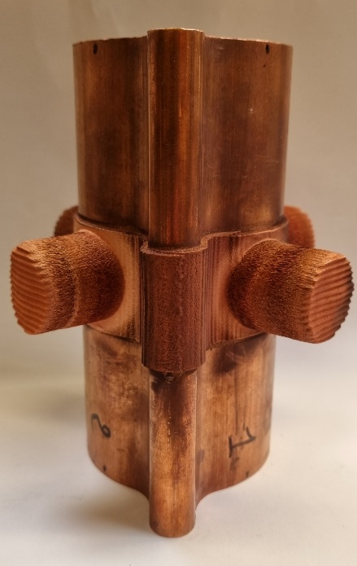
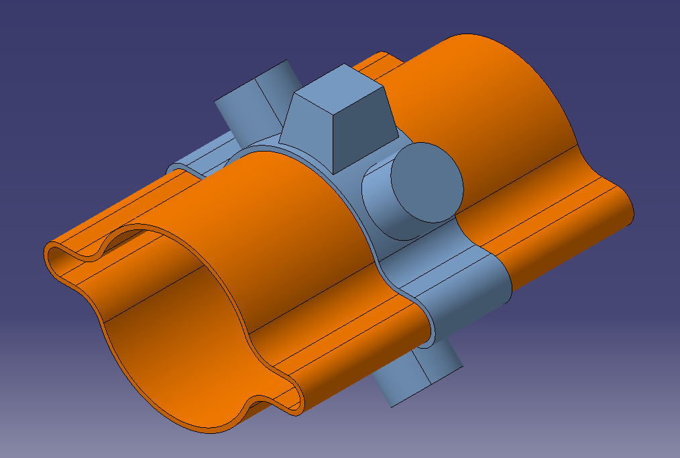
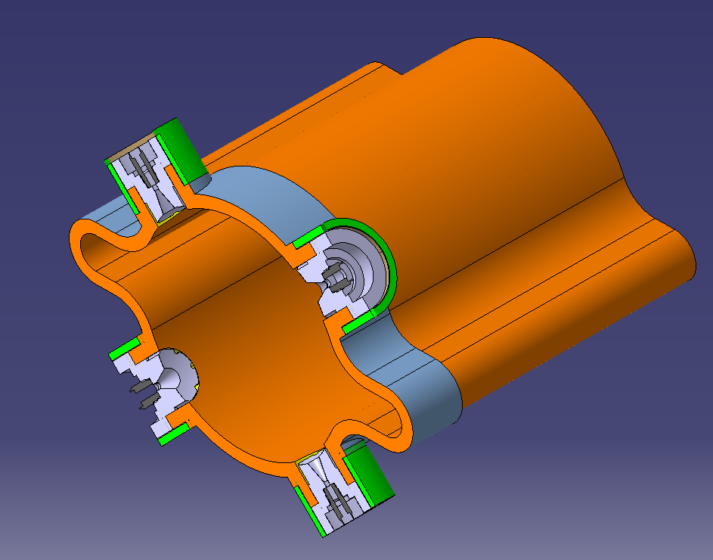
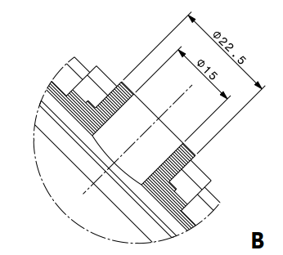
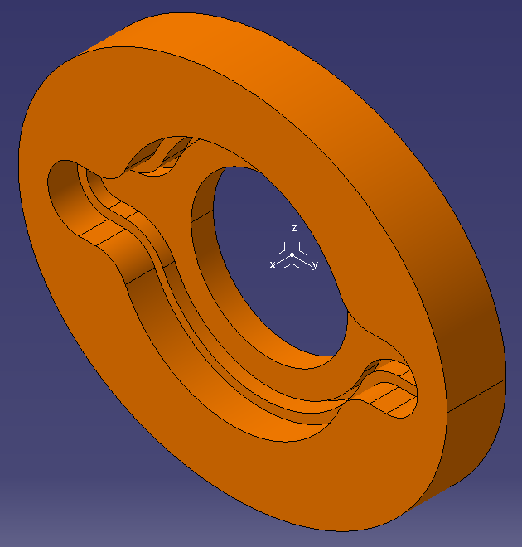
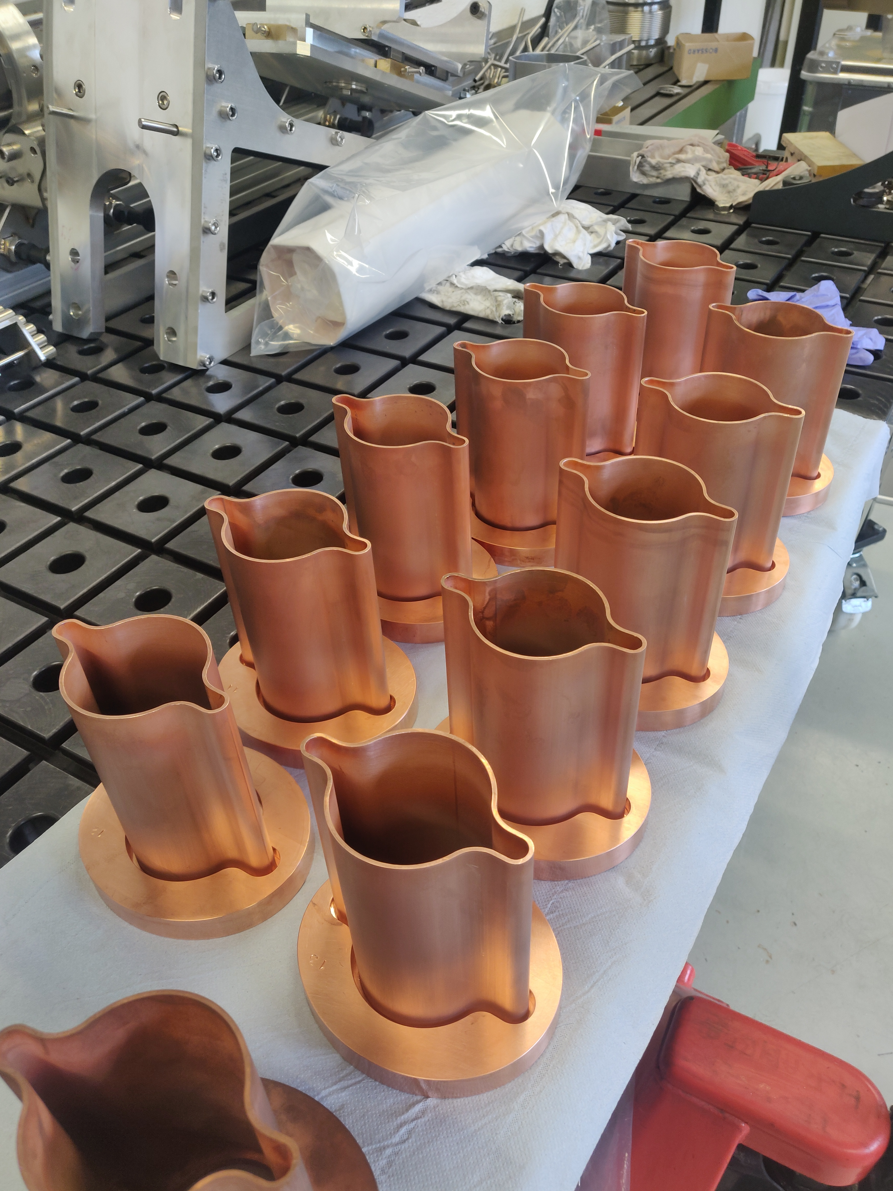
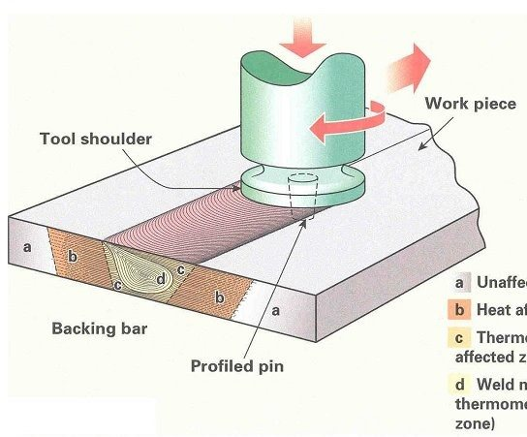
Plasma-sprayed “bosses” for machining the BPM button electrodes
Friction stir welding of elliptical flanges to vacuum chamber extrusion
Shape-memory alloy (SMA) rings used in place of standard ConFlat technology
Chamber: 2mm layer sprayed all around
Chamber prototype with x4 bosses for direct BPM buttons machining and SMA rings
FRICTION STIR WELDING →
Flange is redesigned as per Phase 1 results

Slide 22
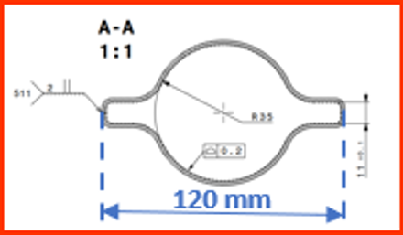
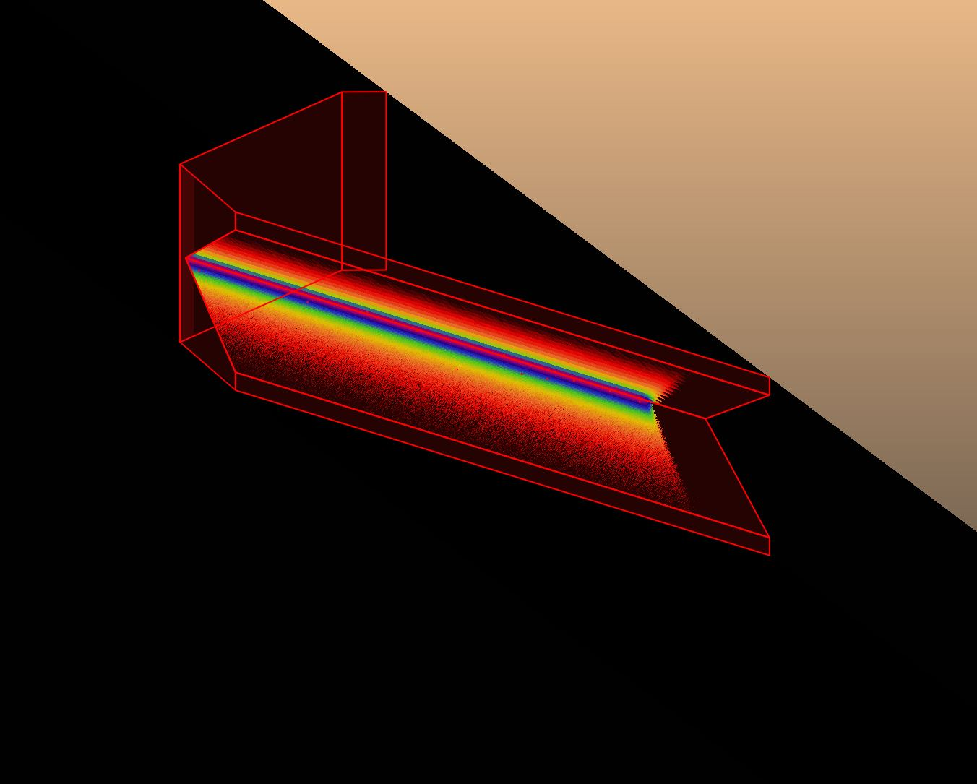
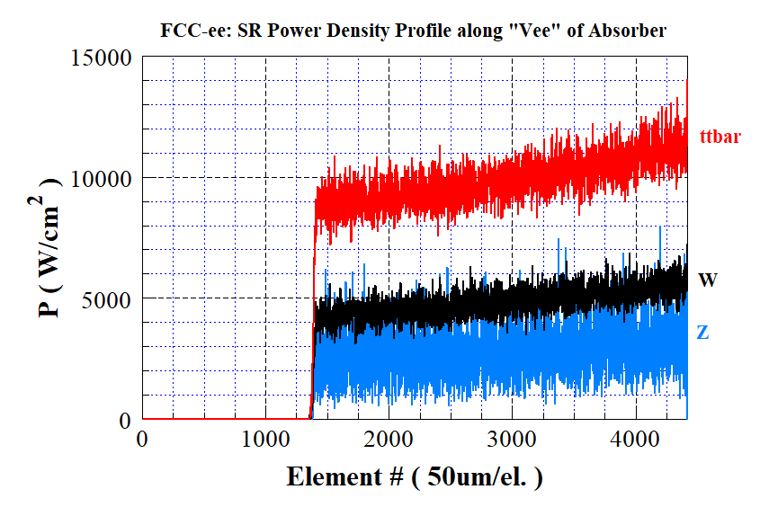
Initial geometry of the SR photon absorber, now superseded by 3D-printed one (next slide)
B
300 mm
18 mm
A
175 mm
A
B

Slide 23
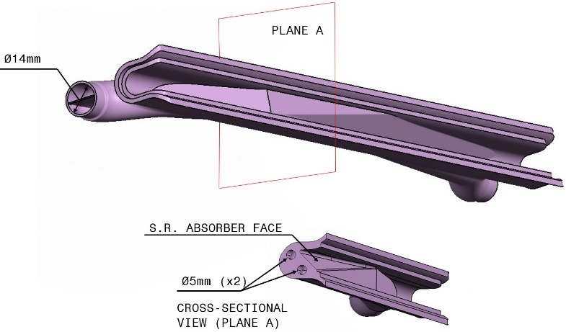
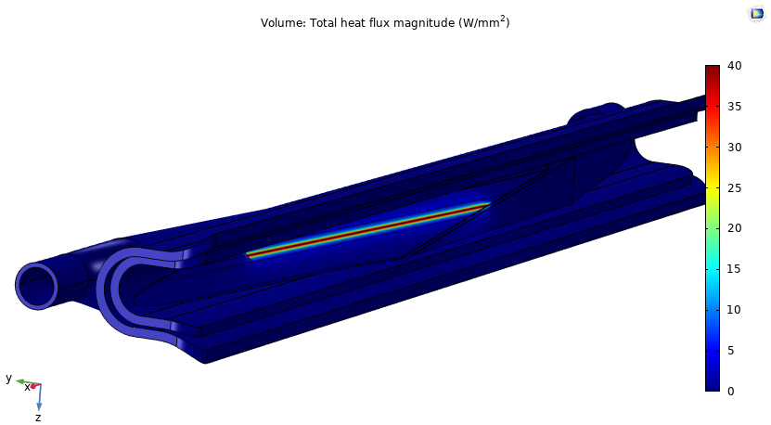
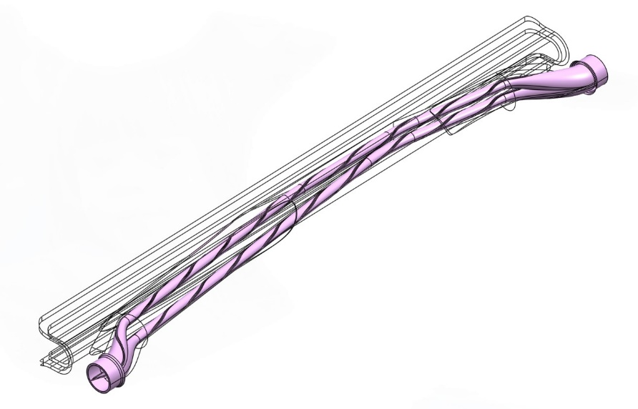
Another example: 3D-PRINTED SR ABSORBER, with INTEGRATED COOLING CIRCUIT AND SWIRL TAPE TO IMPROVE HEAT EXCHANGE

Slide 24
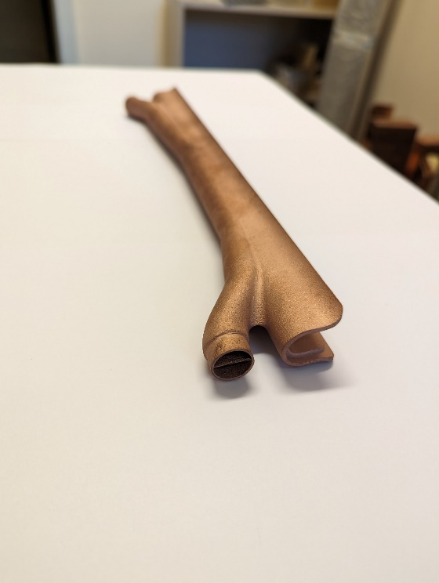
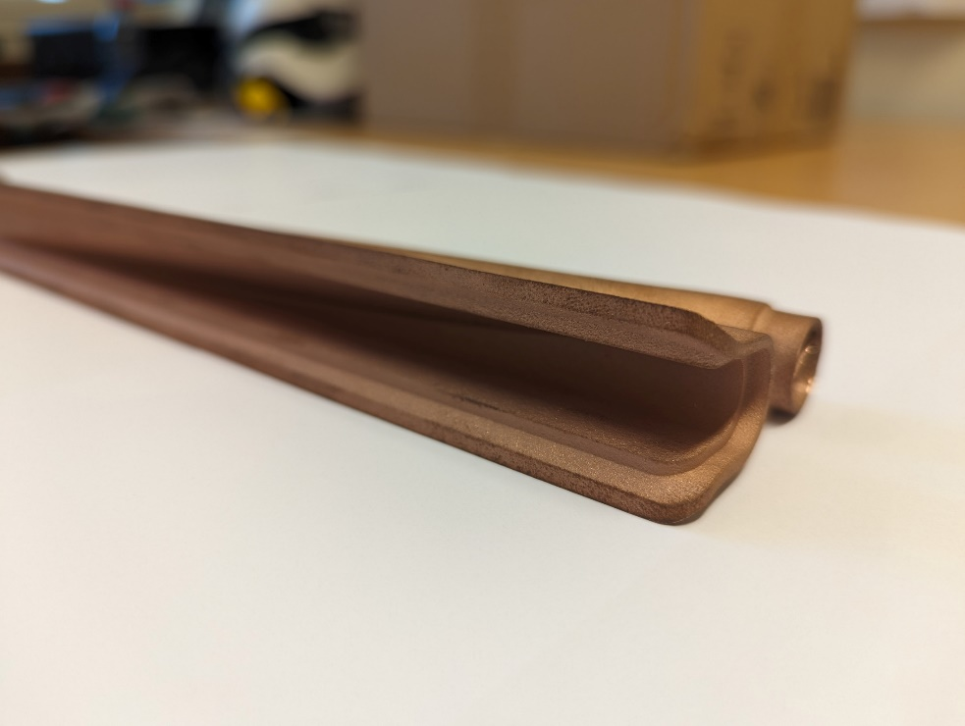
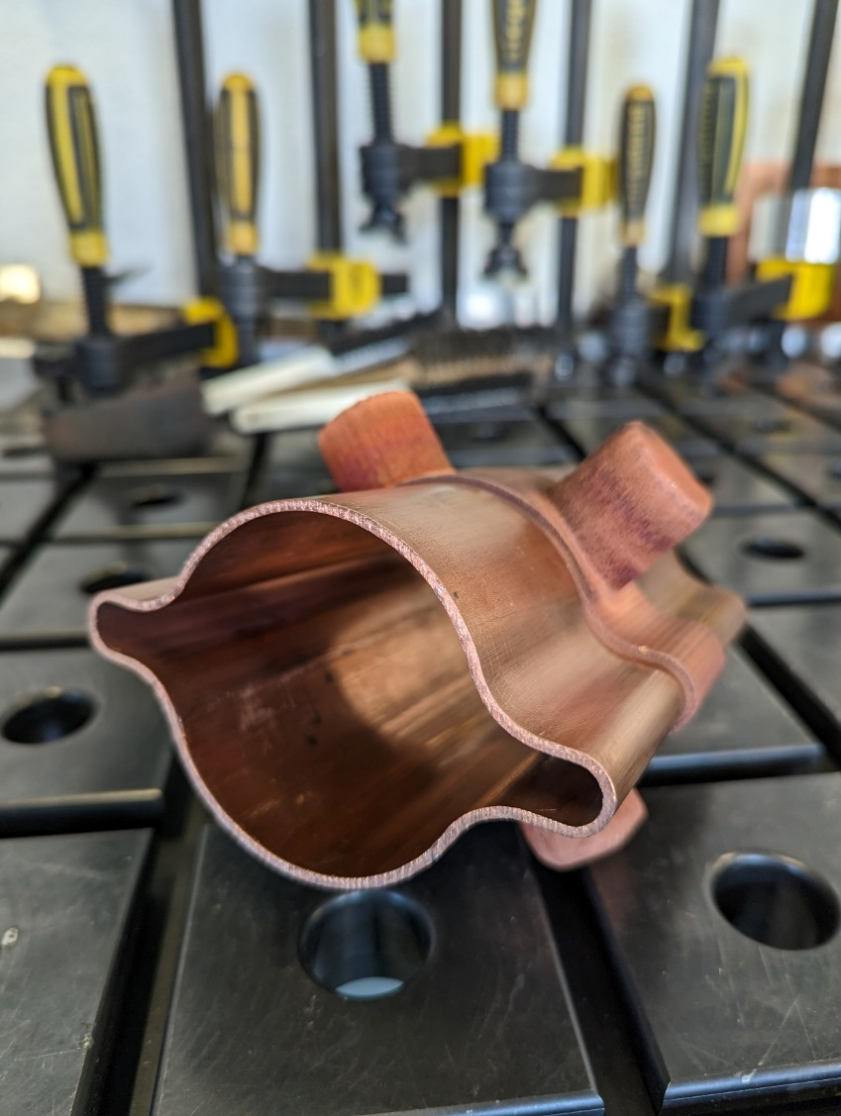
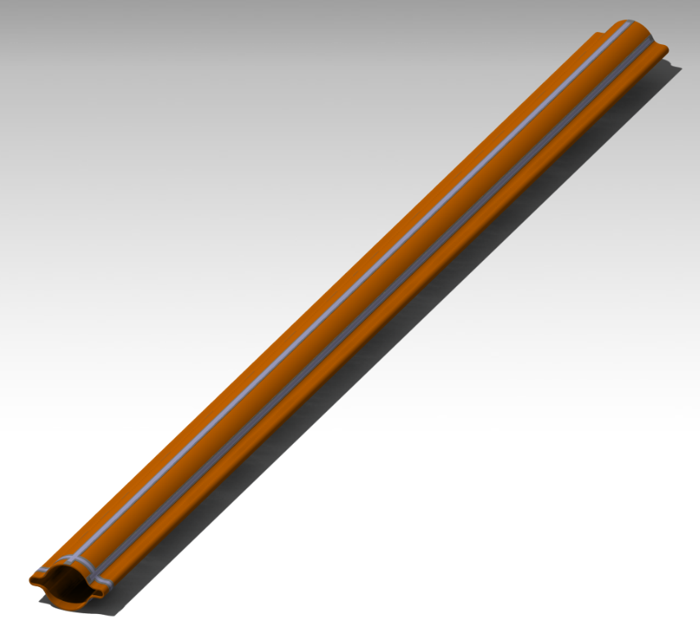
3D-printed SR absorber, with integrated splitting cooling channel
(~300 mm long)
2m-long VC extrusion (70 mm ID) with thin Ti strips for radhard in-situ bake-out

Slide 25
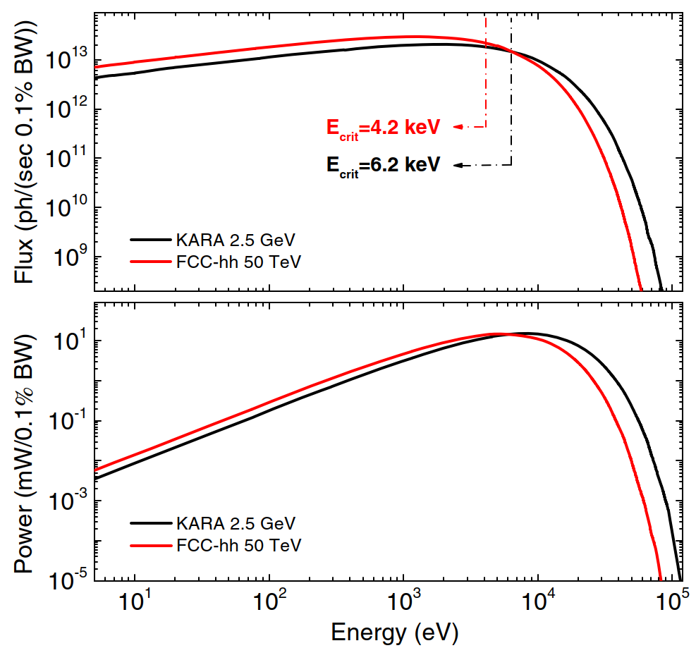
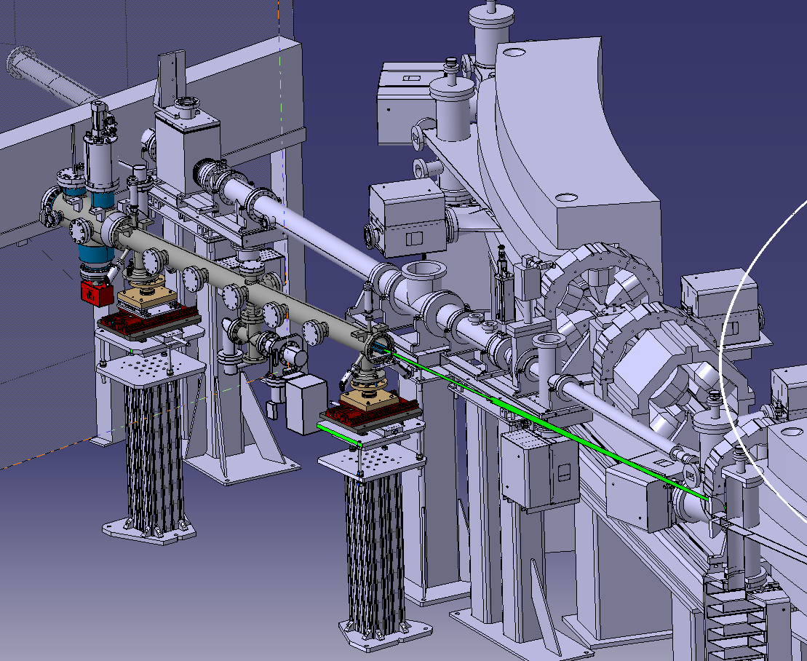
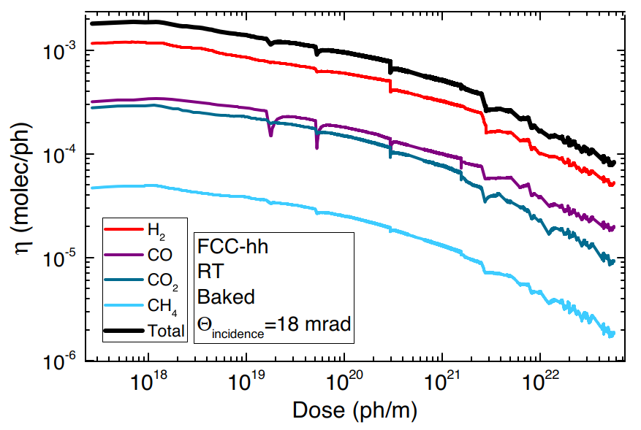
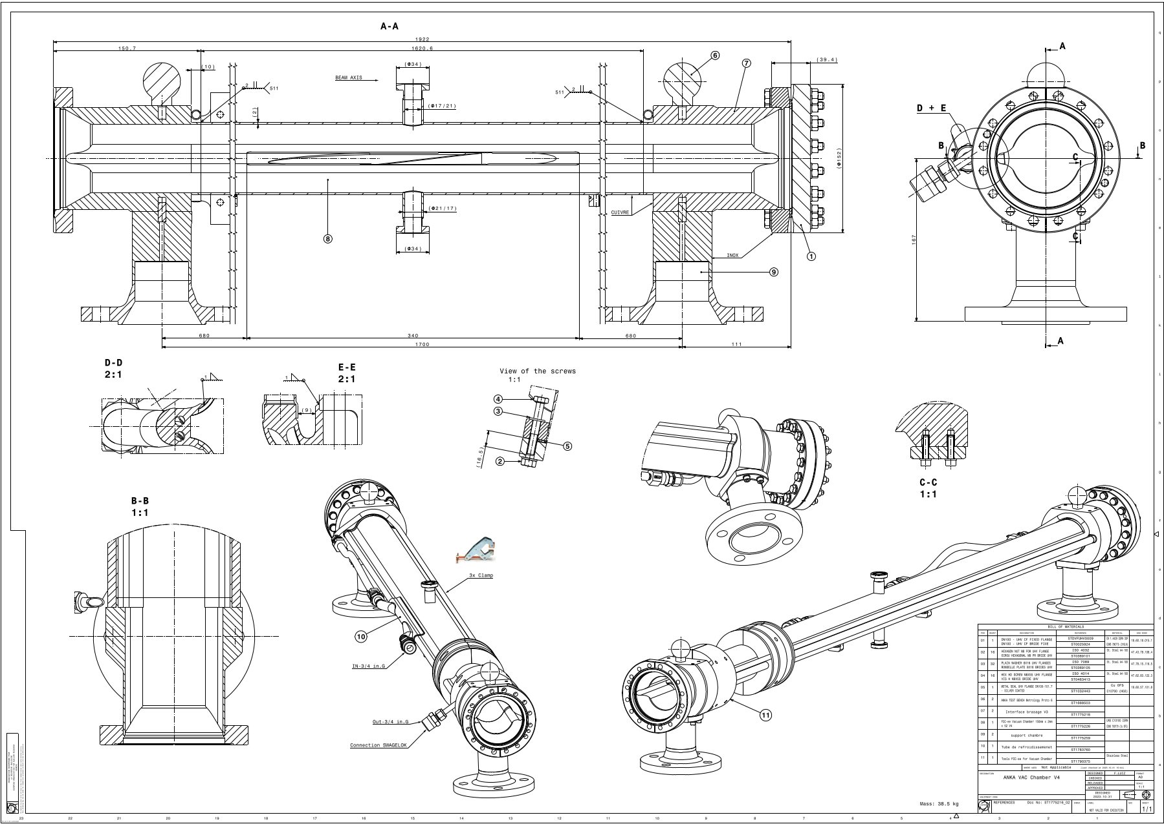
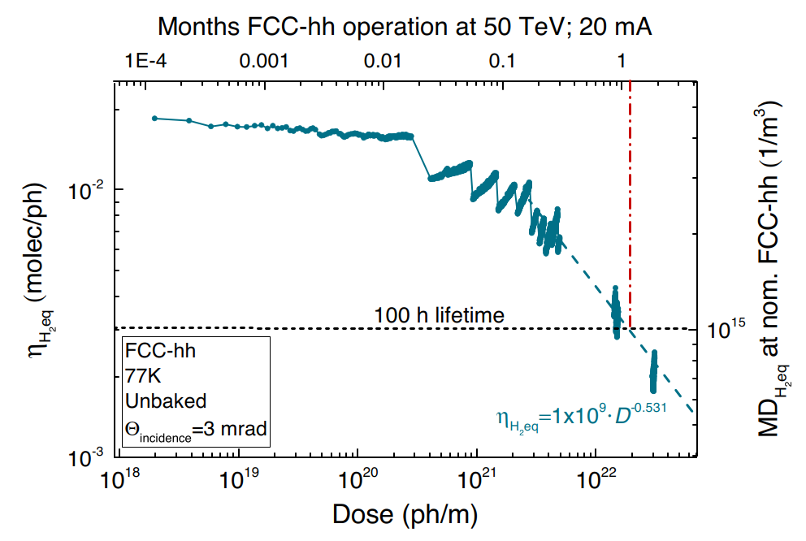
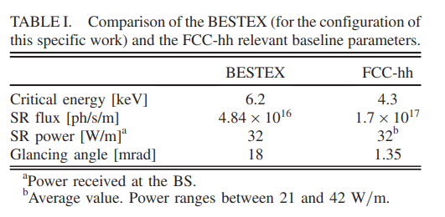
FCC-hh beam screen and FCC-ee vacuum chamber prototype testing
BESTEX at KARA light source (Peter Lindquist Henriksen, formerly L.A. Gonzalez)
L. A. Gonzalez, et al. Commissioning of a beam screen test bench experiment with a future circular hadron collider type synchrotron radiation beam. DOI: 10.1103/PhysRevAccelBeams.22.083201
L. A. Gonzalez, et al. Photostimulated desorption performance of the future circular hadron collider beam screen. DOI: 10.1103/PhysRevAccelBeams.24.113201
PRELIMINARY; Court. F. Luiz, CERN

Slide 26
Schematics of BESTEX at KARA/KIT
PRELIMINARY; Court. F. Luiz, CERN

Slide 27
View of the VACUUM CHAMBERS with PUMPING DOMES (right) and inside QUADRUPOLE and DIPOLE MAGNET (left)
SUPERSEEDED FLANGE DESIGN
(replaced by Shape-Memory Alloy elliptical version)

Slide 28
Conclusions and future work
The design of vacuum system for CEPC and FCC-ee needs careful analysis, since the experience gained over the many light sources and low/medium energy e-e+ colliders post-LEP cannot be applied directly without considering the unique size and environment of 90-100 km-long colliders
The operational experience gained on LEP can help us prevent some design issues with FCC-ee, most notably related to heating problems due to SR fans
The presence of a full-energy booster in the same tunnel adds additional complexity to the design
A quick vacuum conditioning can be achieved by applying NEG-coating to the collider rings
The conditioning of the full-energy booster without bake-out (and no NEG-coating) will be necessarily slow
Prototyping of full-scale components is mandatory
Efficient technology transfer to industry will be a major task
Cost-containment developments are welcome: the vacuum system of CEPC/FCC-ee is among the costliest accelerator sub-systems
For FCC-ee the near future work for vacuum will be the design of the 25 m-long tunnel mockup system, and the definition of vacuum needs and pumping methods for the MDI areas. The time frame left before the end of this study phase is rather short
Also, analysis and design of vacuum system for the SRF cavities, injection/extraction kickers, collimators, etc… needs to be carried out

Slide 29
ACKNOWLEDGMENTS
The material shown during this presentation has been obtained thanks to a team-work lasting10 years: due to the limited time available for this talk only a fraction of the work done has been highlighted
I acknowledge the help/support of the colleagues Cedric Garion, Fabrice Santangelo, Christian Duclos, Frederic Luiz, Sam Rorison, Marco Morrone, Fabrizio Niccoli, our machine shop, Marton Ady, Peter Henriksen, Sergio Calatroni, Patrick Krkotic, and the Technology Department and Vacuum Group management
Continuous support from FCC management is also acknowledged, never turned down a request
The collaboration with the FLUKA team (F. Cerutti, B. Humann, A. Lechner et al.) is also acknowledged
Many thanks to R. Losito for handling our requests for funding for technical development
Fani Kuncheva-Valchkova, for integration into the tunnel
Mauro Migliorati and his team at Univ. Rome, for impedance calculations related to chamber components
Manuela Boscolo and Francesco Fransesini, INFN/LNF/CERN, are acknowledged for coordinating the MDI work and providing information and models for the interaction are vacuum chamber
Andrea Ciarma, Helmut Burkhardt, for data about radiation issues, beam orbits and related loss mechanisms.

