Slide 1

CEPC large scale and precision control system study in EDR
环形正负电子对撞机
Circular Electron Positron Collider
09 April, 2024
Dapeng Jin
Institute of High Energy Physics, CAS, Beijing

Slide 2
Outline
Challenges & current status
Further to do
Summary

Slide 3
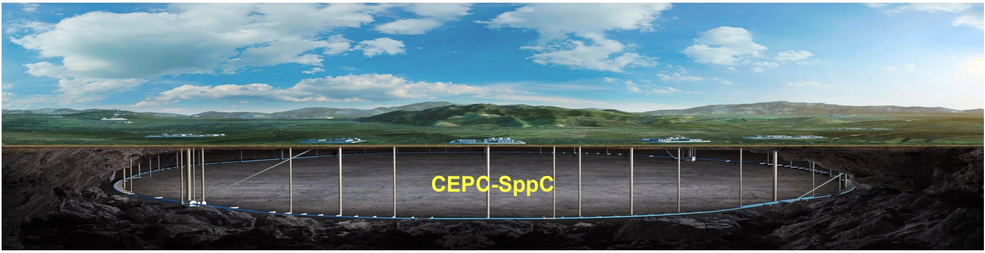
Challenges & current status
Overall
Reliability & availability & low cost on large scale (First priority). Radiation hardness of components in tunnel.
Maintainability : Flexibility : Scalability (Second priority).

Slide 4
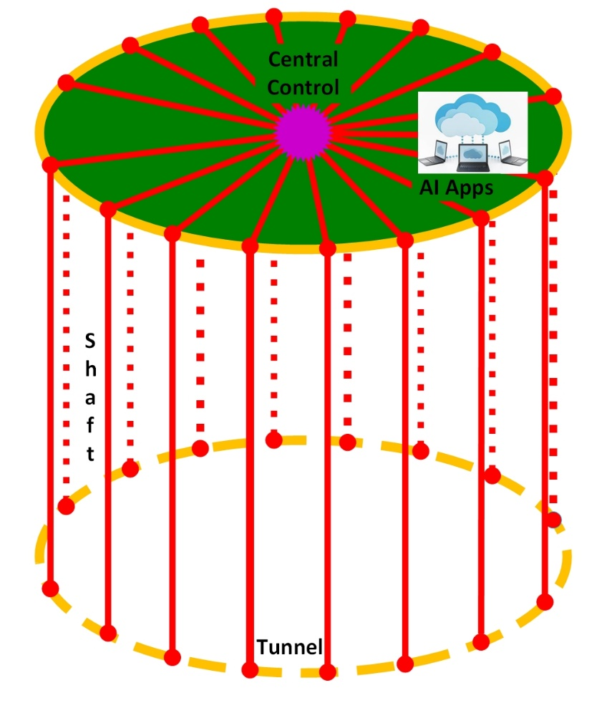
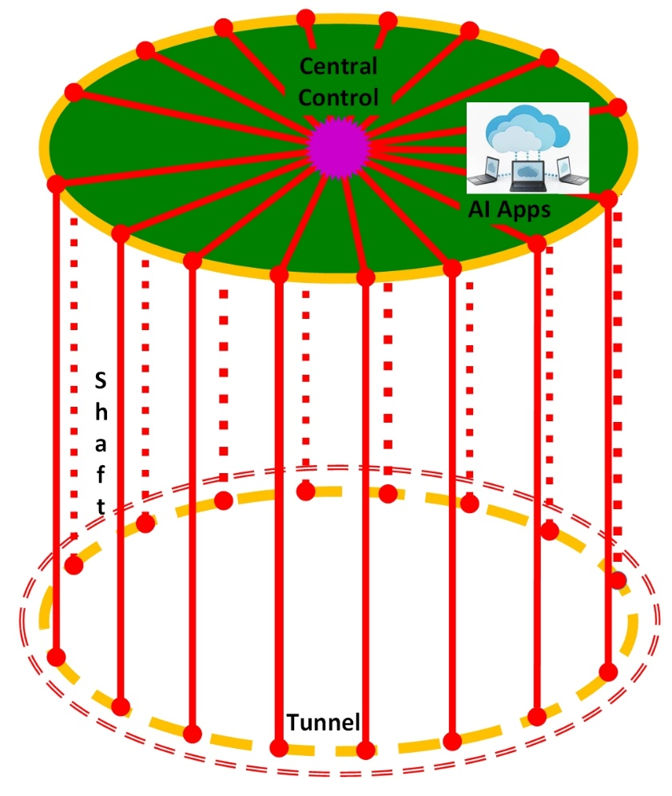
Challenges & current status
Fiber routing
Optical fibers as backbone to minimize cables with high performance|| preliminary routing topology:
  Ground routing to the shafts along the road inside the facility area whenever possible.
  Single fiber length in the tunnel ~3km to ease of routing and maintenance.
  Maybe radiation hard fibers in tunnel.
MPS(Machine Protection System) : Response speed is the key:
  Bidirectional loop structure in the tunnel with redundancy for both reliability and availability.

Slide 5


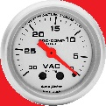
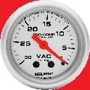

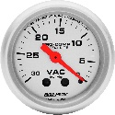
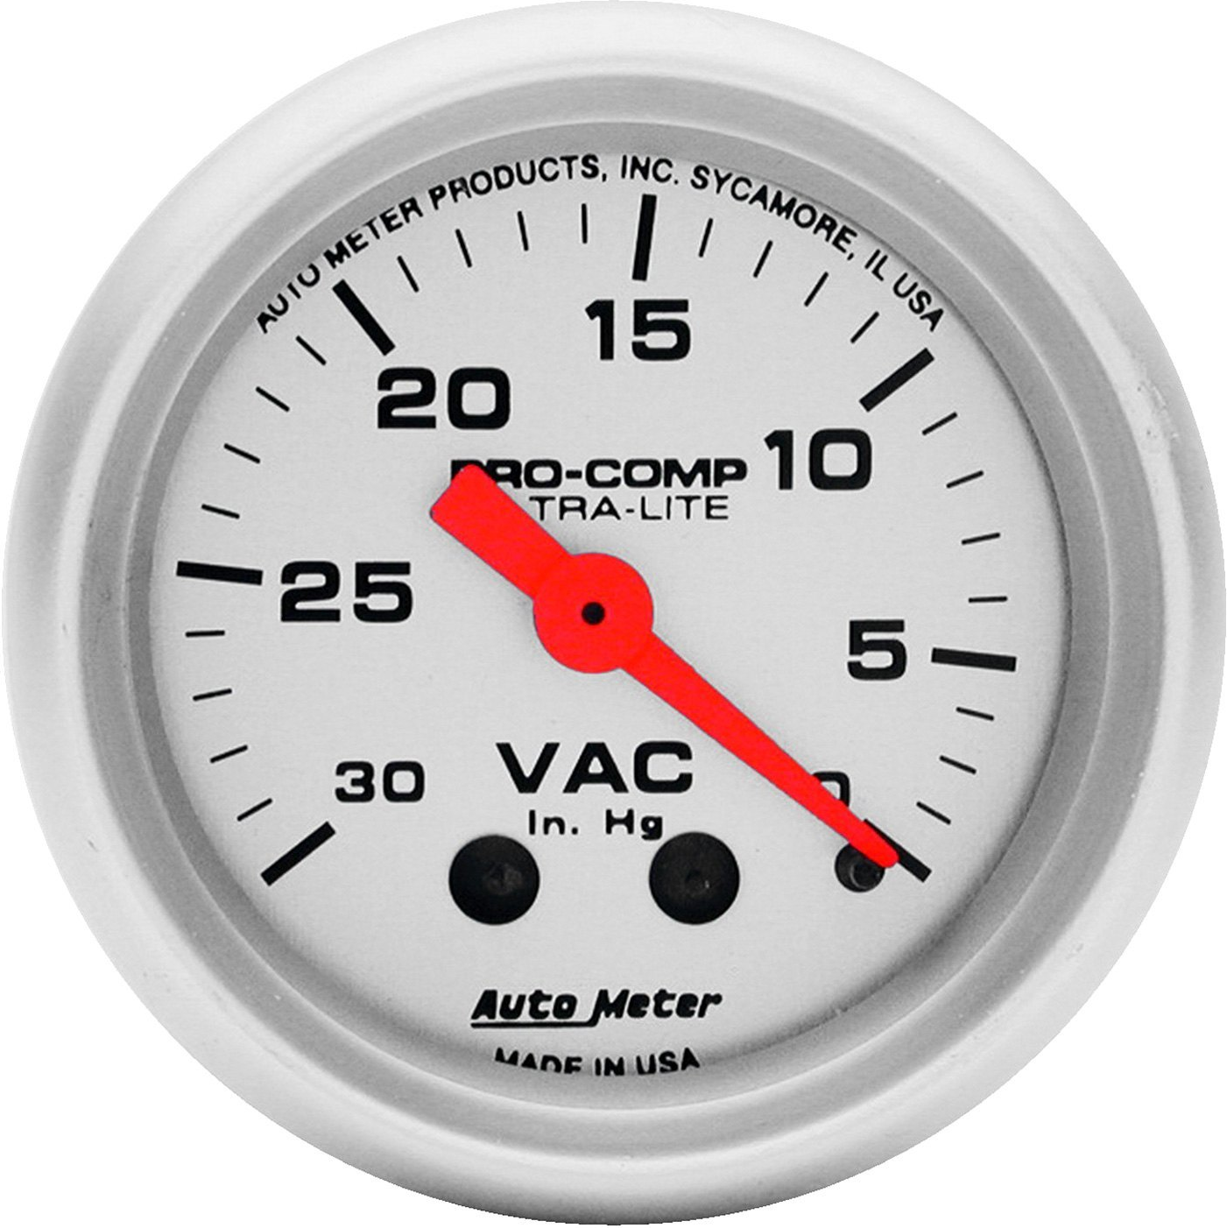

Challenges & current status
Distributed & Global Control
Control network with DAQ
Timing system
Clock(Reference line)
MPS…
Orbit feedback…
BI
Mag. & PS
VAC
Ctrl./DAQ/
Timing/Clock
Part of control along the beam

Slide 6
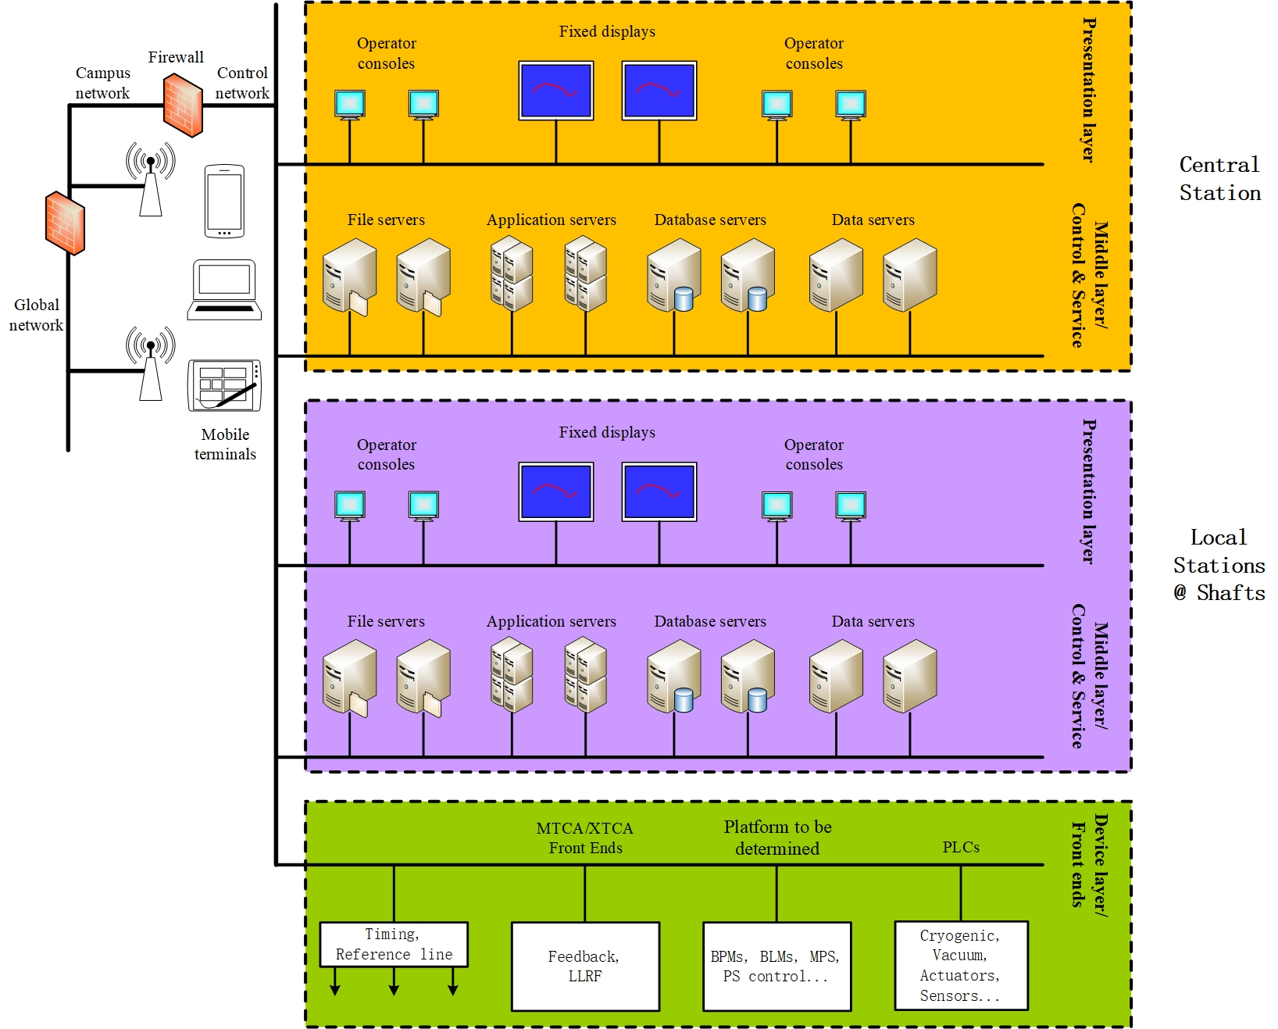

Challenges & current status
Control structure
Local controls at the shafts
for high reliability.
Automation: development, installation, configuration, log, alarm, AI analysis, intelligent OPI, health report, VR …
Joint development & management.

Slide 7
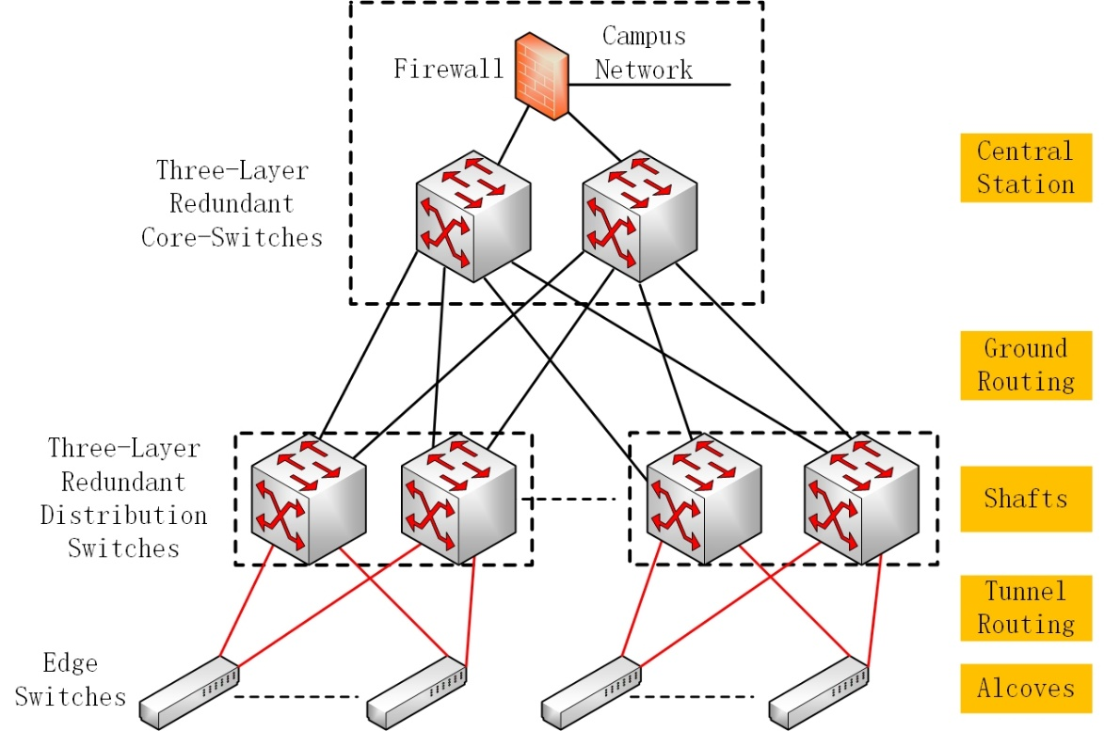
Challenges & current status
Data acquisition and analysis
Distributed data acquisition, online and offline analysis.
Post mortem, real-time health monitoring & AI analysis with 0.1-10MHz sampling segmented data.
(Distributed Logic Analyzer)
Multi-layer network : control and DAQ

Slide 8
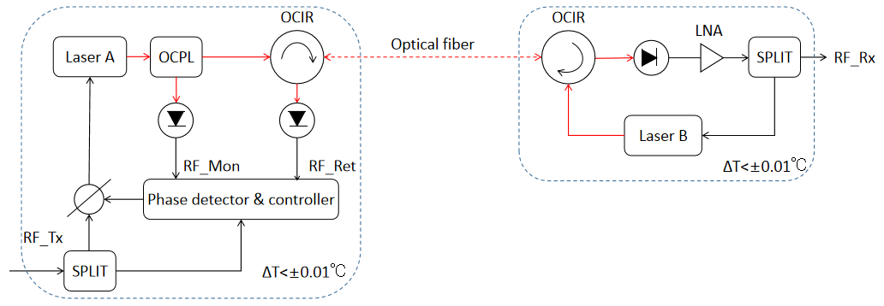
Challenges & current status
Timing system & reference line
Synchronized timing system with real-time delay compensation.
Precise delay compensation and low jitter reference line.
OCPL : Optical Coupler OCIR : Optical Circulator
LNA : Low Noise Amplifier SPLIT : Splitter
Illustration of precise delay compensation of reference line

Slide 9
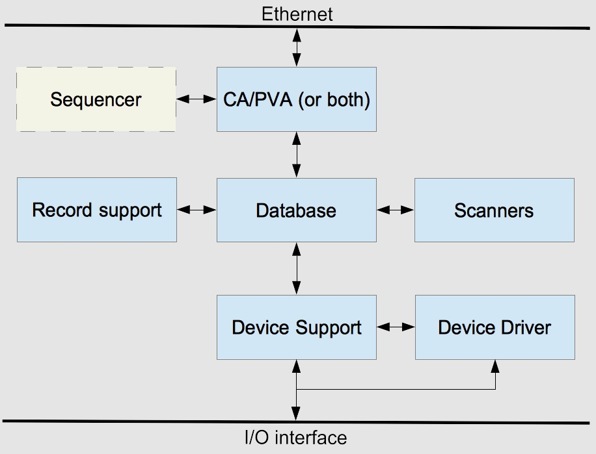
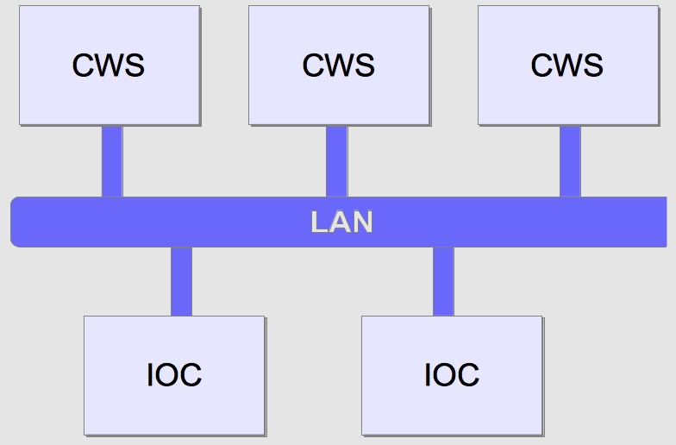
Challenges & current status
Control platform
EPICS is the current selection
  Good structure and performance.
  Good toolsets to use.
  Widely used, also by us.
PV management to reduce broadcasting storm and ease of use.
CWS : Client WorkStation
IOC : Input/Output Controller

Slide 10
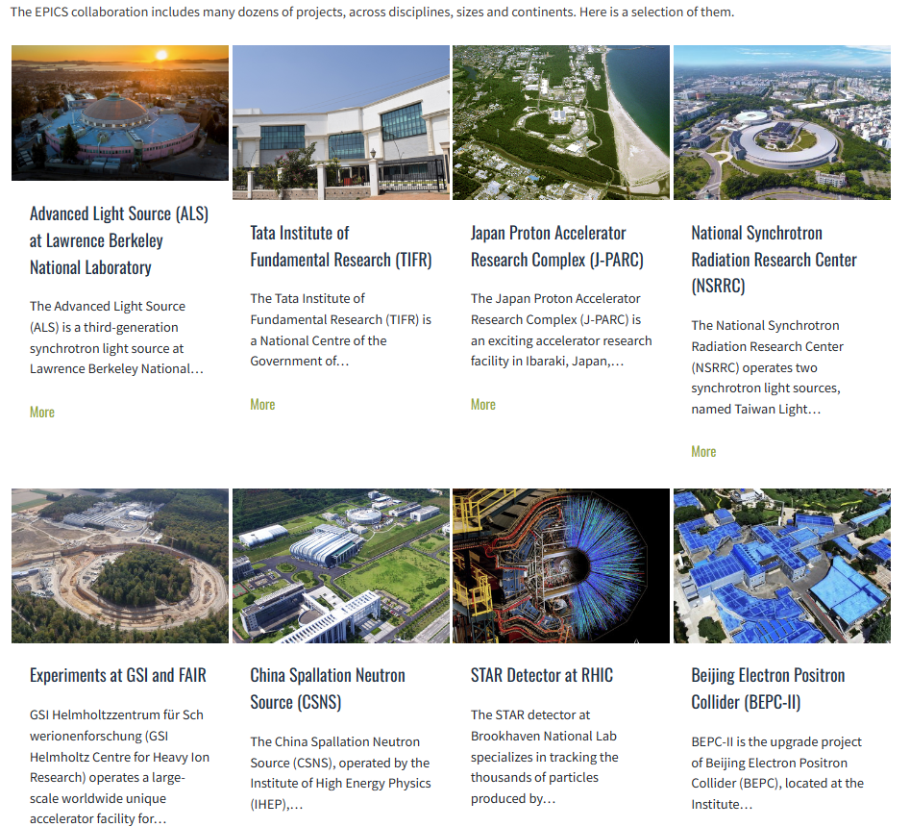
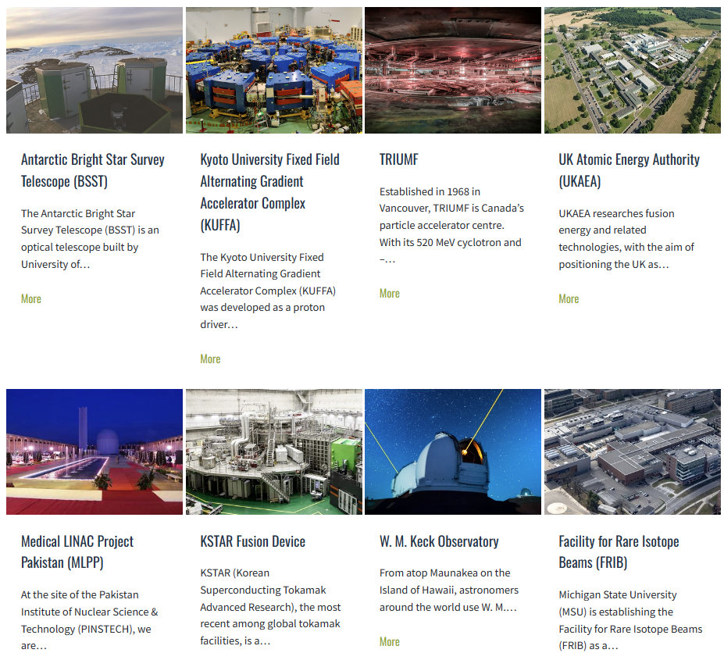
Challenges & current status
Control platform

Slide 11
Challenges & current status
Tunnel inspection
Robot considered to do the inspection
  Easy to avoid strong radiation.
  Easy to install more inspection equipment.
  Low cost.
  Ground guide method to be used.

Slide 12
Further to do
For timing system and reference line, long distance, long time, large temperature variation compensation & test.
Evaluation of radiation to optical fibers, high-speed wireless communication under development and test.
Design of software structure and development for data acquisition, storage, analysis and display, in progress.
Design and development of control structure and automation.
Intelligent OPI, self-drive robot, VR…
Preliminary design of MPS, orbit feedback…

Slide 13
Summary
Key issues : radiation-related front end design, large-scale reference line and timing system, DAQ & applications, automation & intelligence.
Preliminary design & considerations introduced and much work to be done.

Slide 14
Thanks for your attention!

