Slide 1

SRF activities in INFN
Michele Bertucci
INFN Milano – LASA

Slide 2
Outline
History of LASA-INFN activites
LASA expertises:
  Electromagnetic and mechanical design, surface treatments, prototype production, cavity test and diagnostics, series production. Cryomodules, tuners, magnetic shields
Main projects:
  The past: E-XFEL
  The present: ESS
  The future: PIP-II
R&D activities:
  high Q/high G
  New criostat design

Slide 3
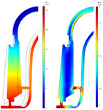
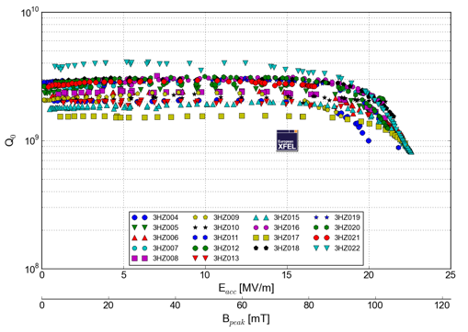
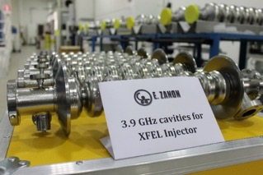
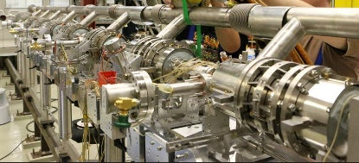
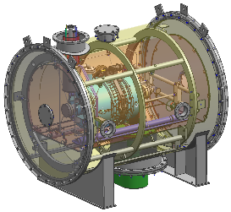
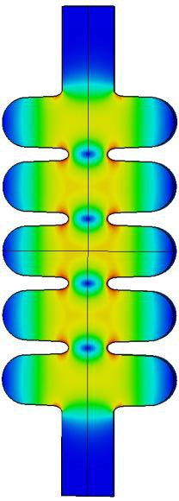
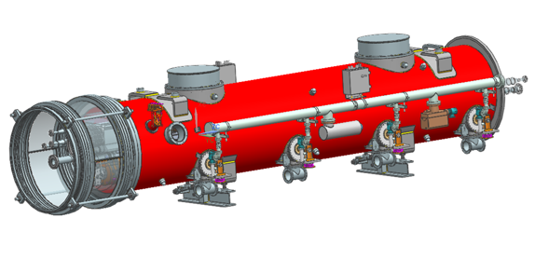
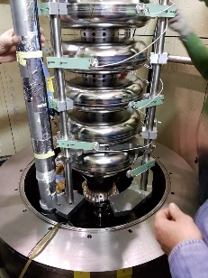
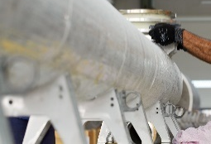
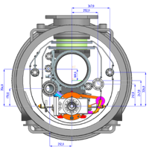
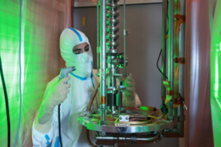
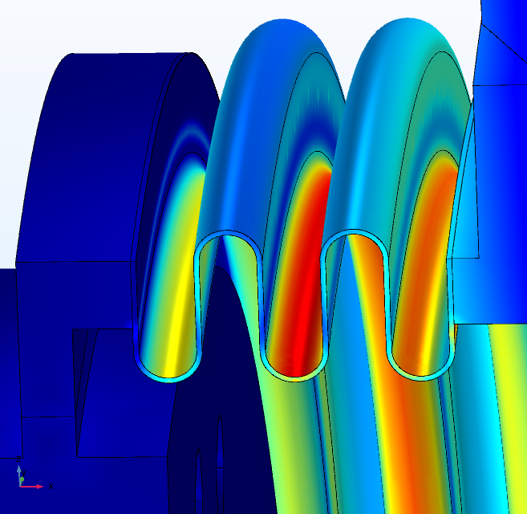
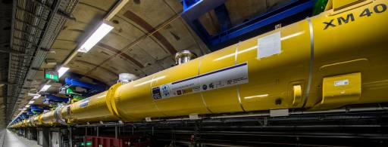
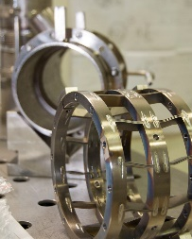
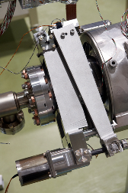
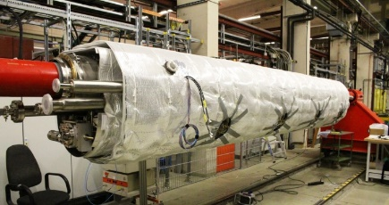
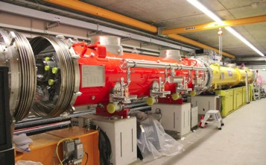
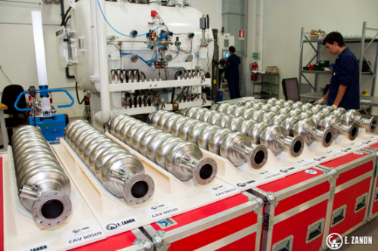
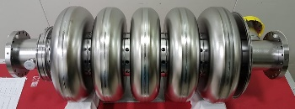





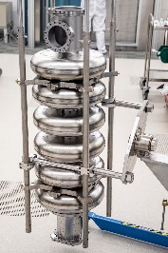
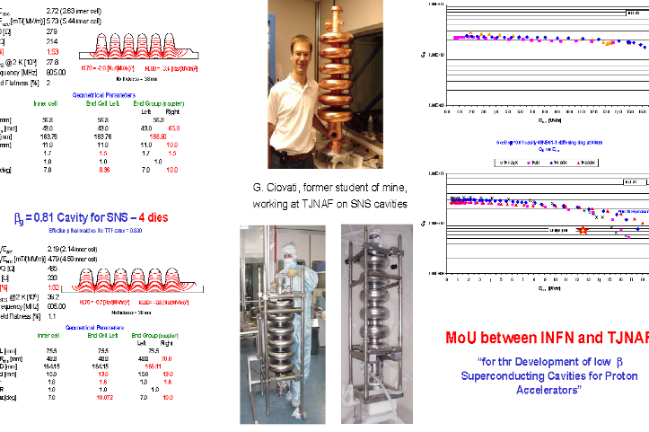


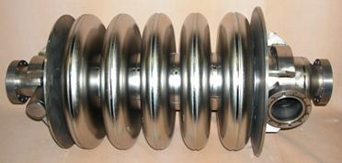
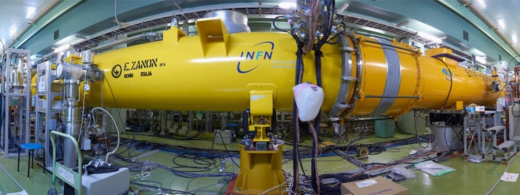

LASA SRF Group: expertise and experience in SRF
LASA SRF Group: expertise and experience in SRF
SRF cavity from design to series production
SRF cryomodule components developments
E.M. Design
Mechanical DEsign
Prototypes
2K Vertical Test
Series Production
Cavity String
Cold Mass
Cryomodule
VT bunker
Tuner
Contribution to International Projects
S1- Global

Slide 4
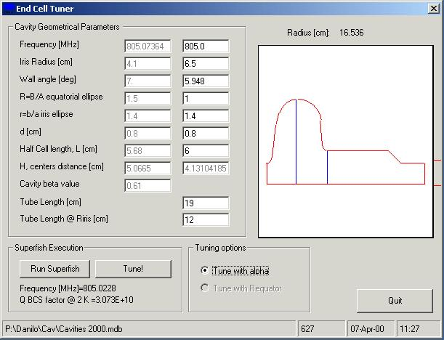
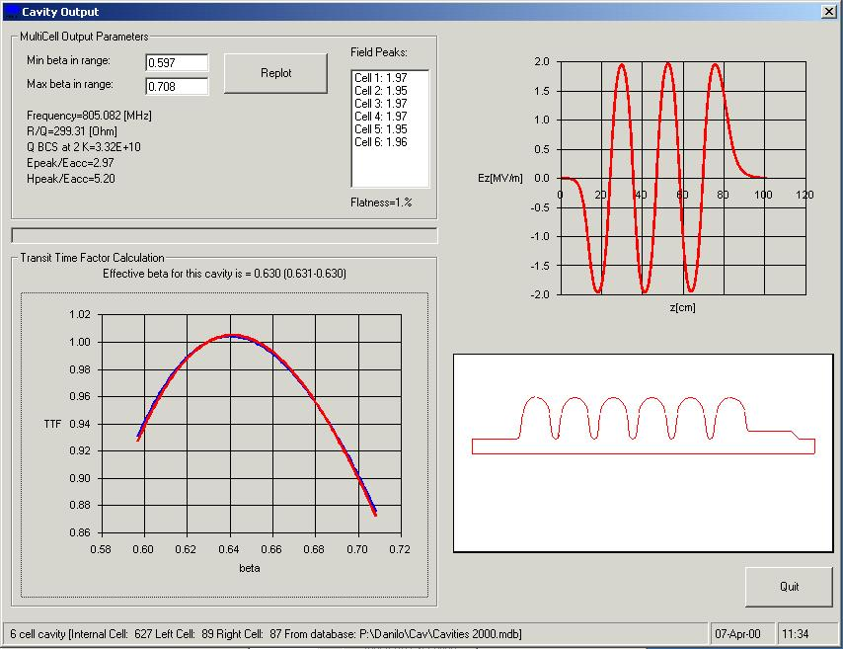

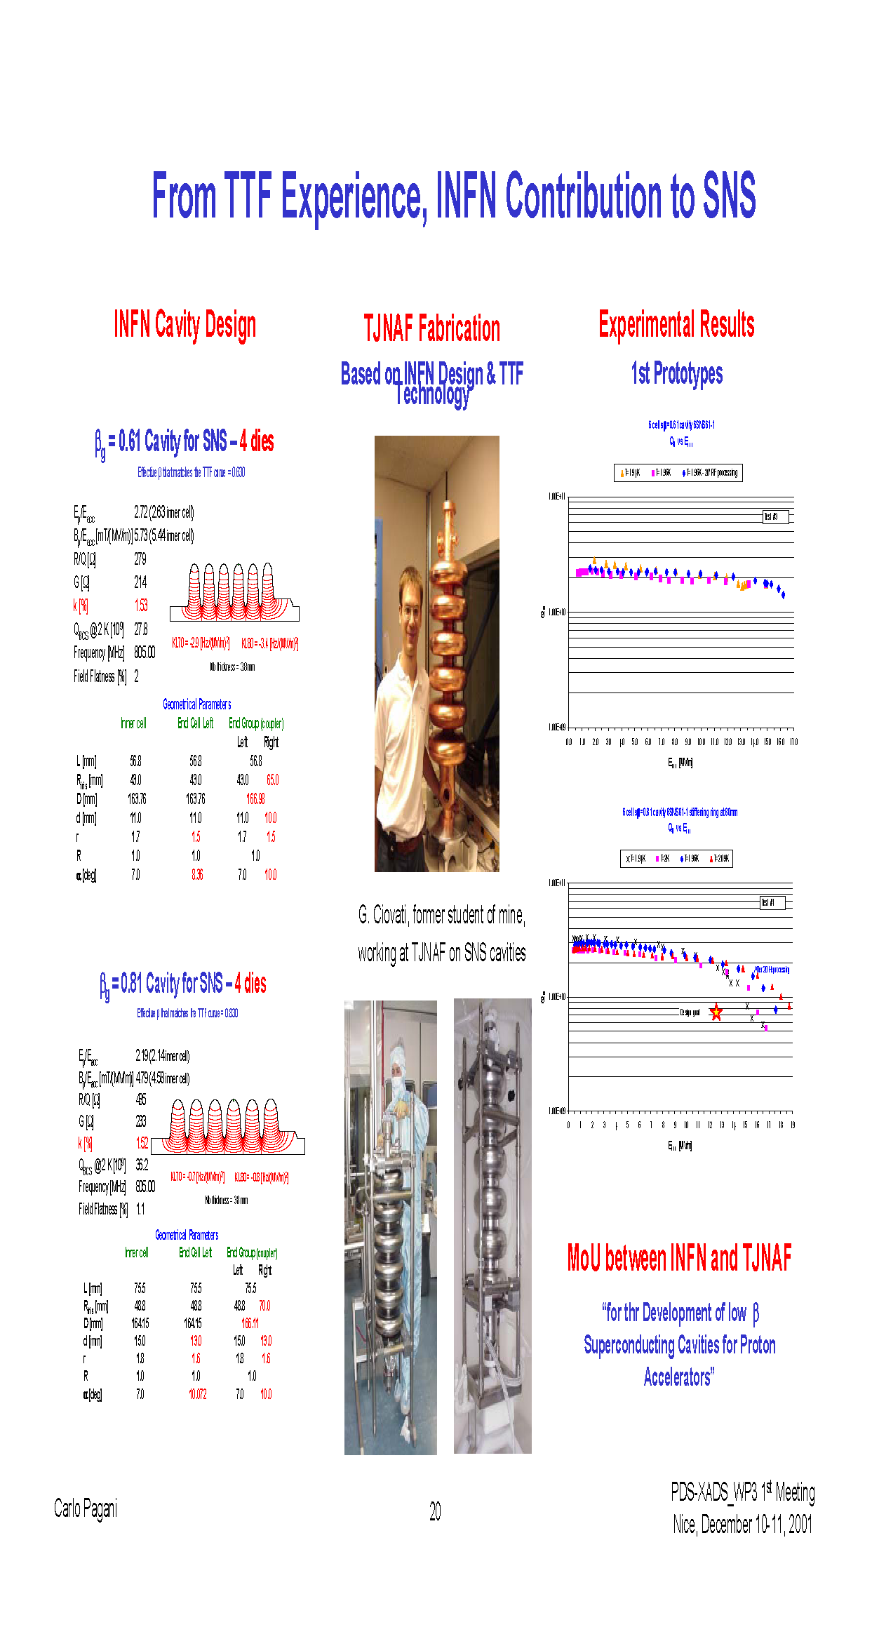

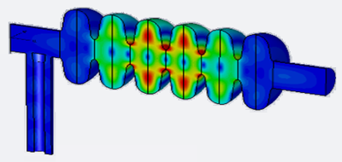
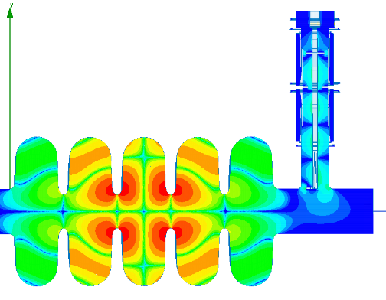
Cavity – Electromagnetic Design
Half Cell Parameters
Full parametric model in terms of 7 geometrical parameters
We built a 2D parametric tool BuildCavity for the analysis of the cavity shape on the electromagnetic parameters based on SUPERFISH
A multicell cavity is then built minimizing Field Flatness error, compute β and TTF as well as final performances
The 2D model constitutes the basis for further 3D simulations (HFSS, CST) for HOMs, multipacting,
field emission considerations
BuildCavity
PIP-II LB Cavity: Example of EM analyses performed: Dipole HOM at 1678 MHz showing partial reflections in the FPC
ESS MB Cavity: Example of EM analyses performed: Dipole HOM at 1742.47 MHz

Slide 5
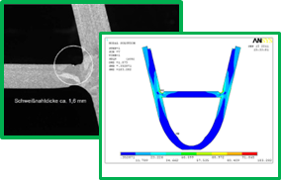
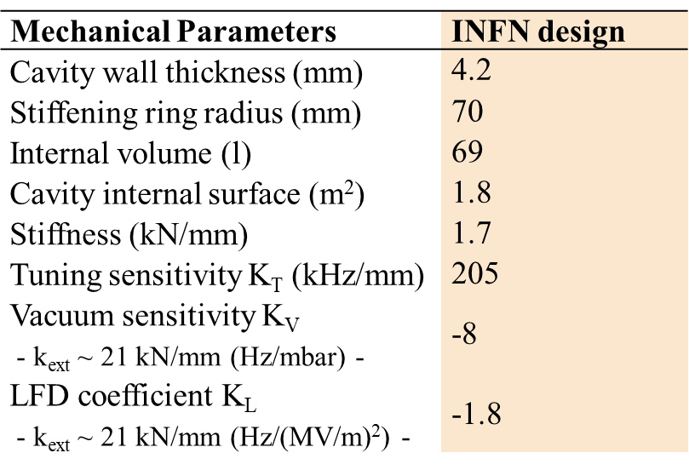
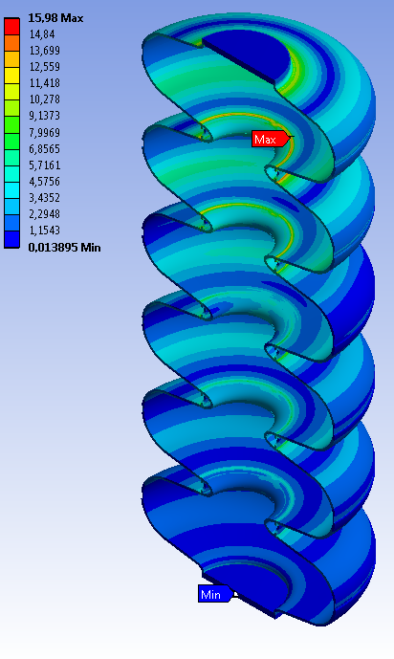
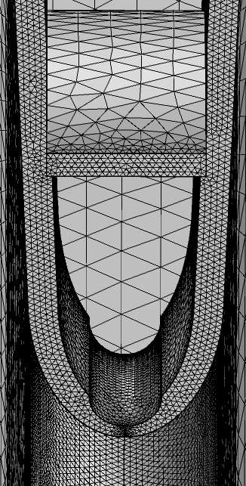
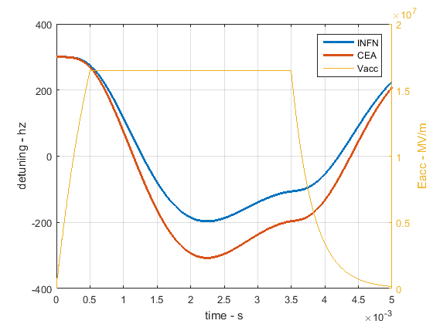
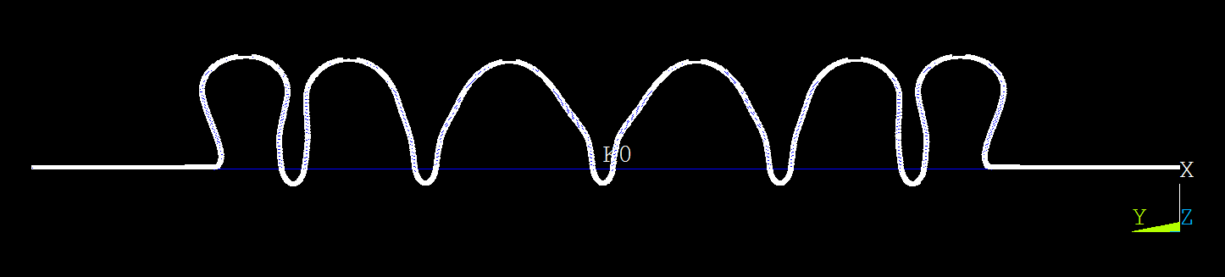
Cavity – Mechanical Design
The EM design is transferred to mechanical analysis (iterative loop) for estimating critical parameters as:
  Ring radius
  Stiffness
  Tuning sensitivity
  Vacuum sensitivity
  Lorentz Force Detuning (LFD)
  PED, ASME compliance
Developed specific tool Mecavity
LFD
Dynamical analyses: natural modes

Slide 6
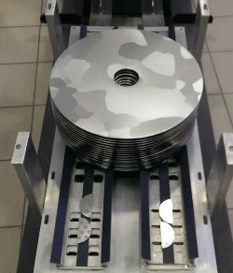
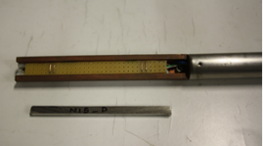
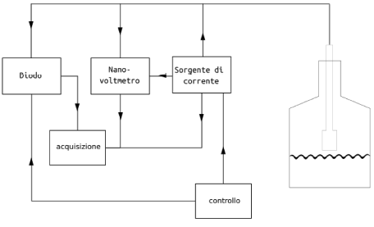
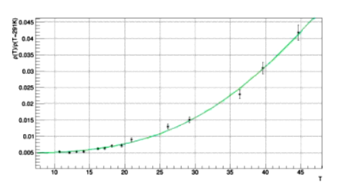
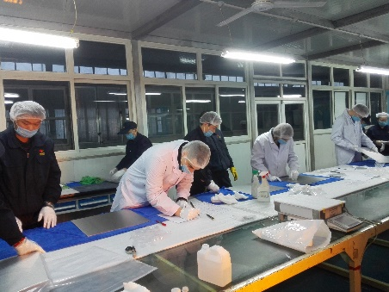

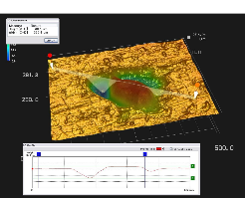
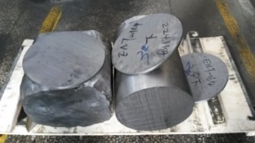
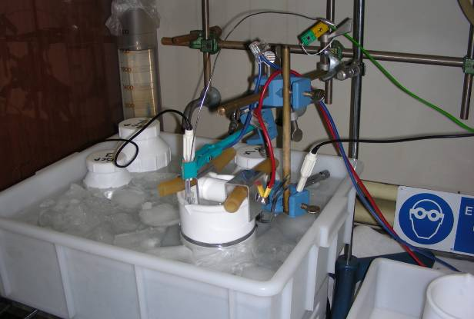
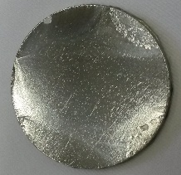
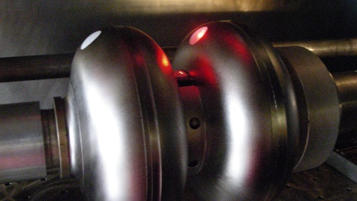
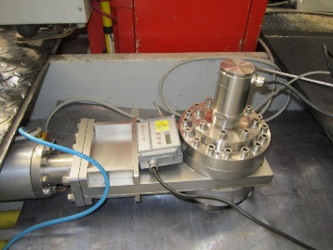
Cavity – Nb studies and characterization
RRR measurements
Nb quality is critical for the final cavity performances:
  Mechanical properties (grain size, hardness, thickness, etc.)
  Chemical composition (elements and gas contents)
  RRR (Residual Resistance Ratio)
  Surface defects (scratches, marks, grease, etc.)
  Foreign materials (ECS – Eddy Current Scanning)
  Traceability (pressure vessel code)
Studies and tools developed:
  Treatment studies (BCP/EP) of
  defect evolution on Nb samples
  Final roughness (Ra) of Nb surface
  RRR measurements set-up
  Experience on FG and LG Nb
  EBW (Electron Beam Welding) studies
LG Nb dics
ECS at DESY
Inspection at Nb supplier
EP set-up at LASA
Pyrometer and gate valve
Measurement during EBW

Slide 7
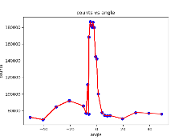
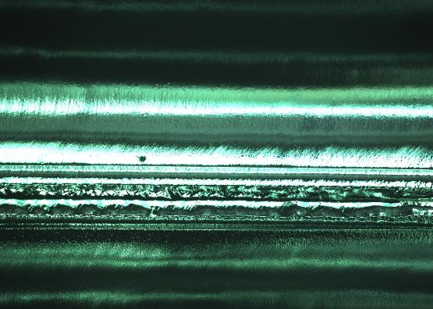
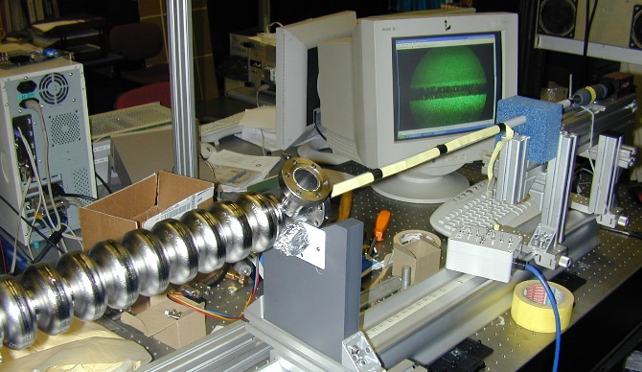
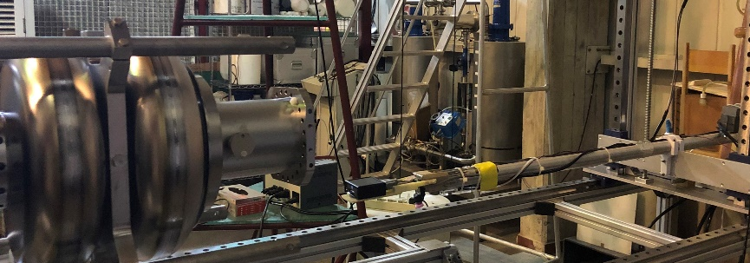
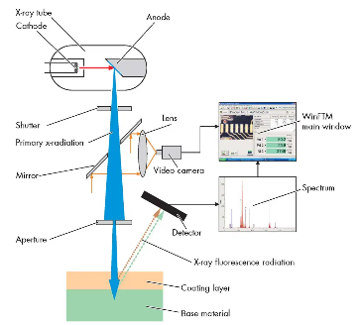



Cavity – Thermal and Surface treatments
Once the mechanical production is complete, thermal and surface treatments play a crucial role in the cavity preparation to reach the final performances.
Thermal treatments for stress release, de-hydrogenation, performance improvement:
  Vacuum quality (RGA - Residual Gas Analysis), pressure and temperature control, RRR
Surface treatments for proper finishing and cleaning of the inner surface exposed to RF:
  BCP (Buffered Chemical Polishing) and EP (Electro Polishing)
Studies and tools developed:
  Depth profile and SEM/EDX for process optimization and quality
  Acid flow simulation and test bench for process improvement
  Temperature and thickness evolution during BCP/EP
  Inner visual inspection set-up for surface finishing check
  X-ray fluorescence set-up for foreign materials analysis (non-destructive diag.)
Annealing cycle
C
EDX
SEM
Depth profile on Nb samples
X-ray fluorescence system and Inner optical inspection
after EBW
after BCP
ESS cavity
E-XFEL 3.9 GHz cavity

Slide 8







Cavity – Cold VT at LASA
Clean Room and UPW
  Ultra-Pure Water plant
  ISO4-7 clean room, HPR system
  Qualified Slow Pumping Slow Venting system
Cryostat: φ 700 mm, 4.5 m length, losses ~ 1 W @ 2 K
Residual magnetic field: < 8 mG (single shield)
  Single μmetal external shield and, second cryogenic
  shield (Cryoperm) installed
Sub-cooling system:
  Cooling power: ∼ 60 W @ 2 K
  Lowest temperature 1.5 K.
  Direct filling at 2 K
RF capability: 500 to 3900 MHz
Dedicated inserts with several diagnostics:
  2nd sound detectors for quench localization
  cryogenic photodiodes
  fast thermometry
  fluxgates/AMR sensors for magnetic mapping
X-ray counter and X-ray NaI spectrometer
Real-time Scintillator
Internal Magnetic Shield
Second Sound
Q₀ = 4 10¹⁰
8

Slide 9
From prototypes to series production
Large projects requirements:
  Large number of components (cavities, cryomodule, ancillaries), massive number of high quality Nb sheets
  Process optimization (industrialization) for high reproducibility and reliability
  High production rate
Laboratory resources:
  not able to manage large numbers in term of quality, man-power, optimized cost, scheduling respect, infrastructures, etc.
Criticalities, warnings (mainly for cavities):
Optimization of components design: feasible for the production and for repairing action
Stable and feasible preparation process: no R&D during series production -> high risk of delays!
Long production cycle: from mechanical production to final steps some months -> risk of several defective cavities and a long and expensive recovery process
High Quality Control (QA/QC plan) is a must: diagnostic of large number of parameters during all production steps (failures mitigation)
Preventive maintenance on plants: mitigation of possible faults

Slide 10


European XFEL
Italian in-kind contribution:
1.3 GHz: 320 cavities, 42 cryomodules, QC 800 tuners
3.9 GHz: 1 cryomodule, 20 cavities (blade tuners, He-tanks, magnetic shields)

Slide 11









European XFEL: 1.3 GHz series cavity
Purposes:
800 SC cavities, 3 Nb suppliers, 2 industries,
2 recipes (Final EP/ Flash BCP)
Average usable E-XFEL gradient
  Q₀=1x10¹⁰ @ 23.6 MV/m, X-Rays <1x10⁻² mGy/min
Delivery rate about 8 CVs/week
How it worked:
Materials and vendors qualification (Nb)
Definition of production specs (2 recipes),
PED 4.3 compliant (prototypes, TESLA experience)
Cavity producers qualification (mechanical)
Technology transfer to industries
Grown and qualification of insfrastrucutes
Qualification of the transferred technology
Set-up of the «external» QA/QC at industries
Series cavities production: continuos monitoring
of key parameters
Prompt feedback of the production quality
(analysis of VT vs. key parameters)
Final EP / Flash BCP
Inclusions
in Nb sheets
Analysis VT @ 2 K vs. running production quality
EBW (EZ)
120 °C baking system (EZ)
HPR cabinet (RI)

Slide 12





European XFEL: 1.3 GHz series cavity results
Results:
Accepted Cavities as Delivered: ≈ 70% (over 800)
After Additional Treatments (mainly HPR):
all cavities accepted
Rejected Cavities (replaced by companies): 8 (1%)
In total 3 years (2013-2015)
Final EP
Cavities ready for the cold test at AMTF (DESY)
Final Performances
E_{max} = 33.0 ±4.8 [MV/m]
E_{usable} = 29.8 ±5.1 [MV/m]
Q₀ (23.6MV/m) = 1.4 ±0.2 [10¹⁰ ]
(E_{goal} = 23.6 [MV/m], Q₀ ≥1·10¹⁰)
After 33.0 ± 4.8 [MV/m]
Before 31.4 ± 6.8 [MV/m]
After 29.8 ± 5.1 [MV/m]
Before 27.7 ± 7.2 [MV/m]

Slide 13







European XFEL: 3.9 GHz cavity and cryomodule results
Results:
Accepted Cavities as Delivered: 85% of 20 overall
After Additional Treatments (only HPR): all accepted
Rejected Cavities: none
Delivery rate: 2 cavs/3 weeks
Blade Tuner
String Assembly (DESY)
3.9 GHz cavities on LASA VT insert
RF Curvature Linearization by AH1
3.9 GHz Blade Tuner
X (i.e. E)
Off
On
September 23, 2015
3.9 GHz cavity ancillaries
Y (i.e. t)

Slide 14


European Spallation Source
High Power
Linear Accelerator:
Energy: 2 GeV
Rep. Rate: 14 Hz
Current: 62.5 mA
Target Station:
He-gas cooled rotating
W-target (5MW average
power)
42 beam ports
16 Instruments in Construction budget
Committed to deliver 22 instruments by 2028
Peak flux ~30-100 brighter than the
Institute Laue-Langevin
10²⁰
Reactor Sources
Spallation Sources
J-PARC
ESS
HIFAR
HFIR
ILL
LANSCE
ISIS
SNS
CSNS
10¹⁵
MTR
HFBR
MARIA
ORPHEE
IPNS
SALAM
HANARO
NRX
NRU
NIST
ZING-P’
Dhruva
FRM-II
CARR
PIK
SAFARI-1
JRR-3
ETERR-2
OPAL
Ion Source
LVR
RSG
SINQ
IBR-II
HOR
JEEP II
KENS
X-10
WNR
Effective thermal neutron flux n/cm²-s
ZING-P
10¹⁰
CP-2
CP-1
10⁵
Berkeley 37-inch cyclotron
Particle driven pulsed
350 mCi Ra-Be source
Particle driven steady state
Pulsed reactor
1
Chadwick
Fission reactors
1930
1940
1950
1960
1970
1980
1990
2000
2010
2020
2030
Year
(Updated from Neutron Scattering, K. Skold and D. L. Price, eds., Academic Press, 1986)
Total cost: 1843 MEuros ₂₀₁₃

Slide 15







ESS: 704.4 MHz series cavity
Purposes:
36 (+2) SC cavities, 1 Nb suppliers, 1 industry, 1 recipe (BCP)
ESS medium β (0.67) Q₀ = 5·10⁹ @ 16.7 MV/m
How it is working:
Definition of Nb specs and QC
(inspection at Nb vendor, ECS at DESY)
Optimization of the RF and mechanical design
Definition of detailed production specs (1 recipe),
PED sound engineering practice compliant
(3 prototypes)
Infrastructures adapted to 704.4 MHz larger geometry
and qualified (BCP treatment, new HPR head geometry,
new inner inspection system, EP treatment,
tuning machine)
Definition of the QC plan -> QC improved for the
interfaces between all partners
(INFN-Industry-DESY-CEA-ESS)
Management of all documentation
(INFN Alfresco based) and database
developed for analysis of key
production parameters
Cold VT at LASA for «special» cavities
(more diagnostics available)
ECS Nb sheets (DESY)
Cavity tuning machine
High Order Mode
1742.466 MHz
QC documents and DB analysis
He tank integration

Slide 16




ESS: 704.4 MHz series cavity results
Results:
Cavities at CEA for string assembly (cryomodule): 36 (+1 spare)
Accepted Cavities as Delivered: 27
Recovered after Additional Treatments
  HPR: 3; EP: 3
Further 4 cavities produced (EP cycle):
  Now integrated in cryomodule 9 @ ESS
Cavities in quarantine: 5
Recovery strategy:
HPR improved to better fit the cell shape
(new head), EP adapted to ESS shape for surface treatment:
-> performance improvement of MP/FE limited cavities
rotating BCP on integrated cavities:
-> some performance improvement
Risk mitigation with 4 new cavities produced:
-> all cavities overcome ESS goal (EP process)
ESS cavity on LASA insert
New series cavties

Slide 17















INFN in-kind contribution to PIP-II
INFN LASA provided a novel RF design for the LB650 cavities, compliant to Fermilab technical interfaces and specifications (outstanding Q₀ requirements).
INFN-LASA contribution will cover the needs of LB650 section:
2 proto cavities to validate processing and tech. transfer
38 SC cavities required to equip 9 cryomodules with 2 spares, delivered as ready for string assembly.
Qualification via vertical cold-test provided by INFN through a
qualified cold-testing infrastructure acting as a subcontractor
Compliance to the PIP-II System Engineering Plan
PIP-II LB650 Project Specifications
Acc. Gradient | 16.9 MV/m
Q₀ | 2.4 10¹⁰
RF rep rate | 20 Hz to CW
Beta | 0.61
INFN Deliverable Components | Acceptance Early Date
LB Jacketed Cavities (Batch 1 - Qty 4) and Pre-Series (Qty 2) | Jun-2025
LB Jacketed Cavities (Batch 2 - Qty 4) | Aug-2025
LB Jacketed Cavities (Batch 3 - Qty 4) | Oct-2025
LB Jacketed Cavities (Batch 4 - Qty 4) | Dec-2025
LB Jacketed Cavities (Batch 5 - Qty 4) | Feb-2026
LB Jacketed Cavities (Batch 6 - Qty 4) | Apr-2026
LB Jacketed Cavities (Batch 7 - Qty 4) | Jun-2026
LB Jacketed Cavities (Batch 8 - Qty 4) | Sep-2026
LB Jacketed Cavities (Batch 9 - Qty 4) | Oct-2026
Cryoplant
Elliptical
HB650 X 4
24 Cavities
650 MHz
Elliptical
LB650 X 9
36 Cavities
650 MHz
Single Spoke
SSR1 X 2
16 Cavities
325 MHz
Single Spoke
SSR2 X 7
35 Cavities
325 MHz
CDS
HWR
8 Cavities
162.5 MHz
H- Ion source
833 MeV
516 MeV
177 MeV
RFQ
PIP-II linac layout
800 MeV, 2 mA, H- beam, CW compatible
10 MeV
32 MeV
2.1 MeV

Slide 18





LB650 on-going activities at INFN
R&D towards high Q₀ and preparation for transfer to industry
  Prototypes to develop proper surface treatments
    B61-EZ-001 jacketed and tested at FNAL
    B61-EZ-002 jacketed and tested at LASA
    B61S-EZ-001 single cell treated and tested at FNAL
    B61S-EZ-002 treated, jacketed and tested at LASA
    B61S-EZ-003 single cell processed and tested at LASA
  Develop diagnostic for process control
  Analytical Field-Emission model
  Cavity transport boxes developed; prototypes built
  Prepare LASA test station for high Q₀ measurements
    Lower residual magnetic field, Helmholtz coils
    Faster cool-down rate across SC transition
Main procurements in view of the series production
  RRR300 Nb tender: 1st batch inspected in Oct. 23 and delivered, next Eddy Current Scanning.
  Agreement with DESY in progress for Eddy current scanning and series cavity vertical tests
  Cavity manufacturing, treatment and preparation: CFT and selection closed, waiting for
  final awarding.

Slide 19


INFN High-Q/High-G R&D activities
Foreseen activity (3 years):
Surface treatments development for reaching High-Q/High-G
perfomances (single-cells)
Industrialization: from single to multicell cavity
R&D on cavity ancillaries (tuner, magnetic shield, etc,)
R&D for High-Q/High-G cavities :
1-cells 1.3 GHz: surface and thermal treatments development & qualification
  E-XEFL (baseline), Mid-T , two-step baking
  Cold VT (qualification) at LASA and in other labs (results validation)
9-cells 1.3 GHz: industrialization (9-cells) of the developed process
Mid-T
Two-step
Upgrade of LASA VT system:
New cryostat dedicated to R&D:
Design specifically for R&D on TESLA type single- and multi-cell cavities
Much faster overall work cycle compared to main cryostat
  Active B-field compensation by design
Sketch of R&D cryostat and insert
Helmholtz coils (based on PIP-II experience)

Slide 20




INFN High-Q/High-G R&D: experience
on PIP-II LB650 single-cells
The same recipes foreseen for the 1.3 GHz cavities are currently carried out on the PIP-II LB650 single cell prototypes
This allows a real-time optimization of treatment parameters (EP, furnace for baking, HPR,….)
Coil field + residual field CST simulation
PIP-II Vertical insert with Helmoltz coils
Field cancellation during cooldown
transient
Done
To be done
Done

Slide 21


Sinergies: ITN e EAJADE
ILC Technology Network (ITN), 2-4 years
derived from ILC IDT (ILC International Development Team) to support pre-lab technological
priorities as identified by the International Expert Panel
  March ’23: budget approved by Japan; KEK-CERN agreement: signed in July 2023
  INFN Milano LASA involved in ILC SRF activities (R&D and industrialization of 1.3 GHz cavities)
  Activities foreseen in 2023-2026
    Treatments targeted to ILC goal (single and 9-cell cavities) towards industrialization with qualified vendors
    Harmonization of pressure vessel codes (PED/ASME/HPGS)
    Fine Grain and Mid Grain Nb studies for single and 9-cell cavities -> in view of the cost reduction
    Assembly at KEK of an ILC cryomodule with 1 EU cavity, 1 US cavity and 6 Japan cavities
EAJADE, 4 years
Staff exchange network for accelerator R&D within elementary particle physics
  Exchange between:
    EU labs/univerisity and US-Japan labs/universities
    EU labs/univeristy and EU industries
  started in March 2023, 4 years duration
  Six WPs
INFN responsibility:
  WP2 lead beneficiary L. Monaco (State-of-the-art high-gradient,
  high-efficiency, reduced-cost radio-frequency structures
  and power Sources)
ILC cavity Goal
Marie Skłodowska-Curie Actions Staff Exchanges

Slide 22
Conclusive remarks
LASA is involved since several years in the field of SRF
  Cavity design (EM and mechanical), prototyping, study of material and surface treatments, vertical test in the LASA facility. Beyond cavities: cryomodule installation, tuner, magnetic shields,...
LASA contributes to the series production of cavities for acceleration of electrons (E-XFEL) and protons (ESS, PIP-II)
LASA is devoted to R&D activities for the development of surface treatments for high-Q/high-G performances in view of future colliders
  Study and industrialization of cutting-edge surface recipes
  Project and development of a cryostat for prototypes with high magnetic hygiene and dedicated diagnostics to investigate possible performance limitations.

