Slide 1
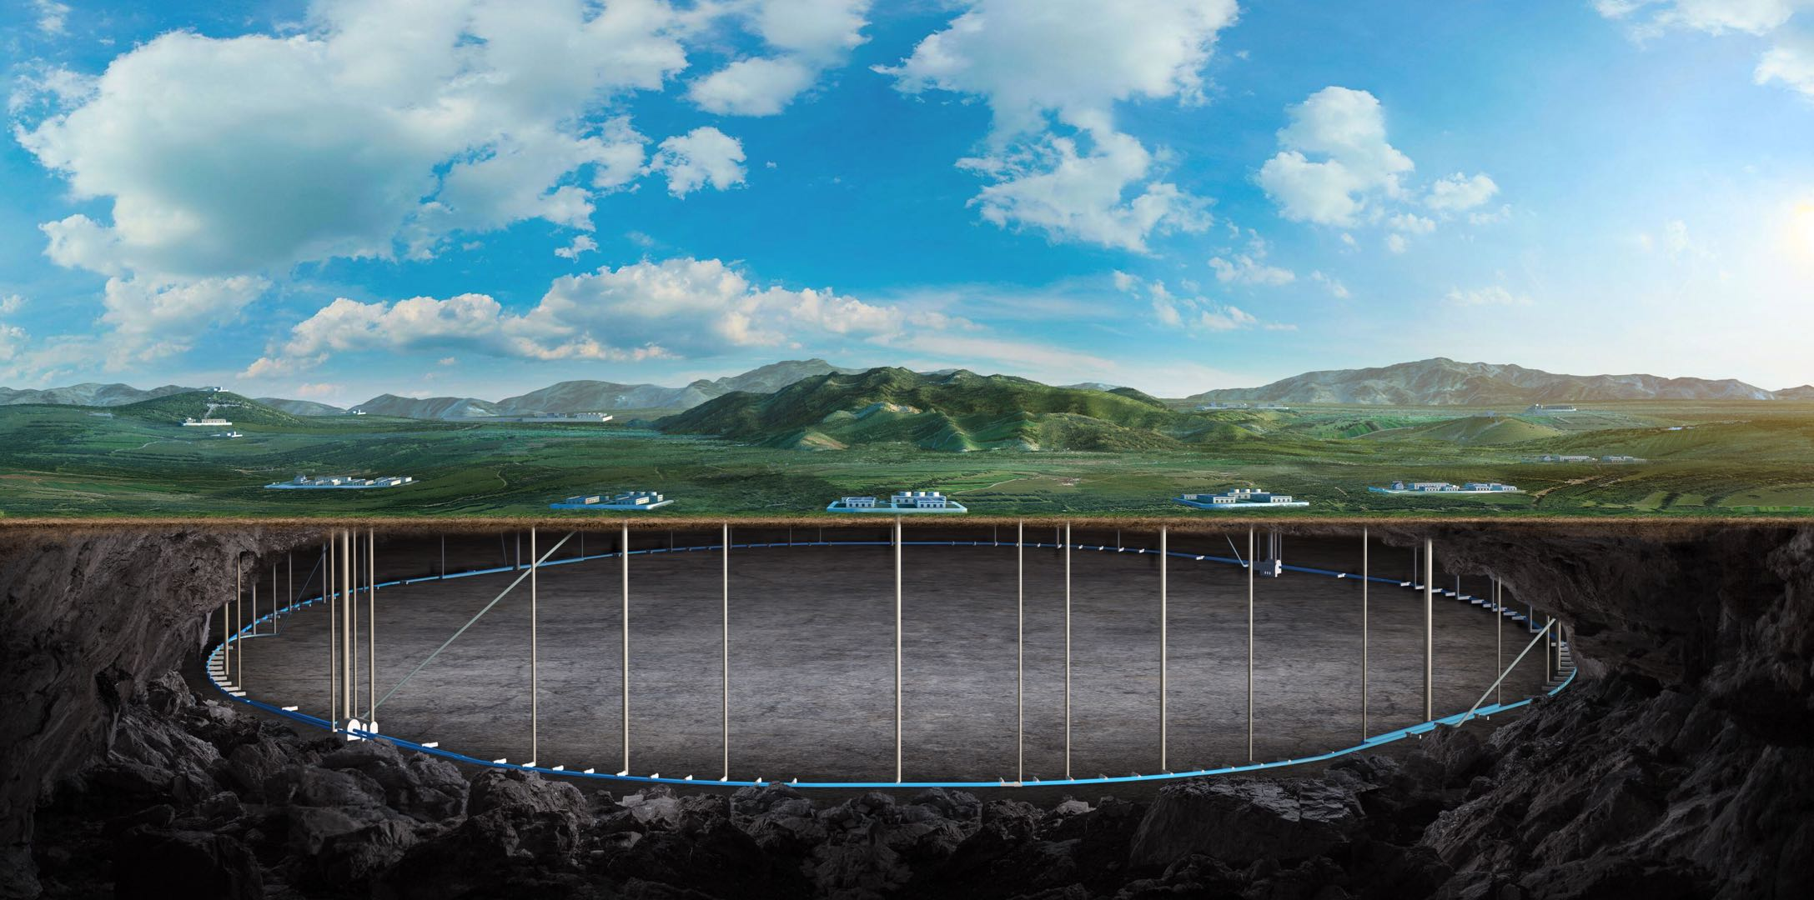
CEPC Booster and Collider ring
magnets in EDR
Wen Kang
On behalf of the CEPC magnet group

Slide 2
Contents
The dipole magnets for the Booster
Automatic magnet production line
Automatic field measurement system
The magnets for the Collider
Summary

Slide 3
The dipole magnets for the Booster
The Booster will share the same tunnel with the Collider, which has a circumference of 100km. There are 19624 magnets equipped with the Booster, the main specifications of the magnets are listed in the table.
 | Number | Length | Min. field | Max. field | Field errors (@45mm)
Dipoles | 14866 | 4.7m/2.35m | 95Gs | 564Gs | 1×10^{–3}
Quadrupoles | 3458 | 2m/1m/0.7m | 2.0T/m | 15.86T/m | 5×10^{–4}
Sextupoles | 100 | 0.4m | 18T/m² | 217T/m² | 1×10^{–3}
Correctors | 1200 | 0.58m | 20Gs | 200Gs | 5×10^{–3}
More than 74% of the Booster's circumference will be covered with magnets. So the cost of magnets is a significant concern in the design of the magnets, particularly the dipole magnets.

Slide 4
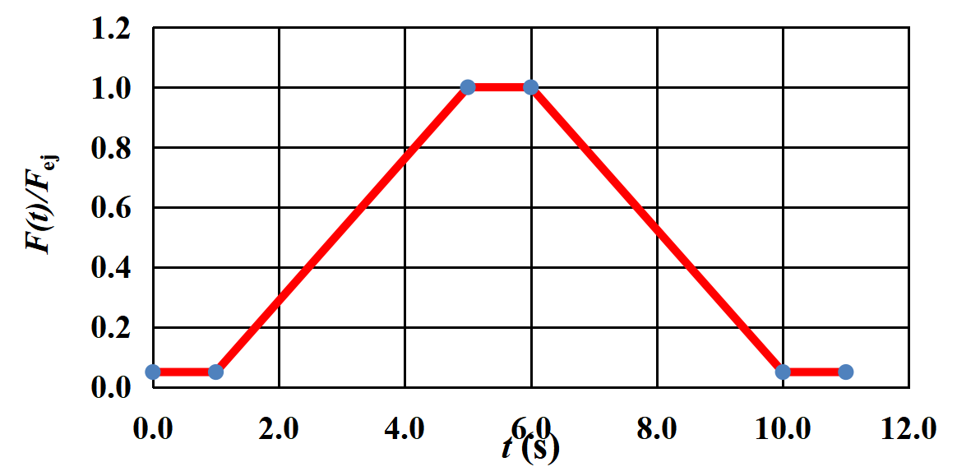
The dipole magnets for the Booster
The field of the magnets will change with the beam energy during the acceleration of particle beams. In order to reduce eddy current, the cores of the Booster magnets will be produced by laminations not by solid iron.

Slide 5
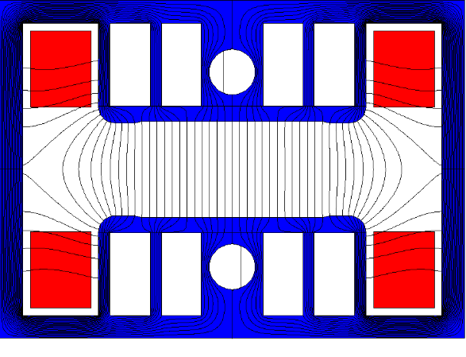
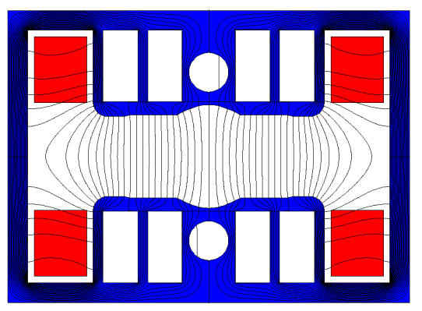
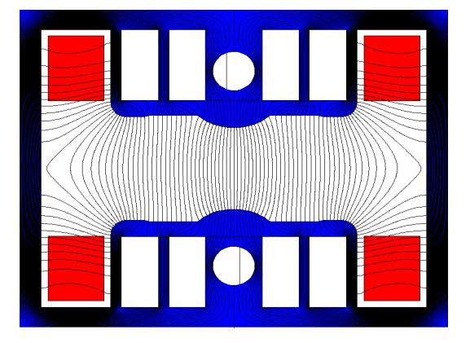
The dipole magnets for the Booster
The Booster dipole magnets are grouped into three families. One is the pure dipoles, the others are the dipole-sextupole combined magnets.
To achieve better shielding effectiveness from the earth's field, a closed H-type core was chosen.
To decrease weight and cost of the magnets, the cores are stacked by steel laminations and aluminium laminations, the return yoke of the core is made as thin as possible, and in the pole areas of the laminations, some holes are punched.

Slide 6
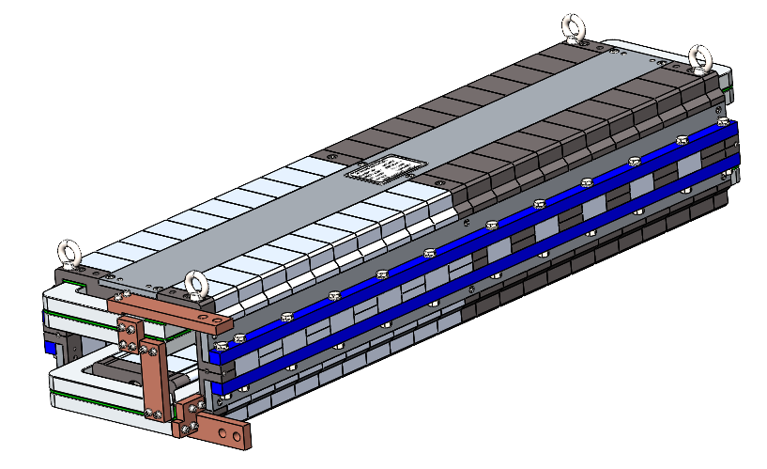
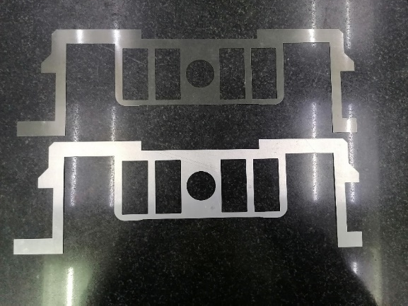
The dipole magnets for the Booster
To study the influence of the thickness ratio between the steel and aluminum lamination as well as to test performance of the newly developed lamination with thickness of 1mm , two kinds of subscale dipole magnets will be developed.
One magnet will be produced by the 0.5mm thick steel laminations and 1mm aluminum laminations. The magnet has two parts, of which the ratio of two laminations are 1:1 and 1:2.
If the field performance of the 1:2 ratio is OK, half magnet with ratio of 1:1 will be replaced by the stacks of newly developed steel laminations and aluminum laminations with ratio of 1:2.

Slide 7
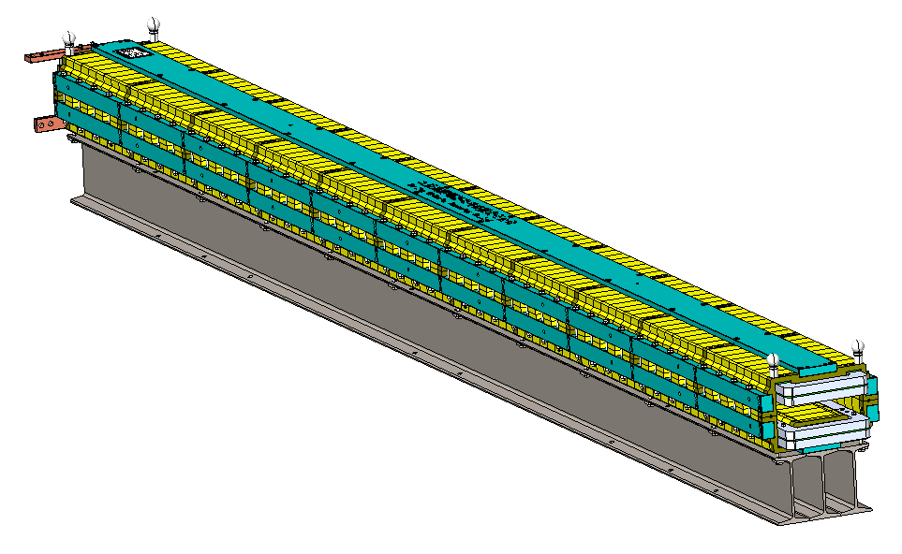
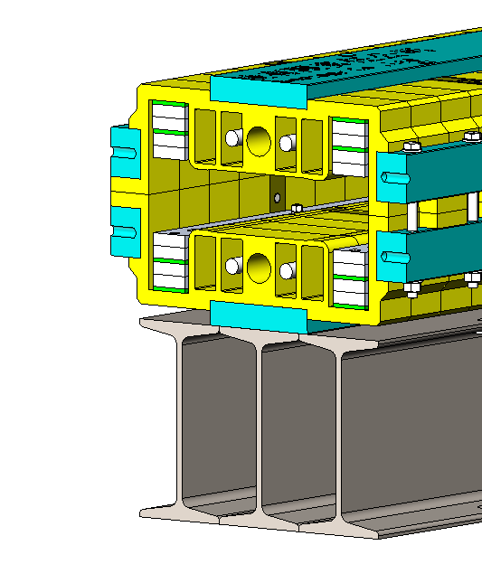
Automatic magnet production line
Purpose：To decrease the production cost and increase the production efficiency of the dipole magnets, three automatic magnet production lines are planned to be developed. Each line will automatically produce 4 magnets every day so that three lines are expected to complete the production of 15000 magnets in five years.

Slide 8
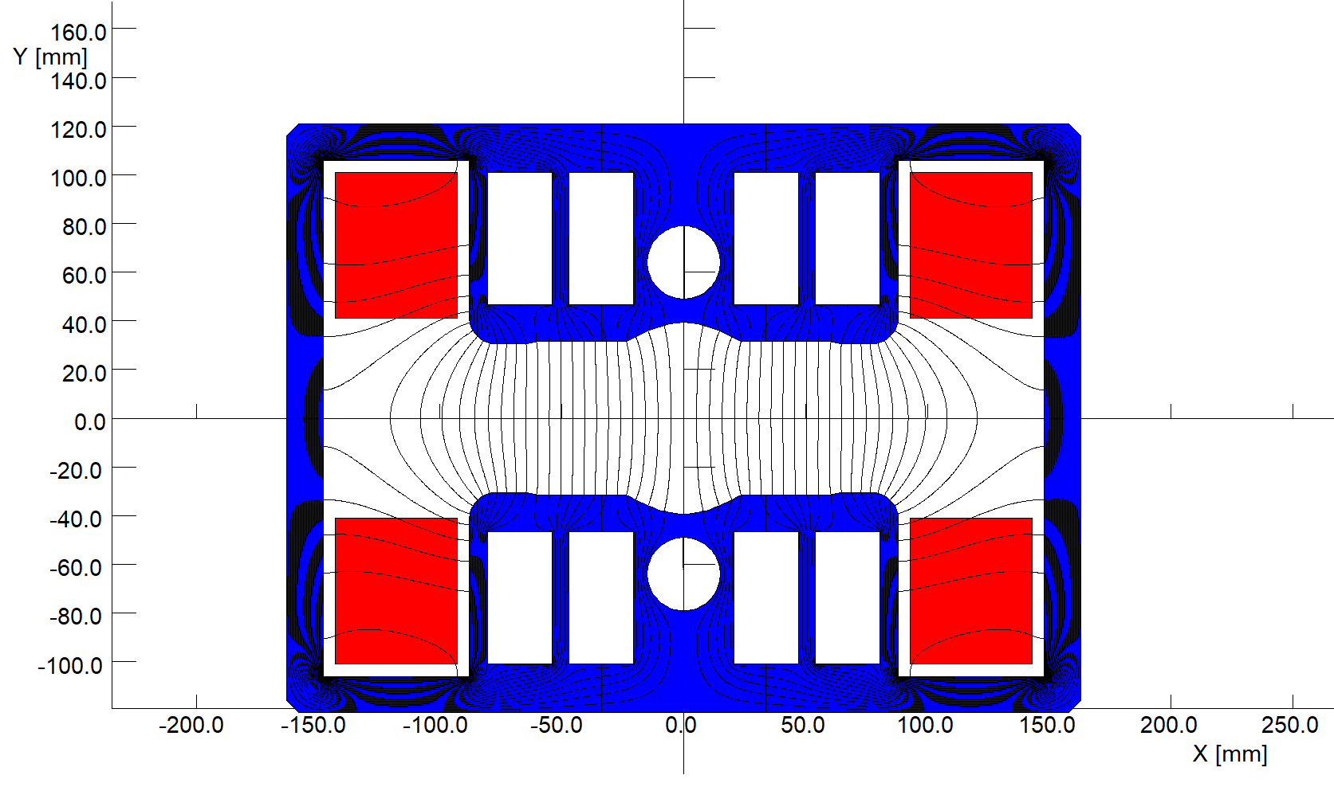
Automatic magnet production line
The first automatic magnet production line will produce one kind of the dipole-sextupole combined magnet for the CEPC Booster. The optimized cross section and magnetic flux lines of the magnet are shown below.

Slide 9
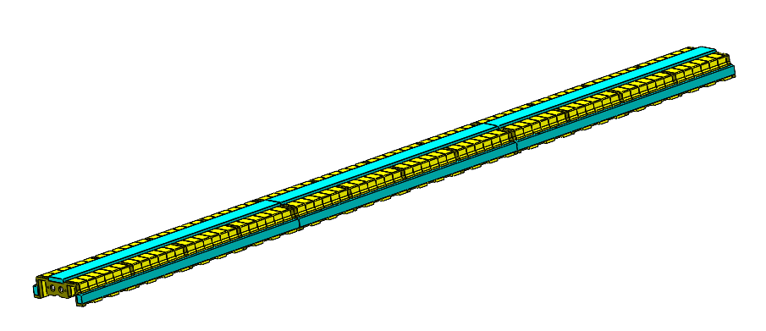
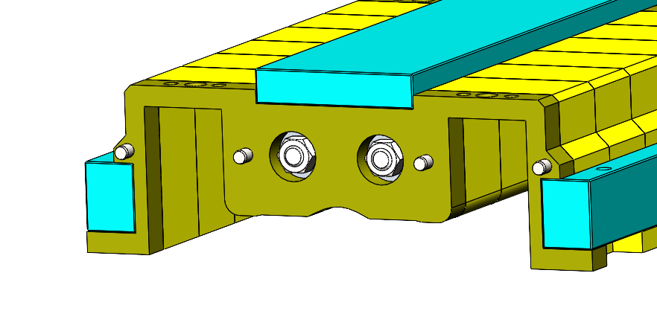
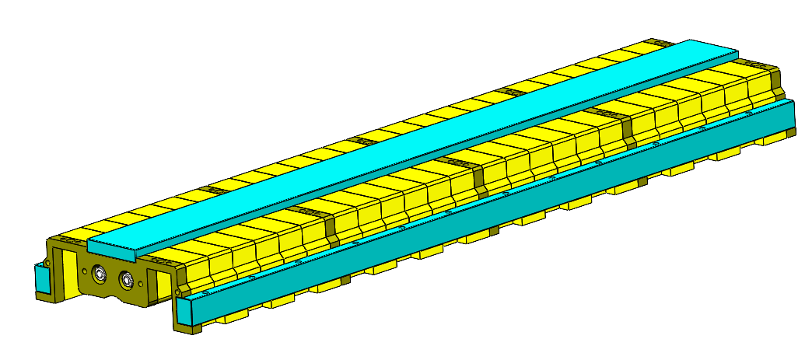
Automatic magnet production line
The magnet has a two-in-one H-type structure, of which the length is 4680mm and the gap is 63mm.
The cores of the magnet are composed of steel and aluminum lamination, iron plates, central and surrounding draw bars.
Since the cores are too long to ensure the production precision, especially produced by automatic production line, the long cores will split into three short ones and then assembled together, so the actual length of the stacked cores is shortened from 4680mm to 1560mm..

Slide 10
Automatic magnet production line
Up to now, the technical route of the automatic magnet production line is mapped out. The preliminary layout of the line is shown below, including the automatic field measurement system.
The automatic magnet production line is composed of four processes, which are stacking of 1/3 long cores, assembly of three 1/3 cores, installation of the coils and assembly of two half magnets.

Slide 11
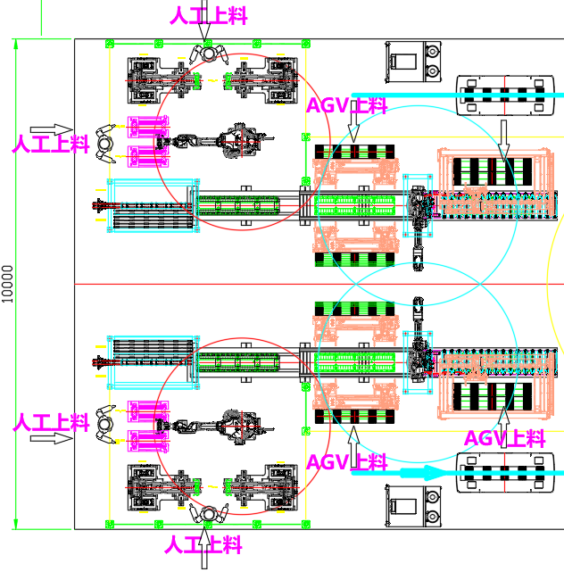
Automatic magnet production line
Stacking of 1/3 long cores
In order to produce 4 magnets per day, the upper and lower half cores are produced at the same time, so automatic production line has two independent half core production lines.
Two kinds of laminations are stacked.
The central bars and surrounding bars are installed.
The laminations and the surrounding bars are welded together
The dimensional tolerance is inspected.

Slide 12
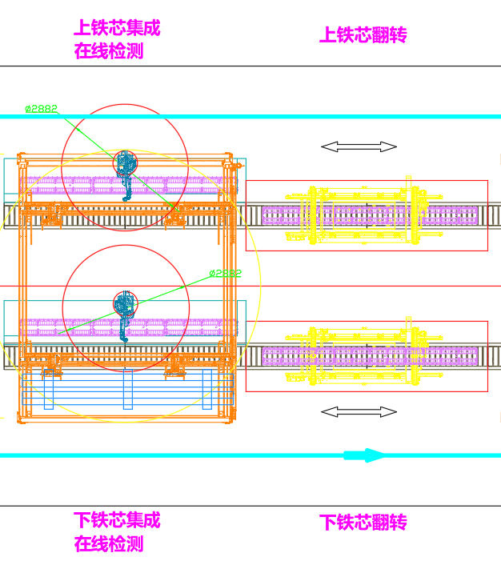
Automatic magnet production line
Assembly of three 1/3 cores
Three cores are precisely assembled on a tooling and tightly pressed.
The end plates between each core are welded together.
The dimensional tolerance is inspected.

Slide 13
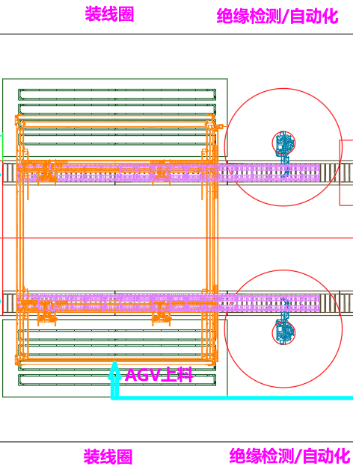
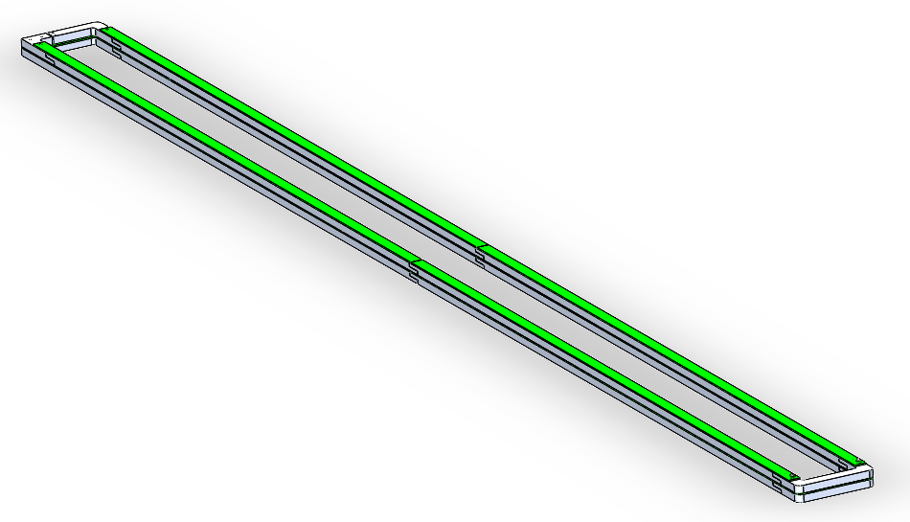
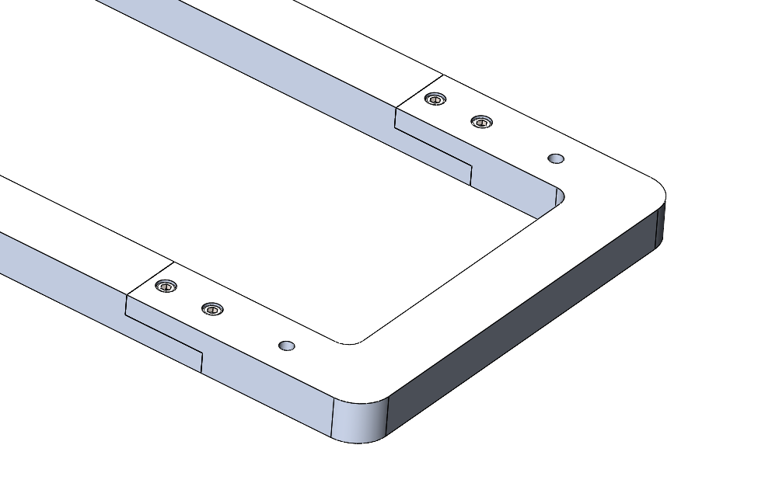
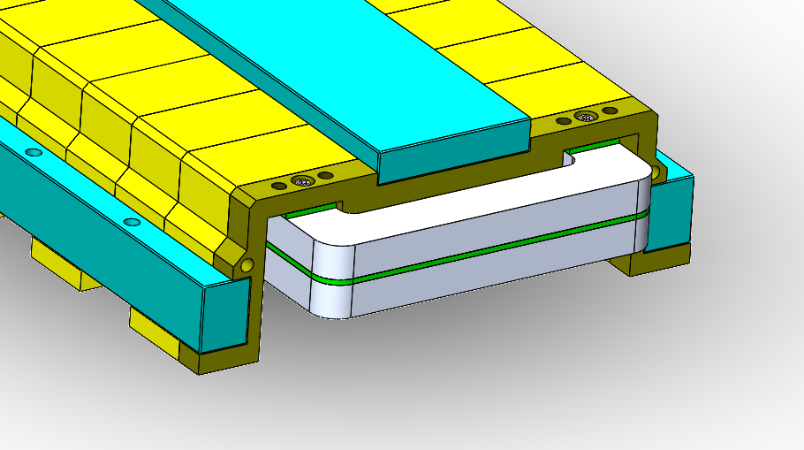
Automatic magnet production line
Installation of the coils
The coils have two turns, which are pieced together by the aluminum bars.
The half cores are rotated 180 degree and the coils are installed.
The coils are fixed on the cores by anti-loosening bolts.
Inspect insulation strength between coils and cores.

Slide 14
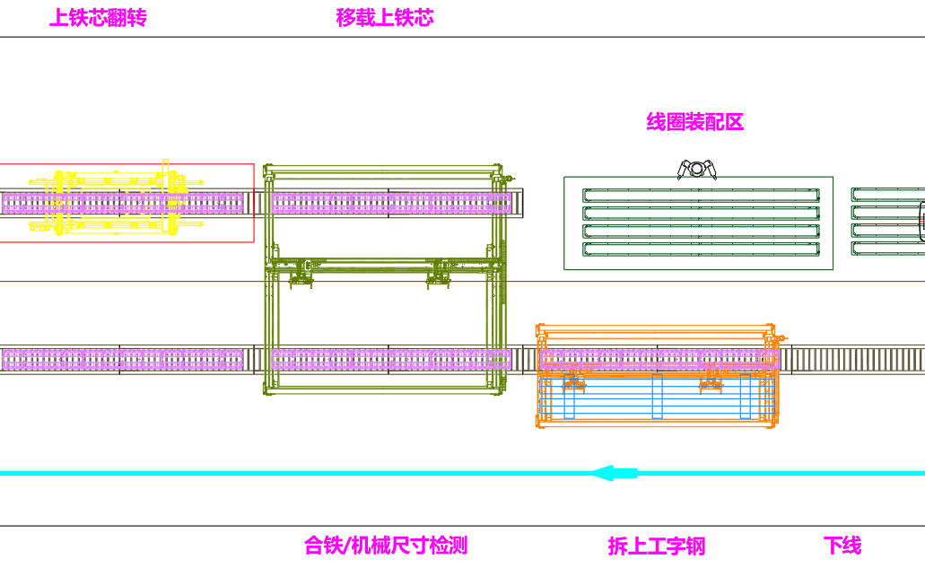
Automatic magnet production line
Assembly of the two half magnets
The upper half magnet (core and coil) is rotated 180 degree.
Put the upper magnet onto the lower magnet at its right position.
Install and tighten the bolts between two half cores.
Inspect the gap and length of the magnet.
Install the connection bars between upper and lower coils.
Check the insulating strength again.
Deliver the magnet into the field measurement lab.

Slide 15
Automatic magnetic field measurement system
The measurement system includes
Magnet bench
Rotating coil
Power supply
Cooling water
Data collector
Control cabinet
Magnet and rotating coil delivery devices
magnet
Coil installation device
Rotating coil
Alignment device
Alignment device
robot
Control cabinet
Cooling water
Power supply
CH1
CH2
CH3
CH4
Data collector
Computer

Slide 16
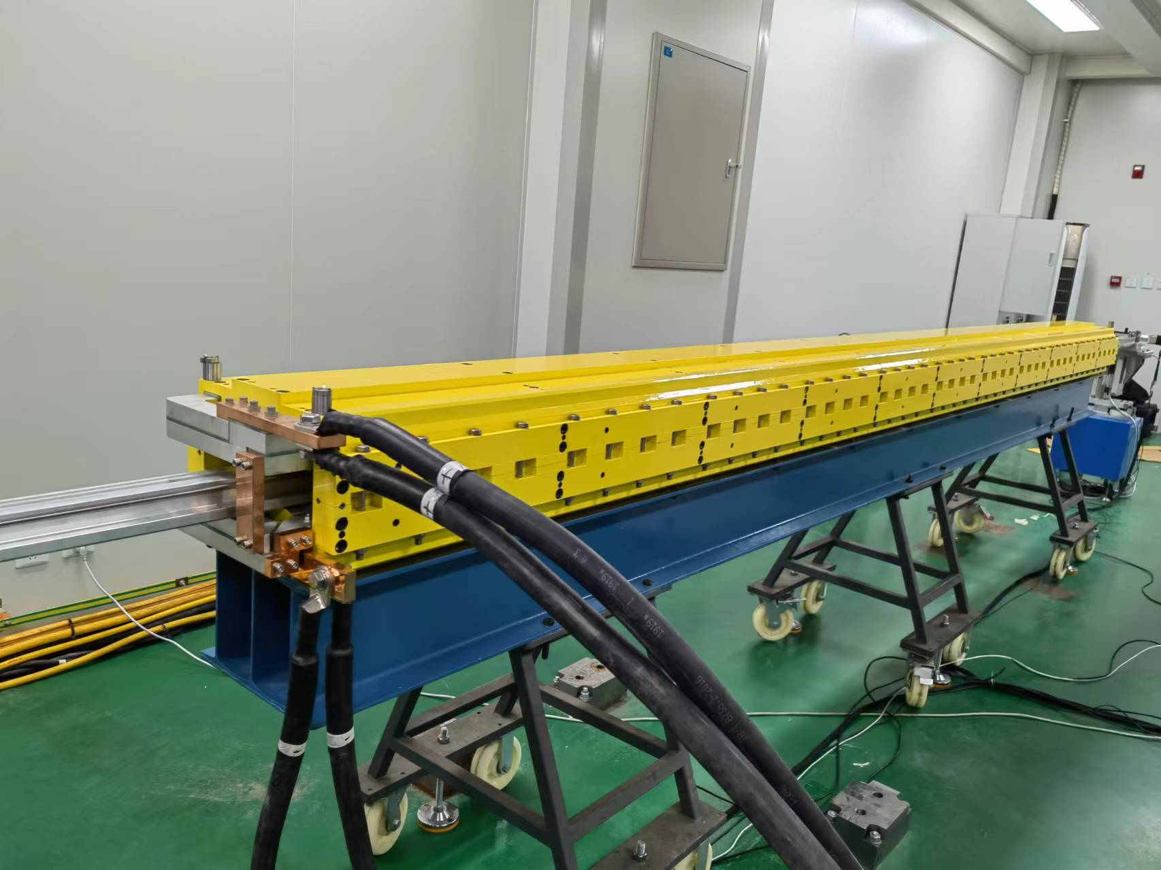
Automatic magnetic field measurement system
Target: To complete the field measurement of 4 magnets produced by the production line every day.
To put the magnet on the test bench and align it.
To connect the cooling water and power supply with the magnet.
To install the rotating coil into the magnet.
To open the cooling water and power supply.
To turn on the program of the measurement system and start up.
To switch off the program, power supply and cooling water after the measurement finished.
All the process above are automatically completed.

Slide 17
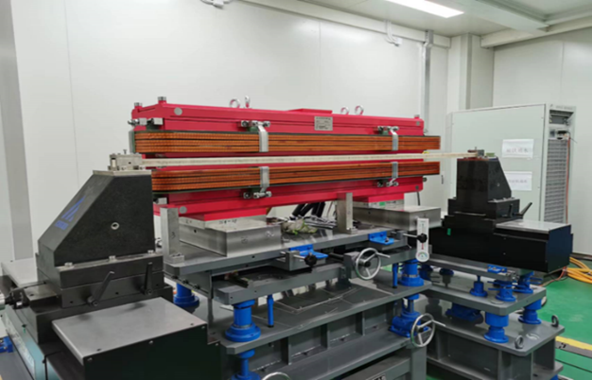
Automatic magnetic field measurement system
Installation and alignment of the magnet
An AGV will deliver the magnet from the magnet production line into the lab and put it on the field measurement bench.
The bench can precisely move the magnet to its right position for installation of the rotating coil.

Slide 18
Automatic magnetic field measurement system
To automatically install the rotating coil
The coil is integrated with its driven part so that the operation of mechanical connection between them can be avoided.
The cables to the data collector, control cabinet and computer can move with the rotating coil, the operation of electrical connections is also avoided.
So the integrated rotating coil with all kinds of cables can be precisely installed in and moved out the magnet aperture by an automatic moving device.

Slide 19
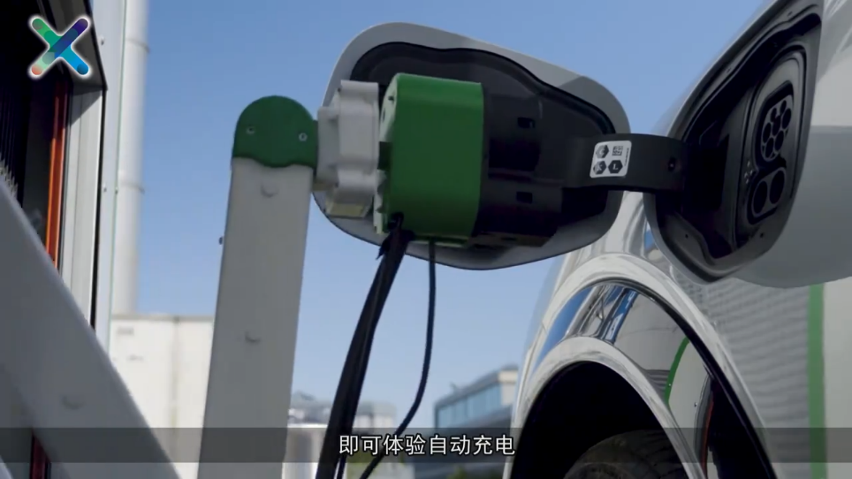
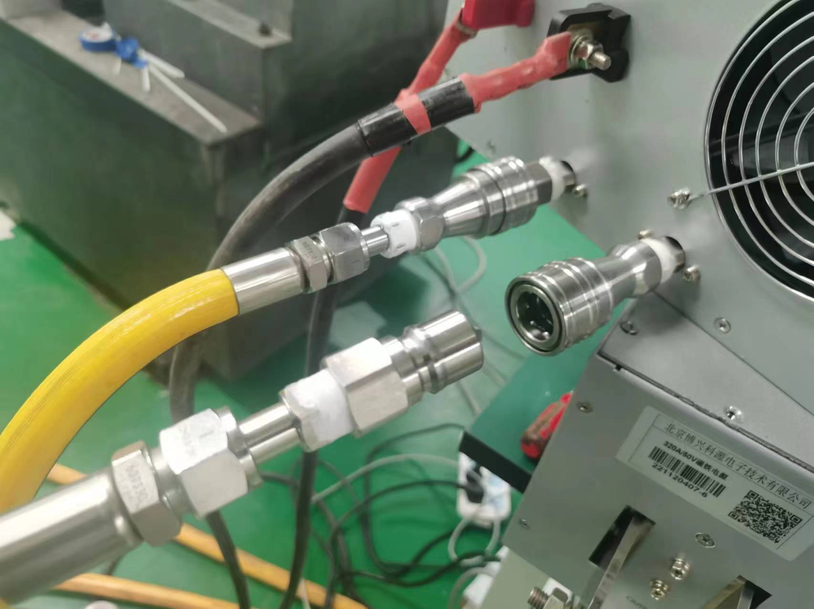
Automatic magnetic field measurement system
Connection of the cables and cooling water tube
The cables from power supply can be connected with the magnet like the cable connection for automatic charging of cars.
By using some kind of quick pack and release water connection, the cooling tube can be connected with the magnet.
All the connection operation above can be realized by a robotic arm.

Slide 20
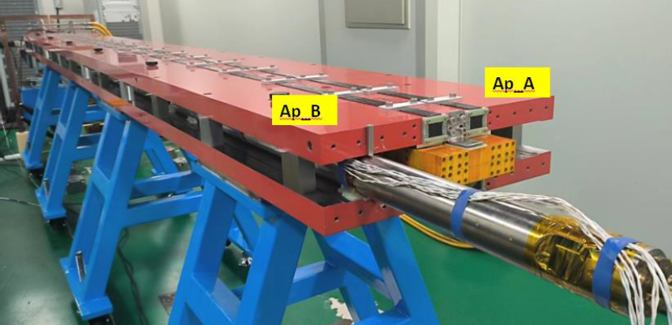
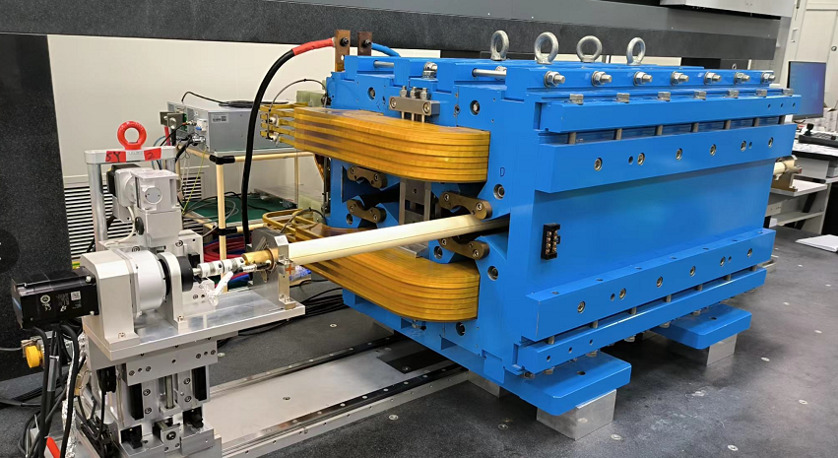
The magnets for the Collider
Dual aperture dipole magnets
In TDR stage：A 5.7m long magnet was developed and its performance was good enough to meet the requirements at 4 colliding energy.
In EDR stage：To reduce the production cost, a short prototype magnet made by some kind of cheaper iron will be developed and tested.
TDR
Dual aperture quadrupole magnets
In TDR stage：A 1m long prototype magnet was developed and its performance reached to the requirements after several times of improvement.
In EDR stage：A 3m long prototype magnet will be developed and researched.
TDR

Slide 21
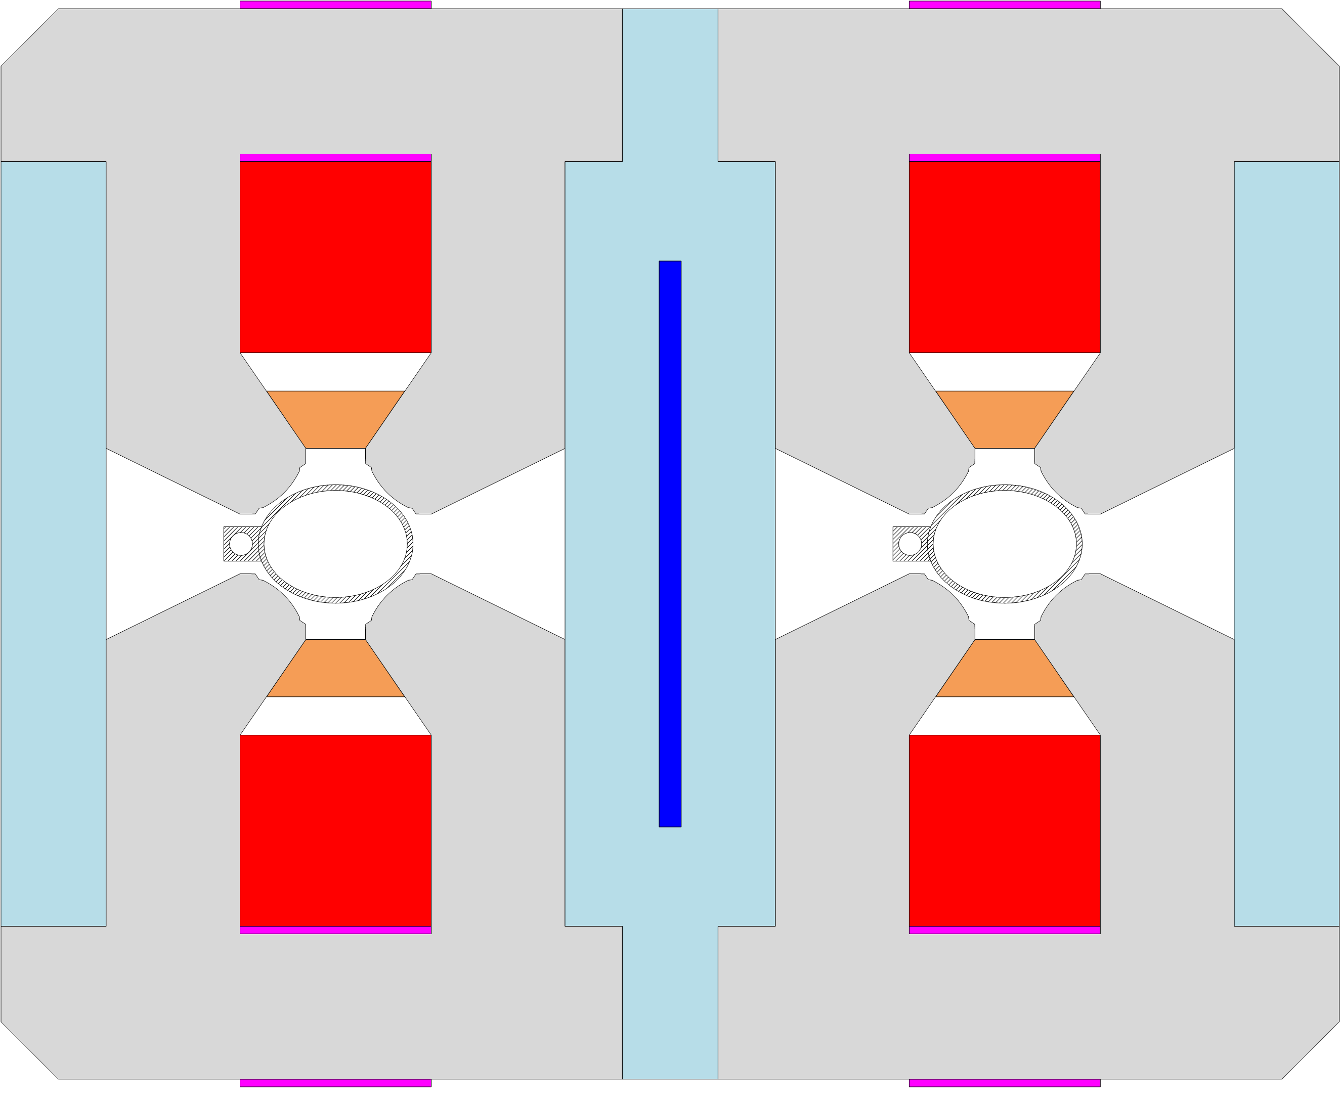
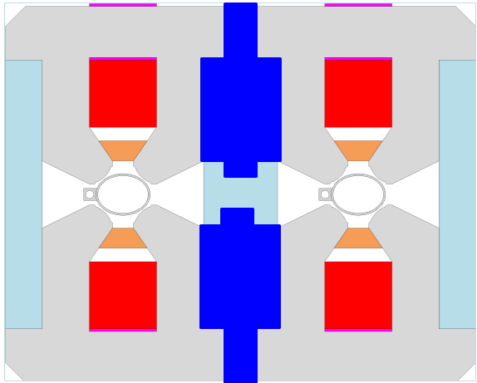
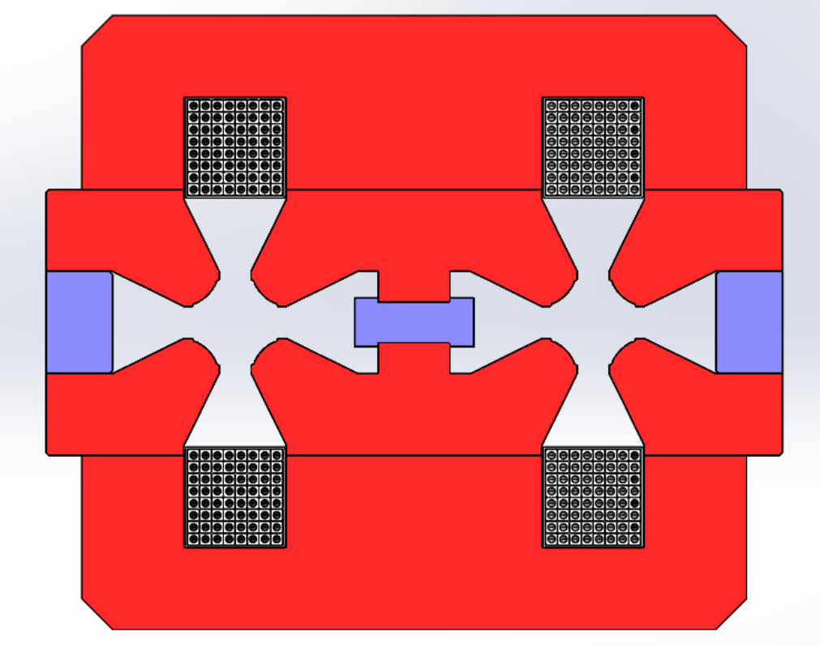
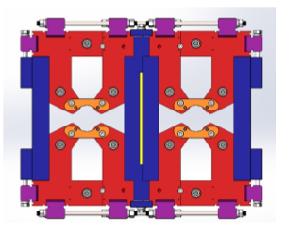
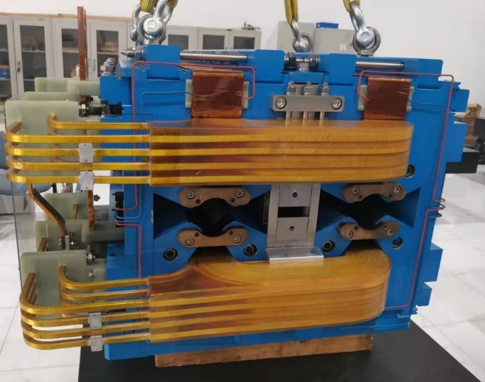
The magnets for the Collider
Mechanical structure evolution of the dual aperture quadrupole magnet
CDR
TDR
EDR

Slide 22
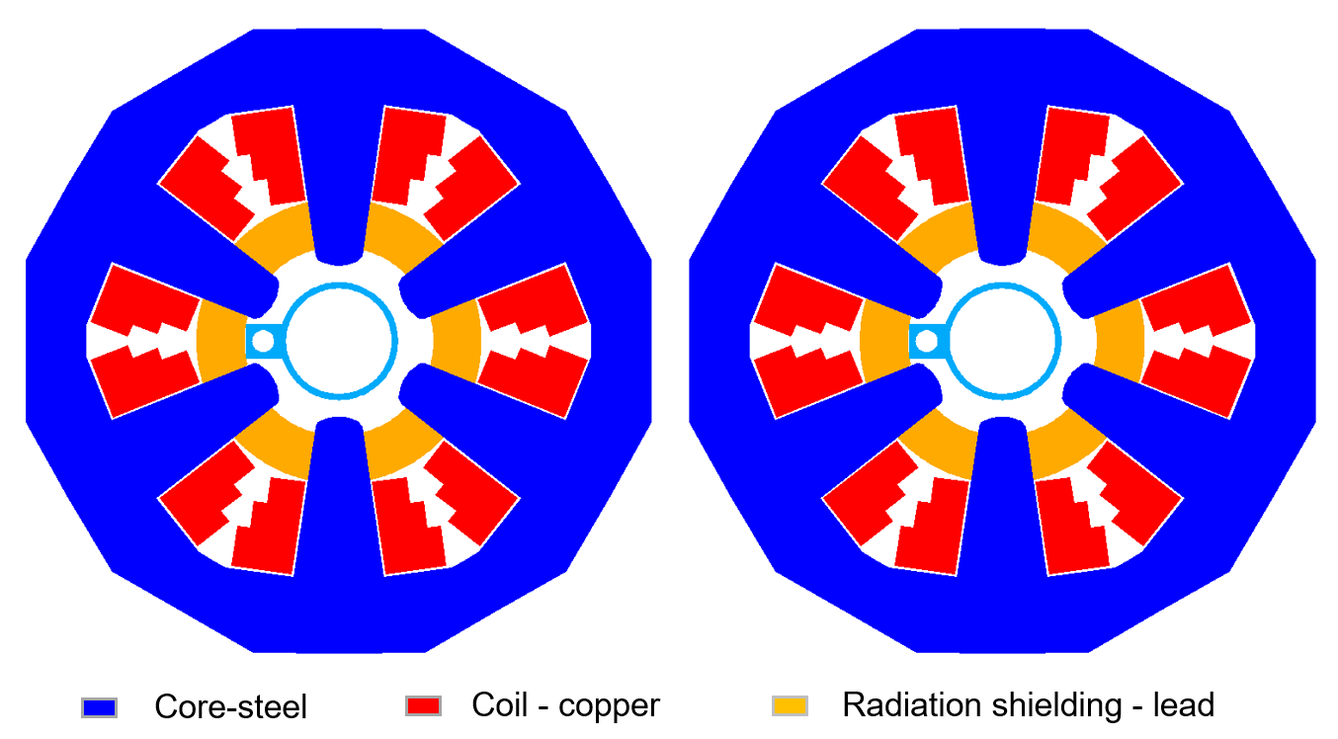
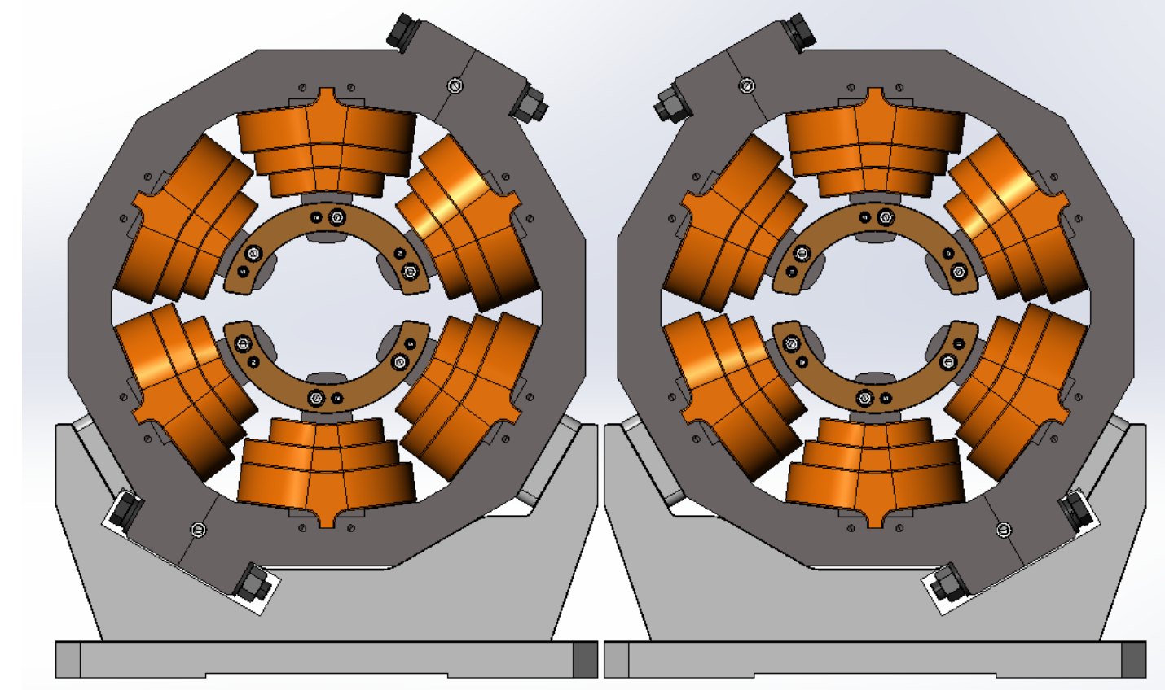
The magnets for the Collider
Sextupole magnets
The length of the magnet is 1.4m and the aperture is 76mm.
The magnet has a two-in-one structure. To install the coil, the central pole of the half core can be moved away.
The central distance between two Collider ring’s magnets is only 350mm.
To avoid the spatial interference between two magnets, the magnets will rotated 60 degree before installed on its girder.

Slide 23
Summary
The CEPC Booster has nearly 15000 dipole magnets with total length of 68 km, which are grouped into three families.
To reduce the production cost and improve production efficiency, three automatic magnet production lines will be developed to produce all these magnets in five years.
Up to now, the preliminary design of the automatic magnet production line including the field measurement system is completed.
The most of dipole and quadrupole magnets for the CEPC Collider are dual aperture magnets, some prototype magnets were developed in TDR stage and some will be developed in EDR stage.

Slide 24
Thank you for your attention.

