Slide 1


Circular Electron Positron Collider
CEPC Polarization studies in EDR
Zhe Duan
On behalf of the CEPC Polarization Working Group
8-11 April 2024, 2024 CEPC Workshop EU Edition, email: duanz@ihep.ac.cn

Slide 2
Outline
Polarized beams @ CEPC
Design & R&D plan in the CEPC EDR Phase
Summary

Slide 3
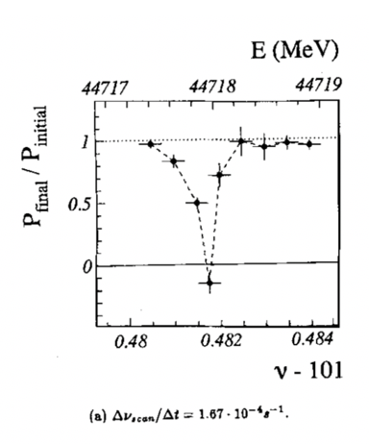
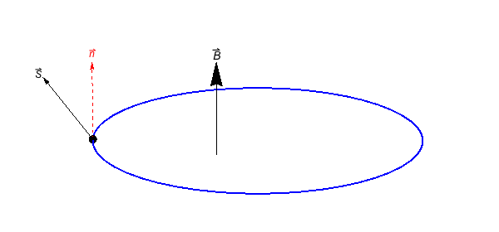



Polarized beams @ CEPC: transverse polarization
Precision beam energy calibration @ Z&W based on Resonant Depolarization (~1e-6 accuracy)
  Precision measurements of Z&W mass (FCC EPOL, arXiv:1909.12245, CDFII: Science 376, 6589)
  Fiducial for Higgs & ttbar mass measurements (LEP2 CM energy evaluation above 80 GeV, arXiv:9901002,)
Requirements:
  Transverse Compton polarimeter: stats uncertainty ~1%/second
  RF depolarizer: specs similar to bunch-by-bunch feedback kicker
  RD measurements every ~ 10 mins
  At least 5%~10% vertical polarization for e+/e-
CEPC Z&W mass, CDR 2019
CEPC W mass: EJPC 80, 66 (2020)
CEPC ttbar, arXiv:2207.12177
IP/detector
$$P_{Y}$$
$$P_{X}$$
IP/detector
polarimeter
depolarizer
$$P_{Z}$$
LEP: Z. Phys. C 66, 45-62 (1995).

Slide 4
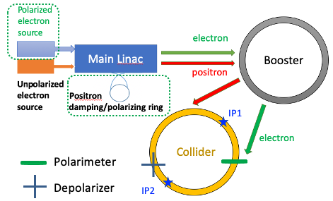
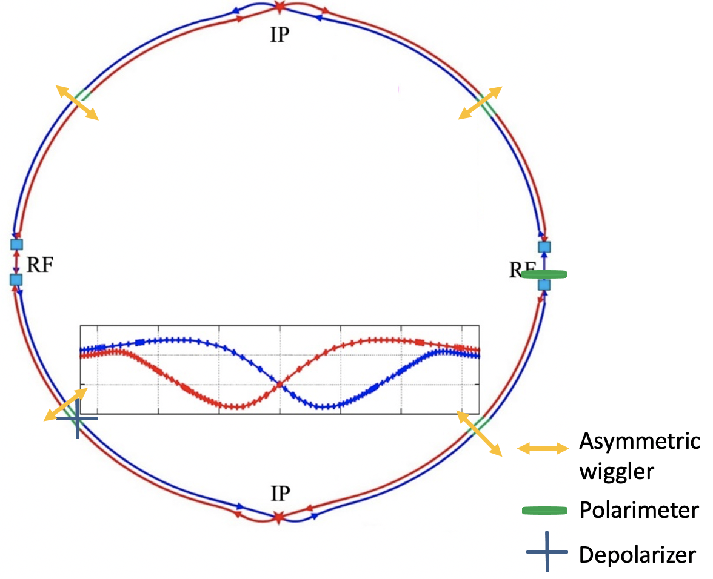
Two schemes of polarization generation for RD
Scheme 1: self-polarization in the Colliders
Scheme 2: Injection of polarized beams
(FCC EPOL, arXiv:1909.12245)
Polarized beams from the source
  Polarized e- gun: > 85% polarization
  e+ damping ring(1.1 GeV -> 1.98 GeV) : > 40% polarization after 10 min store
Polarization loss in the Booster is small requiring no additional hardware ( Chen et al, PRAB 26, 051003, 2023)
No dead time for physics at each fill
Z-pole: >20 hour to reach 10% polarization
  10 asymmetric wigglers switched on to reduce to 1~2 hours
  Incompatible with high luminosity (increase in U₀, energy spread) -> 1~2 hours dead time for physics at each fill
  ~144 pilot bunches dedicated for RD measurements
W: ~2 hour to reach 10% polarization
  ~12 pilot bunches, wigglers not needed

Slide 5
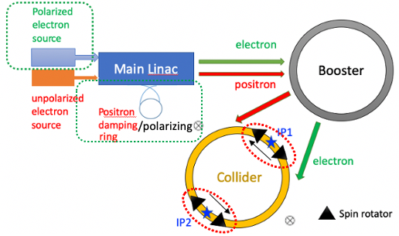
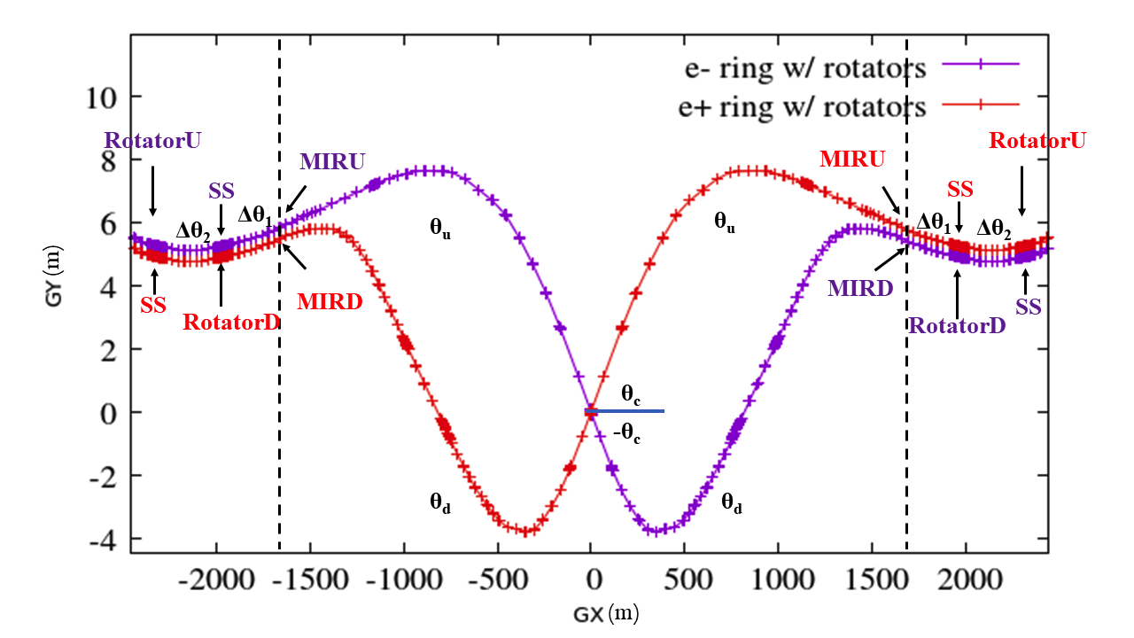
Polarized beams @ CEPC: longitudinal polarization
Weak mixing angle from A_{FB}, A_{LR} @ Z-pole
A_{FB} @ CEPC: CPC 47, (2023) 123002
Solenoid spin rotators around each IP (~500 T$∙$m per IP per ring)
(Xia et al, RDTM 6, 490, 2022)

Slide 6
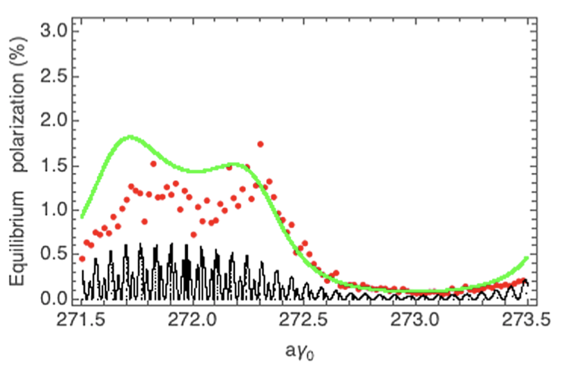
Polarization design studies in the EDR Phase
Accommodate polarized beams in the lattice design
  Collider
    Compton polarimeters
    Wigglers
    Spin rotators (reserve space)
  Injector (improved design)
    Positron damping ring: raise energy
    Booster: lattice optimization for better polarization transmission
Polarized beam applications @ ILC, arXiv:2105.09691, 2111.06687, 2202.07385
Yan et al, PRL 131 (2023) 241801 e+/e- transverse polarization @ Higgs
Study the polarization utilities at Higgs
  It is possible to attain useful polarization in the Collider at Higgs or even higher energies
  Key question: how well can spin resonances be mitigated?
Booster transmission
Collider equilibrium
Higgs
Higgs
Chen et al, PRAB 26, 051003, 2023
Xia et al, PRAB 26, 091001, 2023

Slide 7
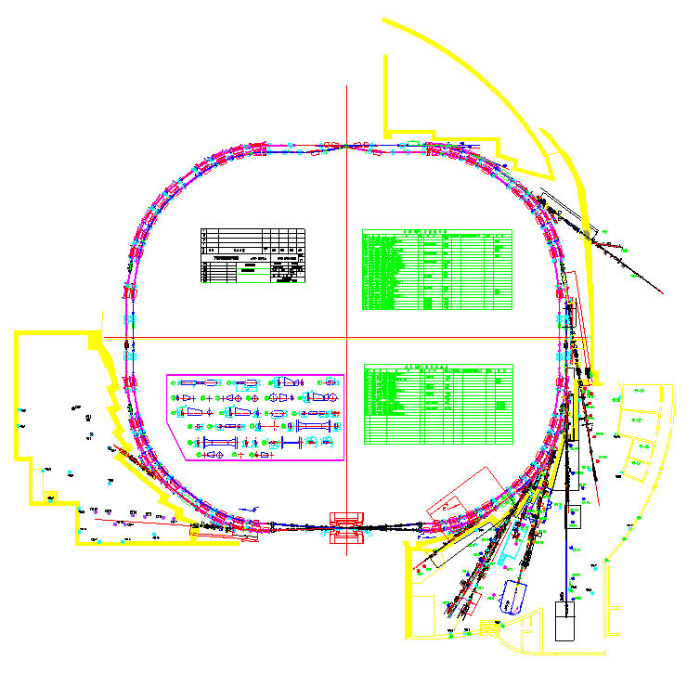
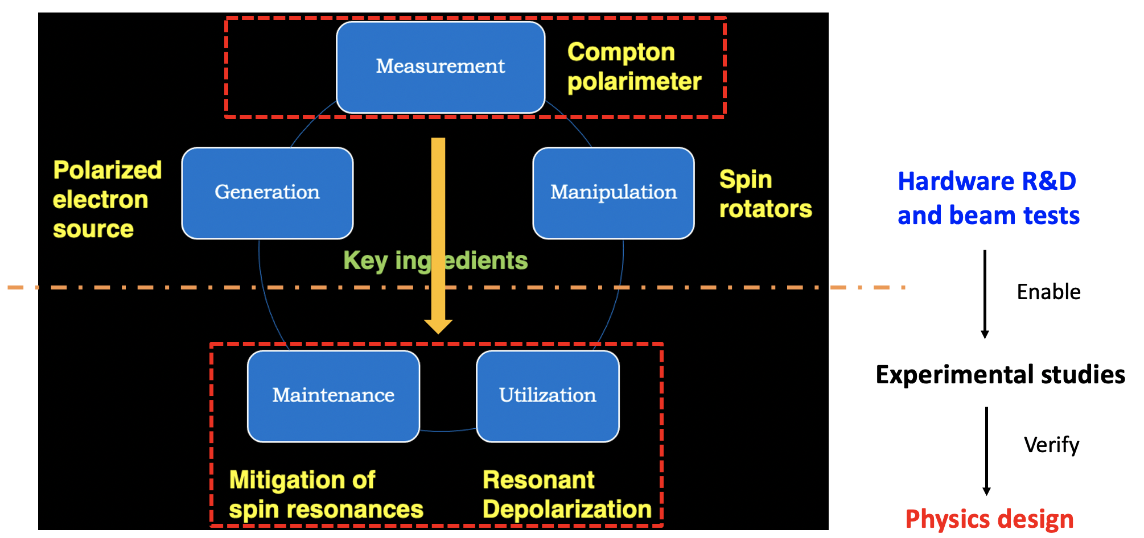
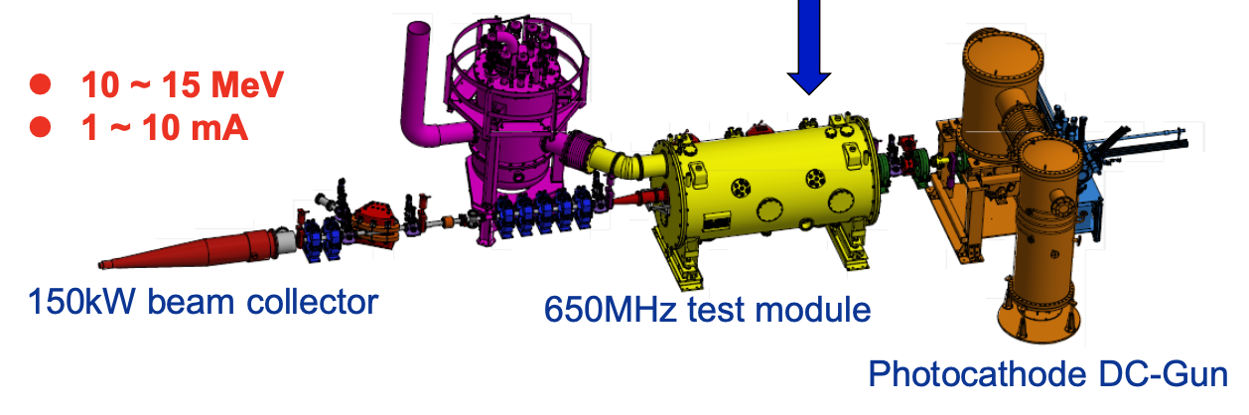
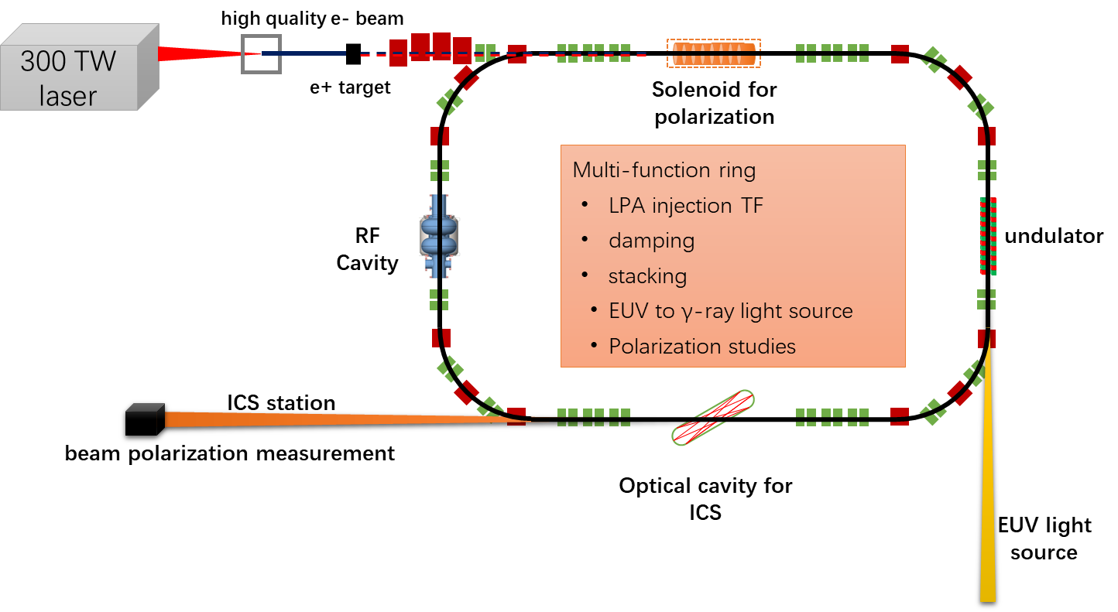
Polarization R&D in the CEPC EDR Phase
BEPCII
Fully exploit IHEP accelerator facilities to carry out beam tests for polarization R&D.
PAPS beam test facility
Laser Plasma Accelerator- e+/e- Ring test facility (under design)

Slide 8
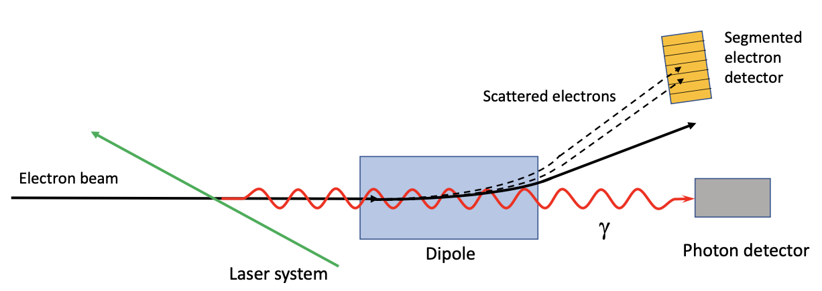
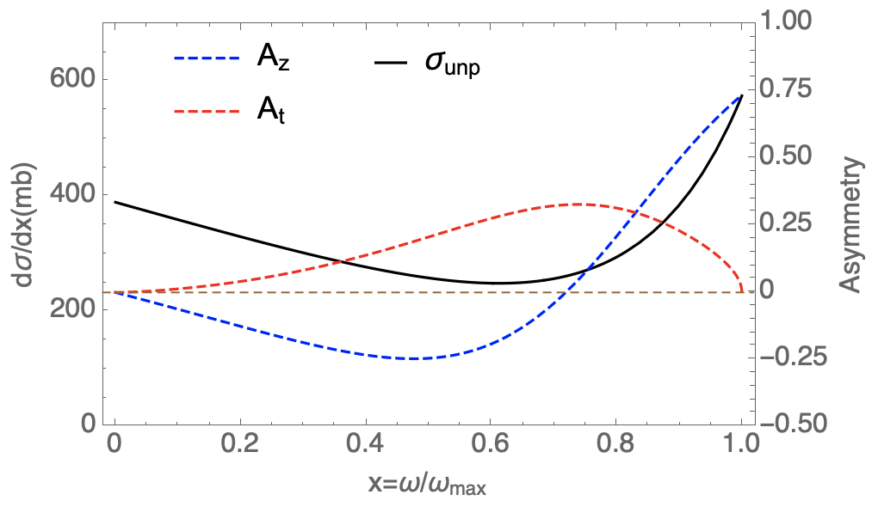
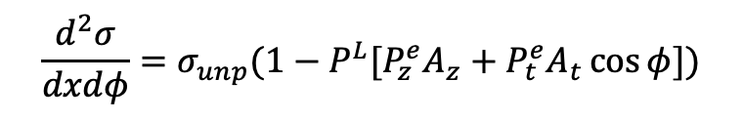
Compton polarimeter for CEPC
FCC-ee polarimeter, arXiv:1803.09595
$$\frac{d^{2}σ}{dxdφ}=σ_{unp}(1−P^{L}[P_{z}^{e}A_{z}+P_{t}^{e}A_{t}\cos{φ}])$$
Eb=45.6 GeV, λlaser=515 nm
Type | Transverse | Longitudinal | Challenges & limitations
Scattered γ | Position detector | Calorimeter | SR background, spatial resolution
Scattered e | Position detector |  | ~100m drift space, Limited to 2D
Chen, et al., JINST, 17 P08005, 2022
Wang, in preparation
Demonstration of a Compton polarimeter at existing facilities would prepare for CEPC
  Knowhow to design & operate such systems
  Pixel detectors for polarization measurement
  Laser polarization control & measurement
(In synergy with FCC EPOL collaboration)

Slide 9
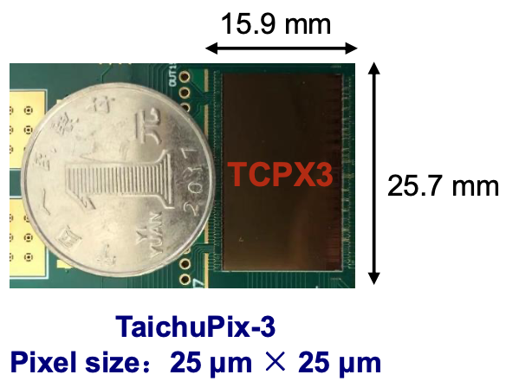
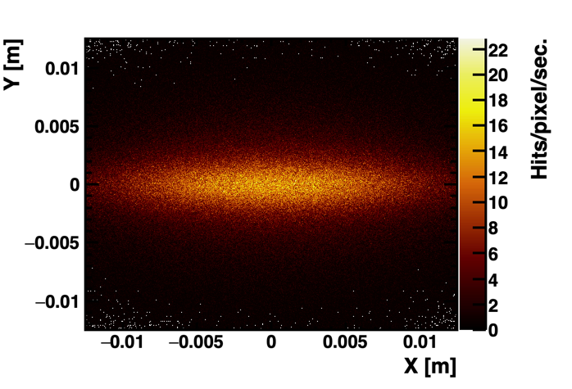
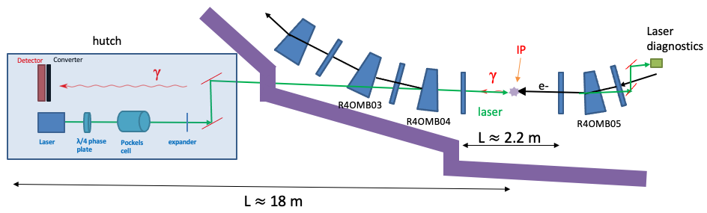
Compton polarimeter measuring self-polarization @ BEPCII
Reuse the beamline of the dismantled wiggler 4W2
  Laser & detector placed in the hutch
  Photon beamline transports both laser & scattered γ-ray
  Collision between laser & electron beams at the source point
Detection of scattered γ position with TaichuPix detectors[1]
First domestic Compton polarimeter, essential for all polarized beam applications in e+/e- storage rings
BEPCII
e-
e+/e- hits on detector
By A. Martens
[1] T. Wu et al., NIM A 1059 (2024) 168945.

Slide 10
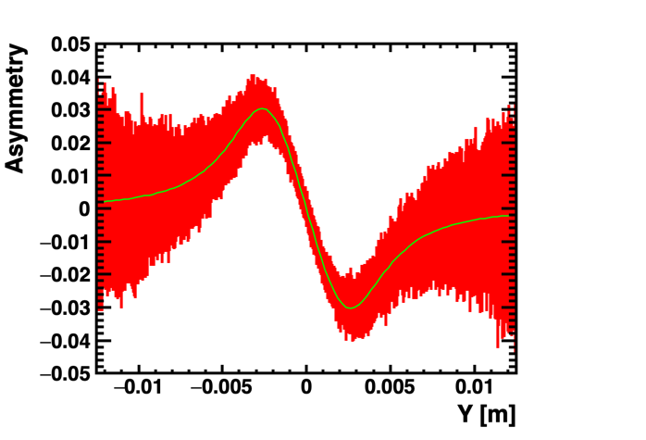
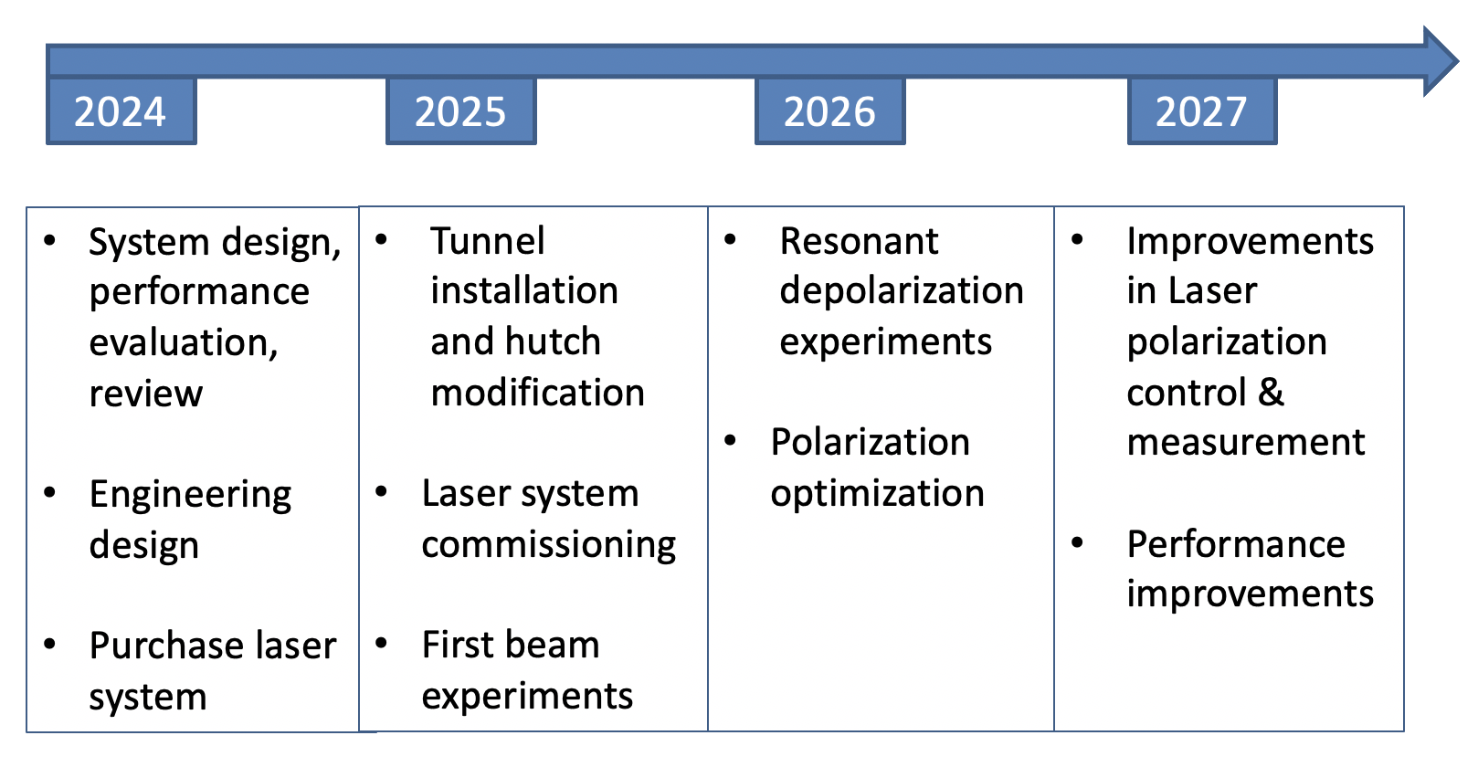
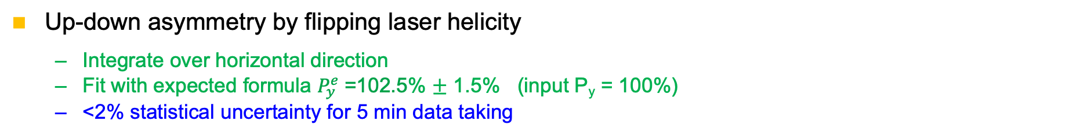
Preliminary simulations, plan and research team
assuming ${|P}^{L}|$=100% $Asymmetry= \frac{N_{L}−N_{R}}{N_{L}+N_{R}}≈P_{y}^{e}A_{y}(Y)$
Up-down asymmetry by flipping laser helicity
  Integrate over horizontal direction
  Fit with expected formula $P_{y}^{e}$=102.5% $±$ 1.5% (input P_{y} = 100%)
  <2% statistical uncertainty for 5 min data taking
By A. Martens
Research team
Aurelien Martens (IJCLab, joint application for FCPPL 2024 funding), Liang Zhijun and his TaichuPix team, Jianli Wang, Guangyi Tang, Daheng Ji, Dou Wang, Mengyu Su. Potential international collaborators: VEPP-4M team
Support from Chenghui Yu (BEPCII manager), Xiaodong Li (BSRF manager), Yanchun Li (4W2 beamline manager) and Qingfu Han (expert on front end & mechanical designs)

Slide 11
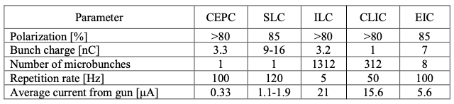
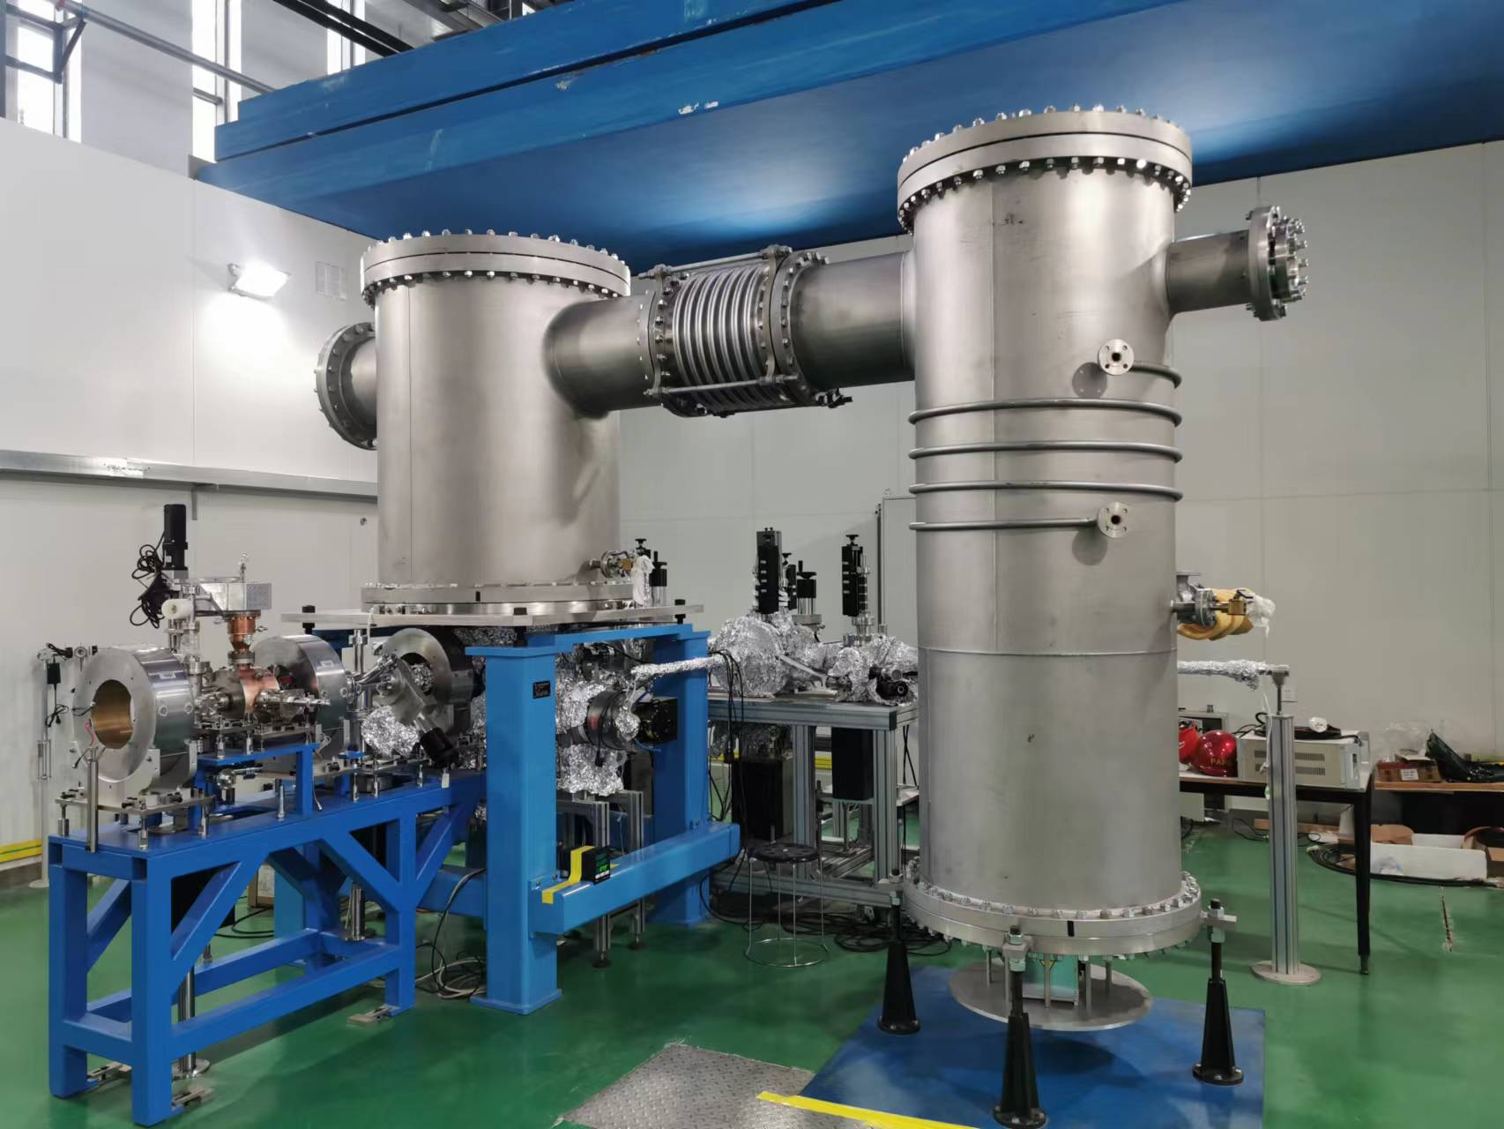
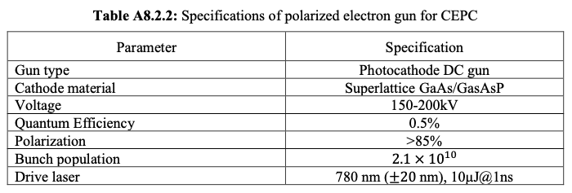
Polarized electron source for CEPC
Polarized electron gun is a key technology in e+e- colliders, well developed in major high-energy physics labs SLAC, JLAB, BNL, KEK, BINP, KPH etc
The parameters required for CEPC is less challenging than ILC and EIC, expecting better cathode lifetime
Polarized electron gun requires ultrahigh vacuum (<10⁻⁹ Pa), is a natural extension of the HV Photocathode DC gun @ PAPS.
PAPS 500kV Photocathode DC gun

Slide 12
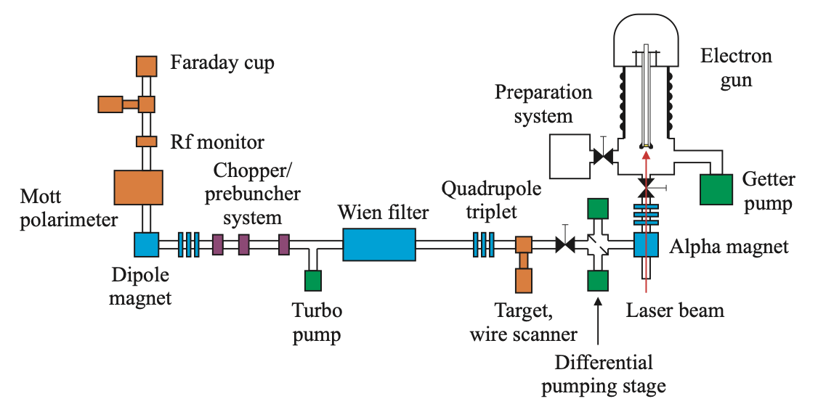
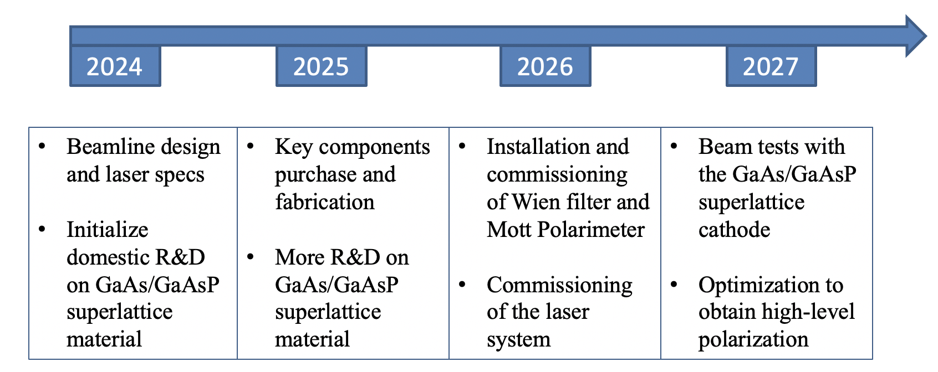
Polarized electron source: polarized DC gun
Convert HV DC photocathode gun @ PAPS to first domestic polarized electron gun for use in high energy accelerators
Schematic drawing of a PES and associated beamline
EPAC 2006, THPCH161
Wien filter + Mott polarimeter: manipulation and measurement of e- beam polarization
GaAs/GaAsP superlattice cathode + 780nm drive laser -> ~85% polarization
Research Team：
Li Xiaoping，Duan Zhe，Valery Tyukin（KPH, PIFI support）, Xu Hang, Xu Jinqiang，Liu Baiqi，Liu Jindong，graduate students : 2-3

Slide 13
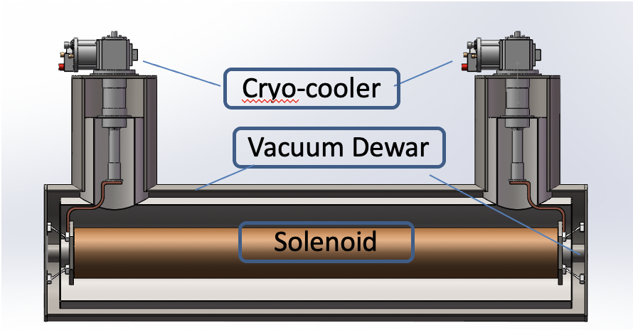
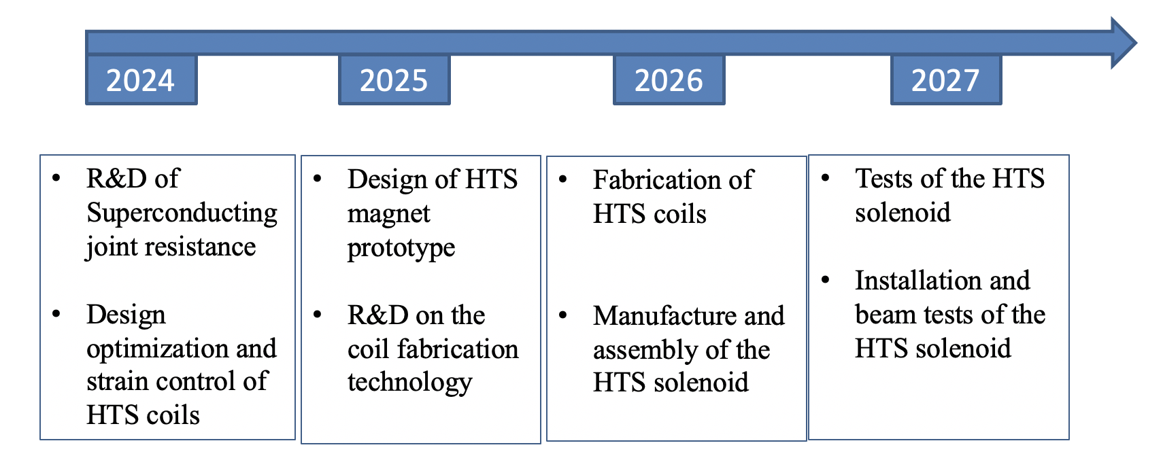
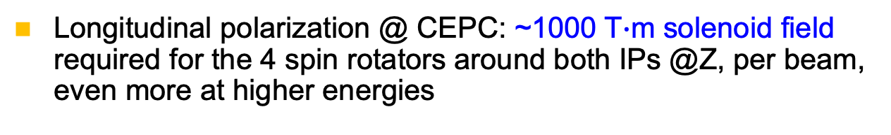
Polarization manipulation: SC solenoid spin rotator
Longitudinal polarization @ CEPC: ~1000 T$∙$m solenoid field required for the 4 spin rotators around both IPs @Z, per beam, even more at higher energies
CEPC IR
R&D: A 12T, 10.5 T$∙$m HTS solenoid prototype based on ReBCO
Conceptual Design：
Whole HTS solenoid operating at 5~10K;
Conduction-cooling by Cryo-coolers: simple structure, lower cost and easier maintenance.
Significance:
Application of HTS with conduction-cooling in accelerator magnets [1]
Beam tests of HTS-based accelerator magnets
Research Team
Xu Qingjin，Zhao Ling，Hou Zhilong，Zhou Jin，Liu Zhongxiu，2~3 graduate students
[1] Similar technology is being pursued for FCC-ee Crab Sextupoles (Foussat, FCC Week 2023)

Slide 14
Opportunities of polarization R&D in LPA-Ring TF
Laser Plasma Accelerator + e-/e+ Damping Ring Test Facility (under design)
Vertical polarization via the Sokolov-Ternov effect
  Measurement w/ Compton polarimeter using an optical cavity
  Extracted polarized e- beams: test if polarization can be maintained in laser-plasma-beam interaction
200MeV – 1.2 GeV
Potential for first experimental demonstration of various polarized electron generation approaches in LPA
  Many proposals based on simulations (arXiv: 2205.00421)
Laser-plasma channel
Moller polarimeter

Slide 15

Opportunities of polarization R&D in LPA-Ring TF
Laser Plasma Accelerator + e-/e+ Damping Ring Test Facility (under design)
Vertical polarization via the Sokolov-Ternov effect
  Measurement w/ Compton polarimeter using an optical cavity
  Extracted polarized e- beams: test if polarization can be maintained in laser-plasma-beam interaction
10.5 T$∙$m Solenoid as a Siberian snake
Potential for first experimental demonstration of various polarized electron generation approaches in LPA
  Many proposals based on simulations (arXiv: 2205.00421)
Beam test of the HTS solenoid as a Siberian snake to achieve longitudinal polarization
Longitudinal polarization
  Spin manipulation, mitigation of spin resonances
  Measurement of longitudinal polarization w/ calorimeter
  First precision test of the theory of kinetic polarization
Polarized beam experiments expect to start in 2027.

Slide 16
Summary
Polarized beams will be accommodated in the CEPC baseline design.
A Compton polarimeter will be implemented in BEPCII.
The HV DC photocathode gun @PAPS will be converted to a polarized electron source.
A prototype of HTS solenoid spin rotator will be developed.
LPA-Ring test facility will provide unique opportunities for beam polarization experimental studies:
  longitudinal polarization w/ Siberian snake (HTS solenoid)
  Beam polarization generation & evolution in LPA
  Compton & Moller polarimeters
Thank you for your attention!

