Slide 1
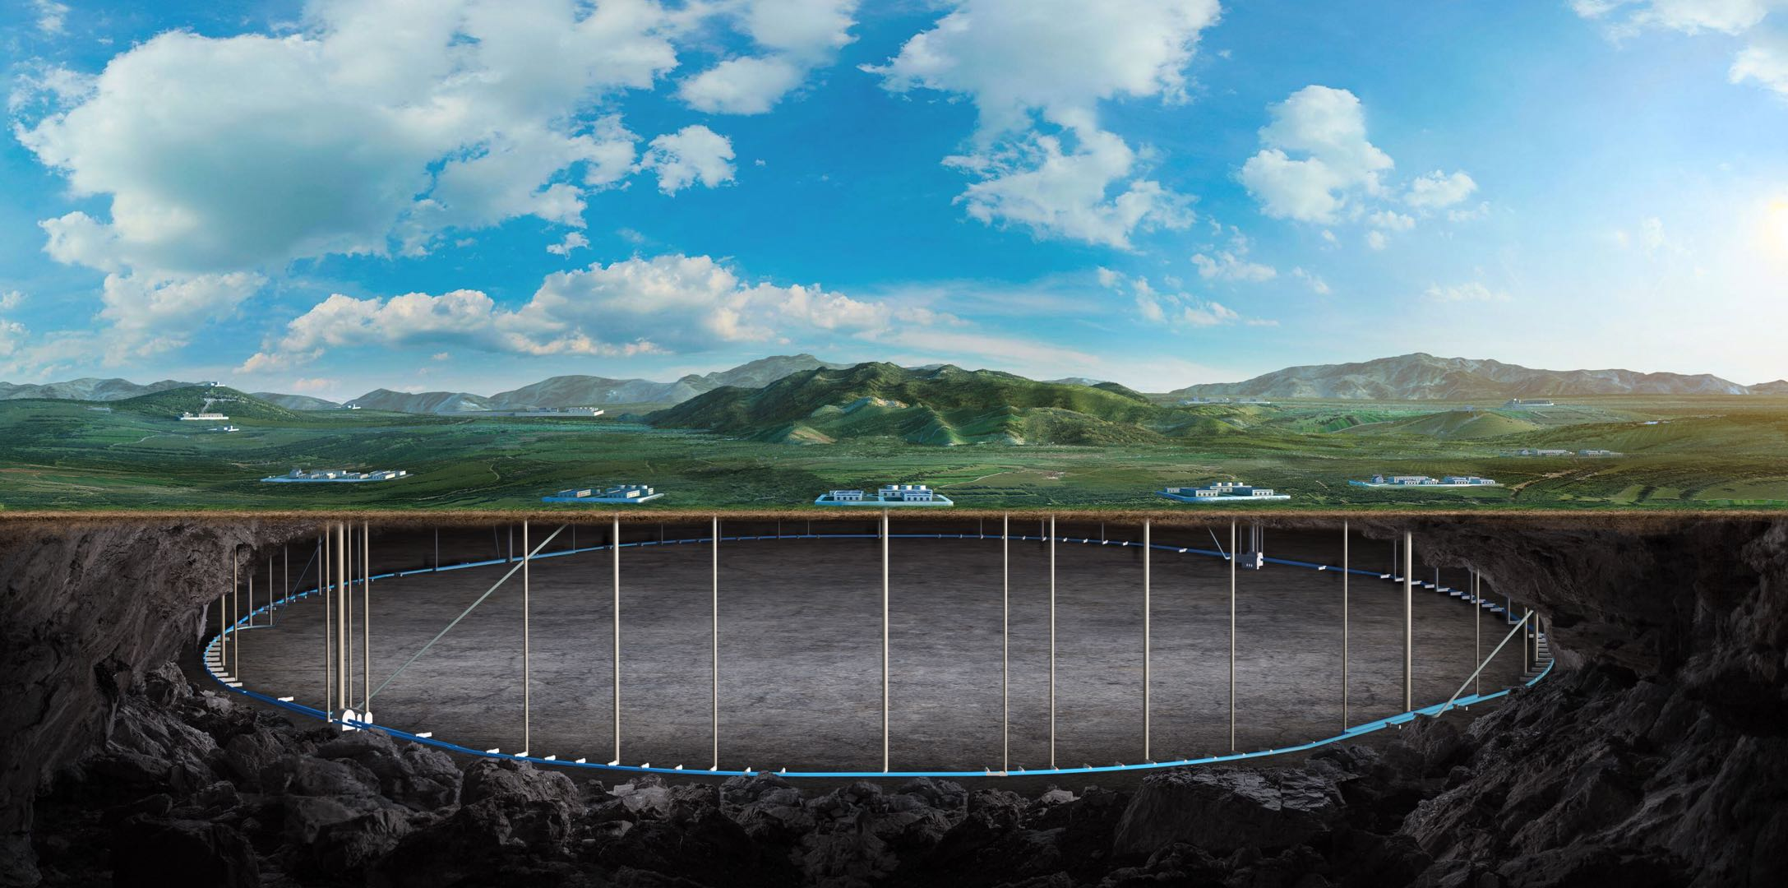
Circular Electron Positron Collider
CEPC collective effects studies in EDR
Na Wang
Institute of High Energy physics
Contributors:
Yuan Zhang, Yudong Liu, Saike Tian, Haisheng Xu, Jintao Li (IHEP)
2024 CEPC Workshop EU Edition, 8-11 Apr. 2024, Marseille, France

Slide 2
Outline
Where are we at the release of the TDR
Main subjects in the EDR
Recent progress on EDR studies
Summary and outlooks

Slide 3
Where are we at the release of the TDR
Impedance modeling
Main impedance issues have been dressed in the TDR (HOMs, not complete)
More intensive studies on HOMs, calculation on more components and try to be complete or convinced.
Instability studies
Main instability issues have been dressed in the TDR (TMCI, MWI, RWI, Ecloud, Ion)
For the issues has been fixed: prove the effectiveness of the mitigation strategies
For the issues hasn’t been fixed: more intensive studies
Main comment or recommendations from the TDR review (Merge into the first two terms)

Slide 4
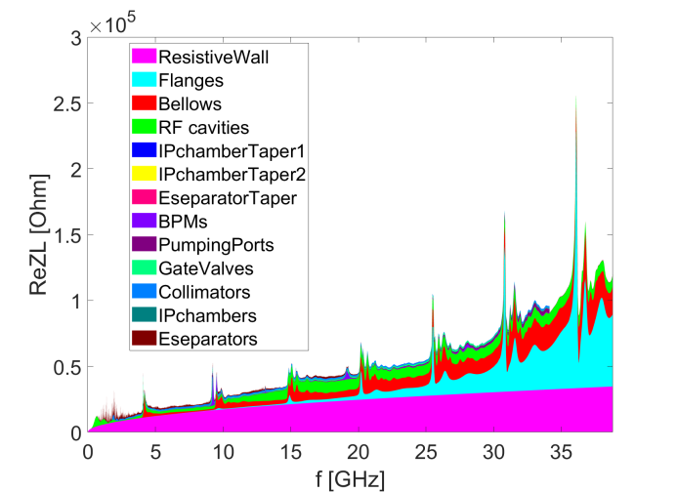
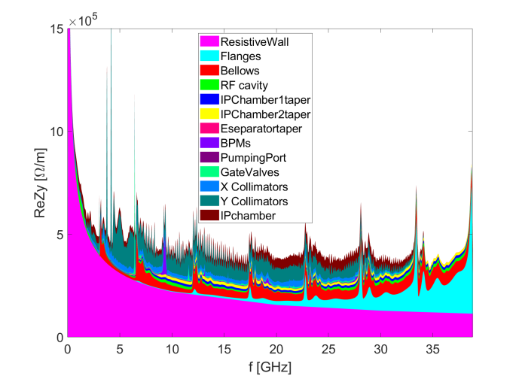
Where are we at the release of the TDR
Impedance modeling
Impedance of the key vacuum components has been evaluated, main impedance issues have been addressed (HOMs, contribution from missing elements, …)
More detailed studies with more robust impedance model are required (HOMs, more impedance contributors, …).
Impedance increases along with the development of the impedance model (especially for ky)

Slide 5
Where are we at the release of the TDR
Impedance modeling
Impedance of the key vacuum components has been evaluated, main impedance issues have been addressed (HOMs, contribution from missing elements, …)
Instability studies
Potential restrictions from the collective effects and their mitigations are investigated based on TDR impedance model
→ no apparent show stopper for Higgs, W and tt
→ Important restriction for Z – performance can be reached with the mitigations
Longitudinal impedance coupling with beam-beam → reduce stable tune region
Transverse impedance restrain single bunch current, which also couple with longitudinal impedance and beam-beam → lower single bunch threshold current, and influence luminosity
Transverse resistive wall instability → restrict total beam current, requires strong FB damping
Coupled bunch instabilities due to HOMs (eg. from RF cavities) → damped with FB
Electron cloud instabilities → restrict beam filling patten, therefore total beam current

Slide 6
Main subjects in the EDR
Impedance
Develop the impedance model with more realistic hardware designs
Provide impedance requirements for the hardware designs along with the impedance optimization and iteration with hardware development.
Do impedance measurements on key vacuum components and test possible impedance mitigations.
Collective effects
Instability evaluations for different operation scenarios based on the impedance development.
Prove the effectiveness of the strategies for the instability mitigations, such as feedback, chromaticity, lattice optimizations, etc.
Develop investigating tools for the self-consistent simulations with both beam-beam and impedance.
More detailed simulation studies on electron cloud effects.
Conduct possible beam-based measurement on BEPCII as a support for the CEPC collective effects studies.

Slide 7
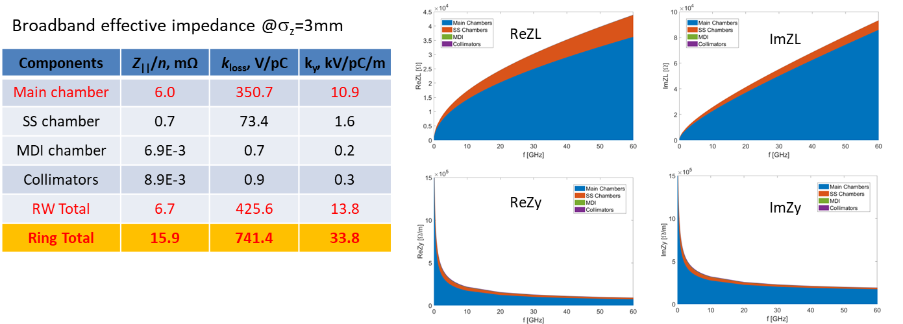
Recent progress on EDR studies
Progress on the impedance modeling
Resistive wall impedance updated by considering different type of vacuum chambers
main vacuum chamber with NEG coating, MDI chamber, collimators in the IR region and stainless steel chamber (flanges, bellows, BPMs)) ⇒ The impedance contributed by the main vacuum chamber dominates both the longitudinal and transverse RW impedance.
TRWI growth time reduced from 2.2ms to 1.7 ms (5 turns)

Slide 8
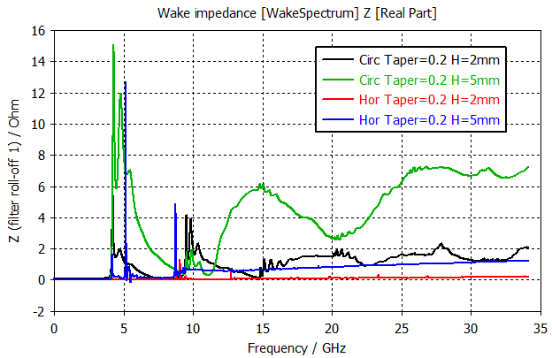
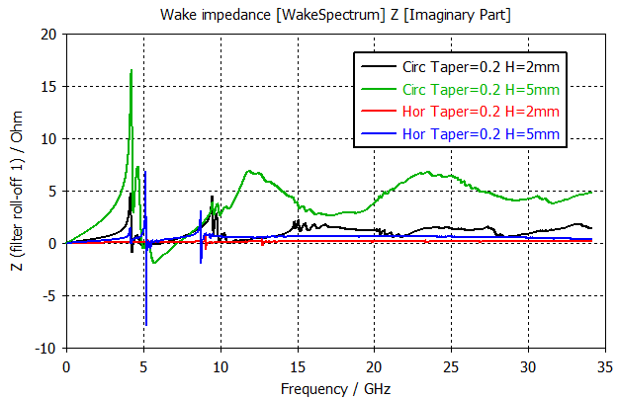
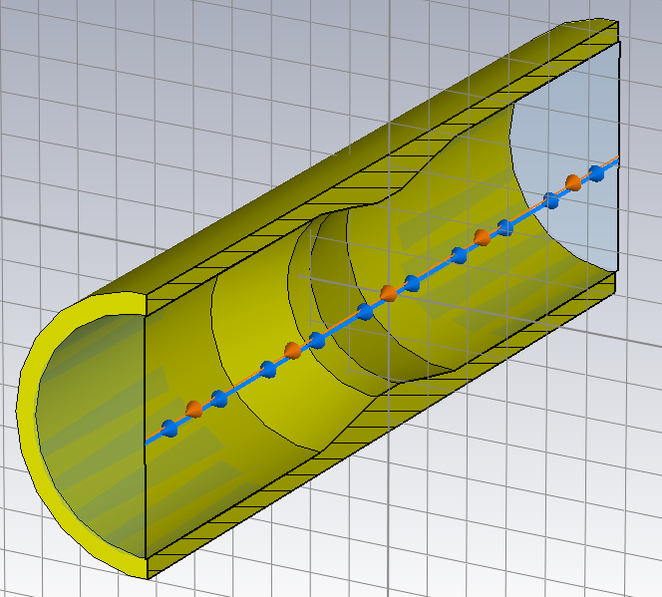
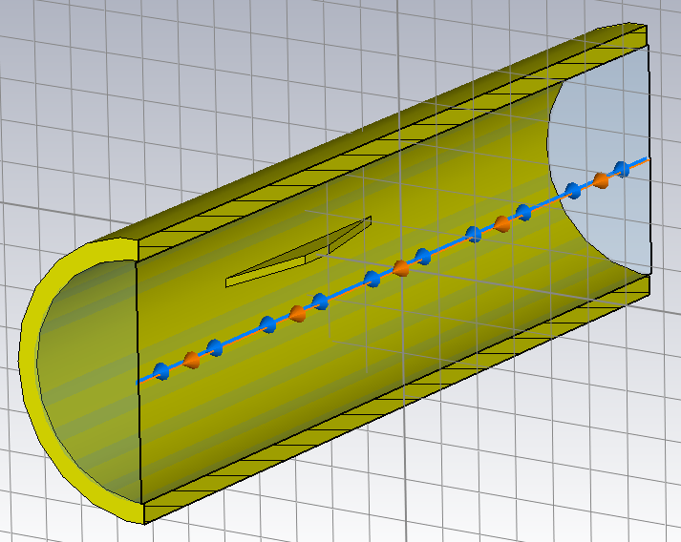
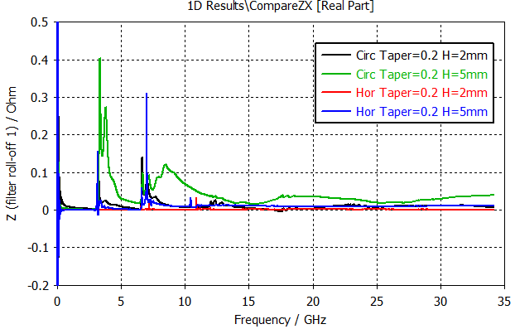
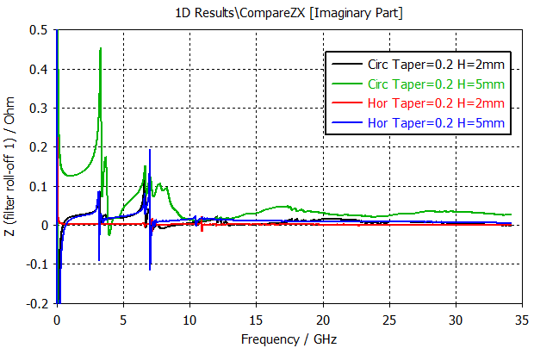
Masks/absorbers
Masks will be installed before each bellows with RF shielding and BPM to protect the downstream elements, with possible height of 2~5mm and total number of ~17k.
Impedance for cylindrical symmetrical mask and horizontal mask is compared.
Longitudinal thickness: 10mm
Horizontal mask：vertical heigh 2mm
Impedance increase with mask height
Lower impedance for horizontal mask

Slide 9
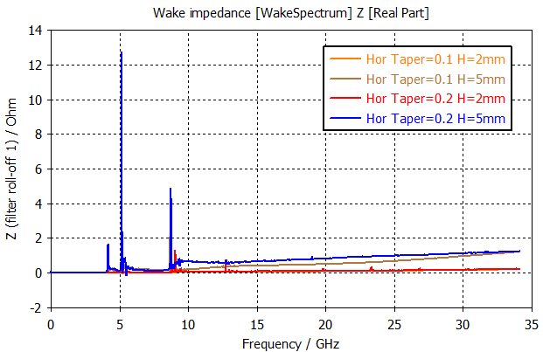
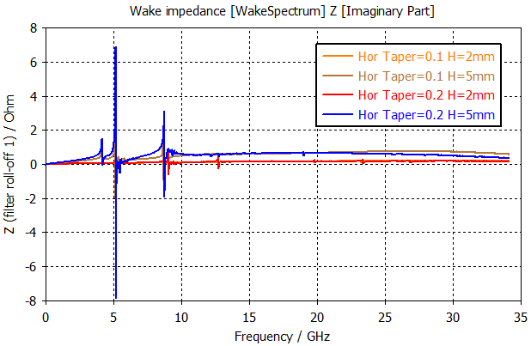
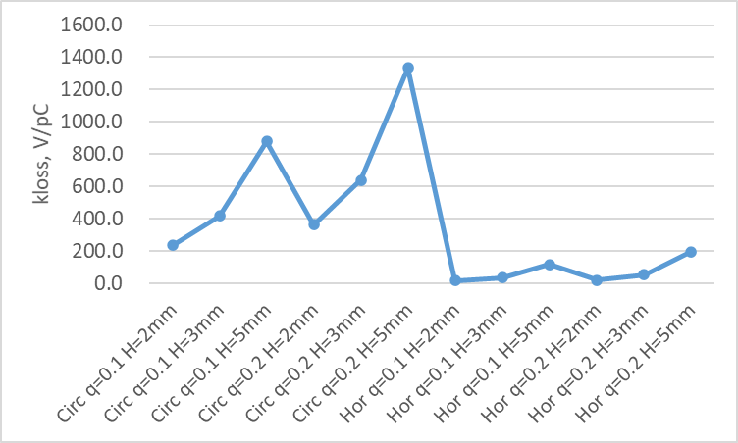
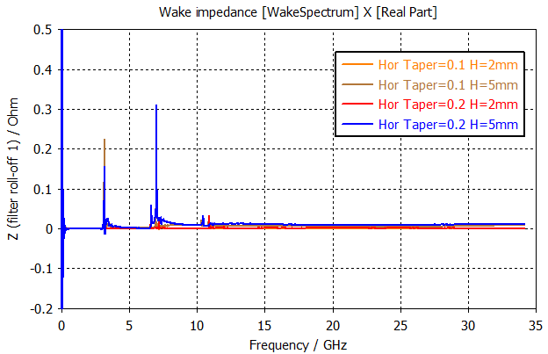
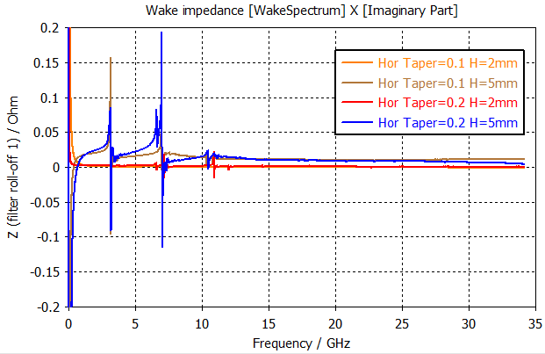
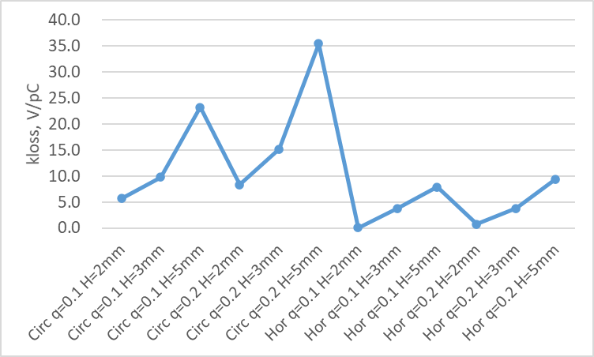
Masks/absorbers (cont.)
Different tapering angle: lower impedance with flat taper, not apparent at small height
Considering the their contribution to the total impedance budget, the mask height should below 3mm, and horizontal mask recommended.

Slide 10
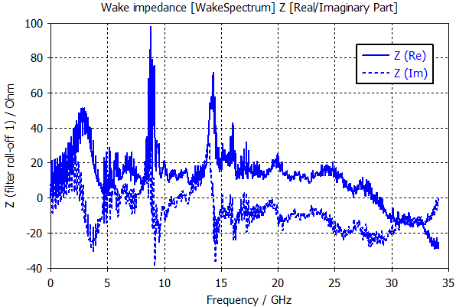
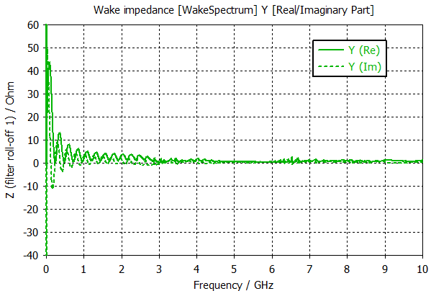
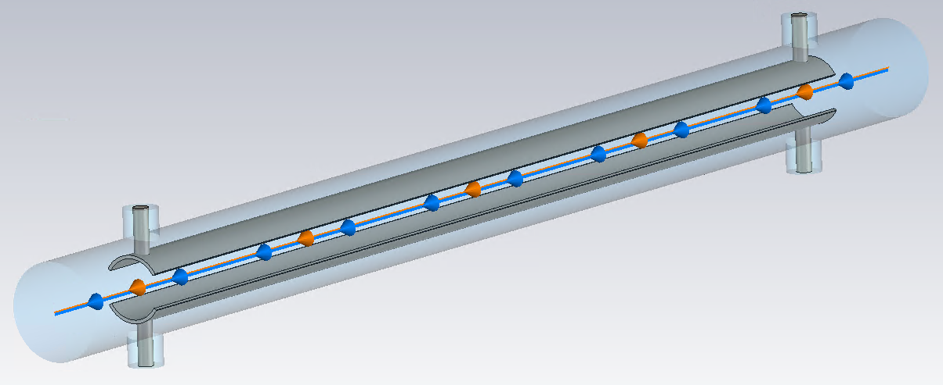
Transverse feedback kickers
Courtesy of X.Y. Liu
Four transverse feedback kickers are required for the efficient bunch-by-bunch feedback of the TRWI in Z operation mode (Damping time ≤1ms).
Preliminary simplified model been used in the impedance evaluations
k_{loss}=0.53V/pC, k_{y}=14.48V/pC/m @sigz=3mm (small contribution to the total broadband impedance budget)
Slot pipe kicker (distance between electrodes = 34mm, beam pipe aperture=28mm)

Slide 11
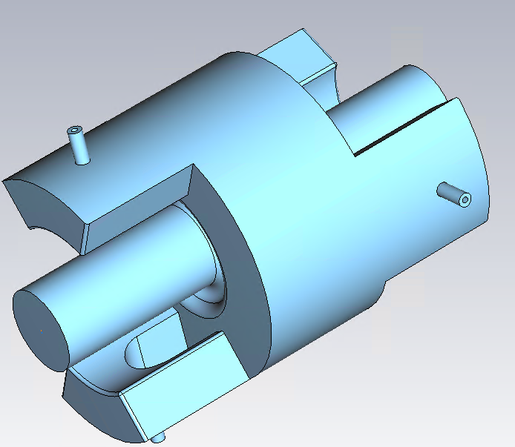
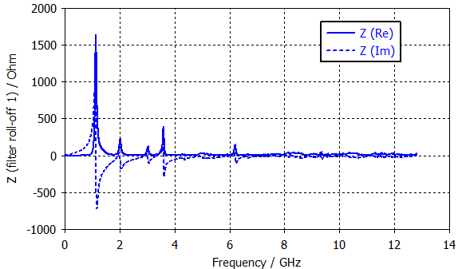
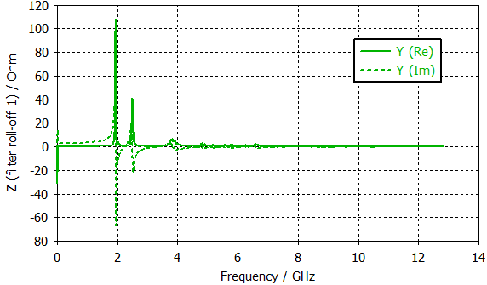
Longitudinal feedback kickers
Courtesy of X.Y. Liu
Four longitudinal feedback kickers are required for the bunch-by-bunch feedback of the longitudinal HOMs in Z operation mode (Damping time ≤12ms).
k_{loss}=0.75V/pC, k_{y}=7.67V/pC/m @sigz=3mm (small contribution to the total broadband impedance budget)
Narrowband resonances above the SR threshold for Z⇒ further optimizations are needed.

Slide 12
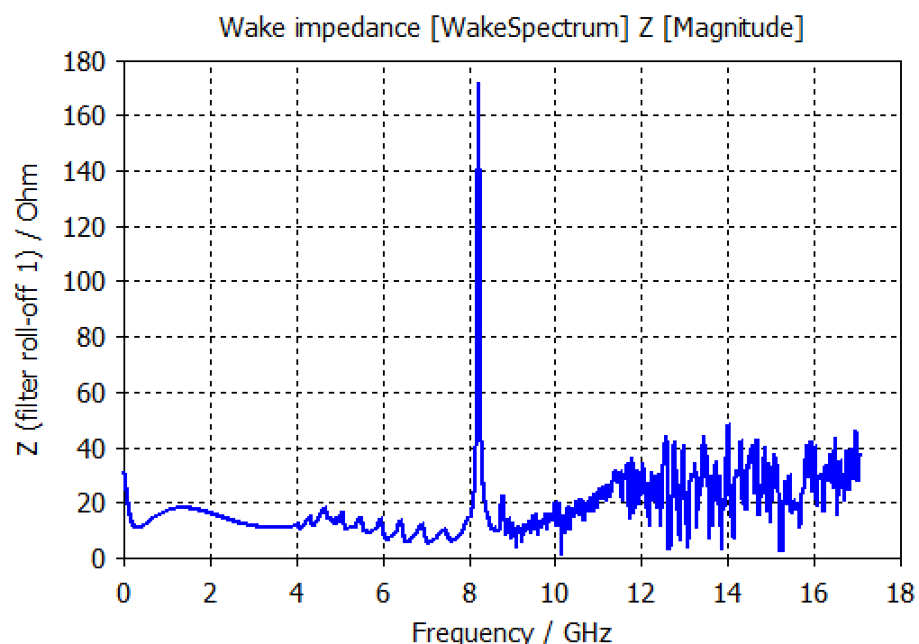
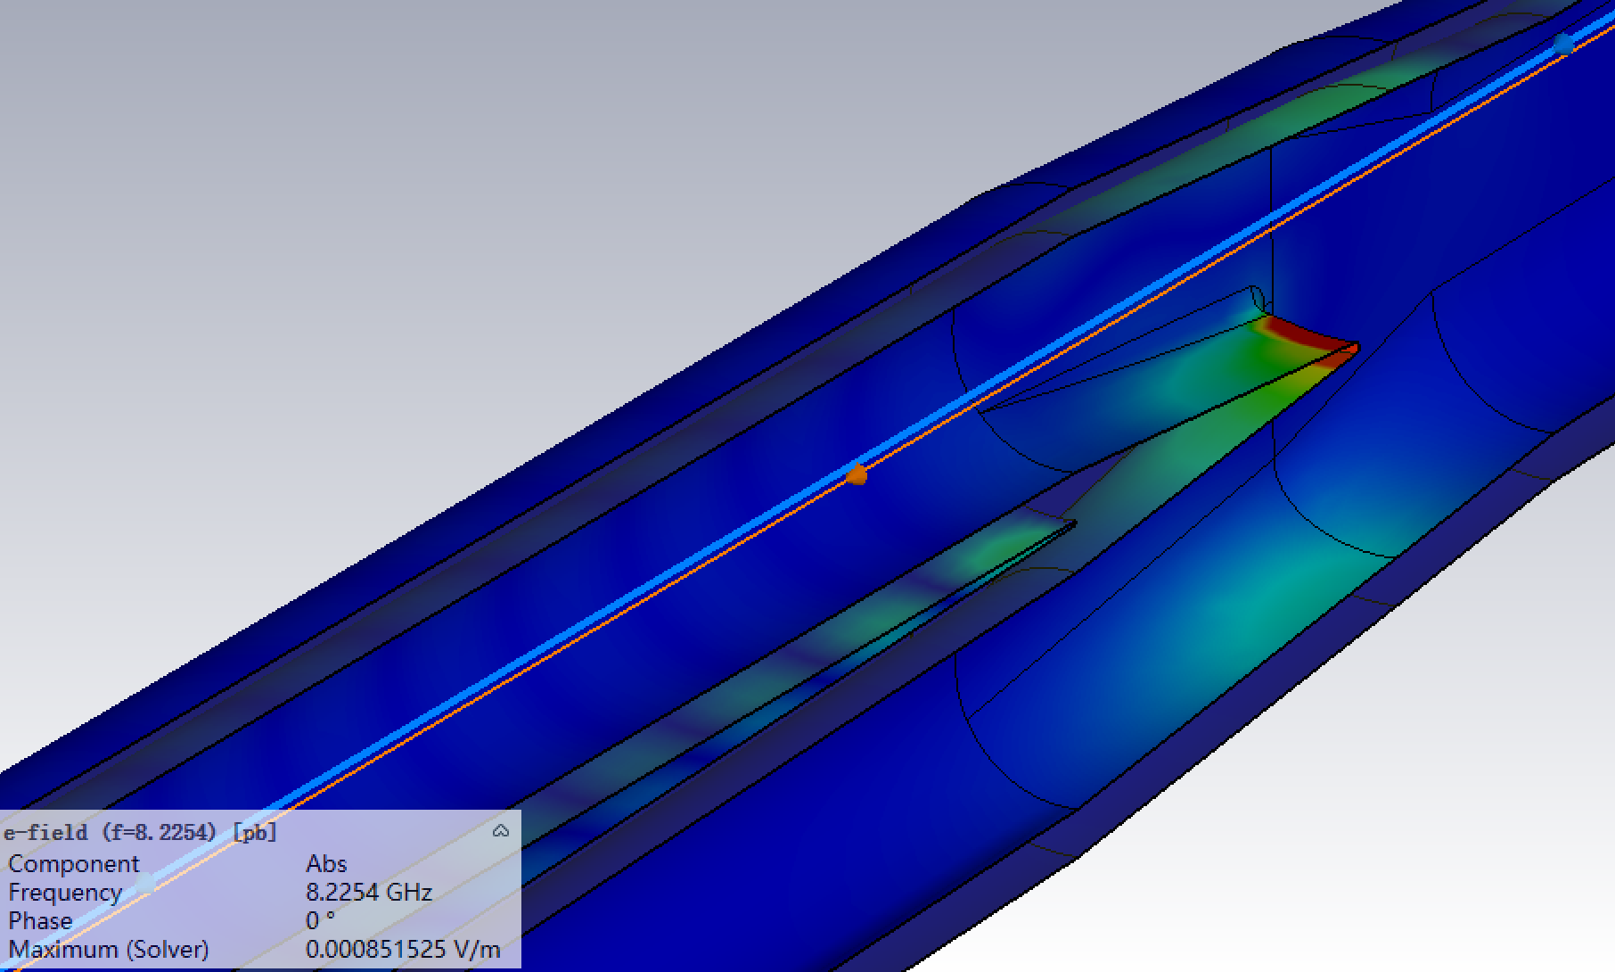
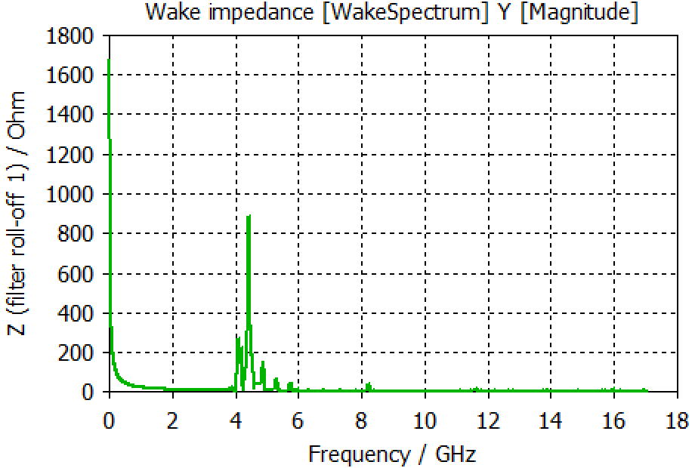
IP chamber
Longitudinal wakefield and impedance
Transverse wakefield and impedance
8.225GHz
Electric field distributions:
8.225GHz
Horizontal offset=1mm
Horizontal impedance shows strong resonances between 4-6GHz → may induce coupled bunch unstable.
There is monopolar horizontal impedance due to the horizontal asymmetry of the IP chamber relative to the beam orbit → may induce emittance blow-up.
More detailed studies are underway.

Slide 13
IP chamber
Power loss dissipations
Resistive wall wakefield – due to finite conductivity, power is doubled for colliding beams
 | Higgs-30MW |  | Z-30MW
 | Single beam | Colliding beam | Single beam | Colliding beam
Beam current [mA] | 16.7 | 16.7 | 803.5 | 803.5
Bunch length [mm] | 3.0 | 4.1 | 6.0 | 8.7
kloss [V/pC] | 0.03 | 0.03 | 0.01 | 0.01
Ploss [W] | 9 | 10 | 179 | 173
27 W (32 W/m)
50 W (41 W/m)
17 W (100 W/m)
50 W (41 W/m)
27 W (32 W/m)

Slide 14
IP chamber
Power loss dissipations
Resistive wall wakefield (Max of 179 W @Z)
Electromagnetic field excited and trapped in the IR geometry
Including material in the wakefield simulation (beam power loss=3.7 kW @Z, it can depends on the beam offset)
Total power loss of 518 W dissipated in the IR walls (total of 38 W at the Be pipe, including contribution from RW+geometry), a large part of the power transport out the pipe
195 W
38 W
286 W

Slide 15
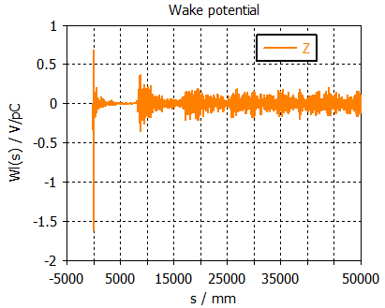
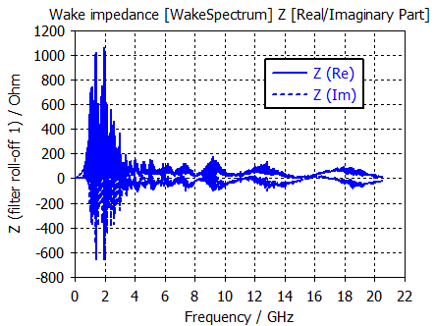
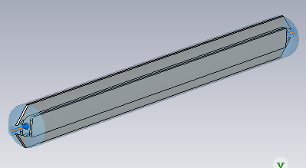
Electro-separator
High beam power loss
Reach of HOMs → could induce CBI ⇒ Needs further investigation on the HOM details and possible mitigations
 | Higgs-30MW |  | Z-30MW
 | with ZL | with ZL&BB | with ZL | with ZL&BB
Beam current [mA] | 16.7 | 16.7 | 803.5 | 803.5
Bunch length [mm] | 3.0 | 4.1 | 6.0 | 8.7
kloss [V/pC] | 1.7 | 1.4 | 1.0 | 0.8
Ploss per beam [W] | 590 | 486 | 18045 | 14436
High power loss deposition can induce：
High voltage arcing/breakdown
Burning of energy absorbing resistors
Increased outgassing which would raise the electron background in the experiments

Slide 16
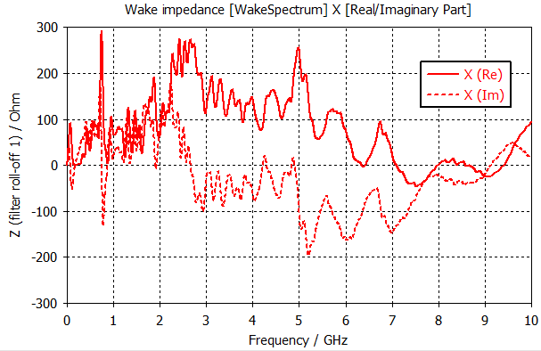
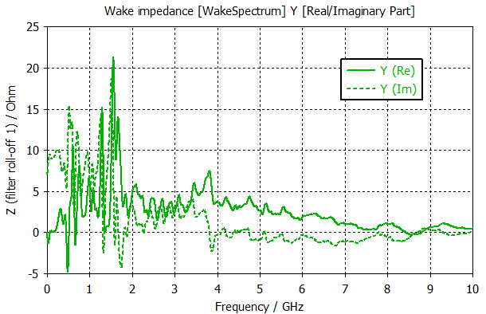
Electro-separator: Renewed Model
More detailed modeling is underway
Supporting parts and HV feedthroughs have been included
Materials have been considered
Total beam power loss per beam is increased to 23 kW
Resonances exist in both longitudinal and transverse planes (wake fields are not converged, with length of 5m)
Mode analysis is required to show details of the HOMs
Longitudinal impedance
Vertical impedance (shift=3mm)

Slide 17
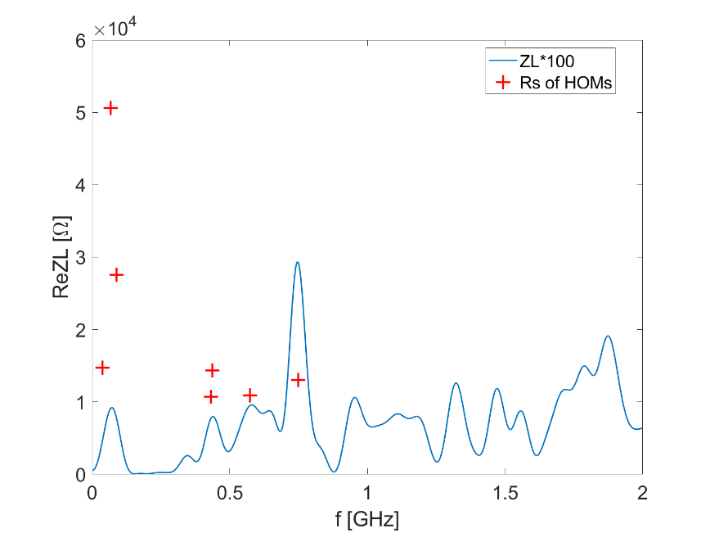
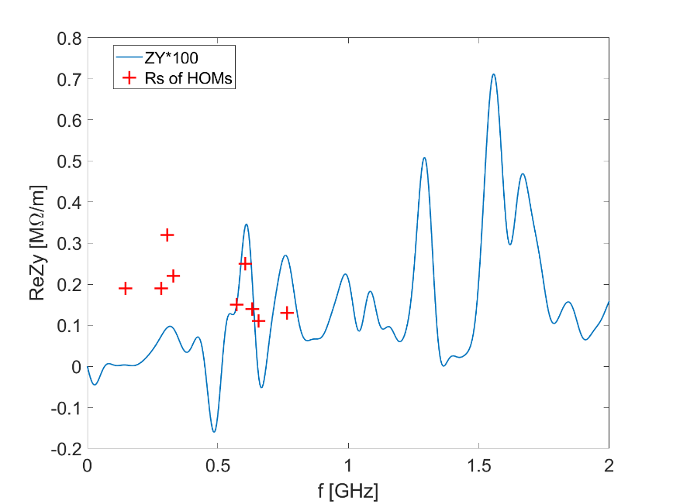
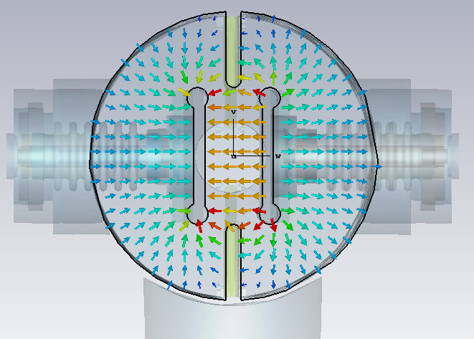
Electro-separator: Mode analysis
Dominant longitudinal modes: f₁=66.6MHz (R_{s}=50.6kΩ), f₂=87.7MHz (R_{s}=27.5kΩ)
Dominant horizontal modes: f₁=32.2MHz (R_{s}=15.3MΩ/m), f₂=59.4MHz (R_{s}=14.7MΩ/m)
Dominant vertical modes: f₁=306MHz (R_{s}=0.3MΩ/m), f₂=604MHz (R_{s}=0.3MΩ/m)
Above the transverse CBI threshold for Z ($fReZ_{||}$<650kΩ⋅GHz, $ReZ_{y}$<0.9MΩ/m)
⇒ Possible mitigations: Optimize the shape of the electrode, ground plate, taper section; damping material surround the supporting component and feedthrough of the electrodes
Strong Horizontal mode: ridge waveguide like
Longitudinal (left) and vertical (right) impedance with HOMs below 1GHz

Slide 18
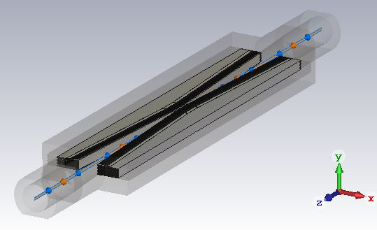
Collimators for machine protection
Impedance evaluation of the preliminary design of the collimators for the machine protection
18 horizontal+12 vertical extra collimators
Rough estimation take the same impedance model as for the IR region (with collimator jaw gap of 4.4mm)
Local betatron functions at the collimators are considered
Their contributions to the transverse broadband impedance is the main concern → Comparable to the total TDR transverse impedance budget ⇒ further optimizations are required.
Their contributions to the longitudinal impedance budget are trivial.

Slide 19
Impedance evolution
The transverse impedance budget increased dramatically ⇐ mainly contributed by the collimators for the machine protection (rough model has been used)
Influences: single bunch current threshold, beam-beam interaction/luminosity reach
Careful machine protection & collimator design with low impedance + instability mitigations
2018
Elliptical cross section (CDR)
Circular cross section
More contributors included (TDR)
2021
More detailed chamber material, collimator updated and betatron function weighing is considered.
2023_V1
2023_V2
Collimators for machine protection, masks and feedback kickers included
Evaluate with rms bunch length of 3mm

Slide 20
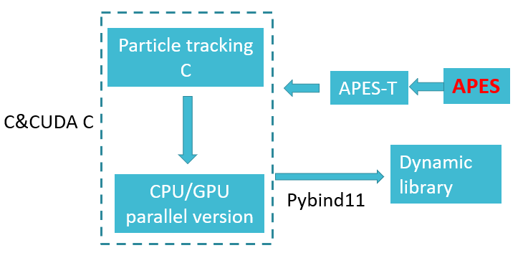
Interplays among different instability mechanisms
Courtesy of Y. Zhang
The interplays among different mechanisms start to play important roles in the evaluation of the beam performance.
Impedance & beam-beam
Without vertical impedance
With vertical impedance
Y. Zhang, PRAB 26, 064401 (2023)
Possible mitigation strategies are proposed and testified:
Feedback
Chromaticity
Asymmetrical tunes
Beam dynamics code development: APES
Motivation: meeting the challenge of CEPC
Simulation code validation with BEPCII
Objective:
accurate modeling and simulation
Self-consistent
High performance (GPU+MPI)

Slide 21
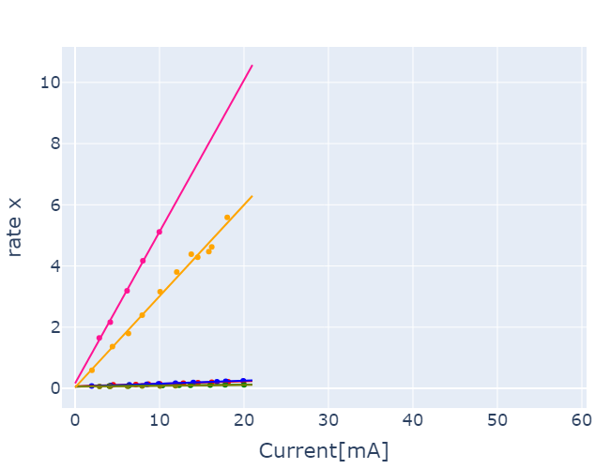
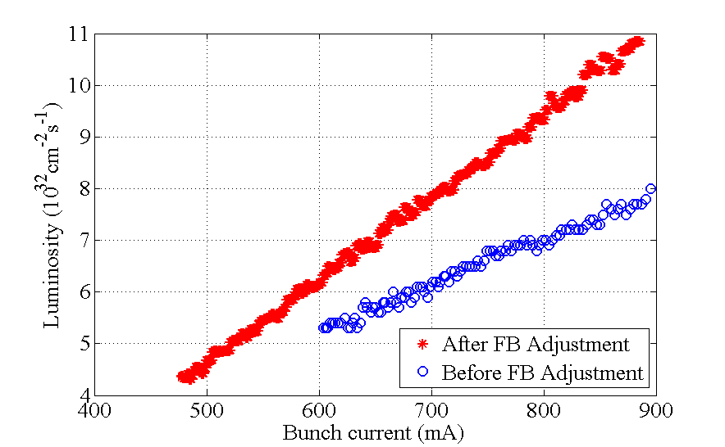
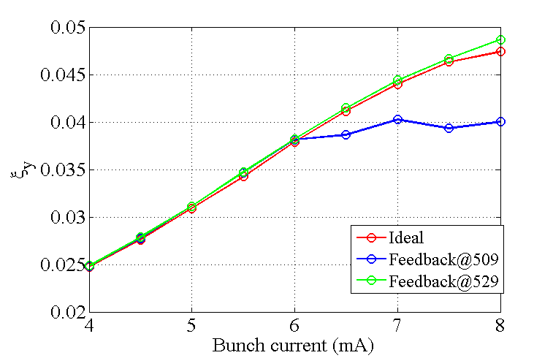
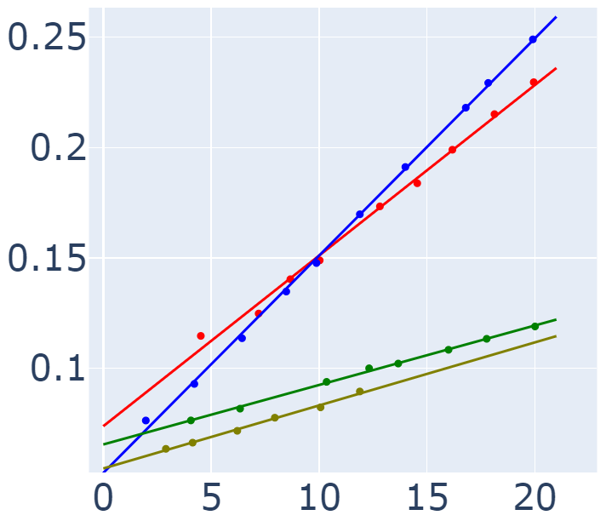
Investigation on BEPCII collective effects as a support for CEPC studies
Courtesy of Y. Zhang and Y. Liu
Beam-Beam + Instability + Feedback
Limited effective bandwidth of feedback induce horizontal beam size blowup, saturation of 𝜉_{𝑥,y} and luminosity loss at higher beam current.
Simulation could explain the experiment qualitatively.
Single bunch damping rate with ξ/FB
FB show strong damping for single bunch instability, which is dominate for BEPCII parameter range
Larger ξ shows stronger damping
BPR ξ=0.9+FB
BER ξ=0.1+FB
Tuning of Multi-Bunch Transverse Feedback System
BPR ξ=2.7
BER ξ=1.5
BER ξ=0.1
BPR ξ=0.9
Better understanding of the existing machines are important for both pushing the machine performance and benefiting the further machine studies

Slide 22
Summary and outlooks
The impedance model will be continuously updated and optimized, along with the development of the hardware designs ⇒ impedance increase is expected with more contributors included.
The main instability constraints from impedance are focused on Z, enough safety margin is reserved for other energies
The interplays among different mechanisms start to play important roles in the evaluation of the beam performance ⇒ A powerful beam dynamics code APES is being developed, along with BEPCII as a possible test facility.
More comprehensive investigations on both impedance modeling and optimization, as well as instability evaluations and mitigations in a self-consistent manner are underway.

Slide 23
Thank you for your attention!

