Slide 1
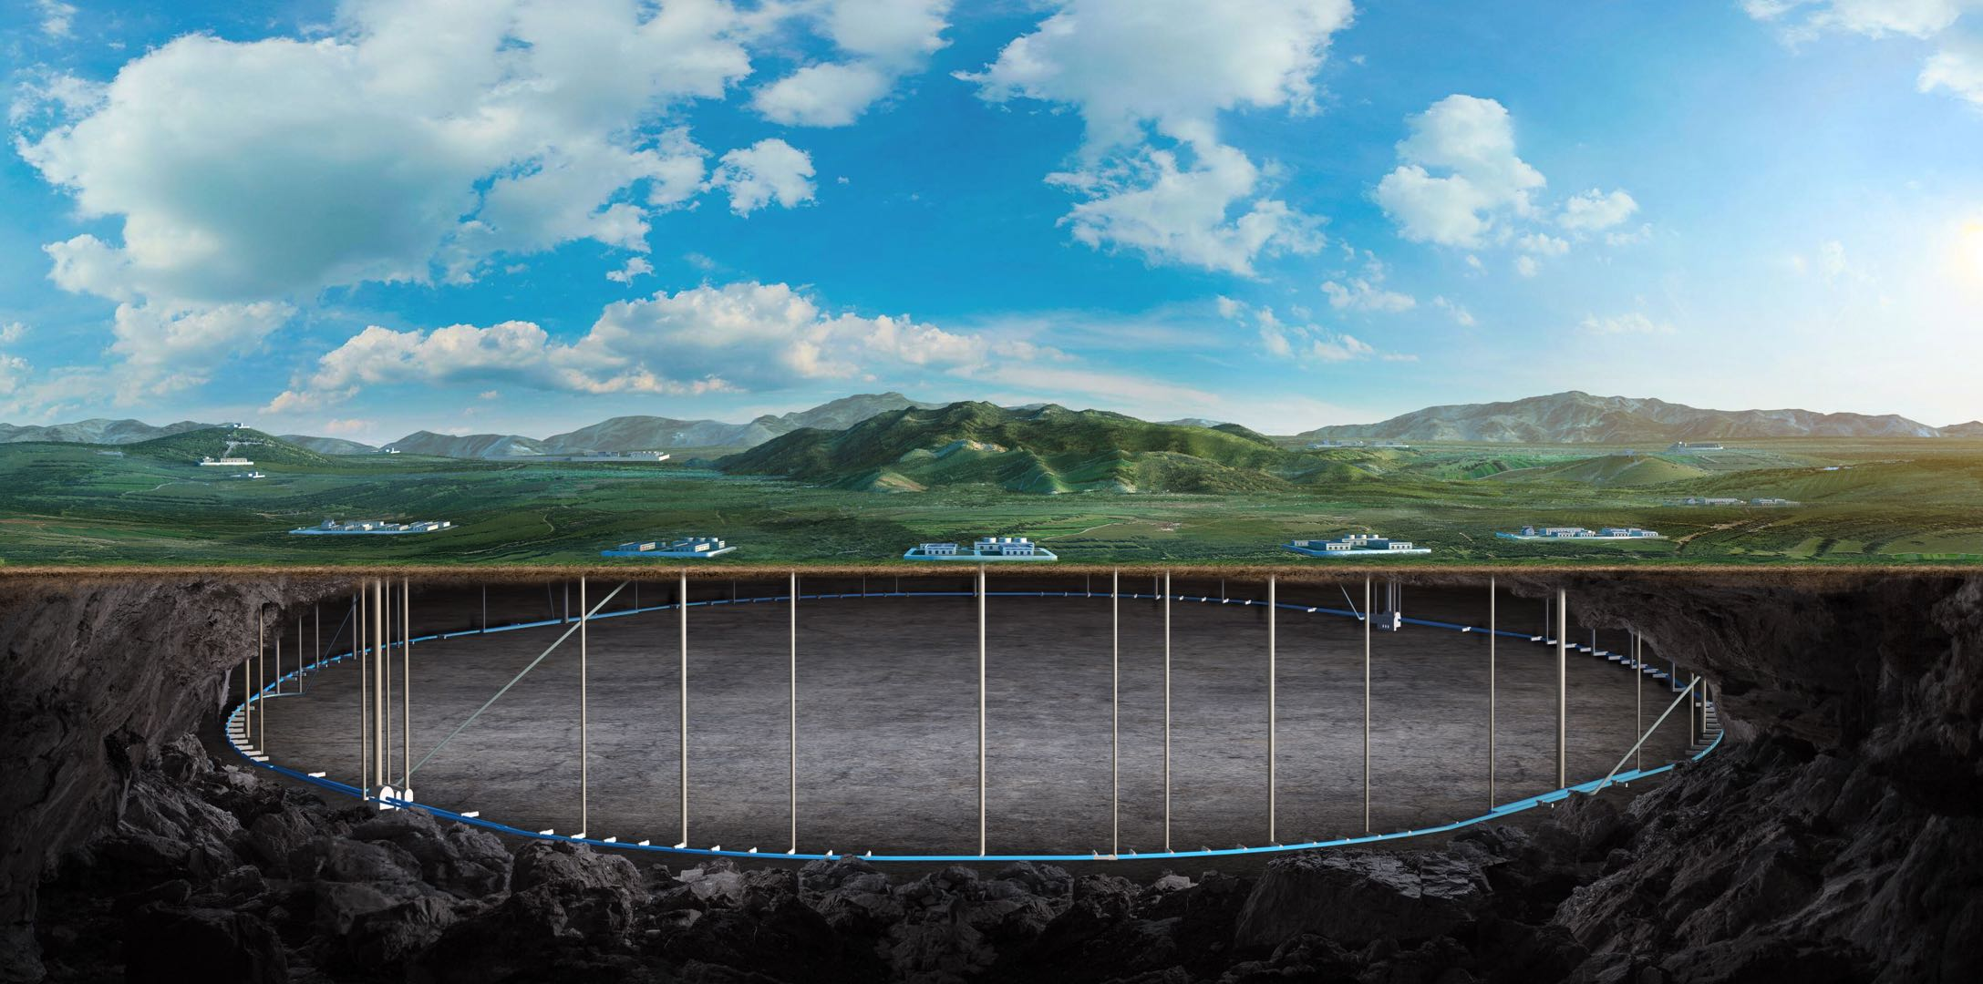
CEPC booster errors studies in EDR
Daheng Ji, Dou Wang(IHEP)
on behalf of CEPC AP group
8. April. 2024, Marseille, France, 2024 CEPC Workshop EU Edition

Slide 2
Content
CEPC Booster
Booster design，Error and correction in TDR
First turn commissioning simulation
Further plan in the EDR
Summary

Slide 3
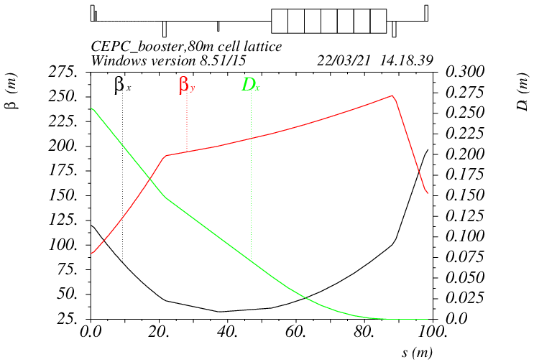
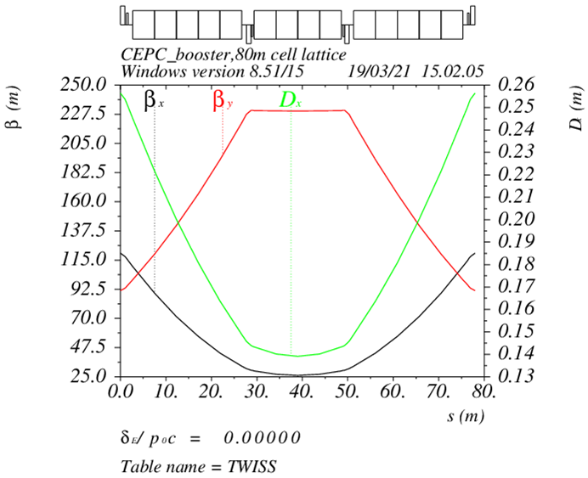
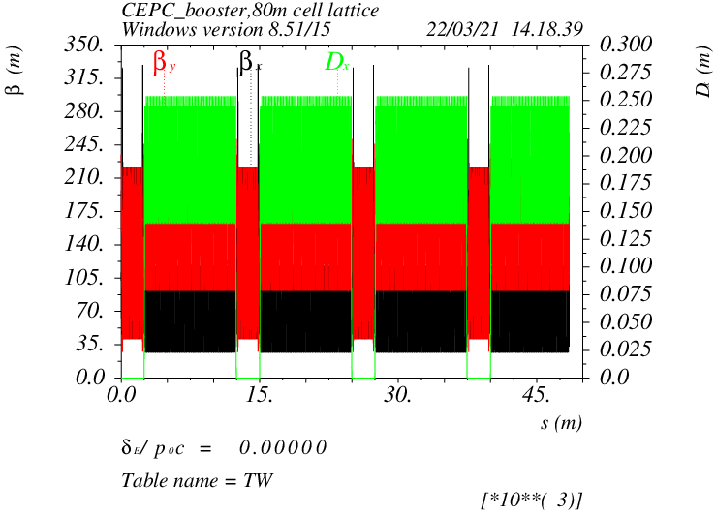
Booster Design
D. Wang, C. H. Yu, Y. M. Peng…
TME like structure (cell length=78m)
Interleave sextupole scheme
Emittance@120GeV=1.26nm
Overall idea: uniform distribution for the Q
Combined magnet (B+S) scheme possible
Phase advance/cell: 100° (H) / 28° (V)
Dispersion sup.
Arc cell
Half ring

Slide 4
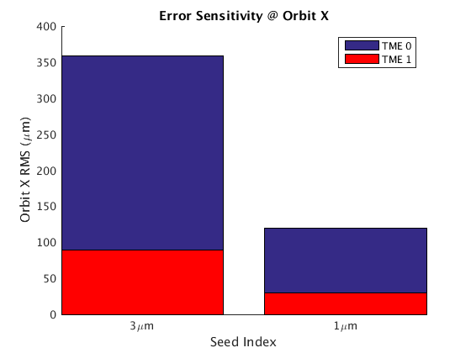
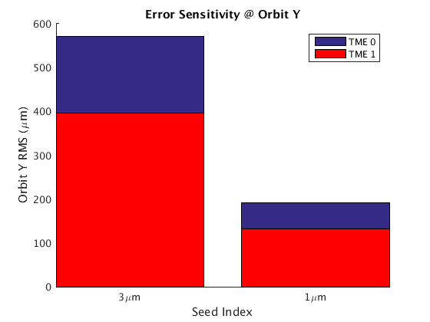
Error Set in Simulation
Simulation based on Accelerator Toolbox(AT).
3σ cutoff | Dipole | Quadrupole | Sextupole
Transverse shift X/Y (μm) | 100 | 100 | 100
Longitudinal shift Z (μm) | 100 | 150 | 150
Tilt about X/Y (mrad) | 0.2 | 0.2 | 0.2
Tilt about Z (mrad) | 0.1 | 0.2 | 0.2
Nominal field | 1e-3 | 2e-4 | 3e-4
 | Accuracy (m) | Tilt (mrad) | Gain | Offset w/ BBA (mm)
BPM(10Hz) | 1e-7 | 10 | 5% | 30e-3
#BPM~2400
#Corrector~1200
dipole | quadrupole
B1/B0 ≤ 2×10⁻⁴
B2/B0 ≤ 5×10⁻⁴ | B2/B1 ≤ 3×10⁻⁴
B3/B0 ≤ 2×10⁻⁵ | B3/B1 ≤ 2×10⁻⁴
B4/B0 ≤ 8×10⁻⁵ | B4/B1 ≤ 1×10⁻⁴
B5/B0 ≤ 2×10⁻⁵ | B5/B1 ≤ 1×10⁻⁴
B6/B0 ≤ 8×10⁻⁵ | B6/B1 ≤ 5×10⁻⁵
B7/B0 ≤ 2×10⁻⁵ | B7/B1 ≤ 5×10⁻⁵
B8/B0 ≤ 8×10⁻⁵ | B8/B1 ≤ 5×10⁻⁵
B9/B0 ≤ 2×10⁻⁵ | B9/B1 ≤ 5×10⁻⁵
B10/B0 ≤ 8×10⁻⁵ | B10/B1 ≤ 5×10⁻⁵

Slide 5
Correction Process
Orbit Correction + Horizontal dispersion
Response Matrix
2-level iteration：
1st Loop: 20%~100% Corrector
2nd Loop：30%~80% Singular Value
Dispersion correction
Energy adjustment by corrector
80um RMS in both plan
Optics correction
RM + LOCO
Based on 30GeV simulation
All quadrupole independent
Dispersion correction included
Coupling and vertical dispersion correction
Mainly used for the simulation of beam polarization. (Z. Duan)
Skew quadrupole magnets are arranged in both the dispersion free section and the arc section to correct coupling and vertical dispersion independently.
the coupling control target being better than 0.5%

Slide 6
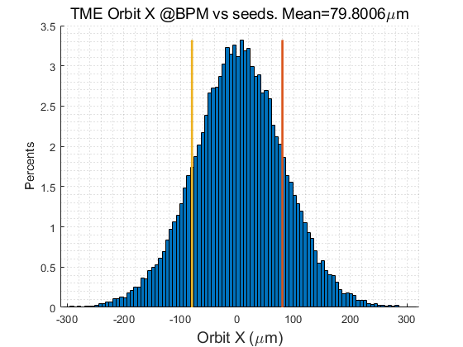
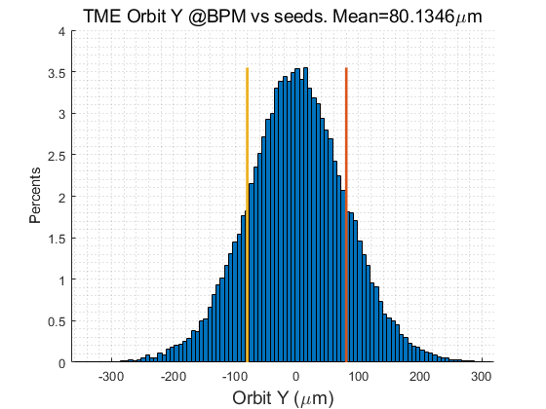
Correction Process
Orbit Correction + Horizontal dispersion
Response Matrix
2-level iteration：
1st Loop: 20%~100% Corrector
2nd Loop：30%~80% Singular Value
Dispersion correction
Energy adjustment by corrector
80um RMS in both plan
Optics correction
RM + LOCO
Based on 30GeV simulation
All quadrupole independent
Dispersion correction included
Coupling and vertical dispersion correction
Mainly used for the simulation of beam polarization. (Z. Duan)
Skew quadrupole magnets are arranged in both the dispersion free section and the arc section to correct coupling and vertical dispersion independently.
the coupling control target being better than 0.5%

Slide 7
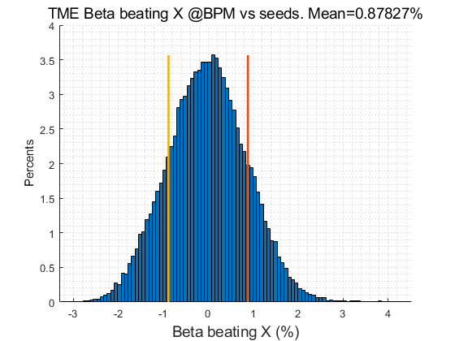
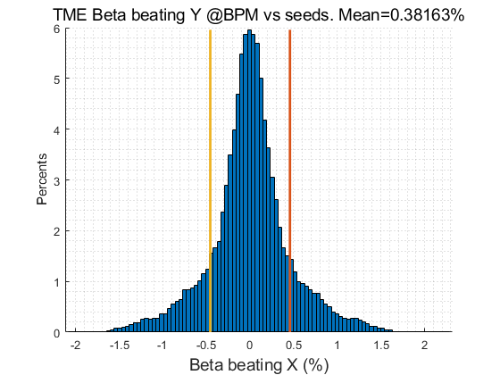
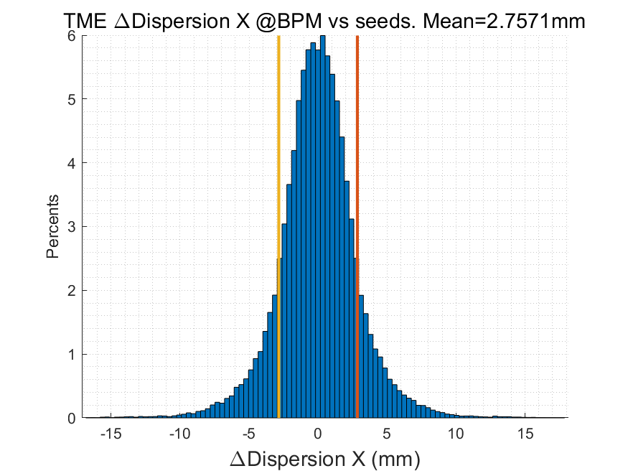
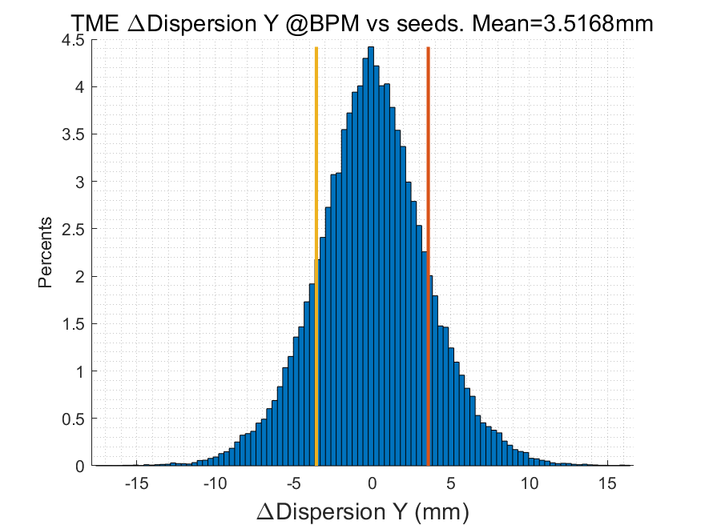
Correction Process
Orbit Correction + Horizontal dispersion
Response Matrix
2-level iteration：
1st Loop: 20%~100% Corrector
2nd Loop：30%~80% Singular Value
Dispersion correction
Energy adjustment by corrector
80um RMS in both plan
Optics correction
RM + LOCO
Based on 30GeV simulation
All quadrupole independent
Dispersion correction included
Coupling and vertical dispersion correction
Mainly used for the simulation of beam polarization. (Z. Duan)
Skew quadrupole magnets are arranged in both the dispersion free section and the arc section to correct coupling and vertical dispersion independently.
the coupling control target being better than 0.5%
RMS@30GeV | X | Y
Orbit (mm) | 0.080 | 0.080
Beta Beating(%) | 0.8 | 0.38
Δ Dispersion(mm) | 2.7 | 3.5

Slide 8
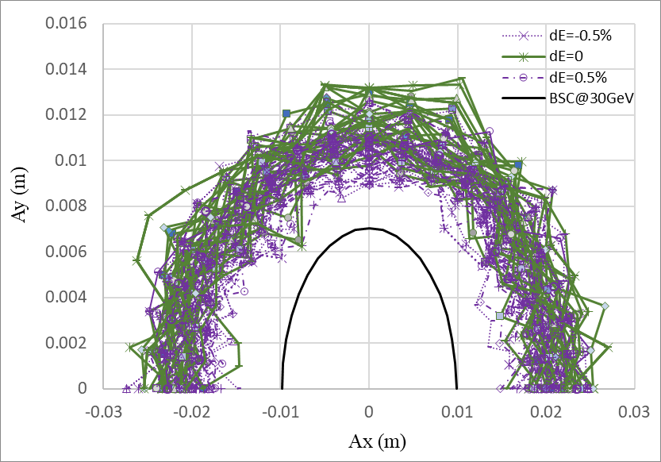
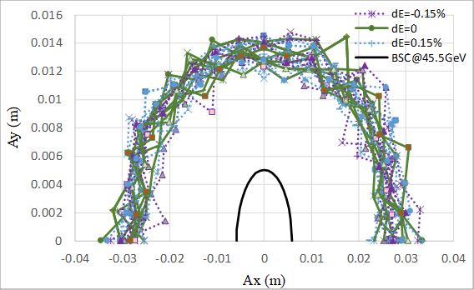
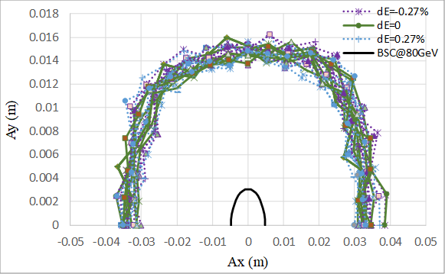
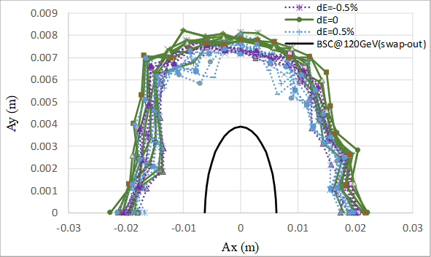
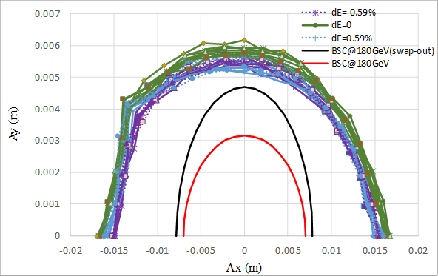
DA w/ Correction
30GeV
45GeV
Tracking by SAD
include errors (w. multipole errors)
Include SR sawtooth orbit
with taper@180GeV
Include SR damping & fluctuation
Off axis injection
to collider
On axis injection
80GeV
120GeV
180GeV
Off axis injection
to collider
Off axis injection
to collider

Slide 9
Further Plan in the EDR
Injection to storage: Filling the gap in the simulation of the entire process commissioning.
First-turn, injection correction program, longitudinal parameter optimization program, etc.
Fast measurement and correction: The application and evaluation of these fast correction programs for the CEPC Booster will be based on the TBT BPM measurement and correction program.
Optimization of correction elements layout: Reducing costs while maintaining performance
Dynamic errors and drift: jitter/vibration/ground drift ↔ feedback
Abnormal situations: Identification and handling in commissioning process
Notes:
gaps in our research regarding the process from beam injection to beam storage.

Slide 10
First Turn Commissioning
Recent simulation studies have been conducted on the initial beam commissioning of the CEPC Booster
These studies can also serve as a reference for related research on the CEPC storage ring.
Simulation settings:
Physical aperture: 56mm
BPM Accuracy and offset: 100um
Other error settings are the same as those in ordinary error correction simulations.
The injection beam jitter and beam distribution are taken into account.
Based on the AT (Accelerator Toolbox) program.
Using the response matrices of orbit, trajectory, working point, and injection beam derived from theoretical models.
A similar correction process has already been applied to the HEPS (High Energy Photon Source) Booster and will be used in the beam tuning of the HEPS storage ring.
Multi-turn Trajectory Correction, Injection Beam Trajectory Correction
Single-turn Trajectory Correction
0
10
100
500
1000
10000
storaged
RF on
Tune tuning,
RF Phase tuning
TBT Optics Correction

Slide 11
First Turn Commissioning
Multi-turn Trajectory Correction, Injection Beam Trajectory Correction
Single-turn Trajectory Correction
0
10
100
500
1000
10000
storaged
RF on
Tune tuning,
RF Phase tuning
TBT Optics Correction
Single-turn trajectory correction: Minimize the trajectory of the beam for the first 5 turns.
Multi-turn trajectory correction: Average the beam trajectory over more than 5 turns to obtain an approximate closed orbit and correct it.
Injection beam trajectory correction: Correct the coordinates of the injection beam at the injection point to reduce the oscillation of the injected beam.
Tune adjustment: Calculate (Phased-CFT) and adjust the working point using the beam over 50 turns.
RF parameters adjustment: Evaluate the beam energy variation with the average of the horizontal trajectory over each turn and adjust the RF parameters to reduce oscillation.
Optics correction: Based on ICA, PCA.

Slide 12
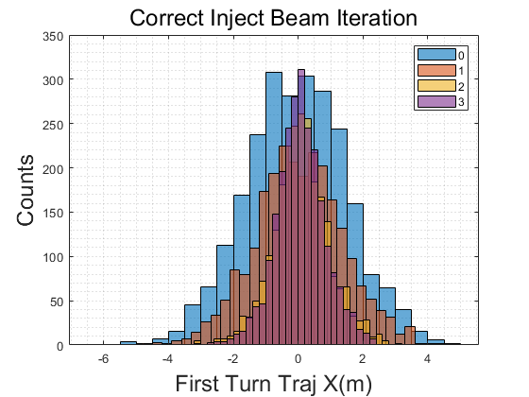
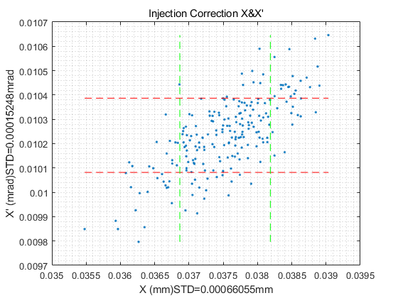
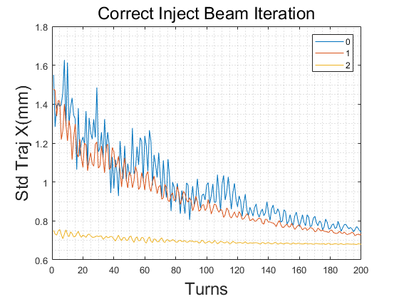
First Turn Commissioning
Multi-turn Trajectory Correction, Injection Beam Trajectory Correction
Single-turn Trajectory Correction
0
10
100
500
1000
10000
storaged
RF on
Tune tuning,
RF Phase tuning
TBT Optics Correction
Single-turn trajectory correction: Minimize the trajectory of the beam for the first 5 turns.
Multi-turn trajectory correction: Average the beam trajectory over more than 5 turns to obtain an approximate closed orbit and correct it.
Injection beam trajectory correction: Correct the coordinates of the injection beam at the injection point to reduce the oscillation of the injected beam.
Tune adjustment: Calculate (Phased-CFT) and adjust the working point using the beam over 50 turns.
RF parameters adjustment: Evaluate the beam energy variation with the average of the horizontal trajectory over each turn and adjust the RF parameters to reduce oscillation.
Optics correction: Based on ICA, PCA.

Slide 13
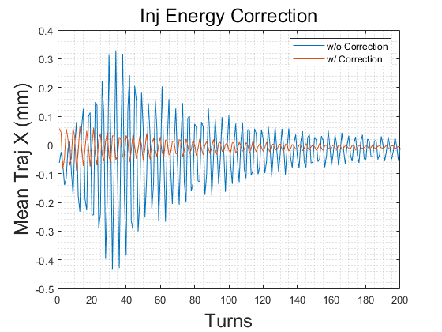
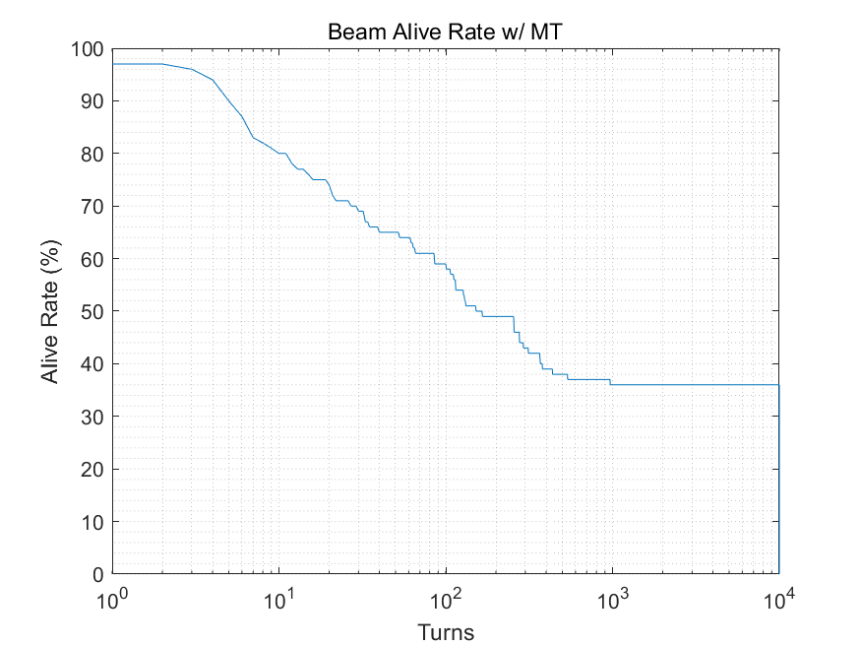
First Turn Commissioning
Multi-turn Trajectory Correction, Injection Beam Trajectory Correction
Single-turn Trajectory Correction
0
10
100
500
1000
10000
storaged
RF on
Tune tuning,
RF Phase tuning
TBT Optics Correction
Single-turn trajectory correction: Minimize the trajectory of the beam for the first 5 turns.
Multi-turn trajectory correction: Average the beam trajectory over more than 5 turns to obtain an approximate closed orbit and correct it.
Injection beam trajectory correction: Correct the coordinates of the injection beam at the injection point to reduce the oscillation of the injected beam.
Tune adjustment: Calculate (Phased-CFT) and adjust the working point using the beam over 50 turns.
RF parameters adjustment: Evaluate the beam energy variation with the average of the horizontal trajectory over each turn and adjust the RF parameters to reduce oscillation.
Optics correction: Based on ICA, PCA.

Slide 14
First Turn Commissioning
Multi-turn Trajectory Correction, Injection Beam Trajectory Correction
Single-turn Trajectory Correction
0
10
100
500
1000
10000
storaged
RF on
Tune tuning,
RF Phase tuning
TBT Optics Correction
Results indicate that after correction, approximately 30% of the particles survive for more than 10,000 turns.
This can meet the needs of subsequent more detailed corrections, forming a complete process with previous simulation correction results.
The algorithm is still undergoing optimization.
The research still lacks many details, with some conditions such as the quality of the injection beam and more detailed physical apertures being updated and iterated.

Slide 15
Further Plan in the EDR
Injection to storage: Filling the gap in the simulation of the entire process commissioning.
First-turn, injection correction program, longitudinal parameter optimization program, etc.
Fast measurement and correction: The application and evaluation of these fast correction programs for the CEPC Booster will be based on the TBT BPM measurement and correction program.
Optimization of correction elements layout: Reducing costs while maintaining performance
Dynamic errors and drift: jitter/vibration/ground drift ↔ feedback
Abnormal situations: Identification and handling in commissioning process
Notes:
gaps in our research regarding the process from beam injection to beam storage.

Slide 16
Summary
For the existing error simulation settings, the corrected TME structure Lattice design (TDR) can meet the aperture requirements at various energy levels.
If the Lattice design needs modification, the existing correction process can promptly provide simulation results and an assessment of the Lattice's robustness.
In the EDR research plan, there is a focus on the needs of the actual machine.
The initial beam commissioning study (starting from the first turn...) has essentially completed its algorithm, and correction attempts aimed at 10000 turns can be successfully accomplished.
The correction algorithm still has room for optimization.
Subsequent related research includes the accumulation of Seeds; iteration between the design and simulation results of injection beams, hardware errors, physical apertures, etc.
Other research directions in the EDR plan are also ongoing, and the plan itself is continuously being supplemented and refined.

Slide 17
Thanks for your attention!

