Slide 1



CEPC Booster and Damping Ring studies in EDR
Dou Wang (IHEP)
on behalf of CEPC Acc group
8-11. Apr. 2024, Marseille, CEPC Workshop 2024- EU Edition.

Slide 2
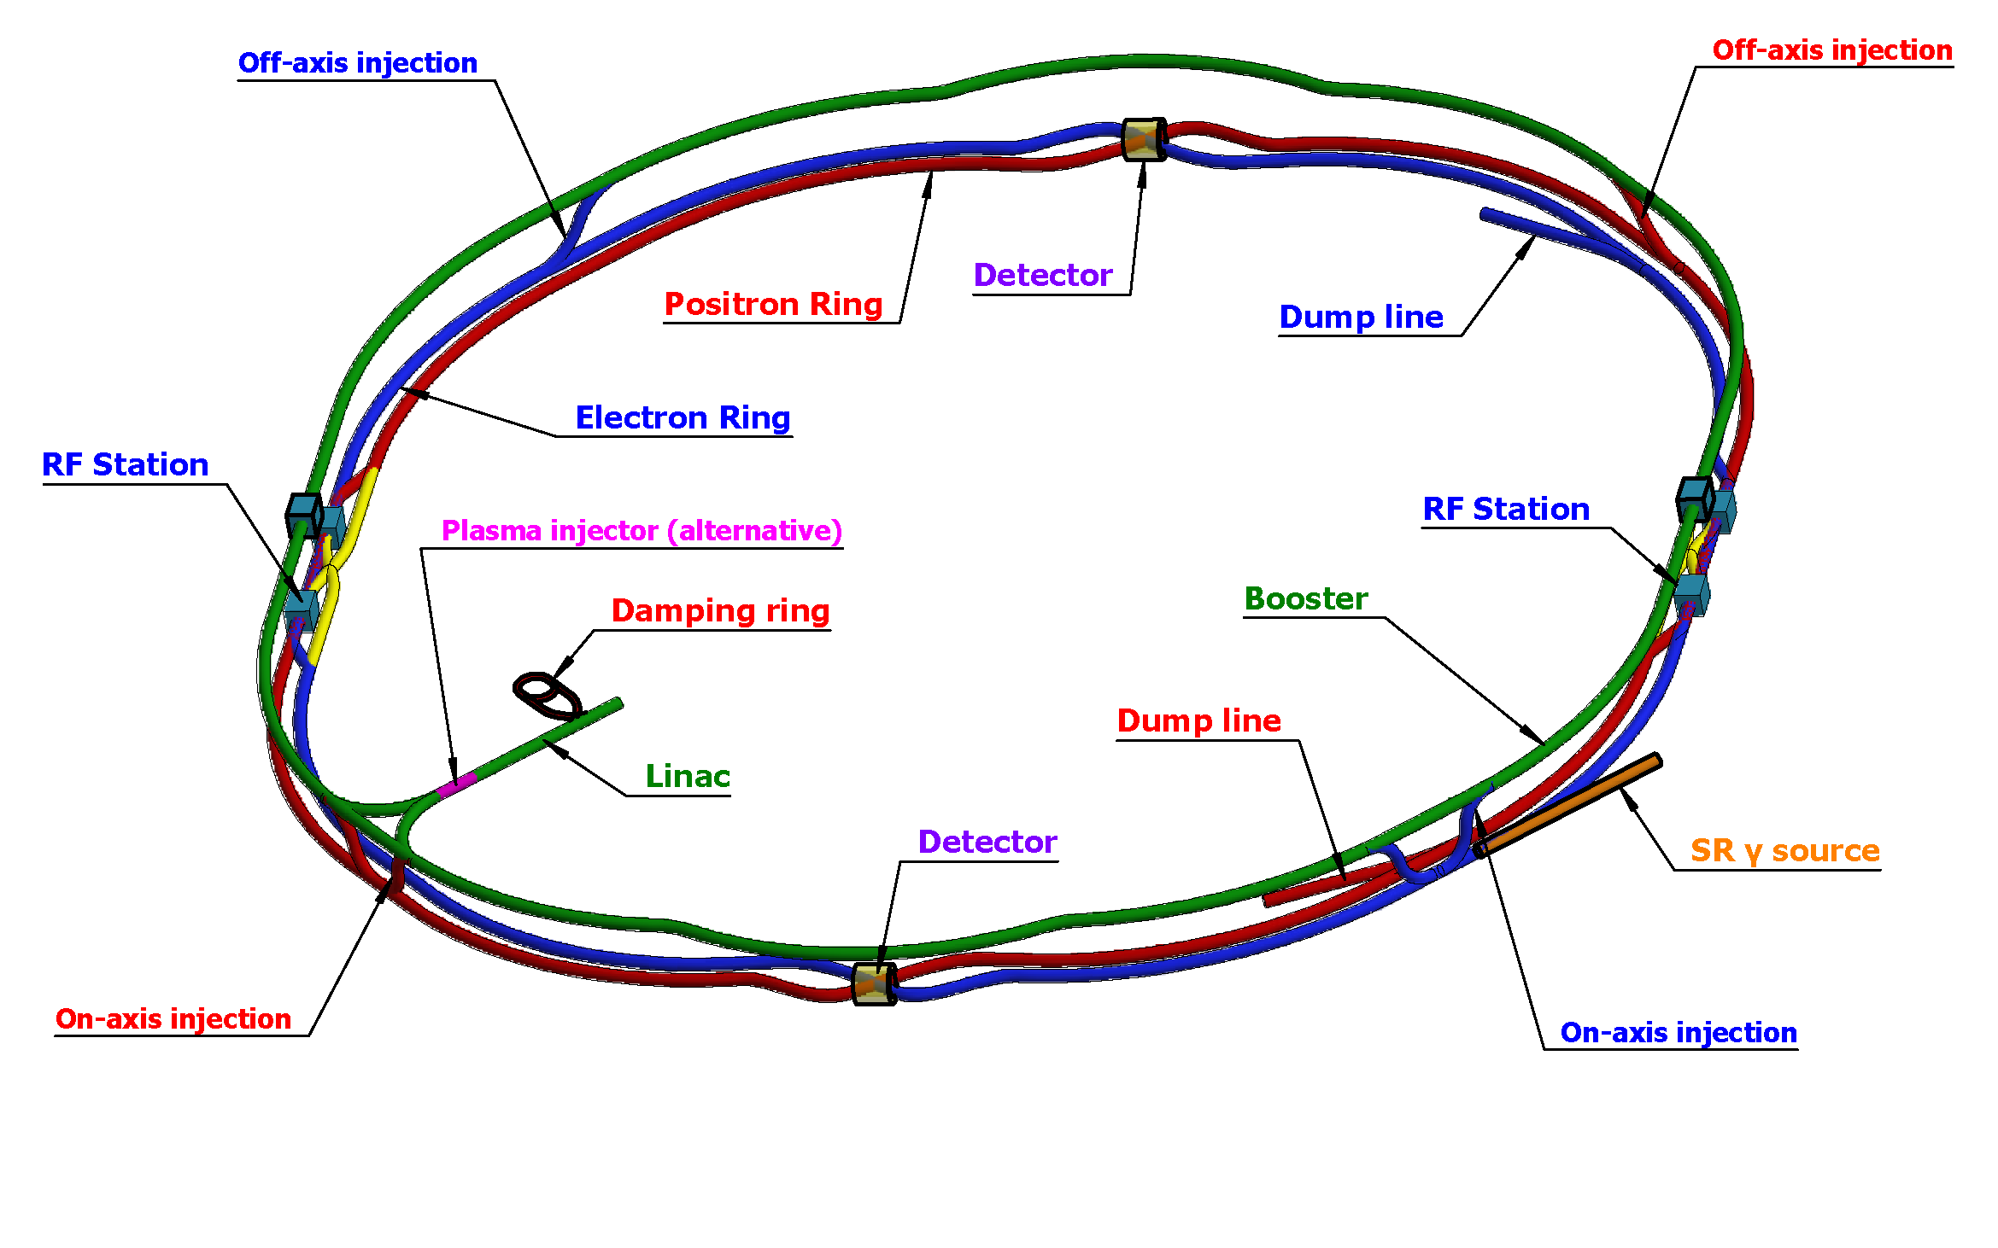
CEPC injector chain
30→180GeV
30GeV
2 RF stations
2 Inj. (Linac to Booster)
2 Inj. (Collider to Booster)
4 Ext. (Booster to Collider)
2 Ext. (Booster to Dump)
100km
30 GeV linac provides electron and positron beams for booster.
Top up injection for collider ring ~ 3% current decay
Booster is in the same tunnel as collider ring, above the collider ring, bypass in IRs (same circumference).
Budget for transfer efficiency 90%: 95% for booster + 95% for transport lines (inj. to collider).
Beam current threshold in booster is limited by RF system.
Feedback systems (Transverse & longitudinal) are need to damp the instability at low energy.

Slide 3
Booster TDR parameters
Injection energy: 10GeV → 20GeV → 30GeV
Max energy: 120GeV → 180GeV
Lower emittance ─ new lattice (TME)
Extraction
Injection
*Diameter of beam pipe is 56mm for re-injection with high single bunch current @120GeV.

Slide 4
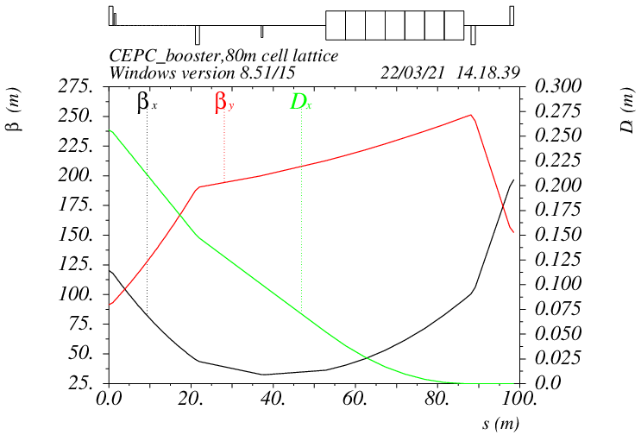
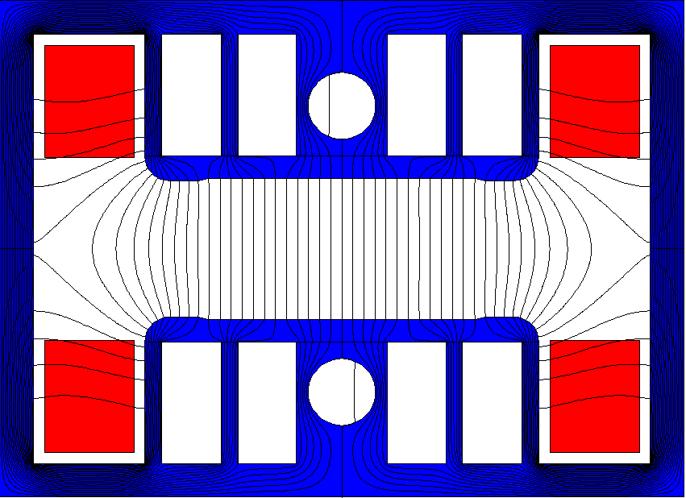
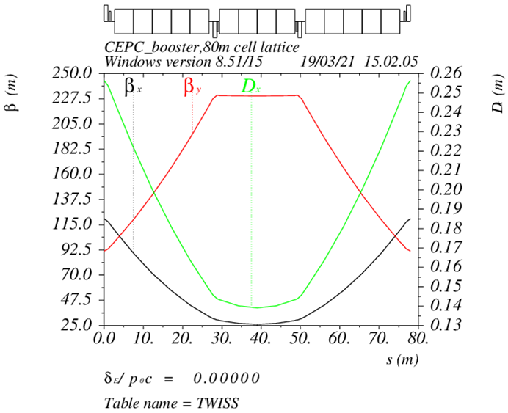
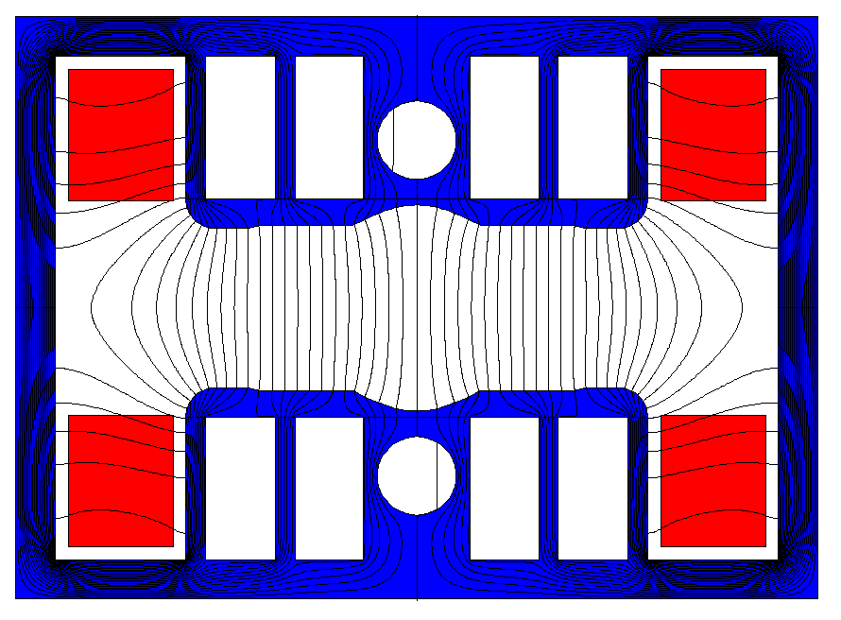
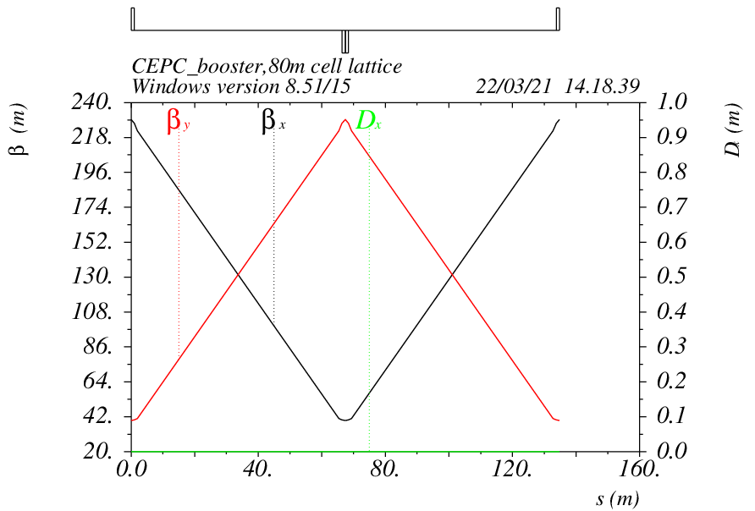
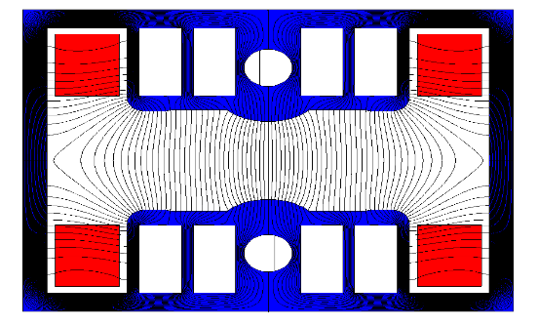
Booster TDR optics
D. Wang, C. H. Yu, D. H. Ji, Y. M. Peng, X. H. Cui,…
Arc: TME like structure (cell length=78m)
Interleave sextupole scheme
Emittance@120GeV=1.26nm
Overall idea: uniform distribution for the Q
Combined magnet (B+S) scheme + 100 sextupoles
Phase advance/cell: 100° (H) / 28° (V)
Dispersion sup.
Arc cell
Straight cell

Slide 5
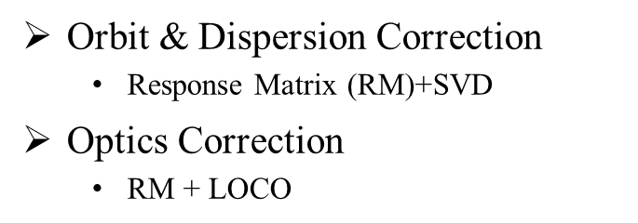
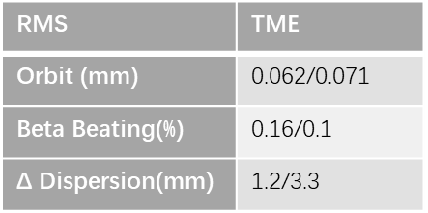
Booster error study and correction
D. H. Ji
 | Dipole | Quadrupole | Sextupole
Transverse shift X/Y (μm) | 100 | 100 | -
Longitudinal shift Z (μm) | 100 | 150 | -
Tilt about X/Y (mrad) | 0.2 | 0.2 | -
Tilt about Z (mrad) | 0.1 | 0.2 | -
Nominal field | 1e-3 | 2e-4 | 3e-4
 | Accuracy (m) | Tilt (mrad) | Gain | Offset w/ BBA(mm)
BPM(10Hz) | 1e-7 | 10 | 5% | 30e-3
(100 seeds)
(93 seeds)
Include multipole errors
DA track in AT w/o SR
dipole | quadrupole
B1/B0 ≤ 2×10⁻⁴
B2/B0 ≤ 5×10⁻⁴ | B2/B1 ≤ 3×10⁻⁴
B3/B0 ≤ 2×10⁻⁵ | B3/B1 ≤ 2×10⁻⁴
B4/B0 ≤ 8×10⁻⁵ | B4/B1 ≤ 1×10⁻⁴
B5/B0 ≤ 2×10⁻⁵ | B5/B1 ≤ 1×10⁻⁴
B6/B0 ≤ 8×10⁻⁵ | B6/B1 ≤ 5×10⁻⁵
B7/B0 ≤ 2×10⁻⁵ | B7/B1 ≤ 5×10⁻⁵
B8/B0 ≤ 8×10⁻⁵ | B8/B1 ≤ 5×10⁻⁵
B9/B0 ≤ 2×10⁻⁵ | B9/B1 ≤ 5×10⁻⁵
B10/B0 ≤ 8×10⁻⁵ | B10/B1 ≤ 5×10⁻⁵

Slide 6
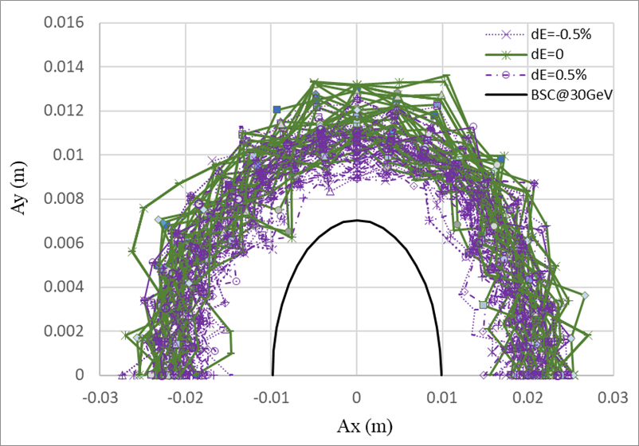
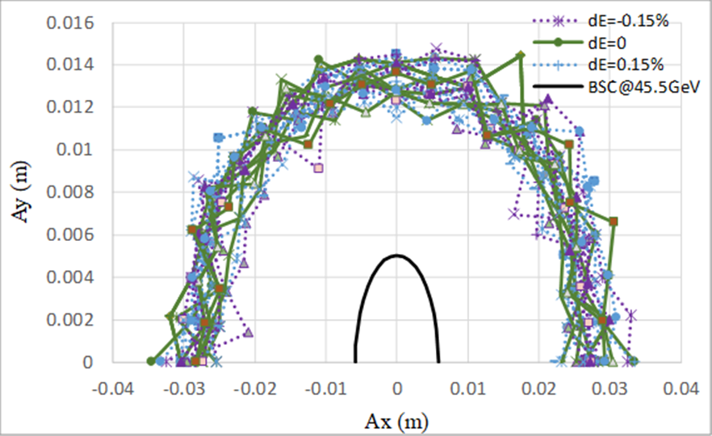
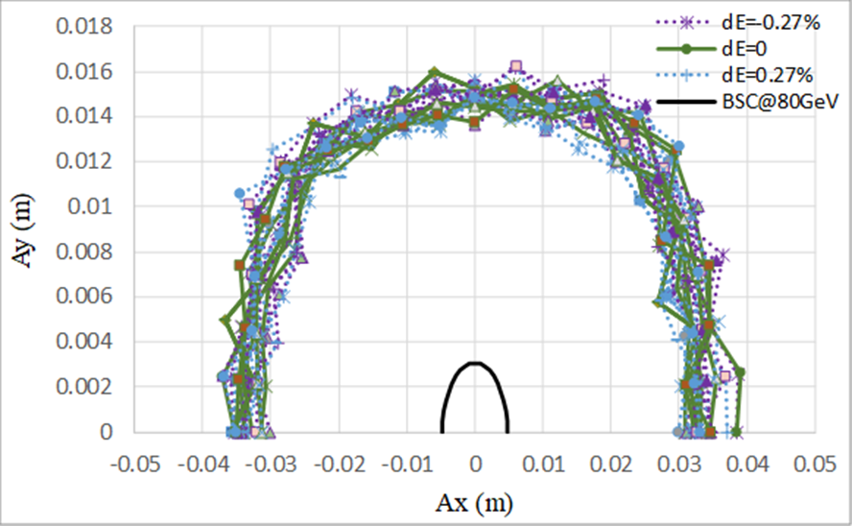
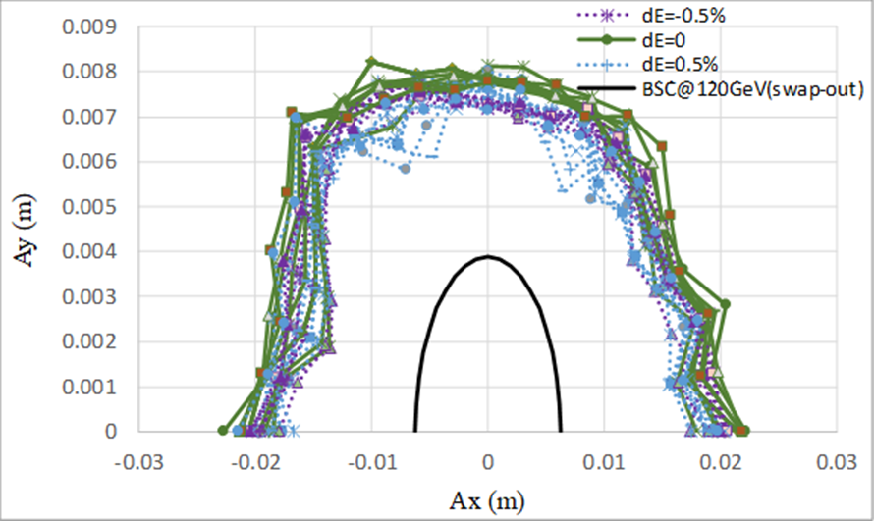
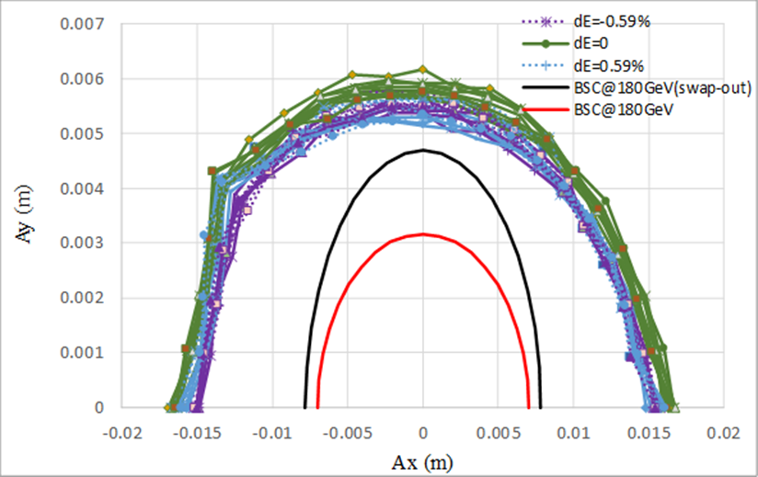
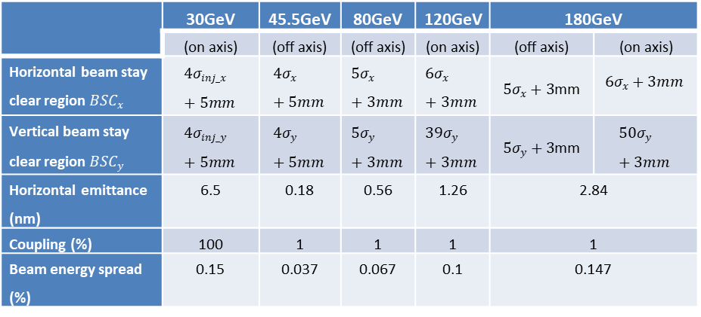
Booster DA results after error correction
30GeV
45GeV
80GeV
120GeV
180GeV
The definition of beam stay clear region at different energies
Lattice design with TME structure, lower emittance than CDR
Sufficient Dynamic Aperture for all energies with errors
Ref: D. Wang, et al., “Low emittance optics design for CEPC booster”, NIMA, 1062 (2024) 169159.

Slide 7
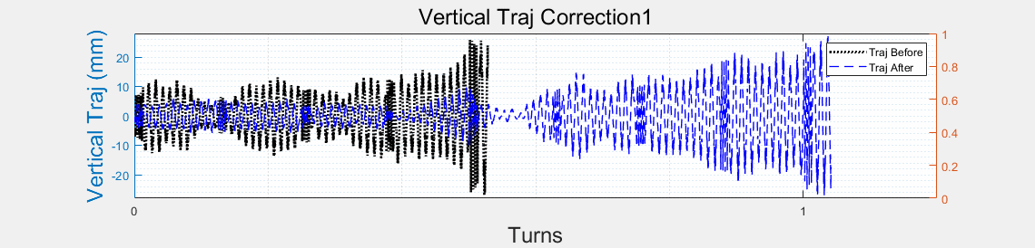
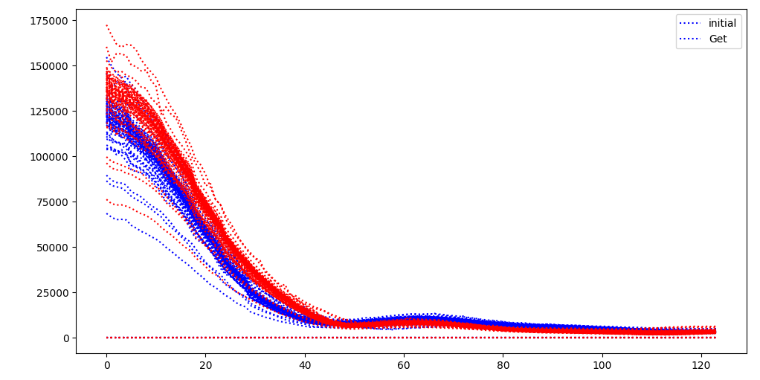
First Turn Commissioning
  Multi-turn Trajectory Correction, Injection Beam Trajectory Correction
D. H. Ji
  Single-turn Trajectory Correction
0
10
100
500
1000
10000
storaged
RF on
  Tune tuning,
  RF Phase tuning
TBT Optics Correction
 | Accuracy (um) | Offset w/o BBA(um)
BPM | 100 | 100
Physical aperture: 56mm
Other error settings are same as ordinary error correction simulation
The injection beam jitter and beam distribution is taken into account
Based on the AT program
Using the response matrices of orbit, trajectory, working point, and injection beam from theoretical models.
* “CEPC booster errors studies in EDR”, talked by Daheng Ji in this workshop.

Slide 8
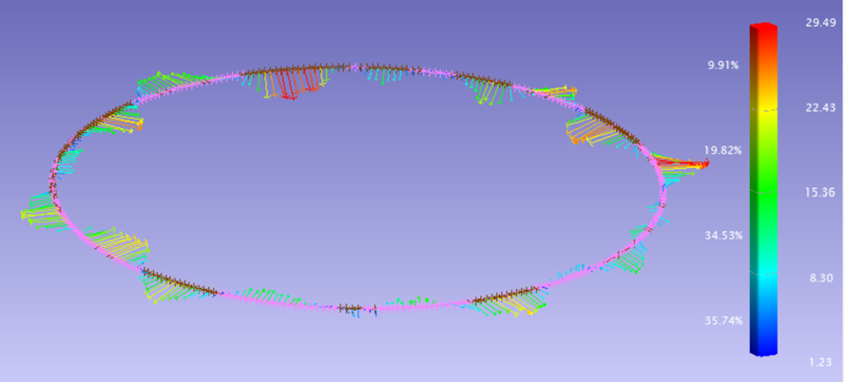
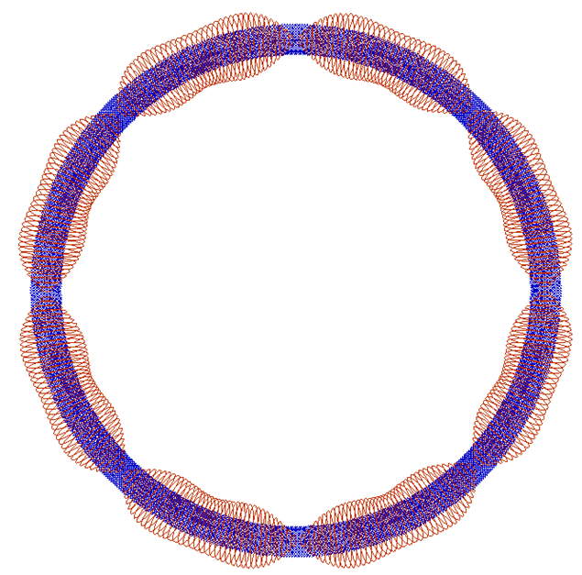
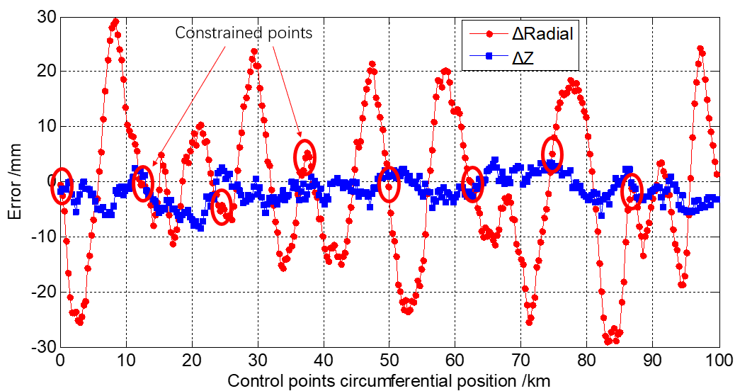
CEPC alignment error simulation
8 ground network control points with random error of 0-7mm.
X. L. Wang
  10 times simulation calculation performed.
Error Ellipses
Difference between the simulation results and the design values
Error | Radial /mm | Elevation /mm
MAX | 29.13~33.5 | 4.07~8.8
MIN | -38.6~-25.7 | -10.4~-5.6
RMS | 13.35~10.69 | 2.8~3.68
333 stations
Error Ellipses, confidence region 95%(2σ)
Error Propagation | Semi-Major Axis | Semi-Minor Axis
MAX | 27.6~29. 6 | 7.2~7.65
MIN | 0 | 0
RMS | 22.79~24.37 | 4.85~5.1
* “CEPC large scale measurement, precision alignment and efficient installation studies in EDR”, talked by X. L. Wang in this workshop.

Slide 9
Booster Physics Study in EDR
RF Beam loading study for the bunch structure with half ring distribution (Higgs & ttbar)
Error tolerance study
Beam dynamics with polarized beam
Injection efficiency simulations related with the on-axis injection
Dynamic simulations during the ramping process
Booster table ramping scheme
Booster machine/beam commissioning plan is proposed.

Slide 10
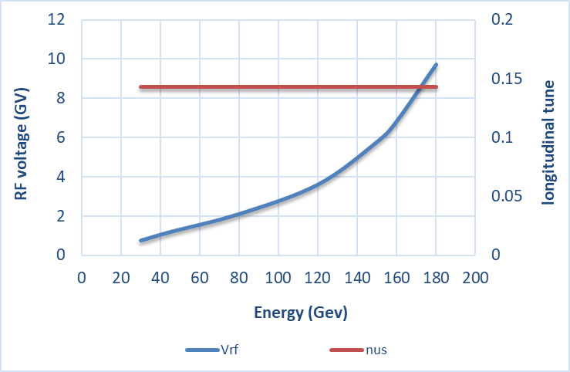
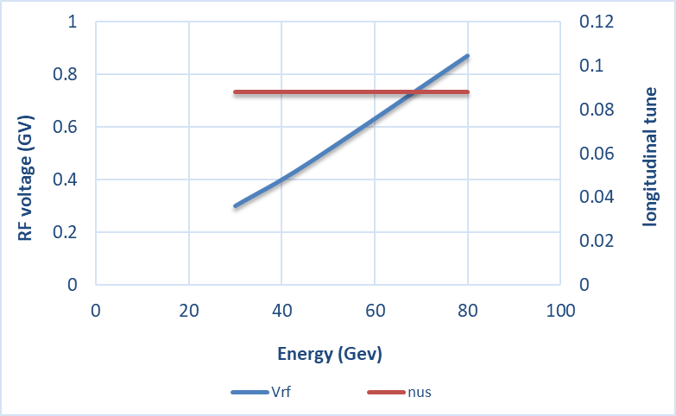
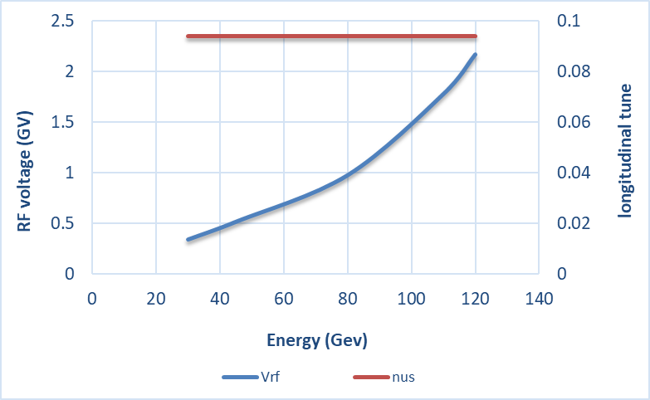
RF ramping curve
D. Wang, J.Y. Zhai
Different RF ramping curve for each energy mode (constant νs )
 | tt | Higgs | W | Z
V_{RF} (GV) | 9.8 | 2.2 | 0.87 | 0.46
ν_{s} | 0.14 | 0.094 | 0.088
νs for tt: 0.14
νs for Higgs: 0.094
νs for W & Z: 0.088
tt
Max RF voltage @tt determined by longitudinal quantum lifetime & DA.
η_{RF}: ~ 12 ×δ
VRF (180GeV)=9.8GV
Higgs
W &Z

Slide 11
CEPC Booster Ring 1.3 GHz RF Parameters
J.Y. Zhai
30/50 MW Collider SR power per beam. 30 GeV injection. Higgs & ttbar half filled. Higgs on-axis injection with bunch swapping. Z injection from empty ring. | ttbar 30/50 MW |  | Higgs 30/50 MW on-axis | W 30/50 MW | Z 30/50 MW
 | New cavities | Higgs cavities
Extraction beam energy [GeV] | 180 |  | 120 | 80 | 45.5
Extraction average SR power [MW] | 0.05 |  | 0.5 / 0.67 | 0.02 / 0.04 | 0.05 / 0.1
Bunch charge [nC] | 1.1 |  | 0.78 (20.3)* | 0.73 | 0.81
Beam current [mA] | 0.12 / 0.19 |  | 1 / 1.4 | 3.1 / 5.3 | 16 / 30
Injection RF voltage [GV] | 0.761 |  | 0.346 | 0.3 | 0.3
Extraction RF voltage [GV] | 9.7 (7.53 + 2.17) |  | 2.17 | 0.87 | 0.46
Extraction bunch length [mm] | 1.8 |  | 1.86 | 1.3 | 0.75
Cavity number (1.3 GHz 9-cell) | 256 | 96 | 96 | 96 | 32
Module number (8 cavities / module) | 32 | 12 | 12 | 12 | 4
Extraction gradient [MV/m] | 28.3 | 21.8 | 21.8 | 8.7 | 13.8
Q₀ @ 2 K at operating gradient | 2E10 | 3E10 | 3E10 | 3E10 | 3E10
Q_{L} | 4E7 | 4E7 | 1.2E7 | 7.3E6 / 4.4E6 | 1.2E7 / 6.3E6
Cavity bandwidth [Hz] | 33 | 33 | 110 | 178 / 296 | 111 / 208
Peak HOM power per cavity [W] | 0.5 / 0.8 |  | ~ 75 / ~ 100 | 11.8 / 19.6 | 146 / 272
Average HOM power per cavity [W] | 0.2 / 0.32 |  | ~ 10 / ~ 15 | 3.8 / 6.3 | 80 / 150
Input peak power per cavity [kW] | 8.3 / 9.2 | 5.1 / 5.9 | 22 / 32 | 10.9 / 18.1 | 17 / 32
Input average power per cavity [kW] | 0.3 | 0.2 | 6.5 / 9.2 | 0.3 / 0.5 | 2.5 / 4.5
SSA power [kW] (1 cavity / SSA) | 10 | 10 | 25 / 30 | 25 / 30 | 25 / 40
Total cavity wall loss @ 2 K [kW] | 0.36 | 0.05 | 0.5 | 0.02 | 0.08
1.3 GHz 9-cell cavities
Higgs and ttbar booster are half filled for the injection timing with Collider ring.
Transient beam loading for Higgs on-axis injection tolerable (both at injection and extraction).
Increased average HOM power of HL-Z requires ERL-type 1.3 GHz cryomodule (HOM absorber at low temperature between cavities). Four cryomodules for Z with RF bypass, also to reduce impedance and increase current limit.
High gradient high Q 9-cell cavities for ttbar.
Narrow bandwidth high gradient cavity voltage ramping through the multipacting region to be studied. Counter-phasing ramp.
* The small bunch charge number before the parenthesis is for the bunches injected from the linac. The large bunch charge number in the parenthesis is for the bunches injected back from the Collider ring during the swap-out injection at Higgs energy.

Slide 12
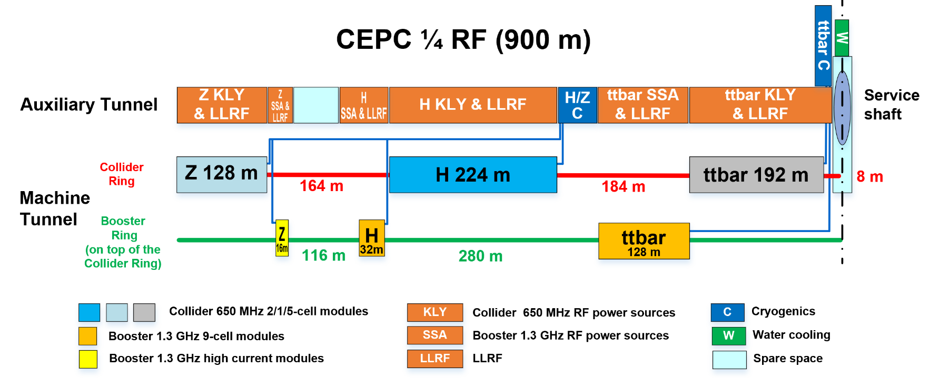
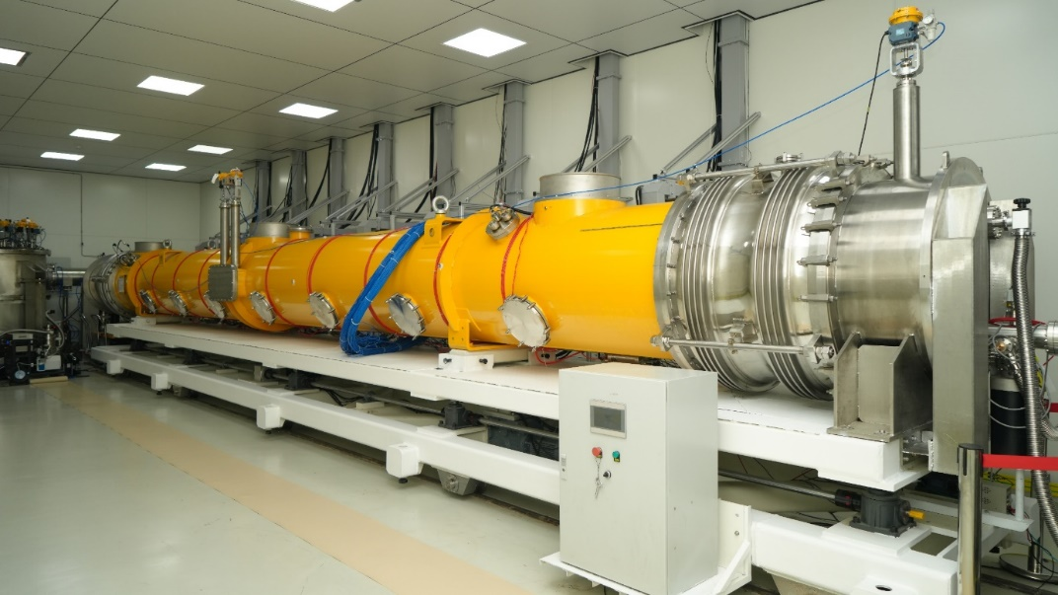
CEPC Booster Superconducting RF R&D in EDR
J. Y. Zhai
Higgs high Q 1.3 GHz cryomodule prototyping: based on the successful verification module, build two more mid-T bake module prototypes using domestic CW FEL funding. Make improvements and increase module average CW gradient to > 25 MV/m with Q₀ > 3E10. Complete engineering design for CEPC Higgs booster module (without cold BPM and quadrupole as in FEL module).
Z-pole high current 1.3 GHz cryomodule design: complete conceptual design and component development in synergy of domestic ERL project R&D.
ttbar high gradient and high Q 1.3 GHz cryomodule R&D: build one ILC/XFEL type 8x9-cell module prototype using domestic pulsed XFEL funding. Achieve module average gradient > 35 MV/m with high Q.

Slide 13
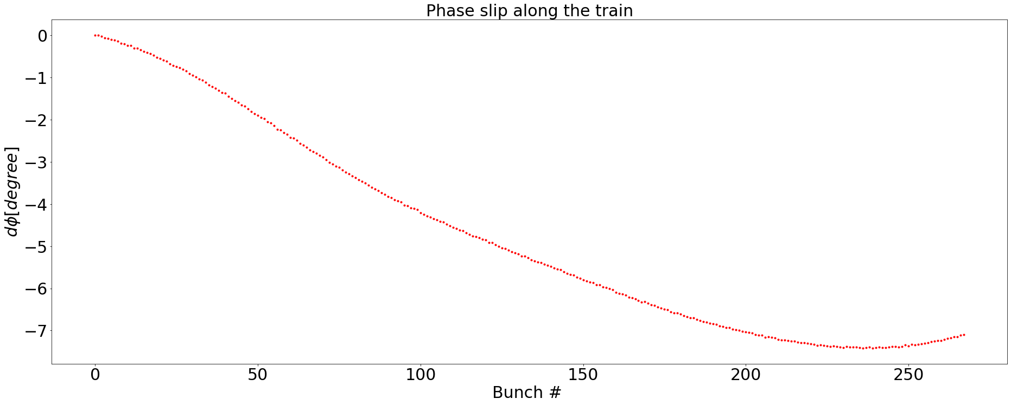
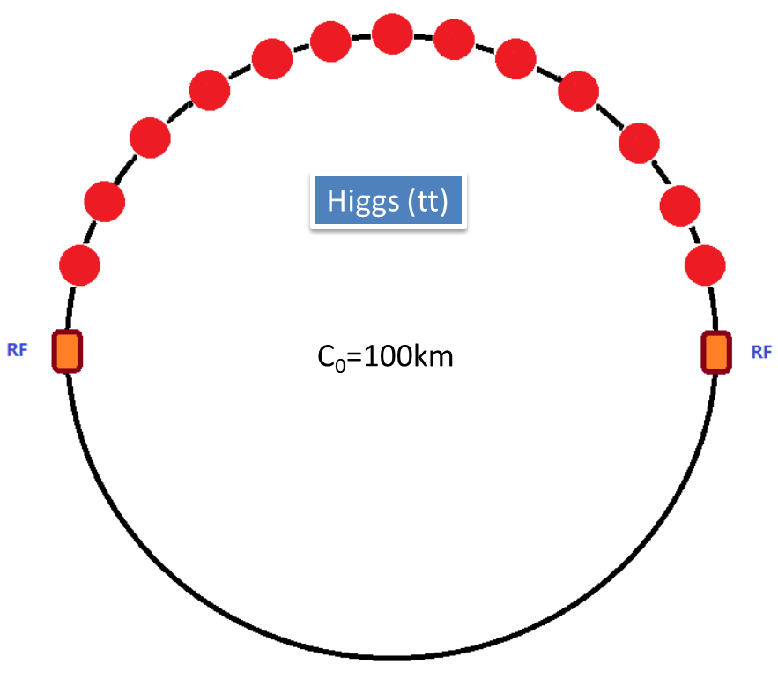
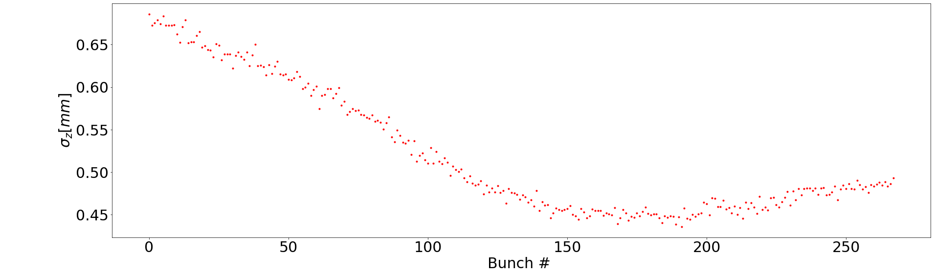
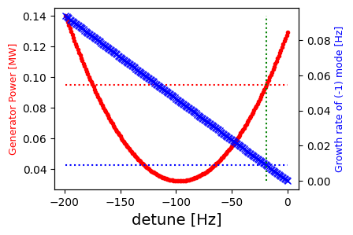
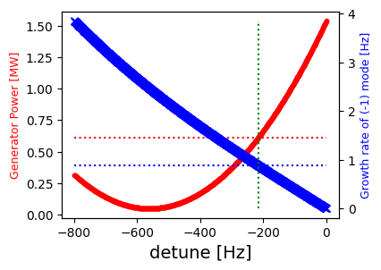
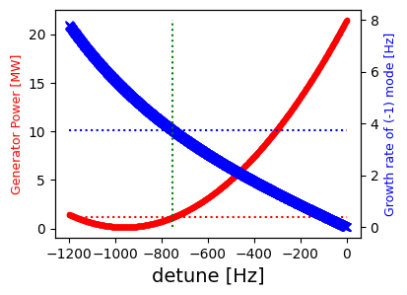
RF beam loading effect @ 30 GeV
T. M. Xin, J. Y. Zhai
Transient beam loading due to half filled ring in Higgs mode.
Assuming a constant detuning and a consistent loaded Q optimized for the top energy in each energy mode.
The longitudinal coupled bunch mode will be effectively managed with the aid of bunch-by-bunch feedback.
However, for Z mode we might need to consider adding more power to meet the requirement.
Higgs
Higgs
Higgs
W
Z
df = -19.4 Hz
df = -216 Hz
df = -752 Hz
Pg = 0.095 MW
Growth rate = 3.7 Hz
Pg = 0.61 MW
Growth rate < 0.01 Hz
Pg = 1.14 MW
Growth rate = 0.88 Hz

Slide 14
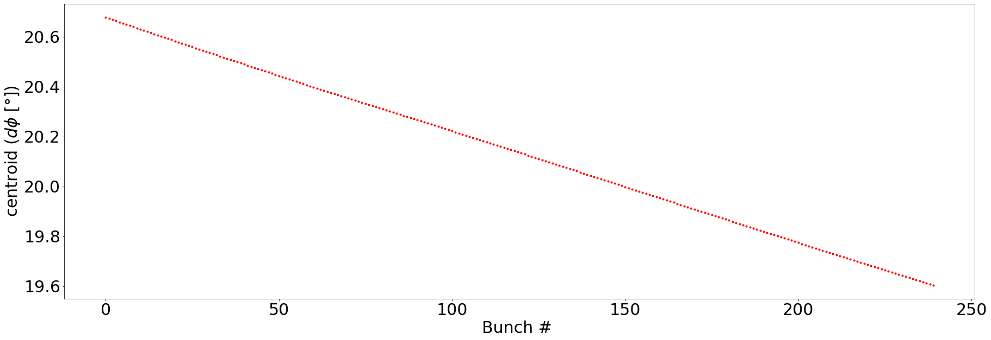
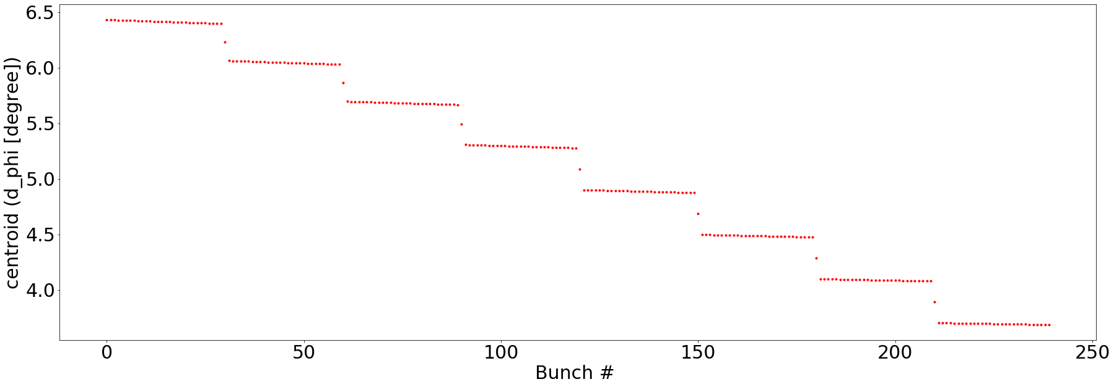
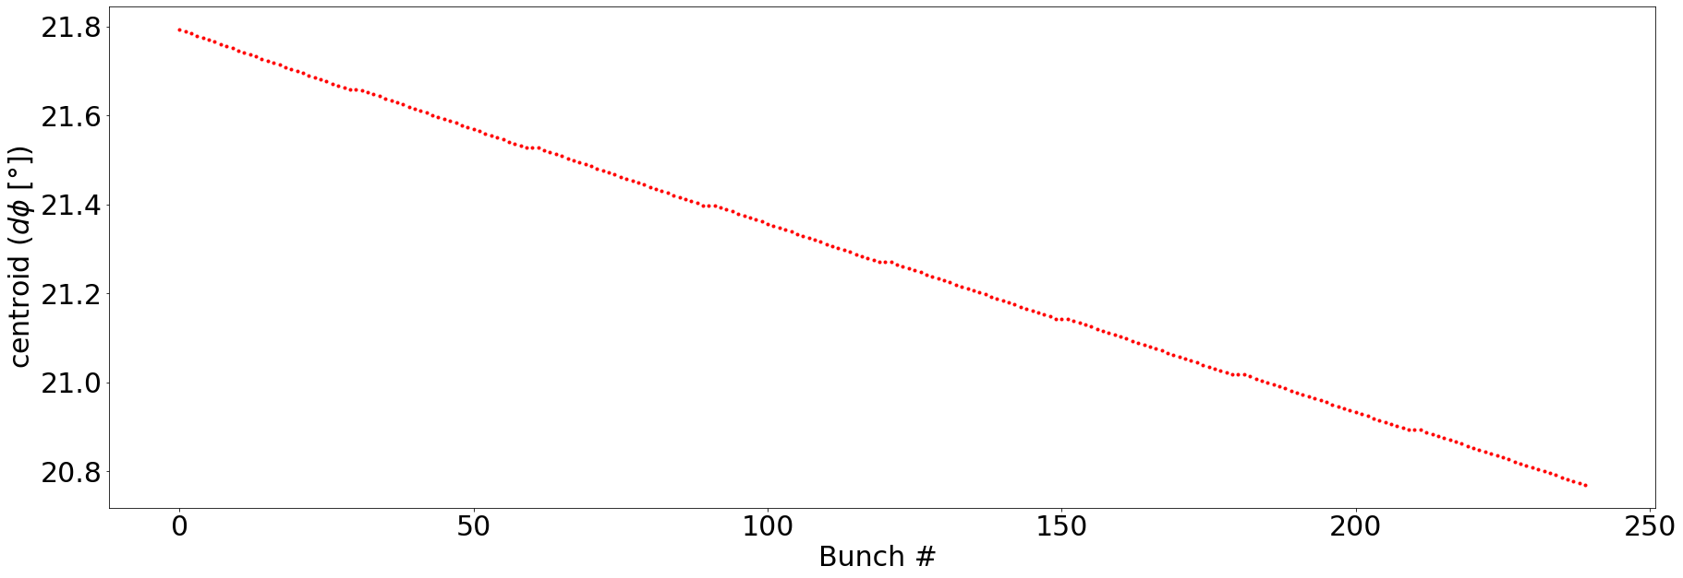
Transient Beam Loading during the Top Up Injection
T. M. Xin, J. Y. Zhai
During the Top up injection process in Higgs mode, 7 to 13 large bunches will be back injected from the Storage ring;
The change of beam pattern will cause different transient phase slip compare to the normal half fill pattern (Doubled total phase slip between head and tail and jumps between the small trains);
After several synchrotron oscillations, the large bunch will be completely merged with the small existing bunches. Then the large bunches will be injected into the storage ring again;
The bunch pattern again will change because of the vacancies and a new transient phase pattern will occur.
No apparent instability detected during the whole process.
Before
During
After

Slide 15
Beam Loading Study Plan in EDR
T. M. Xin, J. Y. Zhai
Check rest of the parts in the full cycle:
  Confirm the phase stability during the rampping process;
  Estimate the thermal load and tuning requirement;
  Investigate the solution for the possible power shortage in Z mode;
Run the full cycle simulation
Legend:
checked
Injection from the LINAC
not yet
Energy rampping
Injection into the Storage Ring
Back injection from the Storage Ring
Replenish the Storage Ring.

Slide 16
Magnets Requirement
D. Wang, W. Kang
Dipoles (series connection) -- 14866
Sextupoles & correctors
Dipole | BST-63B-Arc | BST-63B-Arc-SF | BST-63B-Arc-SD | BST-74B-IR
Number | 10192 | 2017 | 2017 | 640
Gap [mm] | 63 | 63 | 63 | 63
Dipole strength [Gs]@180GeV | 564 | 564 | 564 | 549
Dipole strength [Gs]@120GeV | 376 | 376 | 376 | 366
Dipole strength [Gs]@30GeV | 94 | 94 | 94 | 91
Sext. Strength [T/m^2]@180GeV | 0 | 16.0388 | 19.1423 | 0
Sext. Strength [T/m^2]@120GeV | 0 | 10.6925 | 12.7615 | 0
Sext. Strength [T/m^2]@30GeV | 0 | 2.67 | 3.19 | 0
Length [mm] | 4700 | 4700 | 4700 | 2350
Good field region [mm] | 45 | 45 | 45 | 45
 | Number | Length [m]
Sextupole | 100 | 0.4
Corrector | 1200 | 0.58
Quadrupoles (series connection + 3200 independent PS) --3458
Quadrupole | QDM-63 | QFM-63 | QM-RF-63 | QFM-ARC-63 | QDM-ARC-63 | QF-DIS-63 | QD-DIS-63
Number | 64 | 48 | 264 | 1016 | 2018 | 16 | 32
Gap[mm] | 63 | 63 | 63 | 63 | 63 | 63 | 63
Quad. Strength [T/m]@180GeV | 12.8811 | 16.3553 | 12.7248 | 12.0313 | 12.0313 | 18.0522 | 15.8575
Quad. Strength [T/m]@120GeV | 8.5874 | 10.9036 | 8.4832 | 8.0209 | 8.0209 | 12.0348 | 10.5717
Quad. Strength [T/m]@30GeV | 2.147 | 2.726 | 2.121 | 2.005 | 2.005 | 3.008 | 2.643
Length [mm] | 2000 | 2000 | 1000 | 2000 | 700 | 2000 | 1000
Good field region [mm] | 45 | 45 | 45 | 45 | 45 | 45 | 45

Slide 17
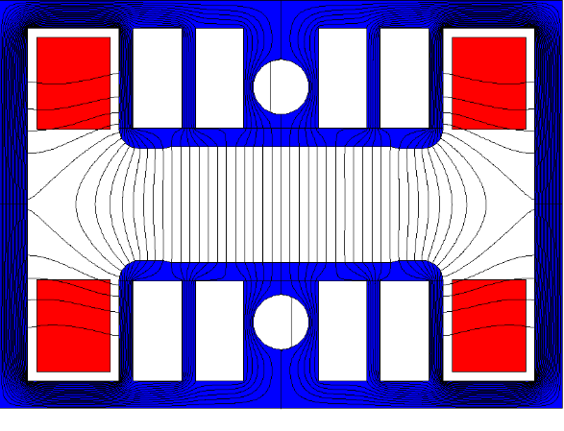
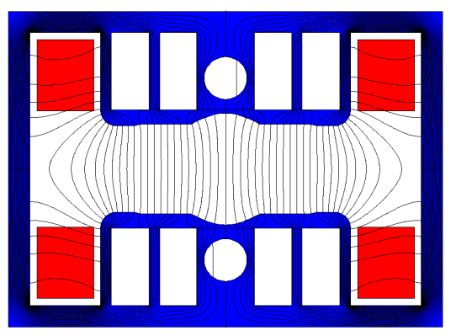
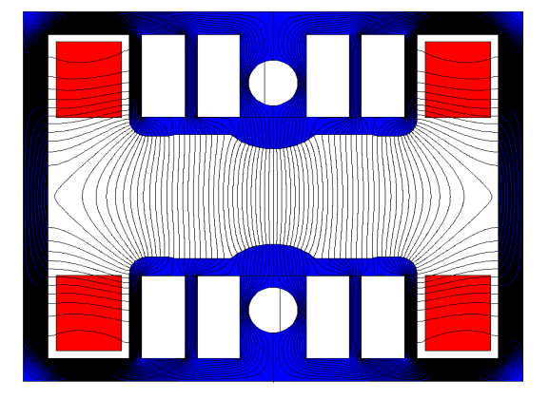
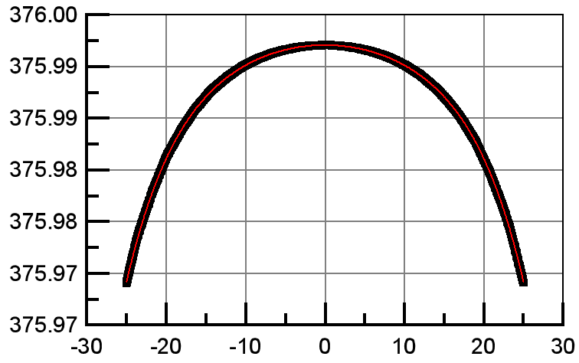
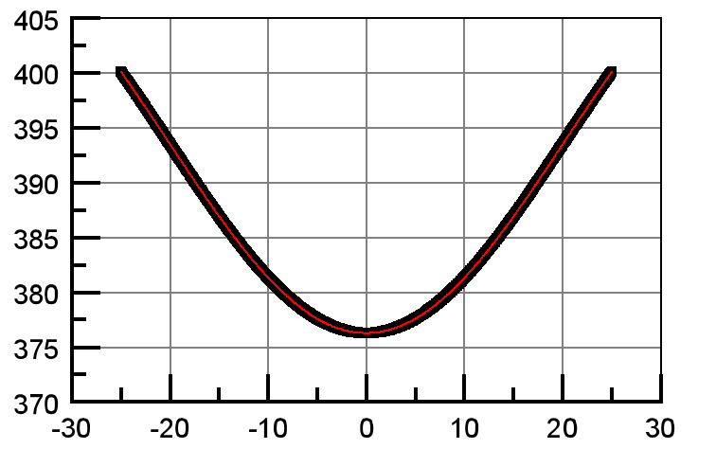
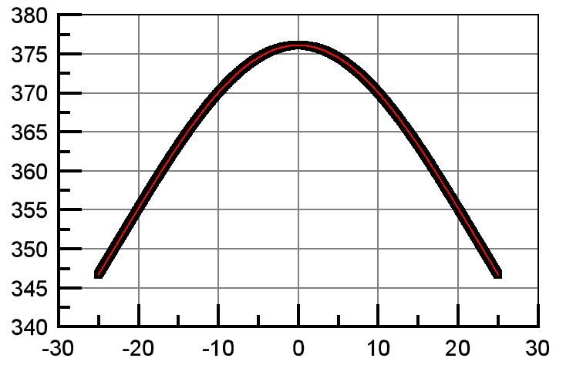
Introduction of the dipole magnets
W. Kang
There are three families of dipole magnets in the CEPC booster. One family is the pure dipoles while the other two families are the dipole-sextupole combined magnets.

Slide 18
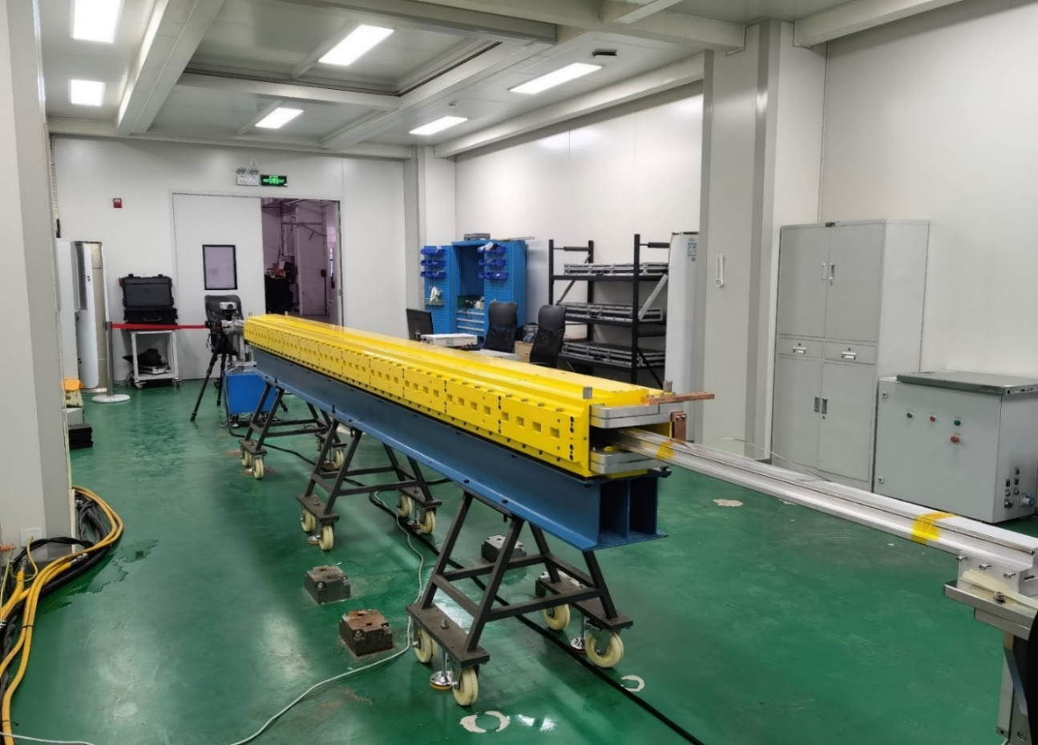
Booster magnet R&D in TDR
W. Kang
In TDR stage, a full-scale pure dipole magnet for the CEPC booster has been produced and the field performance is satisfied with the requirements.

Slide 19
The plan of the Booster magnet production in EDR
W. Kang
In the EDR stage, in order to verify the magnetic field design of the dipole-sextupole combined magnet, a full scale prototype magnet will be developed and measured by a harmonic coil field measurement system.

Slide 20
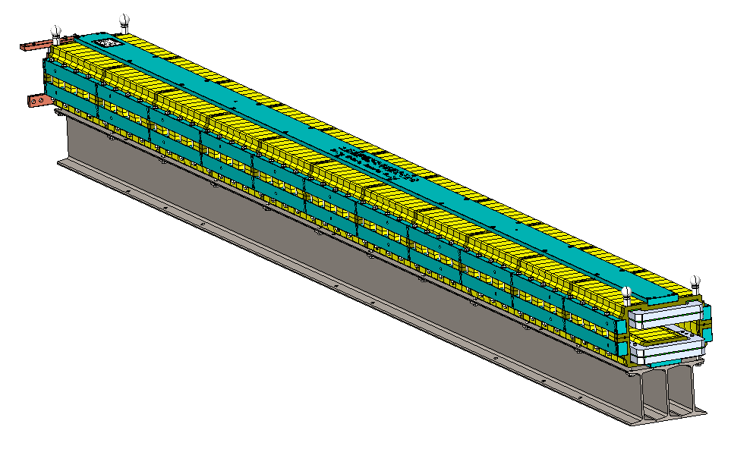
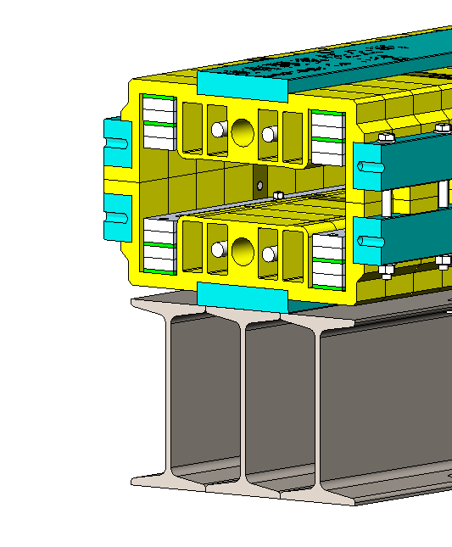
Automatic magnet production line
W. Kang
Purpose：To decrease the production cost and increase the production efficiency of the dipole magnets, three automatic magnet production lines are planned to be developed. Each line will automatically produce 4 magnets every day so that three lines are expected to complete the production of 15000 magnets in five years.

Slide 21
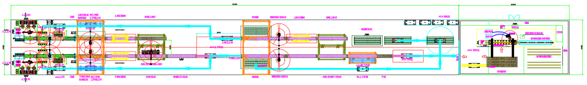
Automatic magnet production line
W. Kang
Up to now, the technical route of the automatic magnet production line is mapped out. The preliminary layout of the line is shown below, including the automatic field measurement system.
* “CEPC collider ring and booster magnets in EDR and industrial fabrication preparation”, talked by Wen Kang in this workshop.

Slide 22
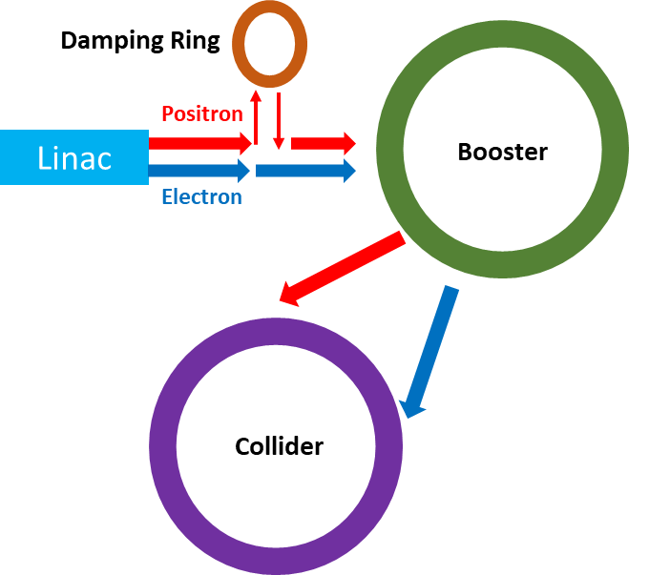
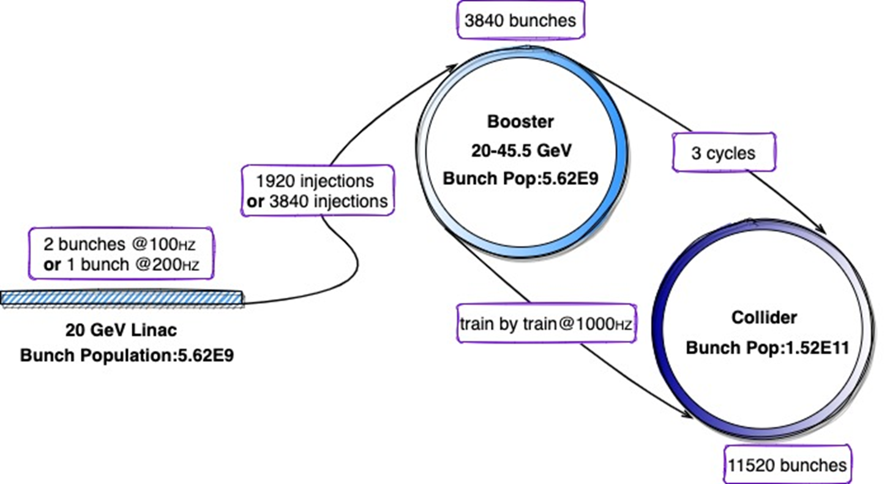
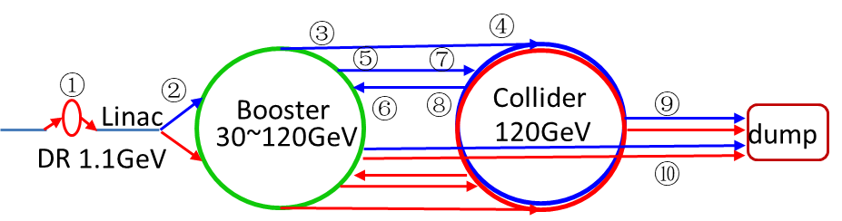
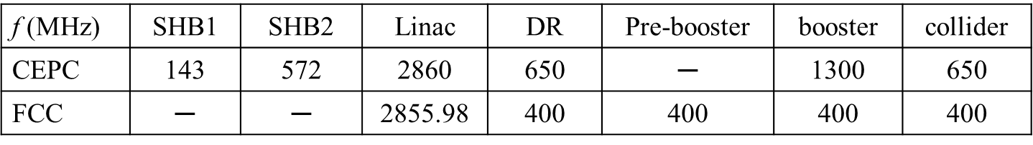
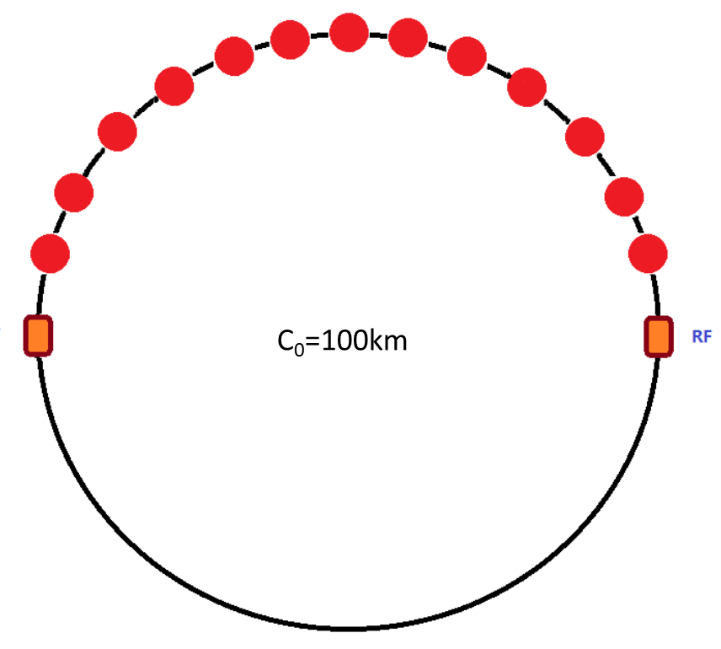
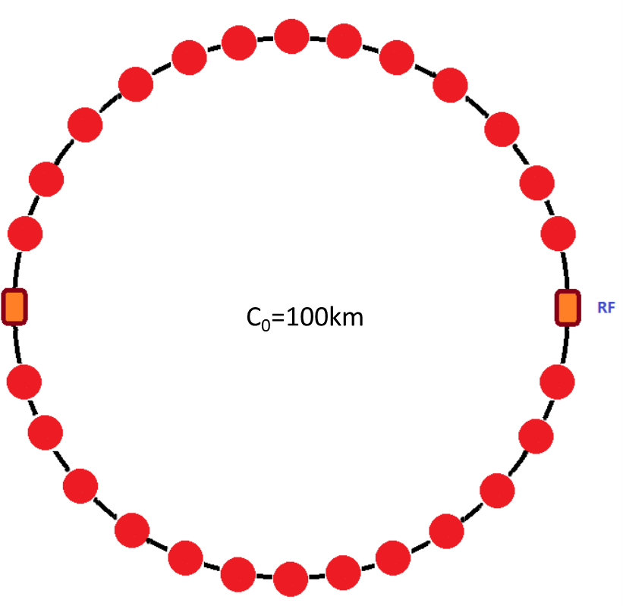

CEPC Inj. & ext. scheme and timing structure
D. Wang,
X. H. Cui, Cai Meng,
J. H. Chen
Linac Energy: 30 GeV
For Higgs, W, Z, tt modes, the bunch pattern is different in the booster.
For Higgs, W and tt modes, the bunch pattern in the booster is the same as that in the collider.
For Z mode, the bunch number in the booster is 1/3 of that in the collider, and bunches are arranged in bunch trains.
top up
pulse
100Hz single bunch for H/W/tt
Higgs/ttbar
W/ Z
There are 10 injection and extraction sub-systems.
All transport lines are designed;
Injection/ramping timing was given for different energies
10ms
t
100Hz double bunch for Z
Ref: D. Wang*, et al, “Problems and considerations about the injection philosophy and timing structure for CEPC”, International Journal of Modern Physics A， Vol. 37, (2022) 2246006.
22

Slide 23










CEPC inj. & ext. hardware R&D in EDR
J. H. Chen
The hardware R&D in IHEP has covered almost all types of inj. and ext. devices for CEPC. Especially for R&D projects that overlap with HEPS.
The distributed parameter (delay-line) dipole kicker and the distributed parameter (delay-line) nonlinear kicker (trapezoid/adjustable PW=440~2420ns) are dedicated for CEPC.
40~2000ns
1kHz
200ns
200ns
A delay-line kicker (NLK) prototype was done. But magnet characteristic impedance is a little high and volume is Large; Beam impedance issue of ceramic vacuum chamber with Ti coating is not clear
A solid-state pulser prototype based on SiC MOSFET was done. But the pulse HV dose not meet CEPC requirement yet.
Voltage is lower
18-stage@800V：14.2kV into 10Ω

Slide 24







Mechanics plan in EDR
H. J. Wang
Magnet supports and mockup tunnel
  For the TDR design, the Booster ring is 2.4 meters higher above Collider. → Reasonable stability by optimizing the supports.
Change support height
Change steel sections
Change support number

Slide 25


Mechanics plan in EDR
H. J. Wang
Booster magnet supports plan
  The final magnet support scheme
  The deformation and stability simulation and optimization.
  Verification of support structure, stability, installation and alignment in a mockup tunnel.
  Considering method for efficient installation and alignment: semi-automatic adjustment and high-precision alignment field.

Slide 26





CEPC Damping Ring
Damping with reversed bending magnet
60° FODO (θ_{r} /θ₀=0.355)
4 (max. 8)-bunch storage, storage time:20 (40) ms
Emittance: 2500→ 166/75 (97/3) mm.mrad
DA with errors
tt/Higgs/W
Z
Both the DR and trans. lines are well optimized in TDR, with lower emittance than CDR.

Slide 27


Damping Ring RF requirement
The total cavity voltage requirement is 2.5MV
5 cell cavity aperture is decided by impedance、HOM and instability threshold
  Taking into account the simulation results for impedance threshold and HOM power, the 5-cell cavity with a 90 mm aperture is considered the best choice

Slide 28







Damping Ring RF cavity design
J. R. Zhang
The design of the 650MHz 5 cell cavity finished
  RF cavity design
  Input coupler and doorknob design
  Vacuum design
  Mechanical design
Parameters | Unit | Value
Operation frequency | MHz | 650
Voltage per cavity | MV | 1.25
Cell length | mm | 5×230.61
Shunt impedance | M | 16
R/(Q×l) | Ω/m | 430
Q factor |  | 32000
Dissipated power per cavity (20% margin) | kW | 59
Emax | MV/m | 8.5
Tunner
Coupler
Cavity
Ion pump distribution
  Mechanical design
Electromagnetic field distribution

Slide 29

Damping Ring RF cavity R&D in EDR
Further optimize the 5 cell cavity design
We hope to process a DR normal conducting 5 cell cavity. And finished the cold test of the cavity.
After the machining of the cavity completed, use PAPS (a test bench of IHEP at Huairou) test bench to do the high-power test of the DR normal conducting 5 cell cavity
J. R. Zhang
  Mechanical design

Slide 30



Booster lattice optimization for better polarization transmission
The TDR lattice suffers from superstrong resonances before Z energy
  Injected vertical emittance 6.5nm -> Polarization trans. ~ 50% @ Z & W, 20% @ Higgs
  Injected vertical emittance 1.5 nm -> Polarization trans. ~ 80% @ Z & W, 30% @ Higgs
Potential optimization:
  Move the location of superstrong resonances
  Mitigation of imperfection resonances
    Reduce lattice sensitivity
    Harmonic spin matching & partial snakes
Z. Duan
TDR bare lattice
Intrinsic resonance
TDR lattice (one seed)
Imperfection resonance

Slide 31


Positron damping/polarizing ring
Optimization of a dual-purpose design
  Bunches stay ~ 20 msec for regular refill
  Bunches stay ~ 10 min to accumulate > 20% polarization for resonant depolarization in the Colliders
Cost and benefit comparison between two schemes
  Higher beam energy without asymmetric wigglers
  Lower beam energy with asymmetric wigglers
Z. Duan
Asymmetric wigglers

Slide 32
Summary
The CEPC booster TDR parameter and design optimizations for all four energies (Higgs, W/Z and ttbar) have been studied. The results demonstrate that the physics design satisfies the scientific goals.
CEPC booster development was reported on the TDR international review meeting and cost review meeting from June 12-16, 2023 and Sept. 11-15, 2023
R&D plan for EDR phase (2024-2027) before construction have been established, with the aim of starting the construction in “15th five-year-plan” (2026-2030) .

Slide 33
Thanks for your attention!

