Slide 1




PaNOSC + EOSC + CNRS
22 Janvier, 2020
Presenter: Andy Götz (coordinateur de PaNOSC)
Meeting: Journée EOSC au CNRS
Venue: Auditorium Marie Curie, Paris
This project has received funding from the European Union’s Horizon 2020 research and innovation programme under grant agreement No. 823852

Slide 2
Questions de Laurent Lellouch
Y-a-t-il des leçons (écueils à éviter, difficultés, recettes gagnantes, etc.) que vous pouvez partager avec des communautés moins avancées que vous?
Y-a-t-il des outils que vous avez développés qui pourraient être utiles à d'autres communautés?
Comment le CNRS pourrait vous être utile dans la mise en place d'un OSC PaN, pas seulement au travers de moyens financiers, mais également en expertise scientifique?
Comment pourriez-vous être utiles au CNRS dans la mise en place de son Open Science policy?

Slide 3
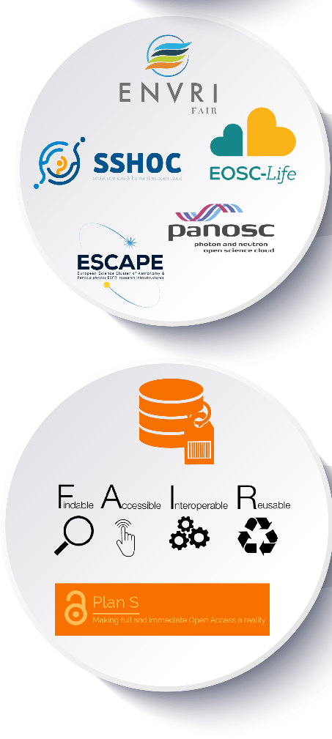

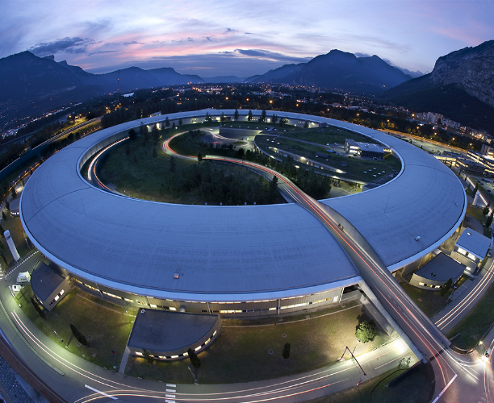

PaNOSC in the EOSC context
Cluster projects
FAIR
Photon + Neutron
ESFRI
ESRF
EBS

Slide 4

PaNOSC in the EOSC context
Cluster projects
FAIR
Photon + Neutron
ESFRI
ESRF
EBS

Slide 5

PaNOSC factsheet
Call: Horizon 2020 InfraEOSC-04
Partners: ESRF, ILL, XFEL.EU, ESS, CERIC-ERIC, ELI-DC, EGI
Description: cluster of ESFRI Photon and Neutron sources
Observers/non-funded: GÉANT, EUDAT, national Ris
Co-funded project: ExPaNDS
Linked 3rd parties via EGI: DESY, STFC, CESNET
Status: Started 1/12/2018
Github: https://github.com/panosc-eu
Home page: https://panosc.eu
Twitter: @PaNOSC_eu #PaNOSC
Budget: 12 M€
Coordinator: ESRF
Started: 1/12/2018
Ends: 1/12/2022
Duration: 4 years
This project has received funding from the European Union’s Horizon 2020 research and innovation programme under grant agreement No. 823852

Slide 6
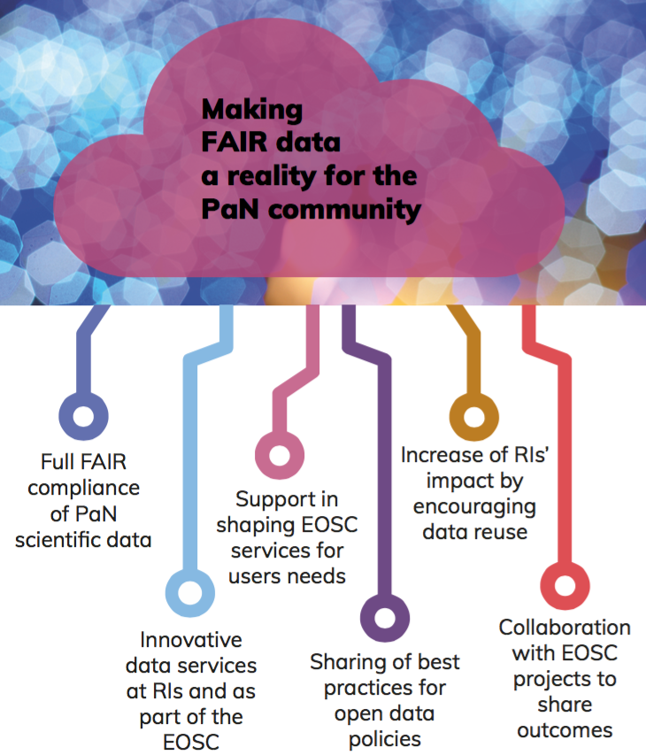
PaNOSC goals
PaNOSC works closely with the PaN sources in Europe to develop common policies, strategies and solutions in the area of FAIR data policy, data management and data services, integrating them into the EOSC.
This project has received funding from the European Union’s Horizon 2020 research and innovation programme under grant agreement No. 823852

Slide 7
PaNOSC = data policy + management + analysis
+ simulation + training
FAIR
Data Policy
DMP
Certify
Storage
FAIR
Metadata elogbook
Data Format
Data
Portal
Analysis Portal
Jupyter notebooks
Compute resources
Algorithms
Algorithms
Jupyter
Notebooks
Compute resources
e-training platform
Training material
Workshop
Code camps
Data Policy
Metadata
Analysis
Simulation
Training

Slide 8
  Data management enables
Artificial
Intelligence
Publications
Data analysis
Open Data
Analysed Data
Digital Objects
Machine Learning
Algorithms
Data Mining
Federated catalogues
On-site data reduction
Reduced Data
Archived Data
Data + metadata
Raw Data
This project has received funding from the European Union’s Horizon 2020 research and innovation programme under grant agreement No. 823852

Slide 9
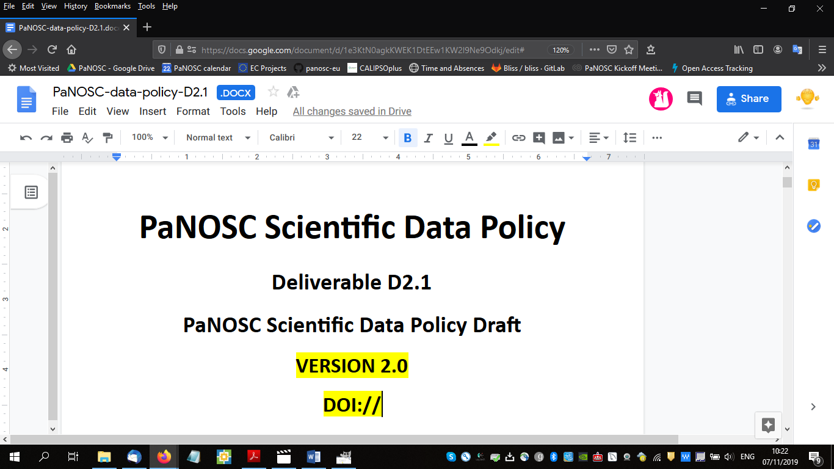

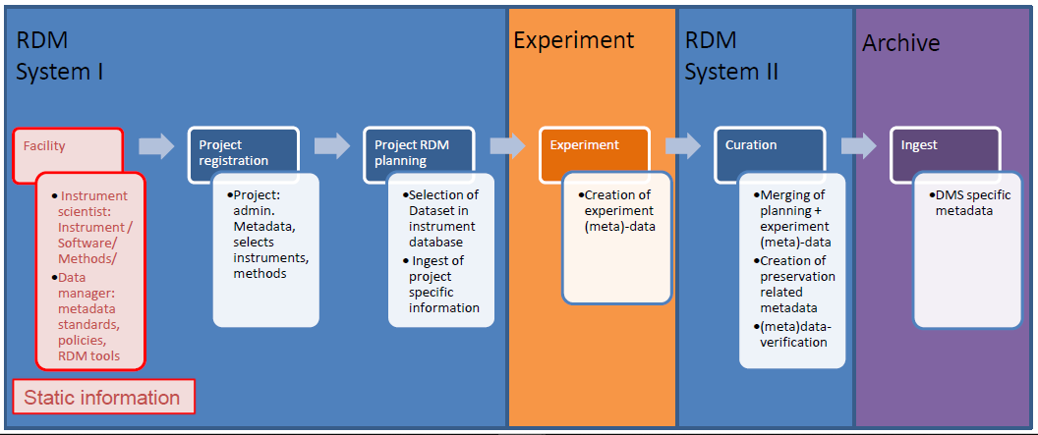
Data policy WP2
Update the PaNdata data policy
Include the FAIR concepts and make it FAIR compliant (52 criteria)
Update existing Data Policies to be compatible with the Data Policy 2.0 framework
Develop a tool for Data Management Plans together with ExPaNDS
Share outcomes with
→
→
This project has received funding from the European Union’s Horizon 2020 research and innovation programme under grant agreement No. 823852

Slide 10
Data catalogue WP3
Develop an Application Programmers Interface (API) for searching for FAIR data
Integrate search API into EOSC portal
Use Nexus/HDF5 for metadata
Automate metadata collection on beamlines
Use e-logbook to make data FAIRer
Long term storage (100s of Petabytes)
→
→
This project has received funding from the European Union’s Horizon 2020 research and innovation programme under grant agreement No. 823852

Slide 11
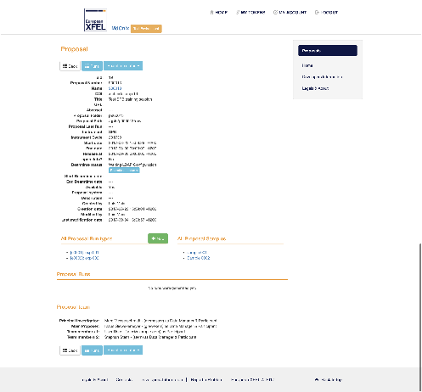
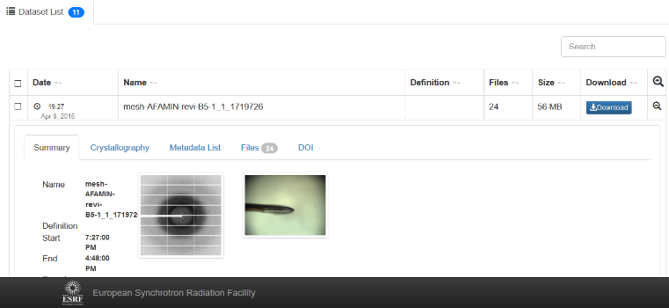
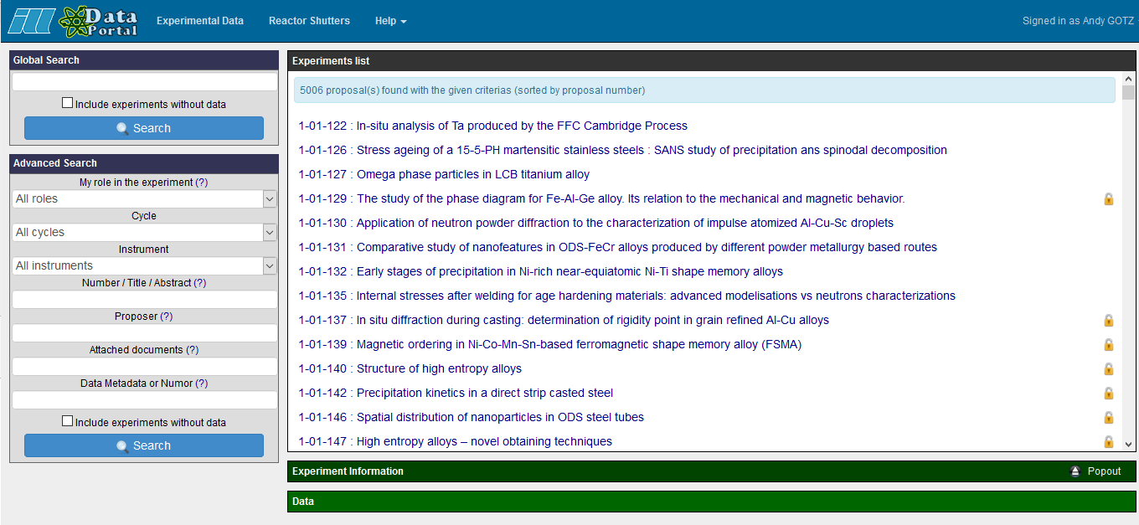
PaNOSC has 6 data catalogues with different APIs + UIs
WP3
ESRF
(icat)
CERIC
(icat)
ESS
(SciCat)
ILL
(local)
ELI
(tbd)
XFEL
(MyMdc)
50 PB/yr
15 PB/yr
<1 PB/yr
.6 PB/yr
10 PB/yr
100 PB/yr
https://data.esrf.fr
https://data.ill.fr
This project has received funding from the European Union’s Horizon 2020 research and innovation programme under grant agreement No. 823852

Slide 12

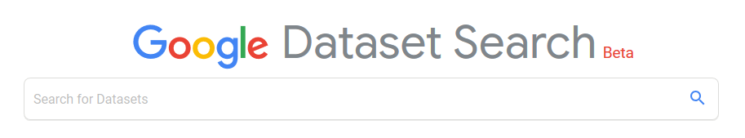
PaNOSC common API across all sites
WP3
Common API to search across all PaNOSC catalogues
ESRF
(icat)
CERIC
(icat)
ESS
(SciCat)
ILL
(local)
ELI
(tbd)
XFEL
(MyMdc)
50 PB/yr
15 PB/yr
<1 PB/yr
.6 PB/yr
10 PB/yr
100 PB/yr
This project has received funding from the European Union’s Horizon 2020 research and innovation programme under grant agreement No. 823852

Slide 13
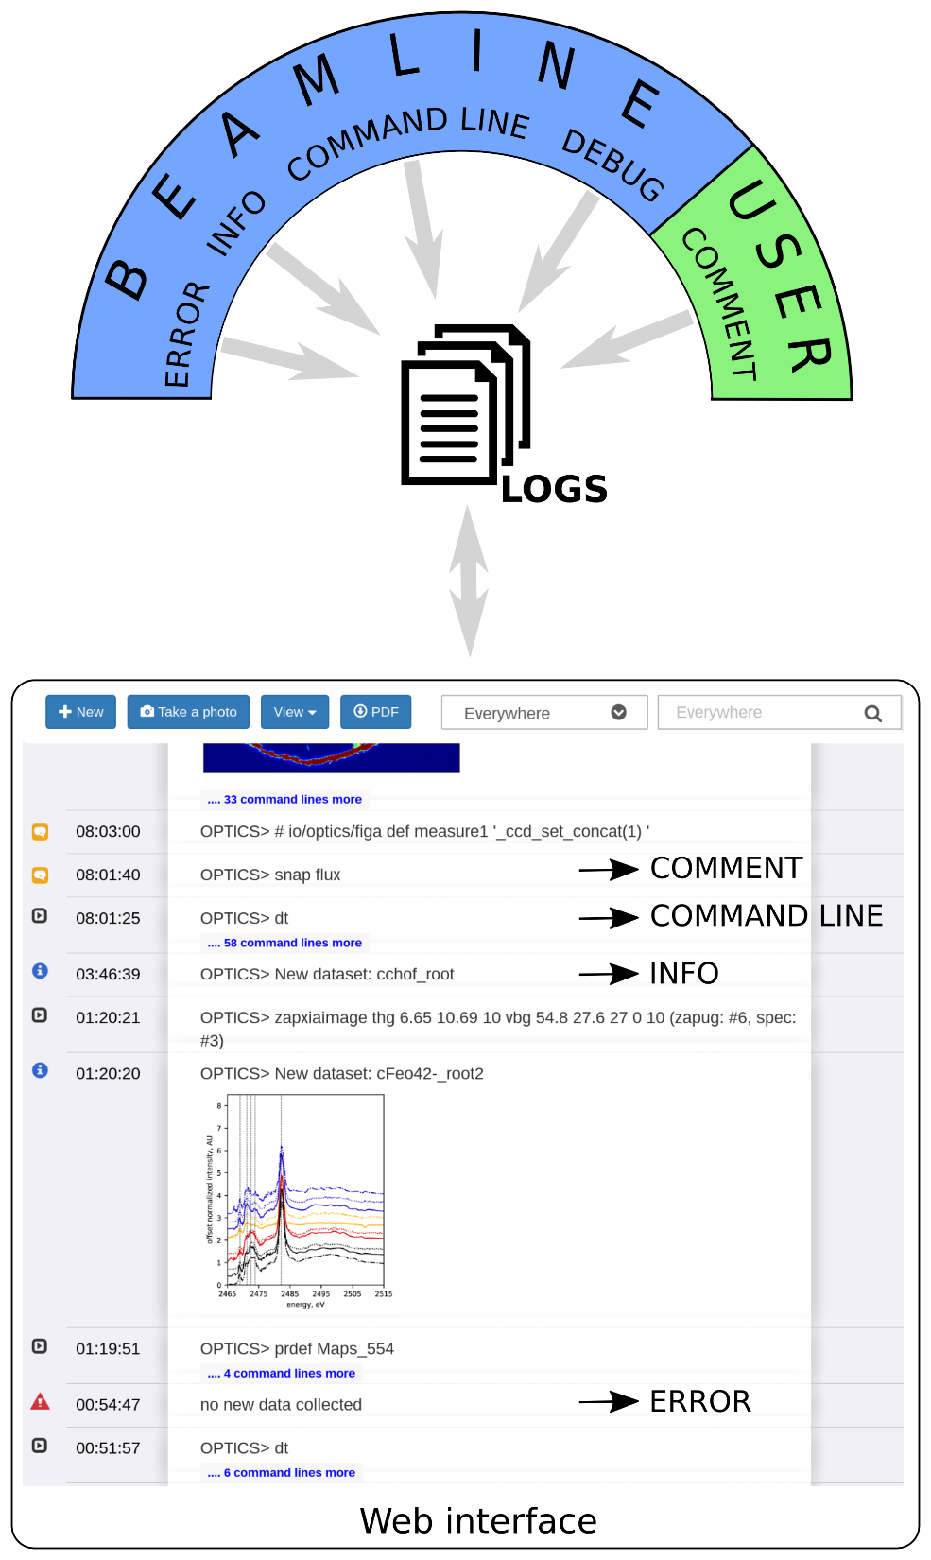
E-logbook makes experiments FAIRer

Slide 14
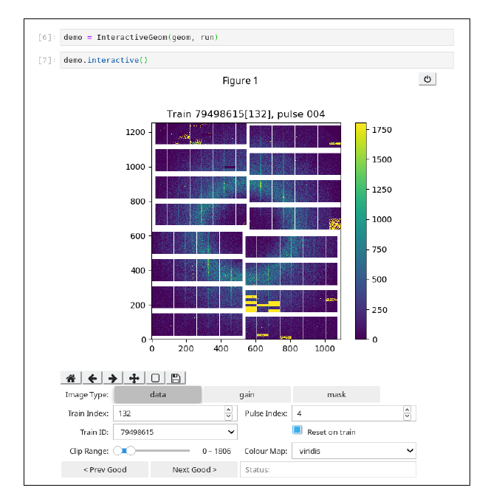
Data Analysis Services WP4
→
Data Analysis portal
Jupyter Python Notebooks
Remote Desktop in Browser
Remote data analysis portal
HDF5 and visualisation in notebooks
Package software for s/w catalogue
This project has received funding from the European Union’s Horizon 2020 research and innovation programme under grant agreement No. 823852

Slide 15
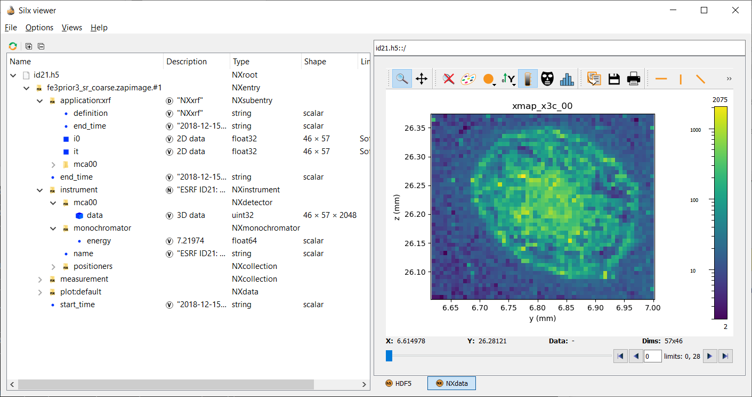
Example data format (Nexus/HDF5)+ silx viewer

Slide 16
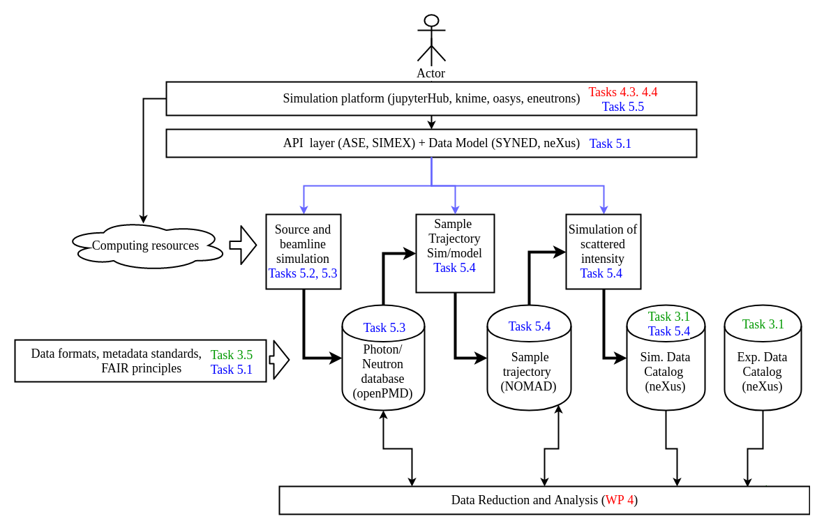
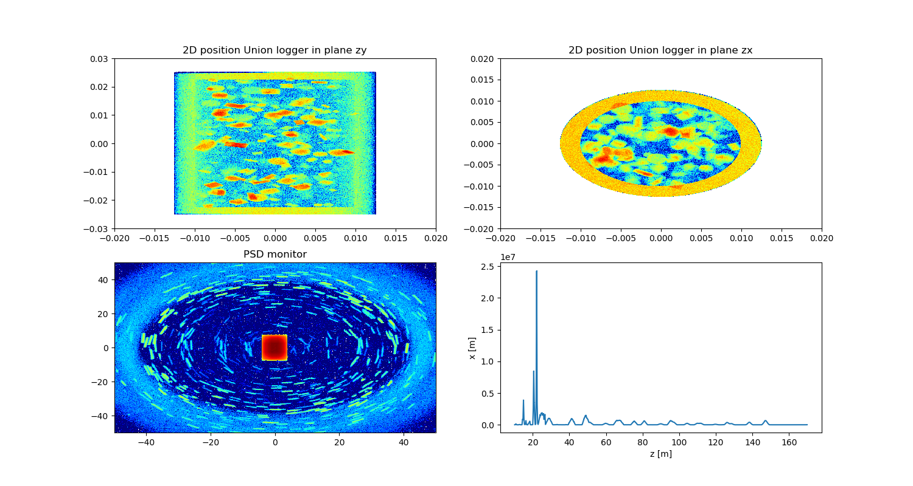
Simulation services WP5
SIMEX: Start-to-end photon experiment simulation library (python)
McStas-script: python API for Neutron ray-tracing with McStas
OASYS: Wavefront propagation for beamline design (WISE)
EPOCH particle in cell + McStas: Simulation of laser driven neutron sources and ray tracing
Scattering in sample
Intensity on detector
Sample y [m]
Detector y [cm]
This project has received funding from the European Union’s Horizon 2020 research and innovation programme under grant agreement No. 823852
Sample x [m]
Detector x [cm]

Slide 17
EOSC Integration WP6
AAI = Authentication and Authorisation Infrastructure
  Critical if we want to identify people and define roles
  EOSC must solve at least the AAI problem
  PaNOSC is working with GÈANT to make UmbrellaId sustainable
Develop a PaNOSC data analysis as a service portal
Integrate PaNOSC services into EOSC
Data download service (terabytes via internet)
Software catalog service
→
→
→
This project has received funding from the European Union’s Horizon 2020 research and innovation programme under grant agreement No. 823852

Slide 18
EOSC Integration – Data transfer
WP6
3 uses cases :
  User driven data transfer (e.g. Globus Online)
  Data archiving for RI (STFC as the archive center with FTS3)
  Transfer from RI to compute facilities on behalf of users (i.e. based on the scenario where users perform analysis on a different infra than the one of the RI where the data have been produced). Currently exploring OneData, and simple solution without caching (webdav)
This project has received funding from the European Union’s Horizon 2020 research and innovation programme under grant agreement No. 823852

Slide 19
Sustainability WP7
Develop a model to calculate cost of FAIR data
Propose a sustainability plan for RIs
Develop models for different service levels
Participate and contribute to EOSC Sustainability WG
Cost-benefit analysis of EOSC for PaN RIs
This project has received funding from the European Union’s Horizon 2020 research and innovation programme under grant agreement No. 823852

Slide 20
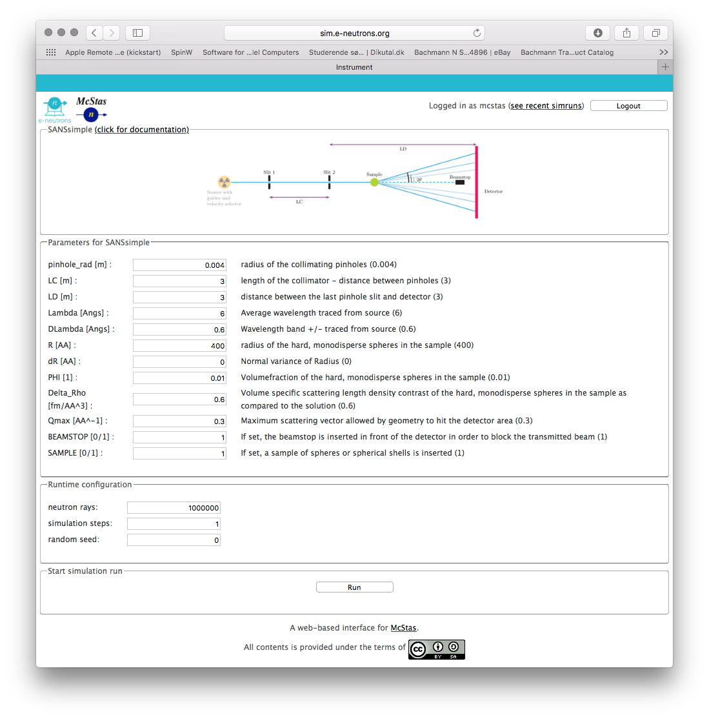


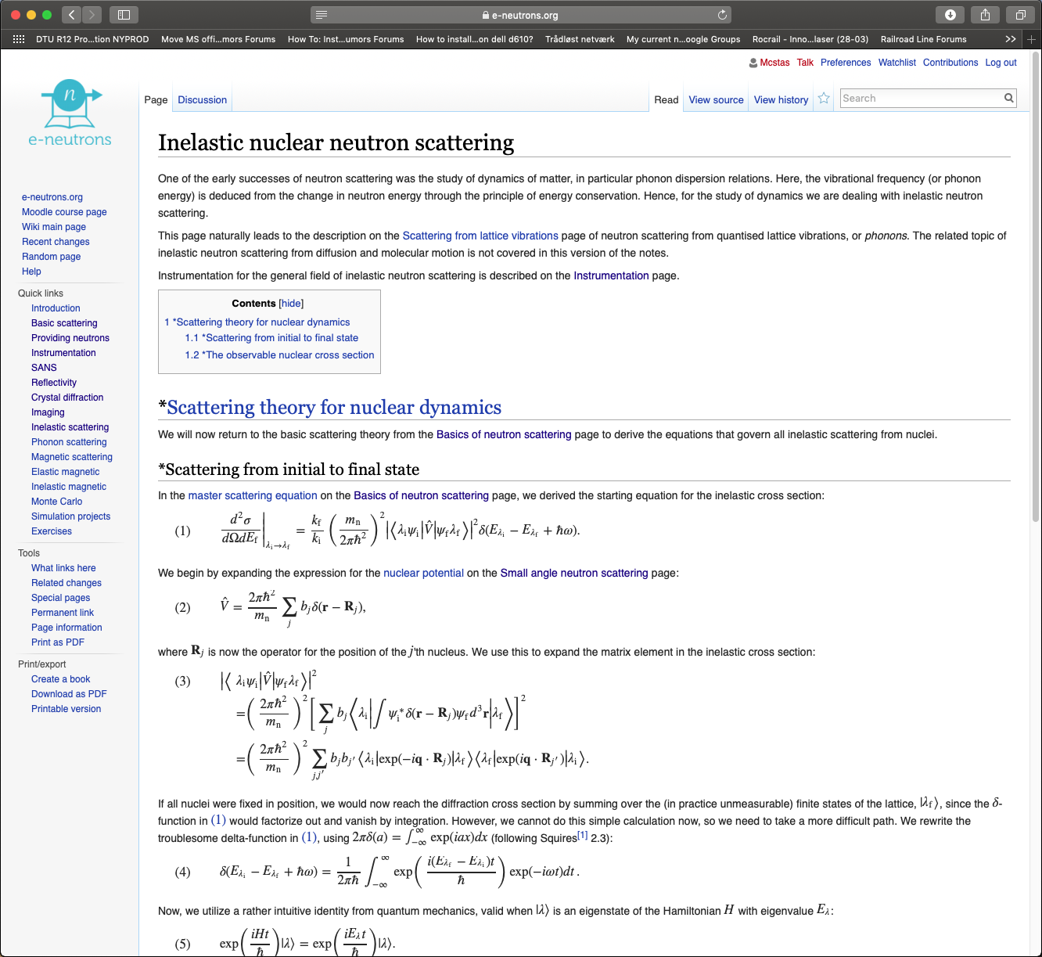
Training + e-learning WP8
→
e-neutrons.org
  Wiki with neutron scattering theory
  Web instrument simulation using McStas
  Quizzes using both theory and simulation
Extensions:
Support for Jupyter Notebooks
Integrate data analysis services
Integrate simulation services
What is the EOSC training platform?
This project has received funding from the European Union’s Horizon 2020 research and innovation programme under grant agreement No. 823852

Slide 21

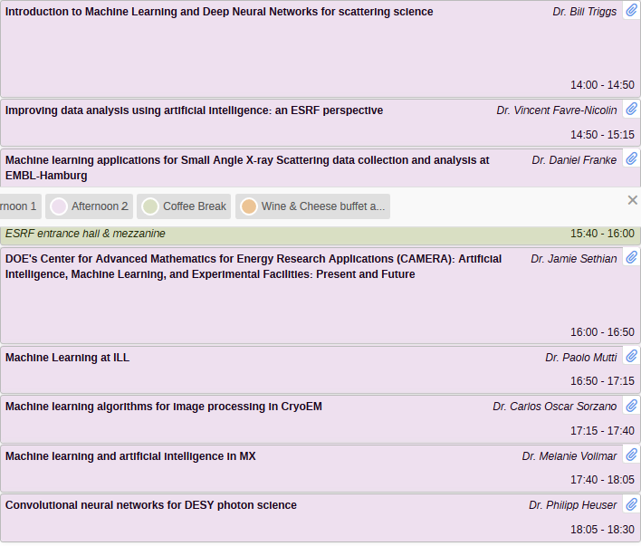
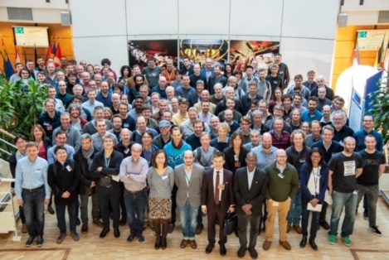
AVAILABLE here →
https://www.youtube.com/user/LightforScience/videos

Slide 22
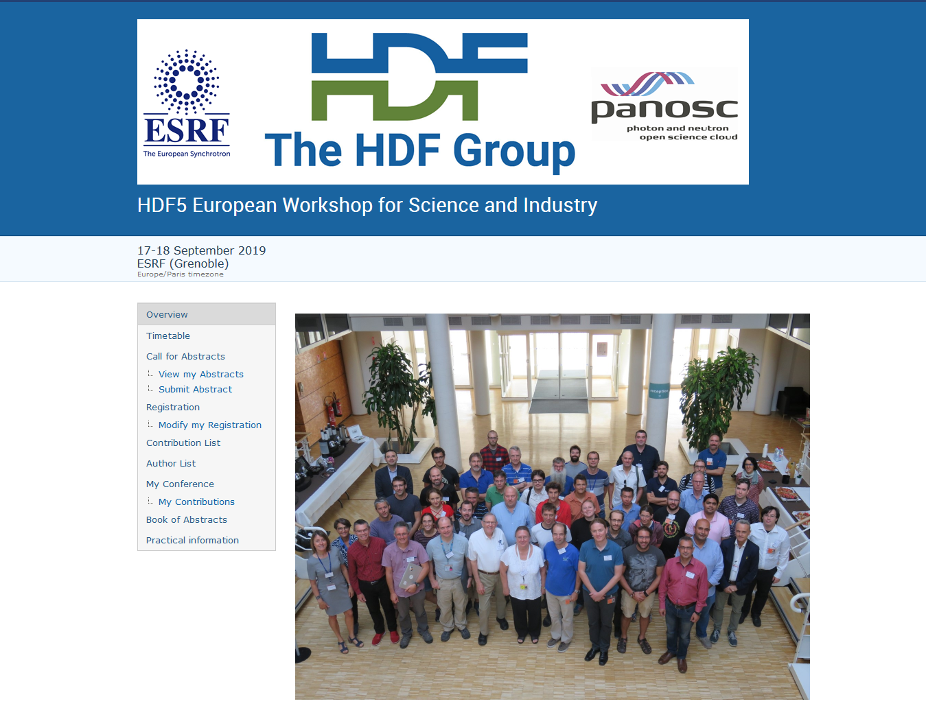

Slide 23
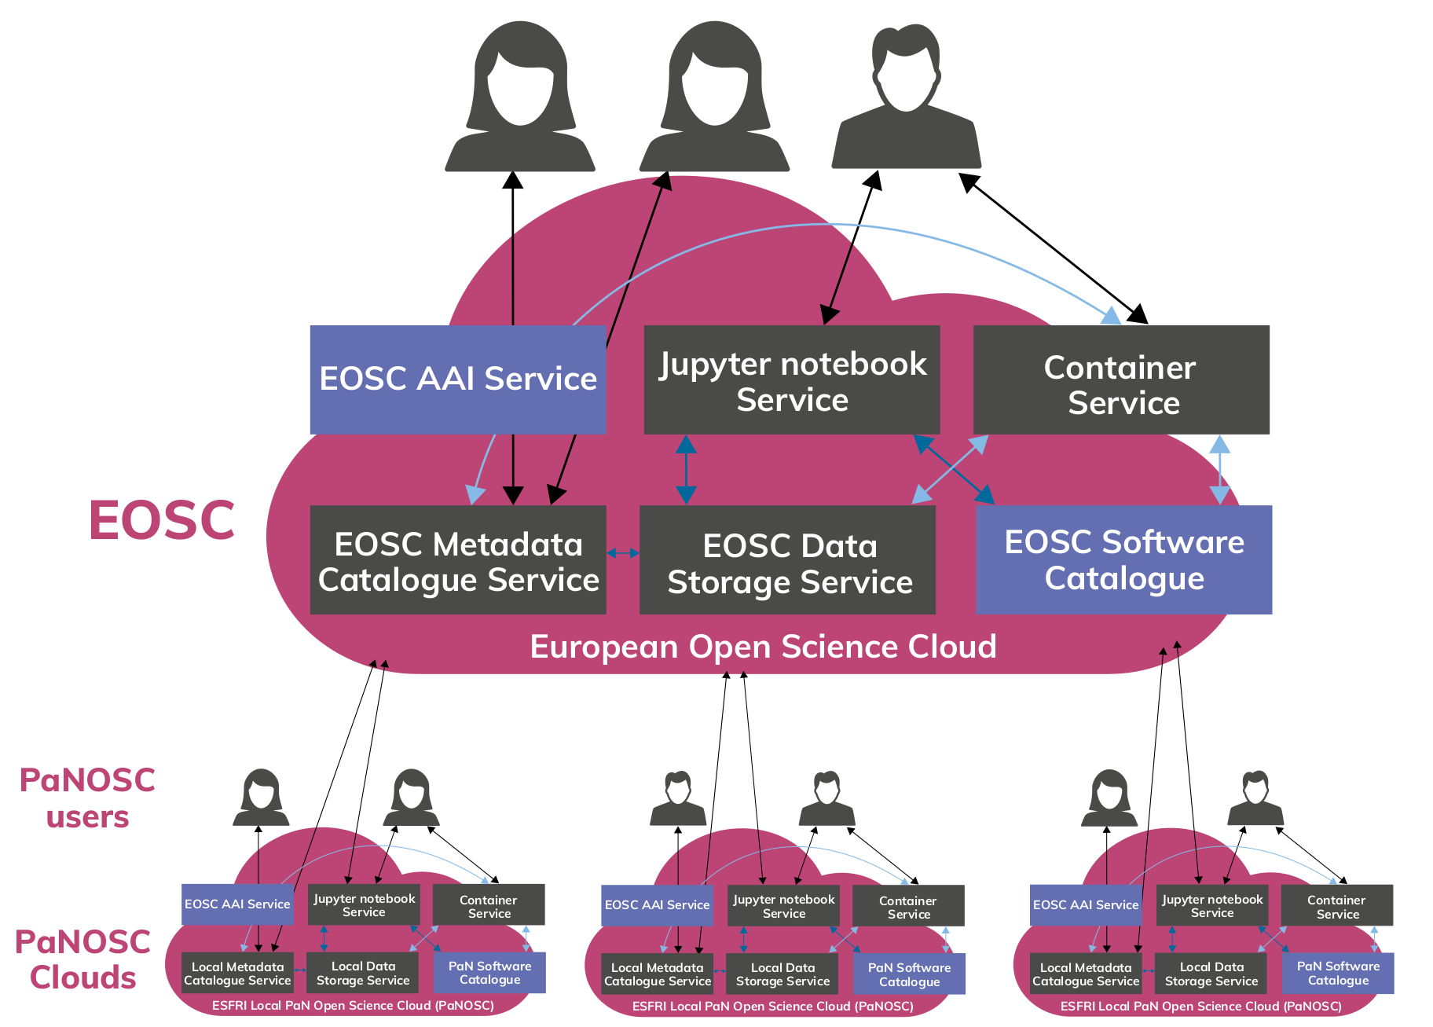
PaNOSC Vision – a PaN scientific commons
This project has received funding from the European Union’s Horizon 2020 research and innovation programme under grant agreement No. 823852

Slide 24
Minimal Viable EOSC - PaNOSC Position Paper (22/11/2019)
1. A common way of identifying, authenticating, and authorising users (AAI) across Europe. The EOSC should operate and sustain AAI as part of the EOSC infrastructure. The EOSC AAI should support the AAI features PaNOSC is implementing on the UmbrellaId AAI [6].
2. A service for transferring and downloading data efficiently (distributed and high bandwidth);
3. A solution for long-term archiving of large quantities of open data (petabytes) coupled to high-performance storage and compute resources for the (re)analysis of open data;
4. A federated search capability for searching and finding scientific data in a wide variety of domains;
5. A set of services for data simulation and analysis ranging from generic services like Jupyter notebooks to domain specific applications per scientific application in the PaN software catalogue [5].

Slide 25
PaNOSC + ExPaNDS contribution to EOSC
Petabytes of raw and processed data in a wide variety of scientific domains
2. Meta-data that will create FAIR raw and processed scientific data
3. Software for generic and specific data simulation and data analysis
4. Workflows and expertise for reducing and analysing data
5. Reference training material and training platform for understanding photon and neutron science and associated handling of data
6. Interface to large user communities of photon and neutron sources and their expectations for services

Slide 26
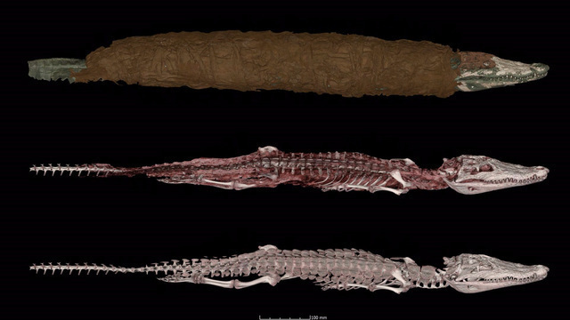
Why we make data open ? on http://paleo.esrf.fr
“Data is going to die if it’s not used, so you want your data to be as easily usable as possible, and a Creative Commons license is an integral part of that.”
William Noel
Synchrotron tomography
Porcier S. M., Berruyer C., Pasqali S., Ikram S., Berthet D., Tafforeau P. « Wild crocodiles hunted to make mummies in Roman Egypt: Evidence from synchrotron imaging ». Journal of Archaeological Science, 1 octobre 2019. Vol. 110, p. 105009. DOI : https://doi.org/10.1016/j.jas.2019.105009
This project has received funding from the European Union’s Horizon 2020 research and innovation programme under grant agreement No. 823852

Slide 27
Questions de Laurent Lellouch
Avez-vous des attente vis-à-vis la France comme pays hôte d'ESRF? (e.g. des connections internet à très haut débit, l'accès à des centres de calcul, etc.)
OUI – connections tres haut debit vers des centres de calcul / cloud
Quels sont les coûts financiers et humains associés à la mise en place de PaNOSC au niveau de l'ESRF?
4-5 CDI + 3 COD + 1 million euros (archivage long terme)
Avez-vous une idée des coûts qui seront associés au maintien de la contribution de l'ESRF à PaNOSC?
3 CDI + 100 mille euros / ans (archivage long terme)
Même question pour l'intégration de PaNOSC dans EOSC et l'ouverture à des communautés au delà de celle des utilisateurs d'infrastructures PaN? En particulier, est-ce que ces infrastructures ont actuellement les moyens de proposer les services à des communautés plus grandes?
NON

Slide 28
Conclusion
PaNOSC vision is to create a Scientific Data Commons for Photon and Neutron sources and make the data available via the EOSC (whatever that may be)
PaNOSC will collaborate closely with ExPaNDS to make FAIR data a reality for all PaN RIs
PaNOSC has been running for 1 year and is now up to speed however the implementation of EOSC is still not defined
PaNOSC et CNRS doit travailler ensemble sur des sujets comme l’archivage long terme, politique des données, API de recherche des donnée, logiciels scientifiques open source, et aider les scientifiques à partager et reutiliser les données
This project has received funding from the European Union’s Horizon 2020 research and innovation programme under grant agreement No. 823852

Slide 29
Vision
The EOSC could become the GitHub of Open Science in Europe. This means making it a platform for scientists to share their data analysis and workflows and link these back to open data and other workflows – either their own, or that of other scientists. To achieve this, it will be necessary to provide scientists with a personal space where they can create content (data analysis recipes, workflows, publications), store analysed data and share their work with collaborators via a versioning system like git.
Example of a different approach to building a platform for Open Science à la EOSC → https://cos.io
This project has received funding from the European Union’s Horizon 2020 research and innovation programme under grant agreement No. 823852

Slide 30
PaNOSC Resources
https://panosc.eu
https://github.com/panosc-eu/panosc
“Enabling Open Science for Photon and Neutron sources”
presented at ICALEPCS 2019 http://icalepcs2019.vrws.de/papers/tubpl02.pdf
PaNOSC Position Paper - https://github.com/panosc-eu/panosc/blob/master/Work%20Packages/WP6%20EOSC%20Integration/PaNOSC_EOSC_position_paper.pdf
This project has received funding from the European Union’s Horizon 2020 research and innovation programme under grant agreement No. 823852

Slide 31
BACKUP SLIDES
This project has received funding from the European Union’s Horizon 2020 research and innovation programme under grant agreement No. 823852

Slide 32
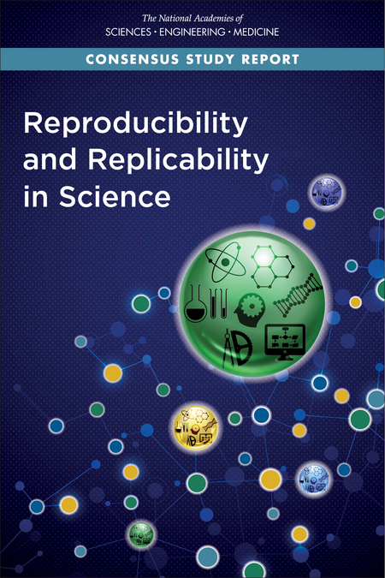

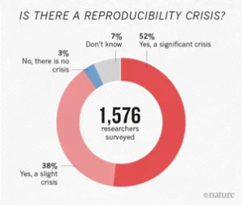
Reproducibility crisis in science
Baker, M. 1,500 scientists lift the lid on reproducibility. Nature 533, 452–454 (2016) doi:10.1038/533452a
This project has received funding from the European Union’s Horizon 2020 research and innovation programme under grant agreement No. 823852

Slide 33
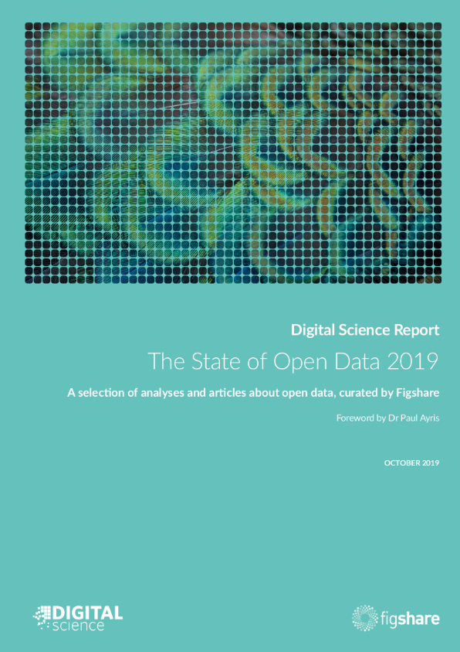
State of Open Data
2019
https://digitalscience.figshare.com/articles/The_State_of_Open_Data_Report_2019/9980783
This project has received funding from the European Union’s Horizon 2020 research and innovation programme under grant agreement No. 823852

Slide 34
What is the European Open Science Cloud ?
“The main goal of the EOSC initiative was to offer European researchers a virtual environment with free, open, and seamless services for the storage, management, analysis and re-use of research publications, data and software that are linked to their research activities across borders and disciplines.
The model proposed for realising EOSC was to federate existing and newly developed research data infrastructures under a common governance structure, assist the shared procurement of additional required capacity from public and private service providers, and support the development of added-value services for the exploitation of research data. “
EOSC Partnership Proposal – 16 December 2019

Slide 35
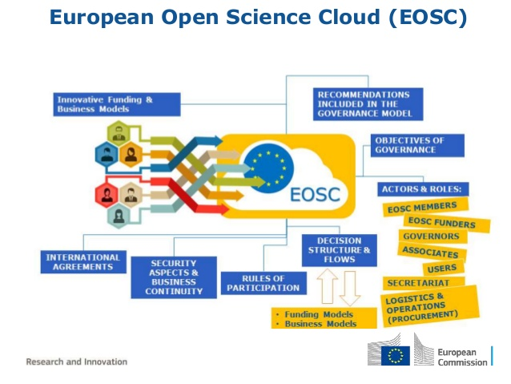
EOSC
This project has received funding from the European Union’s Horizon 2020 research and innovation programme under grant agreement No. 823852

Slide 36
Feedback to the Executive Board (PanOSC Position Paper)
Provide a clear technical definition of “what is the EOSC”
Define common standards for FAIR data so that the different scientific fields have a common approach and understanding
Provide long-term sustainable plan for how the EOSC will be maintained and financed
Provide cloud resources for running data analysis workflows and simulations, ideally enough to make a significant difference for users needing access to computing resources beyond what can be offered by the PaNOSC partners
Collaborate with publishers to generalise the requirement for citing data in publications and making open data a publication in its own right
Provide documentation and training material on the EOSC
Do a cost-benefit analysis of what the EOSC provides

Slide 37
PUMA publication metrics
WP7
Publications and citations per instrument
Delay between a proposal and a publication
Countries and laboratories which use ILL (ESRF, …) data
  Look for potential new users
Scientific trends
Impact factor per science facility
Integrate in OpenAIRE ?
This project has received funding from the European Union’s Horizon 2020 research and innovation programme under grant agreement No. 823852

