Slide 1
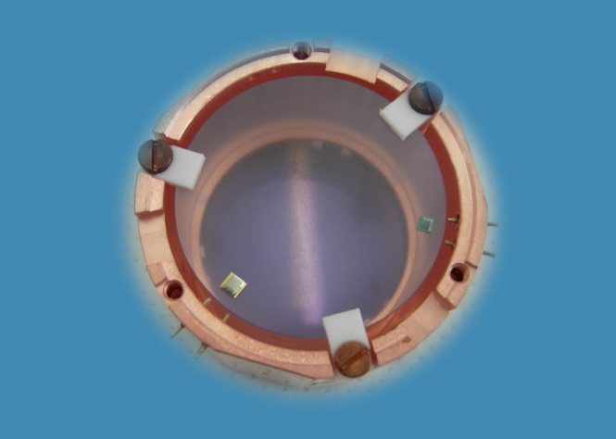
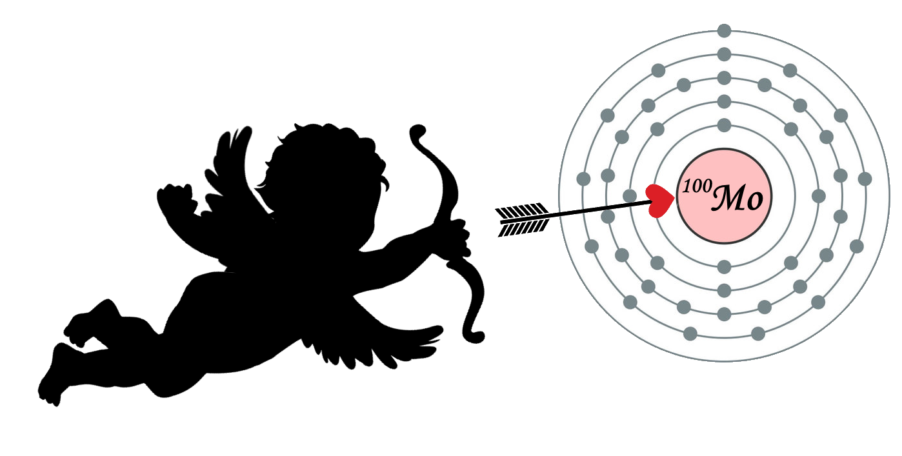
CUPID-Mo
inauguration
December 11th, 2019
Fourneaux, France
CUPID-Mo
Claudia Nones
CEA IRFU – Saclay

Slide 2
Outline
Structure and assembly
Technical performance
Background discussion
Prospects

Slide 3
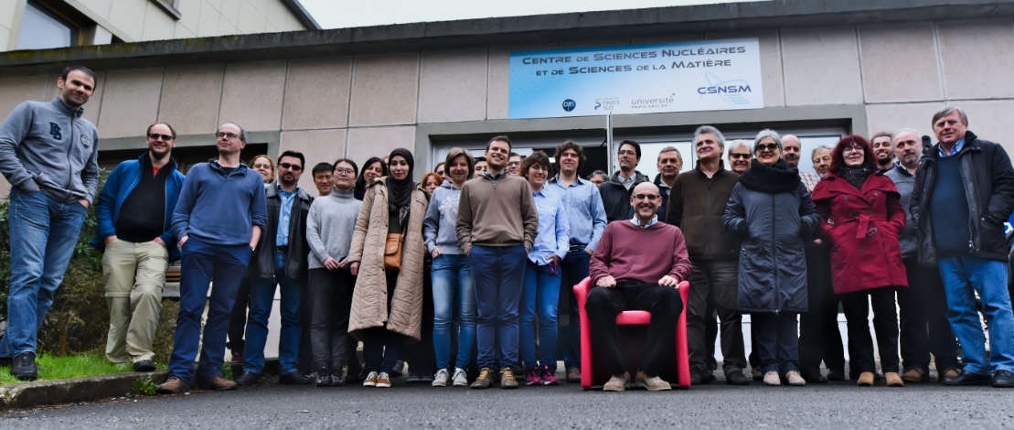
CUPID-Mo collaboration
7 countries, 15 institutions, ∼90 collaborators
arXiv:1909.02994v1 – commissioning paper – accepted by EPJC
arXiv:1911.10426v1 – first data including background – TAUP 2019 proceedings

Slide 4
Outline
Structure and assembly
Technical performance
Background discussion
Prospects

Slide 5
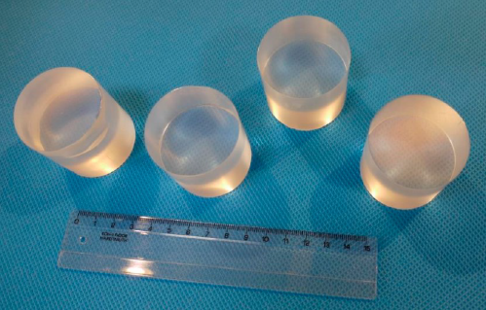
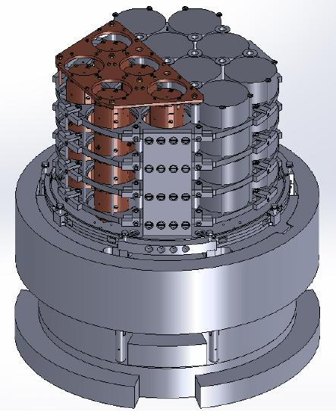
The CUPID-Mo demonstrator
CUPID-Mo in a nutshell
20 ¹⁰⁰Mo-enriched (97%) Li₂MoO₄ ⇒ ∼2.3 kg of ¹⁰⁰Mo
20 Ge light detectors
5 towers with 4 detectors each
EDELWEISS set-up @ LSM (France)
History of the installation
Installation in cryostat: January 2018
First cryogenic problem (1K pot valve) →delay
First commissioning: Spring 2018
Second cryostat failure: Summer 2018
- long time to fix cryogenics
- take advantage to improve light detector
performance (change NTD, add reflectors)
Second commissioning: Winter 2019
Cooling water problem up to March 2019
From April 2019 in steady data taking with satisfactory performance
EDELWEISS
CUPID-Mo
Phase I

Slide 6
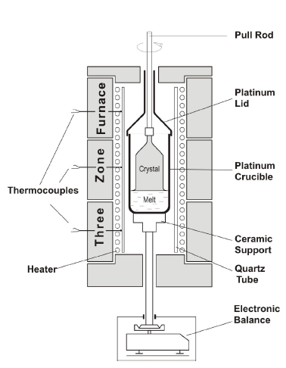
Low thermal gradient Czochralski
Li₂MoO₄ crystals are produced at the Nikolaev Institute of Inorganic Chemistry, Novosibirsk, Russia
Enriched material from ITEP, Moscow, Russia (previously used in NEMO-3)
Crystals are grown with a special technology with the following features:
Low thermal gradient with respect to traditional Czochralski (0.05 – 1 °C/cm)
Fully closed platinum crucible (∅70×130 mm) → monitor growth by weight
Grow rate: 0.5 – 0.75 mm/h (a boule is grown in about 10 – 12 days)
Double crystallization is applied → the second step crystallization is made from the outcome of the first step and form the scraps of the preceding final element preparation → crucial to reduce K content
J. Mat. Sci. Eng. B 7 (2017) 63-70

Slide 7
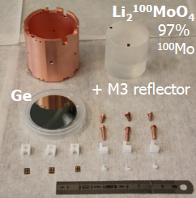
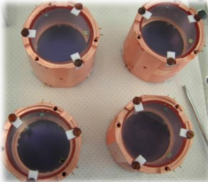
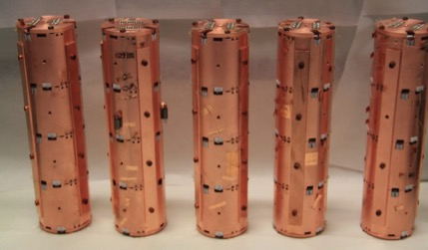
CUPID-Mo: detector details
Single-module
Absorber: Li₂¹⁰⁰MoO₄ - Ø 44 x 45 mm, 210 g
Light detector: Ge wafer Ø 44 mm x 170 μm with antireflective SiO coating on both sides
NOSV copper holders
PTFE for thermal and mechanical coupling
X20
Four modules in each tower
Five towers: 20 heat & 20 light channels
Notes:
56% e’ molibdeno
56% x 90% in 100Mo

Slide 8
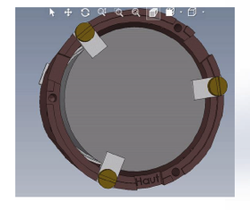
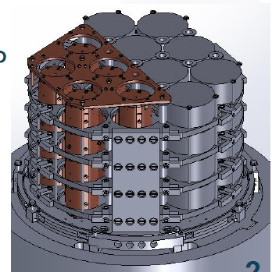
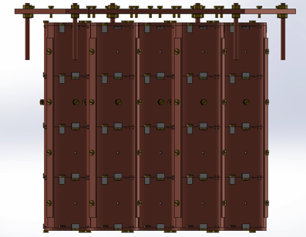
Design and realisation
Conception, realisation and tests of above-ground prototypes done at CSNSM and CEA/DPhP
Designed by CEA/SPEC, realisation at the LAL mechanical workshop

Slide 9
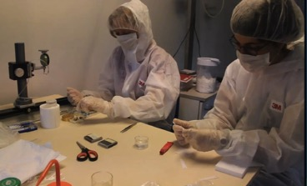
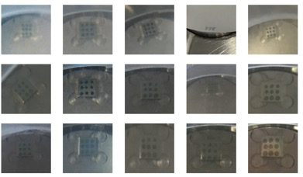
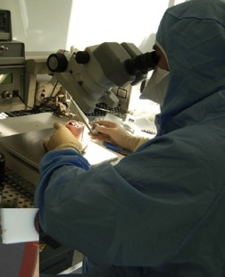
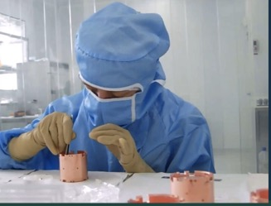
Gluing, cleaning, bonding, assembly
Gluing: performed in a temporary clean room at CSNSM
Cleaning, bonding and assembly: performed in a LAL clean room (class 1000 and 10)

Slide 10
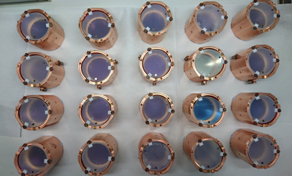
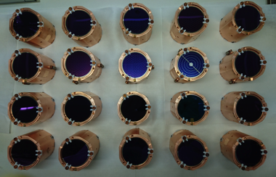
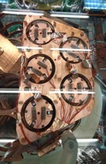
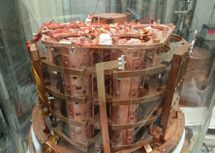
Detector details and installation
crystal-side view
20 modules
light-detector-side view
side view
5 towers in the cryostat
top view

Slide 12
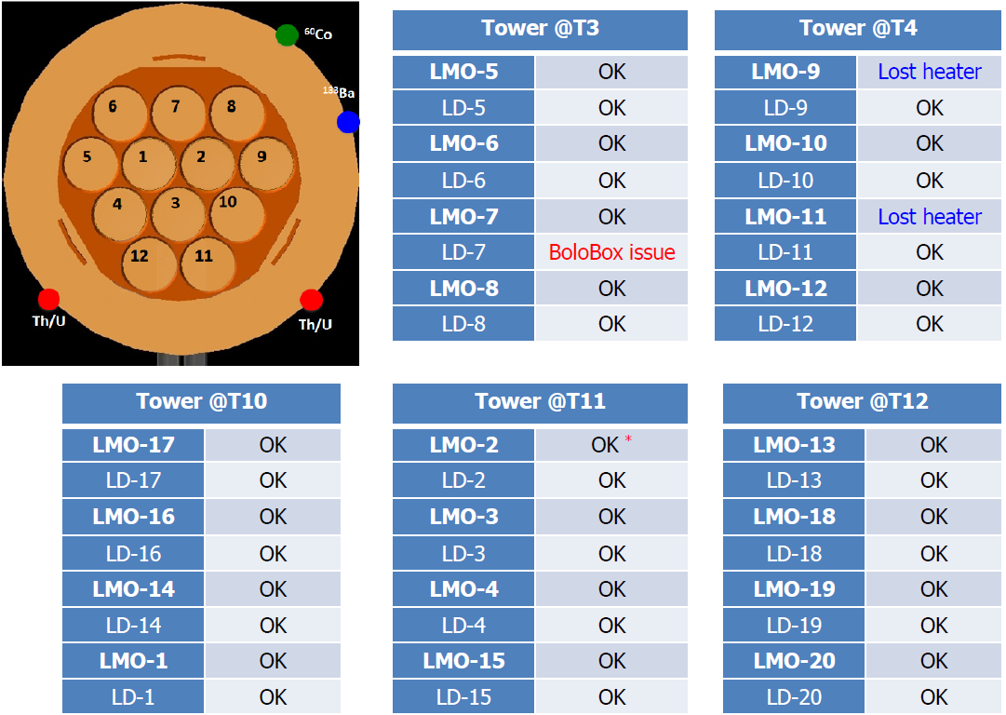
Scheme of installation – channel status
Light detector calibration
Low energy calibration
CUPID-Mo
High energy calibration
*Heavy noise related not to the detector but to the read-out line

Slide 13
Outline
Structure and assembly
Technical performance
Background discussion
Prospects

Slide 14
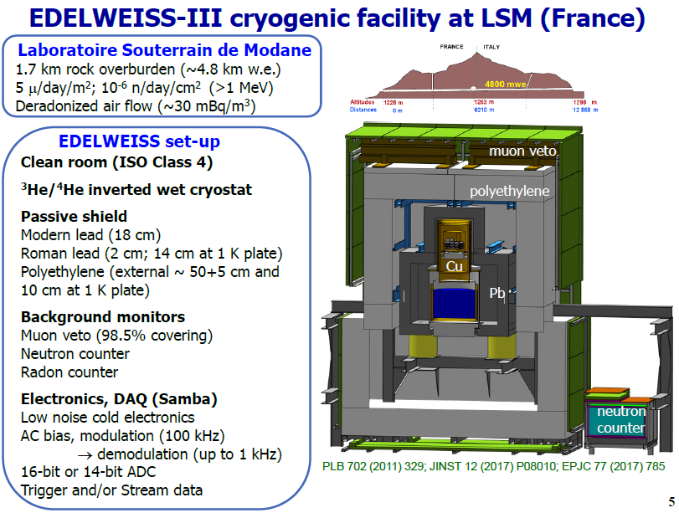
EDELWEISS cryostat in Modane
CUPID-Mo took advantage of the cryogenics, electronics, DAQ developed for EDELWEISS

Slide 15
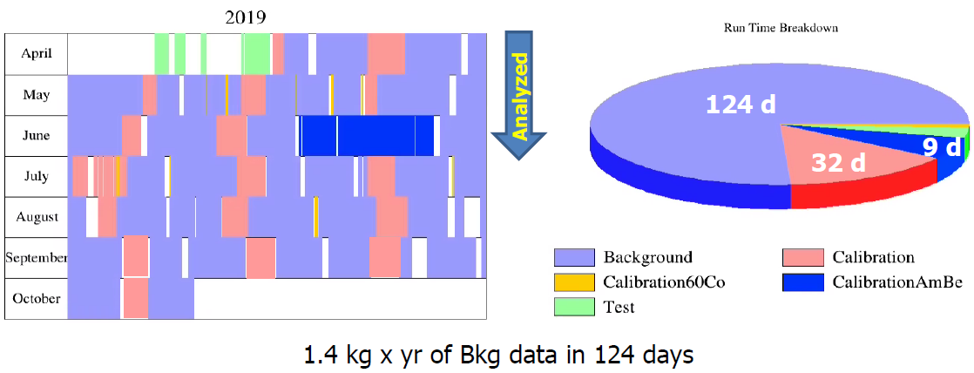
CUPID-Mo data taking
Pre-commissioning @ 20 & 19.25 mK Jan 5th – Feb 28th
Commissioning @20.7 mK Mar 23rd – Apr 8th
Neutron activation Apr 9th
Physics data taking @ 20.7 mK Apr 15th – Oct 9th
@ 21.0 mK Oct 10th – Nov 7th
@ 22.0 mK Nov 8th – now
L. Marini, this inauguration
analyzed up to now
Notes:
very good we are awesome
change the info on the total\analyzed exposure
Three things: energy res
discrimination
radiopurity

Slide 16
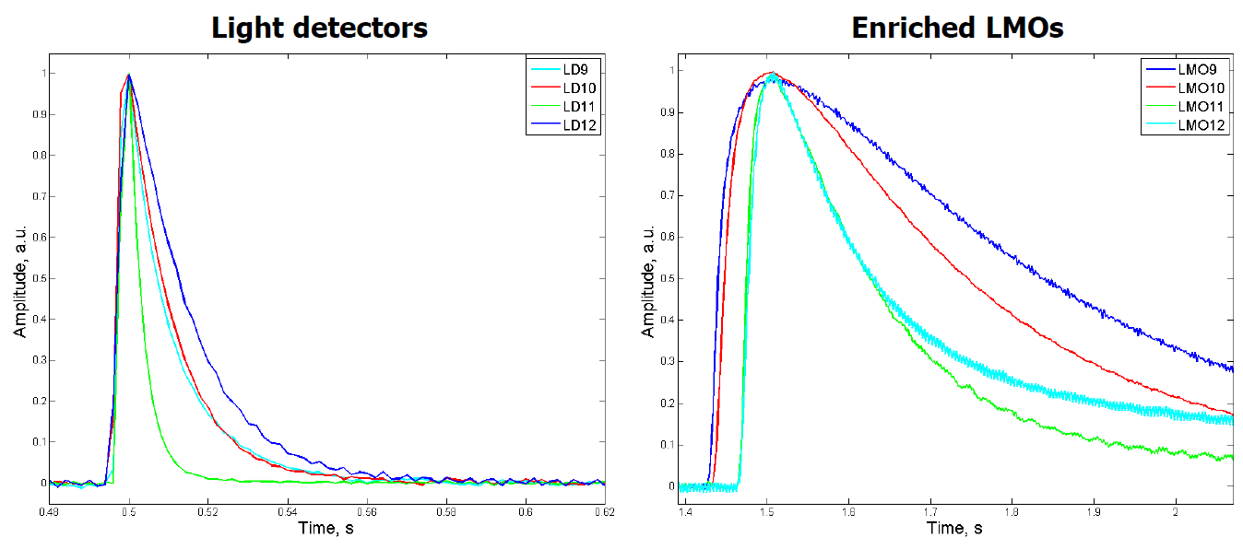
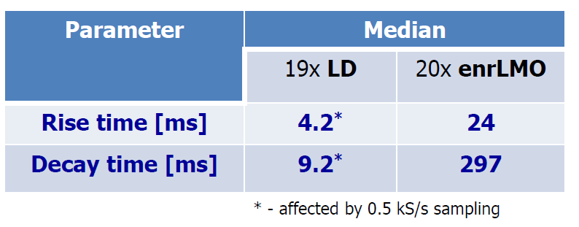
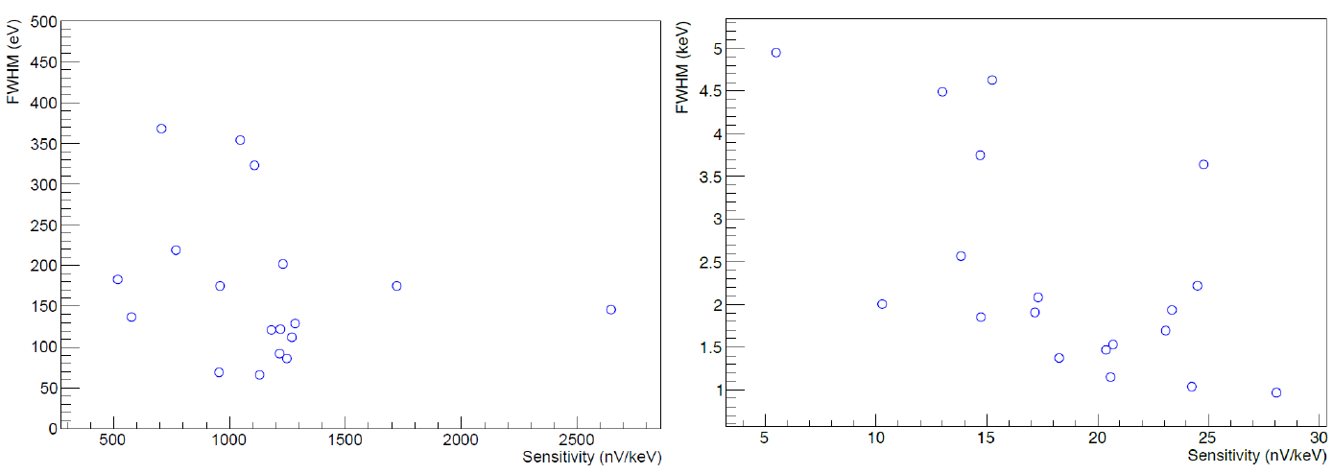
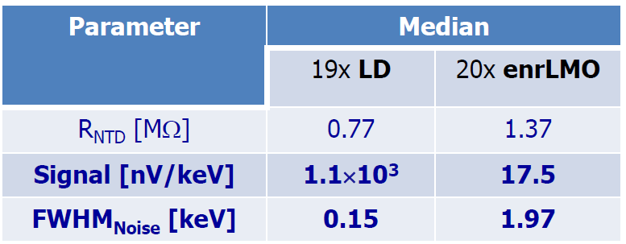
Pulses: basic features
Pulse time parameters
Large dispersion: to be understood
Sensitivity and
signal-to-noise ratio
Light detectors are calibrated using X-ray fluorescence induced by a high-activity ⁶⁰Co source used by EDELWEISS for the regeneration of the ionization detectors.
Notes:
very good we are awesome
change the info on the total\analyzed exposure
Three things: energy res
discrimination
radiopurity

Slide 17
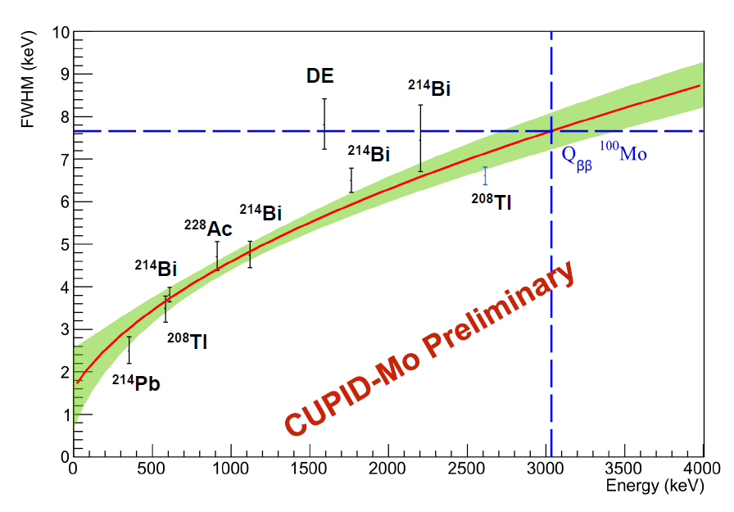
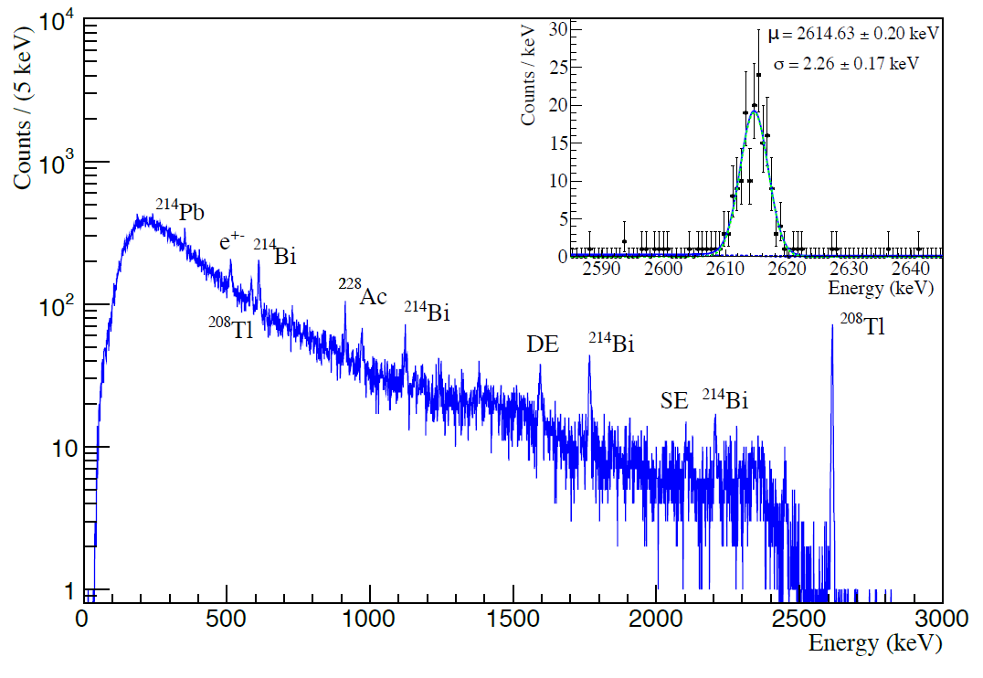
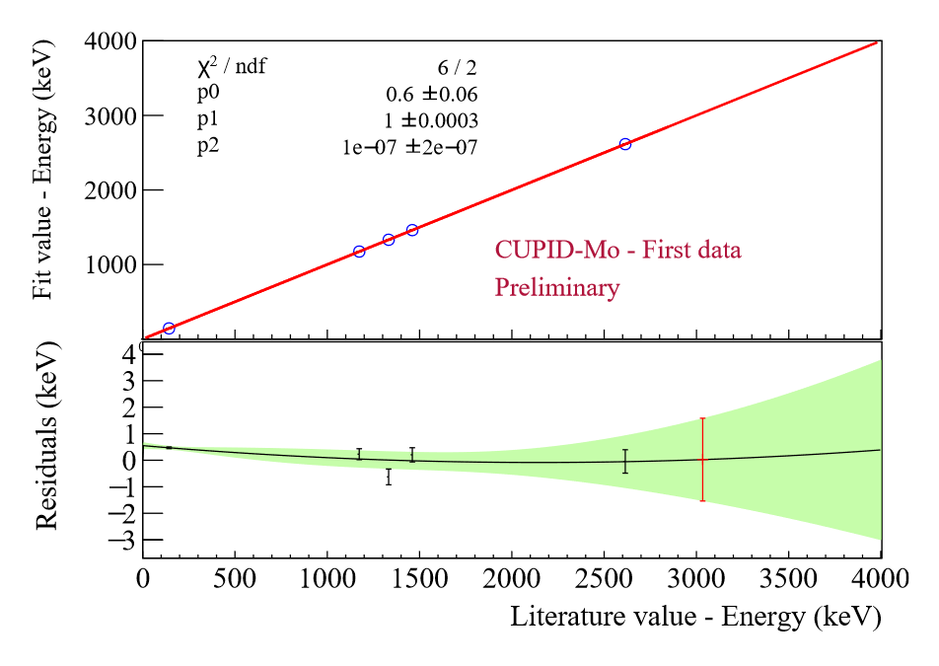
Heat-channel calibration
Summed calibration spectrum
for 19/20 Li₂MoO₄ bolometers
→ all the major peaks are labeled.
The inset shows a fit of the ²⁰⁸Tl γ peak at 2614.5 keV.
ΔE_{FWHM} = 7.7 ±0.4 keV @ 3034 keV
(extrapolated)
ΔE_{FWHM} = 5.3 keV @ 2615 keV
(0.2 %)
Linearity
Thorite source:
Th + U lines
Calibration above 2615 keV is necessary → ⁵⁶Co campaign
Notes:
very good we are awesome
change the info on the total\analyzed exposure
Three things: energy res
discrimination
radiopurity

Slide 18
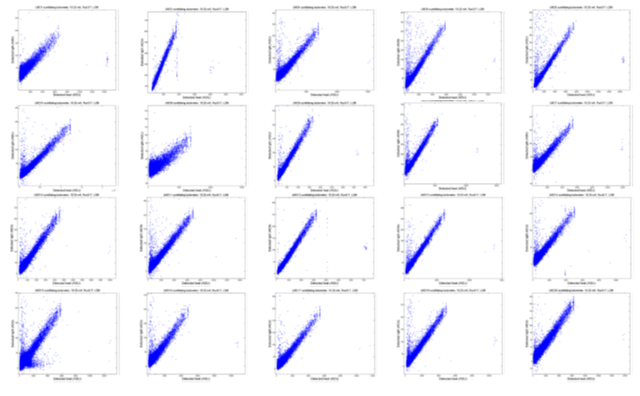
Light vs. Heat and α rejection
Scatter plot zoology
> 99.9% α rejection with > 99.9% β/γ acceptance for all the 20 channels
LIGHT →
HEAT →

Slide 19
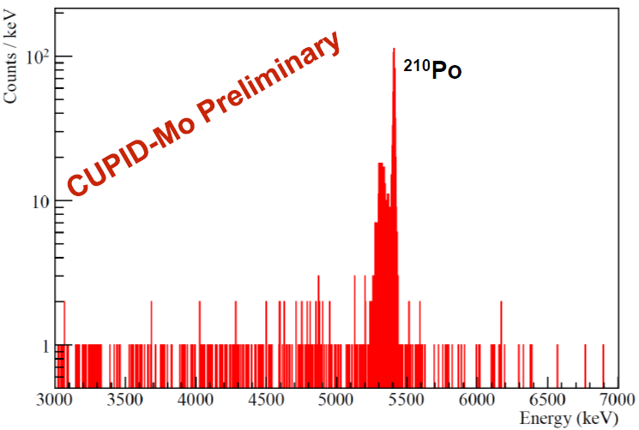
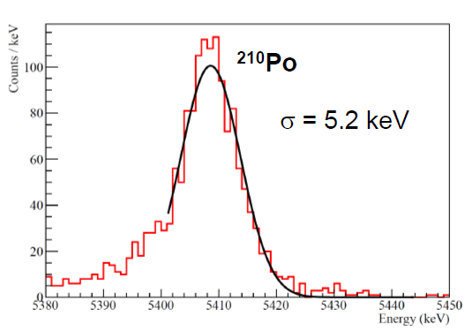
Radiopurity of Li₂¹⁰⁰MoO₄
Exposure: ∼0.5 kg × y
Looking the α region:
Minimal cuts (pile-up cut)
> 97% signal acceptance
Estimate contamination in ± 15 keV window
²¹⁰Po (²¹⁰Pb) ∼ 158(3) mBq/kg
¹⁹⁰Pt ∼ 0.37(15) mBq/kg
Degraded alphas [3,4] MeV:
0.16(2) counts/kev/kg/y
Contamination for both Th- and U-series are ∼ 10 x better than assumed in CUPID preCDR
U: ∼ 0.5 μBq/kg
Th: ∼ 0.3 μBq/kg
arXiv:1911.10426v1 – TAUP 2019 proceedings

Slide 20
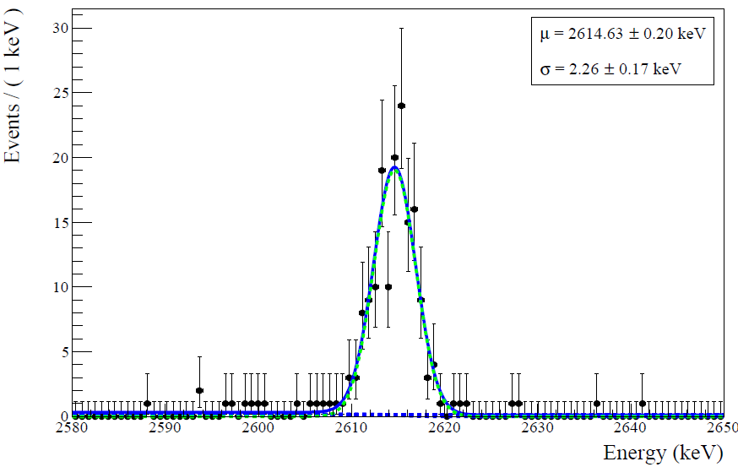
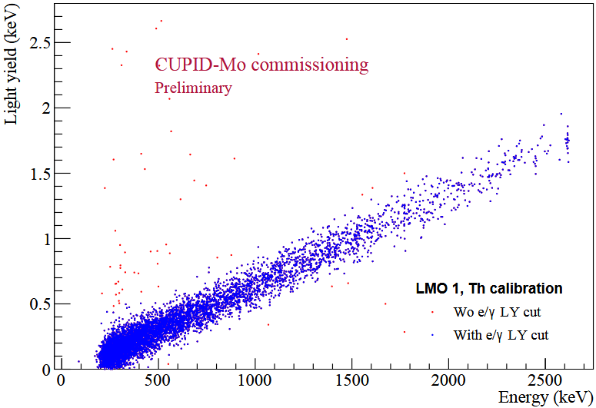
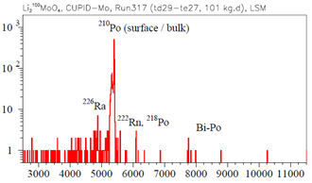
CUPID goals achieved
M. Pavan, this inauguration
With a view to CUPID, technical detector performance in terms of energy resolution, α rejection power and internal radiopurity has been achieved by CUPID-Mo
> 99.9% α rejection
< 1 μBq/kg
U, Th
FWHM ∼ 5 keV

Slide 21
Outline
Structure and assembly
Technical performance
Background discussion
Prospects

Slide 22
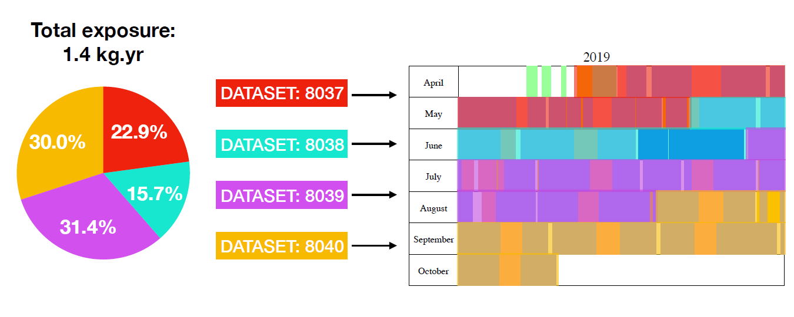
CUPID-Mo total background
TAUP data – 0.54 kg × y
ROI accessible (zero background)
3034 keV ± 50 keV
More details: L. Marini, this inauguration
new data – 0.86 kg × y
ROI blinded

Slide 23
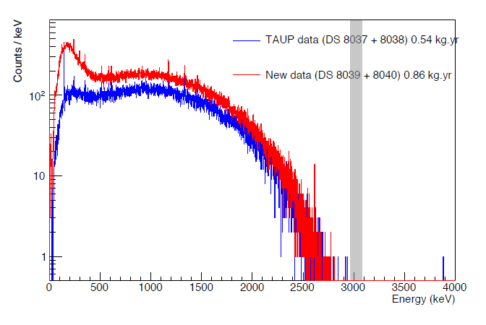
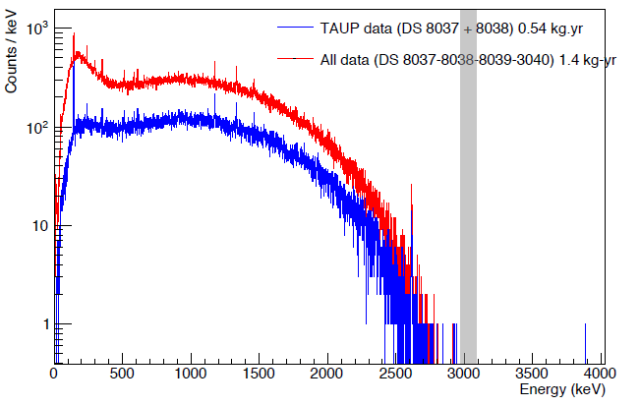
CUPID-Mo total background
Exposure: 0.54 kg × y
L. Marini, this inauguration
Adding new data
1.4 kg × y
2984-3084 keV
b < 1.4×10⁻²
c/keV/kg/y
in 3084-3200 keV

Slide 24
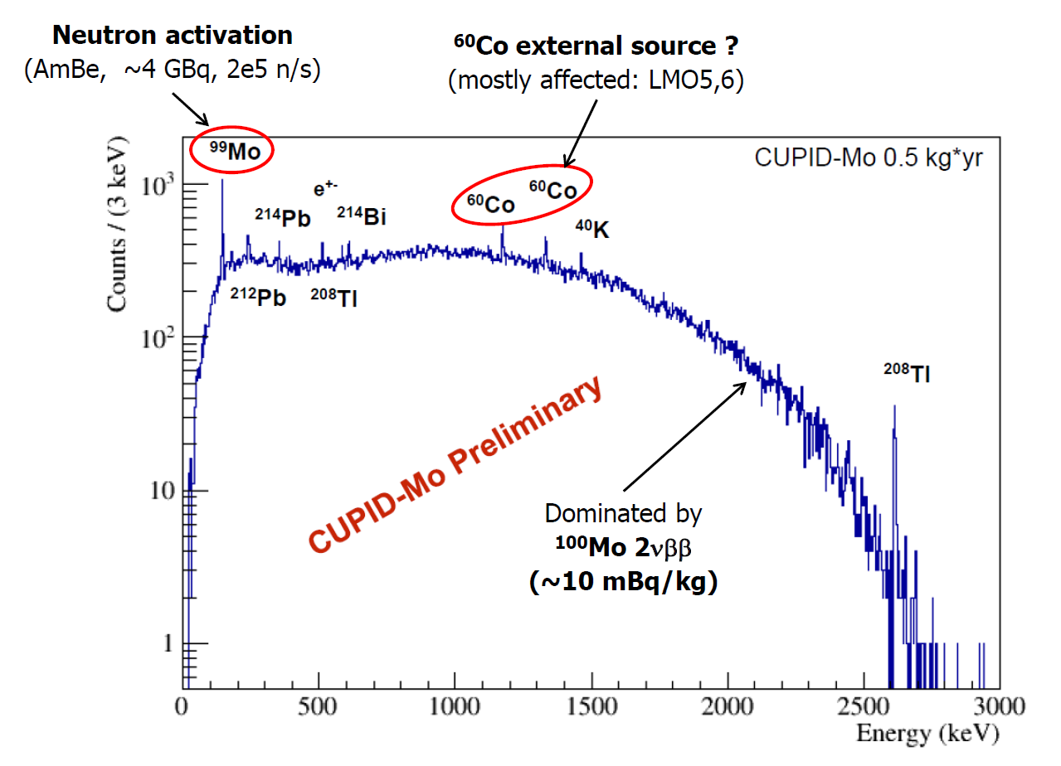
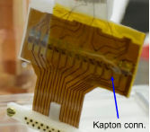
Background components
Rate in the 2615 keV peak
(CUPID-Mo / R&D before CUPID-Mo) ∼0.66 / 1.1(2) cnts/day/kg
To be compared
-CUORE-0 ∼ 0.08 cnts/day/kg -CUPID-0 ∼ 0.14 cnts/day/kg
-CUORE ∼ 0.013 cnts/day/kg
⁶⁰Co collimated external source
or localized internal source ?
We have ²³²Th contaminated connectors close to the detectors (from EDELWEISS readout)
Challenge
Simultaneous absorption of 2614 keV and 583 keV or 510 keV from ²⁰⁸Tl

Slide 25
Outline
Structure and assembly
Technical performance
Background discussion
Prospects

Slide 26
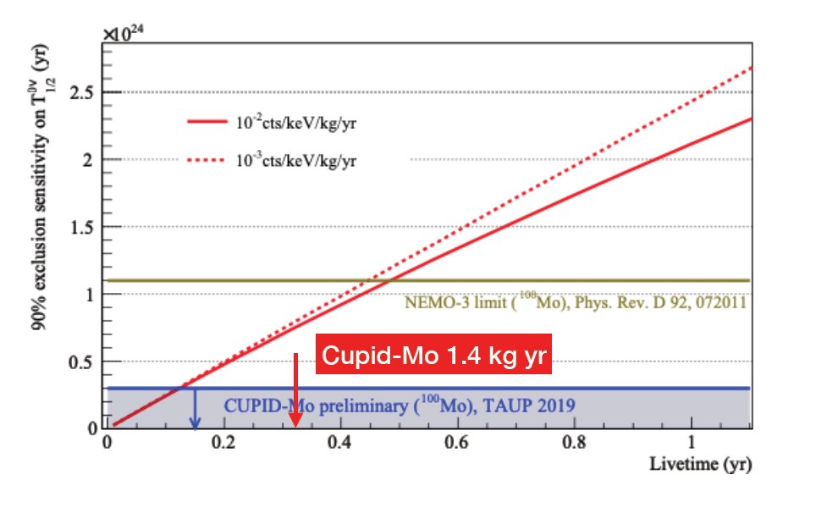
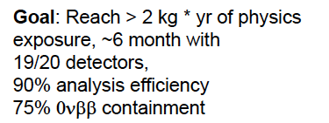
CUPID-Mo as a 0ν2β experiment

Slide 27
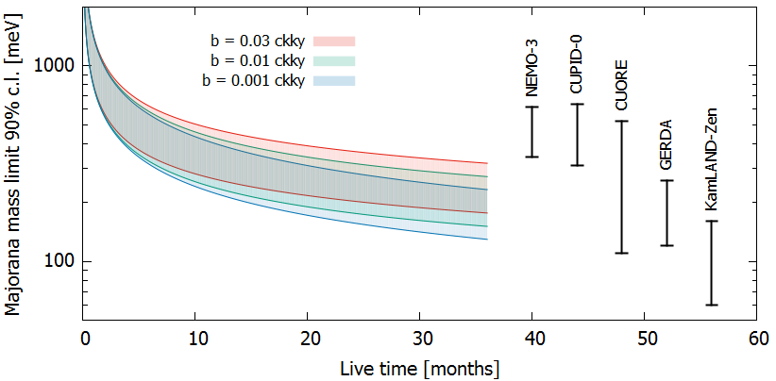
CUPID-Mo as a 0ν2β experiment
¹⁰⁰Mo nuclei: 1.37 × 10²⁵
ROI = 10 keV
Efficiency = 69%

Slide 28
Final considerations
Final considerations
CUPID-Mo in the most important demonstrator for CUPID since it tests directly the selected technology
It has clearly demonstrated that the LMO bolometric performance is adequate (energy resolution + alpha rejection)
It has shown that LMO crystals with ernriched molybdenum can be grown with a radiopurity level an order of magnitude better than CUPID requirements
It is potentially the most sensitive ever neutrinoless double beta decay experiment on the promising isotope ¹⁰⁰Mo
The program of CUPID-Mo is to take data until the end of February 2020, in order to set the best limit on neutrinoless double beta decay half life of ¹⁰⁰Mo and to develop an accurate background model
March 2020 will be dedicated to a ⁵⁶Co gamma calibration with peaks at energies higher than the Q-value of ¹⁰⁰Mo

Slide 29
BACK UP

Slide 30
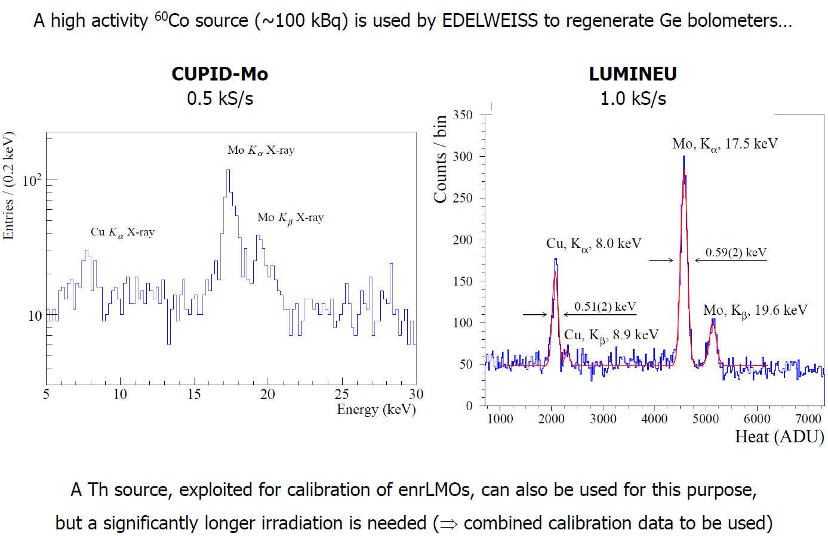
Light-detector calibration
Notes:
very good we are awesome
change the info on the total\analyzed exposure
Three things: energy res
discrimination
radiopurity

Slide 31
Set-up issues in Modane
The EDELWEISS cryostat was conceived to detect WIMPs looking at a signal in the keV region and is not ideal to run low-background scintillating bolometers for 0ν2β
Important microphonic noise induced by the thermal machines
Reverse geometry makes difficult the isolation of vibrations
Instabilities of the noise conditions (it depends on closing-opening of the shield, liquid helium refill, cryostat suspension status)
Instabilities of the base temperature – critical role of the cooling water used for thermal machine compressors and electronics
AC bias – resistances higher than ∼1 Mohm are not tolerated
→ Base temperature around 20 mK → low sensitivities
Difficult stabilization (cross-talks induced by heater signals – double response to pulser excitation) – not important for DM, critical for 0ν2β
²³²Th internal contamination (connectors, kapton, solder, ….)
Finally, the cryogenic infrastructure is old and would need deep refurbishing

Slide 32
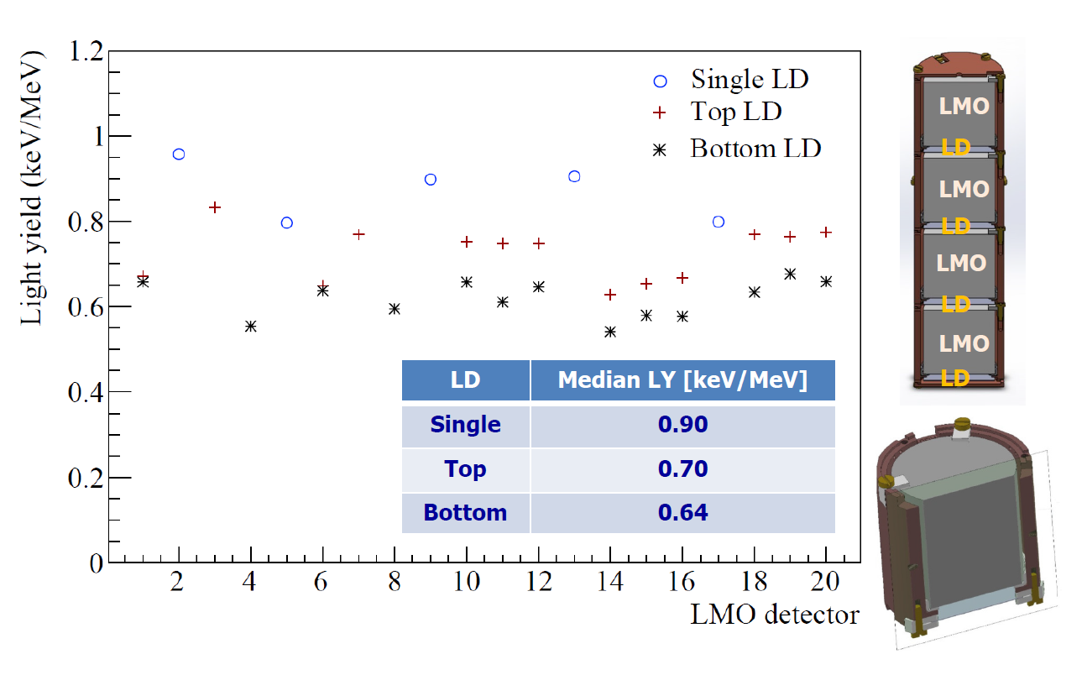
Light yield
The light yield (not corrected by light collection efficiency) reflects the tower structure
Additional information provided by double light detector
→ H. Khalife, this inauguration

Slide 33
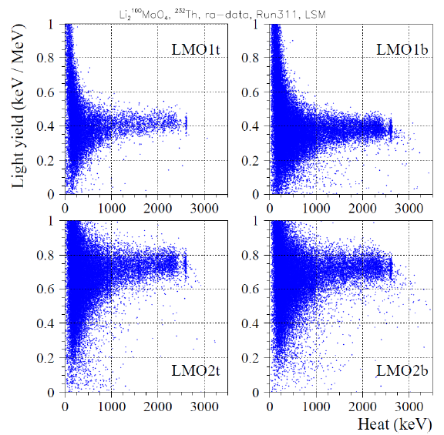
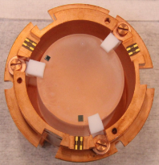
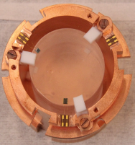
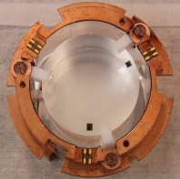
Light yield with/without reflectors
In first assembly, after results from CUPID-Mo precursors, reflectors were not used
Light-yield plots with ²³²Th calibration
Without
reflecting foil
Significant LY reduction without reflecting foil
(∼ 50%)
With
reflecting foil
α/β separation is sufficient even without reflecting foil
In second assembly, reflectors were added for a safer rejection

