Slide 1
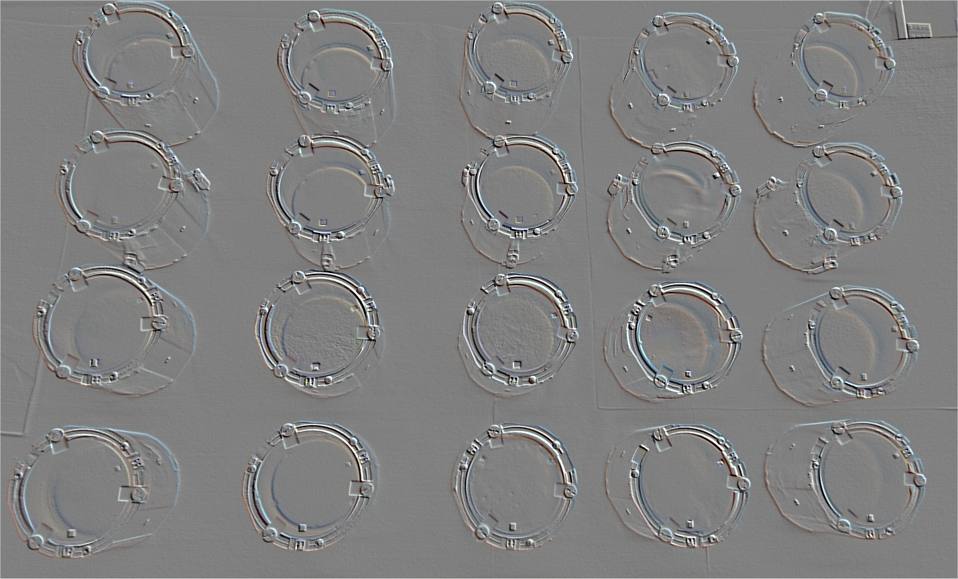

Scintillating Bolometers, some history…..
Stefano Pirro – INFN-LNGS
CUPID-Mo Inauguration, Forneaux 11-12 Dec 2019

Slide 2
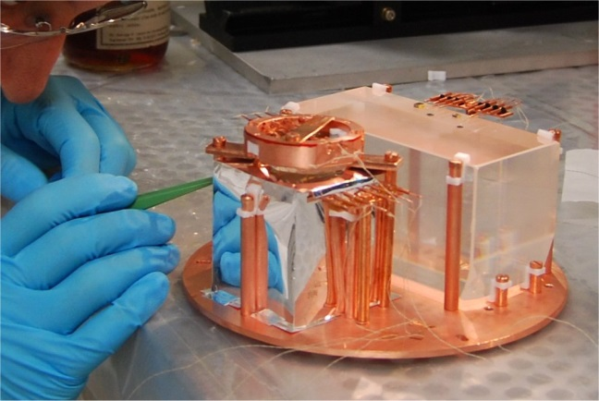
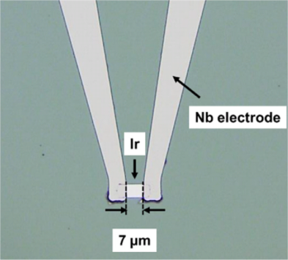
Bolometers
2.1 kg
~ 8* 10⁻¹⁵ kg
Y. Miura et al. https://doi.org/10.1016/j.nima.2019.04.074
L. Cardani et al. https://doi.org/10.1088/1748-0221/7/01/P01020
photon & X-ray applications
~0 ÷ 50 µg
Rare event physics (REP)
~ > 1 g
MICRO
MACRO
ΔE~ fractions of eV
ΔE~ few keV

Slide 3
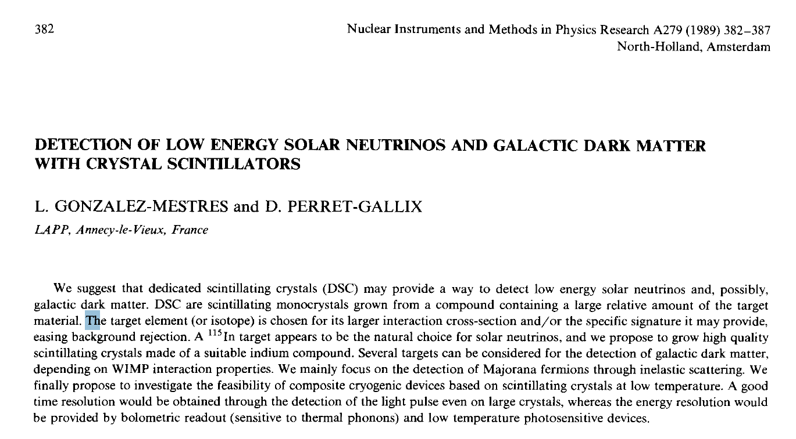
Some history of scintillating bolometers
__
___________________________________________________________________________

Slide 4
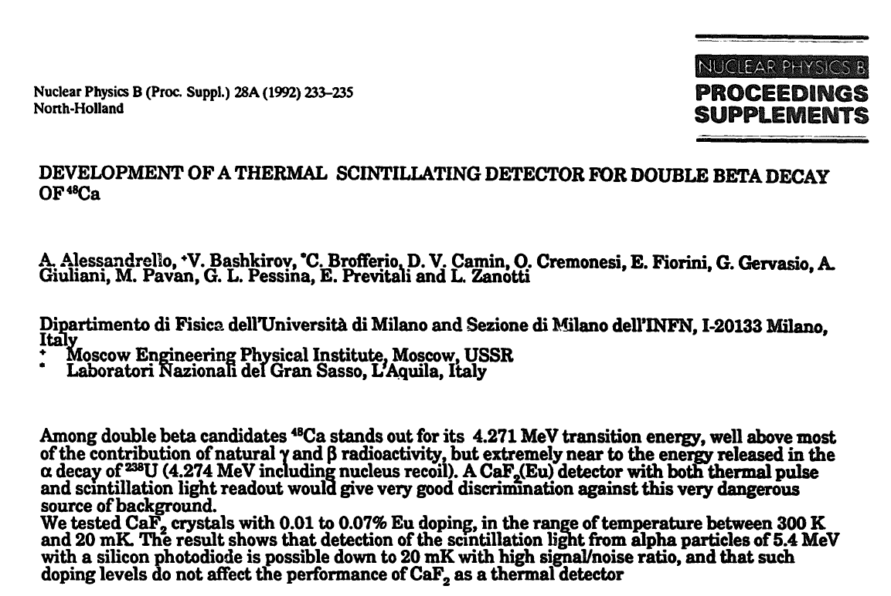
First light readout @20 mK Alessadnrello et al 1992

Slide 5
First light-heat scatter plot 1997 with BLD Coron et al.
0.3 g crystal

Slide 6
Bolometric Light Detectors for Dark Matter: TES
6 g CaWO₄ crystal
10x20x0.5 mm³ SOS

Slide 7
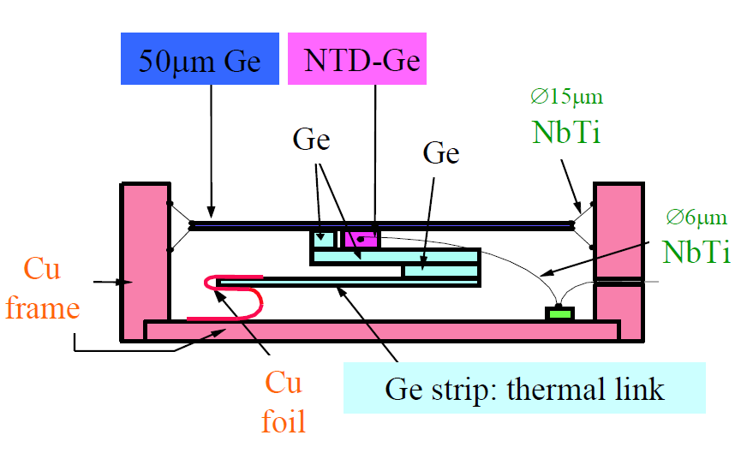
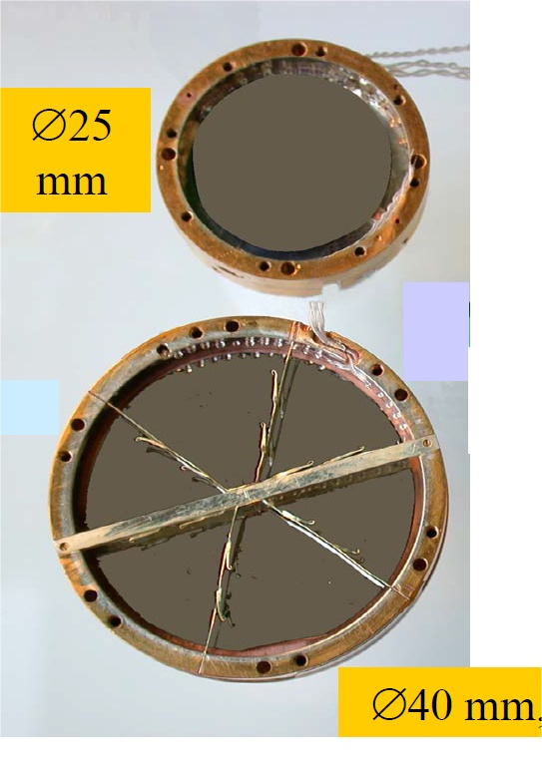
NTD BLD for Dark Matter and….
σ(E)= 20 eV
Opt. Eng. 43(7) 1568–1576 (July 2004) received Oct. 16, 2003

Slide 8
NTD: Rare event physics and……….
Nature 422, 876–878 (2003)

Slide 9
Double Beta Decay !!!!
P. De Marcillac LTD 10, Genova (2003) - Nucl. Inst. Meth 520 (2004) 159

Slide 10
Rosebud Experiment first underground measurement
Al₂O₃ + BGO crystals

Slide 11
CRESST: the “top” of the technique
σ(E) ~5 eV !!!

Slide 12
From Dark Matter to Double Beta
The work started from the observation of the flat background above the 2615 keV ²⁰⁸Tl line that was clear in the
MiBeta 20 detector (totaling 6.7 kg TeO₂) array (1997-2000). The “problem” became much more clear (and
troublesome in CUORICINO)
The amount of surface radioactivity is extremely small
0.2 c/keV/kg/y
0.003 c/cm²/day/MeV
TeO₂ 150 cm²
Best (commercial) low background surface barrierer alpha spectrometer
0.05 counts/hr/cm²
CUORE was aiming at 0.01 c/keV/kg/y
We were able to mitigate surface radioactivity
We were (are !) blind to surface radioactivity control

Slide 13
The role of the transition energy
This is a “famous” picture that was/is often show to illustrate the role of natural radioactivity. It was taken during
the commissioning of the Ultra-low background HPGe Gempi3 in 2005. M. Laubenstein was testing the “just
arrived” detector and I asked “for fun” to take a background measurement with the detector still in his (shipping)
Wood box.
Even with some caveat, it is clear
that high Q-value Nuclei are extremely
favored

Slide 14
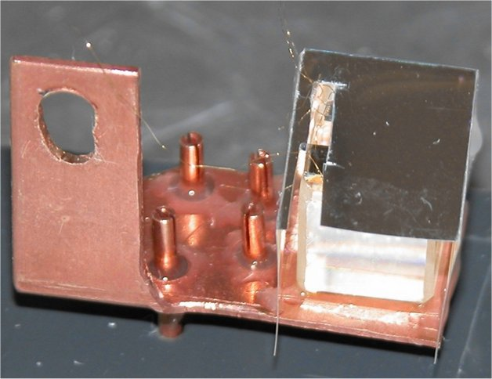
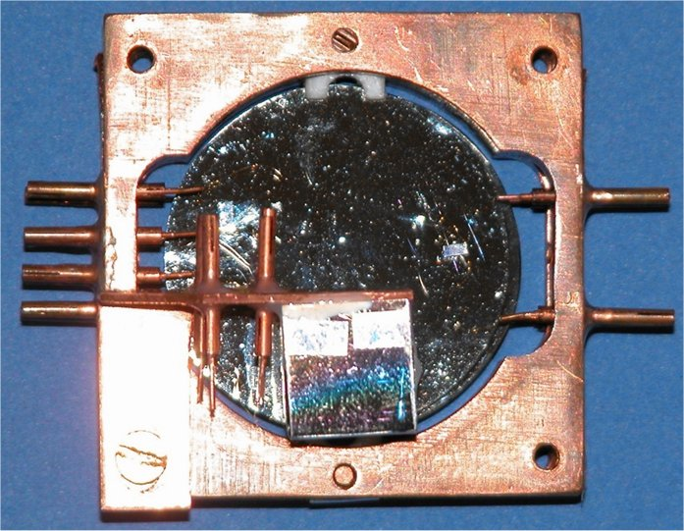
Scintillating DBD Bolometer… just for fun….
The scintillating Double Beta Decay bolometers R&D started in March 2004 (after the commissioning of
CUORICINO). The LD was originally tested as an alpha detector to by faced to TeO₂ crystals in order
o study α background. We then decided to face a very old PbMoO₄ sample towards this “former alpha detector”
And we got, immediately a very good result.
1 cm³ PbMoO₄ crystal, glued on a copper slab
1 cm³ PbMoO₄ faced to a 36 mm dia 1 mm thick Ge
with a 3x0.4x1.5 mm MiBeta thermistor

Slide 15
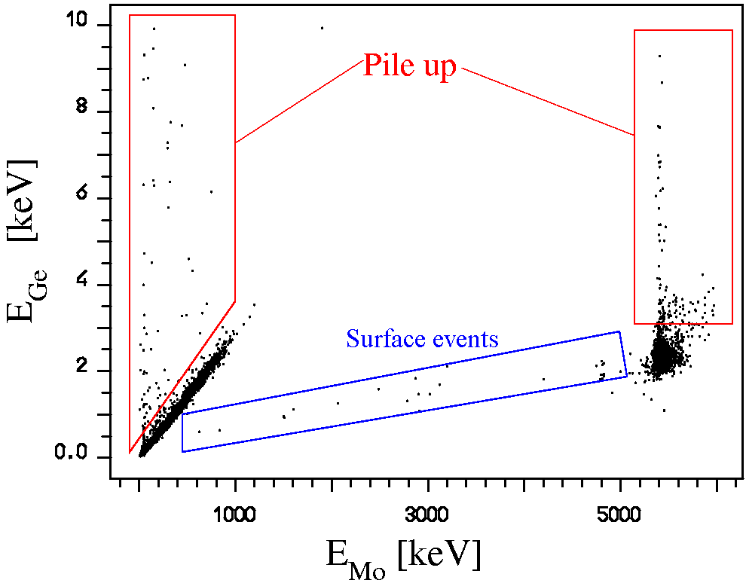

The first-ever Mo-bolometer Light-Heat scatter plot
Actually also this “first” scatter plot was never published……

Slide 16
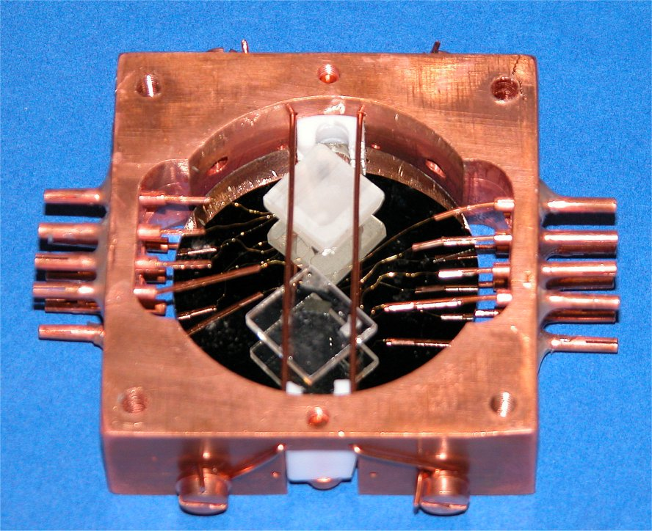
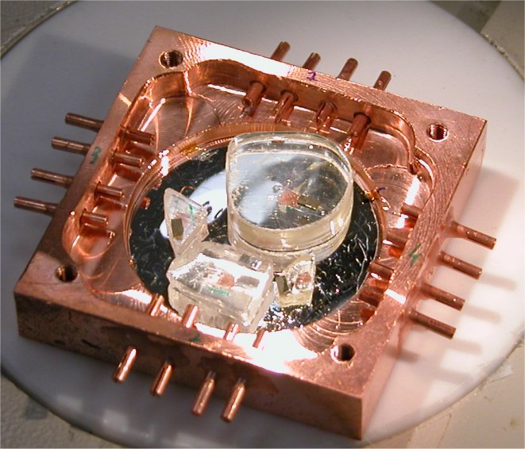
Scintillating DBD Bolometer the years of “discovery”
At the early 2000 it was not so easy to find Mo-based compounds… all the first samples were given as “gift” from
different “crystal growers”, most of them in Russia and Ukraine
May 2005
1x1x0.25 cm³ PbMoO₄
MgMoO₄
PbMoO₄
May 2004
1x1x0.2 cm³ PbWO₄
SrMoO₄
CaMoO₄

Slide 17
2005: the year of the first coming-out (1)
Proceeding of Non-Accelerator Astroparticle Physics conference, Dubna 2005

Slide 18
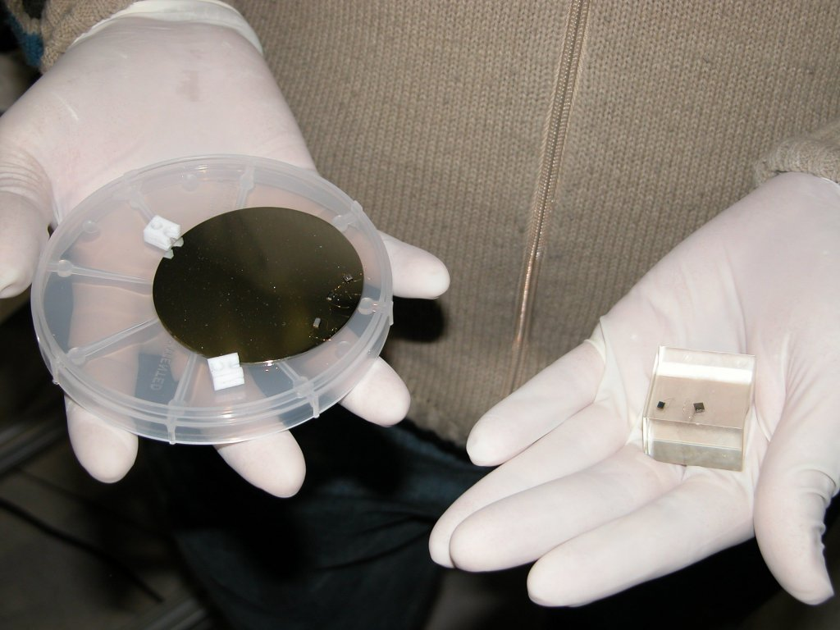
2005: the year of the first coming-out (CdWO₄)
A very impressive result was indeed obtained as a by-product.
The idea was to measure the thermal neutrons flux inside the CUORE R&D
cryostat using a CdWO₄ crystal, via the (¹¹³Cd,n)γ reaction.
6.3 cm dia 1 mm thick Ge
3x3x2 cm³ CdWO₄
(140g)
Q_{ββ}(¹¹⁶Cd)=2802 keV
Proceeding of Non-Accelerator Astroparticle Physics conference, Dubna 2005

Slide 19
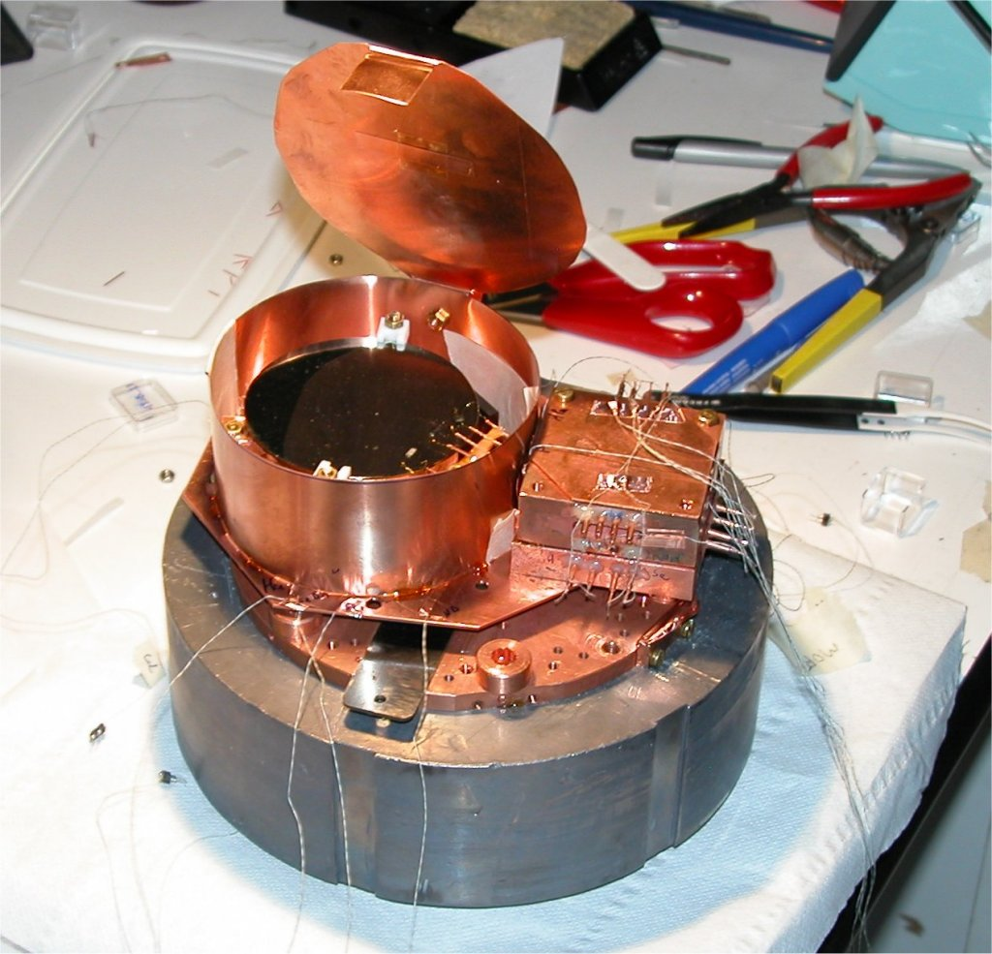
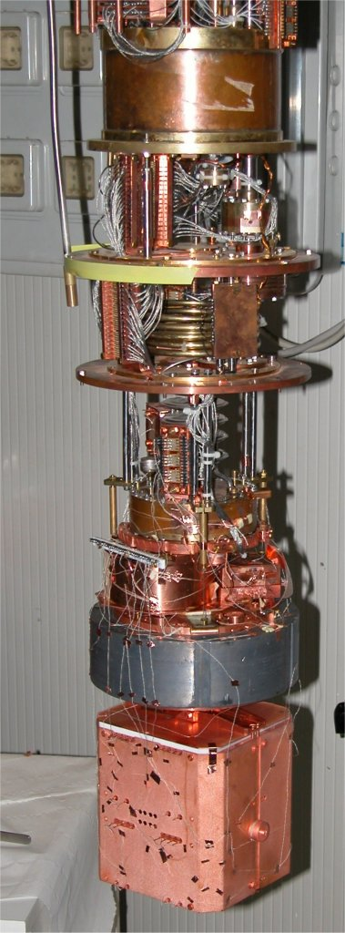
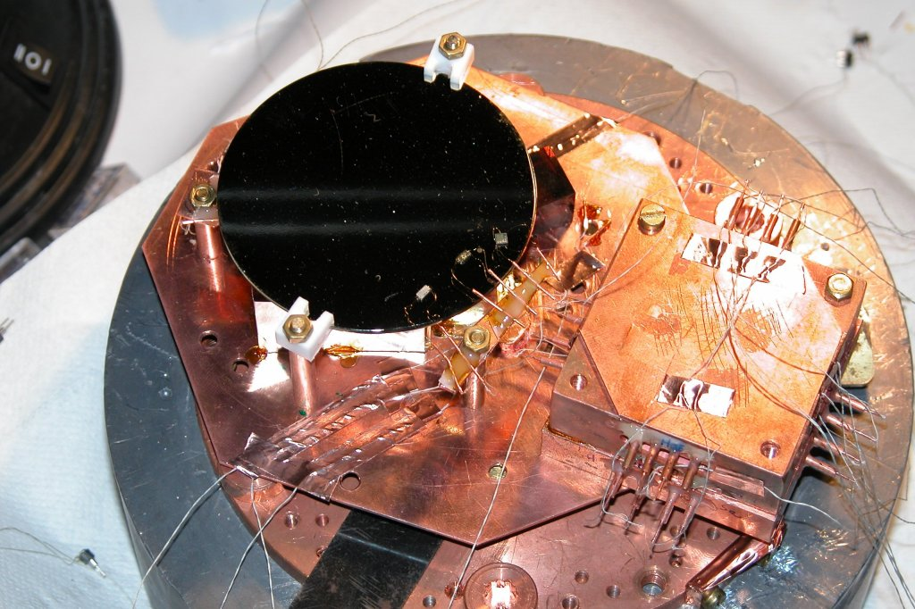
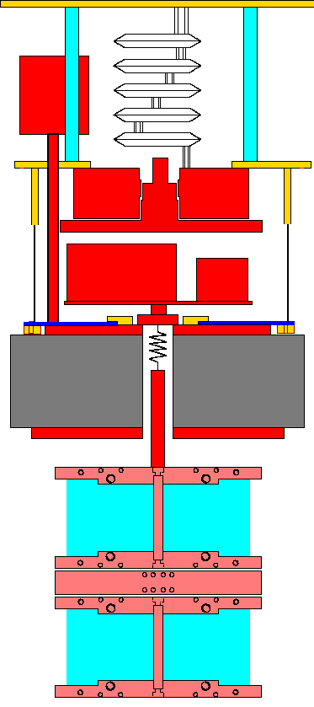
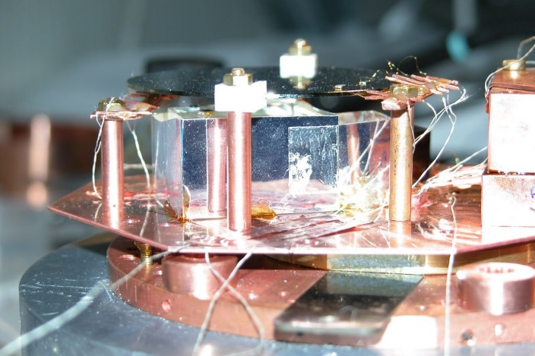
2005: the year of the first coming-out (CdWO₄)
Very “un-clean” setup”
RAD detector- Test of (surface) radioactivity
for CUORE (Gold wires- Heaters – PTFE)

Slide 20
2005: the year of the first coming-out (CdWO₄)
417 h background
This was the actual demonstration of the power of the scintillating bolometer technique for DBD

Slide 21
2005: the beginning of a story that only few knows…..
During the11th National Conference on Crystal Growth NKRK-2004 (Moskov) , Serge Nahornii
met O. Barinova and after this discussion he got a small, bad quality sample of Mo-based crystal
In 2005 he brought the crystal to LNGS and together with his PhD advisor, F. Danevich, gave me that sample

Slide 22
A titbit of history………
In 2008, after some funding from INFN for the development of BLD, I decided to apply to the ERC grant (Ideas)
to develop the technique and to perform a small demonstrator of ¹¹⁶CdWO₄
2. Quality of the proposed research project Ground-breaking nature of the research: Does the proposed research address important challenges in the field(s) addressed? Does it have suitably ambitious objectives, which go substantially beyond the current state of the art (e.g. including trans-disciplinary developments and novel or unconventional approaches)? Potential impact: Does the research open new and important scientific, technological or scholarly horizons? Methodology: Is the outlined scientific approach (including the activities to be undertaken by the individual team members) feasible? | 3,75 / 5
2. Quality of the proposed research project
The research topic that will be addressed is of high current interest as it is the only way to determine the nature of the neutrino. The combination of two bolometric methods to measure the rare events is daring and interesting but remains risky.

Slide 23
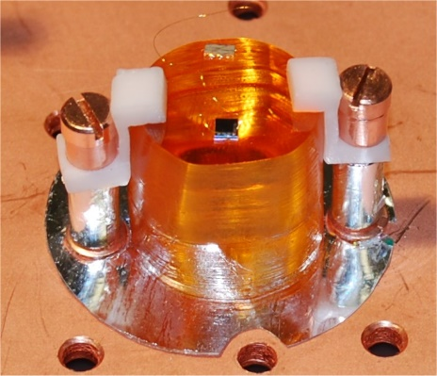
The hunt for the best candidate continues: ZnMoO₄
Particle recognition
from (only !) the heat channel

Slide 24
Particle Identification without light
With the molybdates it came out that the scintillation time will influence the heat signal giving rise to a change in the shape of
the signal
Actually the particle identification through shape is the key cut for CUPID-0

Slide 25

2010-2012: the boost of LUCIFER and Lumineu
A boost arise from
Lucifer ERC Grant (F. Ferroni) (2010-2015)
Lumineu (A.Giuliani) (2012-2017)

Slide 26






Lucifer
LUCIFER Low-background Underground Cryogenics Installation For Elusive Rates
isotope: ⁸²Se , ¹⁰⁰Mo , ¹¹⁶Cd
material: ZnSe , ZnMoO₄ , CdWO₄
technique: scintillating bolmeter
https://web.infn.it/lucifer/
The Lucifer ERC Grant (2010-2015) was dedicated to R&D to be finalized in one enriched
Demonstrator made of enriched scintillating crystals in the order of few kg of enriched material.
During the R&D several crystals containing ⁸²Se , ¹⁰⁰Mo , ¹¹⁶Cd were tested and also the tiny
Cherenkov light from a (non scintillating) TeO₂ was measured.

Slide 27
Lucifer
LUCIFER Low-background Underground Cryogenics Installation For Elusive Rates
Choice induced by non availability on
the market (2012) of ¹⁰⁰Mo and ¹¹⁶Cd
isotope: ⁸²Se , ¹⁰⁰Mo , ¹¹⁶Cd
material: ZnSe , ZnMoO₄ , CdWO₄
technique: scintillating bolmeter
JW Beeman et al, Ad. in High Energy Phys. 2013, Article ID 237973
From 2016 this activity is funded by INFN under the INFN-CUPID Project. For this reason,
LUCIFER is called now CUPID-0, the first demonstrator in view of CUPID.

Slide 28
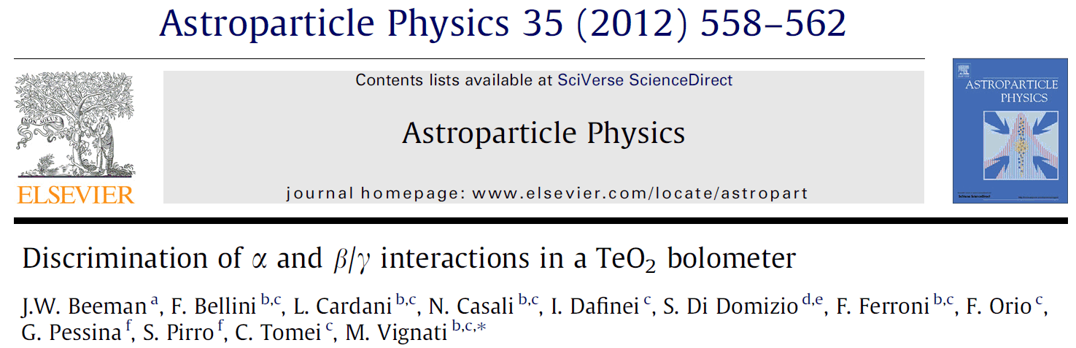
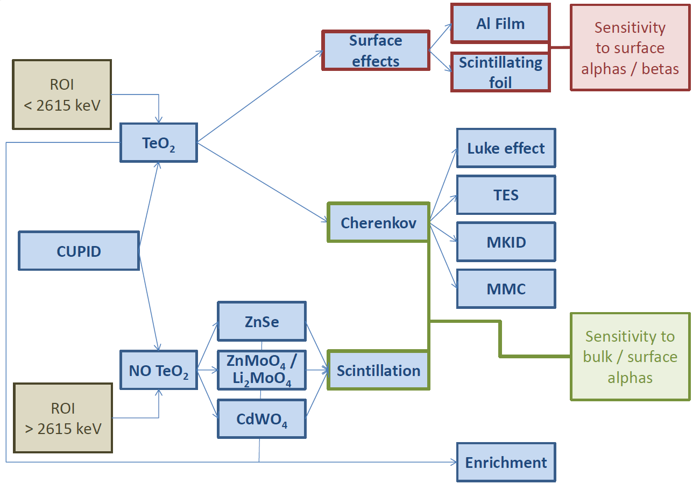
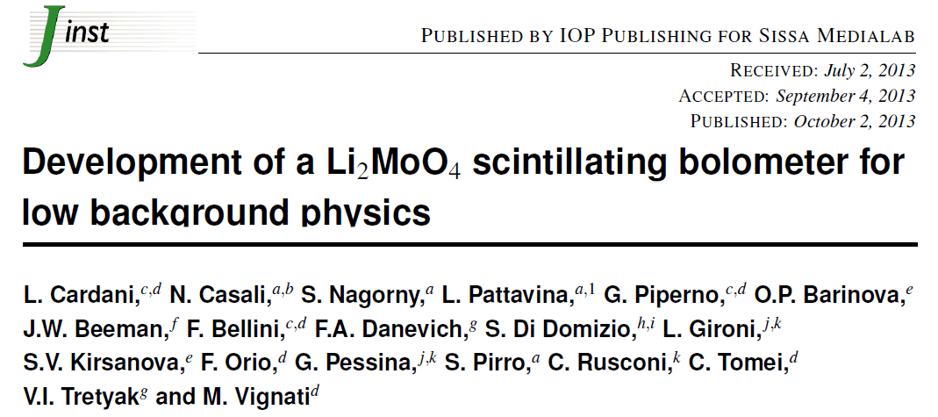
Lucifer – The forerunner of CUPID: Te and Mo
CUORE Upgrade with Particle IDentification
R&D towards CUPID: arXiv:1504.03612 CUPID : arXiv:1504.03599

Slide 29
Lumineu (2012-2017)
The Lumineu project was (originally) aiming to the development of enriched Zn¹⁰⁰MoO₄ crystals
Then “turn” to Li₂MoO₄ due to several problems in the ZnMoO₄ crystal growth

Slide 30
Lumineu to CUPID-Mo
Li₂MoO₄ became a mature technology in very short time

Slide 31
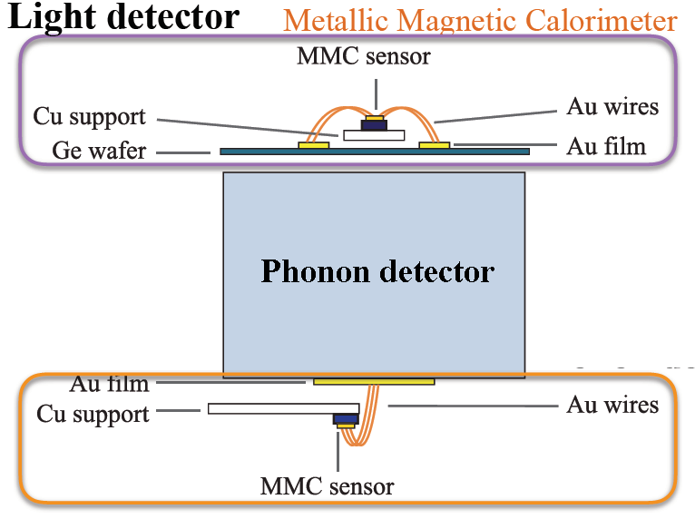
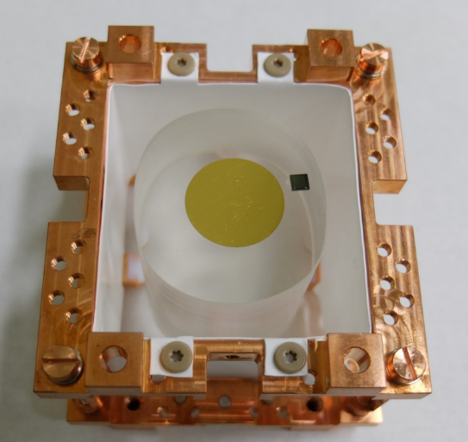
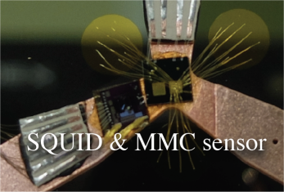
Scintillating Bolometers: AMORE ¹⁰⁰Mo
Micro Magnetic Calorimeter detectors, Heat & Ligtht detector
The collaboration is deciding which
type of crystal Li₂MoO4 CaMoO₄
PbMoO₄ ….

Slide 32
Some important points….

Slide 33
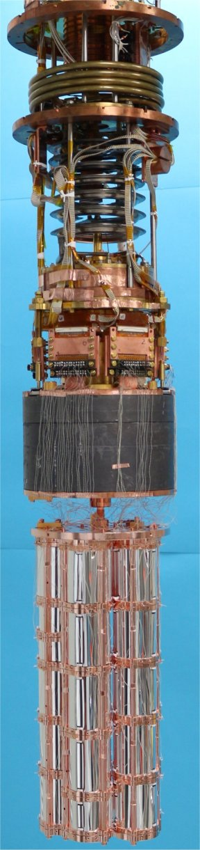
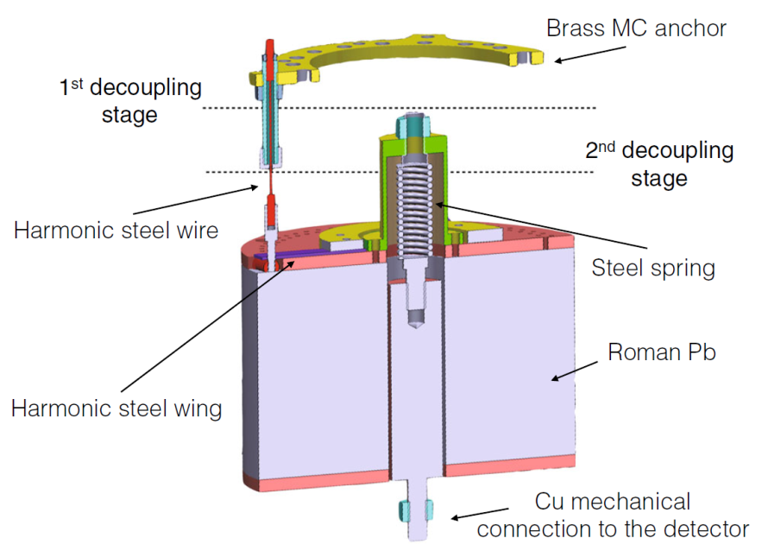
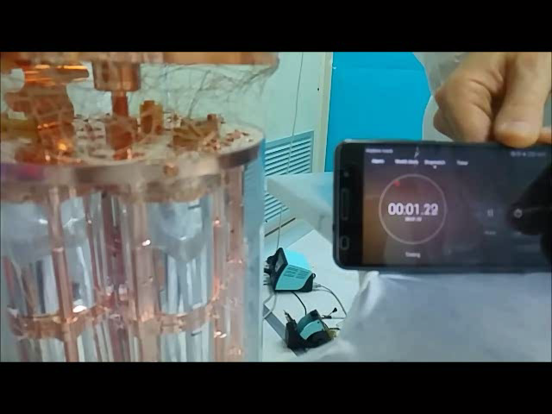
The CUPID-0 “secret”
600 mK
50 mK
³He - ⁴He MC
More videos @ https://cupid-0.lngs.infn.it
Roman Lead 10 cm
CUPID-0: the first array of enriched scintillating bolometers for 0νββ decay investigations
A. Azzolini et al. , Eur. Phys. J. C (2018) 78:428 (https://arxiv.org/abs/1802.06562)
CUPID-0
5 tower, 26 ZnSe

Slide 34
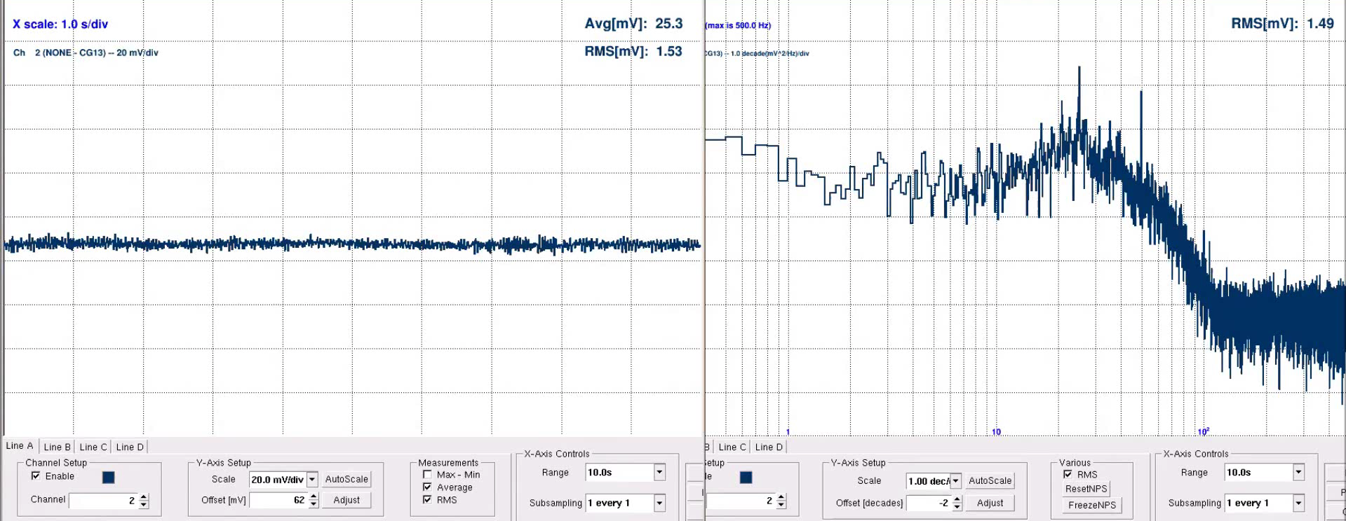
Microphonic noise with resistive NTD

