Slide 1


MICROCHAnNEL COOLING
Prospectives IN2P3 – GT08
24 January 2020
M. Bomben
G. Calderini
P. Delebecque
S. Jezequel
J. Leveque
S. Beurthey
J. Cogan
G. Hallewell
O. Leroy
M. Perrin-Terrin

Slide 2
OUTLINE
Thermal management problematic for pixel sensor
Cooling with Si microchannel
Silicon microchannel cooling applications
Aida 2020 ongoing developments
Silicon microchanel cooling optimization @IN2P3
Prospectives IN2P3 - GT08 - 24 January 2020

Slide 3
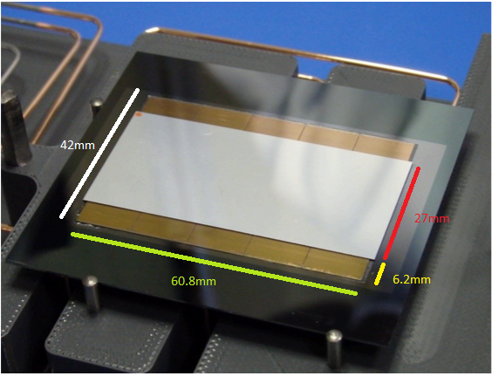
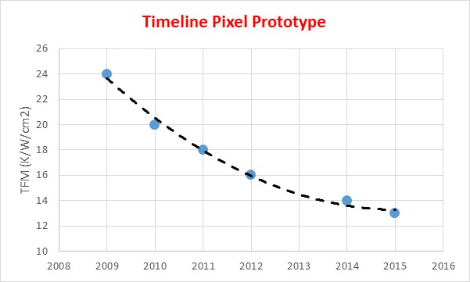
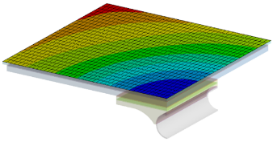

Thermal management problematic for pixel sensor
Future pixel sensors will require more and more cooling
Active elctronic consumption
Thermal management issues
  Lifespan > 10 years - Availability and reliability : 7/7
  High magnetic field – High radiation
  Material must be minimal
  Sensor T<<0°C
  Coolant T cannot be lowered at will : low TFM
LHCb : 0.5 W/cm²
LHCb upgrade I (2021) or ITK : ~2 W/cm²
NA62 – GTK sensor
LHCb upgrade II (2034) : ~ 3 - 5 W/cm² (estimation)
Micro/nano technologies progress
Etching size reduction
T_{sensor}
T_{fluide}
Consumption reduction
TFM=$\frac{(Tsensor− Tfluide)}{Surface power density}$
Densification
Time resolved pixel
Current Trend
P= 2W/cm² & T_{fluide} = -35 °C
→ T_{sensor} > - 9°C
Consumption increase
TFM for Conductive cooling
E. Anderssen et al., Advanced Materials and Tools Research, Forum on Tracking Detector Mechanics 2015 (Amsterdam, NL): https://indico.cern.ch/event/363327/contribution/34

Slide 4
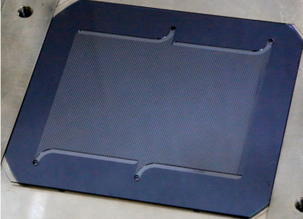
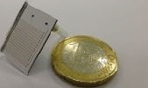
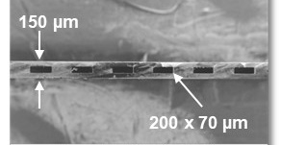
cooling with Si microchannel
μ-fluidics (microchannel) device as heat exchanger for thermal management of heat source
inlets and distribution manifolds (1.6 x 0.28 mm)
Equivalent Diameter < 1 mm
Single or dual (boiling) phase flow
Microchannel etched on Si wafer
Silicon wafer
outlets
2 independent networks of 75 µchannels
Microchannel on NA62-GTK
Etching (DRIE)
Locally distributed cooling
Large thermal exchange surface
Minimal path of thermal resistances
Low X₀
Temperature Homogeneity
Radiation hard
Compatible with “HEP fluids”
No CTE mismatch with Si
Minimizing TFM
Si-Si direct bonding (1200°C-200b)
Thinning
Typically TFM for Si cold plate circulating boiling CO₂ is lower than 3 K.cm²/W
Prospectives IN2P3 - GT08 - 24 January 2020

Slide 5
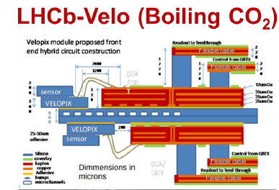
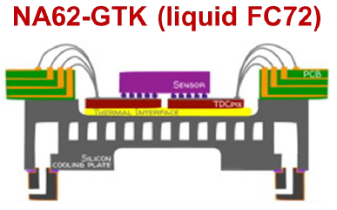
Si microchannel cooling applications
(Liquid C6F14)
Chanel restriction (LHCb-Velo)
Advantage
Low TFM (~3Kcm²/W)
Minimum material budget: very thin coldplate (250-500μm)
No CTE mismatch with Si sensor
Channel failure has little impact on cooling
Channel defects
Drawback:
  Expensive process (>120 steps)
  Size limitation
  Few competent subcontactors
  Direct bonding difficult
  Bad prod. Output
  Simulation not enough predictive
No defect
Silicon microchannel production on LHCb
Prospectives IN2P3 - GT08 - 24 January 2020

Slide 6
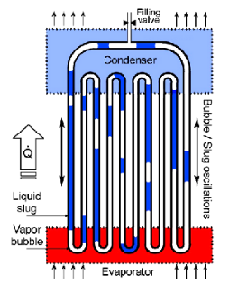
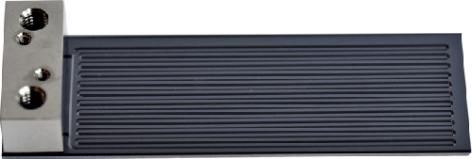
Aida 2020 Ongoing development
Alternative process
Condenser
Evaporator
60 mm
Micro oscillating heat pipe: « caloduc »
No pump
Self-contained and self-actuated.
Eliminate connectors
Ti 3D printing
  Low mass
  Cheap
  Easy to integrate
Carbon microvascular
  Ultralight
  Can be very long
Céramic 3D printing
  Lighter than metal
  Flexibility
  CTE compatible
Microchannel back to sensor
  CMOS Compatible
  Silicon advantage
  No bonding
Prospectives IN2P3 - GT08 - 24 January 2020

Slide 7
Silicon microchanel cooling optimization @IN2P3
Objectives
  Cost reduction
  Design optimization
→ Kaizen approach instead of technological breakthrough
  Process optimization
    Laser etching & cutting
    Direct bonding replaced by anodic bonding coated glass
  Optimization of the connections
    Anodic bonding
    Serialization of cooling plates
  Design optimization
    Predictive Simulation
    Caraterisation : heat engineering
Inexpensive, flexible
and fast process
TFM optimization
Material optimization
Fast design

Slide 8
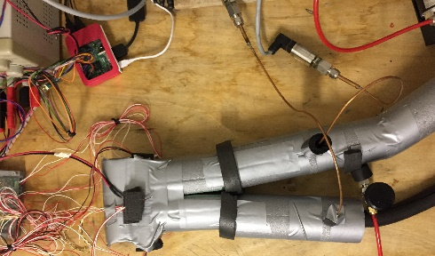
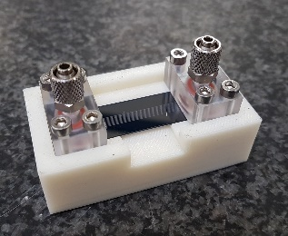
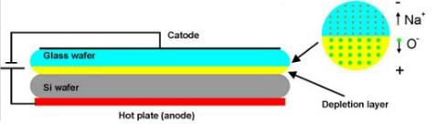
Silicon microchanel cooling optimization @CPPM
Process optimization :
  Laser etching
  Anodic bonding Si wafer coated (electron beam) with 5μm of glass
Low cost for a prototype (<1k€)
Fast prototyping and optimization
Adapted to SiC
Complementary to chemical etching
Tests in progress
5cm
Low cost (<1k€)
Fast production
Mature technology
Bonding can be done at home
Possibility to do complex structure
Glass deposition
Wafer Si
Thin layer of glass (5μm)
Pressure tests 06/2020
Etching (DRIE)
Anodic Bonding
Thining
4 inch wafer with a thickness of 500 μm
Prospectives IN2P3 - GT08 - 24 January 2020

Slide 9
Silicon microchanel cooling optimization @CPPM
Process optimization possibilties:
  Anodic bonding of connector on cooling plate
  Anodic bonding of sensor/electronic on cooling plate
  In chip 3D etching
→ Cost & time saving
Call for tender
in September
→ Time & material saving
Thesis in co-tutuelle?
O. Tokel & Al - In-chip microstructures and photonic devices fabricated by nonlinear laser lithography deep inside silicon
Nat. Photon. VOL 11 | OCTOBER 2017 | 639–645 |
Onur et al., In chip microstructures and photonics devices fabricated by nonlinear laser lithography deep inside silicon. Nat Photon 11, 639-645 (2017)
Prospectives IN2P3 - GT08 - 24 January 2020

Slide 10
LAPP EXPERIENCE from CO2 COOLING OF FUTURE ATLAS PIXEL
Metallic tube of 2-3 mm diameter
New parametrisation of CO2 heat exchange in High Heat Flux regime
Prospectives IN2P3 - GT08 - 24 January 2020

Slide 11
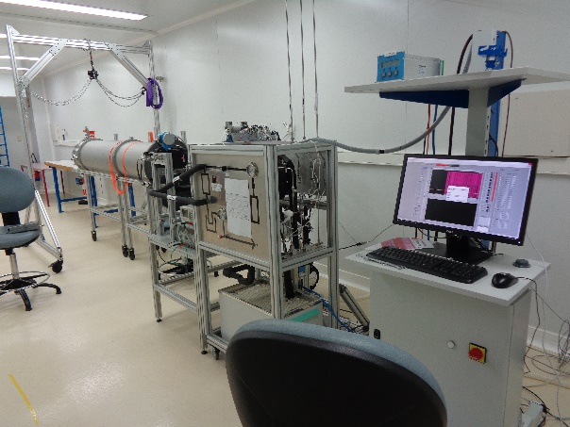
LAPP CONTRIBUTION FOR MICROCHANELS DEVELOPMENTS
Thermo-fluidic di-phasic CO2 simulation
Prototype measurement
Current studies : 3D thermal models + 1D fluid models
New studies : 3D thermo-fluidic models (ANSYS FLUENT)
1- Validate the simulation with Pierre Barroca data
2- Perform simulation + mesurements for critical parameters (roughness, …)
3D simulations seems pretty difficult to manage
Expertise from OPTIFLUIDES company (https://www.optifluides.net/)
Publications :
New insights on boiling carbon dioxide flow in mini- and micro-channels for optimal silicon detector cooling
DEPFET pixel detector for future e-e+ experiments
Prospectives IN2P3 - GT08 - 24 January 2020

Slide 12

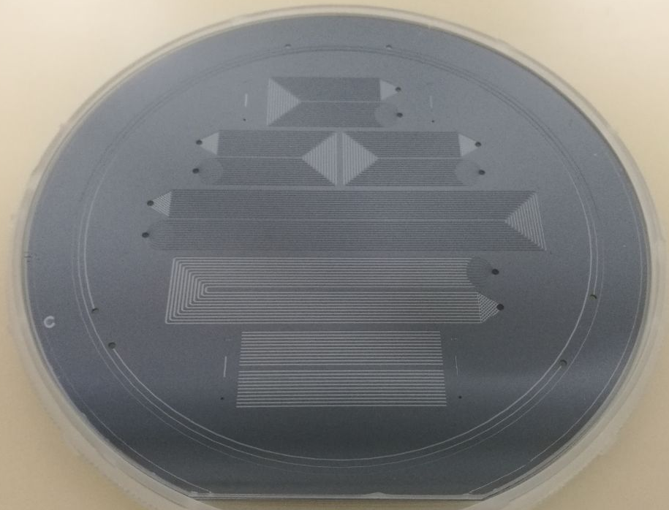

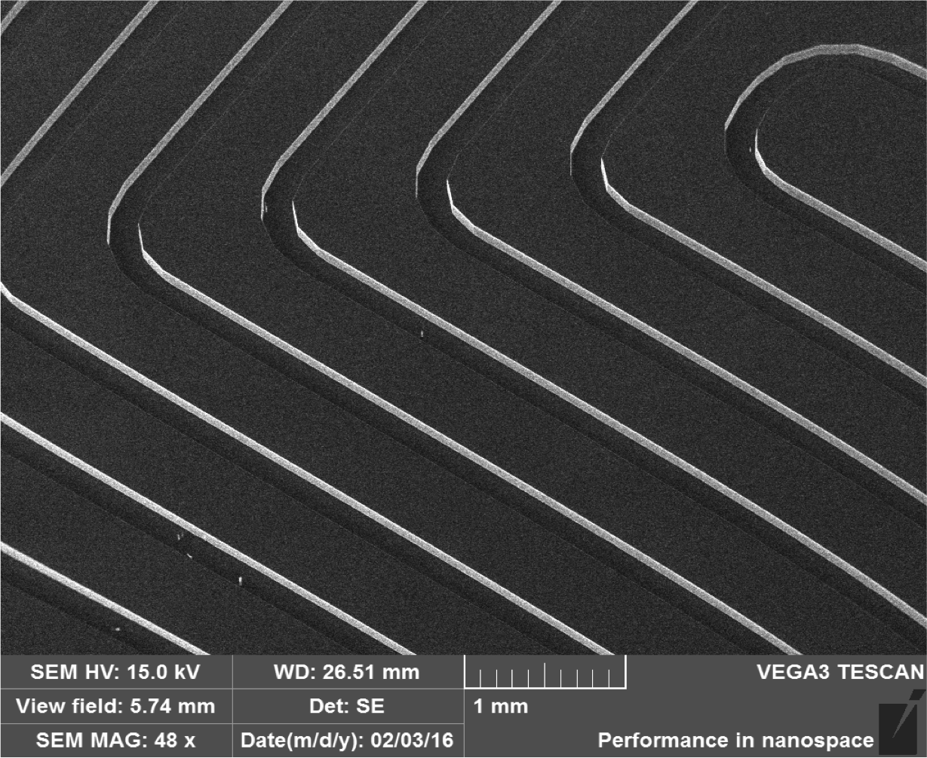
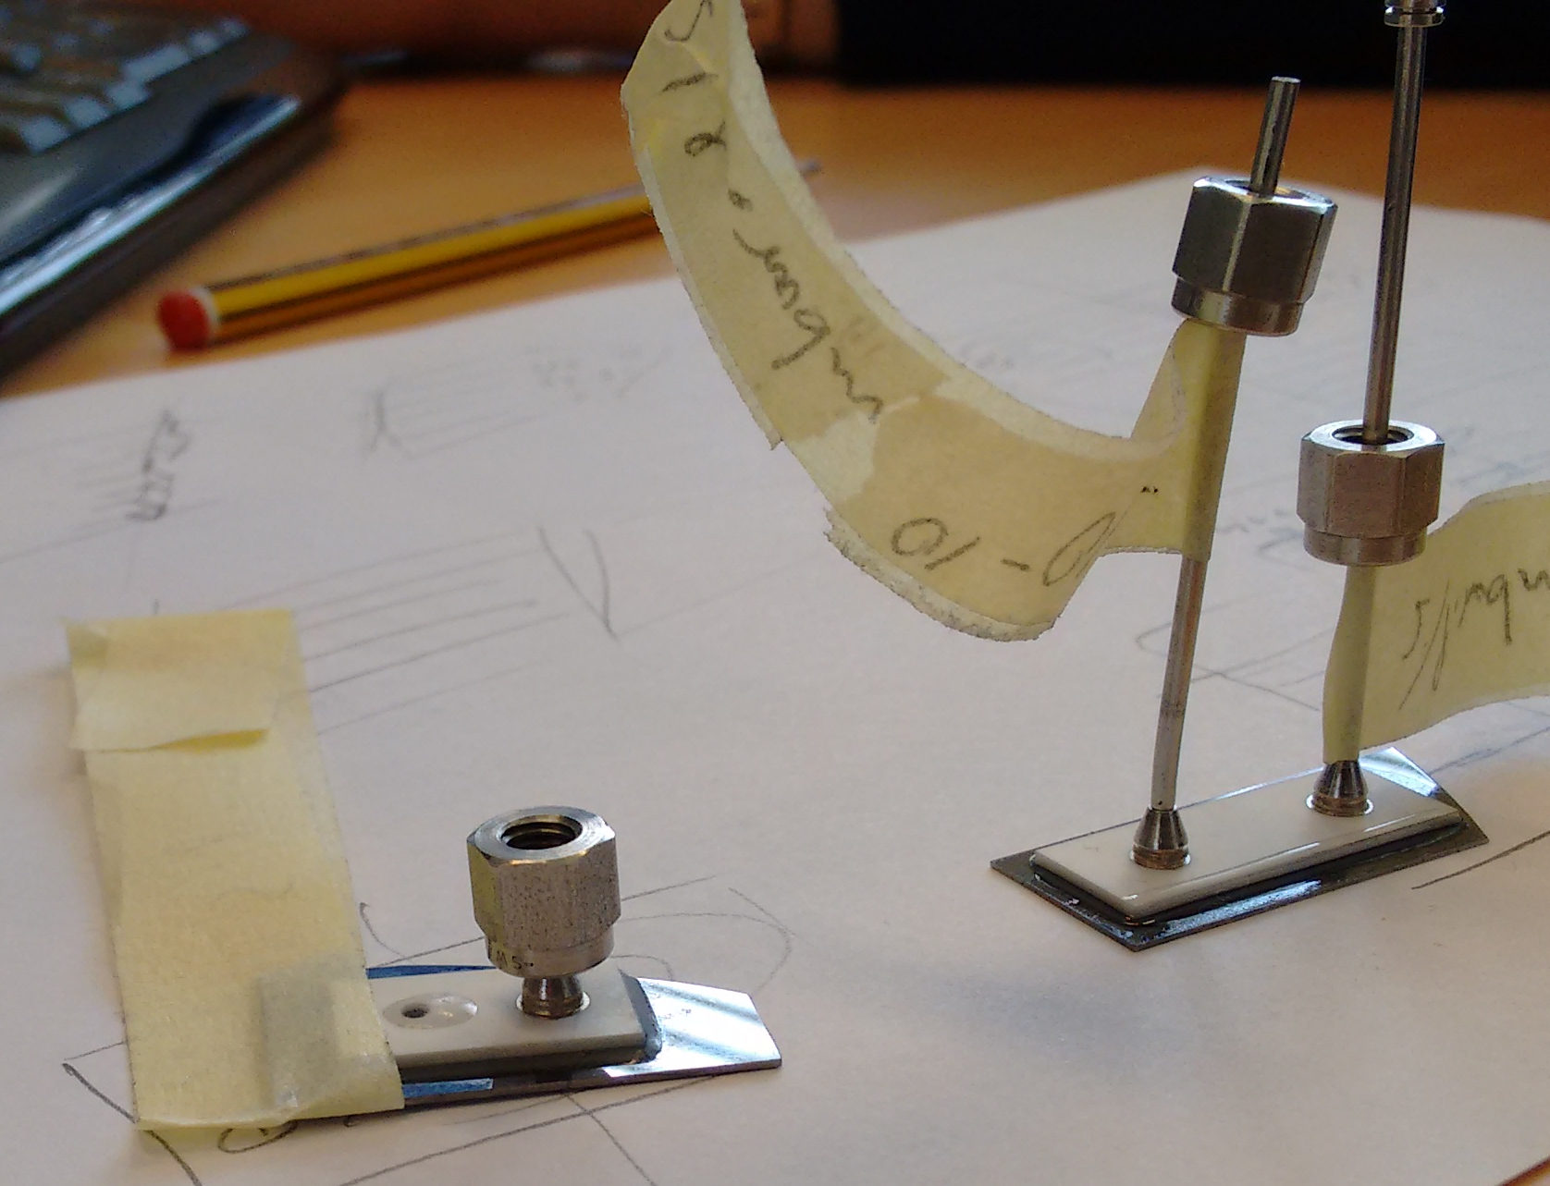
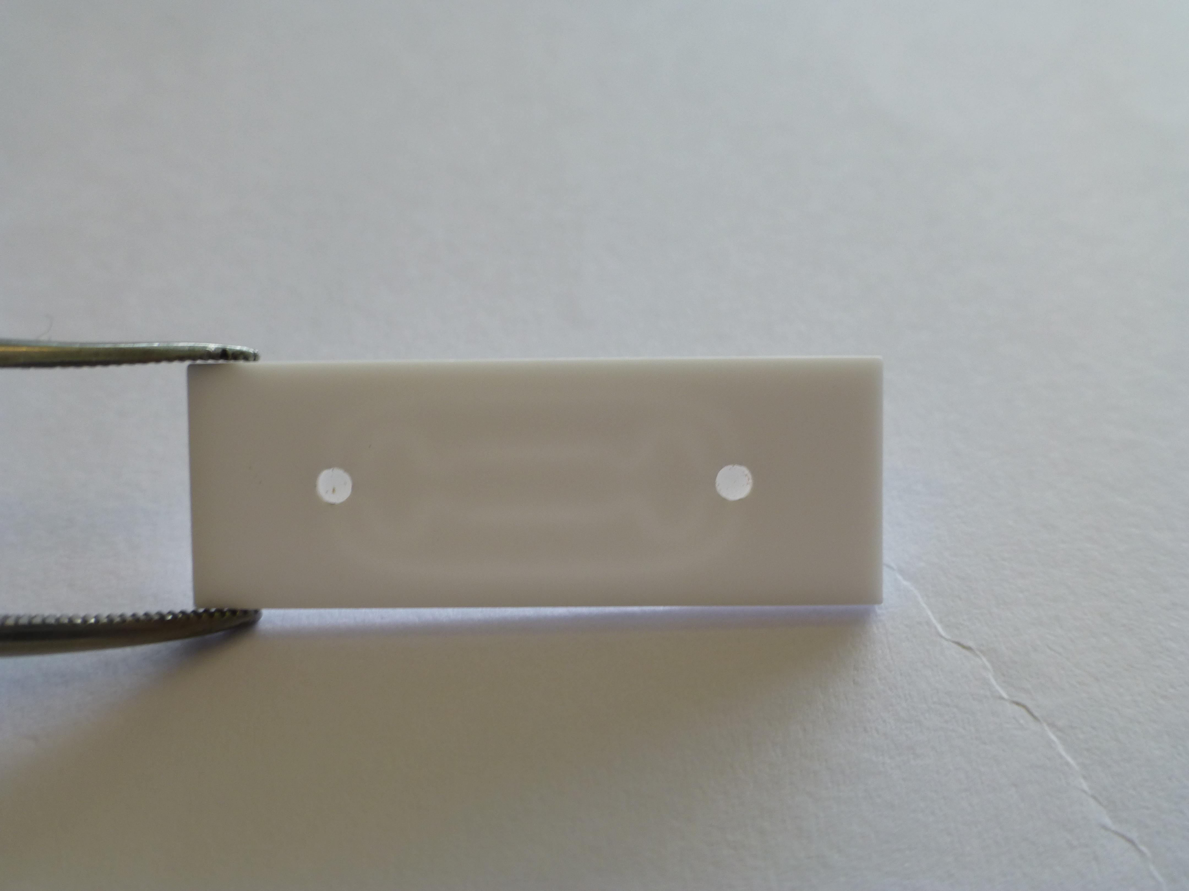
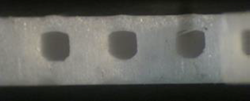
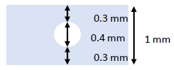


LPNHE Experience from CO2 COOLING OF FUTURE ATLAS PIXEL
* PI: M. Bomben
Thanks to Reflecs* & Reflecs2* proj. (CNRS-Defi instr. 2014&15) it was possible to:
Realize prototypes of µ-channels etched in silicon and sealed with pyrex
Connectors in 3D-printed ceramic:
D. Hellenschmidt, M. Bomben, G. Calderini et al.
Nucl. Instrum. Meth. (2019) 162535.
CO₂ boiling enhanced
at restrictions
6”
Round single channel to
study 2-phase fluid at high-pressure
(50-100 bar) in micro-channels: valuable data to improve simulations
Ceramic conn.
Silicon µ-chann’s

Slide 13

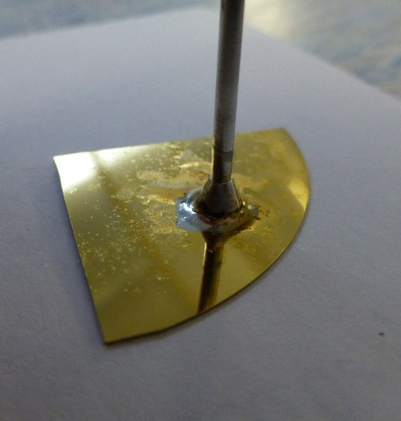
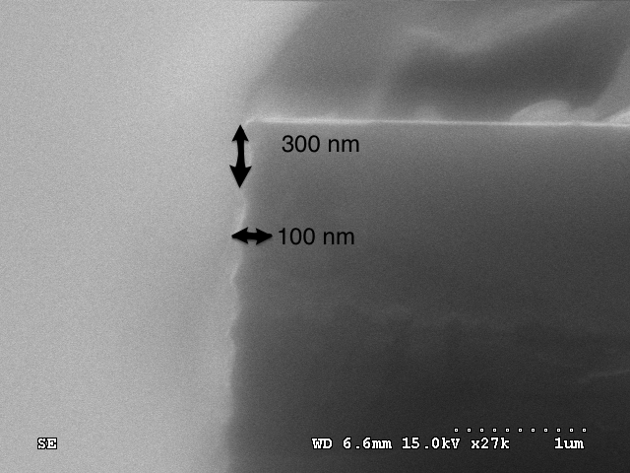
LPNHE CONTRIBUTION FOR MICROCHANELS DEVELOPMENTS
New production being prepared at C2N (Saclay)
  Test of different walls rugosity to see the influence on boiling
Continue prototype testing – e.g soldering
More work on connectivity among building block samples
Pressure test → no leak until 600 bar
Leak test with Helium: taux de fuite: 9x10⁻¹⁰ mbar l/s
“Rallonges” to be inserted somehow between one inlet unit and one outlet one
Using existing ceramic connectors?
To be continued...
Prospectives IN2P3 - GT08 - 24 January 2020

Slide 14
Conclusions
Strong interest in microchannel cooling for tracker detectors :
  NA62 GTK wishes to use microchannels by anodic bonding in 2021.
  R&D for LHCb-upgrade II vertex detector - Contribution to framework TDR in 2021 ?
  FCC, BELLE, AIDA++ …
We can play a major role in the development of microchannel if we intensify our efforts
Complementary skills on :
  LAPP: simulation, tests
  CPPM: process
  LPNHE: connectors, tests
Industrial transfer potential (computers, biology, space, microreactors, etc.)
Prospectives IN2P3 - GT08 - 24 January 2020

