Slide 1
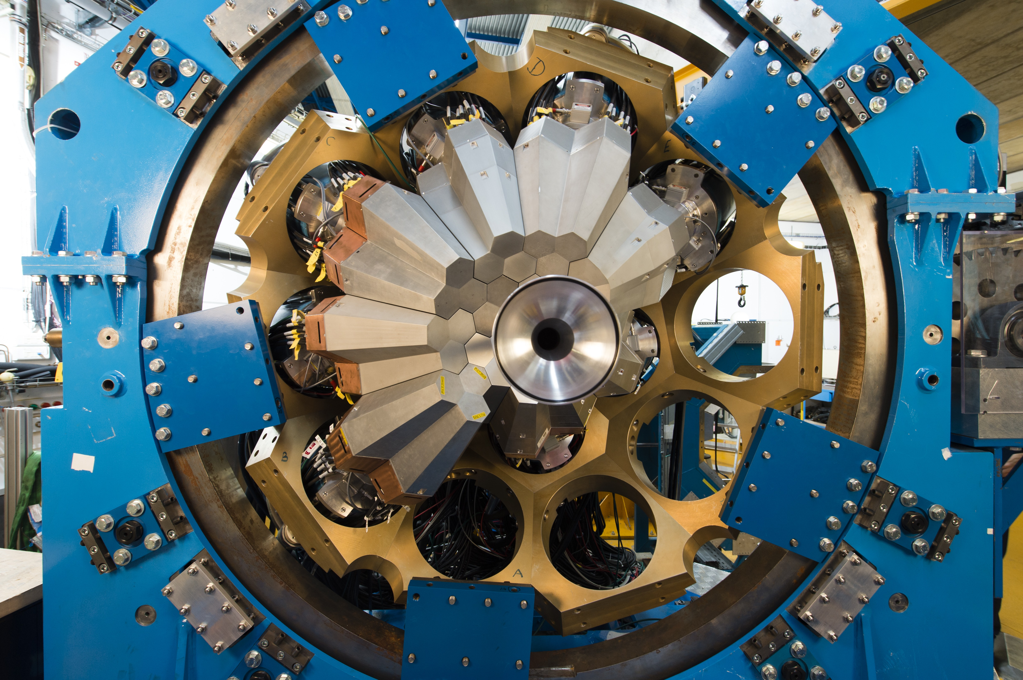
R&D for AGATA
What is AGATA ?
AGATA detectors
AGATA instrumentation
Conclusion & perspectives
G. Duchêne, J. Dudouet, N. Karkour, A. Korichi, E. Legay, A. Lopez-Martens and the AGATA-France collaboration

Slide 2


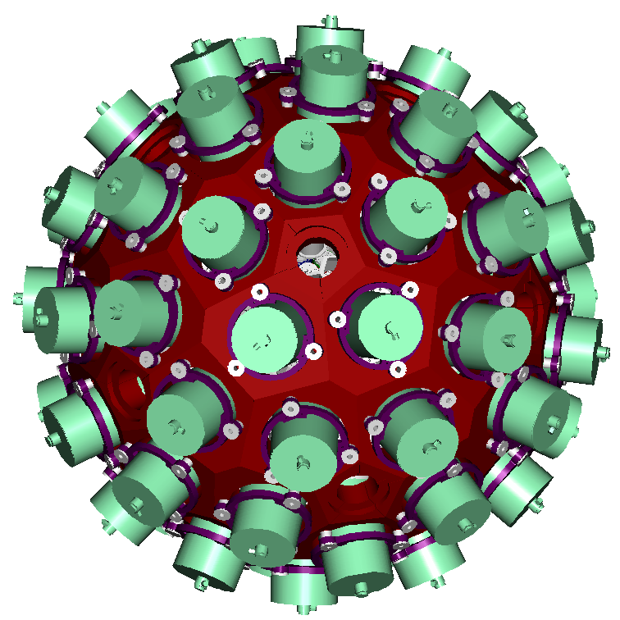











AGATA project
http://www.agata.org
http://agata.in2p3.fr
180 segmented crystals (60 triple clusters)
362 kg of Ge
82 % solid angle
50 kHz Ge crystal counting rate
Energy resolution & range: ~0.2%, 5 keV-180 MeV
Angular resolution : ~1º
Efficiency: 35 % (M_{γ}=1) , 20% (M _{γ} =30)
Pic/Total: 50%(M_{γ}=1), 40% (M_{γ}=30)
Mobile detector
Large inner radius to accommodate ancillary devices

Slide 3
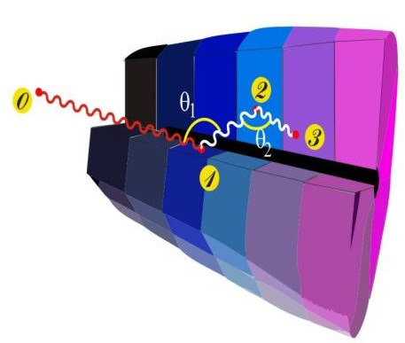
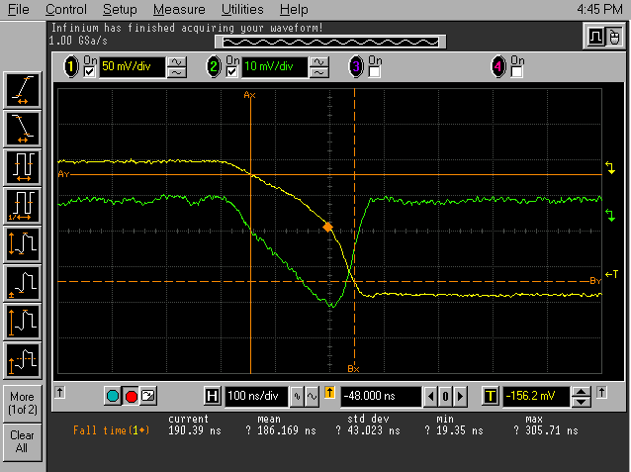
Tracking ingredients
5 MB/s/detector
4
900 MB/s
1
36-fold segmented +
HPGe detectors
Identified interaction points
Reconstruction of photon trajectories by tracking algorithms
(x,y,z,E,t)_{i}
Current on-line PSA limit:
4-5 kHz/detector
Pulse Shape Analysis
to decompose
recorded waves
3
2
380 MB/s/detector
<100 MB/s
100 MHz, 14 bit sampling of segment and central contact signals
50 kHz event rate/detector
100-sample traces/segment
200 MB/s/segment
reconstructed -ray energies,
emission & scattering directions
Notes:
AGATA fonctionne avec un higher level trigger- car limitation actuelle du PSA online à 5kHz
Improvement of algorithm, machine learning and balancing & distribution of PSA resources by a high-flux daq

Slide 4
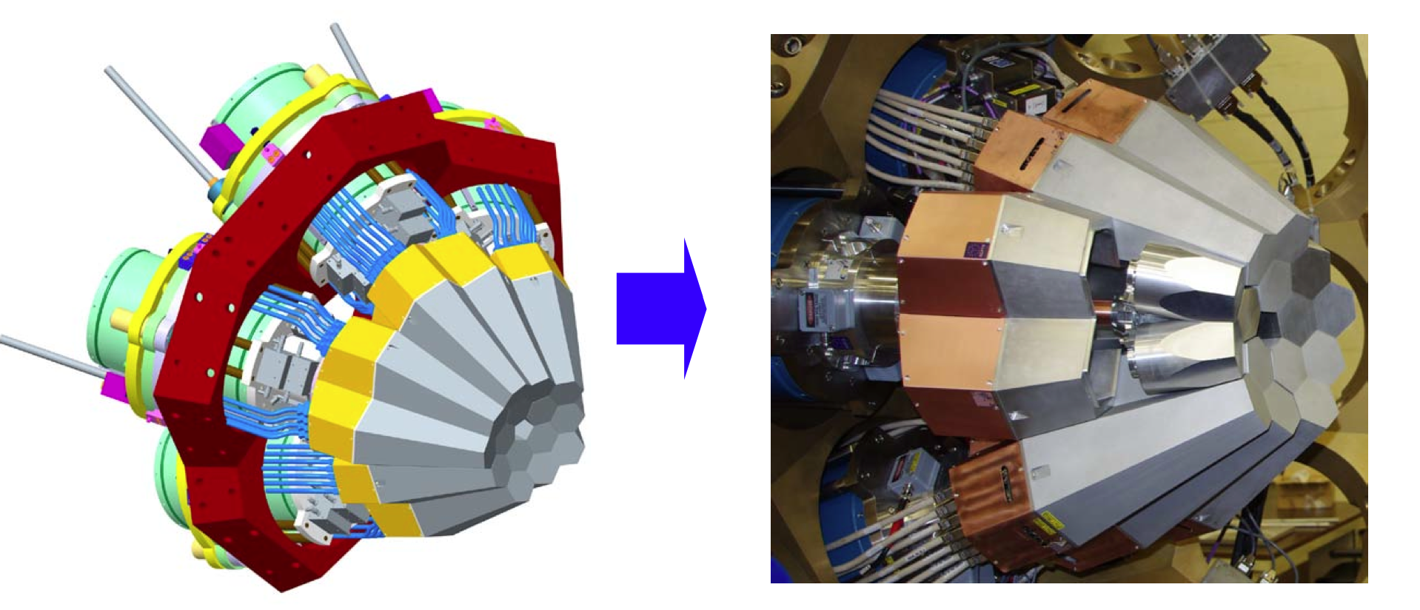
Phase 0 (2003-2008) : Demonstration
5 triple clusters , online PSA & tracking, in-beam commissioning at Legnaro
Agata Technical Design Report (2008, http://npg.dl.ac.uk/agata_acc/publications_documentation/TDR_EUJRA.pdf)
AGATA – Advanced GAmma Tracking Array: S. Akkoyun et al., Nucl. Instr. Meth. A 668 (2012) 26–58

Slide 5

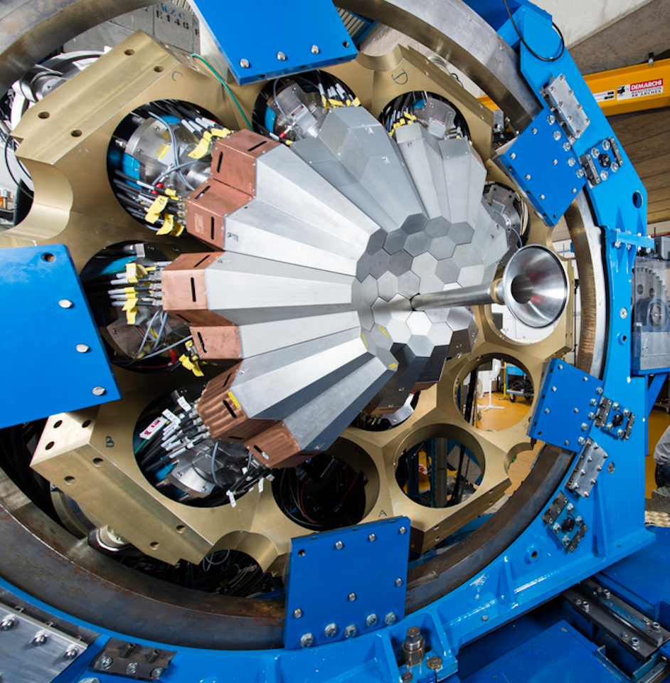
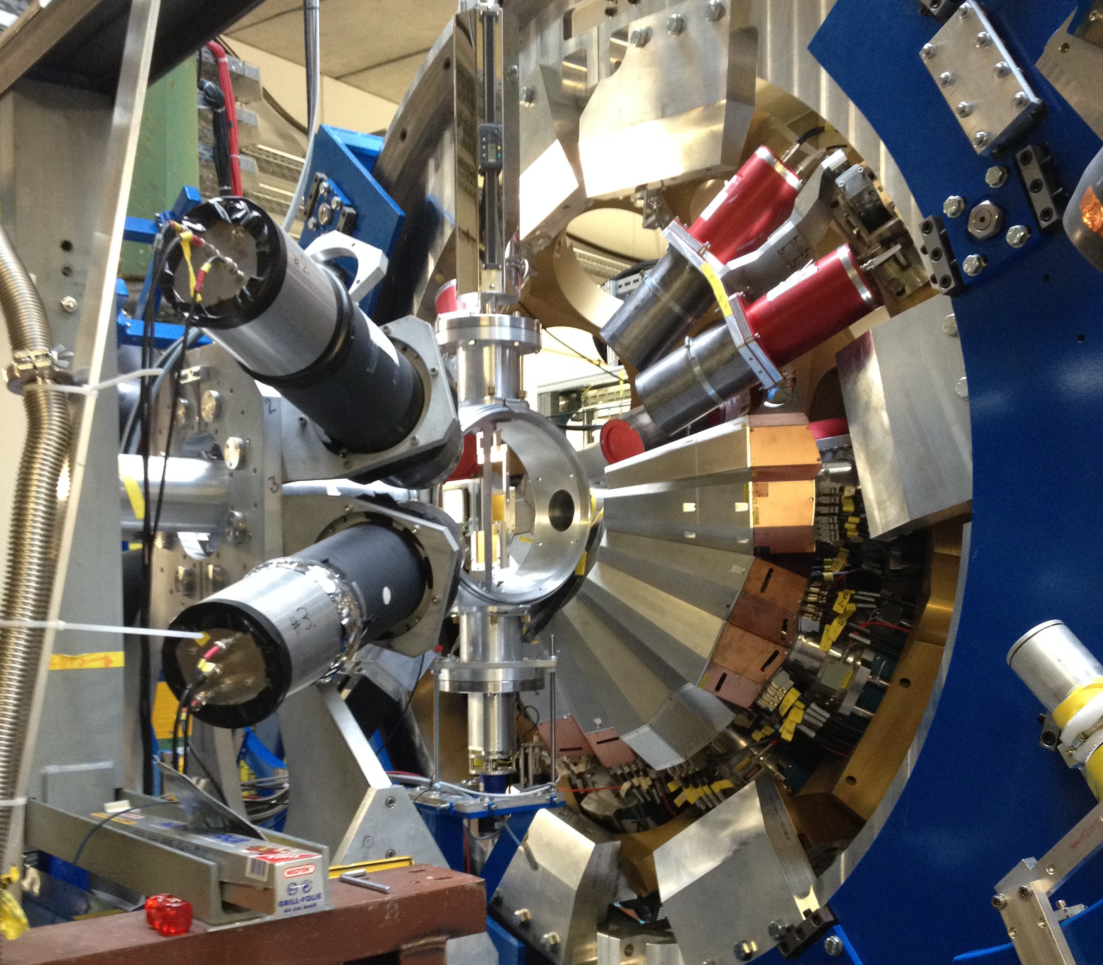

Construction Phase 1 (2009-2020): from 3 to 20 triple clusters
45 detectors
GANIL
Coupled to VAMOS,
NEDA/N-Wall, DIAMANT, FATIMA, PARIS, MUGAST
22 detectors
15 detectors
GSI
Fast radioactive beams coupled to Lycca
LNL
Coupled to the magnetic spectrometer PRISMA
LNL 2010-2011
GSI 2012-2014
GANIL 2015-2021
~60 weeks of beam on target, 57 scientific and 40 technical papers since 2010

Slide 6
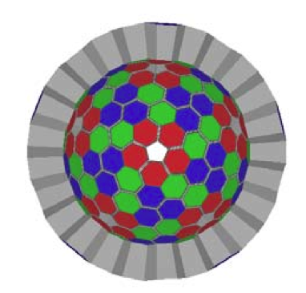
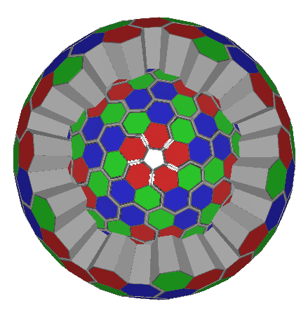
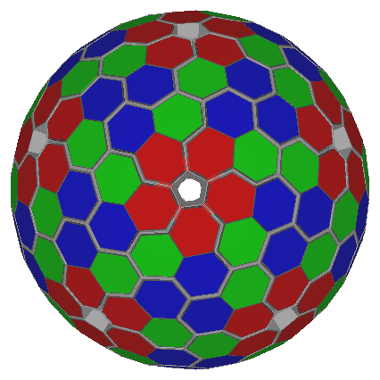
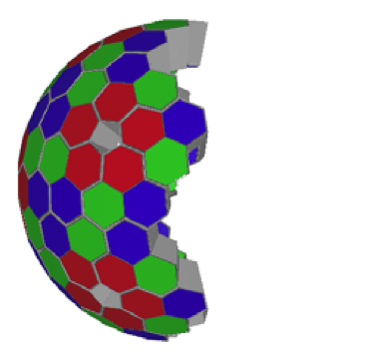
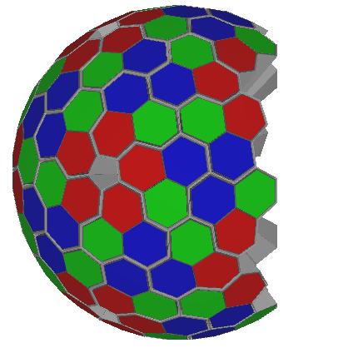
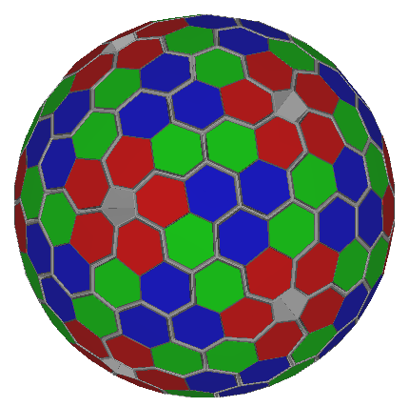
Phase 2 : from 20 to 60 triple clusters
New Technical Design Report & White Book (submitted to Eur. Phys. J. A)
2π
3π
4π
Stable beams & accelerated ISOL beams
Radioactive ion beams
(projectile fragmentation & fission)
Stable beams & accelerated ISOL beams
LNL 2022-2025
FAIR/ISOLDE 2026-2028 ?
JYFL/GANIL 2029-2030 ?
Notes:
Procurement of 12 capsules/y -> 3pi at the end of GSI, 4 pi at the end of JYFL (other labs: ISOLDE & GANIL)

Slide 7
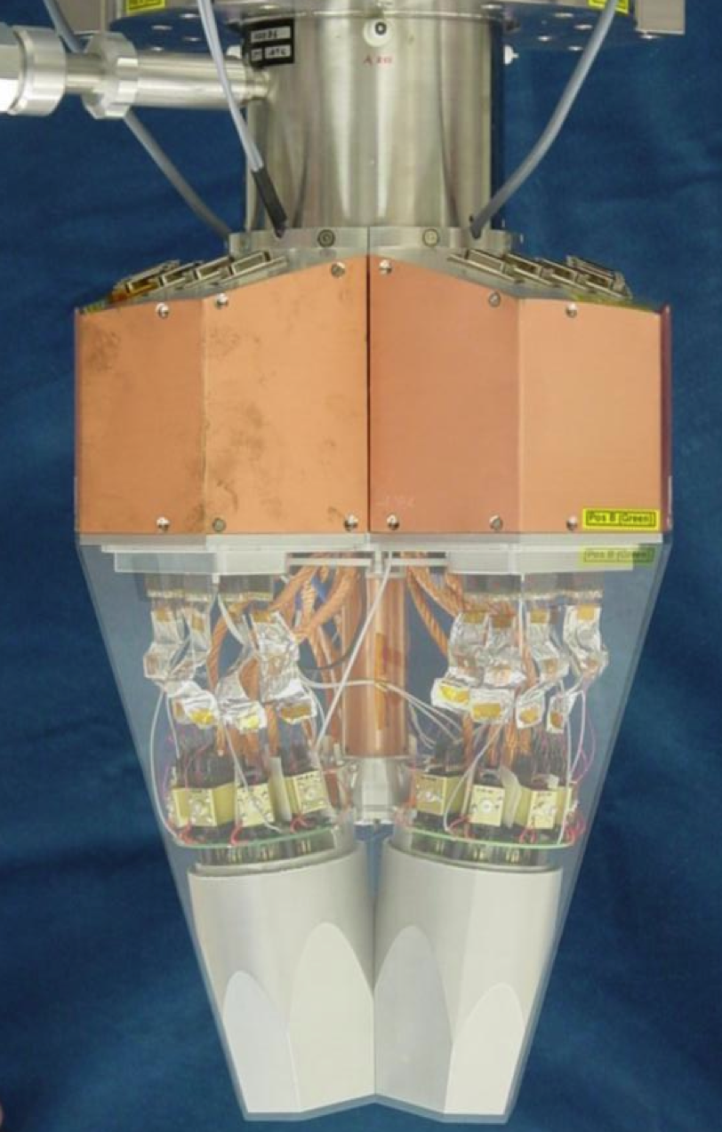
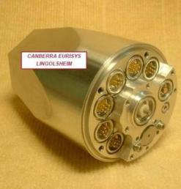
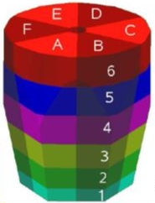
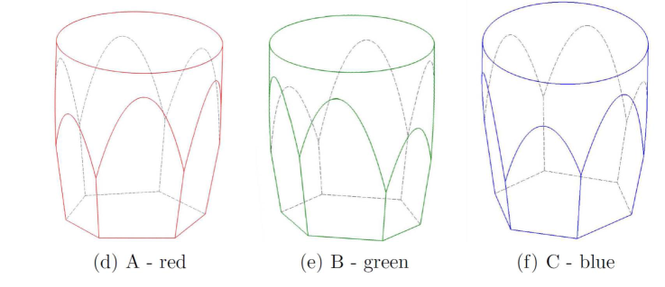
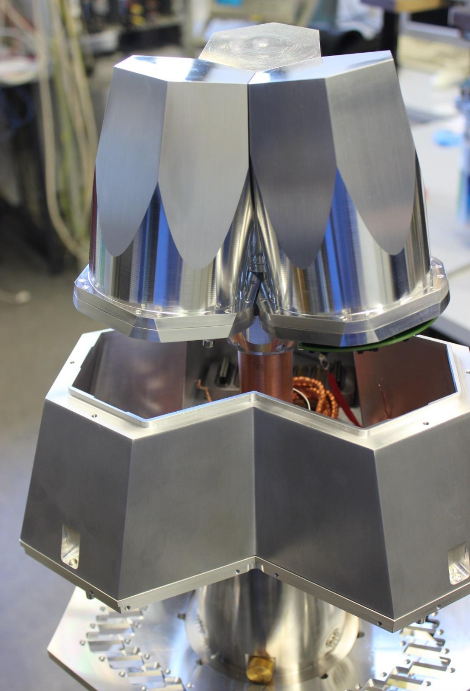
AGATA detectors
80 mm
90 mm
36-fold electrically-segmented encapsulated n-type HPGe crystals procured at Canberra/Mirion-Lingolsheim
Triple cryostat provided by CTT integrating 111 high-resolution spectroscopic channel with cold FET technology
New encapsulation technique by IKP-Cologne
R&D on detector technology within ENSAR2 PSeGe JRA (new passivation/protection methods, new thinner contacts,…)
Notes:
All segmented coaxial detectors are n-type because the technology of stable segmented p-type contacts is missing or unreliable
Capsule and lid sealed by electron-beam welding : easy to handle detectors for maintenace and mounting, long lifetime:
But: complex technology to manufacture and maintain, destructuve opening of the capsule for detector reparation
internal getter, vacuum< 10-6mb
Temperature range-196 0C to+110 0C => metallic elastic seal
Fragility of passivation in highly segmented detectors, dead layers in passivated areas
Reduced n-damage effect in sgement signals: investigate Segmented n-contacts for p-type Ge detectors

Slide 8
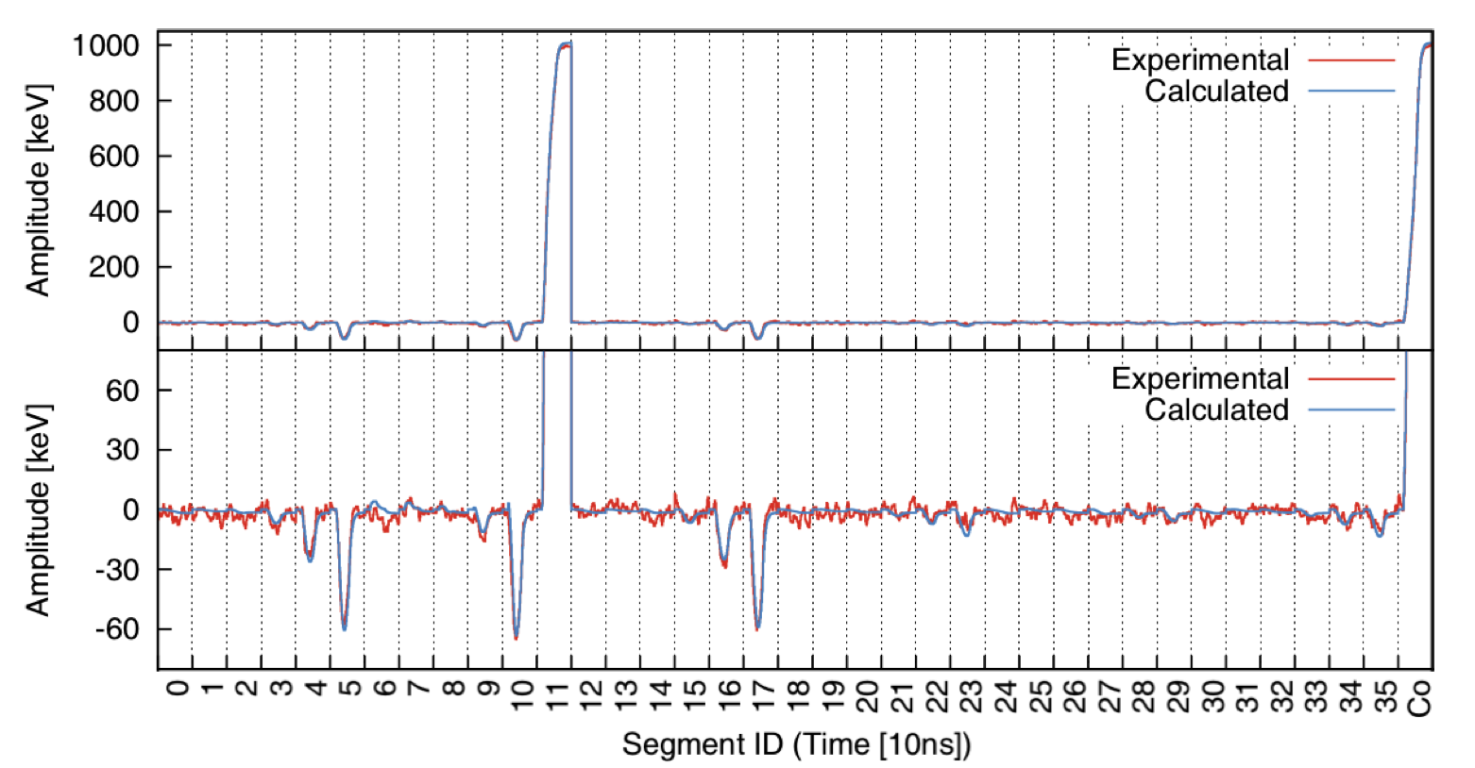
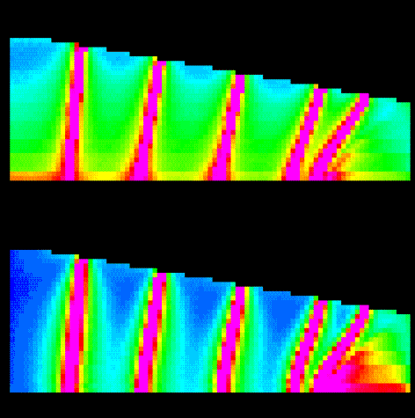
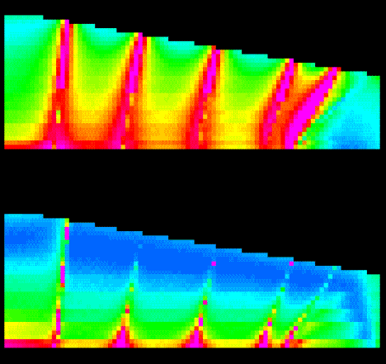

Detector R&D
Average 5mm (FWHM) position resolution has been achieved with PSA ✓
Clustering of interaction points in certain areas of the detector
total
dy
high
dz
dx
=> Improve detector modelling & PSA (ongoing R&D)
=> Improve position sensitivity
low

Slide 9
Improved position sensitivity
Comparative study of 3 segmentation schemes in collaboration with MIRION
Current segmentation
Characterisation & validation with the IPHC fast scanning table & in-beam at ILL (imaging)
ANR SEPAGE submitted in 2019
PI: J. Dudouet (IP2I):
Laboratoriess: IP2I, IPHC, IJCLab, ILL
~4 years
4 man.months/segmentation scheme
Cost: ~200 kEuros
Notes:
Segmentation Patterns optimization in HPGe detectors,
when the interaction points are located in reduced position sensitive areas, the induced charges in the neighbouring segments (above and bellow), called transient signals, are in the most sensitive areas

Slide 10
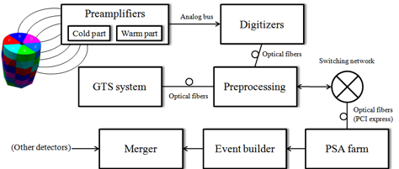
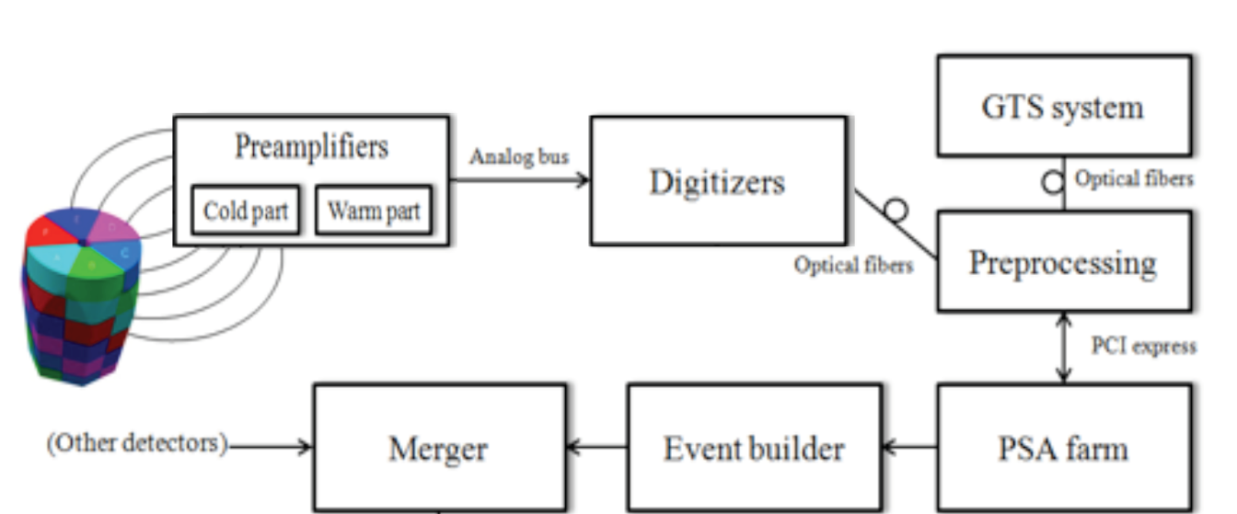
AGATA Electronics
10 m MDR
Phase 0
Designed in 2004
24 channels available
Price : 90-100 k€ / crystal
Not included cost :
  7 optical fibers from digitizer to ATCA
  4 optical fibers from ATCA to computing node
  1 server per crystal
ATCA
IN2P3 IPHC - Uni.Liverpool STFC Daresbury - IN2P3 IPNO - IN2P3 CSNSM - INFN Padova
Phase 1
Designed in 2012
23 channels available
Price : 30 k€ / crystal
Not included in cost
  4 Optical fibers from digitizer to computing node
  1 server per crystal
PCIe
INFN Milano - INFN Padova - INFN LNL - IFIC Valencia - ETSE Uni-Valencia
Notes:
2 ATCA carrier boards/crystal – digitizers sends data over optical fibres in groups of 6 -> 7 fibers
1 preprocessig board /crystal – digitizers sends data over optical fibers in units of 12 -> 4 fibers
Obsoescence of components & compatibility issues (workstations & ggp for eg) also HR issues for maintenance and repair

Slide 11
Phase 2 medium-term electronics solution
MDR cables
Link
PSU
Control And Processing board
(CAP)
Phase 1 digitizers Digiopt12
Input Data Mezz.
(IDM)
Pre processing
Local
Power
(CAP-LPSU)
FMC
Control & Monitoring
Digitization – Milano
Hardware – Valencia
  IDM
  CAP
Pre processing – IPHC
Control & Monitoring – IJCLab/Daresbury
Readout – IJCLab
Trigger/Timestamp: SMART proposition by GANIL
10Gb Eth
Readout
READOUT
Ethernet
10Gb
FMC
GTS/SMART
Trigger & Timestamp
Data Processing and Ethernet Transfer boards design on SoM commercial Mezzanines
Reduced Design time
Increased Maintenance capability
Proof of principle : mid-2019 ✓
Production early 2021 – late 2021
Price estimate ~ 16 k€ / crystal
Notes:
Ethernet standard
DIGITIZER based on DIGIOPT12 :Improved Differential linearity (Sliding Scale).
Pre-processing being tested on a Virtex Kintex or Zinq Ultrascale
SMART proposal comaptible with gts
SoMbased solutions (off the shelf System on Modules) : facilitate design & production; guarantee of spare parts
Firmware aiming to improve the triggering, processing and read-out capabilities.
Inspection and monitoring information for diagnostic with a friendly GUI

Slide 12
Longer-term developments
DAQ
Exploit the new opportunities for data filtering & analysis given by the 10Gb readout from FEE
Electronics
Reduce infrastructure, power consumption & overall cost
Improve EMC & enhance detector mobility
GT08: J.P. Cachemiche
Notes:
.

Slide 13
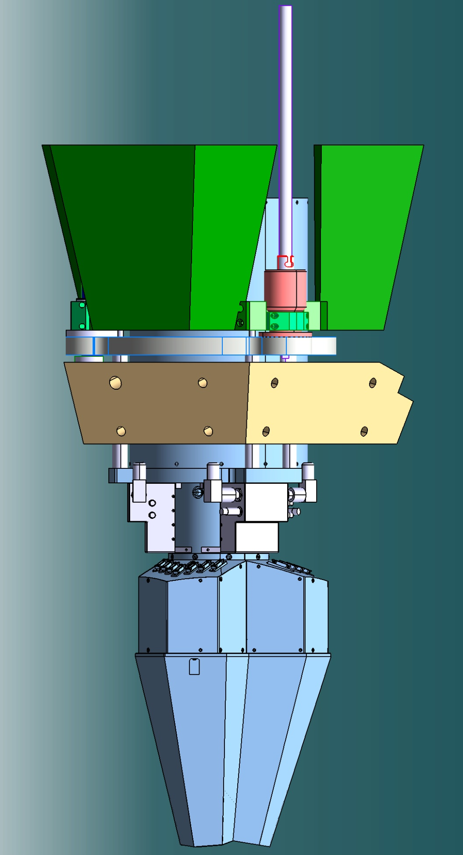
Long-term Electronics R&D
warm digitizers + preprocessing boards + 10 Gb/s ethernet readout in close proximity
VLSI fast reset low-power preamps in cryostat
Test cryostat
(manufacturer CCT )
5 years (t₀ >2022)
FEE: ~ 150 kEuros, 119 man.months
Cryostat: ~ 200 kEuros, 68 man.months for tests

Slide 14
Conclusion & Perspectives
Successful collaboration
Continuous construction/upgrade in parallel with data taking
Envisaged future R&Ds on detectors and FEE could further improve the performance, the overall cost and mobility of the array
Limited technical manpower (ongoing R&D for phase 2 electronics with already limited human resources)

