Slide 1
SDHCAL status
I.Laktineh
On behalf of the French SDHCAL groups
IP2I, LPC,OMEGA

Slide 2
Outline
SDHCAL ongoing activities
Module0 progress
Detectors
Readout electronics
Gas recycling
Future activities
Conclusion

Slide 3
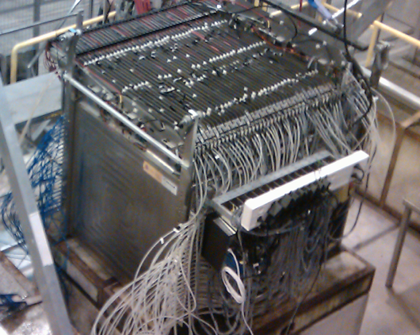
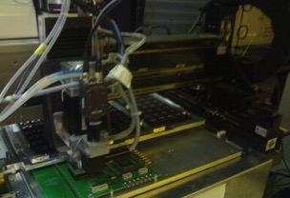
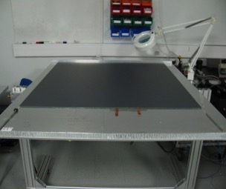
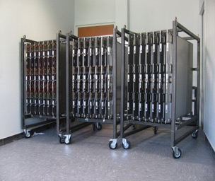
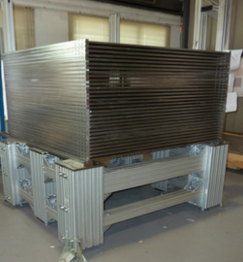
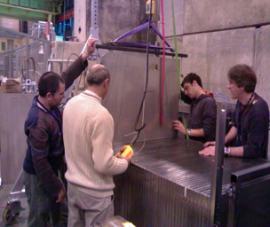
SDHCAL Since 2011
SDHCAL prototype construction
10500 64-ch ASIC were tested and calibrated using a
dedicated (ASICs layout : 93% ).
310 PCBs were produced, cabled and tested.
They were assembled by sets of six to make 1m² ASUs
170 DIF, 20 DCC were built and tested.
50 detectors were built and assembled with
their electronics into cassettes.
Self-supporting mechanical structure.
DAQ system using both USB and HTML protocol
was developed and used.
Full assembly took place at CERN.
1 cm x 1 cm pads, 48 layers, power-pulsed, mechanical self-supporting structure
TB: 2012,2015, 2016, 2017 and 2018 with ECAL

Slide 4
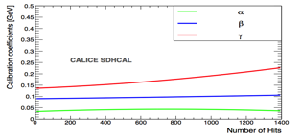
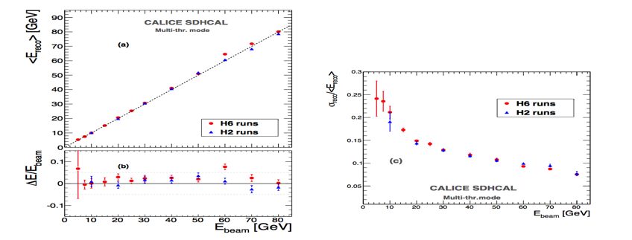
Energy estimation
The thresholds weight evolution with the total number
of hits obtained by minimizing a χ²
Χ² = (E_{beam}-E_{rec})²/E_{beam}
E_{rec =} α (N_{tot}) N₁ + β(N_{tot}) N₂ + γ(N_{tot}) N₃
N₁,N₂ and N₃ : exclusive number of hits associated to first,
second and third threshold.
α, β, γ are quadratic functions of the total number of hits (N_{tot})
Events of H2 runs corresponding to energies : 5, 10, 30 , 60
and 80 GeV were used to fit the 9 parameters.
Then the energy of hadronic events in
both H2( only pions) and H6 (presence of protons)

Slide 5
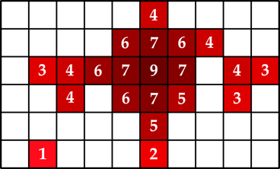
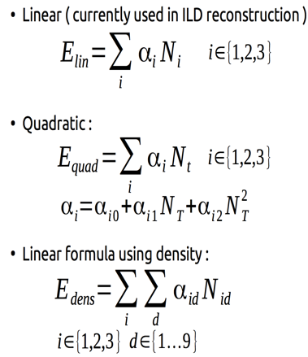

Energy reconstruction
The density of each hit is the number of hits in the surrounding 3x3 cells (including itself)
It can vary from 1 (lone hit) to 9 (completely surrounded)
  For these 3 formulas, the α parameters are found using a chi2 minimisation :

Slide 6
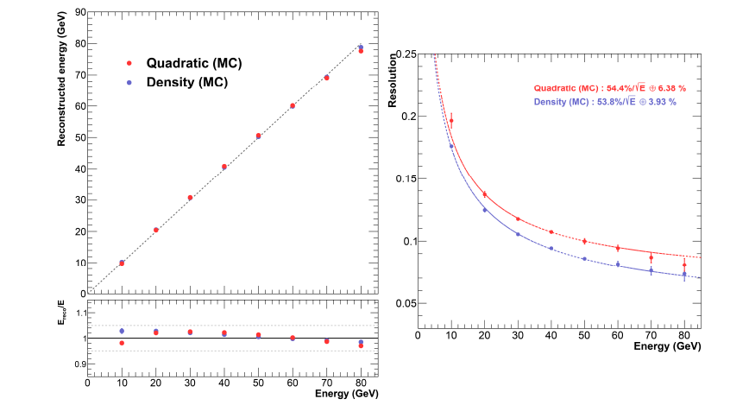
2015 TB@H2-SPS
Preliminary
Preliminary

Slide 7
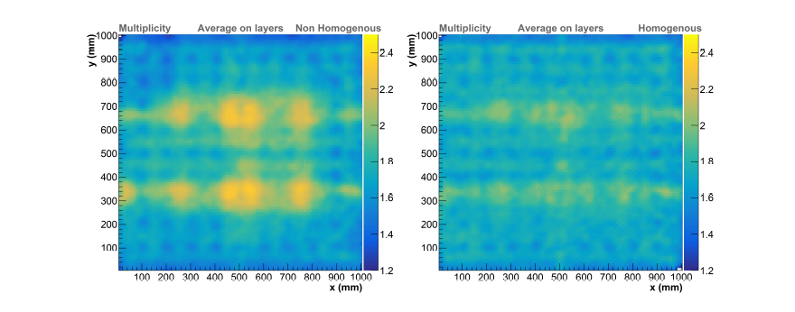
Homogenization of the SDHCAL response:
-Use the muons threshold scan to study both efficiency and multiplicity.
-Use the average multiplicity and that of the second and the third threshold efficiency as a reference and then for each ASIC change the thresholds to obtain the average values.
2015 TB@H2-SPS

Slide 8
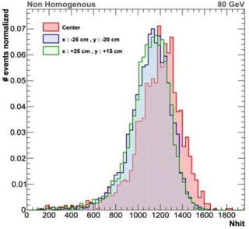
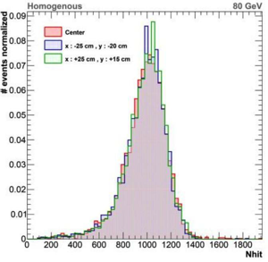
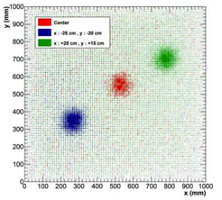
Homogenization of the SDHCAL response:
-Use the muons threshold scan to study both efficiency and multiplicity.
-Use the average multiplicity and that of the second and the third threshold efficiency as a reference and then for each ASIC change the thresholds to obtain the average values.
2017 TB@H2-SPS

Slide 9
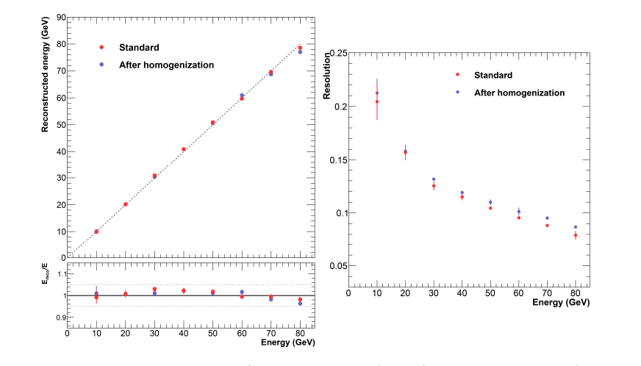
2015 TB@H2-SPS
Preliminary
Preliminary

Slide 10
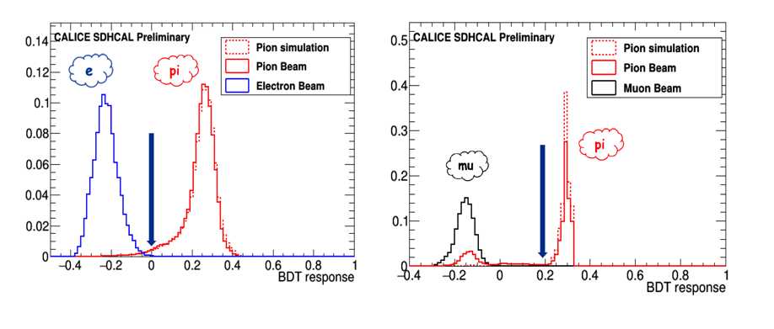
SDHCAL is a powerful tool to identify particles: muons, electrons and hadrons. Using BDT one can separate efficienctly the different species.
2015 TB@H2-SPS
CALICE-CAN-2019-001
→ Paper after final review within CALICE

Slide 11
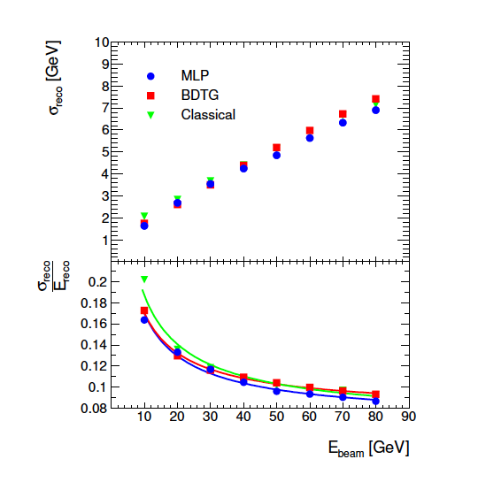
SDHCAL is a powerful tool to identify particles: muons, electrons and hadrons. Shower shapes could also be used to extract the energy.
JINST 026P 0519 (2019)
Energy reconstruction for a hadronic calorimeter using
multivariate data analysis methods applied on SDHCAL simulated events,
a paper just published. A collaboration between IP2I and SJTU

Slide 12
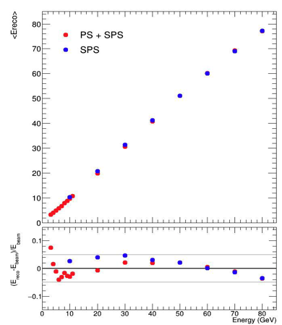
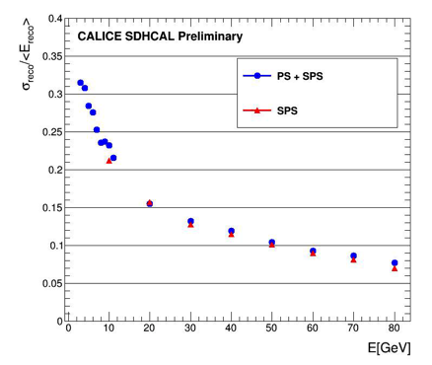
Associating PS and SPS 2015 results
This allows us to demonstrate the capability of SDHCAL to identify the different species (no Cerenkov) and to cover a large dynamic range.
A CALICE note is in preparation

Slide 13
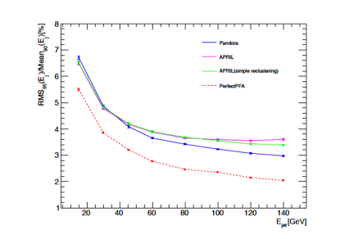
Main online software activities
APRIL : the SDHCAL PFA for ILD
Original ARBOR-PFA developed
using PandoraPFA-SDK.
by Remi Ete for his PhD
Taken over by Currently Bo Li
(IP2I postdoc until end of this month)
A paper in preparation.
Digitizer:
simulate GRPC+electronics response to Geant4 steps.
Originally developed by G. Grenier and A Steen.
Improved by by G Garillot ( part of MarlinReco of ILC)
Improved modelling : correct for primary ionisations fluctuations
(D. Boumediene).
Gerald

Slide 14
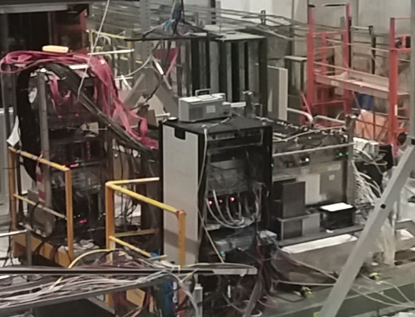
First common test with the technological SiW ECAL prototype
Common DAQ: same start acquisition (using the spill start), busy from SDHCAL

Slide 15
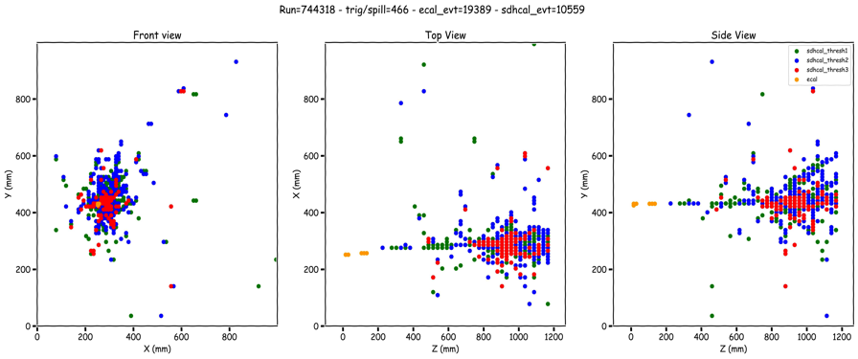
Antoine Pingault (Gent)
&IP2I&CIEMAT&
ECAL groups
First common test with the technological SiW ECAL prototype

Slide 16
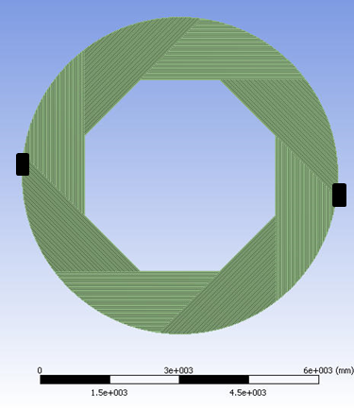
SDHCAL for ILD
We propose the videau structure as a baseline for the SDHCAL

Slide 17
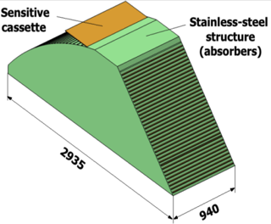
SDHCAL R&D for ILD
Detectors as large as 3m X 1m need to be built
Electronic readout should be the most robust with
minimal intervention during operation.
DAQ system should be robust and efficient
Mechanical structure to be similar to the final one
Envisage new features such timing, etc..
GRPC
Glass Resistive Plate Chambers
SDHCAL
ILD Module
Goal: to build new prototype with few but large GRPC with the new components
→ ILD Module0

Slide 18
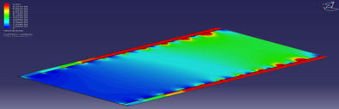
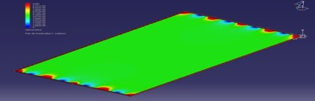
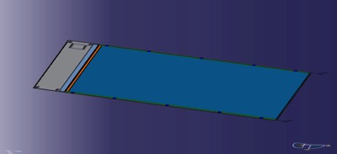
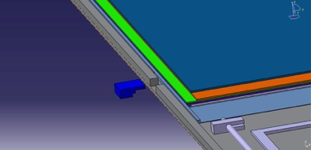
Detector conception
Construction and operation of large GRPC necessitate some improvement with respect to the present scenario.
Gas distribution : new scheme is proposed
Prototype circulation system
New circulation system
inlet
outlet
1 m
2 m
Cassette conception to ensure good contact between the detector and electronics is to be improved

Slide 19
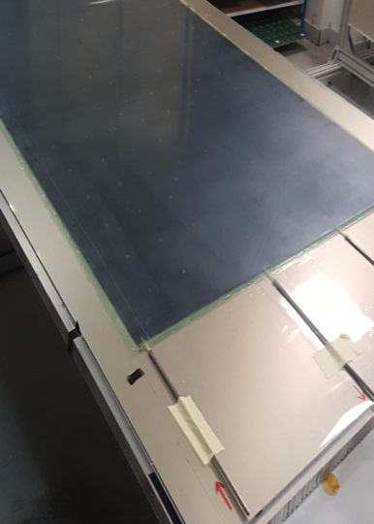
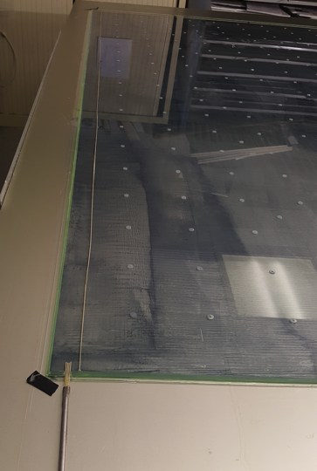
Detector conception
IP2I
First 2x1 m² RPC chamber was successfully built with a new gas circulation system

Slide 20
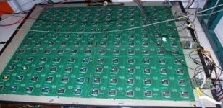
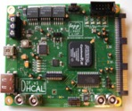
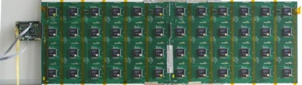
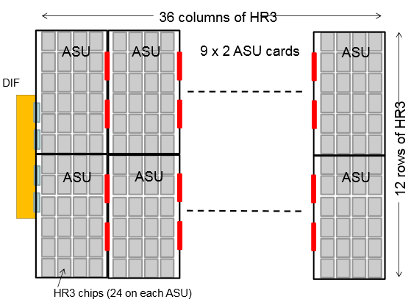
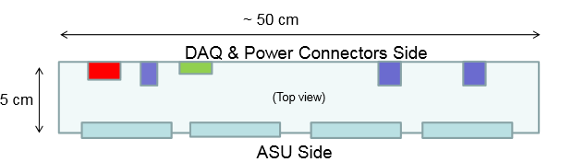

New electronics
IP2I&CIEAMT
Electronics readout for the 1m³ prototipo
HADROC chip
(ASIC)
1m² board ➔ 6 ASUs hosting 24 ASICs
3072 ch
DIF #1
144 ASICs= 9216 channels/1m²
USB
ASU1
ASU2
33 cm
DIF #2
HDMI
DIF
100 cm
DIF #3
1 DIF (detector InterFace) for 2 ASU (Active Sensor Unit.- PCB+ASICs) ➔ 3 DIFs for ONE 1m2 GRPC detector
Electronics readout for the final detector
Only 1 DIF per GRPC (any size) with small dimensions to fit in the small space available at the ILD detector
Uo to 9
DIF dimensions

Slide 21
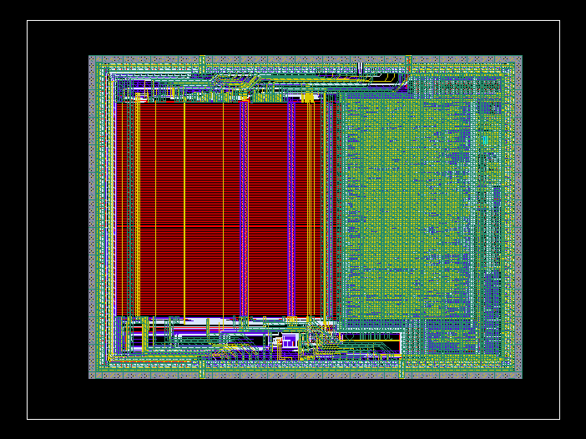
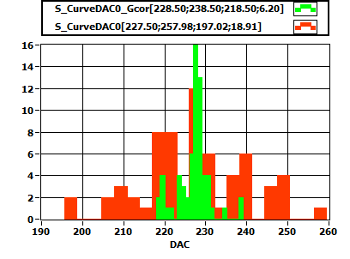
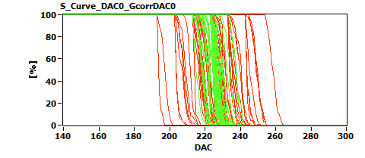
New electronics: ASIC
OMEGA
HARDROCR3 main features:
  Independent channels
  Zero suppress
  Extended dynamic range (up to 50 pC)
  I2C link with triple voting for slow control parameters
  packaging in QFP208, die size ~30 mm²
  Consumption increase (internal PLL, I2C)
6,3 mm
4,7 mm
H3B TESTED : 786, Yield : 83.3 %

Slide 22
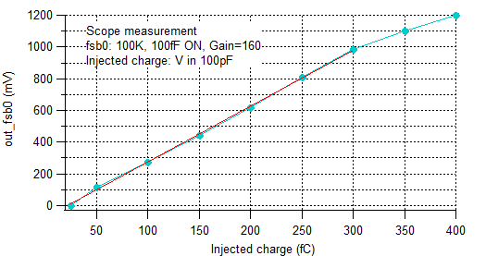
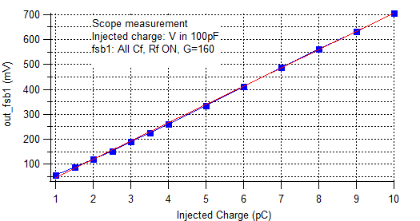
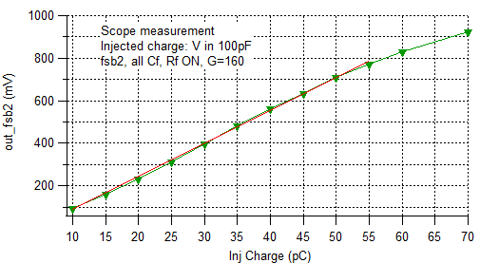
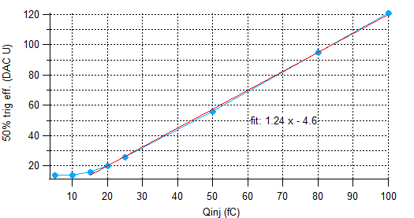
HARDROC3: Analog linearity
OMEGA
Fast shaper outputs (mV) vs Qinj (fC)
FSB0
FSB1
Up to 10 pC
50% trig. Eff. (DAC units) vs Qinj (fC)
FSB0: 5σ noise limit= 15 fC
FSB2
Up to 50 pC
Dynamic range: 15fC - 50 pC

Slide 23
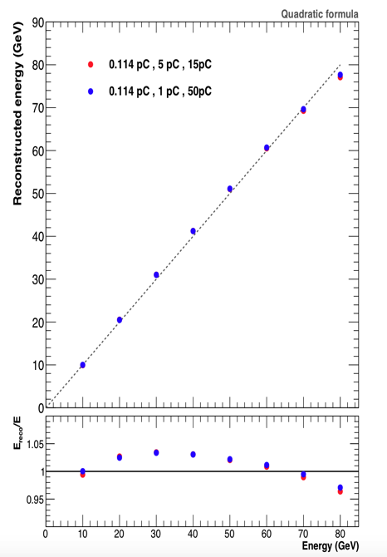
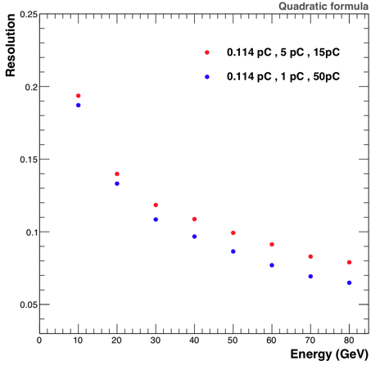
SDHCAL Simulation
IP2I
Up to 20% improvment is expected

Slide 24
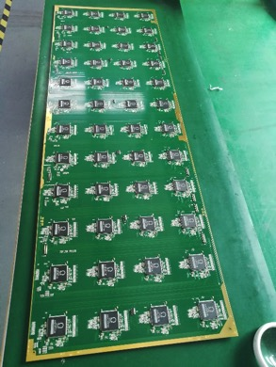
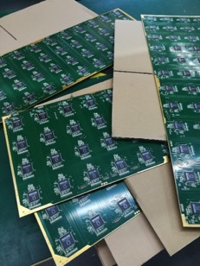
ASU (Active Sensor Unit)
IP2I
An important challenge is to build a PCB up to 1m length with good planarity to have a homogeneous contact of pads with RPCs in order to guarantee an uniform response along all the detector.
A company was found and 1x0.33 m2 with 13 layer ASUs have been built.
ASU
HR3
ASICs
PCB
The ASU-ASU (= ASU-DIF) connections also produced

Slide 25
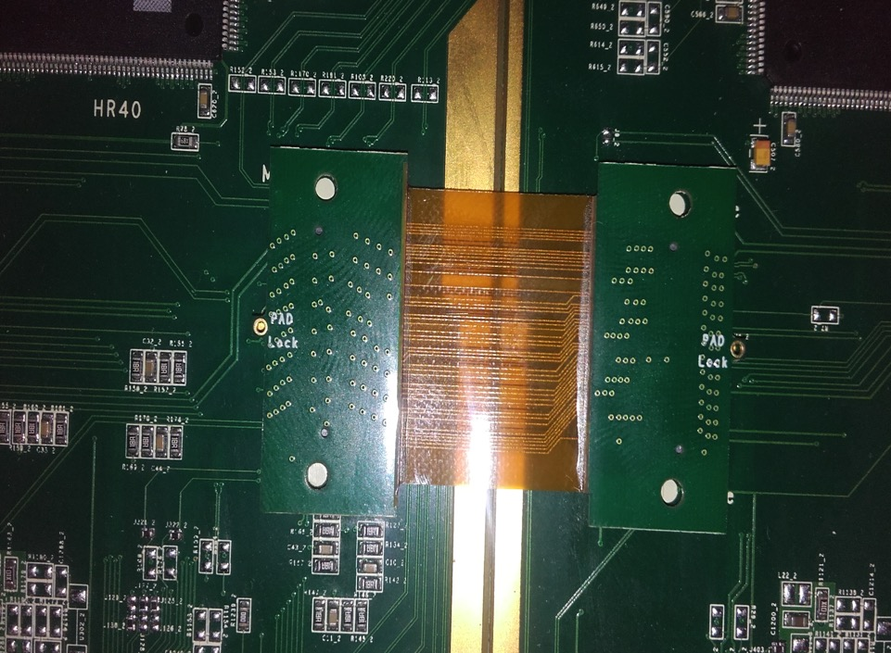

Slide 26
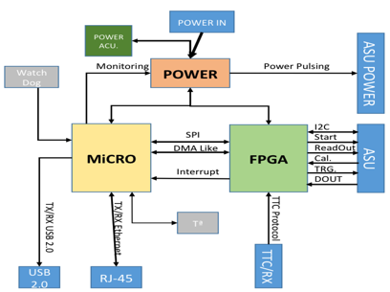
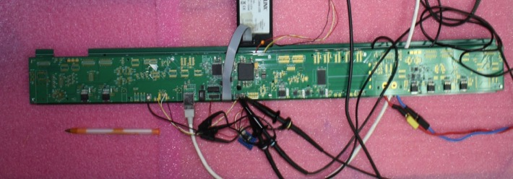
New electronics : DIF
CIEMAT&IP2I
DIF sends DAQ commands (config, clock, trigger) to front-end and transfer their signal data to DAQ. It controls also the ASIC power pulsing
• Only one DIF per plane (instead of three)
• DIF handle up to 432 HR3 chips (vs 48 HR2 in previous DIF)
• HR3 slow control through I2C bus (12 IC2 buses).
Keeps also 2 of the old slow control buses as backup & redundancy.
• Data transmission to/from DAQ by Ethernet
• Clock and synchronization by TTC (already used in LHC)
• 93W Peak power supply with super-capacitors
(vs 8.6 W in previous DIF)
• Spare I/O connectors to the FPGA (i.e. for GBT links)
• Upgrade USB 1.1 to USB 2.0
TEXAS TM4C1294U
FPGA XC7A35TFGG484
POWER
POWER
POWER

Slide 27

New electronics
CIEMAT&IP2I
New readout electronics is being tested
100 cm
6 cm
33 cm
Firmeware is almost fianlized

Slide 28

New electronics
CIEMAT&IP2I
33 cm
Two ASUs are being connected and tested

Slide 29
Tests with new electronics on large detectors
The absence of manpower in CIEMAT and IP2I in Digital Electronics/DAQ
(involved in CMS upgrade projects) is a problem.
We would like to test the new electronics that we produced 2 yeas ago but for this we need qualified staff.

Slide 30

Gas system
IP2I
Gas recycling is necessary to reduce cost :
-Goal: reduce the gas consumption to reduce the cost.
-Gas renewal of 5-10% rather than 100%
-Conceived by the CERN gas group and successfully used.
We will start using HFO1234ze soon (GPW=3)
We have also now a remotely a gas controller

Slide 31



2020-2022
Timing : the new dimension
- Build large MRPC (fast timing detectors)
- Develop fine timing readout (PETIROC or equivalent ASIC) of 10-100 ps
- Develop appropriate TDC ( for time measurement and ToT)
- Conceive ASUs with pads of 1x1 cm²
- Develop a new DAQ system with the time information.
- Build a small prototype

Slide 32



2020-2022
The principle is simple: the charge is shared among several pads/pixels. The pads/pixels are inter-connected in a smart way so one can identify the position of the impinging particle by identifying the fired strips and thus find the hit as the crossing points.
In addition there is no ambiguity as far as the number of particles crossing the particles is not very high thanks to the use of at least 3 directions strips.
Patented:
(PCT/EP2018/053561-FR3062926: I.Laktineh)
Avalanches
3 HR2 ASICs rather than 20 for the same surface
Lozenge’s large diagonal : 1 cm

Slide 33

2020-2022
We would like to use the scheme to instrument very large gaseous detectors.
Well controlled inductance and well matched impedance will help to keep the signal in good shape for long distances.
This scheme that was successful for RPC could be easily applied to resistive MM and GEM.
FEB

Slide 34


We would like to use the scheme to instrument very large gaseous detectors.
Well controlled inductance and well matched impedance will help to keep the signal in good shape for long distances.
This scheme that was successful for RPC could be easily applied to resistive MM and GEM.
Funded by PULSALYS

Slide 35
Summary and plans for SDHCAL
Technological protoype running successfully since 2012
Many results validate the potential of the concept
Large prototype with the new generation of readout electronics is on the rails but digital electronics staff is missing ( we need help)
We have several ideas for the future....

Slide 36


Slide 37

- 8 détecteurs de type GRP de 70x80 ont été construits
Des PCBs de type strips tissés (TRICOT) ont été conçues, testées
Des cartes readout avec un ASIC+MP+ ont été conçues, fabriquées et
récemment testées
Le système d’acquisition permettant de synchroniser les cartes, leur envoyer des commandes et récupérer leur données a été récemment finalisé et actuellement en test.

