Slide 2
Background :
PIC is a data center of excellence for scientific-data processing supporting scientific groups working in projects which require strong computing resources for the analysis of massive sets of distributed data.
Currently, PIC generates a large quantity of data.
- Order of PetaBytes per year, that is distributed in real time scientific centers.

Slide 3
Goals :
By means of RUCIO :
Register the data locally placed (in PIC) data in the RUCIO catalog.
Rule of Replication: Distribute it among the datalake.

Slide 4
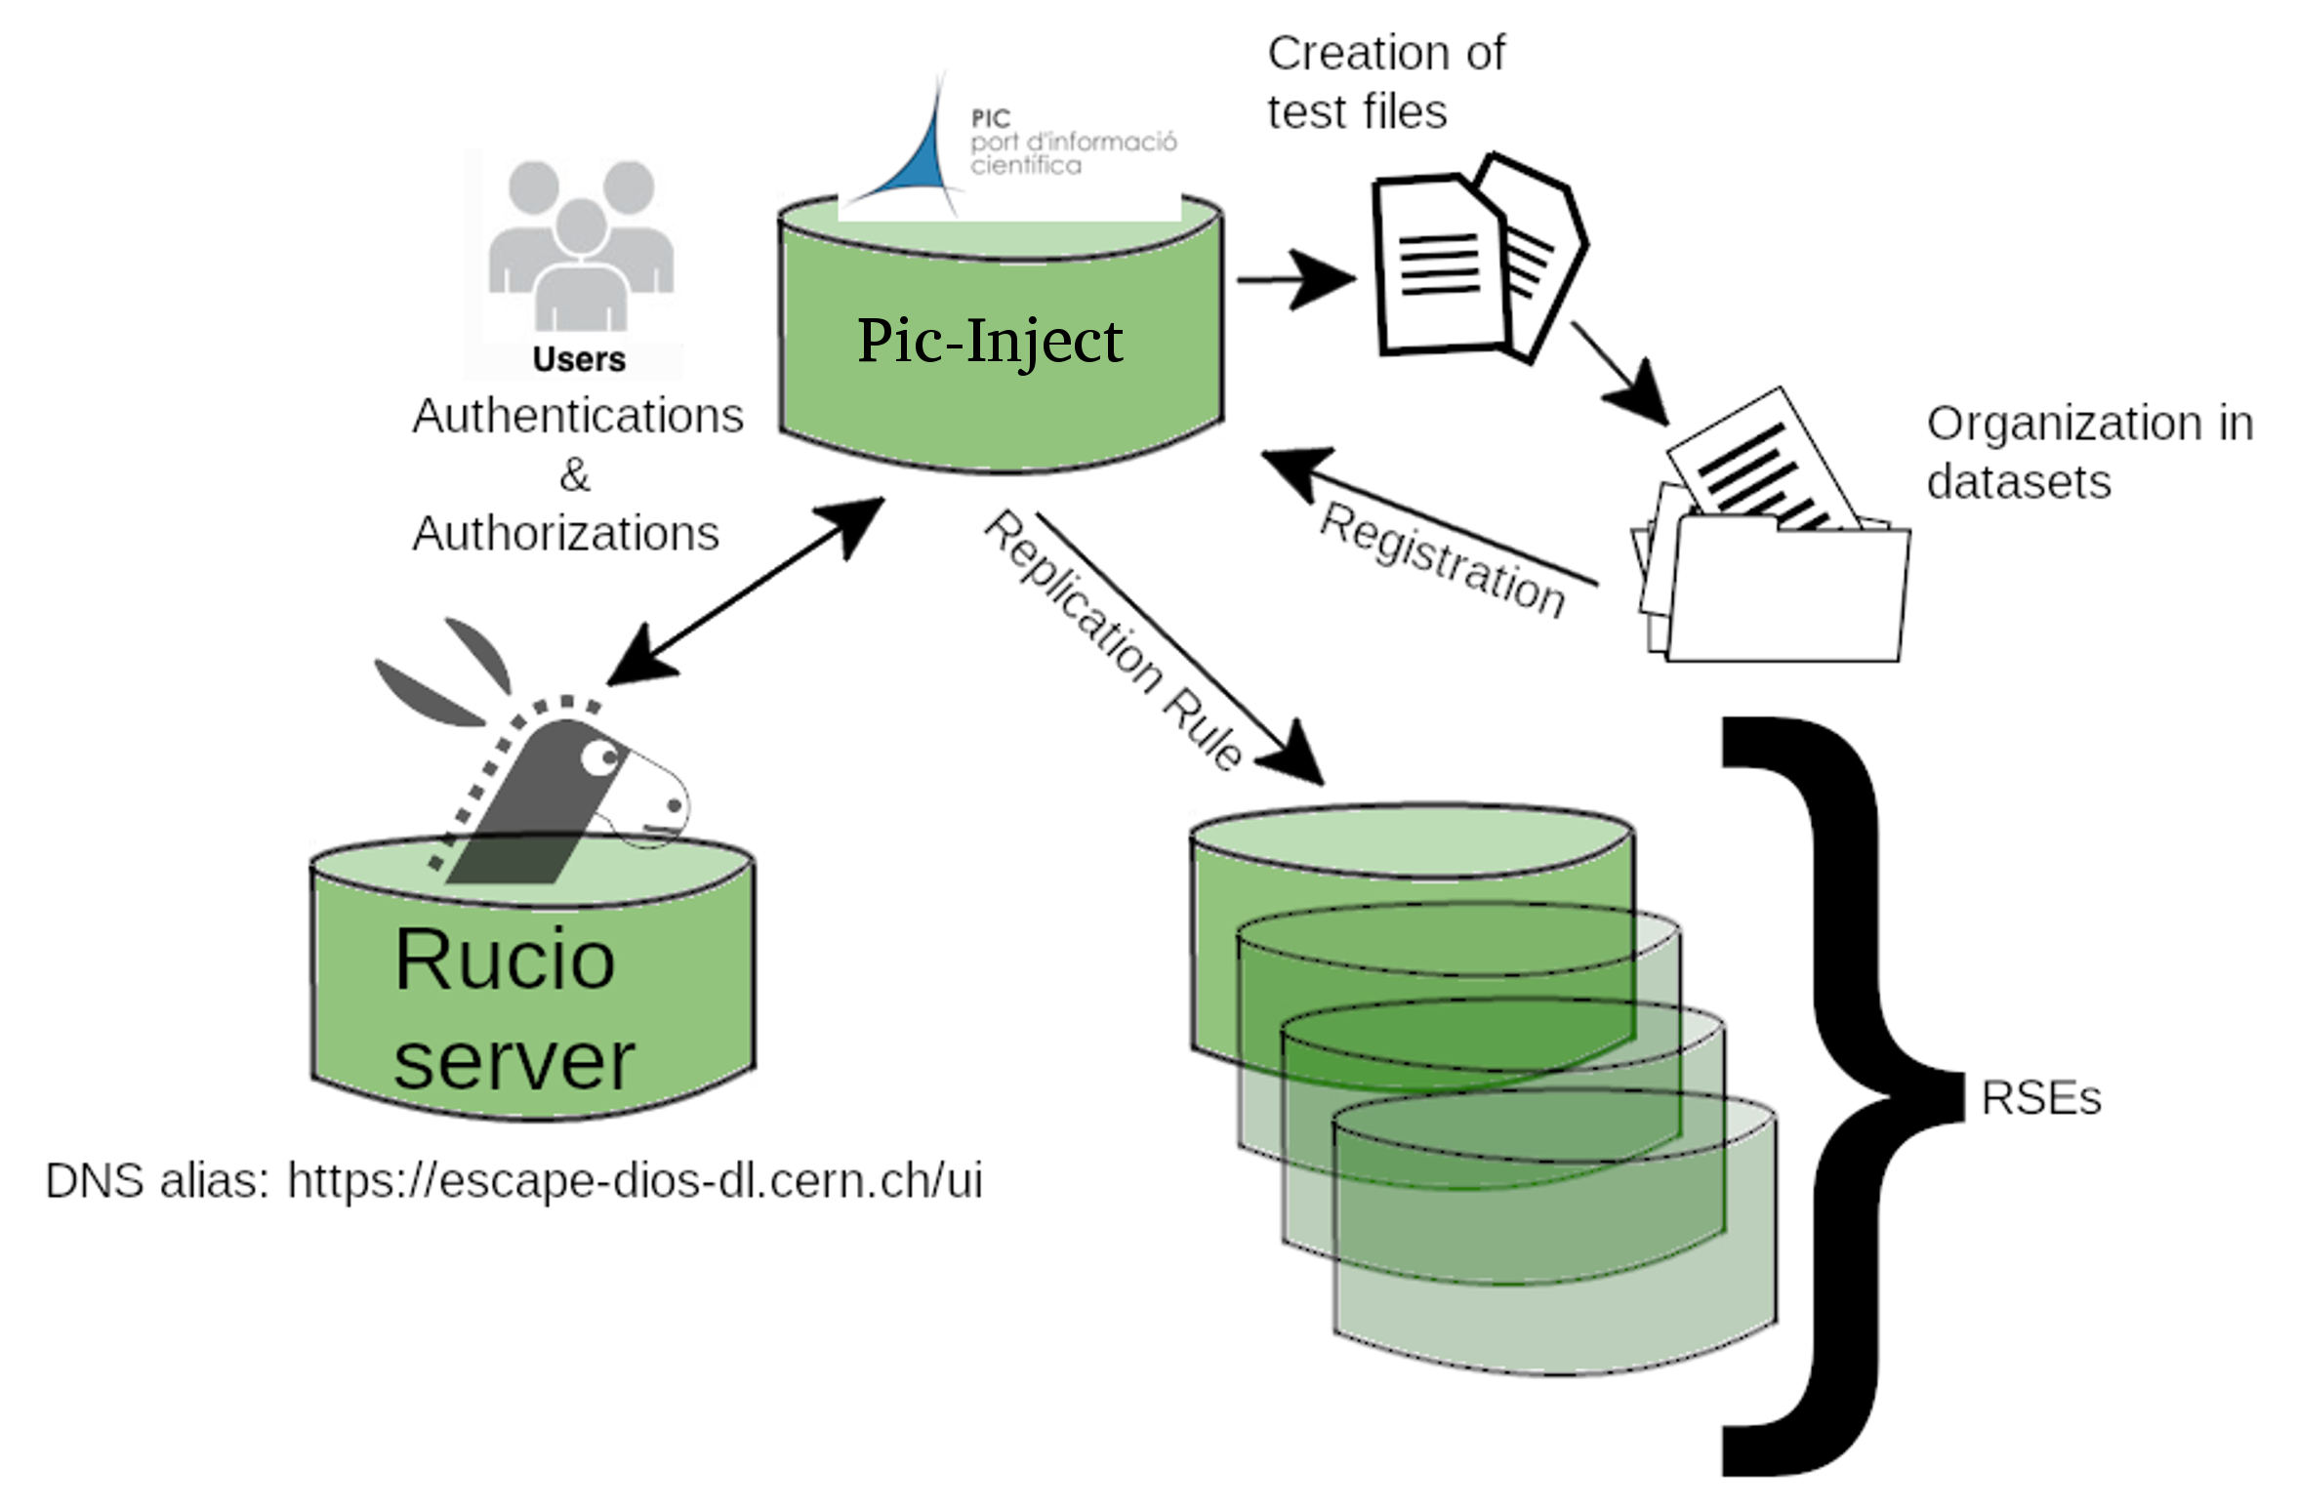
In order to test the registration, as well as, the different levels of organization within RUCIO:
We will carry on the registration on dummy data
Order of 10MB
2. The origin RSE is a non-deterministic RSE :
Allow registering files with their original path in the detector.

Slide 5
Rucio Storage Elements are logical entity of space.
Deterministic RSE : Rucio automatically manage storage, and creation of a path, only by knowing the scope and name of a data identifier (Ignoring the static prefix of the storage endpoint).
- PIC-DCACHE
NON-deterministic RSE : requires full path on the storage to the file. It offers more flexibility in placing the files on storage.
- PIC-INJECT

Slide 6
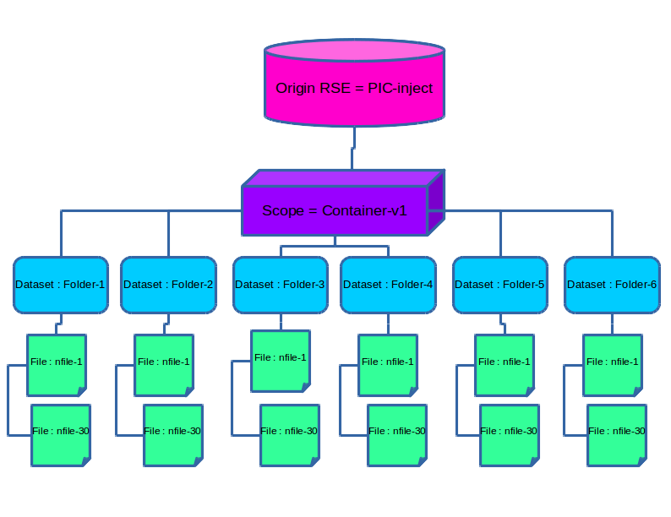
Data Registration :
All data will be held in a single container.
This container will include 6 datasets, equivalent to the number of folders created, with 30 files each, corresponding to the total number of files included in each folder.
For example: the Folder-1 folder will be the same name as the dataset that will contain the files in this folder (nfile-1, ... nfile-30).

Slide 7
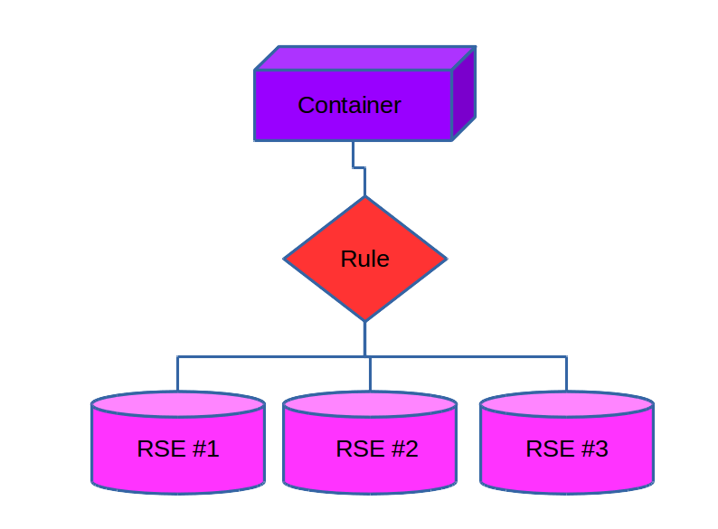
Replication Rules :
This container will be replicated to other RSEs.
Sites – ESCAPE testbed:
INFN-NA-DPM
CNAF-STORM
DESY-DCACHE

Slide 8
Next Steps :
To implement ‘/’ in the naming of file, in order to archive more informative naming files and supporting pre-existing naming convention.
i.e. : std:RAW/M1/CrabNebula/2020_03_13/20200313_M1_05089889.008_D_CrabNebula-W0.40+215.raw.gz
Develop an algorithm that builds the folder path from the name-space of the file at the destination RSE.
Configure INJECT RSE for gridftp endpoint in La Palma Observatory.
Perform replication tests with realistic MAGIC dataset (1.2 TB)
Ultimate Scope :
Design and implement realistic telescope data transfer within the datalake

Slide 9
Conclusions :
NON-Determinsitc RSEs are useful to register locally placed files.
Acknowledgements :
Special thanks and congratulations to Aristeidis Fkiaras and his team.

Slide 10
Video 1 :
Creation and preparation of data
Local path in non-deterministic RSE (PIC-Inject) :
i.e. ‘root://xrootd.pic.es:1094/pnfs/pic.es/data/escape/rucio/pic_inject/’

Slide 12
Video 2 :
Data Registration and generation of replication Rules
PIC offers a service for running Jupyter notebooks on CPU or GPU resources.
https://pwiki.pic.es/index.php?title=Jupyter.pic.es

Slide 13
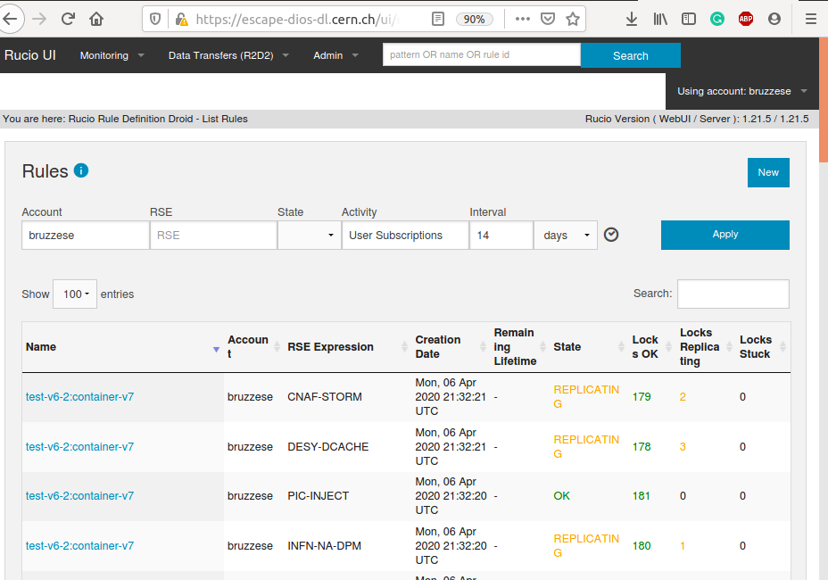
Check Rules replication
https://escape-dios-dl.cern.ch/ui/r2d2

Slide 14
The scripts :
Generate_random_folders.py :
The code generates a number of associated files and folders to be defined by the user
https://gitlab.pic.es/bruzzese/Rucio-register-files/blob/master/Generate_random_folder.py
Rucio_Organizer_v2.py :
The scripts allows the registration, organization and replication among different RSEs.
https://gitlab.pic.es/bruzzese/Rucio-register-files/blob/master/Rucio_Organizer_v2.py

