Slide 1


HOM Damping for PERLE
R. Calaga, S. G. Zadeh
CERN, Rostock University
Oct 10, 2019

Slide 2
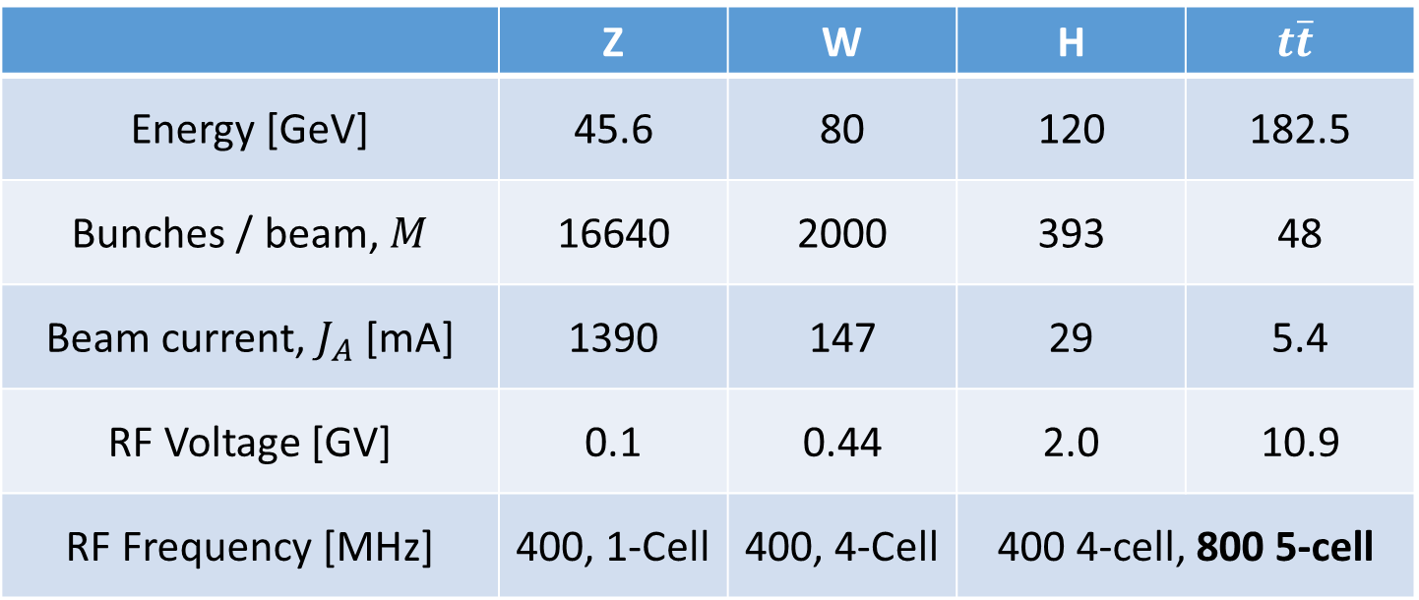
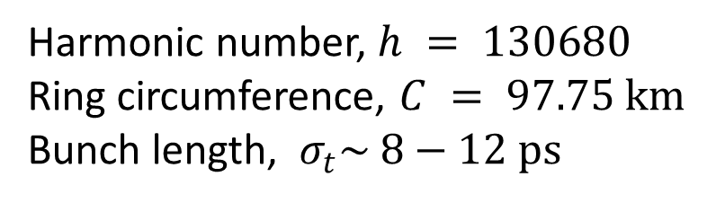
FCC-ee Parameters
 | Z | W | H | $$t\overline{t}$$
Energy [GeV] | 45.6 | 80 | 120 | 182.5
Bunches / beam, $M$ | 16640 | 2000 | 393 | 48
Beam current, $J_{A}$ [mA] | 1390 | 147 | 29 | 5.4
RF Voltage [GV] | 0.1 | 0.44 | 2.0 | 10.9
RF Frequency [MHz] | 400, 1-Cell | 400, 4-Cell | 400 4-cell, 800 5-cell
Harmonic number, $h = 130680$
Ring circumference, $C = 97.75 km$
Bunch length, $σ_{t}\sim 8−12 ps$

Slide 3
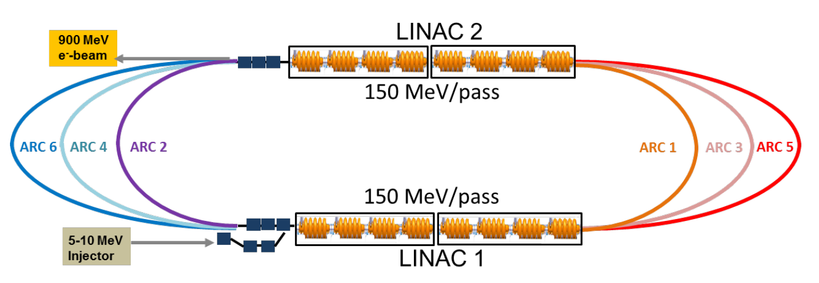
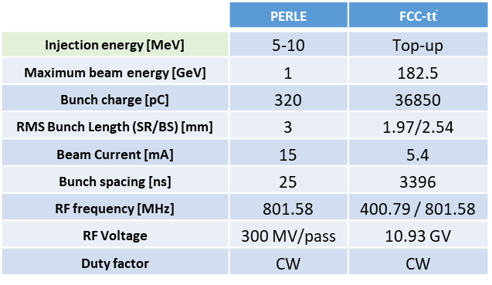
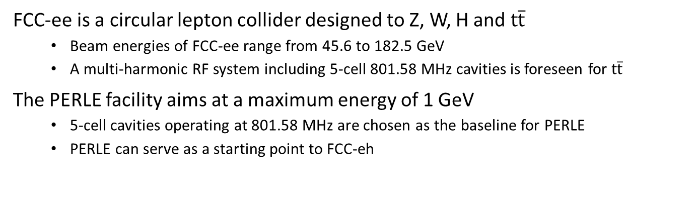
RF parameters of PERLE and $t\overline{t}$ operation of FCC-ee
FCC-ee is a circular lepton collider designed to Z, W, H and $t\overline{t}$
  Beam energies of FCC-ee range from 45.6 to 182.5 GeV
  A multi-harmonic RF system including 5-cell 801.58 MHz cavities is foreseen for $t\overline{t}$
The PERLE facility aims at a maximum energy of 1 GeV
  5-cell cavities operating at 801.58 MHz are chosen as the baseline for PERLE
  PERLE can serve as a starting point to FCC-eh
 | PERLE | FCC-$t\overline{t}$
Injection energy [MeV] | 5-10 | Top-up
Maximum beam energy [GeV] | 1 | 182.5
Bunch charge [pC] | 320 | 36850
RMS Bunch Length (SR/BS) [mm] | 3 | 1.97/2.54
Beam Current [mA] | 15 | 5.4
Bunch spacing [ns] | 25 | 3396
RF frequency [MHz] | 801.58 | 400.79 / 801.58
RF Voltage | 300 MV/pass | 10.93 GV
Duty factor | CW | CW
905 MeV
PERLE layout
755 MeV
305 MeV
305 MeV
155 MeV
455 MeV
Ref: PERLE, Powerful Energy Recovery Linac for Experiments, conceptual design report, May 2017

Slide 4
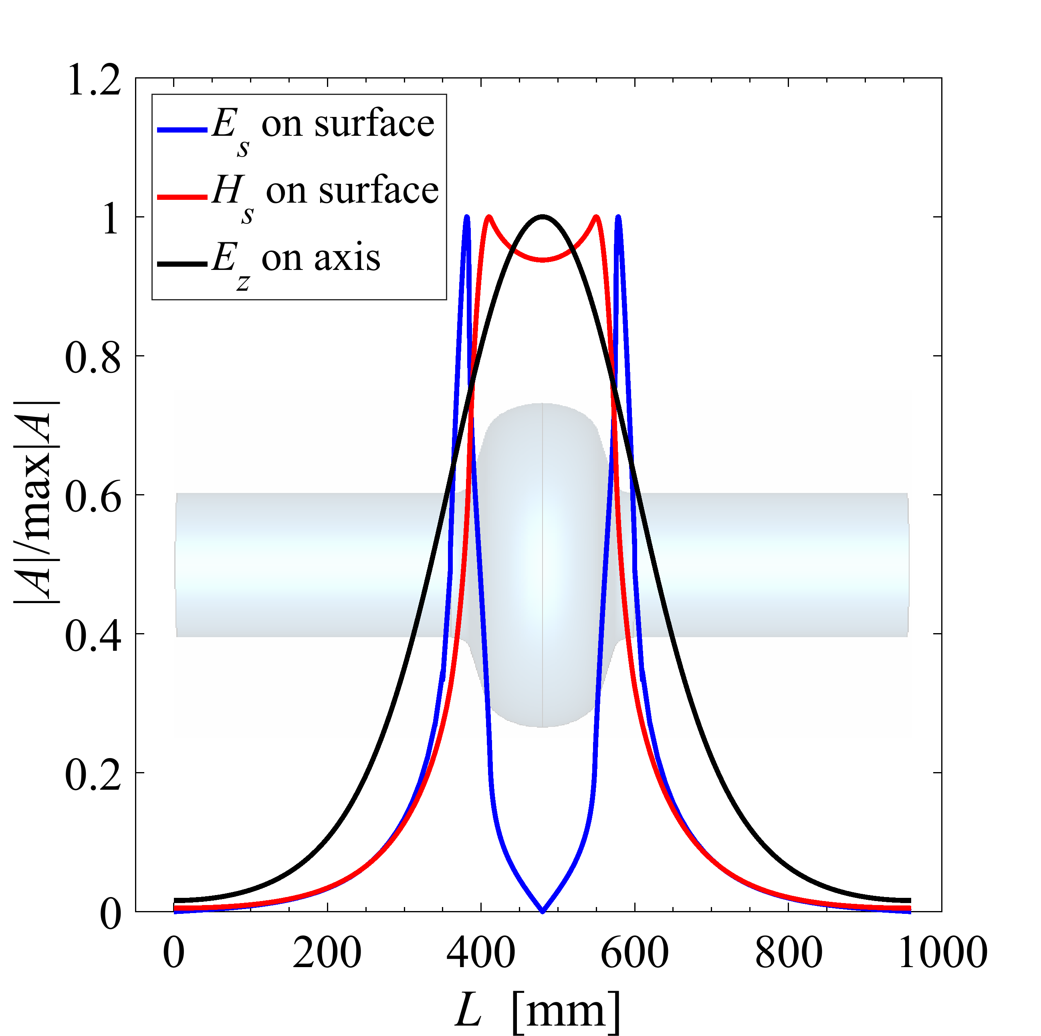
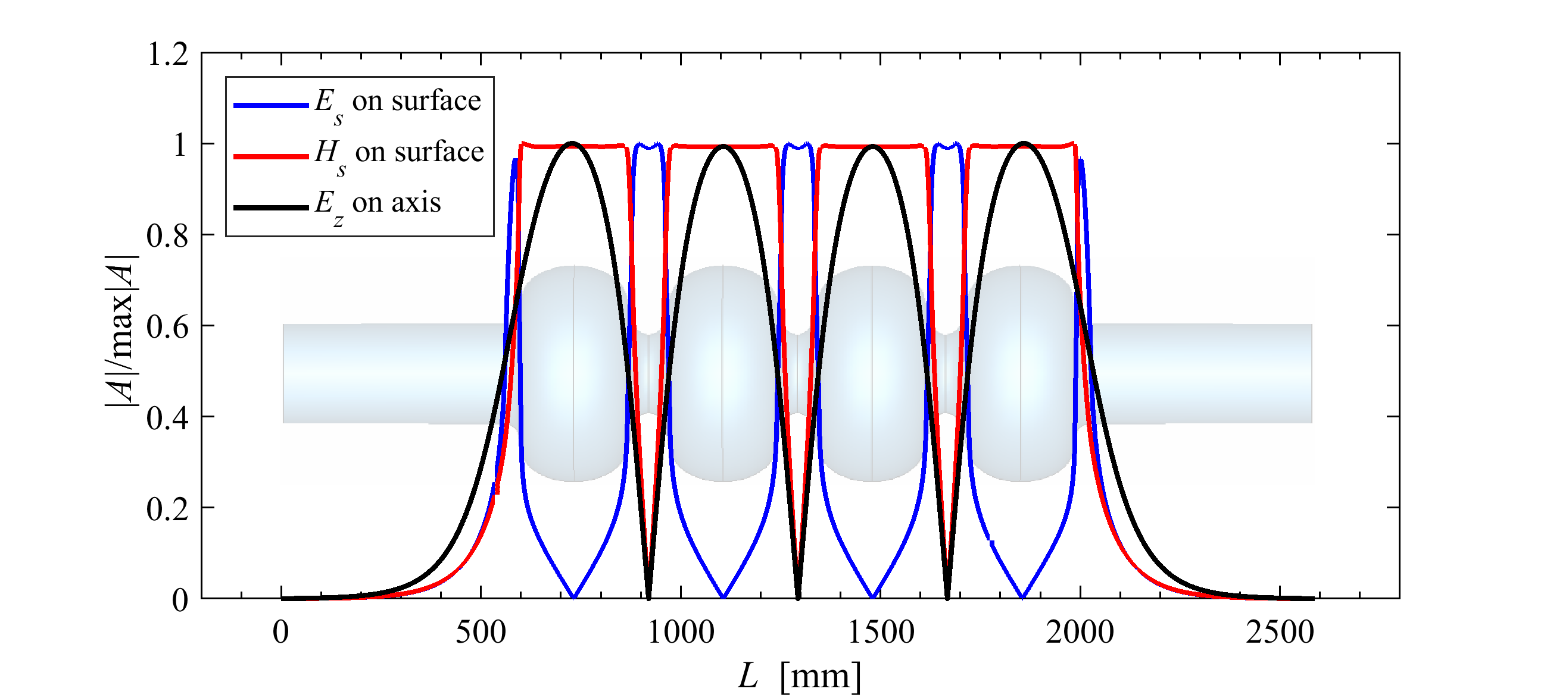
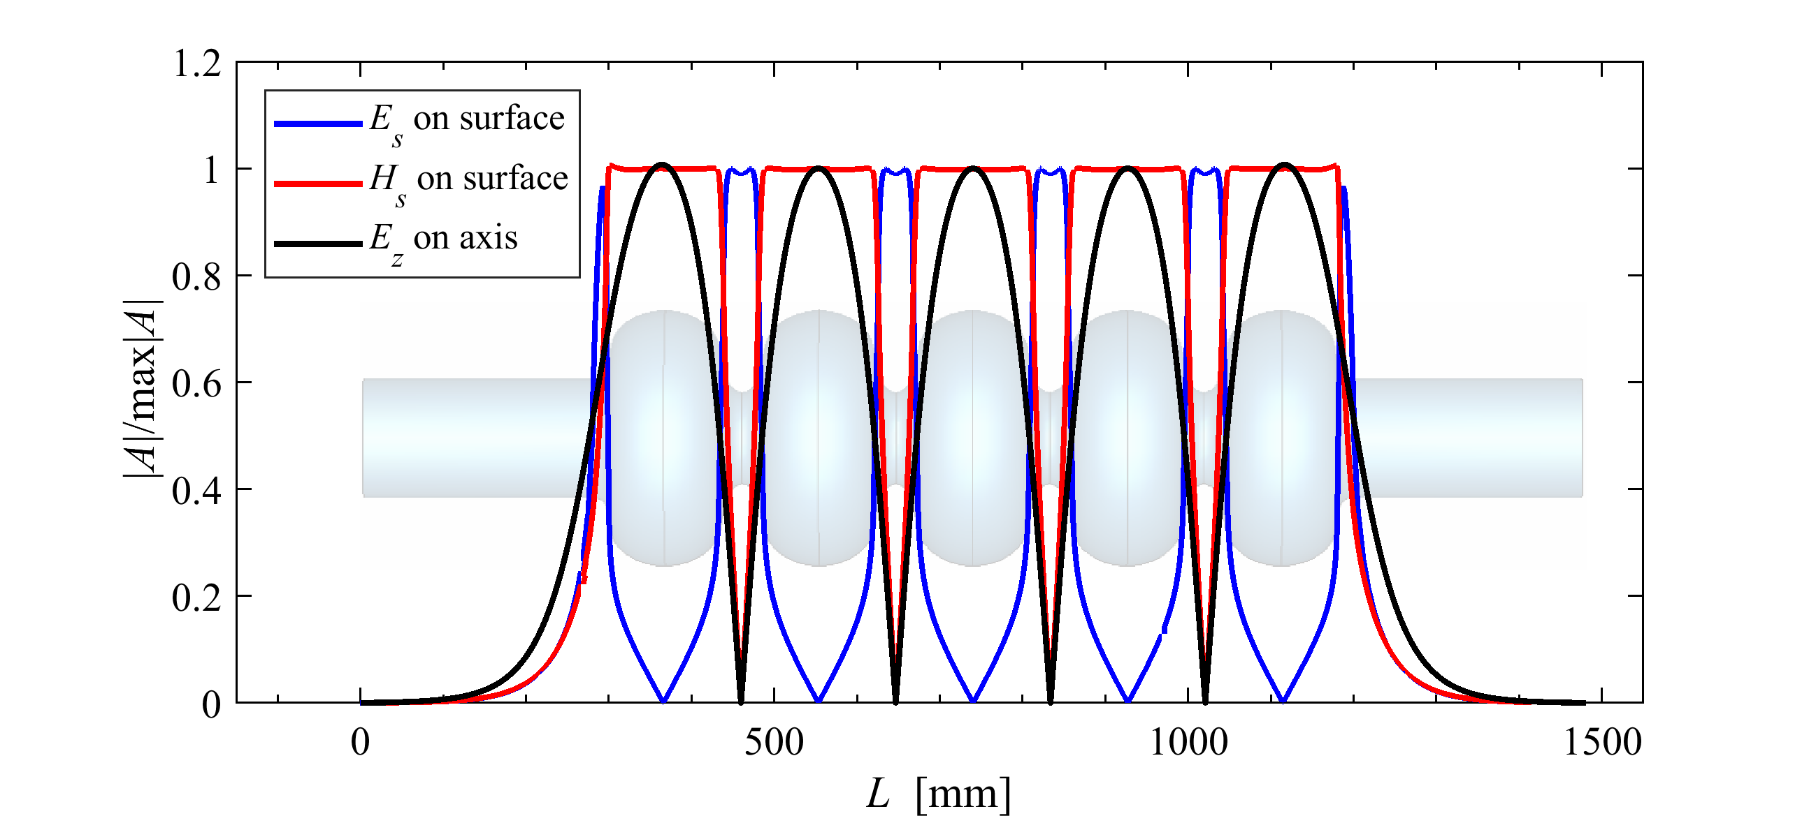
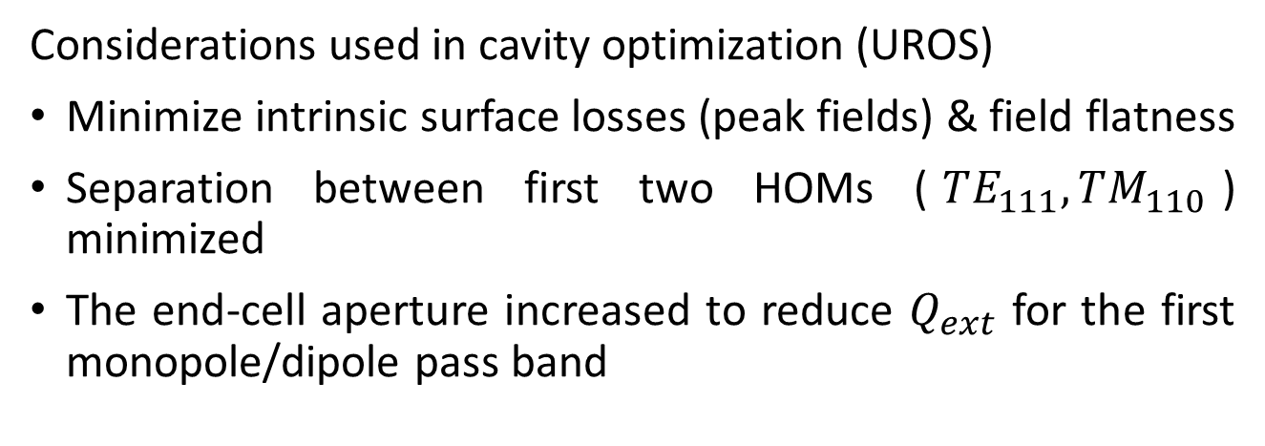
Cavity Optimization
Considerations used in cavity optimization (UROS)
Minimize intrinsic surface losses (peak fields) & field flatness
Separation between first two HOMs ($TE_{111}, TM_{110}$) minimized
The end-cell aperture increased to reduce $Q_{ext}$ for the first monopole/dipole pass band
1-cell cavity at 400.79 MHz
4-cell cavity at 400.79 MHz
5-cell cavity at 801.58 MHz

Slide 5
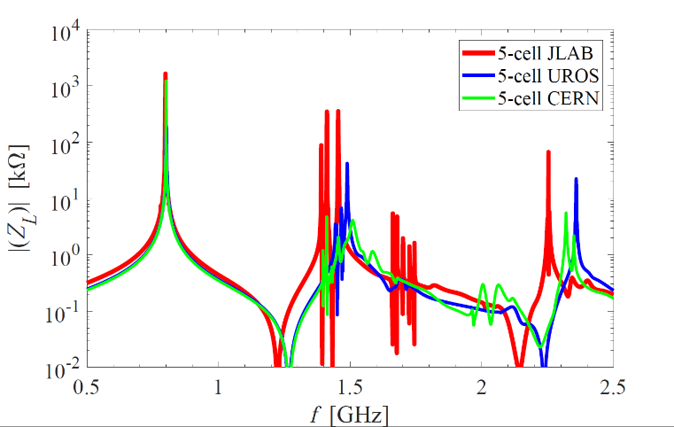
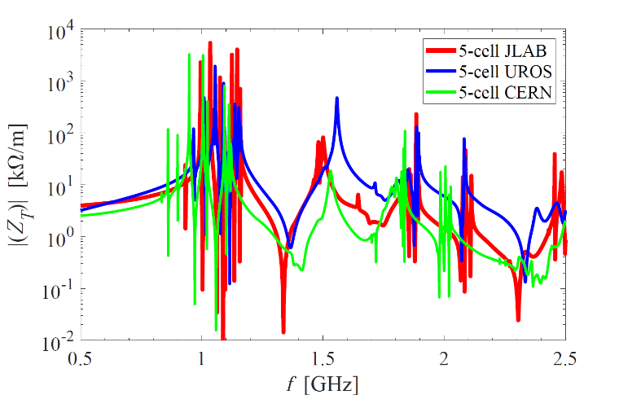
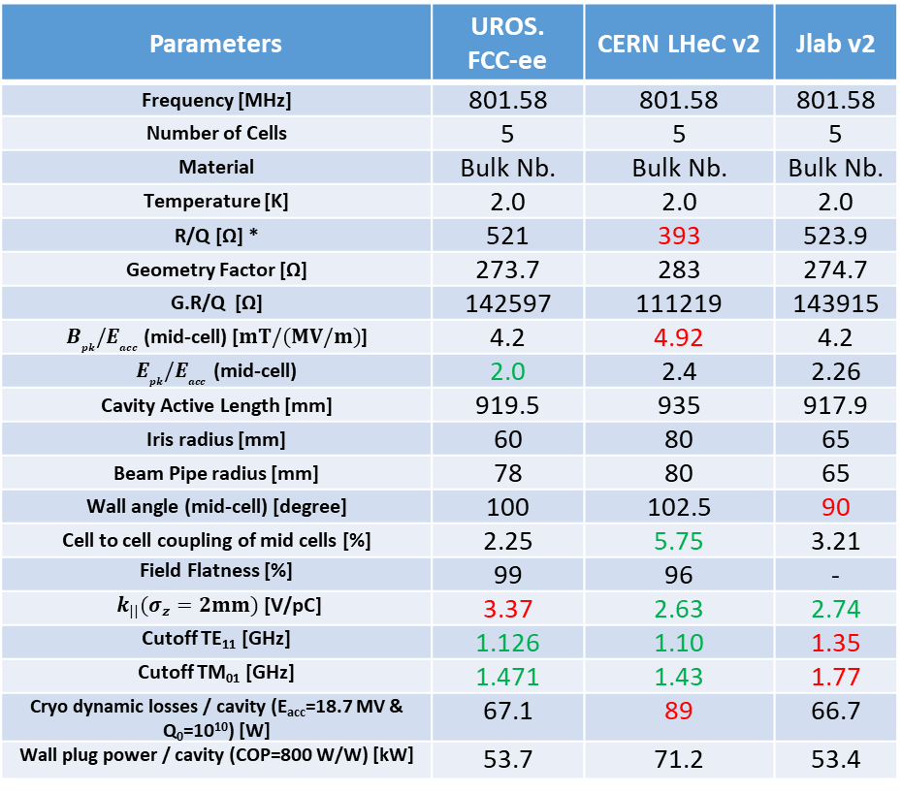
Main Parameters
Parameters | UROS. FCC-ee | CERN LHeC v2 | Jlab v2
Frequency [MHz] | 801.58 | 801.58 | 801.58
Number of Cells | 5 | 5 | 5
Material | Bulk Nb. | Bulk Nb. | Bulk Nb.
Temperature [K] | 2.0 | 2.0 | 2.0
R/Q [Ω] * | 521 | 393 | 523.9
Geometry Factor [Ω] | 273.7 | 283 | 274.7
G.R/Q [Ω] | 142597 | 111219 | 143915
$B_{pk}{/E}_{acc}$ (mid-cell) [$mT/(MV/m)$] | 4.2 | 4.92 | 4.2
$E_{pk}{/E}_{acc}$ (mid-cell) | 2.0 | 2.4 | 2.26
Cavity Active Length [mm] | 919.5 | 935 | 917.9
Iris radius [mm] | 60 | 80 | 65
Beam Pipe radius [mm] | 78 | 80 | 65
Wall angle (mid-cell) [degree] | 100 | 102.5 | 90
Cell to cell coupling of mid cells [%] | 2.25 | 5.75 | 3.21
Field Flatness [%] | 99 | 96 | -
$k_{||}(σ_{z}=2mm)$ [V/pC] | 3.37 | 2.63 | 2.74
Cutoff TE₁₁ [GHz] | 1.126 | 1.10 | 1.35
Cutoff TM₀₁ [GHz] | 1.471 | 1.43 | 1.77
Cryo dynamic losses / cavity (E_{acc}=18.7 MV & Q₀=10¹⁰) [W] | 67.1 | 89 | 66.7
Wall plug power / cavity (COP=800 W/W) [kW] | 53.7 | 71.2 | 53.4
Monopole
Dipole
Note: Impedances are for bare cavity and the peaks are not fully resolved.
*Note: Input power not to be forgotten ($Qe \sim 8×{10}^{6}$ → 40-60 kW, detuning $\sim 50 Hz$)

Slide 6
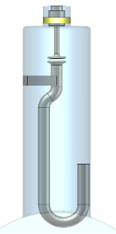
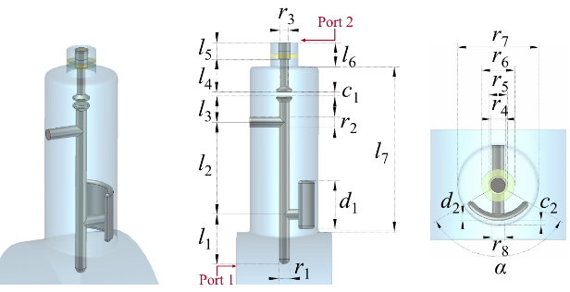
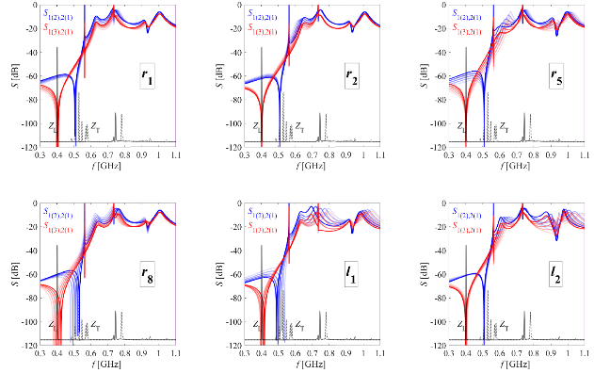
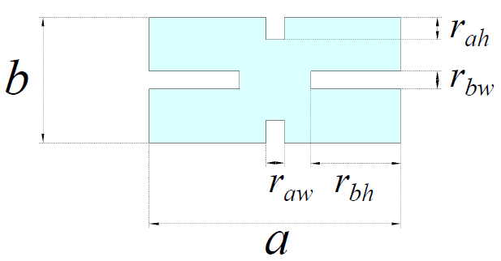
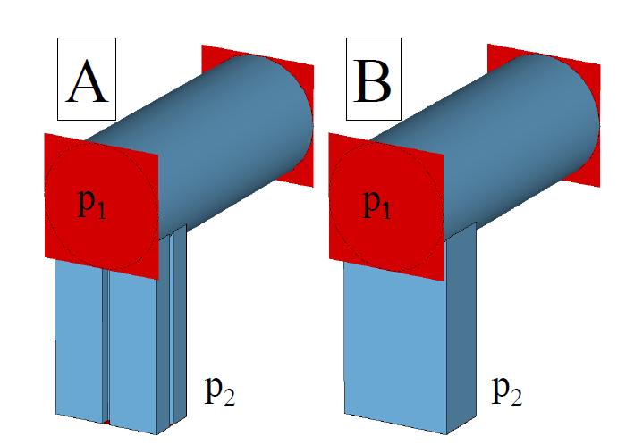
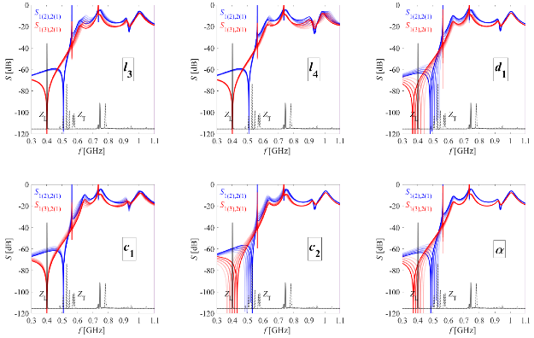
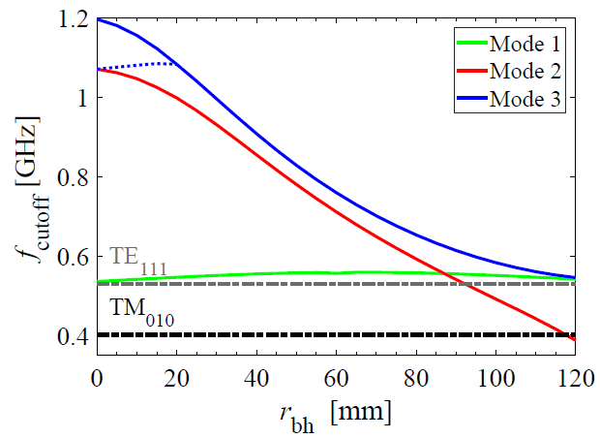
HOM damping
LHC Hook-type
DQW HOM Coupler
LHC Probe-type
Coaxial HOM couplers
  LHC Hook-type coupler
  LHC Probe-type coupler
  DQW coupler
Waveguide (WG) HOM couplers
  Rectangular waveguide coupler (B)
  Quad-ridged waveguide (QRWG) coupler (A)
Cross section of QRWG

Slide 7
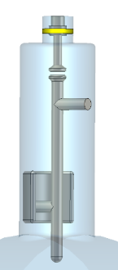

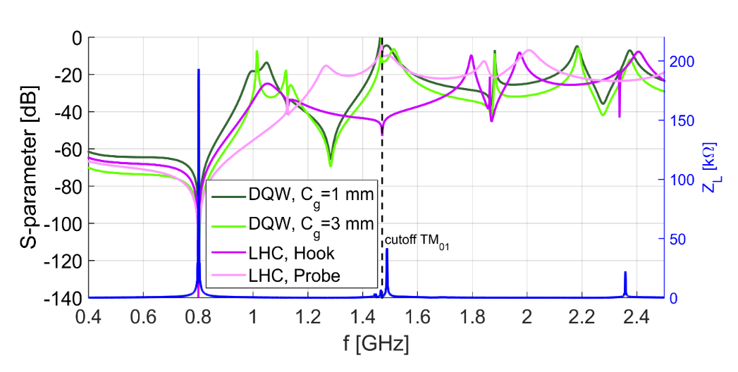
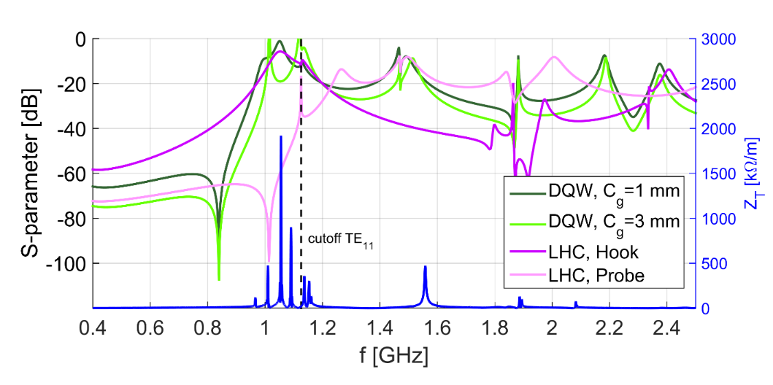
Coaxial HOM Coupler (UROS)
The notch effect of all couplers is tuned to 801.58 MHz for the monopole coupling.
The DQW HOM coupler can deliver a high value of transmission at both first higher order dipole and monopole band.
LHC Probe-type
LHC Hook-type
DQW HOM Coupler
TM01-TEM transmission (Monopole coupling)
TE11-TEM transmission (Dipole coupling)
TE11-TEM transmission (Dipole coupling)
Impedances are for bare cavity and the peaks are not fully resolved.

Slide 8
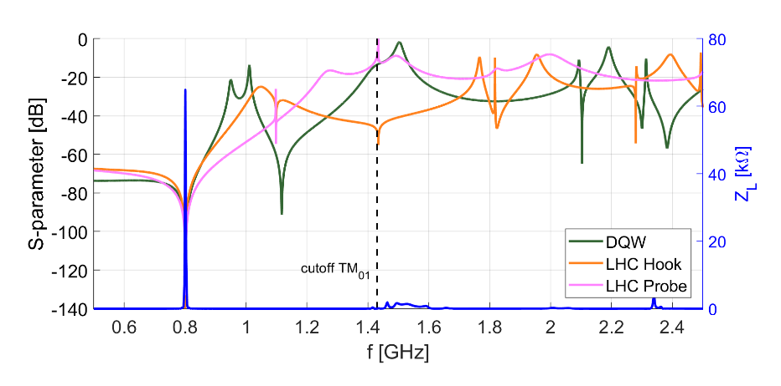
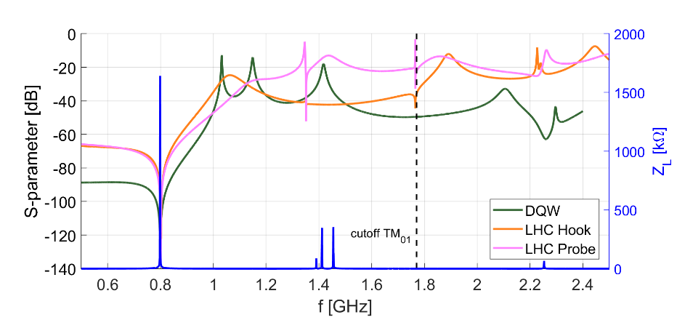
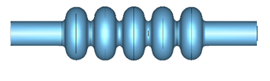

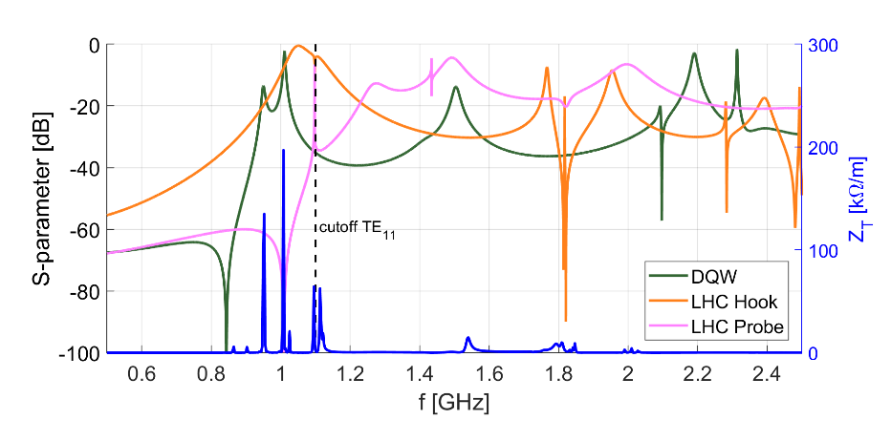
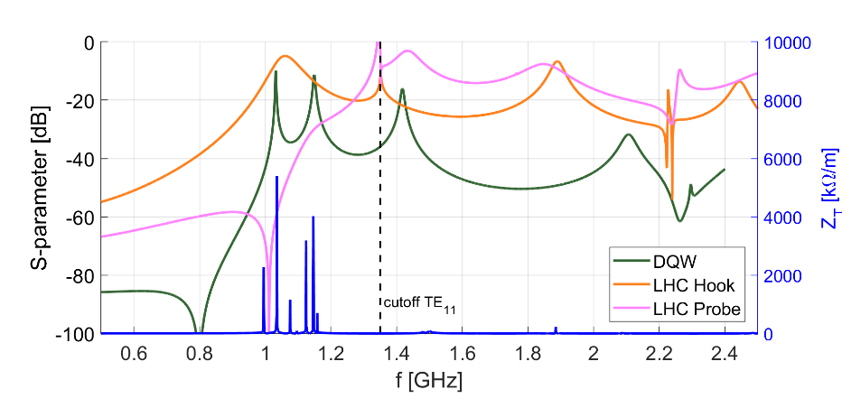
HOM couplers: Cernv2 and Jlab 5-cell
TM01-TEM transmission (Monopole coupling)
TM01-TEM transmission (Monopole coupling)
Cern-v2
Jlab
TE11-TEM transmission (Dipole coupling)
TE11-TEM transmission (Dipole coupling)
Cern-v2
Jlab
Impedances are for bare cavity and the peaks are not fully resolved.

Slide 9
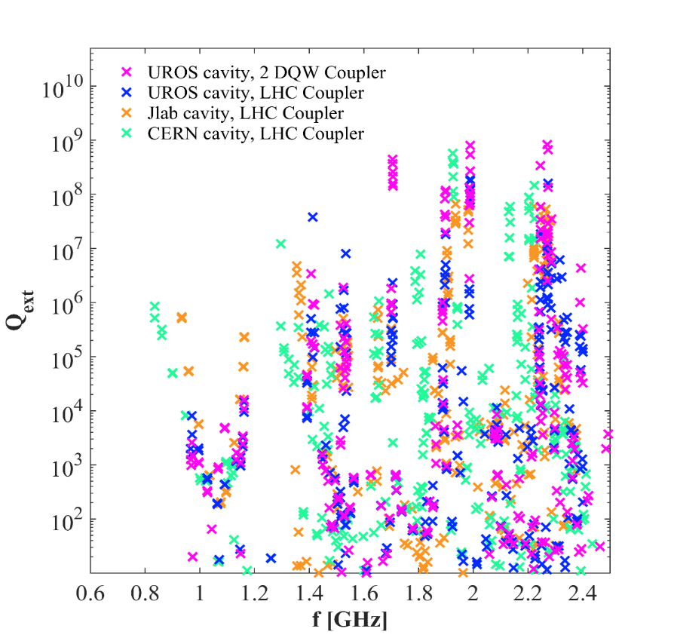

$Q_{ext}$ of Cernv2, Jlab and UROS cavity
Q_{ext} of first dipole band of UROS cavity is smaller because the frequencies of the first dipole band modes are more concentrated and could be damped easier by the HOM coupler.
Few dipole modes of the first dipole band of the UROS cavity are above cutoff frequency and their damping is eased by the help of the beam pipes.
Using different type of couplers (LHC type couplers) lowers the risk of having high Q_{ext} in frequencies for which the coupler is not tuned (that helps to avoid having a trapped mode with Q_{ext} close to Q₀ of the cavity)
Nonlinear eigenmode solver of CST STUDIO 2018 is used for the calculation of Q_{ext}

Slide 10
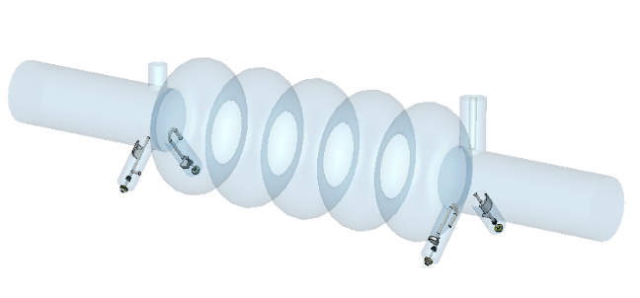
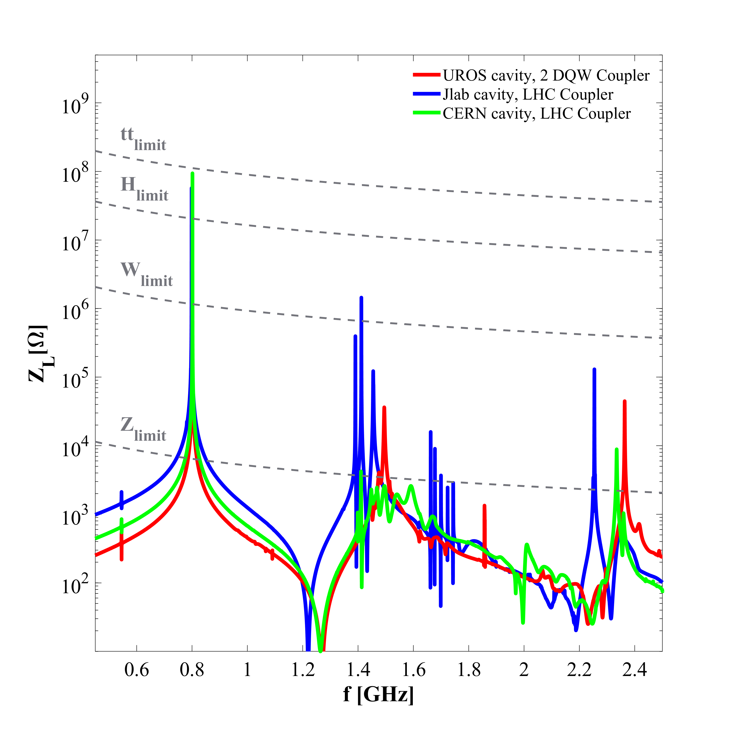
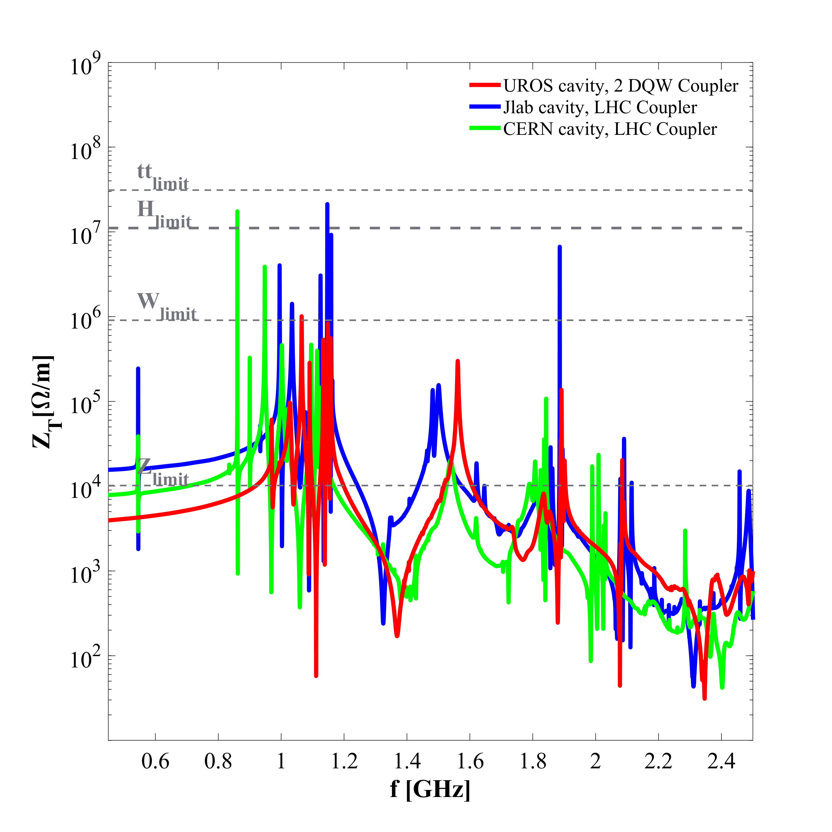
Cernv2, Jlab and UROS cavity impedance with coaxial HOM coupler
*There are different versions of Jlab cavity. For further information see “Next Generation HOM damping” by F. Marhauser

Slide 11
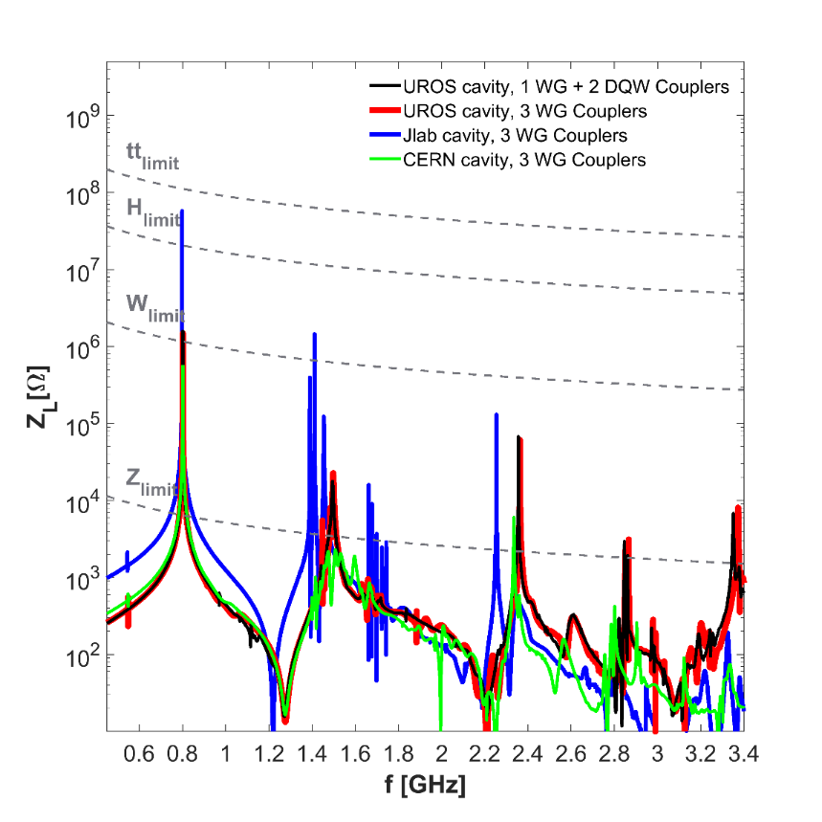
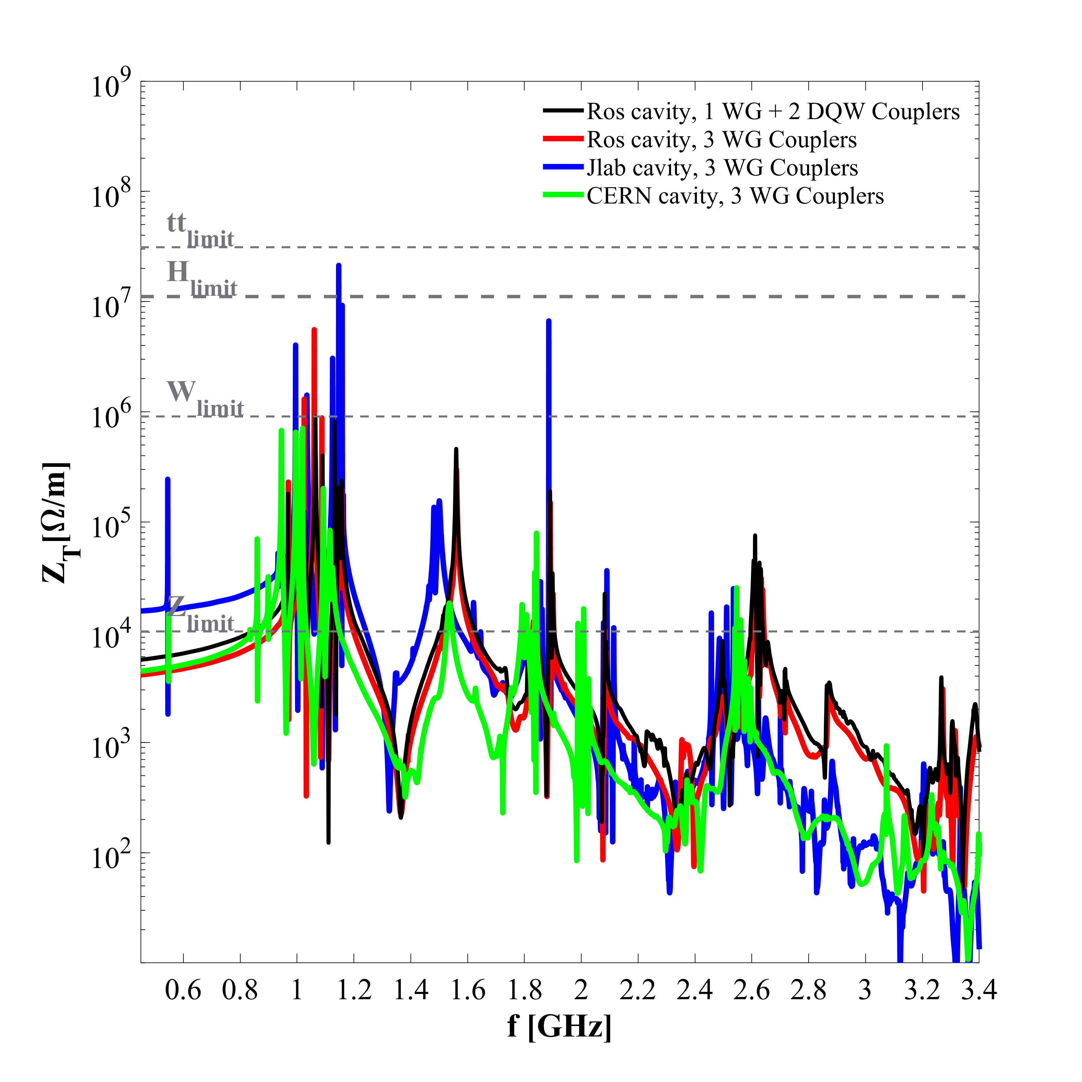
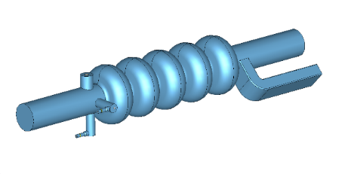
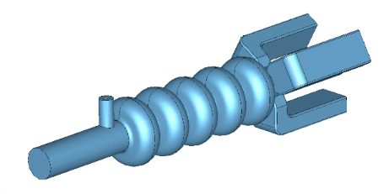
Cernv2, Jlab and UROS cavity impedance
Coaxial coupler performs better than waveguide couplers in damping the first dipole band (studies done for FCC-ee)
1 WG + 2 DQW Couplers
WG cutoff frequency is set at 1.11 GHz
3 WG Couplers
WG cutoff frequency is set at 0.91 GHz
*There are different versions of Jlab cavity. For further information see “Next Generation HOM damping” by F. Marhauser

Slide 12
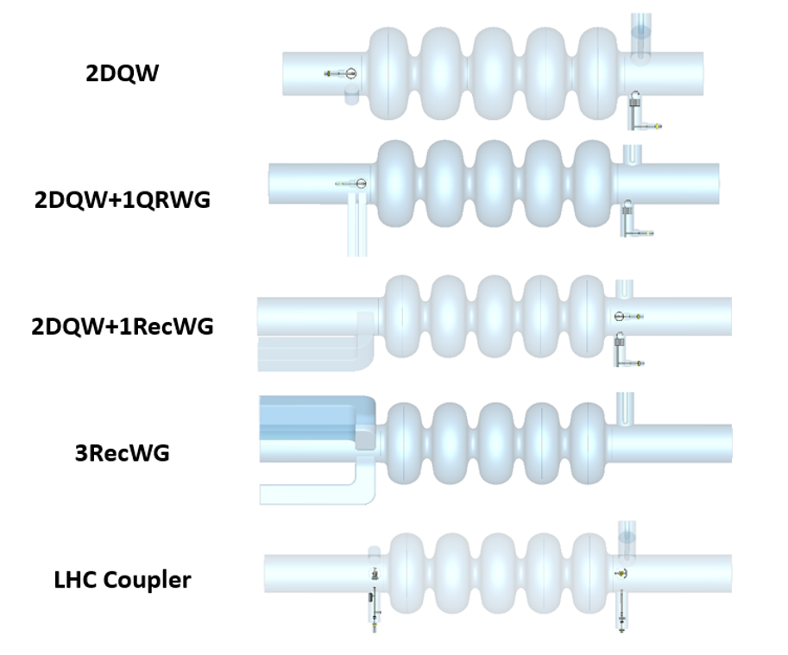

Damping schemes for the $t\overline{t}$ running
Five damping schemes are compared in the following slides
7.7 m

Slide 13
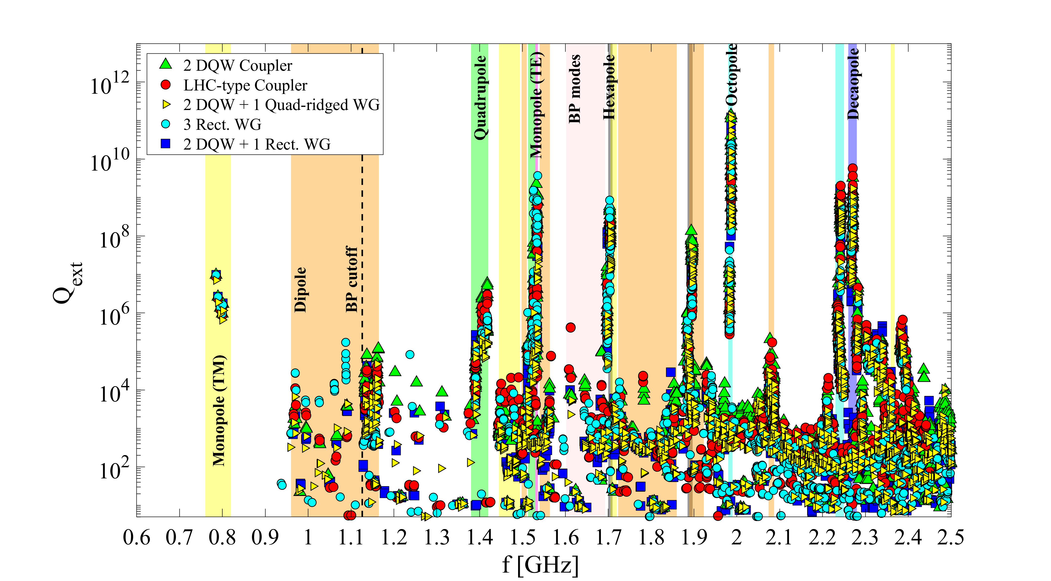
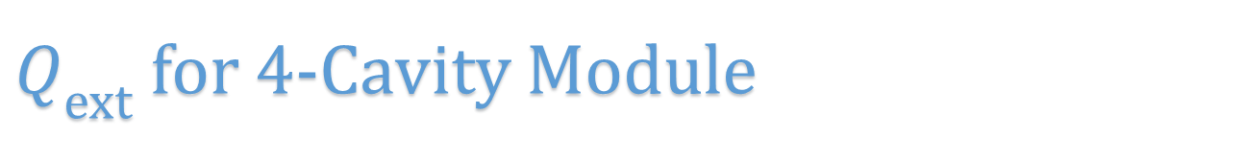
$Q_{ext}$ for 4-Cavity Module
Above the waveguide’s cutoff frequency the damping of monopole, dipole and quadrupole bands is improved by adding a WG
Octopole and decapole modes are trapped, thus using a different coupler does not influence their damping

Slide 14
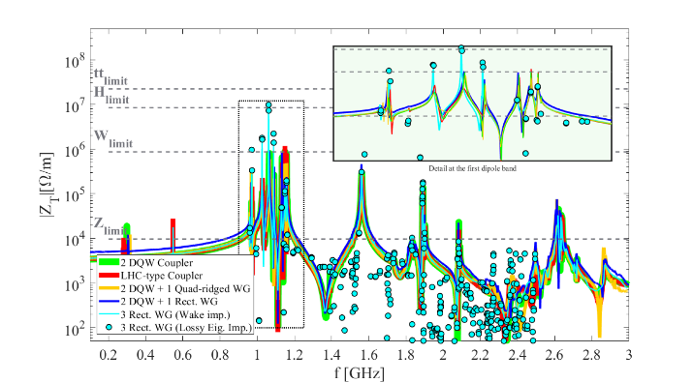
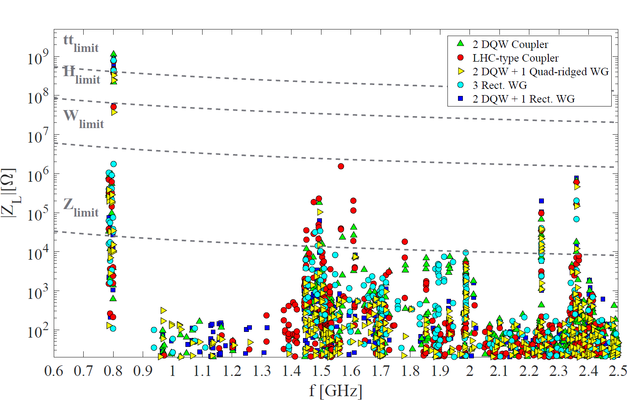
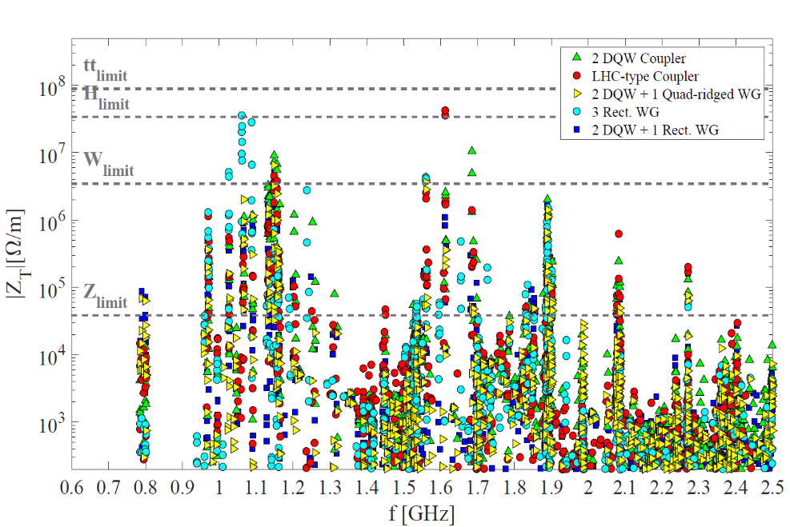
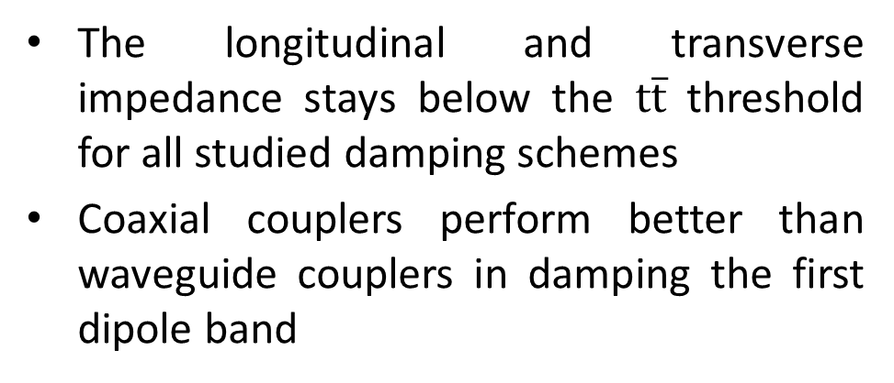
Impedance of the five-cell cavities
The longitudinal and transverse impedance stays below the $t\overline{t}$ threshold for all studied damping schemes
Coaxial couplers perform better than waveguide couplers in damping the first dipole band
One cavity (wake length 1000m)
Four-cavity module (from SSC method)
Four-cavity module (from SSC method)
Modes trapped in the beam-pipe

Slide 15
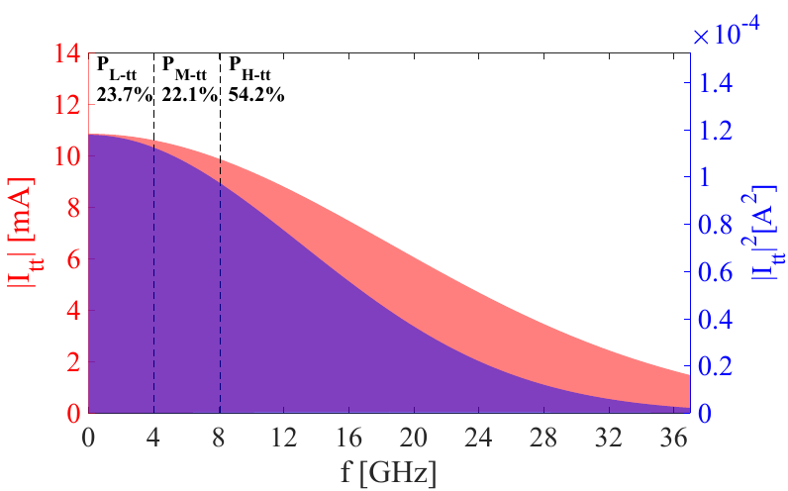
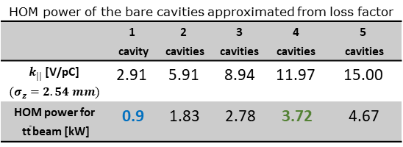
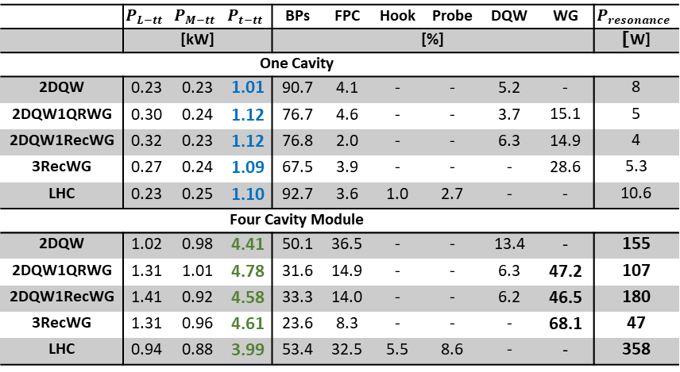
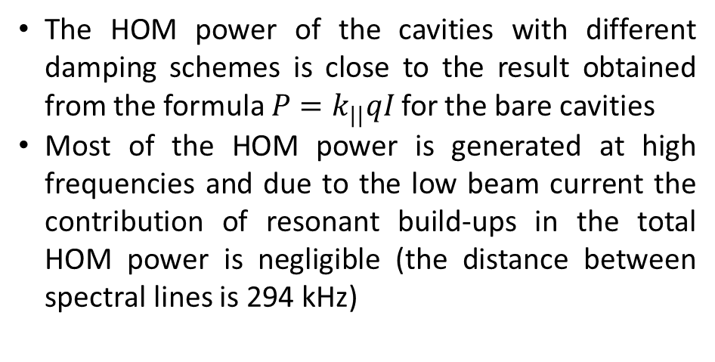

HOM power of the five-cell cavities
The HOM power of the cavities with different damping schemes is close to the result obtained from the formula $P=k_{||}qI$ for the bare cavities
Most of the HOM power is generated at high frequencies and due to the low beam current the contribution of resonant build-ups in the total HOM power is negligible (the distance between spectral lines is 294 kHz)
The total power is approximated by
$P_{t−tt}=P_{L−tt}+P_{M−tt}+\frac{54.2}{22.1}P_{M−tt}$
With one WG per cavity, around half of the HOM power is absorbed by the WG couplers
 | $$P_{L−tt}$$ | $$P_{M−tt}$$ | $$P_{t−tt}$$ | BPs | FPC | Hook | Probe | DQW | WG | $$P_{resonance}$$
 | [kW] |  |  | [%] |  |  |  |  |  | [W]
One Cavity
2DQW | 0.23 | 0.23 | 1.01 | 90.7 | 4.1 | - | - | 5.2 | - | 8
2DQW1QRWG | 0.30 | 0.24 | 1.12 | 76.7 | 4.6 | - | - | 3.7 | 15.1 | 5
2DQW1RecWG | 0.32 | 0.23 | 1.12 | 76.8 | 2.0 | - | - | 6.3 | 14.9 | 4
3RecWG | 0.27 | 0.24 | 1.09 | 67.5 | 3.9 | - | - | - | 28.6 | 5.3
LHC | 0.23 | 0.25 | 1.10 | 92.7 | 3.6 | 1.0 | 2.7 | - | - | 10.6
Four Cavity Module
2DQW | 1.02 | 0.98 | 4.41 | 50.1 | 36.5 | - | - | 13.4 | - | 155
2DQW1QRWG | 1.31 | 1.01 | 4.78 | 31.6 | 14.9 | - | - | 6.3 | 47.2 | 107
2DQW1RecWG | 1.41 | 0.92 | 4.58 | 33.3 | 14.0 | - | - | 6.2 | 46.5 | 180
3RecWG | 1.31 | 0.96 | 4.61 | 23.6 | 8.3 | - | - | - | 68.1 | 47
LHC | 0.94 | 0.88 | 3.99 | 53.4 | 32.5 | 5.5 | 8.6 | - | - | 358
HOM power of the bare cavities approximated from loss factor
 | 1 cavity | 2 cavities | 3 cavities | 4 cavities | 5 cavities
$k_{||}$[V/pC] $(σ_{z}=2.54 mm)$ | 2.91 | 5.91 | 8.94 | 11.97 | 15.00
HOM power for $\text{t}\overline{\text{t}}$ beam [kW] | 0.9 | 1.83 | 2.78 | 3.72 | 4.67

Slide 16
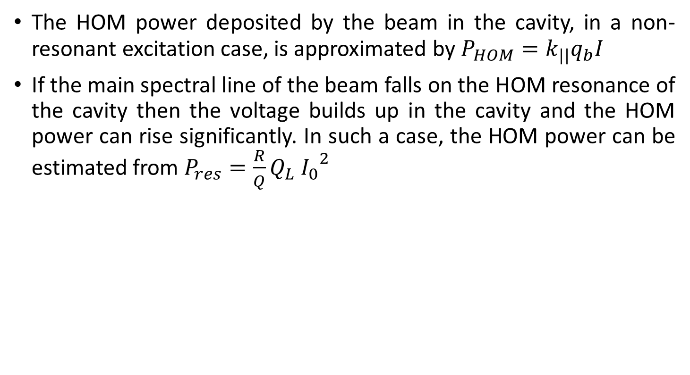
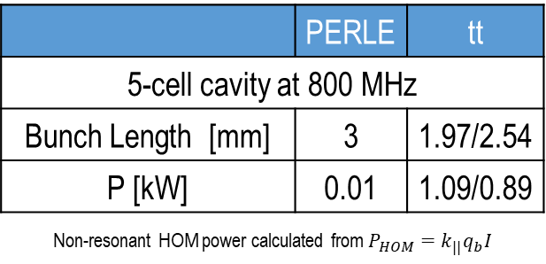
HOM power of 5-cell for PERLE beam
The HOM power deposited by the beam in the cavity, in a non-resonant excitation case, is approximated by $P_{HOM}=k_{||}q_{b}I$
If the main spectral line of the beam falls on the HOM resonance of the cavity then the voltage builds up in the cavity and the HOM power can rise significantly. In such a case, the HOM power can be estimated from $P_{res}=\frac{R}{Q}Q_{L}{ I_{0}}^{2}$
 | PERLE | tt
5-cell cavity at 800 MHz
f* [GHz] | P_{res} [W]
1.49 | 16 | 8
2.36 | 20 | 10
* Resonance excitation power of two monopole modes with the highest longitudinal impedance
 | PERLE | tt
5-cell cavity at 800 MHz
Bunch Length [mm] | 3 | 1.97/2.54
P [kW] | 0.01 | 1.09/0.89
Non-resonant HOM power calculated from $P_{HOM}=k_{||}q_{b}I$

Slide 17
Appendix

Slide 18
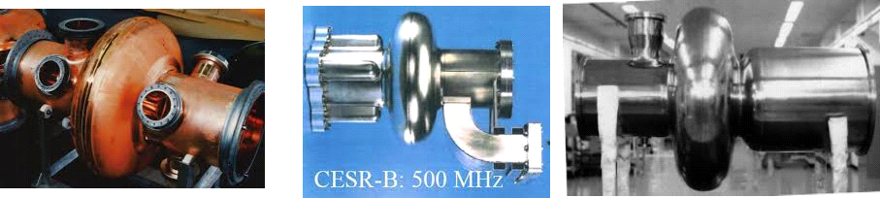
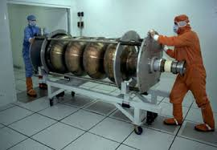

FCC-ee, Cavity Options
Single cell for high current (Z-pole, FCC-hh)
400 MHz: LHC, Nb-Cu
500 MHz: KEKB, Nb
400 MHz 4-cell for higher energies
352 MHz: LEP, bulk Nb variant
352 MHz: LEP, Nb-Cu

Slide 19


HOM Power (Average)
The high HOM power of Z machine reaffirms the choice of 1-cell cavity at 400 MHz
Coaxial HOM couplers can handle the HOM power of H and $t\overline{t}$
 | Z | W | H | $$t\overline{t}$$
4-cell cavity at 400 MHz
Bunch Length [mm] | P [kW] | P [kW] | P [kW] | P [kW]
SR (3.5, 3.0, 3.15, 1.97) | 47.95 | 5.09 | 1.16 | 0.81
BS (12.1, 6.0, 5.3, 2.54) | 17.34 | 2.89 | 0.76 | 0.66
5-cell cavity at 800 MHz
Bunch Length [mm] | P [kW] | P [kW] | P [kW] | P [kW]
SR (3.5, 3.0, 3.15, 1.97) | 66.11 | 6.94 | 1.59 | 1.09
BS (12.1, 6.0, 5.3, 2.54) | 23.91 | 4.09 | 1.06 | 0.89
* Average HOM power for both BS and SR bunch lengths calculated from $P_{HOM}=k_{||}q_{b}I$

Slide 20

Three Scenarios: FCC-ee
 |  | Z | W | H |  | $$t\overline{t}$$
 | Total beam voltage [GV] | 0.1 | 0.75 | 2.0 |  | 5.465 |  | 10.93
Scenario 1 | Voltage [GV] | 0.1 | 0.75 | 2.0 |  | 2.0 (5.465) | 3.465 | Reorder and align both rings for the rest
 | f [MHz] | 400 | 400 | 400 |  | 400 | 800
 | No. cell per cavity | 1 | 4 | 4 |  | 4 | 5
 | No. Cavities per beam | 52 | 52 | 136 |  | 136 (364) | 186
 | E_{acc} [MV/m] | 5.1 | 9.6 | 9.8 |  | 9.8 (10.0) | 19.9
 | P_{cav} [kW] | 962 | 962 | 367 |  | 150 (137) | 158
 | Q_{ext} [10⁶] | 0.045 | 0.53 | 1.44 |  | 3.51 (4.01) | 4.22
 | P_{HOM} (SR / BS) [kW] | 9.5 / 3.7 | 5.09 / 2.89 | 1.16 / 0.76 |  | 0.81 / 0.66 | 1.09 / 0.89
Scenario 2 | Voltage [GV] | 0.1 | 0.75 | 2.0 |  | 2.0 (5.465) | 3.465 | Reorder and align both rings for the rest
 | f [MHz] | 400 | 400 | 400 |  | 400 | 800
 | No. cell per cavity | 1 | 2 | 2 |  | 2 | 5
 | No. Cavities per beam | 52 | 100 | 268 |  | 268 (732) | 186
 | E_{acc} [MV/m] | 5.1 | 10.0 | 10.0 |  | 10.0 (10.0) | 19.9
 | P_{cav} [kW] | 962 | 500 | 186 |  | 76 (68) | 158
 | Q_{ext} [10⁶] | 0.045 | 0.59 | 1.58 |  | 3.86 (4.33) | 4.22
 | P_{HOM} (SR / BS) [kW] | 9.5 / 3.7 | 1.91 / 1.19 | 0.44 / 0.31 |  | 0.28 / 0.24 | 1.09 / 0.89
Scenario 3 | Voltage [GV] | 0.1 | 0.75 | 0.75 | 1.25 | 0.75 | 4.715 | Reorder and align both rings for the rest
 | f [MHz] | 400 | 400 | 400 | 800 | 400 | 800
 | No. cell per cavity | 1 | 2 | 2 | 5 | 2 | 5
 | No. Cavities per beam | 52 | 100 | 100 | 68 | 100 | 252
 | E_{acc} [MV/m] | 5.1 | 10.0 | 10.0 | 19.7 | 10.0 | 20.0
 | P_{cav} [kW] | 962 | 500 | 207 | 430 | 77 | 167
 | Q_{ext} [10⁶] | 0.045 | 0.59 | 1.44 | 1.51 | 3.84 | 4.03
 | P_{HOM} (SR / BS) [kW] | 9.5 / 3.7 | 1.91 / 1.19 | 0.44 / 0.31 | 1.59 / 1.06 | 0.28 / 0.24 | 1.09 / 0.89

Slide 21


FCC-ee Layout
45-175 GeV $e^{+}e^{−}$ collider with superconducting RF cavities as the main driver
0.1-9.5 GV to compensate synchrotron radiation
Maximum available power 50 MW determines the maximum current at each energy

Slide 22



FCC-ee RF Layout
Two straight sections of 2.8 km, symmetrically placed
At 175 GeV $ΔE$ between two RF sections $\sim 2\%$, energy losses from HOMs are not significant $\sim 20 MeV$per turn

Slide 23

FCC-ee, CDR Baseline
Present baseline considers 400 MHz, Nb-Cu technology for all options
An alternative: Hybrid option using 5-cell 800 MHz for H, ttbar options are also studied
400 MHz 4-cell (W, H, ttbar)
2-Cell an option, not baseline
400 MHz 1-cell (Z, FCC-hh)

Slide 24


FCC-ee RF Constraints
Large variation of detuning between Z-pole and ttbar (detuning ${≫f}_{rev}$)
Large HOM power for high current

Slide 25

FCC-ee Injector
Injector: Requires fast rep rate and top up injection with a booster ring foreseen at full energy
Assumes total currents much lower
  RF source is modest (SSPA?) but injection transients need detailed study
  The # of cavities determined by FCC-ttbar (10 GV)
  FCC-Z, with 2x9000 bunches → 60 kW (@1 MV) → 10MW
  400 MHz 4-cell (or 5-cell 800 MHz) is assumed baseline to be consistent collider technology

Slide 26




Input Power & Coupler
Choice of $Q_{L}$ is not unique, two available designs (E. Montesinos)
 | Z | W | H | ttbar | H | ttbar | FCC hh
Freq | 400 MHz |  |  |  | 800 MHz |  | 400 MHz
MV/m | 5 | 10 |  |  | 20 (?) |  | 5
kW | 1000 |  | 500 | 200 | 300 | 100 | 1000
Coupling | Fixed | Fixed | Two fixed positions no venting |  |  |  | Mobile
LHC
High Gradient

Slide 27







Beam Loading, Z
Assuming detuning $=Δω_{opt}/\sin^{2}{φ_{s}}$
$$I_{b,RF}\left(t\right)=2I_{b,DC}{\left[1+a_{b}\left(t\right)\right]e}^{−i\left[φ_{b}\left(t\right)+φ_{s}\right]}$$
$$V\left(t\right)=V_{cav}{\left[1+a_{V}\left(t\right)\right]e}^{iφ\left(t\right)}$$
$a_{V}\left(t\right)$ – amplitude modulation $→$ spread of $σ$ and $Q_{s}$
$φ\left(t\right)$ – phase modulation $→$ collision point shift
Modulation dominated by abort gap ($t_{gap} >2 μs$) $→$pk-to-pk: $a_{V}$ > 6%, $φ$ > 70 ps
$→$ Collision point shift gap transients are matched
$$Δω_{opt}=ω_{0}−ω_{RF}=−ω_{RF}\frac{\left\langle I_{b,RF}\right\rangle R/Q sin\left(φ_{s}\right)}{2V_{cav}}$$

Slide 28





LLRF, Long. Coupled Bunch
For short Gaussian bunches the growth rate of the mode m is*
$$\frac{1}{τ_{m}}≈\frac{eηω_{RF}}{4πEQ_{s}}I_{b,DC}N_{cav}\left(Re{\{Z}_{∥}\left[ω_{RF}+\left(m+Q_{s}\right)ω_{rev}\right]\}−Re{\{Z}_{∥}\left[ω_{RF}−\left(m+Q_{s}\right)ω_{rev}\right]\}\right)$$
For the fundamental mode impedance & optimum detuning ($\sim 4×f_{rev}$)
the most unstable mode is $m=$ -4
Mitigation with strong RF feedback using flat response
$$1/G=R/Qω_{RF}τ_{d}$$
Loop delay $τ_{d}≈700$ ns (similar to LHC)
Feedback on

Slide 29



LLRF, RF Noise
10-1000 Hz – Reference Noise
10-400 kHz – Measurement Noise
50 Hz – HV ripples, Dips - OTFB
FCC
LHC

Slide 30






HOM Power & Stability, Z
For resonant case, long. coupled-bunch, HOMs
stability
$$\frac{1}{τ}=\frac{e\left|η\right|I_{b,DC}}{2EQ_{s}}f_{r}R$$
If $τ>τ_{SR}$ $→$ stability
For non-resonant cases
Weak scaling with bunch or train spacing for modes above cut-off

Slide 31


HOMs vs. Filling Schemes
Resonant case when the beam spectral line overlaps with HOM if $\left|1−\frac{\left[f_{r}t_{tt}\right]}{f_{r}t_{tt}}\right|<\frac{1}{Q}$
Some filling schemes should be avoided in machine operation (implying restrictions for train and bunch spacings)
Dangerous
Present design
Safe

Slide 32

FCC-ee, CDR Baseline
Proposed staging of the different energies (O. Brunner et al.)
400 MHz CMs
400 MHz CMs
800 MHz CMs
H
ttbar1, ttbar2
Re-arrange to share RF system between beams 1&2

