Slide 1
Gravitational waves
A new area of astronomy
Christelle Buy
Christelle.buy@l2it.in2p3.fr
Optical engineer
CNRS/IN2P3 – L2IT

Slide 2
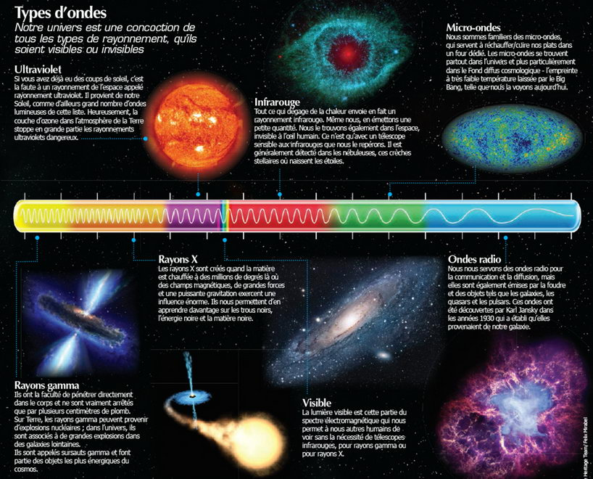
Overview
The universe is mainly observed and studied thanks to electro-magnetic (EM) waves
WE estimate to know only 10% of the observable universe with EM

Slide 3

Overview
GW – space-time curvature disturbance – generated by accelerated supermassive objects open a new field of analysis
  Test of the general theory relativity
  Information of the state equation of neutron stars
  Physics of supernovae
  Cosmology
  Detection of cosmological background
  In general…a new messenger for astrophysics and cosmology

Slide 4
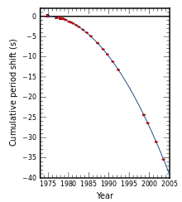
Overview
Use another way: gravitational waves (GW)
Predicted by Einstein in 1915 (general relativity)
Observed indirectly by Hulse & Taylor in 1974 (orbital degenration of Pulsar PSRB19+16 due to gravitational radiation)
- Detected pulsed radio emissions: pulsar
- Systematic variation in the arrival time of the pulses, periodicly
- Pulsar in binary orbit with another pulsar (neutron star): binary system
- Orbital decay of the binary system: emission of energy in the form of GW

Slide 5

What is a GW?

Slide 6

What is a GW?

Slide 7
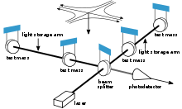
How to detect GW?
When they reach the Earth, the amplitude of the GW is of the order of 10⁻²²-10⁻²³ -> extremly sensitive detector are needed
  Interferometric detectors

Slide 9
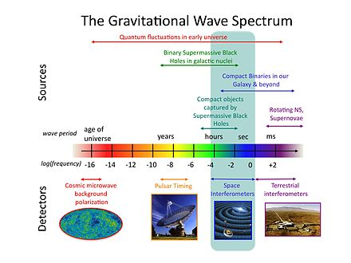
Detectors
Advanced Virgo (France/Italie)
LIGO Hanford & Livingston (USA) + site Inde
GEO (Allemagne)
KAGRA (Japon)
LISA (consortium / ESA / NASA)

Slide 10
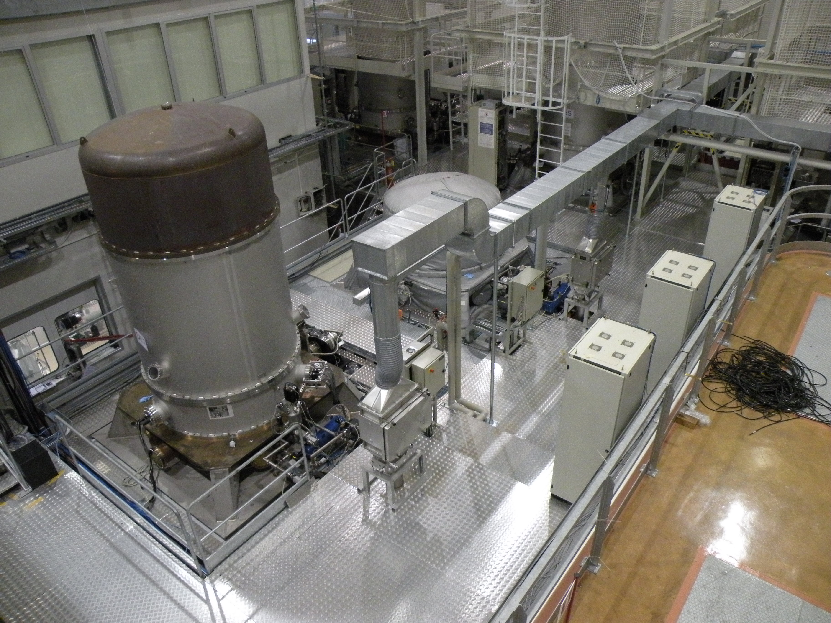
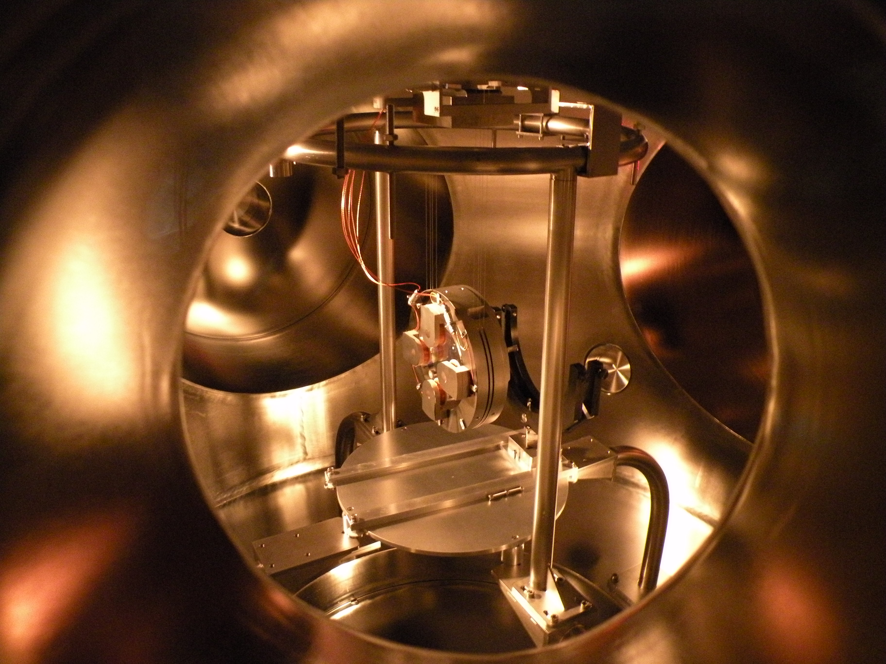
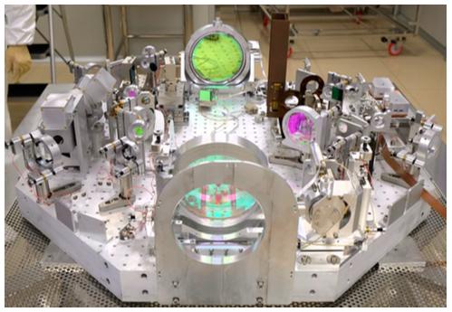
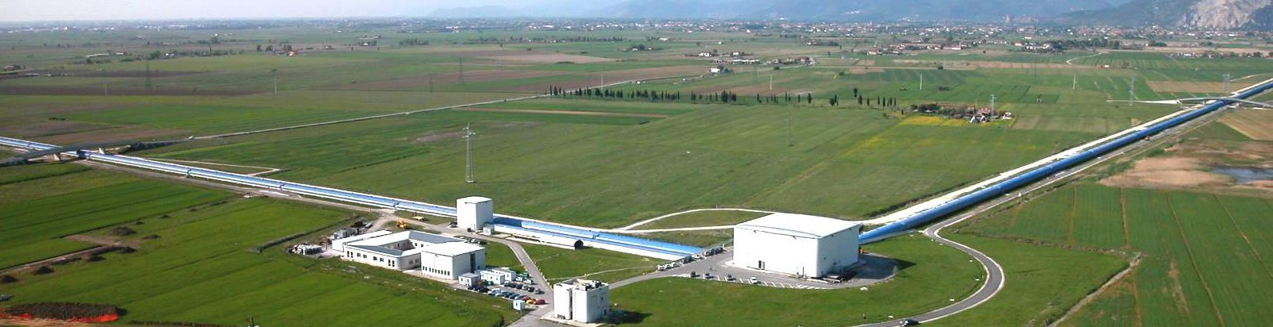
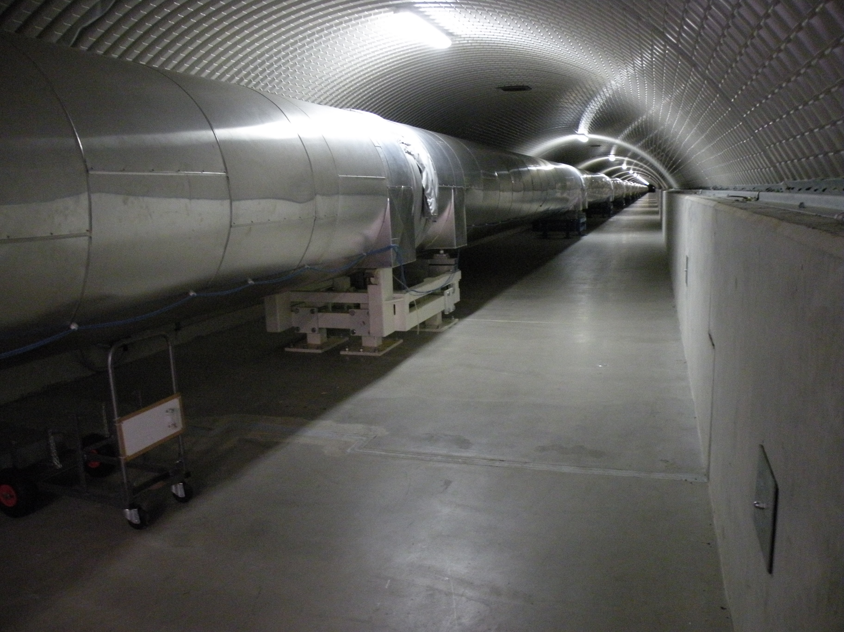
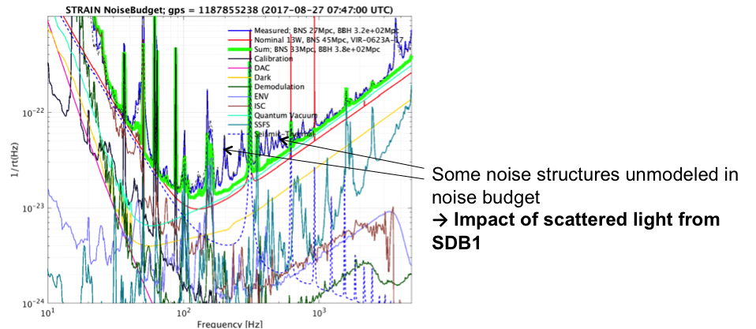
Virgo
Super attenuators
Suspended mirrors
Suspended benches
Suspended optical bench
Diffused light
Long arms (vacuum 10⁻⁹ mbar)

Slide 11
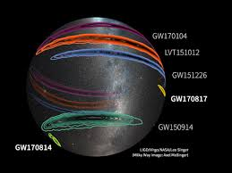
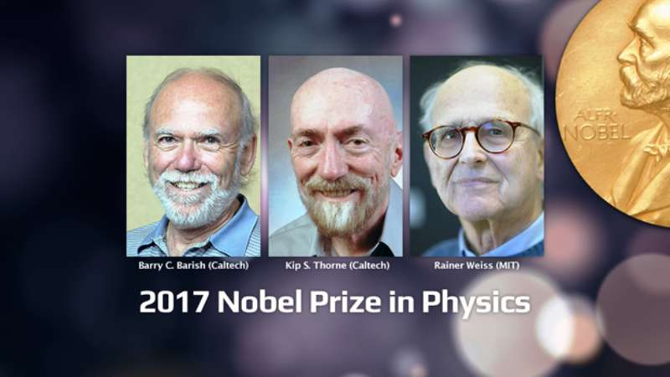
Direct detection
First direct detection in september 2015 (LIGO) public disclosure february 2016: GW150914
Joint detection LIGO/Virgo and 70 EM Telescope (multi messenger) in august 2017: GW170817
Physic’s Nobel Prize in 2017
Detector improvement: Avanced Virgo+, A+ (LIGO), + Einstein Telescope, LIGO Voyager, Cosmic Explorer

Slide 12
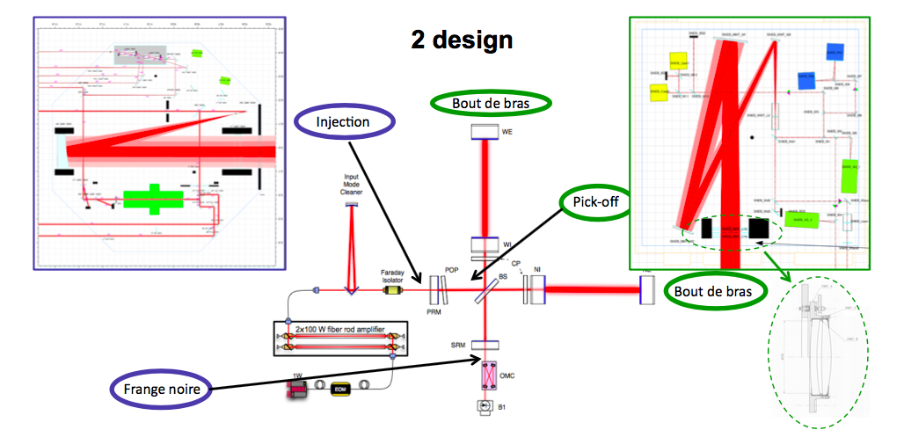
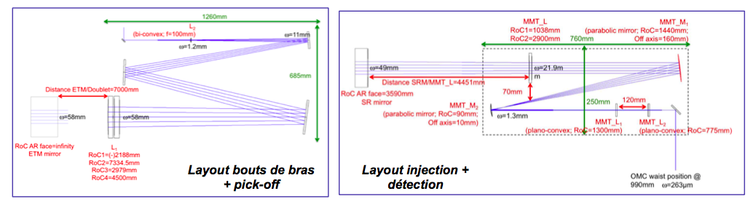
Optical contribution (challenge)/1
Advanced Virgo:
Mode-matching Telescopes (five)
Optical design, mechanical design of the mounts, realization, tests, integration and commisssioning

Slide 13
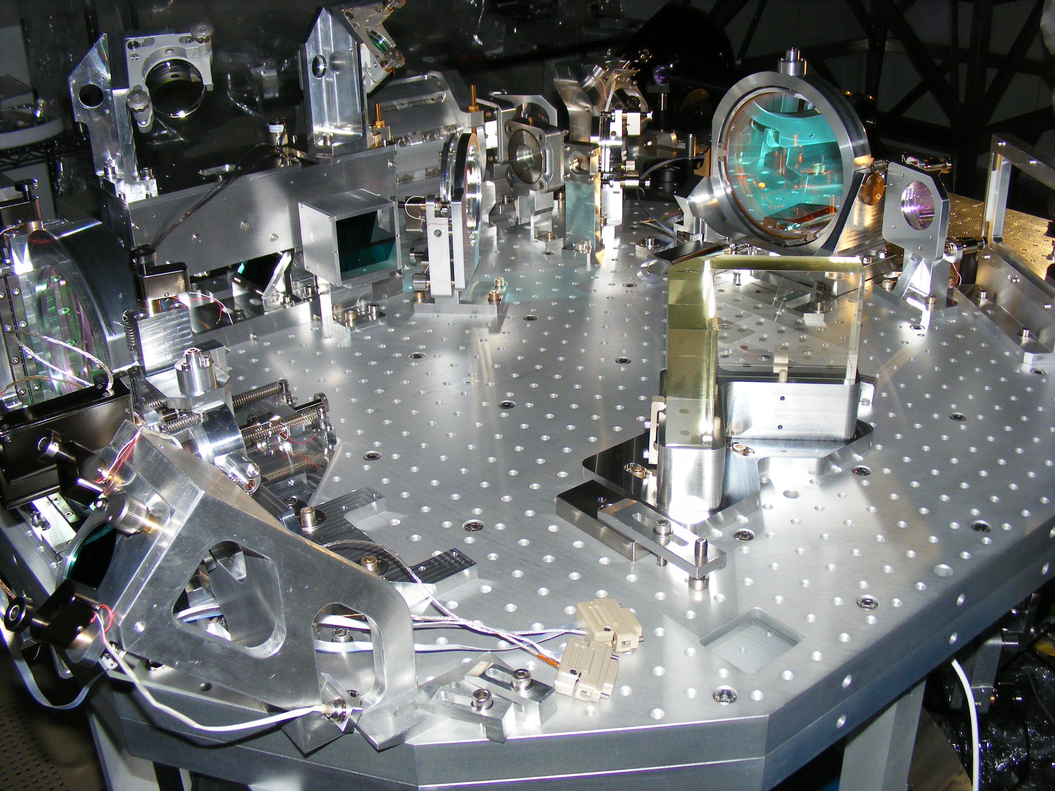
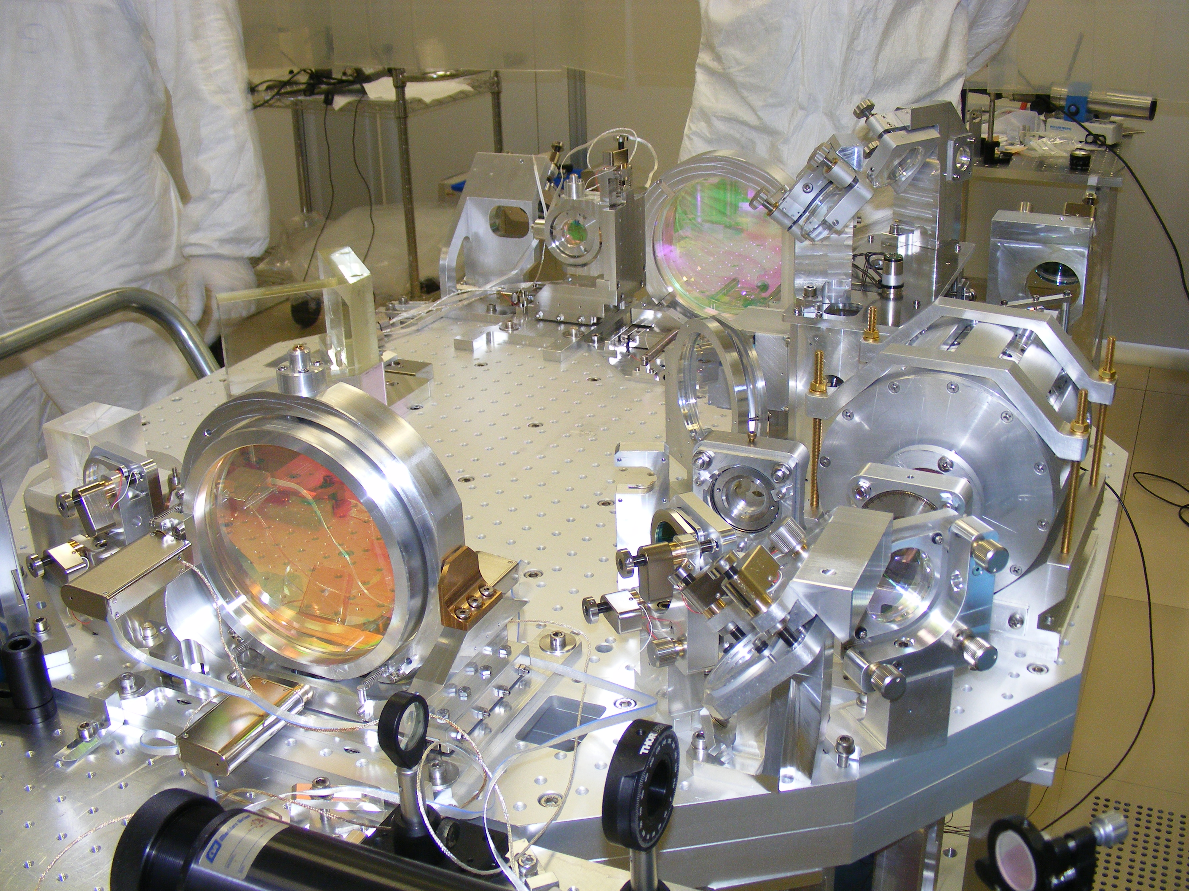
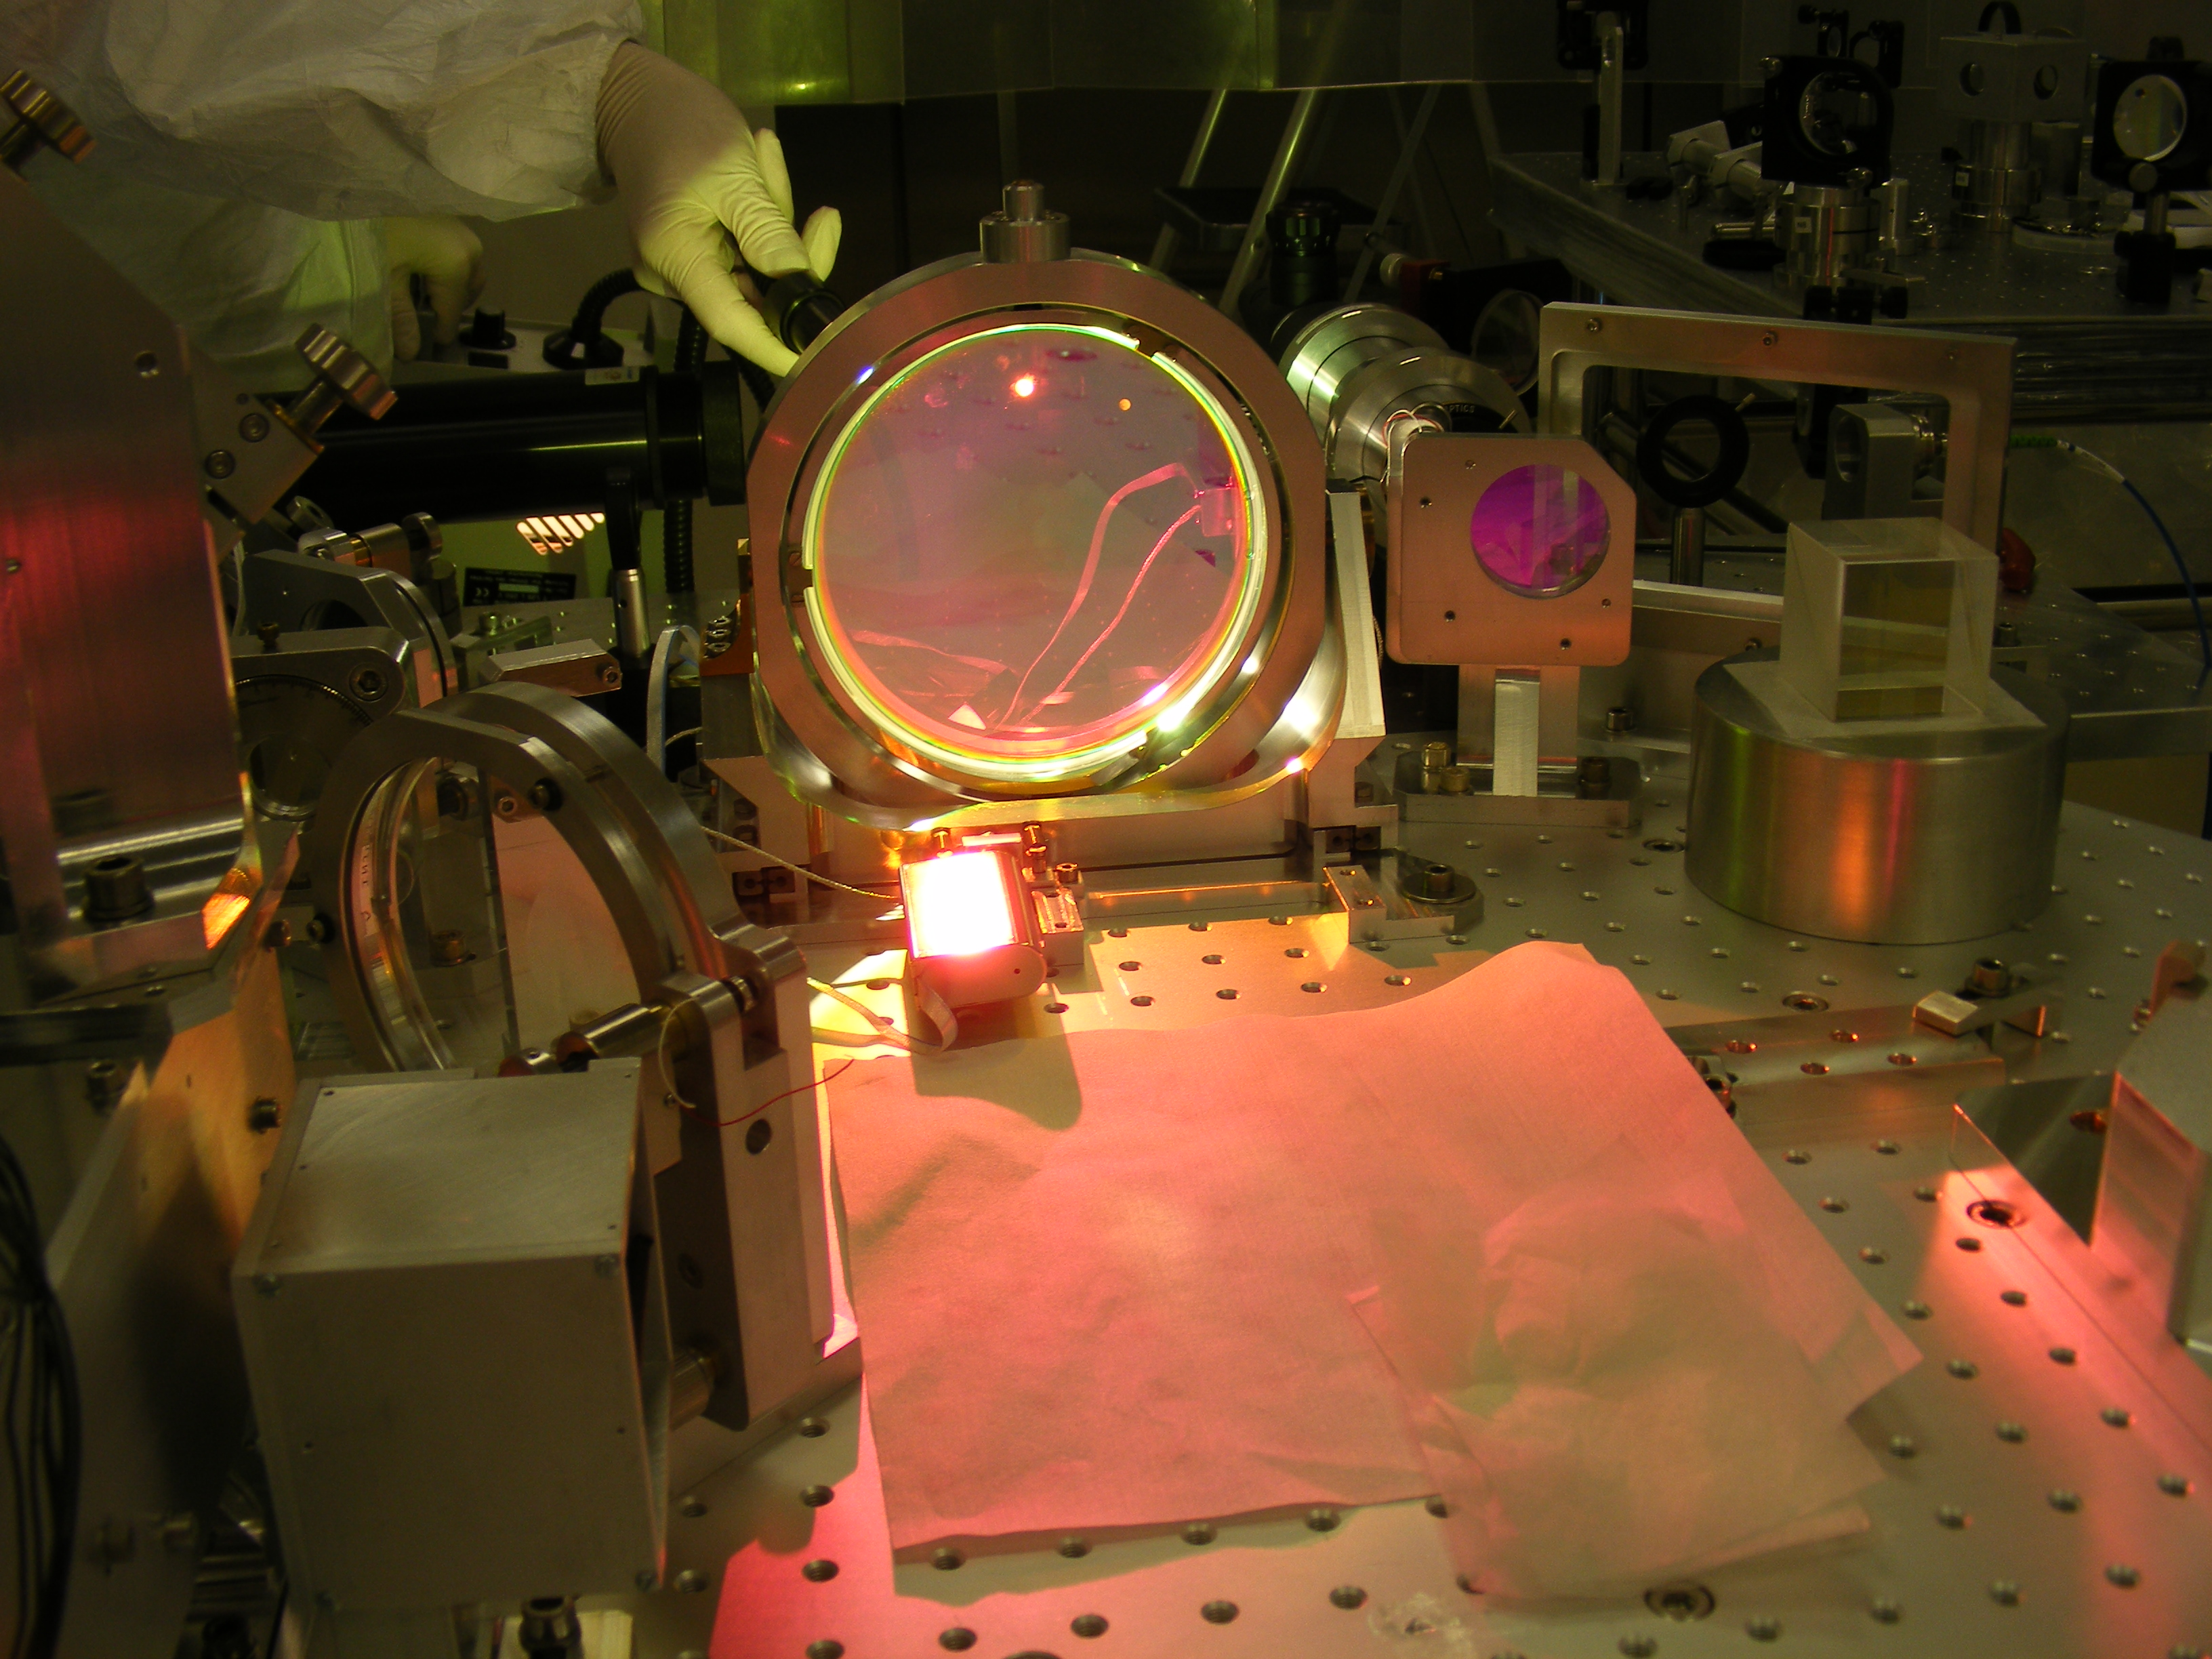
Optical contribution (challenge)/2
Major challenges:
Optical quality of the beam (mode-matching)
Alignment
Scattered light

Slide 14
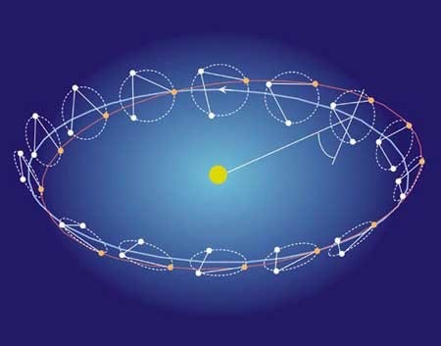
LISA (Laser Interferometer Space Antenna)
CNES/ESA/NASA
Constellation of three spacecraft arranged in an equilateral triangle with sides 2.5 million km long, flying along an Earth-like heliocentric orbit.

Slide 15
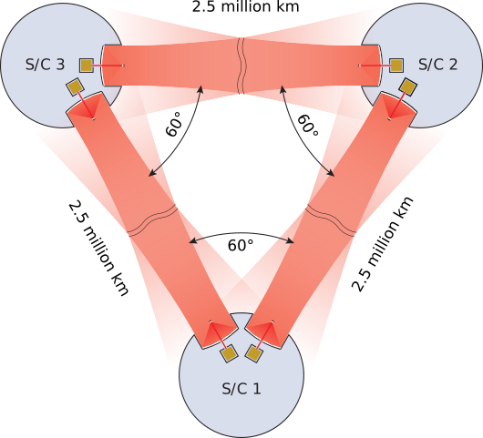
LISA Instrumentation
2 ‘Instruments’ / spacecraft
Technological developments by LISA Pathfinder :
  Inertial flight
  Local picometer interferometry
Challenges for LISA
  Long arm interferometry
  Control of the noise budget
Metrology need:
~10 pm/√Hz @ 1 mHz

Slide 16
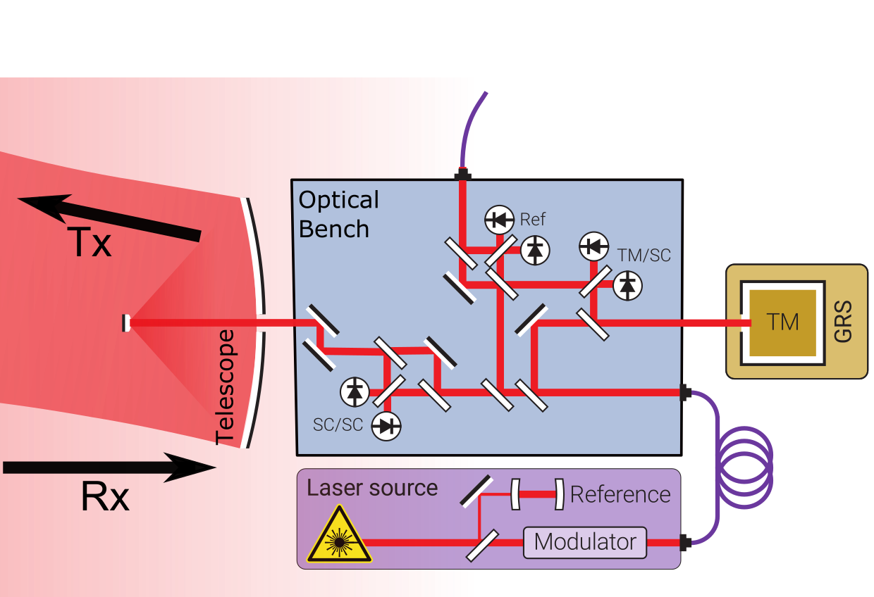
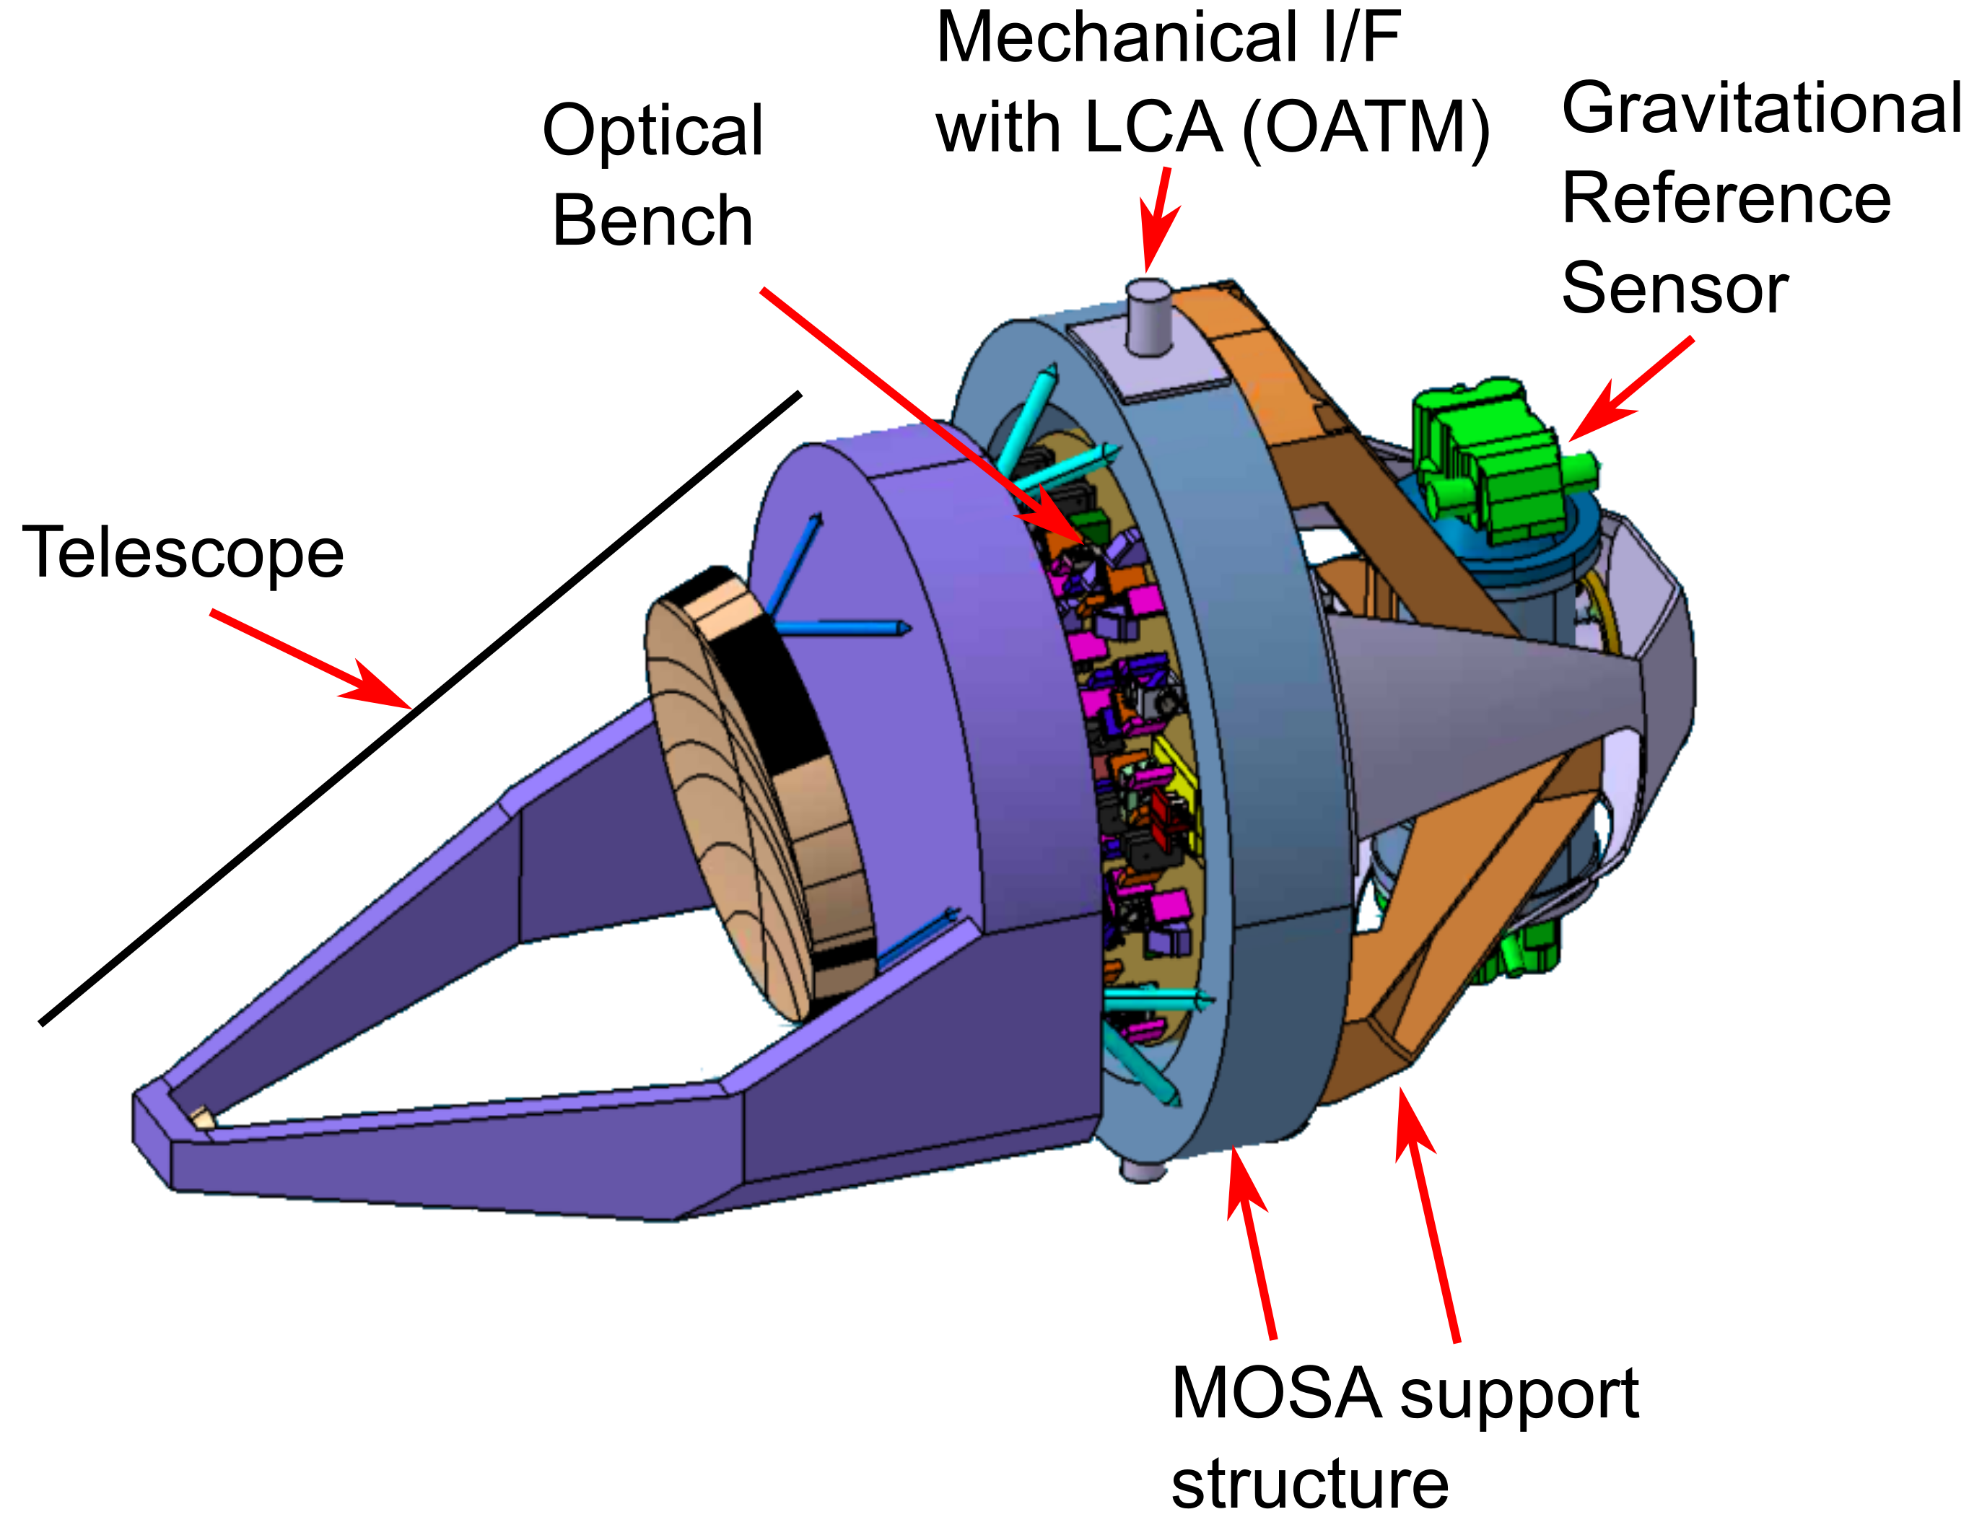
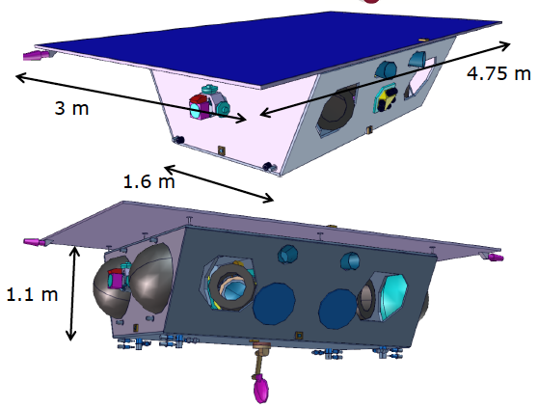
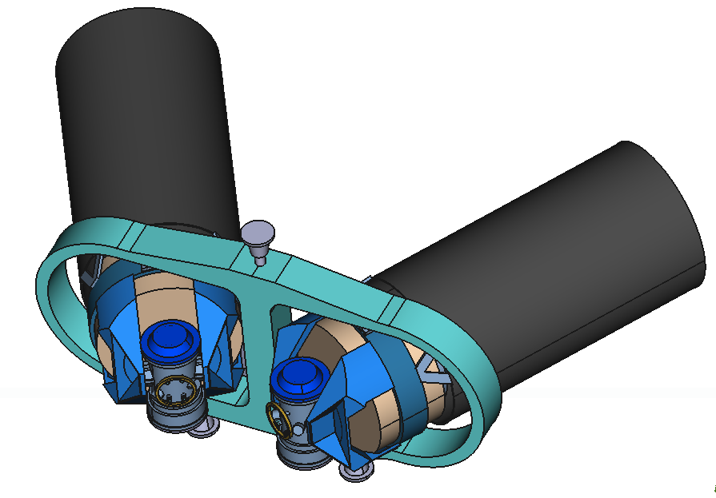
LISA Instrumentation and payload

Slide 17
Optical contribution (challenge)
Preparation of the AIVT (Assembly, Integration, Validation and Tests)
Preparation of the OGSEs (Optical Ground Support Equipments)
Design and realization of a demonstrator for the OGSEs
Major challenges:
Alignment, stability (better than the LISA payload specifications pm/sqrt(Hz))
Scattered light

Slide 18
Conclusion
Direct detection confirm the general relativity theory
GW: a new eye on the Universe
Technical challenges to improve the detectors and build the new generations

Slide 19
L2IT contribution
GW group: work on Advanced Virgo+ and LISA
Optical developments, data analysis
Link with local scientific community on simulations, optical analysis, data analysis…

