Slide 1

Status of the FCC
OUTLOOK
Alain BLONDEL
LPNHE-Paris Sorbonne
With many thanks to all in the FCC collaboration – and in particular M. Benedikt, P. Janot

Slide 2






Future Circular Collider Study
LHC
HE-LHC
PS
SPS
FCC
http://cern.ch/fcc
Work supported by the European Commission under the HORIZON 2020 projects EuroCirCol, grant agreement 654305; EASITrain, grant agreement no. 764879; ARIES, grant agreement 730871; and E-JADE, contract no. 645479
photo: J. Wenninger
photo: J. Wenninger

Slide 3

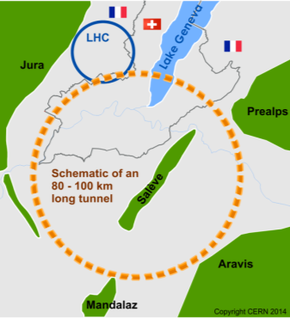
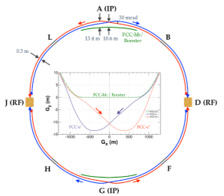
The FCC integrated program at CERN
inspired by successful LEP – LHC (1976-2038?) program
Comprehensive cost-effective program maximizing physics opportunities
Stage 1: FCC-ee (Z, W, H, tt) as first generation Higgs EW and top factory at highest luminosities.
Stage 2: FCC-hh (~100 TeV) as natural continuation at energy frontier, with ion and eh options.
Complementary physics
Integrating an ambitious high-field magnet R&D program
Common civil engineering and technical infrastructures
Building on and reusing CERN’s existing infrastructure.
FCC-INT project plan is fully integrated with HL-LHC exploitation
and provides for seamless continuation of HEP
FCC-ee
FCC-hh

Slide 4
CDR
FCC-Conceptual Design Reports:
  Vol 1 – Physics
  Vol 2 – FCC-ee,
  Vol 3 – FCC-hh,
  Vol 4 – HE-LHC
  1338 authors
  Preprints since 15 January 2019 on http://fcc-cdr.web.cern.ch/ and INSPIRE
  CDRs published in European Physical Journal C (Vol 1) and ST (Vol 2 – 4)
  ESPP summaries: FCC-integral, FCC-ee, FCC-hh, HE-LHC http://fcc-cdr.web.cern.ch/
  FCC-ee «Your questions answered» https://arxiv.org/abs/1906.02693v1
  “Circular vs linear, another story of complementarity” arXiv:1912.11871v2
A public presentation of the CDR was given on 4-5 March
at CERN https://indico.cern.ch/event/789349/
→ many further details can be found there!

Slide 5
FCC-France
2019: https://indico.in2p3.fr/event/19693/ 14-15 Nov. 2019 (87 participants)
2020: https://indico.in2p3.fr/event/20792/ 14-15 May 2020 (more!)
FCC-contacts
- Responsable IN2P3 (Master projet FCC-Acc) : Jean-Luc Biarotte
- Responsable IN2P3 (Master projet FCC-Phys) : Gregorio Bernardi
- Responsable IRFU : Roy Aleksan
- FCC-contacts dans les laboratoires ou dans les master-projets (MP) reliés:
Jeremy Andrea (IPHC-Strasbourg)
Auguste Besson (MP microvertex pour collisionneurs linéaires)
Vincent Boudry (MP Calice)
Suzanne Gascon (IP2I Lyon)
Thibault Guillemin (LAPP-Annecy)
Fairouz Malek (LPSC Grenoble)
Stephane Monteil (LPC Clermont)
Nicolas Morange (IJC-Lab Orsay)
Steve Muanza (CPPM Marseille)
Luc Poggioli (LPNHE Paris)
Roberto Salerno (LLR Palaiseau)
Jan Stark (L2IT, Toulouse)

Slide 6
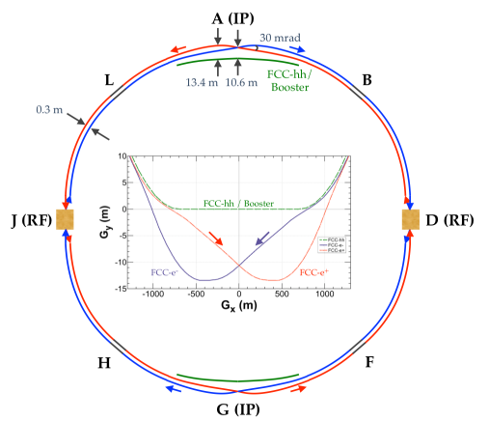
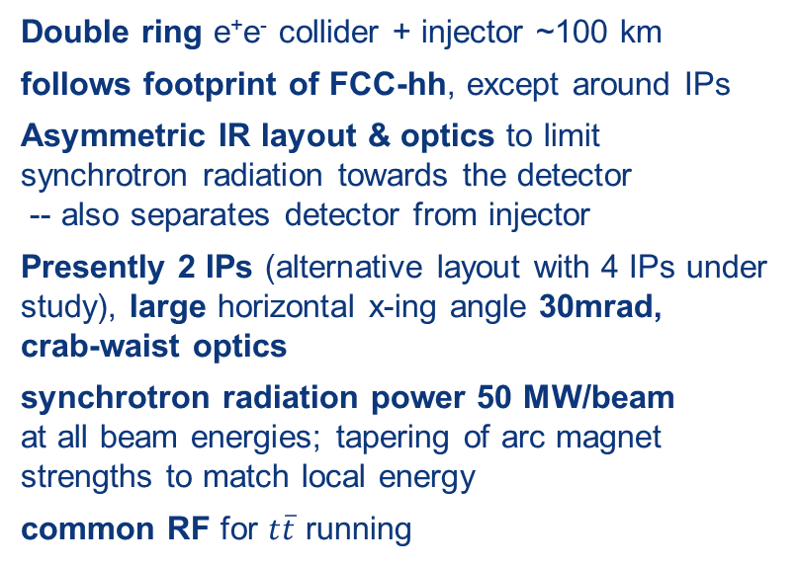
FCC-ee basic design choices
Double ring e⁺e⁻ collider + injector ~100 km
follows footprint of FCC-hh, except around IPs
Asymmetric IR layout & optics to limit synchrotron radiation towards the detector
-- also separates detector from injector
Presently 2 IPs (alternative layout with 4 IPs under study), large horizontal x-ing angle 30mrad,
crab-waist optics
synchrotron radiation power 50 MW/beam
at all beam energies; tapering of arc magnet strengths to match local energy
common RF for $t\overline{t}$ running
K. Oide et al.
top-up injection requires
booster synchrotron in collider tunnel
Beam Polarization and energy calibration, wigglers, polarimeters, depolarization kicker for Z and WW operation.

Slide 7
FCC-ee Collider Parameters
parameter | Z | WW | H (ZH) | ttbar
beam energy [GeV] | 45 | 80 | 120 | 182.5
beam current [mA] | 1390 | 147 | 29 | 5.4
no. bunches/beam | 16640 | 2000 | 393 | 48
bunch intensity [10¹¹] | 1.7 | 1.5 | 1.5 | 2.3
SR energy loss / turn [GeV] | 0.036 | 0.34 | 1.72 | 9.21
total RF voltage [GV] | 0.1 | 0.44 | 2.0 | 10.9
long. damping time [turns] | 1281 | 235 | 70 | 20
horizontal beta* [m] | 0.15 | 0.2 | 0.3 | 1
vertical beta* [mm] | 0.8 | 1 | 1 | 1.6
horiz. geometric emittance [nm] | 0.27 | 0.28 | 0.63 | 1.46
vert. geom. emittance [pm] | 1.0 | 1.7 | 1.3 | 2.9
bunch length with SR / BS [mm] | 3.5 / 12.1 | 3.0 / 6.0 | 3.3 / 5.3 | 2.0 / 2.5
luminosity per IP [10³⁴ cm⁻²s⁻¹] | 230 | 28 | 8.5 | 1.55
beam lifetime rad Bhabha / BS [min] | 68 / >200 | 49 / >1000 | 38 / 18 | 40 / 18

Slide 8
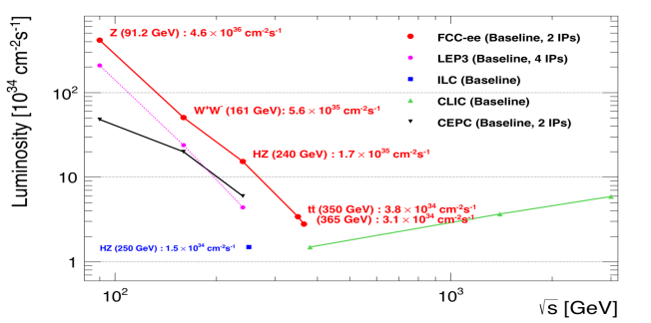
Z WW HZ tt
FCC-ee
LEPx10⁵!
Event
statistics :
E_{CM} errors:
Z peak E_{cm} : 91 GeV 5 10¹² e+e- → Z
WW threshold E_{cm} : 161 GeV 10⁸ e+e- → WW
ZH threshold E_{cm} : 240 GeV 10⁶ e+e- → ZH
‾tt threshold E_{cm} : 350 GeV 10⁶ e+e- →‾tt
LEP x 10⁵
LEP x 2.10³
Never done
Never done
<100 keV
<300 keV
2 MeV
5 MeV
Great energy range for the heavy particles of the Standard Model.

Slide 9
FCC-ee with > 2 IPs?
Almost 2x higher total luminosity, or equal luminosity at half the SR power (70% total)
baseline w 2 IPs
periodic alternative
with 4 IPs
less symmetric alternative
with 4 IPs
IP1
RF
(W,Z,H,t)
IP1
RF
(H,t)
IP1
IP3
IP4
RF
(W,Z,H,t)
RF
(H,t)
RF
(W,Z,H,t)
RF
(H,t)
IP4
IP3
RF
(H,t)
RF
(H,t)
IP2
IP2
IP2
K. Oide,
D. Shatilov
works fine
so far OK for lattice
and beam-beam
not yet studied,
but considered challenging
OK for FCC-hh layout to be confirmed

Slide 10
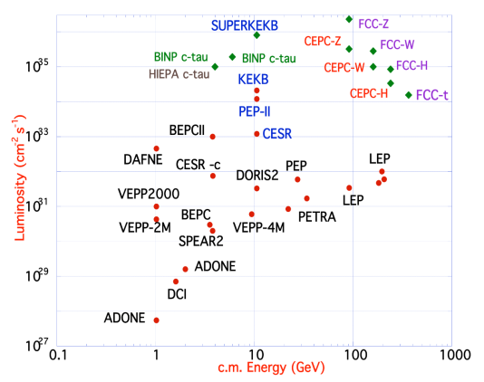
FCC-ee design
based on lessons and techniques from past colliders
B-factories: KEKB & PEP-II:
double-ring lepton colliders,
high beam currents,
top-up injection
DAFNE: crab waist, double ring
SuperB-factories, S-KEKB: low β_{y}*
LEP: high energy, SR effects
VEPP-4M, LEP: precision E calibration
KEKB: e⁺ source
HERA, LEP, RHIC: spin gymnastics
L/IP
Marica Biagini
combining successful ingredients of several recent colliders
→ highest luminosities & energies

Slide 11
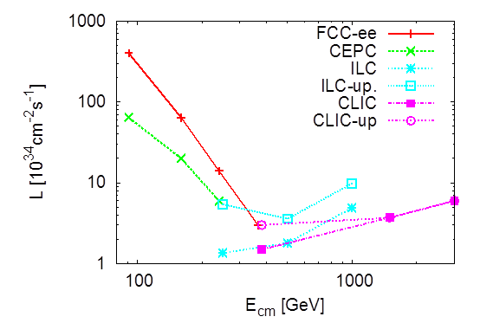
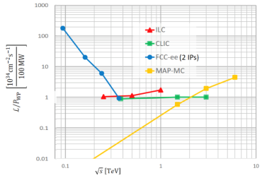
Circular vs linear complementarity
plots from Briefing Book
Luminosity
Luminosity/Power → Energy efficiency
cross-over ~350 GeV
Luminosity vs Energy circular below 365GeV linear above 340 GeV
Efficiency : 9 (5) GJ/Higgs at FCC-ee with 2(4)IP 50GJ/Higgs for ILC250 (first 15 years)
Beam polarization: circular: transverse → ppm beam energy calibration
linear: longitudinal : e- ±80% easy, (e+ ±30% difficult) → additional d.o.f
Monochromatization for e+e- → H (125 GeV)
Long term energy upgrade circular: pp, AA, e-h linear: High energy lepton collisions
Interaction points circular: 2-4 linear: 1 IP (at a time)
Run limited in time by arrival of hadron collider Run is open ended

Slide 12
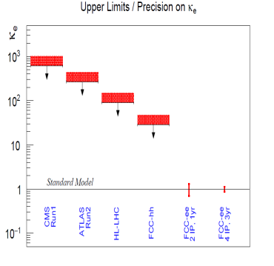
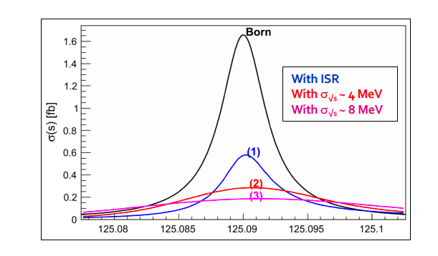
Something unique!
e+e- → H @ 125.xxx GeV requires
-- Higgs mass to be known to <5 MeV from 240 GeV run (CEPC group almost there)
-- Huge luminosity
-- monochromatization (opposite sign dispersion using magnetic lattice) to reduce σ_{ECM}
-- continuous monitoring and adjustment of E_{CM} to MeV precision (transv. Polar.)
-- an extremely sensitive event selection against backgrounds
-- a generous lab director to spend 3 years doing this and neutrino counting

Slide 13
FCC-ee Luminosity vs Energy
H s-channel
with mono-
chromatization

Slide 14
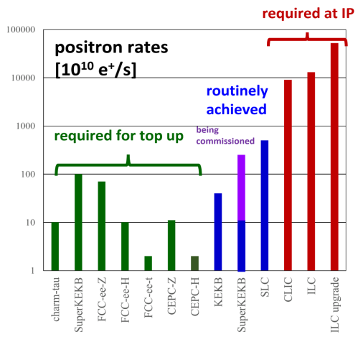
several key design parameters
are on conservative side
-- x/y coupling 0.2%
simulations typically 10 times smaller
-- positron source requirements →
< superKEKb, SLC
<< CLIC, ILC
-- β_{y}* 0.8mm(Z) – 1.6 mm(top)
-- RF gradients
There are safety margins…
and there might be some room for
luminosity improvement at given power.

Slide 15
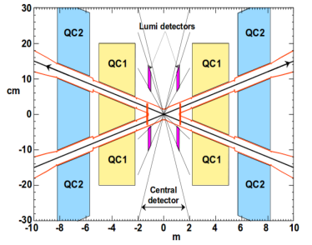
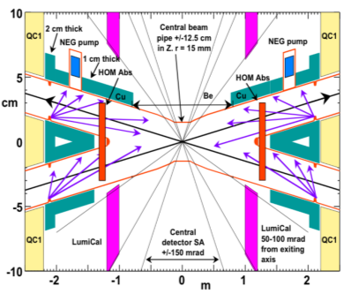

FCC-ee Interaction Region Design
A. Novokhatski, M. Sullivan, E. Belli, M. Gil Costa, and R. Kersevan, Unavoidable trapped mode in the interaction region of colliding beams, Phys. Rev. Accel. Beams 20, 111005 (2017)
M. Boscolo, H. Burkhardt, and M. Sullivan, Machine detector interface studies: Layout and synchrotron radiation estimate in the future circular collider interaction region, Phys. Rev. Accel. Beams 20, 011008 (2017)
heat loads: rad Bhabha (kW), beamstrahlung (MW), res. wall (kW), HOMs, quadr. synchrotron rad.
Q1 with shielding
solenoid
luminometer
IP
3D sketch of key IR systems over ﬁrst 3 m from IP
compensation
solenoid
stiff-skeleton cryostats?
M. Boscolo, N. Bacchetta, A. Bogomyagkov, H. Burkhardt, M. Dam, D. El Khechen, M. Koratzinos, E. Levichev, M. Luckhof, A. Novokhatski, L. Pellegrino, S. Sinyatkin, M. Sullivan, et al.

Slide 16
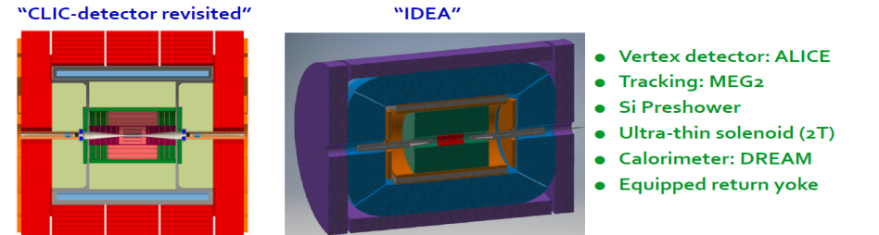
FCC-ee Detectors
Detectors can be done and work for the FCC-ee but physics optimization remains to be done.
Two integration, performance and cost estimates:
-- Linear Collider Detector group at CERN has undertaken the adaption of
CLIC-SID detector for FCC-ee
-- IDEA, detector specifically designed for FCC-ee (and CEPC)
MAPS
SiD at ILC, CLD at FCC-ee IDEA at FCC-ee & CEPC

Slide 17
FCC-hh (pp) collider parameters
parameter | FCC-hh |  | HE-LHC | HL-LHC | LHC
collision energy cms [TeV] | 100 |  | 27 | 14 | 14
dipole field [T] | 16 |  | 16 | 8.33 | 8.33
circumference [km] | 97.75 |  | 26.7 | 26.7 | 26.7
beam current [A] | 0.5 |  | 1.27 | 1.1 | 0.58
bunch intensity [10¹¹] | 1 | 1 | 2.5 | 2.2 | 1.15
bunch spacing [ns] | 25 | 25 | 25 | 25 | 25
synchr. rad. power / ring [kW] | 2400 |  | 101 | 7.3 | 3.6
SR power / length [W/m/ap.] | 28.4 |  | 4.1 | 0.33 | 0.17
long. emit. damping time [h] | 0.54 |  | 1.8 | 12.9 | 12.9
beta* [m] | 1.1 | 0.3 | 0.45 | 0.15 (min.) | 0.55
normalized emittance [μm] | 2.2 |  | 2.5 | 2.5 | 3.75
peak luminosity [10³⁴ cm⁻²s⁻¹] | 5 | 30 | 16 | 5 (lev.) | 1
events/bunch crossing | 170 | 1000 | 460 | 132 | 27
stored energy/beam [GJ] | 8.4 |  | 1.4 | 0.7 | 0.36

Slide 18
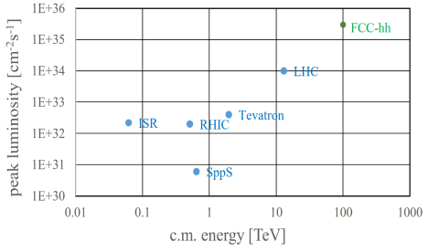
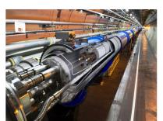
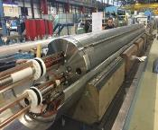
FCC-hh: performance
order of magnitude performance increase in both energy & luminosity
100 TeV cm collision energy (vs 14 TeV for LHC)
20 ab⁻¹ per experiment collected over 25 years of operation (vs 3 ab⁻¹ for LHC)
similar performance increase as from Tevatron to LHC
key technology: high-field magnets
from
LHC technology
8.3 T NbTi
via
HL-LHC technology
11 T Nb₃Sn
16 T Nb₃Sn

Slide 19
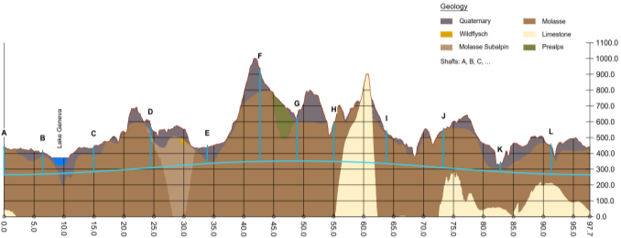
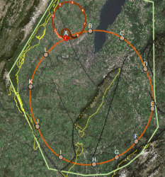
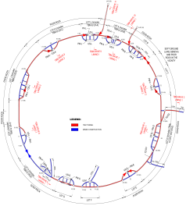
FCC implementation - footprint baseline
Present baseline position was established considering:
lowest risk for construction, fastest and cheapest construction
feasible positions for large span caverns (most challenging structures)
More than 75% tunnel in France, 8 (9) / 12 access points in France.
next step: review of surface site locations and machine layout

Slide 20
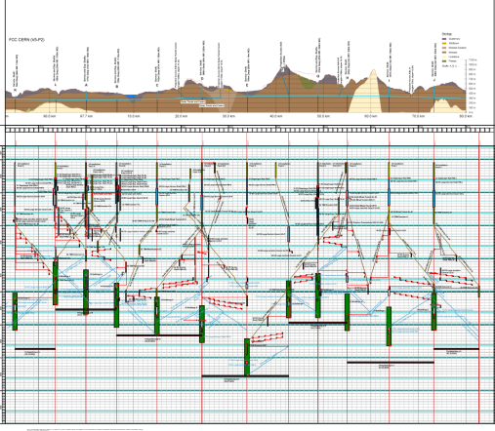
Civil Engineering studies
4.5yrs
6.5yrs
Total construction duration 7 years
First sectors ready after 4.5 years

Slide 21
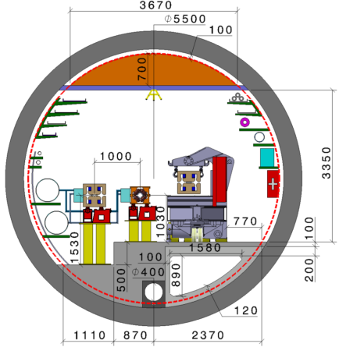
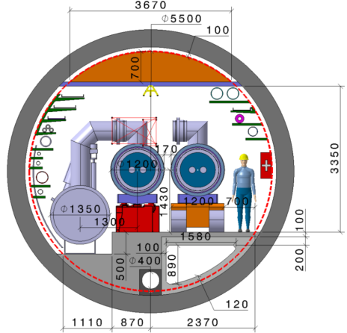
FCC-tunnel integration in arcs
  FCC-ee FCC-hh
  5.5 m inner diameter

Slide 22
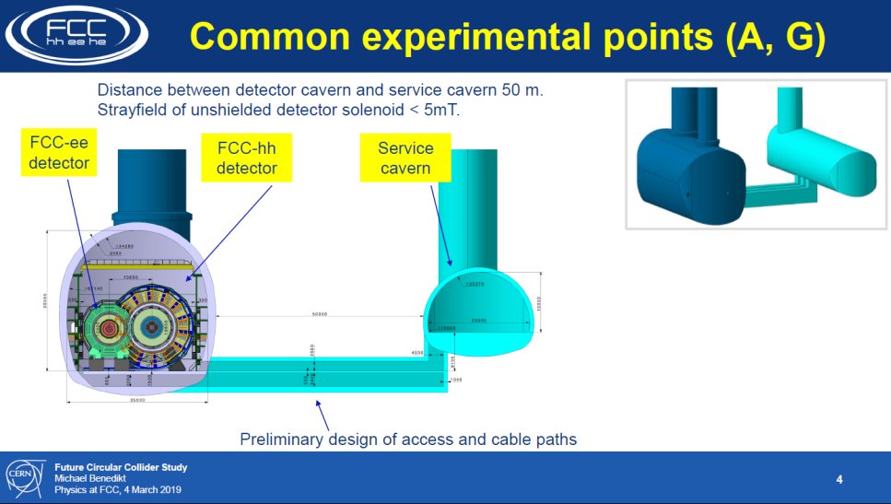

Slide 23
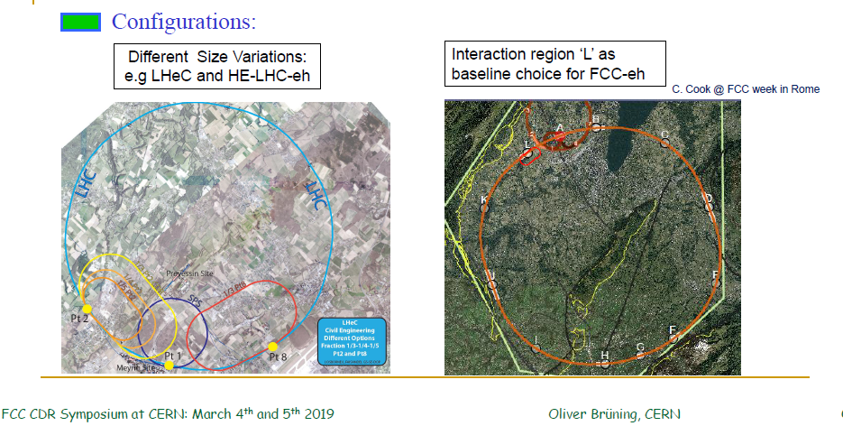
Electron – hadron collisions for LHC and FCC-hh
FCC-ep is conceived to run in parallel with FCC-hh

Slide 24
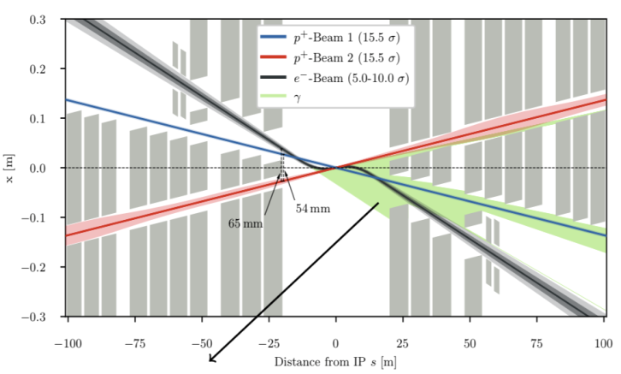
FCC-eh Interaction Region
exit hole - electrons and non-colliding protons
R. Martin @ FCC Week in Amsterdam: FCC-eh triplet
field “free” region
non
focused beam
bypasses
the interaction
Final quadrupole magnet Q1 example design
“sweet spot”
Various options on the table with solutions at hand!
Design work on the ‘Sweet Spot’ magnet is still ongoing!
Final implementation strongly depends on actual IR choice and
FCC-hh optics configuration!!!
β∗ = 30cm
focused interacting
proton beam
SR fan
P_{SR} = 13kW; E_{crit} = 176keV
B. Parker, S. Russenschuck et al.

Slide 25
FCC integral project technical schedule
1
2
3
4
5
6
7
8
9
10
11
12
13
14
15
16
17
18
15 years operation
34
35
36
37
38
39
40
41
42
43
~ 25 years operation
70
Project preparation &
administrative processes
Permis-sions
Update
Permissions
Funding strategy
Funding and
in-kind contribution agreements
Funding and
in-kind contribution agreements
Geological investigations, infrastructure detailed design and tendering preparation
Tunnel, site and technical infrastructure construction
FCC-ee dismantling, CE & infrastructure adaptations FCC-hh
FCC-ee accelerator R&D and technical design
FCC-ee accelerator construction, installation, commissioning
FCC-hh accelerator R&D and technical design
FCC-hh accelerator construction, installation, commissioning
Set up of international experiment collaborations, detector R&D and concept development
FCC-ee detector technical design
FCC-ee detector
construction, installation, commissioning
FCC-hh detector R&D,
technical design
FCC-hh detector
construction, installation, commissioning
Superconducting wire and magnet R&D
SC wire and 16 T magnet R&D, model magnets, prototypes, preseries
16 T dipole magnet
series production

Slide 26
Compare with LEP/LHC
76
81 <- construction ->
89
2000
2010
2038
12 years operation
8+2 years installation
28 years operation
64
20
2038
15 years operation
1
2
3
4
5
6
7
8
9
10
11
12
13
14
15
16
17
18
15 years operation
34
35
36
37
38
39
40
41
42
43
~ 25 years operation
70
Project preparation &
administrative processes
Permis-sions
Update
Permissions
Funding strategy
Funding and
in-kind contribution agreements
Funding and
in-kind contribution agreements
Geological investigations, infrastructure detailed design and tendering preparation
Tunnel, site and technical infrastructure construction
FCC-ee dismantling, CE & infrastructure adaptations FCC-hh
FCC-ee accelerator R&D and technical design
FCC-ee accelerator construction, installation, commissioning
FCC-hh accelerator R&D and technical design
FCC-hh accelerator construction, installation, commissioning
Set up of international experiment collaborations, detector R&D and concept development
FCC-ee detector technical design
FCC-ee detector
construction, installation, commissioning
FCC-hh detector R&D,
technical design
FCC-hh detector
construction, installation, commissioning
Superconducting wire and magnet R&D
SC wire and 16 T magnet R&D, model magnets, prototypes, preseries
16 T dipole magnet
series production

Slide 27
FCC-integrated cost estimate
Total construction cost FCC-ee (Z, W, H) amounts to 10,500 MCHF & 1,100 MCHF (tt).
Associated to a total project duration of ~20 years (2025 – 2045)
Total construction cost for subsequent FCC-hh amounts to 17,000 MCHF.
Associated to a total project duration of ~25 years (2035 – 2060) (FCC-hh stand alone 25 BCHF)

Slide 28




FCC work with Host States
General secretariat of the region Auvergne-Rhône-Alpes and notified body “Centre d'études et d'expertise sur les risques, l'environnement, la mobilité et l'aménagement” CEREMA
Working group with representatives of federation, canton and state of Geneva and representation of Switzerland at the international organisations and consultancy companies
Administrative processes for project preparatory phase developed.
First review of tunnel placement performed.
Requirements for urbanistic, environmental, economic impact, land acquisition and construction permit related processes defined.
For 2019-20, common optimization of collider tunnel and surface site infrastructure implementation.

Slide 29

FCC-ee discovery potential and Highlights
Today we do not know how nature will surprise us. A few things that FCC-ee could discover :
EXPLORE 10-100 TeV energy scale (and beyond) with Precision Measurements
-- ~20-100 fold improved precision on many EW quantities (equiv. to factor 5-10 in mass)
m_{Z,} m_{W}, m_{top} , sin² θ_{w}^{eff} , R_{b} , α_{QED} (m_{z}) α_{s} (m_{z} m_{W} m_{τ}), Higgs and top quark couplings
model independent «fixed candle» for Higgs measurements, ee-H coupling.
DISCOVER a violation of flavour conservation or universality and unitarity of PMNS @10⁻⁵
-- ex FCNC (Z --> μτ , eτ) in 5 10¹² Z decays and τ BR in 2 10¹¹ Z→ τ τ
+ flavour physics (10¹² bb events) (B→s τ τ etc..)
DISCOVER dark matter as «invisible decay» of H or Z (or in LHC loopholes)
DISCOVER very weakly coupled particle in 5-100 GeV energy scale
such as: Right-Handed neutrinos, Dark Photons, ALPS, etc…
+ and many opportunities in – e.g. QCD (α_{s} @ 10⁻⁴, fragementations, H→ gg) etc….
NB Not only a «Higgs Factory»! «Z factory» and «top» are important for ‘discovery potential’

Slide 30
FCC-hh discovery potential and Highlights
FCC-hh is a HUGE discovery machine (if nature …), but not only.
FCC-hh physics is dominated by three features:
-- Highest center of mass energy –> a big step in high mass reach!
ex: strongly coupled new particle up to >30 TeV
Excited quarks, Z’, W’, up to ~tens of TeV
Give the final word on natural Supersymmetry, and WIMPS
extra Higgs etc.. reach up to 5-20 TeV
Sensitivity to high energy phenomena in e.g. WW scattering
-- HUGE production rates for single and multiple production of SM bosons (H,W,Z) and quarks
-- Higgs precision tests using ratios to e.g. γγ/μμ/ ττ/ZZ, ttH/ttZ @<% level
-- Precise determination of triple Higgs coupling (~2% stat. level) and quartic Higgs coupling
-- detection of rare decays H→ Vγ (V= ρ, ϕ, J/ψ, ϒ, Z …)
-- search for invisibles (DM searches, RH neutrinos in W decays)
-- renewed interest for long lived (very weakly coupled) particles.
-- rich top and HF physics program
-- Cleaner signals for high Pt physics
-- allows clean signals for channels presently difficult at LHC (e.g. H→ bb)

Slide 31
FCC-eh Discovery Potential and Highlights
FCC-ep explores hitherto untouched domain of (x,q2 ) DIS plane and provides
production of high mass SM particles (H, top) in cleaner conditions than pp.
-- extremely precise structure function work
important input on structure functions for FCC-hh
complete resolution of the partonic contents of the proton, for the first time
high precision α_{s} O(10⁻⁴) similar to FCC-ee from totally different source
-- 2 10⁶ Higgs produced from from W & Z to deliver precise H couplings
complementary to ee -- esp (g_{HWW})
-- Searches for new physics (Leptoquarks, RH neutrinos, etc...)
in new domain of mass and couplings
-- rich top (Vtb @% level, FCNC) and HF physics program
-- Discovery in QCD: non-linear parton evolutions, instantons?, ..
-- Unique electron-ion physics related to QGP physics

Slide 32
FCC main goals for 2020 - 2026
Overall goal:
Perform all necessary steps and studies to enable a definitive project decision by 2025/26, at the anticipated date for the next ESU, and a subsequent start of civil engineering construction by 2028/29.
This requires successful completion of the following four main activities:
Develop and establish a governance model for project construction and operation
Develop and establish a financing strategy, including in-kind contributions
Prepare and successfully complete all required project preparatory and administrative processes with the host states (debat public, EIA, etc.)
Perform site investigations to enable CE planning and to prepare CE tendering..
In parallel development preparation of TDRs and physics/experiment studies:
Machine designs and main technology R&D lines
Establish user communities, work towards proto experiment collaboration by 2025/26.

Slide 33
Conclusion: The Physics Landscape
We found the Higgs and the SM is ‘complete’.
We are in a fascinating situation: where to look and what will we find?
For the first time since Fermi theory, WE HAVE NO SCALE
The next facility must be versatile with as broad and powerful reach as possible,
as there is no precise target
➔ more Sensitivity, more Precision, more Energy
FCC , thanks to synergies and complementarities, offers the most
versatile and adapted response to today’s physics landscape

Slide 34
SPARES

Slide 35

Status of Global FCC Collaboration
136
Institutes
25
Companies
34
Countries
EC
H2020

Slide 36

EU H2020 Design Study EuroCirCol
European Union Horizon 2020 program
3 MEURO co-funding
Completed by December 2019
15 European beneficiaries & KEK & associated FNAL, BNL, LBL, NHFML
Scope:
FCC-hh collider key work packages
Optics Design Arc and IR
Cryogenic beam vacuum system design including beam tests at ANKA
16 T dipole design, construction folder demonstrator
Notes:
New slide from Davide.
Showing that conductor development is launched at international level, Russia, Japan, (Korea and Europe in preparation)
Underline importance of that development as main cost driver for the hadron collider machine.

Slide 37

EASITrain Marie Curie Training Network
European Advanced Superconductivity Innovation and Training Network
selected for funding by EC in May 2017, started 1 October 2017
SC wires at low temperatures for magnets (Nb₃Sn, MgB₂, HTS)
Superconducting thin films for RF and beam screen (Nb₃Sn, Tl)
Electrohydraulic forming for RF structures
Optimisation cryogenic infrastructure systems
Magnet cooling architectures
Horizon 2020 program
Funding for 15 Early Stage Researchers over 3 years & training
13 Beneficiaries
I-CUBE
12 Partners

Slide 38
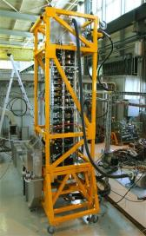
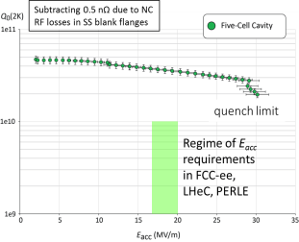
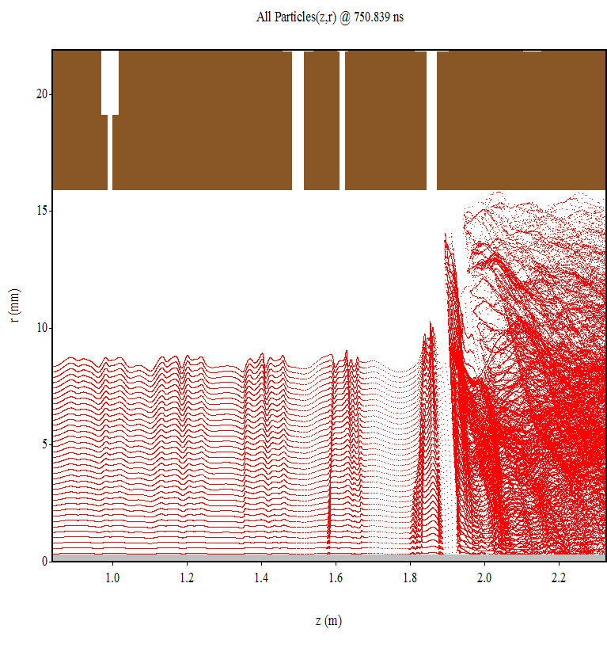

SRF , cryo-modules, RF power sources R&D
Several R&D lines aim at improving performance & efficiency and reducing cost:
  Improved Nb/Cu coating/sputtering (e.g. ECR fibre growth, HiPIMS)
  New cavity fabrication techniques (e.g. EHF, improved polishing, seamless…)
  Coating of A15 superconductors (e.g. Nb₃Sn)
  Bulk Nb cavity R&D at FNAL, JLAB, Cornell, also KEK and CEPC/IHEP
  High efficiency klystrons – synergy with HL-LHC and CLIC
  MW-class fundamental power couplers for 400 MHz
  Cryo-module design optimisation
cryo-modules for FCC-ee:
30 CM with four single cell 400 MHz cavities
100 CM with four 4-cell 400 MHz cavities
200 CM with four 5-cell 800 MHz cavities
80%
Klystron R&D
800 MHz 5-cell Nb
prototype / JLAB

Slide 39



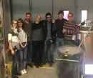

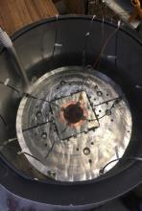
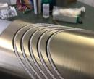
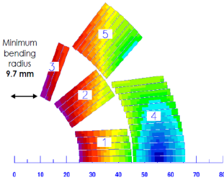
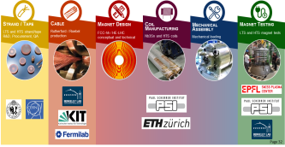
Magnet development: magnet models production
CHART2 – Swiss Accelerator Research and Technology
F2D2 or
CEA: 15.5 T magnet with 14% load line with current wire spec
INFN: 14 T magnet with 14 % margin (FCC spec), 9.5% with current wire spec
First model coil: 11 T will be tested in LBNL soon

Slide 40
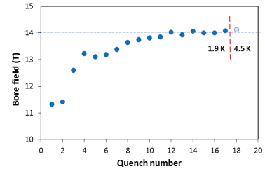
US – MDP: 14 T magnet tested at FNAL
84% on the laodline at 1.9 K
92% on the loadline at 4.2 K
60-mm aperture
4-layer graded coil
15 T dipole demonstrator
Staged approach: In first step pre-stressed for 14 T
Second test foreseen in fall 2019 with additional pre-stress for 15 T

Slide 41
Beneficiaries
H2020 DS FCC Innovation Study (FCC-IS)
Goal: Carry out the technical design study for a 100 km long luminosity frontier circular collider infrastructure at CERN that will extend Europe’s leadership in the domain of fundamental physics research until the end of the 21st century.
The study focuses on the high priority topics to prepare the ground for a construction project by 2026:
optimisation of the particle collider design, which leads to the invariants of the infrastructure project,
planning and necessary investigations for a sustainable civil engineering construction project including the requirements of a circular economy,
implementation and public participation processes in France and Switzerland (CERN host states) including transnational topics such as environmental impact assessment, management of excavation materials and access to shared resources (electricity, water, communication, transport),
definition and implementation of a project exploitation plan considering the need to create a committed user community that exploits the RI from the beginning onwards and to engage every member of the society,
Socio-economic impact assessment with a plan to design the facility for impact creation, including the regional impacts and potential synergies for all participating stakeholders in Europe.

Slide 42
Beneficiaries
H2020 DS FCC Innovation Study - participants
Partners
D.R.R.T. (F)
Etat de Geneve (CH)
DOE (US)
BINP (Ru)
U Oxford (UK)
Beneficiaries

Slide 43
Conclusions
First phase of the FCC conceptual design studies is completed with established baseline machine designs and performance matching the demanding physics requirements, documented in 4 conceptual design reports
An integrated FCC programme has been developed and submitted to the ESU, together with descriptions of the individual machines
Next steps, in parallel to ESU process and in harmony with its recommendations, will develop a concrete local/regional implementation scenario in collaboration with host state authorities, accompanied by machine optimization, physics studies and technology R&D
Increasing international collaboration and links with science, research & development and high-tech industry will be essential to further advance and prepare the implementation of FCC with the long term goal of establishing the world-leading HEP infrastructure for the 21st century.

Slide 44
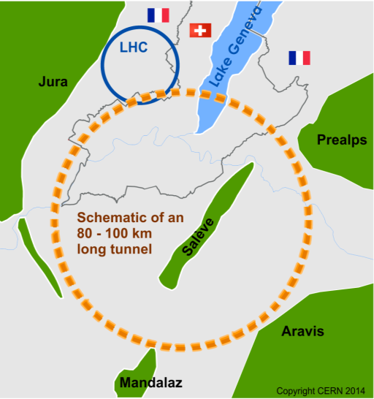
The Future Circular Colliders
CDR and cost review Q4 2018 for ESU
International collaboration to Study Colliders fitting in a new ~100 km infrastructure, fitting in the Genevois
Ultimate goal:
≥100 TeV pp-collider (FCC-hh)
→ defining infrastructure requirements
Two possible first steps:
e⁺e⁻ collider (FCC-ee)
High Lumi, E_{CM} =90-400 GeV
HE-LHC 16T ⇒ 27 TeV
in LEP/LHC tunnel
p-e (FCC-he) option
≥16 T magnets
The way by FCC-ee is the fastest and cheapest way to 100 TeV,
also produces the most physics.
Preferred scenario presented in the CDR.
https://cerncourier.com/cern-thinks-bigger/
It’s also a good start for a μμC!

Slide 45

The Global FCC Collaboration
EC
H2020
133
Institutes
25
Companies
34
Countries

Slide 46
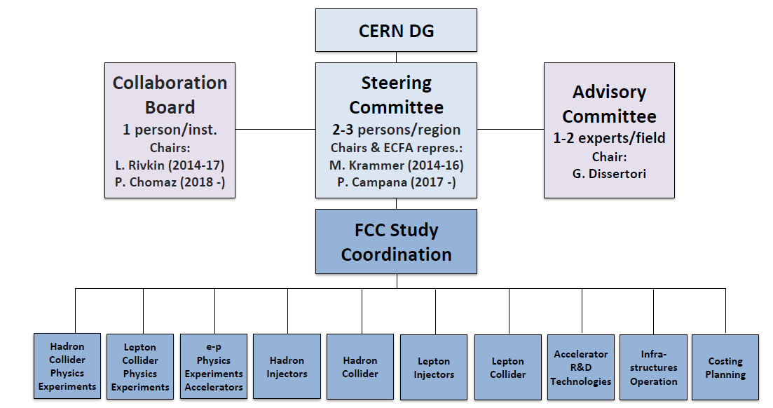

Slide 47
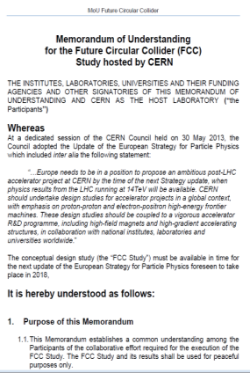

FCC collaboration framework
A consortium of partners based on a
Memorandum Of Understanding (MoU)
Working together on a best effort basis
Pursuing the same common goal
Self governed
Incremental & open to academia and industry
Light general framework, adapted to the needs during a conceptual design study
Detailed project descriptions in specific addenda

Slide 48
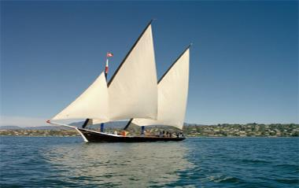
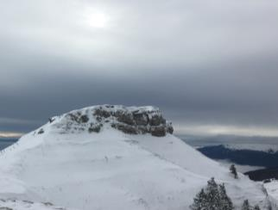
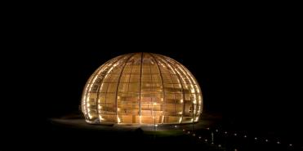
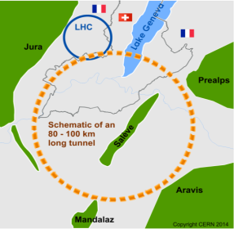
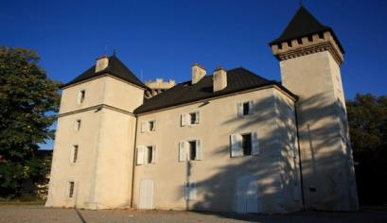
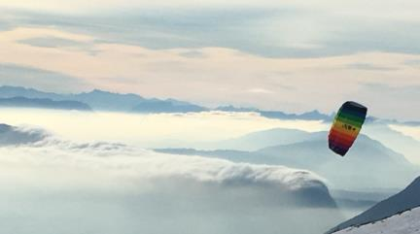
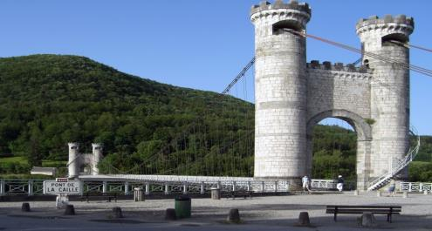
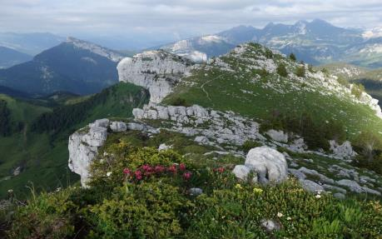

Slide 49
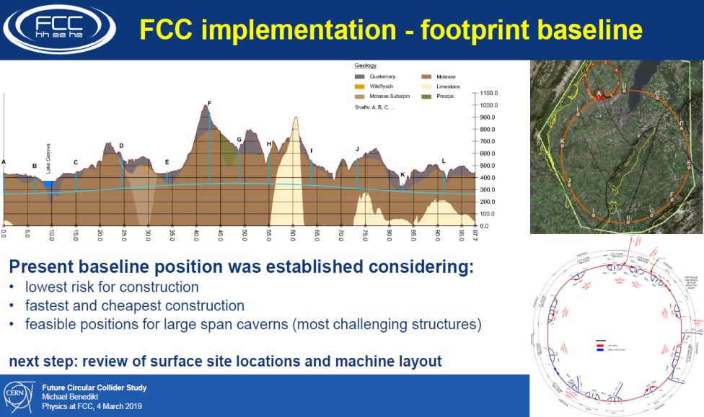

Slide 50

FCC-common layouts
FCC-hh
Common footprint except around IPs
Asymmetric IR layout to limit synchrotron radiation
FCC-ee

Slide 51
Z WW HZ tt
FCC-ee
LEPx10⁵!
Event
statistics :
E_{CM} errors:
Z peak E_{cm} : 91 GeV 5 10¹² e+e- → Z
WW threshold E_{cm} : 161 GeV 10⁸ e+e- → WW
ZH threshold E_{cm} : 240 GeV 10⁶ e+e- → ZH
‾tt threshold E_{cm} : 350 GeV 10⁶ e+e- →‾tt
LEP x 10⁵
LEP x 2.10³
Never done
Never done
<100 keV
<300 keV
2 MeV
5 MeV
Great energy range for the heavy particles of the Standard Model.

Slide 52
100 TeV
Hadron colliders will remain for the foreseable future the most efficient way
to reach high energy (> 10 TeV) parton-parton collisions

Slide 53
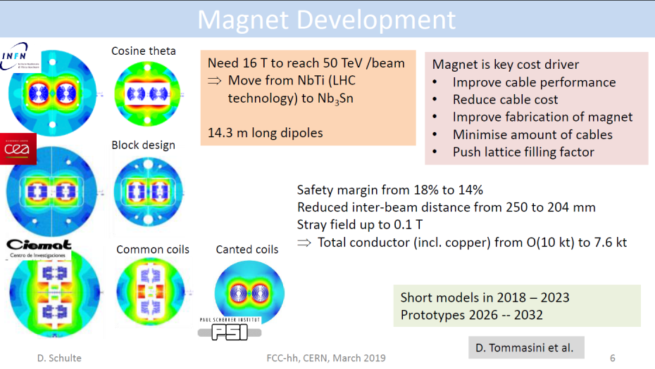

Slide 54
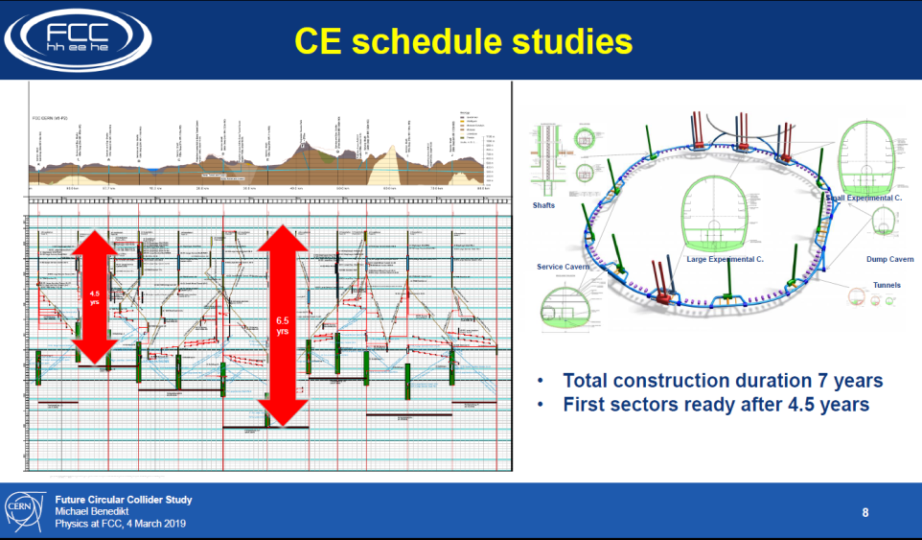

Slide 55
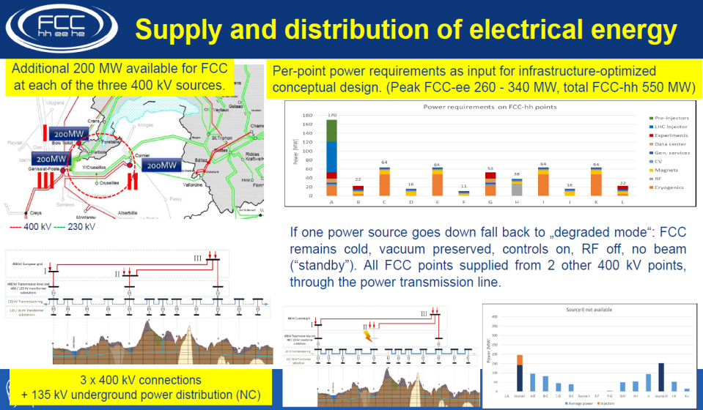

Slide 56


Slide 57

Zimmermann

Slide 58


Slide 59


Slide 60
FCC integrated project timeline
1
2
3
4
5
6
7
8
9
10
11
12
13
14
15
16
17
18
15 years operation
34
35
36
37
38
39
40
41
42
43
~ 25 years operation
70
Project preparation &
administrative processes
Permis-sions
Update
Permissions
Funding strategy
Funding and
in-kind contribution agreements
Funding and
in-kind contribution agreements
Geological investigations, infrastructure detailed design and tendering preparation
Tunnel, site and technical infrastructure construction
FCC-ee dismantling, CE & infrastructure adaptations FCC-hh
Superconducting wire and magnet R&D
SC wire and 16 T magnet R&D, model magnets, prototypes, preseries
16 T dipole magnet
series production
FCC-ee accelerator R&D and technical design
FCC-ee accelerator construction, installation, commissioning
FCC-hh accelerator R&D and technical design
FCC-hh accelerator construction, installation, commissioning
Set up of international experiment collaborations, detector R&D and concept development
FCC-ee detector technical design
FCC-ee detector
construction, installation, commissioning
FCC-hh detector R&D,
technical design
FCC-hh detector
construction, installation, commissioning
work is cut out for physics and detectors
ESPP
70 years seems like a long time!

Slide 61





Did these people know that we would be running HL-LHC in that tunnel >60 years later?
Let’s not be SHY!

Slide 62


Slide 63

most of this to be
recuperated for
FCC-hh!

Slide 64


Slide 65


M. Aleksa
a 10-20 TeV muon collider using the
45 GeV stored e+ as LEMMA SOURCE?
FCC data taking starts at the end of HL-LHC

Slide 66
We have gone a long way!
2010-11-12 : ideas, wishes, basic concepts, (VHE-LHC, LEP3, TLEP), Higgs discovery
2013 ESPP2013 wants «ambitious post-LHC accelerator projcet »
2014 Kick-off meeting
ESPP contributions and CDR submitted
FCC can be done!
Starting with the e+ e- collider.
➔ Start of a new era towards realization
(15 January) CERN directorate New Year Presentation
https://indico.cern.ch/event/779524/
Press release on FCC CDR release
FCC CDR physics presentation 4-5 March at CERN;
Plenary Meeting (ESPP) Granada 13-17 May
FCC General meeting in 24-28 June in Brussels https://indico.cern.ch/event/727555

Slide 67
CONCLUSIONS
CONCLUSIONS
-- The FCC design study has established the feasibility -- or the path to feasibility -- of an ambitious set of colliders after LEP/LHC, at the cutting edge of knowledge and technology. FCC can be done!
-- FCC-ee and FCC-hh have outstanding physics cases
-- each in their own right
-- the sequential implementation of FCC-ee, FCC-hh with eh option
offers the broadest physics reach proposed today
big jumps in Sensitivity, Precision, Energy
The discussions within the community (European Strategy for Patricle Physics 2010)
as well as with the host states (France and Switzerland) are in taking place
-- An attractive scenario of staging and implementation covers 70 years
of exploratory physics, taking full advantage of the synergies and complementarities.
FCC (ee) can start seamlessly at the end of HL-LHC

Slide 68
FINAL WORDS
The proposed integrated FCC is a large, ambitious, expensive facility
The size is optimal for studying the heavy particles of the Standard Model with an e+e- collider, using them to search for new physics;
It guarantees a big jump in energy reach for the hadron collider, which is itself a formidable heavy particle factory.
Alternative facilities that are proposed to provide e.g. the same table of Higgs properties
are 1) less precise 2) not much cheaper and 3) considerably less broad in physics ability.
The other routes to 100 TeV are less precise, less complete, and more expensive.
CERN is the best place for such a challenging enterprise, given its demonstrated extraordinary competence, its international membership, and the CERN existing infrastructure: accelerator complex, including the injectors, cryogenics, etc.
(Building FCC in a green field would be much more challenging and risky)

Slide 69
Particle physics has arrived at an important moment of its history

Slide 70

1989-1999: top mass predicted (LEP, mostly Z mass&width)
top quark discovered (Tevatron)
t’Hooft and Veltman get Nobel Prize 1999
(c) Sfyrla

Slide 71

1997-2013 Higgs boson mass cornered (LEP H, M_{Z} etc +Tevatron m_{t} , M_{W})
Higgs Boson discovered (LHC)
Englert and Higgs get Nobel Prize 2013
IT LOOKS LIKE THE
STANDARD MODEL
IS COMPLETE.....
(c) Sfyrla
NB in fact we know from oscillations and cosmology
that all 3 neutrino masses are less than ~0.1 eV

Slide 72

SEVEN YEARS AGO ALREADY

Slide 73


The Standard Model is a very consistent and complete theory.
It explains all known collider phenomena and almost all particle physics (except ν’s)
– this was beautifully verified at LEP, SLC, Tevatron and the LHC.
-- the EWPO radiative corrections predicted top and Higgs masses
assuming SM and nothing else
we can even extrapolate the Standard Model all the way to the the Plank scale :
FCC 2048

Slide 74


Is it the end?
Is it the end?

Slide 75



We cannot explain:
Dark matter
Standard Model particles constitute only 5% of the energy in the Universe
Were is antimatter gone?
What makes neutrino masses?
Not a unique solution in the SM --
Dirac masses (why so small?)
Majorana masses (why not Dirac?)
Both (the preferred scenarios, see-saw...) ?
➔ heavy right handed neutrinos?

Slide 76
Is it the end?
Certainly not!
-- Dark matter
-- Baryon Asymmetry in Universe
-- Neutrino masses
are experimental proofs that there is more to understand.
We must continue our quest, but HOW?
Direct observation of new particles (but not only!)
New phenomena (ex: Neutral currents, neutrino oscillations, CP violation.. )
Deviations from precise predictions
(ref. Uranus to Neptune, Mercury’s perihelion,
top and Higgs predictions from LEP/SLC/Tevatron/B factories, g-2, etc…)
To which one can add many theoretical questions on the SM
These facts require
particle physics explanations.

Slide 77
The Physics Landscape
We are in a fascinating situation: where to look and what will we find?
For the first time since Fermi theory, WE HAVE NO SCALE
The next facility must be versatile with as broad and powerful reach as possible,
as there is no precise target
➔ more Sensitivity, more Precision, more Energy
FCC , thanks to synergies and complementarities, offers
the most versatile and adapted response to today’s physics landscape,

Slide 78


“Discoveries make the front pages of the newspapers, while precise measurements of known particle don’t, but scientifically they are just as important."

Slide 79



The FCC integrated program FCC (ee and hh, ep) by way of
synergy and complementarity
will provide the most complete and model-independent studies of the Higgs boson
pp provides 2.10¹⁰ Higgs !
(Using ee ‘candle’) will provide
-- model-independent ttH coupling to <1%
-- rare decays (μμ, γγ, Ζγ …)
-- invisible width to 5 10⁻⁴ BR
-- Higgs self coupling g_{HHH} to 5%
ep will produce 2.5 10⁶ Higgs
(using ee ‘candle’) further improves
on several measurements esp. g_{HWW} coupling
ee provides 10⁶ ZH + 10⁵ Hvv evts
-- Model-Independent Γ_{H} determination
-- g_{HZZ} Higgs coupling to Z at 0.17%
→fixed candle for all measurements
(WW, bb, ττ, cc, gg etc… <% level)
→ even possibly Hee coupling!
also first 40% effect of g_{HHH} from loop effect
(22% with 4 IPs)
Superb complementarity!

Slide 80


Pecision EW measurements:
is the SM complete?
-^- EFT D6 operators (some assumptions)
-^- Higgs and EWPOs are complementary
-^- top quark mass and couplings essential!
(the 100km circumference is optimal for this)
<-- many systematics are preliminary
and should improve with more work.
<-- tau b and c observables still to be added
<-- complemented by high energy FCC-hh
Theory work is critical and initiated

Slide 81

FCC proposes a HUGE step in statistical precision w.r.t. LEP/SLC/Tevatron/LHC
(up to factor sqrt(N)~400 improvement)
Also rare processes at the level of <10⁻¹² of Z decays (10⁻⁸ for W, 10⁻⁶ for H and top)
→ need to know rare SM processes at that kind of level!
Experiment (i.e. accelerator physics + experimental physics) will work hard to make sure
that this is matched by experimental systematics and experimental backgrounds
This is a huge challenge for the theoretical community!
QED
QCD (incl. quark masses)
EW
Multi-loop calculations and exponentiation
THIS IS EXPLICITELY INSCRIBED IN THE ESPP SUBMISSIONS AS CRITICAL CHALLENGE
Theoretical challenges

Slide 82


Nima
At higher masses -- or at smaller couplings?

Slide 83

Dark Matter exists. It is made of very long lived neutral particle(s).
Plausible candidates:
indirect detection
direct detection
Particle physics
sterile neutrino
WIMP
UL scalar, axion
Systematic Errors on the Centre-of-mass Ene
Systematic Errors on the Centre-of-mass Ene
Systematic Errors on the Centre-of-mass Ene
Cirelli

Slide 84


DM neutralino search at the FCC-hh
FCC-ee Z Axion-like particle
LHC
FCC-ee
“FCC-hh covers the full mass range for the
discovery of these WIMP Dark Matter candidates”
Z→ γa with a→γγ
FCC-ee (solid lines)
Run-2 of the LHC with 300 fb⁻¹ (dashed)
«The Z run of FCC-ee is particularly fertile for
discovery of particles with very small couplings»

Slide 85


at least 3 pieces are still missing
Since 1998 it is established that neutrinos have mass (oscillations)
and this very probably implies new degrees of freedom
➔ «sterile», very small coupling to known particles
completely unknown masses (eV to ZeV), nearly impossile to find.
.... but could perhaps explain all: DM, BAU,ν-masses

Slide 86






Heavy neutrinos
FCC-ee Z
+
or$l$±ν
(*)
-
FCC-hh
FCC-ee
-- EWPO : sensitivity 10⁻⁵ up to very high masses
-- high sensitivity to single N(→ $l2$± W) in Z decay
FCC-hh
-- production in W-> $l1$± + N(→ $l2$± W) (LNV+LFV)
with initial and final lepton charge and flavour
FCC e-p
-- production in CC e± p → X N(→ $l$±W) high mass
Complementarity:
discovery + studies of FNV and LFV!
Detached
vertices
Massive neutrino mechanisms for generating the matter-antimatter asymmetry in the Universe should be a central consideration in the selection and design of future colliders. (neutrino town meeting report to ESPP)

Slide 87
SYNERGY

Slide 88

Sharing the same tunnel

Slide 89


Slide 90

The same caverns

Slide 91
M. Aleksa
a 10-20 TeV muon collider using the
45 GeV stored e+ as LEMMA SOURCE?
FCC data taking starts at the end of HL-LHC

Slide 92
We have gone a long way!
2010-11-12 : ideas, wishes, basic concepts, (VHE-LHC, LEP3, TLEP), Higgs discovery
2013 ESPP2013 wants «ambitious post-LHC accelerator projcet »
2014 Kick-off meeting
ESPP contributions and CDR submitted
FCC can be done!
Starting with the e+ e- collider.
➔ Start of a new era towards realization
(15 January) CERN directorate New Year Presentation
https://indico.cern.ch/event/779524/
Press release on FCC CDR release
FCC CDR physics presentation 4-5 March at CERN;
Plenary Meeting (ESPP) Granada 13-17 May
FCC General meeting in 24-28 June in Brussels https://indico.cern.ch/event/727555

Slide 93
CONCLUSIONS
CONCLUSIONS
-- The FCC design study has established the feasibility -- or the path to feasibility -- of an ambitious set of colliders after LEP/LHC, at the cutting edge of knowledge and technology. FCC can be done!
-- FCC-ee and FCC-hh have outstanding physics cases
-- each in their own right
-- the sequential implementation of FCC-ee, FCC-hh with eh option
offers the broadest physics reach proposed today
big jumps in Sensitivity, Precision, Energy
-- An attractive scenario of staging and implementation cover 70 years
of exploratory physics, taking full advantage of the
synergies and complementarities.
FCC (ee) can start seamlessly at the end of HL-LHC

Slide 94
FINAL WORDS
The proposed integrated FCC is a large, ambitious, expensive facility
The size is optimal for studying the heavy particles of the Standard Model with an e+e- collider, using them to search for new physics,
It guarantees a big jump in energy reach for the hadron collider, which is itself a formidable heavy particle factory.
Alternative facilities that are proposed to provide e.g. the same table of Higgs properties
are 1) less precise 2) not much cheaper and 3) considerably less broad in physics ability.
The other routes to 100 TeV are less precise, less complete, and more expensive.
CERN is the best place for such a challenging enterprise, given its demonstrated extraordinary competence, its international membership, and the CERN existing infrastructure: accelerator complex, including the injectors, cryogenics, etc.
(Building FCC in a green field would be much more challenging and risky)

Slide 95


Scientific Complementarity: Higgs self - coupling
M Cullough
FCC-ee can determine (at 4 sigma)
the Higgs self-coupling by its effect on the
ZH cross-section vertex correction. →
This is thanks to having two energy points
Same can be done at ILC running at 250 and 500 GeV
but is less precise; fewer events at 250, decreasing σ(E)
«Traditional» two-Higgs production can be performed
also, above 500 GeV by ILC, CLIC
the two are complementary, robust methods
see arXiv:1910.00012v2 B. Di Mico et al
CLIC can achieve ±9% from 380/1TeV/3TeV (30 years)
FCC-hh will reach this precision after 3-5 years
(30 years of FCC) and (± 2 ± 2.5 - 4)% (50 years)
Again quite different environment.

Slide 96

Something unique!
e+e- → H @ 125.xxx GeV requires
-- Higgs mass to be known to <5 MeV from 240 GeV run (CEPC group almost there)
-- Huge luminosity
-- monochromatization (opposite sign dispersion using magnetic lattice) to reduce σ_{ECM}
-- continuous monitoring and adjustment of E_{CM} to MeV precision (transv. Polar.)
-- an extremely sensitive event selection against backgrounds
-- a generous lab director to spend 3 years doing this and neutrino counting

Slide 97
Scientific Complementarity: Electroweak Physics
Low Energy: the realm of FCC-ee
Highest luminosities at 91, 160 and 350 GeV
Transverse polar. at 91 and 160 GeV
m_{Z} (100 keV) Γ_{Z} (25 keV), m_{W} (<500 keV), α_{QED}(m_{Z}) (3.10⁻⁵)
Complete set of EW observables can be measured
Precision unique to FCC-ee + new physics sensitivity
a lot more potential than present treatment.
ILC GigaZ or Zγ evts also interesting with long. polar.
but requires polarized eletrons and positrons
P-violating asymmetries: A_{LR} A_{FB} ^{Pol} less precise but different.
High Energy: the realm of ILC, CLIC
cross-sections and beam polarization asymmetries
for all charged leptons and quarks, WW, ZZ..etc.
Sensitivity at 3 TeV similar to FCC-hh electroweak.

Slide 98

Z line shape example
from the work of the «EPOL group» we estimated the beam energy related errors
on the line shape parameters.
from the three point scan we extract hadron cross-sections and muon forward backward
asymmetry as function of ECM.
m_{Z}, Γ_{Z}, A_{FB} ^{μ} (Pole) and α_{QED}(mZ) from the slope of AFB(s)
These are only the beam energy related errors must add lumi errors.
One of the ways to reduce the point to point errors is to use the muon momentum
distribution.

Slide 99
Pecision EW measurements:
is the SM complete?
-^- EFT D6 operators (some assumptions)
-^- Higgs and EWPOs are complementary
-^- top quark mass and couplings essential!
(the 100km circumference is optimal for this)
<-- many systematics are preliminary
and should improve with more work.
<-- tau b and c observables still to be added
<-- complemented by high energy FCC-hh
Theory work is critical and initiated

Slide 100
More on TeraZ
The flavour factory
Progress in flavour physics wrt SuperKEKb requires > 10¹¹ b pair events, FCC-ee(Z): 10¹²
-- Challenge precision of CKM matrix elements
-- Push forward searches for FCNC, CP violation and mixing
-- Study rare penguin EW transitions such as b ➝s𝜏 +𝜏 −
-- Test lepton universality with 10¹¹ 𝜏 decays (with 𝜏 lifetime, mass, BRs)
a story to be written!
The 3.5 × 10¹² hadronic Z decay also provide precious input for QCD studies
High-precision measurement of αs(mZ) with Rℓ in Z and W decay jet rates, 𝜏 decays, etc. : 10 ⁻⁻ ³ ➝10 ⁻⁻ ⁴
huge √s lever-arm between 30 GeV and 1 TeV (FCC vs ILC)
Testing running of αs to excellent precision

Slide 101


Slide 102

Top Physics at High Energies
More general EFT analysis of top EW couplings
with 10 independent form factors
Requires two energies 365/380 GeV + e.g. 500
Longitudinal polarization adds to the info
also given by observables resulting from
top polarization analysed by V-A decay
need high energy (>500 GeV) lepton collider

Slide 103


Slide 104


