Slide 1

Status of the FCC
OUTLOOK
Alain BLONDEL
LPNHE-Paris Sorbonne
With many thanks to all in the FCC collaboration – and in particular M. Benedikt, P. Janot

Slide 2






Future Circular Collider Study
LHC
HE-LHC
PS
SPS
FCC
http://cern.ch/fcc
Work supported by the European Commission under the HORIZON 2020 projects EuroCirCol, grant agreement 654305; EASITrain, grant agreement no. 764879; ARIES, grant agreement 730871; and E-JADE, contract no. 645479
photo: J. Wenninger
photo: J. Wenninger

Slide 3

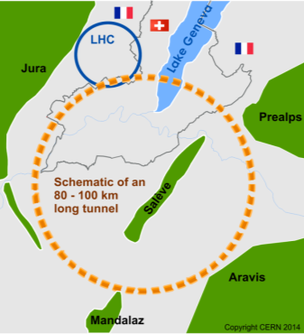
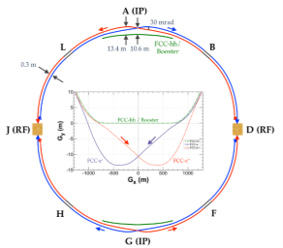
The FCC integrated program at CERN
inspired by successful LEP – LHC (1976-2038?) program
Comprehensive cost-effective program maximizing physics opportunities
Stage 1: FCC-ee (Z, W, H, tt) as first generation Higgs EW and top factory at highest luminosities.
Stage 2: FCC-hh (~100 TeV) as natural continuation at energy frontier, with ion and eh options.
Complementary physics
Integrating an ambitious high-field magnet R&D program
Common civil engineering and technical infrastructures
Building on and reusing CERN’s existing infrastructure.
FCC-INT project plan is fully integrated with HL-LHC exploitation
and provides for seamless continuation of HEP
FCC-ee
FCC-hh

Slide 4
CDR
FCC-Conceptual Design Reports:
  Vol 1 – Physics
  Vol 2 – FCC-ee,
  Vol 3 – FCC-hh,
  Vol 4 – HE-LHC
  1338 authors
  Preprints since 15 January 2019 on http://fcc-cdr.web.cern.ch/ and INSPIRE
  CDRs published in European Physical Journal C (Vol 1) and ST (Vol 2 – 4)
  ESPP summaries: FCC-integral, FCC-ee, FCC-hh, HE-LHC http://fcc-cdr.web.cern.ch/
  FCC-ee «Your questions answered» https://arxiv.org/abs/1906.02693v1
  “Circular vs linear, another story of complementarity” arXiv:1912.11871v2
A public presentation of the CDR was given on 4-5 March
at CERN https://indico.cern.ch/event/789349/
→ many further details can be found there!

Slide 5
FCC-France
2019: https://indico.in2p3.fr/event/19693/ 14-15 Nov. 2019 (87 participants)
2020: https://indico.in2p3.fr/event/20792/ 14-15 May 2020 (more!)
FCC-contacts
- Responsable IN2P3 (Master projet FCC-Acc) : Jean-Luc Biarotte
- Responsable IN2P3 (Master projet FCC-Phys) : Gregorio Bernardi
- Responsable IRFU : Roy Aleksan
- FCC-contacts dans les laboratoires ou dans les master-projets (MP) reliés:
Jeremy Andrea (IPHC-Strasbourg)
Auguste Besson (MP microvertex pour collisionneurs linéaires)
Vincent Boudry (MP Calice)
Suzanne Gascon (IP2I Lyon)
Thibault Guillemin (LAPP-Annecy)
Fairouz Malek (LPSC Grenoble)
Stephane Monteil (LPC Clermont)
Nicolas Morange (IJC-Lab Orsay)
Steve Muanza (CPPM Marseille)
Luc Poggioli (LPNHE Paris)
Roberto Salerno (LLR Palaiseau)
Jan Stark (L2IT, Toulouse)

Slide 6
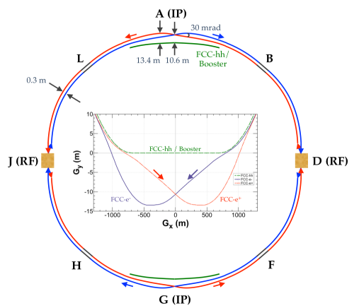
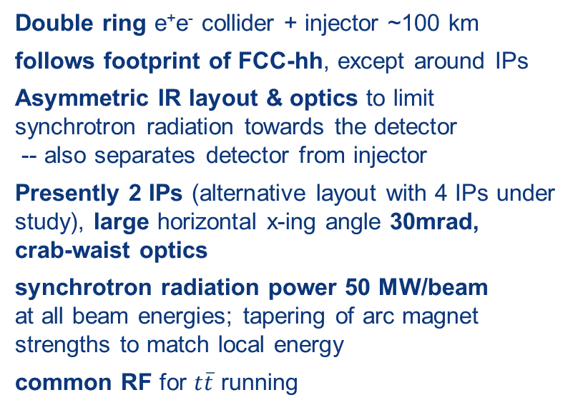
FCC-ee basic design choices
Double ring e⁺e⁻ collider + injector ~100 km
follows footprint of FCC-hh, except around IPs
Asymmetric IR layout & optics to limit synchrotron radiation towards the detector
-- also separates detector from injector
Presently 2 IPs (alternative layout with 4 IPs under study), large horizontal x-ing angle 30mrad,
crab-waist optics
synchrotron radiation power 50 MW/beam
at all beam energies; tapering of arc magnet strengths to match local energy
common RF for $t\overline{t}$ running
K. Oide et al.
top-up injection requires
booster synchrotron in collider tunnel
Beam Polarization and energy calibration, wigglers, polarimeters, depolarization kicker for Z and WW operation.

Slide 7
FCC-ee Collider Parameters
parameter | Z | WW | H (ZH) | ttbar
beam energy [GeV] | 45 | 80 | 120 | 182.5
beam current [mA] | 1390 | 147 | 29 | 5.4
no. bunches/beam | 16640 | 2000 | 393 | 48
bunch intensity [10¹¹] | 1.7 | 1.5 | 1.5 | 2.3
SR energy loss / turn [GeV] | 0.036 | 0.34 | 1.72 | 9.21
total RF voltage [GV] | 0.1 | 0.44 | 2.0 | 10.9
long. damping time [turns] | 1281 | 235 | 70 | 20
horizontal beta* [m] | 0.15 | 0.2 | 0.3 | 1
vertical beta* [mm] | 0.8 | 1 | 1 | 1.6
horiz. geometric emittance [nm] | 0.27 | 0.28 | 0.63 | 1.46
vert. geom. emittance [pm] | 1.0 | 1.7 | 1.3 | 2.9
bunch length with SR / BS [mm] | 3.5 / 12.1 | 3.0 / 6.0 | 3.3 / 5.3 | 2.0 / 2.5
luminosity per IP [10³⁴ cm⁻²s⁻¹] | 230 | 28 | 8.5 | 1.55
beam lifetime rad Bhabha / BS [min] | 68 / >200 | 49 / >1000 | 38 / 18 | 40 / 18

Slide 8
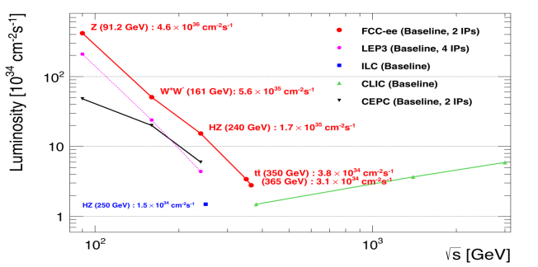
Z WW HZ tt
FCC-ee
LEPx10⁵!
Event
statistics :
E_{CM} errors:
Z peak E_{cm} : 91 GeV 5 10¹² e+e- → Z
WW threshold E_{cm} : 161 GeV 10⁸ e+e- → WW
ZH threshold E_{cm} : 240 GeV 10⁶ e+e- → ZH
‾tt threshold E_{cm} : 350 GeV 10⁶ e+e- →‾tt
LEP x 10⁵
LEP x 2.10³
Never done
Never done
<100 keV
<300 keV
2 MeV
5 MeV
Great energy range for the heavy particles of the Standard Model.

Slide 9
FCC-ee with > 2 IPs?
Almost 2x higher total luminosity, or equal luminosity at half the SR power (70% total)
baseline w 2 IPs
periodic alternative
with 4 IPs
less symmetric alternative
with 4 IPs
IP1
RF
(W,Z,H,t)
IP1
RF
(H,t)
IP1
IP3
IP4
RF
(W,Z,H,t)
RF
(H,t)
RF
(W,Z,H,t)
RF
(H,t)
IP4
IP3
RF
(H,t)
RF
(H,t)
IP2
IP2
IP2
K. Oide,
D. Shatilov
works fine
so far OK for lattice
and beam-beam
not yet studied,
but considered challenging
OK for FCC-hh layout to be confirmed

Slide 10
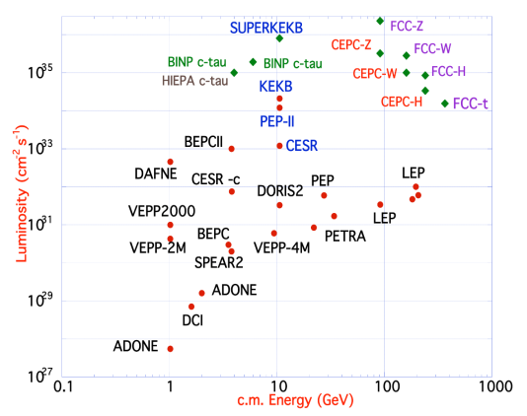
FCC-ee design
based on lessons and techniques from past colliders
B-factories: KEKB & PEP-II:
double-ring lepton colliders,
high beam currents,
top-up injection
DAFNE: crab waist, double ring
SuperB-factories, S-KEKB: low β_{y}*
LEP: high energy, SR effects
VEPP-4M, LEP: precision E calibration
KEKB: e⁺ source
HERA, LEP, RHIC: spin gymnastics
L/IP
Marica Biagini
combining successful ingredients of several recent colliders
→ highest luminosities & energies

Slide 11
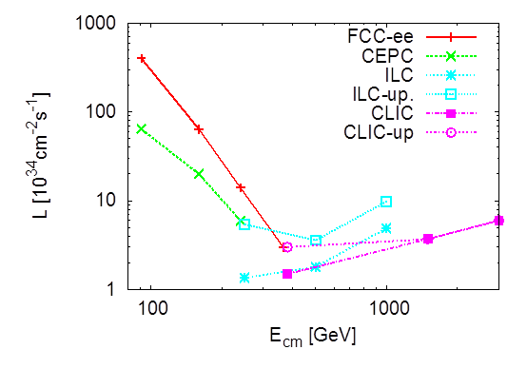
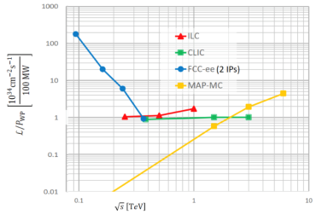
Circular vs linear complementarity
plots from Briefing Book
Luminosity
Luminosity/Power → Energy efficiency
cross-over ~350 GeV
Luminosity vs Energy circular below 365GeV linear above 340 GeV
Efficiency : 9 (5) GJ/Higgs at FCC-ee with 2(4)IP 50GJ/Higgs for ILC250 (first 15 years)
Beam polarization: circular: transverse → ppm beam energy calibration
linear: longitudinal : e- ±80% easy, (e+ ±30% difficult) → additional d.o.f
Monochromatization for e+e- → H (125 GeV)
Long term energy upgrade circular: pp, AA, e-h linear: High energy lepton collisions
Interaction points circular: 2-4 linear: 1 IP (at a time)
Run limited in time by arrival of hadron collider Run is open ended

Slide 12
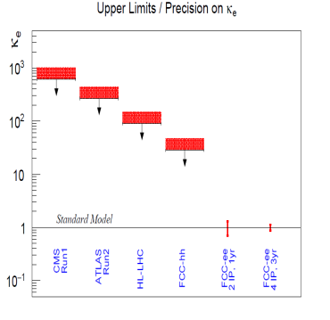
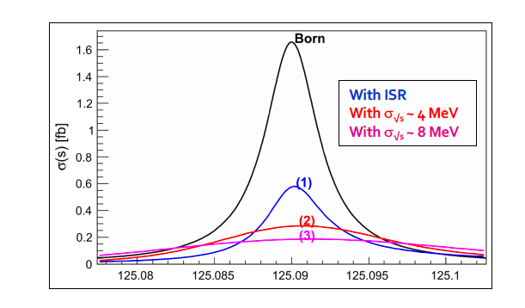
Something unique!
e+e- → H @ 125.xxx GeV requires
-- Higgs mass to be known to <5 MeV from 240 GeV run (CEPC group almost there)
-- Huge luminosity
-- monochromatization (opposite sign dispersion using magnetic lattice) to reduce σ_{ECM}
-- continuous monitoring and adjustment of E_{CM} to MeV precision (transv. Polar.)
-- an extremely sensitive event selection against backgrounds
-- a generous lab director to spend 3 years doing this and neutrino counting

Slide 13
FCC-ee Luminosity vs Energy
H s-channel
with mono-
chromatization

Slide 14
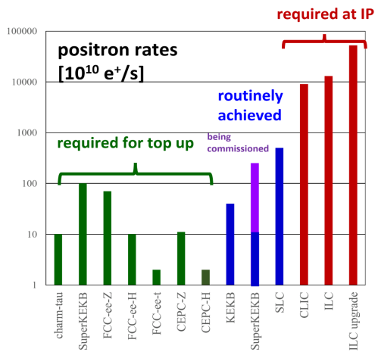
several key design parameters
are on conservative side
-- x/y coupling 0.2%
simulations typically 10 times smaller
-- positron source requirements →
< superKEKb, SLC
<< CLIC, ILC
-- β_{y}* 0.8mm(Z) – 1.6 mm(top)
-- RF gradients
There are safety margins…
and there might be some room for
luminosity improvement at given power.

Slide 15
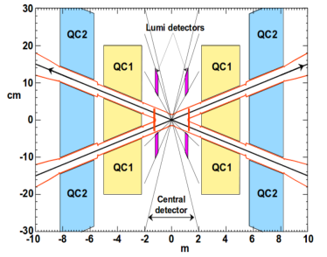
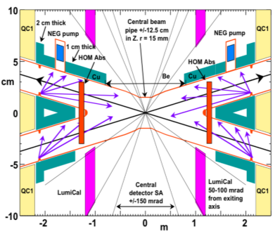

FCC-ee Interaction Region Design
A. Novokhatski, M. Sullivan, E. Belli, M. Gil Costa, and R. Kersevan, Unavoidable trapped mode in the interaction region of colliding beams, Phys. Rev. Accel. Beams 20, 111005 (2017)
M. Boscolo, H. Burkhardt, and M. Sullivan, Machine detector interface studies: Layout and synchrotron radiation estimate in the future circular collider interaction region, Phys. Rev. Accel. Beams 20, 011008 (2017)
heat loads: rad Bhabha (kW), beamstrahlung (MW), res. wall (kW), HOMs, quadr. synchrotron rad.
Q1 with shielding
solenoid
luminometer
IP
3D sketch of key IR systems over ﬁrst 3 m from IP
compensation
solenoid
stiff-skeleton cryostats?
M. Boscolo, N. Bacchetta, A. Bogomyagkov, H. Burkhardt, M. Dam, D. El Khechen, M. Koratzinos, E. Levichev, M. Luckhof, A. Novokhatski, L. Pellegrino, S. Sinyatkin, M. Sullivan, et al.

Slide 16
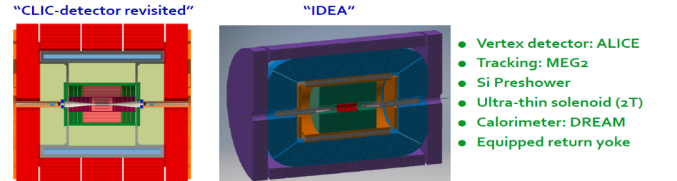
FCC-ee Detectors
Detectors can be done and work for the FCC-ee but physics optimization remains to be done.
Two integration, performance and cost estimates:
-- Linear Collider Detector group at CERN has undertaken the adaption of
CLIC-SID detector for FCC-ee
-- IDEA, detector specifically designed for FCC-ee (and CEPC)
MAPS
SiD at ILC, CLD at FCC-ee IDEA at FCC-ee & CEPC

Slide 17
FCC-hh (pp) collider parameters
parameter | FCC-hh |  | HE-LHC | HL-LHC | LHC
collision energy cms [TeV] | 100 |  | 27 | 14 | 14
dipole field [T] | 16 |  | 16 | 8.33 | 8.33
circumference [km] | 97.75 |  | 26.7 | 26.7 | 26.7
beam current [A] | 0.5 |  | 1.27 | 1.1 | 0.58
bunch intensity [10¹¹] | 1 | 1 | 2.5 | 2.2 | 1.15
bunch spacing [ns] | 25 | 25 | 25 | 25 | 25
synchr. rad. power / ring [kW] | 2400 |  | 101 | 7.3 | 3.6
SR power / length [W/m/ap.] | 28.4 |  | 4.1 | 0.33 | 0.17
long. emit. damping time [h] | 0.54 |  | 1.8 | 12.9 | 12.9
beta* [m] | 1.1 | 0.3 | 0.45 | 0.15 (min.) | 0.55
normalized emittance [μm] | 2.2 |  | 2.5 | 2.5 | 3.75
peak luminosity [10³⁴ cm⁻²s⁻¹] | 5 | 30 | 16 | 5 (lev.) | 1
events/bunch crossing | 170 | 1000 | 460 | 132 | 27
stored energy/beam [GJ] | 8.4 |  | 1.4 | 0.7 | 0.36

Slide 18
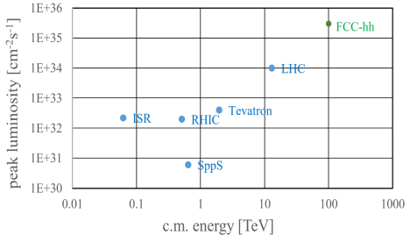
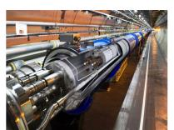
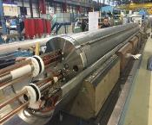
FCC-hh: performance
order of magnitude performance increase in both energy & luminosity
100 TeV cm collision energy (vs 14 TeV for LHC)
20 ab⁻¹ per experiment collected over 25 years of operation (vs 3 ab⁻¹ for LHC)
similar performance increase as from Tevatron to LHC
key technology: high-field magnets
from
LHC technology
8.3 T NbTi
via
HL-LHC technology
11 T Nb₃Sn
16 T Nb₃Sn

Slide 19
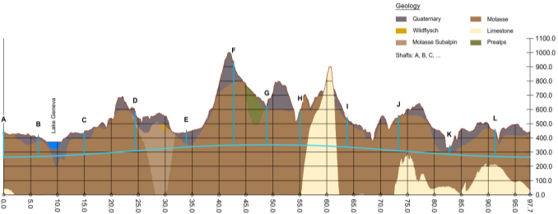
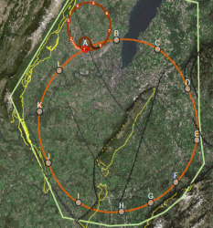
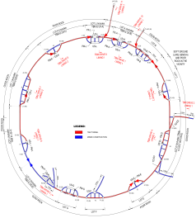
FCC implementation - footprint baseline
Present baseline position was established considering:
lowest risk for construction, fastest and cheapest construction
feasible positions for large span caverns (most challenging structures)
More than 75% tunnel in France, 8 (9) / 12 access points in France.
next step: review of surface site locations and machine layout

Slide 20
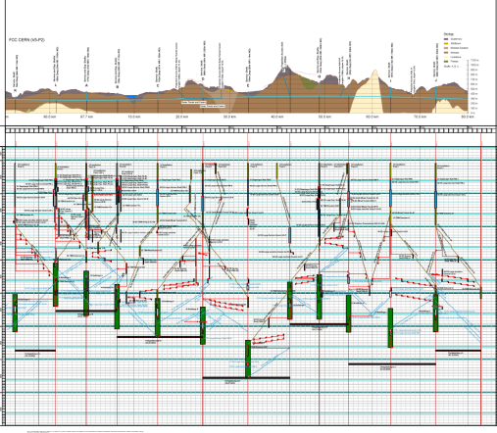
Civil Engineering studies
4.5yrs
6.5yrs
Total construction duration 7 years
First sectors ready after 4.5 years

Slide 21
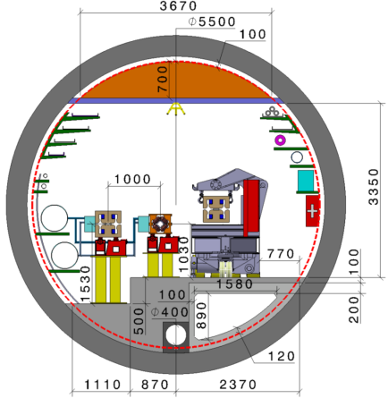
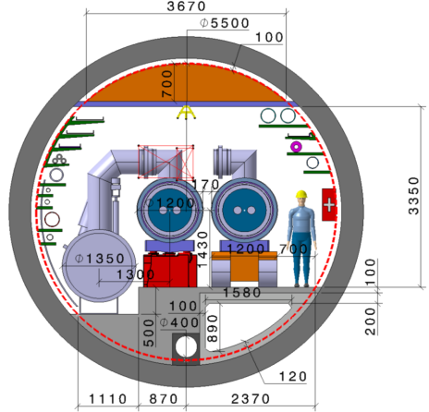
FCC-tunnel integration in arcs
  FCC-ee FCC-hh
  5.5 m inner diameter

Slide 22
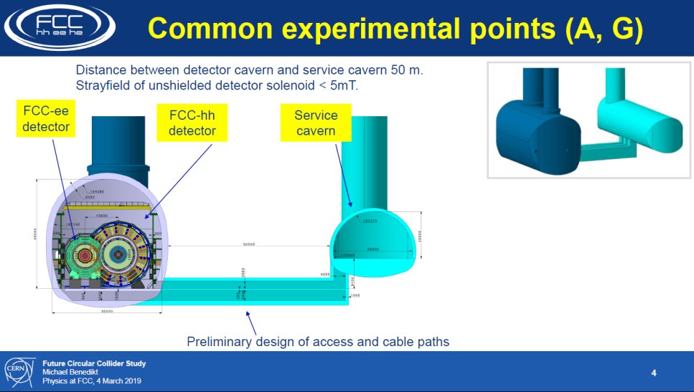

Slide 23
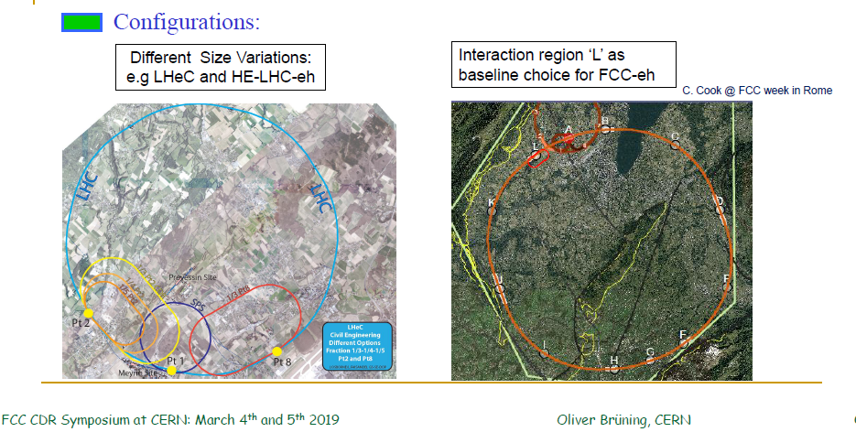
Electron – hadron collisions for LHC and FCC-hh
FCC-ep is conceived to run in parallel with FCC-hh

Slide 24
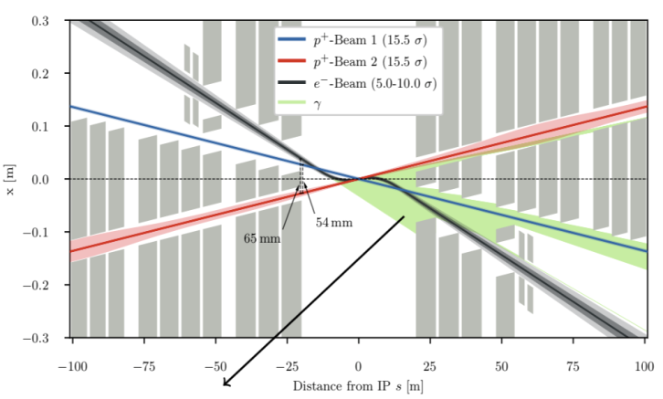
FCC-eh Interaction Region
exit hole - electrons and non-colliding protons
R. Martin @ FCC Week in Amsterdam: FCC-eh triplet
field “free” region
non
focused beam
bypasses
the interaction
Final quadrupole magnet Q1 example design
“sweet spot”
Various options on the table with solutions at hand!
Design work on the ‘Sweet Spot’ magnet is still ongoing!
Final implementation strongly depends on actual IR choice and
FCC-hh optics configuration!!!
β∗ = 30cm
focused interacting
proton beam
SR fan
P_{SR} = 13kW; E_{crit} = 176keV
B. Parker, S. Russenschuck et al.

Slide 25
FCC integral project technical schedule
1
2
3
4
5
6
7
8
9
10
11
12
13
14
15
16
17
18
15 years operation
34
35
36
37
38
39
40
41
42
43
~ 25 years operation
70
Project preparation &
administrative processes
Permis-sions
Update
Permissions
Funding strategy
Funding and
in-kind contribution agreements
Funding and
in-kind contribution agreements
Geological investigations, infrastructure detailed design and tendering preparation
Tunnel, site and technical infrastructure construction
FCC-ee dismantling, CE & infrastructure adaptations FCC-hh
FCC-ee accelerator R&D and technical design
FCC-ee accelerator construction, installation, commissioning
FCC-hh accelerator R&D and technical design
FCC-hh accelerator construction, installation, commissioning
Set up of international experiment collaborations, detector R&D and concept development
FCC-ee detector technical design
FCC-ee detector
construction, installation, commissioning
FCC-hh detector R&D,
technical design
FCC-hh detector
construction, installation, commissioning
Superconducting wire and magnet R&D
SC wire and 16 T magnet R&D, model magnets, prototypes, preseries
16 T dipole magnet
series production

Slide 26
Compare with LEP/LHC
76
81 <- construction ->
89
2000
2010
2038
12 years operation
8+2 years installation
28 years operation
64
20
2038
15 years operation
1
2
3
4
5
6
7
8
9
10
11
12
13
14
15
16
17
18
15 years operation
34
35
36
37
38
39
40
41
42
43
~ 25 years operation
70
Project preparation &
administrative processes
Permis-sions
Update
Permissions
Funding strategy
Funding and
in-kind contribution agreements
Funding and
in-kind contribution agreements
Geological investigations, infrastructure detailed design and tendering preparation
Tunnel, site and technical infrastructure construction
FCC-ee dismantling, CE & infrastructure adaptations FCC-hh
FCC-ee accelerator R&D and technical design
FCC-ee accelerator construction, installation, commissioning
FCC-hh accelerator R&D and technical design
FCC-hh accelerator construction, installation, commissioning
Set up of international experiment collaborations, detector R&D and concept development
FCC-ee detector technical design
FCC-ee detector
construction, installation, commissioning
FCC-hh detector R&D,
technical design
FCC-hh detector
construction, installation, commissioning
Superconducting wire and magnet R&D
SC wire and 16 T magnet R&D, model magnets, prototypes, preseries
16 T dipole magnet
series production

Slide 27
FCC-integrated cost estimate
Total construction cost FCC-ee (Z, W, H) amounts to 10,500 MCHF & 1,100 MCHF (tt).
Associated to a total project duration of ~20 years (2025 – 2045)
Total construction cost for subsequent FCC-hh amounts to 17,000 MCHF.
Associated to a total project duration of ~25 years (2035 – 2060) (FCC-hh stand alone 25 BCHF)

Slide 28
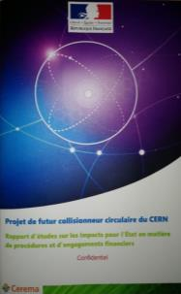



FCC work with Host States
General secretariat of the region Auvergne-Rhône-Alpes and notified body “Centre d'études et d'expertise sur les risques, l'environnement, la mobilité et l'aménagement” CEREMA
Working group with representatives of federation, canton and state of Geneva and representation of Switzerland at the international organisations and consultancy companies
Administrative processes for project preparatory phase developed.
First review of tunnel placement performed.
Requirements for urbanistic, environmental, economic impact, land acquisition and construction permit related processes defined.
For 2019-20, common optimization of collider tunnel and surface site infrastructure implementation.

Slide 29

FCC-ee discovery potential and Highlights
Today we do not know how nature will surprise us. A few things that FCC-ee could discover :
EXPLORE 10-100 TeV energy scale (and beyond) with Precision Measurements
-- ~20-100 fold improved precision on many EW quantities (equiv. to factor 5-10 in mass)
m_{Z,} m_{W}, m_{top} , sin² θ_{w}^{eff} , R_{b} , α_{QED} (m_{z}) α_{s} (m_{z} m_{W} m_{τ}), Higgs and top quark couplings
model independent «fixed candle» for Higgs measurements, ee-H coupling.
DISCOVER a violation of flavour conservation or universality and unitarity of PMNS @10⁻⁵
-- ex FCNC (Z --> μτ , eτ) in 5 10¹² Z decays and τ BR in 2 10¹¹ Z→ τ τ
+ flavour physics (10¹² bb events) (B→s τ τ etc..)
DISCOVER dark matter as «invisible decay» of H or Z (or in LHC loopholes)
DISCOVER very weakly coupled particle in 5-100 GeV energy scale
such as: Right-Handed neutrinos, Dark Photons, ALPS, etc…
+ and many opportunities in – e.g. QCD (α_{s} @ 10⁻⁴, fragementations, H→ gg) etc….
NB Not only a «Higgs Factory»! «Z factory» and «top» are important for ‘discovery potential’

Slide 30
FCC-hh discovery potential and Highlights
FCC-hh is a HUGE discovery machine (if nature …), but not only.
FCC-hh physics is dominated by three features:
-- Highest center of mass energy –> a big step in high mass reach!
ex: strongly coupled new particle up to >30 TeV
Excited quarks, Z’, W’, up to ~tens of TeV
Give the final word on natural Supersymmetry, and WIMPS
extra Higgs etc.. reach up to 5-20 TeV
Sensitivity to high energy phenomena in e.g. WW scattering
-- HUGE production rates for single and multiple production of SM bosons (H,W,Z) and quarks
-- Higgs precision tests using ratios to e.g. γγ/μμ/ ττ/ZZ, ttH/ttZ @<% level
-- Precise determination of triple Higgs coupling (~2% stat. level) and quartic Higgs coupling
-- detection of rare decays H→ Vγ (V= ρ, ϕ, J/ψ, ϒ, Z …)
-- search for invisibles (DM searches, RH neutrinos in W decays)
-- renewed interest for long lived (very weakly coupled) particles.
-- rich top and HF physics program
-- Cleaner signals for high Pt physics
-- allows clean signals for channels presently difficult at LHC (e.g. H→ bb)

Slide 31
FCC-eh Discovery Potential and Highlights
FCC-ep explores hitherto untouched domain of (x,q2 ) DIS plane and provides
production of high mass SM particles (H, top) in cleaner conditions than pp.
-- extremely precise structure function work
important input on structure functions for FCC-hh
complete resolution of the partonic contents of the proton, for the first time
high precision α_{s} O(10⁻⁴) similar to FCC-ee from totally different source
-- 2 10⁶ Higgs produced from from W & Z to deliver precise H couplings
complementary to ee -- esp (g_{HWW})
-- Searches for new physics (Leptoquarks, RH neutrinos, etc...)
in new domain of mass and couplings
-- rich top (Vtb @% level, FCNC) and HF physics program
-- Discovery in QCD: non-linear parton evolutions, instantons?, ..
-- Unique electron-ion physics related to QGP physics

Slide 32
FCC main goals for 2020 - 2026
Overall goal:
Perform all necessary steps and studies to enable a definitive project decision by 2025/26, at the anticipated date for the next ESU, and a subsequent start of civil engineering construction by 2028/29.
This requires successful completion of the following four main activities:
Develop and establish a governance model for project construction and operation
Develop and establish a financing strategy, including in-kind contributions
Prepare and successfully complete all required project preparatory and administrative processes with the host states (debat public, EIA, etc.)
Perform site investigations to enable CE planning and to prepare CE tendering..
In parallel development preparation of TDRs and physics/experiment studies:
Machine designs and main technology R&D lines
Establish user communities, work towards proto experiment collaboration by 2025/26.

Slide 33
Conclusion: The Physics Landscape
We found the Higgs and the SM is ‘complete’.
We are in a fascinating situation: where to look and what will we find?
For the first time since Fermi theory, WE HAVE NO SCALE
The next facility must be versatile with as broad and powerful reach as possible,
as there is no precise target
➔ more Sensitivity, more Precision, more Energy
FCC , thanks to synergies and complementarities, offers the most
versatile and adapted response to today’s physics landscape

