Slide 1
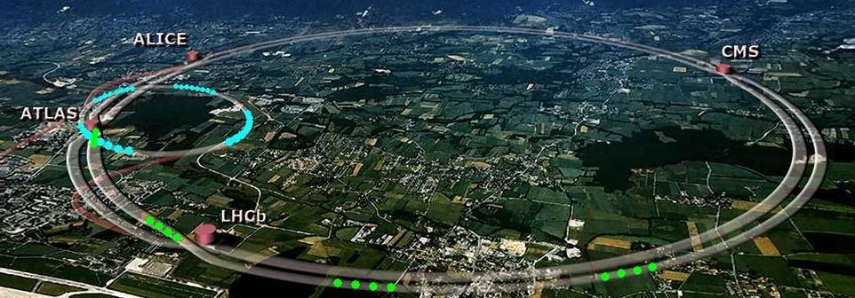
Highlights of LHC, ATLAS, CMS and LHCb upgrades
Séminaire thématique GT01: « Physique des particules »
12 - 13 Mars 2020, IP2I Lyon
D. Contardo - IP2I CNRS/IN2P3

Slide 2
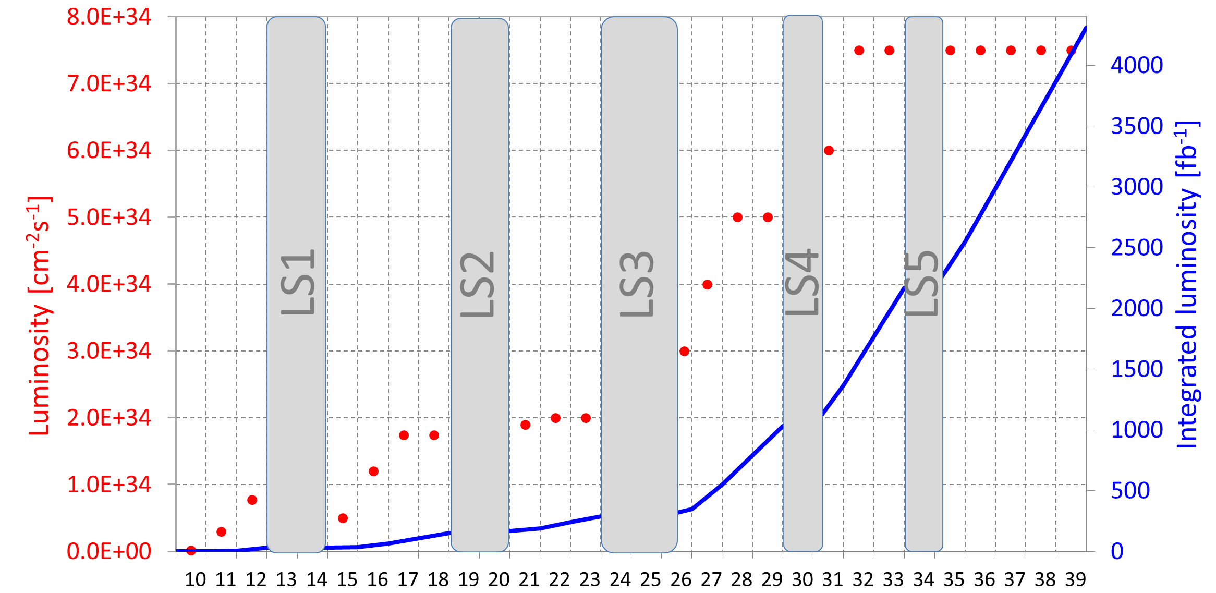
LHC luminosity planning (ATLAS & CMS): Dec. 2019 update
ATLAS small wheels
Restore contingency for ATLAS & CMS upgrades
HL-LHC ultimate: accelerators & experiment upgrade design specifications,
average collision pile-up µ ≃ 200
Instantaneous Luminosity [cm⁻²s⁻¹]*
Run 1 - 7 & 8 TeV - 30 fb⁻¹
Run 2 - 13 TeV - 190 fb⁻¹
Run 3 - ≳ 450 fb⁻¹
LS2 + 2 months + 1.5? decision in June
LS2
LS3 delayed 1 year
LS4
LS1
LS3
LS5
.
.
.
LHC nominal
13 to 14 TeV
decision end of LS2 based on magnet training
Year - end driven by physics and
next accelerator program
* Luminosity leveling since 2017 - accelerator performance exceeds ability of experiments to cope with collision pile-up average µ ≃ 40 up to 60 in Run 2

Slide 3
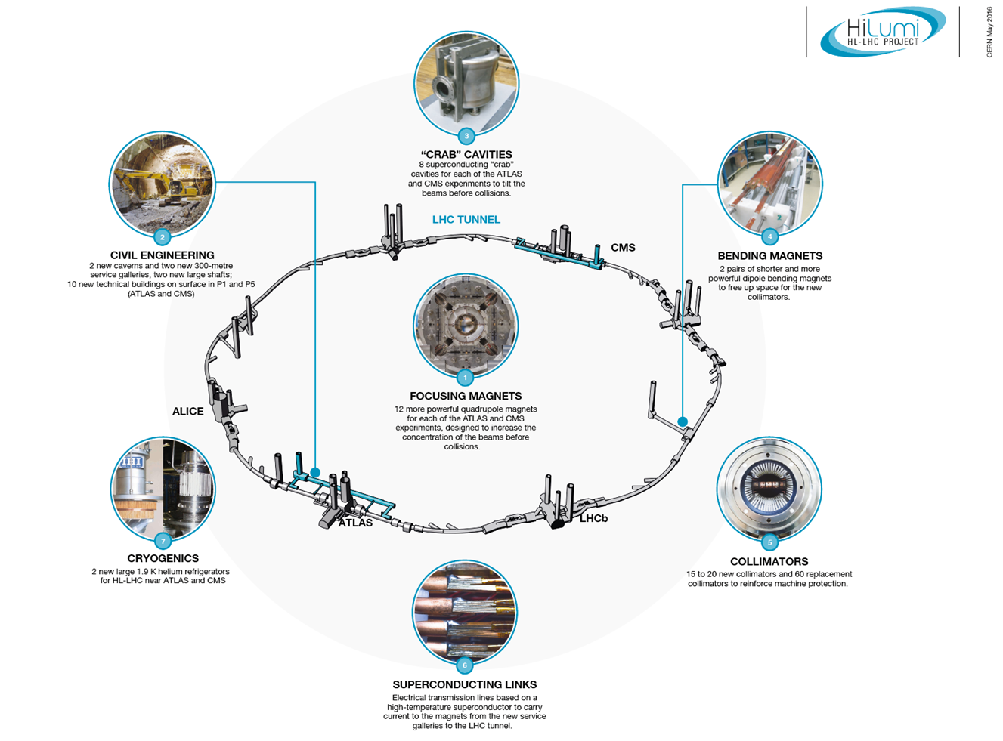
HL-LHC Upgrades: L_{peak} = [n_{b}N_{b}²f_{rev} / 4πβ*ε_{n}] x R ≃ 1.5 x 10³⁵ (Hz/cm²)*
During LS2
LHC Injection Upgrade (LIU): increase intensity (N_{b} x 2) & brightness (Nb/ε_{n}), reliability and availability
Linac 2 @ 50 MeV → Linac 4 @ 160 MeV with H⁻ acceleration
PSB 1.4 → 2 GeV, H⁻ charge injection exchange to p
SPS new 200 MHz RF power system
First 4 x 5.5 m Nb/Sn magnets (dipoles) at 11 T (gain space for beam loss collimation)
Civil engineering**: pits and service caverns for new super conducting links toward magnets
During LS3
Interaction Point upgrades**: increase beam focus β* & tune overlap R
100 magnets of 11 types in matching region around IPs: focusing
New quadrupoles triplets: 12 Nb/Sn magnets at 12 T
“Crab” Cavities : tilt beams for luminosity levelling at 7.5 x 10³⁴ Hz/cm²
4 cavities on each side of IPs
New collimators for machine protection
½ replaced with new material (60) and 15 to 20 new ones
* Before levelling
** At ATLAS and CMS
L. Rossi: https://indico.cern.ch/event/806637/timetable/?view=standard

Slide 4
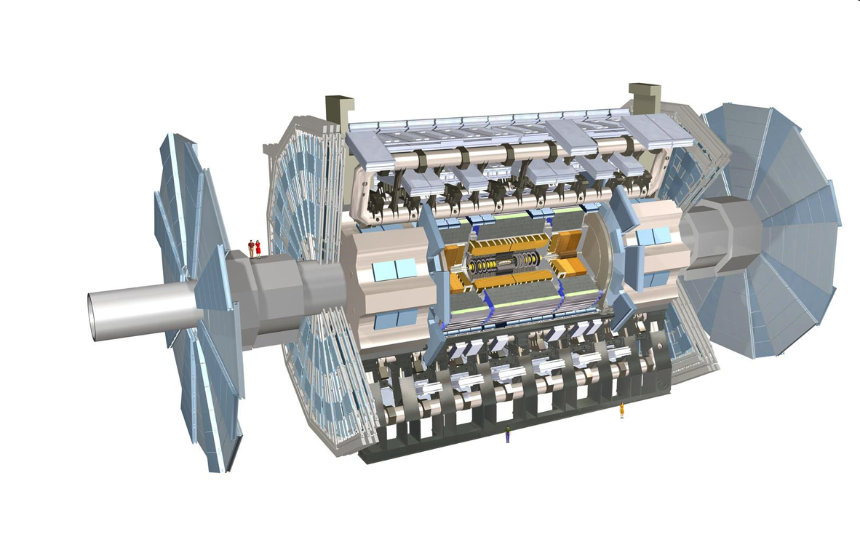
ATLAS Upgrades - rates, radiation tolerance & pile-up
Trigger/HLT/DAQ https://cds.cern.ch/record/2285584
Tracker readout at 1 MHz after 10 µs latency
HLT input 400 kHz with tracks after ≃ 30 µs
HLT output 10 kHz
Muon systems https://cds.cern.ch/record/2285580
New electronics
New inner barrel chambers
New Small Wheels during LS2 and EYETS 21-22
Liquid Argon and Tile calorimeter
https://cds.cern.ch/record/2285583
https://cds.cern.ch/record/2285582
New electronics increased
granularity at 40 MHz
(partly in LS2)
New Tracker
https://cds.cern.ch/record/2257755 https://cds.cern.ch/record/2285585/
Si-Strip & Pixels increased granularity
Extended coverage to η ≃ 4
High Granularity Timing Detector (TDR in preparation)
https://cds.cern.ch/record/2623663
Low Gain Avalanche Diodes 2.4 ≲ η ≲ 4
Pixel: Module production (IJCLab, IRFU, LPNHE), integration of ladders (CPPM, LAPP, LPSC)
LAr calorimeter: FE and calibration ASIC (OMEGA), FE ASIC and board tests (IJCLab), calibration board (LAPP), BE boards and firmware (CPPM, LAPP)
Tile Calorimeter: Production of FE ASIC, HV for PMTs and laser monitoring (LPC)
High Granularity Timing Detector: ASIC FE (OMEGA), Test ASIC and Hybrids (IJCLab, OMEGA, LPC), beam test with sensors (IJClab, LPNHE), module assembly (LPNHE, IJClab), cooling and mechanical structure (IJCLab)
New Small Wheels: Production of 32 chambers (half and the largest - 2m) (IRFU)

Slide 5
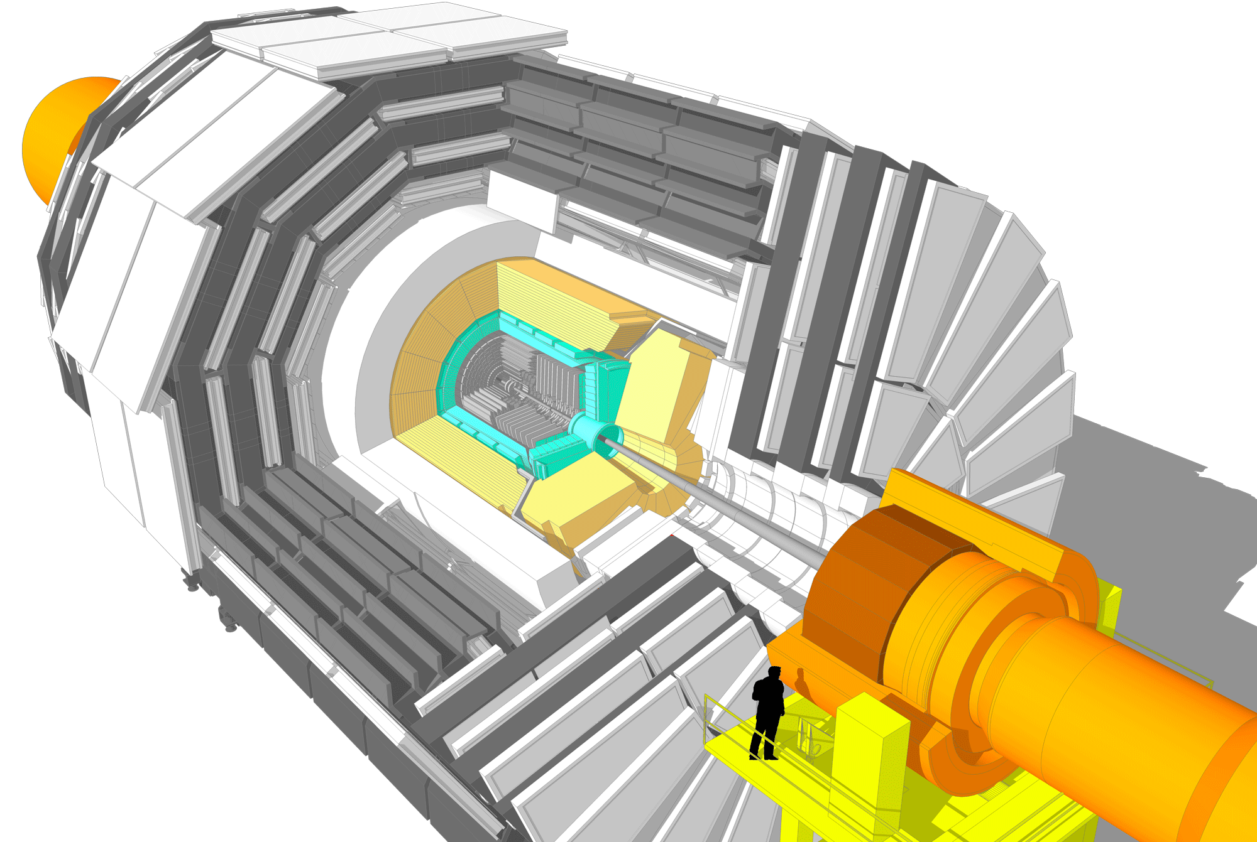
CMS Upgrades - rates, radiation tolerance & pile-up
L1-Trigger/HLT/DAQ (L1 TDR Q1 2020, HLT/DAQ TDR Q2 2021)
https://cds.cern.ch/record/2283192
https://cds.cern.ch/record/2283193
Tracks in L1-Trigger at 40 MHz
PFlow-like, 750 kHz output
HLT output 7.5 kHz
Barrel Calorimeters
https://cds.cern.ch/record/2283187
ECAL crystal granularity readout at 40 MHz with precise timing for e/γ at 30 GeV
ECAL and HCAL new Back-End boards
Muon systems
https://cds.cern.ch/record/2283189
DT & CSC new FE/BE readout
RPC link -board
New GEM/RPC 1.6 < η < 2.4
Extended coverage to η ≃ 3
High Granularity Calorimeter Endcap
https://cds.cern.ch/record/2293646
3D showers and precise timing
Si, Scint+SiPM in Pb-W/SS
Beam Radiation Instr. and Luminosity, Common Systems and Infrastructure
https://cds.cern.ch/record/002706512
Precision Proton Spectrometer
EoI in preparation
Tracker https://cds.cern.ch/record/2272264
Si-Strip & Pixels increased granularity
Design for tracking in L1-Trigger
Extended coverage to η ≃ 3.8c
MIP Timing Detector https://cds.cern.ch/record/2296612
Barrel layer: Crystals + SiPMs
Endcap layer: Low Gain Avalanche Diodes
IPHC: assembly of outer barrel ladders and production of support wheel, DAQ system for outer and inner tracker, system test CYRCé beam line
IP2I: production of endcaps support dees, integration 1/2 of short dees, FE concentrator ASIC TSMC 65 nm, RPC PCB & FE readout boards
LLR: production of HGC cassette plates, system/beam tests, trigger system firmware and software
OMEGA: HGCROC Frontend ASIC in TSMC 130 nm, Muon RPC PETIROC ASIC in AMS 350 nm
IRFU: TDC, PLL of HGCROC, ECAL analog FE ASIC 130 nm, clock distribution for timing (MTD fanout ASIC TSMC 130nm , ECAL, HGC), ECAL laser monitoring

Slide 6
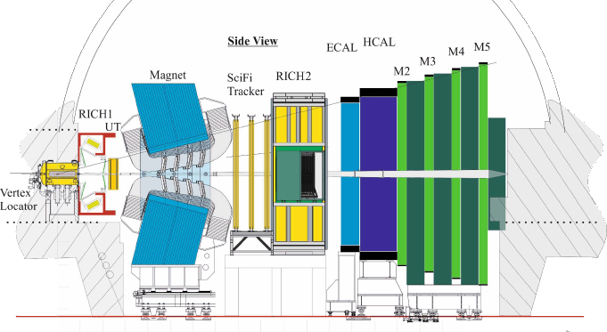
LHCb Upgrades - rates, radiation tolerance & pile-up
LS2 upgrade: L = 2 x 10³³ Hz/cm² (µ ≃ 5) - 50 fb⁻¹ integrated by LS4 upgrade*: L = 2 x 10³⁴ Hz/cm² (µ ≃ 50) toward 300 fb⁻¹
HLT/DAQ https://cds.cern.ch/record/1701361
Software event selection
DAQ output 20 kHz
New readout boards everywhere
PID https://cds.cern.ch/record/1624074
New photosensors in both RICH
Modified optics in RICH1
Precise timing photosensors
TORCH in front or RICH2**
Calorimeter and Muon system
https://cds.cern.ch/record/1333091
https://cds.cern.ch/record/1443882
New FE & BE in calorimeter
New BE in muon stations
µ-Rwell
Tracker https://cds.cern.ch/record/1647400
UT Si-strip, granularity & coverage
T Scintillating Fiber + SiPMs
Magnet low p_{T} stations
HCAL
Sci-Fi Tracker
RICH2
ECAL
Smog
https://cds.cern.ch/record/2673690
Fixed gas target
Running in // with collider mode
ECAL with precise timing**
Spacal
Vertex
https://cds.cern.ch/record/1624070
New Si-pixel system
MAPs* and precise timing layers (LGAD)
IP
** these upgrades or parts could be anticipated to the period between LS3 and LS4
Calorimeters: FE boards and controllers (IJCLab), microcode (firmware) of readout boards (LAPP), removal of SPS/PS, mechanics to replace inner calo. modules
Scintillating Fibers Tracker: FE ASIC and boards (LPC), microcode (firmware) of readout boards (LPNHE), integration and cooling of boards (LPC)
DAQ system: readout boards (CPPM), microcode (firmware) and framework developments (LAPP, CPPM), Real Time Analyses system (LPNHE)
* Physics case https://cds.cern.ch/record/2320509 reviewed by LHCC and CERN RB recommendation for framework TDR in 2021 and approval process

Slide 7
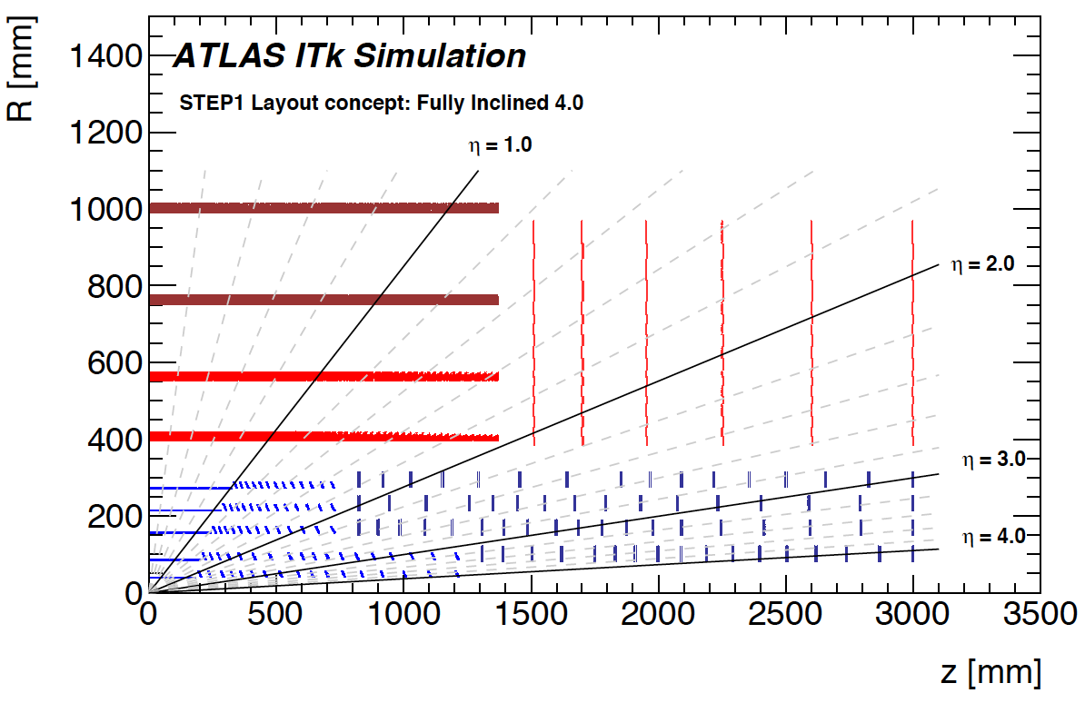
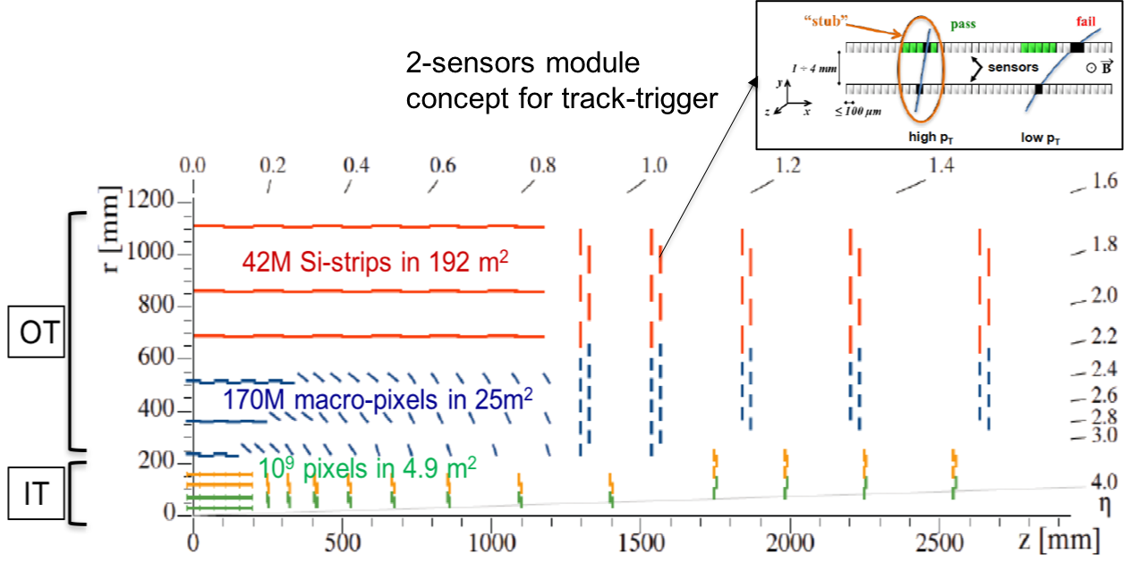
New paradigms: tracking systems
New technologies
Si-sensors: n-in-p (all exp.) & 3D inner pixel layer (ATLAS-CMS), thinner, granularity x 4 to 6
Front-End ASIC: TSMC 65 nm (Pixels, data transmission) increase radiation tolerance and lower power consumption
Material budget: light materials, CO₂ cooling, micro-channel in LHCb, DC/DC powering (CMS tracker weight ≃ 1/2)
LHCb outer tracker: Scintillating fibers, with SiPM photosensors at -40∘
Design optimizations
ATLAS: all Si-tracker with 5 barrel pixel layers
CMS: concept for readout of tracks with p_{T} ≳ 2 GeV at 40 MHz for L1 trigger
ATLAS and CMS: less layer inclined geometries in transition regions, pixel coverage extension to η ≃ 4
LHCb: VELO with pixel sensors very similar to ATLAS and CMS already in LS2 - at 4.5 mm from beam in vacuum
LHCb
VELO prototype
CMS
Stereo for z/r-coordinate in OT
OT
291 mm
IT
160 mm
39 mm
29 mm

Slide 8
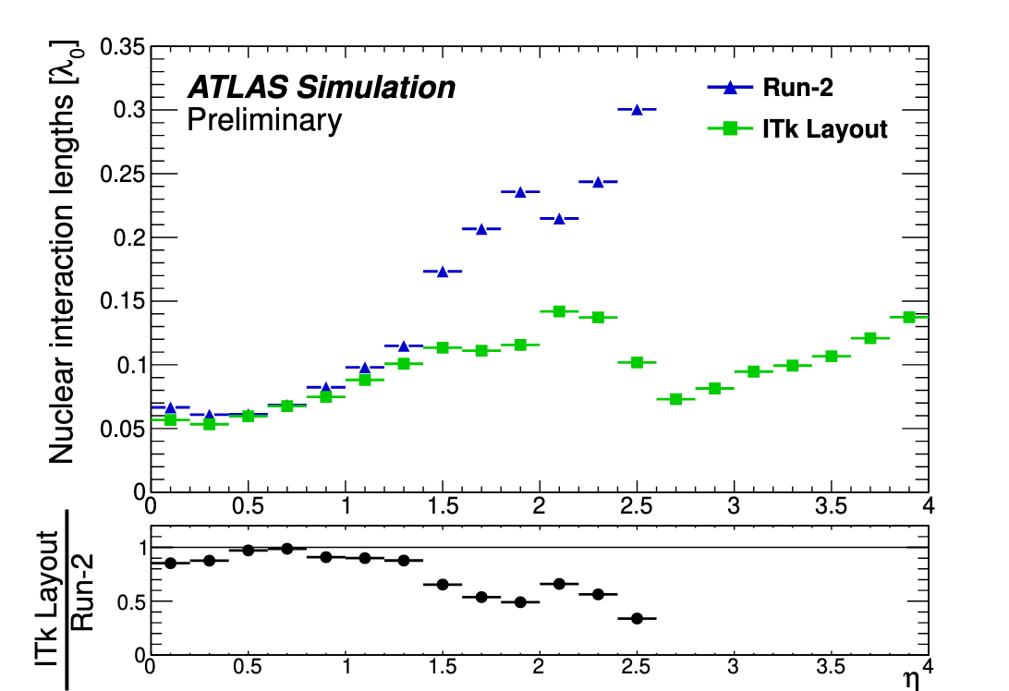
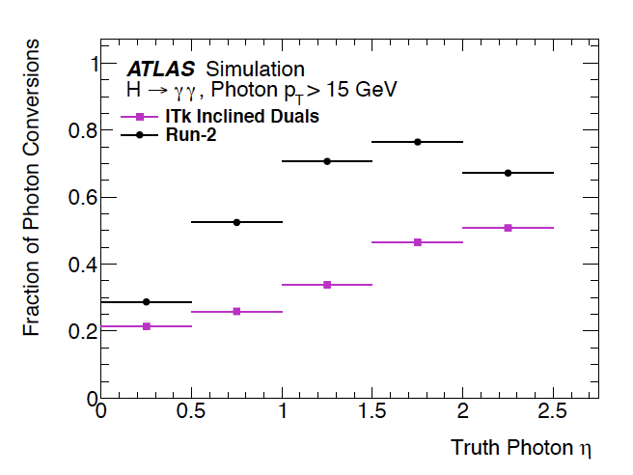
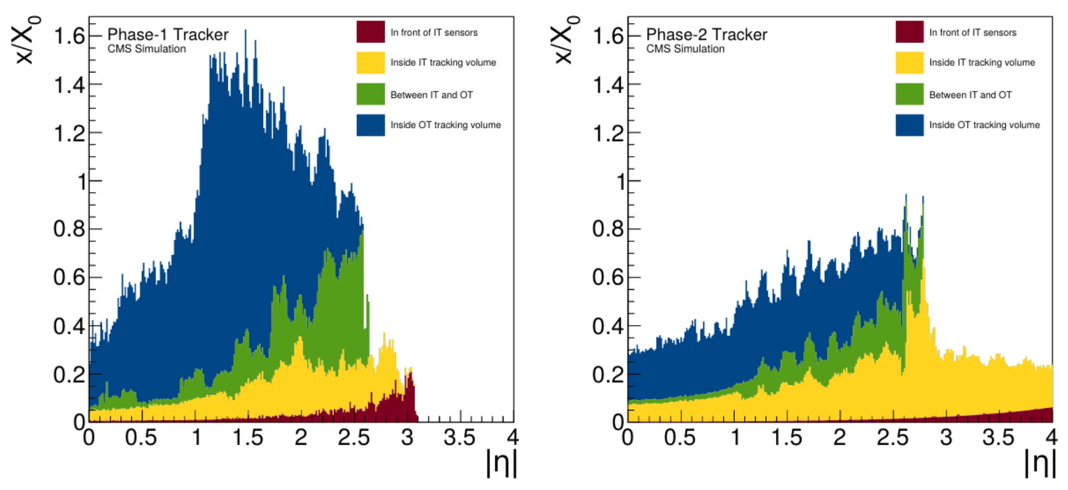
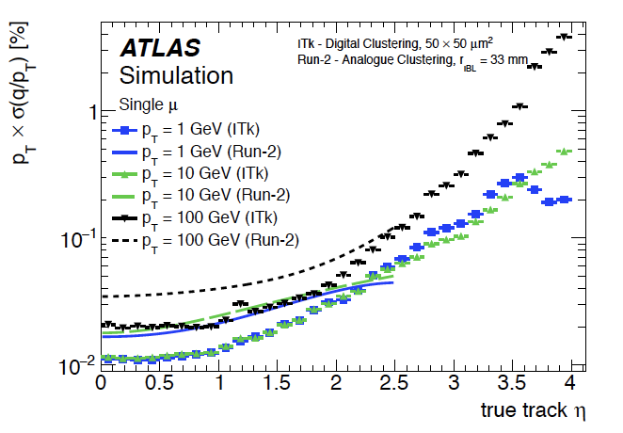
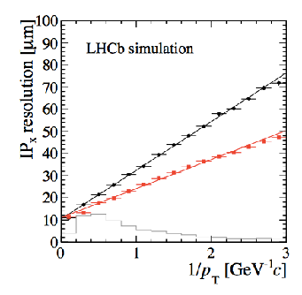
New paradigms: tracking systems
Radiation and Interaction length improvements
Momentum and Impact Parameter improvements
old
new

Slide 9
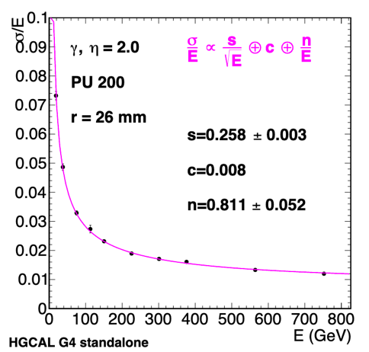
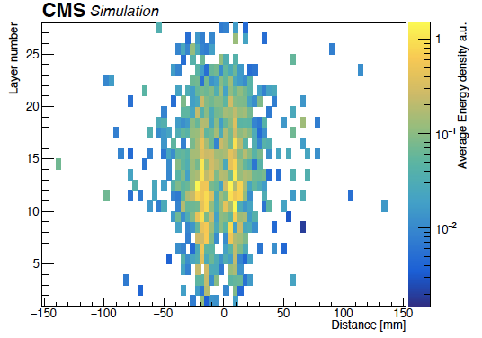
New paradigms: High Granularity Calorimeter in CMS endcaps
CALICE + PFlow concept used for pile-up mitigation in e/γ/τ/Jet ID and in HT and MET*
Design optimization
Electromagnetic (CE-E) 28 layers Si-sensors with W/Pb absorber (26 X₀ - 1.7 λ)
Hadronic (CE-H) 22 layers: 8 Si and 14 mixed Si/Scintillating tuiles + SiPMs in Stainless Steel absorber (9 λ)
Calice
Technologies
First use of 8” Si-sensors (n-in-p)
SiPM photosensors for direct scintillator tile readout
Very complex readout ASIC with 50 ps time precision
Engineering challenges compactness, cooling, weight…
CMS HGC
253 tonnes, total ~150 kW @-30C
500m² Scint. tiles ≃2x2 & ≃5x5 cm²
+ SiPM, ≃ 240kch
600 m², 300000 hexagonal 8” sensors, ~6Mch 0.5 & 1 cm²
2γ
* Also allows energy compensation for hadron energy resolution
Silicium - scintillateur + SiPMs limit defined by radiation tolerance

Slide 10
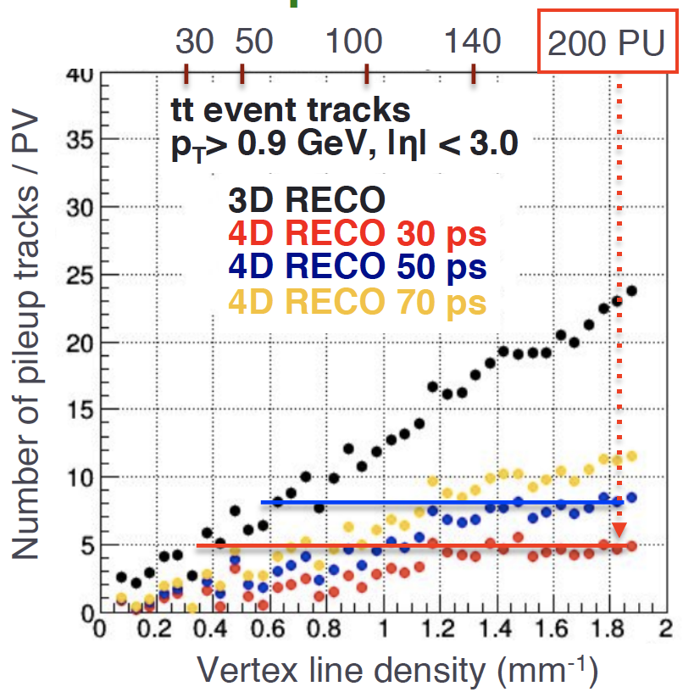
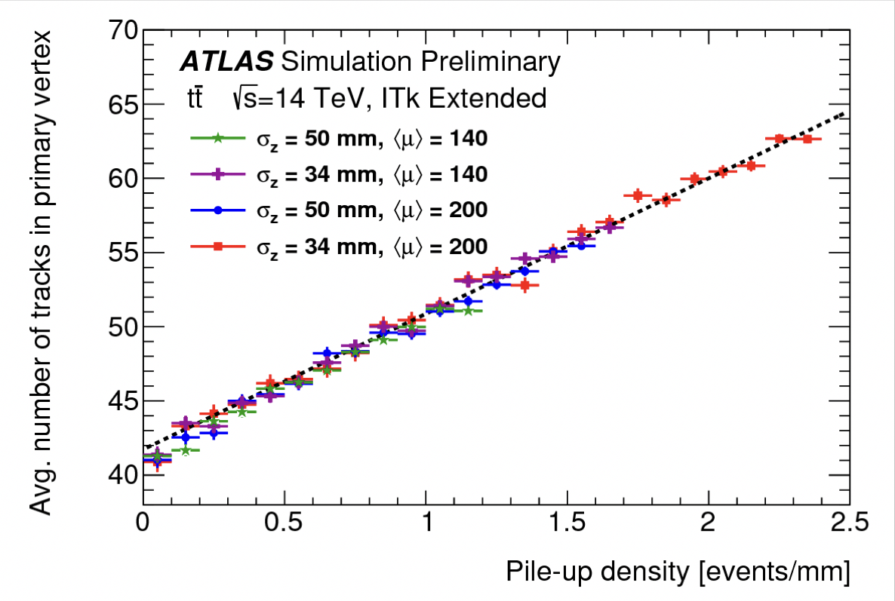
New paradigms: precise ToF MIP
200 p-p collisions BC
MIP precise Time of Flight to recover track purity in hard collision vertices to fully profit from luminosity potential* improves all object reconstruction, particularly beneficial to reject fake jets in forward region and to improve missing transverse energy resolution
ATLAS HGTD in more critical region 2.4 < η < 4.0
CMS hermetic up to η = 3
≃ 20% to 40% luminosity gain in barrel - forward
no CC
200 pile-up
baseline/flat 200 PU
baseline/flat 140 PU
LHC 50 PU
* Luminosity levelling is tunable

Slide 11
New paradigms: precise ToF MIP
30 (40) ps time resolution before (after) irradiation in ATLAS and CMS
New technologies LYSO crystals and Low Gain Avalanche Diodes*, ASICs(clock distribution) resolutions ≃ 20(10) ps
ATLAS High Granularity Timing Detector
CMS MIP Timing Detector**
Two double sided layers (75 mm) covering 2.4 < η < 4.0
2(3) hits per track for R >(<) 30 cm
LGADs 15 x15 array of 1.3 x 1.3 mm² pixels
6.3 m², 3.54 Mch
Barrel layer in Tracker volume (28 mm)
Lyso crystal bars 56 x 3 x3 mm², ≃ 350 kchannels, 40 m²
Readout at both ends with 2 SiPM 3 x 3 mm²,
Endcap 2 layers in front of Calo. Endcap (42 mm)
LGAD 1.3 x 1,3 mm² pads, ≃ 4 Mch, 12 m²
* Also foreseen for LHCb tracking upgrade in LS4, ** provides good ID for low momentum range π/K/p

Slide 12
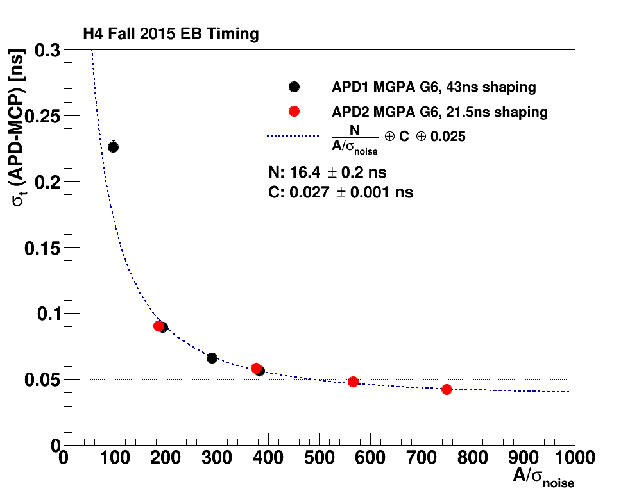
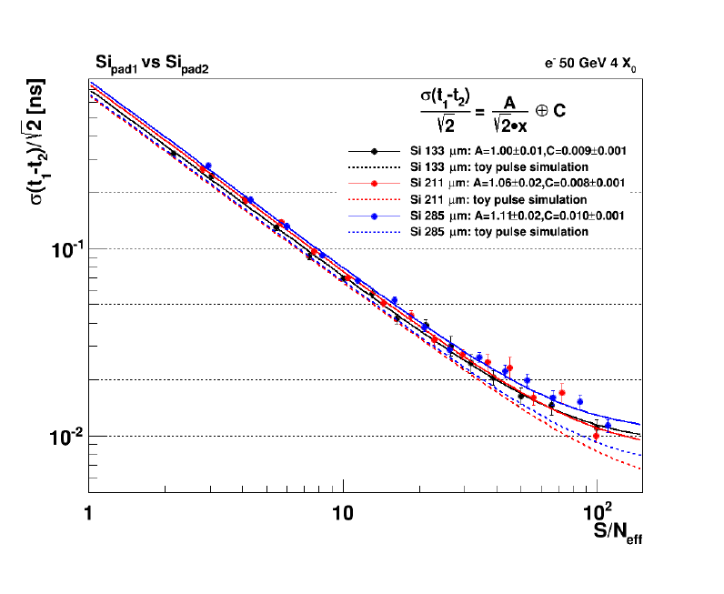
New paradigms: precision ToF showers
Exploit fast signal development in regular Silicon-sensors & Scintillating devices together high S/N in calorimeter showers to further mitigate pile-up effects for neutrals (γ and h₀)
25 ns peaking time and 160 MHz sampling of CMS ECAL FE ASIC
provides 30 ps resolution for γ of 30 GeV
50 ps time resolution of CMS HGC FE ASIC
provides 30 ps resolution for e/γ of few GeV in Si-sensors multiple layers
CMS ECAL
Si-test structures
≳ 50 ps for ≳ 25 GeV e
≳ 30 ps at S/N ≳ 20
50 GeV e
LHCb foresees precise ToF in scintillating device ECAL upgrade in LS4

Slide 13
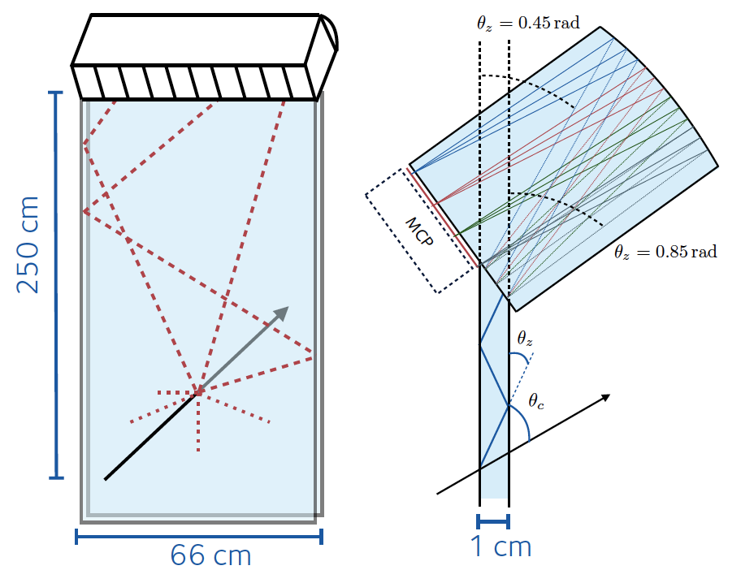
New paradigms: precision ToF of Cerenkov light for PID
Time of Reflected Cerenkov Light Rich (TORCH) for LHCb upgrade in LS4 for low momentum ID*
Wall of 18 elements in front of RICH2
Quartz bar radiator and focusing on MCP-PMT
Target id in the range 2 -10 GeV combining Cherenkov angle and TOF measurements with
σ(ToF) ≃ 15 ps, (≃ 70 ps SPTR & ≃ 30 γ/track)
MCP demonstrated to achieve ≃ 35 ps
TORCH ½ full size prototype tested in 5-8 Gev π/p beam achieved SPTR of ≃ 90 ps
* A similar concept w/o expansion volume (ToP) in Belle-II

Slide 14
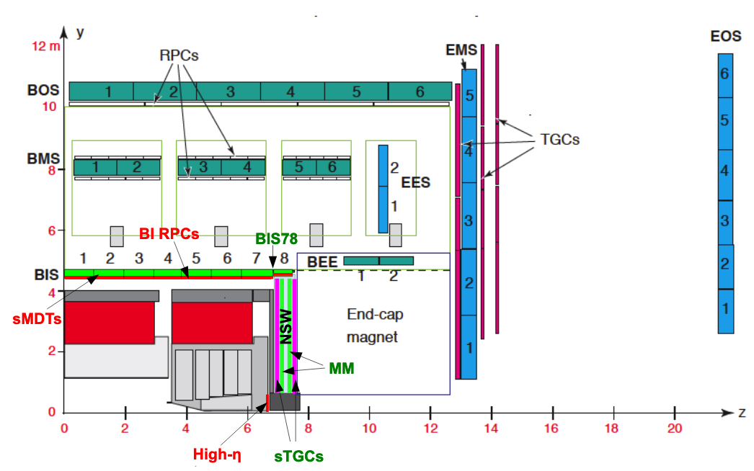
New paradigms: muon systems
Enhancement of forward region for rates and trigger issues, including capability to for LLPs displaced or late vertices (DT and RPC resolution improved to respectively 4 - 2 ns in CMS)
ATLAS
CMS
Station 1
Small Wheels
Small Thin Gap (2.8 mm) Chambers, shorter strips 2 cm to 3.2 mm, 3 mm pitch, σ ≃ 50 µm, up to 2 x 1.2 m²
Resistive strip Micro-Megas (0.5 mm pitch), σ ≃ 80 µm, largest module 2 x 2.3 m² made of 5 PCBs, Ar:CO2 (93:7)
Small Monitoring Drift Tubes
Reduced Φ 30 mm (200 Hz/cm²) to 15 mm (2 kHz/cm²), wires 50 µm, σ ≃ 100 µm, L = 1.6 m, Ar:CO2(93:7)
New GEM stations and extended coverage to η ≃ 3
Triple GEM design, H = 1.8 m x W = 1.2 m wedges with 4 foils, PCB radial strips, pitch 0.7 mm to 1.6 mm, σ ≃ 200 to 450 µm
Single mask foil photolithography, stretching mechanism
Up to > 1 MHz/cm², time resolution O(10ns),
New multigap RPC stations
Low-ρ Bakelite 1-3 10⁶ Ω.cm, thin gap & electrode 2 → 1.4 mm, Φ pitch 1.3∘ to 1.2∘, up to few kHz/cm², σ ≃ 0.3(2) cm ⊥(//)
FE 2 strip-ends readout with 100 ps for r(η)-coordinate
Track time resolution ≃ 2 ns

Slide 15
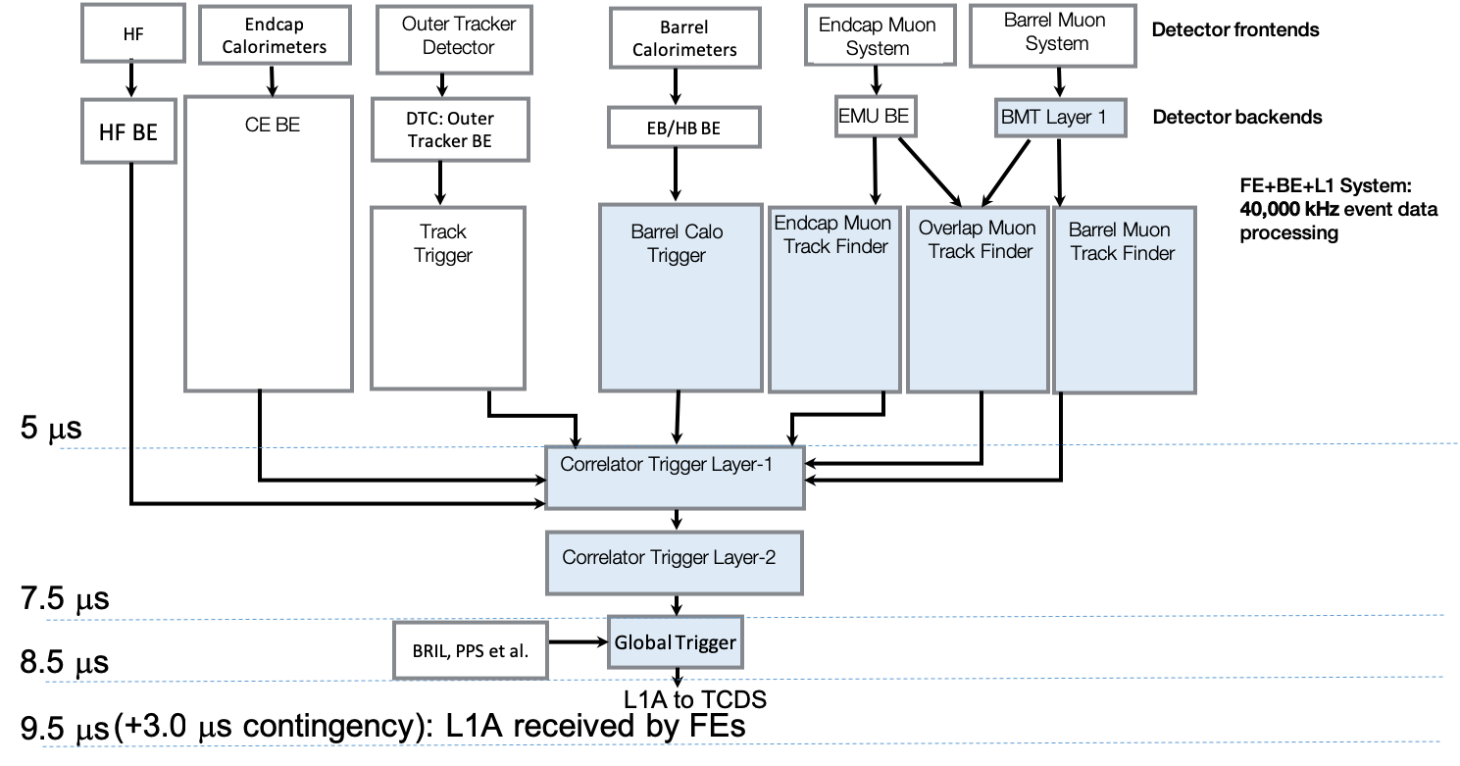
New paradigms: Trigger and DAQ
Technologies:
Generic boards to ease DAQ integration, use interposers to adapt FPGA grade for cost(CPU vs #links (up to 28 Gb/s))
New firmware programming technique (High Level Synthesis), sophisticated algorithms ≃ HLT
Use of GPUs at computing level
ATLAS: baseline below, hardware compatible with L0 at 4 MHz for partial tracker RoI readout and L1 at 1 MHz with HTT
CMS: L1 at 750 kHz with FPGAs, HLT heterogenous processing GPU/CPU with output 7.5 kHz 60 GB/s
LHCb: Software trigger only at new computing center two levels GPU option for L1, full reconstruction at L2
40 MHz full granularity
40 MHz: partial full granularity
40 MHz full readout
L0 readout 1 MHz
FPGA 10 µs
Compressed / 4
Compressed / 4
p_{T} ≳
2 GeV
p_{T} ≳
2 GeV
5 µs
Real Time Analyses
5 TB/s
10 kHz
30 GB/s
Hardware Track Trigger (OT + Pix) with AM regional/global 1/0.1 MHz 30 µs
L1 12.5 µs - 750 kHz - 5 TB/s
20 kHz 10 GPB/s

Slide 16
Outlook
To keep-up with the HL-LHC luminosity capability and the radiation conditions is a challenge for detectors
Several new techniques implemented in Phase-2 upgrades but we are not in a performance asymptote
LHCb upgrades in LS2 already implement some features of ATLAS and CMS Phase-2 - could also be a playfield for future detectors with LS4 upgrade
ATLAS and CMS designs are mostly completed and we are soon entering production stage for Phase-2 upgrades
Lot of work in parallel to Run-3 with still a tight schedule
As well to prepare full exploitation of new features in event reconstruction and selection adjusted to physics goals (eg establish sensitivity to pile-up - make best use of luminosity levelling)

Slide 17
Additional information

Slide 20
ATLAS and CMS Phase-2 Silicon Trackers
ATLAS has a 5 layers pixel detector while CMS has a design for tracks in hardware trigger at 40 MHz pixel coverage is extended from η ≃ 2.4 to η ≃ 4
CMS
Stereo for z/r-coordinate in OT
OT
IT
High granularity (≃ 4 to 6 x present trackers) to maintain low occupancy
Pixel sizes in range ≃ 50 x 50 or 25 x 100 µm² - first layer(s) replaceable
Strip pitch ∼ 75 to 90 µm and length ∼ 2.5 to 5 cm length
Light (1/2 current weight) to reduced multiple scattering, interactions, e-bremsstrahlung and γ-conversions)
Design, new materials - new cooling (CO₂) - DC/DC, serial powering
n-in-p and 3D sensors, radiation tolerance up to NIEL ≃ 2 x 10¹⁶ 1 MeV neq/cm² and TID of 1 GRad

Slide 21
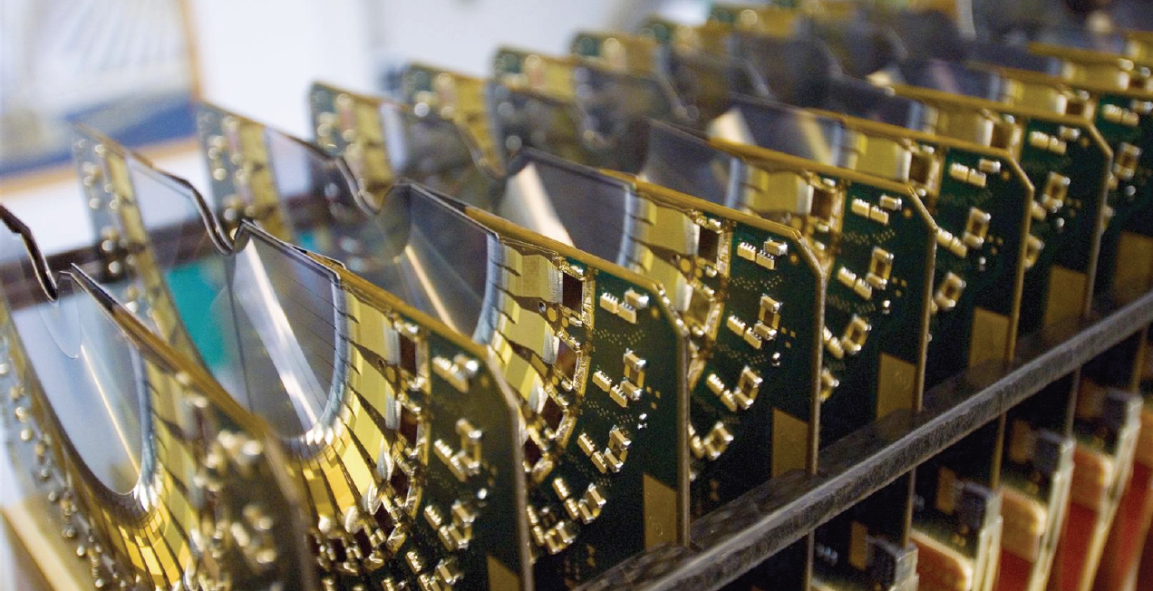
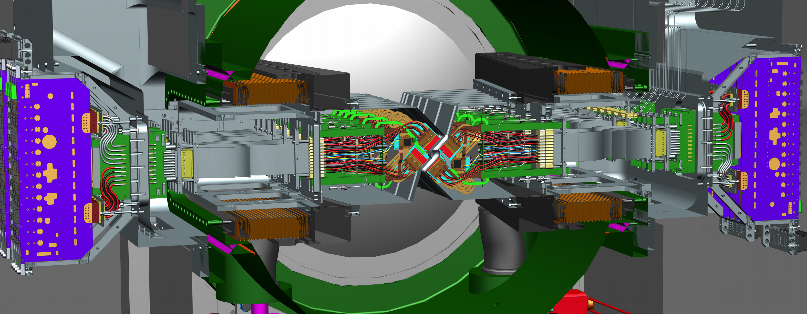
LHCb Vertex (pixel) Locator
LHCb VELO upgrade for installation during 2020
12 disks of 4 modules, inner radius ≃ 4.5 mm
Planar n-in-p sensors fully depleted up to ≃ kV
200 µm thick, 55 x 55 µm² pixels, ≃ 10 µm hit resolution
120 x 120 μm² micro cooling-channel etched in sensor substrate
≃ 1.5% X/X₀ per disk
Radiation tolerance ≃ 10¹⁵ 1 MeV neq/cm² (T ≃ -20∘)
Original strip detector new one with pixels
R measuring strips
with double metal r/o
Phi measuring strips
.
ATLAS
old
new
.
ALICE ITS2 - Belle-II vertex

Slide 22
LHCb scintillating Fiber Tracker
3 stations, each 2.5% X/X0 - 4 plans (X-U-V-X) with ± 5∘ stereo angle - 50-75 µm resolution
3 M fibers Φ 250 µm x 2.5 m (10 000 km)
3 Mrad in inner region
High precision assembly of fiber mats
Readout with 128 SiPM array 250 µm pitch
40∘C cooling to sustain 1.2·10¹² neq. /cm2
2x 2.5 m
2x 3m

Slide 23
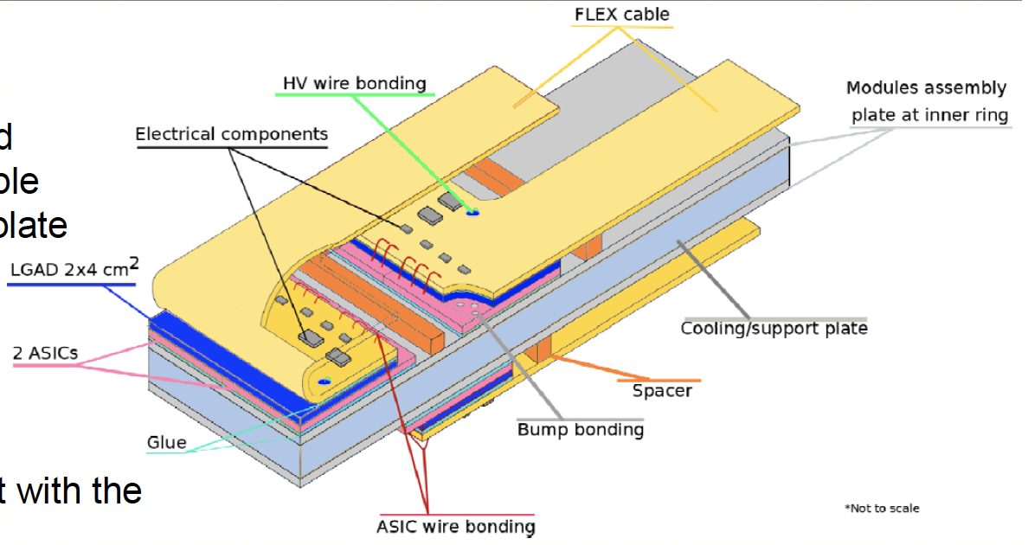
ATLAS High Granularity Timing Detector
Two double sided layers 2.4 < η < 4 in front of Calorimeter endcap (r_{active} = 12 - 64 cm), z < 75 mm
2(3) hits per track for R >(<) 30 cm
30 ps resolution per track after irradiation
LGADs 1.3 x 1.3 mm² pads, 6.3 m², 3.54 Mch
Fluence and TID 4000 fb⁻¹
up to 4 x 10¹⁵ 1 MeV neq/cm² and 400 MRad
Operation at -30∘
Inner ring replaceable
ATLAS HGTD module

Slide 24
CMS Mip Timing Detector
Barrel layer (28 mm) in Tracker volume
Lyso bars 56 mm x 3 x 3 mm², readout both ends with 2 SiPM 3 x 3 mm², 30(40) ps before(after) irradiation
Endcap 2 layers (42 mm each) in front of Calo. Endcap (42 mm), 1.6 < η < 3
LGAD 1.3 x 1.3 mm² pads, 30(40) ps per track before(after) irradiation
28 mm
For 3000 fb⁻¹
TID = 2.5 MRad
42 mm
For 3000 fb⁻¹
TID = 70 MRad

Slide 25
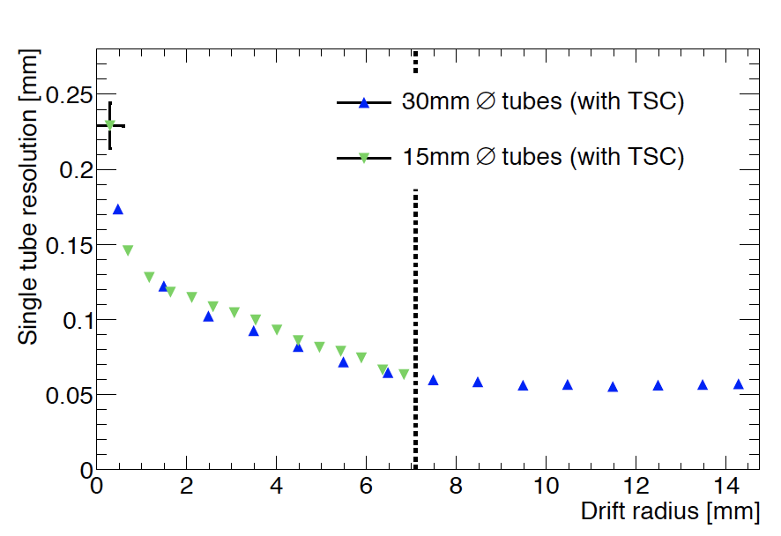
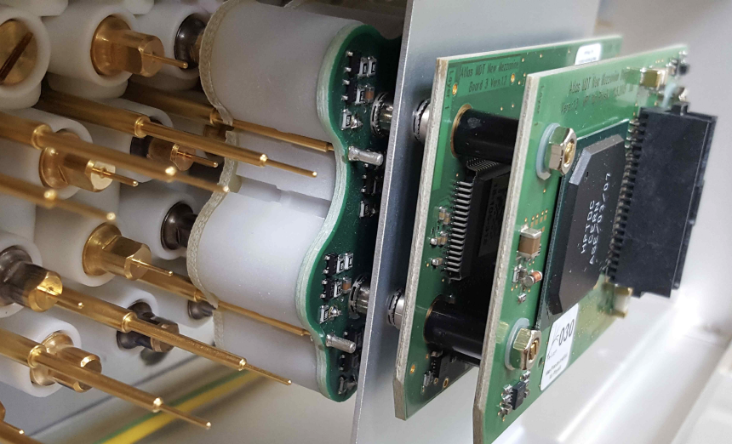
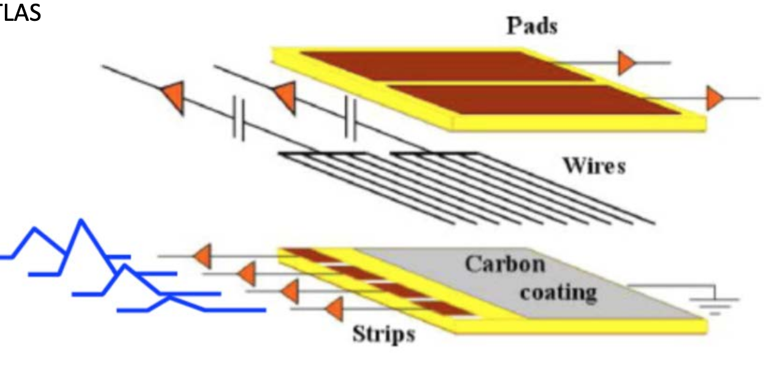
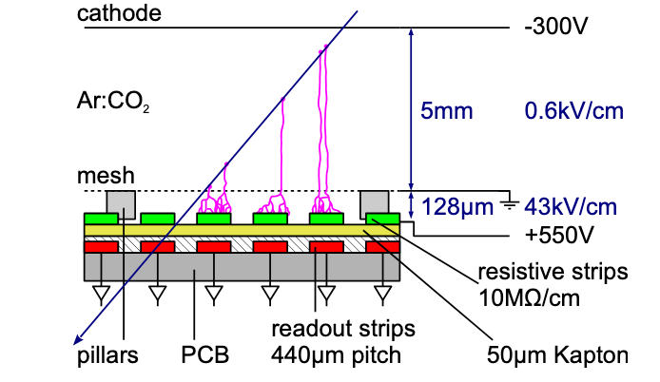
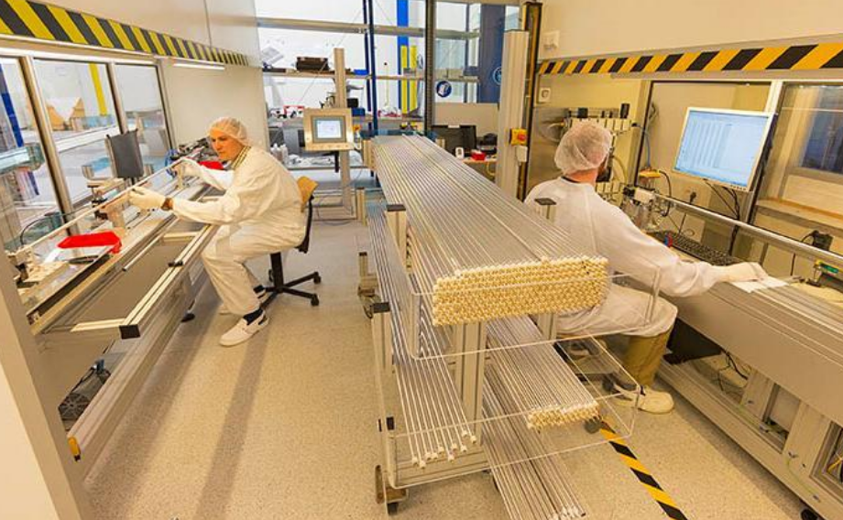
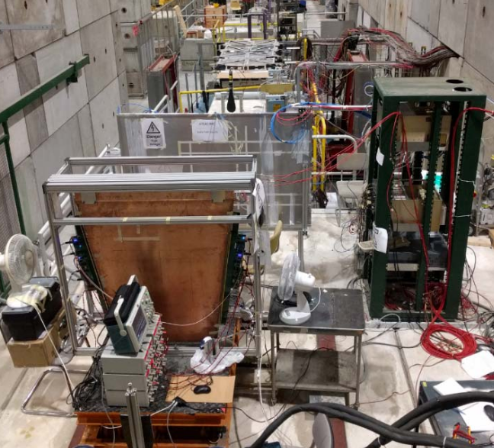
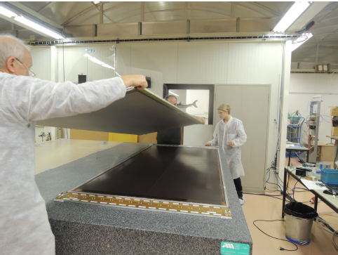
ATLAS muon system upgrades
Small Wheels
Small Thin Gap (2.8 mm) Chambers, shorter strips 2 cm to 3.2 mm, 3 mm pitch, σ ≃ 50 µm, up to 2 x 1.2 m² , CO₂:n-pentane (55:45)
Resistive strip Micro-Megas (0.5 mm pitch), σ ≃ 80 µm per layer, largest module 2 x 2.3 m² made of 5 PCBs, Ar:CO2 (93:7)
Small Monitoring Drift Tubes
Reduced Φ 30 mm (200 Hz/cm²) to 15 mm (2 kHz/cm²), wires 50 µm, σ ≃ 100 µm, L = 1.6 m, Ar:CO2(93:7)
MDT/sMDT resolution
Wires 1.8 mm coarse azimuthal angle
Pads 8 cm pitch
for trigger regions
sMDT
sTGC
Strips 3 mm pitch for precise polar angle
MicroMegas
1 x 1.2 m module

Slide 26
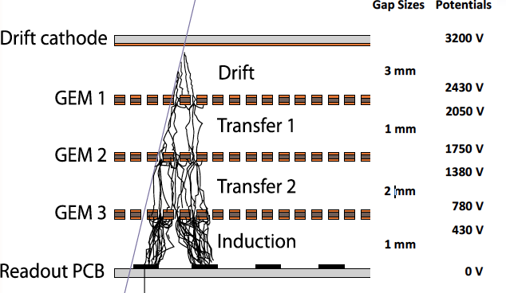
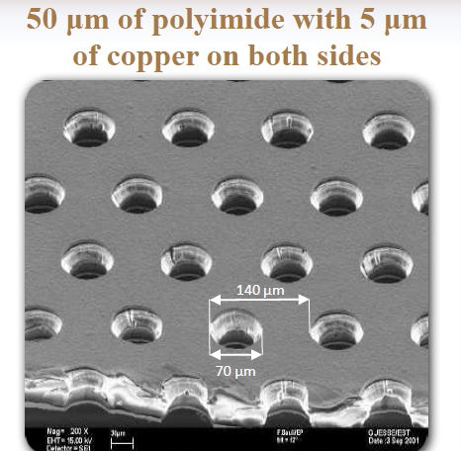
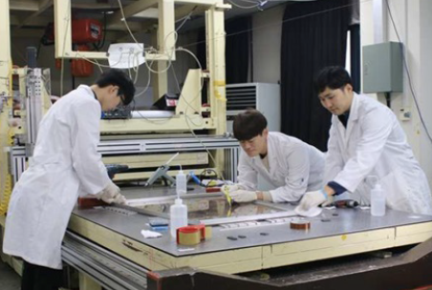
CMS muon systems upgrades
New GEM stations
Triple GEM design, H = 1.8 m x W = 1.2 m wedges in 4 modules largest foil size so far (0.5 x 1.2 m²)
Improved fabrication single mask foil photolithography, foil stretching mechanism
PCB with radial strips, pitch from 0.7 mm to 1.6 mm, σ ≃ 200 to 450 µm
Rate capability up to > 1 MHz/cm², time resolution O(10ns),
New multigap RPC stations
Low resistivity Bakelite 1 to 3 10⁶ Ω.cm, thinner gap and electrodes 2 mm to 1.4 mm,
Φ pitch 1.3∘ to 1.2∘, rate capability few kHz/cm², σ ≃ 0.3(2) cm ⊥ (//) to strips
Front-end electronics with 2 ns time resolution, 2 strip-ends readout for r(η)-coordinate
Ar:CO₂ (70:30)
GEM
RPC

