Slide 1


Forbidden Processes journées de prospectives de l’IN2P3 – GT01
Benoit Clément (with the help of A. Teixeira and G. Pignol)

Slide 2
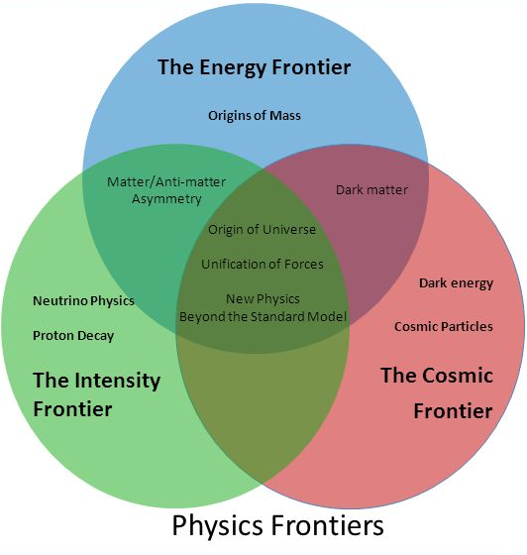
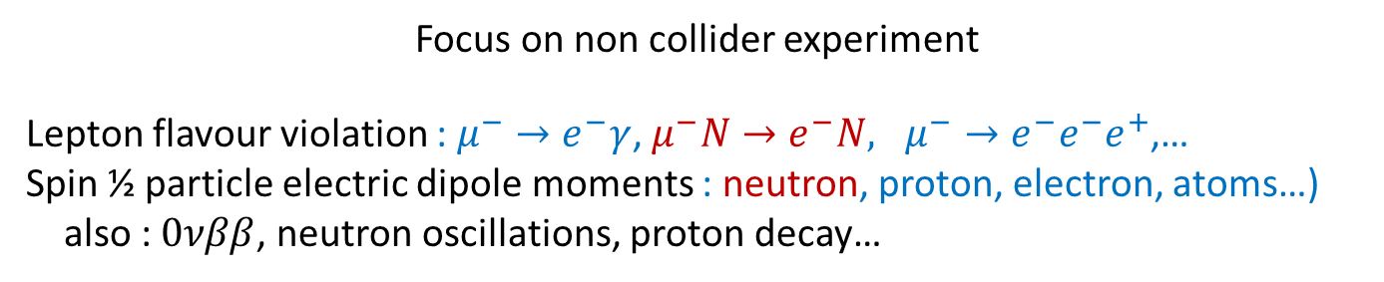
What are forbidden processes
Observables for which the SM expected value is
    zero
    much smaller that experimental sensitivity (multiloop SM contribution)
BSM contribution through 1 or 2 loops
can sensitive to New Physics scales beyond collider reach
Rare processes : Intensity frontier
Any non zero measurement is a signature of new physics
→no SM background
Any zero measurement can exclude some models
Focus on non collider experiment
Lepton flavour violation : $μ^{−}→e^{−}γ$, $μ^{−}N→e^{−}N, μ^{−}→e^{−}e^{−}e^{+}$,…
Spin ½ particle electric dipole moments : neutron, proton, electron, atoms…)
also : $0νββ$, neutron oscillations, proton decay…

Slide 3
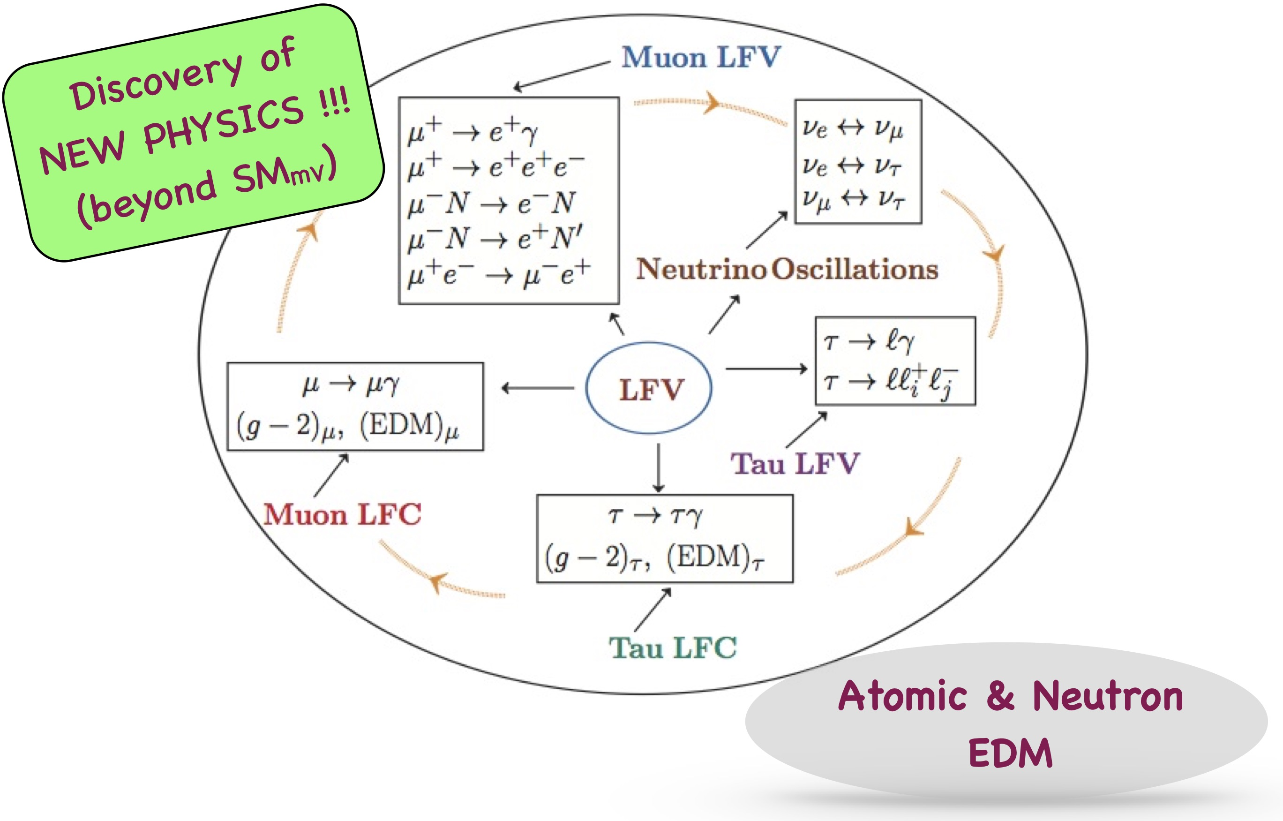
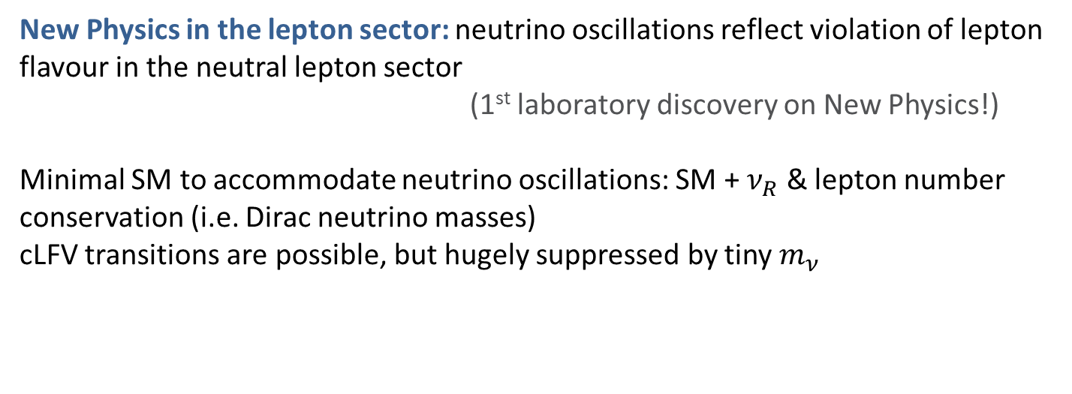
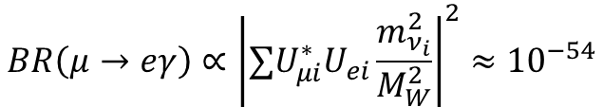
Charged Lepton Flavour Violation
New Physics in the lepton sector: neutrino oscillations reflect violation of lepton flavour in the neutral lepton sector
(1st laboratory discovery on New Physics!)
Minimal SM to accommodate neutrino oscillations: SM + $ν_{R}$ & lepton number conservation (i.e. Dirac neutrino masses)
cLFV transitions are possible, but hugely suppressed by tiny $m_{ν}$
$$BR\left(μ→eγ\right)∝{\left|∑U_{μi}^{∗}U_{ei}\frac{m_{ν_{i}}^{2}}{M_{W}^{2}}\right|}^{2}≈{10}^{−54}$$
Rare processes searched for at high-intensities
⇒ NP discovery (possibly before LHC)
⇒ Complementary information to direct searches
⇒ Sensitive to scales beyond collider reach...

Slide 4
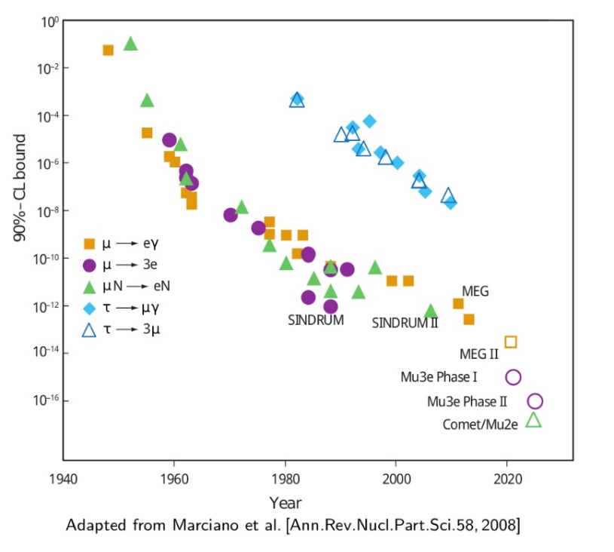
Muons as probe of cLFV
Versatile, abundantly produced, offer many experimental advantages
Past & current searches: very good bounds!
3 golden channels:
radiative
decays
MEGII @ PSI
conversion in nuclei
COMET@J-PARC, Mu2e@FNAL
3-body decays
Mu3e @ PSI
Requirements: very high intensity beams @ PSI, J-PARC, FNAL
Detectors with very good resolution and background rejection
Background control (including physics and accidental backgrounds, machine effects, cosmic rays and badly reconstructed tracks)
Comparison between μ → eγ and μ − e conversion
 | Background | Challenge | Beam Intensity | Beam type
μ → eγ | accidentals | detector resolution | limited | continuous
μ − e | beam | beam background | no limit | pulsed

Slide 5

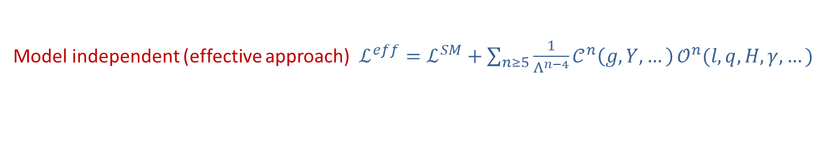
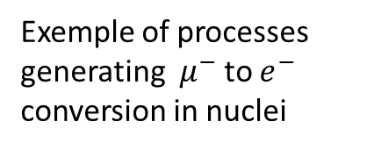
BSM sources of cLFV
Model independent (effective approach) $ℒ^{eff}=ℒ^{SM}+\sum_{n≥5}{\frac{1}{Λ^{n−4}}𝒞^{n}\left(g,Y,…\right)}𝒪^{n}(l,q,H,γ,…)$
Cast observable in terms of effective couplings and NP scale
Apply experimental bounds to constrain Wilson coefficient (dim 6) $C_{ij}^{6}$
* infer sensitivity of a process to $C_{ij}^{6}$
* hints on scale $Λ$ by taking naïve limits ($C_{ij}^{6}$=1)
Or look at specific (well-motivated) models of New Physics:
Exemple of processes generating $μ^{−}$ to $e^{−}$ conversion in nuclei

Slide 6
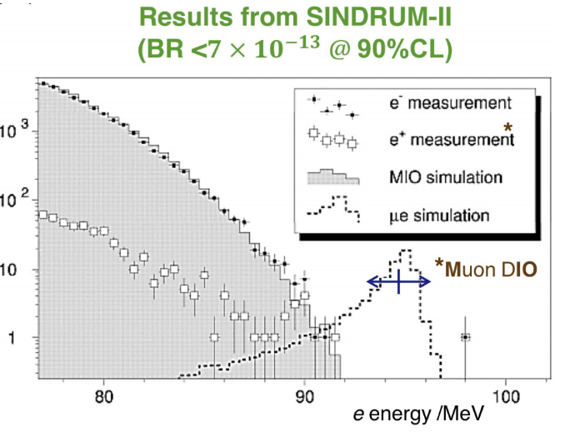

Muon-electron conversion in nuclei
Muonic atoms : 1s bound state formed when $μ^{−}$ stopped in target
SM allowed processes:
decay in orbit (DIO) $μ^{−} →e^{−} {\overline{ν}}_{e} ν_{μ}$ (3 body)
nuclear capture $μ^{−}+(A,Z) →ν_{μ}$ + $(A,Z−1)$
cLFV BSM process :
$μ^{−}−e^{−}$ conversion: $μ^{−}+\left(A,Z\right)→e^{−}+\left(A,Z\right)$
Coherent process, spin-independent rate $∝ Z^{2}$
Event signature: single mono-energetic electron
$$E_{μe}^{N}=m_{μ}−E_{B}\left(A,Z\right)−E_{R}\left(A,Z\right)$$
$$E_{R}=\frac{{\left(m_{μ}−E_{B}\left(A,Z\right)\right)}^{2}}{2m_{N}}$$
$$E_{μe}^{Al,Pb,Ti}≈𝒪(100 MeV)$$
Current bounds:
obtained for Gold nuclei (SINDRUM II @ PSI)
$CR\left(μ−e, Au\right)<7 ×{10}^{−13}$

Slide 7
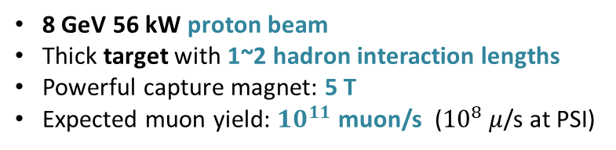
COMET : COherent Muon to Electron Transition
@ J-PARC
8 GeV 56 kW proton beam
Thick target with 1~2 hadron interaction lengths
Powerful capture magnet: 5 T
Expected muon yield: ${10}^{11}$muon/s (${10}^{8}$ $μ$/s at PSI)
COMET Collaboration: over 200 people from 40+ Institutes in 17 countries! (and still growing!)
COMET spokesperson: Y. Kuno (Osaka Univ.)
COMET-France: approved end 2018
Participation from IP2I-Lyon, LPC-Clermont, LPNHE-Paris, LPC-Caen and CCIN2P3

Slide 8
COMET : phases I and II
Different detectors for both phases
Phase-I : CyDet ( Cylindrical Drift Chamber and a Cherenkov Trigger Hodoscope) provides triggering, tracking, momentum measurement and PID
Directly measure muon beam with prototypes of Phase II detector (preparation of Phase II)
Updated SES!
Phase-II :
Straw tracker for momentum measurement
- operating in vacuum
- 12 μm thin straws
Electromagnetic calorimeter for triggering, TOF measurement and PID

Slide 9
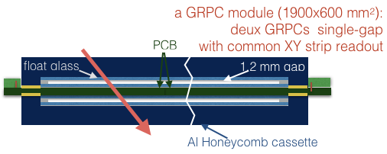
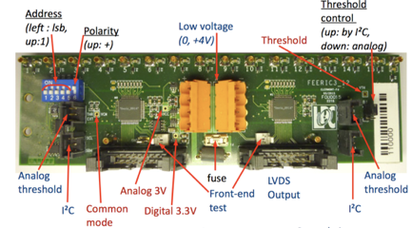
IN2P3 Contribution to Phase-I
Cosmic Ray Veto
Scintillator slabs with embedded WLS-fibres and SiPM readout
Resistive Plate Chambers (RPC) read out with XY strips and Feeric ASIC (LPC/ALICE design)
in the highest neutron yield areas
Data analysis
Software developments:
- tracking : original algorithm implementation & use of GPUs
- simulation of the background induced by atmospheric muons.
- estimation of radiation yields at sub-detector level with MCNPX and PHITS
Hardware contribution to the Cosmic Ray Veto:
- design of the CRV based on GRPCs
- construction and validation of a CRV module based on GRPCs
(resolutions, dead time, efficiency, stability, radiation hardness, etc )
Computing@CCIN2P3: Data Storage and Users Management
FE board for a GRPC module, with two Feeric ASICs

Slide 10
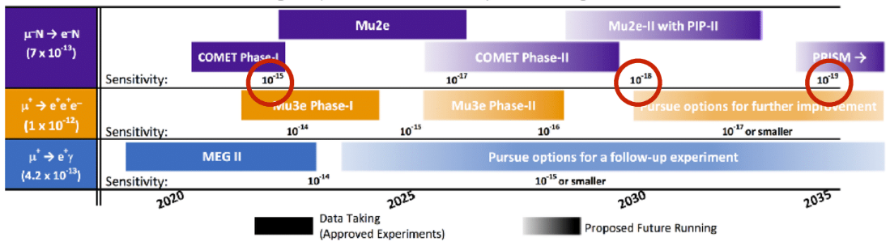
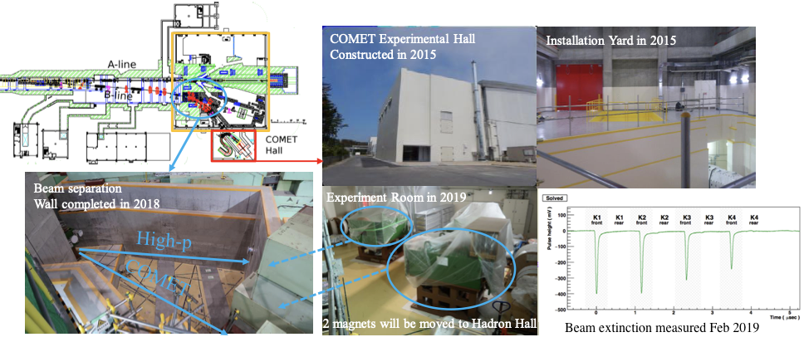
cLVF experiments time scale

Slide 11
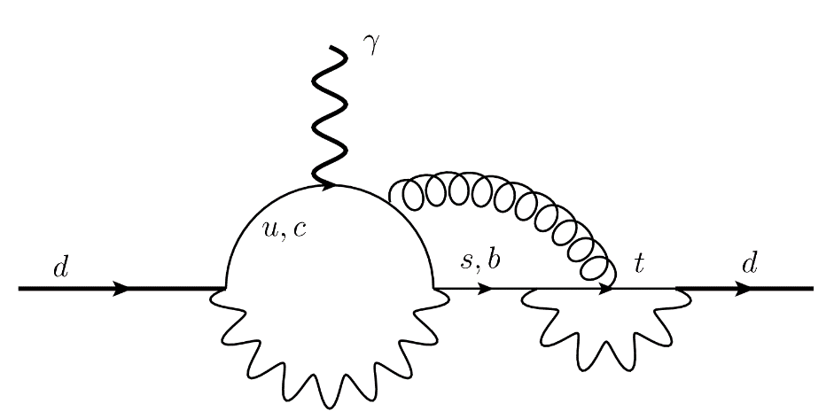
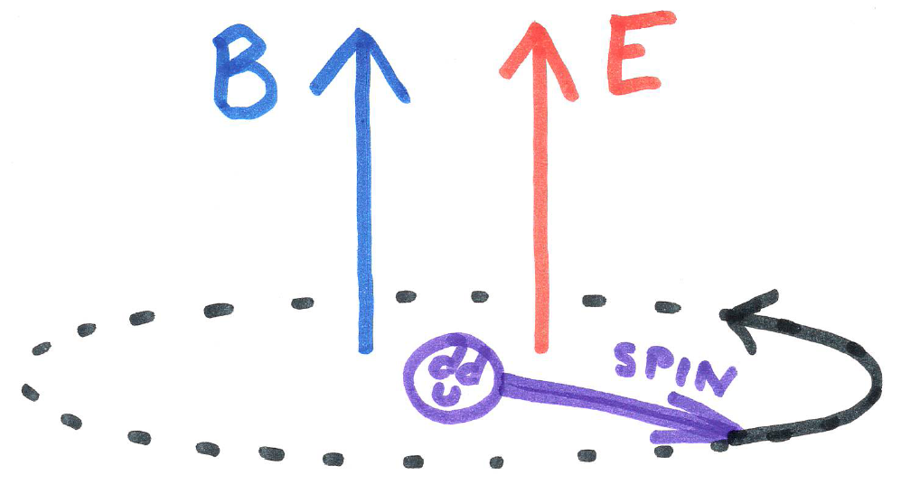
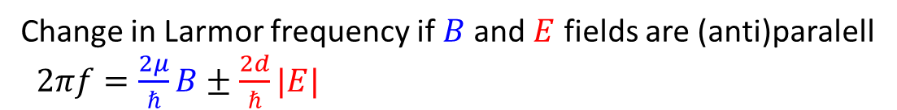

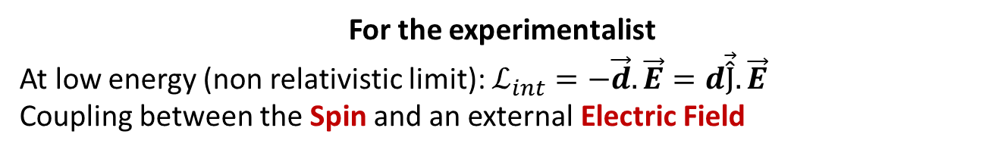
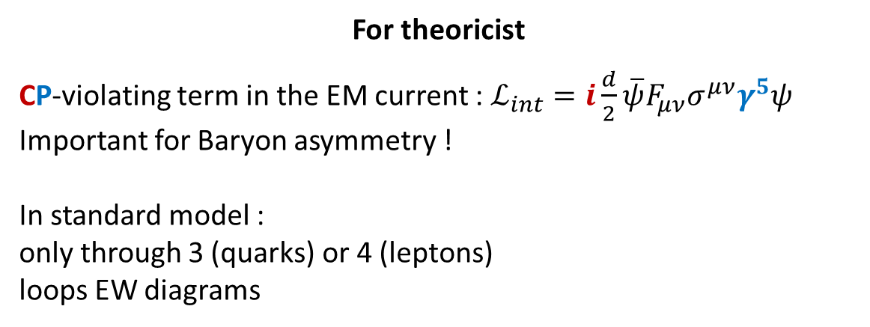
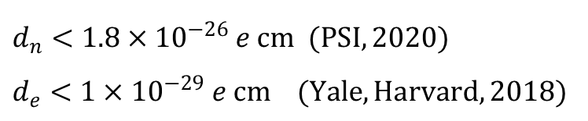
Electric dipole moments
For theoricist
CP-violating term in the EM current : $ℒ_{int}=i\frac{d}{2}\overline{ψ}F_{μν}σ^{μν}γ^{5}ψ$
Important for Baryon asymmetry !
In standard model :
only through 3 (quarks) or 4 (leptons)
loops EW diagrams
For the experimentalist
At low energy (non relativistic limit): $ℒ_{int}=−\vec{d}.\vec{E}=d\vec{\hat{J}}. \vec{E}$
Coupling between the Spin and an external Electric Field
Change in Larmor frequency if $B$ and $E$ fields are (anti)paralell
$2πf=\frac{2μ}{ℏ}B±\frac{2d}{ℏ}|E|$
$$f\left(↑↑\right)−f\left(↑↓\right)=−\frac{2}{πℏ}d E$$
$$d_{n}<1.8×{10}^{−26} e cm (PSI, 2020)$$
$$d_{e}<1×{10}^{−29} e cm (Yale,Harvard, 2018)$$

Slide 12

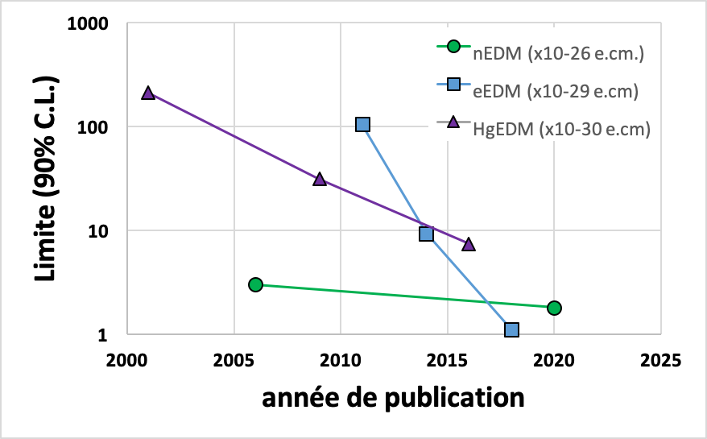
EDMs in the world
Neutrons (~200 ppl)
Beam EDM @ Berne
LANL EDM @ Los Alamos
n2EDM @ PSI
nEDM @ SNS
panEDM @ ILL
PNPI/FTI/ILL
TUCAN @ TRIUMF
www.psi.ch/en/nedm/edms-world-wide
Paramagnetic systems (~80 ppl)
Cs @ Penn State
Fr @ Rikken
BaF @ Nikhef
BaF @ Toronto
HfF+ @ JILA
ThO @ Yale
YbF @ London
Storage rings (~400 ppl)
srEDM/JEDI
muEDM @ PSI
(g-2) @ Fermilab
(g-2) @ JPARC
Diamagnetic atoms (~70 ppl)
Hg @ Bonn
Hg @ Seattle
Ra @ Argonne
Xe @ Heidelberg
Xe @ PTB
Xe @ Rikken
At IN2P3 : only neutron EDM in the nEMD/n2EDM@PSI collabora tion
LPC Caen : 1PR+1MCF
LPSC Grenoble : 2 MCF + 1 DR

Slide 13
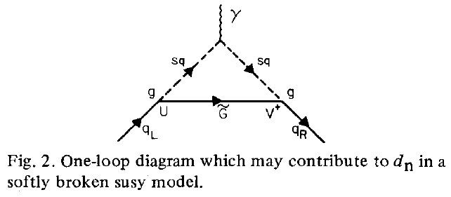
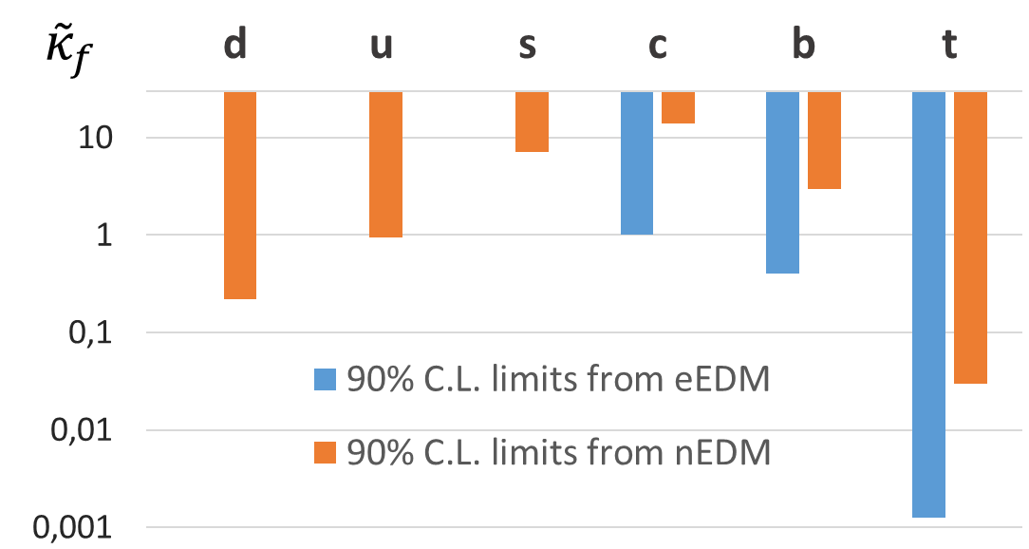
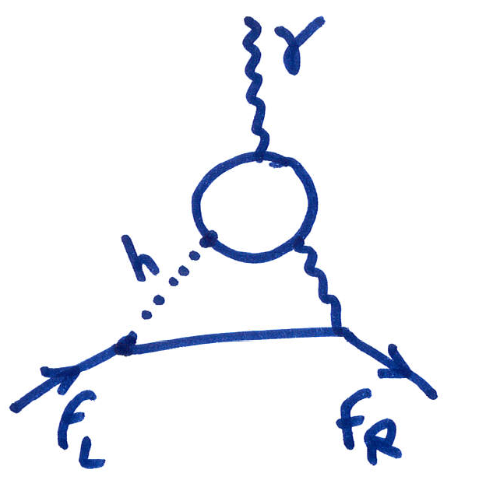
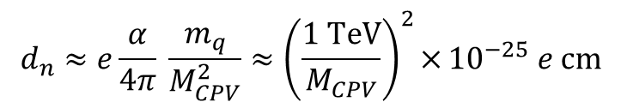
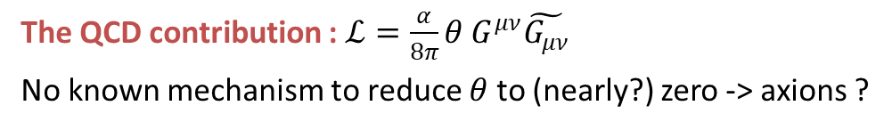
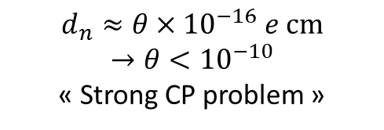
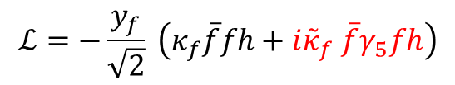
Beyond SM contribution
SM contribution through EW loops :$d_{n}≈{10}^{−33}e cm$
The QCD contribution : $ℒ=\frac{α}{8π}θ G^{μν}\tilde{G_{μν}}$
No known mechanism to reduce $θ$ to (nearly?) zero -> axions ?
$$d_{n}≈θ×{10}^{−16} e cm$$
$$→θ<{10}^{−10}$$
« Strong CP problem »
One loop contribution : for example MSSM contains ~40 CP violating imaginary parameters…
$$d_{n}≈e\frac{α}{4π} \frac{m_{q}}{M_{CPV}^{2}}≈{\left(\frac{1 TeV}{M_{CPV}}\right)}^{2}×{{10}^{−25} e cm}$$
Ellis, Ferrara, Nanopoulos, PLB 114 (1982).
EDM induced by soft mass terms for squarks and gluinos
Two loops contribution :
Modified Higgs Yukawa coupling:
$$ℒ=−\frac{y_{f}}{\sqrt{2}} \left(κ_{f}\overline{f}fh+i{\tilde{κ}}_{f} \overline{f}γ_{5}fh\right)$$
Brod, Haich, Zupan, 1310.1385
Brod, Stamou, 1810.12303
Brod, Skodras, 1811.05480
Barr, Zee, PRL 65 (1990)

Slide 14

Computing nEDM on the lattice
Going from quarks EDMs to the neutron EDM is low energy QCD
Current efforts to compute it in the framework of Lattice QCD using dimension 5 and 6 CP violating extension of the QCD lagrangien :
$$ℒ_{QCD}+iθG_{μν}{\tilde{G}}_{μν}+ i \sum_{q}{d_{q}^{γ}\overline{q}σ^{μν}}{\tilde{F}}_{μν}q+i \sum_{q}{d_{q}^{G}\overline{q} σ^{μν}{\tilde{G}}_{μν}q} + d_{G}f^{abc} G_{μν}^{a}{\tilde{G}}^{νβ,b} G_{β}^{μ,c}$$
$θ$-term
Quarks EDM
Quarks chromoEDM
Weinberg operator
Imaginary nature of CP violating terms pose specific problems and conventional Markov Chain Monte Carlo methods cannot be used
need to develop new techniques

Slide 15
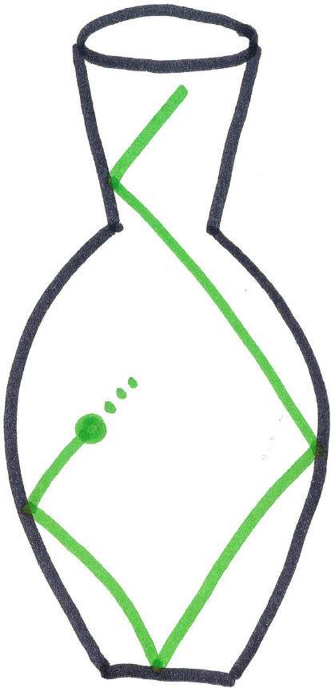
Neutron EDMs in the world
Based on ultra cold neutron storage (all but one)
Neutron production : spallation or nuclear reactor + thermalisation + inelastic cooling (He-II or solid D₂)
Room temperature experiments : UCN need to be produced (source) then extracted/guided to the experimental chamber
Cryogenic experiments : UCN production and EDM measurement takes place at the same place (in superfluid helium at 1K…)
Place | Neutron source | Concept | Stage/Readiness
SNS | Spallation + UCN production in situ | Cryogenic double chamber with helium comagnetometers | « large scale integration » phase
PSI | Spallation + sD2 UCN source | n2EDM: double Ramsey chamber with mercury comagnetometers | Source running, experiment under construction
LANL | Spallation + sD2 UCN source | double Ramsey chamber with mercury comagnetometers | Source running, experiment in design phase
TRIUMF | Spallation + superfluid He UCN source | double Ramsey chamber | Source under construction, experiment in conceptual phase
ILL | Reactor + superfluid He UCN source | panEDM: double Ramsey chamber, no comagnetometers | Source and experiment under construction
PNPI | WWR-M reactor + inpile superfluid He UCN source | Getting a really high density of UCNs | Source under construction
ESS | Spallation + Cold neutron beam | 100m double beam + time of flight | Demonstration phase, small prototype operational @ ILL
Room temperature UCN experiments aiming at a precision of $≈1×{10}^{−27}e cm$

Slide 16
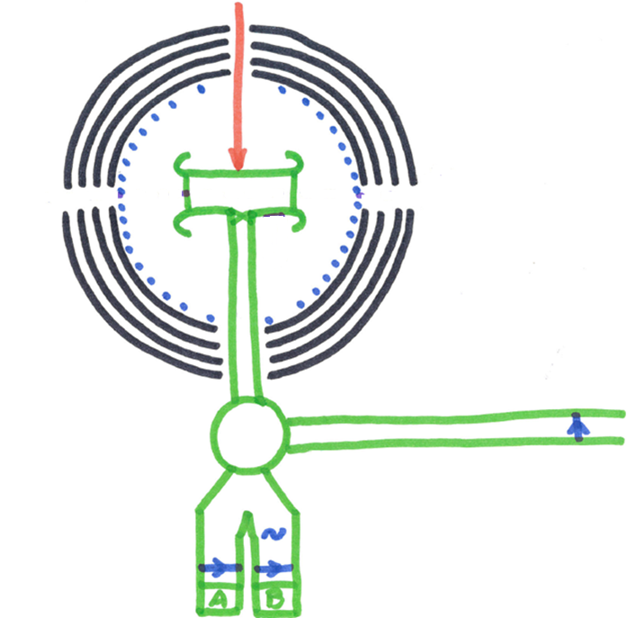
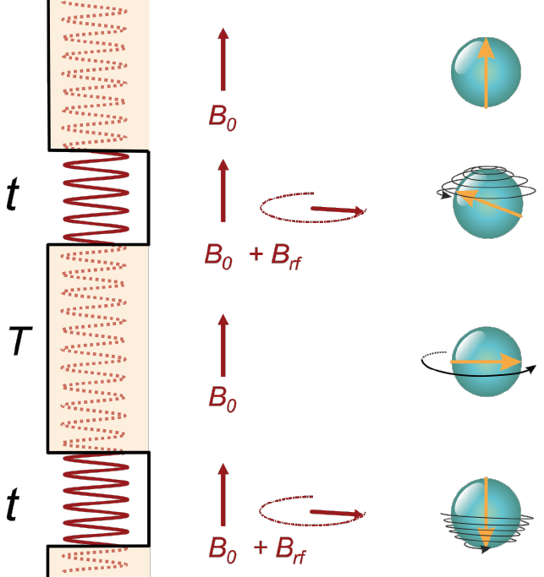
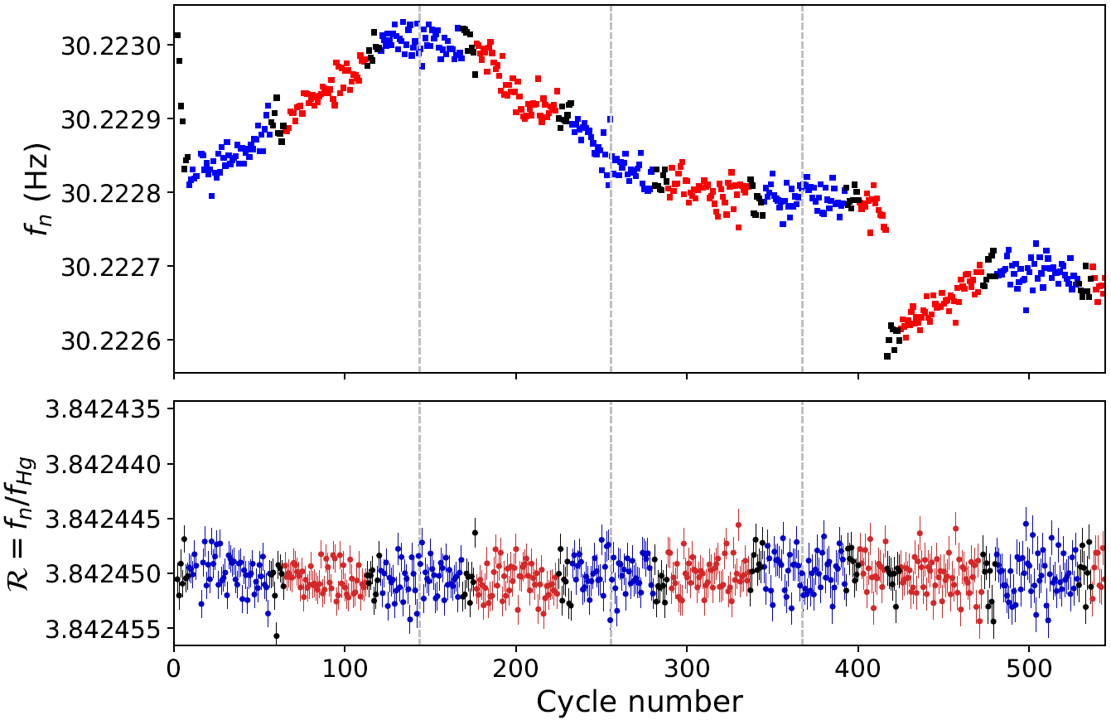


How to measure nEDM
Precession chamber
+
-
+
-
Ramsey method
Polarizer
SWITCH
Analyzer and Detectors
Count neutrons in ↑ and ↓ spin states
Relate asymmetry to precession frequency
Of course many extra subtleties and corrections are needed…
Each point = 1 cycle
Sensitivity to fluctuation of the magnetic field
Correction using
mercury comagnetometer
Statistical sensitivity: $σ_{d_{n}}=\frac{ℏ}{2 α E T \sqrt{N}}$
1 cycle : $T≈ 180s, N = 5000$ to $15000$

Slide 17
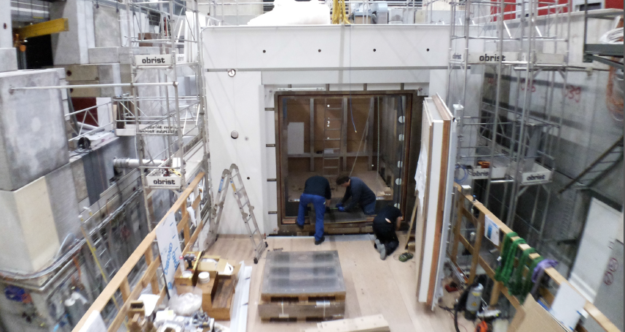
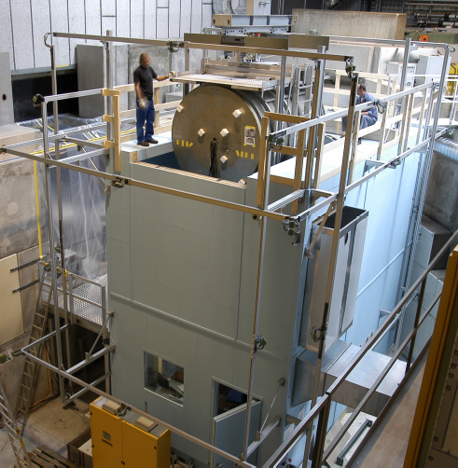
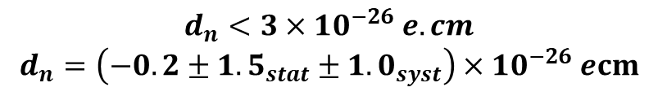
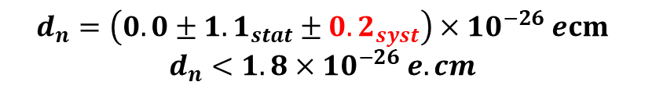
nEDM and n2EDM @ PSI
$$d_{n}<3×{10}^{−26} e.cm$$
$$d_{n}=\left(−0.2±{1.5}_{stat}±{1.0}_{syst}\right)×{10}^{−26} ecm$$
1998
1999
2000
2001
2002
2003
2004
2005
2006
2007
2008
2009
2010
2011
2012
ILL data production
Transfer at PSI (new UCN source)
Various upgrade
New collaboration : nEDM
RAL/Sussex collaboration
New appartus : n2EDM
PSI data
n2EDM installation and comissionning
n2EDM data…
2013
2014
2015
2016
2017
2018
2019
2020
2021
2022
2023
2024
2025
2026
2027
$$d_{n}=\left(0.0±{1.1}_{stat}±{0.2}_{syst}\right)×{10}^{−26} ecm$$
$$d_{n}<1.8×{10}^{−26} e.cm$$
Abel et al., PRL 124 081803 (2020)

Slide 18
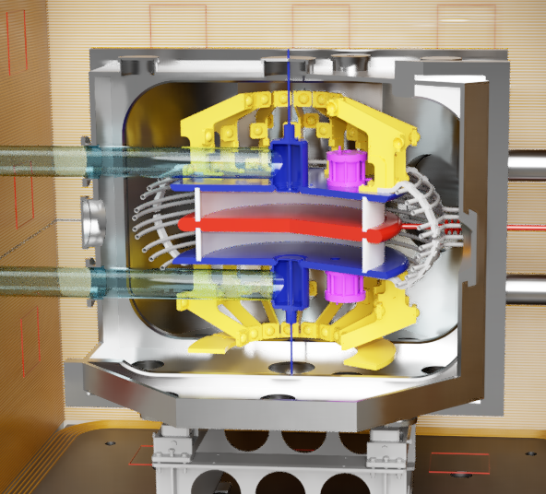
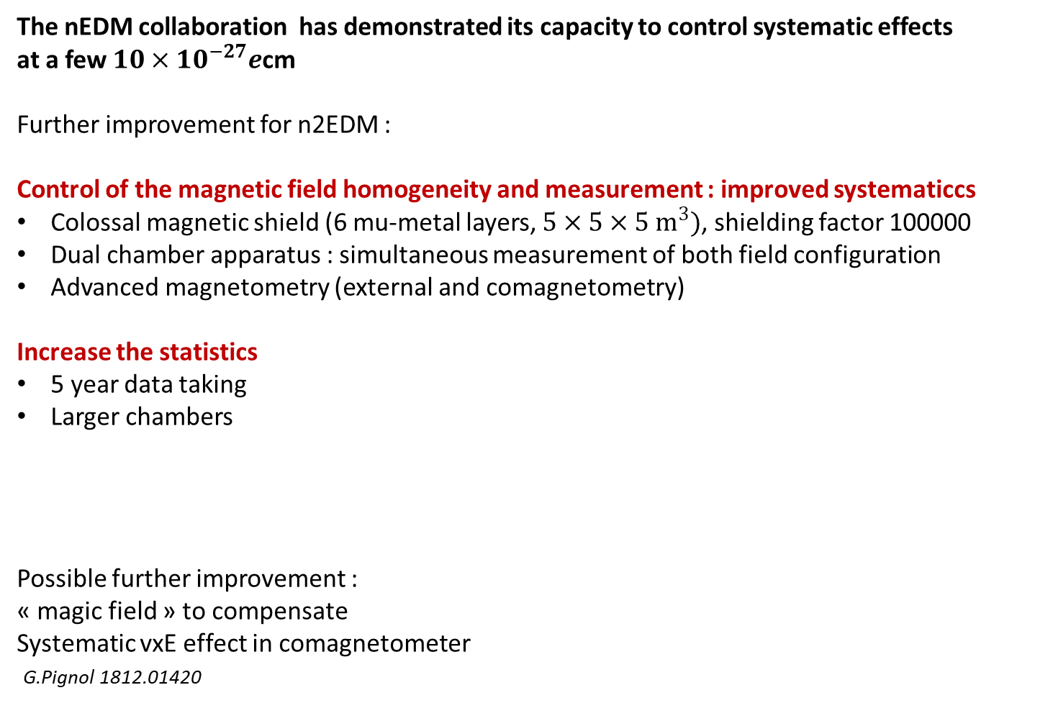
n2EDM @ PSI
The nEDM collaboration has demonstrated its capacity to control systematic effects
at a few $10×{10}^{−27}e$cm
Further improvement for n2EDM :
Control of the magnetic field homogeneity and measurement : improved systematiccs
Colossal magnetic shield (6 mu-metal layers, $5×5×5 m^{3})$, shielding factor 100000
Dual chamber apparatus : simultaneous measurement of both field configuration
Advanced magnetometry (external and comagnetometry)
Increase the statistics
5 year data taking
Larger chambers
Possible further improvement :
« magic field » to compensate
Systematic vxE effect in comagnetometer
G.Pignol 1812.01420

Slide 19
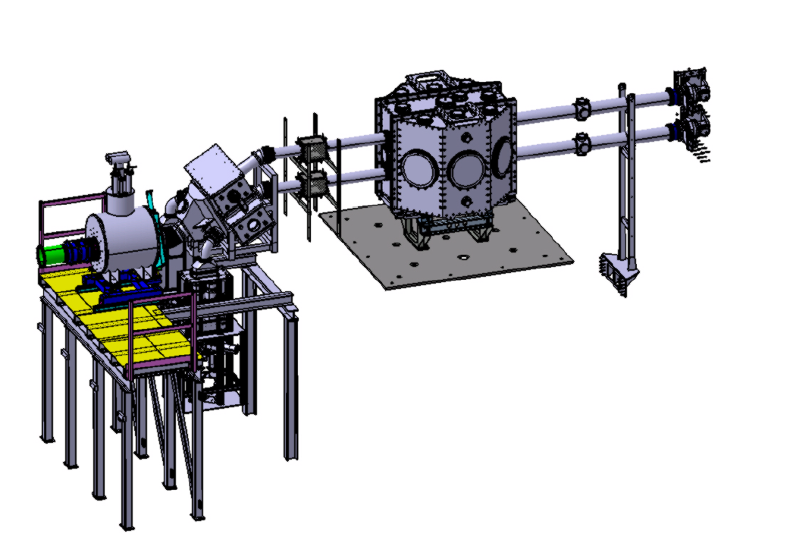
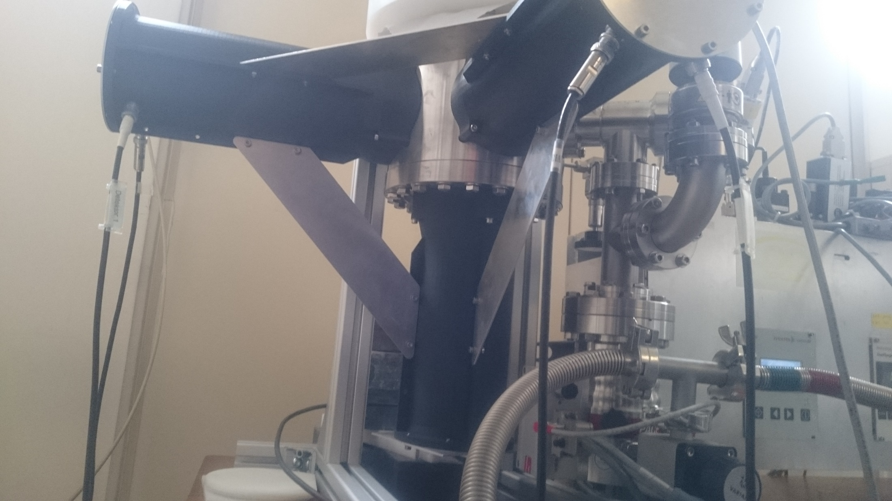
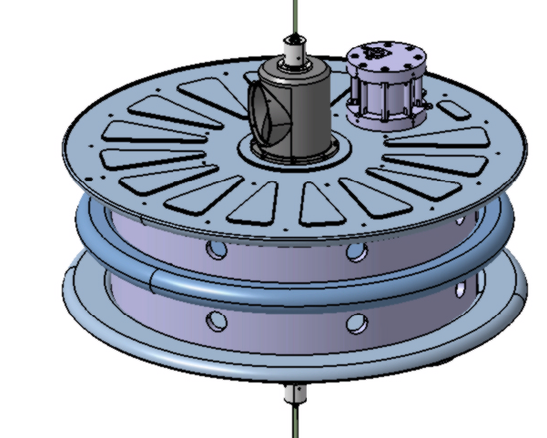
IN2P3 contribution
For n2EDM, French contribution financed mostly through : ANR (Th. Lefort) + ERC (G.Pignol)
Continue in our field of expertise of nEDM : Magnetic field coils, detectors, Hg magnetometry and data analysis
Caen : Vacuum chamber
Grenoble : Neutron distribution « switch »
Grenoble : Hg polarisation and magnetometry
Caen : Fast (500kHz) and efficient UCN detectors Scintillation in 3He

Slide 20
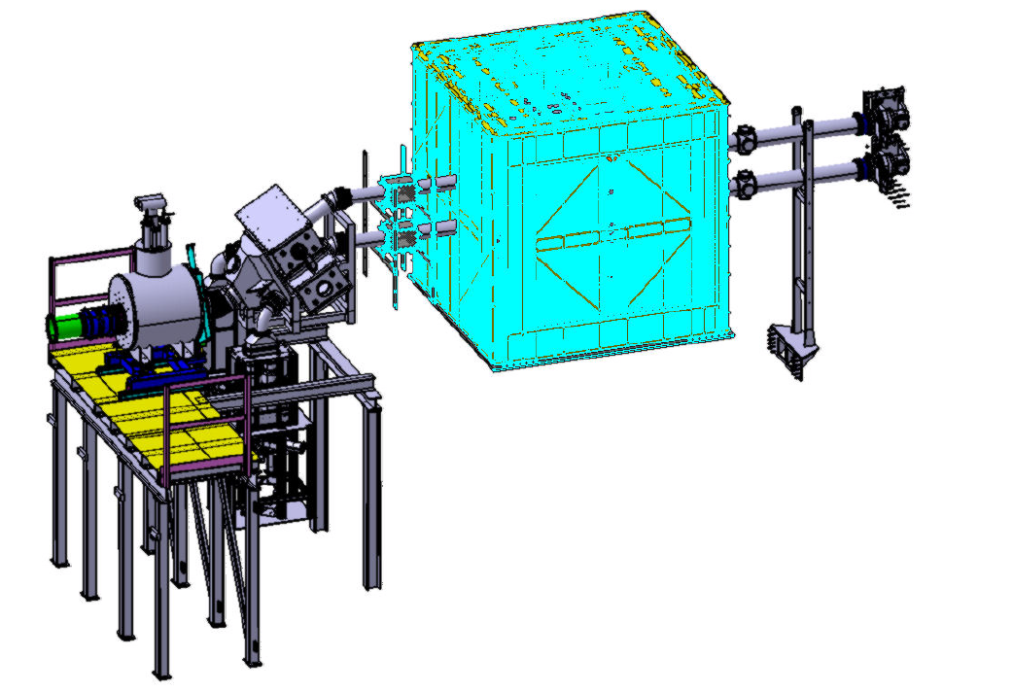
IN2P3 contribution
For n2EDM, French contribution financed mostly through : ANR (Th. Lefort) + ERC (G.Pignol)
Continue in our field of expertise of nEDM : Magnetic field coils, detectors, Hg magnetometry and data analysis
Caen : Magnetic field coils
And many other contributions : magnetic field mapper device (Grenoble), systematic studies, DAQ…

Slide 21

Summary and conclusion
Forbidden processes :
Interesting window into BSM Physics
Complementarity with direct searches
In France :
Small community with both theoricists (phenomenology, effective theories, lattice QCD) and experimentalists.
Two main experimental projects supported by IN2P3
COMET : charged lepton flavour violation
n2EDM : neutron electric dipole moment
Experiments with timescale spanning the coming decade
and beyond!
INFINITY FRONTIER WANTS YOU

Slide 22
Extra material

Slide 23
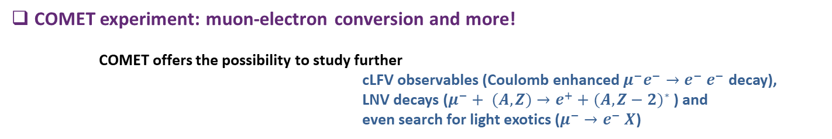
COMET experiment: muon-electron conversion and more!
COMET offers the possibility to study further
cLFV observables (Coulomb enhanced $μ^{−}e^{−}→e^{−}$ $e^{−}$ decay),
LNV decays ($μ^{−}+ (A,Z)→e^{+}$ ${+ (A,Z−2)}^{∗}$ ) and
even search for light exotics ($μ^{−}→e^{−} X$)

Slide 24
COMET experiment: COherent Muon to Electron Transition
COMET: Phase I – backgrounds and Cosmic Ray Veto
Scintillator slabs with embedded WLS-fibres and
SiPM readout
Resistive Plate Chambers (RPC) read out with
XY strips and Feeric ASIC (LPC/ALICE design)
in the highest neutron yield areas
FE board for a GRPC module, with two Ferric ASICs

Slide 25
COMET experiment: COherent Muon to Electron Transition
COMET: Phase I (status end 2019)
COMET facility: ready before end 2022
CDC calibration with atmospheric muons: ongoing
First beam muons expected end 2022

Slide 26

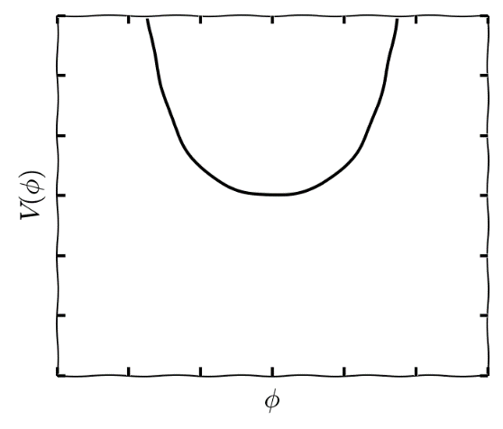
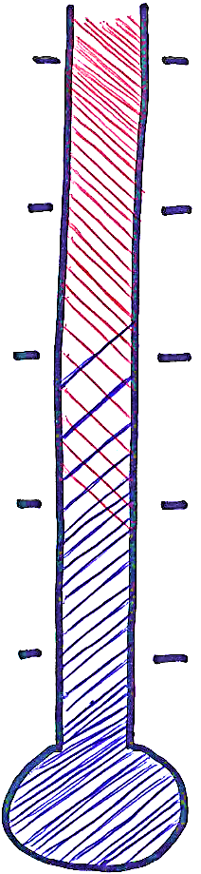
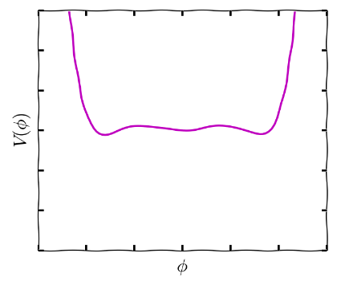
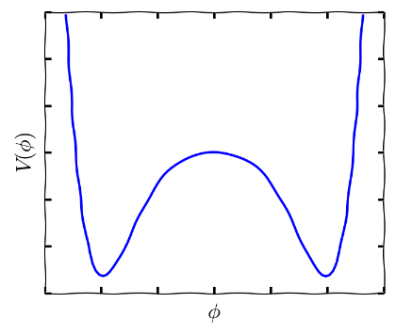


Electroweak baryogenesis?
symmetric phase
$$φ=0$$
Sakharov’s Baryogenesis recipe (1967)
Baryon number not conserved
Universe out of equilibrium
Violation of CP symmetry
>> EDMs
10¹⁵ GeV
Inflation ends?
T = 300 GeV
100 GeV
Electroweak
transition
boiling
1 MeV
T ≃ 100 GeV
1 eV
Decoupling
of CMB
Current EDM bound constrains many scenarios of BSM electroweak baryogenesis
1 meV
Today
broken phase
$$φ≠0$$
T = 20 GeV
26

Slide 27
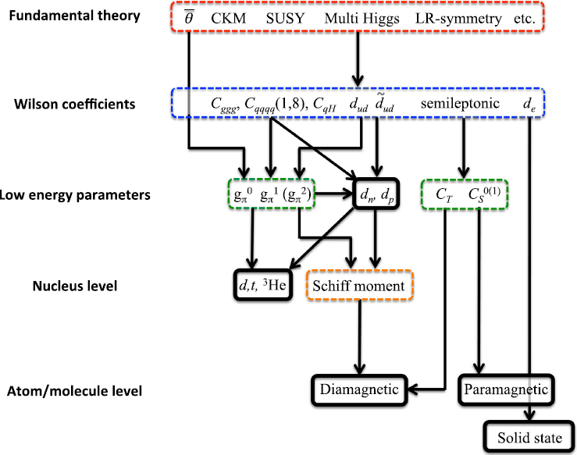
Energy scale ladder

