Slide 1
Exotics, Spectroscopy, Heavy-flavor production (LHCb, Belle II, FCC-ee)
Patrick Robbe, IJCLab, 12 Mar 2020

Slide 2
Introduction
All flavor physics experiments (BaBar, Belle, LHCb run 1/2) in the recent years had large contributions to hadron spectroscopy, in particular with the emergence of exotics heavy-flavor states.
Not the first goals of these experiments but attracted a lot of attention
Together with heavy flavor production measurements, contributed more generally to understanding of QCD, beyond the traditional area of flavor physics (weak interactions)
NB: other experiments not dedicated to flavor physics had also an important contribution to these subjects, in the past (CDF, D0) or in the recent years and in the future (BES III, ALICE, ATLAS, CMS, PANDA, tau/charm factories...)

Slide 3
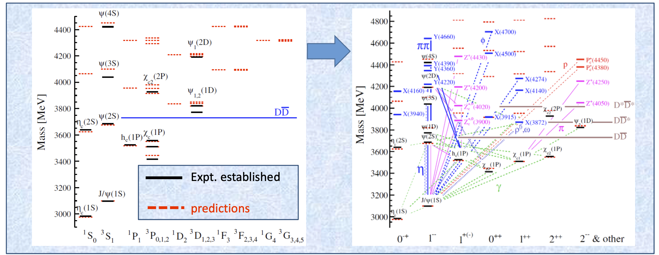
Exotics
X(3872) [Belle PRL 91 (2003) 262001]
Conventional states of the cc spectrum
+ exotic states (X, Y, Z)

Slide 4
Exotics
These states have clear signature of content with 4 quarks : ccqq’
Not excluded by QCD, but exact dynamics of quark arrangement is still unknown.
Most studied state X(3872) = χ_{c1}(3872) is believed now to be a mixture of a conventional charmonium (2 ³P₁₊₊) and of a D^{*0}-D⁰ molecule
Study of more decay modes with higher statistics needed to conclude

Slide 5
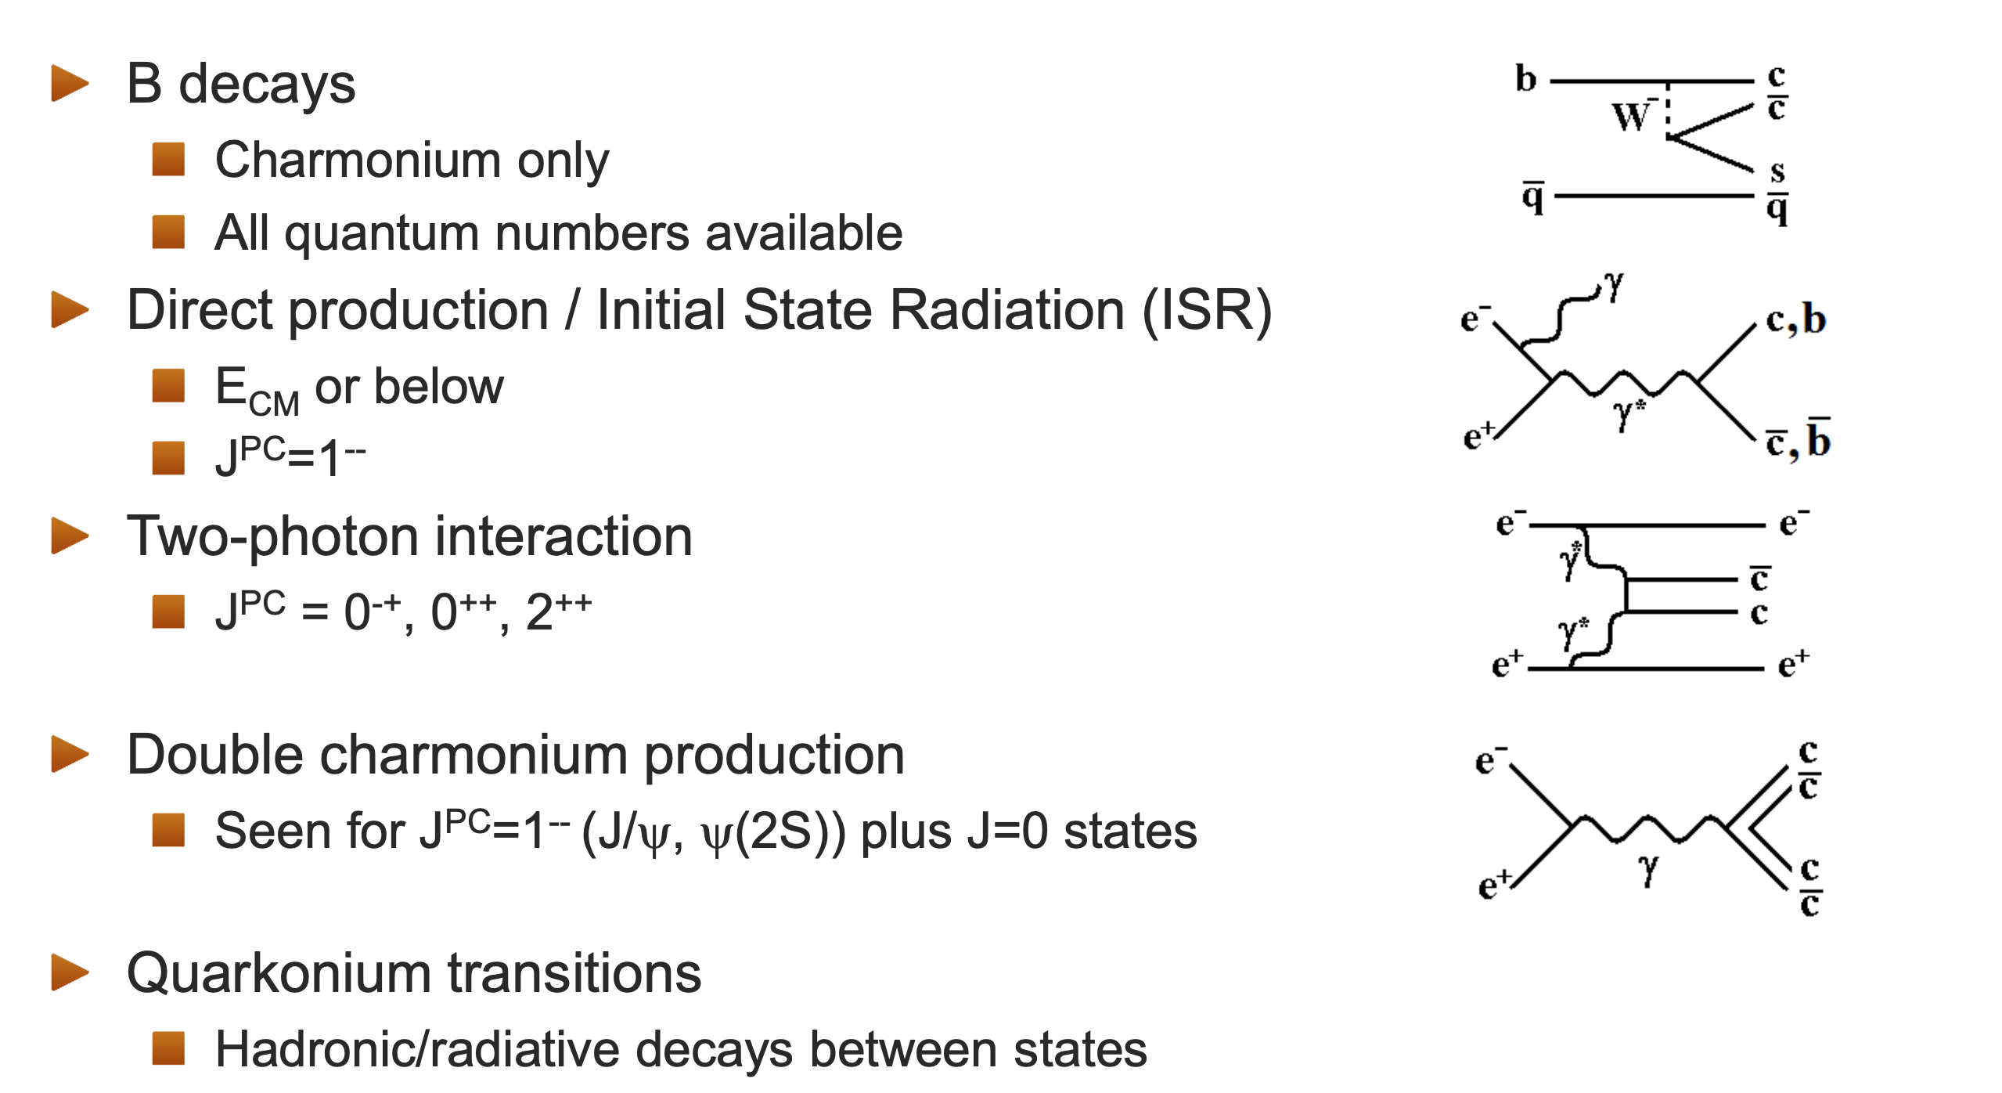
LHCb – Belle II complementarity: production mechanisms (conventional or exotic spectroscopy)
Hadron colliders
e⁺e⁻ colliders
Direct (prompt) production (all masses and quantum numbers):
Decaying weekly: signatures with displaced vertices
Decaying strongly: large background, difficult to observe
(Y(4220), Y(4360), ...)
(h_{c}, η_{c}, ...)

Slide 6
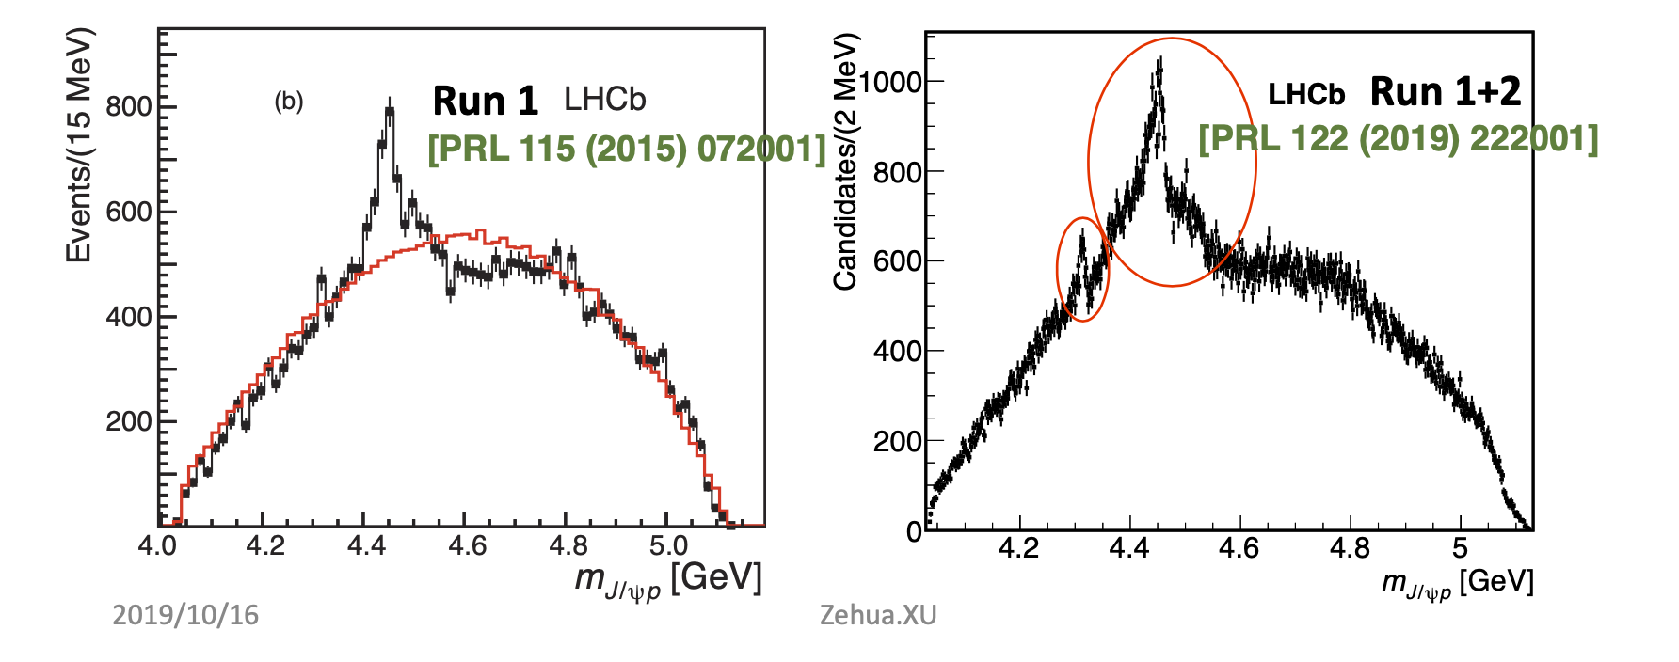
Exotics in the baryon sector
LHCb pentaquarks – produced in Λ_{b} decays (ie not accessible at B-factories), more states with increasing statistics
Potentially the same rich spectroscopy of states (ccq₁q₂q₃) to be explored in several decay modes

Slide 7
Exotics in the beauty sector
First observation of (bbqq’) exotics (Z_{b,} Z’_{b}) at BELLE [PRL 117 (2016) 142001]: must have neutral partners (W_{b}) unobserved so far.

Slide 8
Exotics in the beauty sector
Strong decays: very difficult (=impossible) to study them at hadron colliders
For Belle II: requires dedicated operation at a different center-of-mass energy compared to Y(4S) used for B physics
Beyond: other similar states are also expected with several heavy quarks. For example, (ccqq’) exotics in B_{c}➝D_{s}⁺D⁰D⁰ decays requires LHCb Upgrade 2 statistics to be searched.

Slide 9
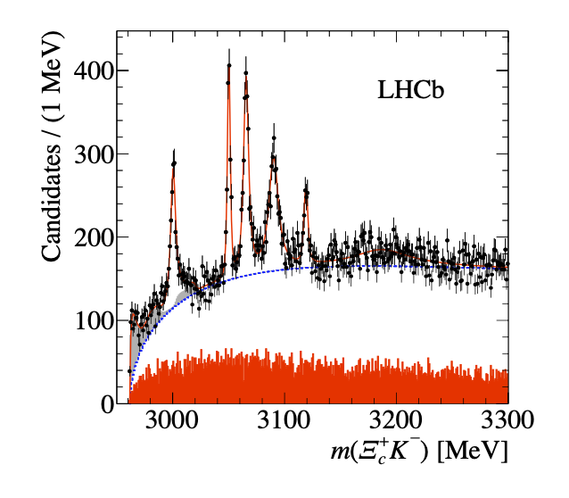
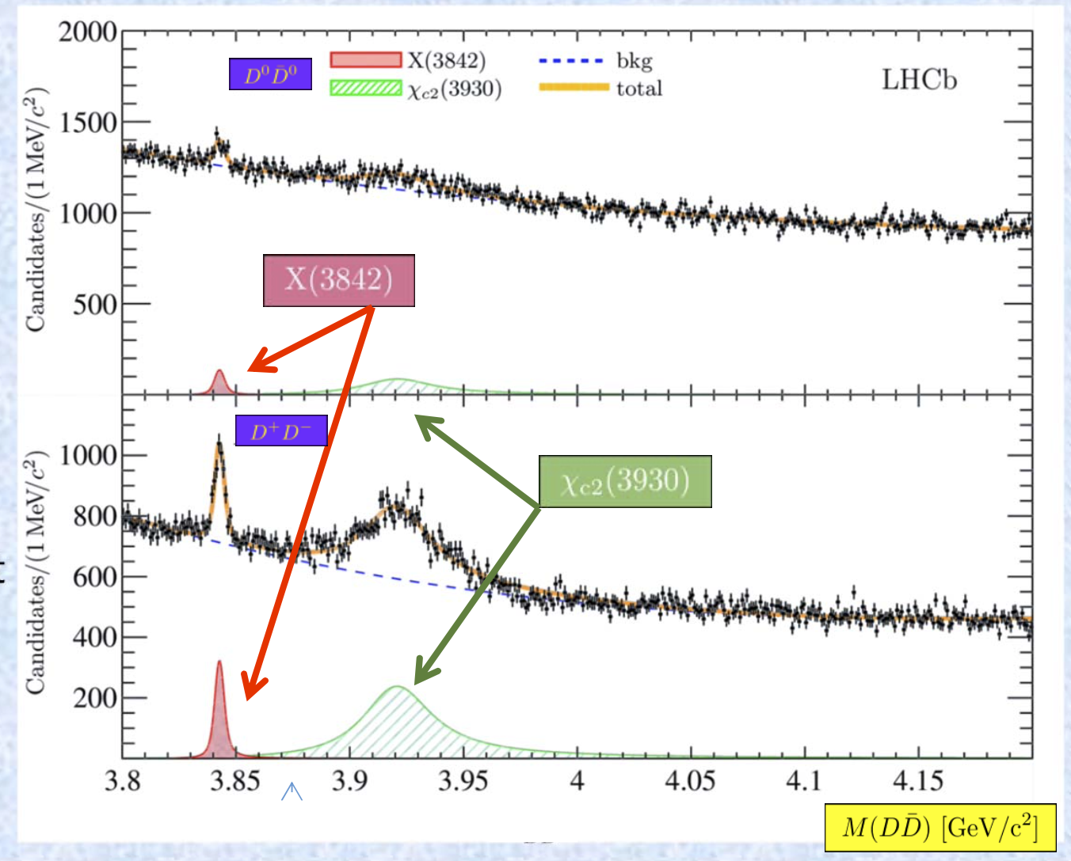
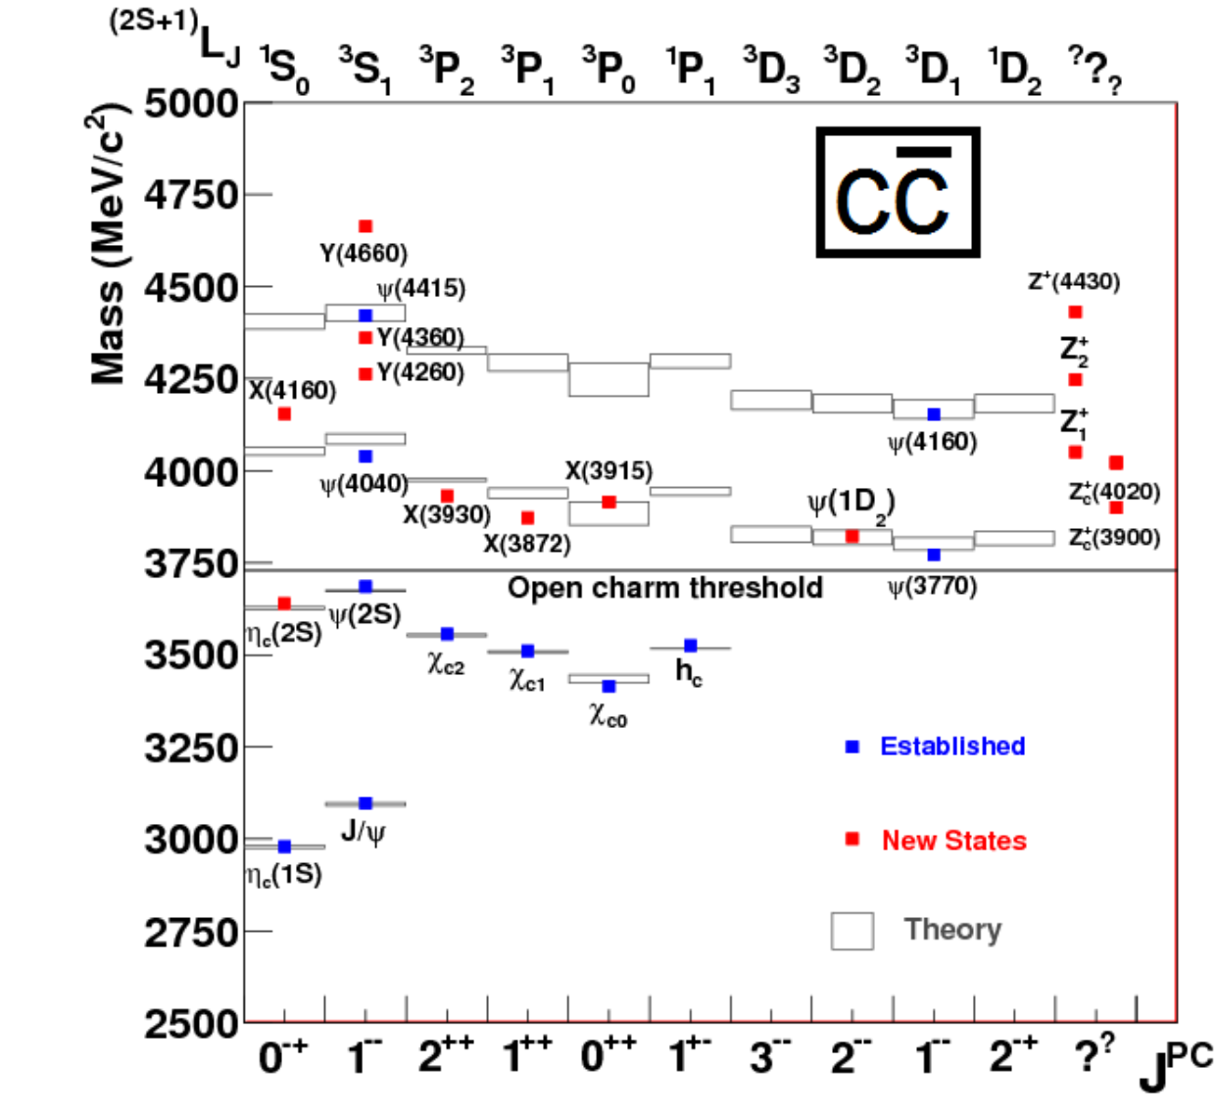
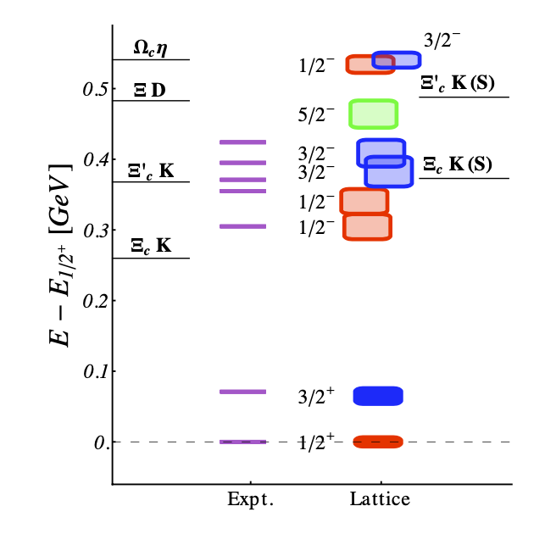
Spectroscopy: conventional hadrons
Many results also for the spectroscopy of conventional hadrons: their properties is a powerful test of Lattice QCD computations
Charm baryons: Ω_{c}* [PRL 118 (2017) 182001]
Charmonium spectrum above open charm threshold: still many expected states to observe with more statistics
JHEP 07 (2019) 035

Slide 10
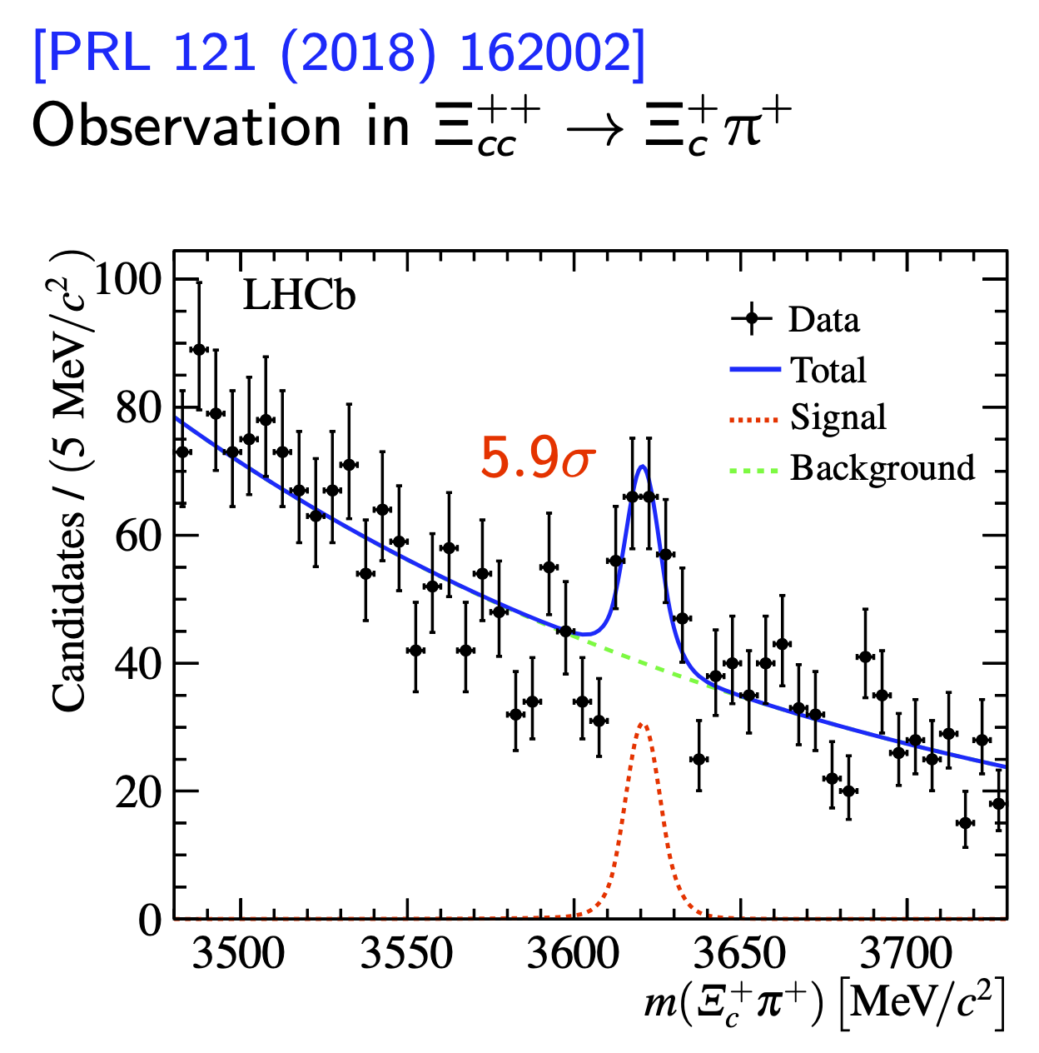
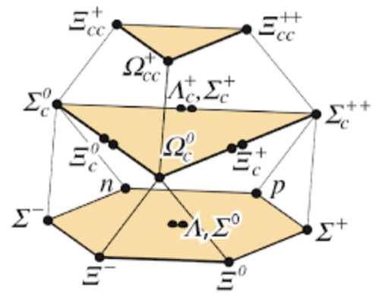
Spectroscopy: multi-heavy quark baryons
The discovery of the double-charm baryon at LHCb also attracted a lot of attention: first baryon with two heavy quarks.
In the end, it is an important confirmation of the quark model, but it also means there are a lot of heavier states with small production rates to be discovered with the statistics of the LHCb upgrades or with the Belle II dataset
+ equivalent baryons with b quarks: Ξ_{bc}, Ω_{bc}, ...

Slide 11
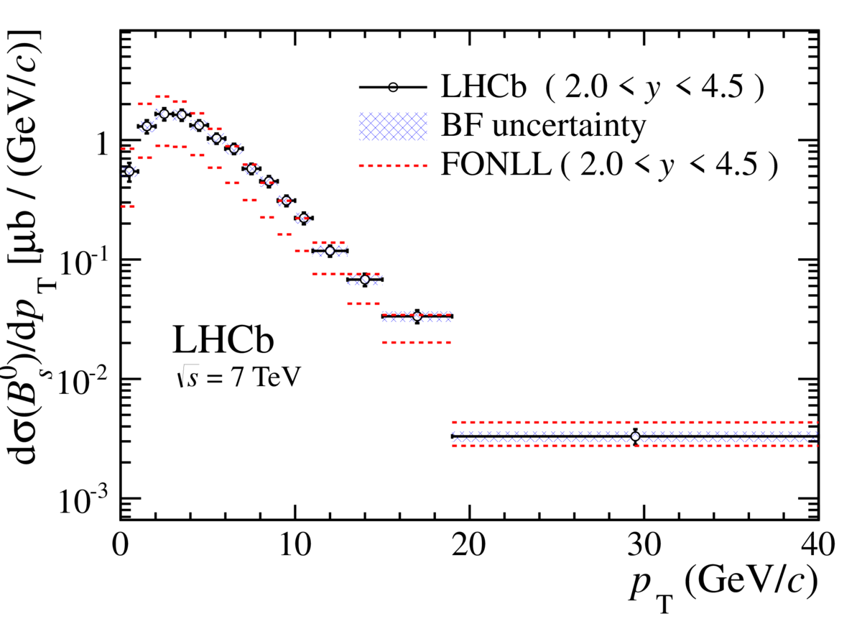
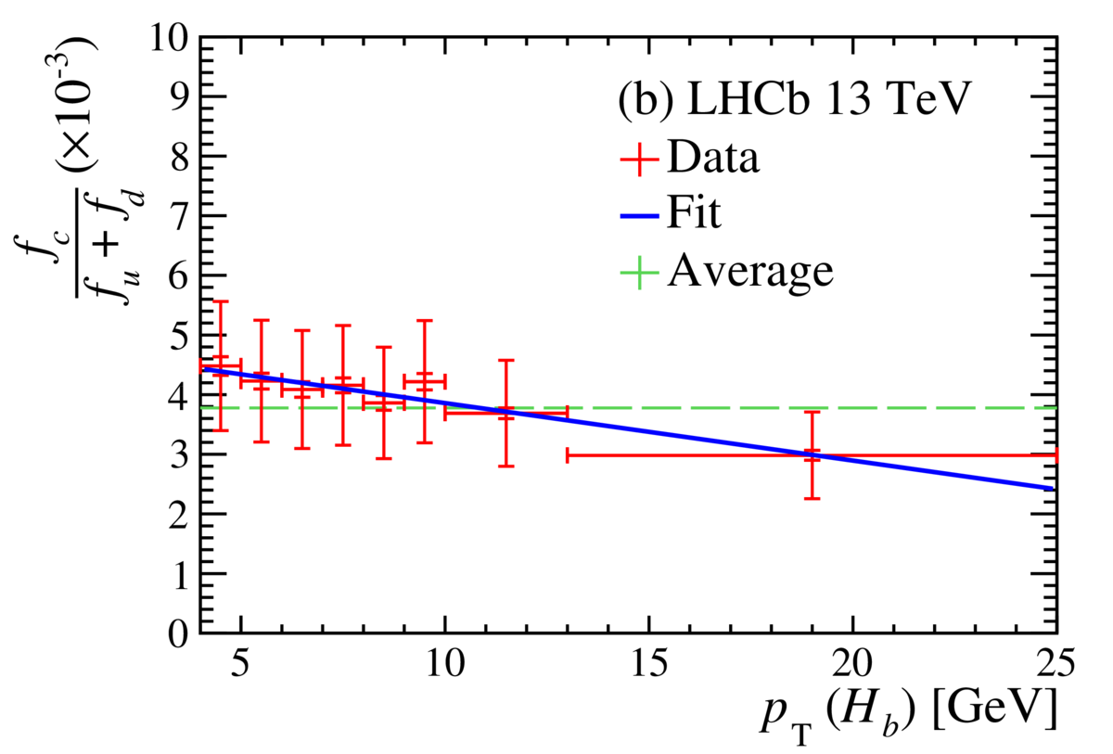
Heavy flavor production
JHEP 08 (2013) 117
At LHC energies, heavy flavor production is relatively well known.
However heavy flavor production is a powerful probe for the behavior of QCD in heavy-ion collisions: for these measurements, precise experiment information about the same production in pp collisions is needed.
For flavor physics itself, precise knowledge of production is important:
Tuning of Monte Carlo generators
At the LHC, absolute B_{s} branching fractions are obtained usually from B⁰/B⁺ branching fractions (from B factories): need to know the fraction of B_{s} produced f_{s}/f_{d} with increasing precision
Idem for the B_{c} which has a very small production rate, but which with the upgrades will become more and more important: knowledge of f_{c}/f_{d} mandatory
Important to continue providing these inputs in the future
PRD 100 (2019) 112006

Slide 12
Heavy flavour production
[A. Kusina, J-P Lansberg, I. Schienbein, H-S Shao, PRL 121 052004]
Charm production measurements in hadron collisions in particular can also provide constraint to determine the nuclear PDFs:
Input to simulation of interaction in targets of long baseline neutrino experiments,
Charm background for high energy cosmic rays, ...

Slide 13
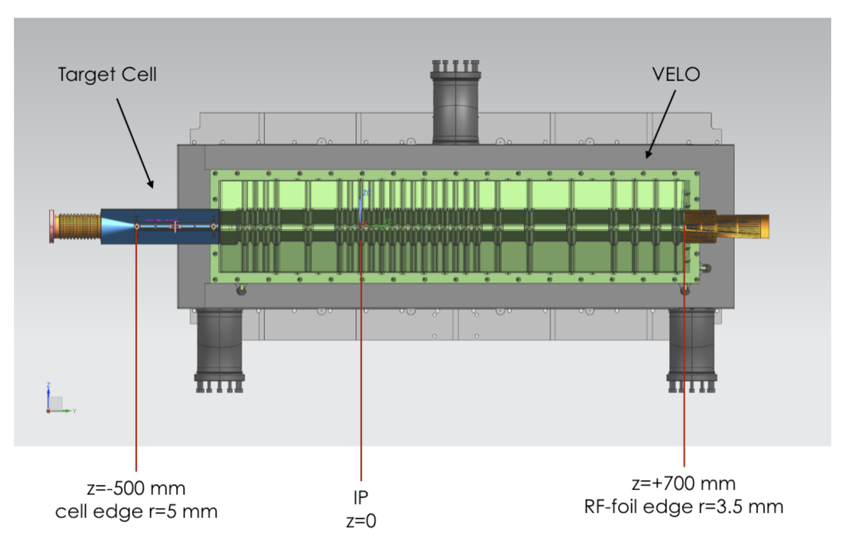
Heavy flavor production: SMOG2
Injection of gas at the LHCb interaction to provide fixed target collisions
Improved system to be installed during Upgrade Phase 1 of LHCb, with plans to upgrade to a polarized gas target after LS3
Measurement of heavy flavor production in this environment gives access to large x quark and gluon pdfs.
[C. Hadjidakis et al., arXiv:1807.00603]

Slide 14
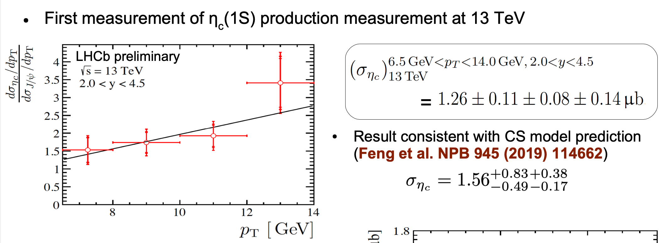
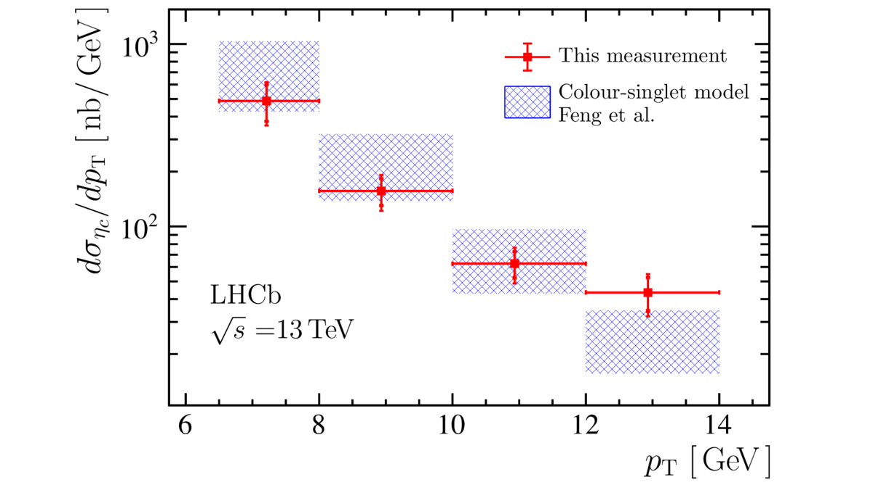
Quarkonium production
Despite huge progresses, QCD mechanisms for quarkonium production not well known.
Computations based on Non-Relativistic QCD give good theory-data agreement for J/ψ or Y(nS) cross-sections, but still has problems to describe for example polarization in hadronic collisions.
NRQCD relies on Long Distance Matrix Elements obtained from fits to all existing experimental data (including Belle and future Belle II ones) that must be improved and extended.
Large statistics foreseen will allow to measure new states, such as η_{c}, with hadronic pp decay.
in pp collisions
[EPJC 80 (2020) 191]

Slide 15
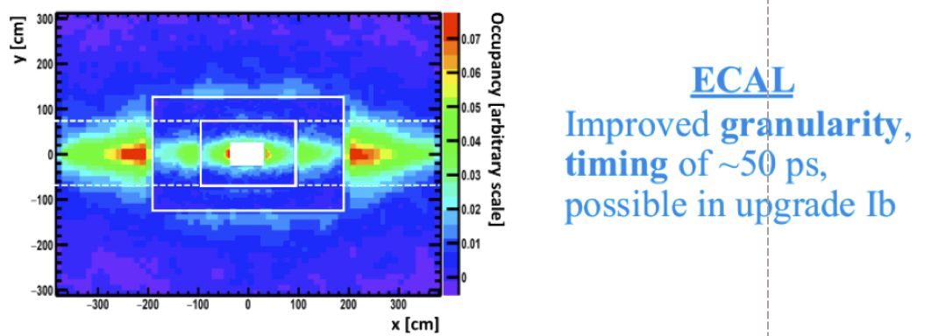
LHCb Upgrade II
French LHCb members interested in participating to developments for Real Time Analysis, DAQ and Calo (3 contributions to GT08 and GT09) and to contribute to the VELO and Tracker projects.

Slide 16
Conclusions
Even if not the initial main goals of the experiments, many measurements done in the area of spectroscopy and production with heavy flavor, some of them having received large visibility.
All LHCb French groups participated in several of these measurements (Ξ_{cc}⁺⁺, J/ψ, Y(nS), χ_{c}, χ_{b}, η_{c}, D, B and B_{c} production in pp collisions or with SMOG, exotics in Λ_{b}➝Λ_{c}Dp or B➝DDK)
Belle II and LHCb upgrades guarantee that this area will remain very active in the next years:
Continue understanding of exotic states
Observation of many new conventional or exotic heavier states
Connections to other fields (QCD theory, understanding heavy-ion collisions, ....)

