Slide 1


New light particles and new forces
(SHIP, OSQAR,JURA,VMB, Axion/ALP, GR tests...)
P. Nedelec UCBL-IP2I GT01/12-03-2020

Slide 2
Axion DM searches
GT06/Oct2019 (F. Hubaut/CCPM)

Slide 3
Axion DM searches
GT06/Oct2019 (F. Hubaut/CCPM)

Slide 4
Axion ALP seraches
GT06/Oct2019 (F. Hubaut/CCPM)

Slide 5
BMV Φ goals
GT06/Oct2019 (F. Hubaut/CCPM)
http://pdg.lbl.gov/2019/reviews/rpp2018-rev-axions.pdf
PDG Data Group, AXIONS AND OTHER SIMILAR PARTICLES, 2016

Slide 6
BMV stattus
GT06/Oct2019 (F. Hubaut/CCPM)

Slide 7
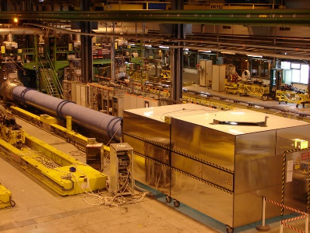
Optical Search of QED vacuum magnetic birefringence, Axion and photon Regeneration
Annual Report 2017
Precise measurement experiment aiming in measurng the Quantum Electrodynamics magnetic Vacuum Birefringence and searching for axions, together with a Photon Regeneration experiment.
3 experiments
  OSQAR-VBM: ultra-fine Vacuum Magnetic Birefringence
  OSQAR-LSW: photon regeneration effect as Light Shining through the Wall
  OSQAR-CHASE: hypothetical particles called Chameleons whose mass depends on the local matter density!
magnetic field of 9 T over 14.3 m
Photon beam is linearly polarized with
Search for pseudoscalar ALPs
Use of a λ/2 wave plate for polarization
Search for scalar ALPs
Use of beam expander telescope to reduce the Laser beam divergence
Photon Source: COHERENT Verdi V18 CW Laser
λ = 532 nm (2.3 eV) - Optical power : 18.5 W
CERN-SM18

Slide 8
Future activities?
Toward JURA & VBM@CERN
https://arxiv.org/pdf/1902.00260.pdf
Conceptual Design Optimization of a 60 T Hybrid Magnet
P. Pugnat & Hans J. Schneider-Muntau

Slide 9



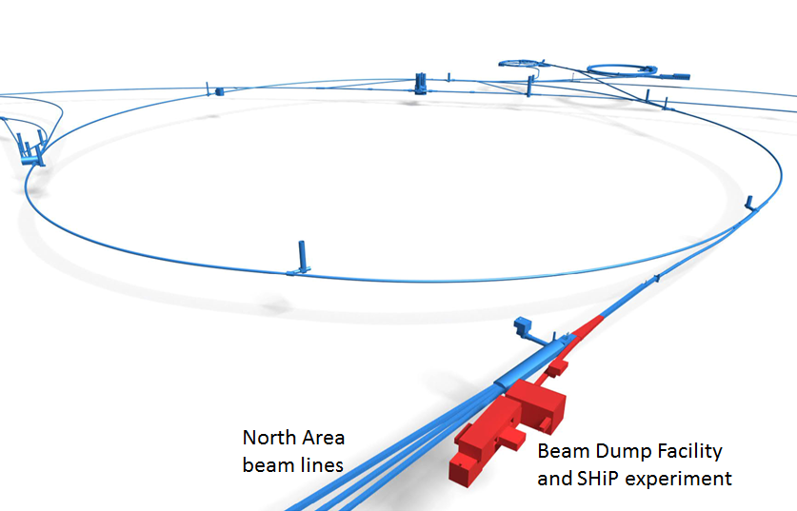
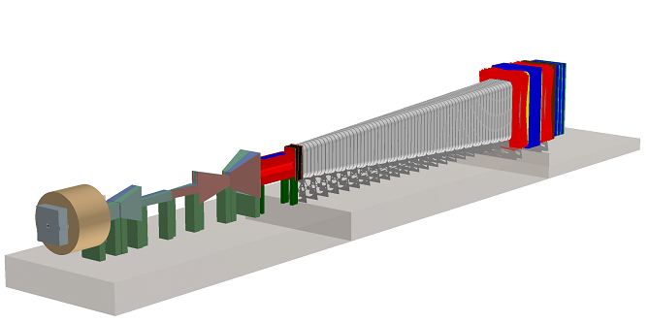
SHiP - Search for Hidden Particles
Proton fixed target experiment
http://ship.web.cern.ch
SHiP is a new general-purpose experiment to be installed in a beam dump facility at the SPS to search for hidden particles as predicted by a very large number of recently elaborated models of Hidden Sectors which are capable of accommodating dark matter, neutrino oscillations, and the origin of the full baryon asymmetry in the Universe
Specifically, the experiment is aimed at searching for very weakly interacting long lived particles including Heavy Neutral Leptons - right-handed partners of the active neutrinos, vector, scalar, axion portals to the Hidden Sector, and light supersymmetric particles - sgoldstinos, etc
The high intensity of the SPS and in particular the large production of charm mesons and photons with the 400 GeV beam allow accessing a wide variety of light long-lived exotic particles of such models and of SUSY
The detector incorporates two complementary apparatuses which are capable of searching for hidden particles through both visible decays and through scattering signatures from recoil of electrons or nuclei. Moreover, the facility is ideally suited to study the interactions of tau neutrinos.
https://cds.cern.ch/record/2704147/files/SPSC-SR-263.pdf

Slide 10
Golutvin
SHiP-2017

Slide 13


Slide 15
A facility to SearcHiP
BSM @ Home 400 GeV p beam (√s=27 GeV); 2.10²⁰ pot (5 y)
The SHiP detector consists of two complementary apparatuses
  scattering and neutrino detector(SND): search for light dark matter (LDM)scattering and perform neutrino physics
  hidden sector (HS) decay spectrometer: visible decays of HS particles by reconstructing their decay vertices in a 50 m long decay volume
SHiP is currently a collaboration of 49 institutes, 5 associate institutes
from 16 countries, CERN and JINR
(Golutvin-2017)

Slide 19
SHIP expected
performances
[12] J. Beacham et al., Physics Beyond Colliders at CERN: Beyond the Standard Model Working Group Report, [arXiv:1901.09966]. March 2019

Slide 20
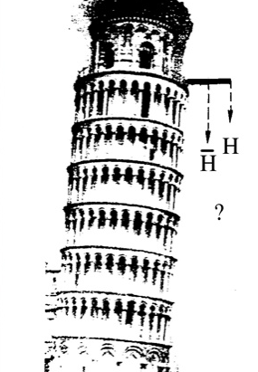
Probing General Relativity with Antimatter
Test Weak Equivalence Principle with antimatter.
  Well tested with matter @ 10⁻¹⁵ (MICROSCOPE 2017, arXiv:1712.01176)
No (strong) theoretical prejudice
  Certain aspect of grand unification theory predict differing interactions for matter and antimatter
  Test Dirac-Milne Universe models (G. Chardin 2018, arXiv:1807.11198v1)
Experimentally
  STRONG evidence of repulsive gravitation (DE)!
  Antimatter factory available today (AD/ELENA+exp): Place to be!
Fabricating antihydrogen under controlled conditions in the lab offers the opportunity of studying fundamental symmetries underlying to the observable universe.
The AD facility at CERN is the sole installation worldwide
providing low‐energy antiproton beams to users.
AEgIS, ALPHA, ASACUSA, ATRAP, BASE and GBAR
D. Lunney (CSNSM‐Orsay) and P. Nédélec (IP2I‐Lyon)
“Antimatter Factory”)

Slide 21
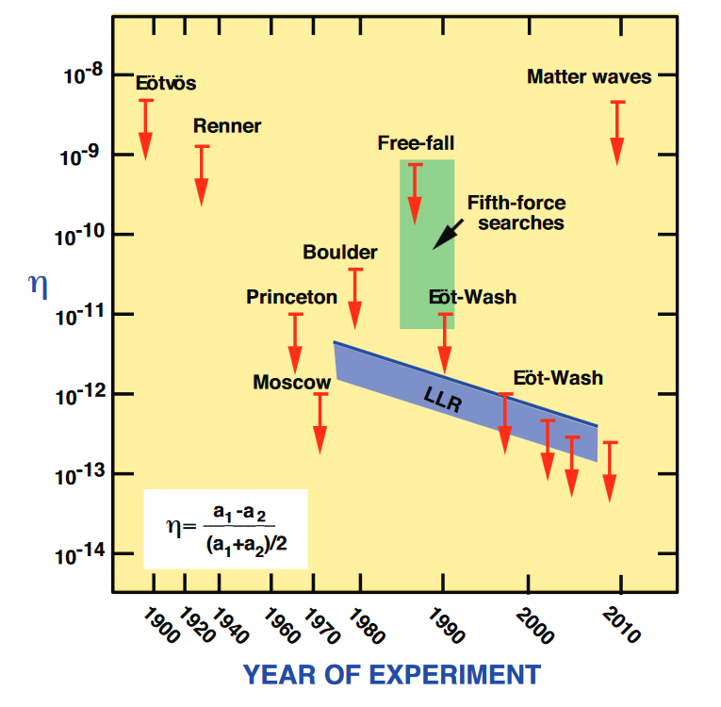
Direct tests of the Equivalence Principle
With normal matter
Eötvös-like torsion balances (2 part per 10¹³)
Lunar laser ranging (3 part per 10⁴)
Cold atoms interferometry (3 part per 10⁸)
With antimatter
Attempts with charged positrons ~ 1967
Attempts with charged antiprotons ~ 1985
Some criticized indirect limits ~ 1987 - 2000
Antihydrogen by ALPHA collab., 2014 (rough, 110 part per 1)
any deviation from the expected acceleration of 9.806 m/s²
would be an indication of new physics

Slide 22



GBAR: Gravitational Behaviour of Antihydrogen at Rest
Both experiments create antihydrogen using a charge‐exchange reaction of low‐energy antiprotons with positronium:
  AEgiS: GBAR
$$\overline{p}+{oPs}^{∗}→{\overline{H}}^{∗}+e^{−}$$
$$\overline{p}+2{Ps}^{∗}→{\overline{H}}^{+}+e^{−}$$
Goals of GBAR
  Produce anti-hydrogen ions, cool them @ uK, photodetach anti-ions to make cold neutral atom. Then g free fall! (@1%)
Status
  e+ beam+trap ;
  Decelerate 100 keV pbar beam
  Produce anti-H+
  Cooling+photo-detachment
  Detect annihilation with uMegas
Program
  Take data by 2021 for 3 years
  Hbar Lamb shift measurement
  Pbar radius
  Q-reflected antiatoms
  …

Slide 23

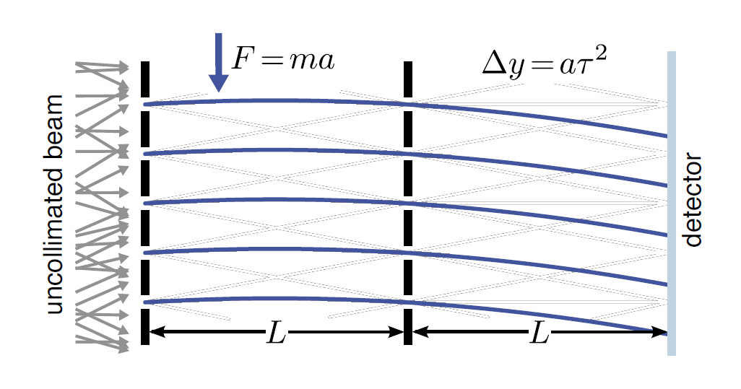
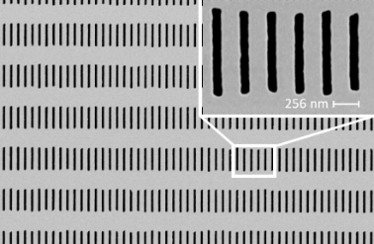




AEgIS: Antihydrogen Experiment, Gravity, Interferometry, Spectrometry
$e$⁺
Goals of AEgiS
  Produce anti-hydrogen neutral beam in fundamental state, send it horizontaly on deflectometer (moire /Talbot-Lau
  For free fall! (@1%)
Status
  e+ beam+trap (10⁸/ spill)+oPS*
  Decelerate 100 keV pbar through thin foil
  Produce pulsed anti-H* à la AEgIS. Make a beam
  Prepare colling (via sysiphus C2- cooling)
  and ground state (via H-)
  Prepare moire/TL deflectometers
$\overline{p}$⁻
Program
  Take data by 2021 for 3 years, produce more Hbar
  Perform first free fall measurement
  oPs physics (Rydberg states, free fall)
  Protonium physics (free fall)
  Antiprotonic atoms…
$e$⁺
e+e-
$e$⁺
$e$⁻
p+pbar
$e$⁻
Nano-grating

Slide 24
GT01-Summary
SM well established! But many unanswered questions
Many interesting, already existing project are running and/or under development.
Great discovery potential
With IN2P3/CNRS/CEA components:
  SHIP,
  OSQAR,JURA,VMB, Axion/ALP,
  GBAR, AEgIS

