Slide 1
Micro-canaux
Collaboration LP3/CPPM
17/04/2019

Slide 2
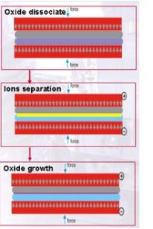
Concept alternatif: Anodic bonding
Micro canaux
Si
Verre
T_{anneal}=350°C
P ~ 20 bars

Slide 3
