Slide 1
Filter Exchange System Status Pierre Karst Filter Exchange System Manager – IN2P3 3 Octobre 2019

Slide 2
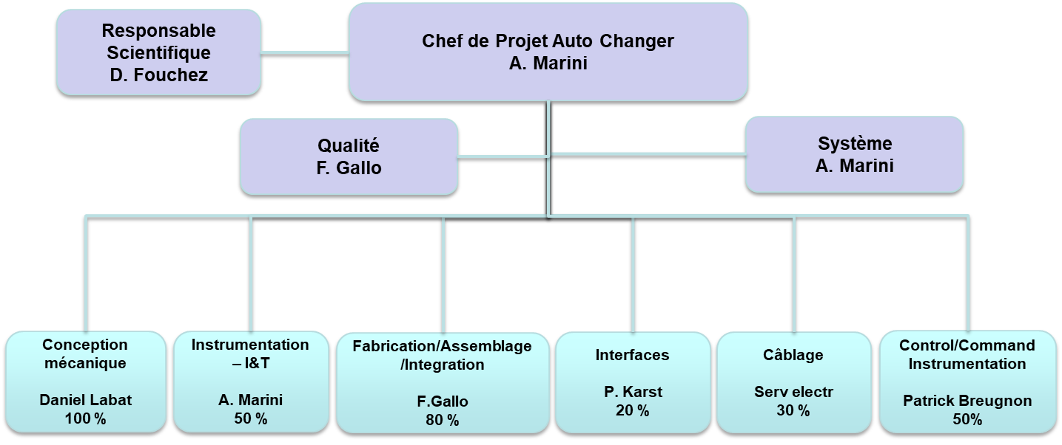
L’équipe CPPM
Chef de Projet Echanger de Filtre
P. Karst

Slide 3
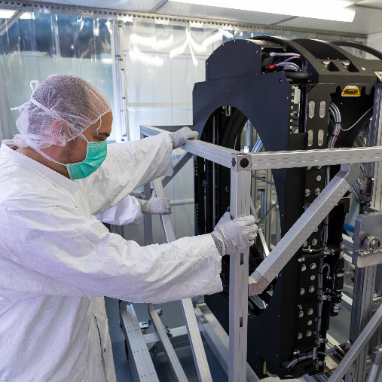
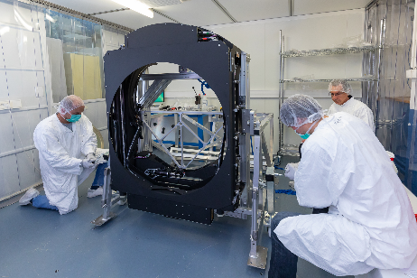
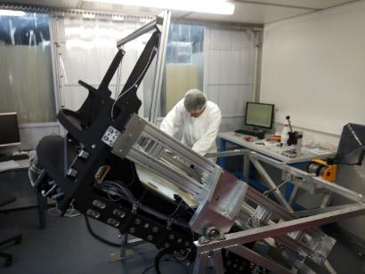
Auto Changer progress in 2018-2019
Prototype unit : Fully assembled and tested (Stand-alone test, cold test, combined tests)
Final unit 1:
The Assembly and the Stand-alone tests are complete
The Combined Test with the Filter Loader and the Carousel is complete
The test at cold and warm Temperature is done (-17°C ; 35°C)
Final unit 2 :
Fabrication in progress : Expected end of June 2020 (Not fully funded in 2019)
Assembly and Stand Alone Test : Spring and Summer 2020
Combined Test : Fall 2020
Delivery : End of 2020, early 2021
Auto Changer on Stan-alone Test Bench
Auto Changer on Stan-alone Test Bench
Auto Changer on the Transport Clean Box

Slide 4
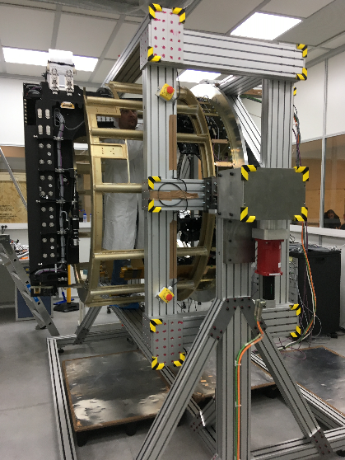
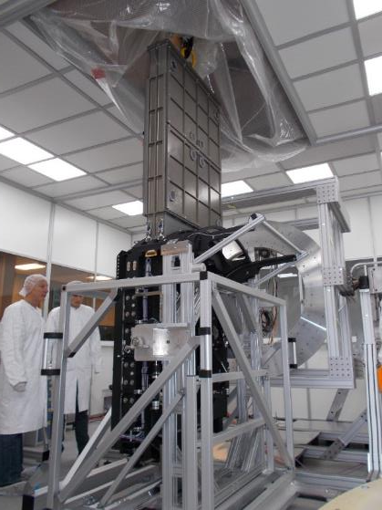
Verification and Validation activities status
Test Loader/Auto Changer :
The alignment of the Loader with the Auto Changer is done.
The Filter Hand-off is verified and validated.
Combined Test :
All the system has been mechanically tested with 5 filters on the carousel (Filter Loading and Filter Hand-off) => June and July 2019
Tuning of the control/command done on August and September 2019
Many travels at Paris
Shipment to US (SLAC) : Early October
BackFlange + Carousel : Plane => End of Novembre
All the System : Boat => Early December
Operations at SLAC :
Unpacking and test : December 2019
Camera Integration : February 2020
Carousel
Loader
Dummy Camera Body
Auto Changer
Auto Changer
Combined Test Auto Changer/Filter Loader
Auto Changer and Carousel on the Test Bench

