Slide 1





« Next » Generation of Targets
B. Jurado, CENBG; C. Cannes, IJCLab; B. Gall, O. Dorvaux, M. Kerveno, IPHC; M. Dubois, O. Bajat, X. Ledoux, G de France, B. Jacquot, J. Piot, D. Ackermann, H. Savajols, G. Frémont, J.-C. Foy, Ch. Stodel, GANIL

Slide 2
GT07
I Stefan, G de France « Possibles développements autour de SPIRAL2 »
P. Jardin, C. Barué, L. Maunoury « Ambitions à long terme de la production de faisceaux d’ions à GANIL »
……………
A transversal activity
GT02 – A. Lopez-Martens « Heavy and super_heavy nuclei »
L. Caceres « Prospectives ISOL, Spectroscopie des états fondamentaux »
B. Jurado « Comment arriver à une description complète de la fission nucléaire? »
GT10 – G. de France “Une plateforme interdisciplinaire pour la R&D production de radioéléments innovants »
GT11 – M. Kerveno « Données nucléaires »
……………………
Target
Spectrometer
Beam Dump
Beam
N_{out}
Detector
GT08
2
~ dam/hm
µm-mm
N*mm
~ m/dam
~ cm/dm
Notes:
Positionner cette thématique dans le contexte des prospectives

Slide 3
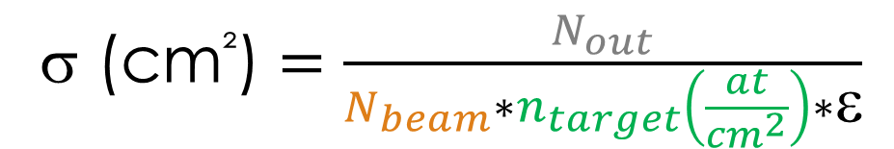
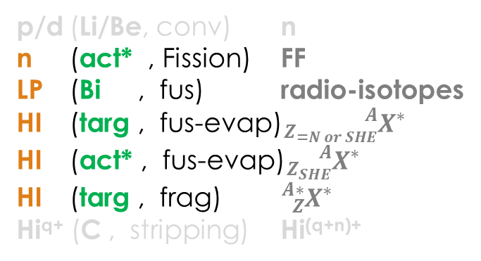
Requirements & constraints
Successful experiment
= Accurate measurements + low background + safe conditions
→ Need of high quality targets with known properties at any time
p/d (Li/Be, conv) n
n (act* , Fission) FF
LP (Bi , fus) radio-isotopes
HI (targ , fus-evap)${}_{Z_{=N or SHE}}^{A}{X^{∗}}$
HI (act* , fus-evap)${}_{Z_{SHE}}^{A}{X^{∗}}$
HI (targ , frag) ${}_{Z}^{A∗}{X^{∗}}$
Hi^{q+} (C , stripping) $\text{Hi}\text{(}\text{q}\text{+}\text{n}\text{)+}$
σ (cm²) $=\frac{N_{out}}{N_{beam}∗n_{target}\left(\frac{at}{cm^{2}}\right)∗ε}$
Areal density
Homogeneity == spatial distribution (to be verified experimentally) (e.g. ensure that all detected neutrons have traversed the same path lenght in the target (no hole) for a correct interpretation of capture and transmission cross-section in resonance regions).
Effective area
Quantification & identification of contaminants and impurities, uncertainty depends on their impact on the measurement.
Target
N_{beam}
N_{out}
D. Sapundjiev et al., Nucl. Instr. Meth. A 686 (2012) 75-81 “Preparation and characterization of thin film nuclear targets for neutron physical measurements”
Characterization techniques not developed here
Notes:
Exigences sur la qualité des cibles pour les résultats
Uncertainties expected to be < 0.5%

Slide 4



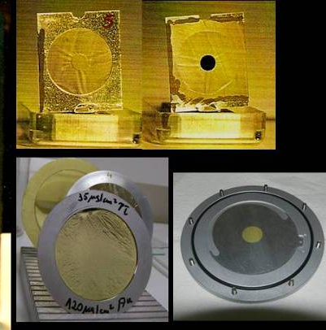
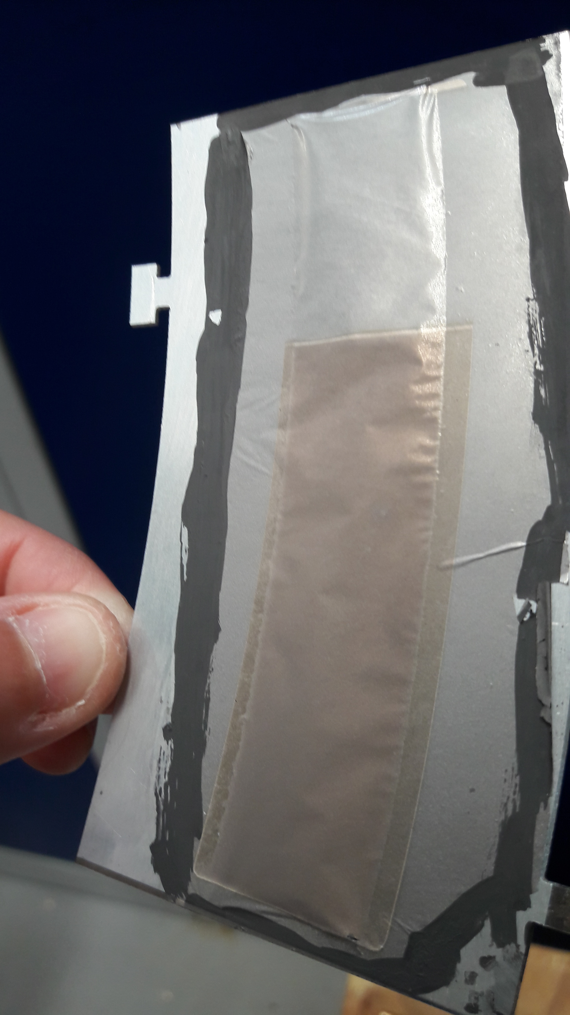

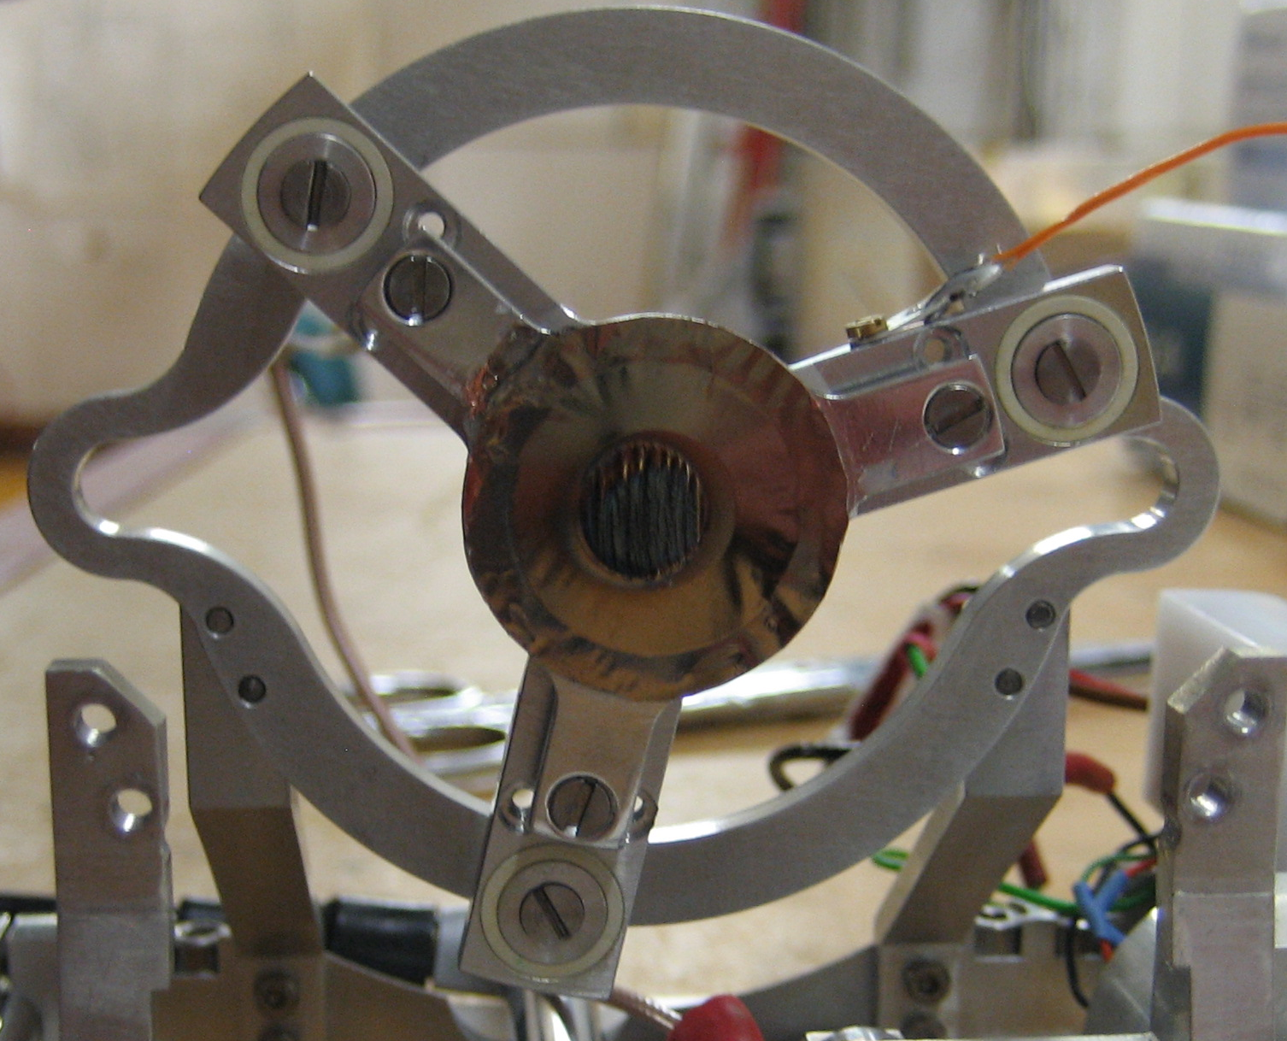
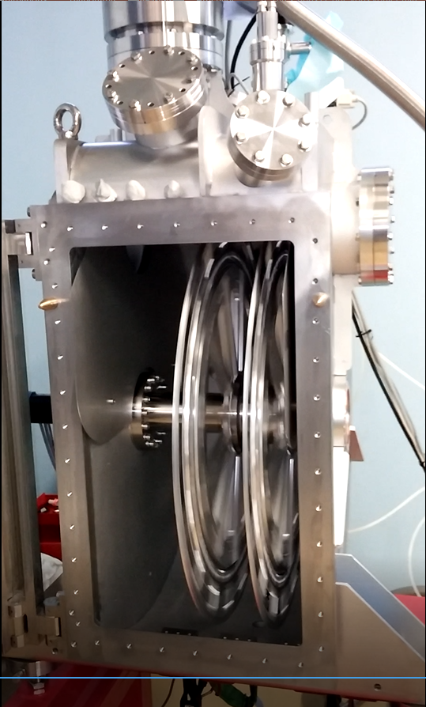
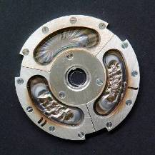
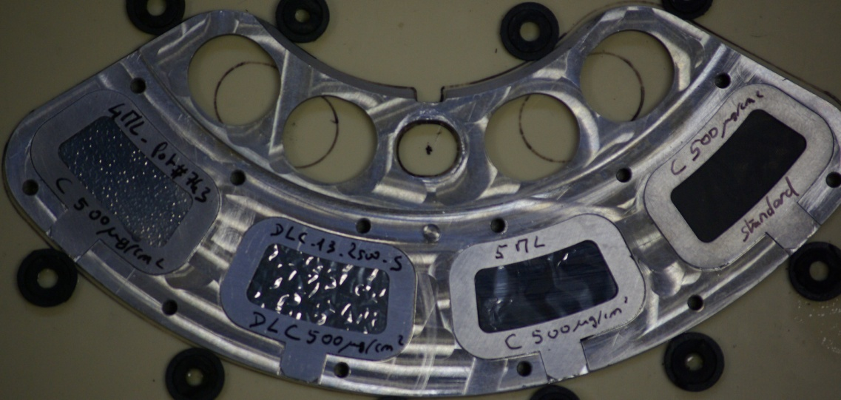
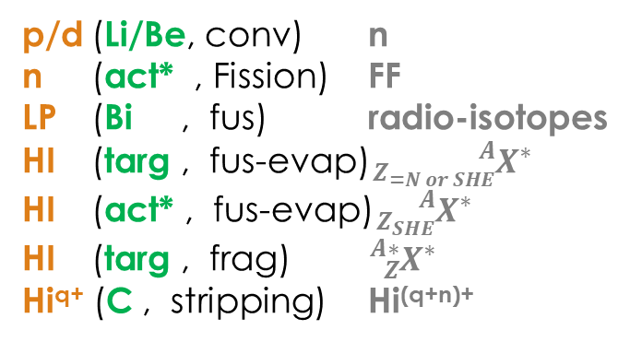
Requirements & constraints
p/d (Li/Be, conv) n
n (act* , Fission) FF
LP (Bi , fus) radio-isotopes
HI (targ , fus-evap)${}_{Z_{=N or SHE}}^{A}{X^{∗}}$
HI (act* , fus-evap)${}_{Z_{SHE}}^{A}{X^{∗}}$
HI (targ , frag) ${}_{Z}^{A∗}{X^{∗}}$
Hi^{q+} (C , stripping) $\text{Hi}\text{(}\text{q}\text{+}\text{n}\text{)+}$
I_{LP, HI}
Temp_{tar}
Radiation damage
→ τ
Target
Plunger targets
N_{beam}
N_{out}
Courtesy of A. Stolarz, A. Mitu
targets mounted on the wheel for TASCA
I_{S3} = 1-1.5 pµA à 5 (existing)
10 (estimated)
20 pµA???
S3 Targets Station
Designed for 10pµA
Notes:
Etat des lieux et diversité des cibles.
Problématique de l’augmentation d’intensité / quelques solutions sur les stations
Aller plus loin

Slide 5
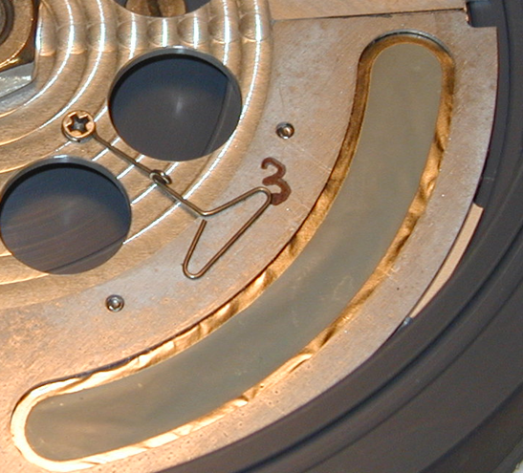
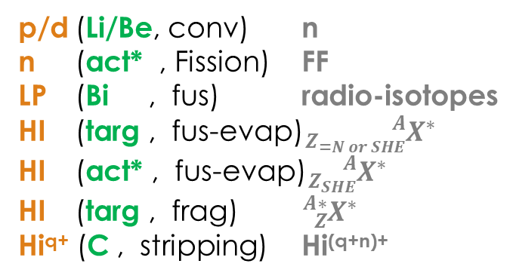
p/d (Li/Be, conv) n
n (act* , Fission) FF
LP (Bi , fus) radio-isotopes
HI (targ , fus-evap)${}_{Z_{=N or SHE}}^{A}{X^{∗}}$
HI (act* , fus-evap)${}_{Z_{SHE}}^{A}{X^{∗}}$
HI (targ , frag) ${}_{Z}^{A∗}{X^{∗}}$
Hi^{q+} (C , stripping) $\text{Hi}\text{(}\text{q}\text{+}\text{n}\text{)+}$
Requirements & constraints
Layout
Li or Bi : T_{fus} low, thin, fragile → liquid targets ?
Stripper : induced damages with HI, fragile
→ liquid or gaseous targets ?
Act* : backings, activity, limited laboratories, Chemical reaction (backing/layer)
→ R&D on deposition & backings
Thin layer deposited on
substrate (backing)
Backing must not interfere with the nuclear reaction used ⇒ Use high purity material
Backing must not interact with the target material
ISOL targ : from beam to target fragmentation to explore new isotopes →temperature stability and release time ?
*[] hidden slides 8, 9, 10
Notes:
Sujets à présenter
Trop large → on va se concentrer sur les Bi liquide, actinides et ISOL targets

Slide 6

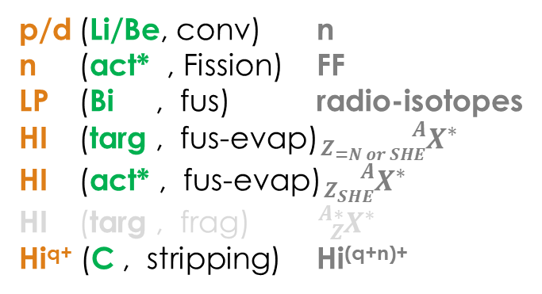
Thin targetsfor nuclear physics experiments
p/d (Li/Be, conv) n
n (act* , Fission) FF
LP (Bi , fus) radio-isotopes
HI (targ , fus-evap)${}_{Z_{=N or SHE}}^{A}{X^{∗}}$
HI (act* , fus-evap)${}_{Z_{SHE}}^{A}{X^{∗}}$
HI (targ , frag) ${}_{Z}^{A∗}{X^{∗}}$
Hi^{q+} (C , stripping) $\text{Hi}\text{(}\text{q}\text{+}\text{n}\text{)+}$

Slide 7
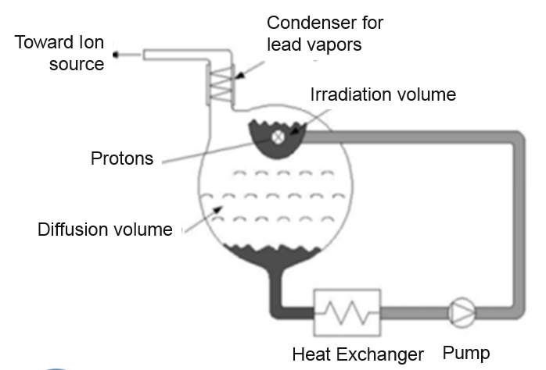

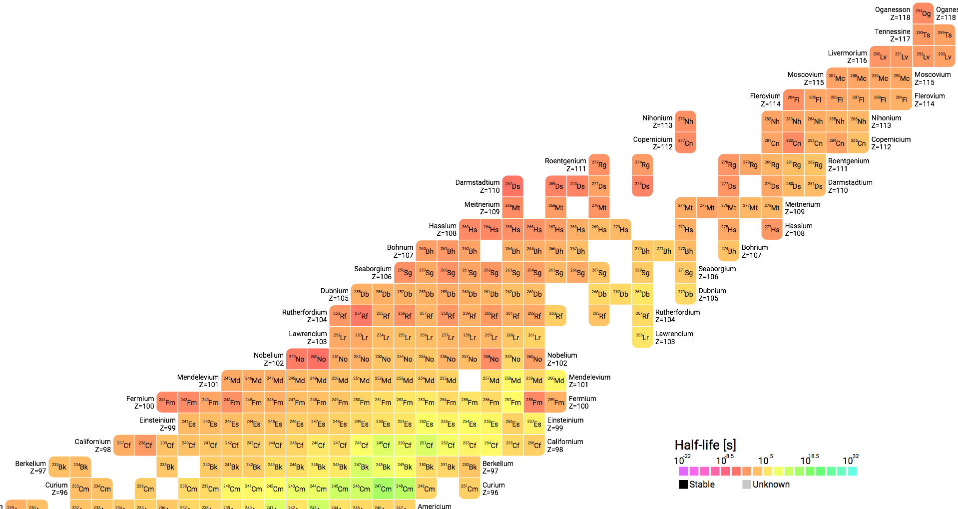
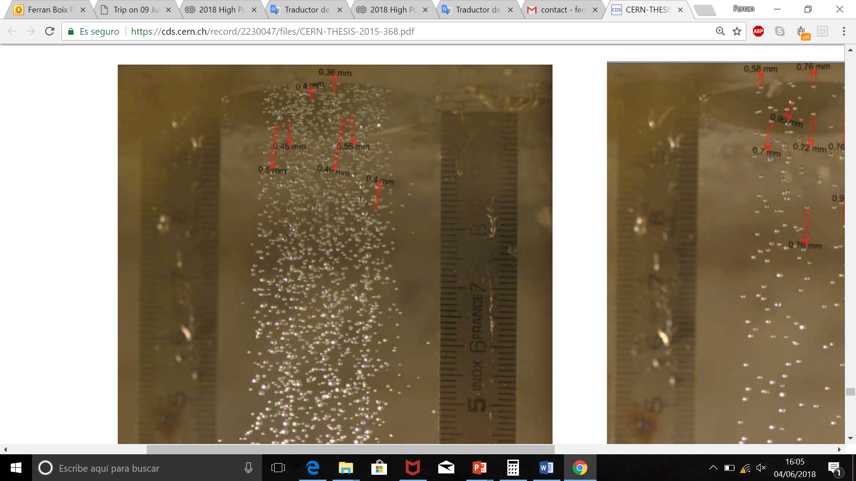
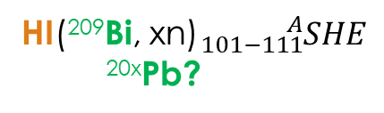
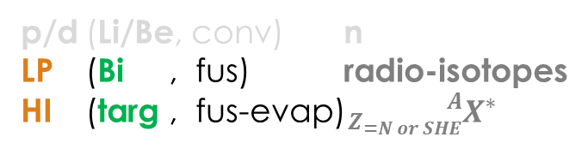
p/d (Li/Be, conv) n
LP (Bi , fus) radio-isotopes
HI (targ , fus-evap)${}_{Z_{=N or SHE}}^{A}{X^{∗}}$
Liquid Targets
Li or Bi : T_{fus} low, thin, fragile → liquid targets ?
LIquid Eutectic lead Bismuth loop targEt
No backing material
Complex system
Homogeneity? Stability of the thickness ?
Higher dP/V
D. Houngbo et al, Nucl. Instr. Meth. B 376 (2016) 57-59 “Develoment of a liquid Pb-Bi target for high-power ISOL facilities”
LIEBE EMIS 2018
ANR REPARE : Research and dEvelopements for the Production of innovAtive RadioElements
WP3: High power liquid target (ARRONAX, SUBATECH, CERN, GANIL)
7
Design proposed by E. Noah and all, EURISOL 100 kW Target Stations Operation and Implications for its Proton Driver Beam, EPAC,2006
²⁷⁶Cn
²⁷²Ds
²⁷⁶Ds
⁴He(²⁰⁹Bi, 2n)²¹¹At
²⁷²Hs
²⁵⁶Sg
²⁵⁷Sg
²⁶⁸Sg
²⁵²Rf
Images from Melanie Delonca CERN Ph.D thesis
people.physics.anu.edu.au/
HI(²⁰⁹Bi, xn)${}_{101−111}^{A}{SHE}$
^{20x}Pb?
Notes:
REPARE: The goal of this work package is to design a high power rotating system able to sustain possibly 10kW beam power on a bismuth target including the extraction method and radioprotection aspects

Slide 8
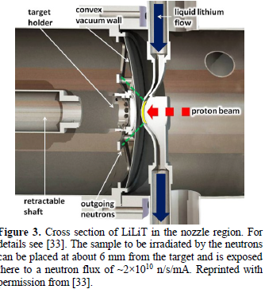
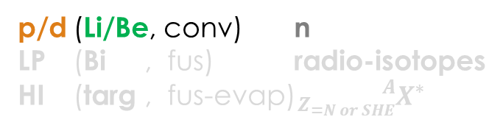
p/d (Li/Be, conv) n
LP (Bi , fus) radio-isotopes
HI (targ , fus-evap)${}_{Z_{=N or SHE}}^{A}{X^{∗}}$
Liquid Targets
Li or Bi : T_{fus} low, thin, fragile → liquid targets ?
1. S. Halfon et al, Rev. Scient. Inst. 84 (2013) 123507 “High power liquid-lithium jet target for neutron production”
2. I. Mardor et al, Eur. Phys. J. A 54 (2018) 91 “The Soreq Applied Research Accelerator Facility (SARAF): Overview, research programs and future plans”
Challenges @ SARAF:
Large volume power density > 1MW/cm³ (>> NFS 3kW/cm³)
Keeping stable temperature, vacuum conditions
Complex system, operation and maintenance
8
from [2]

Slide 9
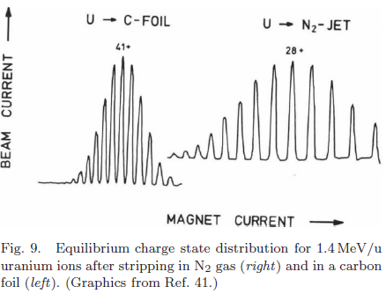
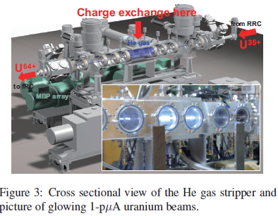
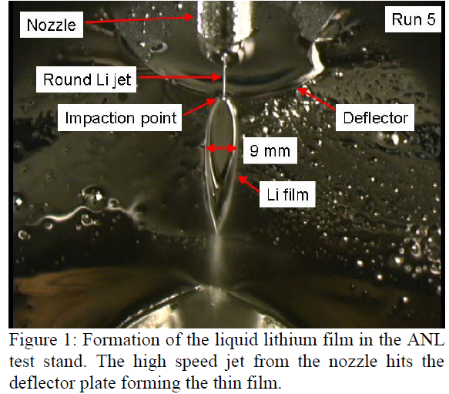
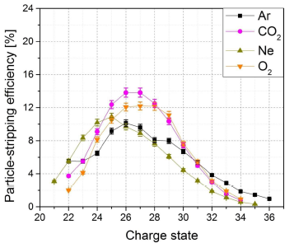

Liquid or Gaseous targets
Hi^{q+} (C , stripping) $\text{Hi}\text{(}\text{q}\text{+}\text{n}\text{)+}$
Strippers Foils
F. Marti, Proc. HIAT2015, pp.134-138, « Development of a liquid lithium charge stripper for FRIB »
P. Scharrer et al, Proc. HIAT 2015 pp. 144-147, « A pulsed-gas stripper for stripping high-intensity, heavy ion beams at 1,4 MeV.u at the GSI UNILAC »
H. Imao et al., Proc. Cyclotrons 2013, pp. 265-268, « R&D of helium gas stripper for intense uranium beams »
from [2]
from [3]
from [1]

Slide 10
Gaseous equilibrium foils for S3 ?
Hi^{q+} (C , stripping) $\text{Hi}\text{(}\text{q}\text{+}\text{n}\text{)+}$
Strippers Foils
Carbon foils for charge equilibraiton of evaporation residues
presently mounted on the wheel able to sustain 10pµA
Gas helps in cooling by convection
Complex system ? Dimensions for equivalent 30µg/cm²?

Slide 11
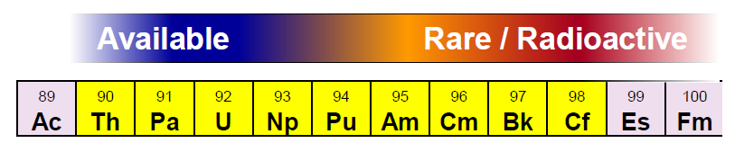
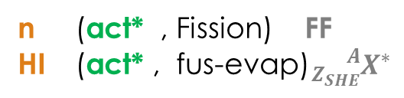
Actinide Targets
Actinide Targets
n (act* , Fission) FF
HI (act* , fus-evap)${}_{Z_{SHE}}^{A}{X^{∗}}$
Constraints:
Limited availability
high specific activity
Backing : material, thickness, roughness
High chemical purity
large surface/numerous
Fragile for transportation
Few expertise in the world
Methods:
High yield
reliability/reproducibility
control of dimensions and thickness
Electro-precipitation
Drop-on-Demand
intermetallic targets
Complementary developments:
backings (material + thickness)
characterization techniques

Slide 12
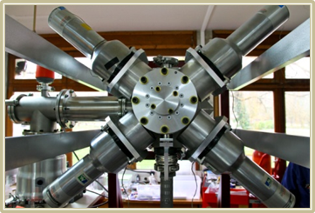
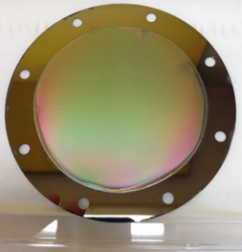
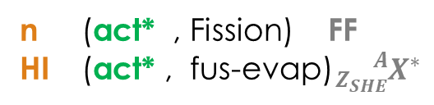
Actinide Targets
n (act* , Fission) FF
HI (act* , fus-evap)${}_{Z_{SHE}}^{A}{X^{∗}}$
Actinide Targets
Applications
GT02 – A. Lopez-Martens « Heavy and super_heavy nuclei »
²⁵²Cf
GT02 – B. Jurado « Comment arriver à une description complète de la fission nucléaire? »
GT11 – M. Kerveno « Données nucléaires »
²⁴⁸Cm
^{24x}Bk
²⁴³Am
^{242,4}Pu
Actinide targets for SHE:
  200 – 500 µg/cm²
  Homogeneous
  Numerous
  Minimizing Eloss in backing
  (now 1,5 µm Ti : dE=2/3dE_{tot})
²³⁸U
Spectrometer for surrogate studies
people.physics.anu.edu.au/
Actinide sample:
  150→1000 µg/cm²
  Active diameter 40-80 mm
  Homogeneous
  Surface roughness as low as possible
  On ultra-thin backing: Ni (250 nm) or PL (220 nm)
Yu. T. Oganessian (JINR), “production of new target materials and development of techniques for making targets with high thermal and radiation stabilities “
J.B. Roberto (ORNL), “progress in the development of heavy actinide targets […] They depend on a robust infrastructure of actinide production, chemical processing, and heavy ion accelerator facilities. Continued scientific progress will require further advances in actinide production, processing, and target technology to enable experiments essential for ………………..;.” Nuclear Physics A 944 (2015)
75 mm
²⁴²Pu / 110 µg/cm²
Courtesy of K. Eberhardt

Slide 13
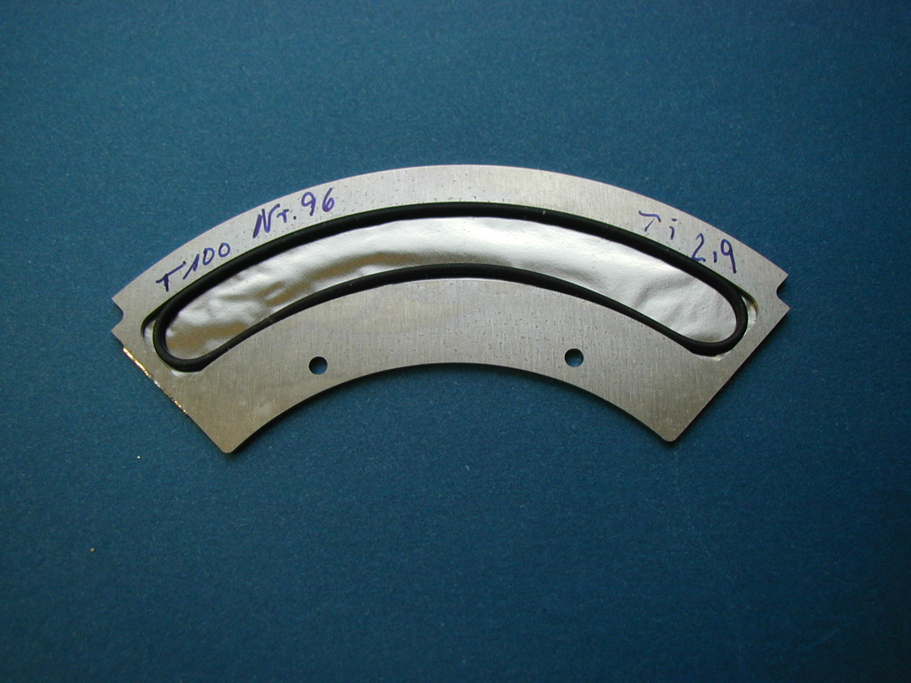
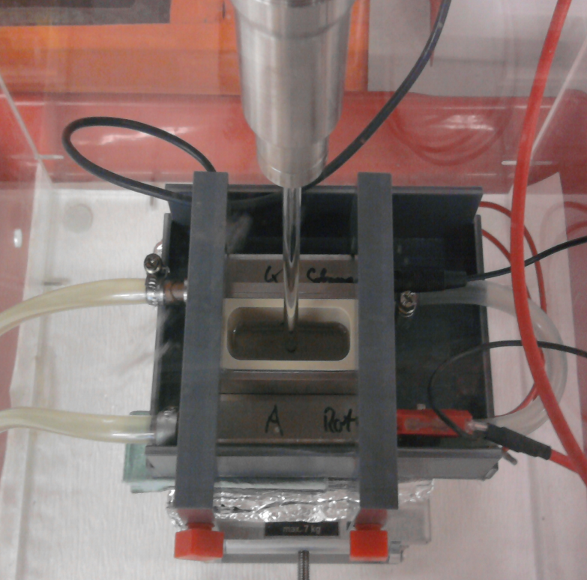
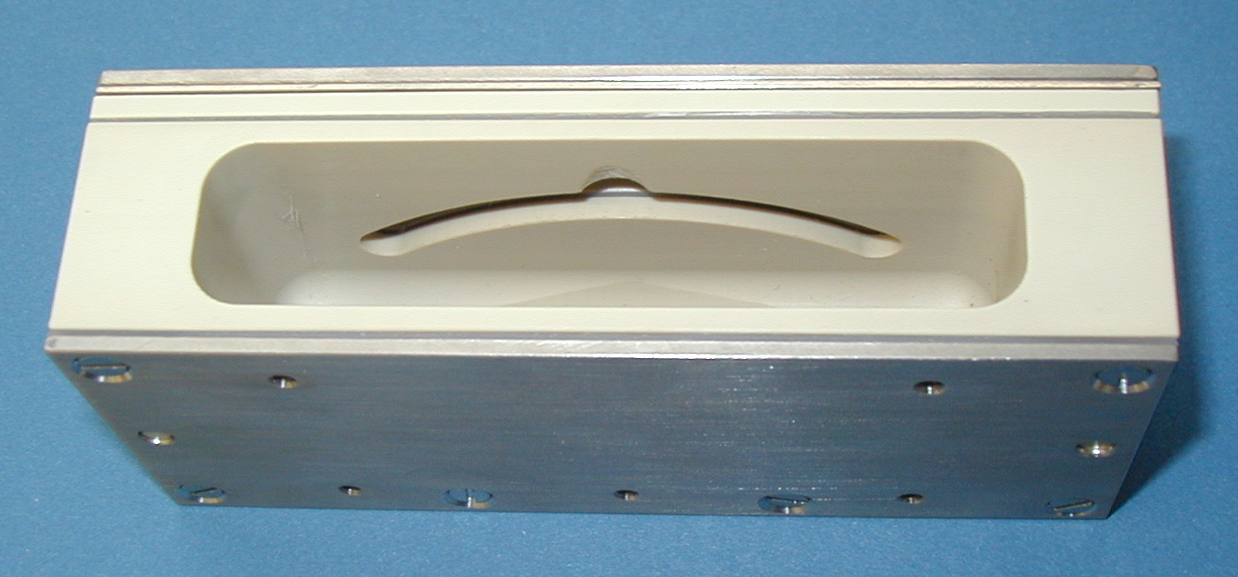

Actinide Targets
Molecular Plating (JGU, IJCLab)
Ultrasonic stirrer
Supporting frame with Ti-backing foil (2 µm)
Backing: 2μm Ti-foil
R&D
Cooling water
C
A
T
H
O
D
E
A
N
O
D
E
Deposition yield: up to 90%
Target thickness: mg/cm² in a single deposition step
PEEK-cell
Actinide compound, dissolved in isobutanol
+ −
Deposition time:
3-6 hours
Voltage: 100 V - 1500 V
Electrochemical cell assembly (26 ml)
Courtesy of K. Eberhardt
Notes:
For MP the compound, typically the chloride or nitrate is dissolved in a small amount of volume of nitric acid and the aqueous phase is mixed with a surplus of an organic solvent(few ml), they are isopropanol, isobutanol or acetone.Under these conditions no electrolytic dissociations occurs by applying an electric current at voltages up to 3000V.
It is assumed that the dissolved molecules form clusters that migrate in the electric field towards the cathode. However the deposition process is not yet well understood.
The composition of the deposit is complex and contains possibly fragments of the solvent

Slide 14
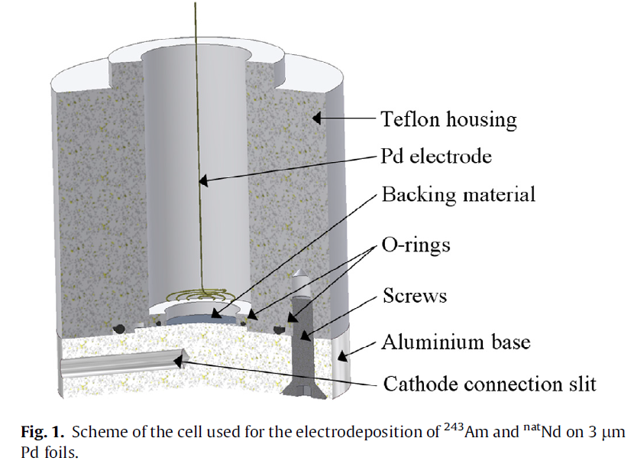
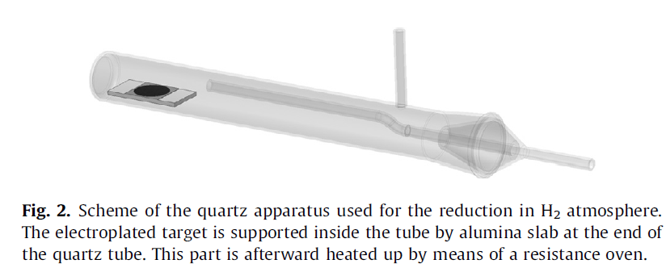
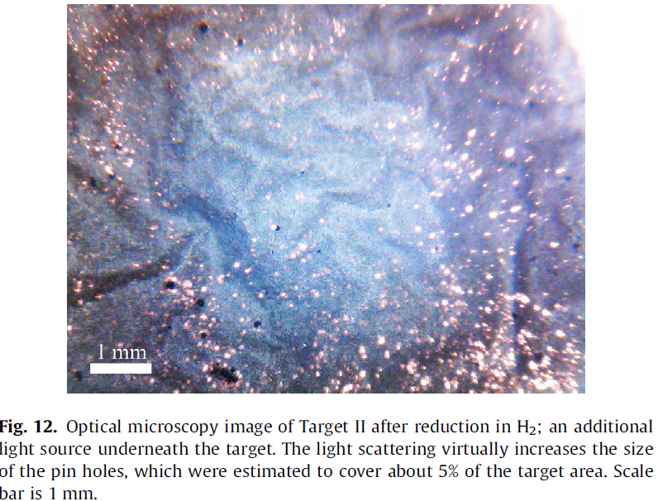
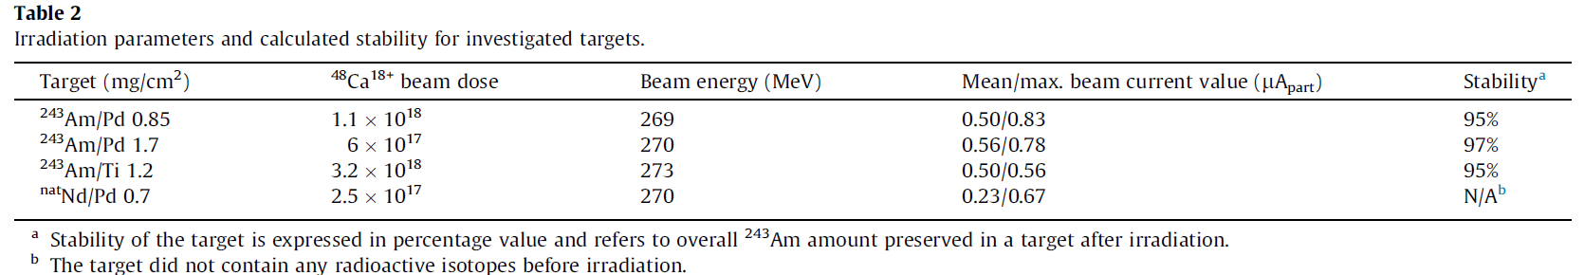
Actinide Targets
Intermetallic Targets (JINR Dubna, PSI)
I. Usoltsev et al, “Preparation and high intensity heavy ion irradiation tests of intermetallic 243Am/Pd targets” Nucl. Instr.Meth. B 318, pp. 297-305, 2014
Oxyde → Metallic state superior for electric & heat conductance, mechanical stability
1/Electro-deposition by molecular plating
2/Reduction
$xPd+$ $y{An}_{x}O_{y}+y H_{2}↔xAnPd+yH_{2}O$
MP +red
MP +red
MP
MP +red

Slide 15
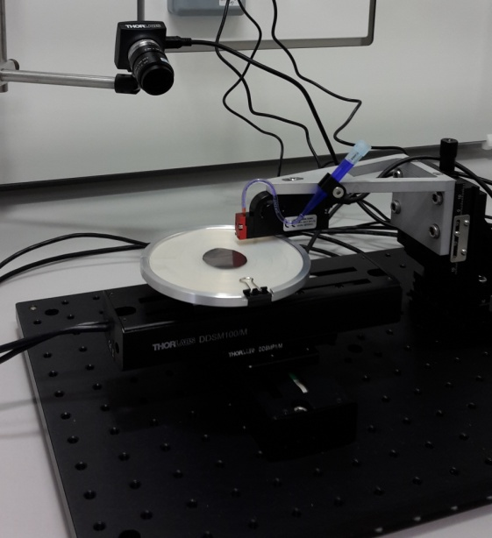
Actinide Targets
Drop-on-Demand technique (JGU)
R. Haas et al, “Development and characterization of a Drop-on-Demand inkjet printing system for nuclear target fabrication” Nucl. Instr. Meth. A 874, pp. 43-49, 2017
Multi geometry of targets + no backing constraint / reduced volume of An*
¹⁴⁰La, ^{198g}Au tracers as natural nitrate solution
on graphene 12 µm or Ti 50µm diam 25 mm
Organic solvents
Other substrate, thickness
Diam = 100 mm
Study of drop formation
Printing of JGU-Logo with NaCl-solution on Ti-surface
1st application: preparation of a ²⁵²Cf fission fragment source for JRC Geel. Very thin backing: Polyamide foil (24 µg/cm²) and graphite foil (10 µg/cm²)
330 µm
4 mm
Stroke: 16.25 µm
Stroke velocity: 150 µm/ms
Droplet size: 15 ± 5 nL
Courtesy of K. Eberhardt, D. Renish
5 mm

Slide 16
Comparisons
Actinide Targets
Drop-on Demand | Molecular Plating | Intermetallic
 | Reliable technique Long-term experience
Quantitative yield | High yields possible (> 90%)
Fast method
Less homogeneous, uniform layer from aqueous solution | Homogeneous layer
Flexible target geometry | 1cell per geometry and actinide
No restrictions for the substrate (metal, polymer, C; ultra thin) | Conductive substrate necessary + tension resistant+ tight(==thick) | ++ Stability of An/substrate
Influence of certain parameters (pH, viscosity, surface roughness, hydrophobicity, …) | Chemical form undefined | - pinhole formation - Broad distribution → not all An efficient & attenuation and scattering of products
Potential for more chemical flexibility (non-aquaeous solvent) ? | Impurities from organic solvent
Performance to be studied | R&D on going IJCLab/GANIL | Higher maximum beam intensities
R. Haas et al, “ODIn – a setup for Off-line Deposit Irradiations of thin layers for nuclear physics applications” Nucl. Instr. Meth. A , available online 26/12/19

Slide 17
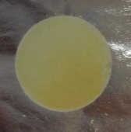
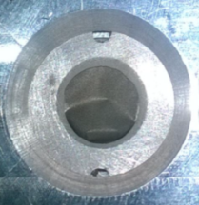
Activités de recherche groupe radiochimie, C. Cannes
Electrodépôt d’actinides et lanthanides en milieux non-aqueux
Actinide Targets
Molecular Plating @IJCLab
Projet en collaboration avec l’ICSM (Marcoule), l’IPNO-groupe PACS, CENBG (Bordeaux), Ganil (Caen)
CDD Ingénieur, David Rodrigues
Thèse de Lu Jin
Projet soutenu par Needs (2016 et 2017)
Paramètres ajustables pour optimiser la qualité des dépôts :
La composition de l’électrolyte : choix du solvant et des additifs ;
La tension ou l’intensité imposée ;
Le temps d’électrolyse ;
La température d’électrolyse ;
Le traitement thermique du dépôt ;
L’état de surface du substrat.
Générateur haute tension
ΔE : 100 à 1000 V
ou I : 1 à 10 mA/cm²
Ex. cibles réalisées :
Anode (substrat)
Cathode (Pt)
[M]
Systèmes étudiés dans l’isobutanol :
Ce, Pr, Nd, U et Pu
U sur Al mince
Pu sur C mince

Slide 18
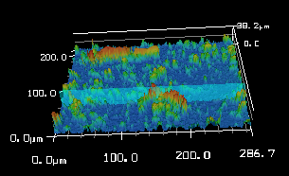
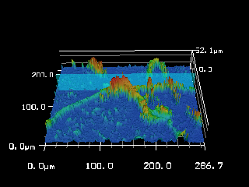
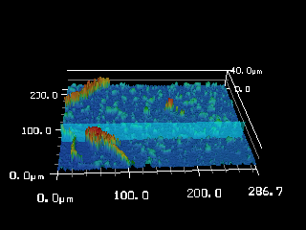
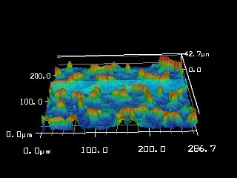
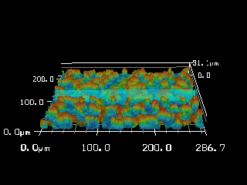
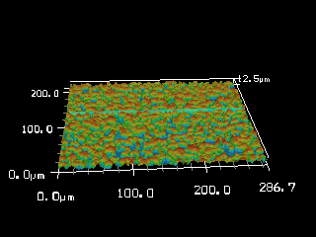
Electrodépôt de Nd sur Al :
Concentration de l’eau et tension imposée
Actinide Targets
Molecular Plating @IJCLab
[Nd] = 5 10⁻⁴ M
[HNO₃] = 10⁻³ M
300 V
500 V
900 V
[H₂O] = 0.22 M
[H₂O] = 1.1 M
Avantage des images 3 D : informations sur la rugosité des dépôts.
On observe des « rubans » composés principalement de C et O (analyse EDX).
La quantité de ces rubans diminue quand ΔE ou la concentration en eau augmente.
Le dépôt est plus couvrant quand ΔE augmente et quand la concentration en eau augmente.

Slide 19
Conclusions et perspectives sur ce projet
Actinide Targets
Molecular Plating @IJCLab
Conclusions :
Des conditions opératoires optimales ont été définies pour le dépôt de Nd sur Al.
Le travail a permis d’établir une démarche expérimentale pour comprendre le rôle de chaque paramètre sur la qualité des dépôts. Ceci est mis à profit pour les dépôts de U sur Al dans le cadre de la thèse de Lu Jin.
Une étude par MEBE sur le traitement thermique des dépôts de U montre que sur Al, les dépôts ont tendance à former des craquelures quand la température augmente et sur C, ils se décollent dès 150°C.
On going studies
Expertise in deposition,
Backings, characterization….
Perspectives :
Comprendre les mécanismes de dépôt de l’uranium pour optimiser la qualité des cibles : Définir les conditions optimales de dépôt, améliorer l’adhérence des dépôts et caractériser les dépôts.
Projet en collaboration avec l’ICSM (Marcoule) et le Ganil (Caen).
Etablissement d’un protocole générique de définition de certaines conditions optimales ? Protocole de suivi de la croissance des couches ?
Préparer une cible de ²⁴²Pu pour des mesures de données nucléaires réalisées par le CENBG (Bordeaux) sur l’installation ALTO en 2022.
Travail réalisé dans le cadre du projet structurant Nacre (projet soumis à Needs en octobre 2019).

Slide 20


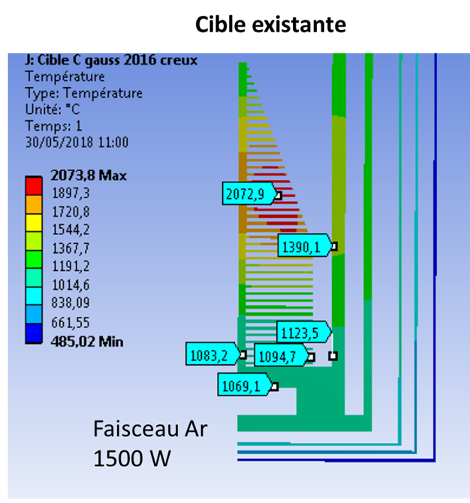

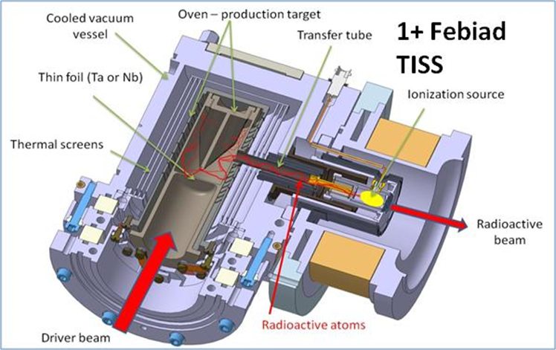
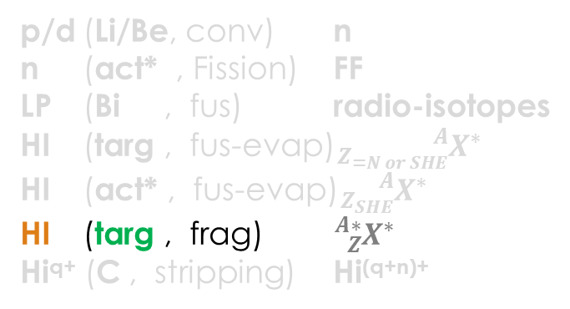
New targets for SPIRAL1
ISOL Targets
p/d (Li/Be, conv) n
n (act* , Fission) FF
LP (Bi , fus) radio-isotopes
HI (targ , fus-evap)${}_{Z_{=N or SHE}}^{A}{X^{∗}}$
HI (act* , fus-evap)${}_{Z_{SHE}}^{A}{X^{∗}}$
HI (targ , frag) ${}_{Z}^{A∗}{X^{∗}}$
Hi^{q+} (C , stripping) $\text{Hi}\text{(}\text{q}\text{+}\text{n}\text{)+}$
O. Bajeat, Groupe Cibles Sources GANIL
ECS Febiad existant avec cibles graphite
Fragmentation du projectile
New isotopes →
Target fragmentation ?

Slide 21
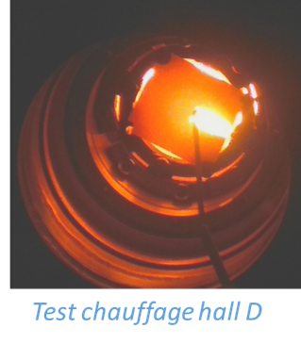
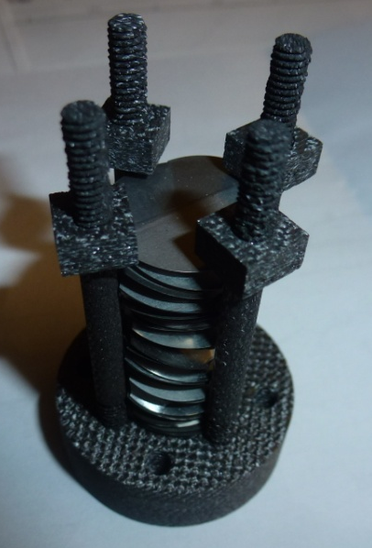
Nouvelles cibles épaisses pour Spiral 1
ISOL Targets
Temperature stability ?
Cible de fragmentation | Faisceau d’intérêt | Estimation de l’intensité accélérée faisceau primaire ¹²C 95 A.MeV 2.10¹³ PPS /3600 W
Nb | ⁶⁰Zn | 1,5.10⁴
 | ⁶⁴Ge | 1,5.10³
 | ⁶³Ga | 6,7.10⁴
 | ⁶⁷As | 2,7.10³
 | ^{72,74,76}Kr | 4,9.10²/1,4.10⁵/3,1.10⁶
 | ⁷⁹Se | 4,5.10⁴
SiC | ²¹⁻²²Mg | 8,2.10²/2.10⁵
 | ²⁵Al | 7,9.10⁴
Al₂O₃ | ¹⁰⁻¹¹⁻¹⁵⁻¹⁶C
CaO | ²⁸Mg, ³⁰P, ³²⁻³³Ar
MgO
F. Ditroi et al, “Study of proton induced reactions on niobium targets up to 70MeV” Nucl. Instr. Meth. B 266, pp. 5087-5100, 2008
Release time ?
Test @LISE
M. Barbui et al, “Calculations and first results obtained with a SiC prototype of the SPES direct target” Nucl. Instr. Meth. B 266, pp. 4289-4293, 2008
Enceinte sous vide
V. Hanemaayer et al, “Composite ceramic targets for high power proton irradiation” ” Nucl. Instr. Meth. B 266, pp. 4334-4337, 2008
Échantillon
nacelle chauffante
Faisceau d’ions radioactifs
Sous forme de feuilles métalliques (Nb), de céramiques poreuses (SiC, Al₂O₃, MgO…) ou de mousse de graphite imprégnée.
collimateur
Détecteur Ge

Slide 22
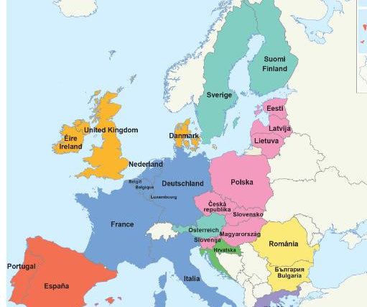

Conclusions & Perspectives
Multi-Physics disciplinary
1- Opportunities with Bi liquid targets: design for radio-isotopes +SHE, feasibility, tests…..
2- Keeping expertise on actinides: R&D on deposition, backings, characterization, exploring new methods (DoD, intermetallic), reinforce collaboration between experts, knowledge transfer - R&D @IJCLab & SANDA EU-Project (h2020-nfrp2018)
Stable
Radioactive
TATOO (Thin Actinide Target Cooperation) Work Program defined in PRCI (not accepted) IPNO, JGU, GSI, ICSM, GANIL
3 – For exotic beams, studies on new materials
+++ mutual work with safety and design departments for thermal, mechanical issues with advanced simulations and prototypes + tests in real conditions

Slide 24
Prospectives à 10 ans
Bilan/demande forces ?
Multi-Physics disciplinary
 | Liquid Bi | Actinides | New targets for SPIRAL1
 | REPARE 2020-2023 | IJC Lab U →2021 Pu:2022→ | 1 material/beam*/3 years?
A TRAVAILLER
 | Année Objectif* | Remarques
²³⁸U | 2021+1 | S3, composé et métallique
²³²Th | 2022+1 | S3
²⁴³Am | 2024+1 | S3
²⁴⁸Cm autres isotopes de Cm ? | 2024+1 | S3
^{242,244}Pu | 2024+1 | S3
autres isotopes de Cm, Pa, Np** | > 2024 | S3
* Les années sont définies en considérant les premières expériences de S3 possibles en 2021.
** Au-delà de 2024, le programme expérimental sur S3 sera complété, on peut envisager des cibles de 1/ curium avec des isotopes autres que 248 (244 ?), 2/protactinium, neptunium, en fonction des capacités de fabrication et de disponibilité des isotopes.

Slide 25
One of the major common concerns for all projects is the development of target technology which will meet the needs of the high intensity beams expected from the new projects.
This is underlined in the papers of Yu. T. Oganessian (JINR) ^{[1]} and J.B. Roberto (ORNL)^{[2]} by the followings sentences:
-“In some laboratories, work has already started on developing accelerator complexes and new experimental facilities with the aim of the synthesis and study of nuclear and atomic properties of the new superheavy elements. Among these is the experimental complex under construction at FLNR (JINR) named the “SHE Factory [..]. Ideas incorporated in the design of the SHE Factory assume the development of the future experimental base in several ways: […] –production of new target materials (running and designed nuclear reactors and enrichment facilities) and development of techniques for making targets with high thermal and radiation stabilities “
“In the past decade, progress in the development of heavy actinide targets has contributed to the discovery of six new elements, elements 113–118, and more than 50 new isotopes. […] They depend on a robust infrastructure of actinide production, chemical processing, and heavy ion accelerator facilities. Continued scientific progress will require further advances in actinide production, processing, and target technology to enable experiments essential for exploring the limits of nuclear stability, heavy element chemistry, and the Periodic Table.”
^{[1]} Yu. T. Oganessian et al, Nuclear Physics A 944 (2015) 62-98
^{[2]} J.B. Roberto et al, Nuclear Physics A 944 (2015) 99-116

Slide 26



Si besoin

Slide 27
Requirements
Why characterization is important ?
Thickness & homogeneity → ions Kinematics
→ Optimal tuning of the spectrometer :
transmission of desired residues
and control of unwanted particles
→ Accuracy (< 5%)
Spectrometer
Beam Dump
N_{beam}
N_{out}
Detector
27

Slide 28
Characterisation
characterization
Energy loss
Precise analytical balance
Spectrophotometry
*Low geometry α-particle (LGA)
*Radiographic Imaging (RI)
TARGET
thickness
thickness uniformity
identification of impurities
surface roughness
surface morphology
Isotopic abundances
Scanning Electron Microscpe (SEM)
AFM
X-ray diffractometer (XRD)
Optical microscope
Rutherford Back Scattering (RBS)
PhotoElectron Spectroscopy (XPS)
Energy Dispersive X-Ray Spectroscopy (EDS)
Particle Induced X-ray Emission (PIXE)
Particle Induced γ-ray Emission (PIGE)
Destructive/non destructive
Locally or over the surface
Thermal Ionization Mass Spectroscopy (TIMS)
Neutron Activation Analysis (NAA)

Slide 29




Summary on thin layers characterization & Monitoring
EDS
X-ray
T
X-ray
LGA
XPS
MeV Ions
neutrons
e⁻
α
RBS / EBS
e⁻
e⁻
α
α
α
e⁻
α
α
e⁻
e⁻
γ−ray
α
e⁻
e⁻
e⁻
e⁻
α
α
α
α
α
RI
α
$${N_{out}}/{N_{in}}{, E}_{out}$$
NAA
$${N_{out}}/{N_{in}}$$
X-ray
$$N_{out}$$
$$E_{out}−E_{in}$$
PIXE

Slide 30





Requirements
How does a target look like ?
The apparatus used in 1919 by Rutherford’s team
¹⁴N + α → ¹⁷O + p
Gaseous or liquid
- gas or liquid flow (the melted metals as well)
- material closed in the chamber kept in the low temperature
- in case of gaseous target:
implantation into the solid backing/carrier (D in PE)
LIEBE
EMIS 2018
Design proposed by E. Noah and all, EURISOL 100 kW Target Stations Operation and Implications for its Proton Driver Beam, EPAC,2006
Images from Melanie Delonca CERN Ph.D thesis
Notes:
Rutherford transmutation „An anomalous effect in nitrogen,”
the alpha particle (from Polonium), which passed through the container with nitrogen gas, and nitrogen nucleus stuck together with a proton flying loose.

Slide 31


Requirements
MagIc Numbers Off Stability
How does a target look like ?
Liquid H₂ target
^{A}X (p , 2p) ^{A-1}Y proton knockout
γ
300 mm
p
e⁻
e⁻
⊕
θ
e⁻
e⁻
⊕
⊕
e⁻
⊕
⊕
E
e⁻
⊕
β
vacuum
Projectile
β_{i}
Fragment
β_{f}
^{A}X
^{A-1}Y
H₂ target
e⁻
⊕
Gas, P=1 atm.
drift
e⁻
⊕
e⁻
⊕
e⁻
⊕
e⁻
⊕
100 - 200 mm
p
http://minos.cea.fr
Obertelli et al, Eur. Phys. J. A 50, 8 (2014)

Slide 32


Application – 3 bis
Actinide Targets
Backing: Si-wafer, sputtered with thin Ti-layer. In total: 37 mg ²⁴²Pu for 8 targets
75 mm
²⁴²Pu / 110 µg/cm²
Courtesy of K. Eberhardt
Actinide sample:
  500 - 1000 µg/cm²
  Active diameter 40-80 mm
  Homogeneous
  Surface roughness as low as possible
  On ultra-thin backing (low surf roughness)
Layer homogeneity by Radiographic Imaging

Slide 33



Application - 2
Nature Vol. 533, pp. 47-51, 2016
Laser excitation of a
nuclear level possible
²³³U
2 %
98 %
^{229m}Th
²³³U-source:
  Thin (11µg/cm²)
  Homogeneous
  Low surface roughness
7.6(5) eV ⇒ 163 nm (deep UV)
Courtesy of K. Eberhardt
^{229m}Th might serve
as „nuclear clock“

Slide 34


Contexte
Besoin de cibles d’actinides et autres radionucléides dans différents domaines de physique
Données nucléaires
L’étude de systèmes innovants pour le nucléaire du futur nécessite des données neutroniques des radionucléides. Ceci est essentiel pour établir l’inventaire des radionucléides, pour simuler le fonctionnement du réacteur ou pour dimensionner les installations.
Besoin de cibles minces (300 µg/cm² ), de grande surface (d : 8 cm) sur Al (≤ 2 µm) :
²³²Th ; ^{233,234,235,238}U ; ²³⁷Np ; ^{241,234}Am ; ^{242,244}Pu
Synthèse et étude d’éléments superlourds (Z > 104)
Besoin de cibles minces (200 à 500 µg/cm²), sur Al, Ti ou C (≤ 2 µm) :
²³⁸U pour la synthèse de Hassium, Darmstadium et Copernicium
²⁴⁸Cm ; ²⁴³Am ; ^{242,244}Pu pour la synthèse de Nihonium
L’atome de petite taille, accéléré par un
cyclotron, bombarde une cible d’actinide
Désintégration du noyau en quelques
secondes
Fusion des 2 noyaux
Atome de petite taille Z₁
Cible d’actinide
Z₂
Élément
super lourd
Z = Z₁ + Z₂

Slide 35
Méthode utilisée : Electroprécipitation
Générateur haute tension
ΔE : 100 à 1000 V
ou I : 1 à 10 mA/cm²
Pour préparer des cibles minces d’actinides de grande surface, méthode la plus adaptée :
électroprécipitation
anode
[M]
cathode
Montage à 2 électrodes :
Cathode : support de la cible, substrat de Z léger (Al, C, Ti)
Anode : métal inerte (Pt)
Electrolyte :
Solvant : isobutanol, isopropanol, Diméthylformamide (milieux visqueux)
Additif : HNO₃, HF, HCl, Me₄NCl (pour stabiliser l’élément en solution et pour augmenter la conductivité de l’électrolyte)

Slide 36


Electroprécipitation : Principe
1. Réduction de l’eau :
2H₂O + 2e H₂ (g) + 2OH⁻
Modification du pH à la surface du substrat
Générateur haute tension
ΔE : 100 à 1000 V
ou I : 1 à 10 mA/cm²
anode
[M]
cathode
avant électrolyse
pendant l’électrolyse
Montage à 2 électrodes :
Cathode : support de la cible, substrat de Z léger (Al, C, Ti)
Anode : métal inerte (Pt)
Bleu de bromophénol : jaune à pH acide et violet à pH basique
2. Diffusion de l’élément à la cathode
Electrolyte :
Solvant : isobutanol, isopropanol, DMF
Additif : HNO₃, HF, HCl, Me₄NCl
3. Formation d’hydroxydes et précipitation à la surface du substrat :
[M] + x OH⁻ M(OH)_{x}

Slide 37
Electroprécipitation :
Optimisation des conditions de dépôt
Paramètres ajustables pour optimiser la qualité des dépôts :
La composition de l’électrolyte : choix du solvant et des additifs ;
La tension ou l’intensité imposée ;
Le temps d’électrolyse ;
La température d’électrolyse ;
Le traitement thermique du dépôt ;
L’état de surface du substrat.
Générateur haute tension
ΔE : 100 à 1000 V
ou I : 1 à 10 mA/cm²
anode
[M]
cathode
Systèmes étudiés dans l’isobutanol :
Ce, Pr, Nd, U et Pu
Montage à 2 électrodes :
Cathode : support de la cible, substrat de Z léger (Al, C, Ti)
Anode : métal inerte (Pt)
Exemples de cibles réalisées :
Electrolyte :
Solvant : isobutanol, isopropanol, DMF
Additif : HNO₃, HF, HCl, Me₄NCl
U sur Al mince
Pu sur C mince

Slide 38
Electroprécipitation :
Cas du néodyme
Générateur haute tension
ΔE : 100 à 1000 V
ou I : 1 à 10 mA/cm²
anode
[M]
cathode
Dépôt de Nd
sur Al dans l’isobutanol
Montage à 2 électrodes :
Cathode : support de la cible, substrat de Z léger (Al, C, Ti)
Anode : métal inerte (Pt)
Electrolyte :
Solvant : isobutanol, isopropanol, DMF
Additif : HNO₃, HF, HCl, Me₄NCl

Slide 39
Electrodépôt de Nd sur Al :
Choix de l’électrolyte
 | Concentration (M) dans l’isobutanol |  |  |  | Conditions d’électrolyse
 | Nd(NO₃)₃.5H₂O | HNO₃ | H₂O | Me₄NCl | ΔE (V) | t
D1 | 5.5e⁻⁴ | 0 | 0 | 0 | 600 | 15 min
D2 | 5.5e⁻⁴ | 0 | 0.22 | 0 | 600 | 15 min
D3 | 5.5e⁻⁴ | 0 | 0.22 | 1e⁻³ | 600 | 15 min
D4 | 5.5e⁻⁴ | 1e⁻³ | 0.22 | 0 | 600 | 15 min
D5 | 5.5e⁻⁴ | 1e⁻³ | 0.22 | 0 | 250 | 1h30
D6 | 5.5e⁻⁴ | 1e⁻³ | 0.44 | 0 | 600 | 15 min
D7 | 5.5e⁻⁴ | 2e⁻³ | 0.44 | 0 | 600 | 15 min
D8 | 5.5e⁻⁴ | 1e⁻³ | 1,1 | 0 | 600 | 15 min
D9 | 5.5e⁻⁴ | 2e⁻³ | 0.22 | 0 | 600 | 15 min
D10 | 7.5e⁻⁴ | 1e⁻³ | 0.22 | 0 | 600 | 15 min
D11 | 1e⁻³ | 1e⁻³ | 0.22 | 0 | 600 | 15 min
Meilleurs dépôts

Slide 40


Electrodépôt de Nd sur Al :
Choix de l’électrolyte, concentration de l’eau
[Nd(NO₃)₃.5H₂O] = 5 10⁻⁴ M [HNO₃] = 10⁻³ M
[H₂O] = 0.22 M
La valeur absolue du courant augmente avec la tension.
La valeur absolue du courant augmente avec la concentration en eau.
Le signal est perturbé quand la tension imposée est élevée. Ceci est dû est à la production de H₂(g).
2H₂O + 2e H₂ (g) + 2OH⁻

Slide 41






Electrodépôt de Nd sur Al :
Concentration de l’eau et tension imposée
[Nd] = 5 10⁻⁴ M
[HNO₃] = 10⁻³ M
300 V
500 V
900 V
[H₂O] =
0.22 M
[H₂O] =
1.1 M
On observe des « rubans » composés principalement de C et O (analyse EDX).
La quantité de ces rubans diminue quand ΔE ou la concentration en eau augmente.
Le dépôt est plus couvrant quand ΔE augmente et quand la concentration en eau augmente.

Slide 42






Electrodépôt de Nd sur Al :
Effet du temps d’électrolyse
[Nd] = 5 10⁻⁴ M [HNO₃] = 10⁻³ M [H₂O] = 1.1 M ΔE = 900 V
10 min
20 min
30 min
Le dépôt est le plus couvrant et le plus homogène pour un temps d’électrolyse de 20 min.
A 30 min d’électrolyse, on observe des trous, certainement formés par le dégagement des bulles de H₂(g).
On obtient dans ces conditions un film de 15 µm d’épaisseur.

Slide 43


Electrodépôt de Nd sur Al :
Cinétique de dépôt
[Nd] = 5 10⁻⁴ M [HNO₃] = 10⁻³ M [H₂O] = 1.1 M ΔE = 900 V
Les rendements de dépôt (mesurés par ICP/AES) sont supérieurs à 90% à partir de 12 min d’électrolyse environ.
Le rendement d’électrolyse est le meilleur pour 20 min d’électrolyse.
L’intensité diminue puis atteint une valeur plateau après 10 min :
la formation du dépôt pourrait être suivie in situ par la mesure de l’intensité du courant.

Slide 44
New targets for SPIRAL1
ISOL Targets
p/d (Li/Be, conv) n
n (act* , Fission) FF
LP (Bi , fus) radio-isotopes
HI (targ , fus-evap)${}_{Z_{=N or SHE}}^{A}{X^{∗}}$
HI (act* , fus-evap)${}_{Z_{SHE}}^{A}{X^{∗}}$
HI (targ , frag) ${}_{Z}^{A∗}{X^{∗}}$
Hi^{q+} (C , stripping) $\text{Hi}\text{(}\text{q}\text{+}\text{n}\text{)+}$
O. Bajeat, Groupe Cibles Sources GANIL

Slide 45
ISOL Targets
ECS Febiad existant avec cibles graphite
Fragmentation du projectile
New isotopes →
Target fragmentation ?

Slide 46
Nouvelles cibles épaisses pour Spiral 1
ISOL Targets
Temperature stability ?
Cible de fragmentation | Faisceau d’intérêt | Estimation de l’intensité accélérée faisceau primaire ¹²C 95 A.MeV 2.10¹³ PPS /3600 W
Nb | ⁶⁰Zn | 1,5.10⁴
 | ⁶⁴Ge | 1,5.10³
 | ⁶³Ga | 6,7.10⁴
 | ⁶⁷As | 2,7.10³
 | ^{72,74,76}Kr | 4,9.10²/1,4.10⁵/3,1.10⁶
 | ⁷⁹Se | 4,5.10⁴
SiC | ²¹⁻²²Mg | 8,2.10²/2.10⁵
 | ²⁵Al | 7,9.10⁴
Al₂O₃ | ¹⁰⁻¹¹⁻¹⁵⁻¹⁶C
CaO | ²⁸Mg, ³⁰P, ³²⁻³³Ar
MgO
F. Ditroi et al, “Study of proton induced reactions on niobium targets up to 70MeV” Nucl. Instr. Meth. B 266, pp. 5087-5100, 2008
M. Barbui et al, “Calculations and first results obtained with a SiC prototype of the SPES direct target” Nucl. Instr. Meth. B 266, pp. 4289-4293, 2008
V. Hanemaayer et al, “Composite ceramic targets for high power proton irradiation” ” Nucl. Instr. Meth. B 266, pp. 4334-4337, 2008
Sous forme de feuilles métalliques (Nb), de céramiques poreuses (SiC, Al₂O₃, MgO…) ou de mousse de graphite imprégnée.

Slide 47
Cibles ISOL Spiral 1
Projet de tests sur LISE
ISOL Targets
Release time ?
Enceinte sous vide
But: qualifier le relâchement des nouvelles cibles en implantant des atomes radioactifs d’intérêt dans des échantillons chauffés.
1ère application pour la cible niobium.
Les ions radioactifs implantés doivent avoir la bonne énergie pour être arrêtés dans la feuille.
L’activité de l’échantillon en fonction du temps permettra de déduire le temps de relâchement.
Échantillon
nacelle chauffante
Faisceau d’ions radioactifs
collimateur
Détecteur Ge

Slide 48


Etude d’une cible Niobium
Étude en cours
⁶⁰Zn, ⁶⁴Ge, ⁶³Ga, ⁶⁷As, ^{72,74,76}Kr, ⁷⁹Se …
La cible à l’étude est constituée de disques de faible épaisseur : 0,1 ou 0,05 mm.
Les distances seront optimisées pour obtenir une température uniforme.
Le pic de Bragg est déposé dans le fond refroidi.
Simulation ANSYS

Slide 49

Actinide Targets
n (act* , Fission) FF
HI (act* , fus-evap)${}_{Z_{SHE}}^{A}{X^{∗}}$
Actinide Targets
Applications
GT02 – A. Lopez-Martens « Heavy and super_heavy nuclei »
²⁵²Cf
GT02 – B. Jurado « Comment arriver à une description complète de la fission nucléaire? »
GT11 – M. Kerveno « Données nucléaires »
²⁴⁸Cm
^{24x}Bk
²⁴³Am
^{242,4}Pu
Actinide targets for SHE:
  200 – 500 µg/cm²
  Homogeneous
  Numerous
  Minimizing Eloss in backing
  (now 1,5 µm Ti : dE=2/3dE_{tot})
²³⁸U
FALLSTAFF spectrometer
http://irfu.cea.fr/en/Phocea/Vie_des_labos/Ast/ast_technique.php?id_ast=4216
people.physics.anu.edu.au/
Actinide sample:
  150→1000 µg/cm²
  Active diameter 40-80 mm
  Homogeneous
  Surface roughness as low as possible
  On ultra-thin backing: Ni (250 nm) or PL (220 nm)
75 mm
²⁴²Pu / 110 µg/cm²
Courtesy of K. Eberhardt

