Slide 1






R&D sur les ERLs: PERLE et eRIB
Exercice de prospective Nationale
Séminaire Thématique G07: Accélérateurs et instrumentation Associée
Walid Kaabi, IJCLab-CNRS/IN2P3
Orsay, 20 janvier 2020

Slide 2
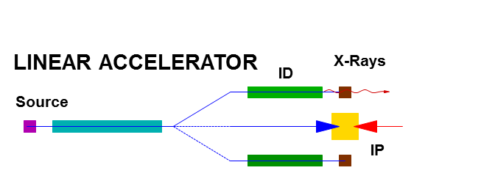
Introduction- ERL concept
STORAGE
ID
RING
IP
X-Rays
beam parameters defined by equilibrium
many user stations
limited flexibility – multi-pass
high average beam power (A, multi GeV)
typically long bunches (20 ps – 200 ps)
beam parameters defined by the source
low number of user stations
high flexibility – single pass
limited average beam power (<< mA)
possible short bunches (sub ps)
ENERGY RECOVERY LINAC
linac-like quality beams
high average beam power with modest amount of RF power
high flexibility in beam parameters
possible multi-user facility
IP
ID
X-Rays
Main Linac
Source
Dump
W. KAABI

Slide 3
Introduction- Energy recovery in RF fields
λ_{Rf}
E_{Out} = E_{Inj}
E = E_{inj} +ΔE
E = E_{inj} +2 ΔE
E_{Inj}
E = E_{inj} +ΔE
E = E_{inj} +ΔE
(β ~ 1)
L = n · λ + λ / 2
L = n · λ
Energy supply → acceleration
Deceleration = “loss free” energy storage (in the beam) → Energy recovery
W. KAABI

Slide 4
Introduction- ERL applications
ERL concept was proposed first in 1965 by Maury Tigner ^{[1]}
[1] M. Tigner: “A Possible Apparatus for Electron Clashing-Beam Experiments”, Il Nuovo Cimento Series 10, Vol. 37, issue 3, pp 1228-1231,1 Giugno 1965
First test was done at Stanford & Los Alamos (1986) for normal conductive facilities accelerating beams at rather low power (for FELs)
Concept become only viable with recent advances in SRF technology (access to CW operation and high current beams acceleration).
Historically, nearly all the ERLs operated were used to drive FELs (high peak current bunches requirement → need of bunch compression).
In recent years, ERLs were proposed for nuclear physics experiments, Compton backscattering sources and strong electron cooling (requirement: long, high charge bunches with small energy spread)
W. KAABI

Slide 5
Introduction to PERLE:
PERLE: A proposed 3 pass ERL based on SRF technology, to serve as testbed for studying, testing and validating a broad range of accelerator phenomena & technical choices for future projects.
Particularly, design challenges and beam parameters are chosen to enable PERLE as the hub for technology development (especially on SRF) for the Large Hadron Electron Collider (LHeC)^{[2]}:
Target Parameter | Unit | Value
Injection energy | MeV | 7
Electron beam energy | MeV | 500
Normalised Emittance γε_{x,y} | mm mrad | 6
Average beam current | mA | 20
Bunch charge | pC | 500
Bunch length | mm | 3
Bunch spacing | ns | 25
RF frequency | MHz | 801.58
Duty factor |  | CW
[2] J.L. Abelleira Fernandez et al, “ A Large Hadron Electron Collider at CERN: Report on the Physics and Design Concepts for Machine and Detector “, J.Phys. G39 (2012) 075001, arXiv:1206.2913
W. KAABI

Slide 6
PERLE in the global landscape:
legacy, decommissioned
Operating (SC, NC)
planned
potential future machine
PERLE
cERL-KEK
W. KAABI

Slide 7
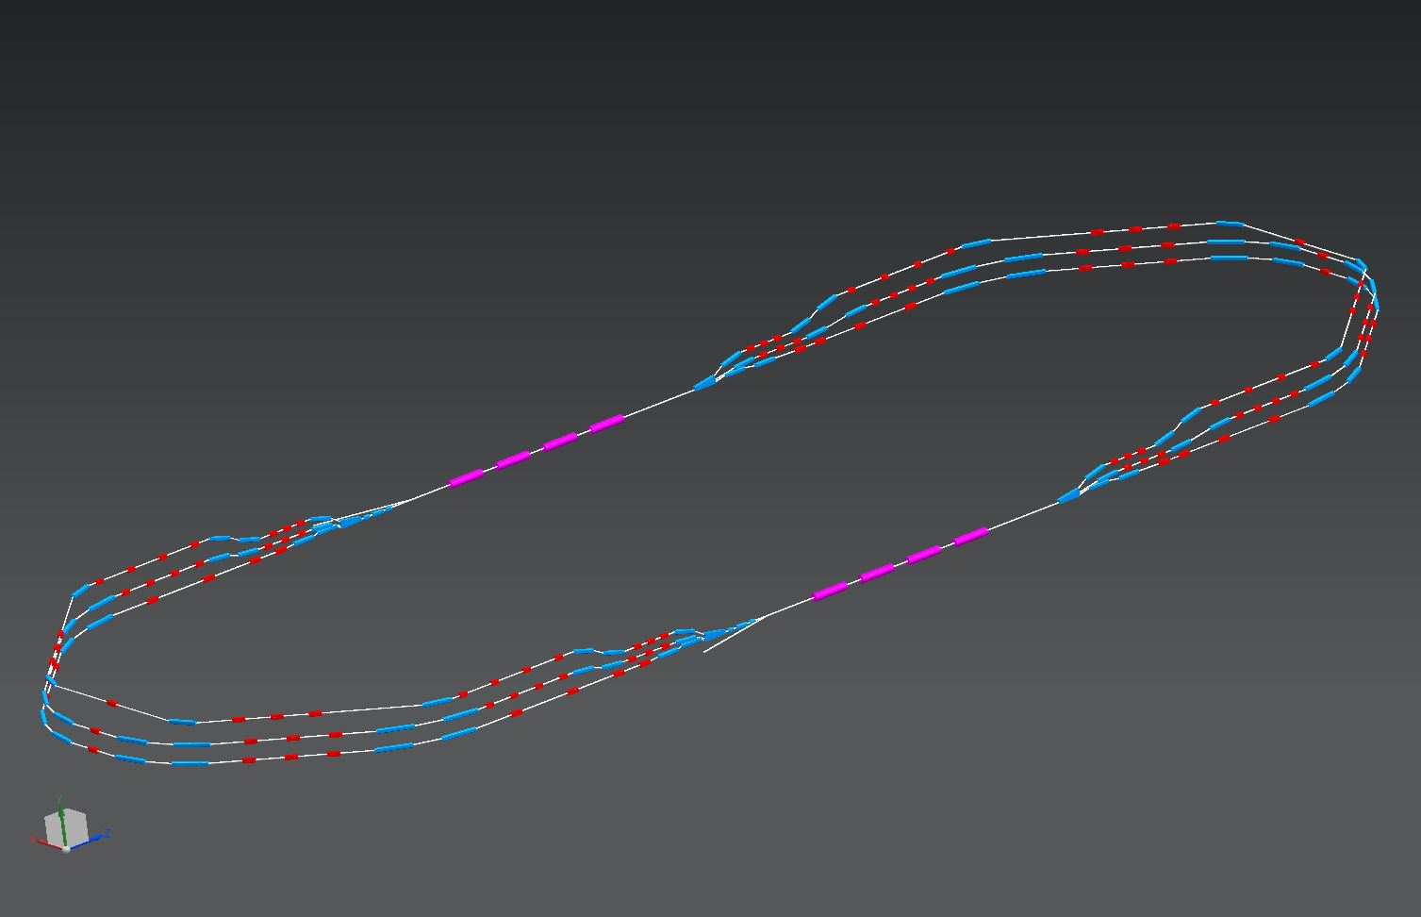
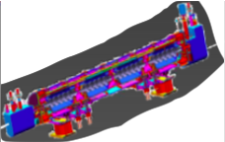
PERLE configuration:
2 Linacs (Four 5-Cell 801.58 MHz SC cavities)
3 turns (160 MeV/turn)
Max. beam energy 500 MeV
1 : 3 : 5
DE = 80 MeV
injector
7 MeV
DE = 80 MeV
2 : 4 : 6
7 MeV
dump
DC = l_{RF}/2
Footprint: 24 x 5.5 x 0.8 m³
W. KAABI

Slide 8
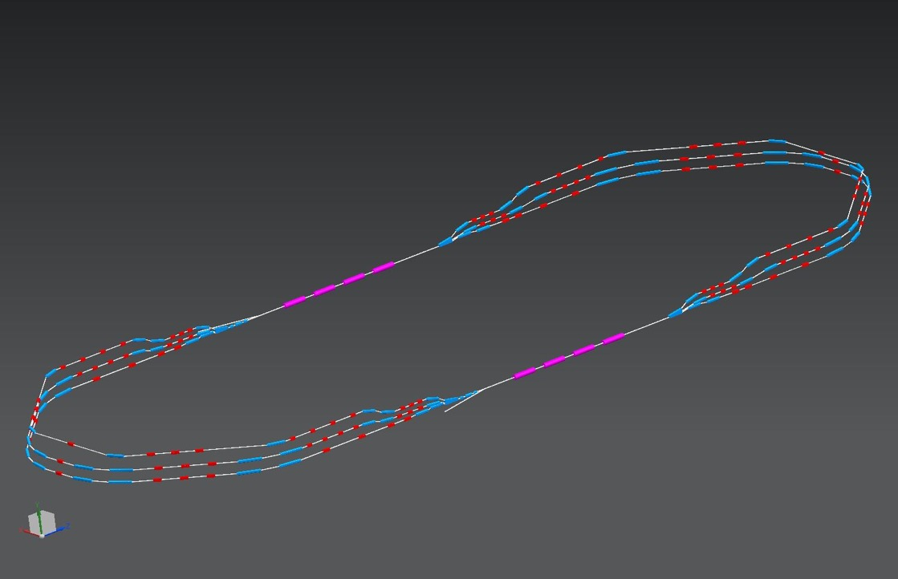
PERLE configuration:
Three passes ‘up’ to reach the maximum energy
1 : 3 : 5
ΔE = 80 MeV
injector
7 MeV
ΔE = 80 MeV
2 : 4 : 6
7 MeV
dump
ΔC in arc 6 = λ_{RF}/2
Electron beam at maximum energy could be used for:
Elastic electron-proton scattering with polarised beam (Particle physics)
Exploration of proton densities in exotic nuclei by electron scattering (Nuclear physics)
Gamma ray production between 0.2 and 5 MeV (wide applications in Photo-nuclear physics),
W. KAABI

Slide 9
PERLE configuration:
Three passes ‘down’ for energy recovery
1 : 3 : 5
ΔE = 80 MeV
injector
7 MeV
ΔE = 80 MeV
2 : 4 : 6
7 MeV
dump
Several benefits from this manipulation:
The required RF power (and its capital cost and required electricity) is significantly reduced to that required to establish the cavity field and make up minor losses.
The beam is constantly renewed: never reach equilibrium state --> provides flexibility to adapt beam properties for specific applications.
The beam power that must be dissipated in the dump is reduced by a large factor.
W. KAABI
Séminaire Thématique: Accélérateurs et instrumentation Associée- Orsay, 20 Janvier 2020

Slide 10
Development and further R&D toward PERLE TDR :
Lattice design: optimization of arcs and switchyards lattice, study of optics tolerances, prototyping of main magnets, start to end simulation.
Development of high-average-current, low-emittance electron gun: upgrade of existent DC gun, photo-cathode development for both unpolarized and polarized electron beam.
Injection line design: design of a buncher, an SRF booster and a merger matching the injector and the main linac.
BBU study in high average current environment: cavity design optimization for an efficient extraction of HOMs considering PERLE parameters: bench pattern recombination, current threshold, cryogenic efficiency…
Design and prototyping of a full dressed SRF cavity: demonstration of level of SRF performance required in CW, high-average current environment, adequate damping of HOM.
Design and prototyping of input power coupler.
Linac cryomodule design: study the possibility of SPL cryomodule adaptation to PERLE need, complete design of a cryomodule for PERLE later.
Collective effects study: effects of Coherent Synchrotron Radiation (CSR) and Longitudinal Space Charge (LSC) on beam quality, microbunching instability and ion cloud mitigation.
Particle tracking studies of halo formation and control of beam loss.
LLRF and feedback system development: RF control and stability under maximum practical Q_{Load}, development of multi-bunch BBU feedback systems.
Beam diagnostics development
W. KAABI

Slide 11
Impact of PERLE toward future ERLs:
PERLE (together with other ERLs under construction: CBETA and bELRin-Pro), will bridge the gap of power between the current record holder (CEBAF-ER at 1MW) and the targeted performances of LHeC (1GW) by exploring an intermediate operational power regime around the 10MW.
It will allow to study of SRF systems stability: BBU in multi-pass system at high current and BBU threshold sensitivity to linac length, dynamic range and number of passes. Reliable extrapolation of the sensitivity dependence is possible for larger machines.
PERLE has large dynamic range (ratio of injected/extracted energy to full energy) and symmetric and flexible transport system. An appropriate tool to explore magnet performances and evaluate the cost implications for larger scale systems.
PERLE probes the regions of parameter space where collective effects (CSR, microbunching instability, LSC) are observable, and offers opportunity to benchmark models and explore mitigation methods. This is also true for other effect like RF heating, resistive wall heating, THz emission heating… acting at lower beam power.
Last but not least, from the strategic point of view, PERLE is considered as the federative project of the IJCLab that could structure its accelerator activity and contribute to its visibility worldwide.
W. KAABI

Slide 12
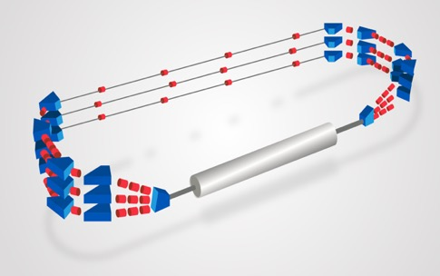
Project staging strategy:
The PERLE configuration entails the possibility to construct PERLE in stages. We propose in the following two main phases to attend the final configuration.
Phase 1: Installation of a single cryomodule in the first straight and three beam lines in the second (consideration motivated by the SPL cryomodule availability)
          To allow a rather rapid realisation of a 250 MeV machine.
To test with beam the various SRF components.
To prove the multi-turn ERL operation.
to gain essential operation experience.
PERLE Phase 1 layout
Phase 2: Realisation of PERLE at its design parameters as a 10MW machine:
Upgrade of the e- gun
Installation of the 2nd Spreader and recombinar
Installation of the second cryomodule in the second straight.
PERLE Phase 2 layout
W. KAABI

Slide 13
Project staging strategy:
Phase 1 is divided in two sub-stages:
Studies and prototyping stage: Mainly for design completion of the main sub-systems, the beam dynamics studies and the prototyping of the main components (cavity, power coupler, HOM, dipoles…). All the outcomes will be included in the PERLE Technical Design Report.
Assembly, test and installation stage: of all the subsystems according to their final design (injection line most likely without the upgrade of the DC gun, the SPL cryomodule, the 6 arcs, a spreader & a recombiner), leading to PERLE-Phase 1 configuration.
It is foreseen that phase 1 includes also the realisation of infrastructure work and the installation of equipment sized as for their final use (beam dump, cryogenics, cooling circuit, shielding, electrical power, etc.).
W. KAABI

Slide 14
Project staging strategy:
Milestones, Timeline & Collaborator Involvement
Phase 1
Phase 2
W. KAABI

Slide 15
Thank you for your attention

Slide 16
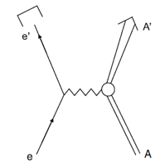
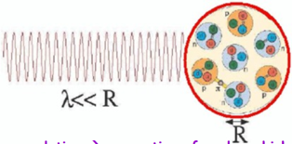
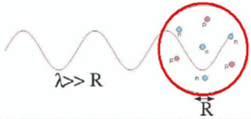
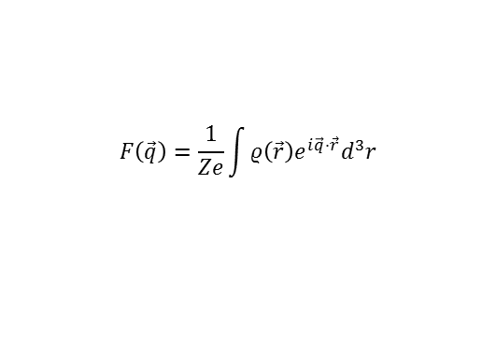
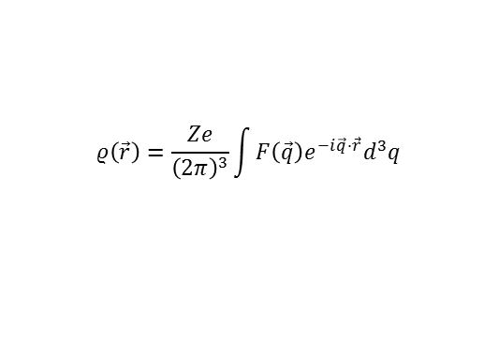

Some physics introduction
The electromagnetic probes for low-energy nuclear physics
• ion manipulation with em fields: mass measurements
• interaction with the hyperfine field : laser spectroscopy, nuclear orientation→ I^{(π)},μ, Q_{s}, δ<r²_{c}>
• γ-spectroscopy : lifetimes, B(Eλ), B(Mλ)
• e- scattering
e momentum transfer q ≈ 1/λ
hadron physics:
structure of the nucleon
nuclear physics:
internal structure of the nucleus
E_{e}= 500 MeV → ≈0.5 fm scale
contrary to hadron probe, the only unknown in the reaction is the nuclear part
A(e,e) elastic cross section
$$F\left(\vec{q}\right)=\frac{1}{Ze}\int{ρ\left(\vec{r}\right)e^{i\vec{q}⋅\vec{r}}d^{3}r}$$
$${\left(\frac{dσ}{dΩ}\right)}_{eA→eA}={\left(\frac{dσ}{dΩ}\right)}_{Mott} \frac{1}{1+\frac{2E}{M}\sin^{2}\left(θ/2\right)}\left|F\left(\vec{q}\right)\right|2$$
form factor
Fourier transform
point charge nucleus
$$ρ\left(\vec{r}\right)=\frac{Ze}{{\left(2π\right)}^{3}}\int{F\left(\vec{q}\right)e^{−i\vec{q}⋅\vec{r}}d^{3}q}$$
charge distribution
“model independent”

Slide 17
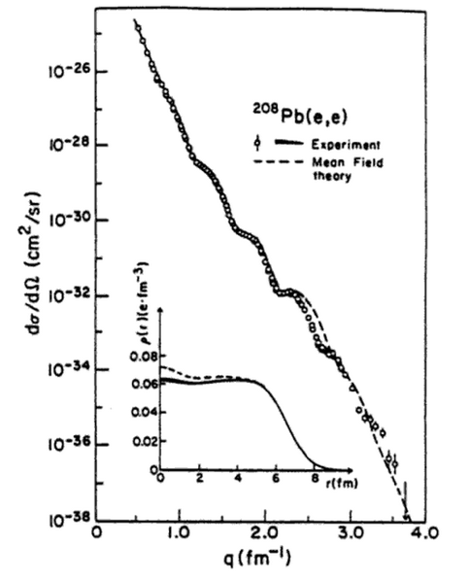
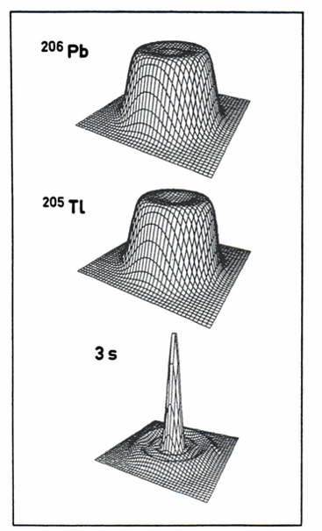
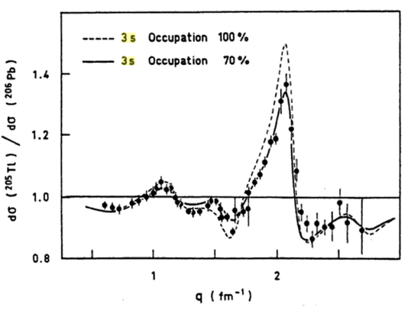
The e-probe revolution
B. Frois et al
in Modern Topics in Electron Scattering
(World Scientific 1991)
12 orders of magnitude !
B. Frois and Papanicolas
Ann. Rev. Nucl. Part. Sci 37 (1987)
Dechargé and Gogny
PRC 81 (1980)
Cavedon, Frois, Goutte et al.
PRL 49 (1982)
etc…
revealed in medium effects
(how far a “single particle” is from a free nucleon)
part of the single-particle quenching has well understood origins:
core (collective) couplings, many-body correlations
short-range correlations, non-local part of the potential
δ<r²_{c}> kinks, neutron skin and giant haloes formation ?
shell evolution ?

Slide 18





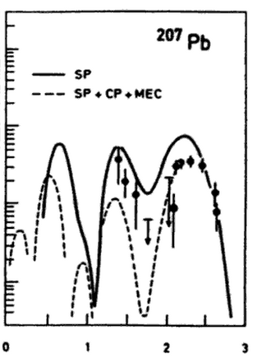
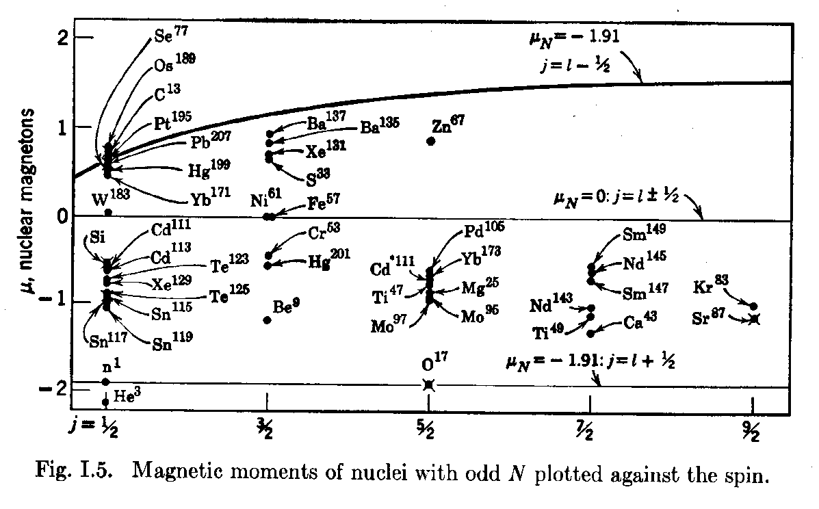

e-scattering as a precision spectroscopy tool
A(e,e’) inelastic cross section
point charge nucleus
longitudinal form factor
transverse form factor
recoil factor
charge transition density
current transition density
μ≈F_{M} for q→0 (elastic at 180°)
30% quenching

Slide 19
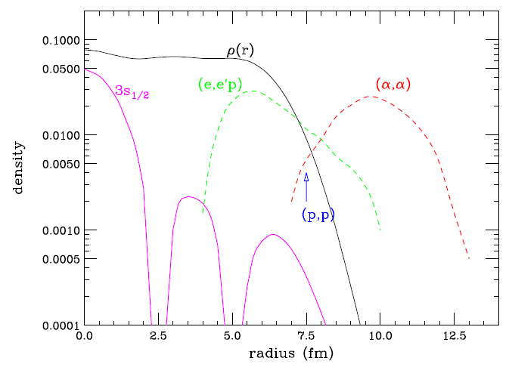
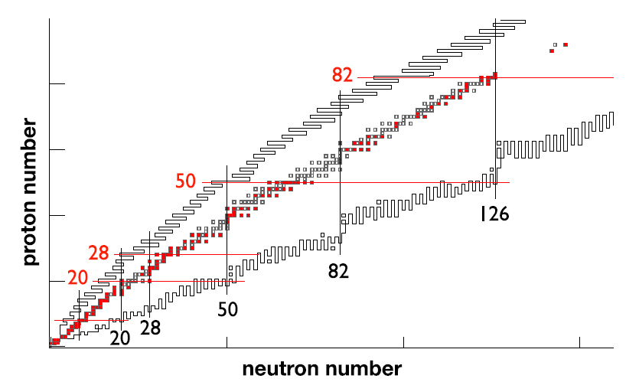
(in)elastic electron scattering off RIB : a vast program
radius, diffusivity
perfect coulomb excitation : forward electron scattering
(no multi-step process)
“clean” excitation of 1p-1h configuration at high multipolarity
Excitation of collective modes (PDR etc)
fission studies (condition on electron energy would give precise information of the initial condition of the fissioning system)
(e,e’)p
E’e=Ee-Eγ
e-
Ee
γ
radioactive ion
T. Suda, H. Simon
Progress in Particle and Nuclear Physics 96 (2017) 1
The possible physics program spans exactly the physics interests of the vast majority of the low-energy nuclear physics community in Orsay-Saclay and in France (and elsewhere)
… with a much more powerful probe!
up to now restricted to stable (non gaseous) targets

Slide 20
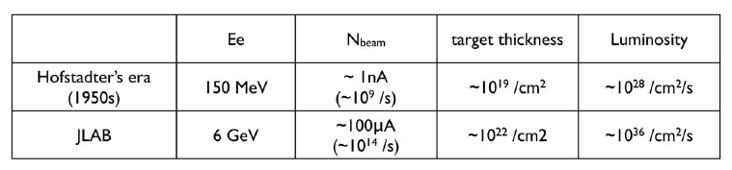
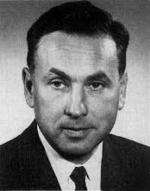

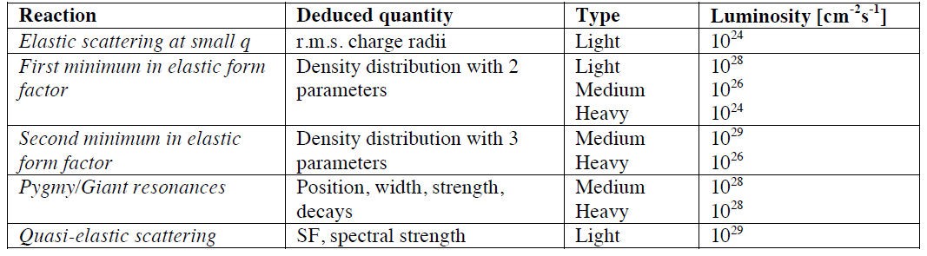
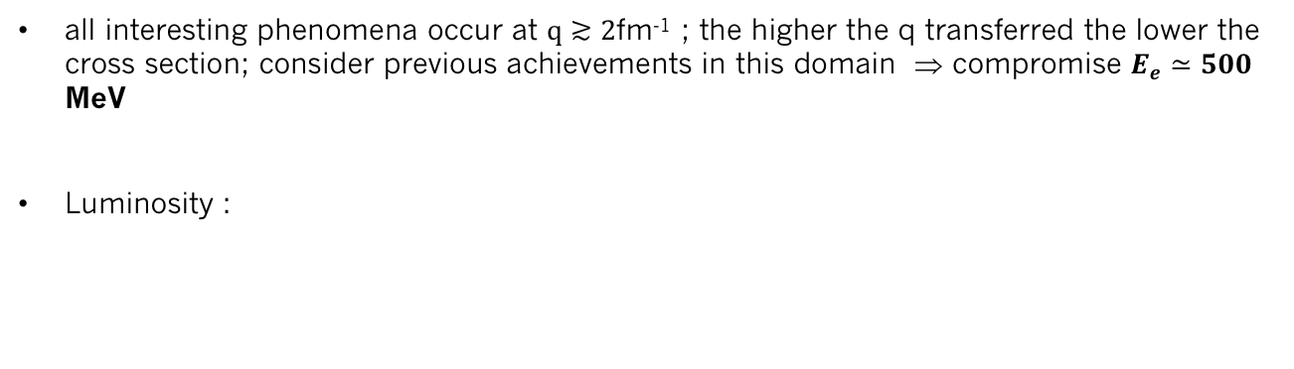
electron/RIB beam requirements
Nobel price 1961
R. Hofstadter
1953 : e on Au Stanford
all interesting phenomena occur at $q≳2$fm⁻¹ ; the higher the q transferred the lower the cross section; consider previous achievements in this domain ⇒ compromise $E_{e}≃500$ MeV
Luminosity :
the aimed luminosity should be 10²⁹ cm⁻²s⁻¹
but much can be already done at $ℒ≃{10}^{28 }$(with unstable nuclei EVERYTHING is new !)

Slide 21
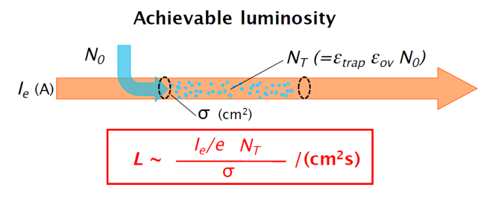
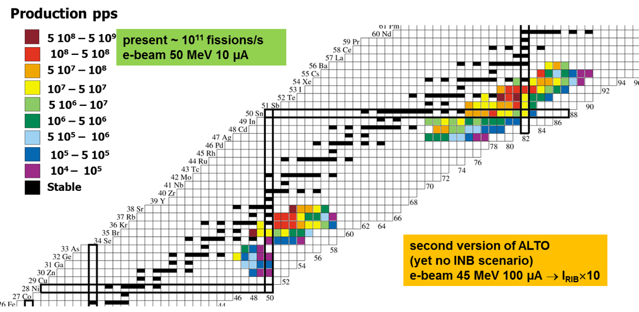
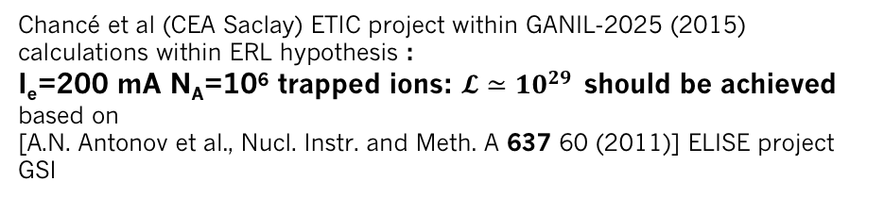
electron/RIB beam requirements
Chancé et al (CEA Saclay) ETIC project within GANIL-2025 (2015)
calculations within ERL hypothesis :
I_{e}=200 mA N_{A}=10⁶ trapped ions: $𝓛≃{10}^{29 }$should be achieved
based on
[A.N. Antonov et al., Nucl. Instr. and Meth. A 637 60 (2011)] ELISE project GSI
PERLE@Orsay : 20 mA → $ℒ≃{10}^{28 }$is probably achievable for a 10⁶ trapped RI population on the principle
but the dynamical e-beam-RI coupling should be investigated : first time with a ERL time structure
e-beam instabilities ? impact on ERL operation ?
ALTO RI production yields

Slide 22
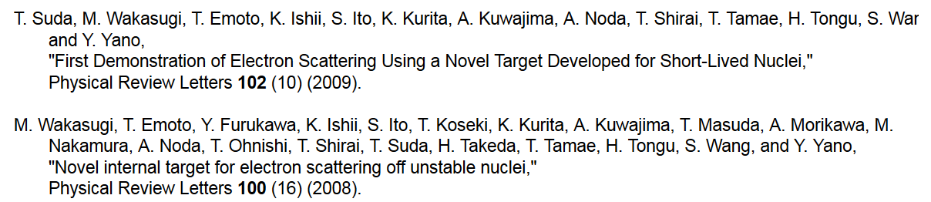
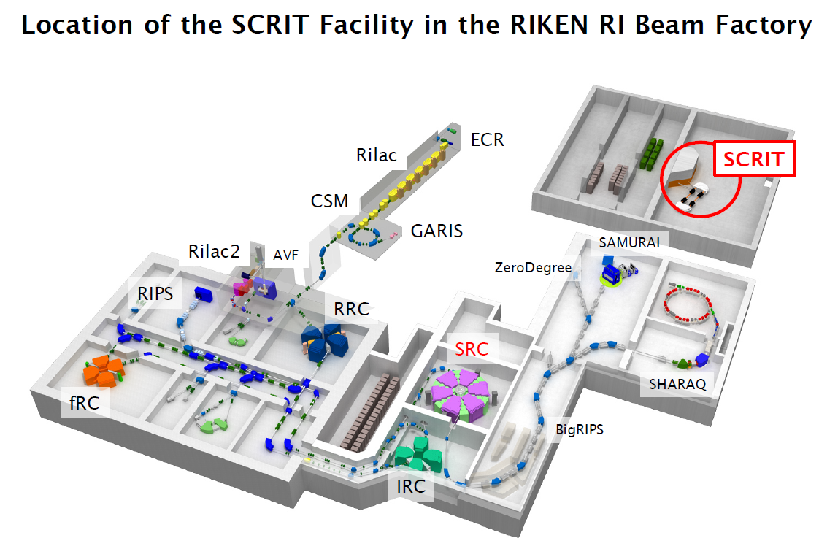
The SCRIT (Self-Confining Radioactive Ion Target) example
taken from : M. Wakasugi
Workshop on e-Ion collision at CEA Saclay
(25-27 Apr. 2016)

Slide 23
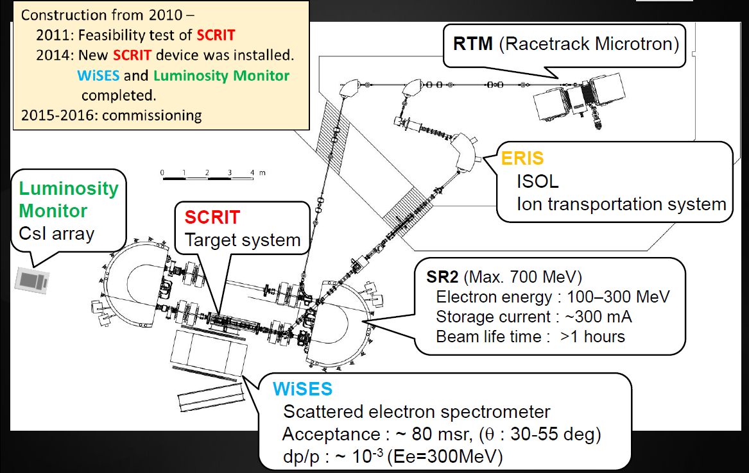
The SCRIT (Self-Confining Radioactive Ion Target) example
taken from : T. Tsukuda
Workshop on e-Ion collision at CEA Saclay
(25-27 Apr. 2016)

Slide 24
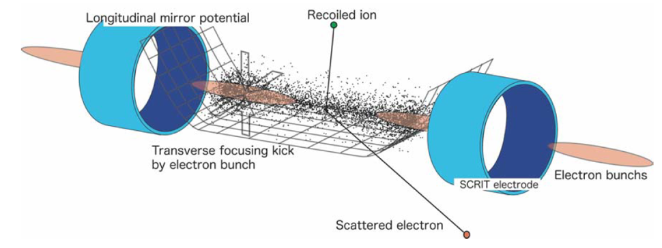
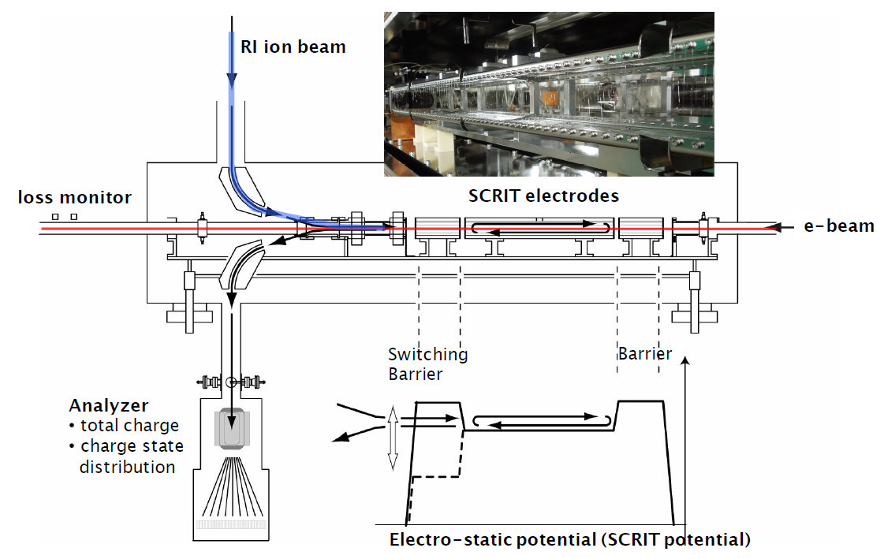
The SCRIT (Self-Confining Radioactive Ion Target) example
adapted from : M. Wakasugi
Workshop on e-Ion collision at CEA Saclay
(25-27 Apr. 2016)

Slide 25
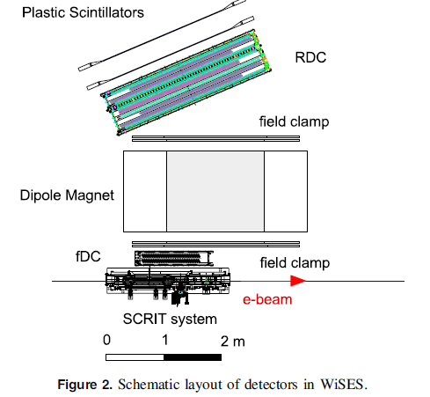
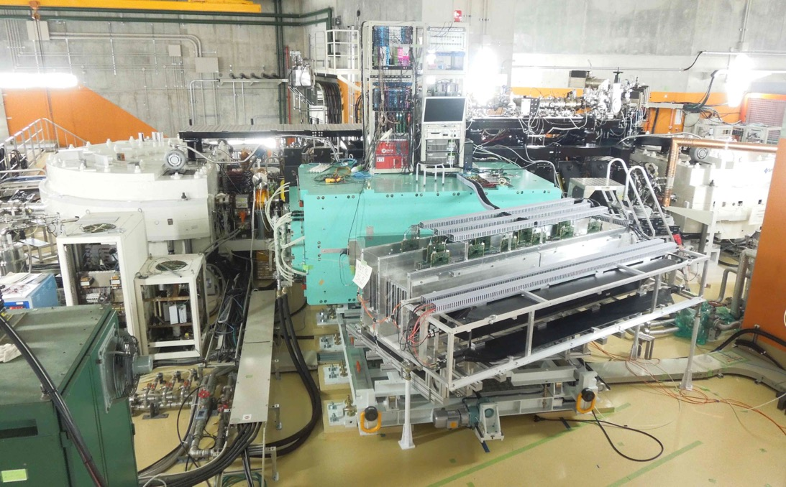
The SCRIT (Self-Confining Radioactive Ion Target) example
Rear drift chamber
Dipole : 0.4 T for 150 MeV
Front drift chamber
T Ohnishi et al
Phys. Scr. T166 (2015) 014071

Slide 26
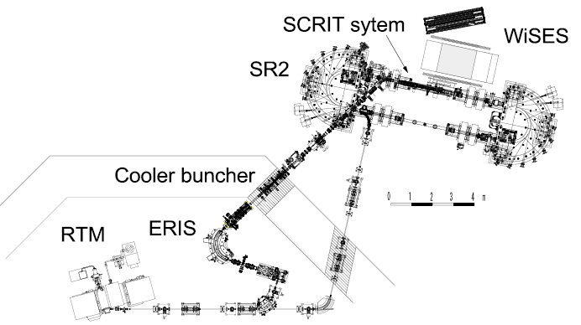
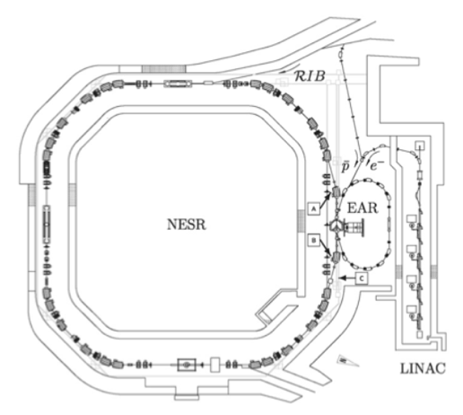
International context/competition
SCRIT @ RIKEN
present luminosity limitations (10²⁷)
RI target Z diversity ?
ELISE @ FAIR
not funded yet (if ever?)
Storage ring at HIE-ISOLDE
abandoned
ETIC proposal within GANIL2025
not retained
PERLE@Orsay ?
At Orsay : long, well established know-how on:
electron acceleration
electron detection
Radioactive Ion Beam ISOL-production
Radioactive Ion Beam manipulation & trapping
and a large nuclear physics users community!
DERICA proposal at JINR Dubna
not yet funded, time scale ?

Slide 27
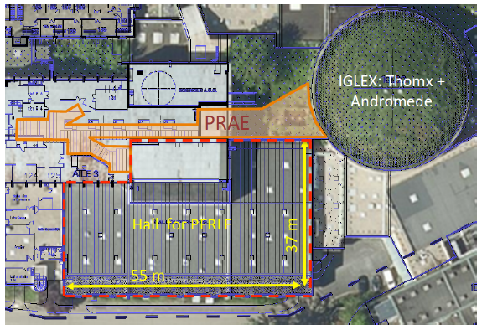
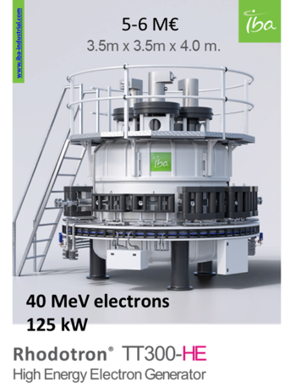
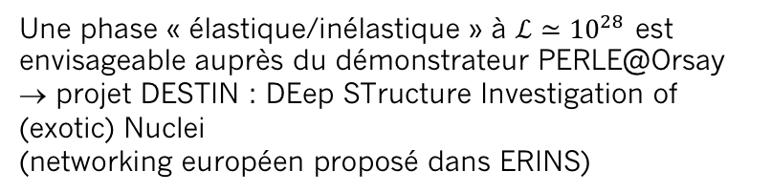
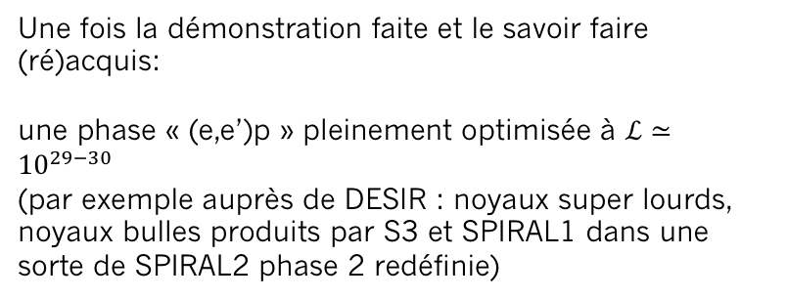
Une idée d’exploitation d’un ERL pour la physique nucléaire
par exemple, dans le cas d’une réalisation de PERLE@Orsay
Une phase « élastique/inélastique » à $ℒ≃{10}^{28 }$est envisageable auprès du démonstrateur PERLE@Orsay
→ projet DESTIN : DEep STructure Investigation of (exotic) Nuclei
(networking européen proposé dans ERINS)
Nécessite la construction d’un front end identique à celui d’ALTO auprès de PERLE@Orsay + nouveau driver électron
(compatible avec un éventuel projet de production de radio-isotopes par réactions photo-nucléaires)
Objectifs :
- démonstration de la possibilité de couplage ERL-RIB
démonstration que la luminosité attendue est bien atteinte
cas physique phare ¹³²Sn
former une génération de physiciens
Une fois la démonstration faite et le savoir faire (ré)acquis:
une phase « (e,e’)p » pleinement optimisée à $ℒ≃{10}^{29−30 }$
(par exemple auprès de DESIR : noyaux super lourds, noyaux bulles produits par S3 et SPIRAL1 dans une sorte de SPIRAL2 phase 2 redéfinie)

Slide 28
Backup slides

Slide 29
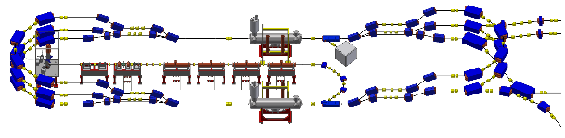
PERLE transport optics:
Appropriate recirculation optics are of fundamental concern in a multi-pass machine to preserve beam quality. The design comprises different regions:
The Spreader optics: The beams need to be directed into the appropriate energy dependent arc. Spreaders separate vertically beams and match optics functions to arcs.
The Arc optics: Disturbing effects on beam space charge such as cumulative emittance and momentum growth have to be counteracted through a pertinent choice of the basic optics cell
The Re-combiner optics: Re-combiners and spreader are mirror symmetric.
W. KAABI

Slide 30
Bunch recombination pattern:
LAL/IPNo – JLAB Collaboration
Basic RF structure, without recirculation: Bunches are injected every 25 ns
When recirculation occurs → bunches at different turns in the linacs:
      → Ovoid bunches in the same bucket
      → Recombination pattern adjusted by tuning returned arcs length of the required integer of λ
Maximize the distance between the lowest energy bunches ( & ): ovoid reducing the BBU threshold current due to the influence of HOMs kicks
Achieve a nearly constant bunch spacing: minimize collective effects
1
6
W. KAABI

Slide 31
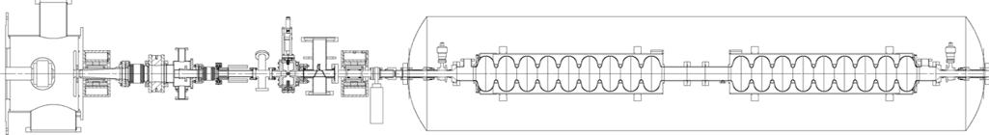
Electron source and injector:
LAL/IPNo – STFC Daresbury- Univ. Liverpool Collaboration
The PERLE injector consists of:
A DC photoemission electron gun (The ALICE DC gun to be upgraded).
A bunching and focusing section: 401 MHz normal conducting buncher cavity placed between two solenoid.
A superconducting booster with five 802 MHz cavities individually feeded and controlled on amplitudes and phases.
Merger to transport the beam into the main LINAC,
Beam diagnostics to be placed between components.
Spin manipulator for the polarised electrons option.
Courtesy to Ben Hounsell
Photocathode gun
Buncher
SRF booster
Light box
Focusing solenoids
Photocathodes choice:
Sb-based photocathodes (unpolarized electrons) operated at 350 kV
GaAs photocathodes (polarized electrons) operated at 220 kV
Photocathode laser choice:
Nd:YAG laser (532 nm) or Ti:Sapphire laser (400 nm).
W. KAABI

Slide 32
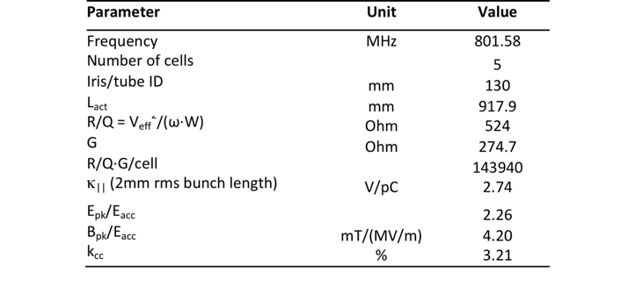
Cavity fabrication and test:
LAL/IPNo – CERN - JLAB Collaboration
Courtesy to Frank Marhauser
The first Nb 802 MHz 5-Cell cavity fabricated October 2017 at JLAB
W. KAABI

Slide 33
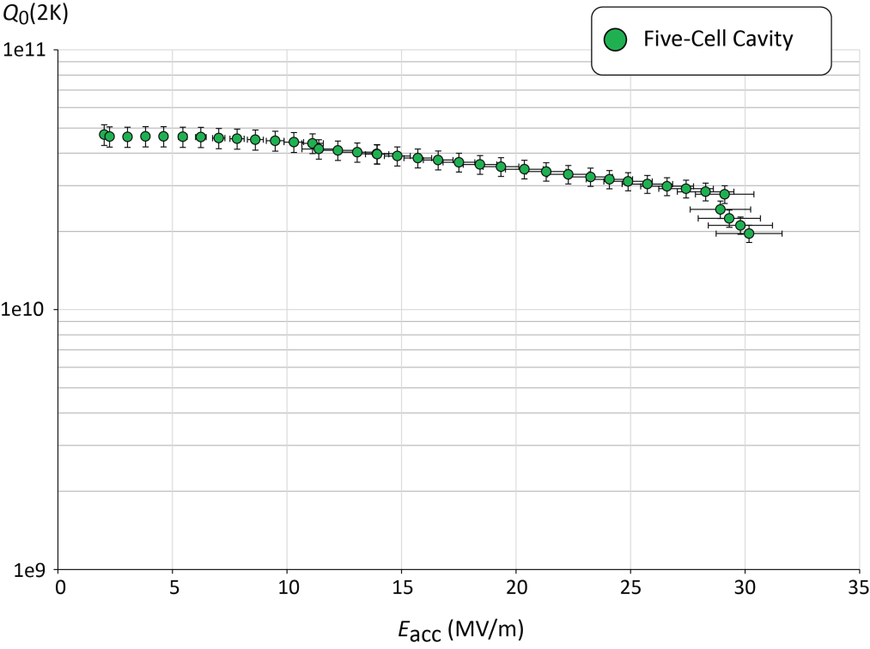
Cavity fabrication and test:
LAL/IPNo – CERN - JLAB Collaboration
Q₀ (2k) = 3 e10 @ ~27 MV/m
Parameter | Unit | CRN5
E_{acc} at quench | MV/m | 30.1
E_{pk} at quench | MV/m | 68.1
B_{pk} at quench | mT | 126.3
FE onset field | MV/m | ~25
FE-induced radiation(max) | mR/hr. | 0.06
Max. Q₀-value | /1e10 | 4.72
Q₀-value at 25 MV/m | /1e10 | 3.12
Lorentz Force Detuning | Hz/(MV/m)² | -1.5
Quench @ E_{acc} ~ 30 MV/m
PERLE requirements
For more details: F. Marhauser’s talk in the FCC Week, April 2018, Amsterdam, Netherland
W. KAABI

Slide 34
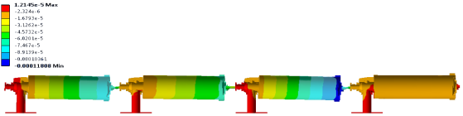
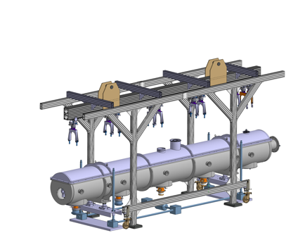
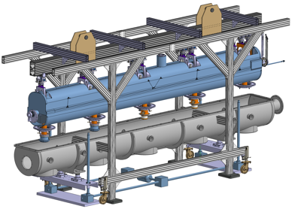
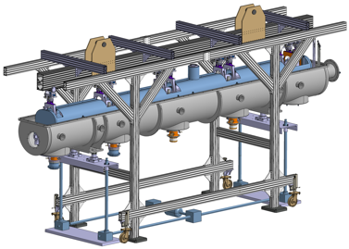
Cryomodule design study:
LAL/IPNo – CERN Collaboration
IPN-Orsay & CERN are studying the SPL cryomodule adaptation for PERLE.
Courtesy to Gilles Olivier
Déformée du train de cavités (poids propre seul)
Max: 0.12 mm
Displacement of the cavity string alone (weight only)
SPL cryomodule: designed to integrate 4 elliptical 5-cells 704 MHz cavities
Cavity string equipped with magnetic shield, CTS, cryogenic lines and thermal shield
Insertion of the complete assembly inside the vacuum vessel
Closing of the top lid and of the beam ports
W. KAABI

