Slide 1
Cavités optiques et systèmes lasers pour l’interaction laser-faisceaux : développements technologiques et applications pour les accélérateurs
J. Bonis, K. Cassou, R. Chiche, D. Douillet, K. Dupraz, G. Iaquaniello, M. W. Krasny, C. Magueur, A. Martens, H. Monard, D. Nutarelli, C. Pascaud, Y. Peinaud, V. Soskov, F. Zomer
With critical scientific contributions from the PhD’s: L. Amoudry, P. Favier, X. Liu, C.F. Ndiaye, H. Wang, T. Williams

Slide 2
A bit of history to introduce…
Polarimetry with optical cavities at HERA
2000
2008
–
2013
Start of collaboration with KEK: Polarized positron demonstrator
2010
–
202x
ThomX R&D
Idea of optimization of burst mode optical cavities:
Start of discussions with STAR, TUE, RadiaBeam LLC, KEK
2016
–
2020
Prospects:
Burst mode optical cavities
Gamma Factory
New, ambitious, acceleration and radiation techniques
2020
–
2030

Slide 3
the outline of this presentation
1. Why R&D on optical cavities ?
2. 20 years of R&D on optical cavities: where do we stand ?
3. What does it bring ?
4. Ongoing and forthcoming projects

Slide 4
the outline of this presentation
1. Why R&D on optical cavities ?
2. 20 years of R&D on optical cavities: where do we stand ?
3. What does it bring ?
4. Ongoing and forthcoming projects

Slide 5
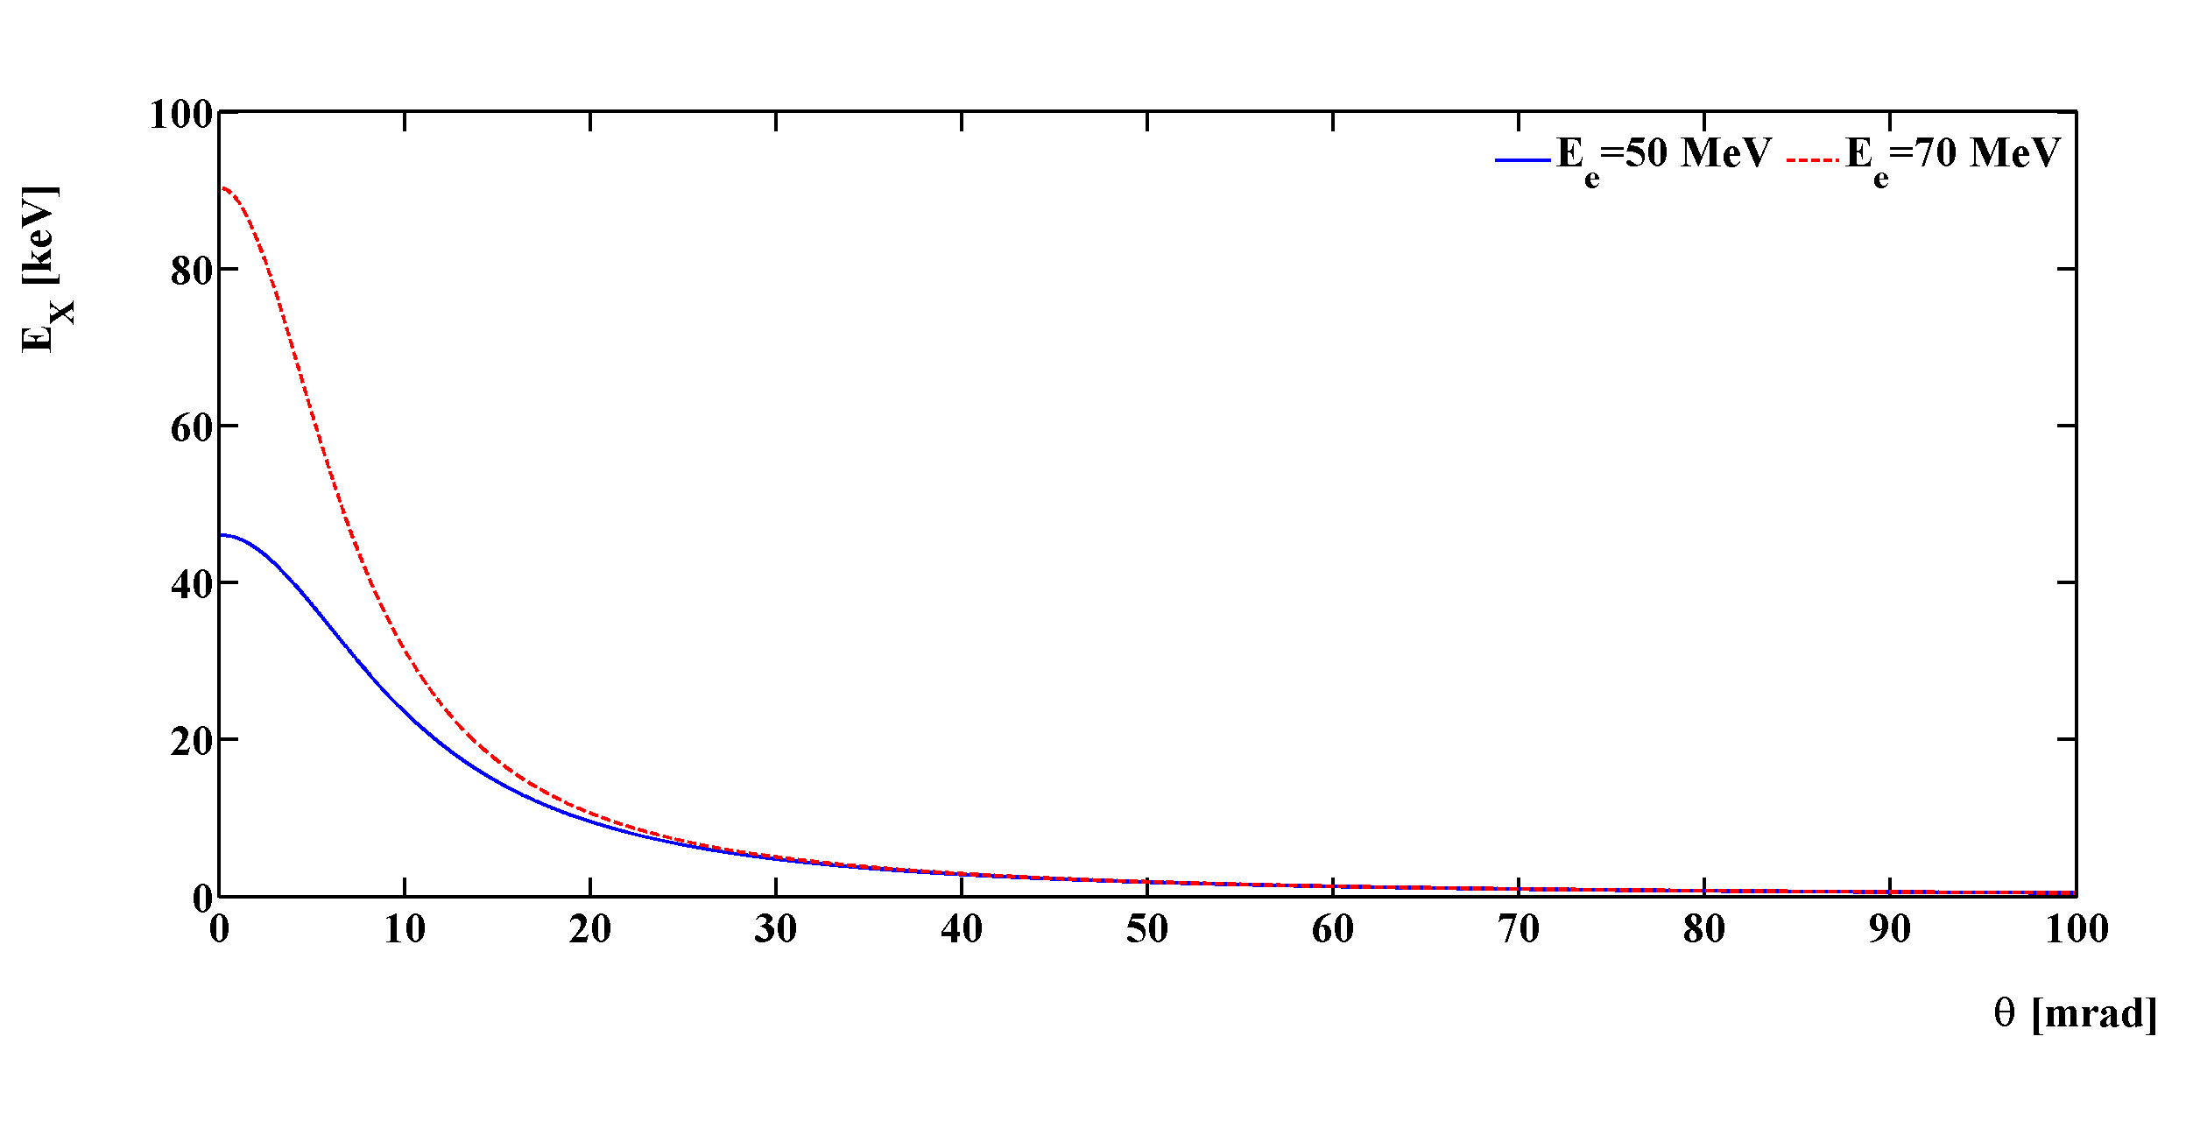


Compton backscattering
laser (E_{λ}=hc/𝜆=1.2eV)
α
Compton photon $E_{X/γ}≃{\frac{4γ^{2}}{1+γ^{2}θ²}E}_{λ}≈45 keV$
θ
e⁻ beam $Ee=50 MeV$

Slide 6

A monochromatic source
laser (E_{λ}=hc/𝜆=1.2eV)
α
Compton photon $E_{X/γ}≃{\frac{4γ^{2}}{1+γ^{2}θ²}E}_{λ}≈45 keV$
θ
e⁻ beam $Ee=50 MeV$
Advantage:
Excellent monochromaticity obtained by use of collimator
Price to pay:
Flux reduction

Slide 7
With a wide range of applications
Compton energy threshold for λ_{laser} = 1µm
Scattered photon energy [MeV]
electron energy [MeV]
Low energy: 10keV to 1 MeV
Radiography & Radiotherapy
Art history
Material science
Lithography
Medium energy (1 to 100 MeV)
Nuclear fluorescence, GDR
Nuclear physics
Nuclear waste management
Medical isotopes production
Inspection, non proliferation
High energy (>100 MeV)
Electron beam polarimetry
Electron beam energy calibration
Secondary beam production
𝛾𝛾 collider

Slide 8
Two main strategies
source
dump
Examples:
newSUBARU: single shot
HI𝛾S: e-beam driven FEL light
Lyncean: industrial product
ThomX: Demonstrator at Orsay
Limitations:
Limited flexibility
Non-linearities in optical cavity
Quality determined by equilibrium of ring
Ring option:
Advantages:
High rate up to 10¹³ photons/s (ThomX)
Optical resonator
Optical circulator
source
Examples of projects:
ELI-NP-GBS: 32 bunches, S+C-band
STAR: single bunch, S-band
Smart*Light: single bunch, X-band
Limitations:
Rate up to 10⁹ photons/s
Dedicated optical system for multibunch
LINAC option:
Advantages:
Excellent source quality
Low average power optical system
Lower cost
dump

Slide 9
Two main strategies
source
dump
Examples:
newSUBARU: single shot
HI𝛾S: e-beam driven FEL light
Lyncean: industrial product
ThomX: Demonstrator at Orsay
Limitations:
Limited flexibility
Non-linearities in optical cavity
Quality determined by equilibrium of ring
Ring option:
Goal is to maximise power in optical cavity for a given accelerator
Advantages:
High flux up to 10¹³ photons/s (ThomX)
Optical resonator
Optical circulator
source
Examples of projects:
ELI-NP-GBS: 32 bunches, S+C-band
STAR: single bunch, S-band
Smart*Light: single bunch, X-band
Limitations:
Flux up to 10⁹ photons/s
Dedicated optical system for multibunch
We do not intend to follow this path anymore, so will skip ELI-NP-GBS achievements
LINAC option:
Advantages:
Excellent source quality
Low average power optical system
Lower cost
dump

Slide 10
The outline of this presentation
1. Why R&D on optical cavities ?
2. 20 years of R&D on optical cavities: where do we stand ?
3. What does it bring ?
4. Ongoing and forthcoming projects

Slide 11
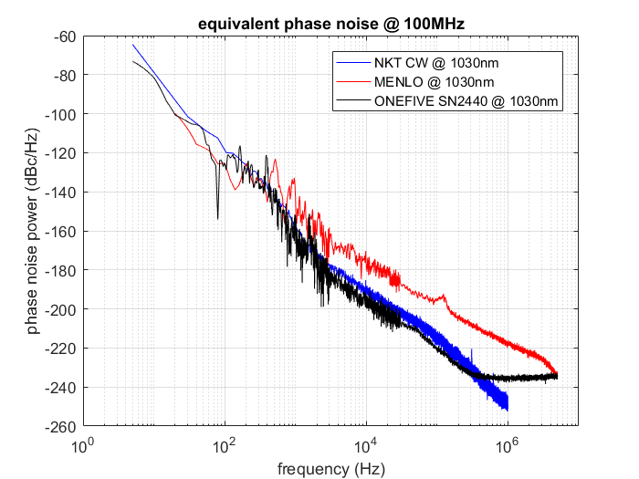
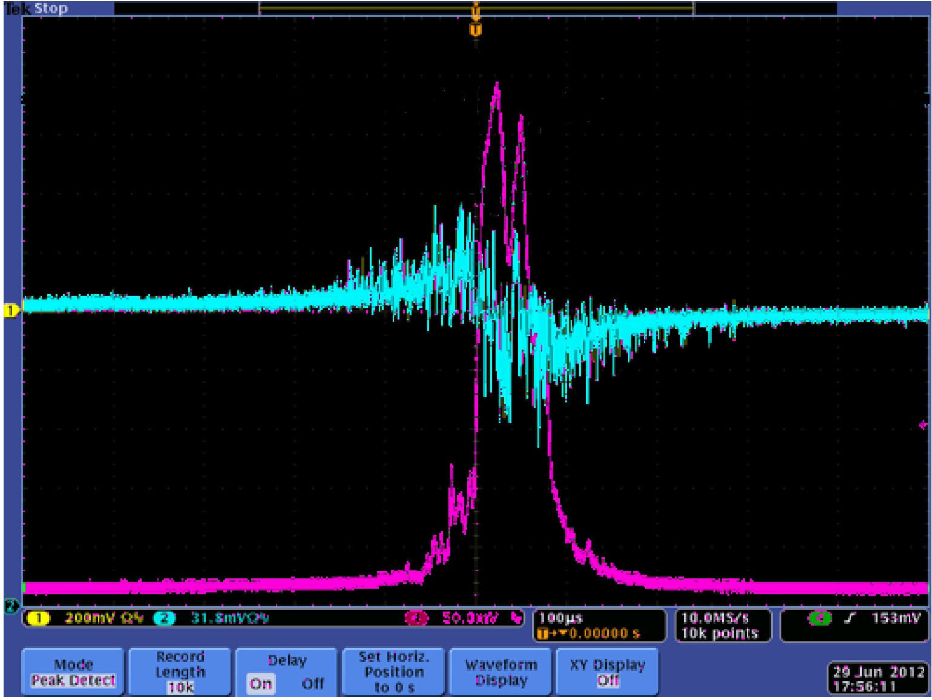
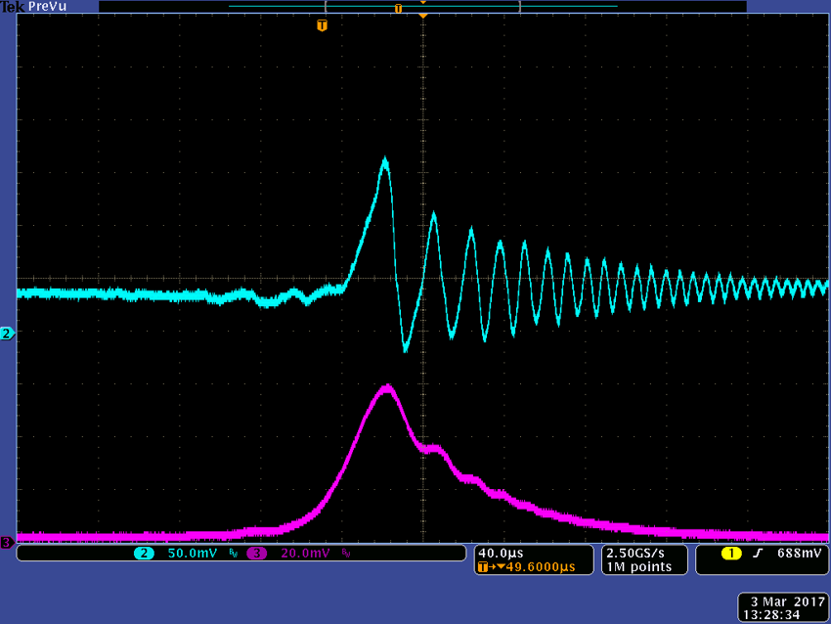
A cost effective approach
State of the art:
Colleagues from Garching (MPI & LMU München) have reached 600 kW stored in a optical cavity but:
  For how long ? With what stability ?
  Not in a accelerator environment,
  with 10 times larger average power (very expensive >1M€) laser developed in their laboratory and lower gain optical cavity
We chose to use lower average power laser systems (<200k€) but investing R&D on higher gain optical cavities
Carstens et al., Opt. Lett. 39 (2014) 2595, P. Favier PhD thesis
Lock examples with bad/good laser
Noise measurement
<1khz linewidth for a 10m 30000 finesse cavity
Only one laser provider that delivers the performances

Slide 12
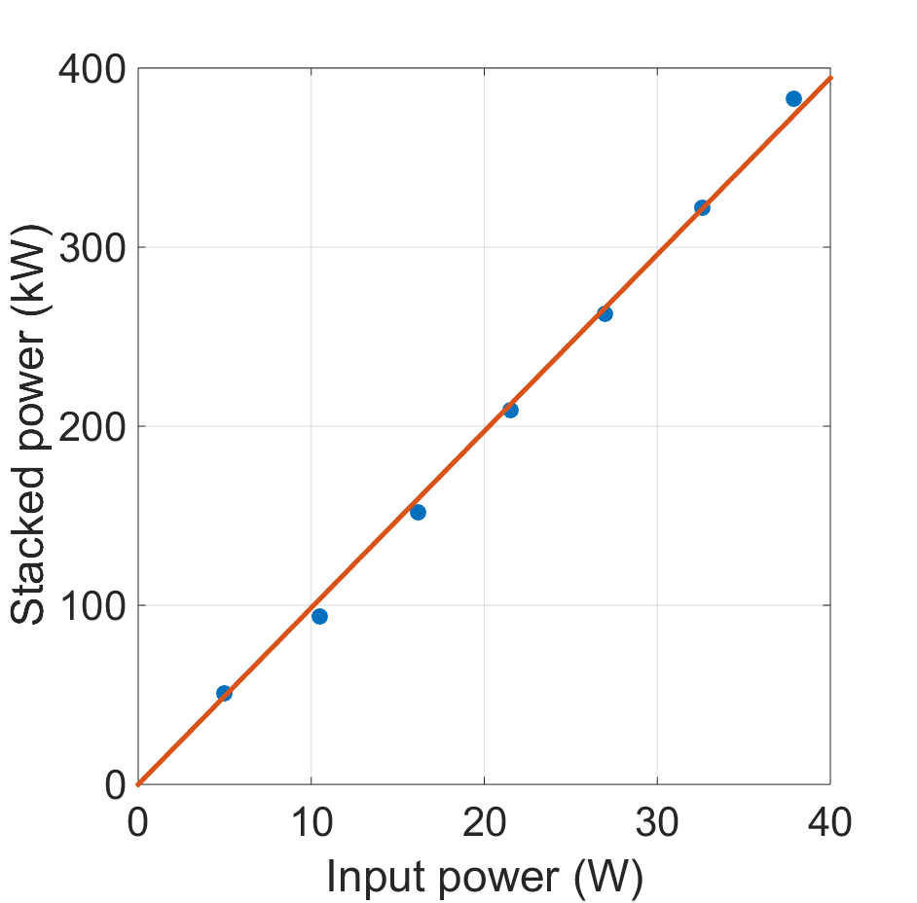
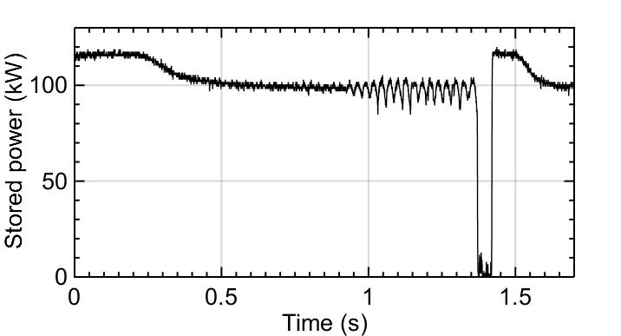
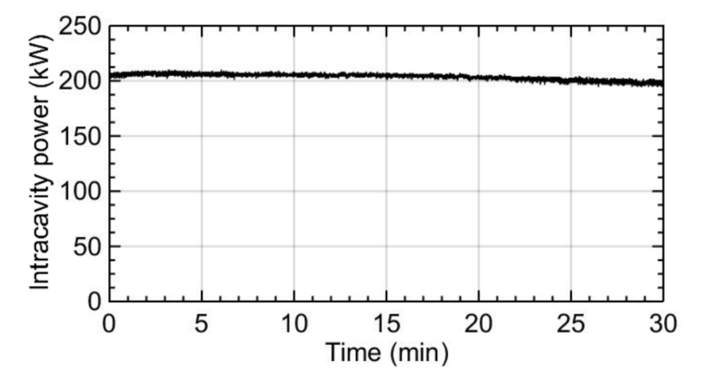
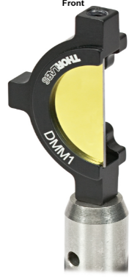
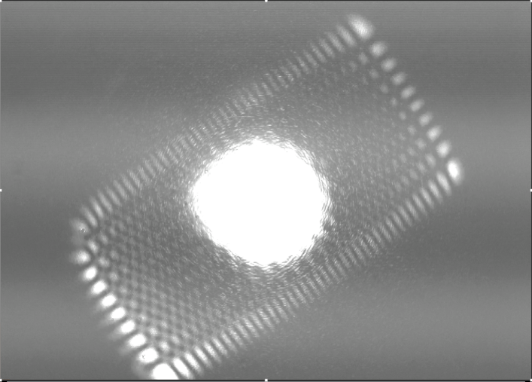
High gain optical cavity state of the art
But unstable at high-power
Favier P., PhD thesis, Amoudry L. & H. Wang, PhD theses (ongoing)
High-order mode instability
Highly sensitive to cavity topology
Rough understanding from simple simulations
→ HOM damping with additional D-cut mirrors in cavity

Slide 13
High power optical cavities: prospects
Long-standing R&D (~20 years) now limited by
  Thermally induced instabilities
    Topology dependent so must be accounted for at design level
    First cure already investigated and successfully implemented
  Cleanliness issues that may be solved through engineering processes
    Profit from collaboration with industry (within LabCom CNRS with Amplitude for instance)?
  Yet unexplored issues as parametric instabilities seen by LIGO-VIRGO
With the goal to reach MW level for various applications (see later):
  X/gamma-ray sources (ThomX, GammaFactory)
  New and ambitious acceleration techniques
Rough budget and manpower needs:
  Requires to pursue and develop the R&D activity on this topic
  Manpower mainly PhDs with permanent staff support
  NB: V. Soskov will retire in a couple of years → hiring an optics assistant engineer is critically needed
  Hardware maintenance of about 10k€/year + support for travels (collaborations)

Slide 14
The outline of this presentation
1. Why R&D on optical cavities ?
2. 20 years of R&D on optical cavities: where do we stand ?
3. What does it bring ?
4. Ongoing and forthcoming projects

Slide 15
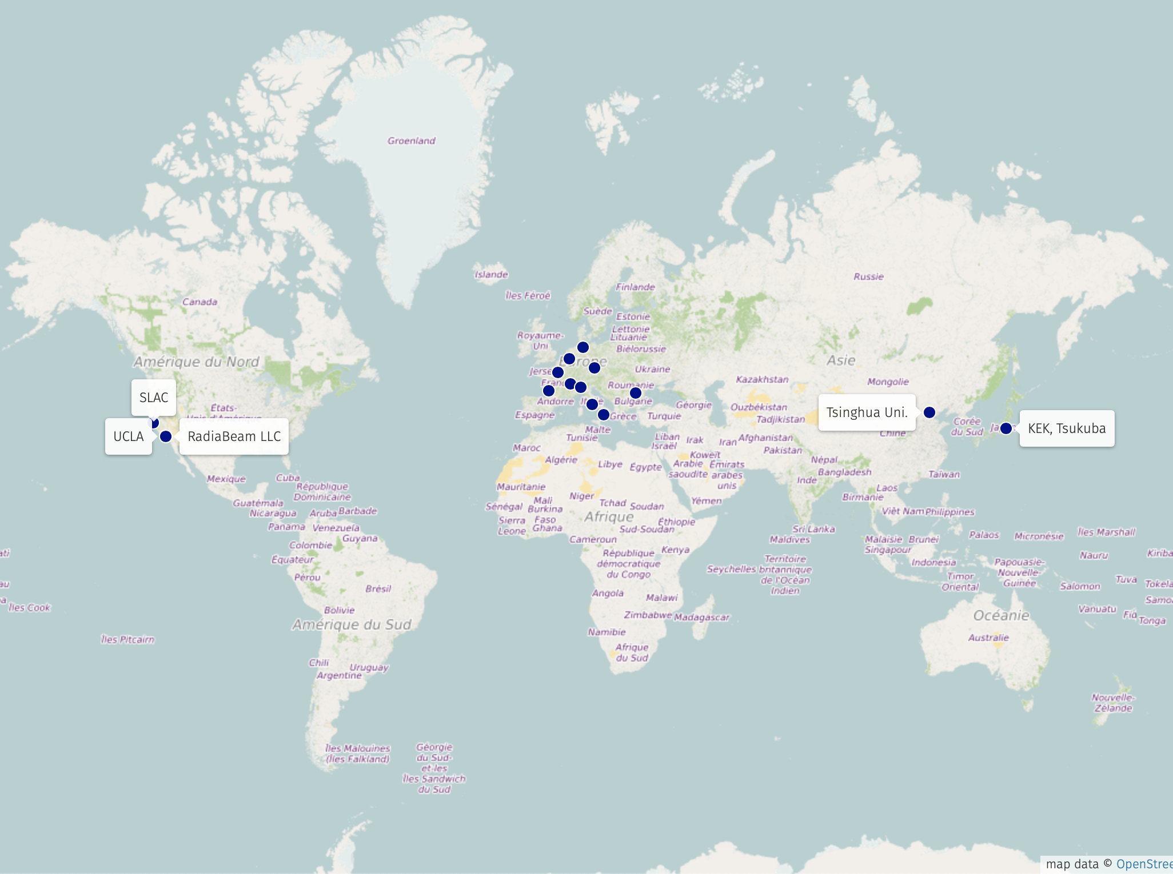
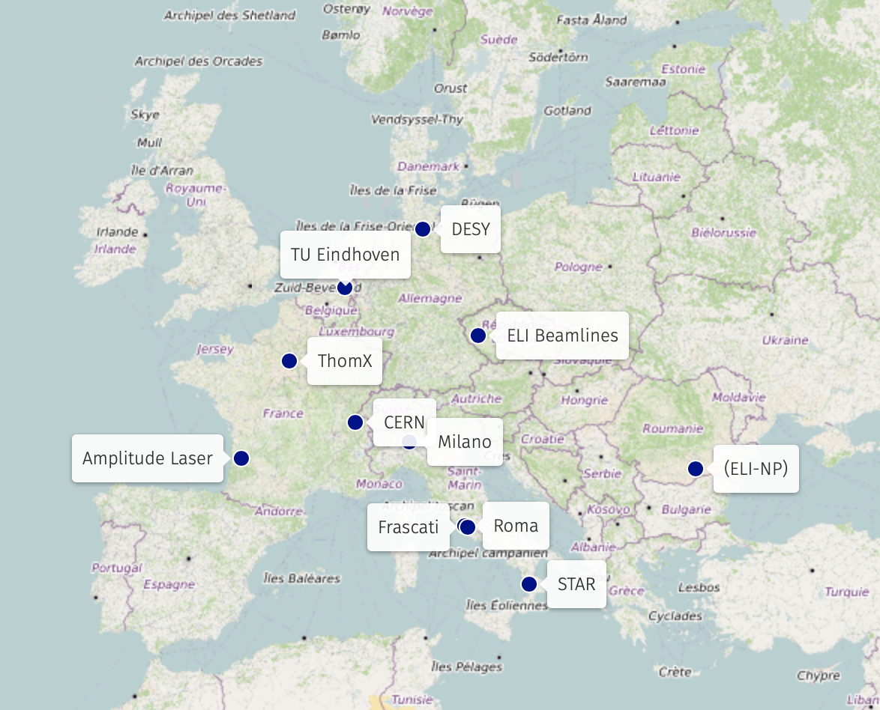
Collaborations and contracts,

Slide 16
thus ideas for optimized designs,
source
Beam charge
LINAC option:
time
dump
Optical resonator continuous operation:
limited by average power, flux reduced (duty cycle)
Laser pulse energy
Sakaue et al., Review of Scientific Instruments 89, 023305 (2018)
time
Burst operation of optical cavity to render optical duty cycle similar to that of RF
Optical resonator burst operation:
Optimizes peak power useful for collisions
Laser pulse energy
time

Slide 17
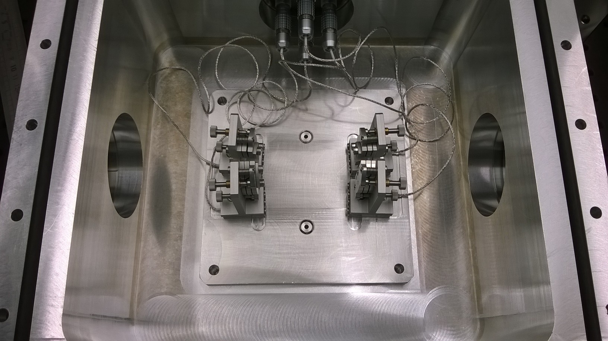
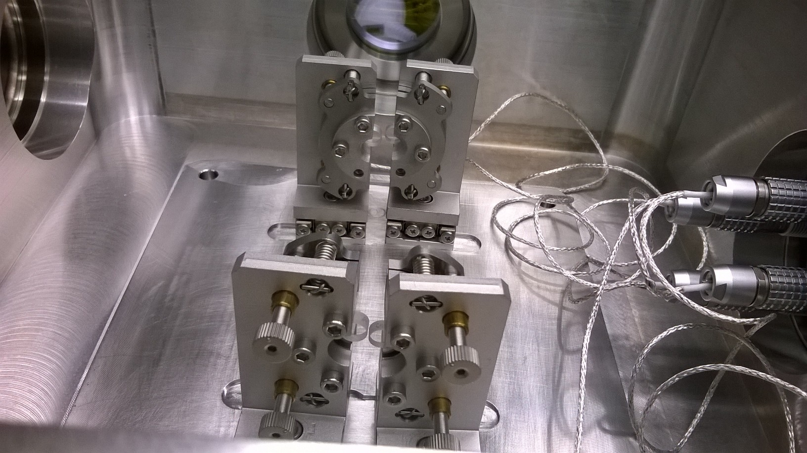
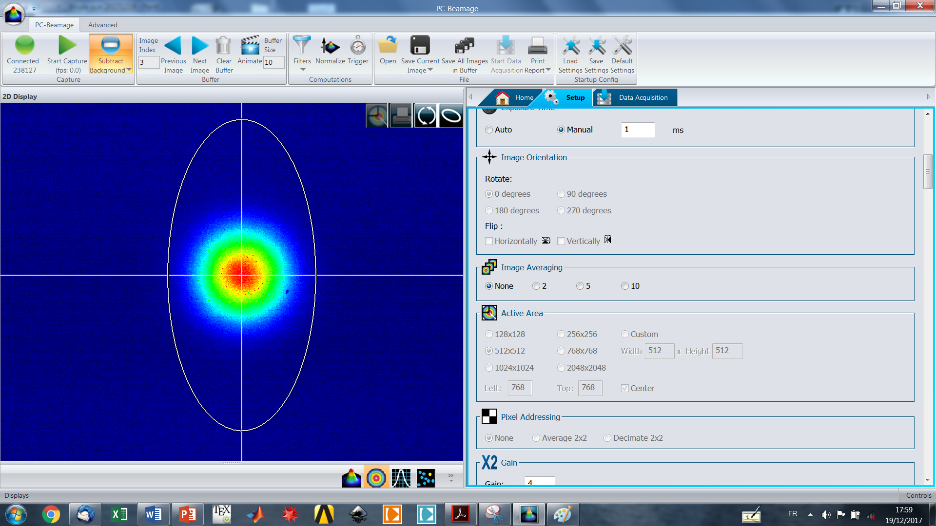
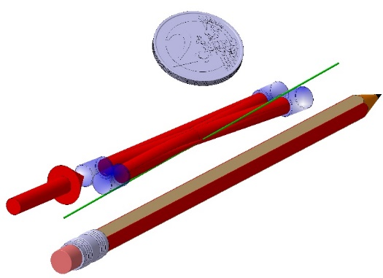
publications,
Upgrades of STAR (in Calabria), Smart*Light (@TU Eindhoven), LUCX (@KEK)
Reach peak powers of several 10MW, with small waist ideal for a clean e-beam source
LAL designed a “small” optical cavity to increase bunch repetition rate to a couple of GHz
Favier et al., Phys. Rev. Accel. and Beams 21 (2018) 121601
waist 15µm

Slide 18
strenghten collaborations
“Soft” collaborations:
  0-order design of STAR upgrade with burst mode optical cavity
  Demonstrate usefulness of burst mode optical cavity for Smart*Light
  Optimization of LUCX operation (KEK), MoU request for approval by IN2P3, existing FJPPL collaboration
Proposal for ELI-XS @ Prague:
  Burst mode optical cavity and re-use part of the material initially delivered to ELI-NP
  Proposal to be submitted in the coming months, dates and budget not discussed at this stage
DARPA GRIT contract: (still to be negociated with DARPA)
  Partner with SLAC, UCLA and RadiaBeam Technologies LLC but not tied to success and performances
  1st phase 2020-2022: R&D at IJCLab in collaboration with Amplitude
  2nd phase 2022-2024: construction of optimized cavity for operation in California, integration driven by industry, not IJCLab
Requires a “Laboratoire Commun” CNRS being set with Amplitude Laser
  Clear legal structure for collaboration with Amplitude in context of DARPA project
  Joint Patent on burst mode small cavities for Compton application
  Will ease the technology transfer to industry of mini-cavity exploiting industry know-how on surface quality handling, thermal dissipation,…
  Will allow limit the IN2P3/IJCLab implication for other projects to design studies
  CIFRE thesis start in 2020
Budget:
  Driven by contracts
  Manpower mainly PhDs with permanent staff support at relatively low fraction
  Activity maintenance in between contracts yearly requires some modest 10k€ for travels + 5k€ for optical room running costs

Slide 19
the outline of this presentation
1. Why R&D on optical cavities ?
2. 20 years of R&D on optical cavities: where do we stand ?
3. What does it bring ?
4. Ongoing and forthcoming projects
4.1 Gamma Factory: broad range applications
4.2 Polarimetry for HEP accelerators
4.3 Emerging technologies

Slide 20
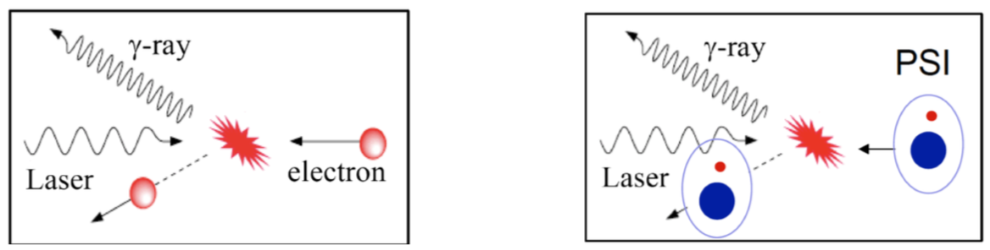
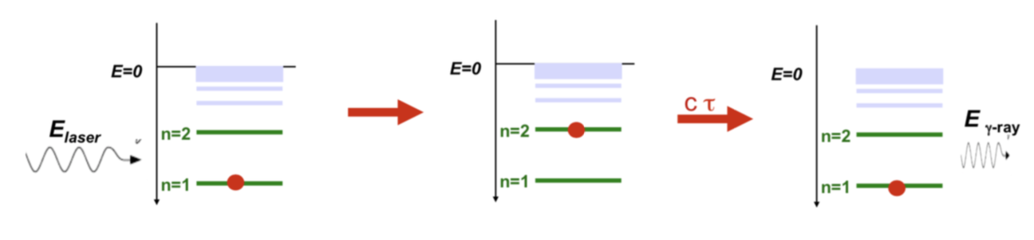
1. The Gamma Factory project
The Gamma Factory Proof of Principle Letter of Intent, SPSC-I-253
💡: Replace electrons with highly ionized atoms (Partially Stripped Ions, PSIs)
  Similar kinematical behaviour (relativistic boost)
  Much higher cross-section by about 9 orders of magnitude
  However reduced luminosity (larger beam size of PSIs) by about 2 to 3 orders of magnitude
  Allows recycling of beam: electrons are often lost due to dynamical aperture, not PSIs

Slide 21
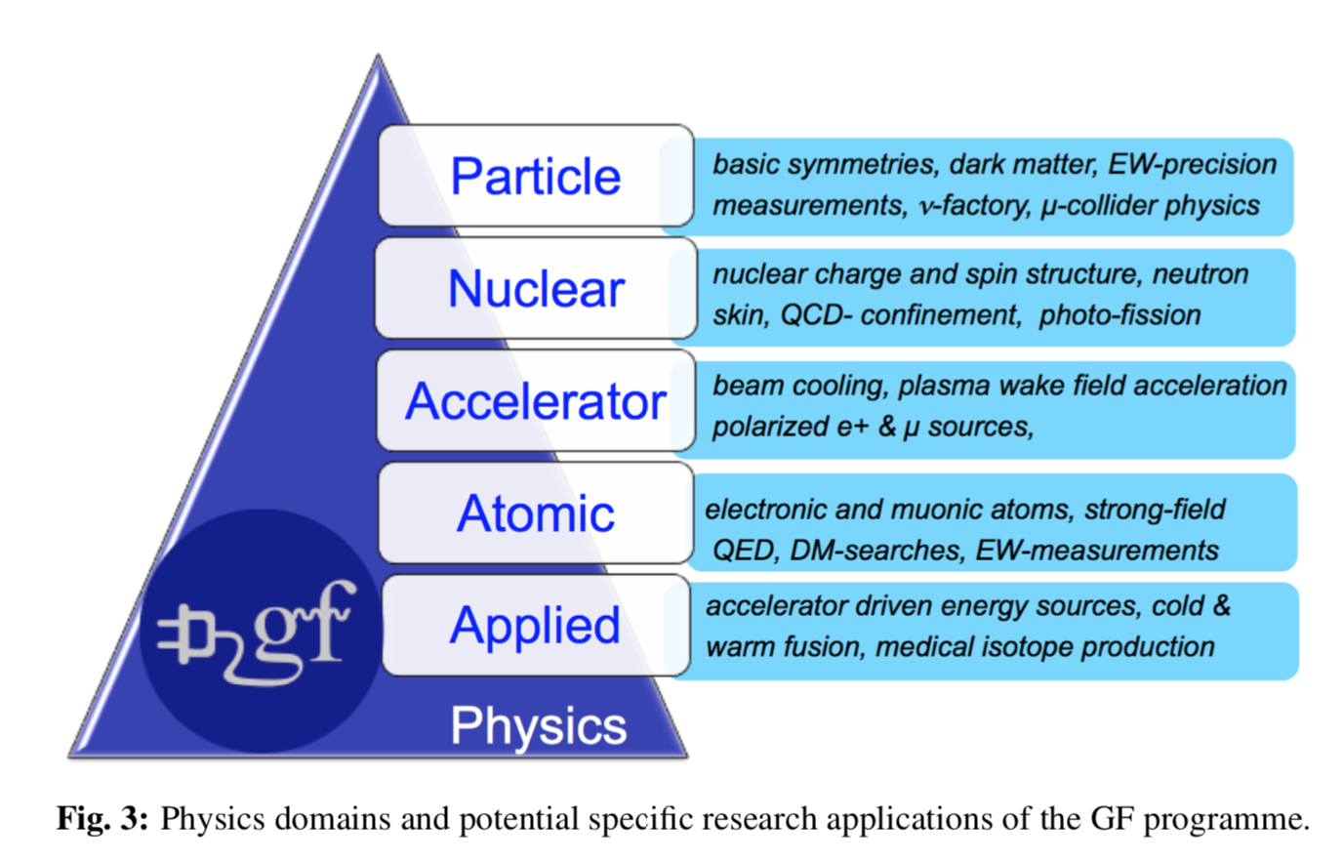
has a wide range of applications
The Gamma Factory Proof of Principle Letter of Intent, SPSC-I-253

Slide 22
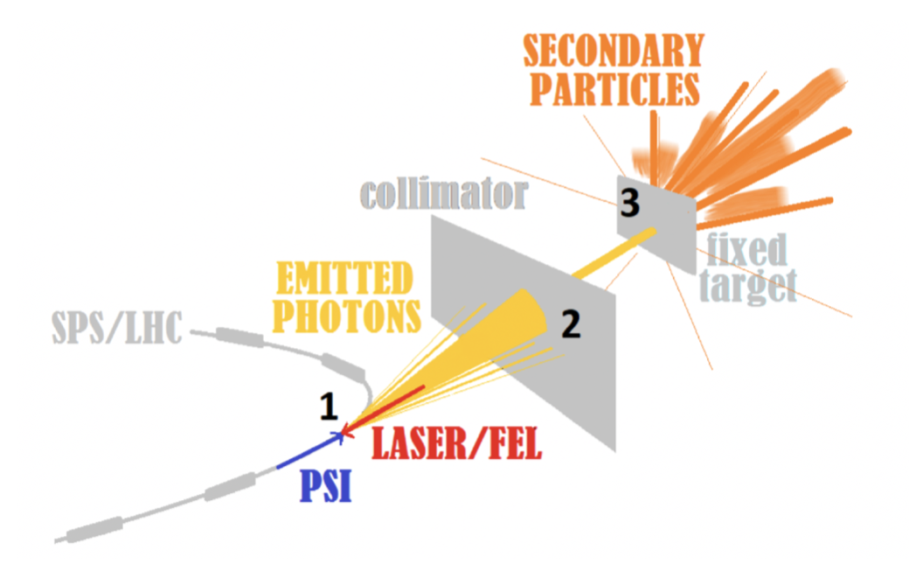
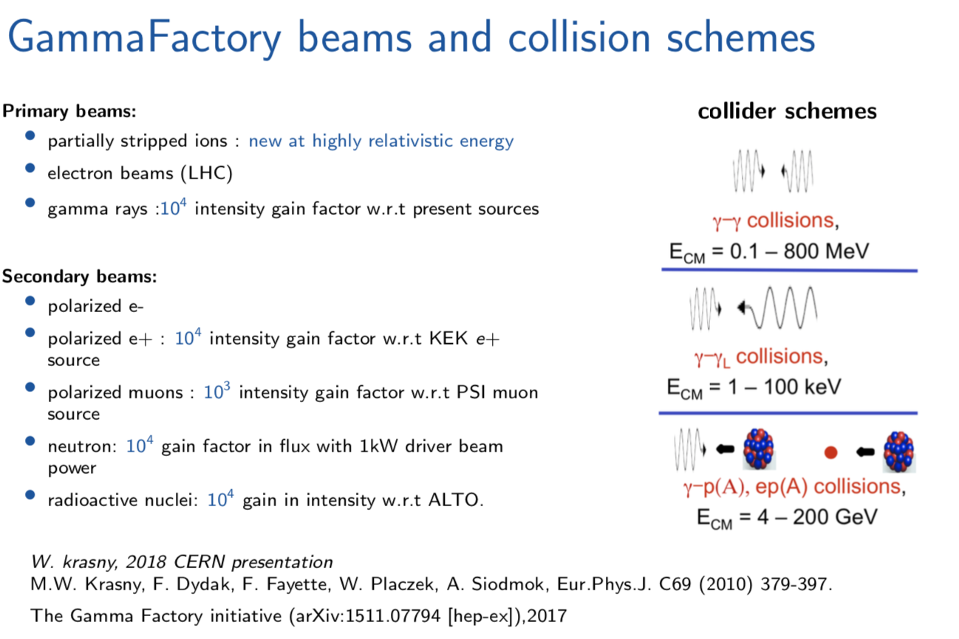
Secondary particles sources
The Gamma Factory Proof of Principle Letter of Intent, SPSC-I-253

Slide 23
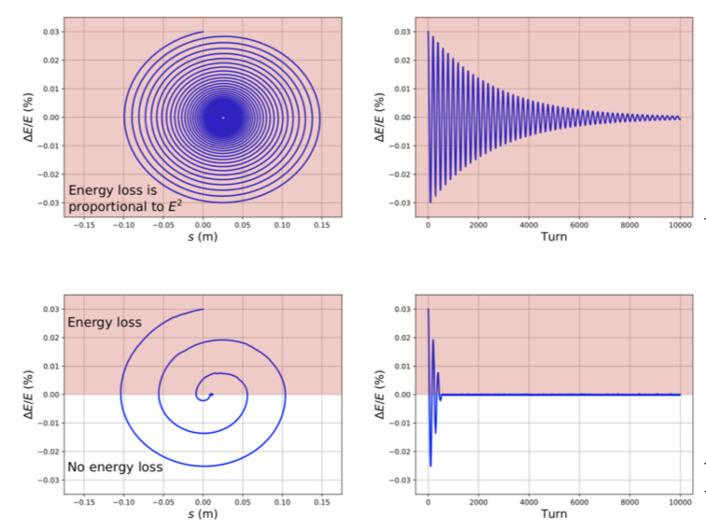
Beam cooling of ion beams
Intrabeam scaterring not yet included, work in progress
The Gamma Factory Proof of Principle Letter of Intent, SPSC-I-253
Transverse cooling also possible in a dispersion section by translating the laser beam

Slide 24
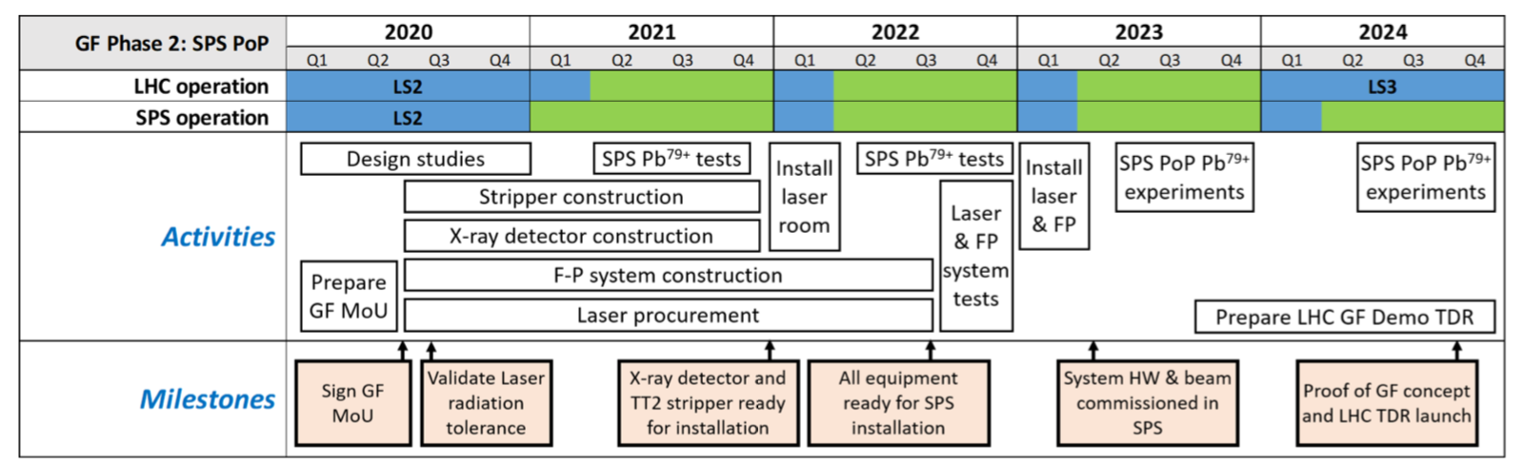
Status of the project/next steps
Letter of intent being reviewed by SPSC:
  Expect answer in the coming months
2.2M€ budget required for the experiment as a whole:
  Naïve hope that CERN may contribute significantly
  European calls to complement if needed
  IN2P3 in-kind contribution limited to early R&D (50k€) + travels to CERN (intense to start integration, then only for 2-3 weeks periods for installation and running)
  Manpower: PhD student (at the beginning) + PostDoc (for running and physics exploitation of experiment results) + permanent staff as main support during construction and commissioning
The Gamma Factory Proof of Principle Letter of Intent, SPSC-I-253

Slide 25
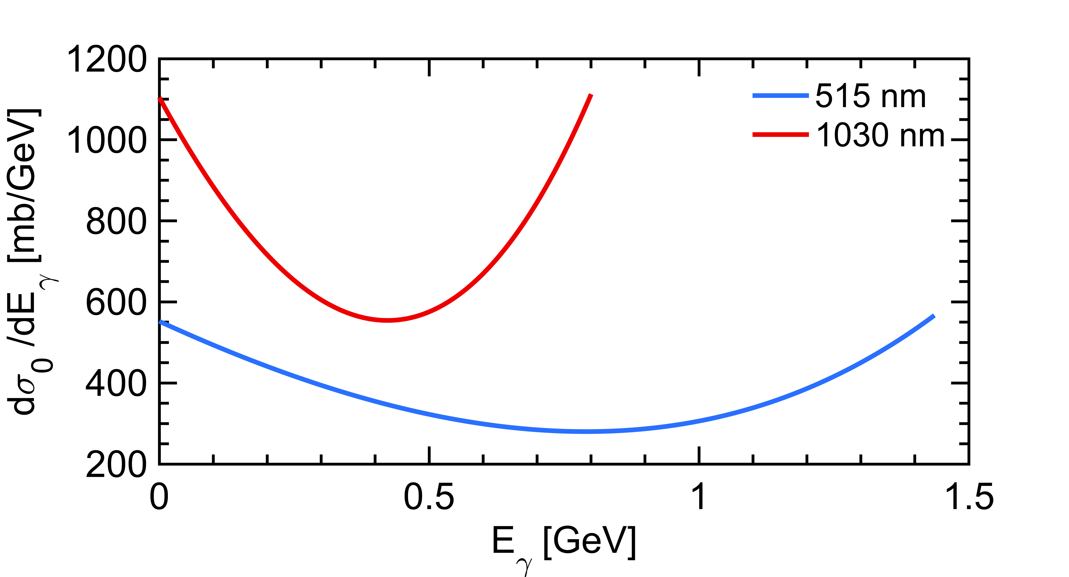
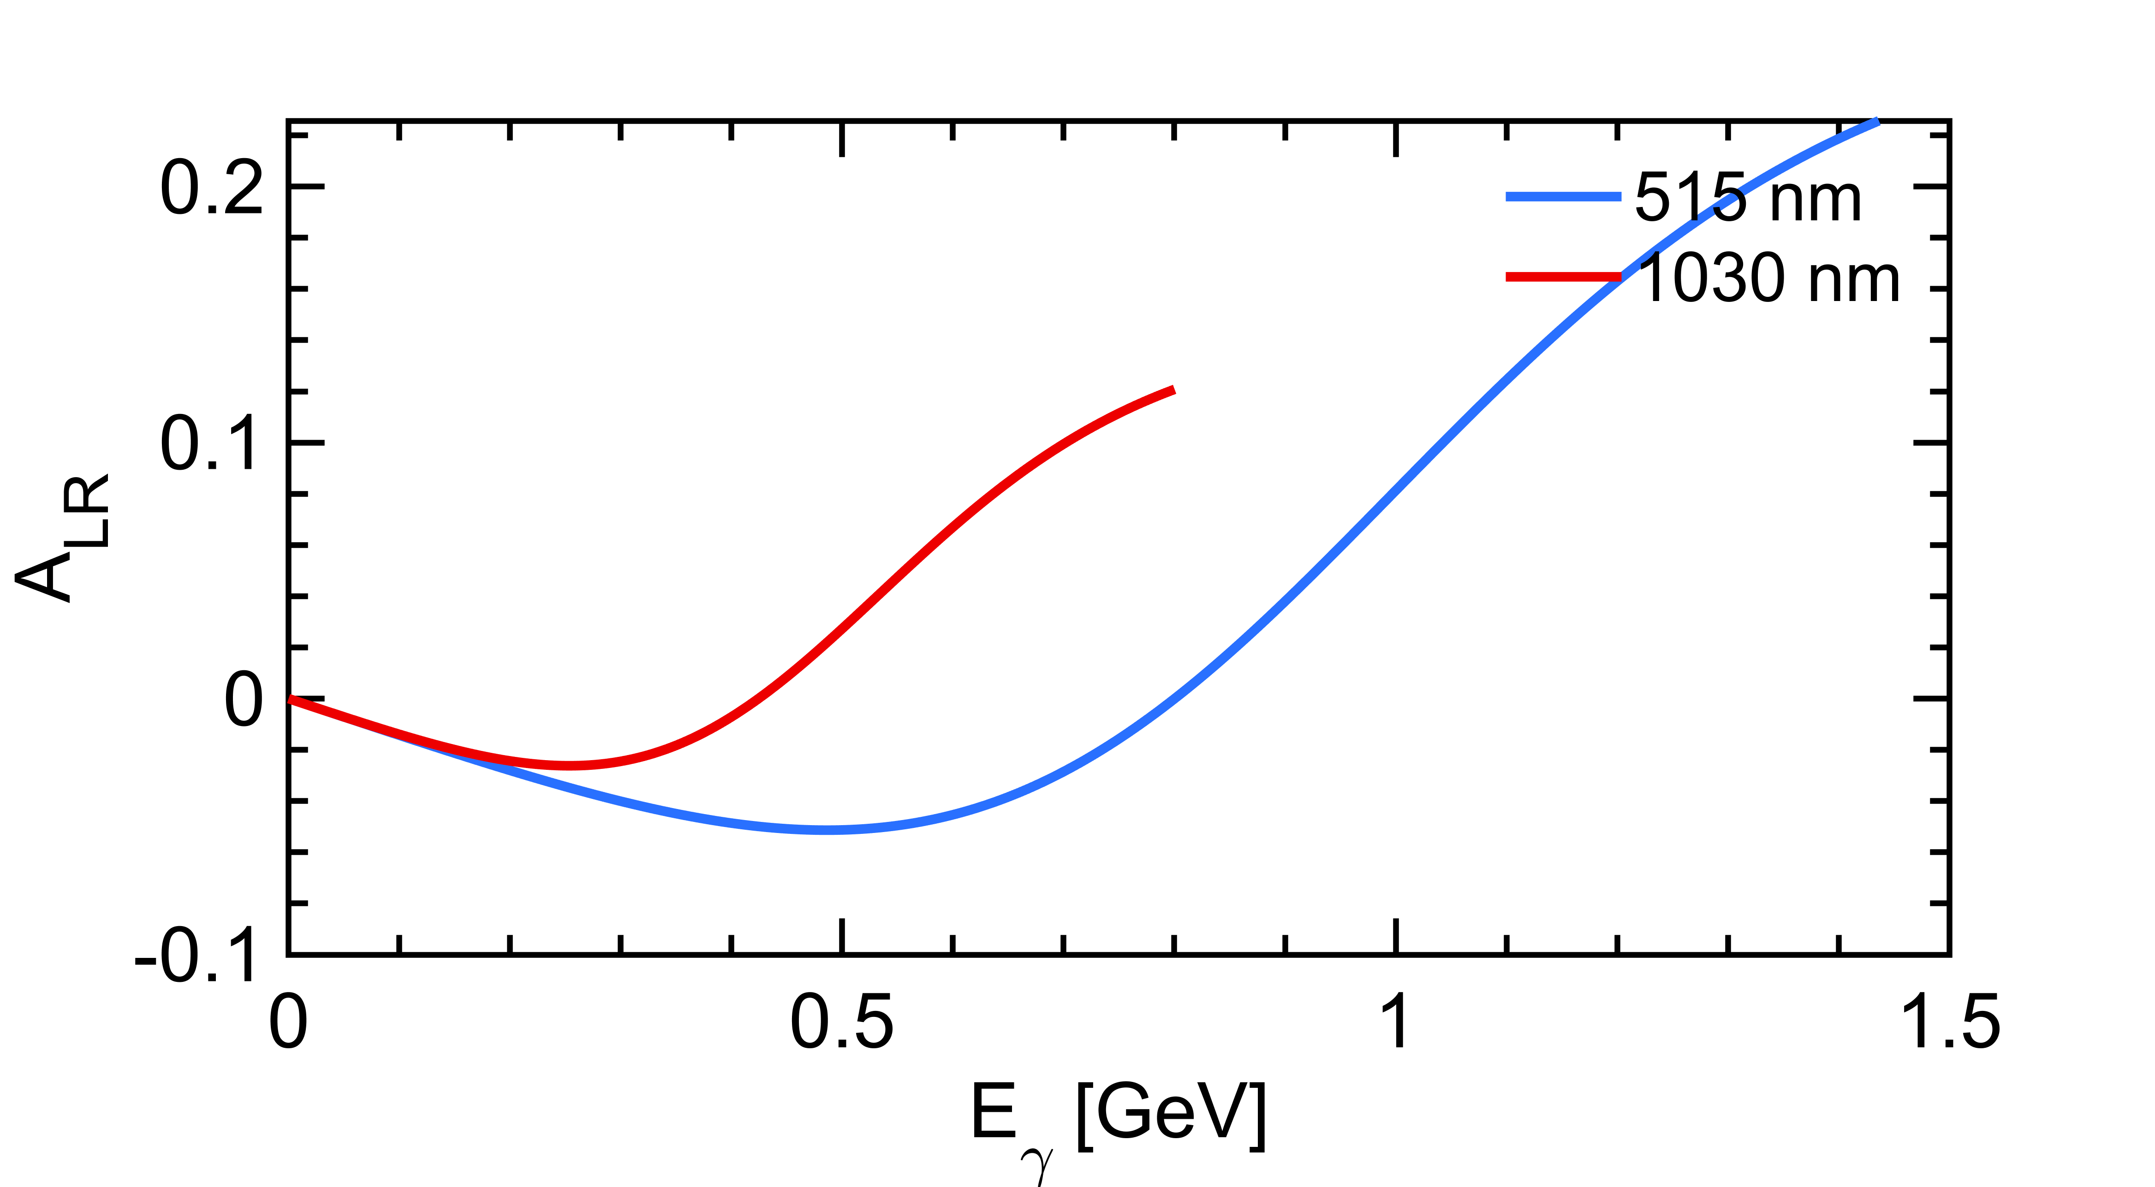
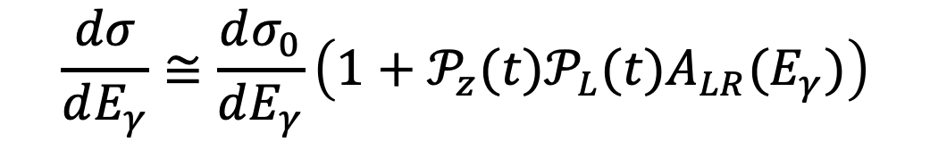
2. Application to polarimetry
Landau-Lifshitz QED book paragaphs 86 and 87
Polarization dependent term generates a left-right asymmetry function of $E_{γ}$
that is robust against QED corrections
$$\frac{dσ}{dE_{γ}}≅\frac{dσ_{0}}{dE_{γ}}\left(1+{𝒫_{z}{(t)𝒫}_{L}(t)A}_{LR}(E_{γ})\right)$$
From HERA experience:
Bunch/bunch measurements are needed
On timescales of seconds
From HERA experience:
Highly sensitive to environmental conditions
Requires real time monitoring (sub-second timescale)

Slide 26
Example for ILC
ILC CDR, Brisson JINST 5 P06006 (2010), Poirson et al. Applied Optics 34 6806 (1995)
Wrong polarization after tilt of a quarter wave plate
About 1 per mil contribution from wrong polarization
Even not discussing:
Thermal load in transmission optics
Thickness defects in wave plates
Effect of vacuum windows
Fine modeling of beam transport is required
Real time monitoring/control may be required

Slide 27
Collaborations & prospects
ILC
  Update of the design of laser systems for ILC downstream polarimeter(s): well placed to contribute to that topic
  require R&D on laser beam polarization control
  May require a close collaboration with laser industry to develop an adapted burst mode laser system
LHeC/PERLE
  0-order contribution to CDRs
SuperKEKB upgrade
  Contribution to discussion group on the requirements for a Compton polarimeter (goal is CDR in 2025)
  Quite prospective, mainly informal discussions
  require R&D on laser beam polarization control (synergy with ILC)
  May contribute on laser system design
  Interest in contributing to design of photon calorimeter (challenging)
FCC-ee:
  Informal discussion with A. Blondel on needs for beam energy calibration through resonant depolarization (similarly to LEP time)
  Laser system and polarization control less challenging
Needs:
  If one of these project starts it will critically require
    manpower (PhD student, engineer)
    substantial budget for hardware needed, typically 25 to 50k€
    Agreements on the in-kind contribution of IN2P3 to these projects
Martens et al. @LCWS 2018, @LHeC/PERLE Workshop 2018, @B2GM October 2019

Slide 28
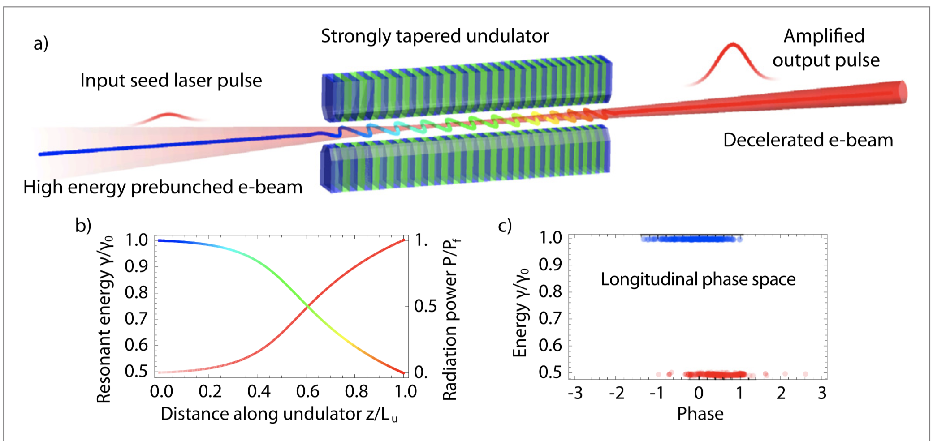
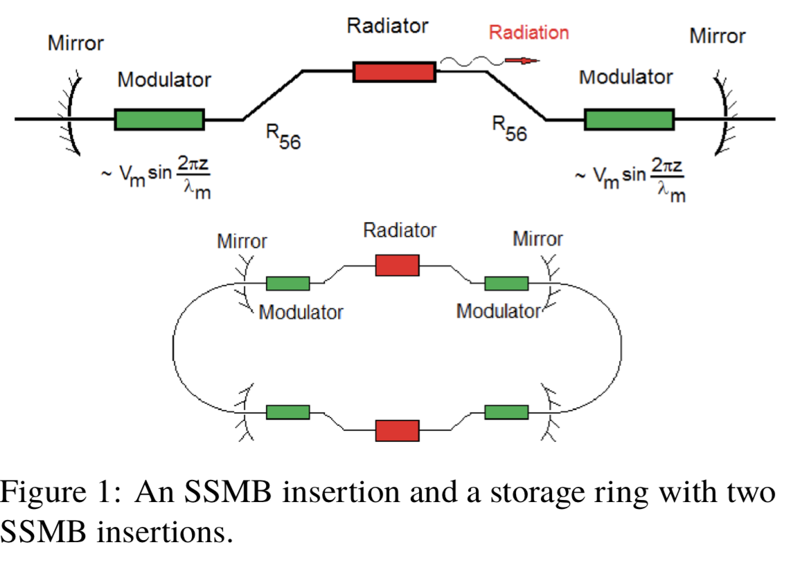
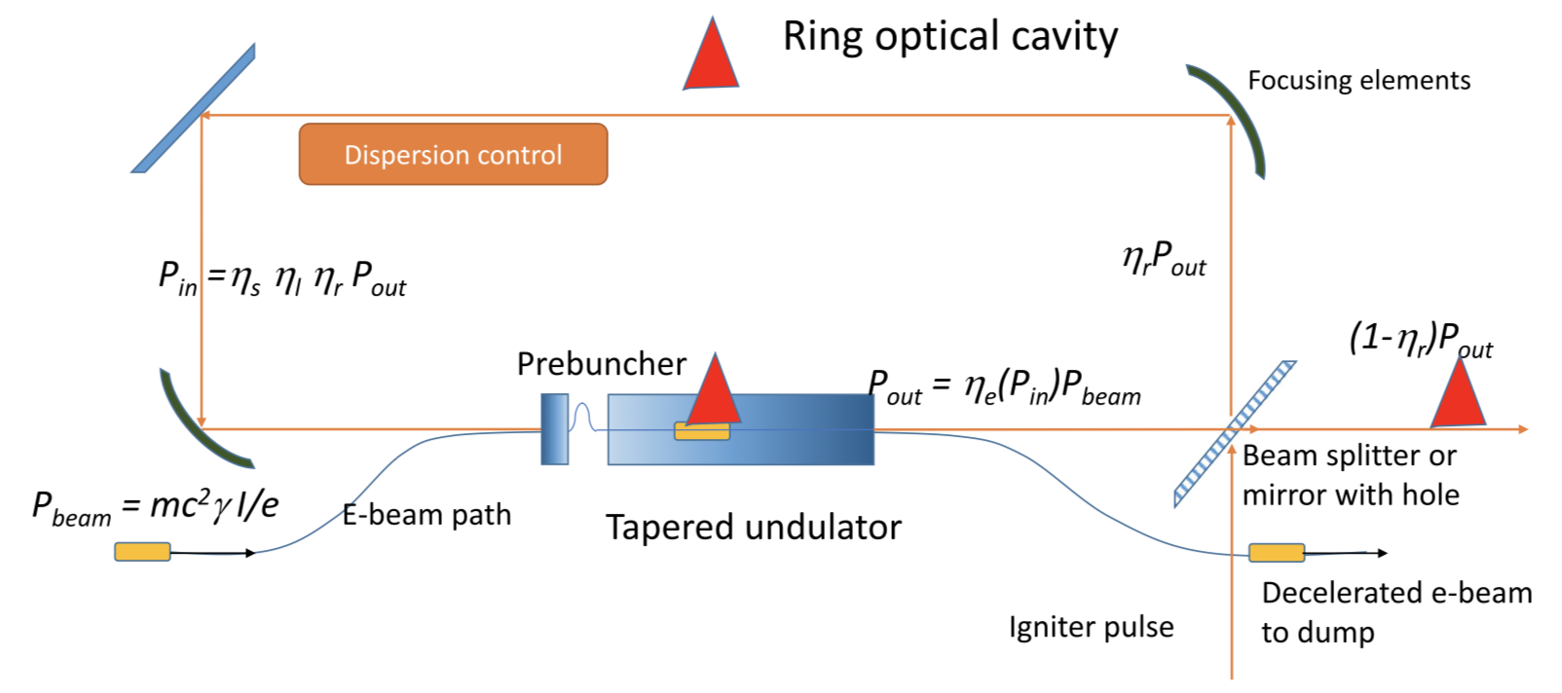
3. New technologies at very long term
TESSA scheme (UCLA)
experimentally demonstrated !
IFEL/microbunching scheme (A. Chao)
Combined with a FEL in a ring
with steady state microbunching !
Lithography
J Duris et al. 2015 New J. Phys. 17 063036, A. Chao et al., IPAC2016
Next step: TESSO scheme (UCLA)
MW level CW laser optical cavity required

Slide 29

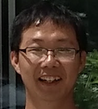


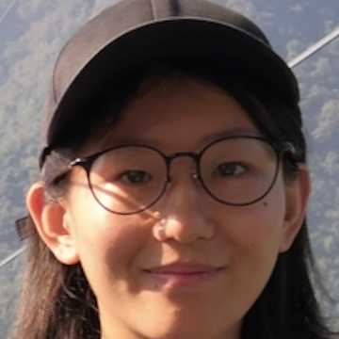


Summary
Technical R&D on optical cavities provided
a unique, worldwide renowned know-how
with an interesting R&D to pursue
that allows us to contribute on high-impact projects,
including critical components for future accelerators for HEP,
with tech-transfer to industry
with vibrant research perspectives
driven by PhD students
and limited ressources needs
k€/year

