Slide 1
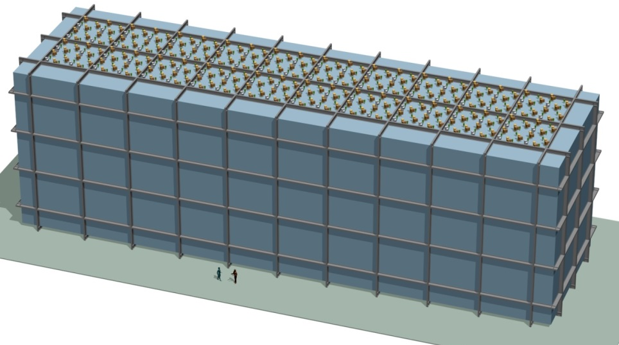
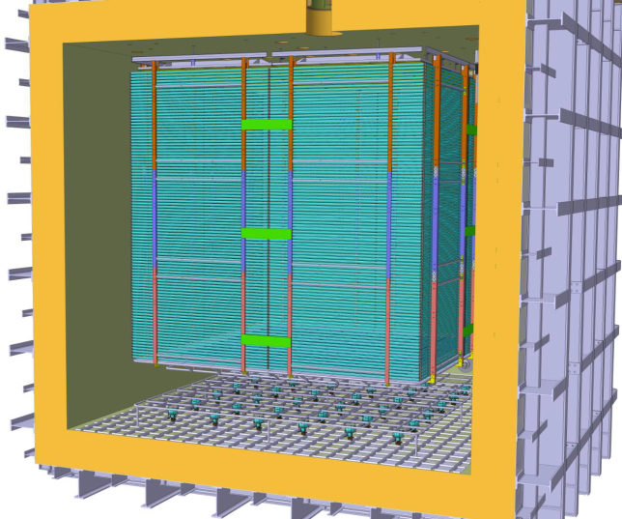
Physique des neutrinos aux US
Dario Autiero, IP2I Lyon
Séminaire Thématique « Physique des neutrinos et matière noire »
Bordeaux, 28/10/2019
DUNE
10 kton module
Dual-Phase ProtoDUNE

Slide 2

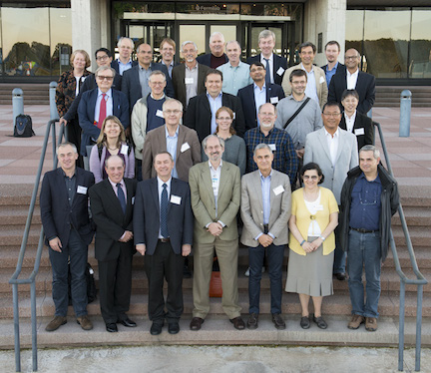
Joint USA-Europe initiative for a common long-baseline experiment based on the liquid argon TPC technology
→ Merging of previous efforts EU (LAGUNA-LBNO) US (LBNE), CERN support (European Strategy)
Quick developments since July 2014:
Top priority of the USA P5 committee (HEP strategy in the USA) May 2014
→ Reformulation of the program
APPEC Meeting on Neutrino Infrastructures Paris June 2014
August 2014: creation of an Interim International Executive Board (IIEB) for LBNF chaired by the Fermilab Director N. Lockyer, active IN2P3 contribution
→ gathering the collaboration for the ELBNF LOI
January 2015: Presentation of the LOI to the FNAL PAC (LBNF (facility) + ELBNF (experiment): 40 kton at Homestake (1300 km from FNAL), 1.2 MW beam upgradable to 2.4 MW, excavation works start in 2017
March 2015: Election of the first two co-Spokesperson and choice of the final name for ELBNF: DUNE
June 2015 DOE CD-1 Refresh approval and completion of the DUNE CDR
Conceptual Design Report

Slide 3
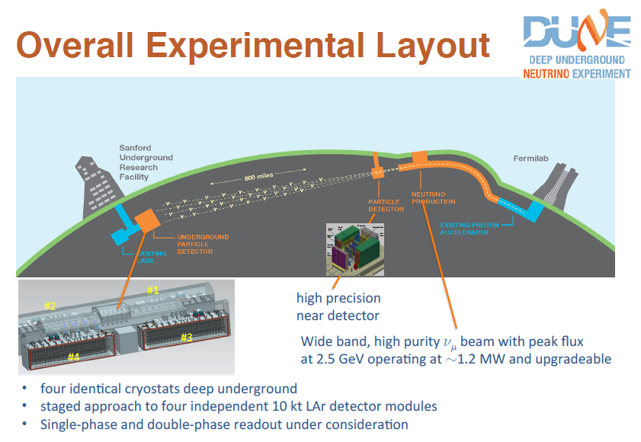
Beam 1.2 – 2.4 MW
40 kton Far Detector mass
Operation foreseen since 2026

Slide 4
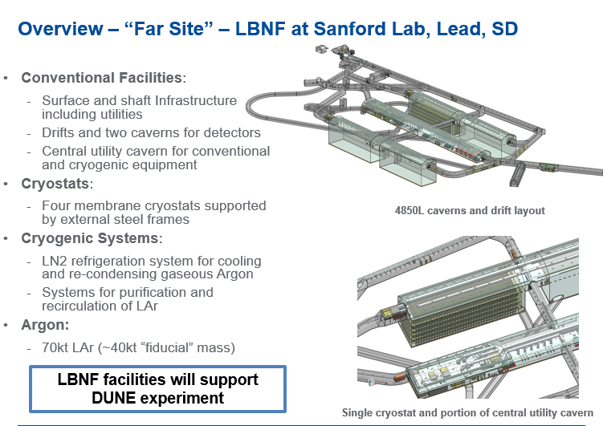
LBNF CD-3a 2016 – Approval of Initial Far Site Construction by DOE

Slide 5
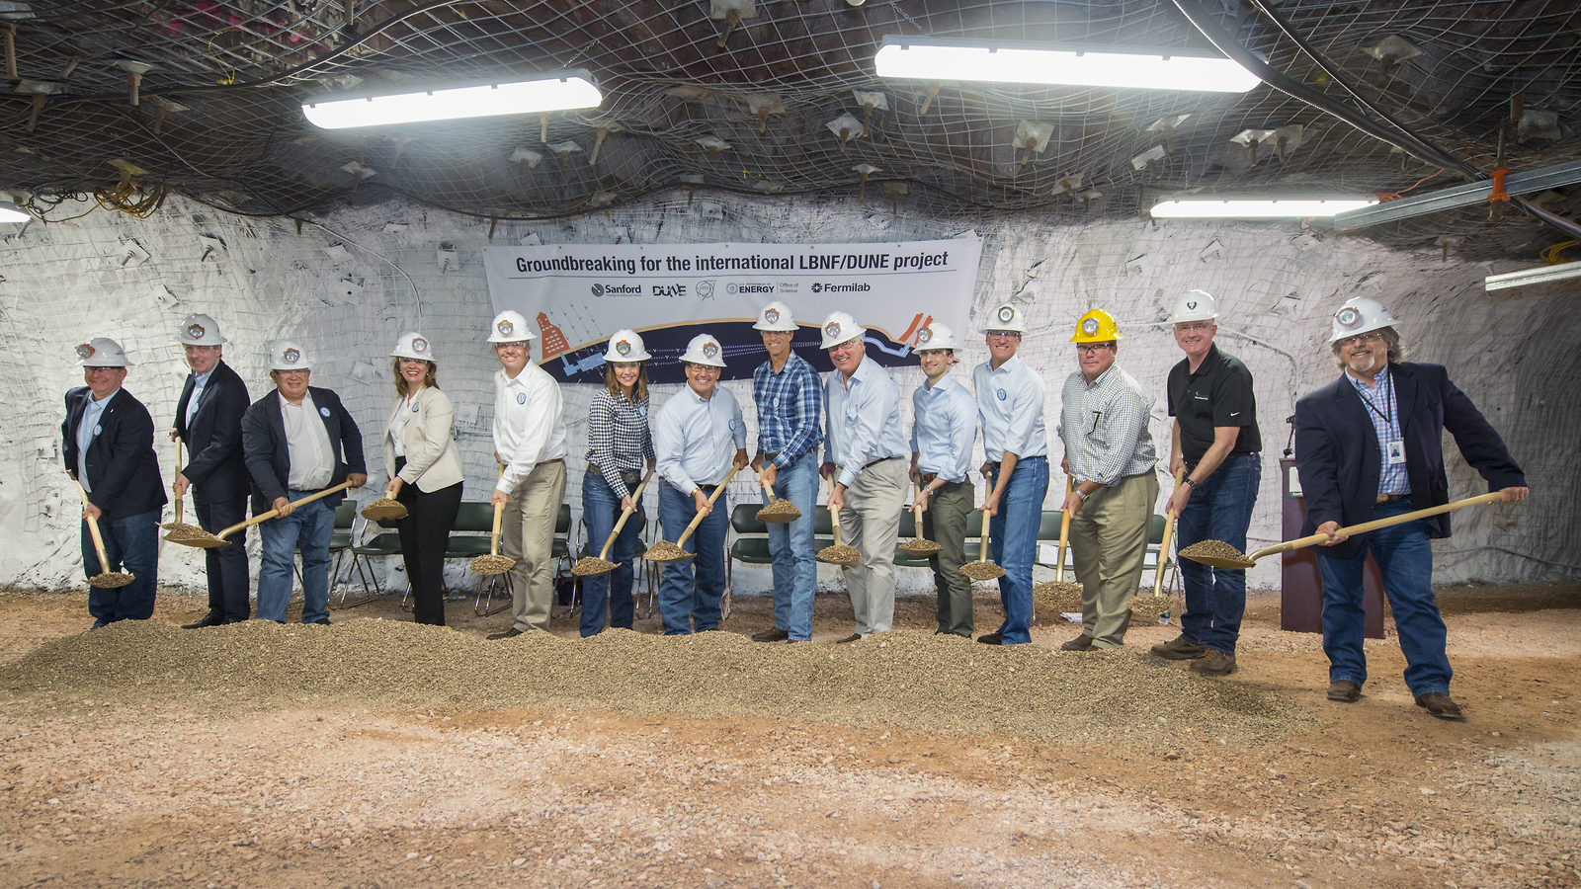
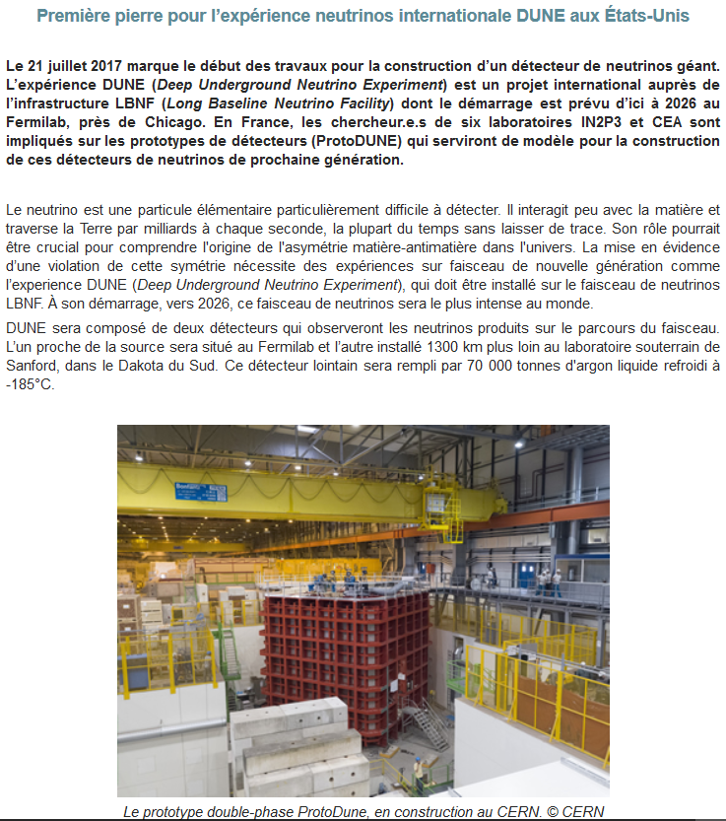
LBNF Groundbreaking 21/7/2017
→ Start of civil engineering works for LBNF
http://www.in2p3.fr/recherche/actualites/2017/nouvelle_experience_dune.html
http://news.fnal.gov/2017/07/construction-begins-international-mega-science-experiment-understand-neutrinos/
Strong commitment constantly reiterated: funding allocated for FY 2019 (130 M$) exceeded expectations and the budget recommended by the House of Representatives/Senate committees (80M$)

Slide 6
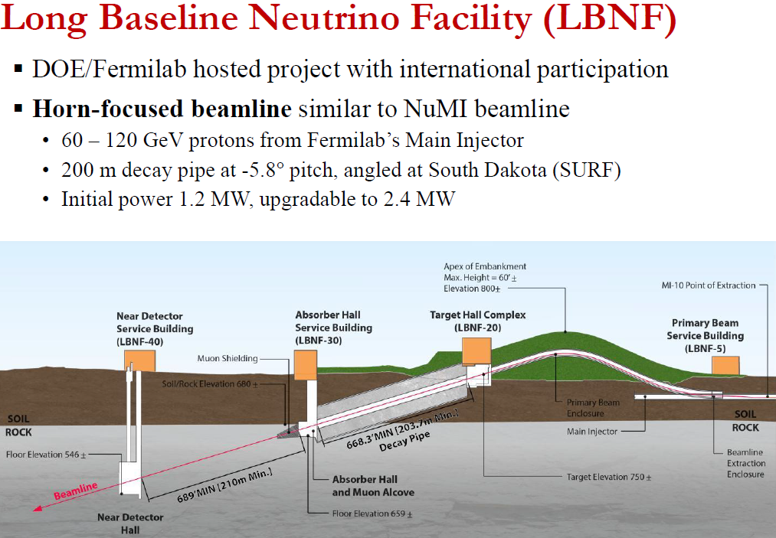

Slide 7
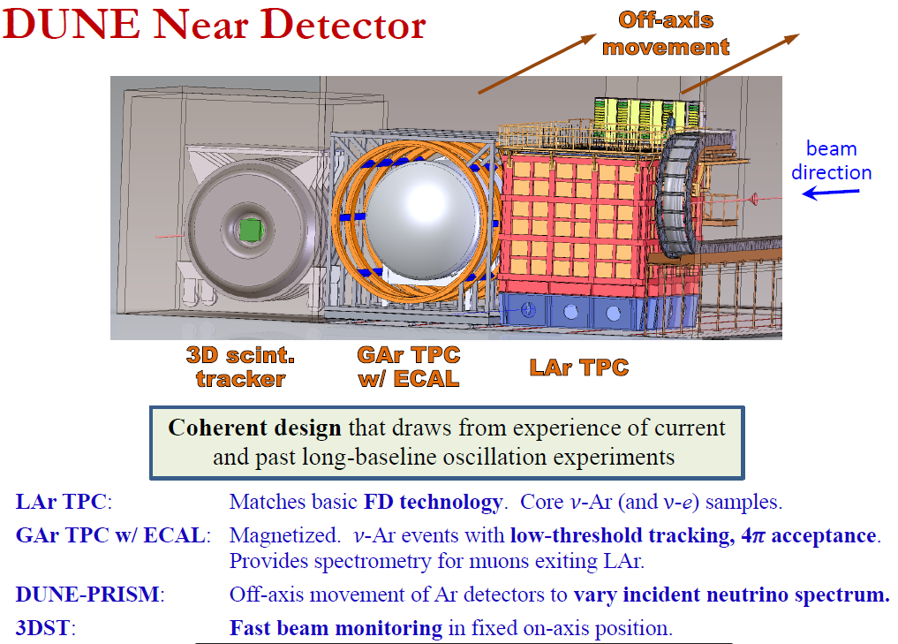

Slide 8
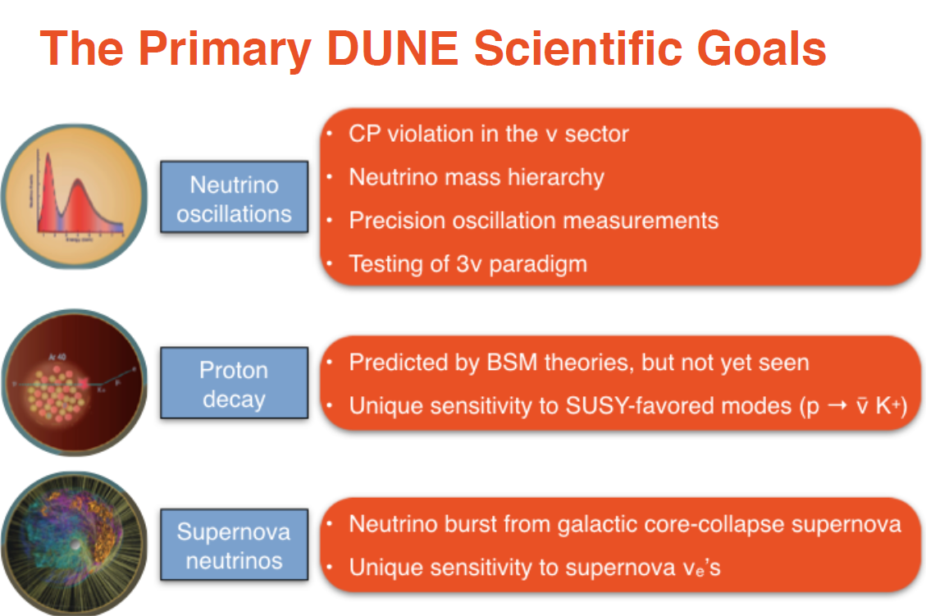

Slide 9
Additional physics goals (ancillary program):
ν_{τ} appearance
Sterile neutrinos
Search for Non Standard Interactions (NSI)
Physics with atmospheric neutrinos: e.g. oscillations, mass hierarchy, BSM
Searches for n–nbar oscillations
Study of neutrino interactions in the near detector
Searches for dark matter signatures
Measurement of solar neutrino if threshold permits
Potentially first observation of diffuse supernova neutrinos
Detection of High Energy Neutrinos from astrophysical sources
Serendipity: intense LBNF neutrino beam and novel capabilities for both ND and FDs probing new regions of parameter space for both the accelerator-based and astrophysical frontiers

Slide 10
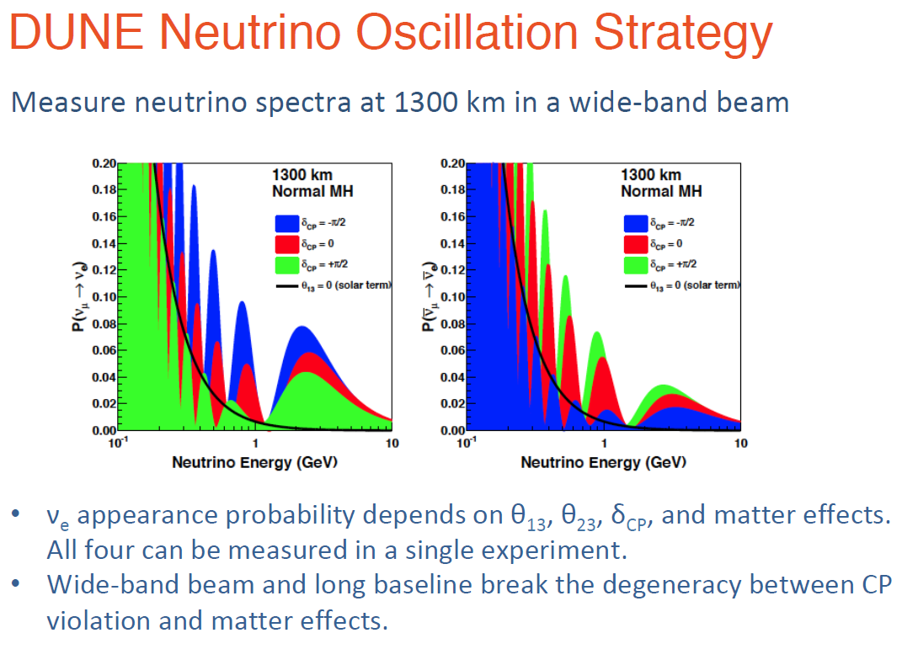
Exploitation of spectral information and 2nd oscillation maximum
DUNE is a unique experiment allowing performing all these measurements (CP search, mass hierarchy, 3 neutrinos phenomenology with also τ appearance, precision measurements) within the same set-up and with high significance for discovery. Checking of CP vs NSI with spectral info.
It also provides a complete neutrino interactions final state reconstruction information

Slide 11
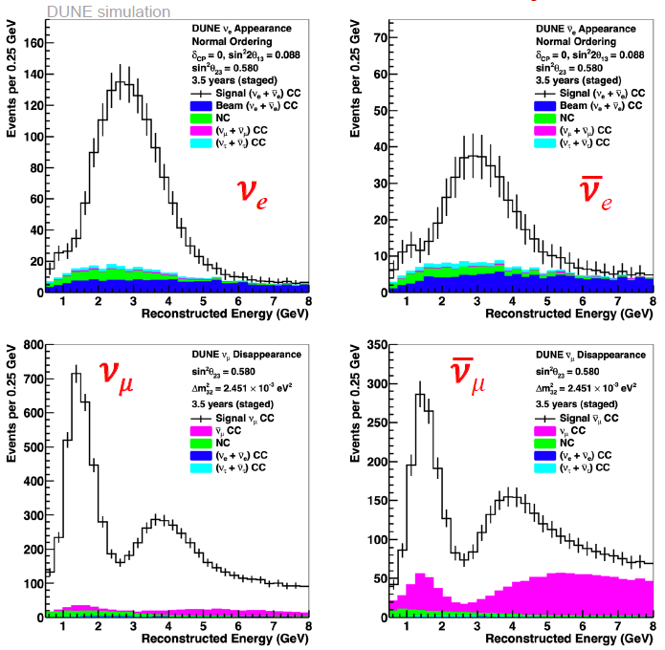
Neutrino oscillations measurement strategy
2nd Max
1st Max
2nd Max
1st Max
ν_{e} anti-ν_{e} appearance
~1000 events in 7 years
Fit 4 samples
→ Oscillation parameters
ν_{μ} anti-ν_{μ} disappearance
~10k events in 7 years

Slide 12
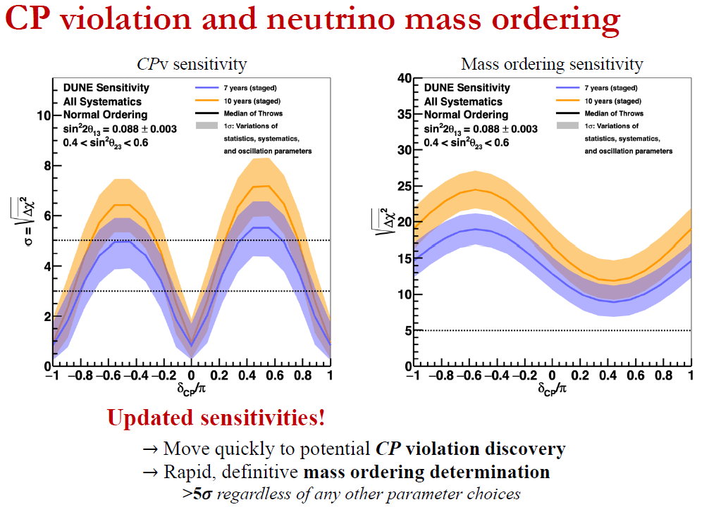
TDR physics update August 2019
(Full reconstruction, CVN classification of events)
Staging:
1.2 MW ⨯20 kton at start
1.2 MW ⨯30 kton after 1 yr
1.2 MW ⨯40 kton after 3 yr
2.4 MW ⨯40 kton after 6 yr
Equal neutrino-antineutrino running, 56% operations up-time
Mass ordering +-40% effect→ larger than any possible δ_{CP} effect
300 kton x MW x year exposure (7 yr)

Slide 13
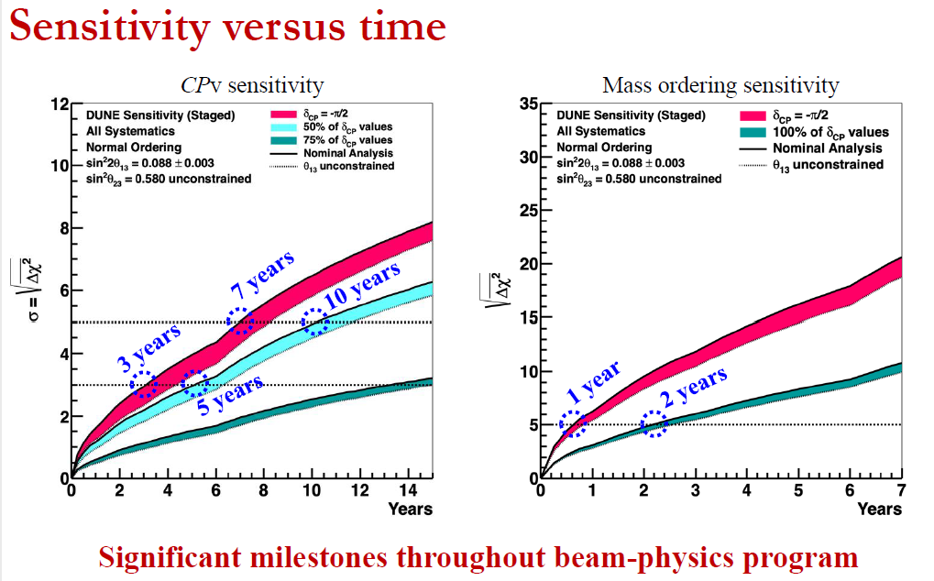

Slide 14
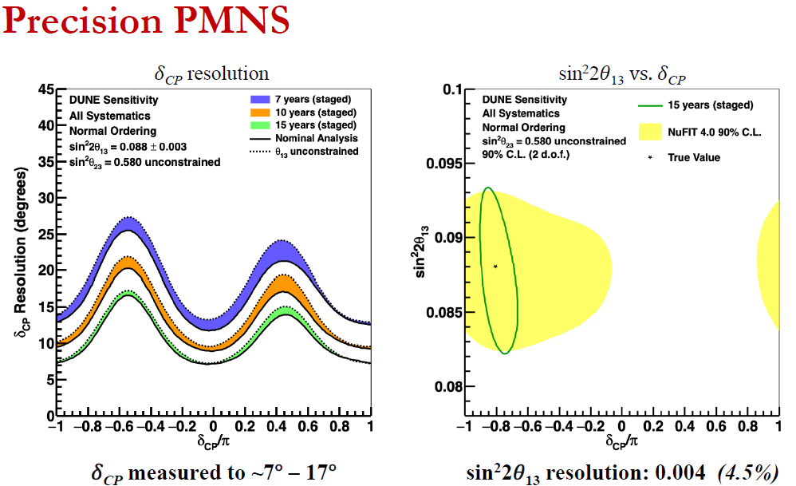

Slide 15
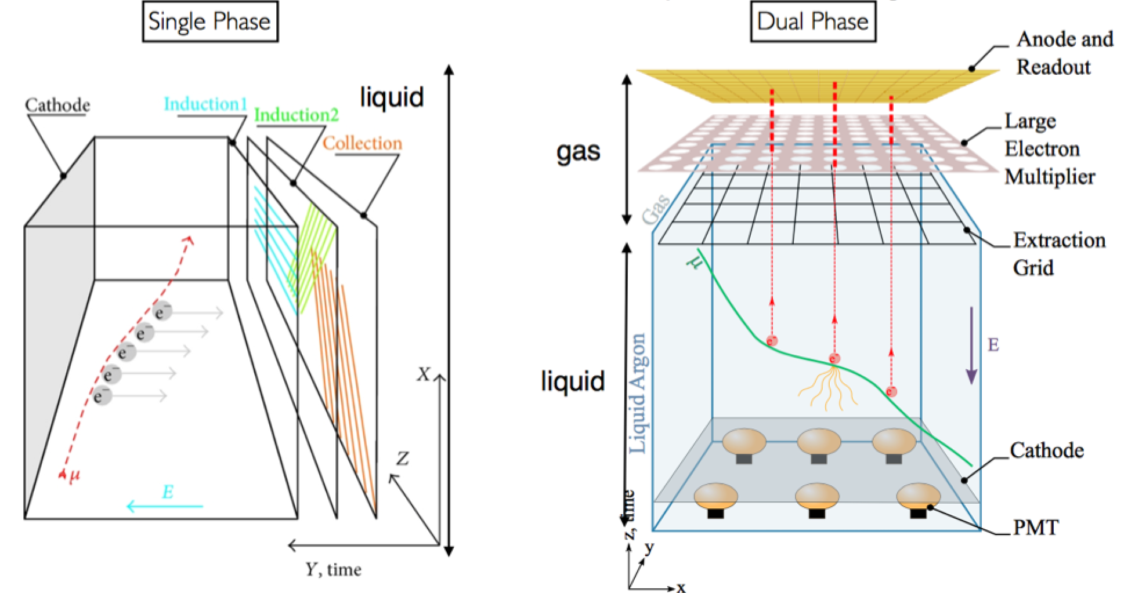
Single-phase Design:
Ionization charges drift horizontally and are read out with wires
Drift up to 3.6 m
No signal amplification in liquid
Read out by APAs (wire planes)
Dual-phase Design: long drift (up to 12 m), high S/N:
Vertical drift → extraction of electrons from the liquid and multiplication in avalanches in micro-pattern detectors LEM (Large Electron Multipliers) operating in pure argon gas.
Tunable LEM gain ~20 , two symmetric collection views, coupling to cold electronics accessible through chimneys on top
Light readout performed with an array of cryogenic photomultipliers below the cathode
DUNE is committed in deploying both technologies in 10 kton modules.
Planning: Module #1 SP, Module #2 DP

Slide 16
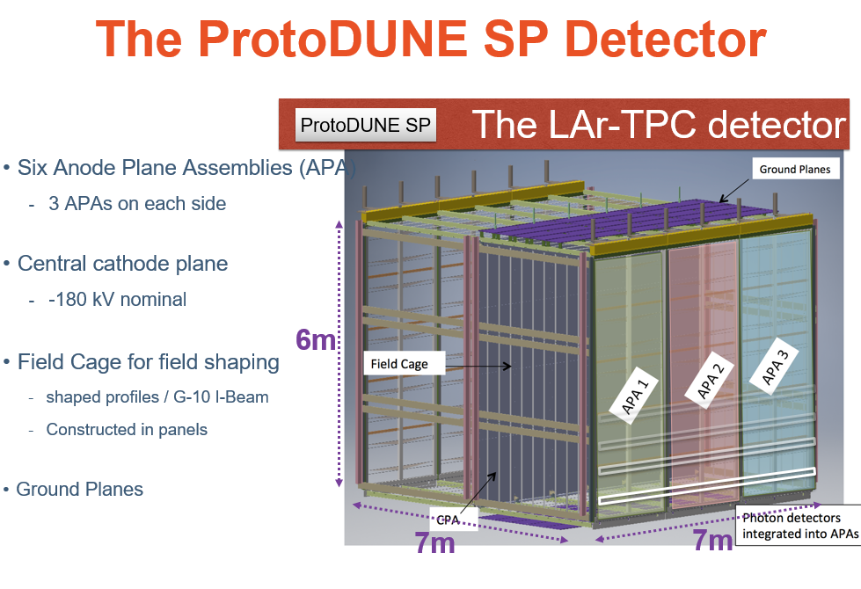
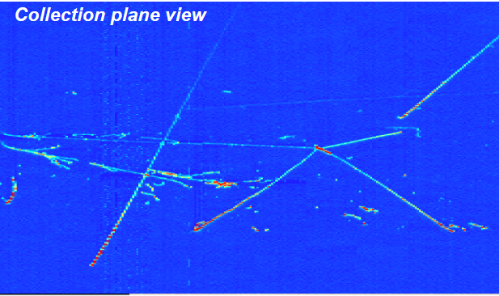
Operational since September 2018 at the CERN Neutrino Platform

Slide 17
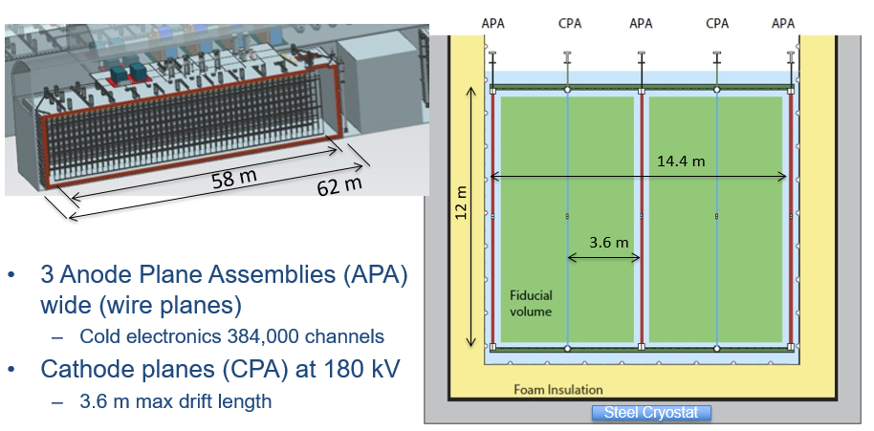
APA
APA
ProtoDUNE-SP
section
APA
Cathode planes
DUNE 10 kton Single-phase module
→ x40 ProtoDUNE-SP

Slide 18
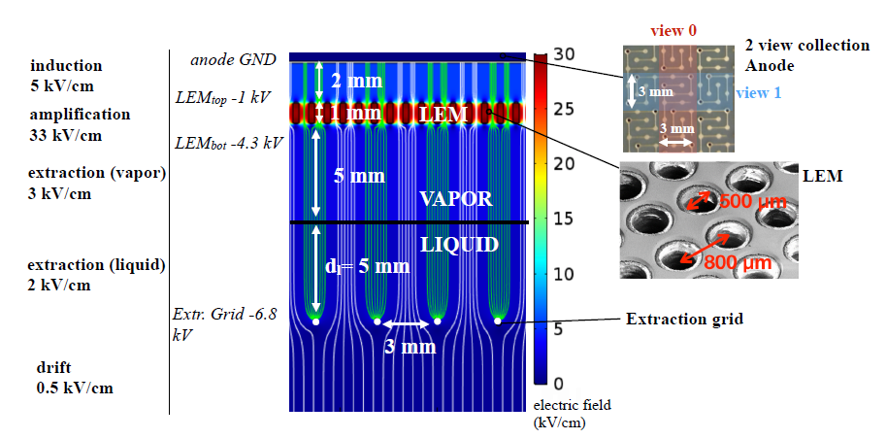
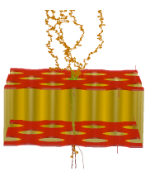
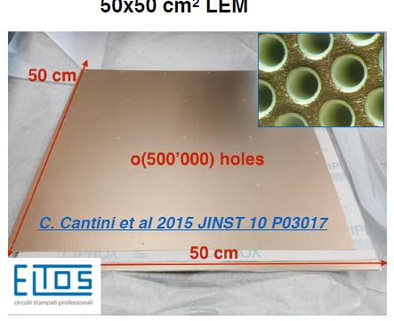
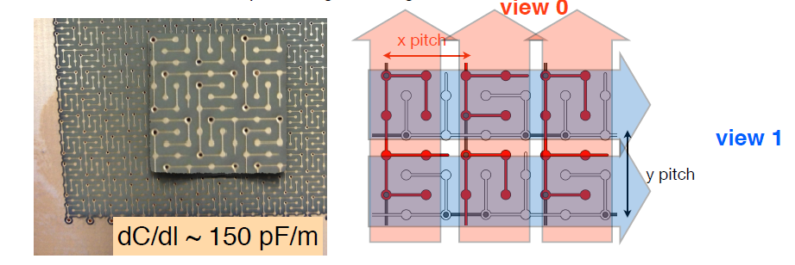
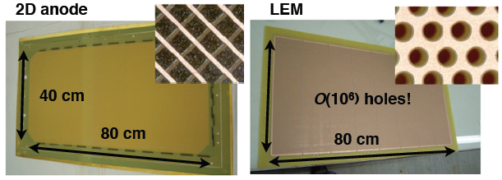
Dual-phase readout
(R&D in France since 2006)
Charge Readout
Plane integrating
LEM-anode sandwiches
Electron avalanche in LEM hole
50x50 cm² LEM
50x50 cm² anodes with 2 collection views

Slide 19
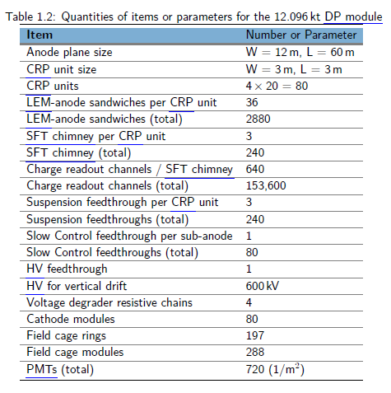
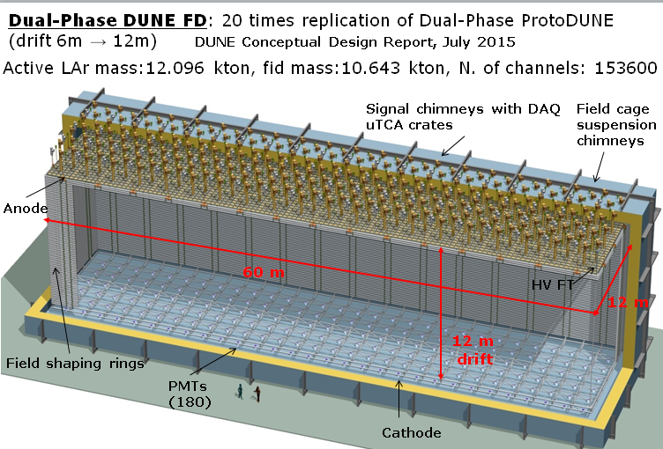
Advantages of dual-phase design:
Gain in the gas phase → robust and tunable S/N, lower detection threshold, compensation for charge attenuation due to long drift paths
Finer readout pitch (3.125 mm), implemented in two identical collection views (X,Y) on 3m long strips
Long drift projective geometry: reduced number of readout channels (153,600 for DP less than half of equivalent SP FD), absence of dead materials in the drift volume
Fewer construction modules
Full accessibility and replaceability of cryogenic front-end (FE) electronics during detector operation

Slide 20
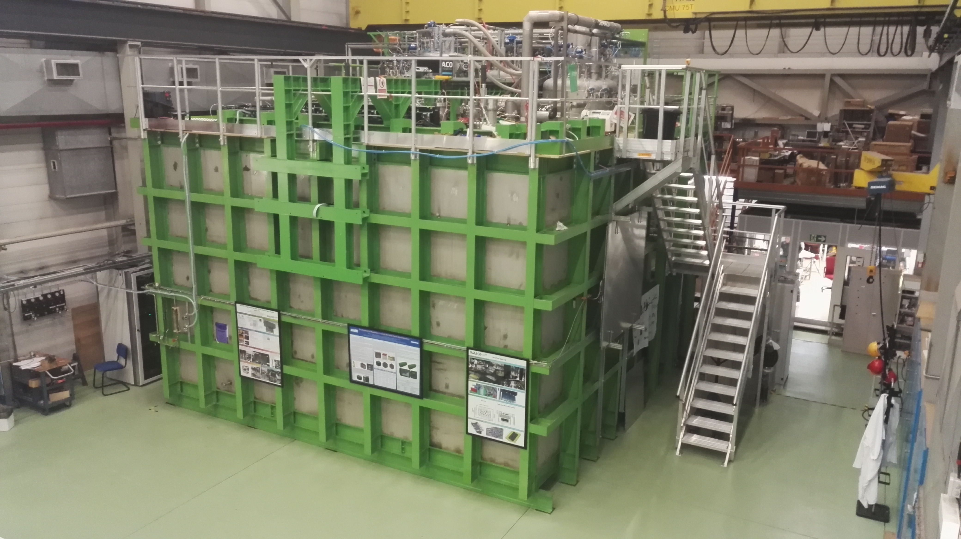
3x1x1:
1280 readout channels
Operation 2016-2017
Successful in proving the
dual-phase concept for a
LArTPC at the 3m²
readout scale.
• 1st GTT cryostat prototype
Electronics + DAQ
Integration procedures, QA
Installation, commissioning
Pre-productions, estimation
of costs
Cold Box:
Summer 2018
Perform electrical and
mechanical tests of each final CRP in nominal thermodynamic conditions:
Characterization of the HV operation of each LEM
Characterization of the HV operation of the extraction grid
CRP planarity test
Test the tensioning of the extraction grid wires
Test of the HV contacts and connections (LEM & grid)
https://arxiv.org/abs/1806.03317

Slide 21
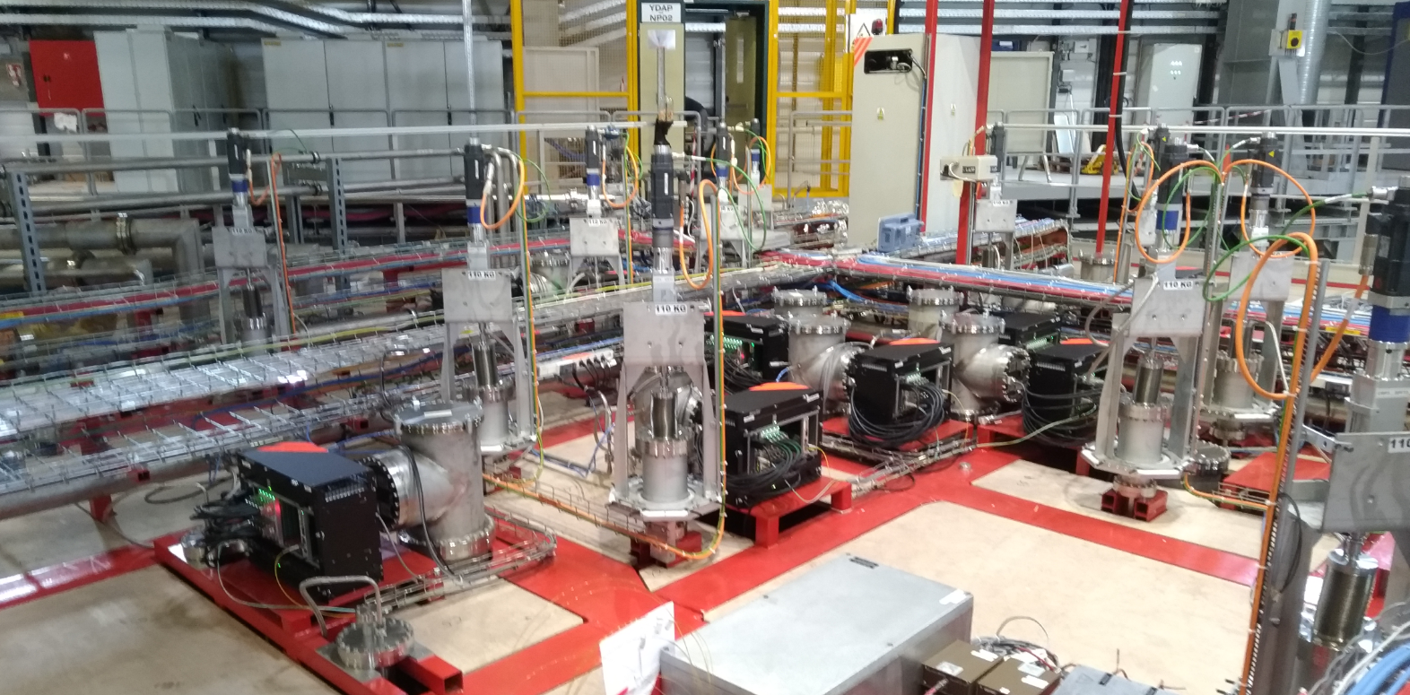
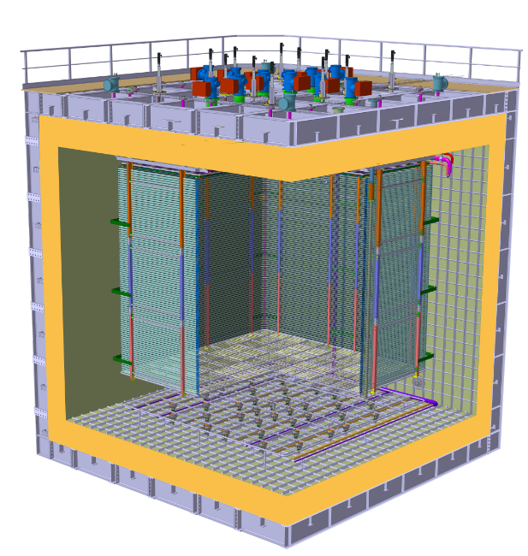
10 kton DP design based on protoDUNE dual-phase:
protoDUNE-DP 4 Charge Readout Planes → 1/20 of 10 kton DP (80 CRPs)
All detector components of ProtoDUNE-DP installed since March 2019
Digital electronics in uTCA crates
Cold FE electronics in
SFT chimneys
Charge Readout Planes
Field Cage modules
Cathode modules
36 cryogenic photomultipliers Hamamatsu R5912-02mod with WLS coating

Slide 22
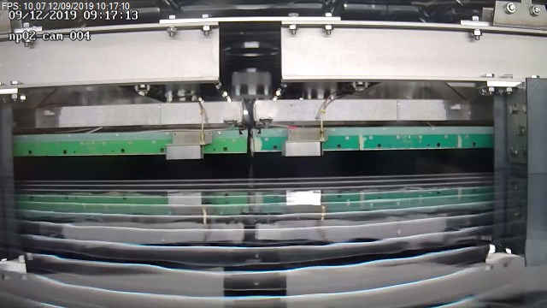
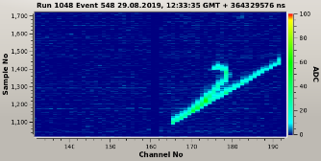
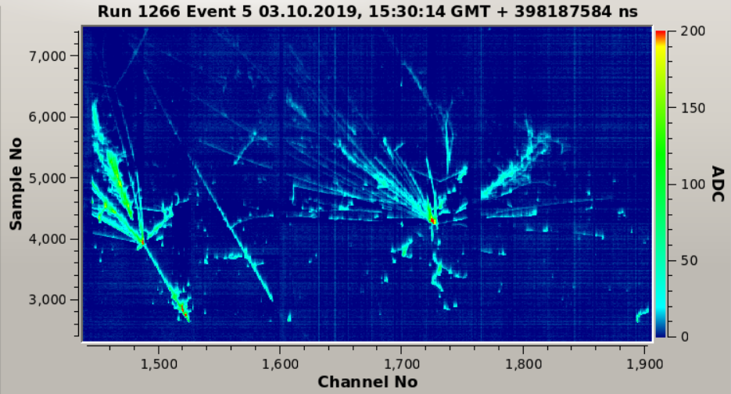
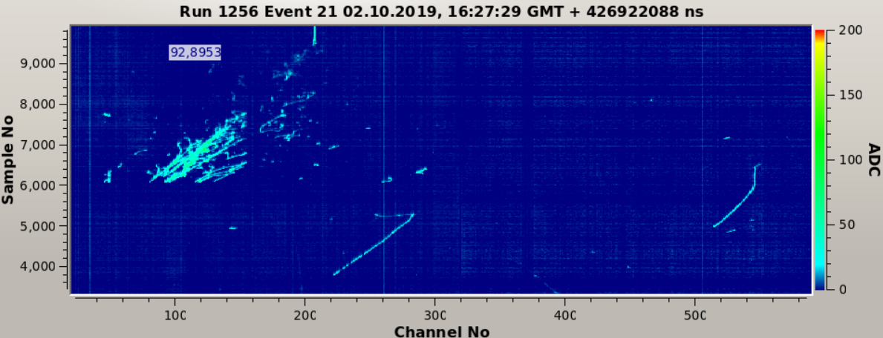
ProtoDUNE dual-phase commissioning
Cryostat filling completed on August 9th
CRPs level meters calibration and alignment activities and HV tests
performed until August 28th
Observation of first short tracks on 29/8 with CRP1 LEMs brought to 2.9 kV ΔV
grid voltage 6kV, electrons lifetime 200 us
Gradual increase of running conditions
events taken with LEMs @ 3.2 kV ΔV,
commissioning in progress, > 1.2 M events collected
One of the very first tracks

Slide 23
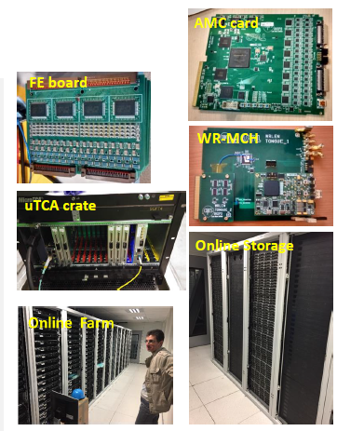
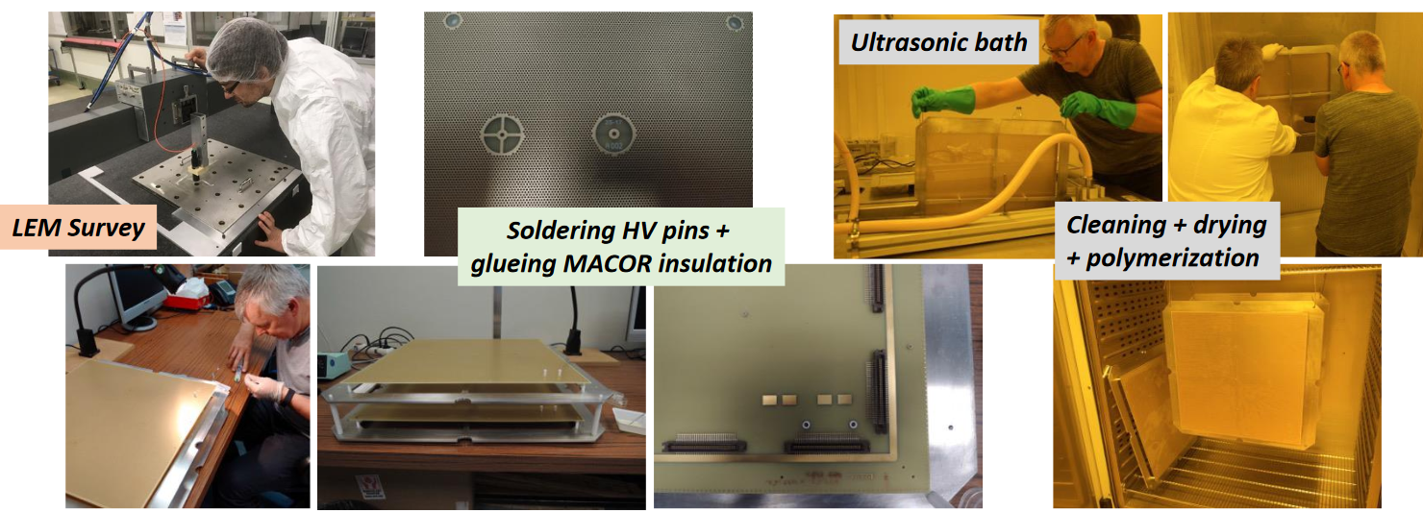
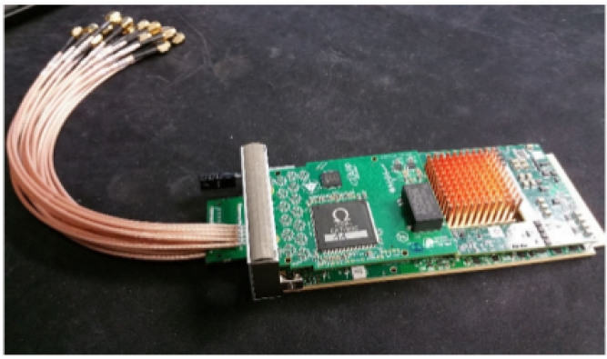
CEA/Irfu and IN2P3 DUNE groups have been involved in ProtoDUNE-DP (formerly known as WA105) since 2013 and in DUNE since its creation (2014-2015)
Current IN2P3 groups APC, IP2I, LAL, LAPP, LPSC (involvement in DUNE dual-phase detector, computing and physics analysis)
Inscription of DUNE to TGIR roadmap March 2018
DUNE project reviewed by CS-IN2P3 June 2018
CEA/IN2P3 TGIR project for DUNE+ PIP II being reviewed by the
HC TGIR
Charge readout analog/digital electronics, DAQ
LEM/anodes
Light readout electronics
Charge Readout Planes

Slide 24
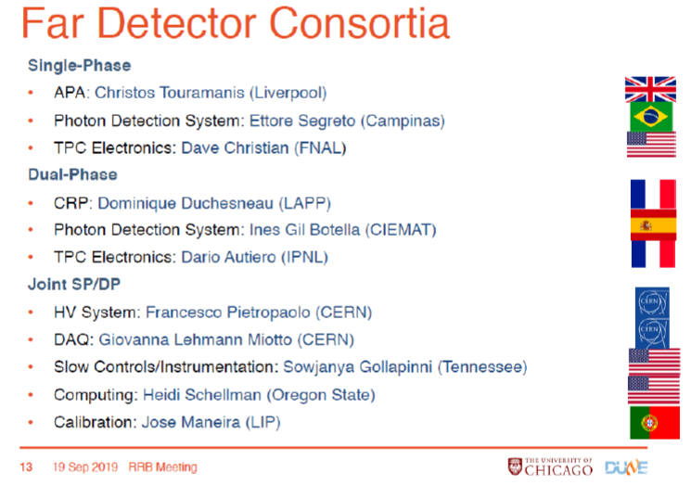
Far Detector:
Intermediate Design Report (Summer 2018)
Technical Design Report (Detectors + Physics) being completed now

Slide 25
Conclusions:
DUNE is an ambitious international project with a broad physics program
Unambiguous 𝜈 mass ordering. CP violation at >5𝜎 for most 𝛿 values
Precision determination of oscillation parameters
Rich physics with supernova neutrinos
Wide-ranging searches for physics beyond the Standard Model
LBNF and DUNE are strongly supported by the US. LBNF is advancing well
The French groups have a strong involvement in DUNE dating from its birth, supported by the participation to the LAGUNA/LAGUNA LBNO programs and the R&D on LAr started in 2006. They have intensively contributed to the preparation and construction of protoDUNE dual-phase and to the dual-phase FD activities in DUNE as well as to the physics and computing activities. A TGIR project for DUNE+ PIP II is in preparation
A continuous support is provided by the CERN neutrino platform to the two ProtoDUNE detectors. ProtoDUNE-DP construction has been completed by June, its filling on August 10th, first tracks observed on August 29th. The running and understanding of the detector are in progress. An after LS2 program is also foreseen
The DUNE TDR volumes, including the Physics update are being completed
The running and exploitation of DUNE provides IN2P3 a very long-term perspective for at least a decade since 2026 with a very reach physics program in neutrino oscillations and astro-particle physics. The program offfers opportunities for having new groups joining and large perspectives of growth of the involved French community, and capitalizing the preparation and R&D efforts occurred over the last 13 years.
.

Slide 27
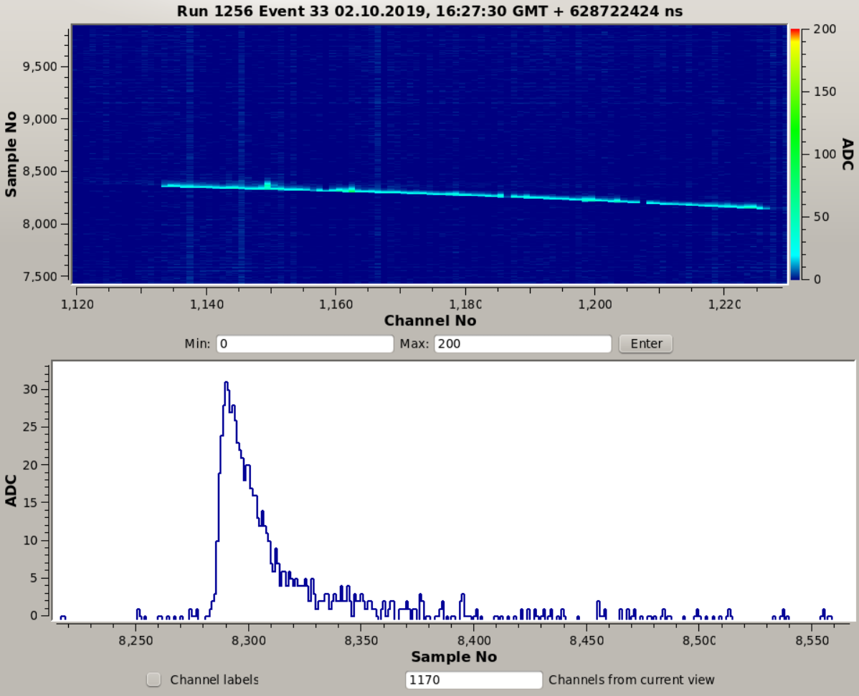
Horizontal muon track
3.1 kV at 1010 mbar, grid at 6100V
No noise filtering
Waveform of a hit on channel 1170
Reconstructed charge proportional to the integral of the hit waveform
Low noise

Slide 28
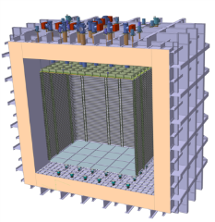
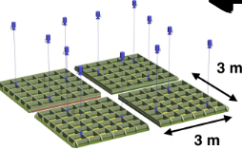
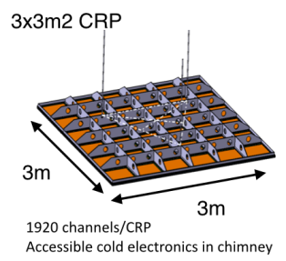
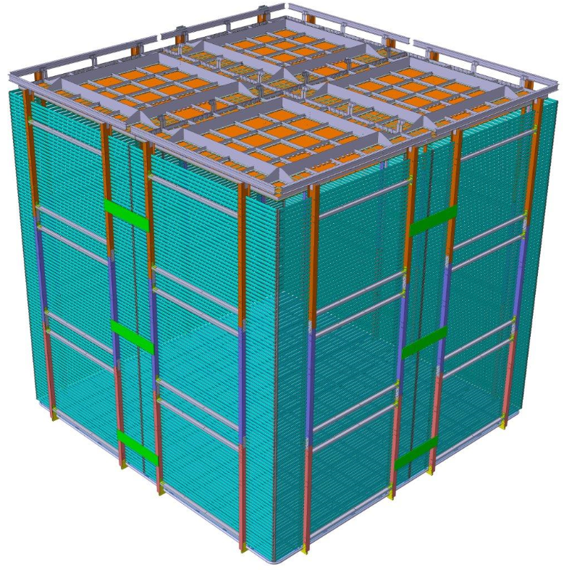
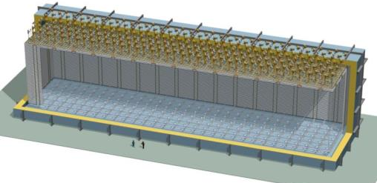
The Dual-Phase ProtoDUNE/WA105 6x6x6 m³ detector is built out of the same 3x3m² Charge Readout Plane units (CRP) foreseen for the 10 kton Dual-Phase DUNE Far Detector (same QA/QC and installation chains)
WA105: 4(2) CRP
10 kton: 80 CRP + 288 field cage sub-modules + 80 cathode/ground grid modules
6 m
12 m
6 m
6 m
60 m
28

