Slide 1

Quelle stratégie de développement de nos installations de physique nucléaire?
Groupe de réflexion: physiciens et ingénieurs des labos de l’IN2P3
- Angot, Julien, LPSC - Assié, Marlène, IJCLab - Ascher, Pauline, CENBG - Beaumel, Didier, IJCLab - Blank, Bertram, CENBG - Blumenfeld, Yorick, IJCLab - Bougault, Rémi, LPC Caen - Càceres, Lucia, GANIL - Cheikh Mhamed, Maher, IJCLab - Clément, Emmanuel, GANIL - De France, Gilles, GANIL - Delahaye, Pierre, GANIL - De Oliveira, François, GANIL - Dorvaux, Olivier, IPHC - Dubois, Mickaël, GANIL - Ducret, Jean Eric, GANIL - Estienne, Magali, Subatech Nantes - Fallot, Muriel, Subatech Nantes - Flavigny, Freddy, LPC Caen - Franberg, Hanna, GANIL - Gall, Benoît, IPHC - Georgiev, Georgi, IJCLab - Grévy, Stéphane, GANIL / CENBG - Harakeh, Muhsin, KVI | - Ibrahim, Fadi, IJCLab - Jardin, Pascal, GANIL - Leblanc, François, IJCLab - Lecesne, Nathalie, GANIL - Lewitowicz, Marek, GANIL - Liénard, Etienne, LPC Caen - Lunney, David, CSNSM - Matta, Adrien, LPC Caen - MacCormick, Marion, IJCLab - Maunoury, Laurent, GANIL - Mattea, Iolanda, IJCLab - Minaya Ramirez, Enrique, IIJCLab - Orr, Nigel, LPC Caen - Porta, Amanda, Subatech Nantes - Perrot, Luc, IJCLab - Piot, Julien, GANIL - Quéméner, Gilles, LPC Caen - Serani, Laurent, CENBG - Savajols, Hervé, GANIL - Stefan, Iulian, IJCLab - Stodel, Christelle, GANIL - Thuillier, Thomas, LPSC - Verney, David, IJCLab - …
Consultation aussi large que possible
Hormis les agents du GANIL, le CEA n’a pas participé
Plusieurs sous groupes créés pour l’étude de différents scénarios
Etudes très préliminaires

Slide 2
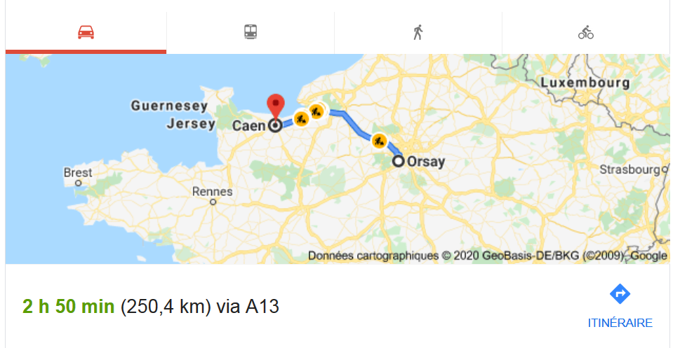
Radioactive ion beam facilities in France
2 facilities: ALTO @IJCLab and GANIL-SPIRAL2

Slide 3
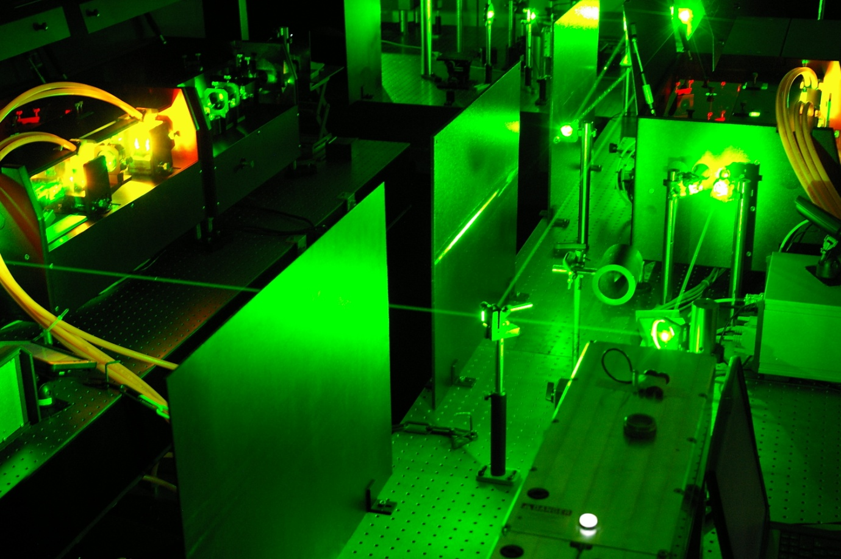
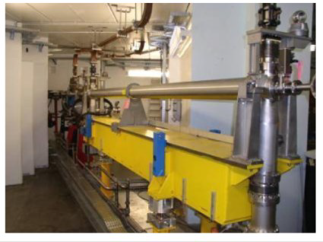
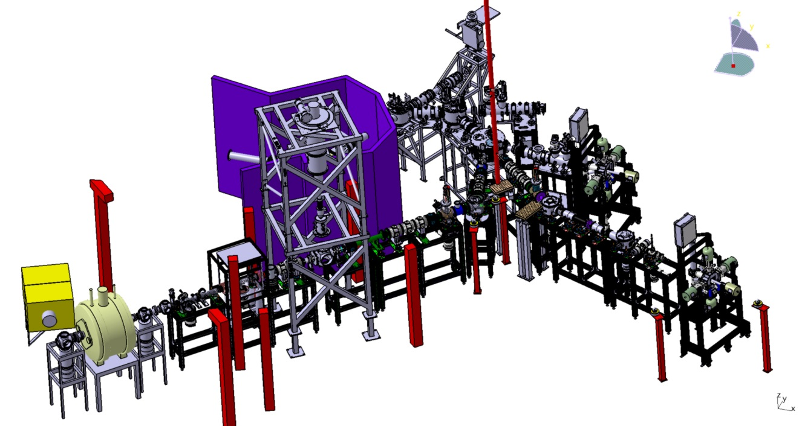
Photofission (installation pilote)
JCLab
Orsay
RILIS station
Identification station
e⁻ LINAC
ISOL ROOM
PARRNe mass separator
TETRA
BEDO
Experimental areas
LINO
10¹¹ fissions/s
Target ion source
Ex: 3⋅10⁷ pps of ¹³²Sn
500W e⁻ sur cible UCx
Faisceaux ISOL de basse énergie
Décroissance, piégeage
Existing experiments
POLAREX
MLLTRAP
Experiments under construction

Slide 4

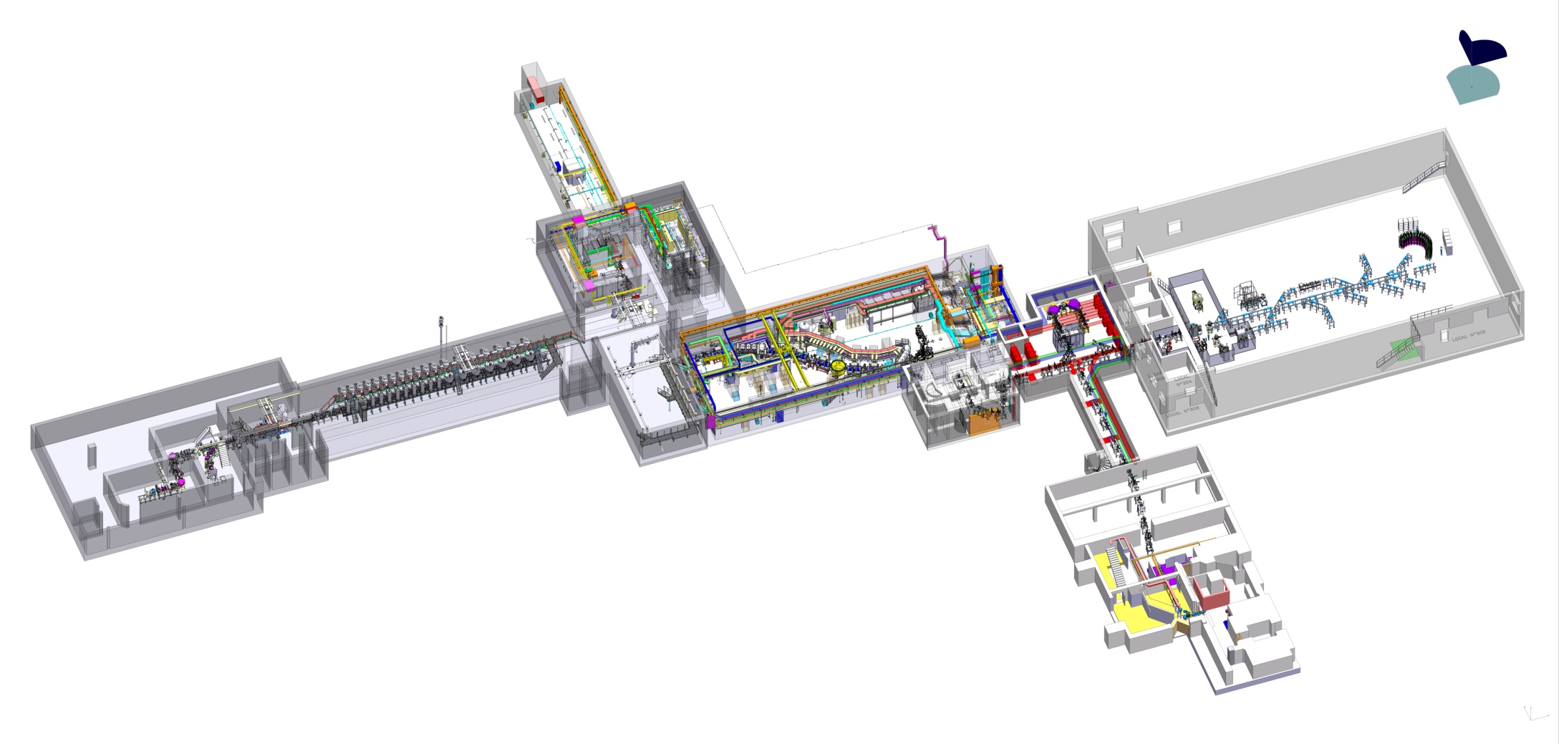
GANIL-SPIRAL 2 – Phase 1
Neutron for Science
Neutrons up to 30 MeV
Experimental areas for very low energy beams:
below 1 eV to 60 keV
High intensity beams of light particles and heavy ions
p, d, He (1-5mA) 30-40 MeV
Heavy ions (1-10 pµA) 14.5 AMeV
NFS
DESIR
SPIRAL 2 LINAC
S3
Super Separator Spectrometer
In flight radioactive ion beams + gas cell
Fusion/transfer reactions
GANIL
Experimental areas and cyclotrons: heavy ions (pµA) up to 95AMeV
SPIRAL 1 facility: RIBs from fragmentation

Slide 5
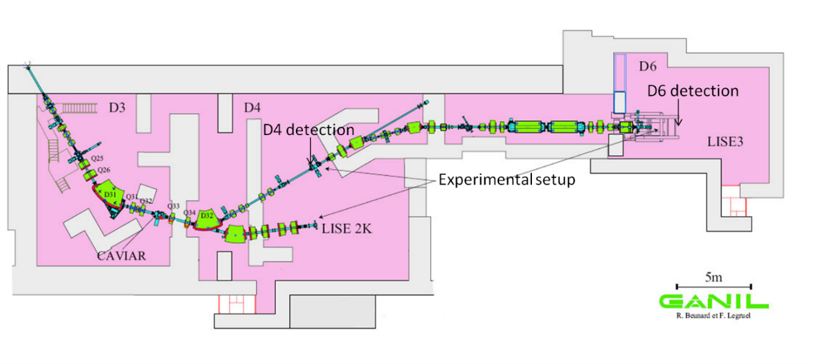
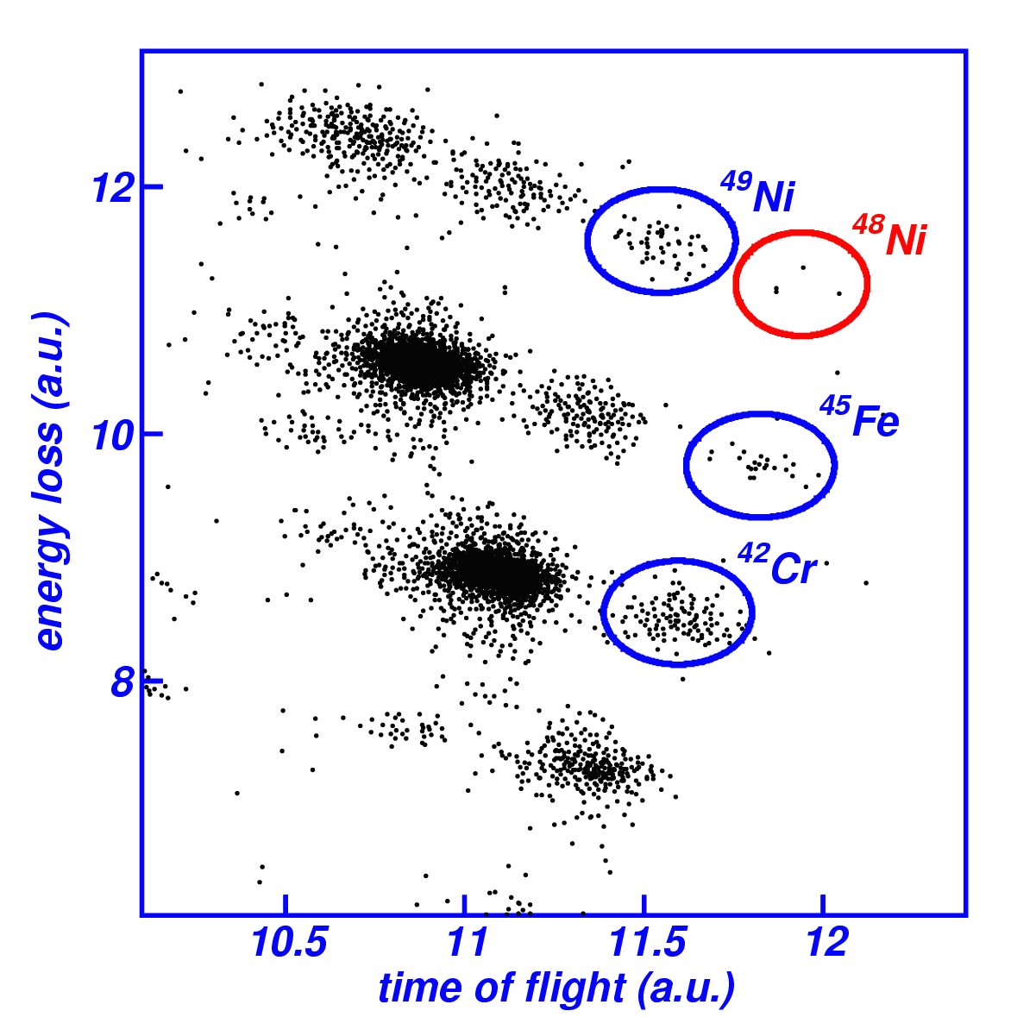
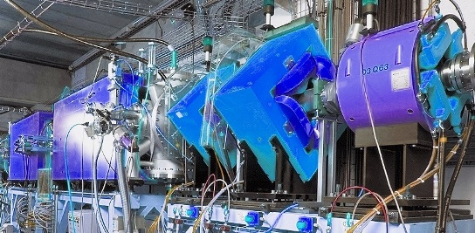
In-flight fragmentation in LISE
GANIL: pioneer facility for in-flight fragmentation techniques
since the 80’s at LISE, SPEG and SISSI
Method still used and continuously evolving at LISE
Is an international in-flight facility a plausible upgrade plan for GANIL-SPIRAL2?

Slide 6
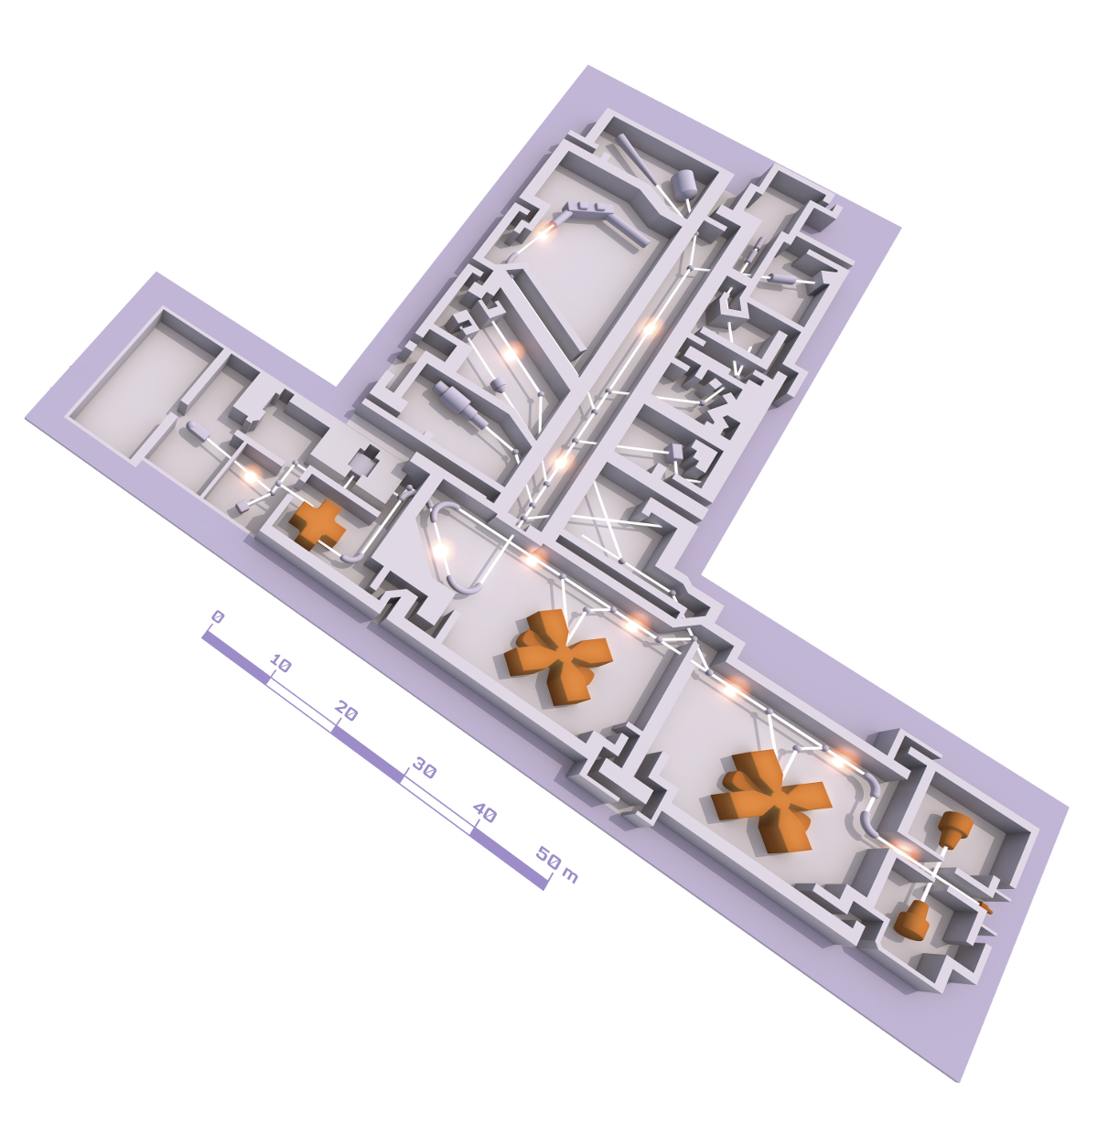
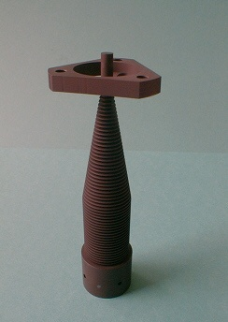
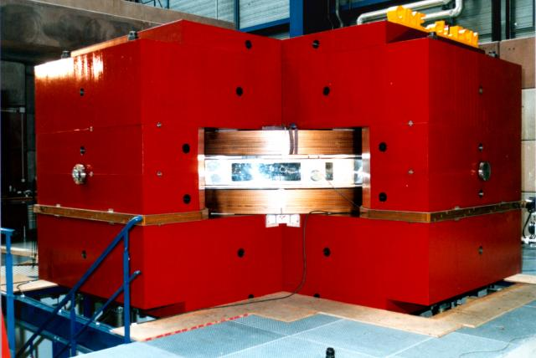
Re-accelerated beams at SPIRAL 1
Isotope Separation On Line (ISOL) techniques in GANIL
Since 2001
Heavy ion fragmentation on graphite targets
Target station
Ex:
⁶He@10keV 3⋅10⁸pps
⁶He@20AMeV: 5⋅10⁶pps
^{38m}K@9 AMeV: 7⋅10⁵pps
LIRAT
CIME
Heavy ion sources and C0
(¹²C up to ²³⁸U)
« Cyclotron d’ions de moyenne énergie »
CSS2
CSS1
Stable ions up to 95 AMeV
Re-acceleration of radioactive ion beams up to 20A MeV

Slide 7
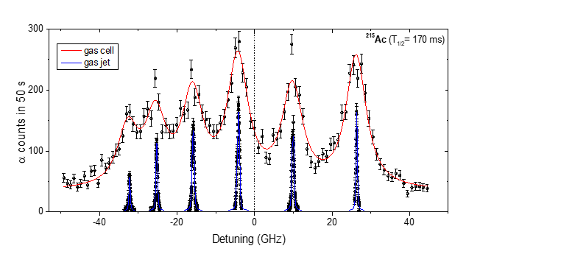
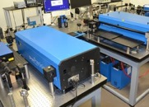
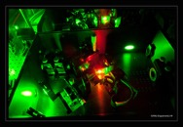
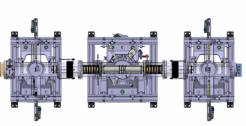
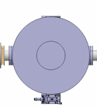

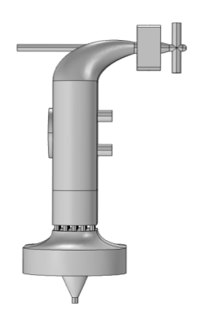
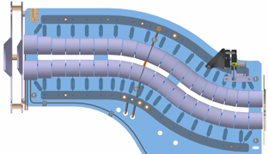
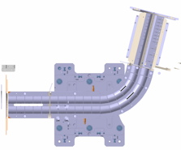


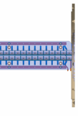
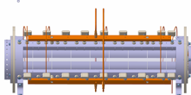
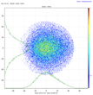
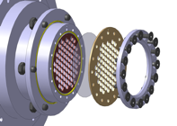








Gas cell in S3 - LEB
REGLIS (Rare Element in Gas-jet Laser Ionisation and Spectroscopy)
in cell (6 GHz)
in jet (400 MHz)
PILGRIM
MR ToF MS
Ex:
¹⁰⁰Sn@30keV ~10 pps
in-gas-jet
Ionization
(medium resolution)
λ₁
SEASON
Decay detector
A few pps to 10⁵ pps
N=Z beams and
superheavies
in-gas-cell
Ionization
(low resolution)
bender
E~0.1 MeV/u
λ_{1,2}
λ₂
Pulse up
(~ 3 kV)
From S³
Commissioning in 2023
Nominal intensities with A/q=7 injector
→ 2027
EVRs
towards DESIR
Neutralized EVRs
Photoions
S-shape RFQ
RFQ
Cooler
Buncher
gas cell
He: 10⁻² - 10⁻³ mbar
diff. pumping
mRFQ
QMF
(m/Δm ~ 100)
Entrance window
Ar: 200 - 500 mbar

Slide 8
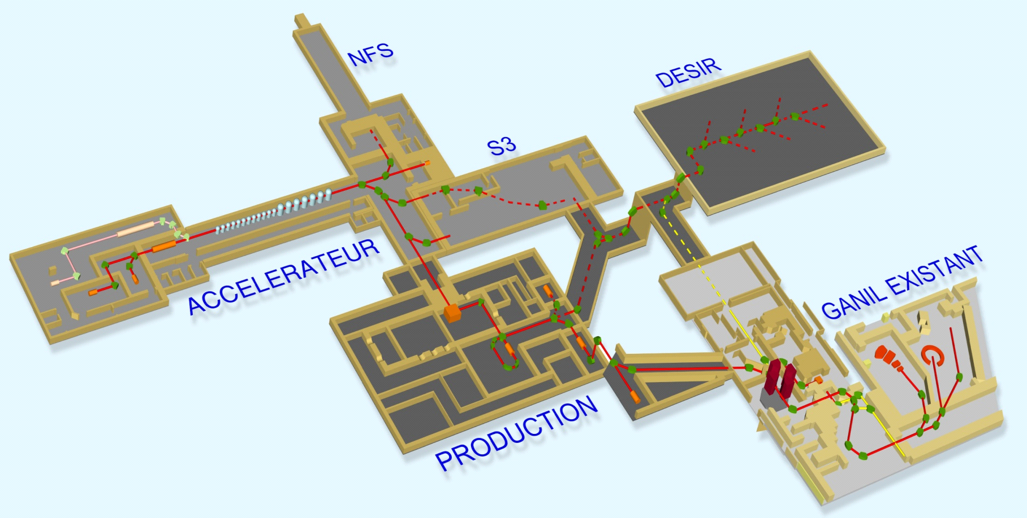
A/Q = 7 Injector
I. Stefan Scientific Coordinator M. H. Moscatello Technical Coordinator
New injector for Linag presented in:
Spiral2 Physics Case, page 171 (2006)
A/Q=3 (existing): E<=14.5 MeV/A
A/Q=7 : E<=7 MeV/A
A/Q=7
New beamline?
not part of this project
good future opportunity
independent of S3
advantageous use of heavy
beams (Pb,U)
A/Q=7 injector
High Intensity
(HI≤ 10¹⁵ pps, p-U)
New line
7 years project: estimated cost ~12 MEuro
Starting year (2020!?) | Starting year+1 (2021!?) | Starting year+2 (2022!?) | Starting year+3 (2023!?)
Construction -> End starting year+7 (2027!?)
Preliminary Definition Phase
Detailed Definition Phase

Slide 9















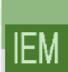



A/Q = 7 Injector
Ions | Intensity (pµA) [A/Q=3] | Intensity [A/Q=7]
¹⁸O | 216 | 375
¹⁹F | 57 | 50
³⁶Ar | 35 | 40
⁴⁰Ar | 5.8 | 30
³⁶S | 9.2 | 30
⁴⁰Ca | 6 | 20
⁴⁸Ca | 2.5 | 15
⁵⁸Ni | 2.2 | 10
⁸⁴Kr | 0 | 20
¹²⁴Sn | 0 | 10
¹³⁹Xe | 0 | 10
²³⁸U | 0 | 2.5
A/Q=7
Solidify and strengthen the existing physics plan for S3, LEB & DESIR
(see talks by L. Caceres and A. Lopez-Martens)
New opportunities
inverse kinematics, multi-nucleon transfer, fusion-fission
D. Ramos et al PRC 97, 054612 (2018)
I. Stefan et al PLB 779, 456 (2018)
Future workshop to solidify those options
✕~5
✕10^{x}
Collaboration S3-LEB-SIRIUS-DESIR
9
9

Slide 10

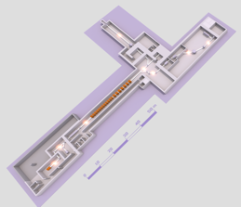

A/Q = 7 Injector: competition
beam intensities [particles/s]* | SPIRAL2 GANIL, Caen |  | SHE factory FLNR, Dubna | RIKEN Nishina Center Wako (Tokyo) |  | GSI Darmstadt
 | LINAG A/q=3 | LINAG A/q=7 (project) | DC-280 | RILAC | RRC (RILAC(2) as injector) | UNILAC (cw-linac project >10×)
¹⁸O | 1.3x10¹⁵ | 2.3x10¹⁵ | 1x10¹⁴ | 6.2x10¹³ |  | 6.2x10¹²
¹⁹F | 3.5x10¹⁴ | 3.1x10¹⁴
³⁶Ar | 2.2x10¹⁴ | 2.5x10¹⁴
⁴⁰Ar | 3.1x10¹³ | 1.9x10¹⁴ | 6x10¹³ | 6.2x10¹³ | 5x10¹² | 5x10¹³
³⁶S | 5.5x10¹³ | 1.9x10¹⁴
⁴⁰Ca | 0.4x10¹⁴ | 1.2x10¹⁴
⁴⁸Ca 100% enriched | 0.2x10¹⁴ | 0.9x10¹⁴ | 0.6-1.2x10¹⁴ | 1.9x10¹³ | 1.6x10¹² | 5x10¹²
⁵⁴Cr | (5x10¹²) | (2x10¹³) | 2x10¹³
⁵⁸Ni | 1.4x10¹³ | 6.2x10¹³ |  |  |  | 1.3x10¹²
⁵⁸Fe |  |  | 1x10¹³ | 6.2x10¹³
⁷⁰Zn |  |  |  | 6.2x10¹³ | 6.2x10¹³ | 4x10¹²
⁸⁶Kr | 0 | 1.2x10¹⁴ |  | 6.2x10¹³
¹²⁴Sn | 0 | 6.2x10¹³ | 2x10¹²
¹³⁶Xe | 0 | 6.2x10¹³ | 1x10¹⁴ | 6.2x10¹³ | 1.6x10¹²
²³⁸U | 0 | 1.6x10¹³ | 5x10¹⁰ | 1.2x10¹² | 3.1x10¹²
* 1 particle μA = 6.2 x10¹² particles/s
A/Q=6 or 7
LINAG
A/Q=1 and 3
DC-280
RILAC
RRC
+ cw-LINAC
UNILAC
Best intensity
Relevant beams for the exiting Spiral2 program (see talks by L. Caceres and A. Lopez-Martens)
Opportunity to be developed in the future

Slide 11
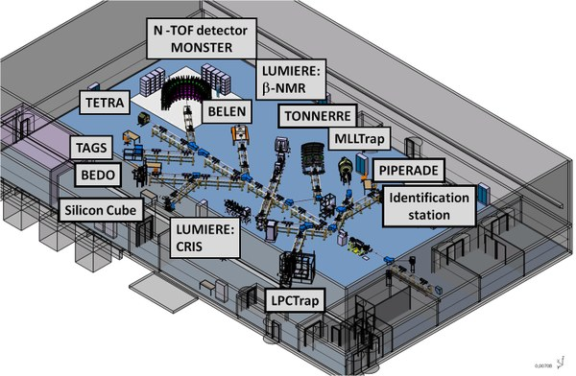
DESIR facility
2024-…
Very low energy beams:
Spectroscopy of ground state properties of exotic nuclei produced at S3-LEB and SPIRAL 1
Traps, laser systems, and decay spectroscopy
Beams from S3-LEB and SPIRAL1

Slide 12
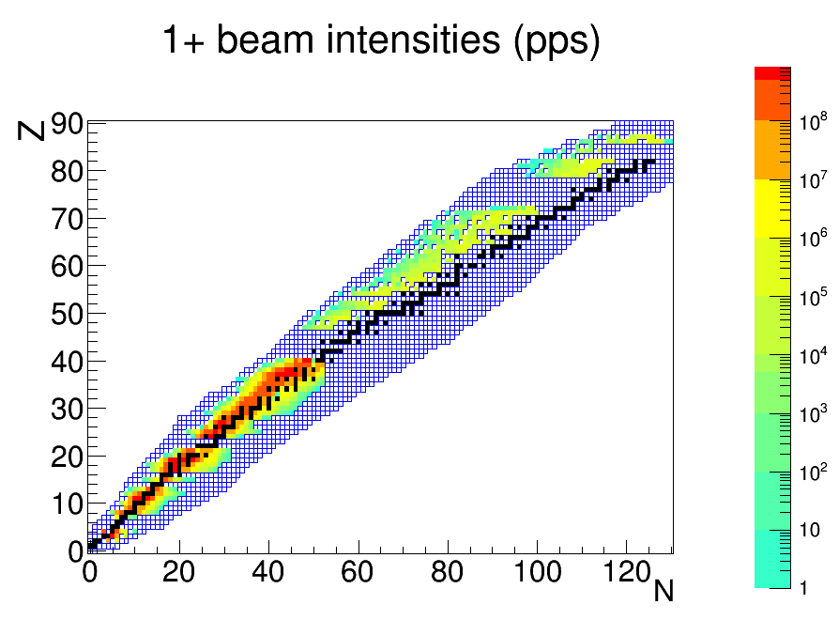
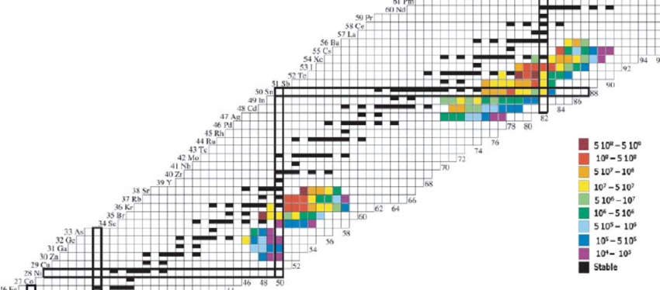
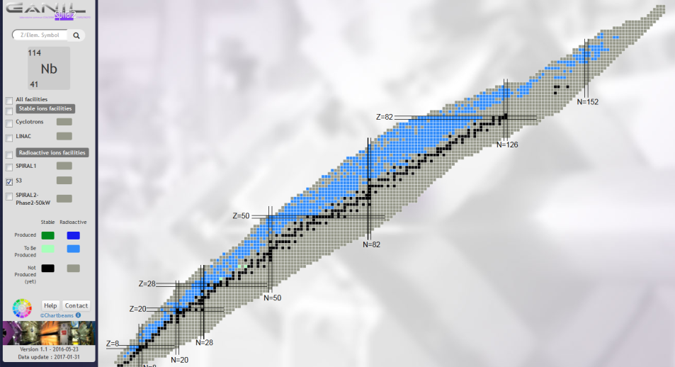
Production at ALTO, SPIRAL 1 & S3-LEB
ALTO
SPIRAL 1
ISOL facility with very intense beams from fragmentation
  A<80:
    Unequalled intensities for some beams
    competitive yields for others
    Interesting estimates from the upgrade
  A>80: Interesting estimates using
  fusion-evaporation reactions, with a
  possibility of reacceleration
Pioneering facility for photofission
Comparable to ISOLDE for ¹³²Sn when using p beam on n converter (~ 10⁷pps)
Fusion - evaporation targets
Fragmentation targets
S3
Facility with unique perspectives for fusion evaporation reactions
  Projected yields are unique for N=Z nuclei
  Projected yields are very competitive for Superheavy nuclei

Slide 13
Present situation
Today - 2020
  2 weeks to 1 month of radioactive beam time at ALTO
  3 months beam time at GANIL per year
  Includes 5 weeks SPIRAL 1 operation, 1 week beam R&D and 3 weeks LISE experiments
  ~1 new beam per year for each RIB facility (ALTO/SPIRAL1)
    With very little time for R&D, the in-beam physics program at SPIRAL 1 is difficult to prepare
    High level physics program for the next ~10 years, what about thereafter?
S3 et S3-LEB: from 2024 onwards
  Unique yields foreseen for N=Z, and Very Heavy / Superheavy nuclei
  Highly ambitious program depends on the A/q=7 upgrade (2027)
    The physics accessible offers perspectives for a part of the community
    N=Z and Superheavy nuclei require extensive beam time, DESIR program in danger at startup
SPIRAL 2 Phase 2: suspended
  Projection of unique yields for long lived fission products (¹³²Sn)
  Rich physics program was very attractive
    No clear timescale and no resources allocated
      Loss of competitiveness compared to HIE-ISOLDE and SPES
      DESIR physics program with neutron rich nuclei will be missing
      Role of ALTO as an R&D facility for SPIRAL 2 is strongly weakened

Slide 14
As a foreword to the following, our considerations were based on…
Bottom line
Ambitions
Optimizing the use of existing facilities and in particular SPIRAL 2
Maintaining a high quality level of scientific production
Assuming constant human ressources
Attempting to meet the desires of the community as a whole
Providing attractive facilities for original scientific production
Consolidating GANIL relations with IN2P3 labs and CEA/IRFU
Attracting new communities; developing interdisciplinary science; addressing societal questions

Slide 15
What should we do?
Continue to dream of phase 2?

Slide 16
2015: analysis of the phase 2 physics program
high:
World leading
medium:
Important
contribution
Low:
Marginally
competitive or
not feasible
Présentation H. Savajols (GANIL 2025)
2015: The international context has since evolved

Slide 17
International context – ISOL/fission
HIE-ISOLDE operational
  The EPIC project: 2 GeV upgrade, more target stations, new experimental areas…
SPES starting in 2022
TRIUMF: ISAC2
  ISAC2 p+UCx already operational
  ARIEL (photofission) will be coming up around 2023
Phase 2: 203x?
  200kW ²H impinging on C converter
  Uses 2.5kg UCx HD targets
  Aims for 10¹⁴ fissions/s
    Latest evaluation predicts 3⋅10¹³ fissions/s
    ENSAR/ACTILAB (2014) studies show long diffusion times from UCx HD targets
    → a real penalty for short-lived isotopes
+Projets at Asian facilities
RISP(RAON), BISOL
All these facilities potentially reach ~10¹³ fissions/s
A late phase 2 is no longer competitive

Slide 18
What should we do?
Continue to dream of phase 2?
  Too late, no longer competitive
  Technically cumbersome: high fission rate for comparatively modest yields
Create a new in-flight facility?

Slide 19
International context – In-flight fragmentation
Radioactive Ion Beam Factory (RIBF) at RIKEN operational (>500M$)
  Record in-flight beam intensities; ~350A MeV beams with 4 cyclotrons
  Ongoing upgrade to multiply primary beam intensities x30 (40M$ upgrade)
FRIB coming on-line in 2022 (>500M$)
  Key Feature is 400kW beam power (200 MeV/u 5 x10¹³ U8/s)
FAIR 203x (>1B€)
  Will be the most advanced in-flight facility with antiprotons and nuclei from rest to 4.9A GeV
  Physics program started (“FAIR 0”)
+Projets at other ASIAN facilities
RAON, HIAF
A competitive in-flight facility seems out of reach

Slide 20
What should we do?
Continue to dream of phase 2?
  Too late, no longer competitive
  Technically cumbersome: high fission rate for comparatively modest yields
Create a new in-flight facility?
  A competitive facility seems out of reach
Improve on what we already do (or will do)?
  LISE
    Very difficult to compete with in-flight facilities
  SPIRAL 1

Slide 21
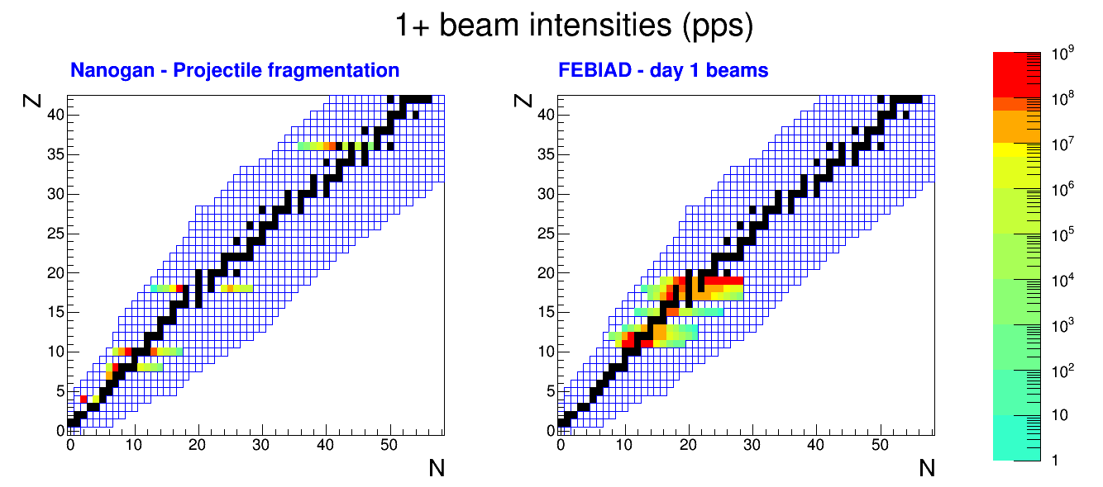
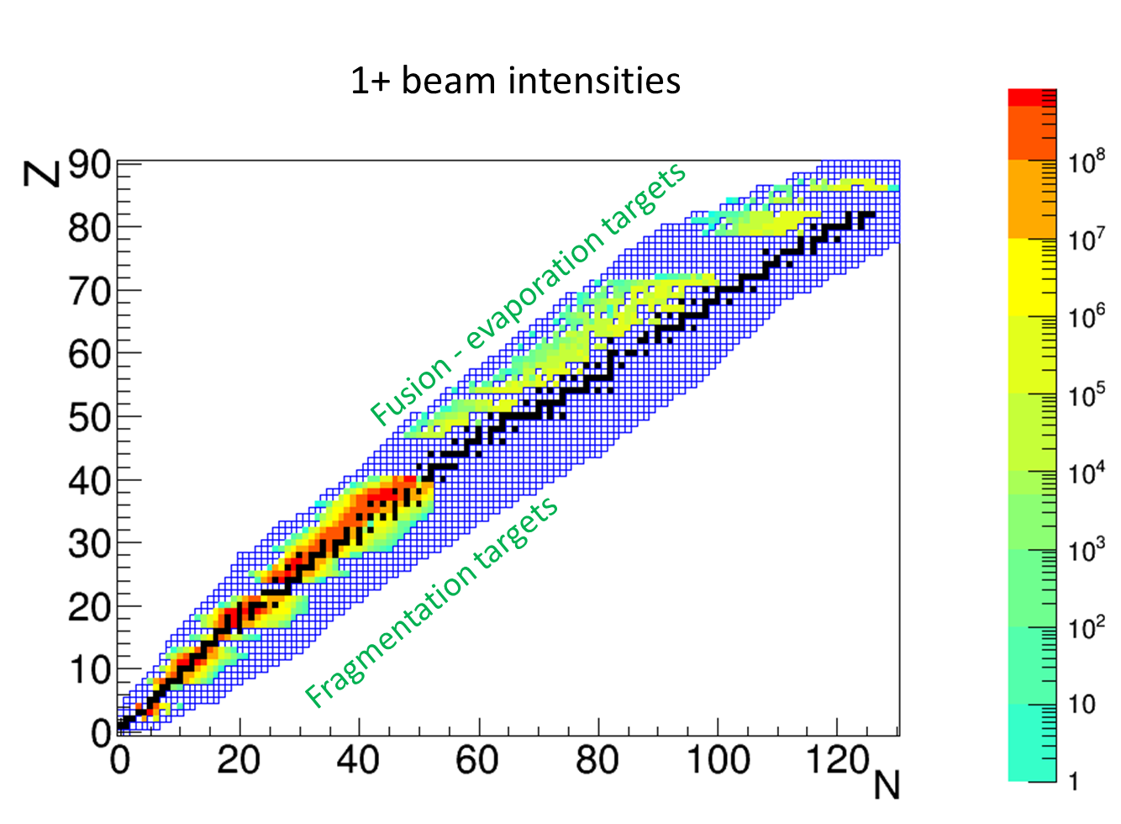
SPIRAL 1 estimates
Let’s imagine
  From today (2020) to tomorrow (20XX)
2001 - 2013
2020 –
With target developments

Slide 22
SPIRAL 1 estimates
Let’s imagine
  From today (2020) to tomorrow (2020+50?)
2001 - 2013
2020 –
1 target station with 5-10 weeks/year
Present objective of ~1 new element / year

Slide 23
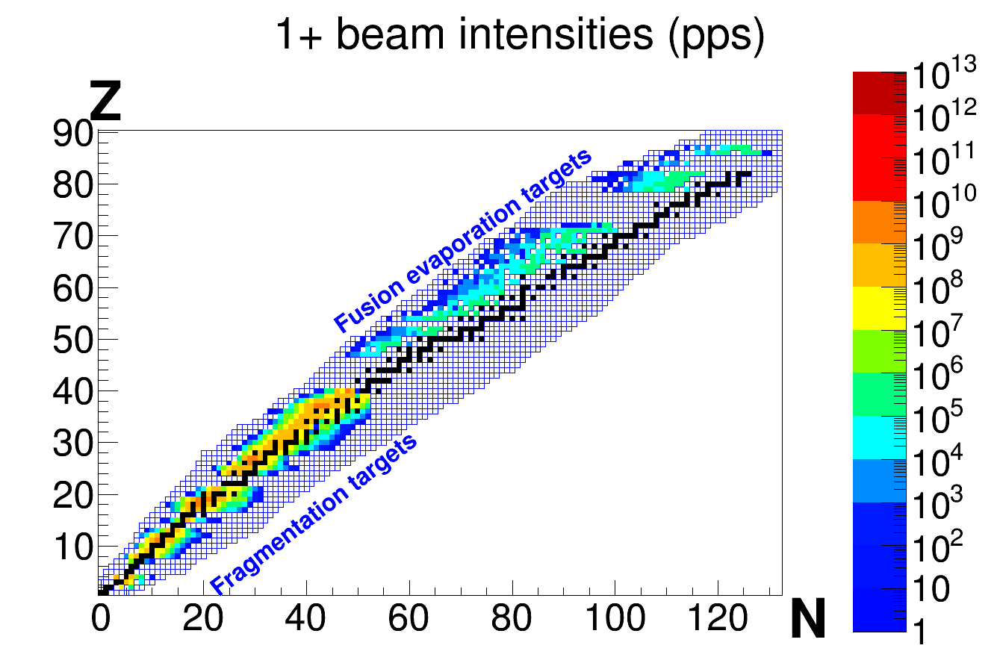
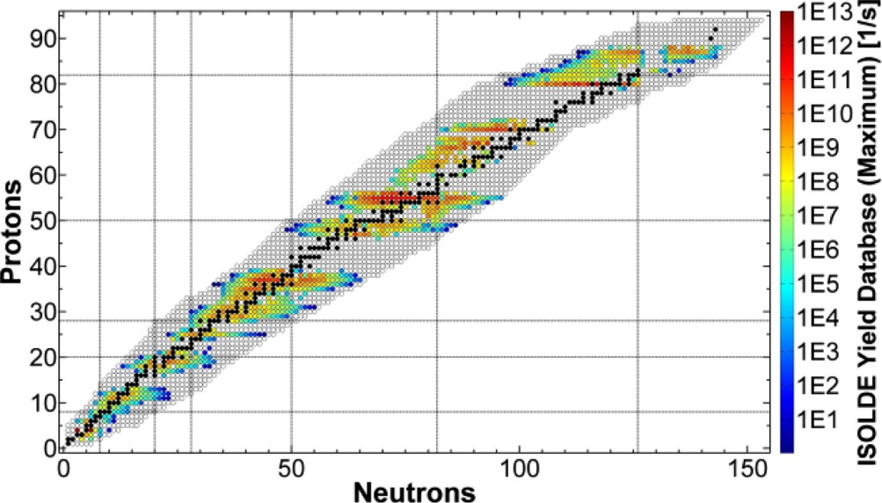
SPIRAL 1 estimates
Let’s compare
ISOLDE today (1970-2015)
SPIRAL 1 tomorrow (20XX?)
100% ISOL based facility
1+ beam intensities (pps)
A. Gottberg, Proceedings of the EMIS 2015 Conference, NIMB 316
~25-30 target ion source systems on-line per year
~2 - 6 target ion source systems on-line per year
2 target stations, being extended to 4
1 target station
Technical limitations strongly limit the pace of beam development at SPIRAL 1

Slide 24
What should we do?
Continue to dream of phase 2?
  Too late, no longer competitive
  Technically cumbersome: high fission rate for comparatively modest yields
Create a new in-flight facility?
  A competitive facility seems out of reach
Improve on what we already do (or will do)?
  LISE
    Very difficult to compete with in-flight facilities
  SPIRAL 1
    Only one target station + time sharing with the rest of GANIL strongly limits the potential of the facility
  Take advantage of improved LINAC capabilities with A/Q=7

Slide 25
What should we do?
Continue to dream of phase 2?
  Too late, no longer competitive
  Technically cumbersome: high fission rate for comparatively modest yields
Create a new in-flight facility?
  A competitive facility seems out of reach
Improve on what we already do (or will do)?
  LISE
    Very difficult to compete with in-flight facilities
  SPIRAL 1
    Only one target station + time sharing with the rest of GANIL strongly limits the potential of the facility
  Take advantage of improved LINAC capabilities with A/Q=7
    Good idea for S3
    Also brings new opportunities for ISOL production in dedicated target stations
Planning one step ahead
  Several options based on a common preparatory stage: consolidated ISOL production
    Consolidated: not necessarily world leading, but highly competitive
    High intensity ISOL beams >10⁶ pps are an asset for each option
  Each option aims to be world-leading
YES
Our suggestion
YES

Slide 26
What should we do? Summary
Possible development | Analysis | ✗✓
Phase 2 | Too late | ✗
New in-flight facility | Out of reach | ✗
Improved LISE as a baseline scenario | Difficult competition from in-flight facilities | ✗
Improved SPIRAL 1 as a baseline scenario | Technical limitations for beam development | ✗
A/Q=7 | Interesting perspectives for ISOL production | ✓
Planning one step ahead | Preparing the next move by consolidating ISOL production at SPIRAL2 | ✓

Slide 27
Prospectives nationales: a new momentum?

Slide 28
Our suggestion
Converging views towards:
  A consolidation phase (2020 – 2030)
    Extending the use of the LINAC beams
      R&D for medical isotope production
      ISOL/Gas cell production with A/q=7
    (Photo)fission with a dedicated commercial accelerator
Production building
Goal: 10¹² to 10¹³ fissions/s
More modest than phase 2, but potentially equivalent yields for many isotopes
Hopefully, faster to build than phase 2 – adapting ambitions to available means
Fully dedicated driver for fission would guarantee reactive beam developments
  Off-the-shelf driver ; maintenance contract with an external company

Slide 29
Our suggestion
Converging views towards:
  A consolidation phase (2020 – 2030)
    Extending the use of the LINAC beams
      R&D for medical isotope production
      ISOL/Gas cell production with A/q=7
    (Photo)fission with a dedicated commercial accelerator
Production building
Goal: 10¹² to 10¹³ fissions/s
Gain in coherence of a multi-user facility:
Both DESIR and S3 physics programs become achievable
Role of ALTO as an R&D base is strengthened
Reactive beam R&D with multiple drivers and target stations
Optimised use of the LINAC becomes possible for other applications
Preparation of the ambitious phase can be done

Slide 30
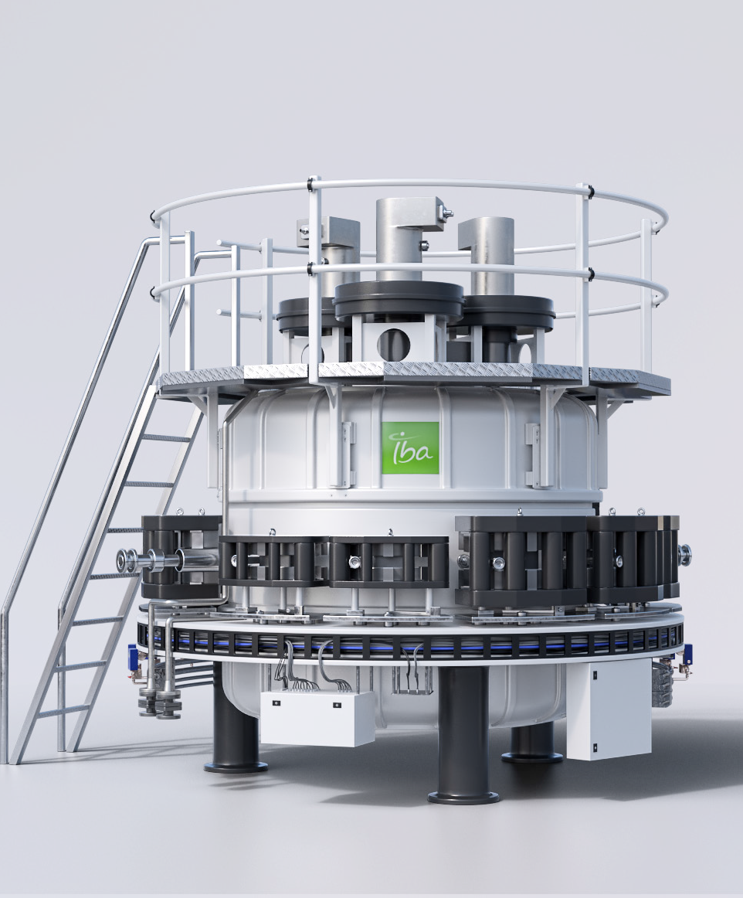
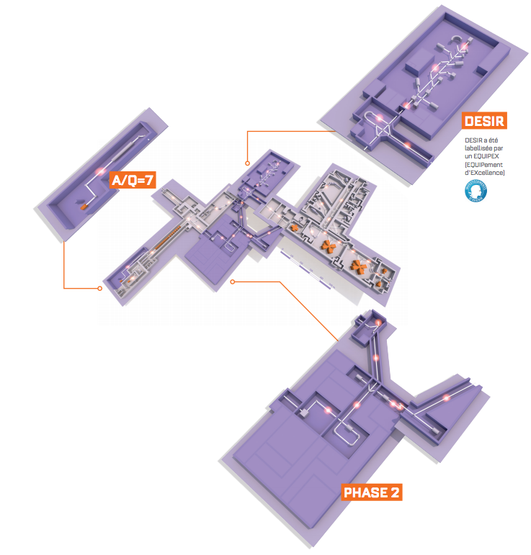


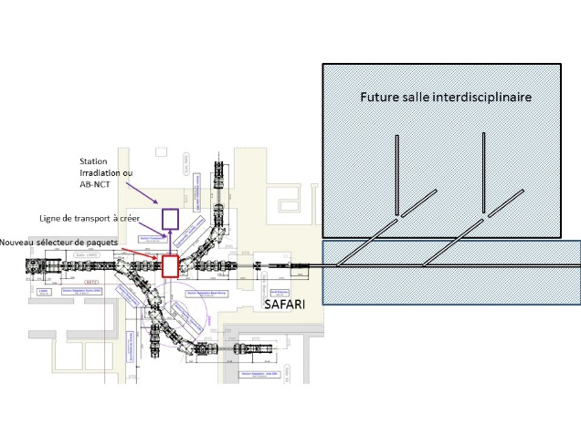
Phase de consolidation
<10 ans
Plusieurs caves de production ISOL / gas cell avec driver dédié qui supplémente le LINAC
Réactions de fusion/transfert avec les faisceaux du LINAC
Photofission/fission induite par particule légère (p,d, ³He/⁴He): jusqu’à~10¹³ fissions/s en utilisant l’expertise d’ALTO
Rhodotron® TT300-HE
High Energy Electron Generator
Utilisation des paquets non utilisés par NFS pour les applications médicales

Slide 31
Our suggestion
Converging views towards:
  A consolidation phase (2020 – 2030)
    Extending the use of the LINAC beams
      R&D for medical isotope production
      ISOL/Gas cell production with A/q=7
    (Photo)fission with a dedicated commercial accelerator
Production building
Goal: 10¹² to 10¹³ fissions/s
Multi-user ISOL facility

Slide 32
Our suggestion
Converging views towards:
  A consolidation phase (2020 – 2030)
    Extending the use of the LINAC beams
      R&D for medical isotope production
      ISOL/Gas cell production with A/q=7
    (Photo)fission with a dedicated commercial accelerator
  An ambitious phase (>2030)
    Three alternative scenarii
      1) Electron scattering on trapped radioactive ions
      OR
      2) Radioactive Ion Beam reacceleration up to 100A MeV
      OR
      3) Storage ring for transfer reactions
Production building
Goal: 10¹² to 10¹³ fissions/s
Multi-user ISOL facility
Common prerequisite

Slide 33
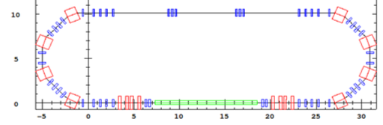
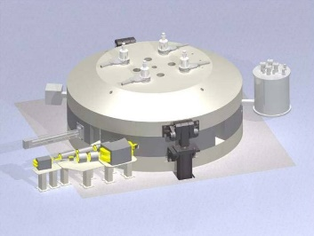
Phase plus ambitieuse
1 option au choix…
Diffusion d’électrons (~500-750 MeV)
Sonde électromagnétique pour les noyaux
exotiques : (e,e’), (e,e’p), fission, etc.
40 m
Design préliminaire:
Chancé
(CEA)
GANIL 2025
10 m
e⁻ intensity
100-200 mA
Anneau de stockage à ~10 AMeV
Réactions de transfert et physique atomique
Réaccélération à ~100 AMeV
Physique in-beam aux énergies de Fermi
Ex:
TSR @HIE-ISOLDE
M. Grieser et al,
EPJ ST 207
Concept de cyclotron
C400 ARCHADE

Slide 34
Detailed study of the scenarii
Consolidation phase
  Adapting the ambitions to the desired timescale
  A step-by-step approach for a production building is possible
    Allowing successive upgrades of target stations
    Adapting the fission rate to relatively easy-to-achieve objectives
    Re-visiting the preparatory studies of SPIRAL 2 phase 2
Ambitious phase
  Selection of the best scenario for the whole community
    Requires a detailed investigation of the physics cases
      Scientific impact?
      How universal are these? Do they serve the community as a whole or, only part of it?
      What is the international context?
    Requires a detailed feasibility study
These studies require time, and this time will have to be allocated in the laboratories
In the following we only expose general ideas!

Slide 35
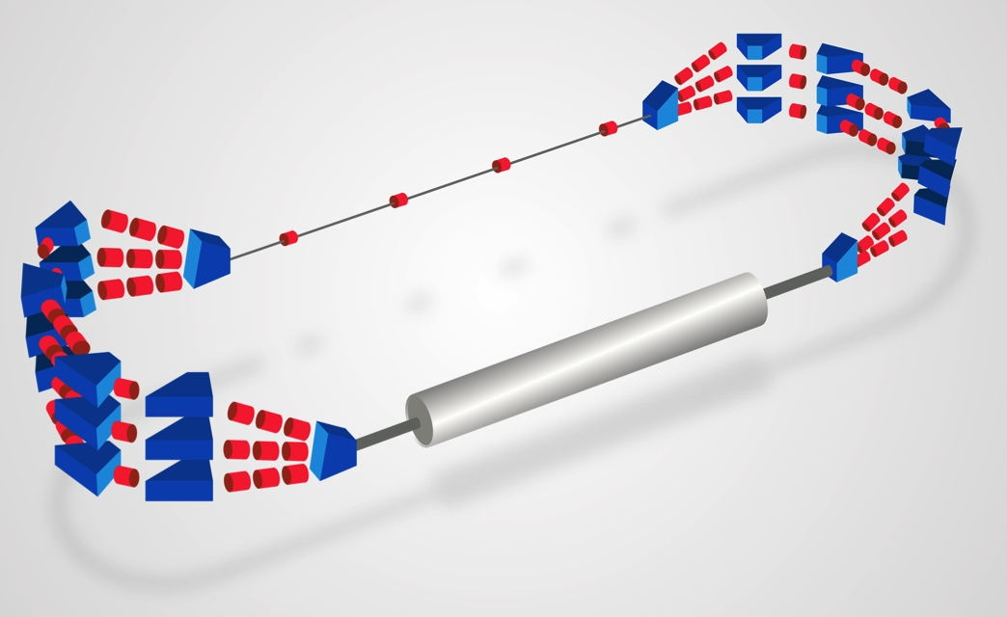
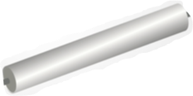
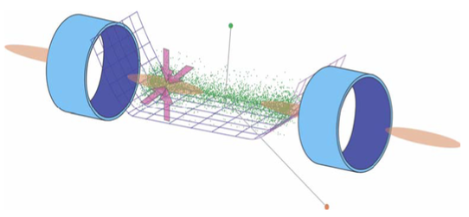
e⁻ scattering on radioactive nuclei
Motivations (pres. F. Flavigny)
Incomparable spatial sensitivity → more constraining for theory
Covers or complements a vast range of nuclear physics interests
Example: Energy Recirculating LINAC (ERL) + SCRIT
I(e⁻) = 200 mA
10 m
Technique
SCRIT-like design – trapping of radioactive ions by e⁻ beam
Targeted Luminosity: 10²⁹ cm⁻²s⁻¹
  Ions piégés: 10⁶
  I_{e} : 200 mA
  Energie: 500-750 MeV
  σ_{x},σ_{y} at IP: 10⁻¹⁰ m²
  ERL demonstrator necessary: L = 10²⁷⁻²⁸ cm⁻²s⁻¹
  Possibility: PERLE @ Orsay - synergy with particle physics
    → R&D + 1st Physics towards optimal machine at GANIL
multi-turn
Strategic advantages:
Uniqueness - No overlap with other facilities (for now)
Could benefit from all RIB sources at GANIL
French expertise (trapping, e- acc., etc.)
Could fit inside existing buildings
Other applications with high-intensity e⁻ beams:
  Material science, Hadron Physics, Medical Physics
Preliminary study
CEA (GANIL 2025)
No showstoppers

Slide 36
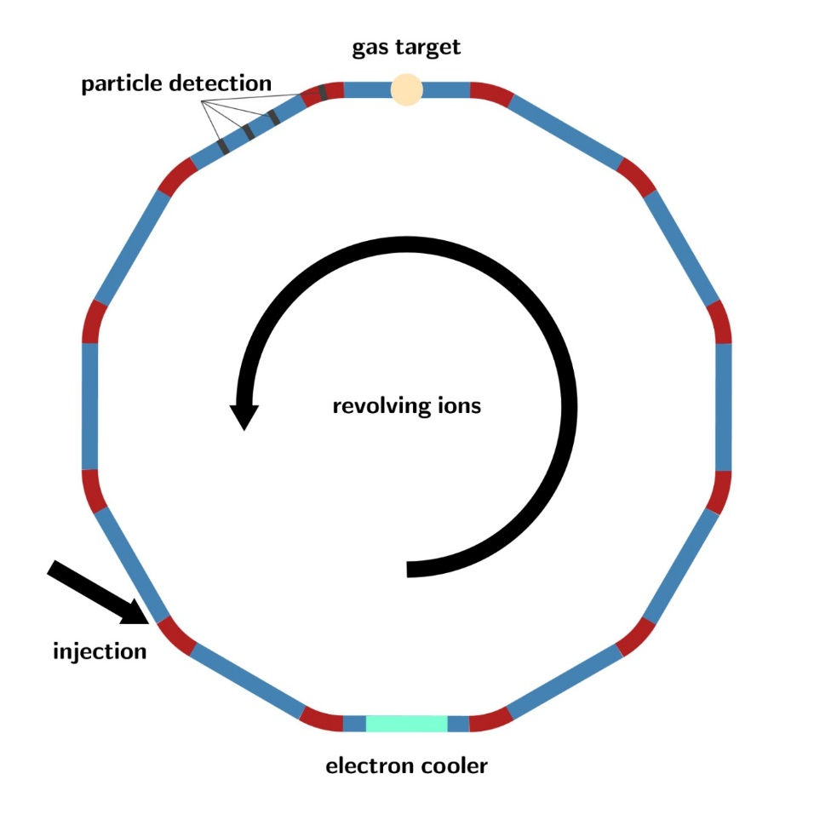
Nuclear reactions in a heavy-ion storage ring at GANIL
The CRYRING at GSI/FAIR
Nuclear structure : transfer reaction with post accelerated Spiral1, S3 and possible future FF
In beam decays
Lifetime measurements
Isomer selection → nuclear reactions with pure isomeric beams
Astrophysics : (n,γ) by surrogate reactions, (p,γ), (α,γ)
Atomic physics
Beam
10 A MeV, ~ 1 MHz
M. Grieser et al., EPJ Special Topics 2017(2012)1
Beam cooling → Excellent energy and position resolution of the beam (emittance ~0.05 mm·mrad), maintained after each passage through the target, negligible straggling effects.
Use of ultra-thin in-ring gas-jet targets ~10¹³-10¹⁴/cm². Effective target thickness increased by ~10⁶ due to revolution frequency (at 10 A MeV).
Pure targets, pure beams, (no backing, no contaminants)!
The E* resolution is only limited by the detector resolution.
Target-like reaction residues with very low energies can be detected.
Beam-like reaction residues can be separated with the ring dipoles.
Cooling time 200 ms - 1 s
Challenge: Detectors in Ultra-High Vacuum (10⁻¹¹-10⁻¹² mbar)

Slide 37
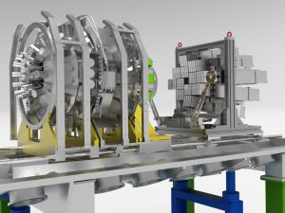
Reacceleration to intermediate energies (10~100A MeV): physics case
Great expertise from GANIL with the physics in this energy range
Wide physics program, very well adapted to the topic “Compact stars and matter at extreme conditions (F. Gulminelli)
only RAON in Korea has long term projects at this energy using ISOL beams, no definite time scale
Optimal use in GANIL of the ‘SPIRAL 2 detectors’: ACTAR, FAZIA, GRIT, PARIS…
Competition of beams slowed down at in-flight facilities (OEDO …) but with much higher optical qualities
Geant resonances - ACTAR
Pick up and Stripping – MUGAST/GRIT
COULEX; PDR - PARIS
Equation of State – FAZIA/INDRA

Slide 38
Reacceleration to intermediate energies (10 – 100A MeV): Cyclotron or LINAC
Superconducting Compact Cyclotron
  K1600 (for instance inspired from C400 for ARCHADE shown above):
    Q>27 for Xe at 70A MeV
    Requires state-of-the-art charge state booster (EBIS or ECRIS)
  Readily available SCC from KVI or NSCL?
  How much transmission?
The possibility to inject in the GANIL cyclotrons has additionnaly to be studied (requires stripping)
Could be inspired from the EURISOL LINAC
Simultaneous acceleration of different charge states (to be studied)
Expensive option: achievable energy depends on length…
Where within GANIL-SPIRAL 2?

Slide 39
Working groups – what follow-up?
Ces études, mêmes préliminaires, sont une restitution des souhaits, idées ou attentes de notre communauté
Nous suggérons qu’elles soient transmises au groupe d’experts qui évaluera les options pour le futur du GANIL
Nous suggérons en outre qu’elles soient approfondies dans les mois prochains par les personnels scientifiques et techniques qualifiés pour en évaluer plus précisément la pertinence et la faisabilité
Phase 1 de SPIRAL 2
Phase de consolidation
  Autres faisceaux que la fission
  Photofission à la ALTO
  Applications médicales
Phase ambitieuse
  Option diffusion d’électrons sur noyaux radioactif
  OU
  Option ré-accélération de qqs 100 keV à 100 AMeV
  OU
  Option anneau de stockage d’ions

Slide 40
Summary – our suggestion
Possible development | Analysis | ✗✓
Phase 2 | Too late | ✗
New in-flight facility | Out of reach | ✗
Improved LISE as a baseline scenario | Difficult competition from in-flight facilities | ✗
Improved SPIRAL 1 as a baseline scenario | Technical limitations for beam develp’t | ✗
A/Q=7 for ISOL production | Rich and coherent perspectives for existing communities; attractive for new communities / interdisciplinary research | ✓
Multi-user ISOL facility

Slide 41
Summary – our suggestion
Consolidation phase 2021-2030
A/Q=7 for ISOL production | Rich and coherent perspectives for existing communities; attractive for new communities / interdisciplinary research | ✓
Multi-user ISOL facility

Slide 42
Summary – our suggestion
Consolidation phase 2021-2030
A/Q=7 for ISOL production | Rich and coherent perspectives for existing communities; attractive for new communities / interdisciplinary research | ✓
Multi-user ISOL facility
Ambitious phase - 1 of the 3 options - 2030 -…
electron scattering | New probe for nuclear structure | ?
10A MeV storage ring | Transfer reactions at their very best | ?
Re-acceleration to 100A MeV | Rich physics program up to Fermi energies | ?

Slide 43
Backup

Slide 44
Estimated timescale

Slide 45
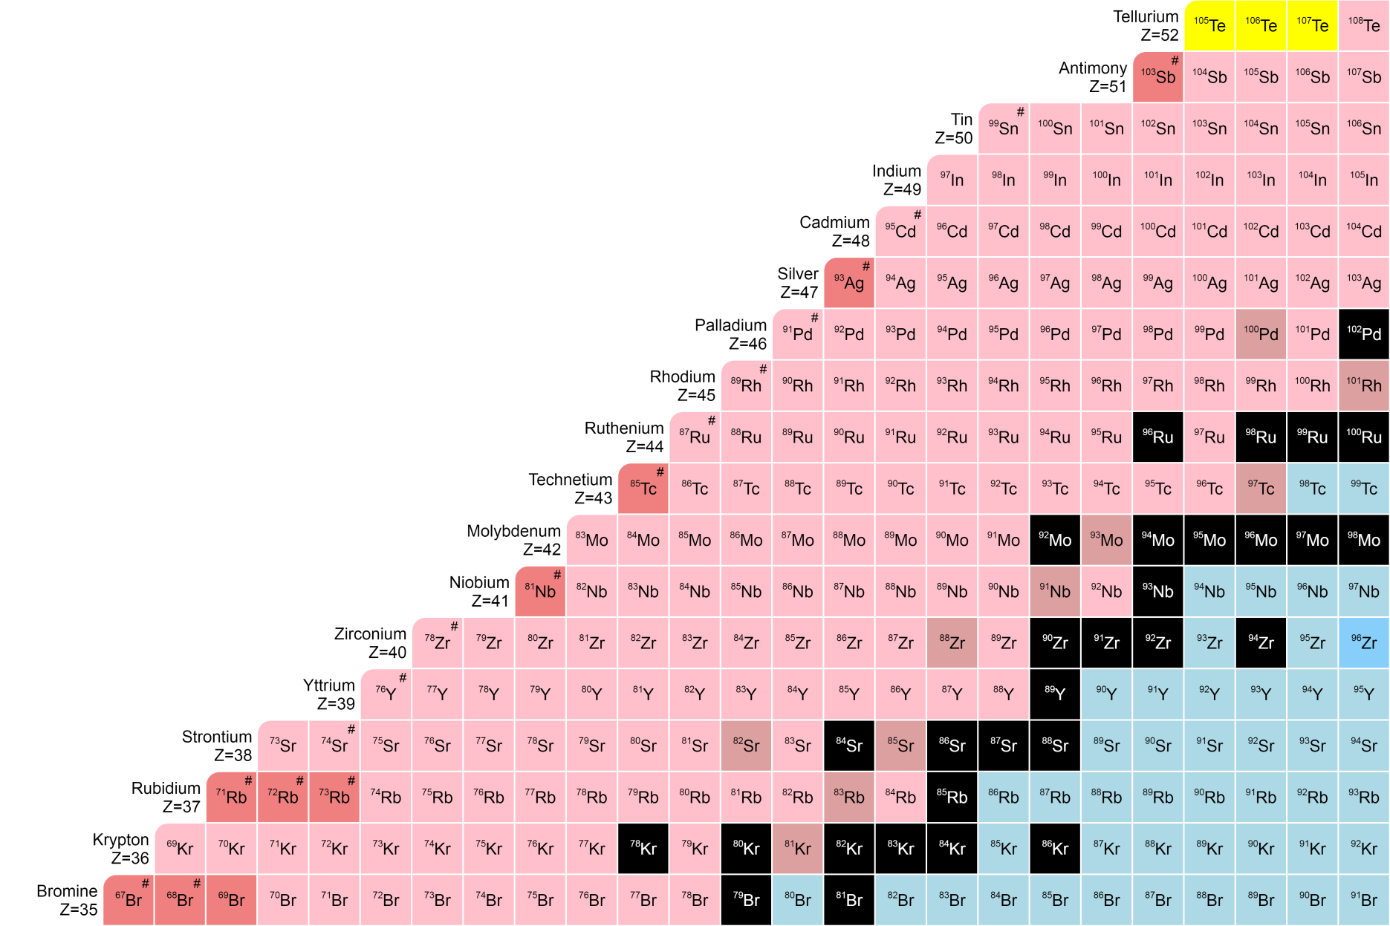
Science with A/Q=7 injector : impact for N=Z physics
N = Z
LOI
S3 workshop (June 18)
Known masses

Slide 46
Science with A/Q=7 injector : impact for N=Z physics
N = Z
LOI
S3 workshop (June 18)
Known masses
A/Q = 3

Slide 47
Science with A/Q=7 injector : impact for N=Z physics
Access to nuclei unavailable for other facilities
The most relevant beams: ⁴⁸Ca, ⁵⁰Cr, ⁵⁸Ni
N = Z
LOI
S3 workshop (June 18)
Known masses
A/Q = 3
A/Q = 7

Slide 48
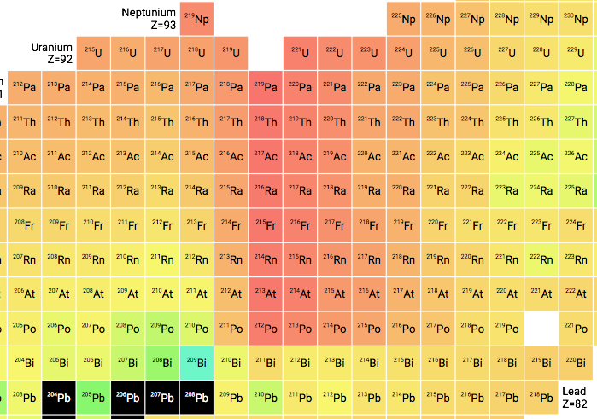
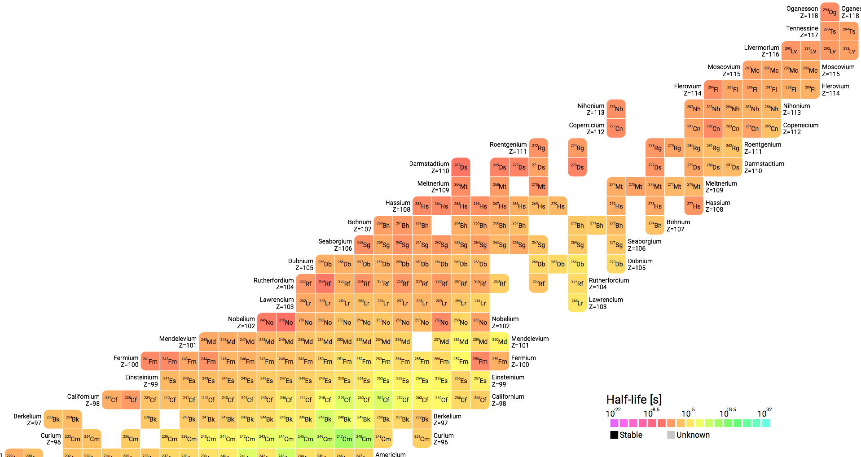
SHE Physics Cases
Science with A/Q=7 injector: SHE physics – A/Q=3 & 7 compared
Map nuclear structure
Bridge the gap between hot and cold fusion
A/Q=3
A/Q=7
Probe the limits of stability
A/Q=3
A/Q=7
SHE synthesis
Opportunity to produce a new element
A/Q=7
N=162
²⁷⁶Cn
²⁷⁶Ds
N=152
²⁷²Ds
N=126
²⁷²Hs
S3 unique advantage => dM/M<1/300
²⁵⁶Sg
²⁵⁷Sg
²⁶⁸Sg
²⁵²Rf
12 Letters of intent for S3
1 Letter of intent for DESIR
Z=100
people.physics.anu.edu.au/
Notes:
Flash setups here

Slide 49
 | I S3 (A/Q=3) | I S3 (A/Q=7) | FRIB1 | FRIB2 | FRIBFinal
100Sn | 6,70 | 34 | 0,08 | 0,40 | 3,25
101Sn | 170 | 850 | 3,40 | 17 | 136
97In | 0,26 | 2,60 | 0,00 | 0,00 | 0,00
98In (g.s) | 1,07 | 11 | 0,04 | 0,19 | 4,10
98In (iso) | 1,53 | 15 | 0,06 | 0,28 | 5,90
99In (g.s.) | 80 | 800 | 4,49 | 6,25 | 267
99In (iso) | 80 | 800 | 4,49 | 6,25 | 267
100In | 740 | 7400 | 389 | 1950 | 15600
98Cd | 3600 | 18000 | 851 | 4260 | 88700
97Cd(g.s) | 19 | 95 | 11 | 54 | 172
97Cd (iso) | 19 | 95 | 11 | 54 | 172
96Cd (g.s.) | 2,96 | 15 | 0,41 | 2,08 | 76
96Cd (iso.) | 0,84 | 4,18 | 0,10 | 0,53 | 19
95Cd | 0,38 | 1,90 | 0,01 | 0,04 | 1,94
94Ag (g.s.) | 136 | 680 | 0,10 | 0,48 | 27
94Ag (iso. 7+) | 524 | 2618 | 0,37 | 1,83 | 105
94Ag (iso 21+) | 16 | 82 | 0,01 | 0,06 | 3,29
95Ag | 870 | 4350 | 52 | 258 | 12500
91Pd | 81 | 405 | 0,05 | 1,32 | 31
92Pd | 810 | 4050 | 2,86 | 14 | 1600
90Rh(g.s.) | 210 | 1050 | 0,10 | 0,49 | 74
90Rh(iso) | 18490 | 92450 | 0,60 | 2,99 | 452
91Rh(g.s.) | 7500 | 37500 | 141 | 705 | 85500
91Rh(iso) | 7500 | 37500 | 141 | 705 | 85500
92Rh(g.s.) | 2222 | 11109 | 7583 | 37964 | 1883700
92Rh(iso.) | 78 | 391 | 267 | 1336 | 66300
88Ru | 820 | 4100 | 16 | 80 | 12000
86Tc | 18 | 90 | 20 | 100 | 2380
87Tc | 180 | 900 | 1380 | 6890 | 605000
https://u.ganil-spiral2.eu/chartbeams/
https://groups.nscl.msu.edu/frib/rates/fribrates.html

Slide 50
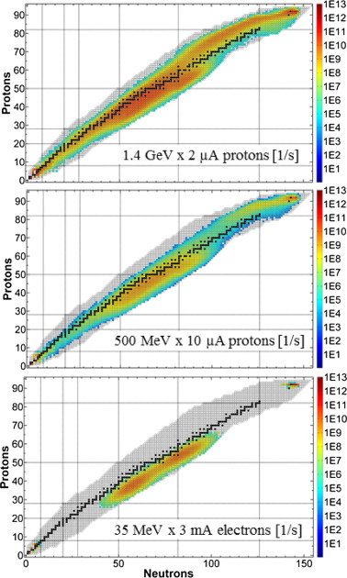
Rôle de la diffusion, effusion et ionisation
ISOLDE
  Temps de réponse: diffusion et effusion
  Efficacité d’ionisation/formation de molécule
Fission « chaude »
Spallation
Challenges: produire des éléments chimiques réfractaires/isotopes de temps de vie courts
A. Gottberg, Proceedings of the EMIS 2015 Conference, NIMB 316

Slide 51
La phase 2 n’est pas nécessairement la solution technique la plus évidente
  200kW d sur convertisseur carbone
    3⋅10¹³ fissions/s, avec un but affiché de 10¹⁴/s
  2.5kg UCx HD
    Etudes menées dans le cadre d’ACTILAB / ENSAR montrent que la diffusion sera pénalisante pour les isotopes courts temps de vie
    relative inutilité d’avoir autant de fissions dans la cible
  Solutions alternatives existent
    Exemple: fission induite par ions légers (type SPES):
    d à 40 AMeV (1kW) à SPIRAL 1 (cas théorique, pas acceptable dans l’installation actuelle)
    1.4⋅10¹² fissions/s, facteur 20 par rapport à SPIRAL 2 phase 2

Slide 52
Calculated intensities
Résultats WP2 GANIL 2025
SPIRAL 1: ²H at 80 MeV
1kW - 1.4 10¹² fissions/s
Exemple de chaîne isotopique plutôt favorable
Calculs dont la validité reste à vérifier
Release (Diffusion + effusion): PARRNe data
Optimistic assumption for SPIRAL 2 large targets
Target aging in the case of SPIRAL 1 to consider

Slide 53
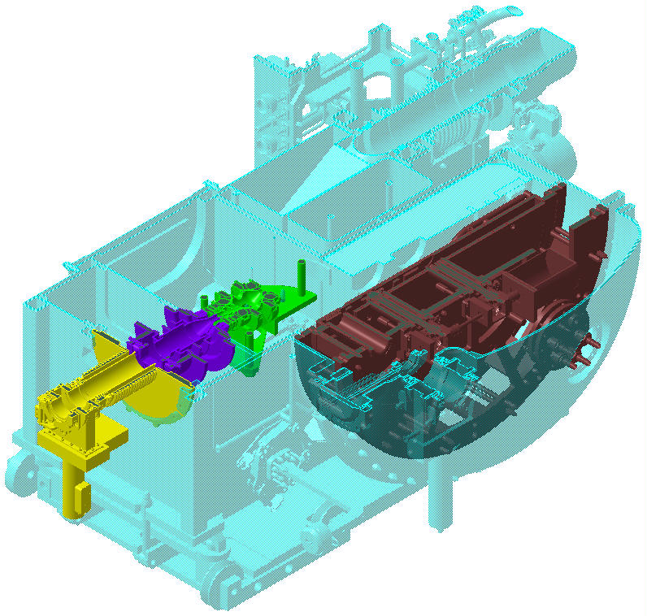
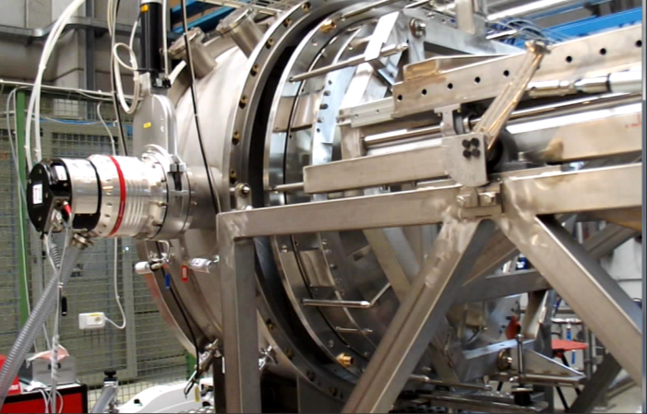

Une source de neutrons compact a SP2?
Strong request (shutdown of research reactors)
Neutron source using the SP2 converter
  Designed for SP2 Phase2
  40 MeV; 5 mA d (200 kW)/proto 50 kW (1.25 mA)
  Converter (200 kW): 10¹² n/cm².s
  Non reactor based

Slide 54

Une source de neutrons compact a SP2?
Neutron converter
  Neutron Converter: 10¹² n/cm².s
  Rotating wheel (400-600 turns/min) with graphite as converter material
  Working temperature up to 1850 °C
  Radiation cooling 50 kW (tested)
  Focusing ~1pi forward angles
  Neutron irradiation
  Neutron radiography
  Radioelements
  Material science

Slide 55

Des opportunités multipliées pour SPIRAL2
Structure en temps sélecteur de paquets en LME
Kicker+déviateur en LHE
Pas 99% mais 60% de la puissance « récupérée »
Probablement plus simple côté LHE (voir sûreté)
Nouveau kicker
SAFARI
Future salle interdisciplinaire

