Slide 1




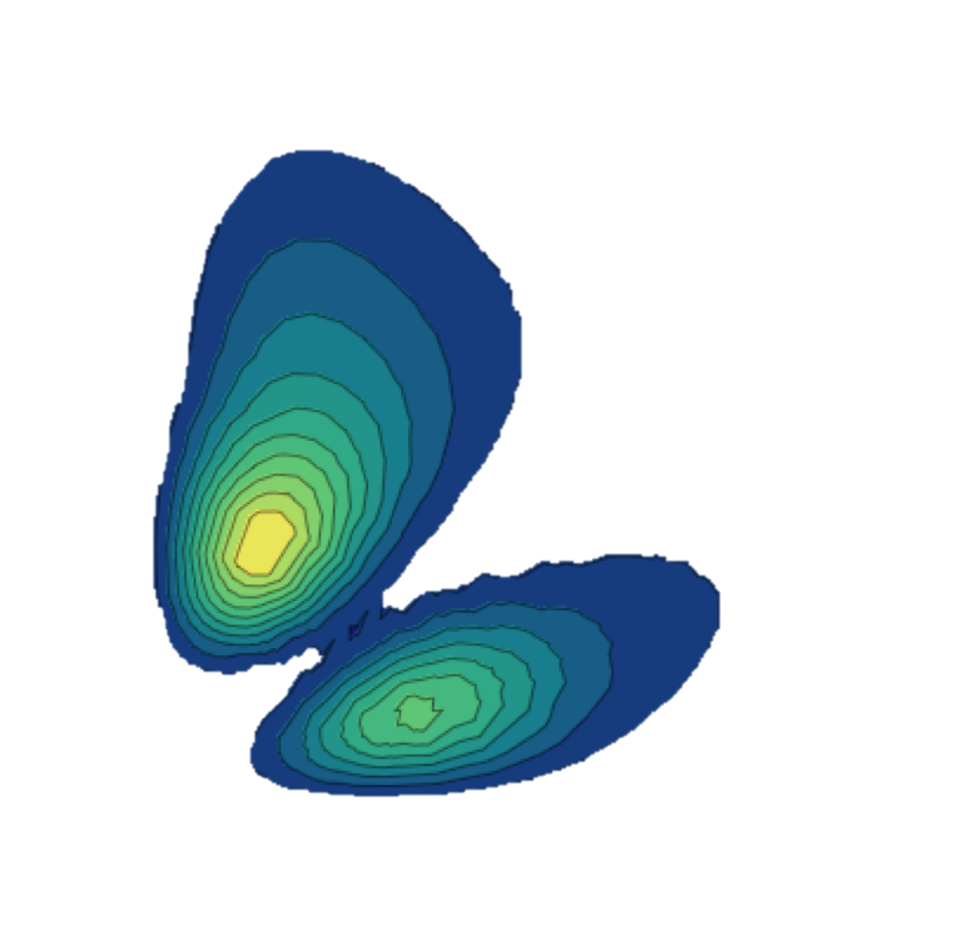




Can anti-matter be a good probe of exotic properties of nuclei?
Guillaume Hupin, CNRS IJClab-PhiNeT
Prospectives nationales IN2P3 GT2, January 31th 2020
  Contributors
  J. Carbonell (IJClab-PhiNeT)
  R. Lazauskas (IPHT)
  U. Von Kolck (IJClab)
  Collaborators
  Puma collaboration
  PI: A. Obertelli (TU Darmstadt)
Notes:
Good morning, my name is Guillaume Hupin. I am both a nuclear structure and reaction theoretician. Those two facets are necessary to describe exotic nuclei which lie close in energy to the reaction threshold. I seek to come to an understanding of nuclei starting from first principle that is starting from the underlying theory of QCD.

Slide 2


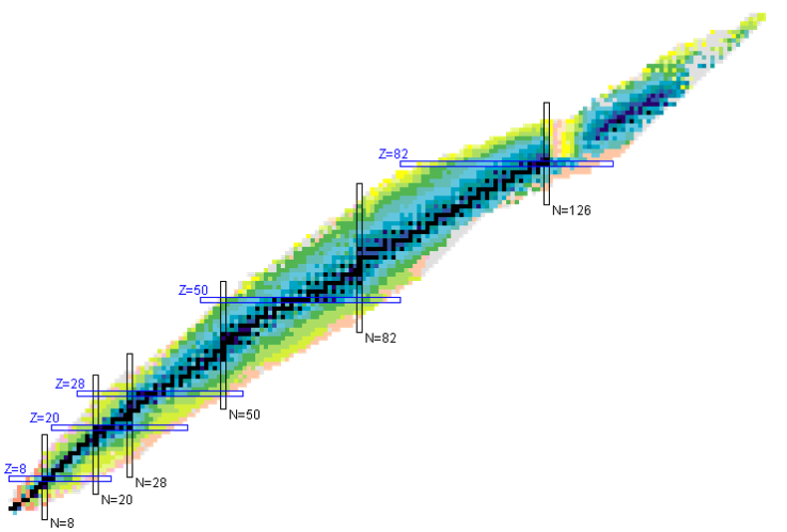

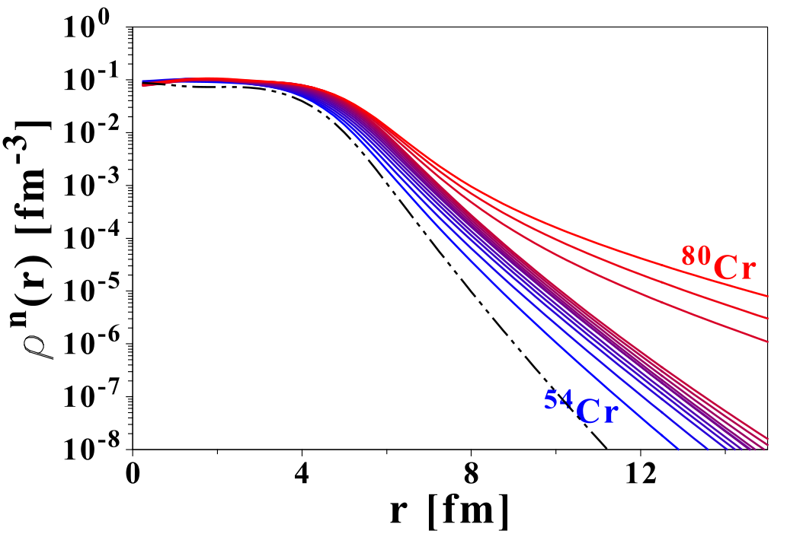
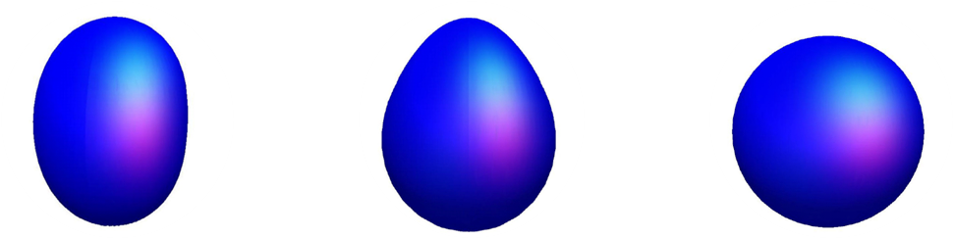




Neutrons & nuclei, a love story
Properties of
Exotic bound states
Resonant states
Scattering
Halos
Cluster/Skins
a unique tool to study nuclear force.
Stable
1932: Neutron discovered
1935: IJC Nobel
$$W$$
Few direct probes:
2012: PREX ²⁰⁸Pb $r_{n}={\text{5.78}}_{−0.18}^{+0.16} \text{fm}\text{.}$
2018: Coherent ¹³³Cs $r_{n}={5.5}_{−1.1}^{+0.9} \text{fm}\text{.}$
2032: ??
Transitions from neutron halo to neutron skin ?
Constraints on symmetry energy.
V. Rotival, et al. PRC79 054308 (2009)

Slide 3
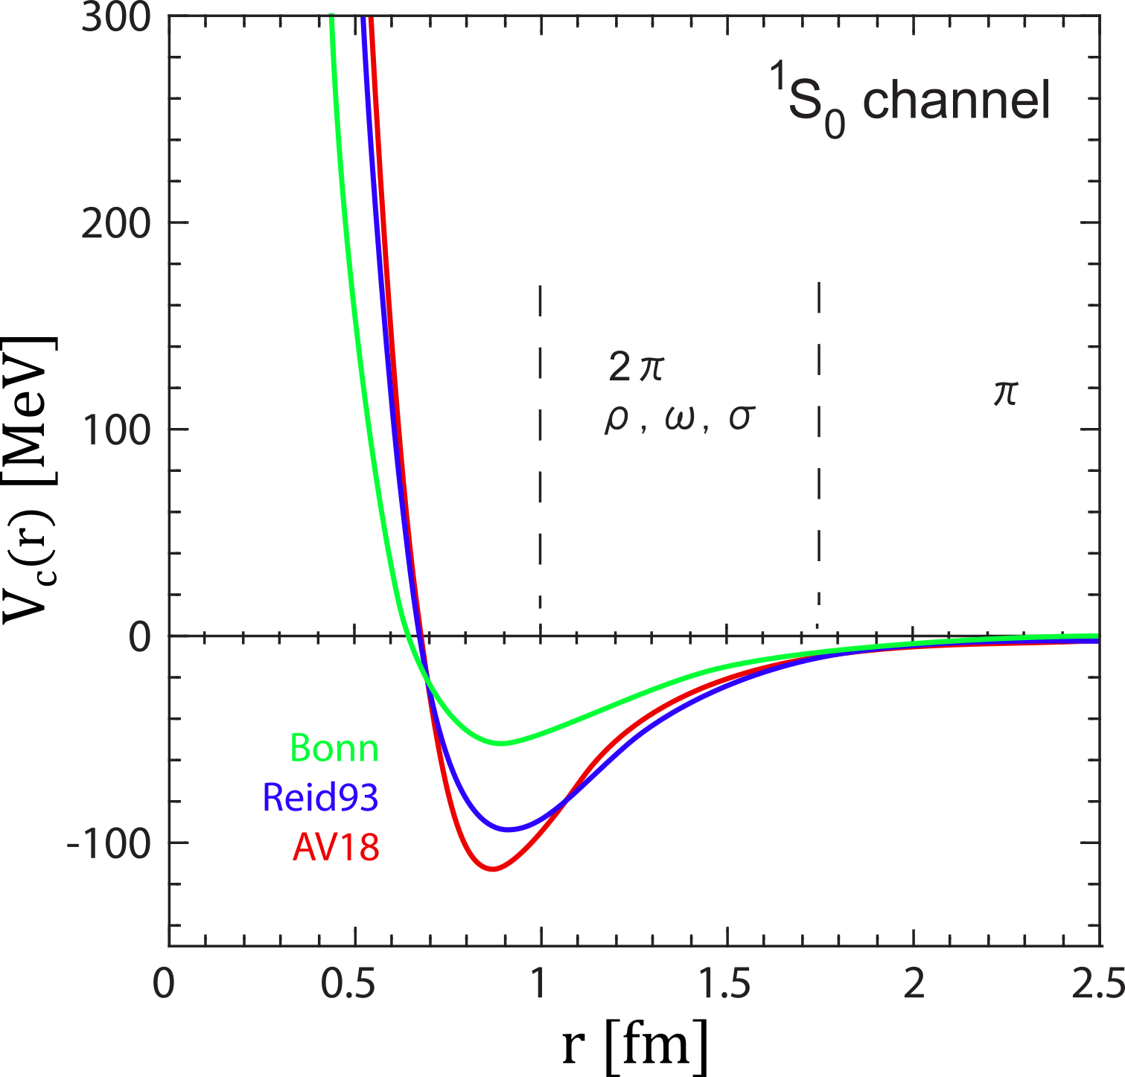








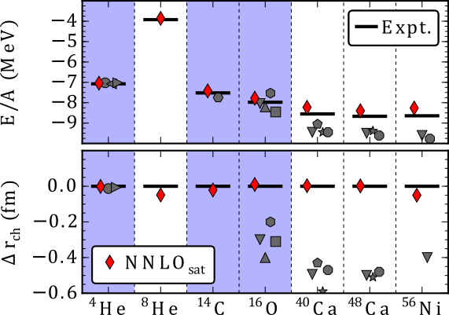
modern nuclear interaction: Chiral effective field theory (NN)
Importance
High quality nuclear interactions.
Various fits and successes.
Picture is incomplete and validity questioned
A. Ekström, et al. PRC91 (R) (2015)

Slide 4
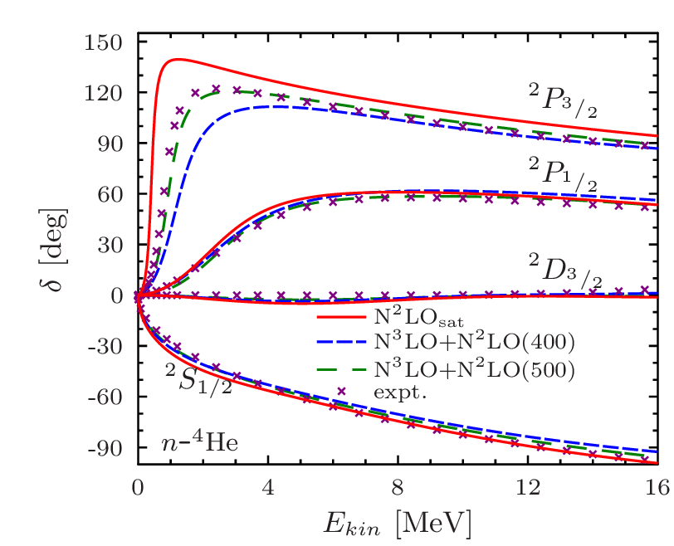
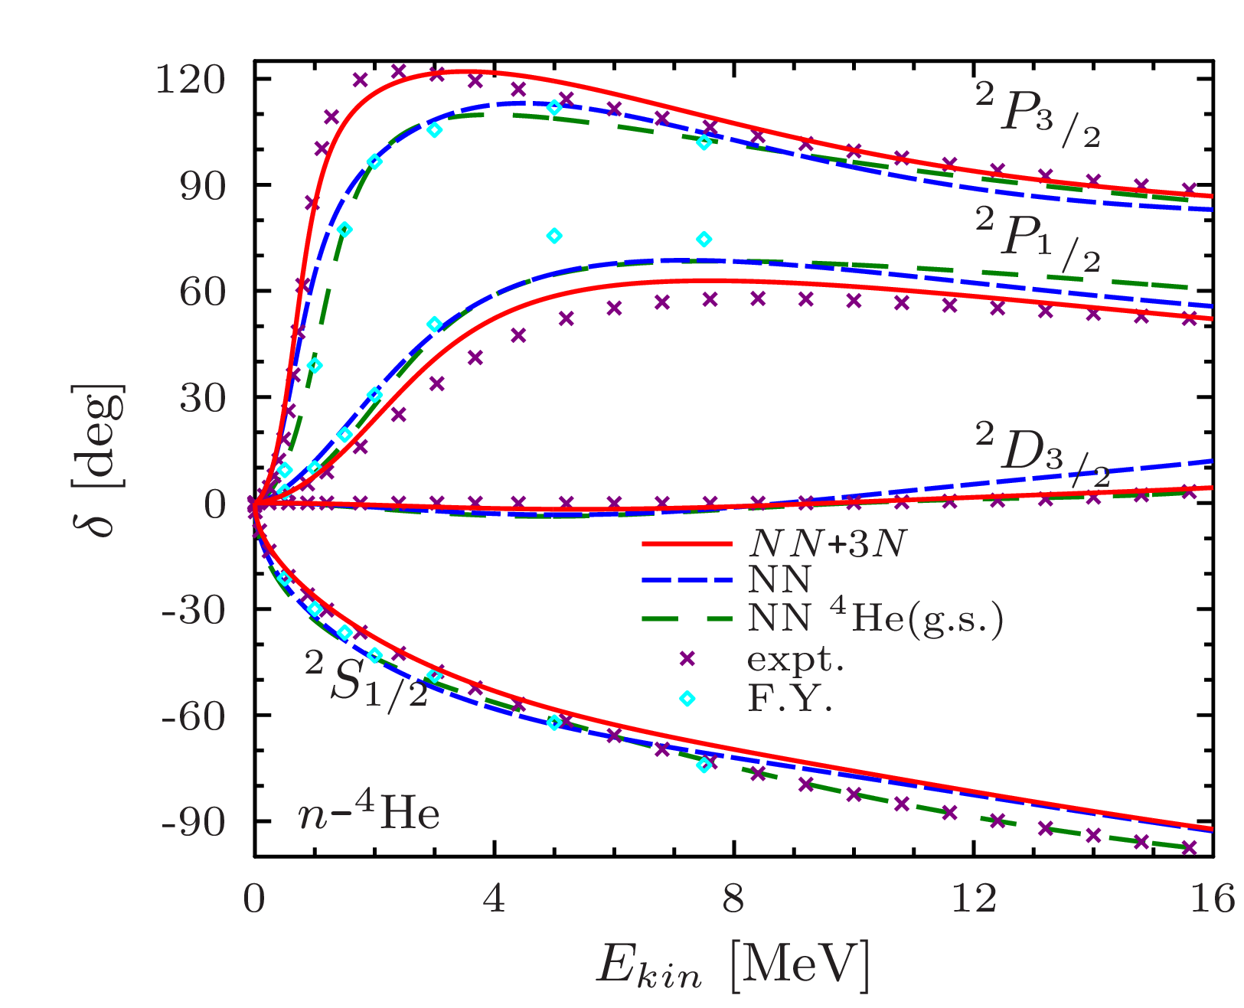

Accuracy and precision of the nuclear Hamiltonian (NN)
n-⁴He scattering phase shifts
R-matrix results from G. Hale
Conservative estimate of EFT accuracy is below precision of 3N force.
Model error dominated by 3N force.
Ab initio models agree.
Exact few-body
Ab initio
Notes:
Let us now get back to our benchmark case namely the n-alpha collision. Again the phase-shift are well determined from experiment. We can there play with the different scenario of interaction: NN-only, NN+3N-ind ie the initial NN-only corresponding to lee-suzuky here we see that clearly the NN-only agreement was just accidental and the real picture with a NN force online is much worse. The 3N force helps a lot to improve the agreement in particular the spin-orbit splitting.

Slide 5
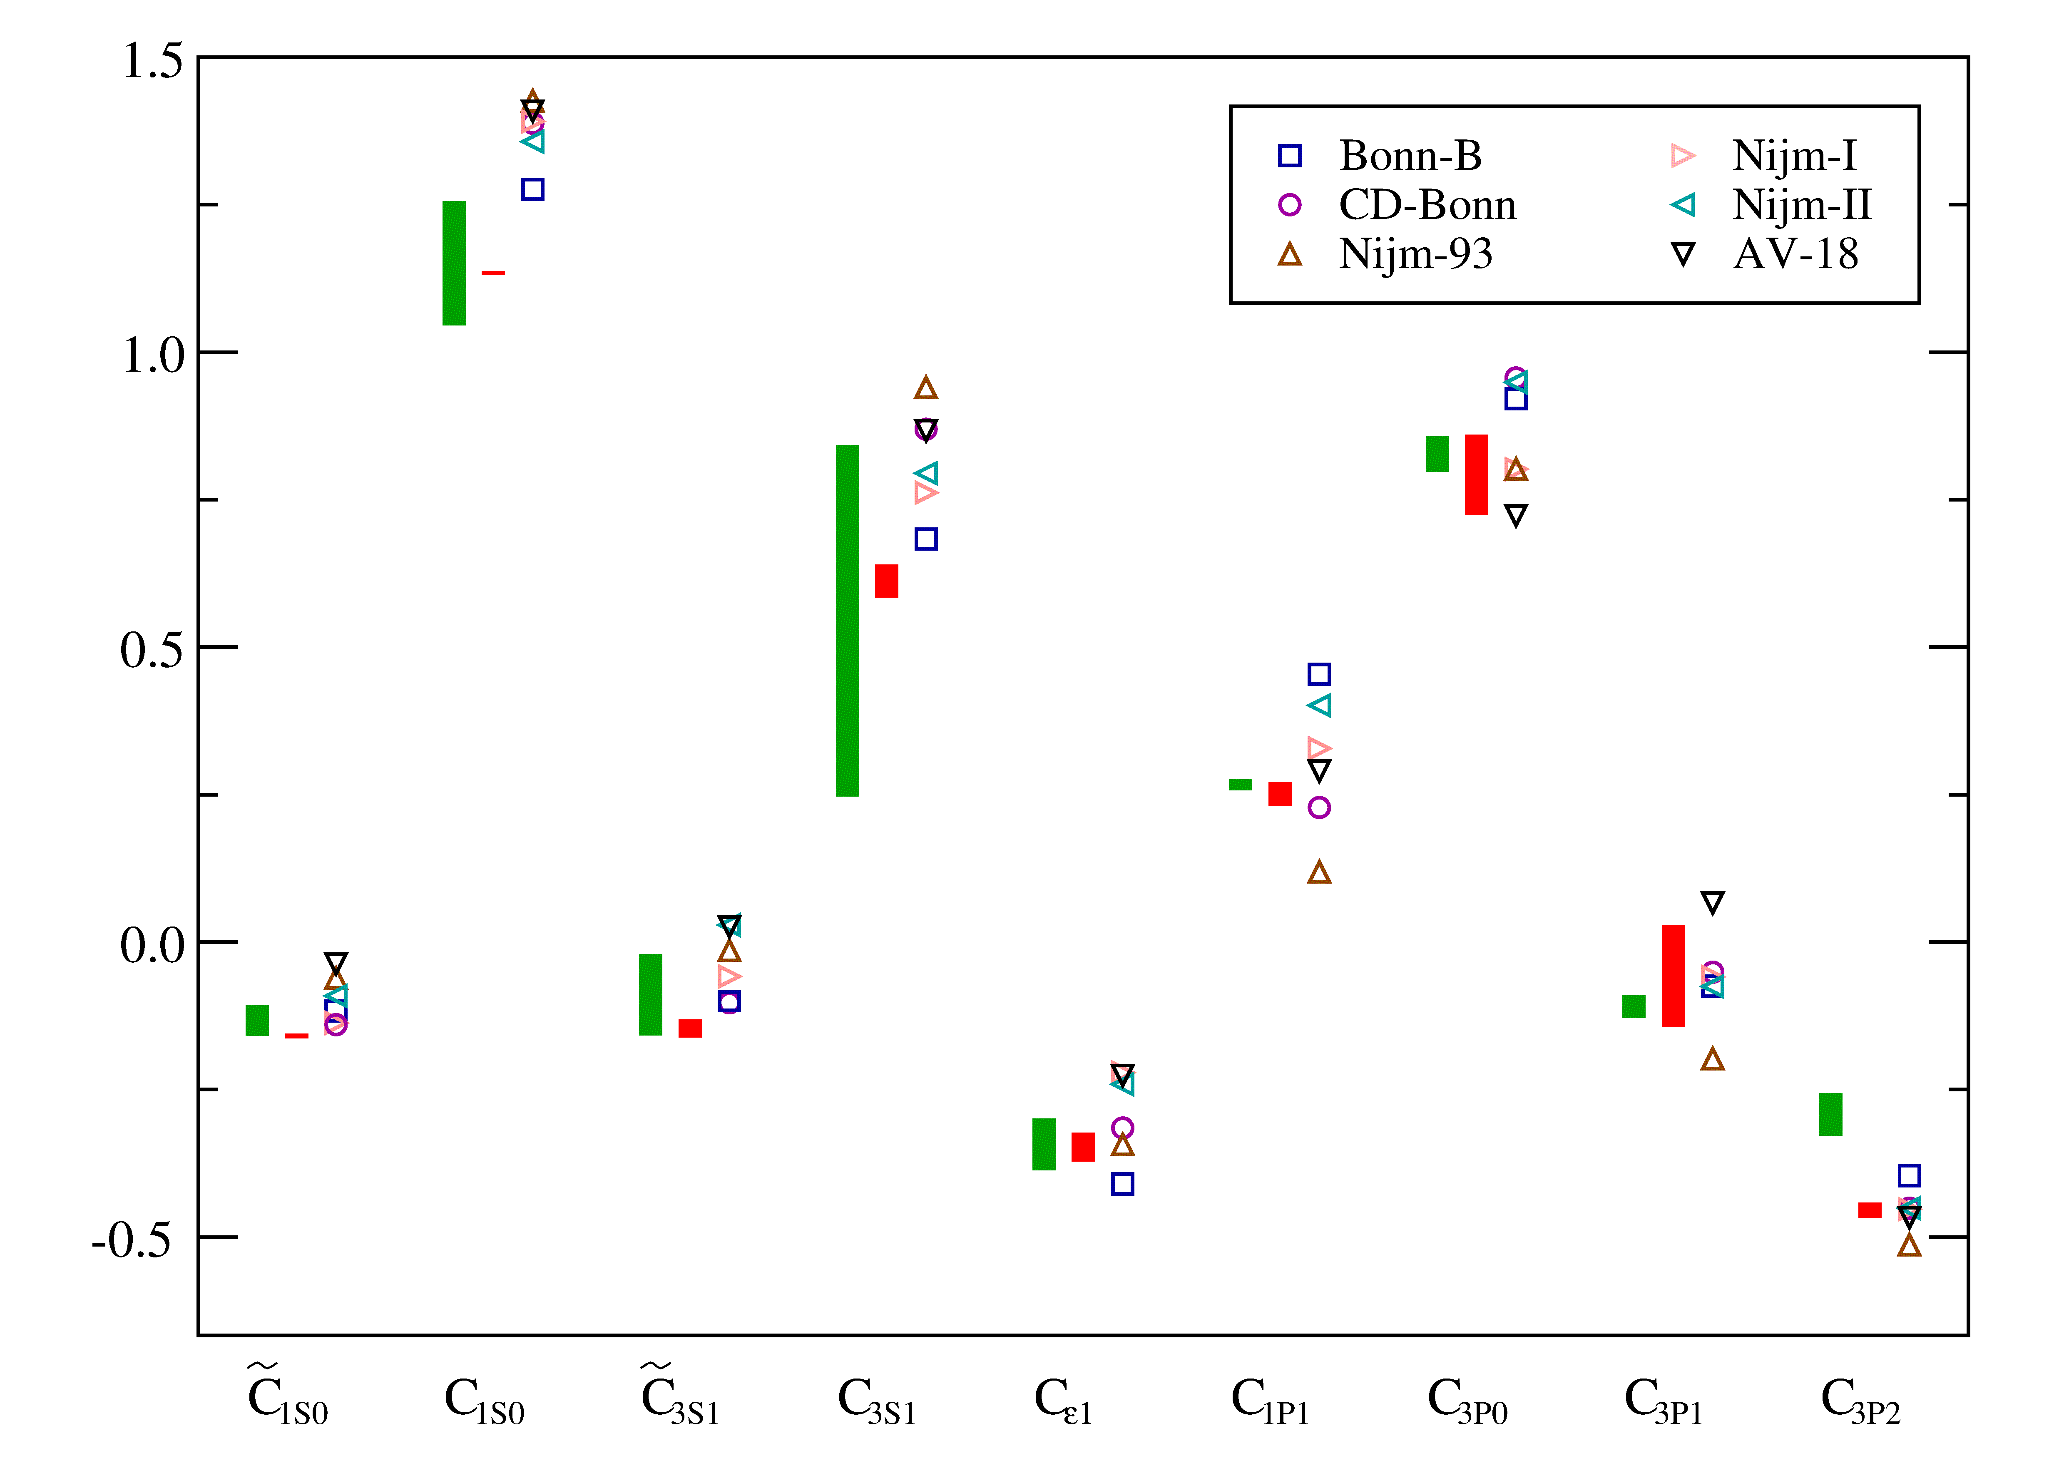


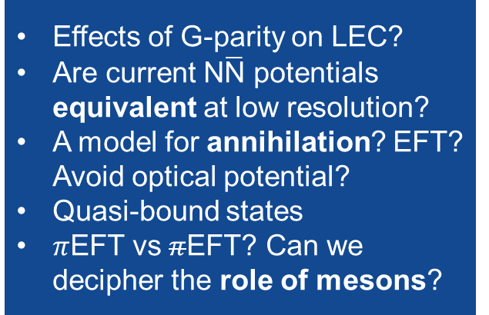

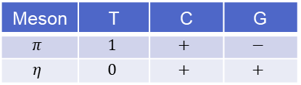


$\text{N}\overline{\text{N}}$ interaction
$\text{N}\overline{\text{N}}$ LEC from OBEP ?
E. Epelbaum, et al. PRC65 (2002)
$\text{N}\overline{\text{N}}$= $\text{N}\text{N} \text{x}$ G-parity of exchanged meson
Meson | T | C | G
$$π$$ | $$1$$ | $$+$$ | $$−$$
$$η$$ | $$0$$ | $$+$$ | $$+$$
Effects of G-parity on LEC?
Are current $\text{N}\overline{\text{N}}$ potentials equivalent at low resolution?
A model for annihilation? EFT? Avoid optical potential?
Quasi-bound states
$π$EFT vs $π$EFT? Can we decipher the role of mesons?
Equivalence at low resolution scale ?
D. Ling-Yun, et al.
JHEP78 (2017)
S.K. Bogner, et al. PLB516 (2003)

Slide 6

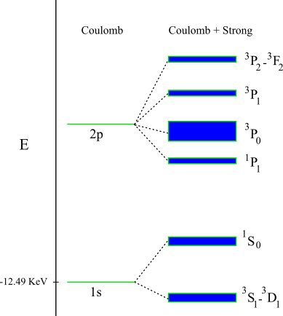


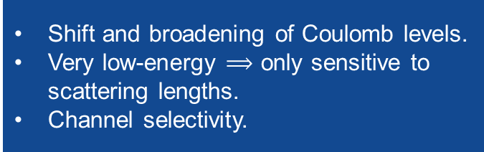








Low-energy physics with antiprotons
$$Z=2$$
r.m.s. radius at annihilation $\sim 7\text{0 }\text{fm}$
Disclaimer: not at scale
$\overline{\text{N}}−A$ capture*
Separation scale: fertile ground for Halo EFT
$$Z≫2$$
$$r_{n} =\frac{57 \text{fm}}{Z} \frac{m}{2μ} n^{2}$$
$$n\sim 4−9$$
r.m.s. radius $\sim 2.4 \text{fm}$
$$V\left(r\right)$$
$$r$$
Nuclear shifted levels*
Coulomb
Nuclear
Annihilation
Atomic cascade*
Auger+X-rays
Annihilation*
Shift and broadening of Coulomb levels.
Very low-energy $⟹$ only sensitive to scattering lengths.
Channel selectivity.
* Open field of research
Notes:
So basically we merge the two approach
The one for the nuclear structure that will get a good shot at the low-lying resonance
The one that will deal with the scattering degree of freedom !
The NCSMC is born cf those paper.

Slide 7
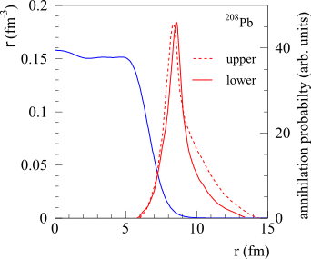
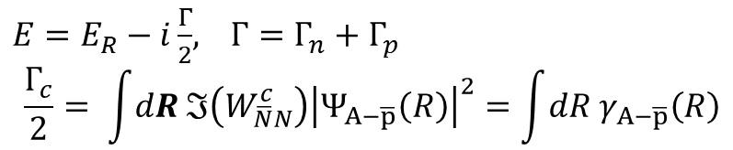
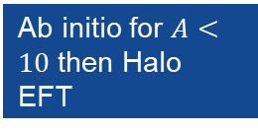
Low-energy physics with antiprotons
$$Z=2$$
r.m.s. radius at annihilation $\sim 7\text{0 }\text{fm}$
Disclaimer: not at scale
$\overline{\text{N}}−A$ capture*
Ab initio for $A<10$ then Halo EFT
$$Z≫2$$
$$r_{n} =\frac{57 \text{fm}}{Z} \frac{m}{2μ} n^{2}$$
$$n\sim 4−9$$
r.m.s. radius $\sim 2.4 \text{fm}$
$$V\left(r\right)$$
In flight capture
$$r$$
Cold capture
Trzcińska, et al. PRC67 (2003)
Nuclear shifted levels*
Coulomb
Nuclear
Annihilation
Atomic cascade*
Auger+X-rays
Annihilation*
$E=E_{R}−i\frac{Γ}{2}$, $Γ=Γ_{n}+Γ_{p}$
$$\frac{Γ_{c}}{2}= \int{dR ℑ\left(W_{\overline{N}N}^{c}\right){\left|Ψ_{A−\overline{p}}\left(R\right)\right|}^{2}}=\int{dR γ_{A−\overline{p}}\left(R\right)}$$
* Open field of research
Notes:
So basically we merge the two approach
The one for the nuclear structure that will get a good shot at the low-lying resonance
The one that will deal with the scattering degree of freedom !
The NCSMC is born cf those paper.

Slide 8
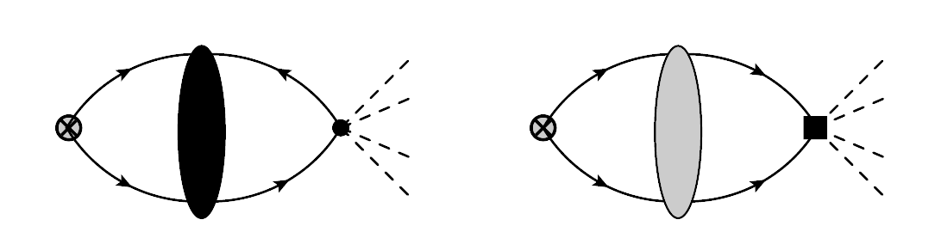
Baryon-Number Violation by Two Units and the Deuteron Lifetime F. Oosterhof, et al. PRL 122 (2019)
Standard Model Effective Field Theory
Chiral EFT
neutron-antineutron
oscillation
direct two-nucleon
annihilation
deuteron lifetime
oscillation time
up to NLO:
(SNO)
≈ 2.5 smaller than potential models
vs.
(ILL)
signal for operator 4 (if dominant)

Slide 9
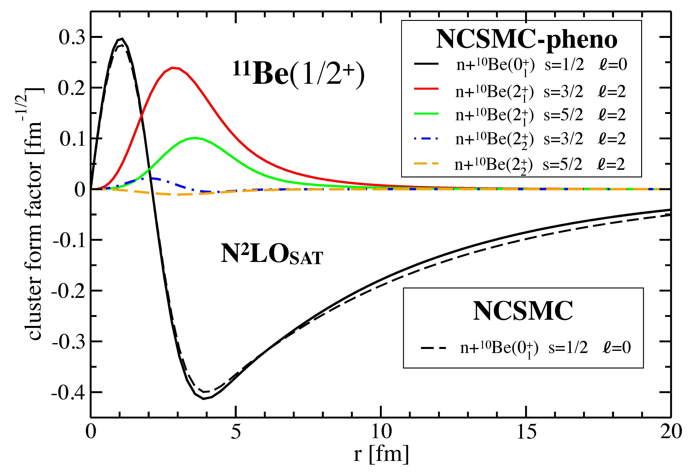
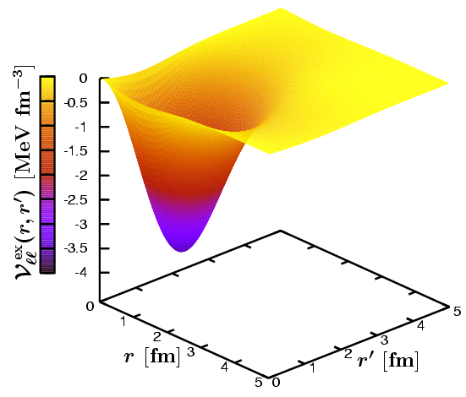
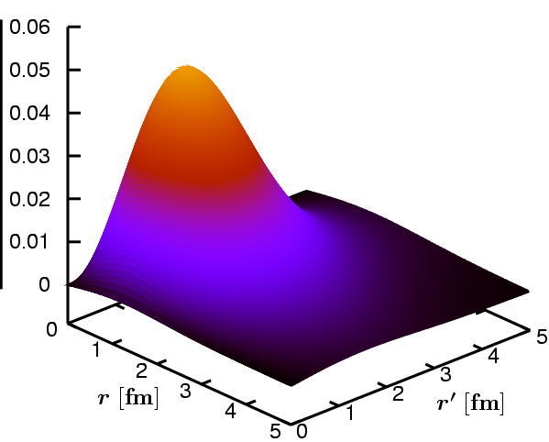

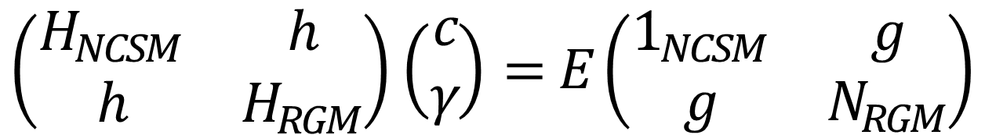




can we do it?
$$(A−1)$$
$$\left\langle \begin{matrix} & & \\ & & \\ & & \end{matrix} | H𝒜 | \begin{matrix} & & \\ & & \\ & & \end{matrix}\begin{matrix} & & \\ & & \\ & & \end{matrix}\begin{matrix} & \\ & \\ & \end{matrix}\right\rangle$$
$${\vec{r}}^{ }$$
$$(a^{ }=1)$$
$$E_{λ} δ_{λλ^{′}}$$
$$\left(\begin{matrix}H_{NCSM} & h \\ h & H_{RGM}\end{matrix}\right)\left(\begin{matrix}c \\ γ\end{matrix}\right)=E\left(\begin{matrix}1_{NCSM} & g \\ g & N_{RGM}\end{matrix}\right)$$
Long-range part of the kernels is computed on the spatial mesh.
Notes:
So basically we merge the two approach
The one for the nuclear structure that will get a good shot at the low-lying resonance
The one that will deal with the scattering degree of freedom !
The NCSMC is born cf those paper.

Slide 10






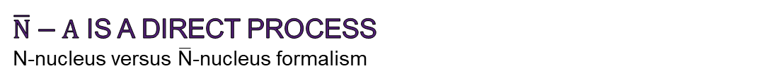


$\overline{\text{N}}−A$ is a direct process
N-nucleus versus $\overline{\text{N}}$-nucleus formalism
$$A$$
$$A$$
$\left\langle Φ_{v^{′}r^{′}}^{J^{π}T} | {\hat{A}}_{v_{ }^{′}}V^{NNN}{\hat{A}}_{v_{ }^{ }} | Φ_{v^{ }r^{ }}^{J^{π}T}\right\rangle$=
$$\left\langle \begin{matrix} & & \\ & & \\ & & \end{matrix}\begin{matrix} & & \\ & & \\ & & \end{matrix}\begin{matrix} & \\ & \\ & \end{matrix} | V^{NNN}\left(1−\sum_{i=1}^{A−1}{{\hat{P}}_{iA}}\right) | \begin{matrix} & & \\ \begin{matrix} & & \\ & & \\ & & \end{matrix} & & \\ & & \end{matrix}\begin{matrix} & \\ & \\ & \end{matrix}\right\rangle$$
$${\vec{r}}^{′}$$
$$({\overline{a}}^{′}=1)$$
$$(\overline{a}=1)$$
$$\vec{r}$$
Direct potential:
$$∝{}_{SD}^{ }{\left\langle A−a{α′}_{1}{I′}_{1}^{{π′}_{1}}{T′}_{1} | a^{†}a^{†}aa | A−aα_{1}I_{1}^{π_{1}}T_{1}\right\rangle } _{SD}^{ }$$
~1Go
~$7. {10}^{3}$ two-body states
-
Exchange potential:
$$∝{}_{SD}^{ }{\left\langle A−a{α′}_{1}{I′}_{1}^{{π′}_{1}}{T′}_{1} | a^{†}a^{†}a^{†}aaa | A−aα_{1}I_{1}^{π_{1}}T_{1}\right\rangle } _{SD}^{ }$$
Notes:
Including the 3N force in this formalism add an extra term to the Hamiltonian kernel which this guy here. The operator on the right accounts for the antysimmetrization of the wf. This contribution decomposes into to distinct terms. The direct and exchange potential. The latter correspond to the exchange of the projectile nucleon with a nucleon inside the target hence increasing the rank of the density matrix involved. This is a good example of the computational difficulty of the problem. We have to deal with up to three-body density matrix and you have to think that we have around 7000 two-body states…

Slide 11










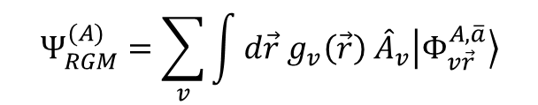








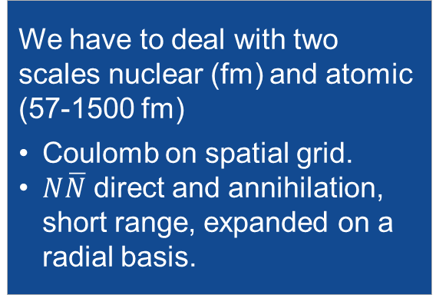


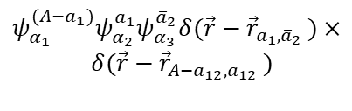

WE could compute nuclear and atomic structure this exotic system
$$(A−1)$$
$$(A−1)$$
$$\left\langle \begin{matrix} & & \\ & & \\ & & \end{matrix} | H𝒜 | \begin{matrix} & & \\ & & \\ & & \end{matrix}\begin{matrix} & & \\ & & \\ & & \end{matrix}\begin{matrix} & \\ & \\ & \end{matrix}\right\rangle$$
$${\vec{r}}^{ }$$
$$(a^{ }=1)$$
$${\vec{r}}^{ }$$
$$(a^{ }=1)$$
$${\vec{r}}_{A,\overline{a}}$$
$$Ψ_{RGM}^{(A)}=\sum_{v}{\int{d\vec{r} g_{v}\left(\vec{r}\right) {\hat{A}}_{v}\left|\left.Φ_{v\vec{r}}^{A,\overline{a}}\right\rangle \right.}}$$
$$\overline{a}$$
$$A$$
$$ψ_{α_{1}}^{A}ψ_{α_{2}}^{\overline{a}} δ(\vec{r}−{\vec{r}}_{A,\overline{a}})$$
Relative wave function (unknown)
Channel basis
Cluster expansion technique
r.m.s. radius $\sim 57−x00 \text{fm}$
Antisymmetrizer
RGM
Cluster formalism for elastic/inelastic/charge exchange/annihilation
We have to deal with two scales nuclear (fm) and atomic (57-1500 fm)
Coulomb on spatial grid.
$N\overline{N}$ direct and annihilation, short range, expanded on a radial basis.
$${\vec{r}}_{A−a_{12},a_{12} }$$
$${\overline{a}}_{1}$$
$${\vec{r}}_{a_{1},{\overline{a}}_{2} }$$
$${\overline{a}}_{2}$$
$$A−a_{1}$$
$$ψ_{α_{1}}^{(A−a_{1})}ψ_{α_{2}}^{a_{1}}ψ_{α_{3}}^{{\overline{a}}_{2}}δ(\vec{r}−{\vec{r}}_{a_{1},{\overline{a}}_{2} })×$$
$$δ(\vec{r}−{\vec{r}}_{A−a_{12},a_{12} })$$
Notes:
So basically we merge the two approach
The one for the nuclear structure that will get a good shot at the low-lying resonance
The one that will deal with the scattering degree of freedom !
The NCSMC is born cf those paper.

Slide 12
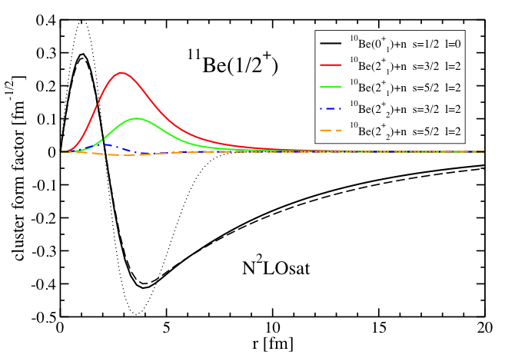
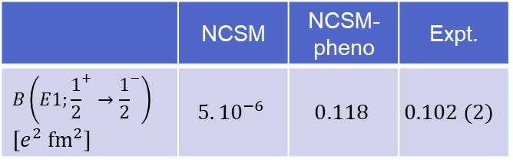
¹¹Be 1n Halo nuclei : EM probes
A. Calci, et al. PRL117 (2016)
Bound to bound
Halo structure
 | NCSM | NCSM-pheno | Expt.
$$B\left(E1;{\frac{1}{2}}^{+}→{\frac{1}{2}}^{−}\right)$$ $$[e^{2} {\text{f}\text{m}}^{2}]$$ | $$5.{10}^{−6}$$ | $$0.118$$ | $$0.102 (2)$$
Bound to continuum
cluster form factor

Slide 13
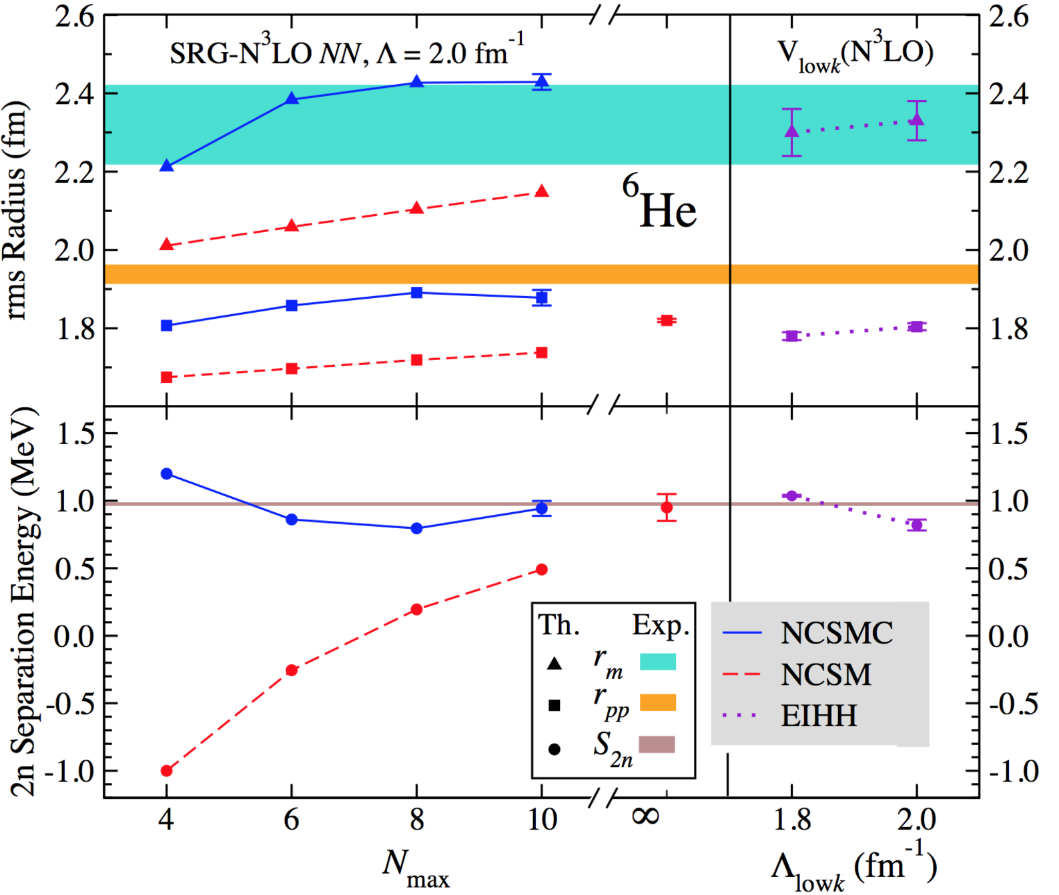
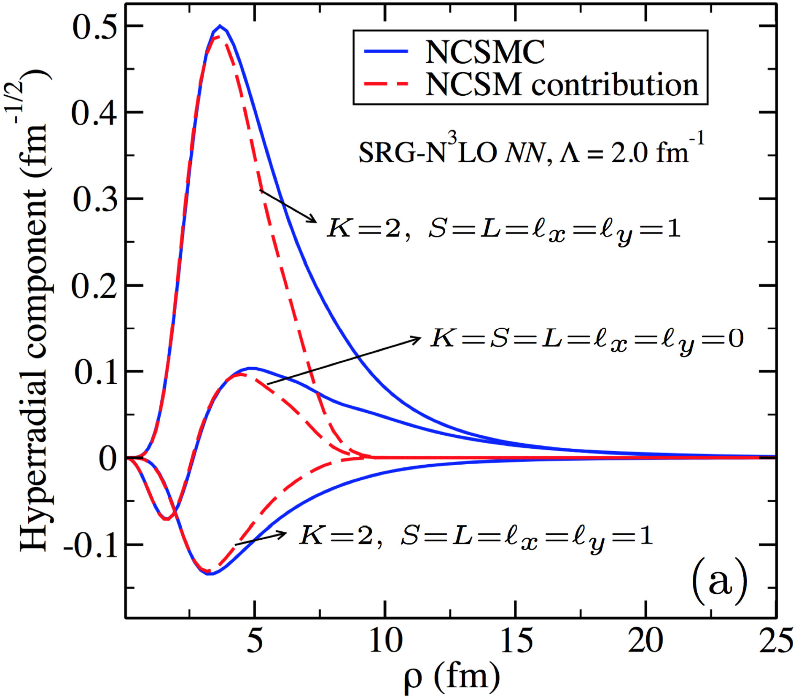
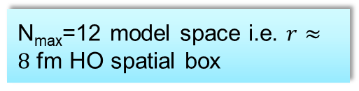
⁶He 2n Halo nuclei
C. Romero-Redondo, S. Quaglioni et al. PRL117 (2016)
⁶He g.s. energy, proton and matter radii
0
N_{max}=12 model space i.e. $r≈8$ fm HO spatial box
Long-distance components are mandatory to model ⁶He.
g.s. energy, proton and matter radii from chiral NN force are close to data.

Slide 14
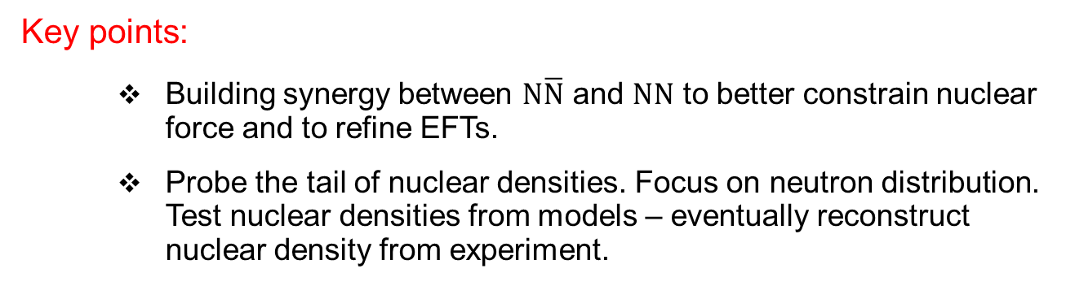
Thank you !
Key points:
  Building synergy between $\text{N}\overline{\text{N}}$ and $NN$ to better constrain nuclear force and to refine EFTs.
  Probe the tail of nuclear densities. Focus on neutron distribution. Test nuclear densities from models – eventually reconstruct nuclear density from experiment.
Request:
  Time, etc...
  ANR REACH (Reactions for Experiments with Atomic nuclei within reach)
Synergy:
  Common effort from few-body physics and nuclear interaction modeling.
  Synergy with physics at the dripline (in that case ~eV from the threshold!). Eventually with new tools for theoretical developments.
Notes:
In conclusion:
We are extending the ab initio no-core shell model to treat low-energy light-ion reactions.
The nucleon scattering on light nuclei with realistic NN potentials represent our recent achievements in this direction.
We have much more work ahead of us. Indeed, we need to implement and test the approach for heavier projectiles, startng with the deuteron projectile, up to the alpha-particle projectile, which is essential to calculate reactions of astrophysical interest.
Inaddition, it is clear that this approach is not always efficient. In particular when the target has a very small disintegration threshold. But we have already an idea of how make our method more efficient.
Merging the NCSM and RGM approaches represents our best opportunity to build a method able to describe both structure and continuum.
Indeed, the RGM equations can be solved also using bound-state boundary conditions. In this regard the RGM method can provide the long range part of the model space needed to describe system like the 6He.
In the next steps we are planning on introducing the NNN potential terms in the RGM formalism, as well as the treatment of two-cluster basis with two-, three- and four-nucleon projectiles.
Finally: our ultimate goal in the long run is to build a more complete microscopic theory of both structure and reactions, the ab initio NCSM with continuum, by constructing an over-complete model space containing the NCSM basis, the cluster basis, but also the coupling between them. With this kind of basis one has a better hope to tackle problems like the 9Be breakup in n+8Be.

